Slide 1

DIRECTOR’S REPORT National Advisory Council for Human Genome Research February 2013 Eric Green, M.D., Ph.D. Director, NHGRI
Notes:
The Open Session of this National Advisory Council for Human Genome Research meeting is being webcast live.
In addition (and as is now our routine), the Open Session of all of our Council meetings are videotaped and made available as a permanent archive on the web, including videos of the presentations themselves and the various associated documents.

Slide 2
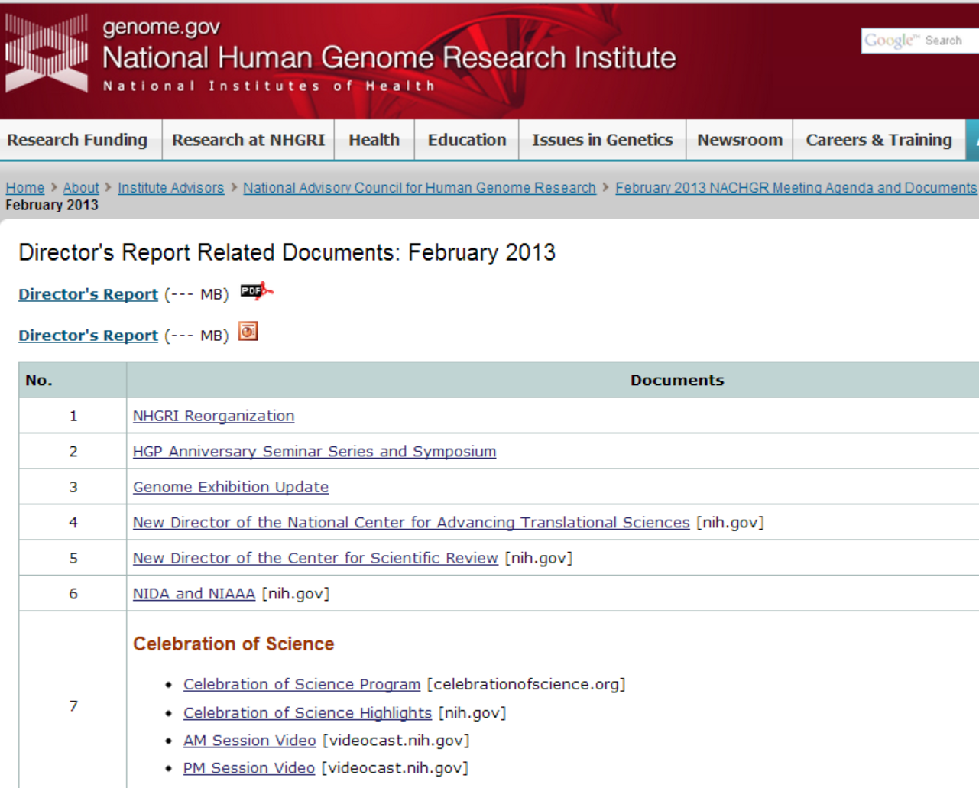
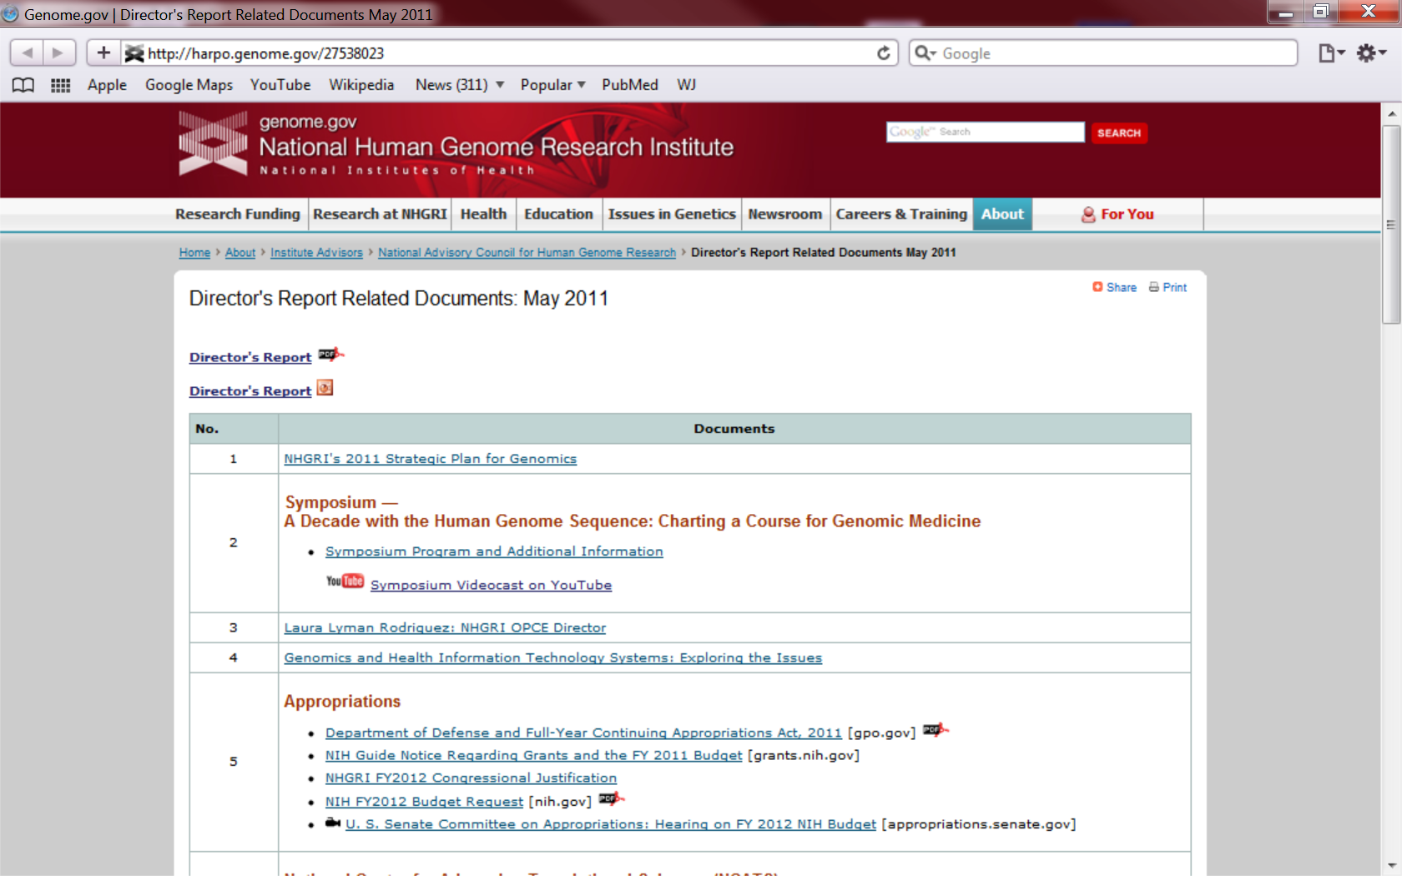
genome.gov/DirectorsReport
Document #
Notes:
For anyone new to our Council meetings, I want to make you aware that there is an ‘electronic resource’ associated with my Director’s Report.
This is analogous to the supplemental materials that are often made available with a published paper, and can be accessed at the URL shown here.
The slides that I am showing during my Director’s Report are also available electronically at this site– * both as a PDF and as a Powerpoint file.
* For slides associated with specific documents or relevant web sites, there is a ‘Document #’ indicated on the bottom right, which then references materials that you can access at the web site shown here.
In addition to the video archive that I mentioned earlier, this web page and all linked documents will be archived on NHGRI’s web site genome.gov as a permanent historic resource.

Slide 3
Open Session Presentations
Presentation by NHLBI Director:
Gary Gibbons
Project Updates:
The Cancer Genome Atlas (TCGA)
Brad Ozenberger
Genotype-Tissue Expression (GTEx) Project
Simona Volpi
Human Heredity and Health in Africa (H3Africa)
Jane Peterson
Notes:
There will be multiple other presentations during the Open Session of this Council meeting. My Director’s Report is tailored around these presentations, and I will not discuss in detail the topics that others will be covering later.
* For starters, we will have a presentation by Dr. Gary Gibbons, the new and recently arrived Director of the National Heart, Lung, and Blood Institute.
* We will then have three project updates from NHGRI staff members. * Brad Ozenberger will talk about The Cancer Genome Atlas (TCGA); * Simona Volpi will talk about the Genotype-Tissue Expression (GTEx) Project; and * Jane Peterson will talk about Human Heredity and Health in Africa Project (H3Africa).

Slide 4
Open Session Presentations
Biennial Report on Inclusion of Women and Minorities in NHGRI-Supported Research
Rongling Li
Centers of Excellence in Genomic Science (CEGS) Program Update:
Jeff Schloss
David Kingsley
Deidre Meldrum
Annual Review of the Statement of Understanding between NACHGR and NHGRI
Rudy Pozzatti
Notes:
* NHGRI’s Rongling Li will then present the Biennial Report on Inclusion of Women and Minorities in NHGRI-Supported Research.
* We will then have a major update about our Centers of Excellence in Genomic Science (or CEGS) program, specifically hearing from Jeff Schloss of NHGRI, followed by presentations from two CEGS grantees (and Council members), David Kingsley and DeeDee Meldrum.
* The last topic in the Open Session is the Annual Review of the Statement of Understanding between the Council and NHGRI, which will be presented by Rudy Pozzatti.

Slide 5
Director’s Report Outline
General NHGRI Updates
General NIH Updates
General Genomics Updates
NHGRI Extramural Research Program
NIH Common Fund Programs
NHGRI Division of Policy, Communications, and Education
NHGRI Intramural Research Program
Notes:
For the rest of my Director’s Report, I will cover the 7 areas listed here.
Together, these areas provide a good framework for reviewing the relevant topics.

Slide 6
Director’s Report Outline
General NHGRI Updates
General NIH Updates
General Genomics Updates
NHGRI Extramural Research Program
NIH Common Fund Programs
NHGRI Division of Policy, Communications, and Education
NHGRI Intramural Research Program

Slide 7

NHGRI Reorganization
October 1, 2012:
Implementation of New
Organizational Structure for NHGRI
Document 1
Notes:
This Council meeting marks the first since we implemented the most substantive reorganization of NHGRI in the Institute’s history. Implementation of the new organizational structure, which Council has been hearing about for over a year now and which mostly affected our Extramural Research Program, took place on October 1, 2012 (at the beginning of the current fiscal year).

Slide 8

New NHGRI Organizational Structure
NHGRI
Division of
Management
Division of Policy,
Communications,
and Education
Division of
Intramural
Research
Division of
Genome
Sciences
Division of
Genomic
Medicine
Division of
Genomics and
Society
Division of
Extramural
Operations
Extramural Research Program
Notes:
Shown here is the Institute’s new 7-Division structure; in particular, note the four new Divisions constituting our Extramural Research Program. A significant amount of hard work went into the many nuances involved in changing our organizational structure, but I can report that, overall, the transition has been a smooth one.
My sincere thanks and appreciation to the entire staff of NHGRI’s Extramural Research Program, in particular, for enduring some fairly significant changes to their part of the Institute; I also want to thank our outstanding administrative staff, who did a tremendous amount of behind-the-scenes work to make such a major reorganization possible. And congratulations to our new leadership team, who are now in their new positions as Division Directors and Division Deputy Directors. You will be hearing from most of these individuals during this Council meeting.
Finally, I have one announcement that I want to make. Recall that I have appointed permanent Directors for all of these Divisions, except for the Division of Genomics and Society. On an interim basis, NHGRI Deputy Director Mark Guyer is serving as Acting Director of that Division. I am now ready to move forward in identifying a permanent Director for the Division of Genomics and Society. As a result, in the next few weeks, I will launch a search to identify this Division Director. Once a few more details are worked out, you can expect to receive an email from me and to see advertisements with information about this important recruitment.

Slide 9
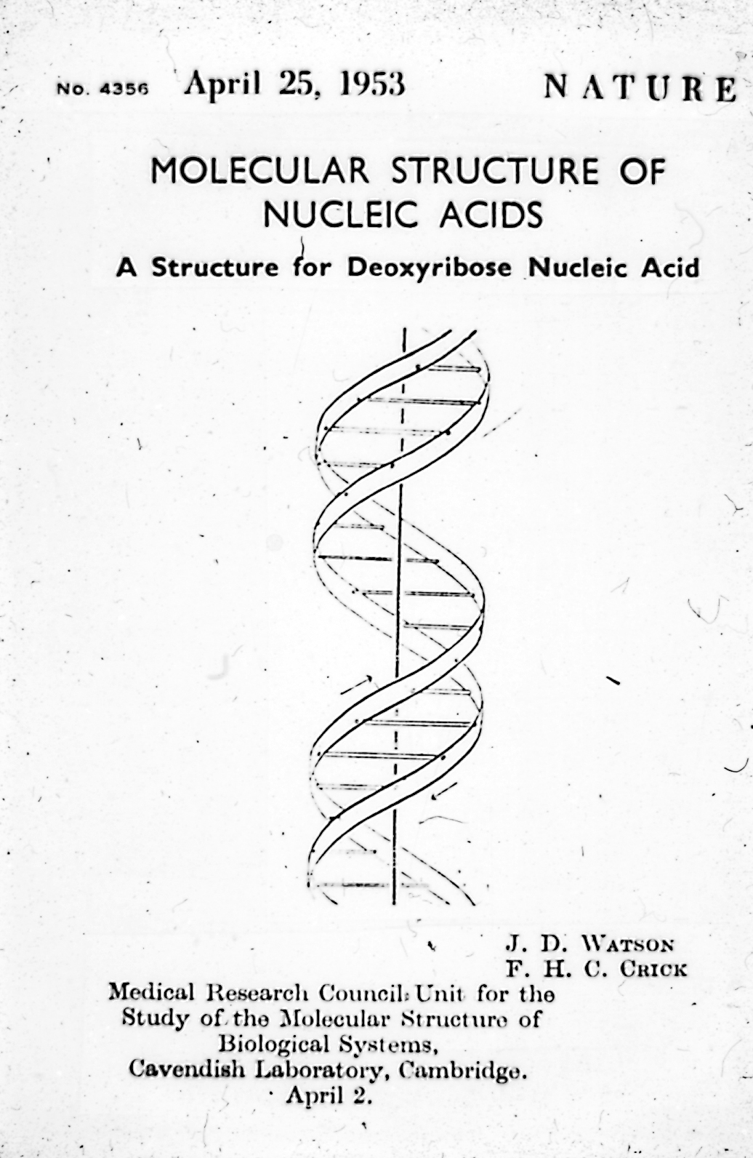
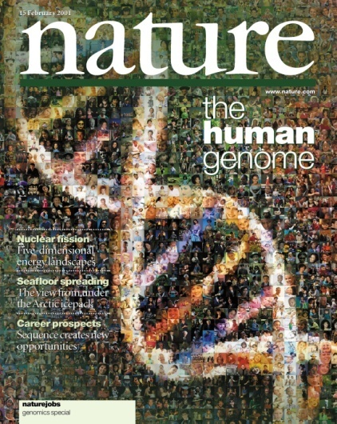
2013: A Celebratory Year for Genomics
60th Anniversary
10th Anniversary
Notes:
Another area of NHGRI updates relates to the year 2013– which will be a spectacular and celebratory year, both for the Institute and for genomics.
* Recall that 2013 will mark the 60th anniversary of the famous publication by Watson & Crick reporting the double-helical structure of DNA.
* And even closer to our own hearts, 2013 will mark the 10th anniversary of the completion of the Human Genome Project.

Slide 10

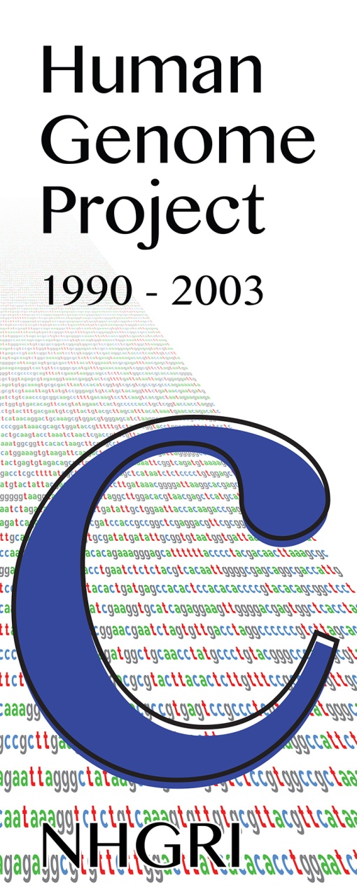
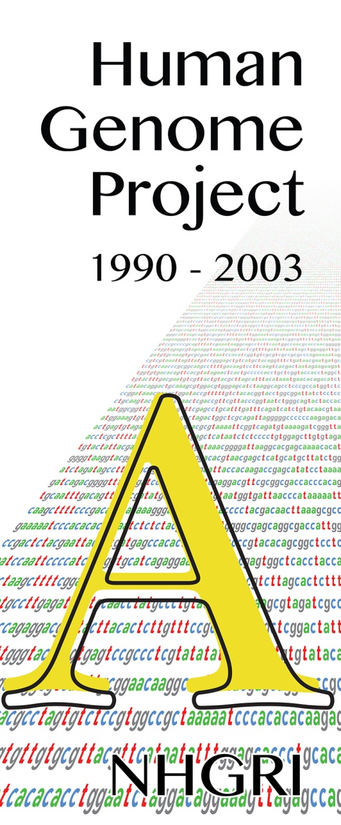

Notes:
As you might expect, NHGRI has been particularly focused on appropriately commemorating the Human Genome Project’s 10th anniversary.
So, let me briefly update you about several major components of our year-long celebration.

Slide 11
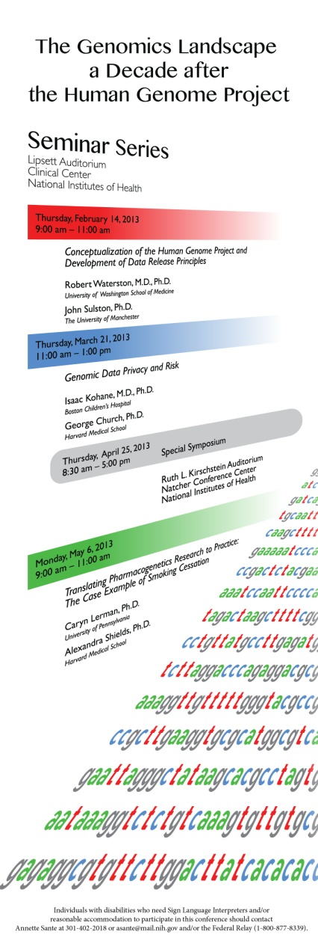
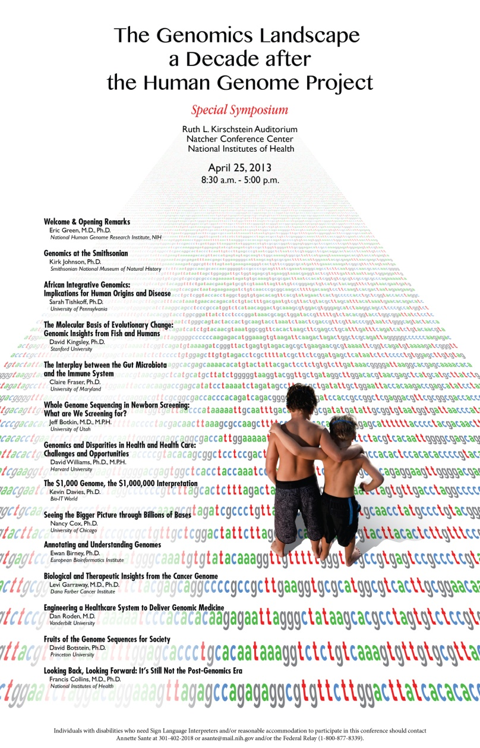
Commemorative HGP Seminar Series and Symposium
Document 2
Notes:
For starters, NHGRI will be hosting two sets of talks at NIH in the coming months to celebrate the Human Genome Project’s 10th anniversary.
The first of these will be given by three pairs of speakers (listed on the left side of this poster). Specifically, there will be paired presentations by Bob Waterston and John Sulston on Thursday of this week, Zak Kohane and George Church in March, and Caryn Lerman and Alexandra Shields in May.
Then, on April 25 (which is DNA Day 2013), NHGRI will hold a day-long special symposium, with participating speakers listed on the right side of this poster). As you might imagine, we have lined up a real all-star cast for this symposium, including Council members David Kingsley and David Williams, as well as Sarah Tishkoff, Claire Fraser, Jeff Botkin, Kevin Davies, Nancy Cox, Ewan Birney, Levi Garraway, Dan Roden, David Botstein, and someone named Francis Collins.

Slide 12
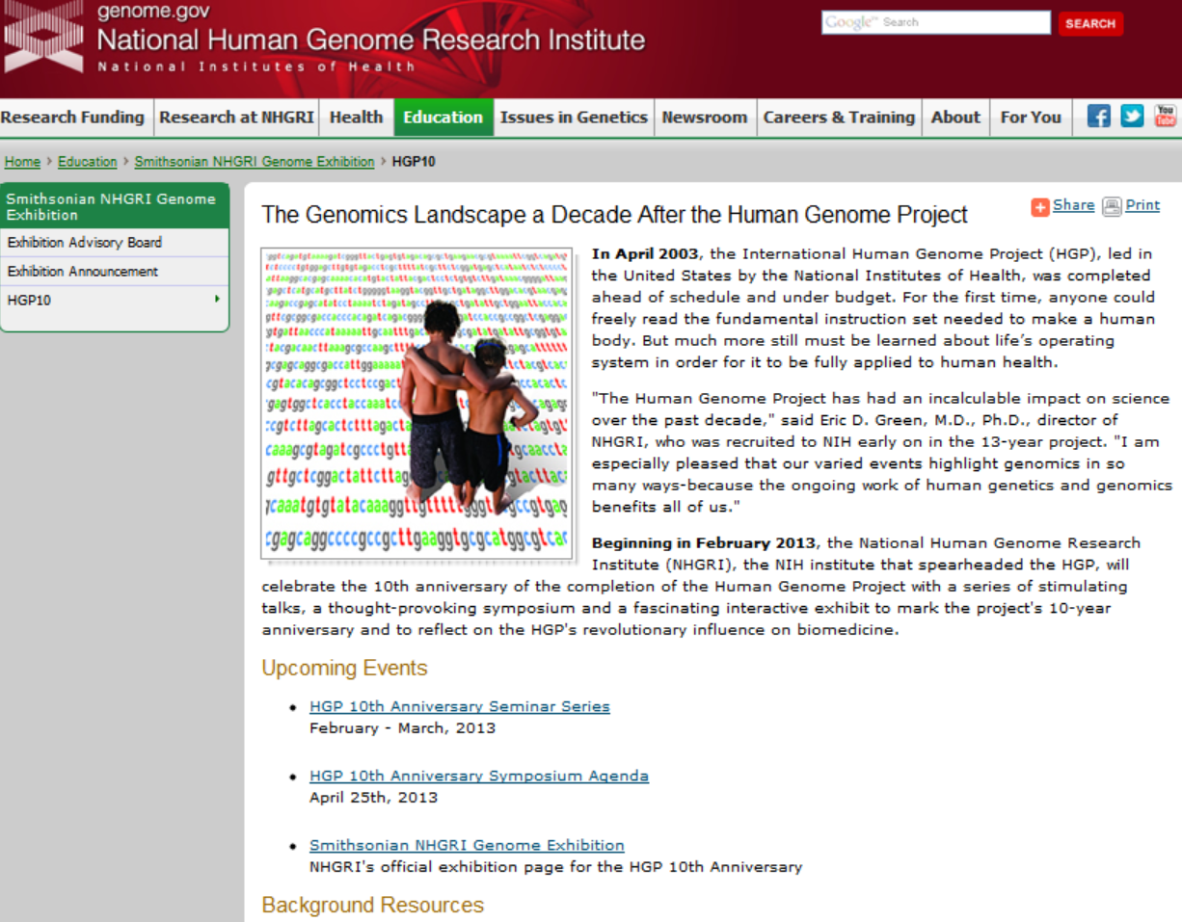
genome.gov/HGP10
Document 2
Notes:
Rest assured that even if you cannot come to Bethesda for any of the paired seminars or for the April 25 symposium, you will be able to watch all of these presentations after the fact via a video archive that we are creating and that will be available on genome.gov via our GenomeTV channel of YouTube.
Shown here is the dedicated web page (with an easy to remember URL) that contains links to all the relevant 2013 celebratory events, including videos of all the presentations (once they are available).

Slide 13
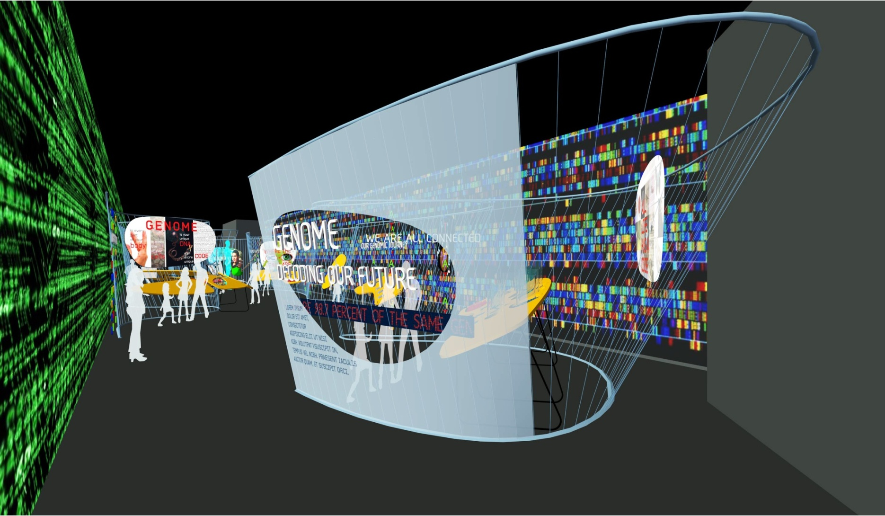
Genome Exhibition Update
Document 3
Notes:
Of course, the centerpiece element of our year-long 2013 celebration will be the opening of the Genome Exhibition at the Smithsonian National Museum of Natural History.
By way of reminder, we announced at the May Council meeting the establishment of a new collaboration with the Smithsonian to develop a traveling exhibition on genomics.
Our partnership with the Smithsonian has been fabulously productive, and staff members from both institutions have been feverishly working together on what is a very tight timeline. I can report that we are currently at the 95% design phase and just a few weeks away from the initial start of fabrication.

Slide 14
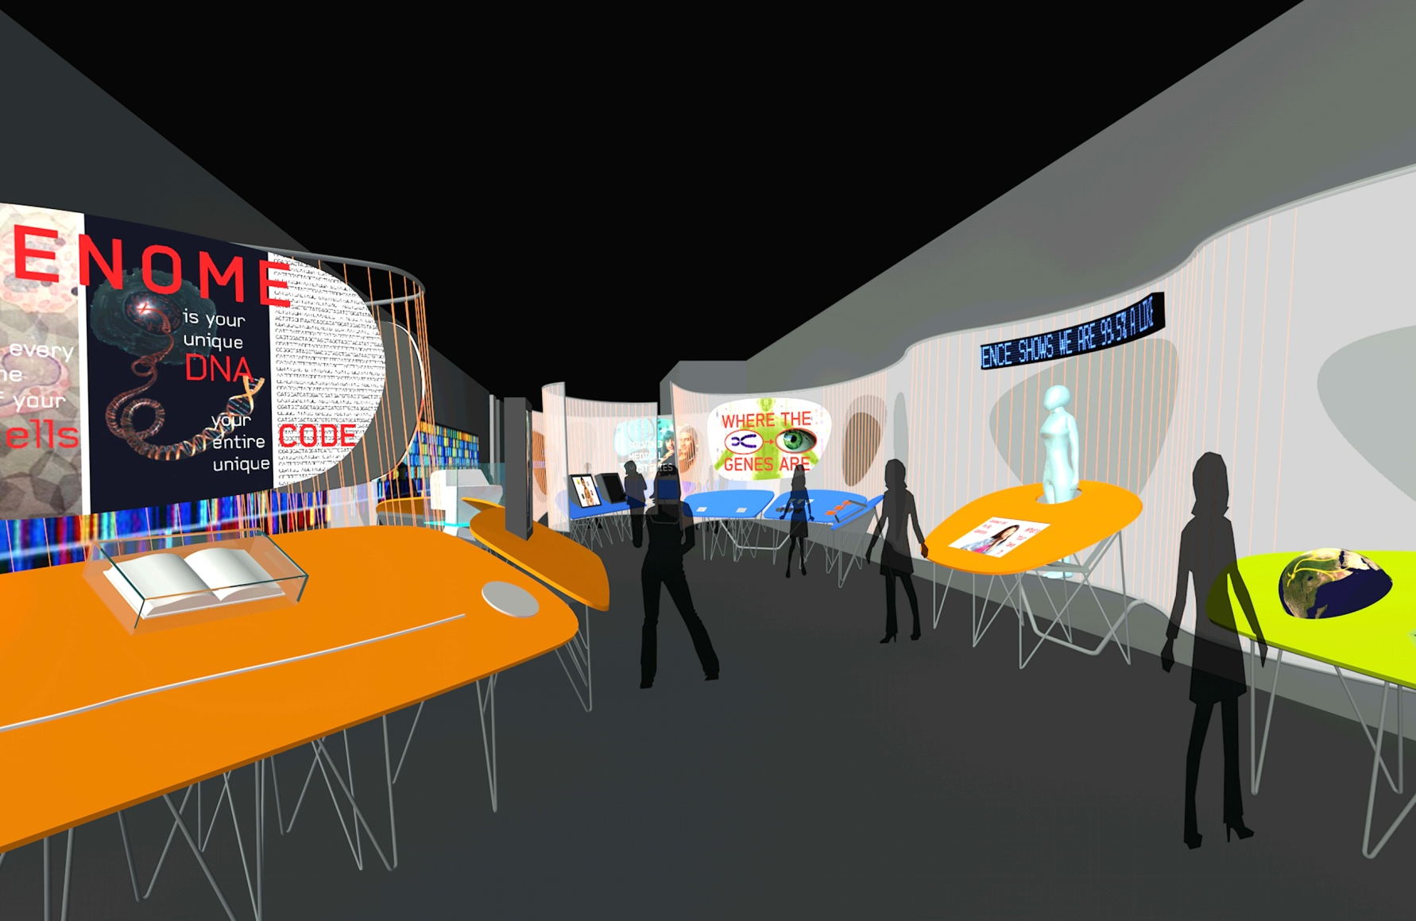
Opening in June 2013
Smithsonian National Museum of Natural History
Genome: Unlocking Life’s Code
Notes:
After many months of discussion, we have decided on the title for the exhibition. And I am pleased to announce that the “Genome: Unlocking Life’s Code” exhibition will officially open on June 14 of this year. While it is resident at the Smithsonian National Museum of Natural History for roughly one year, the exhibition will be located in Hall 23, immediately adjacent to the hall that contains the Hope Diamond.
Starting in late 2014, the exhibition will travel around North American for 4-5 years. The organization responsible for traveling the exhibition is in the process of contacting potential hosting museums and science centers, and the NHGRI Education and Community Involvement Branch is busily planning local and national programming associated with the exhibition (both in the DC area and then elsewhere when the exhibition tours).

Slide 15

Nature 2013
Notes:
Some of you may have seen this nice ‘shout out’ that Nature magazine provided about the Human Genome exhibition in their first issue of 2013, listing it as one of the ‘Hot Tickets’ for 2013 in science and art. Thank you, Nature.
Finally, I am happy to report that we have arranged for the second day of our September Council meeting to be held at the Smithsonian National Museum of Natural History itself, so as to provide all of you a chance to see the exhibition. More details about that to follow later.

Slide 16
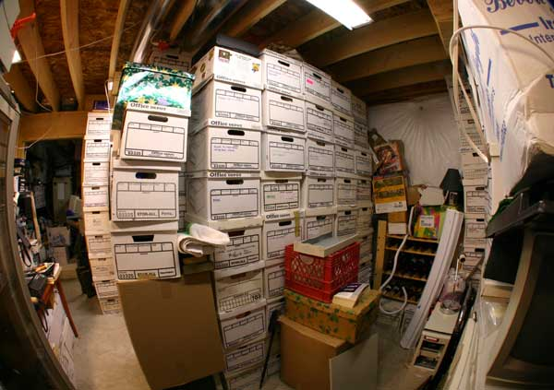
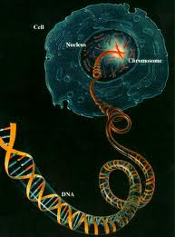

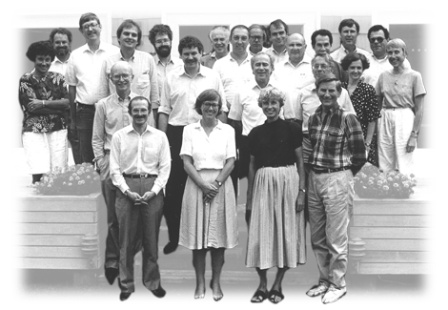
NHGRI Historical Archiving Efforts
Notes:
My discussion about the significance of the year 2013 is a good segue into the last NHGRI update, one related to our historical archiving efforts.
Over the past few years, I have come to realize how many materials NHGRI has that are of historical significance. These include documents, slides, photographs, videos, and other materials related to the Human Genome Project as well as those related to every other major initiative that we have been involved with, from the HapMap project to ENCODE to the $1000 Genome, and so forth.
Needless to say, we needed to get much better organized at archiving these precious resources in a more professional way for science historians to be able to access and utilize in the future.
Towards that end, I have hired a professional archivist and historian, Chris Donohue (introduced to you earlier), and Chris is working to develop an overall historical archiving plan for NHGRI. Eventually, we aim to make these materials publically available.
Meanwhile, there is growing interest in better documenting the history of the Human Genome Project, in particular. And we are in discussions with Cold Spring Harbor Laboratory and the Wellcome Trust about their plans for this. I suspect that I will have more to say about these various efforts at future Council meetings.
16

Slide 17
Director’s Report Outline
General NHGRI Updates
General NIH Updates
General Genomics Updates
NHGRI Extramural Research Program
NIH Common Fund Programs
NHGRI Division of Policy, Communications, and Education
NHGRI Intramural Research Program

Slide 18


New Director of the National Center for Advancing Translational Sciences
Christopher Austin, M.D.
Document 4
Notes:
Shortly after the last Council meeting, Chris Austin was named the new Director of the National Center for Advancing Translational Sciences (or NCATS).
Chris came to the NIH from Merck. He founded and then directed the NIH Chemical Genomics Center, and later the NIH Therapeutics for Rare and Neglected Diseases (TRND) Program. He was later appointed the Scientific Director of the NIH Center for Translational Therapeutics, residing initially within NHGRI and then in NCATS.
Congratulations to our good friend and colleague Chris Austin for his new appointment.

Slide 19


New Director of the Center for Scientific Review
Richard Nakamura, Ph.D.
Document 5
Notes:
Richard Nakamura was recently appointed the new Director of the Center for Scientific Review (CSR). Richard had been serving as the Acting Director of CSR since September 2011.
Prior to that, Richard had a distinguished 32-year career at the National Institute of Mental Health (NIMH), where he served as its Deputy Director and later as its Scientific Director.

Slide 20
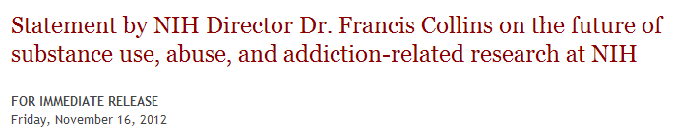


NIDA and NIAAA: No Merger
Document 6
Notes:
After considerable study and discussion, NIH has decided not to merge the National Institute on Drug Abuse (NIDA) and the National Institute on Alcohol Abuse and Alcoholism (NIAAA).
Instead of a structural reorganization, NIH will pursue ‘functional integration’ of relevant programs from each Institute. In doing so, NIDA and NIAAA will retain their institutional identities, while strengthening their ongoing efforts to work more closely with each other and with other Institutes and Centers working in the areas of addiction, substance use and abuse, and related areas.

Slide 21

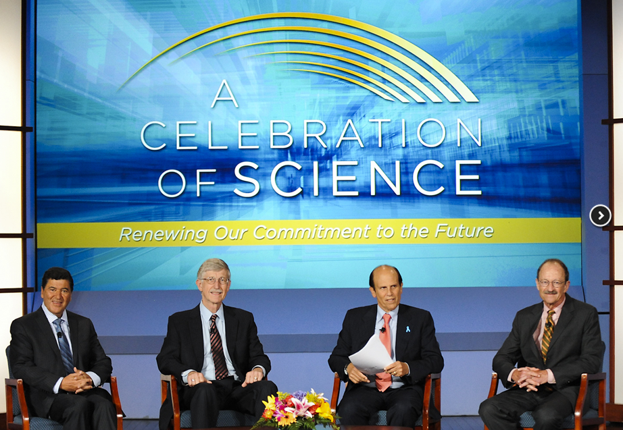
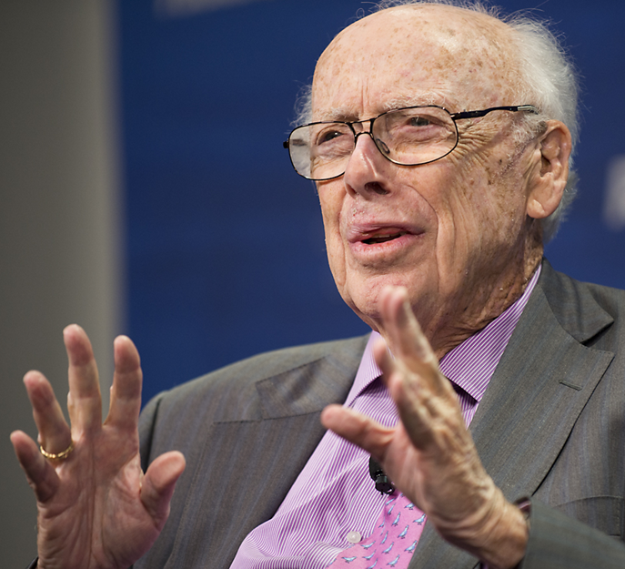


A Celebration of Science
Document 7
Notes:
Last September, NIH joined FasterCures in hosting a 3-day “Celebration of Science” in the DC area.
The events on one of those days were held on the NIH campus, and featured compelling presentations from scientists, patients, and caregivers on topics such as HIV/AIDS, precision medicine, protein folding, neuroscience, and rehabilitation medicine. There were also discussions with policymakers and industry leaders on the health and economic benefits of biomedical research.
For those interested, videos of the various Celebration of Science events are available at the links provided in Document 7.

Slide 22
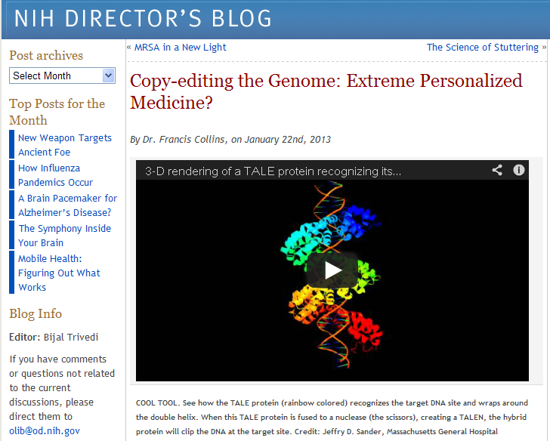
NIH Director’s Blog
Document 8
Notes:
The NIH Director, Francis Collins, has started his own blog to “highlight new discoveries in biology and medicine that are game changers, noteworthy, or just plain cool.”
Francis has been pretty good about blogging, posting new material several times per week. So, if you miss him or feel so inclined, feel free to reach out and blog with him.

Slide 23
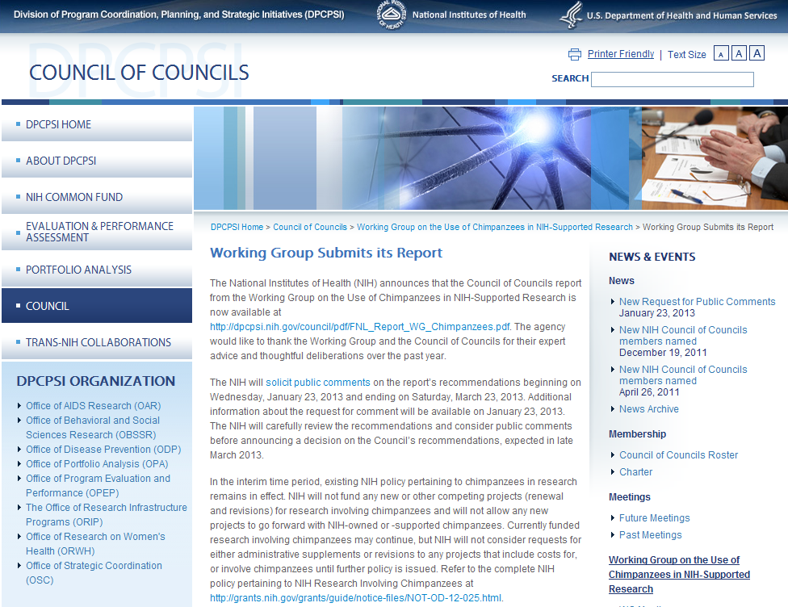
Use of Chimpanzees in NIH-Supported Research
Document 9
Notes:
The report from the Working Group on the Use of Chimpanzees in NIH-Supported Research has been submitted to NIH.
Recommendations in the report pertain to chimpanzee housing, currently awarded projects, size and placement of NIH chimpanzee populations, and a review process for future research. The report recommends retirement and transfer of the majority of NIH chimpanzees to sanctuaries and the end of some research projects.
Public comment pertaining to the report is now open through March 23. NIH plans to announce a decision on the recommendations in late March of this year.

Slide 24
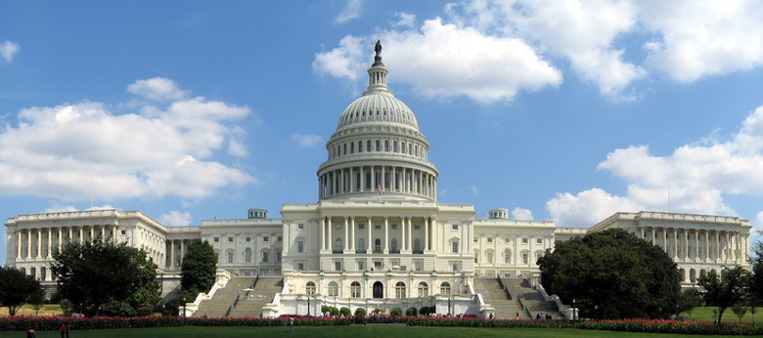
Fiscal Year 2013 Appropriations Update
Continuing Resolution expires on March 27
Congress must still determine appropriations for the rest of Fiscal Year 2013
Notes:
And I will now make a seamless transition from chimpanzees to the Federal government’s appropriation process, but don’t read anything into that artful choreography.
Although we are several months into Fiscal Year 2013, we still do not know what NIH’s or NHGRI’s budget will be this year. I am sure that you have, like me, been following the recent Congressional debates on government spending, and appreciate the continued budgetary uncertainty under which the government is operating.
Here is what we know at this point. * We are currently operating under a Continuing Resolution, which allows the Federal government to continue to operate in the absence of an assigning budget from Congress. This expires on March 27.
* What happens after this date has yet to be decided by Congress. Congress could pass regular appropriations legislation to establish the final budgets for the year, but this is unlikely. A more likely scenario is that Congress will pass a new Continuing Resolution with a new expiration date.

Slide 25
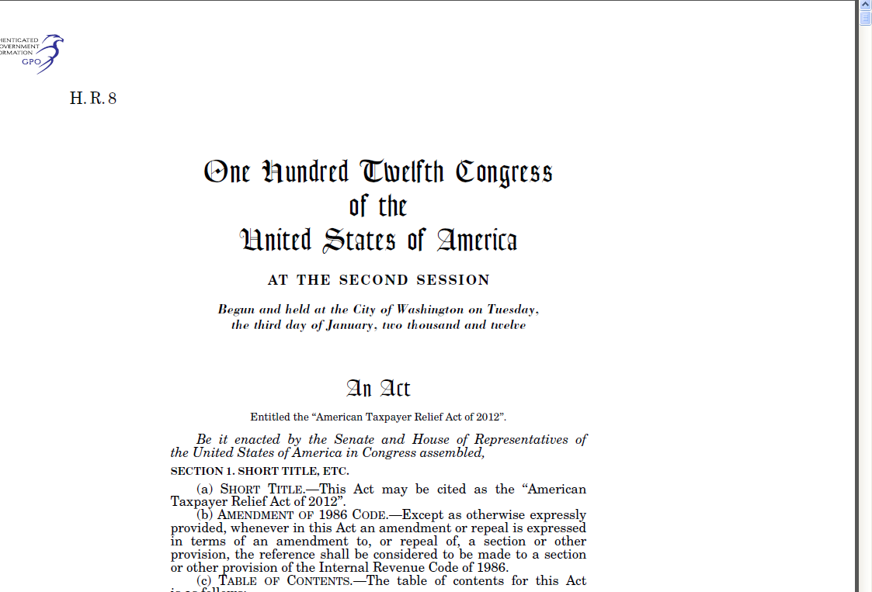
Other Budgetary Complexities
Immediate threat of 8.2% cut averted
If no resolution, a new sequester will be ordered by the President on March 1; implemented on March 27
Potential reduction in Fiscal Year 2013 NIH budget would be less than 8.2%
Notes:
The other major factor in the Federal budget at the moment is the looming threat of sequestration. As a brief reminder, sequestration is an across-the-board cut of 2013 budgets mandated by the Budget Control Act of 2011. In simple terms, what the Budget Control Act means for us is that there would be a major cut to NHGRI’s Fiscal Year 2013 budget unless Congress acts.
Originally, the deadline for Congress to act was January 2. However, the American Taxpayer Relief Act passed on January 1, 2013. * In doing so, the immediate threat of an 8.2% cut to the NIH budget was averted.
We now find ourselves in a new situation. * If Congress does not act by March 1, then on March 27, there will be a new sequester; this time, it is being estimated that * the reduction in the Fiscal Year 2013 NIH budget would be less than the originally projected 8.2%.
For now, NIH will not further ramp down spending in anticipation of a sequester. We will continue to operate cautiously, pursuant to the law as well as general and NIH-specific policies for operating under a Continuing Resolution, until a final Fiscal Year 2013 budget is determined.

Slide 26

Diversity in the Biomedical Research Workforce Working Group
NIH Building Infrastructure Leading to Diversity (BUILD) Program
National Research Mentoring Network (NRMN)
BUILD and NRMN Coordinating and Evaluation Centers
Document 10
Notes:
In June 2012, three Working Groups of the Advisory Committee to the NIH Director delivered their reports and recommendations after roughly a year of deliberations. NIH is now moving forward in implementing most of these recommendations, and I will now briefly update you about each of these areas and Working Groups.
The Diversity in Biomedical Research Workforce Working Group analyzed the NIH intramural and extramural research communities’ retention of underrepresented minorities, persons with disabilities, and persons from disadvantaged backgrounds in the biomedical research workforce.
The Working Group proposed strategies to implement their recommendations on improving diversity in the biomedical workforce, and NIH plans to implement these recommendations. They include establishing the * NIH Building Infrastructure Leading to Diversity (or BUILD) Program and * the National Research Mentoring Network. Both programs are intended to strengthen mentoring and career preparation. * Each program also will create a Coordinating and Evaluation Center to monitor outcomes and enhance fairness in the peer review process through pilot interventions.

Slide 27
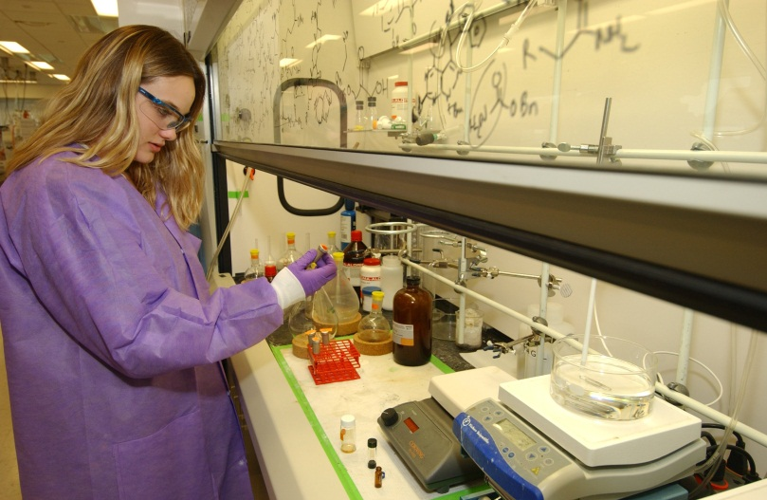
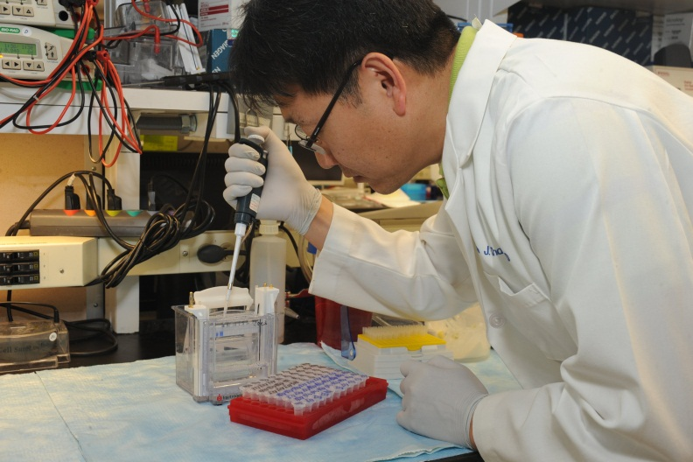
Biomedical Workforce Working Group
Establish a grant program
Improve graduate student/postdoc training
Create an NIH ‘functional unit’ to assess the biomedical research workforce
Document 10
Notes:
The Biomedical Research Workforce Working Group focused on developing a model for a sustainable and diverse U.S. biomedical research workforce able to inform decisions about training the optimal number of people for the appropriate types of positions to advance science and promote health.
The Biomedical Research Workforce Working Group proposed several implementation strategies, and these are also being implemented by NIH. These include elements aiming * to establish a grant program to encourage innovative approaches to biomedical training at institutions receiving NIH funds; * to improve training for graduate students and postdocs; and * to create an NIH functional unit to assess the biomedical research workforce in an ongoing way. The timing and details for all of these implementation steps are currently being worked out.

Slide 28
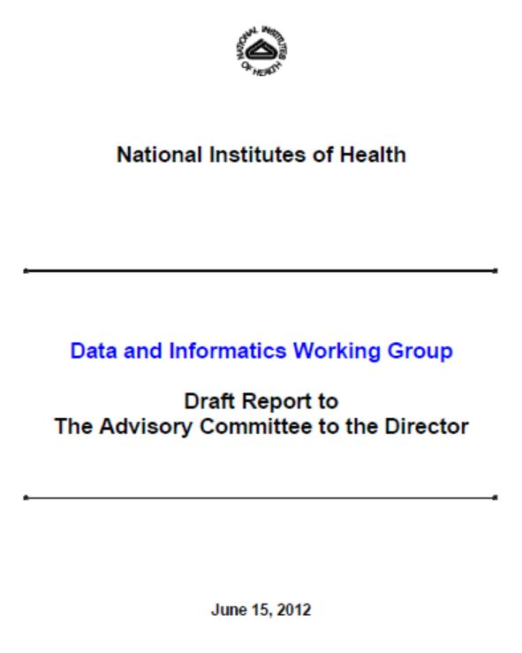

Data and Informatics Working Group
InfrastructurePlus
Scientific Big Data: Three-pronged plan
Document 10
Notes:
The third of the three Working Groups, on Data and Informatics (also referred to as the Big Data Working Group), is the one that NHGRI has been most involved with. Council member Jill Mesirov served on this Working Group, and a number of us at NHGRI have been heavily involved in these discussions, so I thought I would spend a few minutes providing some additional details.
* The report of this Working Group, shown here, is really quite good. The recommendations in this report fall into two broad categories, related to administrative and on-campus NIH data on the one hand and then scientific and biomedical data more broadly on the other hand.
* There is now an implementation plan being pursued to deal with the challenges of administrative data and on-campus NIH data, bundled into an initiative called InfrastructurePlus (which aims to create an adaptive IT environment at NIH to sustain world-class biomedical research). NHGRI is only indirectly involved in this effort, and so I will not discuss this further.
* For scientific Big Data, NIH is acting on the recommendations of the Working Group by implementing a three-pronged plan.

Slide 29


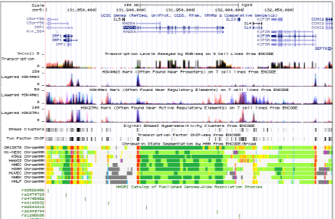
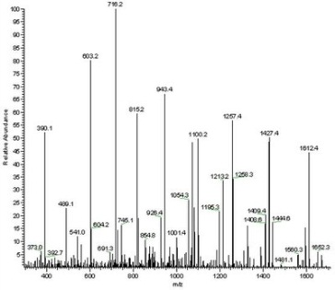
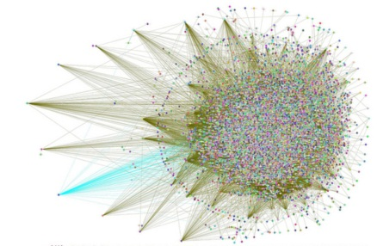
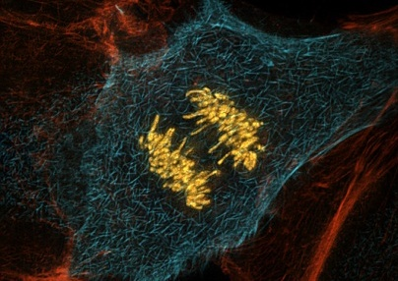
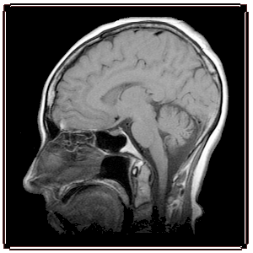




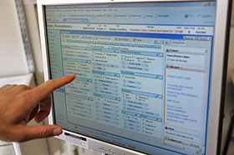

Myriad Data Types
Genomic
Other ‘Omic
Imaging
Phenotypic
Exposure
Clinical
Notes:
Before telling you about the new plans, I want to stress a point made by the Working Group in their report. The current biomedical Big Data problems that all of us face are not limited to genomic data.
* Admittedly, genomics can be considered a ‘poster child’ for the Big Data problems, but there are many other data types (such as those shown here) that currently are (or will increasingly be) contributing to the broader challenges in biomedical research related to Big Data.
In implementing the recommendations of the Data and Informatics Working Group, NIH aims to tackle the problem across all these data types and others. So, just because NHGRI is being asked to play a major role in leading the implementation of new programs, it does not mean that the solutions are limited to genomic data.

Slide 30
NIH is Tackling the ‘Big Data’ Problem
1. New NIH Leadership Position:
Associate Director for Data Science
2. New Internal NIH Governing/Oversight Body:
Scientific Data Council
3. New Trans-NIH Initiative:
Big Data to Knowledge (BD2K)
Notes:
In tackling the Big Data problem, Francis Collins recently announced the implementation of the following three things.
* First, he has established a new NIH leadership position, called the Associate Director for Data Science, an individual who will report to the NIH Director and who will in essence be the NIH’s programmatic leader in data science (broadly defined). On an interim basis, he has asked me to be the Acting Associate Director for Data Science; at the same time, I am co-chairing the search committee that aims to recruit a world-class data scientific into the position. That search will commence in the coming weeks.
* Second, he has created a new internal NIH governing/oversight body for things related to data science and Big Data, called the Scientific Data Council. This group will be chaired by the Associate Director for Data Science, and will have a number of important responsibilities, including overseeing all aspects of the third element, * a new trans-NIH initiative called Big Data to Knowledge (or BD2K).

Slide 31

Big Data to Knowledge (BD2K): Overview
Major trans-NIH initiative addressing an NIH imperative and key roadblock
Transformational, catalytic, and synergistic
Overarching goal:
By the end of this decade, enable a quantum leap in the ability of the biomedical research enterprise to maximize the value of the growing volume and complexity of biomedical data
Notes:
* BD2K is a major trans-NIH initiative that aims to address an NIH imperative and key roadblock in biomedical research related to data science and Big Data. * It is designed to be transformational, catalytic, and synergistic.
* I regard its overarching goal to be something along the lines of: * “By the end of this decade, enable a quantum leap in the ability of the biomedical research enterprise to maximize the value of the growing volume and complexity of biomedical data.”
BD2K is initially being organized for 7 years (through Fiscal Year 2020). Active planning for BD2K will take place throughout this fiscal year, with the launching of some of its initial elements starting in Fiscal Year 2014 (which is only about 8 months away at this point). At a time when budgets are tight, the collective NIH leadership was able to identify both Common Fund monies and Institute/Center funds to allow the initiative to grow to just over $100M by Fiscal Year 2016.
Mark Guyer is leading a trans-NIH group of program directors involved in implementing BD2K, and we expect that NHGRI will end up leading some of the elements of the program. As such, we will likely be bringing BD2K components to this Council for your input.

Slide 32




BD2K: Four Programmatic Areas
Facilitating Broad Use of Biomedical Big Data
II. Developing and Disseminating Analysis Methods and Software for Biomedical Big Data
III. Enhancing Training for Biomedical Big Data
IV. Establishing Centers of Excellence for Biomedical Big Data
Notes:
For that reason, let me briefly list for you the four major programmatic areas of BD2K, with the promise that at future Council meetings, we will for certain be telling you about each of these important areas in greater detail.
The four major areas of BD2K are as follows.

Slide 33
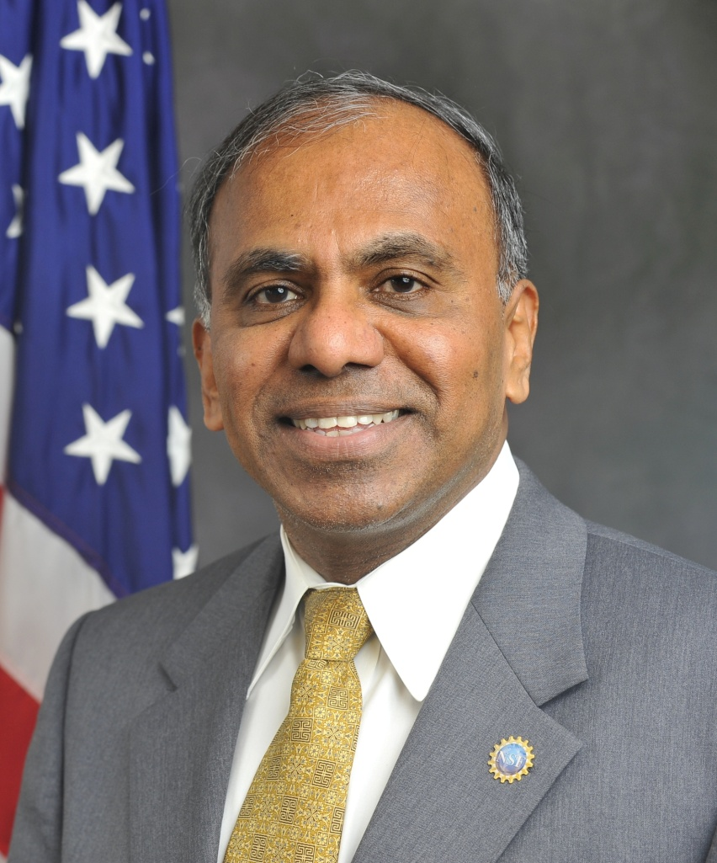


NSF Director to Depart for Presidency of Carnegie Mellon University
Subra Suresh, Sc.D.
Notes:
Last week, it was announced that Subra Suresh, Director of the U.S. National Science Foundation, will be leaving the agency in July to take up the post of President at Carnegie Mellon University.
Subra joined the NSF in October 2010, coming from the Massachusetts Institute of Technology, where he was the Dean of Engineering.

Slide 34
Director’s Report Outline
General NHGRI Updates
General NIH Updates
General Genomics Updates
NHGRI Extramural Research Program
NIH Common Fund Programs
NHGRI Division of Policy, Communications, and Education
NHGRI Intramural Research Program

Slide 35
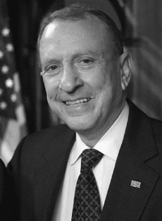
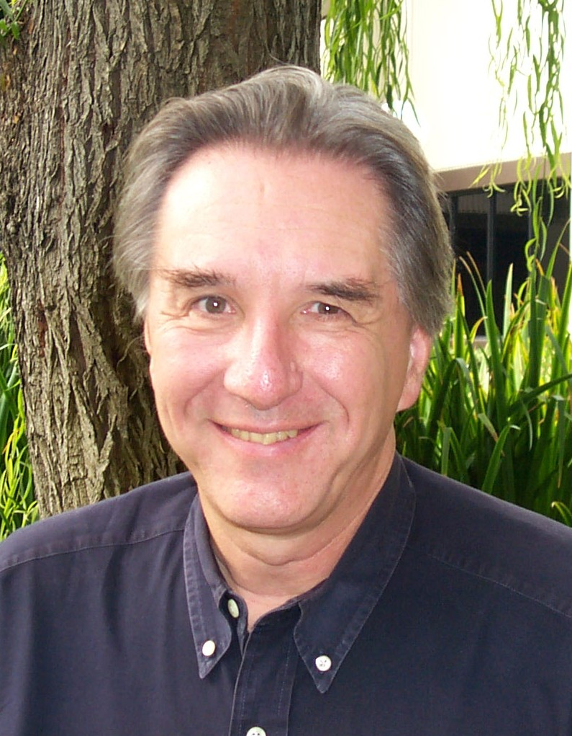

Mourning the Loss of David Cox
Document 11
Notes:
The genomics community (and all of us at NHGRI) were shocked and saddened to learn of the sudden death of our good friend and colleague, David Cox, last month. David was truly a renaissance scientist: a geneticist, a pediatrician, a technology pioneer, and an entrepreneur. His contributions to genetics and genomics were many and were remarkable.
He was formerly Professor of Genetics and Pediatrics at Stanford University and founder of Perlegen Sciences. In 2008, he joined Pfizer to shepherd development of that company’s efforts in genomic medicine. Of particular relevance to NHGRI, he served on the Program Advisory Committee of the Human Genome Project in the early 1990’s.

Slide 36
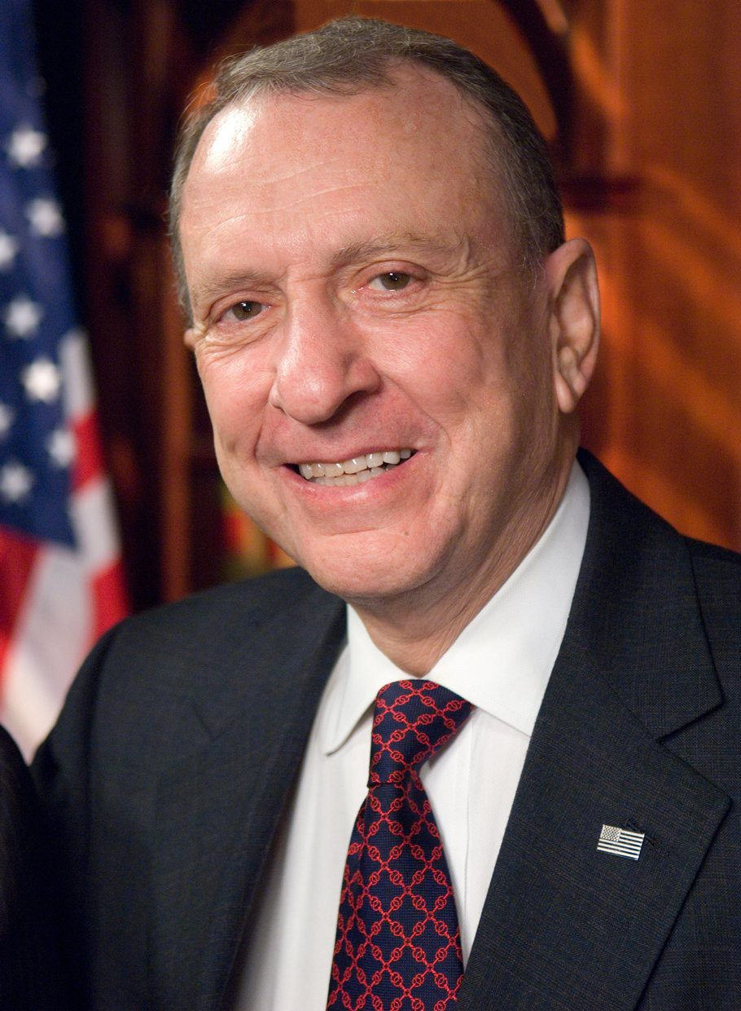

Mourning the Loss of Arlen Specter
Document 12
Notes:
Another good friend and loyal supporter of NHGRI’s and NIH’s, Senator Arlen Specter, passed away this past October at age 82 from complications of cancer.
The former senator from Pennsylvania was a tireless proponent of NIH and its mission. Together with Senator Tom Harkin, Specter led an effort to double the NIH budget from 1998-2003. He latter helped secure $10 billion in stimulus funding for NIH within the 2009 Recovery Act, was a proponent of human embryonic stem cell research, and helped to create the Cures Acceleration Network.

Slide 37


National Medal of Science
Lee Hood, Ph.D.
Document 13
Notes:
A well-known figure within the genomics community, Lee Hood, has been awarded the National Medal of Science. This medal is the highest honor bestowed by the United States Government to scientists, engineers, and inventors.
Lee’s accomplishments include the development of various automated technologies, including the first automated, fluorescence-based DNA sequencer that enabled the mapping and sequencing of the human genome and revolutionized the field of genomics.

Slide 38



Awards at 2012 ASHG Annual Meeting
Francis Collins, M.D., Ph.D.
Jay Shendure, M.D., Ph.D.
Document 14
Notes:
The 62nd annual meeting of the American Society of Human Genetics convened in San Francisco in early November. At the meeting, there were major awards given that are of particular relevance of NHGRI.
* Francis Collins received the 2012 Victor A. McKusick Leadership Award, which recognizes individuals whose professional achievements have fostered and enriched the development of human genetics.
* Jay Shendure, an NHGRI grantee, was awarded the 2012 Curt Stern Award, which recognizes outstanding scientific achievements occurring in the last decade.

Slide 39
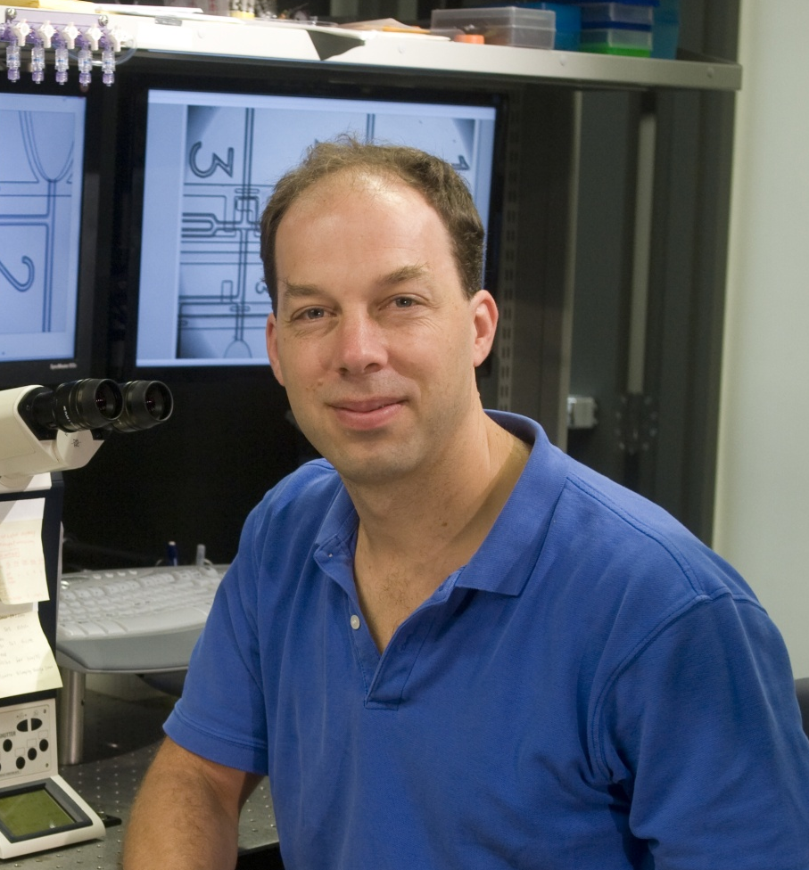
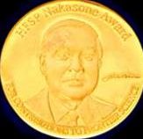

Human Frontier Science Program Organization 2013 Nakasone Award
Stephen Quake, D.Phil.
Document 15
Notes:
Another NHGRI grantee, Stephen Quake, was recently awarded the 2013 Nakasone Award for his work developing technologies in biophysics, biological automation, genome analysis, and personalized medicine.
This award is given by the Human Frontier Science Program Organization.

Slide 40

Taubman Prize for Excellence in Translational Medical Science
Hal Dietz, M.D.
Document 16
Notes:
A good friend of NHGRI’s and former Chair of our Intramural Research Program’s Board of Scientific Counselors, Hal Dietz, was awarded the 2012 Taubman Prize for Excellence in Translational Medical Science.
Hal’s productive career studying Marfan, Loeys-Dietz, and other connective tissue syndromes has led to a clinical trial using the blood pressure drug losartan for treating Marfan syndrome patients at risk for aortic aneurysm.

Slide 41
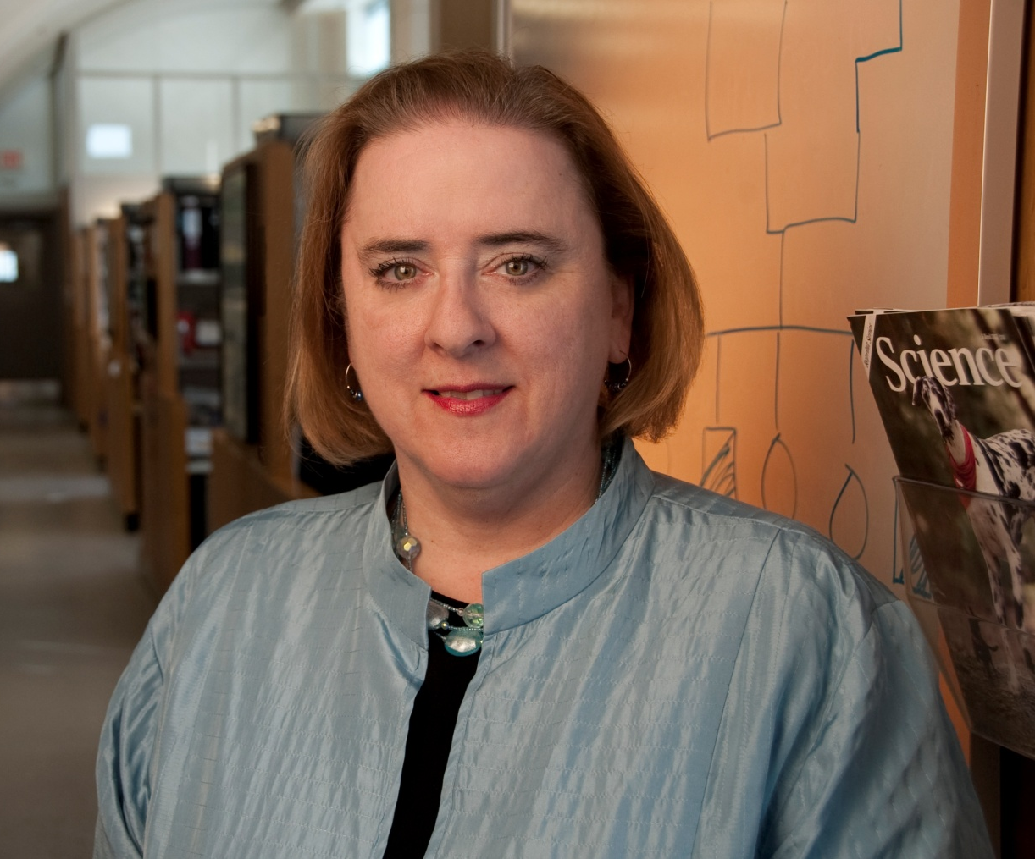

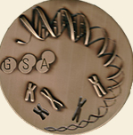
2013 Genetic Society of America Medal
Elaine Ostrander, Ph.D.
Document 17
Notes:
Speaking of our Intramural Research Program, one of our Intramural Branch Chiefs, Elaine Ostrander, recently received a 2013 Genetics Society of America Medal. This award recognizes elegant and highly meaningful contributions to genetics within the previous 15 years of their career.
In addition to her work on human prostate and breast cancers, Elaine is known throughout the scientific community as one of the world's foremost authority on canine genomics.

Slide 42
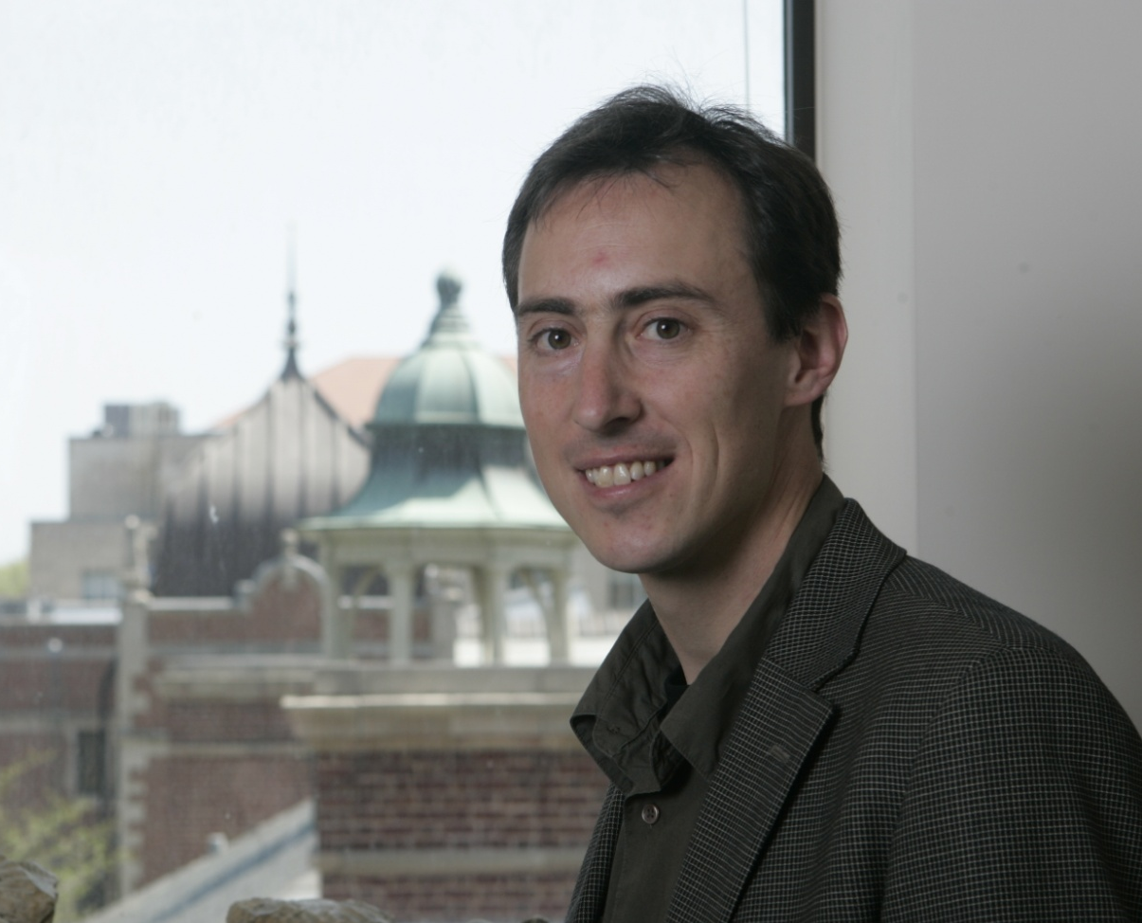
2013 Edward Novitski Prize
Jonathan Pritchard, Ph.D.
Document 18
Notes:
Another Genetics Society of America award, the 2013 Edward Novitski Prize, was recently given to Jonathan Pritchard, an NHGRI grantee. This award recognizes an extraordinary level of creativity and intellectual ingenuity in solving a significant problem in genetics research.

Slide 43


Elected to the Institute of Medicine
Lynda Chin
Daniel Kastner
Stephen Quake
Document 19
Notes:
The Institute of Medicine recently announced their newly elected members. New members of particular significance for NHGRI include Lynda Chin (a major participant of TCGA), Dan Kastner (NHGRI’s Scientific Director), and Stephen Quake (who I mentioned a few slides ago).

Slide 44

Elected to AAAS
Michael Brent
Susan Celniker
Joseph Ecker
Steven Henikoff
Kathy Hudson
Lynn Jorde
Rob Knight
Charles Lee
Elaine Ostrander
Reed Pyeritz
Dan Roden
Jane Silverthorne
John Stamatoyannopoulos
Document 20
Notes:
And the same holds true for recently elected Fellows of AAAS, with the individuals listed here having notable ties to NHGRI.

Slide 45
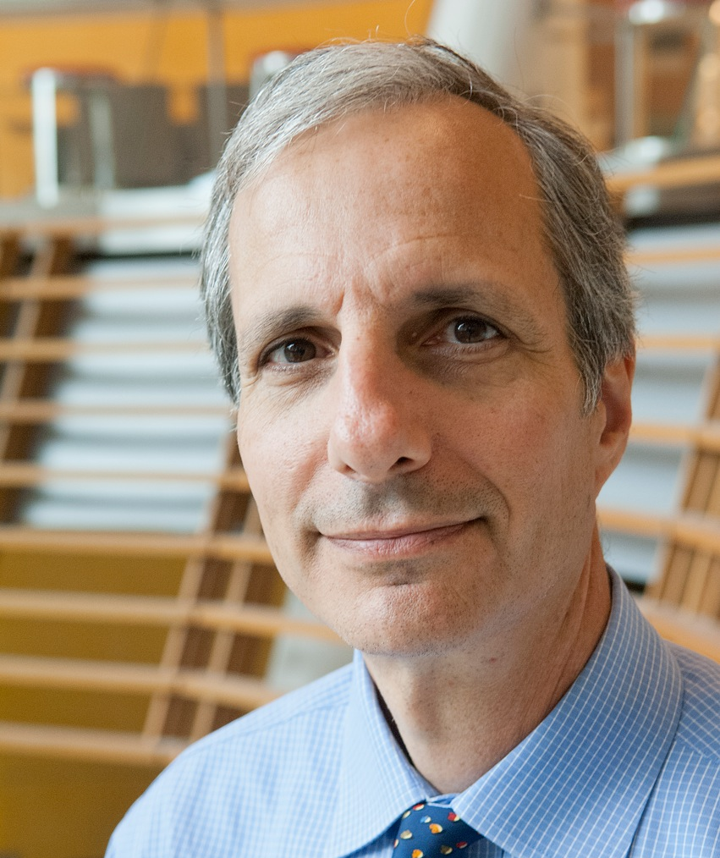

Director Named for the New York Genome Center
Bob Darnell, M.D., Ph.D.
Document 21
Notes:
After a lengthy search, the New York Genome Center has appointed physician-scientific Bob Darnell as its first President and Scientific Director.
Bob is an outstanding researcher and member of the Howards Hughes Medical Institute. His expertise is in molecular biology, internal medicine, and neurology.

Slide 46

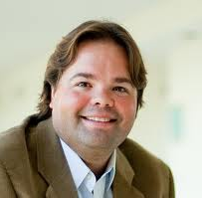


Launching of Stanford Center for Computational, Evolutionary, and Human Genomics
Document 22
Notes:
Stanford University recently announced the launching of a new genomics research center— the Stanford Center for Computational, Evolutionary, and Human Genomics. Council member Carlos Bustamante is Co-Director, along with Mark Feldman.
The Center's focus will be on using expertise and methods for sorting through, integrating, and analyzing large-scale datasets.

Slide 47
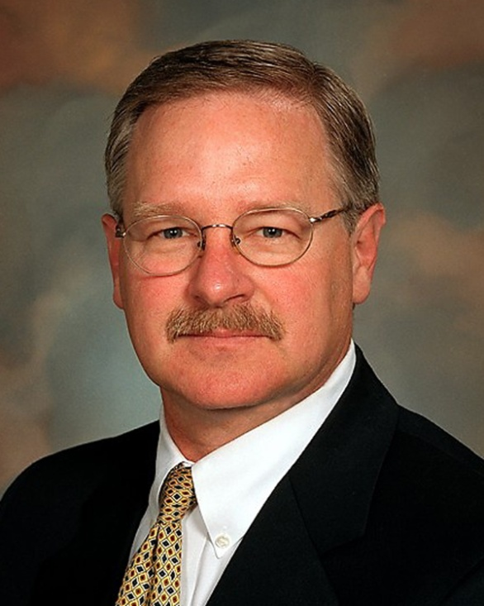
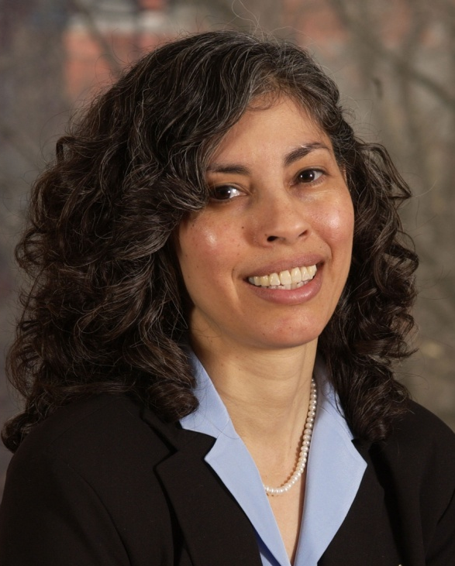
Secretary's Advisory Committee on Human Research Protections: New Members
Jeffrey Botkin,
M.D., M.P.H.
(Chair Designate)
Pilar Ossorio,
J.D., Ph.D.
Document 23
Notes:
The Office for Human Research Protections (OHRP) recently appointed four new members to the Secretary's Advisory Committee on Human Research Protections.
Two of those individuals are well-known to NHGRI, Jeffrey Botkin (the Chair Designate) and former Council member Pilar Ossorio. The other two new members are Thomas Eissenberg and Owen Garrick.

Slide 48


New Executive Vice President of ASHG
Joe McInerney, M.S.
Notes:
In some breaking news announced late last week, Joe McInerney will soon become the new Executive Vice President of the American Society of Human Genetics.
Joe was the director of the National Coalition for Health Professional Education in Genetics (NCHPEG) for ten years until 2010. He has also been active in NHGRI’s ELSI program over the years.
Joe has a master’s degree in genetic counseling, and has been a public proponent for the teaching of genetics and evolution for many years. We look forward to working with Joe when he assumes his new leadership position with ASHG.

Slide 49
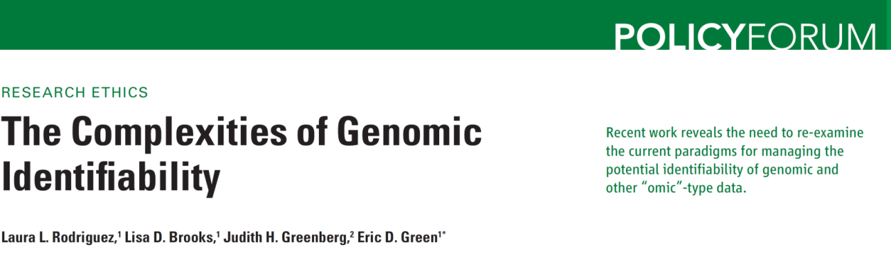
Genomic Identifiability
Surnames of CEPH individuals identified using Y-STR data and publicly accessible Internet resources
Document 24
Notes:
Last month, Gymrek et al. published a paper in Science describing a method to deduce the surnames and then to identify individuals in the well-studied CEPH population using data about short tandem repeats on the Y-chromosome and various publicly accessible Internet resources. Note that the identification of study subjects was possible without a matching DNA sample and with access only to publicly available datasets.
The authors contacted NHGRI and NIGMS about their findings prior to publication, so that we could explore possible options to mitigate the privacy vulnerabilities in the research data. As a precaution, age information for the CEPH participants, which previously was available through public pages within the NIGMS cell-line repository at the Coriell Institute and played a role in the participant identification, was moved out of open access. The PI for the CEPH study and IRB officials at the University of Utah were also contacted to alert them to the new findings in advance of publication. NHGRI also discussed the matter with one of the genealogy resources used in the work to identify the surnames.
To highlight the broader policy context of the reported work, NHGRI staff and Judith Greenberg (NIGMS Acting Director) co-authored an accompanying Policy Forum in the same issue of Science. That paper calls on the research community to engage in a renewed and open discussion about how to balance protection of research participants with the societal benefits of broad data sharing, especially in the context of the increasing opportunities to connect research and non-research information in the public domain.

Slide 50
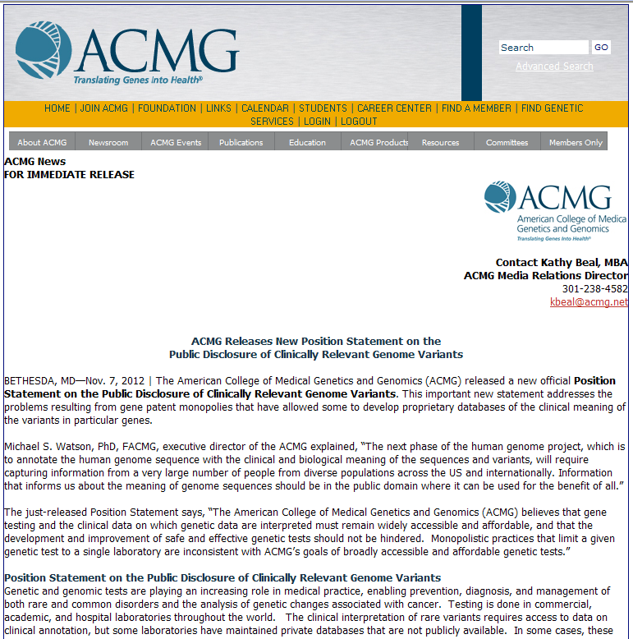
ACMG Statement on Variant Disclosure
“Monopolistic practices that limit a given genetic test to a single laboratory are inconsistent with ACMG's goals of broadly accessible and affordable genetic tests.”
Document 25
Notes:
The American College of Medical Genetics and Genomics released a position statement last November calling for the public disclosure of clinical variant data that laboratories collate from genetic testing. The statement describes the College’s concern about how gene patent monopolies are allowing some laboratories to develop proprietary databases that facilitate the interpretation of individual variants.
In the statement, they explain that ACMG believes that “Monopolistic practices that limit a given genetic test to a single laboratory are inconsistent with [their] policy goals of broadly accessible and affordable genetic tests.”

Slide 51


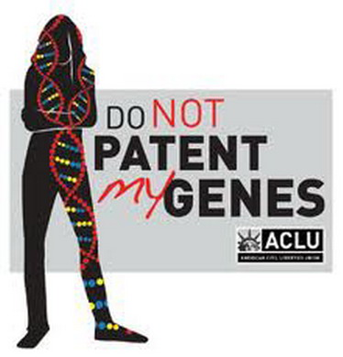

Biotech Patents and the Courts
Document 26
Notes:
The lawsuit over Myriad’s BRCA patents, and possibly gene patents altogether, may be heading towards a final resolution in 2013, with the recent announcement by the Supreme Court that they will hear the case later this year.
As you may recall, the case began in 2009, when several pathology societies, as well as several clinical pathologists and breast cancer patients, challenged the U.S. Patent and Trademark Office, Myriad Genetics, and the directors of the University of Utah Research Foundation over the patentability of Myriad's BRCA1- and BRCA2-related patents. Previously, a Federal District Court ruled in favor of the plaintiffs, finding that Myriad’s claims to the BRCA genes were not patent-eligible, but this decision was reversed by the Court of Appeals for the Federal Circuit. The case was appealed to the Supreme Court.
In March 2012, the Supreme Court asked the Court of Appeals to reconsider the case in light of another long-running biomedical patent dispute (between Prometheus and Mayo Laboratories), but the Court of Appeals came to the same conclusions as before. The Supreme Court recently announced that they will hear the case this coming year, specifically on the question of whether or not human genes are patentable subject matter. The Supreme Court’s ruling in this case will set a binding precedent for the lower courts.

Slide 52

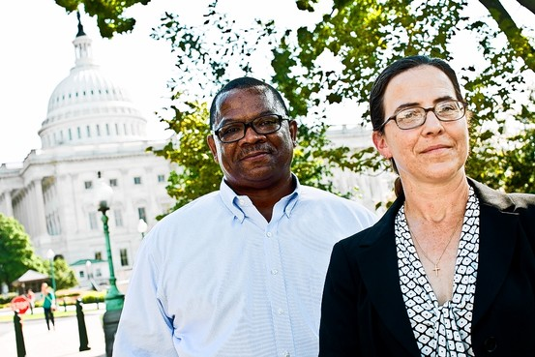
Courts Give NIH hESC Funding the All-Clear
Drs. Sherley and Deisher
Secretary Sebelius
Document 27
Notes:
You may also recall that just over two years ago, NIH was blocked from funding any human embryonic stem cell research as a result of a court case, brought by Drs. James Sherley and Theresa Deisher, against Secretary Sebelius, DHHS, and NIH.
The injunction against allowing NIH to fund embryonic stem cell research was lifted by the appeals court, and Judge Royce Lamberth found in favor of the NIH in July 2011. In late August 2012, the court of appeals considered the case, and also ruled in favor of NIH.
I am pleased to report that on January 7, the Supreme Court announced that they would not consider a final appeal from Drs. Sherley and Deisher, finally bringing this case to a close.

Slide 53
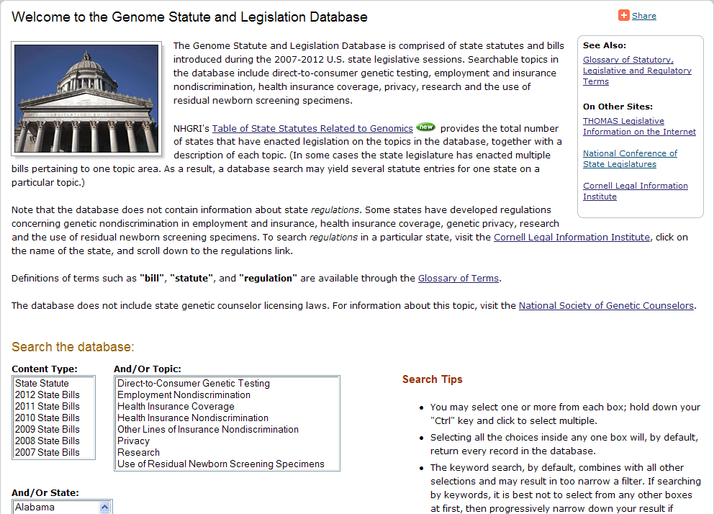
NHGRI State Policy Database
Document 28
Notes:
In addition to Federal laws, individual states pass laws that affect genomics research or have implications for genomic medicine.
Some years ago, NHGRI created a database for tracking legislation at the state level on policy topics such as genetic discrimination by employers or health insurance providers. Over the years, the list of topics tracked has been expanded to include issues such as privacy, informed consent, and, most recently, the use of residual newborn screening specimens.
We have now updated the database to include all new statutes and bills from the last two years, and added a table giving an up-to-date snapshot about the number of states with laws on each topic. The database is accessible at genome.gov.

Slide 54

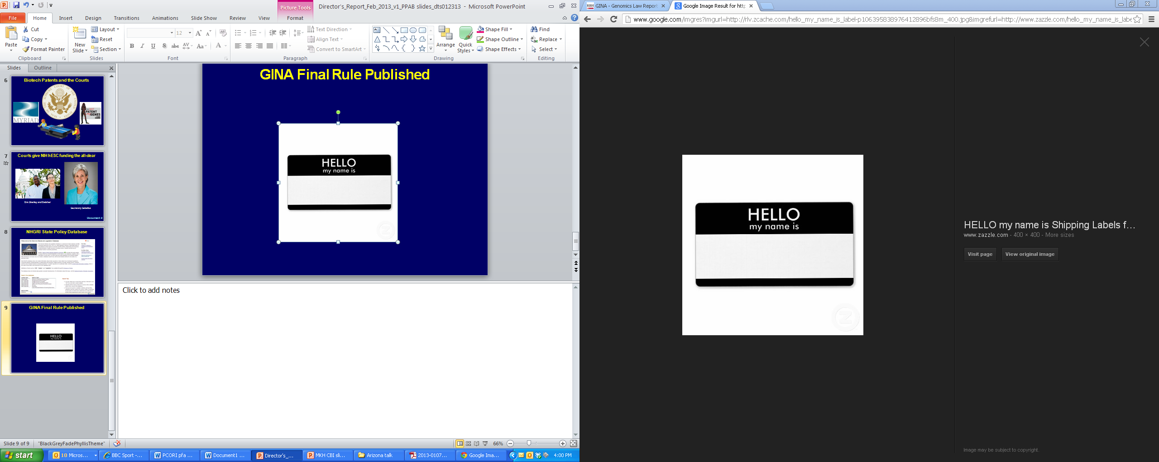
GINA Final Rule Published
Amends HIPAA Privacy Rule to clarify that genetic information is health information
Prohibits use or disclosure of genetic information for underwriting purposes
Covers both private and public health insurance
GINA
Document 29
Notes:
Last month, the Department of Health and Human Services issued a Final Rule implementing Section 105 of the Genetic Information Nondiscrimination Act (or ‘GINA’).
* This Final Rule amends the Privacy Rule of the Health Insurance Portability and Accountability Act (or ‘HIPAA’) to clarify that genetic information is health information.
* It also prohibits the use or disclosure of genetic information for underwriting purposes.
* Consistent with existing HIPAA regulations, the Final Rule covers a variety of health insurance types (both private and public)– including group health plans, issuers of health insurance, Medicare supplemental policies, as well as military and veterans’ healthcare programs.
The Final Rule becomes effective in March. NHGRI continues to monitor GINA-related issues through contact with the agencies responsible for implementation.

Slide 55
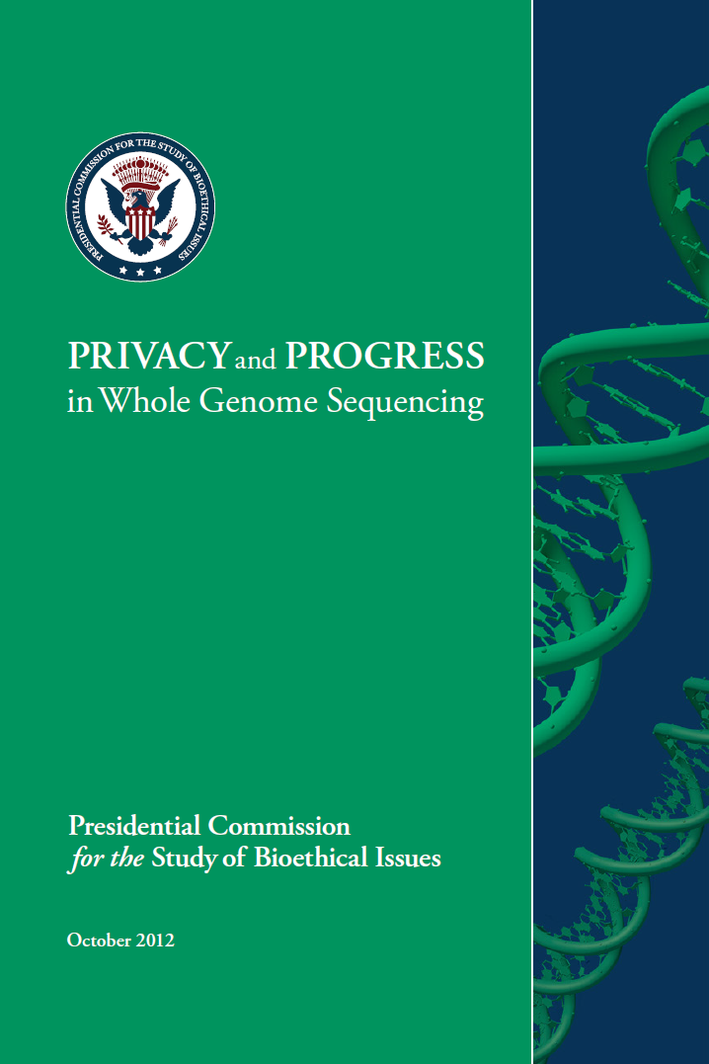

Presidential Commission for the Study of Bioethical Issues
Document 30
Notes:
As you may recall, the Presidential Commission for the Study of Bioethical Issues has been considering bioethics issues raised by advances in human genome sequencing. The Commission released its fourth report, “Privacy and Progress in Whole Genome Sequencing” in October, gathering its information through a Request for Information, a survey of Federal agencies, and a series of public meetings.
In its report, the Commission provides 12 recommendations to ensure privacy and security of whole-genome sequencing data and information. The recommendations are intended to support privacy protections across the three identifie “facets of responsibility”: the conduct of genomic data users, the security of the systems employed to manage genomic data, and the policy frameworks established to oversee access to and use of genomic information. The majority of the report’s recommendations are directed toward research and clinical activities, but there is some discussion relevant to direct-to-consumer companies and other private sector entities.
Upon review of the report, we believe that NIH and NHGRI policies are consistent with the Commission’s recommendations. At the most recent meeting of the Commission in January, they announced that they will be taking up the issue of incidental findings in biomedical research in a future report.

Slide 56

European Science Foundation Report
“…we must gain a clear understanding of what is required to achieve [the promise of personalized medicine] and begin to lay the foundations now that will allow us to benefit in the future.”
Document 31
Notes:
The European Science Foundation, a non-governmental organization fostering scientific collaborations across Europe, recently issued a new report on personalized medicine. Entitled ‘Personalized Medicine for the European Citizen’, it observes that Europe needs to “gain a clear understanding of what is needed to fulfill the promise of personalized medicine and begin to lay the foundations now that will allow us to benefit in the future.”
The report examines the key issues affecting the development and implementation of personalized medicine, and provides a large number of recommendations for maximizing its potential. A meeting was held in Brussels at the end of January to discuss the report and how its recommendations can be implemented.

Slide 57

Joint Genome Institute Workshop Report
Document 32
Notes:
The Department of Energy’s Joint Genome Institute held a strategic planning workshop last spring, and then more recently published this report.
The major themes of the workshop and the report included continued and increasing large-scale genome sequencing, functional and structural annotation, improved bioinformatics methods, capacity to synthesize DNA, automation of biological experiments, and organization of scientific communities.

Slide 58


100,000 British Genome Sequences
Document 33
Notes:
The U.K.’s National Health Service (NHS) recently announced an initiative that aims to sequence the genomes of as many as 100,000 cancer patients. The U.K. government has earmarked £100 million to stimulate DNA sequencing for cancer and rare inherited diseases, to train genetic scientists and healthcare workers to harness genome sequencing technologies, and to build the NHS data infrastructure.
They hope to solidify their plans for this by April 2014.

Slide 59





NHGRI Genome Advance of the Month
Document 34
Notes:
NHGRI continues to feature a ‘Genome Advance of the Month’ on our web site, genome.gov.
Publications that were featured since the last Council meeting described * whole-genome sequencing used to track an infectious agent’s transmission path, * ENCODE’s efforts to decipher functional elements in the human genome, * genes and weight, * the potential of genomics to improve our diets, and * single-cell genome sequencing.

Slide 60





Genomics In The News…
Science Top 10 Breakthroughs in 2012
Document 35
Notes:
A number of genomics stories appeared in the news in recent months.
For starters, ENCODE was named one of the Runner Ups of Science's top 10 breakthroughs in 2012.

Slide 61


Genomics In The News…
#2: Genome Sequencing for Routine Checkups
#3: Matching a Tumor to a Drug
#6: Rejigging Your Genes
Document 35
Notes:
Earlier this year, the Wall Street Journal published a piece highlighting six medical innovations soon to transform the treatment of disease. Three of the six innovations featured genetics and genomics
Specifically, #2 was the use of genome sequencing for routine medical checkups.
#3 was pharmacogenomics for cancer treatment.
#6 was gene therapy.

Slide 62





Time: Top 10 Medical Breakthroughs in 2012
Document 35
Notes:
Similarly impressive for genomics, making both me and NHGRI incredibly proud, was Time magazine's list of the Top 10 Medical Breakthroughs in 2012.
Not one, not two, not three, not four, but five of the ten breakthroughs on the list had genomics’ and NHGRI’s fingerprints all over them.
* #8 was about decoding childhood tumors and the efforts of the Pediatric Cancer Genome Project being carried out by St. Jude’s and Washington University.
* #7 was about speeding DNA-based diagnostics for newborns using next-gen genome sequencing methods.
* #6 was about TCGA’s breast cancer studies.
* #2 was about NIH’s Human Microbiome Project.
* And #1 was about NHGRI’s very own ENCODE project and its impressive set of publications last year.

Slide 63












Genomics In The News…
Document 35
Notes:
And finally, there have been a number of organisms whose genome sequences have been reported since the last Council meeting, and these stories were also covered in the news. These include * barley, * camel, * chickpea, *comb jelly, * flycatcher, * goat, * oyster, * panda, * pig, * watermelon * and * wheat.
And then, of course, there was that disturbing story that got considerable media attention about sequencing the sasquatch genome, but NHGRI does not officially endorse that claim pending further verification.

Slide 64
Director’s Report Outline
General NHGRI Updates
General NIH Updates
General Genomics Updates
NHGRI Extramural Research Program
NIH Common Fund Programs
NHGRI Division of Policy, Communications, and Education
NHGRI Intramural Research Program

Slide 65

Large-Scale Genome Sequencing
and Analysis Centers
310 Tb generated in last grant year
Over 120 ongoing projects: cancer, complex disease, rare diseases, and comparative sequencing
Over 20 papers published or in press this quarter
Document 36
Notes:
The Large-Scale Genome Sequencing and Analysis Centers are undertaking numerous projects, mostly related to complex disease and cancer.
* In the most recent grant year, the three Centers produced over 300 Tb of sequence— the equivalent of approximately 3,000 high-coverage whole human genome sequences (or 41,000 whole-exome sequences).
* At the Centers, there are over 120 ongoing projects focused on cancer, complex disease, rare diseases, and comparative sequencing.
* Meanwhile, these groups together have over 20 papers either published or in press this past quarter alone.

Slide 66


NHGRI
Phase 1 paper published in Nature
Meeting and tutorial at 2012 ASHG annual meeting
Phase 3 sequencing will be complete by March
Document 37
Notes:
For the 1000 Genomes Project, * the Phase 1 paper was published in Nature late last year.
* A 1000 Genomes Consortium meeting was held prior to the 2012 ASHG annual meeting to discuss the last phase of the project and future plans. And then a 1000 Genomes tutorial was held at the ASHG meeting itself, with over 200 attendees. There were many, many presentations and posters that featured 1000 Genomes data at the ASHG meeting.
* Phase 3 sequencing, which will involve more than 2500 samples, will be complete by March of this year.
To discuss analyses of the Phase 3 data, an Analysis Group meeting will be held in May prior to the CSHL Biology of Genomes meeting.

Slide 67


2nd Annual TCGA Scientific Symposium (November 2012)
Two days of presentations, posters, and workshops
>500 participants
Video at genome.gov
NCI-NHGRI Cancer Genomics Strategic Planning Meeting (November 2012)
Document 38
Notes:
The Cancer Genome Atlas (TCGA) held a series of meetings in November, * starting with the 2nd annual two-day public scientific symposium that was filled to its 500-person capacity. TCGA continues to generate and release results at a rapid pace, with findings coming not only from the TCGA Network, but increasingly from the large community of TCGA data users. The symposium was a great forum for sharing these findings and for the user community to interact with TCGA investigators. Presentations from the symposium are available as a videoarchive on genome.gov via our GenomeTV channel of YouTube.
* At the end of that week, there was a joint NCI-NHGRI strategic planning meeting to begin prioritizing areas of research that will follow and leverage TCGA and similar large cancer genomics efforts. Participants included Harold Varmus, TCGA staff from NHGRI and NCI, Acting Directors of NCI’s Center for Cancer Genomics, TCGA PIs, members of this Council, the NCI Board, and various at-large experts. The meeting produced a draft list of highest priority goals, which still needs discussion. One conclusion was that NCI and NHGRI need to continue to work together to push innovation and research in cancer genomics beyond TCGA. NCI and NHGRI staff now are working to plan the next generation of initiatives.

Slide 68

Since the last Council meeting:
“Comprehensive molecular portraits of human breast tumours” Nature (2012)
Papers under review:
Renal Clear Cell Carcinoma
Endometrial Carcinoma
Acute Myeloid Leukemia
No recurrence of cancer for endometrial tumors containing POLE mutations
Document 38
Notes:
Brad Ozenberger will be giving a larger TCGA update later in this Council meeting, but I wanted to briefly note a few TCGA highlights.
* Since the last Council meeting, * a major TCGA paper on breast cancer was published in Nature. * TCGA currently has three additional papers submitted and under review: on renal clear cell carcinoma, on endometrial carcinoma, and on acute myeloid leukemia.
* This Kaplan-Meir survival graph is a small teaser of some of the important results coming out of the TCGA projects. It shows survival of individuals with endometrial tumors of 4 different molecular types based on specific genomic hallmarks. Unexpectedly, those containing mutations in the POLE (pronounced Pole E) gene, seen in the blue line, are completely progression-free. 10% of endometrial tumors have a POLE mutation; in this TCGA study, all of these patients remained disease-free for years following surgery. POLE is thus likely to be an important new genetic marker for oncologists to consider in therapeutic decisions.

Slide 69

Disease Gene Discovery in Year 1
>6000 whole-exome sequences
>150 rare inherited diseases
Discovery of the genes for >20 diseases
~12 manuscripts published/accepted
Outreach and Coordination
Public phenotype lists
Public release of genomic data
International Rare Diseases Research Consortium
Session at 2012 ASHG Annual Meeting
Document 39
Notes:
Our three Centers for Mendelian Genomics have had a * productive Year 1 in terms of disease gene discovery. Specifically, * >6000 whole-exome sequences have been generated for studying * >150 rare inherited diseases. This has resulted in the * discovery of the genes for more than 20 diseases. * Roughly a dozen manuscripts have been published or accepted for publication.
* In terms of outreach and coordination, these Centers are expected to disseminate methodologies and genomic data and coordinate with the rare disease gene-discovery projects worldwide. * Lists of phenotypes being studied by the Centers are publically posted and updated quarterly. * Genomic data are released publically at multiple levels, from the list of candidate genes and disease genes to sequence data (either via open access or via controlled access at dbGaP).
* The International Rare Diseases Research Consortium aims to deliver by 2020 diagnostic tests for most rare diseases and 200 new therapies for rare diseases; Jeff Schloss now represents NHGRI on the Executive Committee. Our Centers mainly organize and participate in the Diagnostic and Sequencing Scientific Committee of this Consortium.
* Among the Centers’ activities was the organization of a well-received session on Mendelian genomics at the 2012 ASHG Annual Meeting.

Slide 70

Clinical Sequencing Exploratory
Research (CSER) Projects
All CSER projects are now recruiting patients; several have begun to return results
Manuscripts in preparation on topics such as variant actionability and sequencing standards for clinical use
Time cover story feature CSER groups
Applications currently in review for re-issued CSER RFA and new Coordinating Center RFA
Document 40
Notes:
The Clinical Sequencing Exploratory Research program (or CSER) had a productive first year. * All CSER projects are now recruiting patients, with several already starting to return results to participants.
* CSER Working Groups are currently preparing manuscripts on a range of topics, including those focused on variant actionability and sequencing standards for clinical use.
* As you may have noticed, our new capabilities to understand our genetic future has entered the popular press. Time magazine featured an article in December on the difficult questions associated with having access to one’s own genomic data and some of the tough decisions beginning to confront patients, parents, and doctors. The article featured four of the six funded CSER groups.
* As a priority area for NHGRI, the CSER RFA was re-issued, and applications were reviewed in January. Again, we had a large number of meritorious applications, showing the substantial activity already underway or being initiated in this area. An RFA for a Coordination Center, which will support the CSER program and the Return of Results Consortium, was also issued; this Center will be important for the integration of CSER efforts with related NHGRI programs and dissemination of best practices.

Slide 71

Genome Sequencing Informatics Tools
GS-IT Program provides ‘researcher-friendly’ sequence analysis tools from six projects
An ‘iSeqTools” Portal grant supplement has been funded to build a program-wide interface
The Portal will use innovative visual strategies to simplify integrated analysis with GS- IT tools
Notes:
The Genome Sequencing Informatics Tools (GS-IT) Program aims to democratize access to sequence analysis for a broad community of users outside of large centers.
* The GS-IT Program provides ‘researcher friendly’ sequence analysis tools from the combined efforts of six projects, which cover a wide range of sequence analysis tasks. Together the projects form the “iSeqTools” Network.
* An “iSeqTools” Portal grant supplement has been funded to build a program-wide interface to help users seeking tools to analyze their sequence data.
* The Portal will use innovative visual strategies and best design practices to simplify sequence analysis and enable users to develop their own analysis workflows with GS-IT tools.

Slide 72




DNA Sequencing Technology Development
Two instruments released ‘genome-in-a- day’ later this year?
Grant awards made in the Revolutionary Sequencing Technology Program
Grantee meeting in the Spring, including a public meeting May 1-2, 2013
Document 41
Notes:
In terms of our DNA sequencing technology development program, * two commercial vendors released instruments last year. By later this year, these are anticipated to be able to produce high-quality sequence for a whole human genome perhaps within a day, as new kits and flow cells are released.
* New grants were awarded as part of our Revolutionary Sequencing Technology Program. Approaches include solid-state nanopores, hybrid between nanopore with the Pacific Biosciences system, faster electronic measurement for nanopores, novel electronic detection of sequencing-by-synthesis, and sequencing by hybridization in a microfluidic format.
* Our program’s annual grantee meeting will be held in San Diego later this Spring, and this will occur back-to-back with a public meeting on new DNA sequencing technologies on May 1-2.

Slide 73


ENCODE
ENCODE/Common Fund Epigenomics Workshop at 2012 ASHG Annual Meeting
ENCODE Phase 3 grants funded: September 2012
ENCODE Production PI Meeting: December 2012
ENCODE Consortium Meeting: May 2013
Document 42
Notes:
* A tutorial workshop was held at the 2012 ASHG Annual Meeting that provided information about both the ENCODE Project and the Common Fund’s Epigenomics Program. The focus of the tutorial was how to use data from these resources to understand the role of genetic variation in human disease. The tutorial was attended by 200 people. Presentations from that workshop are available on genome.gov via our GenomeTV channel of YouTube.
* ENCODE began its third phase last September. Grant awards have been made to 7 production centers, a data analysis center, a data coordination center, and 6 computational analysis groups, in addition to the 11 technology development groups funded earlier.
* An organizational meeting for the ENCODE Production PIs was held in December 2012 to coordinate data production and to establish new working groups.
* ENCODE is planning a Consortium Meeting in May 2013. The data production centers, data analysis and coordination centers, computational analysis groups, and technology development groups will present updates on their projects, begin to develop coordinated analysis plans, and finalize consortium goals and policies.

Slide 74
ENCODE Analysis
Cross-species comparison papers planned:
modENCODE– comparison of fly, worm, and human data
mouse ENCODE– comparison of mouse and human data
Document 42
Notes:
Among the important analyses of ENCODE data being pursued, * there are cross-species comparison papers being planned, with manuscripts likely to be submitted by early this Spring.
* modENCODE is conducting comparisons of fly, worm, and human data. One main paper will examine chromatin, the second will examine transcription factor binding, and the third will compare the transcriptomes of these organisms.
* mouse ENCODE is working on a single paper comparing functional genomic elements in mouse and human.

Slide 75

CEGS Program
Grantee meeting at UNC in October 2012
To discuss CEGS Program continuation today
Applications considered in Closed Session
Document 43
Notes:
The annual CEGS Grantee Meeting was held this past October at the University of North Carolina. Nine Centers shared their latest results through talks, posters, and lots of good conversation.
The CEGS program solicitation expired this past year (these have a 3-year lifetime). * Later today, we will discuss renewing this program. In preparation for that discussion, we will hear about the results of two CEGS projects that are ending from two of our Council members.
* And then in the Closed Session, we will be considering a new set of applications for possible funding.

Slide 76

Genomic Medicine I Colloquium Report
Document 44
Notes:
You may recall that NHGRI has been sponsoring a series of genomic medicine symposia, inviting representatives of academic medical centers and integrated health systems currently engaged in, or hoping to become engaged in, the active application of genomic medicine to clinical practice. This is a key activity led by Council’s Genomic Medicine Working Group.
* A manuscript describing an implementation roadmap for bringing genomic medicine to the clinic was accepted for publication in Genetics in Medicine, and is now available through Nature’s Advance Online Publication service. The implementation roadmap is based on the outcomes of the Genomic Medicine I Colloquium, which took place in June 2011.

Slide 77




Recent Advances in Genomic Medicine
Document 44
Notes:
Meanwhile, as one of its informal roles, Council’s Genomic Medicine Working Group has started to compile high-profile accomplishments in genomic medicine that illustrate the utility of genomics for clinical care. We are cataloguing these on the Genomic Medicine Working Group webpage on genome.gov as a resource. Here are some examples.
* In June, Jay Shendure’s group at University of Washington used whole-genome sequencing of DNA isolated from maternal plasma to sequence the genome of an unborn fetus, demonstrating the ability to do noninvasive genetic screening of a child before birth.
* Here at the NIH, Julia Segre’s group used genome sequencing to track an outbreak of an antibiotic-resistant strain of Klebsiella pneumoniae at the NIH Clinical Center, allowing them to gain insights on its modes of transmission.
* Stephen Kingsmore’s group at Children’s Mercy Hospital in Kansas City created a system that could produce whole-genome sequencing results for diagnosing genetic diseases in NICU patients in 50 hours.
* In October, Shuji Ogino led a Harvard study that showed early stage colorectal cancer patients with mutations in the PIK3CA gene could live longer by taking aspirin after their diagnosis.

Slide 78


Genomic Medicine IV
Main goals:
Identify ongoing efforts and current needs in physician education in genomics
Understand processes for guideline development
Major outcomes:
Convene a Coordinating Committee
Collect current approaches and develop and disseminate best practices
Document 44
Notes:
The Genomic Medicine Working Group held its 4th Genomic Medicine meeting two weeks ago in Dallas. * The main goals of the meeting were to work with professional societies to identify ongoing efforts and current needs in physician education in genomics, understand processes for guideline development in the use of genomics, and promote collaborations among the societies in physician education and guideline development. Representatives from 10 professional societies across a range of disciplines, as well as representatives from two regulatory bodies (The Accreditation Council for Graduate Medical Education and The Accreditation Council for Continuing Medical Education) attended.
The meeting was extremely productive. * The major outcomes emerging from the meeting included consensus to convene a Professional Societies Coordinating Committee. We are working to bring this group together in the next month. Among other activities, the Coordinating Committee would collect current approaches and develop and disseminate societies’ best practices for pharmacogenomics, direct-to-consumer testing, genome sequencing, and incidental findings.
Videos of the meeting will be available shortly on genome.gov via our GenomeTV channel of YouTube. Meanwhile, the Genomic Medicine V meeting is scheduled to take place in late May in Bethesda.

Slide 79

Reimbursement Models to Promote Evidence Generation and Innovation for Genomic Tests
Meeting held in October 2012
Attended by members of Genomic Medicine Working Group and stakeholder representatives
Explored coupling coverage and evidence development
Action items being pursued
Document 44
Notes:
One of the outcomes of an earlier Genomic Medicine meeting was the realization that we needed to better understand the issues surrounding healthcare reimbursement as it relates to clinical genomic advances. In an example of a good collaboration between different parts of NHGRI, staff from the Division of Policy, Communication, and Education took the lead in organizing a workshop focusing on reimbursement models to promote evidence generation and innovation for genomics test. * This meeting took place at NIH in October 2012 and, importantly, was held in partnership with the Center for Medical Technology Policy (CMTP). * In attendance were members of the Genomic Medicine Working Group and representatives from several stakeholder communities, including government, payers, manufacturers of genetic diagnostic tests, and academia.
The attendees discussed the concern that the lack of evidence of clinical utility leads to genomics-based tests not being covered by health insurance. * The groups discussed ways in which this problem may be overcome by coupling the coverage of tests with ongoing research as to their utility. * The meeting identified a number of action items, including an analysis of the legal and policy issues affecting data sharing between stakeholders such as payers and test developers, and research on physician practices related to the ordering of tests.
A summary of the meeting can be accessed on genome.gov. NHGRI and CMTP staff are now working to pursue the action items.

Slide 80

Implicating Sequence Variants in Human Disease Workshop: September 2012
Goal: To develop guidelines for assessing the evidence implicating sequence variants or genes as causal in a specific disease
Manuscript in preparation…
Document 45
Notes:
Because genome sequencing is increasingly being used to diagnose and develop potential treatments for human disease, NHGRI sponsored a workshop immediately after our September Council meeting to address the challenges involved in determining whether a variant is causal in a specific disease.
* The goal of the workshop was to develop guidelines for assessing the evidence implicating sequence variants or genes as causal in a specific disease
In an effort by NHGRI’s Communications Group to provide live video of as many NHGRI workshops as is feasiable, the workshop was the first to be streamed online and the archive is available on genome.gov via our GenomeTV channel of YouTube.
* A consensus manuscript coming out of the workshop is in preparation and should be published later this year.

Slide 81





Document 46
Notes:
The key goal of the eMERGE Network in its current phase is to explore the best avenues to incorporate genetic variants into electronic medical records for use in clinical care among diverse populations.
The eMERGE Network has had a significant impact on the scientific community. One indicator of this is the number of publications coming out of the program. So far, eMERGE has published 23 papers as a network, and 64 publications have come out of individual studies.
* The eMERGE publications highlighted on this slide demonstrate that advances in genomic studies of clinical disease and traits benefit from the linkage of electronic medical records to biorepository samples.

Slide 82

Genomics And Randomized Trials NETwork (GARNET)
GARNET randomized clinical trials:
SUCCESS-A Breast Cancer Trial
Vitamin Intervention for Stroke Prevention Trial (VISP)
Women’s Health Initiative Hormone Therapy Trial (WHI)
30 manuscripts:
9 published
8 accepted or submitted
13 in preparation
Document 47
Notes:
As you may recall, the Genomics and Randomized Trials Network (GARNET) was started in 2009 to identify genetic variants associated with response to treatments in * three randomized controlled clinical trials, as listed here.
The program, which was comprised of a series of genome-wide association studies, held its final Steering Committee Meeting in December 2012, and grants are in their last year of funding.
* So far, GARNET is associated with 30 publications at various stages of maturation, and more are expected as the program finishes its final analyses.

Slide 83

Ethical, Legal, and Social Implications (ELSI) Research Program
Genomics and Society Working Group established
Centers of Excellence in ELSI Research (CEER) applications reviewed
Return of Research Results Consortium to hold joint meeting with CSER in May 2013
Document 48
Notes:
Finally, turning to NHGRI’s ELSI Research Program.
* This past fall, NHGRI established the Genomics and Society Working Group as a working group of this Council. The mission of the Genomics and Society Working Group is to provide advice on short- and long-range planning and priority setting for genomics and society activities at the Institute, with particular emphasis on the ELSI Research Program. The first in-person meeting of this Working Group will be held in April.
* The new Centers of Excellence in ELSI Research (CEER) Specialized Center (P50) and Exploratory Center (P20) applications were reviewed in November, and will be discussed later in the Closed Session.
* Finally, the Return of Research Results Consortium and the Clinical Sequencing Exploratory Research (CSER) Program will hold their second joint meeting in May. This meeting will bring together investigators from CSER as well as the R01, R21, and other independent projects funded by the ELSI Research Program related to return of results.

Slide 84
Director’s Report Outline
General NHGRI Updates
General NIH Updates
General Genomics Updates
NHGRI Extramural Research Program
NIH Common Fund Programs
NHGRI Division of Policy, Communications, and Education
NHGRI Intramural Research Program

Slide 85

Molecular Libraries Program (MLP)
Strategies to transition MLP initiatives off of Common Fund support:
Continue with NIH Institute/Center support
Close out completed initiatives
Transition to private sector support
Document 49
Notes:
The Molecular Libraries Program (MLP) offers researchers access to the screening capacity needed to identify small molecules that can be optimized as chemical probes to study the functions of genes, cells, and biochemical pathways in health and disease. Chemical probes may also be used to validate new drug targets. MLP began in 2004 with Common Fund support, and it will be one of the first large programs to transition off of Common Fund support when it ends in May 2014.
* Several strategies are being used to transition MLP initiatives off of Common Fund support:
* One strategy is to have NIH Institutes and Centers support ongoing initiatives. For example, NCATS is now funding the NIH Chemical Genomics Center (NCGC), which was originally an MLP probe production center.
* Initiatives that have achieved their objectives (like the ‘Pilot Scale Libraries’ initiative) will be closed out.
* Private sector support will be sought for some MLP initiatives, like the Molecular Imaging and Contrast Agent Database.

Slide 86
MLP: Maintain Program Resources
Small Molecule Repository (SMR)
Partial support from NCATS
Public access to compounds at cost
PubChem Database support from NCBI
Assay guidance information at NCATS
Probe Reports on NCBI Bookshelf
BioAssay Research Database at NCATS
Document 49
Notes:
Other MLP resources remain important, and so other sources of support for their maintenance have been identified. * For example, the Small Molecule Repository is a compound bank containing highly diverse compound structures ideal for screening in the search for chemical probes. This repository has grown over the years to become a valuable resource containing about 380,000 compounds. Plans are for this resource to be partially supported by NCATS. NIH is also exploring ways to provide compounds to investigators at cost to help support the repository.
* MLP data sharing policies call for the deposition of all assay and chemical structure data (both positive and negative results) in the PubChem database. This database will be maintained by NCBI after the program ends.
* NCATS is managing and hosting the MLP Assay Guidance Manual and High-Throughput Screening Assay Guidance Criteria.
* Reports on the chemical probes discovered by MLP are available on the NCBI Bookshelf. These Probe Reports are also listed as citations in PubMed.
* MLP is developing a BioAssay Research Database that will provide expanded biological queries of chemical biology data. Plans are for NCATS to maintain the database after Common Fund support ends.

Slide 87

Human Microbiome Project (HMP)
Applications received for HMP2
$15M, 3 years
Starting in Fiscal Year 2013
Trans-NIH Microbiome Working Group
64 members, 16 Institutes/Centers
2013 HMP Meeting: “NIH Human Microbiome Science: Vision for the Future”
Document 50
Notes:
The initial Human Microbiome Project (HMP) effort is in its last year of funding. The Common Fund is proceeding with a smaller next phase for HMP (known as HMP2), with the aim of deciphering the role of the microbiome in human health through the integration of several microbiome multi-omic datasets obtained from human donors.
* Applications for HMP2 were received in response to an RFA. For HMP2, the Common Fund will provide * $5M per year for 3 years, for a total of $15M. * Funding will commence this fiscal year.
* A Trans-NIH Microbiome Working Group is now in place and has * 64 members from 16 Institutes and Centers. This group will track and coordinate microbiome-related funding opportunities across NIH. These efforts will help prospective applicants identify relevant funding opportunities and program staff at NIH.
* HMP will hold a major meeting in 2013 entitled ‘NIH Human Microbiome Science: Vision for the Future.’ This meeting has been organized to provide an overview of cutting-edge work in NIH-supported microbiome research, and to identify the obstacles to and opportunities for progress in this emerging area of biomedical research.

Slide 88


Knockout Mouse Phenotyping Project (KOMP²)
Supplemental funds for phenotyping of embryonic lethal knockouts
High resolution microCT and Optical Projection Tomography (OPT)
$9.6M to be awarded over 3 years
Document 51
Notes:
The most significant event for KOMP2 since the September Council meeting was the * approval of a request to the Common Fund for supplemental funds to support embryo phenotyping.
There is significant interest in the community about the identification and characterization of knockouts that are embryonic lethal. Because this work is expensive, KOMP2 could only afford to confirm embryonic lethality by examining embryos at embryonic day 12.5. This does not provide much granularity in this broad class of mutations. For example, we cannot distinguish early preimplantation lethals from placental failures or identify cardiac malformations or spina bifida.
* Emerging high-resolution imaging technologies, like micro-computed tomography and optical projection tomography, allow detailed examination of the embryos as early as embryonic day 8.5. A position paper summarizing a community meeting held in 2012 is now submitted; this manuscript describes the opportunities and rationale for such an effort. This served as the basis for a request we made to the Common Fund for additional resources.
* The Common Fund has now approved a supplement of $9.6M over the next 3 years to generate these data and to store and distribute the imaging datasets.

Slide 89

Genotype-Tissue Expression Project (GTEx)
GTEx moves from pilot to scale up
eQTL Browser and Data Portal are live
RFA: Enhancing GTEx with molecular analyses of stored biospecimens (U01)
Full program update later today
Document 52
Notes:
The Genotype-Tissue Expression (GTEx) Project aims to study human gene expression and regulation in multiple tissues. The goal is to build valuable insights into the mechanisms of gene regulation and, in the future, its disease-related perturbations.
Following its successful pilot, * GTEx is about to begin its scale-up phase, with the goal of studying 900 donors. Genotype data will be obtained on all donors, and RNA-Seq analyses will be performed on roughly 20,000 samples. The donors will eventually have their genomes sequenced (and a pilot exome sequencing effort will begin soon).
* A GTEx eQTL Browser and Data Portal are now live, and * an RFA designed to enhance GTEx with additional molecular assays is currently open (with a receipt date of March 28).
* You will hear more about this and the rest of the GTEx program in an update later today.

Slide 90

Library of Integrated Network-based Cellular Signatures (LINCS)
2nd Annual Consortium Meeting occurred in November 2012
External Scientific Panel recommendations
Lincsproject.org: LINCS data and tools
LINCS Data Forum: March 2013 (Boston)
Document 53
Notes:
* The 2nd annual LINCS Consortium meeting was held this past November.
At the meeting, * the External Scientific Panel noted that LINCS has made good progress in data generation and technology development, and expressed excitement about data access via the cloud and some of the integrative visualizations in beta release. Their major recommendations for the future included that LINCS explore data reproducibility and variability across replicates, and formally consider a role for the community in selecting new experimental states.
* The redesigned lincsproject.org website also launched in November. This website will act as the central portal through which users can access LINCS data and tools.
* In March 2013, a LINCS Data Forum will be held in Boston. Attendees are invited to participate in discussions about the curation and management of large datasets, methods for integrating data from diverse sources (imaging, biochemical, and gene expression assays as well as genomic data), and the role of standards for data annotation and accessibility. Approaches to query, browse, and perform integrative data analyses with LINCS and other data will also be showcased.

Slide 91



H3Africa
Inaugural Meeting of the H3Africa Consortium held in Ethiopia in October 2012
Official press announcement of awards
H3Africa Steering Committee convened
10 working groups created
Document 54
Notes:
H3Africa, which provides funding directly to African institutions to support genomic research, celebrated its official launch * at its inaugural meeting in Addis Abba, Ethiopia this past October. The meeting included grantees delivering presentations on their proposed research and * a press event to publically announce the initial awards.
The next two days were devoted to a discussion of the policies that will guide the consortium. This resulted in * the convening of an H3Africa Steering Committee (composed of Principal Investigators and funders) and * the creation of 10 working groups.
The next H3Africa Consortium meeting will be held in Accra, Ghana in May, back-to-back with the 2013 African Society of Human Genetics Meeting. You will be hearing more about H3Africa later today.

Slide 92

Undiagnosed Diseases Program
RFA-RM-12-020: Coordinating Center for an Undiagnosed Diseases Network (U01)
Applications received; upcoming review
PA-13-076: Gene Function Studies to Investigate Rare and Undiagnosed Diseases (administrative supplement)
Receipt date: February 26, 2013
Document 55
Notes:
Recall that the NIH Undiagnosed Diseases Program (or UDP) started as an effort within the NIH Intramural Research Program, but has now transitioned to a Common Fund program. The planned expansion into a national UDP network will leverage the experience and resources of the Intramural Program’s UDP to initiate similar endeavors at 5-7 extramural centers around the country.
* An RFA for a Coordinating Center that will serve as a resource to assist in the creation, support, inter-site communication, and management of the new network was issued in November 2012. Applications were received at the beginning of February, and we anticipate funding a Coordinating Center later this year.
* A Program Announcement was issued at the beginning of January to support gene function studies in collaboration with the UDP. These studies will investigate the underlying genetics, biochemistry, and pathophysiology of newly diagnosed diseases identified within the UDP. Applications for this Program Announcement are due later this month, and we anticipate issuing other funding opportunities for gene function studies as the program evolves.

Slide 93
Director’s Report Outline
General NHGRI Updates
General NIH Updates
General Genomics Updates
NHGRI Extramural Research Program
NIH Common Fund Programs
NHGRI Division of Policy, Communications, and Education
NHGRI Intramural Research Program

Slide 94



Genomics in Medicine Lecture Series
Monthly seminars on intersection of genomics and medicine held at Suburban Hospital
Daniel Kastner, M.D., Ph.D.
Document 56
Notes:
Since December 2011, NHGRI has collaborated with Suburban Hospital in Bethesda and the Johns Hopkins University School of Medicine to hold a monthly seminar covering topics in genomic medicine as part of Suburban Hospital’s Grand Rounds. The series is intended to educate healthcare professionals about the increasing role of genomics in clinical care.
The lecture series has been very well-received, and Suburban Hospital has asked us to extend the series twice. Lectures have covered the intersection of genomics and breast cancer, cardiovascular disease, Parkinson disease, and autoinflammatory diseases, among others. The next phase of the series is now being organized, and will focus on genomics and oncology.
Each of the lectures has been attended by 80-100 practicing physicians, mostly internists and medicine subspecialists. In addition and in order to reach a larger audience, all of the talks are being videotaped and made available on genome.gov via our GenomeTV channel of YouTube.

Slide 95

iPad App for NHGRI Talking Glossary of Genetic Terms
Document 57
Notes:
For over a decade, NHGRI’s online Talking Glossary of Genetic Terms has been a favorite tool on the genome.gov website for teachers and students. It features over 30 NHGRI experts explaining roughly 250 genetic terms in plain language and in a conversational style.
A year ago, we released one of NIH’s first ‘Mobile Apps’– in this case, for use of the Talking Glossary on an iPhone. That app has been downloaded more than 10,000 times from the Apple App Store. In January 2013, partly in response to input from teachers and students, we released an iPad version of the Talking Glossary App. The iPad App contains all the same popular features as the online version, including 3D animations, full color illustrations, and the candid explanations of common genetic terms.
Both Apps are available for free at the Apple App Store.

Slide 96

Journal of Nursing Scholarship
2013 Genomics Special Issue
Articles available online
Editorial: “Relevance of genomics to healthcare and nursing practice”
Closing Paper: “A blueprint for genomic nursing science”
Webinars coming soon
Document 58
Notes:
NHGRI’s Jean Jenkins and NCI’s Kathy Calzone spearheaded the publication of a * 2013 Genomics Special Issue of the Journal of Nursing Scholarship, * which was released online on February 1.
* I co-authored the editorial “Relevance of Genomics to Healthcare and Nursing Practice,” which accompanies the eleven articles about genomics of common health conditions.
* The paper closing the Special Issue, “A Blueprint for Genomics Nursing Science”, resulted from a joint effort with the National Institute of Nursing Research, and provides recommendations for nursing research in this area.
* Finally, webinars with insights from authors involved with this special issue will be coming soon and made available on genome.gov via our GenomeTV channel of YouTube.

Slide 97
Director’s Report Outline
General NHGRI Updates
General NIH Updates
General Genomics Updates
NHGRI Extramural Research Program
NIH Common Fund Programs
NHGRI Division of Policy, Communications, and Education
NHGRI Intramural Research Program

Slide 98









NHGRI Intramural Research Highlights
FDA Approval
Exome sequencing of serous endometrial tumors identifies recurrent somatic mutations in chromatin-remodeling and ubiquitin ligase complex genes
Genomic organization, evolution, and expression of photoprotein and opsin genes in Mnemiopsis leidyi: a new view of ctenophore photocytes
Genome-wide association analysis identifies new susceptibility loci for Behçet's disease and epistasis between HLA-B*51 and ERAP1
Document 59
Notes:
As always, there were many recent highlights from NHGRI’s Intramural Research Program. Just to give you a flavor…
* Bill Gahl’s longstanding efforts in studying the lysosomal storage disorder, nephropathic cystinosis, resulted in the FDA approval of the use of cysteamine, which dissolves painful and damaging cystine crystals in patients’ eyes.
* Daphne Bell had an impressive paper published in Nature Genetics, where she described driver mutations in six newly identified genes that play a role in serous endometrial cancer, one of the most lethal forms of uterine cancer.
* Andy Baxevanis’ group sequenced and analyzed the genome of Mnemiopsis, a type of comb jelly, work recently published in BMC Biology.
* KJ Myung’s group reported in the Journal of Cell Biology how deficient ATAD5 results in stalled DNA replication due to a build up of proteins in replication factories, a defect associated with cancer in mice.
* Dan Kastner and collaborators reported in Nature Genetics the results of a GWAS analysis of Behcet’s disease, which pointed to four important regions known to play a role in immune function.

Slide 99

Thanks!
Special Thanks!
Notes:
Finally, a personal thanks to all the various NHGRI staff (probably over 50-60 of you) who helped pull together the roughly 100 slides that I just reviewed. Needless to say, without a group effort across the Institute, I could never give such a detailed Director’s Report at each Council meeting.
*And Special thanks to Kris Wetterstrand, who serves as the ‘ring leader’ in coordinating material development and who directly helps me produce the final Powerpoint product.
Also, thanks to Larry Thompson, Judy Wyatt, and the NHGRI web team for making my Director’s Report an electronic resource.

Slide 100

Advancing human health
through genomics research

