Slide 1
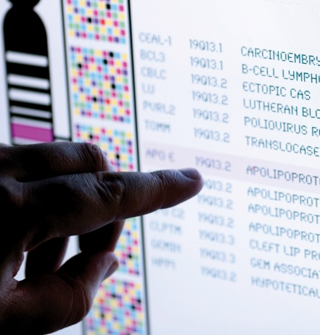
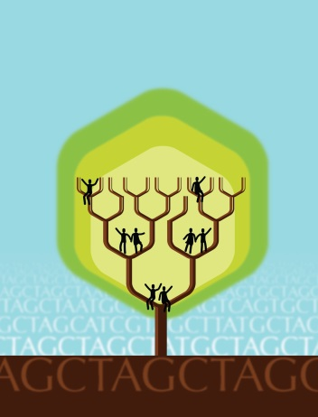
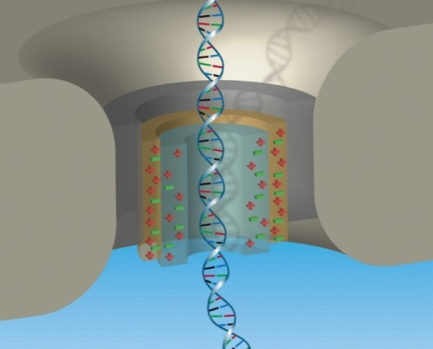


National Advisory Council for Human Genome Research
February 2017
Eric Green, M.D., Ph.D.
Director, NHGRI
DIRECTOR’S REPORT
Notes:
As is now NHGRI’s routine, the entire Open Session of this National Advisory Council for Human Genome Research meeting is being webcast live, including my Director’s Report.
The Open Session is also being videotaped, and those recordings will be made available as a permanent archive on NHGRI’s website (genome.gov), including the presentations themselves and the various associated documents.

Slide 2
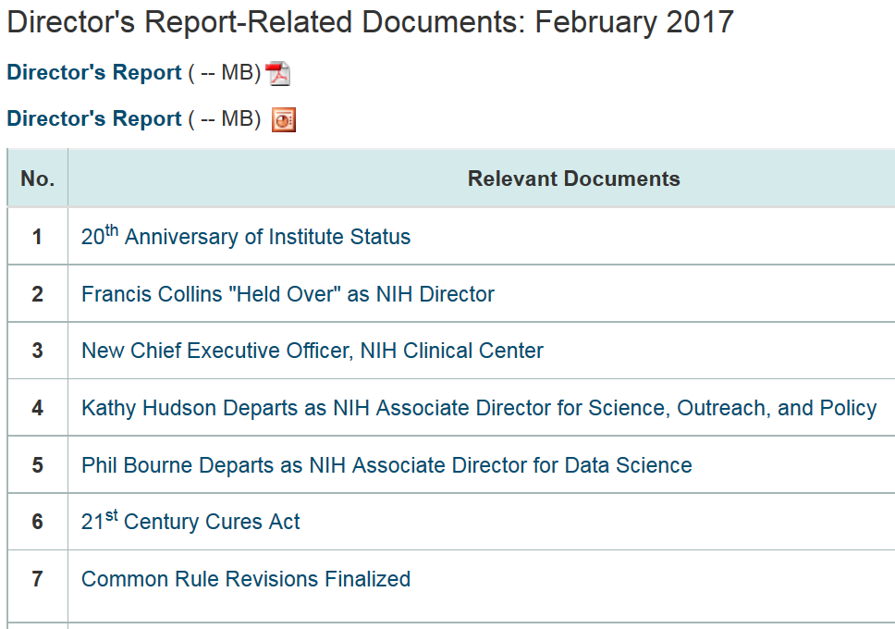
genome.gov/DirectorsReport
Document #
Notes:
For those new to our Council meetings, we create an ‘electronic resource’ associated with my Director’s Report. Analogous to supplemental materials of a published paper, this resource can be accessed at the URL shown here.
The slides that I will show during my Director’s Report are also available electronically at this site – * both in PDF and PowerPoint formats.
* When there are associated documents or relevant websites associated with a particular slide, you will find a ‘Document #’ indicated on the bottom right of that slide; that ‘Document #’ references material that can be accessed and/or downloaded at the website shown here.
In addition to the video archive, this web page and all linked documents will be archived on genome.gov as a historic record of this meeting.

Slide 3
Open Session Presentations
  NIH Data Commons
  Vivien Bonazzi
  NHGRI Data Sandbox
  Valentina Di Francesco
  Genomics and Society Working Group
    Lisa Parker
  Building Bonds between NHGRI and NICHD
    Diana Bianchi
Notes:
There will be several other presentations during the Open Session of this Council meeting. My Director’s Report is tailored around these presentations, and I will not discuss in detail the topics that others will cover.
* After my Director’s Report, Vivien Bonazzi will give a presentation about an important trans-NIH effort to develop an NIH data Commons.
* After lunch, NHGRI’s Valentina Di Francesco will present a Concept Clearance for an “NHGRI Data Sandbox.”
* Next, we will hear a report from the Genomics and Society Working Group of this Council, which will be presented by Lisa Parker.
* Lastly, Diana Bianchi, the new Director of the National Institute of Child Health and Development (or NICHD), will give a presentation entitled “Building Bonds between NHGRI and NICHD.”

Slide 4
Director’s Report Outline
General NHGRI Updates
General NIH Updates
General Genomics Updates
NHGRI Extramural Research Program
NIH Common Fund/Trans-NIH
NHGRI Division of Policy, Communications, and Education
NHGRI Intramural Research Program
Notes:
For the rest of my Director’s Report, I will cover the 7 areas listed here, which reliably provide an effective framework for reviewing the relevant topics.

Slide 5
Director’s Report Outline
General NHGRI Updates
General NIH Updates
General Genomics Updates
NHGRI Extramural Research Program
NIH Common Fund/Trans-NIH
NHGRI Division of Policy, Communications, and Education
NHGRI Intramural Research Program

Slide 6

20th Anniversary of Institute Status
Document 1
Notes:
NHGRI is fond of celebrating anniversaries, and I cannot let this one go by unnoticed.
Last month, NHGRI celebrated its 20th Anniversary of being an NIH Institute. On January 14th of 1997, the National Center for Human Genome Research (or NCHGR) graduated from ‘center status’ to become the National Human Genome Research Institute (that is, NHGRI). While looking for details about the significance of this promotion, I came across this statement: “As an Institute, NHGRI can more appropriately interact with other federal agencies and share equal standing with other Institutes at NIH.” Personally, I have always just thought of this upgrade as being analogous to being allowed to eat at the adult’s table at a family Thanksgiving dinner, instead of the kid’s table.
As NHGRI Director, I have often joked that my life is consumed by dealing with teenagers – two at home and a behemoth one at work. Now, two of three of those has reached 20, so I am left with just one teenager to manage at home (but, in reality, she manages me more than I manage her…). At both work and home, I look forward to the excitement (and complexities) that young adulthood will bring.

Slide 7
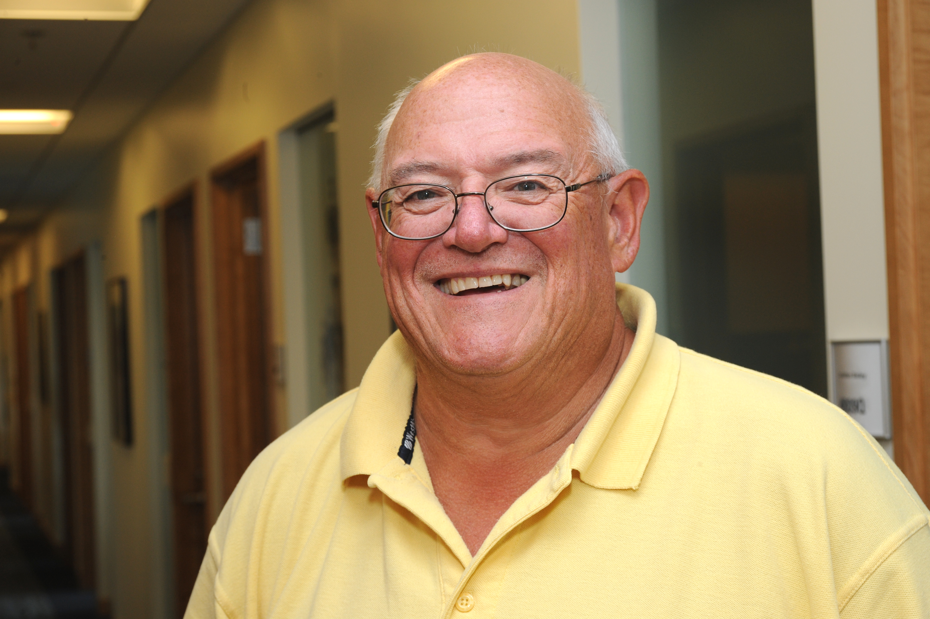
Transition of NHGRI Chief Information Officer
Ed Whitley
Notes:
After almost 24 years as NHGRI’s Chief Information Officer (or CIO) and Chief of the Information Technology Branch, Ed Whitley recently stepped down as a first step in preparing for his retirement next year. Ed was NHGRI’s first CIO, and his accomplishments can be seen in every facet of NHGRI’s information technology infrastructure for many years. He is well-known for his loyalty, dedication, and outstanding customer service. Fortunately for NHGRI, Ed will now be available to provide transitional leadership for the new CIO. Thank you, Ed, for your more than two decades of service to NHGRI.

Slide 8

New NHGRI Chief Information Officer
Joe Henke
Notes:
The other component of this important transition was the appointment of Joe Henke as the new NHGRI CIO. Joe served as NHGRI’s Information Systems Security Officer from 2012-2015, before leaving to take a leadership role at the Health Resources and Services Administration (another Department of Health and Human Services division) as their Deputy Chief Information Security Officer. We were able to recruit Joe back to NHGRI, and are now excited to tap into his extensive experience in information technology.

Slide 9
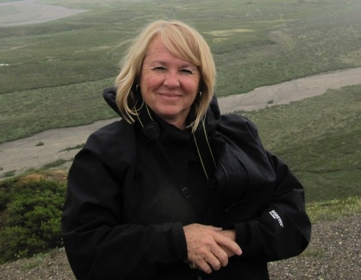
Retirement of Clinical Advisor, Division of Policy, Communications, and Education
Jean Jenkins, PhD, RN, FAAN
Notes:
Last September, Jean Jenkins retired as the Clinical Advisor to the Division of Policy, Communications, and Education. Jean’s career spanned more than 40 years at NIH. For 20 years, she was a nurse at the NIH Clinical Center, before spending time in the intramural research programs at NHGRI and NCI. She then closed out her tenure at NHGRI with nearly 14 years in various roles within the Office of the Director and the Division of Policy, Communications, and Education.
Jean was a principal founder for both the National Coalition for Health Professional Education in Genetics and the International Society of Nurses in Genetics. During her time at NHGRI, she created many educational resources and toolkits for various provider disciplines as well as curricula for health professional educators to use in formal and informal training. NHGRI is particularly grateful to Jean for her many years of work within the Genomic Healthcare Branch, serving as the epicenter of NHGRI’s education outreach to provider communities.

Slide 10
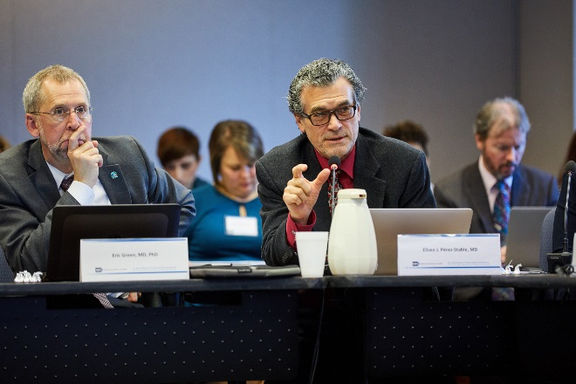
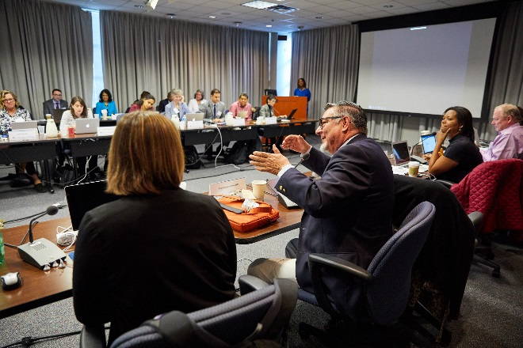
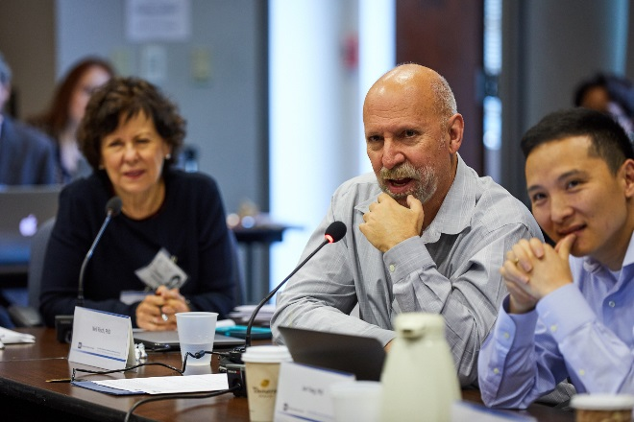
Workshop on the Use of Race and Ethnicity in Genomics and Biomedical Research
Co-sponsored by NHGRI and NIMHD
Examined the complex relationships between individual identity, genetics, and health
Notes:
In October, NHGRI and the * National Institute on Minority Health and Health Disparities (or NIMHD) co-sponsored a workshop to discuss the use of race and ethnicity data in genomics, biomedical, and clinical research, and their influence on minority health and health disparities.
* The workshop’s objective was to examine the complex relationships between individual identity, genetics, and health, including how these descriptors influence minority health and health disparities research. The workshop explored how research participants’ diverse backgrounds and experiences can be described in ways that are scientifically and socially meaningful. Participants included genomic, clinical, and social science researchers, as well as NIH staff, government stakeholders, and other experts.
The workshop generated recommendations for the appropriate use of race, ethnicity, and other population descriptors in scientific research and reports. The two Institutes are finalizing a report of the workshop (including a summary of the discussion and recommendations), and that report will be made available to Council and posted on genome.gov.

Slide 11

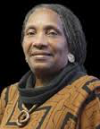
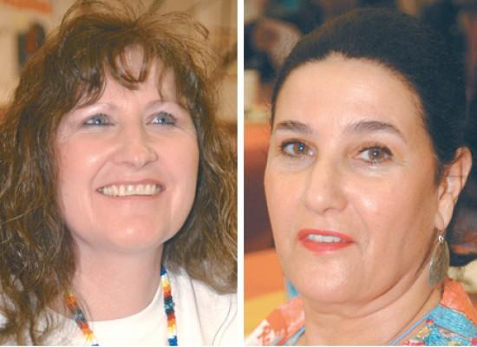
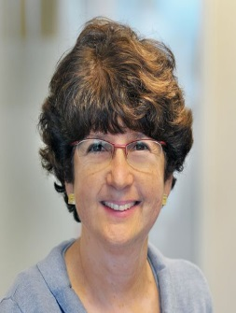
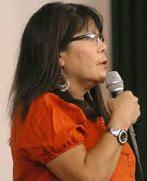




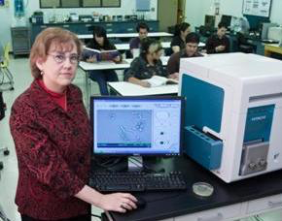
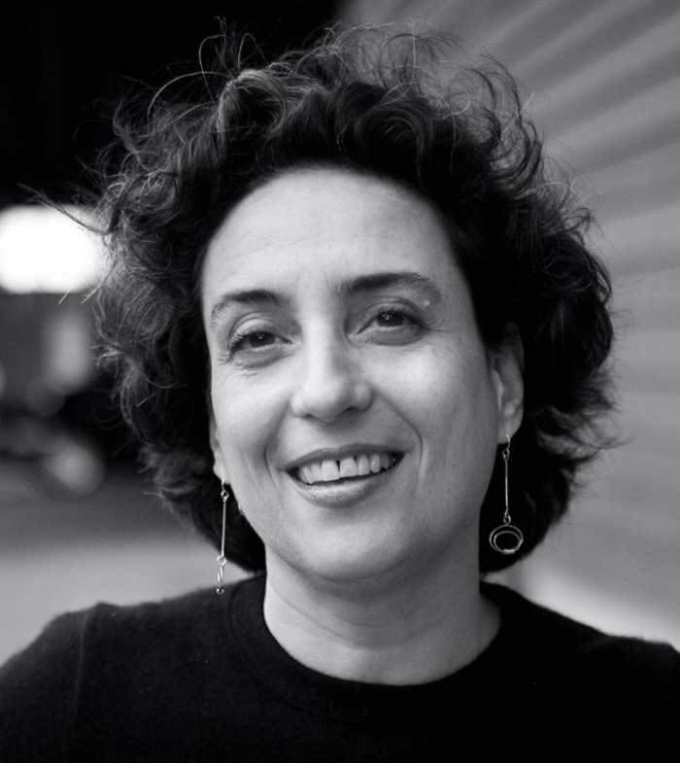

Community Engagement Working Group
Notes:
In recognition of the importance of engaging with community and research participants directly, NHGRI recently constituted a new working group of this Council. The Community Engagement in Genomics Working Group includes community leaders and liaisons, health advocates, community-based researchers, and health practitioners that represent diverse populations from across the nation. The group was established to engage communities, support NHGRI’s and the Council’s understanding of community needs related to genomics, and help the Institute ensure that genomics and genomic medicine benefit all.
The group will be integral to promoting access to (and an understanding of) genomics across diverse communities, and will inform the work, messages, and research portfolio of NHGRI. The Division of Policy, Communications, and Education (through its Education and Community Involvement Branch) will staff and coordinate the Working Group’s activities, and Chanita Hughes-Halbert and Sharon Plon will serve as Council representatives on the Working Group.

Slide 12
Director’s Report Outline
General NHGRI Updates
General NIH Updates
General Genomics Updates
NHGRI Extramural Research Program
NIH Common Fund/Trans-NIH
NHGRI Division of Policy, Communications, and Education
NHGRI Intramural Research Program

Slide 13

Francis Collins “Held Over” as NIH Director
Francis Collins, M.D., Ph.D.
Document 2
Notes:
With each new administration, presidential appointees and federal agency heads are required to submit resignation letters and vacate their posts to make way for new appointees. On January 19, we learned that Francis Collins’ resignation letter was returned to him, and that he will be “held over” as NIH Director, at least for now. There is no additional information about how long he will remain as NIH Director, so stay tuned.
In other news, Dr. Tom Price, an orthopedic surgeon by training, has been nominated – but not yet confirmed – to be the Secretary of the Department of Health and Human Services. To date, he has testified in front of the Senate Health, Education, Labor, and Pensions (or HELP) and Finance Committees. In these hearings, there was very little mention of NIH, with most of the focus being on the Affordable Care Act and Price’s qualifications. Dr. Price has spent the last 20 years in politics, including six terms as a Republican Congressman representing Georgia’s 6th District.

Slide 14
2017 Congressional Leadership
NIH Oversight Committees
 | House | Senate
Appropriation | Labor, HHS, & Education Chairman Tom Cole (OK) Ranking Rosa DeLauro (CT) | Labor, HHS, & Education Chairman Roy Blunt (MO) Ranking Patty Murray (WA)
Authorization | Energy & Commerce Chairman Greg Walden (OR) Ranking Frank Pallone (NJ) Health Subcommittee Chairman Michael Burgess (TX) Ranking Gene Green (TX) | Health, Education, Labor, and Pensions (HELP) Chairman Lamar Alexander (TN) Ranking Patty Murray (WA)
Greg Walden (OR)
Michael Burgess (TX)
Notes:
As with any new session of Congress, there are some changes in the leadership of committees relevant to NIH. Shown here are some key committees relevant to NIH and their leaders.
For committees that directly impact NIH, the positions that have turned over include Chair of the House Energy and Commerce Committee and its Health Subcommittee. Previously, Fred Upton, a Republican from Michigan held this powerful job. A staunch advocate of the 21st Century Cures bill, Mr. Upton was term limited out of this committee position. * His successor is Greg Walden from Oregon. Mr. Walden is a former chair of the Communications and Technology Subcommittee and a former board member of Oregon Health Sciences University.
* The Energy and Commerce Health Subcommittee will now be led by Dr. Michael Burgess. Dr. Burgess is a physician representing a district just north of Dallas, Texas. He is a frequent visitor to NIH, and has previously drafted legislation on a wide variety of NIH issues. He is also a genomics enthusiast.

Slide 15
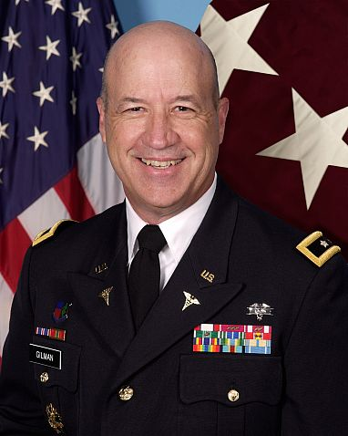

New Chief Executive Officer,
NIH Clinical Center
National Institutes of Health
Clinical Center
Major General James Gilman, M.D.
Document 3
Notes:
Major General James Gilman has been named the inaugural Chief Executive Officer of the NIH Clinical Center. Dr. Gilman is a cardiologist with extensive experience in commanding the operations of numerous hospital systems. As CEO, Dr. Gilman will oversee day-to-day operations and management of the Clinical Center, focusing particularly on patient safety and quality of care, including the development of new hospital operations policies.
Dr. Gilman served for 35 years in the U.S. Army, most recently as commanding general of the U.S. Army Medical Research and Materiel Command in Fort Detrick, Maryland. Following his retirement from the U.S. Army in 2013, Dr. Gilman served as Executive Director of Johns Hopkins Military & Veterans Institute in Baltimore until June 2016.

Slide 16
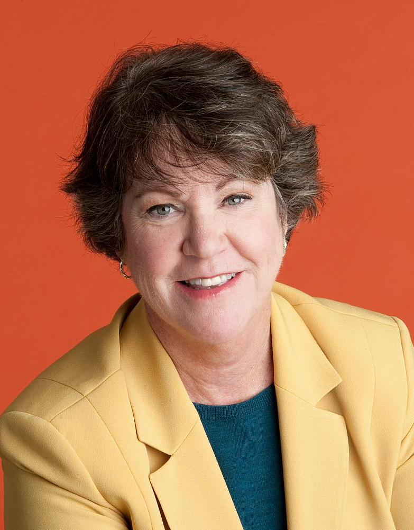
Kathy Hudson Departs as NIH Associate Director for Science, Outreach, and Policy
Kathy Hudson, Ph.D.
Document 4
Notes:
Kathy Hudson has departed as NIH Associate Director for Science, Outreach, and Policy. During her seven years in this position, she contributed to many significant NIH efforts, including the launch of the National Center for Advancing Translational Sciences (or NCATS), the BRAIN initiative, and the Precision Medicine Initiative. In addition, she led efforts to revise and update the Common Rule for human subjects research; to modernize clinical trial reporting; to expand data sharing; and to develop appropriate oversight for rapidly moving areas of medical research, including stem cells, chimeras, and gene editing.

Slide 17

Phil Bourne Departs as NIH Associate Director for Data Science
Philip Bourne, Ph.D.
Document 5
Notes:
In other transitions, Phil Bourne will depart his position as NIH’s first Associate Director for Data Science to become the Stephenson Chair of Data Science, Director of the Data Science Institute, and Professor in the Department of Biomedical Engineering at the University of Virginia.
Phil joined the NIH in March of 2014. In addition to leading the Big Data to Knowledge (or BD2K) program, he was instrumental in developing the concept of an NIH data Commons, a shared virtual space where scientists can find, manage, share, use, and reuse data, software, metadata, and workflows. He also institutionalized the FAIR principles to make data findable, accessible, interoperable and re-usable, and established the NIH Data Science Workforce Development Center to advance data science education.
The new Director of the National Library of Medicine, Patricia Brennan, will serve as Interim NIH Associate Director for Data Science until a new individual is appointed.

Slide 18
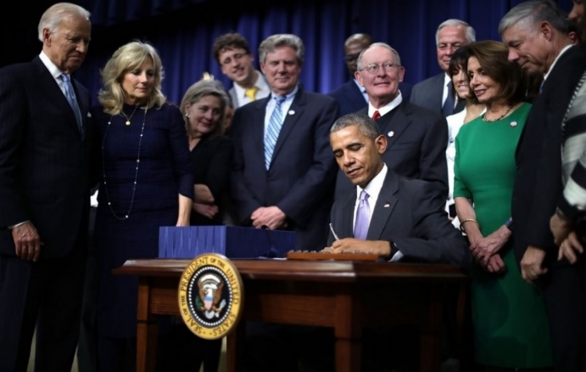
21st Century Cures Act
    $4.8 billion for NIH innovation projects
    Data sharing can be required
    Protection of identifiable and sensitive information: FOIA exemption
    Privacy protection for human research subjects: Certificates of Confidentiality
Document 6
Notes:
After over a year of revisions and negotiations in Congress, the 21st Century Cures Act was passed and signed into law by President Obama on December 13. This bipartisan bill aims to accelerate the discovery, development, and delivery of new medical cures. * Over the course of the next ten years, $4.8 billion is intended to be provided for specific NIH innovation projects: specifically, the Precision Medicine Initiative, the BRAIN Initiative, the Cancer Moonshot, and regenerative medicine research.
21st Century Cures contains over two dozen provisions that affect NIH. Provisions of particular interest to NHGRI are ones stipulating that: (1) * data sharing can now be required for grant recipients that receive NIH funding; (2) * for the protection of identifiable and sensitive information, Department of Health and Human Services agencies can now deny Freedom of Information Act (or FOIA) requests for biomedical information about a research subject if the individual is identified (or if there is a risk that the subject can be identified using other available information); and (3) * privacy protection for human research subjects through a requirement that the Secretary of the Department of Health and Human Services issue Certificates of Confidentiality to federally funded researchers engaged in research where identifiable and sensitive information is collected (note that previously these certificates had to be requested by the research institution, and the privacy protection provided was voluntary).
NIH has an implementation group working to put these provisions in place.

Slide 19
NIH Appropriations and Budget
 | FY2016 Enacted | FY2017
NIH NHGRI | $32.3 B | CR through April 28, 2017
 | $513.2 M | CR through April 28, 2017
Notes:
In December, Congress passed a continuing resolution (or CR) to fund the government through April 28, 2017. December’s CR keeps the government funded at a relatively stagnant level of $1.07 trillion. On April 28, when the CR ends, Congress will likely face a couple of options: pass an actual budget or a year-long CR (technically, a government shut down is always another option, but let’s now go there…). Needless to say, operating under a CR is challenging for every federal agency – the lack of a budget prevents an organization from being able to plan in a strategic way beyond the short term.

Slide 20

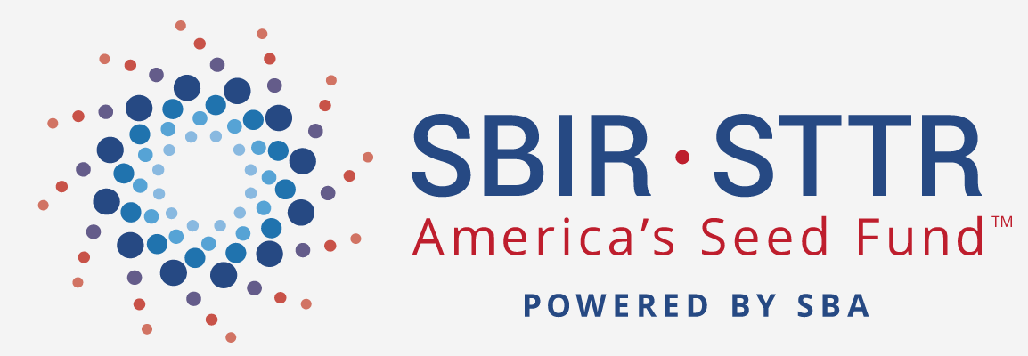
SBIR/STTR Reauthorization
Notes:
At the September Council meeting, I mentioned that both the House and the Senate had introduced bills that would reauthorize the Small Business Innovation Research (or SBIR) and Small Business Technology Transfer (or STTR) Programs, with some proposed budgetary adjustments. In December, the SBIR/STTR reauthorizations were attached to the National Defense Authorization Act, but these reauthorizations did not include any of the proposed changes. On December 23, President Obama signed the National Defense Authorization bill, which included the reauthorizations for both programs at their current levels – 3.2% of the extramural research budget for SBIR and 0.45% for STTR. The programs will be up for reauthorization again in 2022.

Slide 21
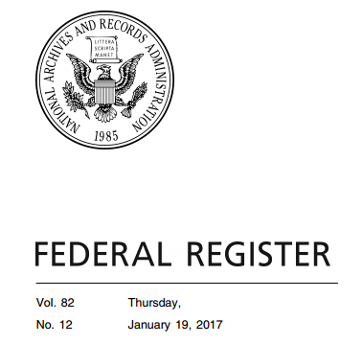
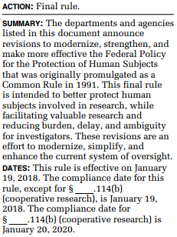
Common Rule Revisions Finalized
Improve informed consent
Calibrate review to study risks
Allow broad consent for secondary use of biospecimens
Does not require consent for the use of de-identified biospecimens
Streamline IRB review
Document 7
Notes:
On January 19, the Department of Health and Human Services and 15 other federal agencies issued a Final Rule to update the ‘Common Rule’ for protecting human subjects in research. Compliance with most provisions of the rule must begin within one year of this publication date. The revisions aim to bring the regulatory provisions for protecting human research participants in line with the changing nature of research since the Common Rule’s original publication in 1991. Specific changes aim to better safeguard research participants, while streamlining research oversight and decreasing ambiguity for responsible parties.
Major revisions in the Final Rule include * improving the informed consent processes with more meaningful consent forms, * calibrating the level of review for studies to the risks posed, and * allowing broad consent for the secondary research use of identifiable biospecimens. * The Final Rule does not adopt the earlier proposed revision to require consent for the use of de-identified biospecimens.
* Additional revisions aim to streamline review by requiring the use of a single Institutional Review Board (or IRB) for multisite research studies and removing continuing review requirements for certain ongoing studies. These changes are consistent with the new NIH single-IRB policy.

Slide 22


Regulatory Updates
    FDA’s Laboratory Developed Test (LDT) guidance delayed
    NIH Single-IRB Policy: Effective date extended to Sept. 25, 2017
Document 8
Notes:
This past November, * the FDA announced that it would delay finalizing its draft guidance for Laboratory Developed Tests (or LDTs). This guidance would have expanded FDA’s premarket review and postmarket surveillance requirements to LDTs. Initially, the agency sought to finalize this guidance before the end of the Obama Administration; however, in anticipation of the changes brought by the incoming administration, the agency decided to place finalization on hold for now. Last month, the FDA posted a “Discussion Paper on LDTs” to synthesize stakeholder feedback that it had received on the LDT guidance. This discussion paper, while not official guidance from the agency, lays out potential changes that FDA would make in its approach to regulating LDTs.
* Additionally, I mentioned at the last Council meeting that NIH had released a new policy on the use of a single Institutional Review Board (or IRB) for multi-site research – research in which more than one site conducts the same protocol involving human participants. The new policy was released in June, and its original date of implementation was May 25, 2017. However, last month, the NIH Office of Science Policy announced that it would extend the effective date to September 25, 2017.

Slide 23
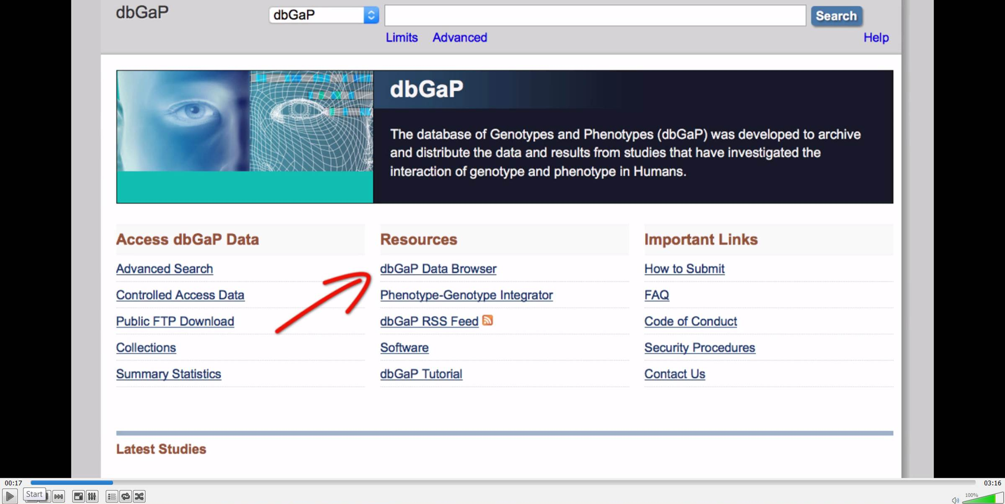
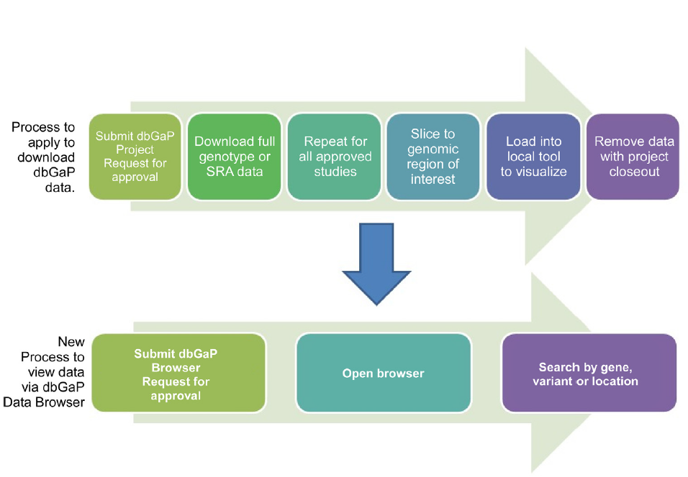
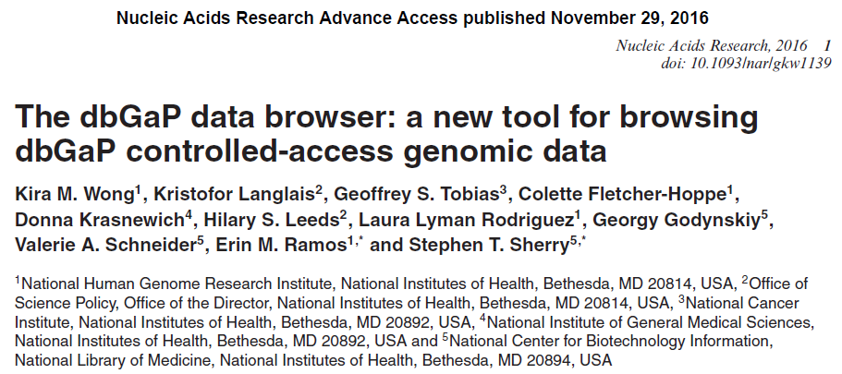



New dbGaP Data Browser
Document 9
Notes:
A new trans-NIH working group, led by Erin Ramos from NHGRI and Steve Sherry from NCBI, developed a new tool to support access to genomic data under the NIH Genomic Data Sharing Policy. The dbGaP Data Browser provides researchers with view-only access to a compilation of dbGaP data designated for general research use through a simplified controlled-access process. * The new Browser is described in detail in a recent Nucleic Acids Research article. Former and current NHGRI program analysts Kira Wong and Colette Fletcher-Hoppe contributed significantly to this effort.
* The Browser eliminates several steps necessary to access individual-level data through dbGaP. Just like the standard access-request process, investigators interested in the Browser submit a Browser Request with their existing eRA or NIH credentials, and agree to the specified terms of use. However, they do not need to write a research use statement since there are specific functionalities built into the Browser. Once the request is approved by the home institution and the NIH Central Data Access Committee, the investigator can open the Browser and immediately visualize the dbGaP general research use data.
* A link to the controlled-access Browser is available on the dbGaP home page. An accompanying YouTube tutorial provides information on how to submit a Browser-access request.

Slide 24
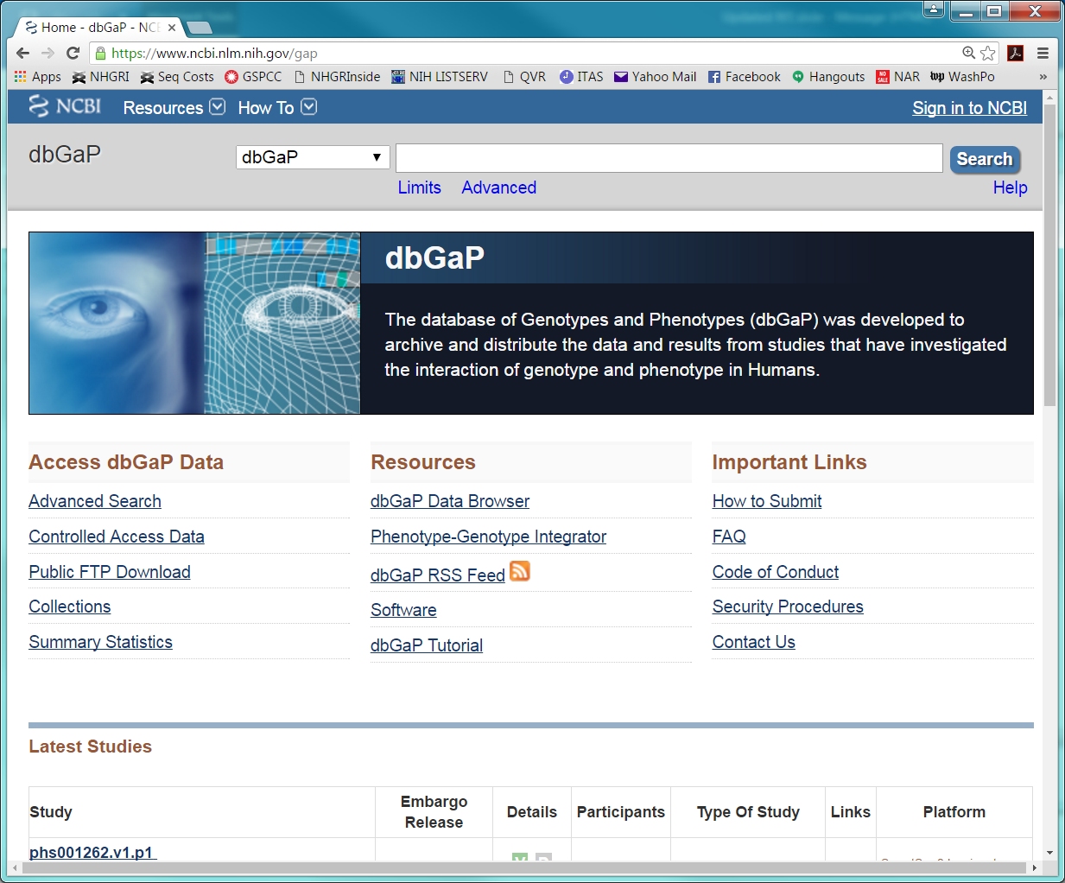

RFI on dbGaP Streamlining
    Will solicit feedback on data-submission and data- access processes
    Also will include policy-related questions:
      Alternate controlled-access models
      Benefits and risks associated with sharing genomic summary statistics
      Use of genomic research data held in dbGaP for clinical reference purposes
Document 10
Notes:
As an element of broader efforts to enhance and streamline management of data under the NIH Genomic Data Sharing Policy, * NIH expects to release a Request for Information (or RFI) to solicit feedback on the data-submission and data-access processes associated with the database of Genotypes and Phenotypes (or dbGaP).
The RFI will include * policy-related questions pertaining to * alternate controlled-access models that might increase efficiency of the management, oversight, and use of data at institutions; * the benefits and risks associated with sharing genomic summary statistics (a topic of an NHGRI workshop last May); and * the potential use of genomic research data held in dbGaP for clinical reference purposes.
Once published, the RFI will be posted on the NIH Genomics Data Sharing Website, and will be open for a 45-day public comment period. Laura Rodriguez from the Division of Policy, Communications, and Education works with the NIH Office of Science Policy on genomic data sharing oversight, and can answer any questions about this RFI that you or your colleagues might have once the RFI becomes available.

Slide 25
NIH-ACMG Fellowship in Genomic Medicine Program Management
    Goal to increase the pool of physicians trained in managing research and implementation programs in genomic medicine
    Applications due March 1, 2017
    Fellowship begins July 2017
Document 11
Notes:
NIH and the American College of Medical Genetics and Genomics (or ACMG) have established a Genomic Medicine Program Management Fellowship, a 24-month opportunity for qualified physicians to acquire credentials and experience for leading genomic medicine research and implementation programs at the NIH, major medical centers, and other organizations. * The goal of the program is to increase the pool of physicians trained in managing research and implementation programs in genomic medicine.
The NIH-ACMG Genomic Medicine Program Management Fellowship focuses on working with NIH’s genomic medicine research and implementation programs and with similar programs within the ACMG. Fellows can also work with the NIH Intramural Research Program. In addition, time is provided for clinical genomic activities at NIH or nearby hospitals and approved electives tailored for each fellow.
Two fellows will be selected each year. An appropriate stipend plus benefits will be provided through ACMG. Qualified applicants must have graduated from medical or osteopathic school, have U.S. citizenship, and be licensed to practice medicine in the United States. Post-graduate residency training is preferred but not required. * Applications are now open and are due March 1, 2017. * The fellowship will begin in July 2017.

Slide 26
Director’s Report Outline
General NHGRI Updates
General NIH Updates
General Genomics Updates
NHGRI Extramural Research Program
NIH Common Fund/Trans-NIH
NHGRI Division of Policy, Communications, and Education
NHGRI Intramural Research Program

Slide 27

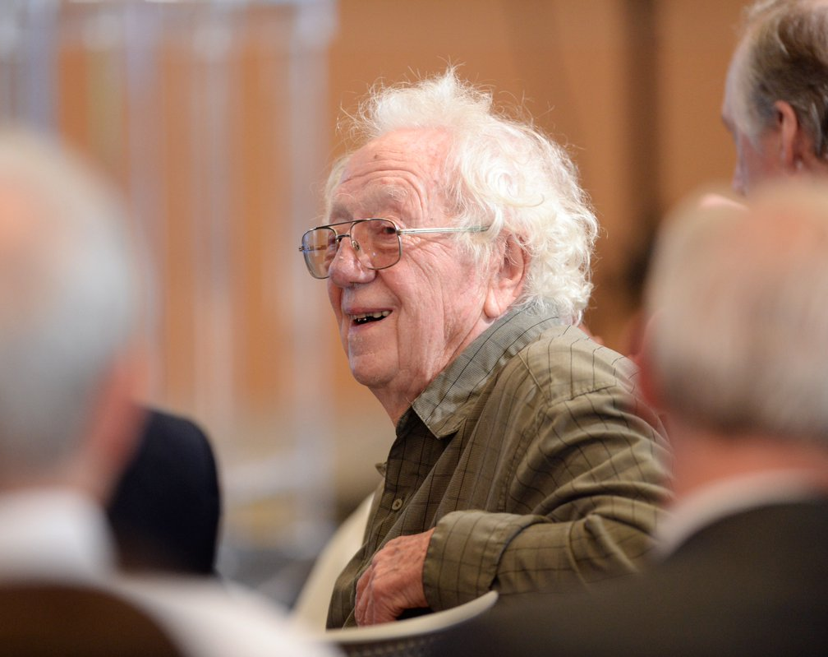
Mourning the Loss of Oliver Smithies
Document 12
Notes:
Last month, Oliver Smithies, a faculty member at the University of North Carolina and a good friend of NHGRI’s, passed away. Oliver shared the Nobel prize with Mario Capecchi and Martin Evans in 2007 for developing gene-targeting methods in mice. He also invented starch gel electrophoresis in the 1950’s. As an indication of his love of science, Oliver continued to be active in research and held NIH grants up until his death. The field of genetics has truly lost a legend.

Slide 28
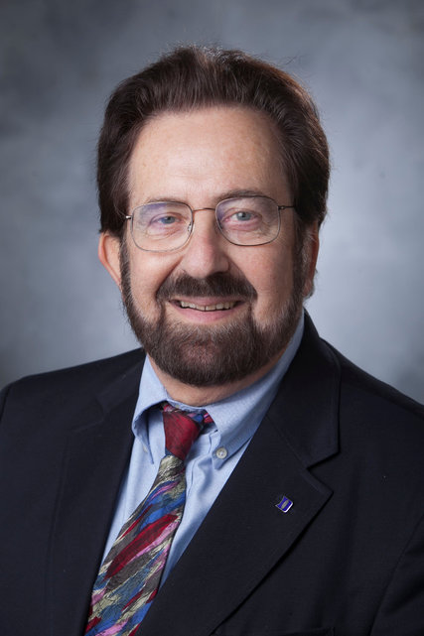
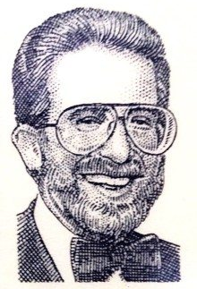
Mourning the Loss of Allen Roses
Document 13
Notes:
Allen Roses, a faculty member at Duke University School of Medicine, passed away in September. Allen is known for his contribution to Alzheimer's disease research. More recently, he implicated a simple sequence repeat in Lou Gehrig's disease. He was Chief of Neurology for over 27 years at the Duke University Medical Center. In addition, he served as Senior Vice President of Research and Development at GlaxoSmithKline for 10 years.

Slide 29

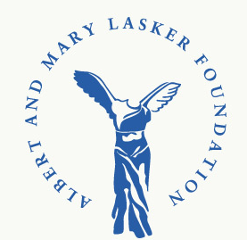
Lasker~Koshland Special Achievement Award in Medical Science
Bruce Alberts, Ph.D.
Document 14
Notes:
Bruce Alberts was recently awarded the Lasker~Koshland Special Achievement Award in Medical Science for “fundamental discoveries in DNA replication and protein biochemistry; for visionary leadership in directing national and international scientific organizations to better people’s lives; and for passionate dedication to improving education in science and mathematics.” Bruce has had a hand in various aspects of genomics, especially in the earliest days of planning the Human Genome Project.

Slide 30
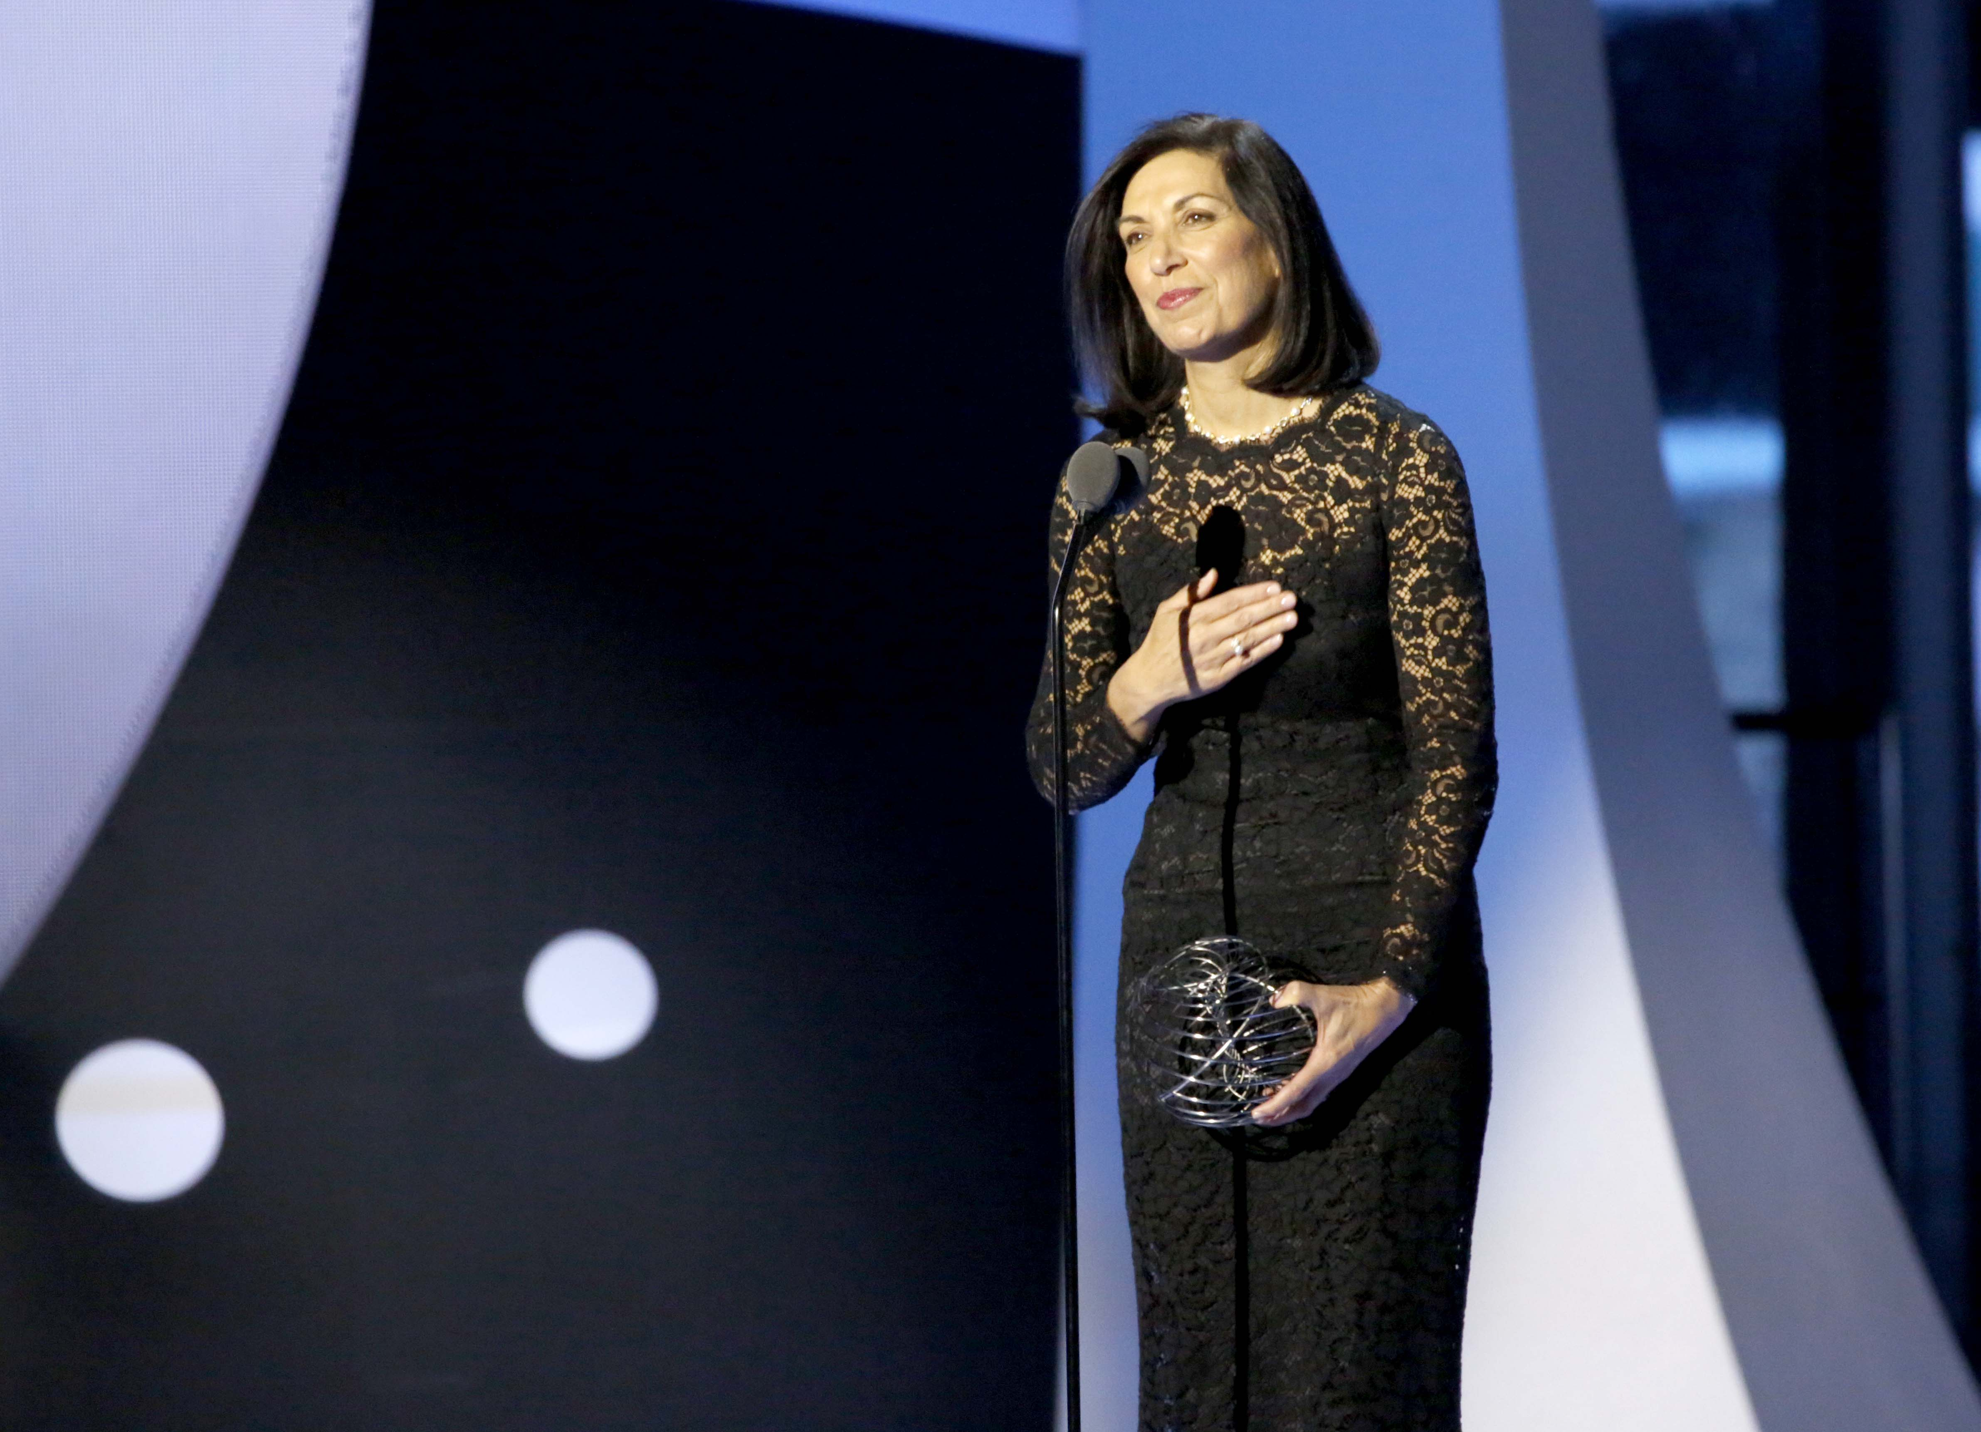


2017 Breakthrough Prize in Life Sciences
Huda Zoghbi, M.D.
Document 15
Notes:
One of the 2017 Breakthrough Prizes in Life Sciences was awarded to Huda Zoghbi for her discoveries of the genetic causes and biochemical mechanisms of spinocerebellar ataxia and Rett syndrome, findings that have provided insight into the pathogenesis of neurodegenerative and neurological diseases. Huda is a terrific geneticist and a good friend of NHGRI’s.

Slide 31

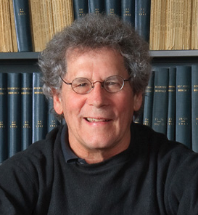

2016 ASHG Awards
Brendan Lee,
M.D., Ph.D.
David Valle,
M.D.
Document 16
Notes:
The American Society of Human Genetics gave awards to two members of our community at their 2016 annual meeting.
* Brendan Lee was awarded the Curt Stern Award, which recognizes a genetics and genomics researcher who has made significant scientific contributions during the past decade.
* David Valle was presented the Award for Excellence in Human Genetics Education, which recognizes someone who has made significant contributions to human genetics education.
Both of these outstanding investigators have strong ties to NHGRI, both as grantees and as advisors.

Slide 32


New Steering Committee Chair, Global Alliance for Genomics and Health
Ewan Birney, Ph.D.
Document 17
Notes:
The Global Alliance for Genomics and Health recently appointed Ewan Birney to lead its efforts to accelerate medical and research advancements through the responsible sharing of genomic and clinical data. Specifically, Ewan assumed the position as Steering Committee Chair of the Global Alliance in November.

Slide 33
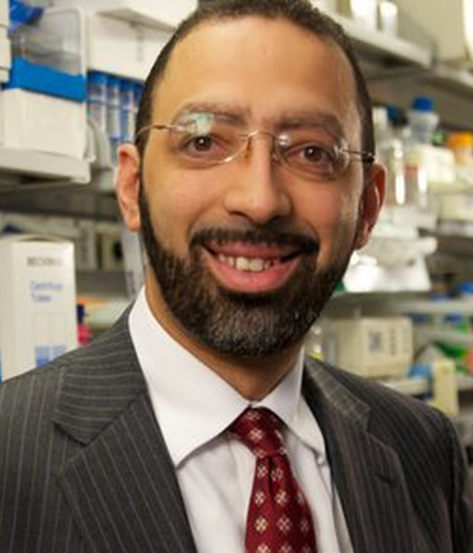

New Senior Vice President of Global Oncology, Lilly
Levi Garroway, M.D., Ph.D.
Document 18
Notes:
Last month, Levi Garraway left the comforts of Boston (and the Broad Institute) and joined Lilly as Senior Vice President of Global Development & Medical Affairs, specifically for Lilly's Oncology business. Levi is an NHGRI grantee and advisor, and certainly an outstanding physician-scientist.

Slide 34
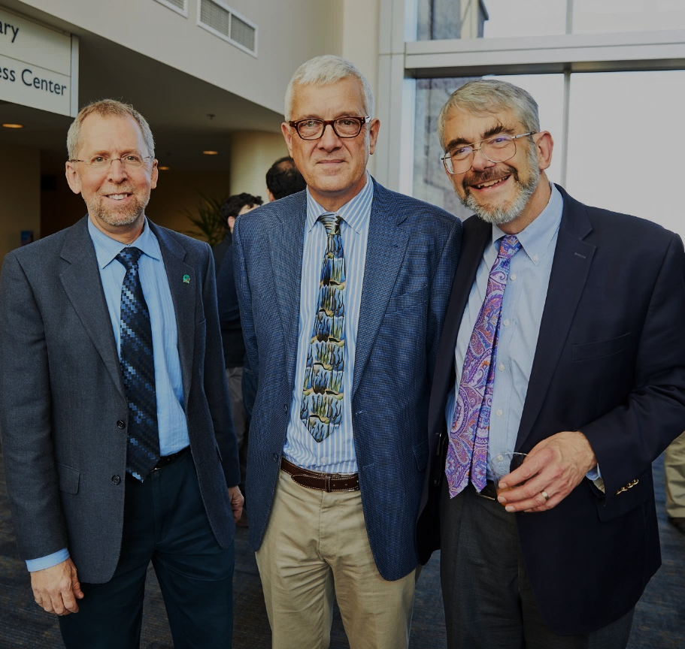


Elected to the National Academy of Medicine
Anita Allen
Leslie Biesecker
Rob Califf
Joseph DeRisi
Allison Goate
Mark Musen
Kenneth Offit
Craig Venter
Huntington Willard
Xiaoliang Sunney Xie
David Walt
Document 19
Notes:
The National Academy of Medicine recently announced their newly elected members. That list includes the individuals listed here, who have notable connections and relevance to NHGRI, including: a former council member, some grantees, some otherwise very distinguished geneticists and genomicists, and * NHGRI’s very own Les Biesecker, a Senior Investigator within the Institute’s Intramural Research Program.

Slide 35

Elected to the AAAS
Paul Aristoff
Stephen Fodor
Monica Justice
Craig Lindsley
Clifton Poodry
Gary Stormo
Sharlene Weatherwax
Document 20
Notes:
Similarly, an impressive number of genetics and genomics researchers as well as good friends of NHGRI’s were recently elected to be Fellows of the American Association for the Advancement of Science (or AAAS), with their names listed here. Congratulations to these colleagues as well as those recently elected to the National Academy of Medicine.

Slide 36


2016 SBIR Hall of Fame and Tibbetts Award
Document 21
Notes:
Two genomics companies recently received small business awards. Illumina was named to the Small Business Innovation Research (or SBIR) Hall of Fame and 23andMe received the Tibbetts Award.
The SBIR Hall of Fame recognizes companies and individuals with a long period of extraordinary success in research, innovation, and commercialization within the SBIR program.
The Tibbetts Awards is named after Roland Tibbetts, who was instrumental in developing the SBIR program. These awards are presented to those who are beacons of promise and models of excellence in high technology.

Slide 37
2016 Science Breakthrough of the Year Runner Up
Pocket-Size DNA Sequencer
Document 22
Notes:
Moving on to year-end accolades, nanopore DNA sequencing was one of the nine Runners Up for Science’s Breakthrough of the Year. Oxford Nanopore Technologies began marketing the first nanopore DNA sequencing device last year. Science noted that “The device uses a breakthrough technology called nanopore sequencing to read the letters of DNA directly.” The article noted the low startup costs for this technology and the already demonstrated novel applications, including identifying Ebola and other viruses in a few hours, sequencing of the gut microbiome and the genome of a fungal pest of maize, and soil microbiome sequencing on the International Space Station.

Slide 38




The Scientist’s Top Ten Innovations 2016
Pacific Biosciences >>
The Sequel System
Thermo Fisher Scientific >> LentiArray CRISPR Libraries
Thermo Fisher Scientific >>
GeneArt Platinum Cas9 Nuclease
Document 23
Notes:
When The Scientist came out with its Top Ten Innovations of 2016, genomic technologies once again populated the list. Three genomic innovations were included, as listed here. Each of these three innovations involve some aspect of genome sequencing or genome editing.

Slide 39


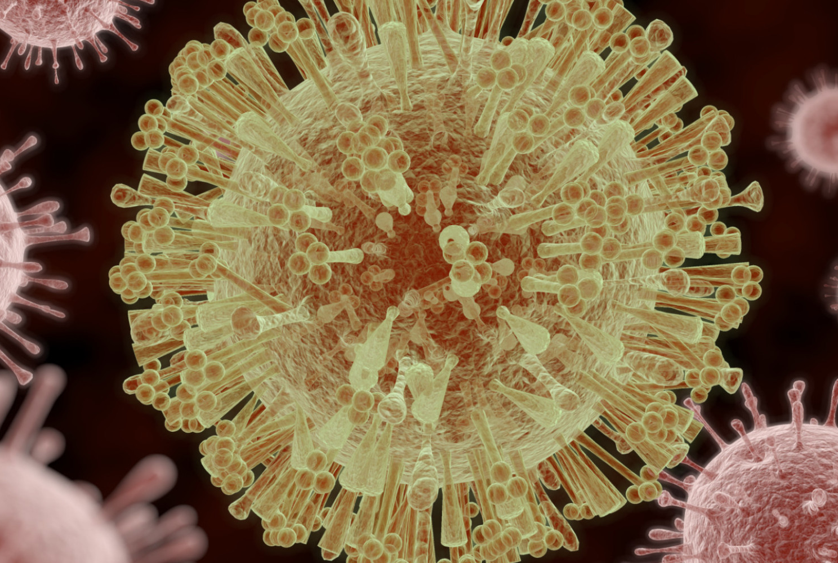


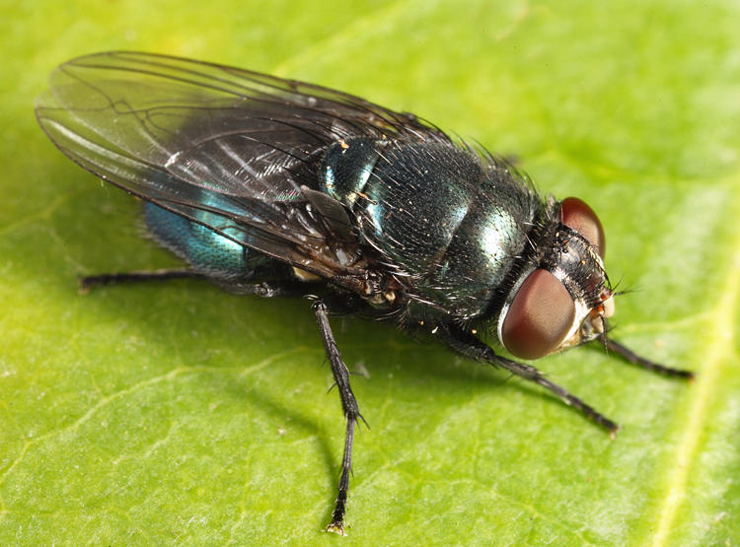

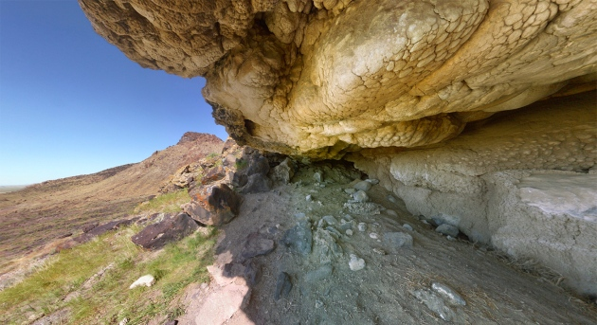
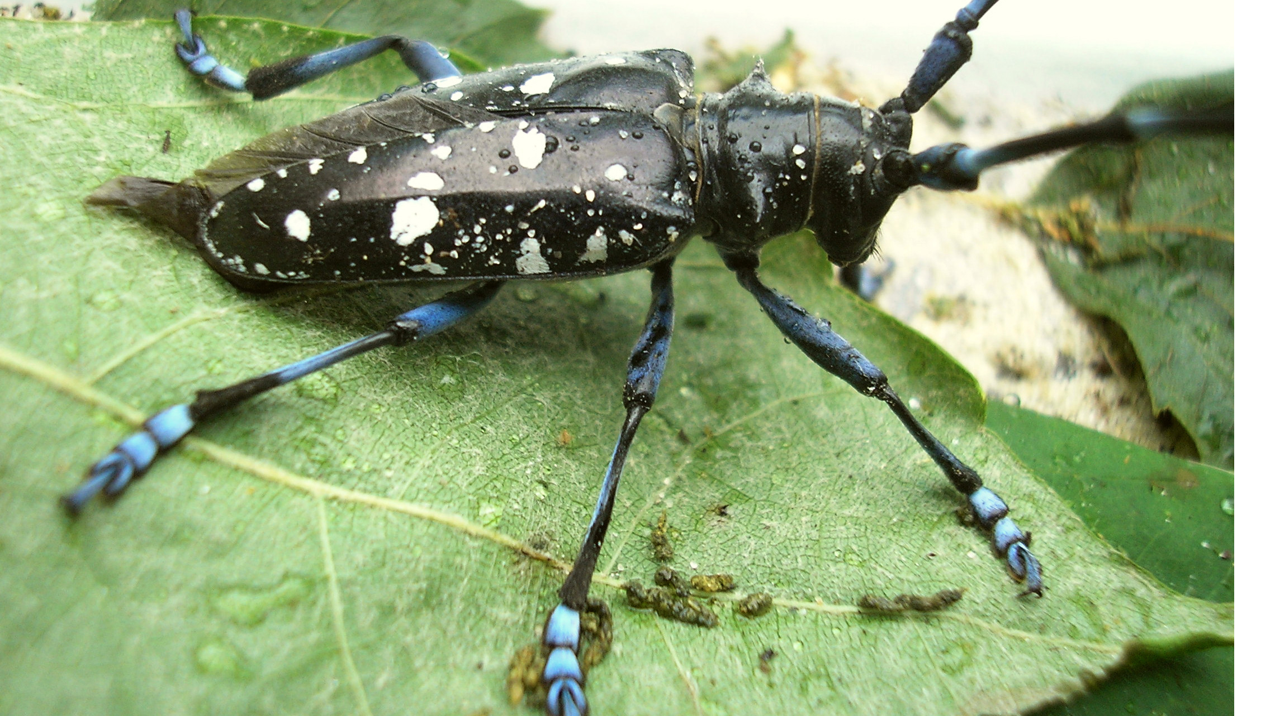



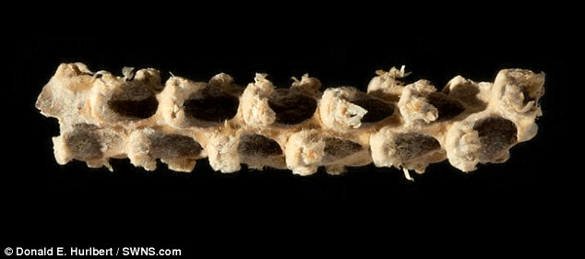



Genomes In The News…
Document 24
Notes:
In terms of ‘Genomes In The News’ – there have been a number of recently generated genome sequences reported since the last Council meeting, including: * zika virus, * beer yeast (actually, 157 industrial strains of Sacchromyces cerevisiae), * ocean sunfish, * five-pacer viper, * leopard, * Asian long-horned beetle, * back blow fly, * an ancient corn cob, * gingko biloba, * the Spirit Cave mummy (a 10,000 year-old mummy from Nevada), * African wild dog, * tiger tail seahorse, * British ash tree, and * Canadian beaver.

Slide 40
Director’s Report Outline
General NHGRI Updates
General NIH Updates
General Genomics Updates
NHGRI Extramural Research Program
NIH Common Fund/Trans-NIH
NHGRI Division of Policy, Communications, and Education
NHGRI Intramural Research Program

Slide 41
Genome Sequencing Program
Centers for
Mendelian Genomics
  GSP Collaborations
    NHLBI Trans-Omics for Precision Medicine (TOPMed)
    CCDGs
    CMGs
    GSP Analysis Centers
    NIA Alzheimer’s Disease Sequencing Program (ADSP)
    CCDGs
    NEI
  CMGs
GSP Analysis Centers
GSP Coordinating Center
Centers for
Common Disease
Genomics
Document 25
Notes:
The NHGRI Genome Sequencing Program (or GSP) just started its second year of its current phase of funding. The program is composed of 4 components: the Centers for Common Disease Genomics (or CCDGs), which investigate common, complex diseases; the Centers for Mendelian Genomics (or CMGs), which investigate rare, Mendelian diseases; the GSP Analysis Centers, which take advantage of the data produced from the sequence-production centers to perform data analyses; and the GSP Coordinating Center, which provides scientific and logistical support for the whole program.
* The GSP is also supported by several collaborations with other NIH Institutes. These include efforts with * the National Heart, Lung, and Blood Institute for the Trans-Omics for Precision Medicine Program (or TOPMed) within the CCDGs, CMGs, and analysis centers; with * the National Institute of Aging for the Alzheimer’s Disease Sequencing Program within the CCDGs; and with * the National Eye Institute within the CMGs. These collaborations deal with common challenges, ranging from disease-related genomic variant discovery to data harmonization for use across studies. An example of these collaborations was evident at a recent meeting hosted by the analysis centers and TOPMed to discuss analysis plans; it is worth noting that representatives from NHGRI’s ENCODE program were also present at this meeting to discuss potential collaborations.

Slide 42
Genome Sequencing Program
  Centers for Common Disease Genomics (CCDGs)
Cardiovascular Diseases
Neuropsychiatric Diseases
Autoimmune/Inflammatory Diseases
~ 18,000 whole genomes sequenced
~ 19,000 whole exomes sequenced
  Centers for Mendelian Genomics (CMGs)
  ~ 200 articles published
  ~ 1,000 genes discovered
  ~ 19,000 whole exomes sequenced
Document 25
Notes:
In terms of progress, each GSP component has been making significant strides towards its scientific goals. * The CCDGs are currently studying multiple diseases from three broad areas: cardiovascular disease (specifically, early onset coronary artery disease, hemorrhagic stroke, and atrial fibrillation); neuropsychiatric disease (specifically, autism and epilepsy); and autoimmune/inflammatory disease (specifically, asthma, type 1 diabetes, and inflammatory bowel disease). * Since 2016, the CCDGs have sequenced around 18,000 whole genomes and 19,000 whole exomes for these projects.
* Since 2011, the CMGs have published around 200 articles, detailing the approximately 1,000 genes discovered to contribute to Mendelian diseases. These findings are based on generating and analyzing roughly 19,000 whole exomes.

Slide 43

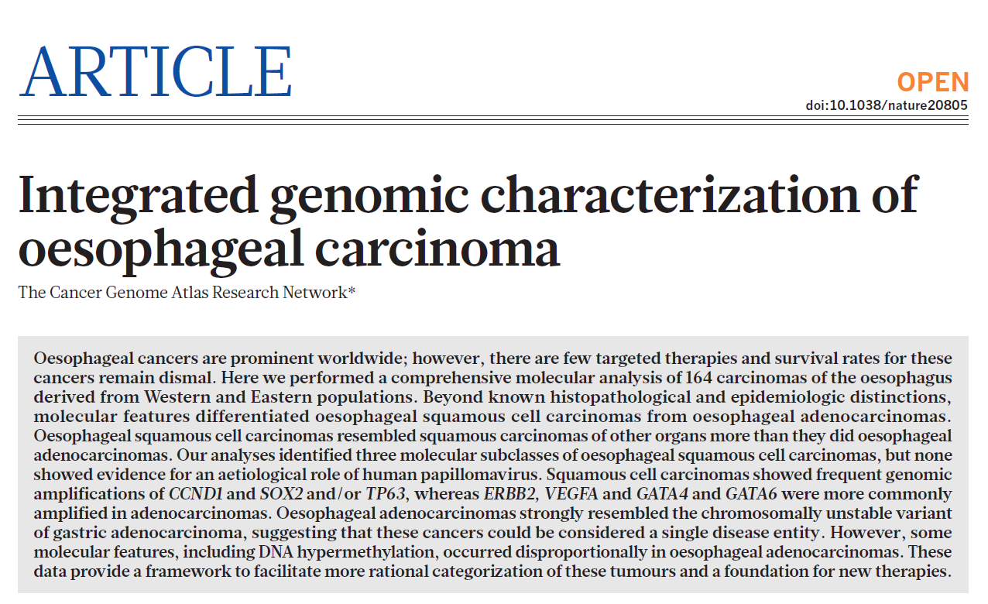
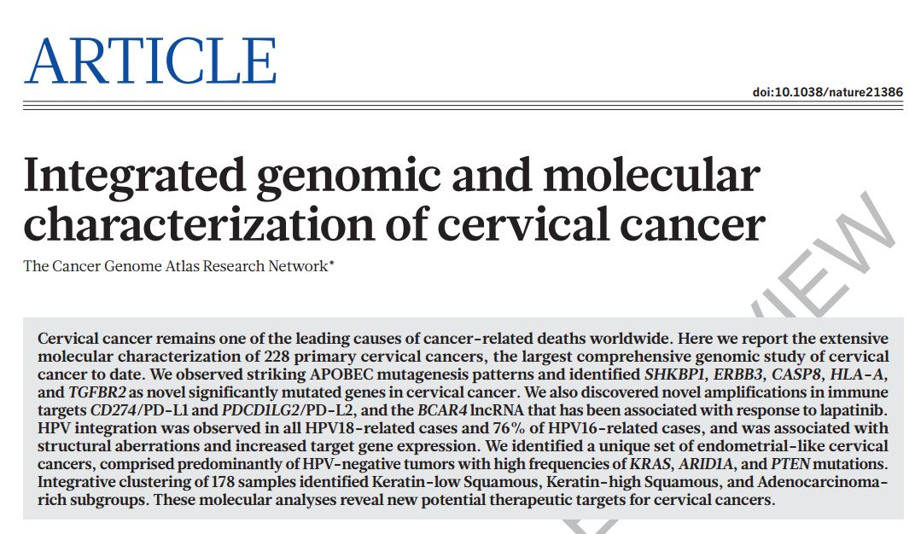
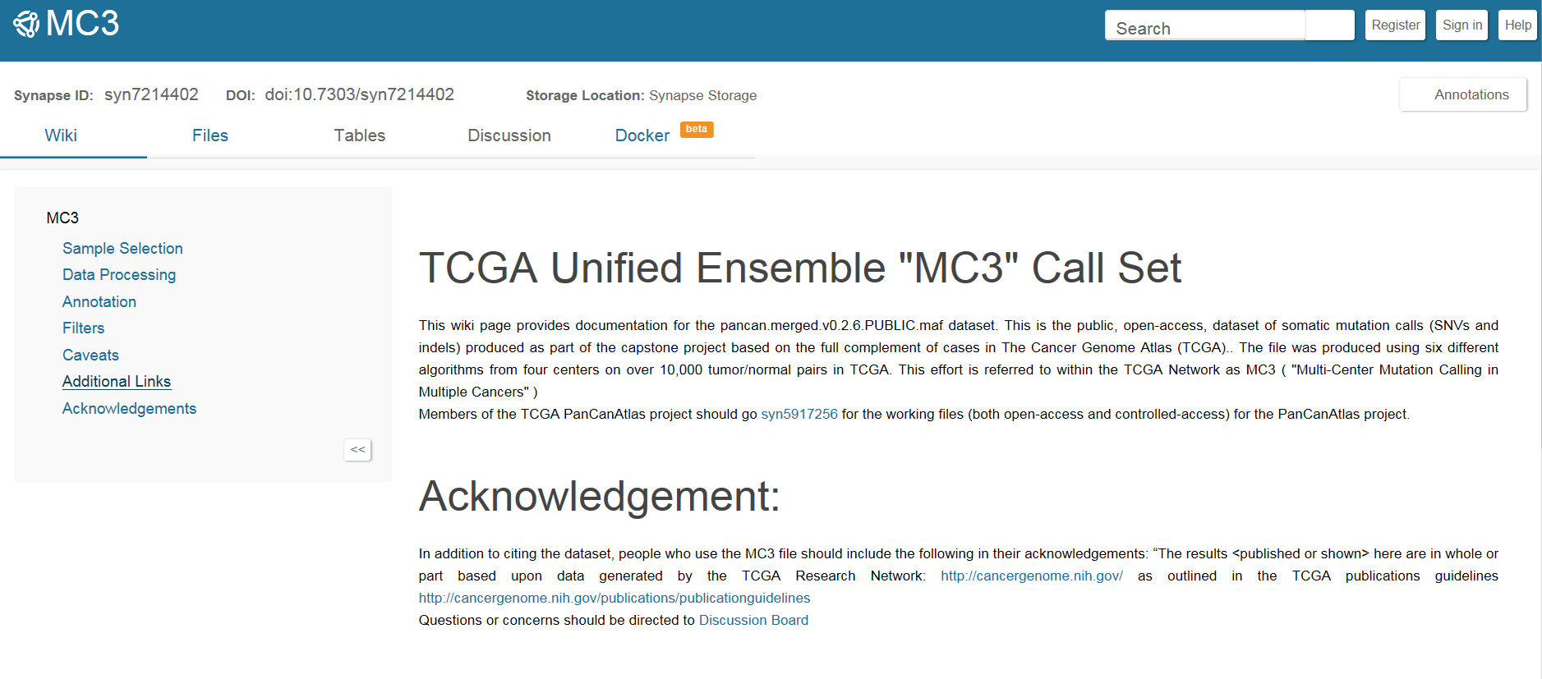
Nature 2017; 541(7636):169-175. doi: 10.1038/nature20805. Epub 2017 Jan 4.
Nature 2017; doi: 10.1038/nature21386. Epub ahead of print
synapse.org/MC3
Document 26
Notes:
In previous years, The Cancer Genome Atlas (or TCGA), was a major focus of the GSP. TCGA is a coordinated effort to better understand the molecular basis of cancer. Data production on over 10,000 tumor/normal pairs has been completed, and TCGA is focused on final manuscript writing.
For each of the over 30 cancer types, the TCGA Network has published a comprehensive, integrated account of sequence/mutation analysis, copy-number variation, gene and miRNA expression, and promoter methylation.
The most recent TCGA publications, which were focused on * esophageal carcinoma and * cervical cancer, were published in Nature in January.
The TCGA Network is now coordinating a capstone project called the PanCanAtlas. This project aims to answer big, overarching questions about cancer by examining the full set of over 10,000 tumors characterized in TCGA. To facilitate the PanCanAtlas analysis, TCGA investigators performed standardized somatic mutation-calling of the entire dataset, comprising an ensemble of six different mutation-calling algorithms. * An open-access version of these somatic genomic variant calls was made publically available last December.

Slide 44

Technology Development Program
  Novel Nucleic Acid Sequencing Technology Development
  RFA-HG-15-031 (to 33; R01, R21, and R43/44)
  Upcoming due date: June 15, 2017
  Novel Genomic Technology Development
  PAR-16-14 (to 17; R01, R21, R43/44, and R44)
  Upcoming due date: October 31, 2017
Document 27
Notes:
NHGRI’s Technology Development Program continues to move forward and has several funding opportunities that deserve highlighting.
* There are active Requests for Applications for Novel Nucleic Acid Sequencing Technology Development that involve both DNA and direct RNA sequencing. The second set of applications for this RFA have been reviewed, and will be discussed during this Council meeting. There is also an upcoming application due date in mid-June of this year.
* Program Announcements for Novel Genomic Technology Development yielded the first round of applications, and initial awards were made this past fall. The second round of applications were received in October, and these will be reviewed in the coming months and discussed at the May Council meeting. The next application due date is in October of this year.

Slide 45

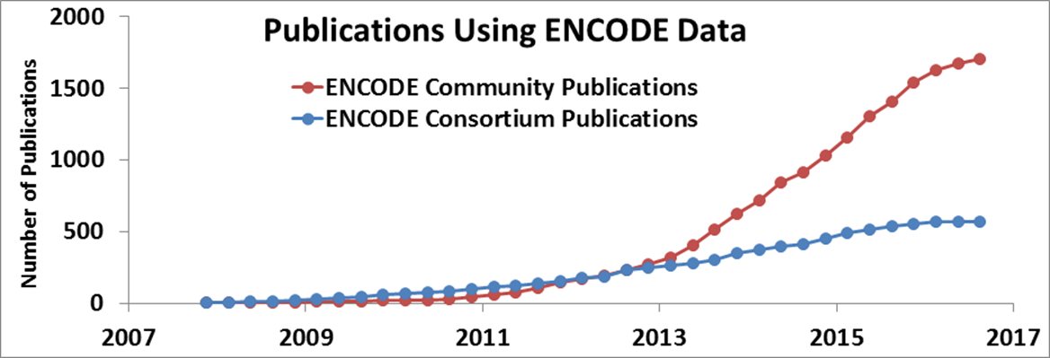
Encyclopedia of DNA Elements (ENCODE)
  ENCODE Outreach and Collaboration
    ENCODE-DREAM In Vivo Transcription Factor-Binding Site Prediction Challenge
Document 28
Notes:
The goal of the Encyclopedia of DNA Elements (or ENCODE) project is to create catalogs of all functional elements in the human and mouse genomes, and to make those catalogs available as a resource to the biomedical community.
* The ENCODE project regularly organizes outreach activities to help a broad range of scientists use ENCODE resources. Additionally, ENCODE is interested in engaging the community to spark development of new or improved scientific approaches to enhance the utility of the ENCODE resource. * As an example, the ENCODE-DREAM challenge, funded in part by NHGRI, established an open competition where leading computational biologists vied to create models capable of accurately predicting transcription factor-binding sites across the genome. More than 30 international teams participated. The winning teams presented their results publicly in November, and a comparison of the methods developed will be published in the near future.
* As a result of outreach and collaboration, ENCODE data continue to be heavily used. There are more than 1,700 community publications (reflected by the red line) from groups without ENCODE funding but who used ENCODE data for their published work. ENCODE Consortium members have produced more than 550 publications to date (reflected by the blue line).

Slide 46

Encyclopedia of DNA Elements (ENCODE)
  4th phase of ENCODE grants
  Expand the catalog
  NEW Functional Characterization Centers
Funded Initiative | # of Awards
Mapping Centers | 8
Functional Characterization Centers | 5
Computational Centers | 6
Data Analysis Center (DAC) | 1
Data Coordinating Center (DCC) | 1
Document 28
Notes:
Last week, NHGRI announced that ENCODE is entering its fourth phase.
* Awards have been made to 8 mapping centers, 5 functional characterization centers, 6 computational centers, a data analysis center, and a data coordinating center.
* ENCODE will continue to expand the catalog of candidate functional elements in the human and mouse genomes through high-throughput data-generation pipelines using a diversity of genome-wide assays.
* New to this phase of ENCODE is the introduction of functional characterization centers, which will develop and apply generalizable approaches to characterize the role of candidate functional elements identified by ENCODE in specific biological contexts.

Slide 47
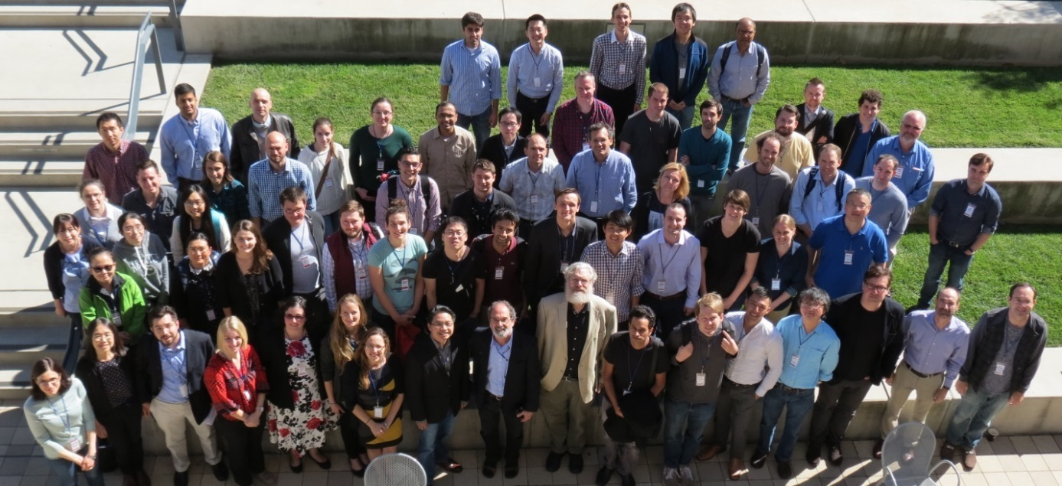
Centers of Excellence in Genomic
Science (CEGS) Program
  Two new CEGS awards:
  Broad Institute
    Center for Cell Circuits
  University of Chicago
    Center for Dynamic RNA Epitranscriptomes
Document 29
Notes:
NHGRI’s Centers for Excellence in Genomic Science (or CEGS) are multi-investigator, interdisciplinary projects to develop innovative genomic approaches to achieve a very substantial advance that addresses a critical issue in genomic science or genomic medicine.
* Two new CEGS awards were made last year. * The CEGS at the Broad Institute, led by Aviv Regev, was renewed for a second (and final) five years. The goal of this CEGS is to develop and apply massively parallel analysis to understand cellular circuits by using iterative cycles of measuring many outputs, developing computational models, and testing those models by perturbing circuit components. This renewal will advance the work from single cells to groups of interacting cells.
* The new CEGS at the University of Chicago, led by Chuan He, is focused on abundant RNA modifications. This group will develop new methods for high-throughput sequencing of RNA modifications at single-base resolution and suitable for low-sample input, with the development of accompanying bioinformatics tools for data analysis.
New CEGS applications were received last May, reviewed in November, and will be considered later in this Council meeting. The CEGS program announcement was re-issued last September. Finally, * last year’s CEGS grantee meeting, pictured here, was held at Stanford and hosted by Dr. Howard Chang.

Slide 48
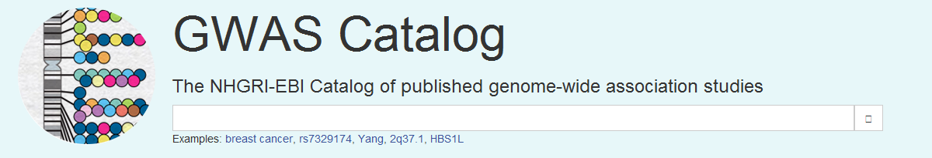
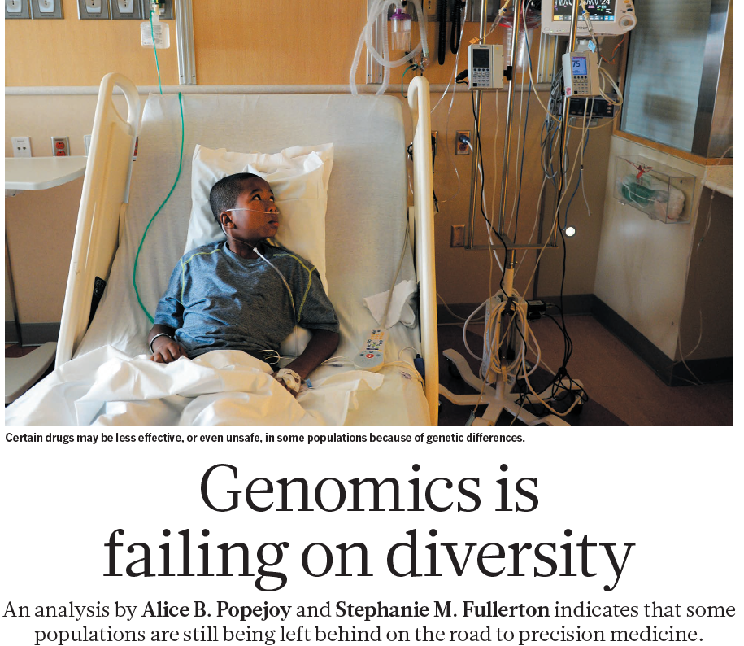
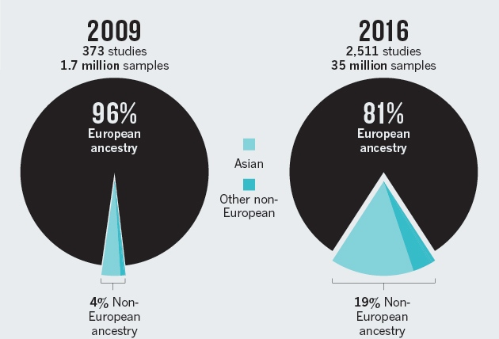
GWAS Catalog
Ancestry Distribution of GWAS Participants
Nature. 2016;538(7624):161-164. doi: 10.1038/538161a.
    Nature commentary highlights GWAS Catalog data
    Updated, comprehensive analysis underway
Document 30
Notes:
The NHGRI-EBI GWAS Catalog is a curated, downloadable, and user-friendly resource that catalogs the findings from published genome-wide association studies (or GWAS). It is produced as a collaborative effort involving NHGRI, the European Bioinformatics Institute (or EBI), and the National Center for Biotechnology Information (or NCBI).
Last October, Nature featured a commentary highlighting the bias of recent GWAS publications towards European participants. * In 2009, 96% of participants in GWAS publications featured in the Catalog were estimated to come from European ancestry populations; in 2016, this percentage decreased to 81%, but overall is still heavily biased toward European ancestry groups. The authors urge the scientific community to recognize the impact of this bias on genomics and precision medicine studies, and to push for fundamental changes (such as incentivizing creation of ancestrally diverse cohorts and improving training opportunities and infrastructure that serve diverse populations).
* A complementary and comprehensive analysis of updated ancestry data is now underway by the GWAS Catalog team to examine this situation further.

Slide 49





PhenX Toolkit
90 new and updated measures added
Integration by larger research programs
FOAs citing PhenX
(cumulative)
dbGaP mapping
dbGaP Study containing PhenX “Alcohol 30 Day Freq” measure
Candidate Gene Association Resource (CARe)
NEIGHBOR Consortium Glaucoma GWAS
Genetic Multiple Sclerosis Association (GeneMSA)
The Vaginal Microbiome: Disease, Genetics, and the Environment
GenADA/LONG/Imaging (Genetic Alzheimer’s Disease Associations)
Document 31
Notes:
The PhenX project, which is charged with producing an online resource of standard measures for capturing data on common diseases, phenotypic traits, and environmental exposures, continues to add more features and expand its user base. * 90 new and updated measures have been added to the PhenX Toolkit since last year, bringing the total number of standard measures to over 500. These new measures address areas such as early psychosis, pregnancy, and tobacco regulatory research. * The graph on the bottom right shows that by the end of 2016, there were 182 NIH Funding Opportunity Announcements that encourage the use of PhenX measures, highlighting the adoption of PhenX across the NIH.
* Furthermore, many NIH-funded research programs have already integrated (or soon will integrate) PhenX measures into their study design. Examples include the Population Assessment of Tobacco and Health study, the Adolescent Brain Cognitive Development project, Environmental Influences on Child Health Outcomes study, and the All of Us component of the Precision Medicine Initiative.
* Lastly, through a collaboration with NCBI, all 15,000 PhenX variables have been mapped to hundreds of dbGaP studies, greatly facilitating data harmonization. For example, the mapping project identified 9 dbGaP studies that use a alcohol 30-day frequency variable, 5 of which are shown in the table.

Slide 50

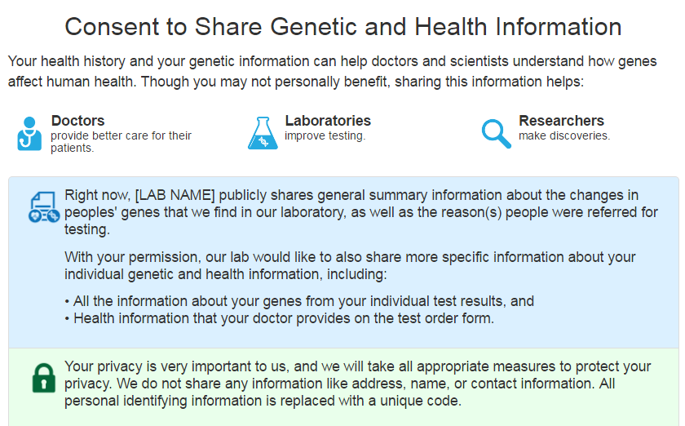

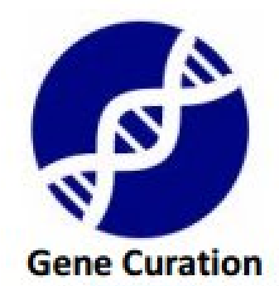
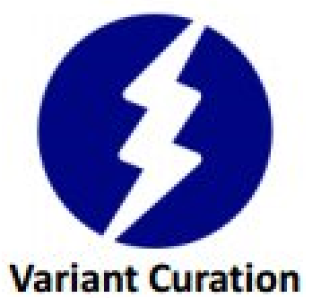
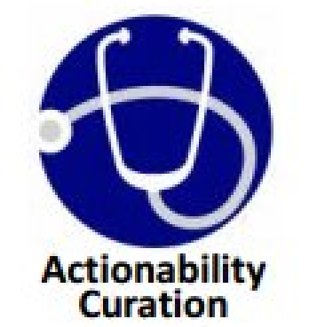

RFA-HD-17-001
NICHD Genomic Clinical Variant Expert Curation Panels
Document 32
Notes:
The Clinical Genome Resource (or ClinGen) defines and disseminates the clinical relevance of genomic variants for use in precision medicine and research. There are several new ClinGen collaborations and tools worth mentioning.
* In October, the Eunice Kennedy Shriver National Institute of Child Health and Human Development issued a funding opportunity to establish expert curation panels for diseases of high priority to their Institute. These expert panels will use ClinGen’s curation tools, and will be integrated into ClinGen’s curation ecosystem. Applications were due in January, and will be reviewed later this spring.
* ClinGen’s informatics teams led by Mike Cherry at Stanford and Alex Milosavljevic at Baylor have released production versions of their gene, variant, and actionability curation interfaces that guide curators through all aspects of curation – from reviewing publications to calculating final scores. Demo versions of these are available on the ClinGen website.
* Lastly, broad data sharing is a priority for ClinGen. ClinGen’s Education Working Group developed a one-page plain language consent form with supplemental online material to facilitate data sharing in the clinical setting. The consent form and short videos are available at the ClinGen website. Spanish, French, and Chinese translations of the form and video will be available soon.

Slide 51



Appl Clin Inform. 2016;7(3):817-31. doi: 10.4338/ACI-2016-04-RA-0058.
Genome Med 2016;8(1):117. doi: 0.1186/s13073-016-0367
Genome Med 2016; 8(1):95 doi: 10.1186/s13073-016-0351
Document 32
Notes:
Recent publications highlight additional important work coming out of ClinGen.
* ClinGen researchers have worked to integrate ClinGen resources into electronic health records through the Health Level Seven Infobutton standard.
* The Somatic Cancer Working Group developed a consensus set of minimal genomic variant-level data for sharing and curating somatic genomic variant data, and is working toward integrating this data standard into ClinVar.
* Finally, ClinGen has developed a good working relationship with the Food and Drug Administration (or FDA). In a Genetics in Medicine commentary, ClinGen investigators share their perspective on the importance of engaging with regulatory stakeholders to facilitate the transition of genomics from bench to bedside.

Slide 52



Clinical Sequencing Exploratory Research Program
Enrolled 5,135 adults and 1,320 children
288 publications, 18 working group publications
Document 33
Notes:
The Clinical Sequencing Exploratory Research (or CSER) Program focuses on the integration of genome sequencing into the clinical workflow, including the generation, interpretation, and clinical reporting of genomic information.
* CSER has now enrolled over 5,000 adults and over 1,300 children. For over 5,000 of these individuals, germline genome sequence data will be generated, and for over 1,000, tumor genome sequence data will be generated. As one measure of overall impact, * CSER has generated 288 publications, including 18 cross-CSER working group publications.
* CSER was prominently featured at both the National Society of Genetic Counselors Annual Education Conference in September and the American Society of Human Genetics Annual Meeting in October. In total, there were 45 CSER-related posters and presentations at these two meetings, including talks on healthcare outcomes and costs after genome sequencing, genomic services in community health centers, and enhancing diversity in genomic medicine research.

Slide 53

Clinical Sequencing Exploratory Research Program
95% return findings in ACMG 56 genes
Variation in return of secondary findings:
  10% return variants for complex traits
  57% return variants related to monogenic diseases of adult onset
67% allow patient opt-out for secondary findings
Genet Med 2016; doi: 10.1038/gim.2016.152
14%
other
sequence
variants
5%
none
Orthogonal confirmation practices among labs
(n = 21)
81%
all or only diagnostic variants
Document 33
Notes:
* One recent CSER highlight is an Actionability-Return of Results Working Group paper published in Genetics in Medicine, which summarizes the genome-sequencing and reporting practices of 21 clinical labs around the country, including 9 CSER labs.
* Among those 21 labs, orthogonal confirmation using Sanger-based DNA sequencing or other methods was used by 81% of labs for all reported genomic variants or for variants considered to represent possible diagnostic findings. 14% of laboratories confirmed other sequence variants, and 5% of laboratories did not confirm any variants.
* Additionally, among those 21 labs, 95% return findings in the ACMG 56 genes. * There was variation in the return of secondary findings: * 10% of labs routinely return variants for complex traits, and * 57% return variants related to monogenic diseases of adult onset. * 67% of labs allow patient opt-out for receiving secondary findings. Overall, the paper highlighted areas of consensus that are indicative of developing standards. Areas with notable divergence and in need of future discussion include the use of phenotypic data to inform case analysis; the interpretation and reporting of case-specific quality metrics and methods; and the process for initiating reanalysis of sequence data.

Slide 54




Implementing Genomics In Practice (IGNITE) Network
85
IGNITE publications
Document 34
Notes:
The Implementing Genomics in Practice (or IGNITE) Network works to enhance the use of genomic medicine by supporting the development of methods for incorporating genomic information into clinical care. To date, IGNITE research has resulted in more than 85 publications.
* One exciting outcome of IGNITE research could drastically reduce adverse events for patients taking anti-clotting medication. IGNITE collected data from 7 institutions on approximately 1800 patients undergoing percutaneous coronary intervention and CYP2C19 clinical genotyping. Results showed a higher than two-fold rate of major adverse cardiovascular events (the y-axis on the graph) in patients carrying a CYP2C19 loss-of-function allele who were prescribed clopidogrel compared to those with the loss-of-function allele on an alternative antiplatelet therapy. Switching medication from clopidogrel reduced the risk of major adverse cardiovascular events by more than half.
These results were presented at the late-breaking trials session of the American Heart Association meeting in November. In many ways, the strength of this study lies in the collaborative efforts of the participating sites.

Slide 55


Newborn Sequencing In Genomic medicine and public HealTh (NSIGHT)
Document 35
Notes:
The Newborn Sequencing in Genomic Medicine and Public Health (or NSIGHT) program explores, in a limited but deliberate manner, the implications, challenges, and opportunities associated with the possible use of genomic sequence information for the care of newborns.
Recently the four sites published a marker paper describing the consortium in Pediatrics. The article, “Newborn Sequencing in Genomic Medicine and Public Health,” examines some of the challenges of newborn genome sequencing in three distinct clinical settings (diagnostic, preventive, and predictive), describes the four projects, and puts the NSIGHT consortium’s research in the context of current and future strategies for newborn screening and genome sequencing of newborns in the clinic.

Slide 56
4th ELSI Congress
Expanding the ELSI Universe #ELSICon
  Co-sponsored by NHGRI, the Jackson Laboratory, Columbia University Medical Center, and UCONN Health
  Keynote Speakers:
    Eric Dishman
    Alondra Nelson
    Wylie Burke
    James Evans
    Pearl O’Rourke
  Topics:
    Precision medicine
    Genome sequencing enters the clinic
    Genes, ancestry, and identity
Document 36
Notes:
The Ethical, Legal, and Social Implications (or ELSI) Research Program supports research on the implications of genomics for individuals, families, and communities. The ELSI Research Program is co-sponsoring the 4th ELSI Congress, to be held in June at the Jackson Laboratory in Farmington, Connecticut. This will be a major conference addressing a wide range of ELSI issues - the first such meeting to be held since the 2011 Congress hosted by the University of North Carolina.
* Keynote speakers include Eric Dishman, Alondra Nelson, Wylie Burke, James Evans, and Pearl O’Rourke. Their talks will cover a variety of ELSI topics in both genome science and genomic medicine. The Congress has also received over 190 abstracts for paper, poster, and panel presentations, including a number of international submissions. The final program will be released later this spring.

Slide 57

Computational Genomics and
Data Science Program
Workshop in Bethesda September 2016
  Co-chairs: Mike Boehnke, Carol Bult, Trey Ideker, Aviv Regev, and Lincoln Stein
Goal: Elicit discussion about NHGRI’s future extramural computational genomics and data science portfolio
Final report will be presented at May Council meeting
Document 37
Notes:
The NHGRI Computational Genomics and Data Science Program held * a workshop in Bethesda at the end of September. It was co-chaired by Mike Boehnke, Carol Bult, Trey Ideker, Aviv Regev, and Lincoln Stein. About 40 extramural scientists from academia and industry as well as colleagues from NHGRI, the Big Data to Knowledge (or BD2K) program, and the National Center Institute attended.
* The goal was to elicit discussion about NHGRI’s future extramural computational genomics and data science portfolio. The workshop presentations and discussion were designed to gain community input on priority areas. * Feedback on the priority areas were interactively collected using a multi-voting method, as shown in this screenshot.
* A report and proposed actions is currently being developed, and will be presented at the May Council meeting.

Slide 58

Small Business Grants
Small Business | Phase I Proof of Principle | Phase II Pre-Commercialization
Innovation Research (SBIR) | 18 | 13
Technology Transfer (STTR) | 6 | 1
Total | 24 | 14
Document 38
Notes:
NHGRI provides about $12.4 million dollars in small business grants annually.
* Our current Small Business Innovation Research (or SBIR) and Small Business Technology Transfer (or STTR) portfolio includes 24 Phase I proof of principle and 14 Phase II pre-commercialization awards. New Phase II awards are supporting work on next-generation DNA sequencing sample and library preparation innovations at SomaGenics; single-cell transcriptional analysis at BioSpyder Technologies; improving genotype imputation of diverse populations at 23andMe; and developing genome-wide CRISPR library screening platforms at Cellecta. These small business grants are drawn from an increasingly stronger application pool.

Slide 59
Director’s Report Outline
General NHGRI Updates
General NIH Updates
General Genomics Updates
NHGRI Extramural Research Program
NIH Common Fund/Trans-NIH
NHGRI Division of Policy, Communications, and Education
NHGRI Intramural Research Program

Slide 60



Genotype-Tissue Expression (GTEx)
    Enrollment complete (965 donors)
    Version 7 data release in summer 2017
      >600 whole-genome sequences
      RNA-Seq data on >12,000 samples
Second most downloaded data set after TCGA in FY16 (531 requests vs 1478)
Barcelona, Spain in April 2017
Document 39
Notes:
The Genotype-Tissue Expression project (or GTEx) aims to create a public atlas of human gene expression and its regulation across multiple tissue types, and to aid in the functional interpretation of genetic associations with disease.
* In late 2015, GTEx reached its target enrollment of 965 donors. In October 2015, Version 6 of the GTEx data was released through dbGaP. In this version, there were 351 whole-exome sequences and 160 whole-genome sequences, which were generated with whole blood DNA. * Version 7 of the data is anticipated in the summer of 2017, and this will include over 600 donors with whole-genome sequences and RNA-Seq data on more than 12,000 tissue samples. GTEx data production is still ongoing.
* GTEx data can be found in dbGaP, where it is the second most downloaded dataset after TCGA. * In April, GTEx will hold an open European Community Meeting at the Center for Genomic Regulation in Barcelona, Spain to engage European researchers. Meanwhile, plans are proceeding for the final GTEx Community Meeting and Steering Committee meeting to be held in late June or early July in the DC area.

Slide 61





Papers Published Annually
    >9,000 registered users from >90 countries
    48,826 gene-expression profiles downloaded
    >220 papers using GTEx data, mostly from non-consortium members
Document 39
Notes:
Currently, the GTEx Portal is the primary place where users access GTEx data. GTEx Portal usage is tracked by user registrations and by IP addresses. * As of October 2016, the portal had over 9,000 registered users, an increase of 67% compared to 2015. The GTEx Portal has been accessed from 48,454 unique IP addresses from over 90 countries.
* As of December 2016, over 48,000 gene-expression profiles have been downloaded from the GTEx Portal. * Over the last three years, more than 220 papers have been published using GTEx data, mostly from non-consortium members (as shown by the purple and blue regions on this bar graph).
* The GTEx Portal is now being referenced by other significant data resources. The UCSC Genome Browser and Ensembl teams have integrated GTEx data within their genome browsers. GeneCards and The Human Protein Atlas have also integrated GTEx data.

Slide 62



Human Heredity and Health in Africa (H3Africa)
  9th Consortium Meeting in October 2016
  Opening by Dr. Ameenah Gurib-Fakim, President of Mauritius
  Last Consortium meeting of Phase 1: May 2017
  Review of Phase 2 applications: March 2017
Document 40
Notes:
H3Africa’s central goal is to develop a sustainable and collaborative African genetics and genomics research enterprise. * This past October, H3Africa had the honor of receiving the President of Mauritius to speak at the opening of the 9th H3Africa Consortium meeting. The President (shown in the photograph on the left) emphasized the importance of making the public aware of the remarkable research being carried out on the continent, reiterating her long-standing belief that African governments need to increase their support of research. This message was both heartening and topical, as the Consortium continues to work on its plans for sustainability as it completes its first phase and enters into its second (and final) phase of support from the NIH Common Fund.
* This coming May, H3Africa will host the final Consortium meeting of Phase 1 in Botswana, presenting their progress from the first five years and charting a course for the future.
* Applications for Phase 2 of the H3Africa program have been received, and will be reviewed in March before coming to the May Council meeting.

Slide 63














Undiagnosed Diseases Network (UDN)
UDN Site Locations
1062 Applications
414 Acceptances
Document 41
Notes:
The NIH Common Fund’s Undiagnosed Diseases Network (or UDN) aims to improve the level of diagnosis and care for patients with undiagnosed diseases, facilitate research into the etiology of these diseases, and create an integrated and collaborative research community to identify and share improved options for optimal patient management.
* To date, the UDN has received over 1000 applications and accepted 414 patients for evaluation at the 7 UDN Clinical Sites across the nation. To apply, one needs to access the UDN Gateway by * clicking on the “Apply” button, which appears on all the UDN webpages.
* In November, the UDN received approval for a second phase of Common Fund support, which will run from Fiscal Years 2018 through 2022. Pending the availability of funds, the program expects to publish Funding Opportunity Announcements this summer for this second phase. Components are expected to include a coordinating center, 8-10 clinical sites, and 3-6 core laboratories.

Slide 64



Precision Medicine Initiative
The Precision Medicine Initiative® (PMI) Cohort Program
Document 42
Notes:
As I have mentioned in previous Director’s Reports, NIH has been heavily involved implementing the U.S. Precision Medicine Initiative (or PMI). NIH’s funding for Fiscal Year 2016 included $70 million for the National Cancer Institute to lead efforts in cancer genomics as part of PMI for Oncology, as well as $130 million to build a national large-scale longitudinal research cohort of one million or more volunteers.
* The latter activity, which was formally referred to as the PMI Cohort Program, has now been rebranded as the All of Us Research Program. All of Us aims to engage a million or more Americans as active participants in a research program designed to improve disease prevention, treatment, and health outcomes through a data-driven approach to precision medicine.
* A nation-wide survey published by a team of NIH researchers, including NHGRI’s David Kaufman, showed broad support for the Precision Medicine Initiative, * indicating that the majority of Americans are interested in a cohort study along the lines of the All of Us Research Program.

Slide 65



New England Precision Medicine Consortium
Boston, MA
Mayo Clinic Biobank
Rochester, MN
Trans-American Consortium for the Health Care Systems Research Network
Detroit, MI
Hudson River Health Care
Peekskill, NY
Community Health Center, Inc.
Middletown, CT
Illinois Precision Medicine Consortium
Chicago, IL
California Precision Medicine Consortium
San Diego, CA
Columbia/Cornell/Harlem Hospital HPO
New York, NY
Precision Approach to healthCARE Enrollment Site Pittsbugh, PA
Scripps and Vibrent Participant Technologies/ Direct Volunteer Opps
La Jolla, CA
Geisinger Health System
Danville, PA
Cherokee Health Systems
Knoxville, TN
San Ysidro Health Center
San Ysidro, CA
Eau Claire Cooperative Health Center
Columbia, SC
University of Arizona - Banner Health Enrollment Center
Tucson, AZ
Jackson-Hinds Comprehensive Health Center
Jackson, MS
Federally Qualified Health Centers
Vanderbilt/Broad/Verily Data and Research Support Core
Nashville, TN
Regional Medical Centers
Recruitment at VA Hospitals
Direct volunteer recruitment nationwide
Biobank
Data and Research Support Core
Participant Technology Center
Document 42
Notes:
At the September Council meeting, I outlined the funded components of the All of Us Research Program, including recruitment at Federally Qualified Health Centers, regional medical centers and Veterans Administration hospitals, a biobank, a data and research support center, and a participant technology center. In October, the Program announced four new regional medical centers, including the New England Precision Medicine Consortium, the Geisinger Health System, the Trans-American Consortium for the Health Care Systems Research Network, and the California Precision Medicine Consortium.
The All of Us program team is actively working to develop the infrastructure needed to launch participant recruitment. As Director Eric Dishman told you at the September Council meeting, the program will launch when ready and right. As part of the preparation for that launch, the program is holding several meetings. For example, * there was a Research Program Stakeholder briefing this past October. In addition, the program will be holding a meeting on Return of Results, including genetic and genomic results, in March. The NIH All of Us Program webpage will be updated over the next few weeks with more information about this meeting.

Slide 66
Director’s Report Outline
General NHGRI Updates
General NIH Updates
General Genomics Updates
NHGRI Extramural Research Program
NIH Common Fund/Trans-NIH
NHGRI Division of Policy, Communications, and Education
NHGRI Intramural Research Program

Slide 67


ASHG-NHGRI Fellowships
2017-2018 Application Process Open
    Genetics and Public Policy Fellowship
    Genetics and Education Fellowship
    Application deadline: April 24, 2017
Document 43
Notes:
NHGRI’s Division of Policy, Communications, and Education partners with the American Society of Human Genetics (or ASHG) to sponsor two training fellowships— * the well-established Genetics and Public Policy Fellowship and * the recently launched Genetics and Education Fellowship.
To date, these programs have sponsored 16 Genetics and Public Policy Fellows and 3 Genetics and Education Fellows. We are currently accepting applications for the 2017-2018 fellowship year, which runs from September 2017 to December 2018.
During the fellowship, the fellows complete a series of rotations with NHGRI and ASHG, as well as external rotations on Capitol Hill or in educational organizations. * Applications are due on April 24, 2017. Please share this information with your departments and institutions as well as any individuals whom you think might be interested in these exciting opportunities.

Slide 68

Genome: Unlocking Life’s Code Exhibition
Travel Schedule
2017
  April 1-May 29
  Peoria Riverfront Museum
  Peoria, IL
  June 12-September 11
  Health Museum
  Houston, TX
  September 30-January 1
  Science North
  Sudbury, Ontario, Canada
Document 44
Notes:
The Genome: Unlocking Life’s Code exhibition continues to make stops across North America. The exhibition closed at Exploration Place in Wichita, Kansas in the beginning of the year, and will open on April 1 at the Peoria Riverfront Museum in Peoria, Illinois. Later this year, it will next travel to the Health Museum in Houston, Texas, followed by a stop in Canada at Science North.

Slide 69


Genome: Unlocking Life’s Code Exhibition
Website Award
Document 44
Notes:
As you may recall, the Genome: Unlocking Life’s Code exhibition is associated with a website to extend the experience of visiting the exhibition and to bring its content to students and teachers outside the cities it visits. One of the most popular interactives on this website, In and Beyond Africa, received a highly prestigious and recognized education honor – the Teachers’ Choice Award for the Classroom 2017, awarded by Learning Magazine. A panel of teachers evaluated In and Beyond Africa based on quality, instructional value, ease of use, and innovation. It was one of 30 winners, and was profiled in the January 2017 issue of Learning Magazine.
In and Beyond Africa helps students explore how Homo sapiens evolved in East Africa and across the globe. Learners discover the migration patterns that influenced genomic diversity, test tool-making skills, learn about some of the genes responsible for skin-color variations, and engage in related game-style activities.

Slide 70
Genomic Literacy, Education, and Engagement (GLEE) Initiative
    Possible launching of a national campaign to enhance genomic literacy
    Proposed target audiences: K-16, public, and healthcare professionals
    Strategic Visioning Meeting: March 2017
Notes:
NHGRI has had multiple conversations over the past year with colleagues in academia, industry, the non-profit community, and government about the needs for increased awareness about genomic concepts and genomic medicine applications. The strong consensus is that overall ‘genomic literacy’ of the general public and healthcare professionals is profoundly lagging behind the pace at which genomic advances are entering (or will enter) day-to-day life, and that NHGRI is uniquely suited to take a leadership role in pursuing efforts to address this growing problem.
* As a result of these conversations, NHGRI is exploring the possibility of launching a highly collaborative national campaign to enhance genomic literacy. For now, we are calling this effort the Genomic Literacy, Education, and Engagement (or GLEE) Initiative. At present, GLEE is envisioned as an effort to coordinate and augment ongoing genomics education and outreach efforts, as well as to address important opportunities or gaps in educational needs. * Currently, we are anticipating that GLEE could support the enhancement of genomic literacy efforts within three major target audiences: K-16 students, the ‘general public,’ and healthcare professionals.
* To assess the opportunities and potential goals for such an initiative, NHGRI is hosting a GLEE Strategic Visioning Meeting in March on the NIH campus. We plan to update you about this meeting at the May Council meeting.

Slide 71


2017 NHGRI Short Course in Genomics
K-12, Community College, and Tribal College Faculty
Applications Open: Feb. 2017
Nurses, Physician Assistants, and Educators
Applications Open: March 2017
Document 45
Notes:
Later this month, the Education and Community Involvement Branch will begin accepting applications for its 2017 NHGRI Short Course in Genomics. * This Short Course is for K-12, community college and tribal college faculty members teaching genetics, biology, or related science courses. This year’s course will be held on the NIH campus starting at the end of July. Selected educators will come to NIH for three days to hear lectures and receive teaching resources from leading NHGRI and NIH researchers, clinicians, and staff; to discuss ways to incorporate genomics content into their classrooms; and, to participate in tours of NIH facilities. Topics discussed during the course range from undiagnosed and rare diseases, bioinformatics, CRISPR/Cas9, cancer genomics, ethical issues in genomics research, and health disparities, among others.
In March, the Genomic Healthcare Branch will begin accepting applications for its 2017 Short Course. * This Short Course is for practicing nurses and physician assistants as well as for the educators of these practitioners. This course will also be held on the NIH campus starting in early August. During the first two days, participants will listen to lectures on genomics across the healthcare curriculum and the challenges of implementing and educating professionals about genomics, pharmacogenomics, genetic counseling, and case studies. The last two days will focus on implementation, highlighting resources and successful academic and clinical strategies.

Slide 72



My Family Health Portrait
    Family history tool website revised to improve the user experience
    ‘NLM Hackathon’ to extend interoperability and expose programmers to family history and relevant resources
Document 46
Notes:
The Surgeon General's My Family Health Portrait, which is an NHGRI-based effort, provides a web-based tool that the public can use to record family health history and share it with family (or provide it to their healthcare provider). * To make the website housing the tool easier to use, the Genomic Healthcare Branch worked with NCI’s Center for Biomedical Informatics and Information Technology to improve the user experience. This 9-month project culminated in release of Version 3.4 just before National Family History Day on Thanksgiving. Work is continuing to update the foreign language translations for the revised website.
* In January, the My Family Health Portrait was included in a ‘hackathon’ hosted by the National Library of Medicine (or NLM). It was the first time a health information technology-related project was included in such a hackathon. A diverse team of 7 programmers unfamiliar with family history tools developed plans and drafted code to extend the interoperability and decision-support functions of this public tool. The goal of the hackathon was to expand the use of the tool (which is open source), and to teach programmers and others about family history and available family-history resources.

Slide 73
Director’s Report Outline
General NHGRI Updates
General NIH Updates
General Genomics Updates
NHGRI Extramural Research Program
NIH Common Fund/Trans-NIH
NHGRI Division of Policy, Communications, and Education
NHGRI Intramural Research Program

Slide 74


International Summit in
Human Genetics and Genomics
    Five-year initiative (2016-2020)
    Help developing nations build expertise in genetics and genomics
    September 2016: 19 participants from 13 countries across the globe
Document 47
Notes:
Max Muenke and colleagues in the Medical Genetics Branch of the NHGRI Intramural Research Program held the first International Summit in Human Genetics and Genomics this past September. * This was the first such Summit, which is part of a 5-year initiative that will involve annual month-long workshops. * The Summit is designed to help developing nations build and expand their expertise, infrastructure, systems, and technologies in genetics and genomics. The goal is to help them understand the prevalence and basis of genetic diseases in their nations, and to help them address the associated public health challenges. The Summit was sponsored by NHGRI; a collection of other Institutes and Centers; the Foundation for the NIH; and additional profit and non-profit partners.
* The first Summit in September had a month-long curriculum that included courses and tailored training for participants. The program is intended to train healthcare professionals and trainees from developing nations that are in their early to mid career stage. A total of 19 participants came to this first Summit from 13 countries across the globe, including Cuba, Egypt, Ethiopia, India, Indonesia, Malaysia, Morocco, Nigeria, Rwanda, Peru, Sri Lanka, Tanzania, and Turkey. Participants experienced over 50 lectures, field trips to the NIH Intramural Sequencing Center and various other sites, a bioinformatics workshop, and a patient panel.
Applications for the next Summit will be accepted in April 2017.

Slide 75


Master, American College of Rheumatology
Dan Kastner, M.D., Ph.D.
Document 48
Notes:
Dan Kastner, NHGRI Scientific Director, received recognition as a Master of the American College of Rheumatology (or ACR). This is one of the highest honors the College bestows. The designation of Master is conferred to ACR members who have made outstanding contributions to the ACR and the field of rheumatology through scholarly achievement and/or service to their patients, students, and profession.

Slide 76


International Genetic Epidemiology
Society Leadership Award
Alec Wilson, Ph.D.
Document 49
Notes:
Alec Wilson, Senior Investigator and Co-Branch Chief in the NHGRI Intramural Research Program, has been awarded the International Genetic Epidemiology Society Leadership Award. This award is given to a scientist that has made significant contributions to the field of genetic epidemiology through teaching, research, and service.

Slide 77




NHGRI Intramural Research Highlights
Biallelic hypomorphic mutations in a linear deubiquitinase define otulipenia, an early-onset autoinflammatory disease
Systemic AAV9 gene therapy improves the lifespan of mice with Niemann-Pick disease, type C1
Extracellular Hsp60 triggers tissue regeneration and wound healing by regulating inflammation and cell proliferation
Document 50
Notes:
NHGRI Intramural investigators have once again been quite productive since the last Council meeting.
* Ivona Aksentijevich and colleagues discovered a rare and sometimes lethal inflammatory disease - otulipenia - that primarily affects young children. They also identified anti-inflammatory treatments that ease some of the patients' symptoms, including fever, skin rashes, diarrhea, joint pain, and overall failure to thrive.
* Chuck Vendetti and his colleagues demonstrated in mice that gene therapy may be the best method for correcting the single faulty gene that causes Niemann-Pick disease Type C1, a rare and fatal disorder of the central nervous system.
* Shawn Burgess and his colleagues identified a novel role for a gene known as heat shock protein 60 (or Hsp60). They found that the protein is critical in tissue regeneration and wound healing, and that topical treatment of an Hsp60-containing gel dramatically accelerates wound closure in a diabetic mouse model.

Slide 78

To receive The Genomics Landscape,
go to list.nih.gov
Search for NHGRILANDSCAPE
Past issues can be accessed at: genome.gov/27527308
Document 51
Notes:
Before ending my Director’s Report, I would like to (as always) put in a plug and say that anyone wishing to receive my monthly email update (called The Genomics Landscape) can simply go to list.nih.gov and then search for “NHGRILANDSCAPE.”

Slide 79


Thanks!
Special Thanks!
Notes:
Finally, a personal thanks to the 50-60 NHGRI staff members who contributed slides and information that I just reviewed. As always, such a group effort is essential for getting this large amount of information conveyed efficiently at each Council meeting.
An additional thanks to the NHGRI communications group and web team for making my Director’s Report into an electronic resource.
And * special thanks to the usual ‘ring leader’ for preparing my Director’s Report each time, Kris Wetterstrand. Shown here is Kris at some exotic marine location, enjoying her favorite pastime – scuba diving.

Slide 80

s
Advancing human health
through genomics research

