Slide 1
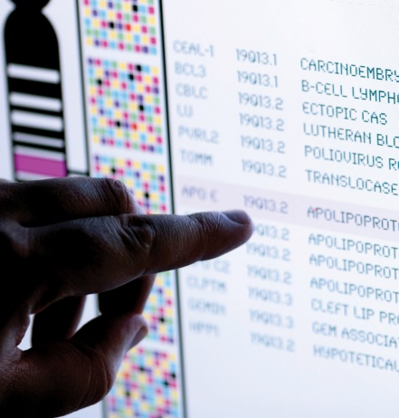
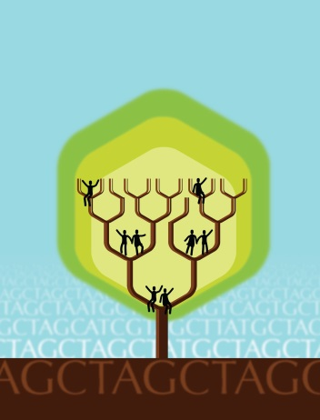
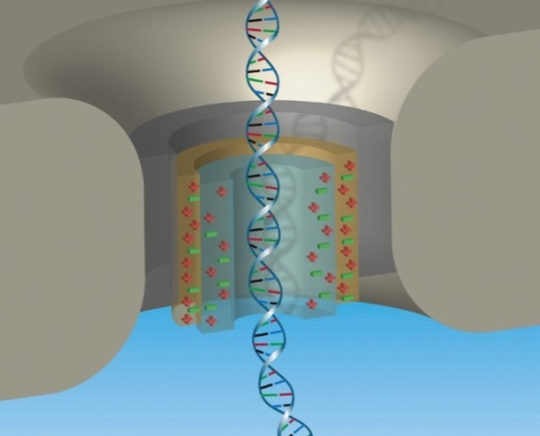


National Advisory Council for Human Genome Research
February 2018
Eric Green, M.D., Ph.D.
Director, NHGRI
DIRECTOR’S REPORT
Notes:
As is our routine, the entire Open Session of this National Advisory Council for Human Genome Research meeting is being webcast live (including my Director’s Report), and so I would like to personally welcome all of you joining us remotely.
The Open Session is also being videotaped, and those recordings will be made available as a permanent archive on NHGRI’s website (genome.gov), including the presentations themselves and the various associated documents.

Slide 2
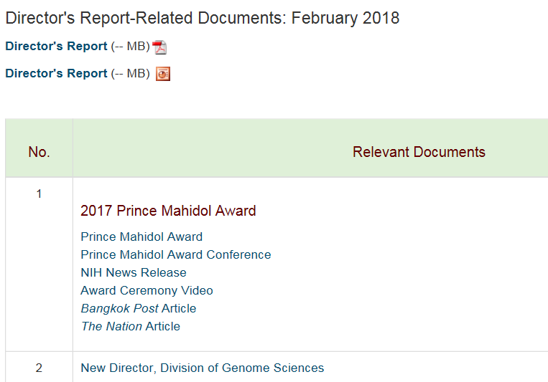
genome.gov/DirectorsReport
Document #
Notes:
For those new to our Council meetings, I want to make you aware of the ‘electronic resource’ that has been developed for my Director’s Report. Analogous to supplemental materials of a published paper, this resource can be accessed at the URL shown here.
The slides that I will show during my Director’s Report are also available electronically at this site – * both in PDF and PowerPoint formats.
* When there are documents or relevant web sites associated with a particular slide, you will find a ‘Document #’ indicated on the bottom right of that slide; that ‘Document #’ references materials that can be accessed and/or downloaded from the web page shown here. This web page and all linked documents will be archived on genome.gov as a historic record of this meeting.

Slide 3
Open Session Presentations
  En Route to a “2020 Vision for Genomics”: The Next Round of NHGRI Strategic Planning
  Eric Green
  Updates from Building 1: Next Generation Researchers Initiative and Clinical Trial Reforms
    Michael Lauer
  Concept Clearance: Novel Nucleic Acid Sequencing Technology Development
  Michael Smith
Notes:
There will be a number of other presentations during the Open Session of this Council meeting. My Director’s Report is tailored around those presentations, and I will not discuss in detail the topics that others will cover.
* Immediately after my Director’s Report, you will hear from me again in a presentation entitled, “En Route to a ‘”2020 Vision for Genomics”: The Next Round of NHGRI Strategic Planning.”
* Then after lunch, Michael Lauer (NIH Deputy Director for Extramural Research) will talk about “Updates from Building 1: Next Generation Researchers Initiative and Clinical Trial Reforms.”
* NHGRI’s Michael Smith will then present a concept clearance for “Novel Nucleic Acid Sequencing Technology Development.”

Slide 4
Open Session Presentations
  Report: The Human Microbiome Project Lita Proctor
  Report: Recommendations from the 2017 eMERGE and Beyond Workshop
      Sharon Plon
  NCBI in a Data-Enabled World
      Jim Ostell
Notes:
Two reports will then follow:
* NHGRI’s Lita Proctor will talk about “The Human Microbiome Project.”
* And Council member Sharon Plon will talk about the “Recommendations from the 2017 eMERGE and Beyond Workshop.”
* Finally, Jim Ostell (Director of the National Center for Biotechnology Information or NCBI) will give a presentation entitled, “NCBI in a Data-Enabled World.”

Slide 5
Director’s Report Outline
General NHGRI Updates
General NIH Updates
General Genomics Updates
NHGRI Extramural Research Program
NIH Common Fund/Trans-NIH
NHGRI Division of Policy, Communications, and Education
NHGRI Intramural Research Program
Notes:
For the rest of my Director’s Report, I will cover the 7 areas listed here, which reliably provide an effective framework for reviewing the relevant topics.

Slide 6
Director’s Report Outline
General NHGRI Updates
General NIH Updates
General Genomics Updates
NHGRI Extramural Research Program
NIH Common Fund/Trans-NIH
NHGRI Division of Policy, Communications, and Education
NHGRI Intramural Research Program

Slide 7
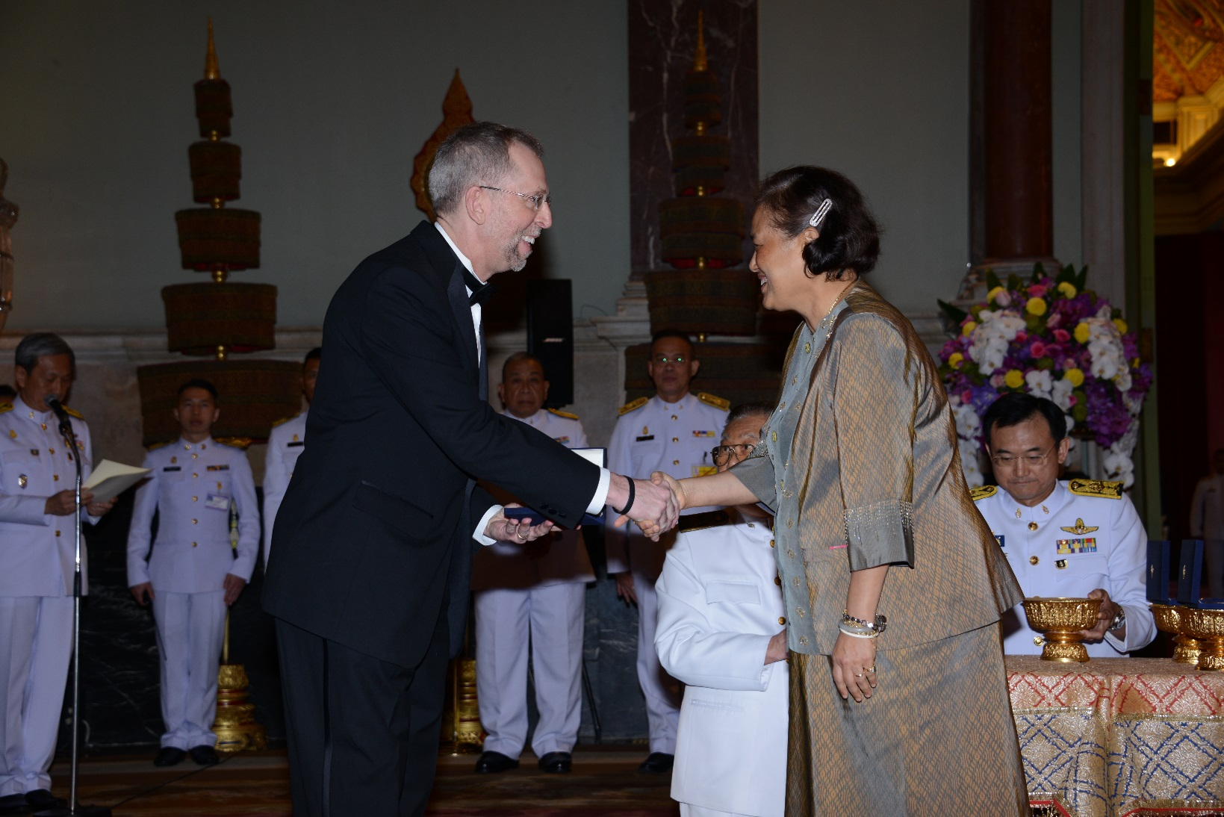

2017 Prince Mahidol Award
Field of Medicine: Human Genome Project
Document 1
Notes:
Two weeks ago, I was honored to travel to Bangkok, Thailand to accept the 2017 Prince Mahidol Award in the field of medicine, which was given to the Human Genome Project. By way of background, the Prince Mahidol Award was established in 1992 to honor the late Prince Mahidol, the grandfather of the present King of Thailand. Prince Mahidol modernized the medical service and education systems of Thailand last century, and is often referred to as the father of modern medicine and public health in Thailand.
The award is given annually in two categories: one in the field of medicine and one in the field of public health. The 2017 award in the field of medicine was given to the Human Genome Project. To read from the press release: “The Prince Mahidol Award (in the Field of Medicine 2017) recognizes the Human Genome Project for its collaborative success that has contributed to the remarkable advancement of medicine to the enormous benefit of mankind.” The entire field of genomics, and in particular all of those who worked on the Human Genome Project from 1990-2003, should be immensely proud to be given this prestigious award.
I was truly honored to be asked to accept the award on behalf of the Human Genome Project. The photo shown here is from the actual award ceremony in the Grand Palace in Bangkok, where I accepted the award from H.R.H. Princess Maha Chakri Sirindhorn of Thailand.
Of note, the 2017 Prince Mahidol Award in public health was given to a group of four researchers who worked on developing a vaccine for Haemophilus influenzae type b.

Slide 8
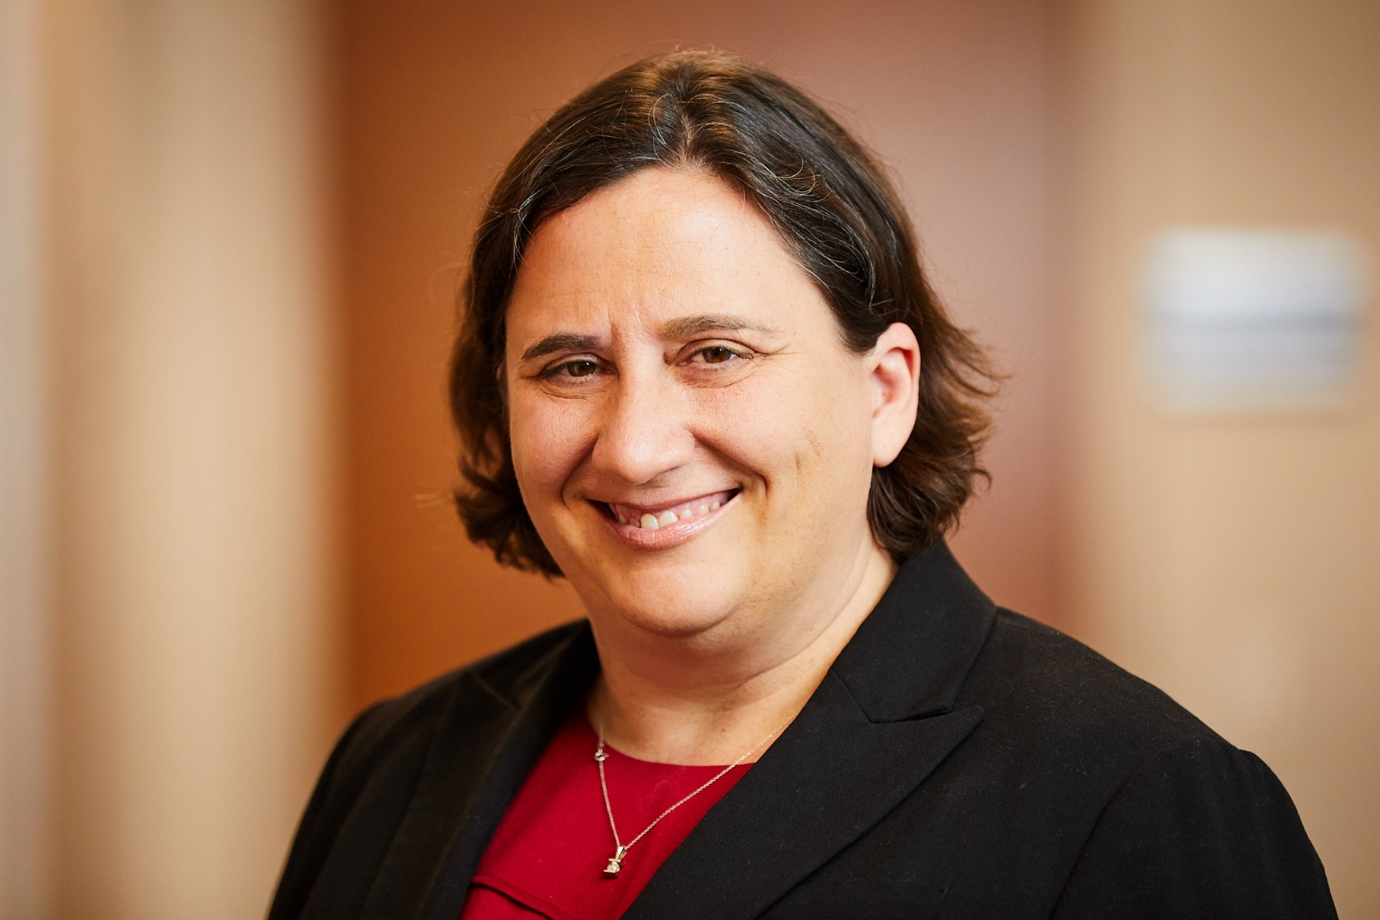
New Director, Division of Genome Sciences
Carolyn Hutter, Ph.D.
Document 2
Notes:
I am delighted to report that Carolyn Hutter has been selected as the new Director of NHGRI’s Division of Genome Sciences. She has been serving as Acting Director of this division since January 2017.
Prior to her arrival at NIH, Carolyn was a senior staff scientist at the Fred Hutchinson Cancer Research Center and a lecturer at the University of Washington, where her research focused on genome-wide association studies and gene-environment interactions for cancer and other complex diseases. She joined NHGRI in 2013 as the lead for The Cancer Genome Atlas (or TCGA), after serving as a program director in the National Cancer Institute’s Epidemiology and Genomics Research Program.
Carolyn’s background in genetics and epidemiology, in conjunction with her experience in managing large research collaborations, will serve her well in leading the largest component of NHGRI’s Extramural Research Program.

Slide 9
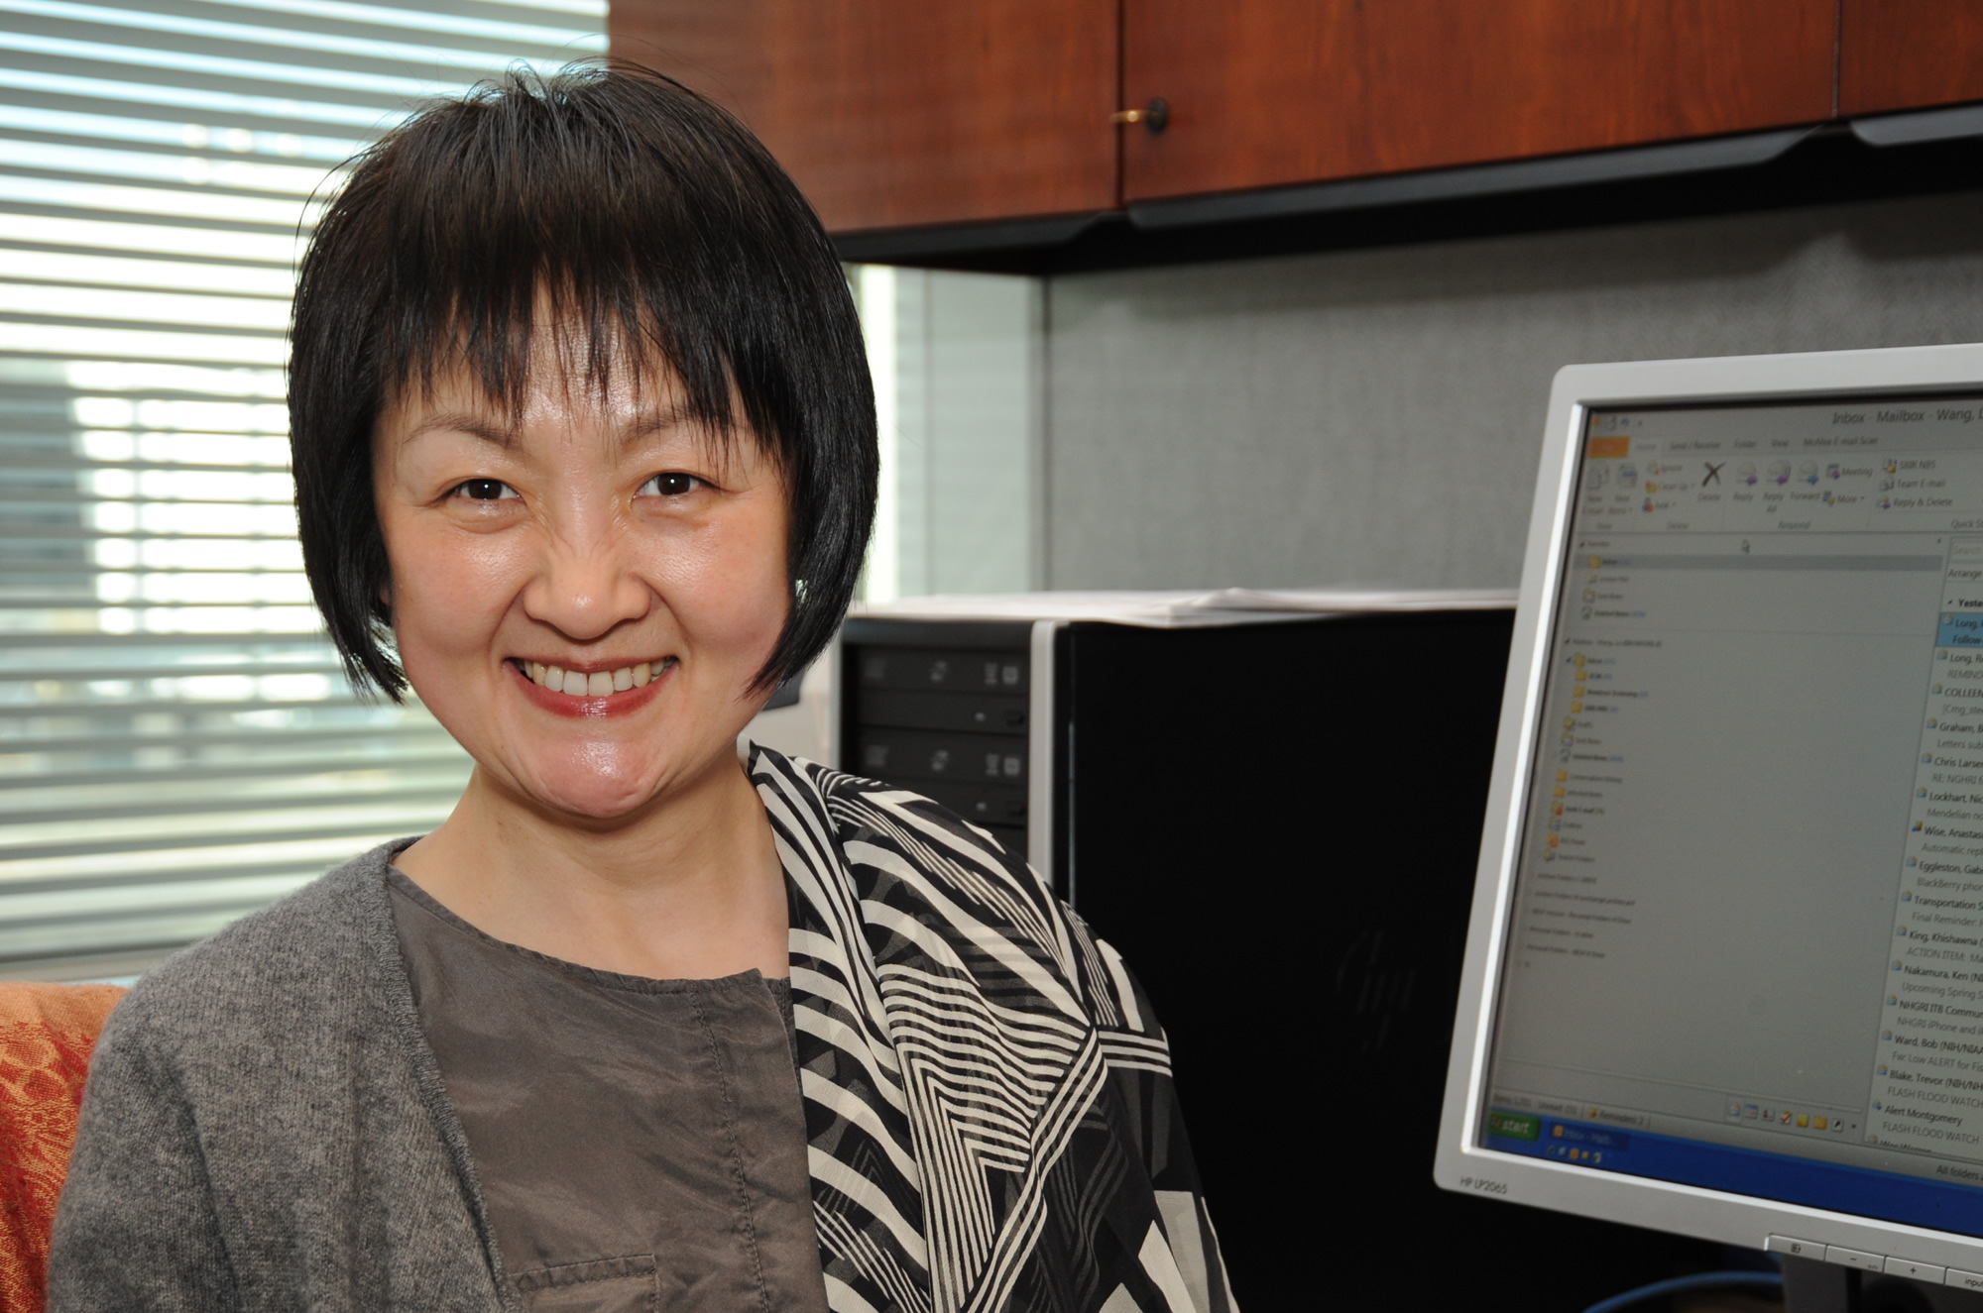
Departure of NHGRI Program Director
Lu Wang, Ph.D.
Notes:
After 11 years, Lu Wang will be leaving NHGRI to take a new position as Chief of the Translational Genomics Branch at the National Institute of Dental and Craniofacial Research. In fact, Friday will be her last day with the Institute.
Lu came to NHGRI in 2006, bringing with her genetics and microbiology expertise coupled with experience in private industry. During her entire time at NHGRI, she has been part of the Genome Sequencing Program, administering grants in the areas of Mendelian disorders, pathogens and vectors involved in infectious diseases, comparative genome evolution, and medical sequencing. She specifically managed the Centers for Mendelian Genomics Program. She also served on a number of NIH and external committees that coordinate or oversee rare disease gene discovery, organism-specific databases, or access to publicly available genomic and phenotypic data.
We wish Lu all the best with her new endeavors.

Slide 10
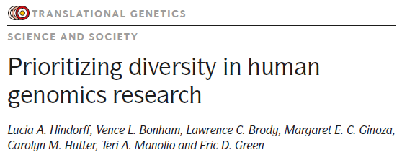
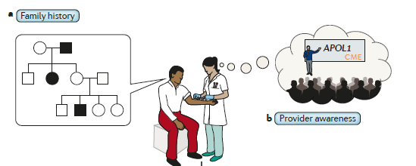

NHGRI Perspective: Prioritizing Diversity
Published in Nature Reviews Genetics
Highlights importance of diversity at all levels of research
Focuses on lessons learned and near-term recommendations
Reddit AMA in December
Document 3
Notes:
NHGRI staff was invited to write a commentary in Nature Reviews Genetics highlighting our role in prioritizing diversity in human genomics research. This Perspective was published online in Nature Reviews Genetics in November and will be out in print shortly.
* The paper highlights the importance of diversity at all levels of human genomics research, from formulating research questions to applying knowledge to healthcare systems. * In addition to sharing lessons learned from NHGRI-supported research about how diversity can accelerate discovery and translational efforts, the Perspective also offers near-term recommendations for researchers, funding agencies, and journal editors. It also includes an illustrative example of how diversity can contribute to the implementation of genomic medicine, * from family history and provider awareness * to clinical sequencing and genomic variant interpretation * to returning genomic results and seeking follow-up care.
* To further engage the scientific community, NHGRI held a Reddit Ask Me Anything (or AMA) session in December. NHGRI staff answered questions during this session, ranging from the role of genes versus environment to challenges in recruiting diverse participants for genomics research to tips for the next generation of researchers interested in this area.

Slide 11
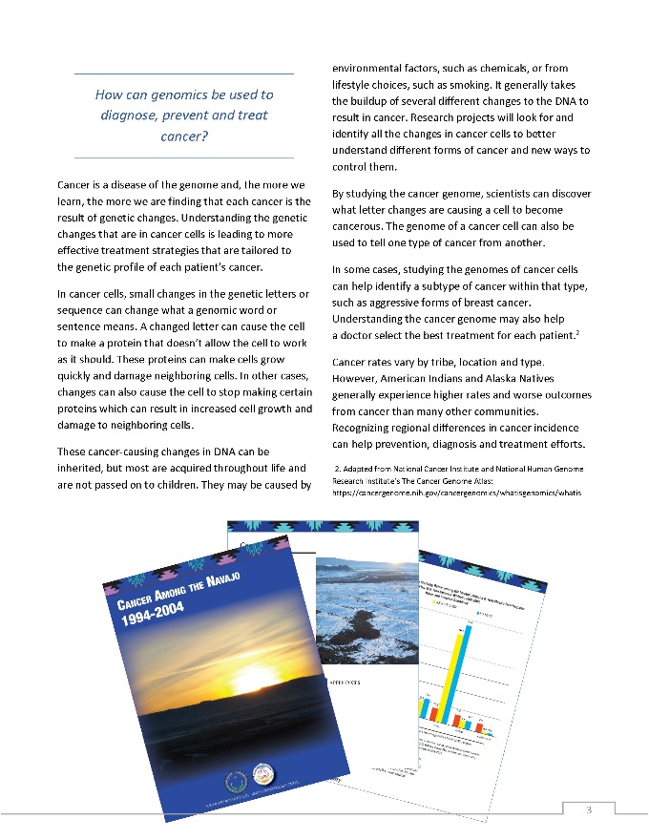
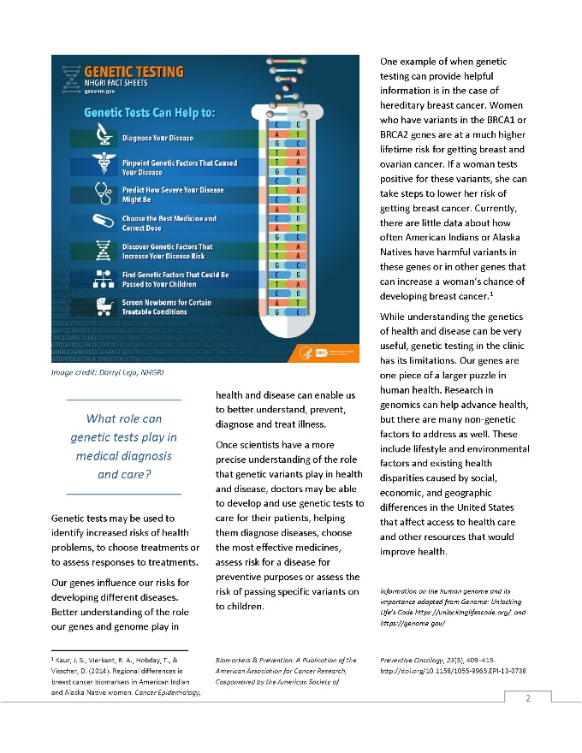

American Indian and Alaska Native Communities and Genomics Research
    New guide to genetics and genomics research for tribal communities
    Discusses key aspects of genetics and genomics research, with examples
Document 4
Notes:
NHGRI, in collaboration with the NIH Tribal Health Research Office, has developed a new resource for American Indian and Alaska Native Communities to learn about key aspects of genetics and genomics research, and to provide examples of current and recently completed genomics research projects funded by NHGRI.
This resource was debuted at a policy development workshop held last September and hosted by the University of New Mexico Comprehensive Cancer Center, NIH, and the Navajo Nation. At this workshop, Navajo President Russell Begaye announced that the tribe is considering whether to lift their moratorium on genetics research, which has been in place since 2002. NHGRI’s Genomics and Health Disparities Program and the Education and Community Involvement Branch continue to lead the Institute’s engagement with American Indian and Alaska Native communities, and we look forward to increasing our collaborations with these nations.

Slide 12
Director’s Report Outline
General NHGRI Updates
General NIH Updates
General Genomics Updates
NHGRI Extramural Research Program
NIH Common Fund/Trans-NIH
NHGRI Division of Policy, Communications, and Education
NHGRI Intramural Research Program

Slide 13


New Secretary, Department of Health and Human Services
Alex Azar, J.D.
Document 5
Notes:
Alex Azar was sworn in as the 24th Secretary of the U.S. Department of Health and Human Services (or HHS) late last month. Mr. Azar received a B.A. in government and economics from Dartmouth University and a J.D. from Yale University. Early in his career, he served as a law clerk for Supreme Court Justice Scalia, and under President George W. Bush, he served as General Counsel for HHS and subsequently Deputy HHS Secretary. Mr. Azar has also served as President of the U.S. division of Eli Lilly and Company, and was a member of the Board of Directors of the Biotechnology Innovation Organization.

Slide 14
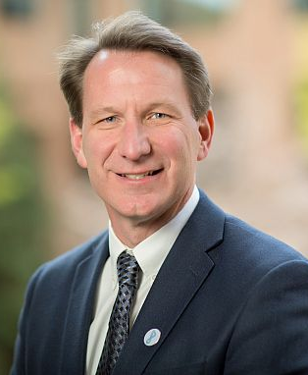

New Director,
National Cancer Institute
Ned Sharpless, M.D.
Document 6
Notes:
In October, Norman “Ned” Sharpless was sworn in as the new Director of the National Cancer Institute. Dr. Sharpless was most recently the Director of the Lineberger Comprehensive Cancer Center and the Wellcome Distinguished Professor in Cancer Research at the University of North Carolina. He is a practicing oncologist caring for patients with leukemia, and leads a research group studying the cell cycle and its role in cancer and aging. He earned his undergraduate and medical degrees from the University of North Carolina at Chapel Hill.

Slide 15


New Director, National Center for Biotechnology Information
Jim Ostell, Ph.D.
Document 7
Notes:
Jim Ostell has been appointed Director of the National Center for Biotechnology Information (or NCBI). Dr. Ostell has been with NCBI since it was established by Congress in 1988. NCBI is a major component of the National Library of Medicine, and runs more than 40 online databases (including GenBank and PubMed) accessed daily by thousands of researchers worldwide. Prior to his appointment as NCBI Director, Dr. Ostell served as Chief of the NCBI Information Engineering Branch. We will be hearing a presentation from him later today.

Slide 16
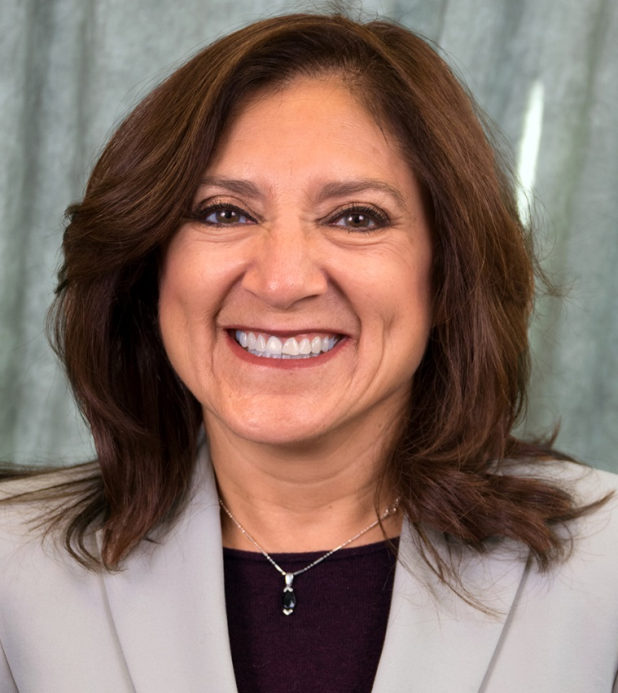

New Scientific Director, National Institute on Minority Health and Health Disparities
Anna María Nápoles, Ph.D., M.P.H.
Document 8
Notes:
Anna María Nápoles has been appointed the Scientific Director of the National Institute on Minority Health and Health Disparities (or NIMHD). Dr. Nápoles joins NIMHD after serving as a professor and behavioral epidemiologist at the University of California, San Francisco since 2001. She has been at the forefront of developing methods for community-engaged translational research to improve the health of disparity populations.

Slide 17



Roderic Pettigrew Departs as
Director, National Institute of Biomedical Imaging and Bioengineering
Roderic Pettigrew, Ph.D., M.D.
Jill Heemskerk, Ph.D.
Document 9
Notes:
After 15 years, Roderic Pettigrew has departed as Director of the National Institute of Biomedical Imaging and Bioengineering (or NIBIB). As founding NIBIB Director, Dr. Pettigrew established and built a brand-new enterprise at NIH devoted to biomedical imaging and bioengineering. In his new position, he will become the Chief Executive Officer of a new program called “EnHealth,” that will integrate engineering into all of the Texas A&M colleges that are part of the healthcare enterprise. In addition, he will be the Executive Dean of a new Houston-based engineering medicine track within the initiative, called “EnMed,” which will train Texas A&M medical students to invent solutions to challenging medical problems.
* While a national search for a new NIBIB Director is conducted, Dr. Jill Heemskerk will serve as Acting Director.

Slide 18
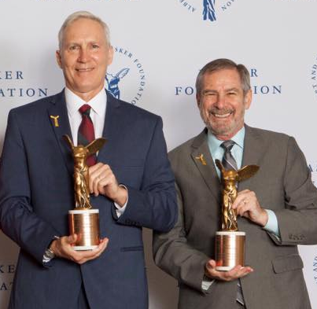
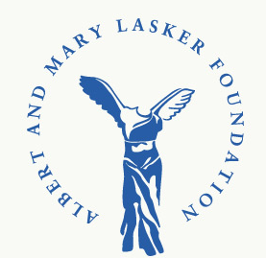
Lasker~DeBakey Clinical Medical
Research Award
John Schiller, Ph.D. & Doug Lowy, M.D.
Document 10
Notes:
John Schiller and Doug Lowy of the National Cancer Institute were the recipients of the 2017 Lasker~DeBakey Clinical Medical Research Award. This award was given to these two researchers in recognition of their foundational discoveries that led to the development of human papillomavirus (or HPV) vaccines. Their important research has led to the approval of three preventive HPV vaccines by the U.S. Food and Drug Administration.

Slide 19
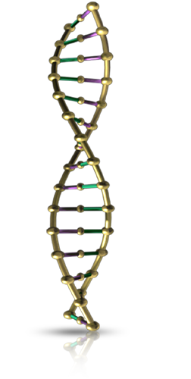


Updating Access to Genomic
Summary Results
    Update the access procedures for Genomic Summary Results (GSR) under NIH Genomic Data Sharing Policy
    Proposed update:
      GSR from most genomic studies to be available through a new ‘rapid access’ tier
      GSR from ‘sensitive studies’ to remain accessible through controlled access
Notes:
NIH released a proposed data management update to the access procedures for Genomic Summary Results (or GSR) under the NIH Genomic Data Sharing Policy.
* The proposed update would * enable genomic summary results from most studies deposited in NIH-designated data repositories (such as dbGaP) to be accessible through a new ‘rapid access’ tier intended to facilitate access, while also reminding users of the information about the NIH expectations for responsible data use.
* GSR from studies designated as ‘sensitive’ by their submitting institutions would remain accessible as they are currently through controlled-access procedures. NIH is now considering the public comments received and hopes to announce a final decision on access to genomic summary results in the next few months.

Slide 20
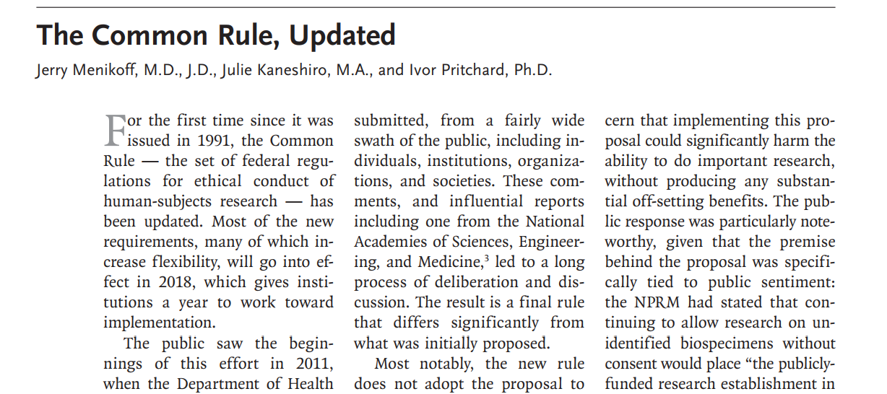
Delay in Common Rule Implementation
DELAYED
    Interim final rule delays effective date to July 19, 2018
    Institutions can begin implementing some provisions now
    A notice of proposed rulemaking will likely propose a further delay
Document 11
Notes:
Final revisions that would have updated the Common Rule were issued last year and were set to go into effect on January 19, 2018. * However, an interim final rule has now been issued to delay the effective date by six months, to July 19, 2018; this will provide institutions with more time to comply with the revisions. * Before the effective date, institutions can begin implementing some provisions of the revised Common Rule that are not in conflict with the current Common Rule, such as including the new elements of informed consent in consent forms. * Federal departments and agencies are also working to develop a notice of proposed rulemaking that would likely propose a further delay in implementation of a revised Common Rule and would be open for public comment – so stay tuned.

Slide 21
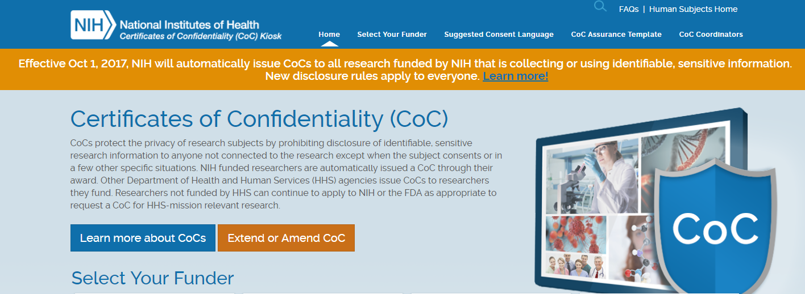
New Policy on Certificates of Confidentiality (CoCs)
    New CoC policy to provide additional privacy protections to research participants
    Policy covers all applicable ongoing and new research funded by NIH on or after December 13, 2016
    Investigators issued CoCs are prohibited from disclosing identifying information about participants
Document 12
Notes:
The 21st Century Cures Act, passed in December 2016, contained a provision * strengthening the protections offered by Certificates of Confidentiality (or CoCs) and requiring HHS to issue such Certificates to all federally funded investigators conducting research that collects identifiable, sensitive information. Certificates of Confidentiality are intended to protect researchers and their organizations against having to disclose identifiable information about their research participants in legal proceedings, such as in the case of a subpoena. * NIH issued a policy to implement these new statutory requirements, which has been in effect since October 1, 2017, and it covers all applicable ongoing and new research funded by NIH on or after December 13, 2016.
* Under the new policy, investigators funded by NIH are automatically issued Certificates when their research collects identifiable, sensitive information about individuals. The policy also provides additional privacy protections to research participants through a new prohibition that prevents researchers from disclosing identifiable, sensitive information about their research participants, with some exceptions. Under the previous authority, the protection was voluntary on the part of the Certificate-holding institution.
NIH has updated its Certificate of Confidentiality webpages to reflect the changes in policy and to help investigators and institutions comply with the outlined responsibilities.

Slide 22
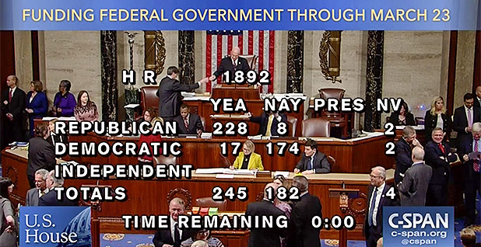
Budget Update
Notes:
As you know, Fiscal Year 2018 began on October 1, 2017, but the Federal government still does not have a budget for the year. Since October, the government has been operating under a series of Continuing Resolutions (or CRs). Very early last Friday – after another (albeit short) government shutdown – the House and Senate passed yet another CR, this time funding the government through March 23.
But importantly, this latest bill also reflects a bipartisan deal that provides a general ‘topline’ budgetary framework for the next two years. With the high-level budget numbers agreed to, the appropriators will now spend the next six weeks writing an omnibus spending package that should include exact numbers for NIH through the end of Fiscal Year 2018. This is welcome news since it should end the cycle of shutdown threats and CRs – at least for this Fiscal Year.

Slide 23
NIH Appropriations
 | Fiscal Year 2017 Budget | Fiscal Year 2018 Senate Appropriations Labor-HHS Spending Bill
NIH | $34.1 B | $36.1 B
NHGRI | $528 M | TBD
Document 13
Notes:
Meanwhile, as March 23 approaches, we will all be anxiously waiting to see the final Fiscal Year 2018 budget numbers for NIH and for NHGRI. It would certainly be nice if NIH’s appropriation resembles the level already approved by the Senate Appropriations Committee. As you may recall, the Labor HHS bill that detailed funding for NIH includes a $2 billion dollar increase for NIH (for a total funding level of $36.1 billion).

Slide 24
Director’s Report Outline
General NHGRI Updates
General NIH Updates
General Genomics Updates
NHGRI Extramural Research Program
NIH Common Fund/Trans-NIH
NHGRI Division of Policy, Communications, and Education
NHGRI Intramural Research Program

Slide 25

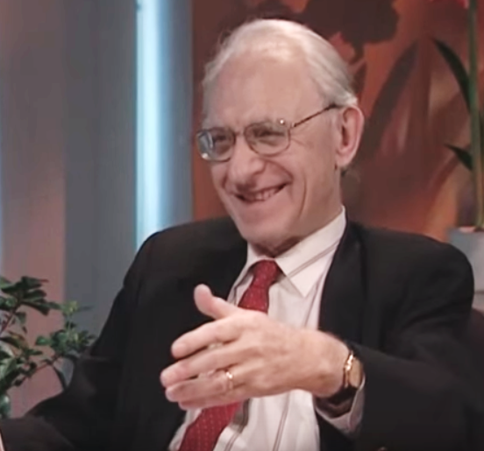
Mourning the Loss of Arno Motulsky
Document 14
Notes:
Last month, Arno Motulsky passed away at the age of 94. Dr. Motulsky was a prominent and highly accomplished human and medical geneticist, and a founder of the field of pharmacogenomics. He was the first to describe negative interactions between drugs and enzymes produced by human genes in people, thus illustrating a role of genomic variation in the response to pharmaceuticals. He co-authored with Friedrich Vogel a human genetics textbook on what was considered ‘THE’ textbook of human genetics for many years. His work greatly influenced all corners of human and medical genetics.

Slide 26


George Cunningham Visionary Award in Newborn Screening
American Public
Health Laboratory
Association
Jeff Botkin, M.D., M.P.H.
Document 15
Notes:
Council member Jeff Botkin received the 2017 George Cunningham Visionary Award in Newborn Screening, an honor given by the American Public Health Laboratory Association. The ceremony for this award actually kept him from attending the September Council meeting in person. Dr. Botkin was honored for both his research and leadership. His research has influenced the national dialogue and policies on newborn screening and secondary uses of residual dried blood spots. He has also served on relevant committees at both the national and state levels to improve newborn screening.

Slide 27
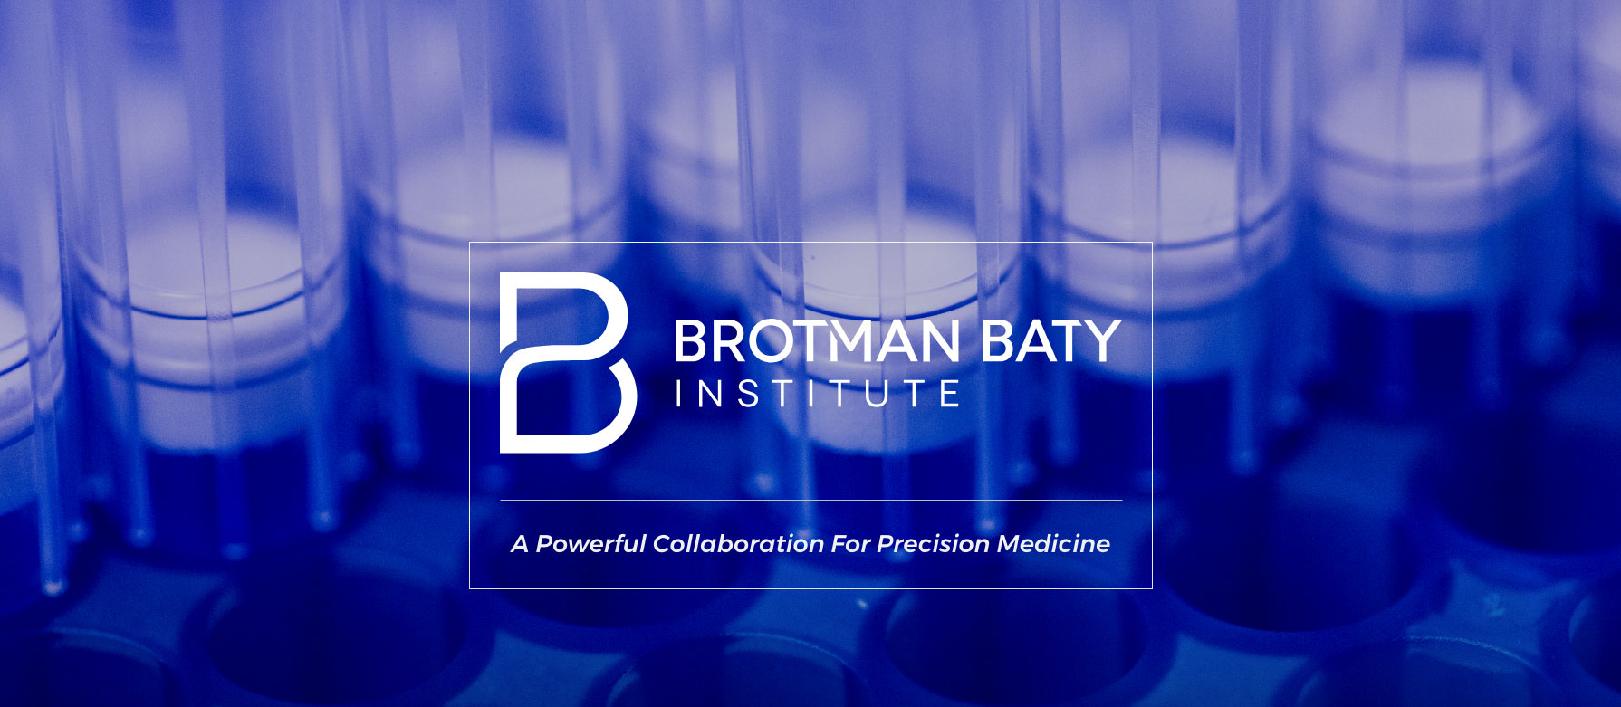
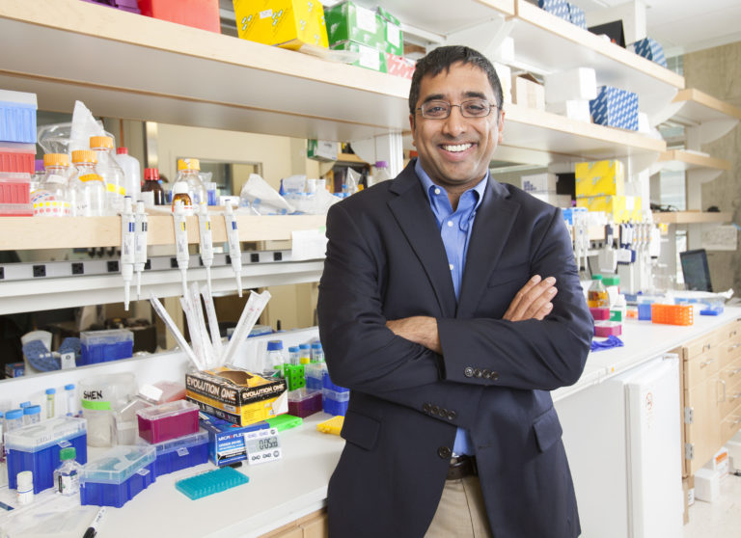
Brotman Baty Institute for Precision Medicine Launched
Jay Shendure, M.D., Ph.D.
Document 16
Notes:
In other developments involving Council members, a new institute – called the Brotman Baty Institute for Precision Medicine – has been launched in Seattle. The University of Washington, the Fred Hutchinson Cancer Research Center, and Seattle Children’s Hospital will collaborate to discover personalized treatments based on patients' genetic and molecular profiles. Jeffrey and Susan Brotman and Pam and Dan Baty have made a $50 million gift to create the institute, and, importantly, * Council member, Jay Shendure, will direct it.

Slide 28





2017 ASHG Awards
Kári Stefánsson, M.D.
Arthur Beaudet, M.D.
John Mulvihill, M.D.
Daniel MacArthur,
Ph.D.
Document 17
Notes:
The American Society of Human Genetics gave awards to four members of the genomics community at its 2017 annual meeting.
* Kári Stefánsson was given the William Allan Award, which recognizes a scientist for substantial and far-reaching scientific contributions to human genetics.
* Arthur Beaudet received the Victor A. McKusick Leadership Award, which recognizes individuals who have fostered and enriched the development of human genetics and its assimilation into the broader context of science, medicine, and health.
* John Mulvihill (a Senior Consultant in the NHGRI Division of Genomic Medicine) was presented the Mentorship Award, which recognizes ASHG members who have significant records of accomplishment as mentors.
* Daniel MacArthur received the Early-Career Award for his contributions to genetics and genomics in the first ten years of his career as an independent investigator.

Slide 29

National Academy of Sciences Award in Molecular Biology
Document 18
Notes:
Howard Chang is the recipient of the 2018 National Academy of Sciences Award in Molecular Biology. The award has a rich history, including serving as a precursor to 14 Nobel Prizes. The award cites Dr. Chang’s contributions to genome sciences and new technologies that were made possible by the NHGRI Centers of Excellence in Genomic Sciences (or CEGS) program.

Slide 30

Elected to National Academy of Medicine
Cori Bargmann
Howard Chang
Mark Daly
Josh Denny
Karen DeSalvo
Evan Eichler
Christine Grady
Chanita Hughes-Halbert
George Koob
Document 19
Notes:
The National Academy of Medicine recently announced the election of new members. Of particular relevance to the genomics community and to NHGRI are the individuals listed here. We extend our heartfelt congratulations to these individuals, especially Council member Chanita Hughes-Halbert.

Slide 31

Elected to AAAS
Susan Dutcher
Joshua Gordon
Gail Jarvik
Hongzhe Li
Mona Miller
Bhramar Mukherjee
Griffin Rodgers
Michelle Southard-Smith
Monte Westerfield
Document 20
Notes:
Similarly, an impressive group of genetics and genomics researchers as well as NHGRI friends were recently elected to be Fellows of the American Association for the Advancement of Science (or AAAS), with their names listed here. Congratulations to these colleagues as well.

Slide 32


New Vice President for
Genomic Research at AbbVie
Howard Jacob, Ph.D.
Document 21
Notes:
And meanwhile, former Council member Howard Jacob has left HudsonAlpha to join AbbVie, a pharmaceutical research and development company, as the Vice President for Genomic Research. Along with some broad responsibilities, Dr. Jacob will work towards developing a rare disease program at AbbVie.

Slide 33

2017 Science Breakthrough of the Year Runners Up
Pinpoint Gene Editing
Cancer Drug’s Broad Swipe
Gene Therapy Triumph
Document 22
Notes:
Moving on to year-end accolades, three genomics-related efforts were named Runners Up for Science’s Breakthrough of the Year: “pinpoint gene editing,” “a cancer drug’s broad swipe,” and “gene therapy triumph.” It was hard to compete with the winner – the merger of two neutron stars.

Slide 34

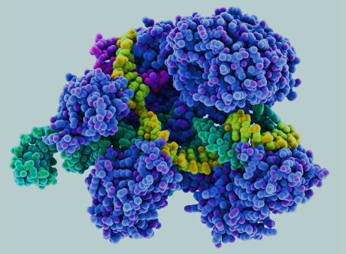
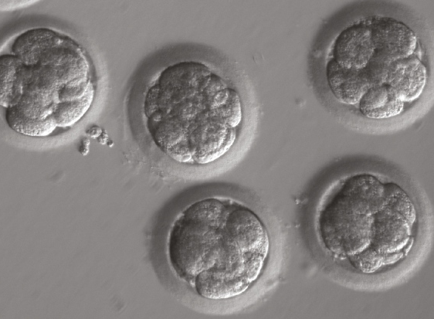
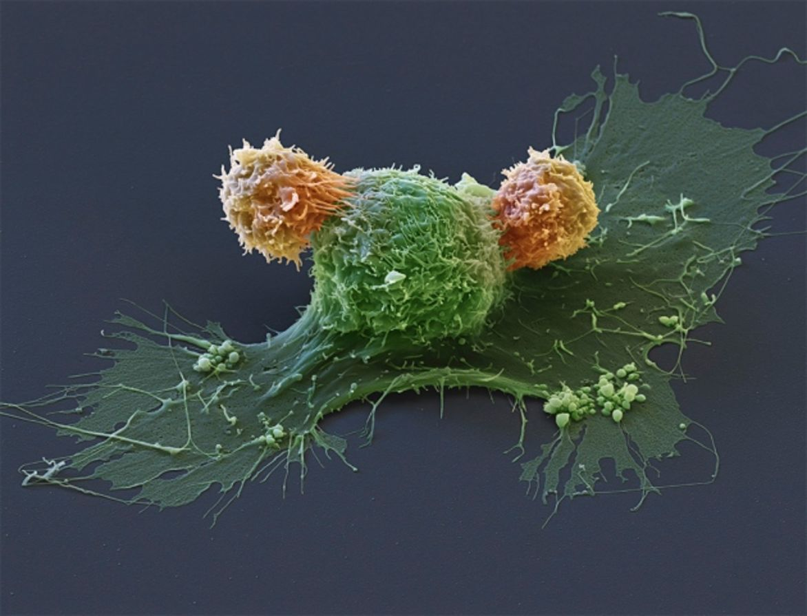
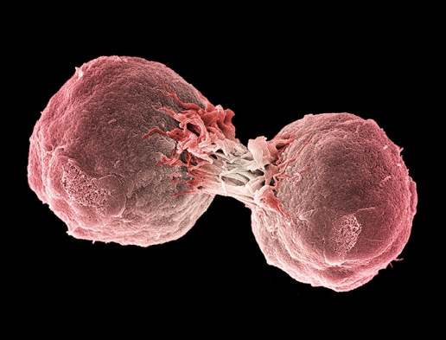
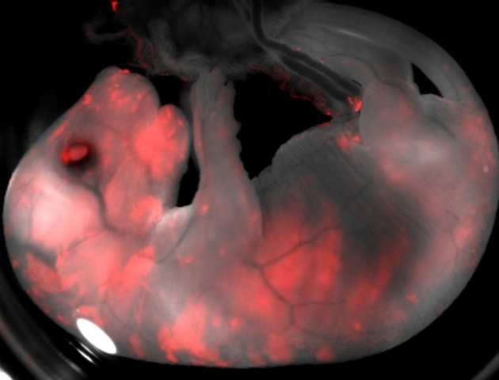
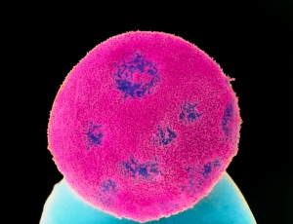
2017 Nature Science Events that Shaped the Year
Genetics Bonanza
Document 23
Notes:
Meanwhile, Nature’s list of Science Events that Shaped the Year honors other genomic breakthroughs, collectively calling them a “genetics bonanza.”

Slide 35
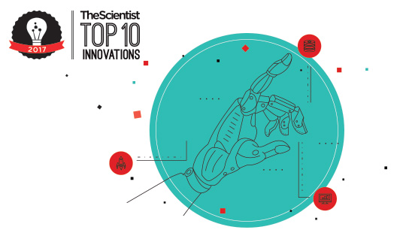
The Scientist’s Top Ten Innovations 2017
Dharmacon | Edit-R crRNA Library—Human Genome
10x Genomics | Chromium
Thermo Fisher Scientific | Invitrogen TrueCut Cas9 Protein v2
Document 24
Notes:
When The Scientist came out with its Top Ten Innovations of 2017, genomic technologies once again appeared on the list. Three genomic innovations were included, as listed here. Each of these three innovations involves some aspect of genome sequencing or genome editing.

Slide 36





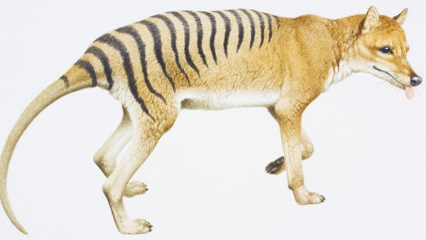



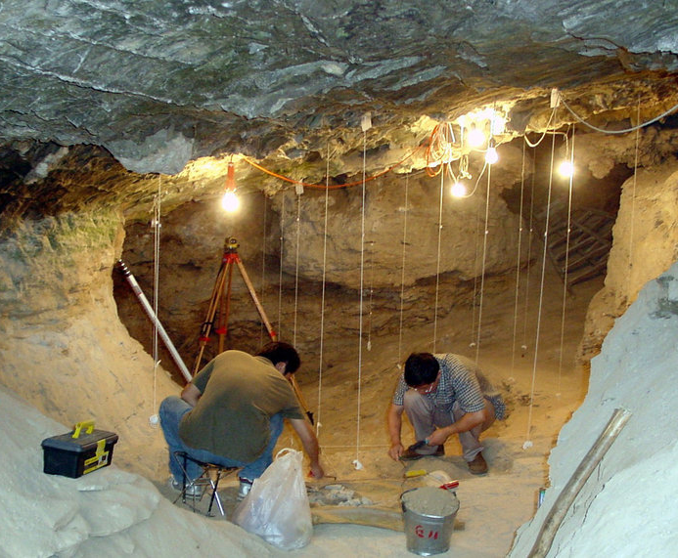

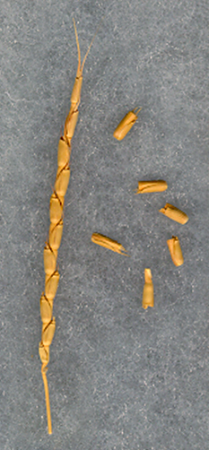

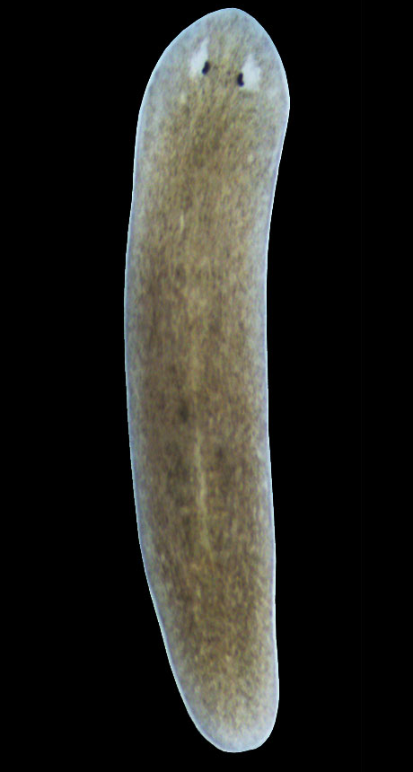
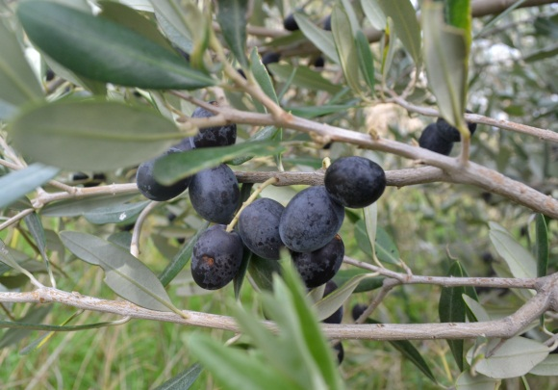


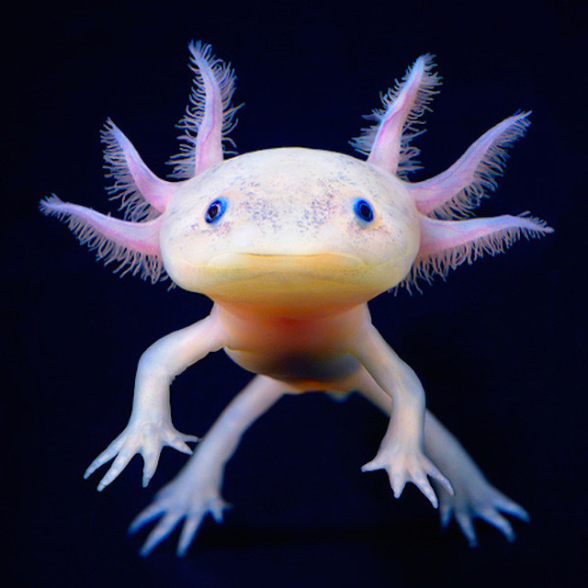

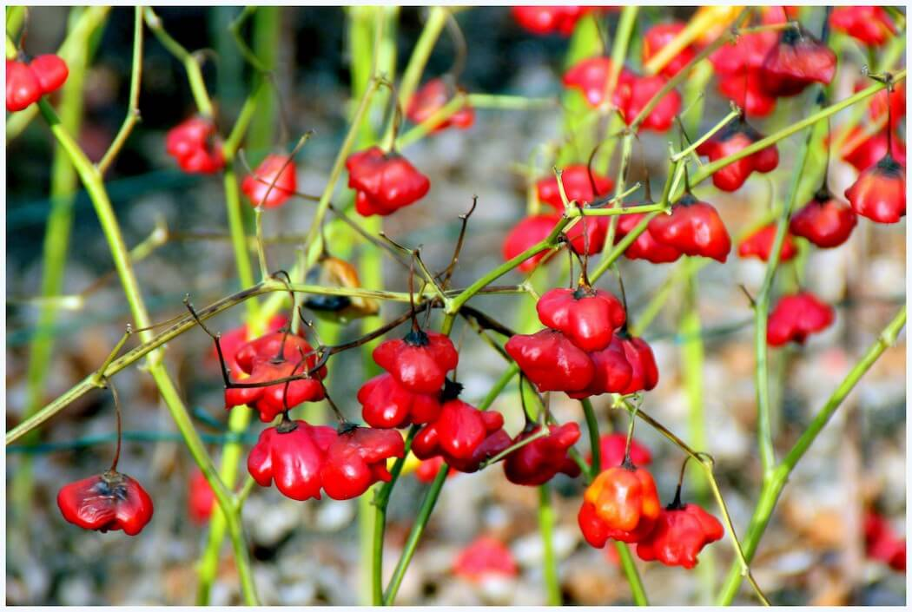
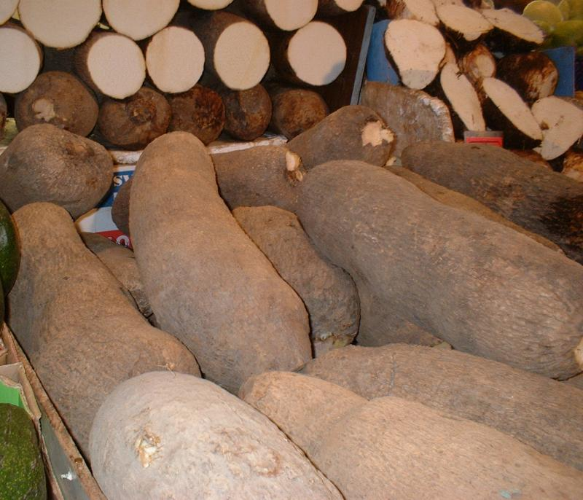

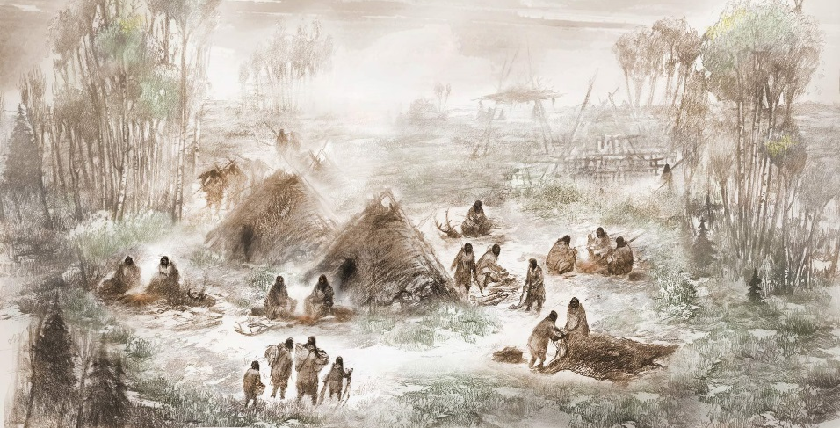

Genomes In The News…
Document 25
Notes:
In terms of ‘Genomes in the News’ – there have been a number of recently generated genome sequences reported since the last Council meeting, including: * Orchid, * Firefly, * Wheat, * White Guinea Yam, * Ginseng, * Durian, * Wild Olive, * Sea Cucumber, * 40,000 Year-Old Man from Tianyuan Cave, China, * Placid Killer Bees from Puerto Rico, * Reindeer, * Wheat Progenitor, * Two Hot Peppers, * Tasmanian Tiger, * Beluga Whale, * Ancient Alaskan, * Sooty Mangabey, * Dingo, * Cannabis, * Mexican Axolotl, and * a Planarian Flatworm.

Slide 37
Director’s Report Outline
General NHGRI Updates
General NIH Updates
General Genomics Updates
NHGRI Extramural Research Program
NIH Common Fund/Trans-NIH
NHGRI Division of Policy, Communications, and Education
NHGRI Intramural Research Program

Slide 38









      Genome Sequencing Program
CMG
CCDG
Analysis Center
Coordinating Center
Document 26
Notes:
The Genome Sequence Program (or GSP) is composed of a coordinating Center, four analysis Centers, four Centers for Common Disease Genomics, and four Centers for Mendelian Genomics, as shown here on the map. The GSP received budgetary support from other organizations besides NHGRI, specifically the National Heart, Lung, and Blood Institute, the National Institute on Aging, the National Eye Institute, and the Simons Foundation.

Slide 39




      Genome Sequencing Program
    51,000 whole genomes and 38,000 whole exomes
    Freeze 1 data (20,000 WGS) delivered to the consortium
    Collaboration with NHLBI’s TOPMed Program on joint data calls and analyses
    GSP-TOPMed joint analysis workshop at Vanderbilt
Document 26
Notes:
The * Centers for Common Disease Genomics are using large-scale genome sequencing to discover genomic variants underlying common diseases, to learn about disease architectures and study designs, and to identify rare risk and protective genomic variants.
* The Genome Sequencing Program Analysis Centers undertake novel, investigator-initiated computational analyses of the data produced by the data-generating Centers. They also intend to develop improved and novel analysis methods and study designs across the entire Program.
* The Centers for Common Disease Genomics have sequenced almost 51,000 whole genomes and 38,000 whole exomes.
* The first freeze of this data, which includes 20,000 whole-genome sequences, was delivered to the Program’s consortium in November 2017.
* The Genome Sequencing Program is collaborating with NHLBI’s Trans-omics for Precision Medicine (or TopMed) Program to perform joint data calls, with the eventual goal of large-scale joint data analyses.
* As a follow-up to the Program’s partnership with TOPMed, representatives from each program convened for a day and half joint analysis workshop at Vanderbilt last month.

Slide 40

      Genome Sequencing Program
    >2,600 conservative or suggestive genes implicated
    Public list of phenotypes and genes
    65 presentations at 2017 ASHG Meeting
    >400 publications co-authored with researchers and patient families
    Data are included in driver projects for GA4GH
Document 26
Notes:
The Centers for Mendelian Genomics program is halfway through its current funding cycle. These Centers aim to use genome sequencing and analysis to discover the genomic basis underlying as many Mendelian diseases as possible. In doing so, they will accelerate gene discovery by disseminating methods and results within the consortium and broader research community.
* These Centers have implicated >2,600 disease genes using conservative and suggestive criteria. Many of the suggestive genes potentially represent novel discoveries. * The CMGs post on their website a public list of studied phenotypes and genes, with links to OMIM and PubMed IDs.
* These Centers were associated with 65 presentations at the 2017 American Society of Human Genetics meeting. * To date, there are >400 publications that involve co-authorships with Center researchers and patient families. These publications detail disease gene discoveries, method and tool development, disease diagnosis, group collaborations, and future perspectives.
The Centers regularly contribute data to Matchmaker Exchange and the Monarch Initiative. * Data from these platforms are being used as part of driver projects for the Global Alliance for Genomics and Health (or GA4GH), which aims to drive the uptake of standards and frameworks for genomic data sharing within research and healthcare communities.

Slide 41

Technology Development Program
  Advanced Genomic Technology
  Development Meeting
  Grantee Meeting: May 30-31, 2018
  Public Meeting: June 1, 2018
Document 27
Notes:
NHGRI’s Technology Development Program continues to move forward, paving the way to develop new and improve existing technologies to enable genomic discoveries and facilitate adoption of genomics in medicine.
* An Advanced Genomic Technology Development Meeting will be held again this year in May at Northeastern University. Novel nucleic acid sequencing and genomic-technology grantees from the program will meet over several days to facilitate communication, collaboration, and interaction. An adjacent public meeting on June 1 will allow for broader community participation and interaction with NHGRI staff.

Slide 42

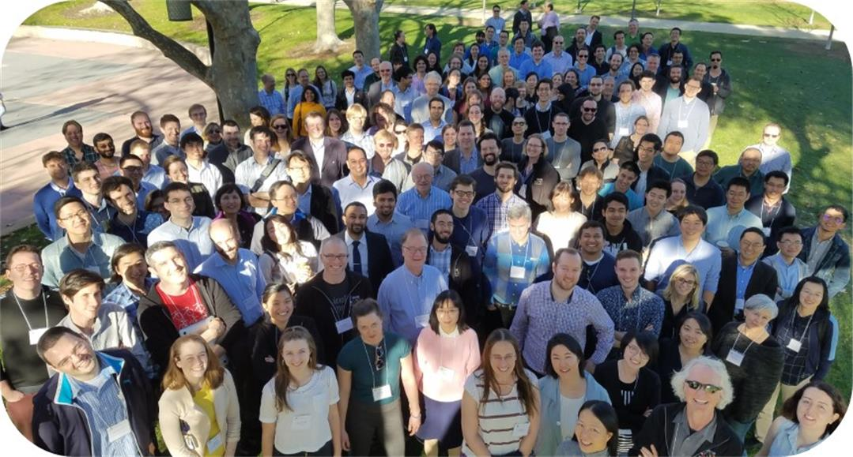
ENCyclopedia Of DNA Elements (ENCODE)
February 2018 in Palo Alto, California
Document 28
Notes:
The goal of the Encyclopedia of DNA Elements (or ENCODE) project is to create catalogs of all functional elements in the human and mouse genomes, and to make those catalogs available as a resource to the biomedical research community.
The ENCODE Consortium held its annual meeting last week in Palo Alto, California. This was the first time the ENCODE 4 Mapping, Computational Analysis, Data Analysis, Data Coordination, and new Functional Characterization Centers came together. The meeting served as a platform for the Consortium to present its accomplishments from this past year, discuss ongoing research, and lay out goals for the Consortium moving forward.
ENCODE data continue to be heavily used by the research community as evidenced by the approximate 2,00 publications to date from researchers outside of the Consortium that use ENCODE data and associated resources. Of these, more than 500 focused on human diseases, attesting to the translational value of the ENCODE resource.

Slide 43
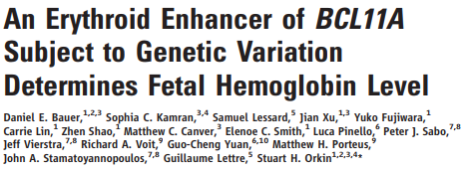
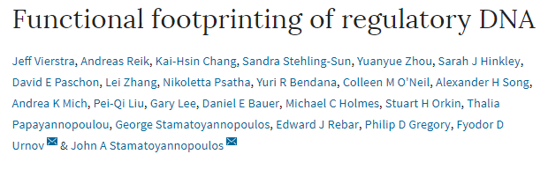
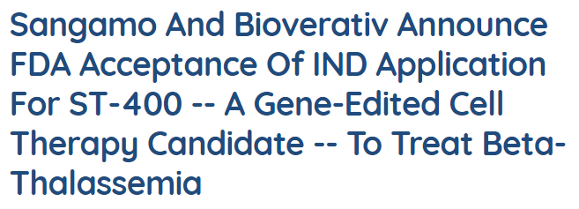
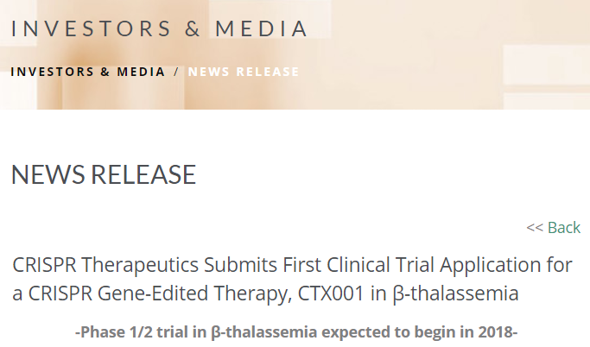
ENCyclopedia Of DNA Elements (ENCODE)
ENCODE Enabling Gene Therapy Clinical Trials
Document 28
Notes:
Shown here is an example of how ENCODE data are being used to help direct gene therapy targets. Gene therapy clinical trials for beta thalassemia and sickle cell disease are now on the horizon, including efforts to target an erythroid enhancer identified, in part, using ENCODE data. This enhancer selectively regulates the expression of BCL11A, a gene encoding a transcription factor that is responsible for down-regulating the expression of fetal hemoglobin in erythroid cells. It is hoped that by disrupting the expression of BCL11A, fetal hemoglobin expression will not be down regulated. Individuals who are genetically predisposed to having elevated levels of fetal hemoglobin as adults have less severe forms of beta thalassemia and sickle cell disease.
* In October 2017, Sangamo Therapeutics and Bioverativ announced FDA’s acceptance of an Investigational New Drug (or IND) application for a gene therapy method designed to delete the erythroid enhancer to treat beta thalassemia, with the plan to then begin enrolling patients this year.
* Similarly, in December 2017, CRISPR Therapeutics in collaboration with Vertex Pharmaceuticals announced submission of a Clinical Trial Application for genome editing that targets the BCL11A erythroid enhancer to treat beta thalassemia. These approaches, which are the first to target a non-coding regulatory region, represent one of several emerging avenues of pursuit for gene therapy to treat these hemoglobinopathies.

Slide 44
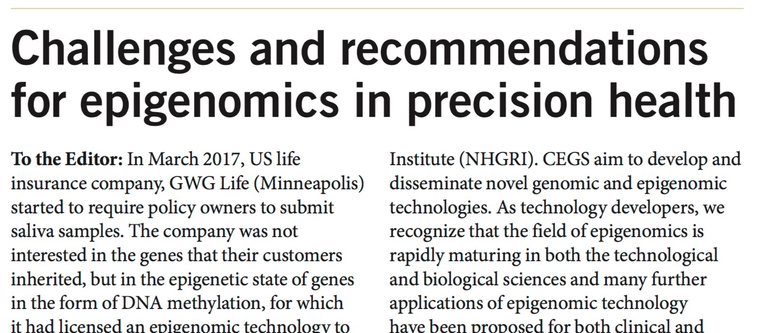
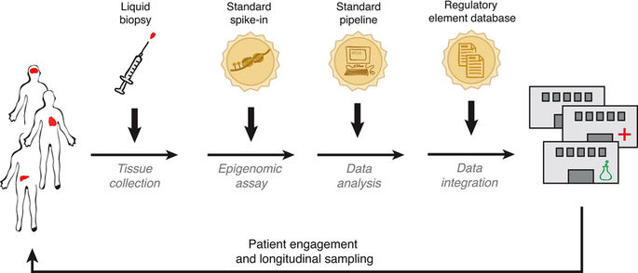
Centers of Excellence in Genomic
Science (CEGS) Program
Document 29
Notes:
The Centers of Excellence in Genomic Science (or CEGS) program supports interdisciplinary research teams to develop highly innovative approaches in genomics research. We expect to announce a new CEGS award in Spring 2018.
As an example of the types of collaborative discussions that can come out of this Program, several CEGS PIs met to discuss the needs in the area of epigenomics and precision health.
* From that meeting, these PIs published their recommendations about standard reagents, analysis pipelines, and naming of functional elements, and about studying how well-accessible tissues (such as blood and saliva) can provide information about inaccessible tissues. These are important issues that apply to all functional data types.

Slide 45
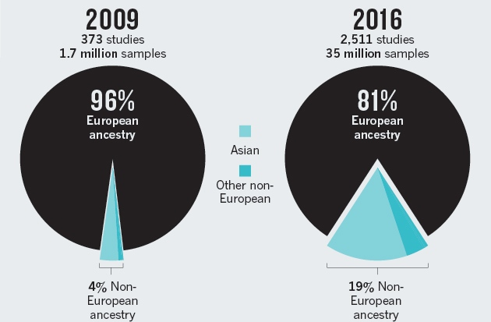
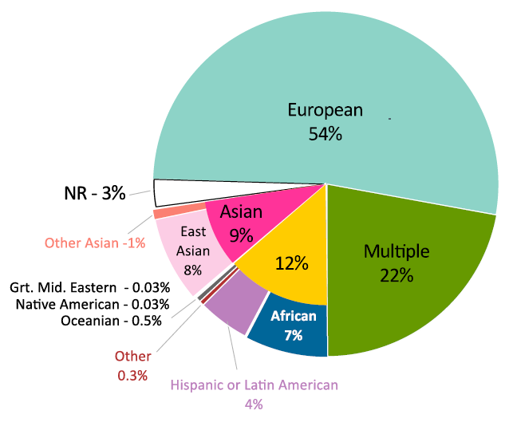
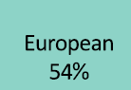
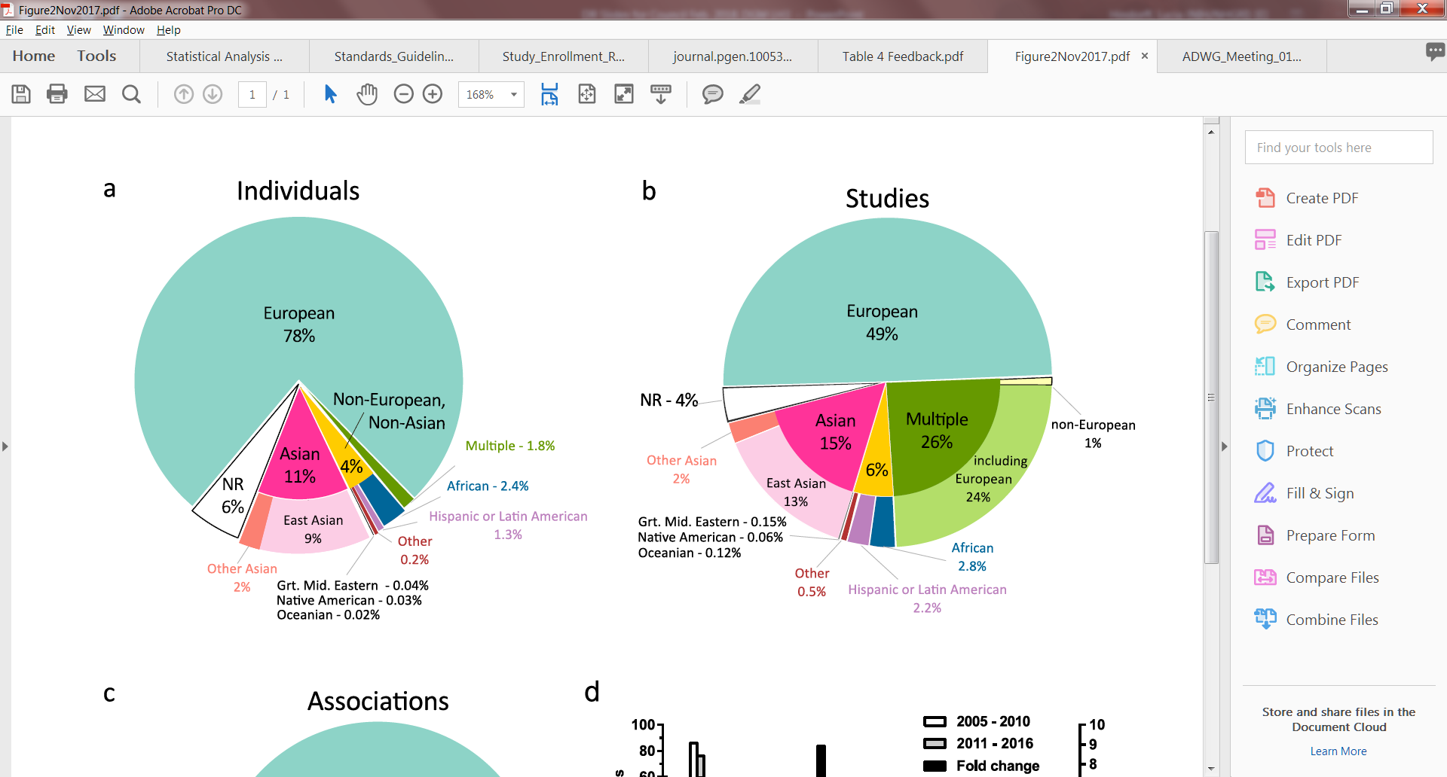
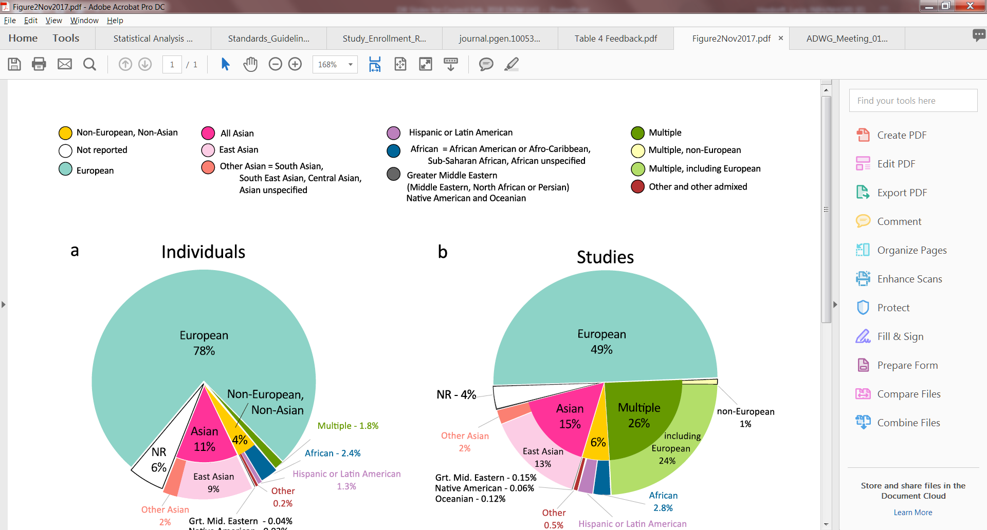

Ancestry in the GWAS Catalog
Individuals
Legend
Associations
Non-European, Non-Asian
Not reported
European
Not reported – 3%
All Asian
East Asian
Other Asian
Hispanic or Latin American
Mid. Eastern – 0.03%
Native American – 0.03%
Oceanian – 0.5%
Not reported
6%
African
Middle Eastern
Mid. Eastern – 0.04%
Native American – 0.03%
Oceanian – 0.02%
Multiple
Multiple, non-European
Non-European
22%
Multiple, including European
Non-European
46%
Other and other admixed
    Bias toward European participants remains (78%)
    Non-European populations contribute disproportionately more associations
Document 30
Notes:
The NHGRI-EBI Genome-Wide Association Studies (or GWAS) Catalog is an online resource providing curated results from GWAS papers and user-provided summary statistics. Last September, a commentary by Popejoy and Fullerton based on GWAS Catalog data observed a marked bias toward European ancestry populations in published GWAS findings.
* In a more recent and detailed analysis in press at Genome Biology, the GWAS Catalog team expanded upon this initial observation. A bias toward European ancestry participants remains, with 78% participants of European ancestry, compared to 22% across different non-European ancestry categories.
* However, non-European populations contribute disproportionately (46%) more associations than expected given the distribution of participants. For example, African ancestry contributes 2.4% of participants but 7% of the associations. Similarly, Hispanic/Latin American ancestry contributes 1.3% of participants but 4% of the associations. This underscores the scientific value of including diverse ancestry participants in GWAS, which will likely continue to identify new associations.

Slide 46






PhenX Toolkit: Chinese Translations
Dr. Jim Zhang, Shanghai Jiao Tong University
294 protocols from 21 PhenX research domains
Document 31
Notes:
The PhenX Toolkit is a growing online resource of standard measures for capturing data on common diseases, phenotypic traits, and environmental exposures. It continues to add more features, including new translations of existing measures.
* Dr. Jim Zhang has now published Chinese translations of 294 protocols from 21 PhenX research domains. These translations are now freely available on the PhenX Toolkit website. * Shown here is the translation of Measure #010600 for recording a participant’s self-reported race. * In addition to the question and response categories, background information about the protocol has also been translated, * including the definition and purpose of the * selected PhenX measure.

Slide 47


eMERGE and Beyond: The Future of EHR and Genomics Workshop
Develop better phenotyping methods and technologies
Build pipelines to automatically interpret/reinterpret genomic variants and to integrate data into EMRs
Promote shareable electronic clinical decision support
Generate evidence for genomic medicine
Document 32
Notes:
The Electronic Medical Records and Genomics (eMERGE) network conducts genomic discovery and clinical implementation research by leveraging data from large biorepositories linked to electronic medical records. In October, NHGRI hosted a program review workshop entitled “eMERGE and Beyond: The Future of EHR and Genomics” – as eMERGE Phase III will end June 2019. This workshop was attended by external experts in key areas of genomic medicine, including some NHGRI Council members, who also served as planning group members, presenters, discussants, and moderators. The workshop reviewed the current goals and accomplishments of eMERGE as well as suggested future directions for a possible continuation of eMERGE.
There were several major recommendations coming out of the meeting. These include * developing better phenotyping methods and technologies, and also incorporating machine-learning methods; * building pipelines to automatically interpret/reinterpret genomic variants and to integrate genomic data into EMRs; * promoting shareable electronic clinical decision support by enhancing existing knowledge repositories; and * generating evidence for genomic medicine through communicating directly to patients, through family sharing, health literacy, and automated technologies.
You will hear more about this workshop later in the Open Session in a presentation by Council member Sharon Plon.

Slide 48

Examined the Institutional Review Board (IRB) process at 9 academic institutions
Information can help investigators more effectively engage with IRBs
Document 32
Notes:
In addition, last month, the eMERGE investigators published a article entitled, “Ethical Considerations Related to Return of Results from Genomic Medicine Projects: The eMERGE Network (Phase III) Experience”.
* The article examined the Institutional Review Board (or IRB) process at 9 academic institutions for proposed electronic health record-based genomic medicine studies, and identified common questions and concerns related to studies that involve the return of results from genome sequencing. The most common concerns raised by the various IRBs were related to participant understanding of the study results, and the best way to mitigate these concerns is to provide robust participant support, such as establishing mechanisms to answer questions regarding any portion of the research during consent and providing easily understandable interpretations of testing results. It was also found that communicating with IRB staff prior to and during protocol review appeared to be beneficial for clarifying study considerations and may reduce the time to approval.
* The information published in this article can now help investigators more effectively engage with IRBs for genomic medicine implementation research.

Slide 49








Clinical Genome Resource
Phase 2
Multi-PI Teams
    J. Berg, K. Goddard, M. Watson, & M. Williams
    C. Bustamante & S. Plon
    H. Rehm, D. Ledbetter, & C. Martin
Goals
    Accelerate curation and expand to new disease areas
    Develop quantitative approaches to enhance the ACMG sequence variant interpretation guidelines
    Define consent and disclosure recommendations
Document 33
Notes:
The Clinical Genome Resource (or ClinGen) defines and disseminates the clinical relevance of genomic variants for use in precision medicine and research. We are pleased to announce that in Fall 2017, ClinGen was renewed for an additional four years.
* The three multi-PI teams listed here will continue to work to accelerate curation activities and expand to new disease areas, including pediatric neurology, hematology, and skin diseases.
* Furthermore, they will develop quantitative approaches to enhance the use of the ACMG sequence variant interpretation guidelines among many new activities aimed at improving their suite of tools to facilitate gene and variant curation.
* Additionally, with co-funding from the NHGRI ELSI Research Program, ClinGen will continue work to define consent and disclosure recommendations for gene-disease pairs. These recommendations will help non-genetics clinicians identify when to refer patients to genetic counselors or medical geneticists.

Slide 50


Clinical Genome Resource
Collaborations
Hematology Curation
  Myeloid Malignancies
  Genetic Platelet Disorders
Child Health Curation
  Brain Malformations
  Mitochondrial Disorders
  Maturity Onset Diabetes of the Young
Document 33
Notes:
We are also pleased to announce new collaborations with the American Society of Hematology and the Eunice Kennedy Shriver National Institute of Child Health and Human Development. Both of these organizations have provided funding to assemble expert ClinGen curation panels in their respective disease areas.
* The American Society of Hematology panels will focus on myeloid malignancies and genetic platelet disorders, while the * National Institute of Child Health and Human Development panels will target brain malformations, mitochondrial disorders, and maturity onset diabetes of the young. Each of these expert panels will use ClinGen tools and curation frameworks to evaluate the clinical relevance of genes and variants, and then share their results through ClinGen and ClinVar.

Slide 51



Clinical Sequencing Evidence- Generating Research Program
CSER Working Groups
Clinical Utility, Health Economics, & Policy
ELSI & Diversity
Education & Return of Results
Survey Measures & Outcomes
Patient, Community, & Clinical Stakeholder Engagement
Sequence Analysis & Diagnostic Yield
CSER PIs & NIH Staff at the September 2017 Meeting
Document 34
Notes:
The Clinical Sequencing Evidence-Generating Research (or CSER) Program aims to generate evidence related to the clinical utility of genome sequencing, with a major emphasis on recruiting ancestrally diverse and medically underserved populations.
* Work from Phase I of CSER was prominently featured at the American Society of Human Genetics (or ASHG) Meeting this past October. In total, there were 14 CSER-related posters and presentations, including a session on the psychological and health behavior research outcomes of translational genomics featuring 3 CSER investigators.
* The second phase of CSER held its kickoff meeting in September 2017 and, more recently, a second meeting in January 2018, with topics ranging from harmonization of CSER-wide measures to stakeholder engagement. CSER also heard from guest speaker Dara Richardson-Heron, the Chief Engagement Officer of the All of Us Research Program.
* CSER investigators have established six working groups to collaborate across multiple program areas, with the names of those working groups provided here.

Slide 52


Newborn Sequencing In Genomic medicine and public HealTh (NSIGHT)
Time ( October 2, 2017)
Document 35
Notes:
The Newborn Sequencing in Genomic Medicine and Public Health (or NSIGHT) program explores, in a limited but deliberate manner, the implications, challenges, and opportunities associated with the possible use of genomic sequence information for the care of newborns.
Recently, the work of the Kingsmore group was featured in Time magazine. The article, entitled “Genetic Testing is Providing New Hope for Babies Born with Mysterious Ailments,” describes how the NSIGHT study at Rady Children’s Institute for Genomic Medicine is using genome sequencing to provide diagnoses and suggest changes in treatment for critically ill infants in the neonatal intensive care unit. For Sebastiana, * shown here, genome sequencing led to a change in the drug used for treatment, reducing the occurrence of her seizures.

Slide 53

Computational Genomics and
Data Science Program
NHGRI Meeting of the AGR and MODs Spring 2018
  Assess the progress of the AGR
  Discuss future directions of the AGR and MODs
External Scientific Panel
Mark Johnston (U. Colorado)
Owen White (U. Maryland)
Valerie Reinke (Yale U.)
Hugo Bellen (BCM)
Jim Ostell (NLM)
Bill Pavan (NHGRI)
Document 36
Notes:
The NHGRI Computational Genomics and Data Science Program supports research and development of data science methods, resources, and tools that facilitate the use of genomic data for biomedical research. The program supports widely used genomic informatics platforms and data resources.
The Alliance of Genome Resources (or AGR) is a consortium of six model organism databases and the Gene Ontology Consortium, and was established in September 2016 with supplemental funding from NHGRI and the NIH Common Fund through September 2019.
* NHGRI will host a one-day meeting of the AGR and the Model Organism Databases (or MODs) in Spring 2018. The goals of the upcoming meeting include assessing the progress of the AGR and discussing future directions and organization of the AGR and its MOD members.
* An external scientific panel was established by NHGRI for this meeting, and consists of Council member Mark Johnston, as well as the individuals listed here. In addition to the external scientific panel, the meeting will be attended by AGR PIs and key personnel, as well as NHGRI and NIH staff.

Slide 54

4th iDASH Genomic Privacy Challenge
    October 2017
    Challenge tasks: (1) de-duplicating patient identifiers, (2) secure GWAS, (3) machine learning with genotype & phenotype data
    Industry partners: Microsoft Research & Intel
    Wang et al. paper in Genomic Medicine (2017): “A community effort to protect genomic data sharing, collaboration and outsourcing"
Document 37
Notes:
The iDASH Genomic Privacy Challenge was held in October 2017 in coordination with the Global Alliance for Genomics and Health (or GA4GH) plenary meeting, where data sharing and analysis while preserving privacy was also a major topic. Now in its fourth year, the iDASH Genomic Privacy Challenge brings together leaders in biomedical informatics, computer science, and cryptography to test cutting-edge solutions for working with and sharing sensitive data while preserving privacy.
* This year the challenge tasks included (1) de-duplicating patient identifiers across sites, (2) secure GWAS, and (3) privacy-preserving machine learning with genotype and phenotype data to predict disease.
* Industry partners, such as Microsoft Research and Intel, are leading efforts to advance the underlying privacy technologies that are used in the challenge, such as homomorphic encryption and software guard extension chips.
* The results from last year’s competition were published in Genomic Medicine in a paper by Wang et al.

Slide 55

Small Business Grants
Small Business | Phase I Proof of Principle | Phase II Pre-Commercialization
Innovation Research (SBIR) | 19 | 13
Technology Transfer (STTR) | 5 | 1
Document 38
Notes:
NHGRI provides $14 million dollars in small business grants annually. Our current Small Business Innovation Research (or SBIR) and Small Business Technology Transfer (or STTR) portfolio included 24 Phase I proof of principle and 14 Phase II pre-commercialization awards in 2017. New Phase II awards are supporting work on HiC-based phasing of human genome sequences at Arima Genomics, single-cell genomics at Mission Bio, gene expression analysis at Biospyder Technologies, and adaptive PCR instrumentation at Bioventures. These small business grants are drawn from an increasingly strong pool of applications.

Slide 56
Director’s Report Outline
General NHGRI Updates
General NIH Updates
General Genomics Updates
NHGRI Extramural Research Program
NIH Common Fund/Trans-NIH
NHGRI Division of Policy, Communications, and Education
NHGRI Intramural Research Program

Slide 57

Human Microbiome Project
  2007-2017, $215M
  Community Resource Effort
  Open Session Presentation
Document 39
Notes:
In 2007, the NIH Common Fund initiated a 10-year, $215M initiative – The Human Microbiome Project (or HMP). This Project was conceived of as a community resource effort to develop research resources for the emerging field of microbiome research.
The HMP developed and provided rapid access to a suite of resources, including multi-omic reference datasets, computational tools, and analytical pipelines for analyzing and interpreting microbiome data, and clinical and Institutional Review Board protocols for sampling microbiomes and for conducting microbiome research with human cohorts.
As this program is coming to an end, * Lita Proctor, the NHGRI program director who has ably managed this program, will make a presentation about the program’s goals and its accomplishments later in the Open Session of this Council meeting.

Slide 58


Knockout Mouse Phenotyping Project (KOMP2)
    KOMP-CMG Joint Meeting at ASHG 2017
    Articles in Nature Communications
      “A large scale hearing loss screen reveals an extensive unexplored genetic landscape for auditory dysfunction”
      “Identification of genetic elements in metabolism by high-throughput mouse phenotyping”
Document 40
Notes:
The Knockout Mouse Phenotyping Project (or KOMP2) will create and phenotype 3,000 strains of knockout mice using CRISPR technology between 2016 and 2020. The project is on track to meet its Spring 2018 goals. This program is part of the larger International Mouse Phenotyping Consortium (or IMPC).
* Last October at the ASHG Meeting, NIH staff convened a joint meeting between investigators involved in the KOMP2 program and the Centers for Mendelian Genomics. The purpose of the meeting was to build a partnership to improve gene discovery and to enable functional characterization of new Mendelian disease genes. Following the successful meeting, a KOMP-CMG working group was established to organize further collaborative efforts.
* Also in October, the IMPC published a paper in * Nature Communications demonstrating a large, unexplored genetic landscape involved in auditory function. By phenotyping 3,006 knockout strains for auditory function, investigators identified 52 genes not previously associated with hearing loss.
* Then in January, the IMPC published another paper in Nature Communications describing an analysis of metabolic phenotypic data from 2,016 knockout mouse strains. That study identified 23 genes with new strong metabolic phenotypes that also have links to human metabolic disorders.

Slide 59

Knockout Mouse Phenotyping Project (KOMP2)
    >1,400 publications using KOMP2 resources from 2004-2017
    KOMP SELENBP1-knockout mouse used to confirm genetic variation that causes extra-oral halitosis
Document 40
Notes:
The resources produced by the KOMP2/IMPC program have strong community uptake, as the number of publications using KOMP2 resources has increased to greater than 1,400 as of last month.
* As an example, a recent Nature Genetics article identified mutations in the gene SELENBP1 that were present in patients with extra-oral halitosis. The researchers used the KOMP Selenbp1-knockout mice created to show that the biochemical characteristics in mice were similar to those in humans. * This genetic link to bad breath got several mentions in the popular press, including a feature in the self-proclaimed America’s Finest News Source: The Onion.

Slide 60


Genotype-Tissue Expression (GTEx)
Document 41
Notes:
The Genotype-Tissue Expression (or GTEx) Project aims to create a public atlas of human gene expression and its regulation across multiple tissue types and to aid in the functional interpretation of genetic associations with disease.
* Several manuscripts have been published in high-profile journals using the Version 6 (or ‘midway’ dataset). Nature featured and summarized the manuscripts published in October 2017; this collection features more than 10 papers, including News & Commentary, Research Articles, and Methods publications.

Slide 61





Genotype-Tissue Expression (GTEx)
Document 41
Notes:
Several Methods papers were also published in the * November issues of Genome Research and * Nature highlighting ways to predict the causal tissues for complex traits and diseases * and how to predict causal variants affecting expression using whole-genome sequence data and * RNA-seq data from multiple human tissues. * The marker paper for the enhancing GTEx (or eGTEx) project was also published, which described the efforts in bridging the gaps between genotype, gene expression, and disease.
Other recent papers published in Nature include * the dynamic landscape and regulation of RNA editing in mammals, * a comprehensive analysis of the genetic effects on gene expression, * the impact of rare and * structural variation on gene expression and * the landscape of X-chromosome inactivation across multiple human tissues.

Slide 62


Human Heredity and Health in Africa (H3Africa)
  10th Annual Meeting of the African Society of Human Genetics in November 2017 (Egypt)
  11th Consortium Meeting in March 2018 (Uganda)
Document 42
Notes:
The central goal of the Human Heredity and Health in Africa (or H3Africa) Consortium is to develop a sustainable and collaborative African genetics and genomics research enterprise. * This past November, the 10th African Society of Human Genetics Meeting was held in Egypt in partnership with H3Africa and the Egyptian National Society of Human Genetics. The presenters included both current and former H3Africa investigators.
* Additionally, we are pleased to announce that the H3Africa Consortium has reached 163 total publications as of December 2017.
* H3Africa will host its 11th Consortium meeting in Uganda this coming March. This will be the first Consortium meeting for Stage II of the program, and we are looking forward to welcoming both new and returning grantees into the next five years of the H3Africa program.

Slide 63
Human Heredity and Health in Africa (H3Africa)
  Stage II Awards (Fall 2017)
Funded Initiative | Funding ICs | Participating African Countries
Coordinating Center | Common Fund, FIC, NCI, NEI, NHGRI, NICHD, NIDCD, NIDDK, NIEHS, NHLBI, NIMH, NINDS, OAR, ORWH | South Africa, Morocco, Zimbabwe, Botswana, Egypt, Nigeria, Sudan, Senegal, Tunisia, Ghana, Malawi, United Republic of Tanzania, Uganda, Mauritius, Mali, Kenya, Cameroon, Swaziland, Gambia, Sierra Leone, Rwanda, Democratic Republic of the Congo
Bioinformatics Network
Bioinformatics Training Program
Collaborative Centers
Research Projects
ELSI Collaborative Center
ELSI Projects
Document 42
Notes:
For Stage II of H3Africa, new and renewing awards were made in Fall 2017. Augmenting the NIH Common Fund, 14 Institutes and Centers provided additional funds for awards given to institutions in 22 African countries. The Stage II NIH awards include:
* A coordinating center to provide administrative support; a bioinformatics network and four bioinformatics training programs that will implement a informatics infrastructure across the H3Africa Consortium; seven collaborative centers and eight research projects that will explore the link between genetics and disease (such as sickle cell, glaucoma, HIV, and others); an ELSI collaborative center that will build an evidence base to inform the development of policies relating to the return of individual genomic research results; and one new ELSI project, in addition to two ongoing ELSI projects, that will investigate other ethical issues relevant to genomics research in Africa.
The NIH Common Fund will also continue to support three biorepository projects, which are not listed on this slide; these will be located in Nigeria, South Africa, and Uganda, and will collect, process, store, and distribute H3Africa biospecimens on a regional and international scale. Also, additional awards for H3Africa were just made last week by our funding partners, the Alliance for Accelerating Excellence in Science in Africa and the Wellcome Trust.

Slide 64




Undiagnosed Diseases Network (UDN)
UDN Applications and Acceptances
1918
588
824
329
167
Follow us on social media for real-time research updates.
udnconnect and @UDNconnect
Document 43
Notes:
The NIH Common Fund’s Undiagnosed Diseases Network (or UDN) aims to improve the level of diagnosis and care for patients with undiagnosed diseases, facilitate research into the etiology of these diseases, and create an integrated and collaborative research community to identify and share improved options for optimal patient management.
To date, the UDN has received over 1,900 applications, accepted 824 participants for evaluation at the seven UDN Clinical Sites across the country; working together as a network, these sites made 167 diagnoses. * To apply to the network, access the UDN Gateway by clicking on the “Apply” button, which appears on all the UDN webpages. You can also find real-time research updates by following the network on social media at udnconnect.

Slide 65

Human BioMolecular Atlas Program (HuBMAP)
    New Common Fund Program
    RFA-RM-17-025: Transformative Technology Development
    RFA-RM-17-027: Tissue Mapping Centers
    COMING SOON – HuBMAP Integration, Visualization and Engagement (or HIVE)
Document 44
Notes:
The Human BioMolecular Atlas Program (or HuBMAP) is a new NIH Common Fund program starting this year. Its vision is to catalyze development of an open, global framework for comprehensively mapping the human body at a cellular resolution, and its premise is that better insights into the principles governing organization-function relationships will potentially lead to better understanding of the significance of inter-individual variability, changes across the lifespan, tissue engineering, and the emergence of disease at the biomolecular level.
Two Request for Applications (or RFAs) have been released for this new program: * the transformative technology RFA and * the tissue mapping centers RFA. Applications are due March 2.
* An announcement should come out soon for the HuBMAP Integration, Visualization, and Engagement (or HIVE), which will manage data generated by the Consortium, coordinate Consortium activities, develop novel tools, and build an atlas of tissue maps.

Slide 66
Somatic Cell Genome Editing
    Develop quality tools to perform effective and safe genome editing in human patients
    Program elements: delivery systems, novel editors, improved assays for safety and efficacy, and a dissemination center
    Funding announcements published in January 2018
Document 45
Notes:
There is yet another new Common Fund program being launched soon on the topic of “Somatic Cell Genome Editing,” which aims to * develop quality tools to perform effective and safe genome editing in human patients.
* The program elements will include improved delivery systems, novel genome editors, and in vitro and in vivo assay platforms for testing safety and efficacy. The information and materials will constitute a ‘genome editing toolkit’ that will be distributed through a dissemination center.
* The funding announcements for this new program were published in January 2018.

Slide 67



NIH Data Commons Pilot Phase
Data Commons Pilot Phase OT Awardees
Stanley Ahalt, RENCI | Isaac Kohane, Harvard
Titus Brown, UC Davis | Avi Ma’ayan, Mt. Sinai
Merce Crosas, Harvard | Lucila Ohno-Machado, UCSD
Brandi Davis-Dusenbery, SevenBridges | Benedict Paten, UCSC; Robert Grossman, UChicago; Anthony Philippakis, Broad Institute
Ian Foster, UChicago | Owen White, UMD
Datasets:
TOPMed
    Pilot Phase Kickoff Meeting: December 2017
    Establishment of an NIH cloud ‘marketplace’
Document 46
Notes:
The NIH Data Commons is a cloud-based platform for storing, sharing, accessing, and computing on FAIR (or Findable, Accessible, Interoperable, and Reusable) biomedical research data. The Pilot Phase for the NIH Data Commons started at the end of September 2017. * Ten awards were made to support the establishment of an NIH Data Commons Pilot Phase Consortium.
* The NIH Data Commons will initially be populated with datasets from the Common Fund Genotype-Tissue Expression (or GTEx) project, the NHLBI-funded Trans-Omics for Precision Medicine (or TOPMed) program, and the NHGRI-funded Alliance for Genome Resources (or AGR).
* The kickoff meeting of the Consortium’s pilot phase took place this past December, after which awardees worked collaboratively to develop a project plan for the first stage of the Pilot Phase, which is expected to start this month. * As part of the Pilot Phase, a cloud ‘marketplace’ will be established to facilitate the procurement of cloud resources by NIH Institutes and Centers.

Slide 68



    Expanded beta testing
    14 new community partners
    NLM partnership for public libraries
Feedback Due
February 23!
Document 47
Notes:
The All of Us Research Program aims to gather data from one million or more people living in the United States to accelerate research and improve health. By taking into account individual differences in lifestyle, environment, and biology, researchers will uncover paths toward delivering precision medicine.
All of Us has undertaken a number of activities to prepare for a national launch, including conducting expanded beta testing of consents, surveys, physical measurements, and biospecimen collection. Over 15,000 participants have enrolled in the program to date. Funding is now being provided to 14 additional national community partners to help raise awareness of the program and inform the best ways to engage and retain diverse communities, and All of Us is now partnering with the National Library of Medicine to support engagement efforts by public libraries across the United States.
* All of Us is also reaching out to researchers, community organizations, and citizen scientists for input on research questions that could uniquely be addressed by the program. This information will help identify how to better support research across a range of health topics. * The deadline for this effort has recently been extended to February 23.

Slide 69

  Genomics Working Group Report
  Considerations:
    Genome-wide genotyping
    Exome sequencing
    Whole-genome sequencing
  Potential pilot of 50,000 participants
Document 47
Notes:
Of particular interest to this Council, the Genomics Working Group of the All of Us Advisory Panel recently released a report on considerations toward a comprehensive genomics strategy for the program. As I mentioned to you in September, this Working Group was co-chaired by Debbie Nickerson and former Council member Lon Cardon. I was a member of this group, along with current Council members Jay Shendure and Wendy Chung.
* The report details considerations about the relative benefits of genome-wide genotyping, exome sequencing, and whole-genome sequencing for the program. * The Working Group suggested a phased approach, starting with a pilot study of approximately 50,000 participants to assess the process and methods in preparation for a genomics plan that can scale to at least one million participants.
The All of Us staff and awardees are assimilating this input, while considering additional aspects, such as return of genomic information and genetic counseling needs. The program expects to outline a comprehensive genomics plan before its national launch in Spring 2018.

Slide 70
Director’s Report Outline
General NHGRI Updates
General NIH Updates
General Genomics Updates
NHGRI Extramural Research Program
NIH Common Fund/Trans-NIH
NHGRI Division of Policy, Communications, and Education
NHGRI Intramural Research Program

Slide 71


2017 ASHG Meeting Policy Luncheon:
FDA Oversight of Genomics Research
    Discussed FDA’s Investigational Device Exemption (IDE) regulation for genomics studies
Document 48
Notes:
At the 2017 American Society of Human Genetics Meeting, NHGRI participated in the first annual policy luncheon. The topic of this luncheon was to learn about the Food and Drug Administration’s (or FDA’s) Investigational Device Exemption (or IDE) regulation. The IDE regulation requires additional oversight for some clinical genomics studies that are considered to pose a ‘significant risk’ to participants. Since many in the genomics community have not yet encountered the IDE process, NHGRI and several of our grantees have been working with the FDA to clarify aspects of this regulation in the genomics research context.
At the luncheon, our policy Branch Chief Cristina Kapustij joined a panel that included FDAs Kate Donigan (a former ASHG/NHGRI policy fellow) and Jonathan Berg (an NHGRI grantee) to explain when the IDE regulation applies and what steps are necessary to comply. The luncheon sold out, and attendees asked questions about how aspects of a study (such as return of results and use of biobanked samples) could affect the applicability of the IDE. A summary of the luncheon, the associated slides, and additional resources can be found on ASHG’s website or on genome.gov.

Slide 72

Genomic Literacy, Education, and Engagement (GLEE) Initiative
Engaging Stakeholders to Promote Genomic Literacy
Notes:
At the May 2017 Council meeting, I described the outcomes of the Genomic Literacy, Education, and Engagement Initiative (or GLEE) Strategic Visioning Meeting hosted last March by NHGRI and the Foundation for the National Institutes of Health.
Since that meeting, the Education and Community Involvement Branch and the Genomic Healthcare Branch have continued working with the K-16, Community and Public, and Healthcare Provider Working Groups; they have also engaged new partners at various national meetings throughout 2017.
* Last June, we hosted a session at the NIH SciEd Conference, convening education researchers, teachers, and resource developers to discuss the design of a K-16 educational framework for genomic literacy. * At the October American Society of Human Genetics Meeting, NHGRI hosted a pre-meeting session with 30 participants from the original Strategic Visioning Meeting to discuss the outcomes of that meeting, the current activities, and future plans for each of the three target audience groups. * Finally, in November, we worked with the National Association of Biology Teachers (or NABT) to host a session on evaluating and promoting genomics education resources for teachers. Fifteen educators from high schools and 2- and 4-year colleges as well as other education organizations developed an evaluation tool for resources that will be promoted through the NABT website and communications channels.

Slide 73

National DNA Day
‘15 for 15’ Celebration
    15 topics shared each day via social/digital media
    Partner engagement
    NHGRI-hosted events
Document 49
Notes:
April 25th is National DNA Day, an annual time when we and many of our stakeholders come together to encourage students, teachers, and the public to learn more about genetics and genomics. The day commemorates the completion of the Human Genome Project in April 2003 and the reporting of DNA's double-helical structure in 1953.
To commemorate the 15th anniversary of DNA Day and inspired by the energy and creativity of the 2017 GLEE Strategic Visioning Meeting, NHGRI and its partners will launch a public awareness campaign that we are calling the ’15 for 15’ Celebration. This effort will be centered around 15 core topics that illustrate the advances made in genomics since the end of the Human Genome Project and the importance of genomics in people’s lives. The messages associated with each topic and the associated supporting content are being shaped for the three target audiences identified through the GLEE meeting: K-16 teachers and students, communities and the general public, and healthcare professionals.
The campaign will be leveraged through three major vehicles: * on each of the 15 days leading up to DNA Day, we will be sharing one of the 15 topics via NHGRI’s social and digital media outlets; will are also * engaging partners and asking them to host community events and to participate in the social media campaign; and * we will be hosting public programs. We invite you all to participate in the ‘15 for 15’ Celebration as well as DNA Day. Please visit NHGRI’s DNA Day website for more information.

Slide 74

Genome: Unlocking Life’s Code Exhibition
Travel Schedule
2018
  January 28-April 24
  Rochester Museum and
  Science Centre
  Rochester, NY
June 23-September 15
  Mayo Clinic
  Rochester, MN
Document 50
Notes:
The Genome: Unlocking Life’s Code exhibition returned to the United States following a brief run in Canada and is now in the ‘Rochester’ phase of its tour. Specifically, the exhibition opened last month in Rochester, New York at the Rochester Museum and Science Centre. Then, later this year, it will move on to the Mayo Clinic in Rochester, Minnesota.
Please continue to check the exhibition’s website and follow it on social media for the most up-to-date program information.

Slide 75

Tribal Colleges Consortium on
Genomics Training (TCCGT)
Notes:
For just over a year, NHGRI staff from our Education and Community Involvement Branch have been partnering with two Tribal College faculty members who attended our annual NHGRI Short Course in 2016 on a new initiative called the Tribal Colleges Consortium on Genomics Training (or TCCGT). The focus of TCCGT is to increase coordination between Tribal Colleges, research universities, and federal agencies with regards to genomics education; to inform agencies and universities about the education and research needs of tribal nations; and to increase recruitment and preparation of tribal college students interested in genomics.
In November, TCCGT held a pre-conference workshop at the First Americans Land Grant Consortium meeting. The meeting, which was considered to be the launch of the initiative, brought together about 50 interested Tribal College faculty, staff, and leaders to discuss the major challenges to advancing genomics education at Tribal Colleges, and how collaboration among Tribal Colleges, research institutions, federal agencies, and other organizations could advance genomics education. The meeting generated considerable interest in defining short- and long-term outcomes. Plans for a further roll-out of TCCGT are underway.

Slide 76

Global Genetics and Genomics
Community Case Study
    New case study: Familial Hypercholesterolemia
    ‘Expert Commentary’ provided by Robert Shamburek (NHLBI)
Document 51
Notes:
The Genomic Healthcare Branch has added a new case study on familial hypercholesterolemia to the 16 existing simulated patient case studies found on the Global Genetics and Genomics Community education website (or G3C). G3C users can select questions typically asked by a provider during a patient exam and view videotaped answers from actors. Users are able to compile and analyze patient responses and complete supplemental learning activities. After completion, the user receives a summary of their performance on the case. Faculty supplemental information and classroom discussion recommendations are included, as well as published resources for further study. A videotaped ‘Expert Commentary’ provides answers to a series of questions by a recognized expert in the field, along with recommended next steps.
* Dr. Robert Shamburek from the National Heart, Lung, and Blood Institute (or NHLBI) provided the commentary for this latest case study. I encourage you to take a look at this resource, and share it with your colleagues in provider disciplines.

Slide 77

National Family Health History Day
Document 52
Notes:
Every year around Thanksgiving, NHGRI promotes National Family Health History Day. Last year’s efforts included distribution of our social media toolkit, digital signage throughout the NIH campus, and social media pushes via Facebook, Twitter, and a Thunderclap in collaboration with the Centers for Disease Control and Prevention. Over three million people were reached through these social media efforts.
In advance of National Family Health History Day, My Family Health Portrait (a free tool for inputting family health information supported by NHGRI’s Genomic Healthcare Branch) was updated to include revised disease risk calculator descriptions, a risk and condition table, and guides for users in need of additional support. You can review these changes at the My Family Health Portrait website.

Slide 78

Inter-Society Coordinating Committee for Practitioner Education (ISCC)
7th In-Person Meeting
Document 53
Notes:
The Inter-Society Coordinating Committee for Practitioner Education (or ISCC) aims to improve practitioner genomic literacy and to enhance the practice of genomic medicine through the sharing of educational approaches and joint identification of educational needs. A little over a week ago, the 7th ISCC in-person meeting was held at NIH.
The goals of the meeting were to facilitate discussions regarding new projects and important topics in genomics education, and to share updates on current projects. In addition, Dr. Hannah Valantine (the first NIH Chief Officer for Scientific Workforce Diversity) gave a presentation about approaches to, and positive impacts of, increasing diversity among genomic medicine practitioners. She also discussed unconscious bias among educators and practitioners and how it relates to using genomics in clinical care.

Slide 79
Director’s Report Outline
General NHGRI Updates
General NIH Updates
General Genomics Updates
NHGRI Extramural Research Program
NIH Common Fund/Trans-NIH
NHGRI Division of Policy, Communications, and Education
NHGRI Intramural Research Program

Slide 80


Society for the Indian Academy of Medical Genetics S. S. Agarwal Oration Honor
Les Biesecker, M.D.
Document 54
Notes:
Les Biesecker, Senior Investigator and Chief of the Medical Genomics and Metabolic Genetics Branch in the NHGRI Intramural Research Program, received the SS Agarwal Oration honor at the 4th National Conference of the Society for Indian Academy of Medical Genetics and the Indo-US Symposium on Human Genetic Disorders of Prenatal and Postnatal Growth.
The SS Agarwal Oration was started by the Society for the Indian Academy of Medical Genetics in memory of the late Dr. SS Agarwal, who was one of the pioneers of medical genetics in India. Dr. Biesecker presented a talk entitled “Towards predictive genomic medicine.”

Slide 81


New Editor in Chief, American Journal of
Medical Genetics
Max Muenke, M.D.
Document 55
Notes:
Max Muenke, Senior Investigator and Chief of the Medical Genetics Branch in the NHGRI Intramural Research Program, is the new Editor in Chief of the American Journal of Medical Genetics.

Slide 82







NHGRI Intramural Research Highlights
Multimodal mapping of the brain’s functional connectivity and the adult outcome of attention deficit hyperactivity disorder
Loci associated with skin pigmentation
identified in African populations
Noonan syndrome in diverse populations
Document 56
Notes:
The NHGRI Intramural Research Program has once again been quite productive since the last Council meeting:
* Phillip Shaw and his collaborators published a study of why some people grow out of childhood attention deficit hyperactivity disorder (or ADHD), while others continue to have symptoms into adulthood. They discovered that adults with ADHD persisting from childhood partly lose the usual balance of connections between brain networks that control action and those that control daydreaming or introspecting.
* Bill Pavan and Stacie Loftus were part of an international team of genomics researchers who identified regions of the human genome that are associated with skin color variation in some African populations. The findings open new avenues for research on skin diseases and cancer in all populations.
* Paul Kruszka and collaborators used facial analysis software to diagnose Noonan syndrome in Africans, Asians, and Latin Americans, and updated their Atlas of Human Malformation Syndromes in Diverse Populations.

Slide 83

To receive The Genomics Landscape,
go to list.nih.gov
Search for NHGRILANDSCAPE
Past issues can be accessed at: genome.gov/27541196
Document 57
Notes:
Before ending my Director’s Report, I would like to (as always) put in a plug and say that anyone wishing to receive my monthly email update (called The Genomics Landscape) can simply go to list.nih.gov and then search for “NHGRILANDSCAPE.”

Slide 84


Thanks!
Special Thanks!
Notes:
Finally, a personal thanks to the 50-60 NHGRI staff members who contributed the slides and associated materials that I just reviewed as part of my Director’s Report. As always, such a group effort is essential for getting this large amount of information conveyed efficiently at each Council meeting.
An additional thanks to the NHGRI communications group and web team for making my Director’s Report into an electronic resource.
And * a special thanks to the usual ‘ring leader’ for preparing my Director’s Report each time, Kris Wetterstrand. Kris reports that she did not do anything interesting since last the last Council meeting, so her picture here is just her standard staff photo.

Slide 85

s
Advancing human health
through genomics research

