Slide 1
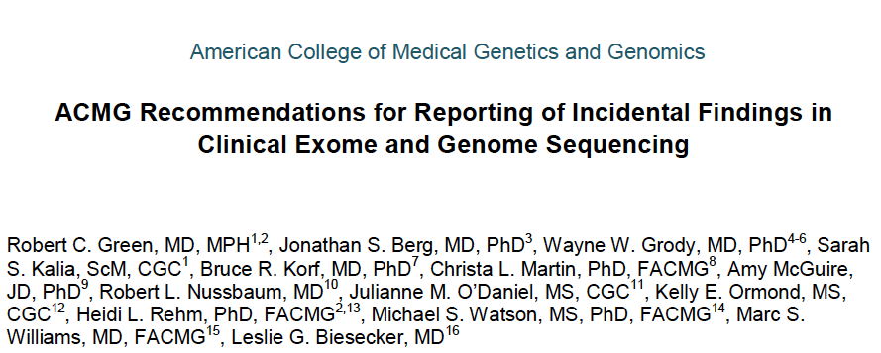

Slide 2
ACMG Recommendation:
All laboratories conducting clinical sequencing should seek and report expected pathogenic mutations for a short list of carefully chosen genes and conditions.
Minimal List
Establishes a precedent for reporting incidental findings
Recommendation, not a requirement

Slide 3
Why did ACMG feel there was a need for guidance?
Lack of consistency and consensus on what to report in the face of growing clinical use of whole exome and genome sequencing for specific indications (unsolved developmental delay, unexplained familial cancer, etc.)

Slide 4
What’s in The ACMG Report
Defines obligations of laboratories to report incidental findings that meet a high threshold of clinical utility (high penetrance, presymptomatic intervention beneficial)
Acknowledges this is a “Work in Progress” and recommends a mechanism for ongoing review/revision

Slide 5
The Report is Not Without Controversy

Slide 6
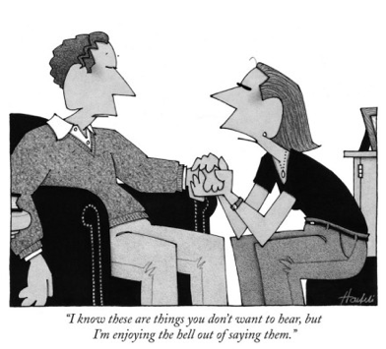
The Report Asks for To Much
Report does NOT say: Patients should be forced to learn information they may not want to know
Report does say: These are recommendations for LABORATORIES, who have little if any relationship with the patient, and NOT for the PHYSICIAN whose professional relationship led to ordering the test.

Slide 7
The Report Contradicts Previous Testing Policies for Children
Report does NOT recommend overriding the autonomy of children deciding whether to be tested when families know the children are at risk for an adult onset disease
Report does weigh (i) the beneficence of alerting families of risk versus (ii) respecting the child’s decision making autonomy when families do not even know they are at risk.

Slide 8
The Report Asks for Too Little
The authors left out:
Pharmacogenetic variants
Carrier state for recessive disorders
Variants of personal utility but with +/- actionability

Slide 9
The Report Was Developed in an Ivory Tower with No Outside Input
Authors spent over a year discussing the issues
Authors reached out to a panel of domain-specific experts
Authors held public fora

Slide 10
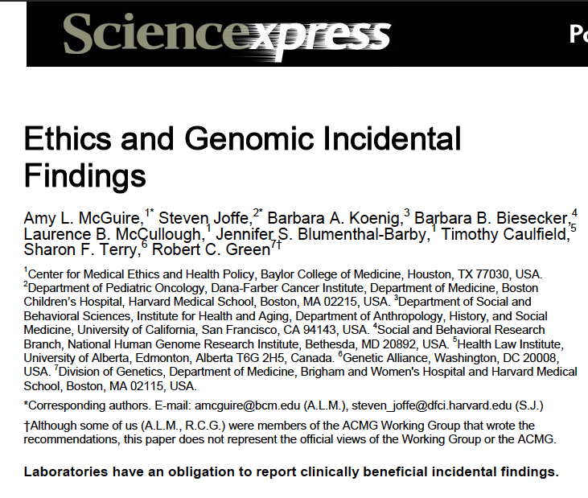
http://www.sciencemag.org/content/early/recent / 16 May 2013 / Page 1/ 10.1126/science.1240156

