Slide 1
Genomics and Society
Working Group: Update and Report
NACHGR
May 20, 2013
Pamela Sankar, PhD
University of Pennsylvania

Slide 2
NHGRI
DIVISION OF INTRAMURAL RESEARCH
DIVISION OF EXTRAMURAL RESEARCH
OFFICE OF THE DIRECTOR
NHGRI RE-ORGANIZATION
Office of Administrative Management
Office of Population Genetics
Office of Policy Communication& Education
NHGRI
Division of Management
Division of Policy, Communication and Education
Division of Intramural Research
Division of Genome Sciences
Division of Genomic Medicine
Division of Genomics and Society
Division of Extramural Operations

Slide 3
From ELSI to Division of
Society and Genomics
ELSI Research Program
Genomics &Society Division
Fosters basic & applied research on the ethical, legal and social implications of genetic & genomic research for individuals, families and communities.
Funds & manages studies, & supports workshops, research consortia and policy conferences related to these topics.
Budget: 5% NHGRI extramural set-aside; FY 2012= $19M
Houses ELSI research program;
Stimulates & enhance genomics & society activities across NHGRI;
Collaborates closely with Division of Communication, Policy & Education to ensure that ELSI research both informs & is informed by ongoing policy activities.
Collaborates with others outside of NHGRI, including other NIH Institutes and Centers, national & international organizations, in order to maintain awareness of society & genomics issues & coordinate with relevant research efforts
5% NHGRI extramural set-aside; FY 2012= $19M

Slide 4
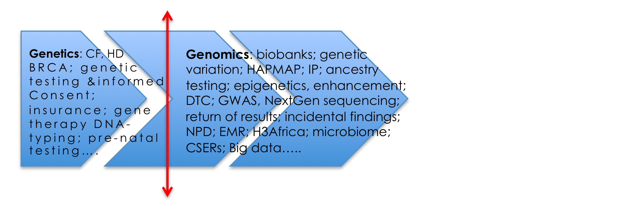
From genetics to genomics

Slide 5
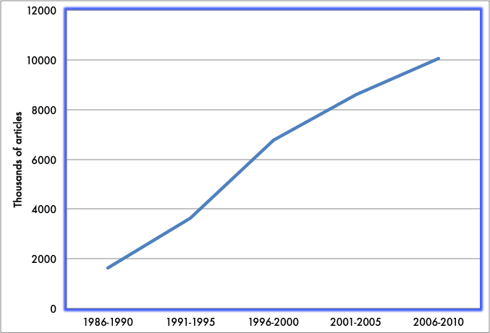
Articles indexed to selected MeSH terms related to ELSI and genetics, 1985 - 2010
SANKAR 2013

Slide 7
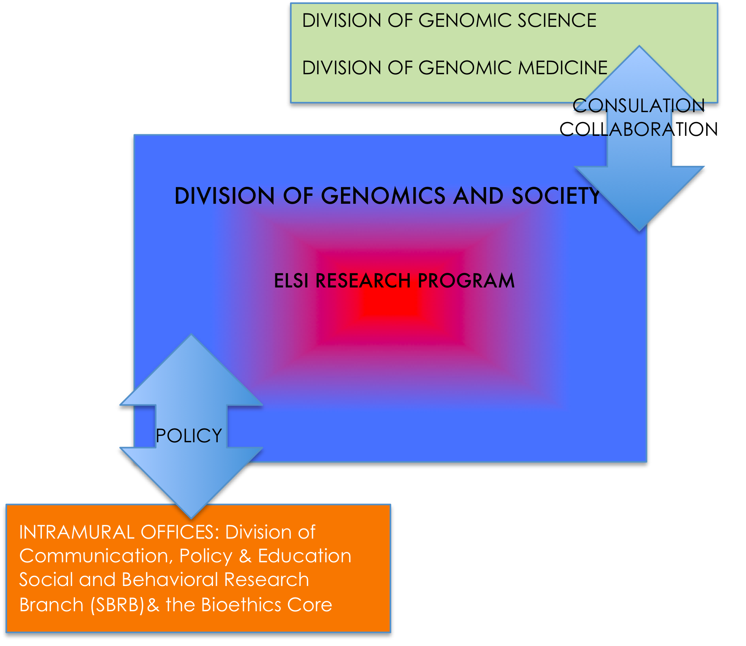
FROM ELSI TO DGSOC

Slide 8
GSWG Mission
Provides input about ELSI Research Program, including input about research priorities, balance between investigator-initiated &program-initiated research, & best use of limited budgetary & staff resources;
Provides input about DGSoc activities in light of changes in genomics, genomic medicine, & policy landscape, aims to identify emerging issues or gaps;
Identifies potential synergies or collaborations among different GS research & policy components of NHGRI;
Identifies areas of potential synergy or collaboration between NHGRI & other NIH Institutes & national &international organizations; and,
Identifies GS issues and activities that are more appropriately addressed by other NIH Institutes or other agencies or organizations.

Slide 9
Working group members
Pamela Sankar* UPenn
Timothy Caulfield University of Alberta
Wendy Chung Columbia
Jeffrey Long University of New Mexico
Gary Marchant Arizona State University
Amy McGuire* Baylor
Lisa Parker University of Pittsburgh
Andrea Patenaude Dana-Farber
David Williams* Harvard University
  *NACHGR MEMBERS

Slide 10
GSWG meeting I
April 19-20, 2013 NHGRI, Rockville, MD
Day I Goals
  Orient members to organizational and background issues
Talks by Mark Guyer, Eric Green, Jean McEwen, & Joy Boyer
  NHGRI re-organization
  Goals and mandate of Division of Genomics and Society
  History, organization, and challenges of ELSI Research Program
  ELSI budget and finances

Slide 11
Discussion Day 2:
Defining ELSI research program priorities
Identify most productive & effective ELSI research funding mechanisms
Identify evolving content of ELSI research; toward what issues is field moving
Improve balance for program staff between research-related & service-oriented activities
Endorse growth of DGSoc to enable some duties to be transferred out of the ELSI Research Program to new personnel.

Slide 12
Discussion Day 2: Integrating ELSI research into genomic research &policy
Different models of integration
  Embedded, independent, service oriented, scholarly
How to assess value of embedded ELSI component
  risk of harm without ELSI component
  novel or important research
  could embedded component help to
    foster relationships and collaborations
    build infrastructure for future ELSI projects
Proposal:
  ELSI program staff can develop a standardized series of questions to ask NHGRI Program Directors to help them identify if there should be an ELSI component in an upcoming RFA.

Slide 13
GSWG Meeting II
November 14-15, 2013, Bethesda/DC area
Presentations by GSWG members:
  Devise strategies for priority-setting within ELSI and DGSoc Assess benefits of various funding mechanisms for integrating ELSI research into genomic research & policy
ELSI training efforts (Joy Boyer)
Update on the Division Director search
Presentations from intramural programs
  Division of Communications, Policy, & Education
  Bioethics Core in Intramural Research Program.

Slide 14
Thanks for GSWG support
To ESLI & NHGRI leadership & staff
  Eric Green
  Mark Guyer
  Jean McEwen
  Joy Boyer
  Nicole Lockhart
  Karen Rothenberg
  Kathie Sun

Slide 15
Questions?

