Slide 1
Interpreting Variation in Human Non-Coding Genomic Regions Using Computational Approaches with Experimental Support
Lisa Brooks, Ph.D., Mike Pazin, Ph.D.
NHGRI Advisory Council
May 20, 2013

Slide 2
Whole-Genome Sequencing
..ATTCGCAATTGTAAGGATA - - - CATGCTGC..
..ACTCAC - ATTCTTAGGGTACATCATGCAGG..
“We do not know how to interpret variation in non-coding regions.”

Slide 3
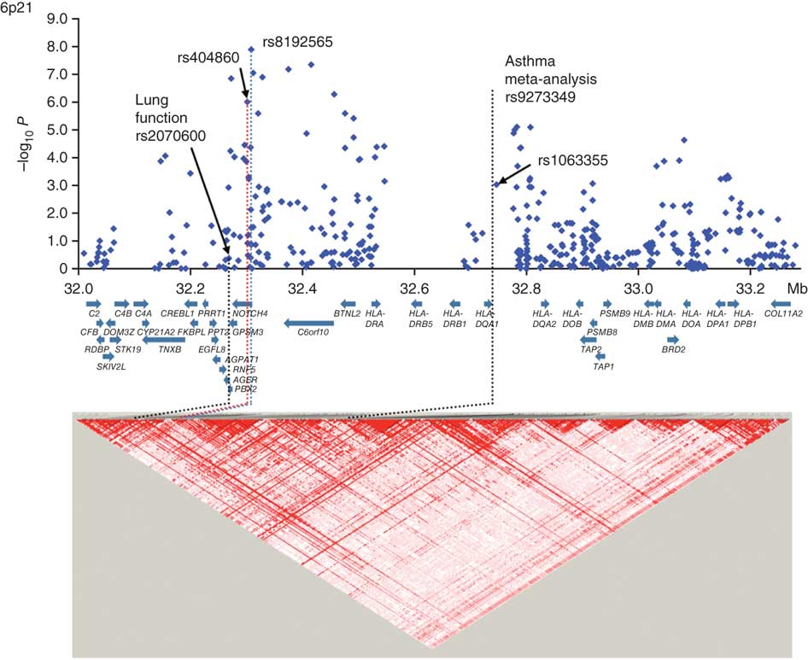
Many Genes and Variants are Associated with a Disease Which are Causal?
Notes:
http://www.nature.com/ng/journal/v43/n9/images/ng.887-F1.jpg

Slide 4
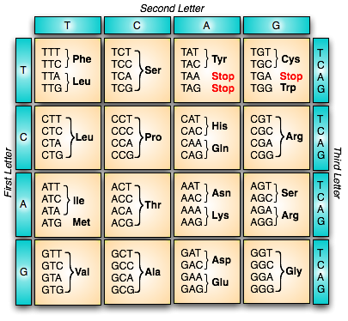
Coding Regions Have the Genetic Code
Variants:
Synonymous
Non-synonymous
Stop
Even this is complex, but a start.

Slide 5
Exon Regions
1.5% of
genome
Looking under the lamppost for your keys

Slide 6
Non-coding DNA Variants are Known to Cause Human Diseases
Prostate cancer
Thyroid carcinoma
Hereditary mixed polyposis syndrome
Thalassemias
Fragile X syndrome
Alzheimer’s disease
Notes:
Genome Res. 2012 Aug;22(8):1437-46. Epub 2012 Jun 4. (ENCODE data used)
Integrative functional genomics identifies an enhancer looping to the SOX9 gene disrupted by the 17q24.3 prostate cancer risk locus.
Zhang X, Cowper-Sal lari R, Bailey SD, Moore JH, Lupien M.
Hum Mutat. 2012 Aug 7. doi: 10.1002/humu.22176. [Epub ahead of print]
Investigation of the relationship between prostate cancer and MSMB and NCOA4 genetic variants and protein expression.
Fitzgerald LM, Zhang X, Kolb S, Kwon EM, Liew YC, Hurtado-Coll A, Knudsen BS, Ostrander EA, Stanford JL.
Proc Natl Acad Sci U S A. 2012 May 29;109(22):8646-51. Epub 2012 May 14.
The polymorphism rs944289 predisposes to papillary thyroid carcinoma through a large intergenic noncoding RNA gene of tumor suppressor type.
Jendrzejewski J, He H, Radomska HS, Li W, Tomsic J, Liyanarachchi S, Davuluri RV, Nagy R, de la Chapelle A.
Nat Genet. 2012 May 6;44(6):699-703. doi: 10.1038/ng.2263.
Hereditary mixed polyposis syndrome is caused by a 40-kb upstream duplication that leads to increased and ectopic expression of the BMP antagonist GREM1.
Jaeger E, Leedham S, Lewis A, Segditsas S, Becker M, Cuadrado PR, Davis H, Kaur K, Heinimann K, Howarth K, East J, Taylor J, Thomas H, Tomlinson I.
Diabetes. 2011 Jan;60(1):336-44. Epub 2010 Sep 28.
Both polymorphic variable number of tandem repeats and autoimmune regulator modulate differential expression of insulin in human thymic epithelial cells.
Hum Mol Genet. 2012 Jan 15;21(2):322-33. Epub 2011 Oct 11.
Long-range DNA looping and gene expression analyses identify DEXI as an autoimmune disease candidate gene.
Hum Mol Genet. 2012 Jun 1;21(11):2412-9. Epub 2012 Feb 17.
Long-range gene control and genetic disease.
Hum Mol Genet. 2012 Jun 1;21(11):2412-9. Epub 2012 Feb 17.
Whole-genome sequencing reveals a coding non-pathogenic variant tagging a non-coding pathogenic hexanucleotide repeat expansion in C9orf72 as cause of amyotrophic lateral sclerosis.
Am J Hum Genet. 2006 Jun;78(6):936-46. Epub 2006 Apr 10.
Promoter mutations that increase amyloid precursor-protein expression are associated with Alzheimer disease.
PLoS One. 2012;7(6):e37858. Epub 2012 Jun 6.
IL-6-174 G/C and -572 C/G polymorphisms and risk of Alzheimer's disease.
Annu Rev Genomics Hum Genet. 2007;8:109-29.
Annu Rev Genomics Hum Genet. 2007;8:109-29.
The pathophysiology of fragile x syndrome.
Loots GG, Kneissel M, Keller H, Baptist M, Chang J, et al. 2005. Genomic deletion of a long-range bone enhancer misregulates sclerostin in Van Buchem disease. Genome Res. 15:928–35

Slide 7
Non-Coding DNA is Important for Therapeutics
Non-coding variants are known to cause differences in drug metabolism
Chemotherapy
Anticoagulants
Mood stabilizers
Blood. 2010 May 6;115(18):3827-34
Pharmacogenomics. 2010 Apr;11(4):547-57
J Neurosci. 2007 Mar 14;27(11):2793-801
Notes:
Pharmacogenomics. 2010 Apr;11(4):547-57.
Functional analysis of the role of the TPMT gene promoter VNTR polymorphism in TPMT gene transcription.
Blood. 2005 Jan 15;105(2):645-9. Epub 2004 Sep 9.
A polymorphism in the VKORC1 gene is associated with an interindividual variability in the dose-anticoagulant effect of warfarin.
Br J Haematol. 2006 Apr;133(2):183-7.
The c.-1639G > A polymorphism of the VKORC1 gene is a major determinant of the response to acenocoumarol in anticoagulated patients.
Blood. 2010 May 6;115(18):3827-34. Epub 2010 Mar 4.
Warfarin pharmacogenetics: a single VKORC1 polymorphism is predictive of dose across 3 racial groups.
J Neurosci. 2007 Mar 14;27(11):2793-801.
Differential regulation of the serotonin transporter gene by lithium is mediated by transcription factors, CCCTC binding protein and Y-box binding protein 1, through the polymorphic intron 2 variable number tandem repeat.

Slide 8
Most GWAS Hits are Not in Exons
88-93% not in exons
NHGRI GWA Catalog
www.genome.gov/GWAStudies

Slide 9
Non-Coding DNA is Important for Disease and Adaptation
About 90% of GWAS findings lie outside of protein-coding regions.
More than 80% of recent adaptation signatures in three recent studies lie outside of protein-coding regions.
Stamatoyannopoulos, Science 337-1190, 2012
Kingsley, Nature 484-55, 2012; Sabeti, Cell 152-703, 2013
Fraser, Genome Research 2013, PMID: 23539138

Slide 10
Non-Coding Regions
Many types of functional elements

Slide 11
Concept for RFA
Interpreting Variation in Human Non-Coding Genomic Regions
Using Computational Approaches with Experimental Support
Looking for highly innovative computational approaches to
combine data sets to identify or narrow the set of potential variants
that affect organismal function
leading to disease risk or other traits.
Notes:
Sequencing has been a major success.
Now we are getting the data.
Bottleneck is now interpretation of the data.

Slide 12
Interpret the Variation
Which variants potentially affect organismal function?
May address how the effect is brought about.
May show the genetic architecture of a disease, including gene-gene and gene-environment interactions.

Slide 13
RFA Applications
Include development of computational approaches to identify which variants potentially affect organismal functional
Include experimental data to support and assess these predictions.
Not include production of functional data
(aside from data to support predictions)
Not include databases or simple aggregation of information

Slide 14
Examples of Data Sets to Use
GWAS, sequence, genotype, phenotype,
ENCODE, expression, methylation, transcription factor binding sites, other functional studies,
patterns of variation, genetic architecture of disease,
gene x gene, gene x environment,
animal models, …

Slide 15
Initiative Focus
Genome-wide interpretation, not particular variants, genes, or regions.
Focus on non-coding variants (OK if some are coding).
May focus on particular classes of variants, such as CNVs, transcription factor binding sites, or CpG islands.
The approaches must generalize beyond the specific datasets and diseases studied.

Slide 16
Narrow the Set of Variants (Example)
--------------------whole genome-------------------
GWAS
region 1 region 2 region 3
Transcription in cell types of disease
variants in region 2 genes
ENCODE and regulation data
small set of variants

Slide 17
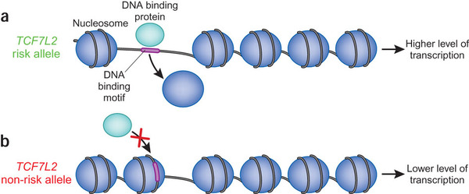
Other Examples
Variation data - genomic regions with selection
Chromatin structure - indels affect regulation
Promoter binding - promoter variants affect transcription factor binding, gene expression
Epigenomic variability - organismal function

Slide 18
Experimental Support
Each study must include experimental data (done by them or others).
Provide support for the computational predictions.
Allow assessment of prediction accuracy.
Range of types - more than plausibility, not necessarily gold-standard validation.
May use model organism data.
Notes:
Sequencing has been a major success.
Now we are getting the data.
Bottleneck is now interpretation of the data.

Slide 19
Related Initiatives
NHGRI: ENCODE tech development - exp
NHGRI: Church CEGS - exp
NIGMS: Function of variants – comp, exp
NHLBI: Functional analyses - exp

Slide 20
Timeline
Concept May 2013
Release RFA Aug 2013
Receipt Jan 2014 Jan 2015
Review June 2014 June 2015
Council Sept 2014 Sept 2015
Funding Jan 2015 Jan 2016
First round Second round

Slide 21
Funding
Each award up to $500,000 direct costs/yr.
Make ~ 5-6 in each round.
Round FY 15 FY 16 FY 17 FY 18 ($M)
First $4.5 $4.5 $4.5
Second $4.5 $4.5 $4.5
Total $4.5 $9 $9 $4.5

Slide 22
Whole-Genome Sequencing
..ATTCGCAATTGTAAGGATA - - - CATGCTGC..
..ACTCAC - ATTCTTAGGGTACATCATGCAGG..
“We can start to interpret variation in non-coding regions.”

