Slide 1

National Advisory Council for Human Genome Research
May 2014
Eric Green, M.D., Ph.D.
Director, NHGRI
DIRECTOR’S REPORT
Notes:
The Open Session of this meeting of the National Advisory Council for Human Genome Research is being webcast live.
And as a reminder, the Open Session of all Council meetings are videotaped and made available as a permanent archive on the internet, including the presentations themselves and the various associated documents.

Slide 2
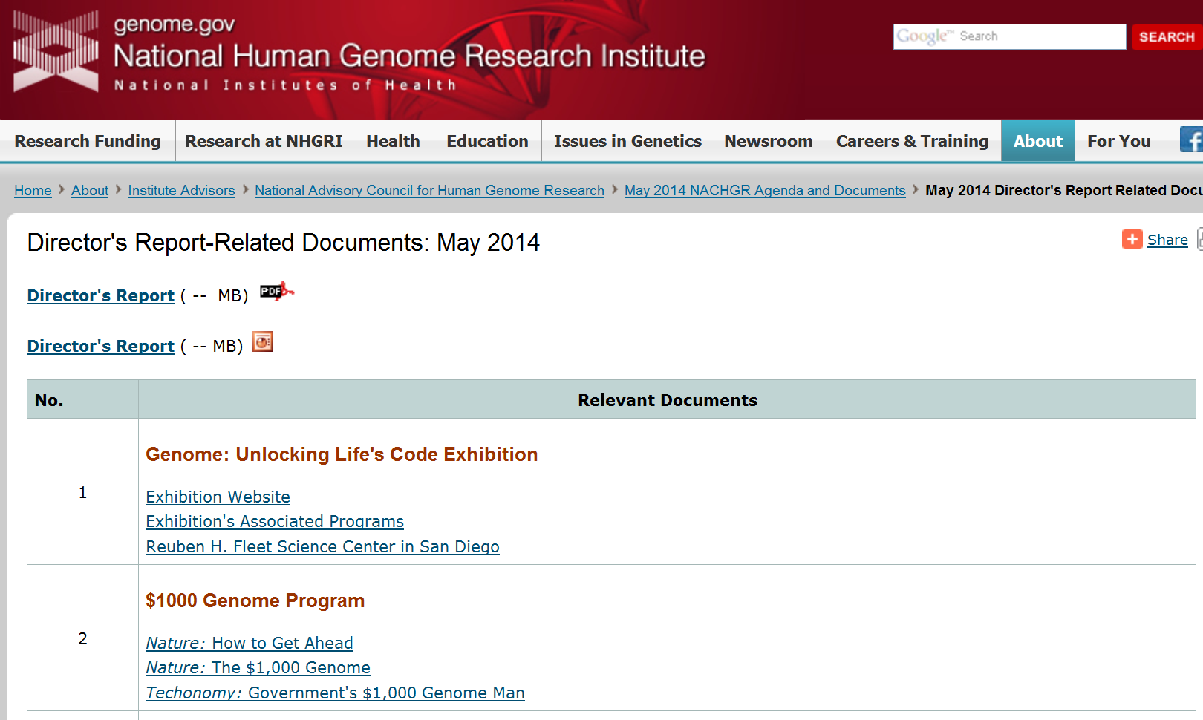
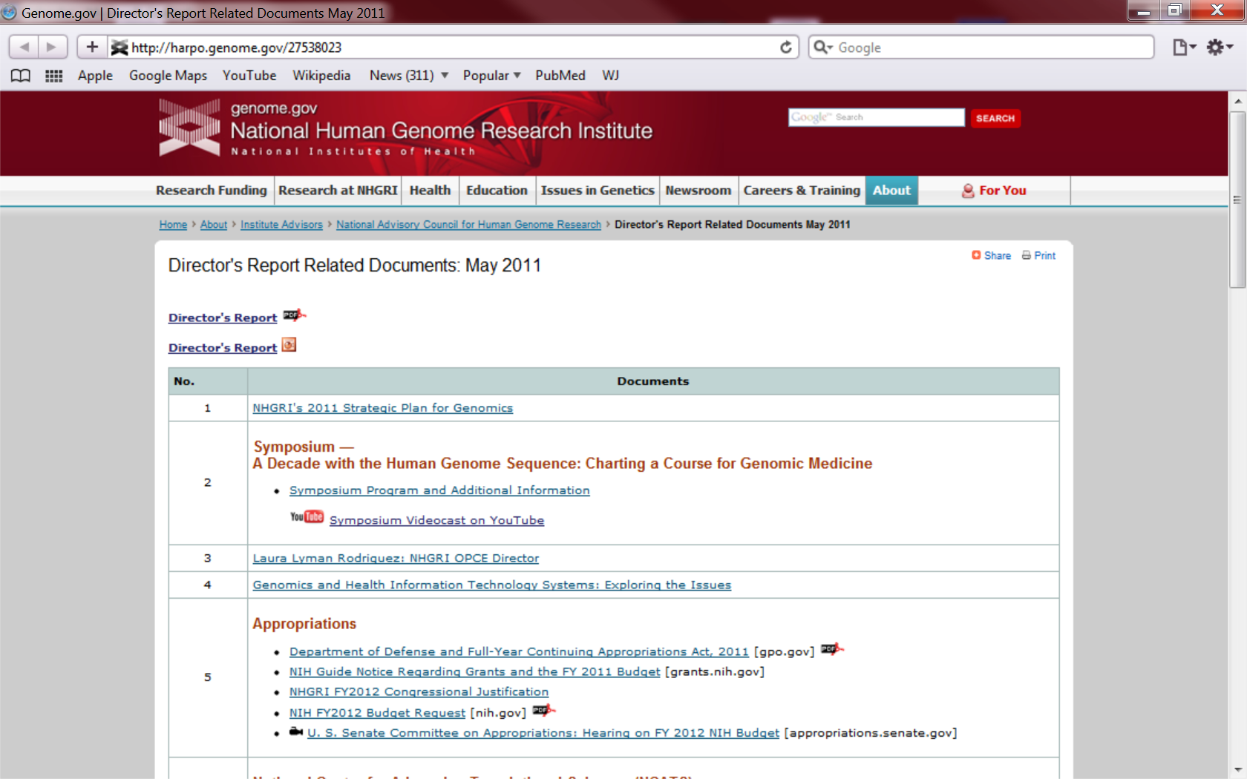
genome.gov/DirectorsReport
Document #
Notes:
For anyone new to our Council meetings, I want to make you aware that there is an ‘electronic resource’ associated with my Director’s Report. This is analogous to the supplemental materials of a published paper, and can be accessed at the URL shown here.
The slides that I am showing during my Director’s Report are also available electronically at this site– * both as PDF and Powerpoint files.
* For slides associated with specific documents or relevant web sites, there is a ‘Document #’ indicated on the bottom right, which references materials that can be accessed at the website shown here.
In addition to the video archive, this web page and all linked documents will be archived on NHGRI’s website (genome.gov) as a permanent historic resource.

Slide 3
Open Session Presentations
  Presentation from NIGMS Director
    Jon Lorsch
Concept Clearance: eMERGE III
      Teri Manolio
  Genome Sequencing Program Presentations:
  Clinical Sequencing Exploratory Research Program
    Jim Evans
  Centers for Mendelian Genomics
    Rick Lifton
Notes:
There will be several other presentations during the Open Session of this Council meeting. My Director’s Report is tailored around these presentations, and I will not discuss in detail the topics that others will cover later.
* To begin with, later this morning, you will hear from the still relatively new Director of the National Institute of General Medical Sciences (NIGMS), Jon Lorsch.
* Later, Teri Manolio will present a Concept Clearance for an eMERGE phase III funding opportunity.
There will also be presentations later today regarding * two of the major components of our Genome Sequencing Program. Specifically, * Jim Evans will give an overview of the Clinical Sequencing Exploratory Research (or CSER) program, and * Rick Lifton will provide an overview of the Centers for Mendelian Genomics program.

Slide 4
Director’s Report Outline
General NHGRI Updates
General NIH Updates
General Genomics Updates
NHGRI Extramural Research Program
NIH Common Fund/Trans-NIH
NHGRI Division of Policy, Communications, and Education
NHGRI Intramural Research Program
Notes:
For the rest of my Director’s Report, I will cover the 7 areas listed here, which together provide a good framework for reviewing the relevant topics.

Slide 5
Director’s Report Outline
General NHGRI Updates
General NIH Updates
General Genomics Updates
NHGRI Extramural Research Program
NIH Common Fund/Trans-NIH
NHGRI Division of Policy, Communications, and Education
NHGRI Intramural Research Program
Notes:
And we will start with some General NHGRI Updates.

Slide 6
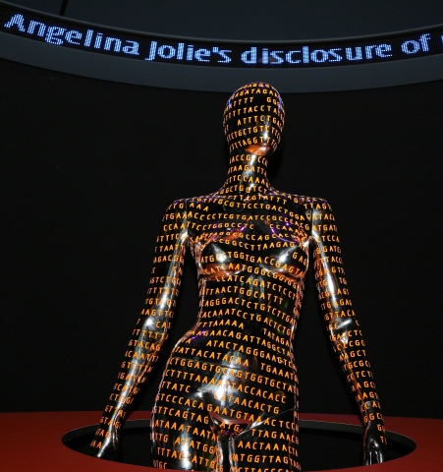

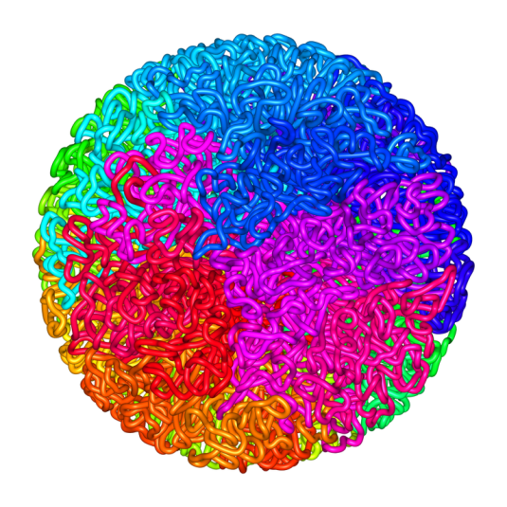
Genome: Unlocking Life’s Code Exhibition
  >2.3 million visitors since June 2013 opening
  15% of museum visitors specifically came to see genome exhibition
  Exhibition programming: Neanderthal genomics, drama and genomics, & Saturday lectures
  1St stop on 4-5 year traveling tour: San Diego
Document 1
Notes:
The NHGRI-Smithsonian exhibition, Genome: Unlocking Life’s Code, has now been open at the National Museum of Natural History for roughly eleven months. * The most recent assessments indicate that, remarkably, >2.3 million visitors have seen the exhibition to date— and that is before the start of the busy summer season at the Smithsonian.
To assess what visitors think about the exhibition, survey and interview data have started to be gathered by the Smithsonian Institution’s Office of Policy and Analysis. * For example, something like 15% of recent museum visitors specifically came to the museum to see our exhibition.
* As I have mentioned before, our associated exhibition programming efforts are quite active. There have been a number of such events since the last Council meeting. These included a public lecture by Svante Paabo (who spoke about the Neanderthal genome sequence), an exploration of drama and genomics, and several Saturday public lectures (for example, by myself and Francis Collins about the human genome and Elaine Ostrander about dog genomics).
* The exhibition will leave the National Museum of Natural History in September to begin its 4-5 year traveling tour, starting at the Reuben H. Fleet Science Center in San Diego.

Slide 7
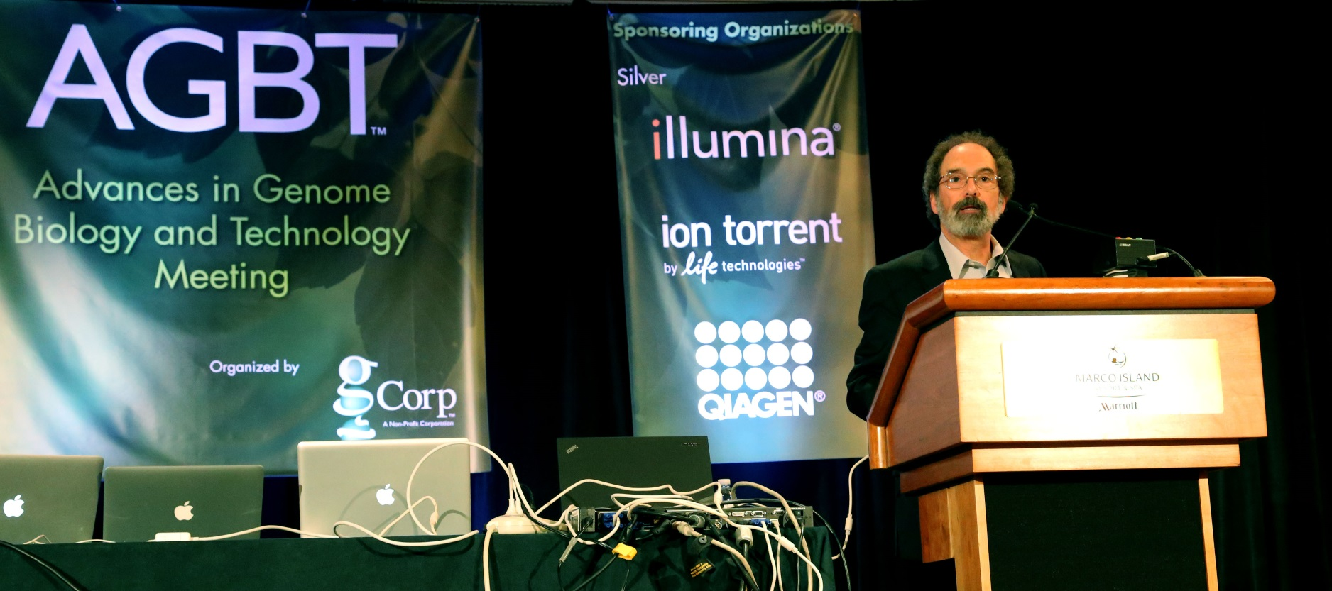
Featured Presentation at Advances in Genome Biology and Technology Meeting
Jeff Schloss, Ph.D.
Notes:
In February, Jeff Schloss, Director of NHGRI’s Division of Genome Sciences, was honored at the 15th annual Advances in Genome Biology and Technology (AGBT) meeting in Marco Island. For many years, Jeff has been the Program Director overseeing the Institute’s extramural Technology Development Program, where he has skillfully managed a diverse portfolio of grants aiming to develop nucleic acids-related technologies— in particular, DNA sequencing technologies.
To highlight the incredible achievements of this program, Jeff submitted a poster-designated abstract to the AGBT meeting on the history of technology development at NHGRI and our $1000 Genome program. For the first time in the history of the meeting, the organizers elected to decline his request to give a poster presentation and instead to give an oral presentation— in fact, they wanted him to give a featured talk kicking off the plenary session on technology development.
The title of Jeff’s talk was “Ambitious Goals, Concerted Efforts, Conscientious Collaborations – 10 Years Hence.” This honor speaks to the true nature of Jeff’s impact and accomplishments over the past 18 years.

Slide 8
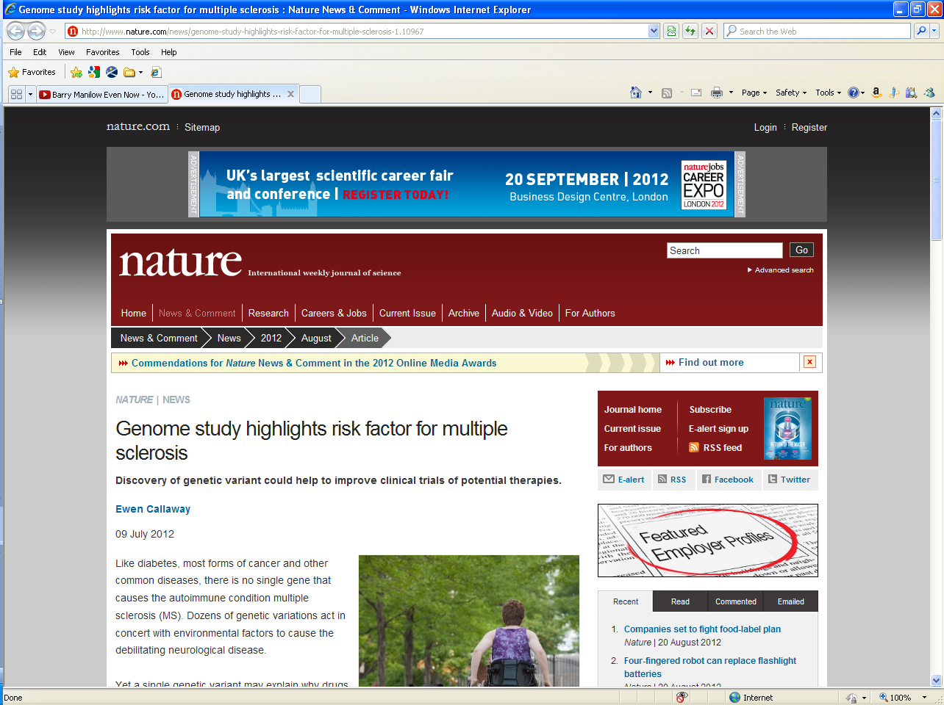
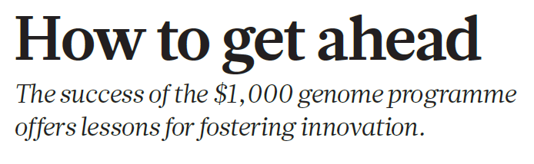
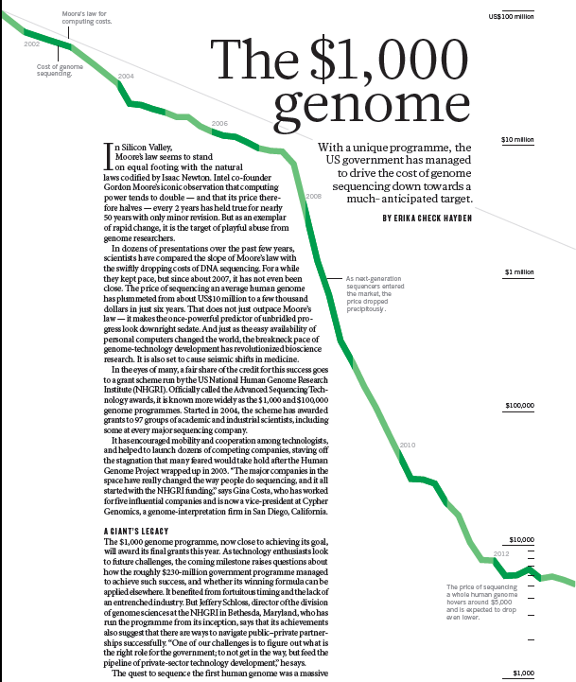
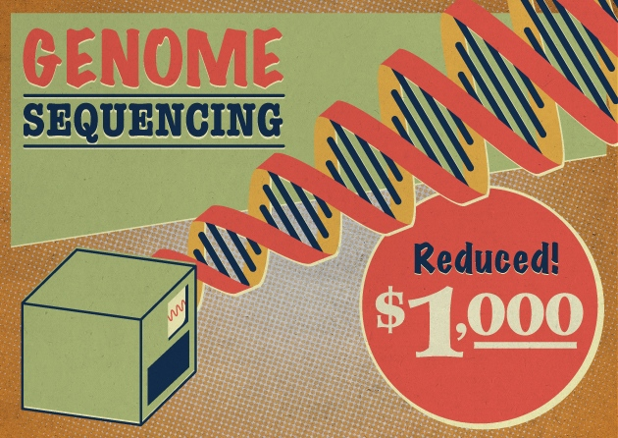
$1000 Genome Program
“In the eyes of many, a fair share of the credit for this success goes to a grant scheme run by the US National Human Genome Research Institute (NHGRI).”
Document 2
Notes:
But the Schloss-a-thon did not end there…
* In March, Nature published a very nice piece about NHGRI’s $1000 Genome program, which was accompanied by an editorial about this effort that discussed how the success of the $1000 Genome program offers important lessons for fostering innovation.
* The main article had a very nice shout out about NHGRI, specifically saying that: “In the eyes of many, a fair share of the credit for this success goes to a grant scheme run by the US National Human Genome Research Institute (NHGRI).”

Slide 9
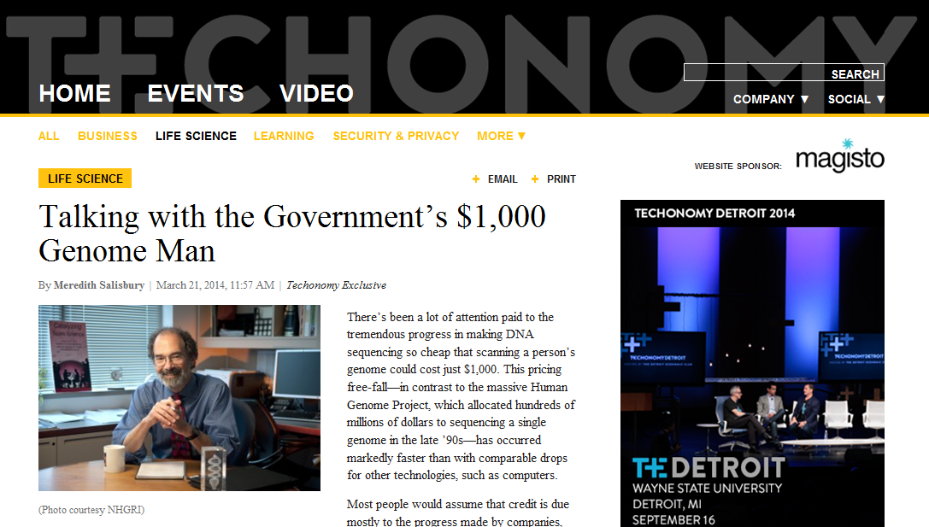
$1000 Genome Program
Document 2
Notes:
And finally, Jeff was recently interviewed by Techonomy as the “Government’s $1,000 Genome Man.”
These articles accurately describe and credit what has arguably been the most successful technology development program in the history of NIH (not just NHGRI). They nicely and appropriately credit Jeff Schloss for his outstanding leadership of this program since its inception. So, big kudos to Jeff!

Slide 10
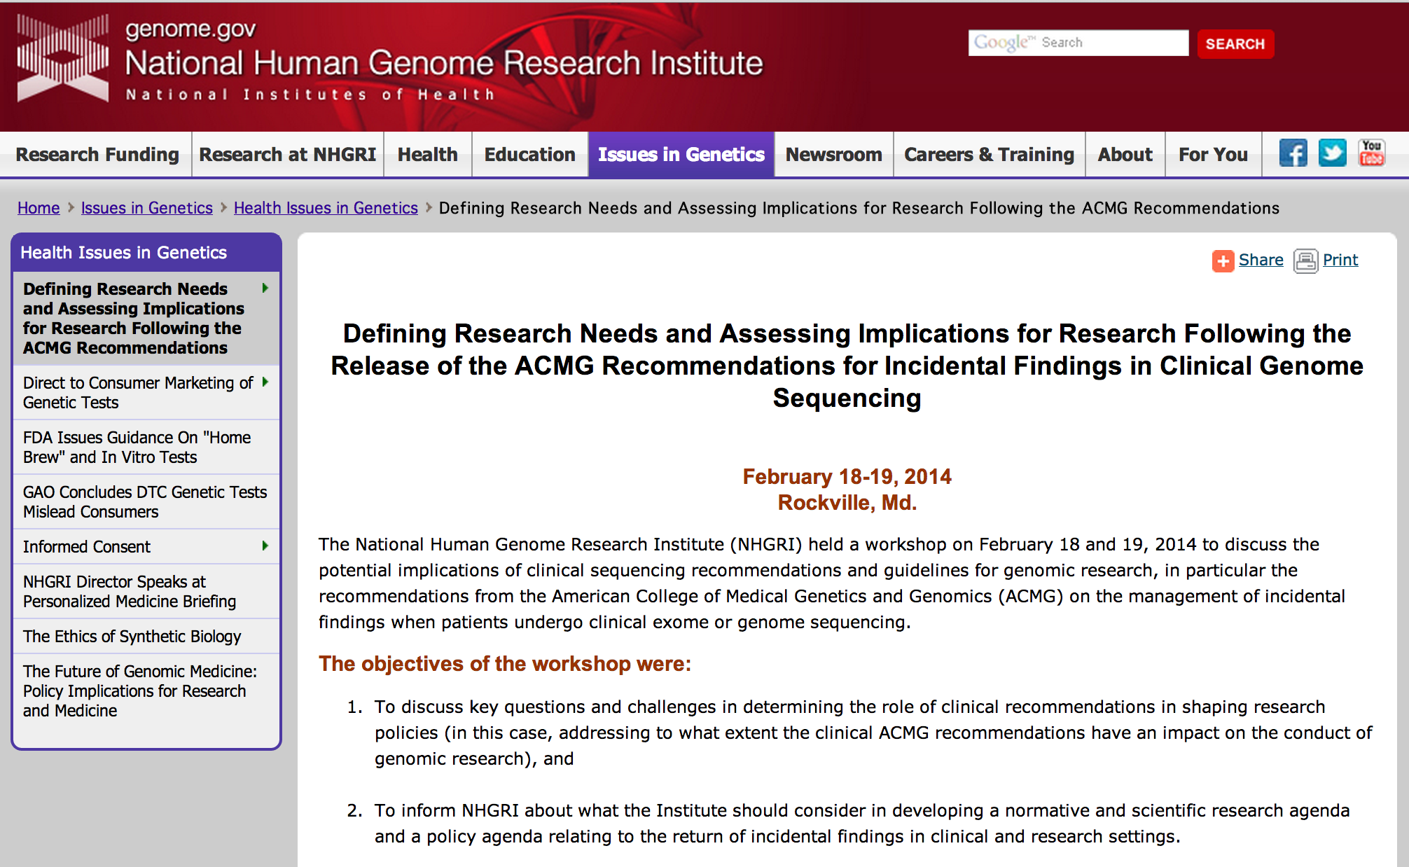
NHGRI Incidental Findings Workshop
Document 3
Notes:
In February, NHGRI brought together a distinguished group of geneticists, researchers, clinicians, and bioethicists for a candid and interactive discussion of the potential research implications of clinical recommendations for the return of incidental findings, such as those released in 2013 by the American College of Medical Genetics and Genomics.
The workshop was organized into a series of panel-led discussions on some of the key challenges of returning incidental findings in research settings. Meeting participants included Council members Jim Evans and Bob Nussbaum, and they identified research questions that should be addressed for both clinical and research settings— such as examining what types of results patients or participants want to know, what people do in response to learning such results, and what data are required for the validation of any proposed guidelines.
A summary of the workshop discussions is posted on genome.gov, and several workshop participants are collaborating on potential publications exploring ideas that emerged during the meeting.

Slide 11
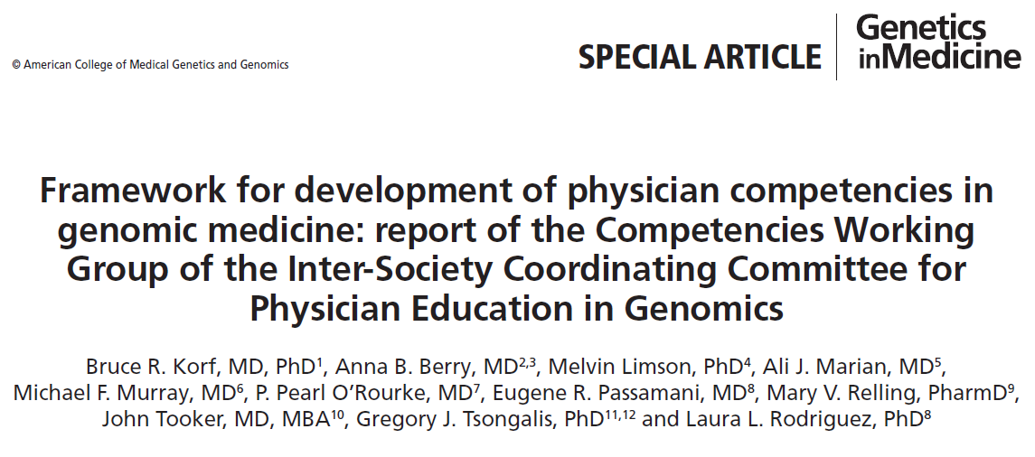
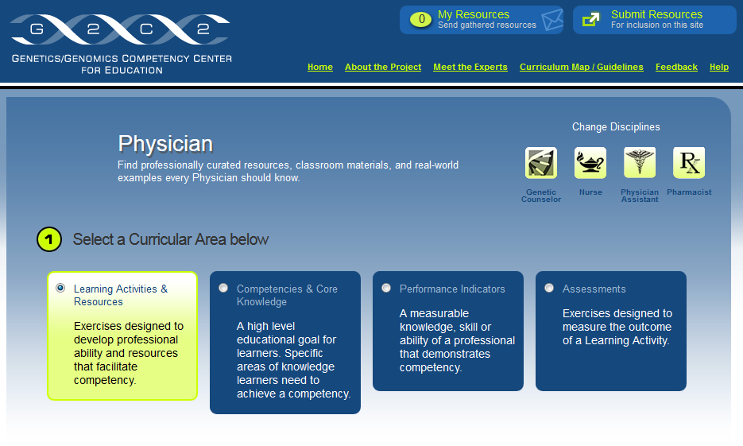
Inter-Society Coordinating Committee for Practitioner Education in Genomics
Document 4
Notes:
The Inter-Society Coordinating Committee for Practitioner Education in Genomics (more easily referred to as the ISCC) was created from our 4th Genomic Medicine Meeting.
* The Committee’s ‘Framework for the Development of Physician Competencies in Genomic Medicine’ was published in the journal Genetics in Medicine in April.
In addition, this group held its second in-person meeting in April. At that meeting, the Committee approved * a set of physician-specific educational materials to be added to the Genetics/Genomics Competency Center (G2C2) website, which is a free online resource for genomics education targeting health professionals created and maintained by our Genomic Healthcare Branch. Following internal review, these materials will become available to the public at this site, hopefully in early June.
I am also happy to report that the Committee has recruited representatives from ophthalmology, family medicine, dentistry, and the Canadian professional boards and societies. New use cases to explore genomic medicine in practice, including pathology and dental use cases, are under development.

Slide 12
Director’s Report Outline
General NHGRI Updates
General NIH Updates
General Genomics Updates
NHGRI Extramural Research Program
NIH Common Fund/Trans-NIH
NHGRI Division of Policy, Communications, and Education
NHGRI Intramural Research Program

Slide 13
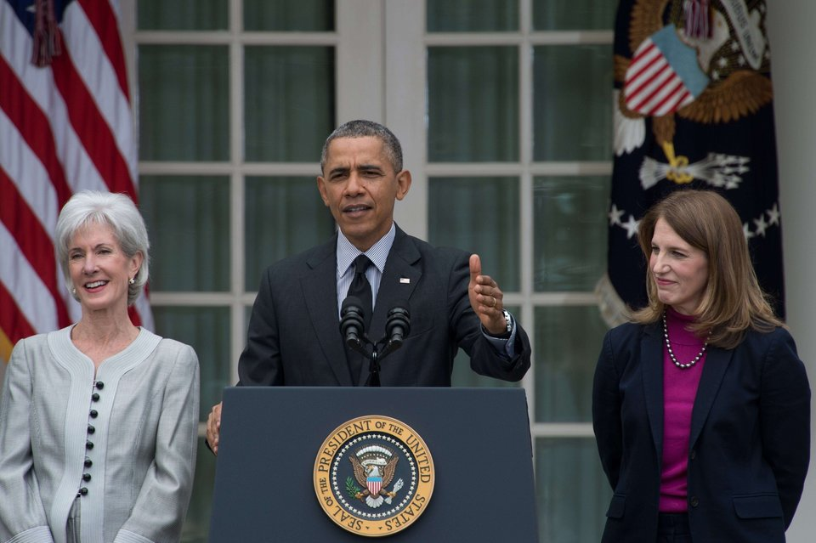
DHHS Secretary: Nomination of
Sylvia Mathews Burwell
Notes:
In April, President Obama announced the resignation of Department of Health and Human Services (DHHS) Secretary Kathleen Sebelius. He also announced his nomination of Sylvia Mathews Burwell, the current Director of the Office of Management and Budget, to replace Secretary Sebelius. Burwell’s appointment is subject to Senate approval, but is expected to be relatively smooth based on her unanimous confirmation in 2013 to become the Office of Management and Budget Director.
To date, the Senate Health, Education, Labor, and Pensions Committee and the Senate Finance Committee have held their confirmation hearings, but the whole Senate has yet to vote on the final approval.

Slide 14
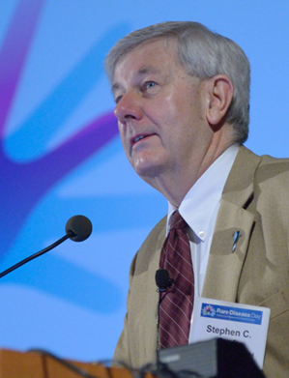
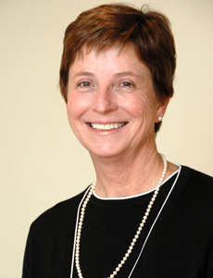

Retirement of Stephen Groft,
Rare Disease Research Champion
Stephen Groft, Pharm.D.
Pamela McInnes,
D.D.S.
Document 5
Notes:
Long-time rare disease research champion Stephen Groft, Director of the Office of Rare Diseases Research (ORDR) within the National Center for Advancing Translational Sciences, retired from government service in February. During his 20+ years as ORDR Director, Steve worked with legislators, regulators, researchers, pharmaceutical representatives, patients, families, and patient advocacy groups to create an environment fostering support, communication, research, and development of treatments for rare and orphan diseases. Steve and his colleagues collaborated with NHGRI to establish the Genetic and Rare Diseases Information Center (GARD) and the Therapeutics for Rare and Neglected Diseases Program as well as the Undiagnosed Diseases Program. His passion, commitment, and leadership leave a remarkable legacy.
Pamela McInnes, Deputy Director of the National Center for Advancing Translational Sciences, is now serving as ORDR Acting Director while the search for a new Director is carried out.

Slide 15
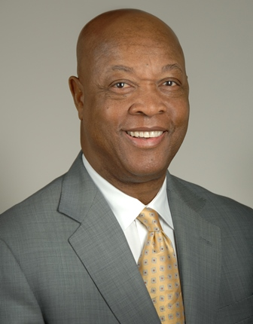
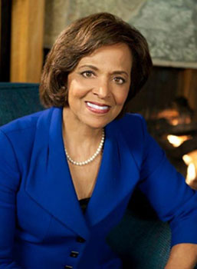

National Institute on Minority Health
and Health Disparities
John Ruffin, Ph.D.
Yvonne Maddox, Ph.D.
Document 6
Notes:
There have been other staff changes around the NIH.
John Ruffin retired from his position as Director of the National Institute on Minority Health and Health Disparities. For more than 24 years, he has been an NIH champion of efforts to eliminate health disparities and to advance minority health.
Yvonne Maddox has been appointed as Acting Director of the Institute while the search for a new Director is conducted. Previously, she served as the Deputy Director of the Eunice Kennedy Shriver National Institute of Child Health and Human Development.

Slide 16

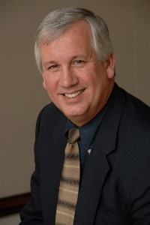

NIH Office of Behavioral and
Social Sciences Research
Robert Kaplan, Ph.D.
William Riley, Ph.D.
Document 7
Notes:
Robert Kaplan, Director of the NIH Office of Behavioral and Social Sciences Research (OBSSR), has moved to the Agency for Healthcare Research and Quality (AHRQ) to serve as their Chief Science Officer.
Dr. Kaplan has made numerous contributions to behavioral and social sciences research at the NIH, including leading a variety of activities in dissemination and implementation research in health and providing support for training in systems science methodologies to facilitate the study of behavioral and social dimensions of health.
William Riley (Chief of the Science of Research and Technology Branch, Behavioral Research Program, Division of Cancer Control and Population Sciences at the NCI) has been named the Acting Director of OBSSR while the search for a new Director is conducted.

Slide 17
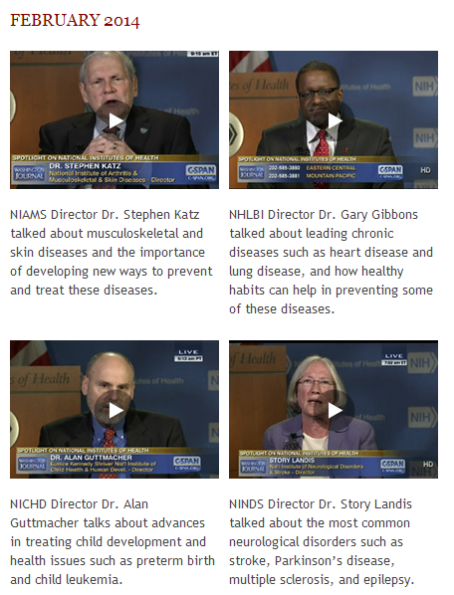

C-SPAN’s Washington Journal:
NIH Feature Round 2
Document 8
Notes:
You may recall that in February, I reported that C-SPAN came out to NIH to do a 2.5-hour Washington Journal program that featured interviews with Francis Collins, Tony Fauci, Harold Varmus, Tom Insel, and me.
C-SPAN recently returned to NIH to talk to more Institute Directors about important groundbreaking research. This time, they spoke with NIAMS Director Steve Katz, NHLBI Director Gary Gibbons, NICHD Director Alan Guttmacher, and NINDS Director Story Landis.
This dedicated coverage of NIH by C-SPAN is a really good thing, and we appreciated their coverage of our science and our programs.

Slide 18
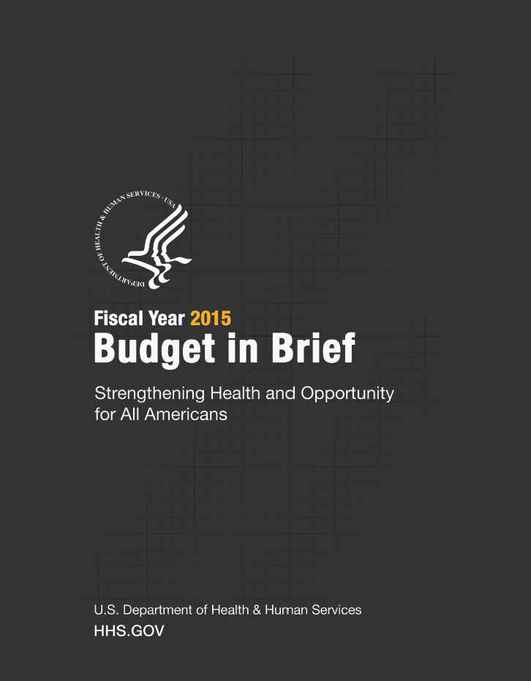
NIH Fiscal Year 2015 Appropriations
 | Fiscal Year 2012 | Fiscal Year 2013 | Fiscal Year 2014 | Fiscal Year 2015 President’s Budget
NIH | $30.9 B | $29.2 B | $30.2 B | $30.4 B
NHGRI | $513 M | $483 M | $497 M | $498 M
Document 9
Notes:
At the February Council meeting, I reported that Congress had wrapped up their work in funding government agencies for Fiscal Year 2014 and, accordingly, their attention had turned to Fiscal Year 2015.
* In March, President Obama sent his Fiscal Year 2015 budget proposal to Congress. This included * the following for NIH and NHGRI.
As shown in the far-right column, the President has proposed $30.4 billion for NIH, an increase of $211 million, which includes $100 million for the new Brain Research through Advancing Innovative Neurotechnologies (or BRAIN) Initiative.
The President’s budget calls for NHGRI to receive $498 million, which represents an increase of approximately $1 million over our current funding. Such an amount would still be lower than our pre-sequestration funding level.

Slide 19
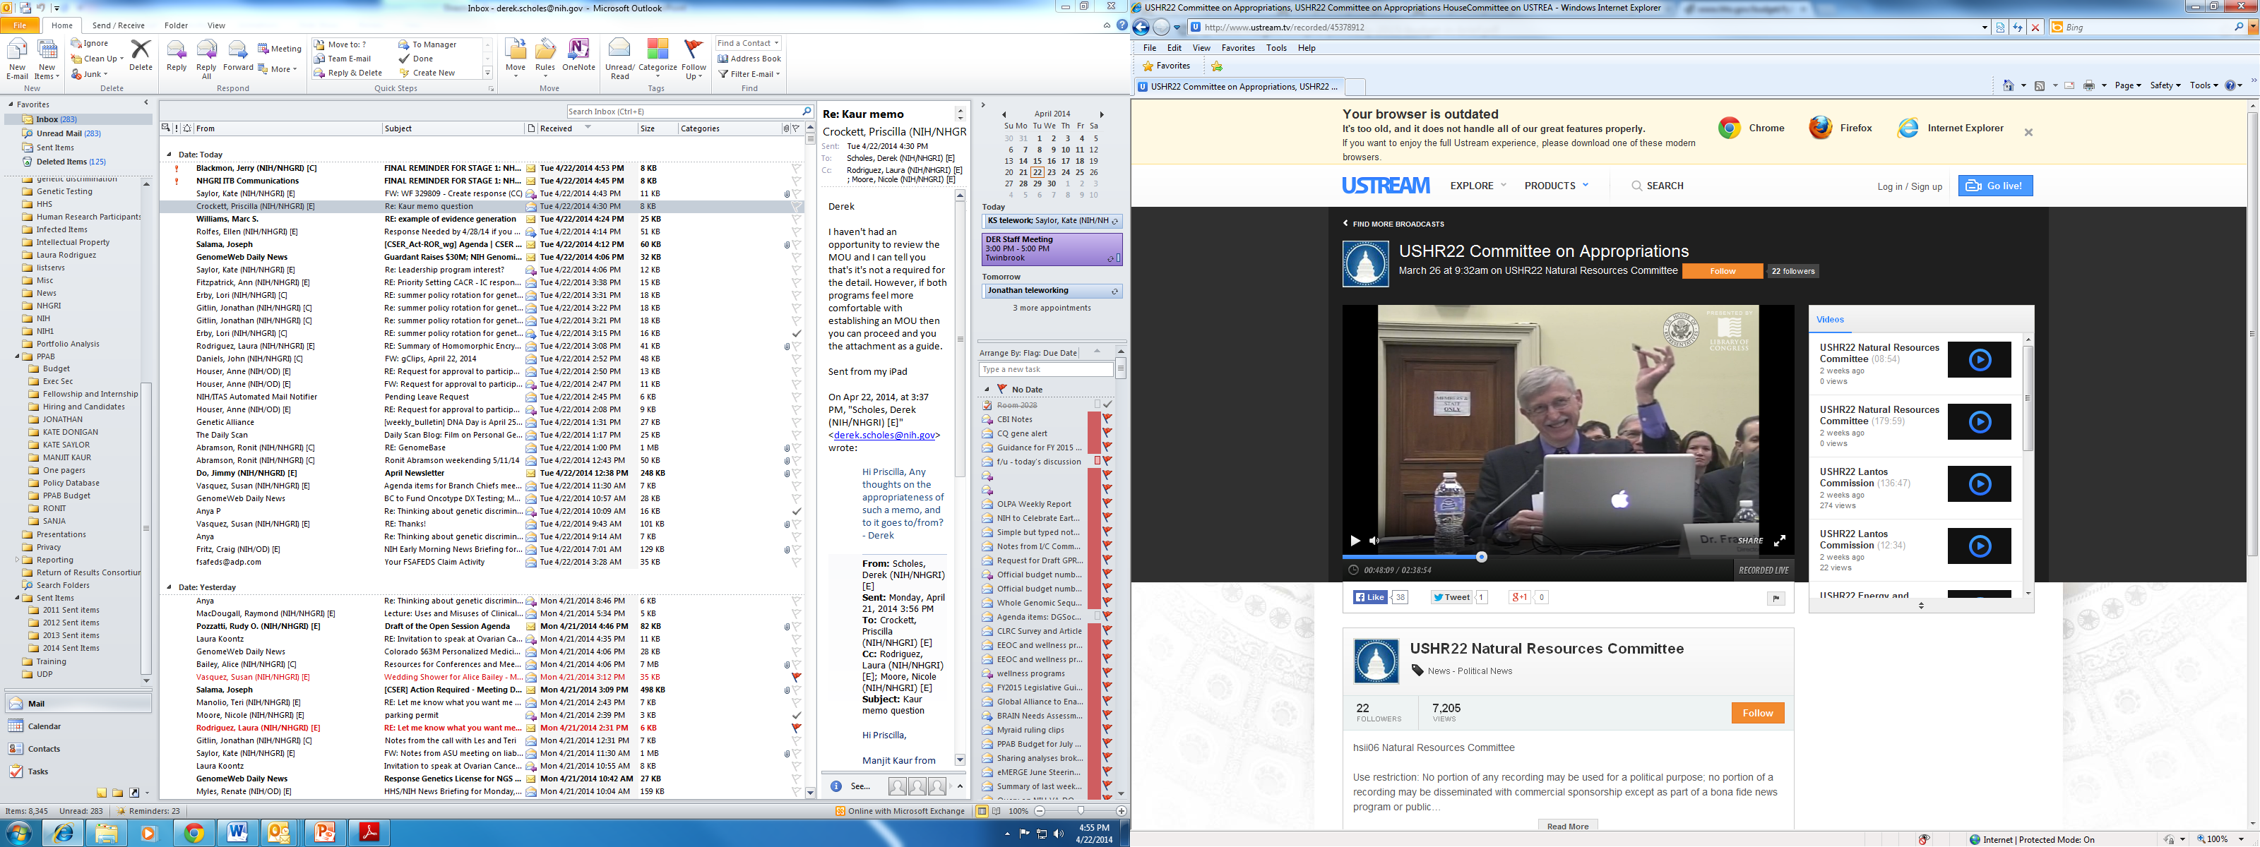
Congressional Appropriations Hearings
Document 9
Notes:
With the Fiscal Year 2015 budget process in full swing, the Congressional committees with key roles in determining NIH’s budget have now held hearings to consider the President’s request for the agency. In March, Francis Collins testified before the House Appropriations Labor-HHS Subcommittee. At the request of Chairman Kingston, Francis showed a ‘next-generation’ DNA sequencing chip and described NIH’s remarkable success in fostering the innovation of new DNA sequencing technologies.
The following week, Francis testified on the other side of Congress, before the Senate Appropriations Labor-HHS Subcommittee. This hearing was notable as being the last NIH hearing chaired by Senator Tom Harkin, who is retiring at the end of this Congressional session. Senator Harkin noted that he first became Chair of the Subcommittee in 1989, immediately before the launch of the Human Genome Project, and reflected on the remarkable progress that has been made in genomics over the past 25 years.

Slide 20
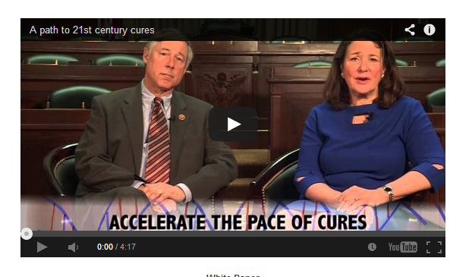

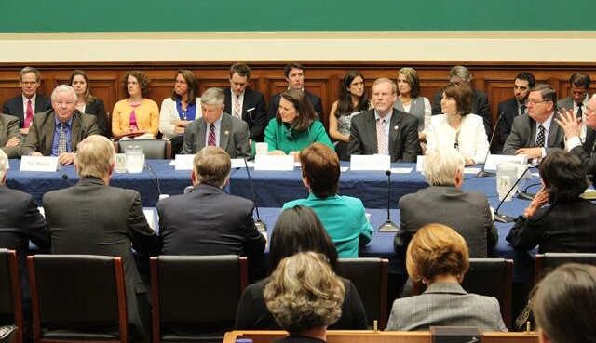
Congressional Hearings:
“A Path to 21st Century Cures”
April 30
May 6
Document 9
Notes:
On April 30, a new initiative called “A Path to 21st Century Cures” was announced in the House of Representatives. It is being lead by Congressman Fred Upton (Chairman of the House Committee on Energy and Commerce) and Congresswoman Diane DeGette (a member of the same Committee), both of which are shown here. Over the next several months, the Committee will be holding a series of roundtables and hearings to explore how to accelerate the pace of scientific discovery and its translation to treatments and cures, and to keep the United States at the forefront of medical innovation.
The first roundtable was held on May 6, and the NIH was represented by Francis Collins. Dr. Collins spoke of the need for a consistent stream of funding for NIH, and his concern that other countries (such as China and Korea) are investing more in biomedical research at a time when the United States is cutting back. In addition to NIH, the FDA, academia, and advocacy groups were also represented.
There is much unknown about the long-term expectations for this initiative, but it has bipartisan support in the House, and we do anticipate that there will be a lot more activity to report in the months to come.

Slide 21
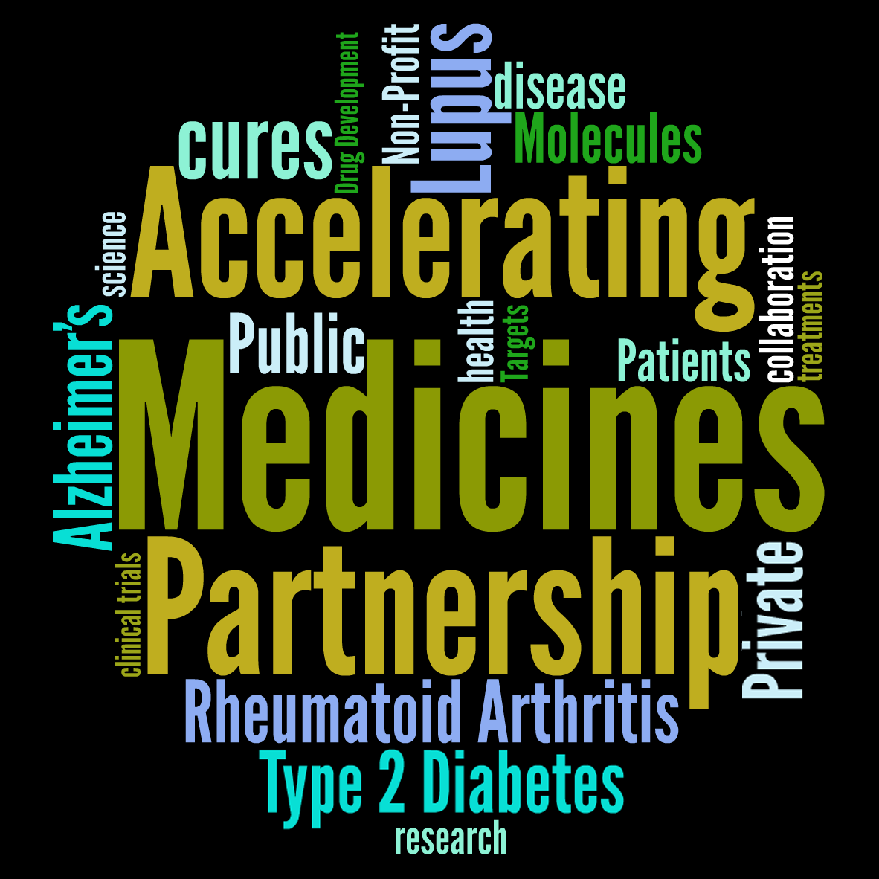
Accelerating Medicines Partnership (AMP)
Document 10
Notes:
The NIH, 10 private companies, and 11 nonprofit organizations recently launched the Accelerating Medicines Partnership (or AMP), which aims to identify and validate biological targets of disease most likely to respond to new therapies and to characterize molecular indicators of disease (otherwise known as biomarkers).
Technological advances, such as those made in genomics, have led to the discovery of more than 1000 risk factors for common diseases. AMP aims to do some of the hard work in identifying those factors that could be likely targets for therapies, and make those findings widely available.
Through the Foundation for the NIH (FNIH), AMP will invest more than $230 million in 3-5 year pilot projects in 3 research areas: Alzheimer’s disease, type 2 diabetes, and the autoimmune disorders rheumatoid arthritis and lupus.

Slide 22
Director’s Report Outline
General NHGRI Updates
General NIH Updates
General Genomics Updates
NHGRI Extramural Research Program
NIH Common Fund/Trans-NIH
NHGRI Division of Policy, Communications, and Education
NHGRI Intramural Research Program

Slide 23
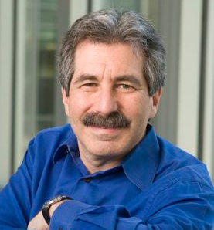
ILCHUN Molecular Medicine Award
Geoffrey Ginsburg, M.D., Ph.D.
Notes:
Former Council member Geoff Ginsburg is the 2014 recipient of the ILCHUN Molecular Medicine Award.
This award is presented annually by the Korean Society for Biochemistry and Molecular Biology in collaboration with the ILCHUN Genomic Medicine Institute in Korea, and celebrates researchers with dedicated achievement in molecular medicine.

Slide 24
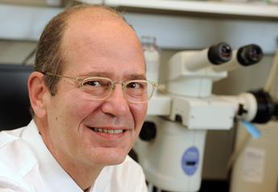
Harrington Prize for Innovation in Medicine
Hal Dietz, M.D.
Document 11
Notes:
The inaugural Harrington Prize for Innovation in Medicine has been awarded to pediatric cardiologist and genetics researcher Hal Dietz of the Johns Hopkins University School of Medicine. Hal is a good friend of NHGRI’s and former Chair of our Intramural Board of Scientific Counselors.
The Harrington Prize for Innovation in Medicine, established this year by the Harrington Discovery Institute at University Hospitals Case Medical Center and the American Society for Clinical Investigation, recognizes a physician-scientist who has successfully navigated the path to advance discovery into clinical application.

Slide 25
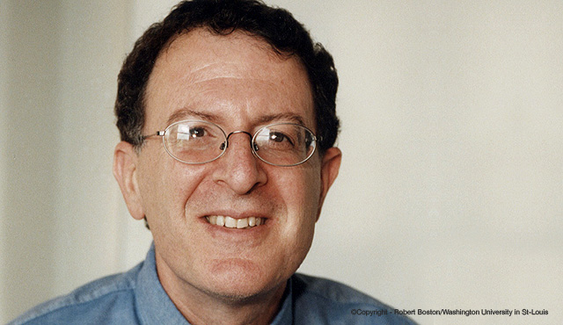

Passano Foundation Award
Jeff Gordon, M.D., Ph.D.
Document 12
Notes:
Jeff Gordon, Director of the Center for Genome Sciences and Systems Biology at Washington University School of Medicine, has been awarded the 2014 Passano Foundation Award.
Established in 1943, this annual award recognizes scientists who have made outstanding contributions to medical research. Gordon's research focus has led to discoveries about the human microbiome, including novel characteristics of the gut microbiome in obesity.

Slide 26

National Academy of Sciences: Newly Elected
Cynthia Burrows
Bob Darnell
Julian Davies
Michael Green
Vamsi Mootha
Monty Slatkin
Henry Yang
Document 13
Notes:
Recently, a number of scientists with ties to NHGRI were elected to the U.S. National Academy of Sciences.
That list includes * Cynthia Burrows, * Bob Darnell, * Julian Davies, * Michael Green, * Vamsi Mootha, * Monty Slatkin, and * Henry Yang.

Slide 27

U.K. Royal Society: Newly Elected
Ewan Birney
Julian Parkhill
Document 14
Notes:
And then on the other side of the pond, the U.K. Royal Society recently announced the election of genomicists * Ewan Birney and * Julian Parkhill to their prestigious group.

Slide 28

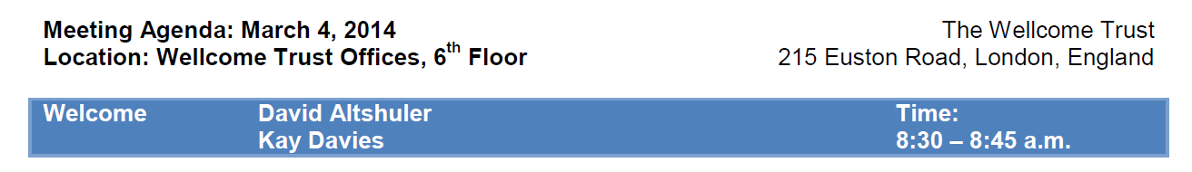
  Four Working Groups have been established:
    Regulatory and Ethics Working Group
    Genomic Data Working Group
    Security Working Group
    Clinical Working Group
Document 15
Notes:
The Global Alliance for Genomics and Health (GA4GH) is a recently established international coalition that aims to formulate standards and a framework to enhance world-wide data sharing. Over 150 organizations across the world are involved. There is a GA4GH Steering Committee led by David Altshuler. NIH’s new Associate Director for Data Science, Phil Bourne, has recently joined that Steering Committee. * The first face-to-face meeting of the GA4GH took place in March at the Wellcome Trust in the U.K.
* Four working groups have been established and are busy at work: * The Regulatory and Ethics Working Group focuses on ethics and the legal and social implications, including developing consent, privacy procedures, and best practices in data governance and transparency.
* The Genomic Data Working Group concentrates on data representation, data storage, data analysis, and developing standards that will facilitate interoperability.
* The Security Working Group addresses issues on the technology aspects of data security, user access control, and audit functions, working to develop or adopt standards for data security, privacy protection, and user/owner access control.
* The Clinical Working Group addresses the establishment of linkages to phenotypic and clinical (health) informatics data.
NHGRI continues to stay in close touch with the GA4GH and the activities of these various working groups.

Slide 29
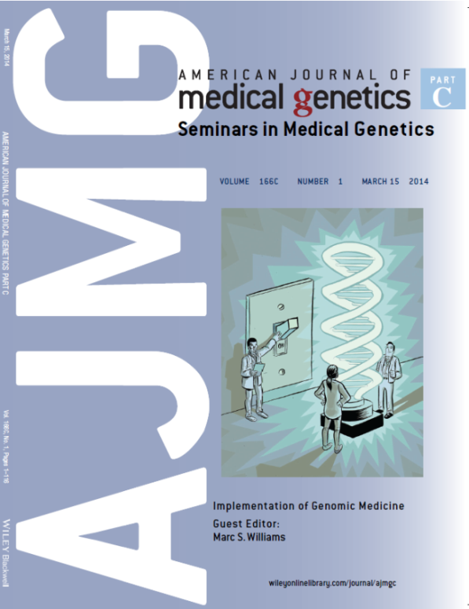
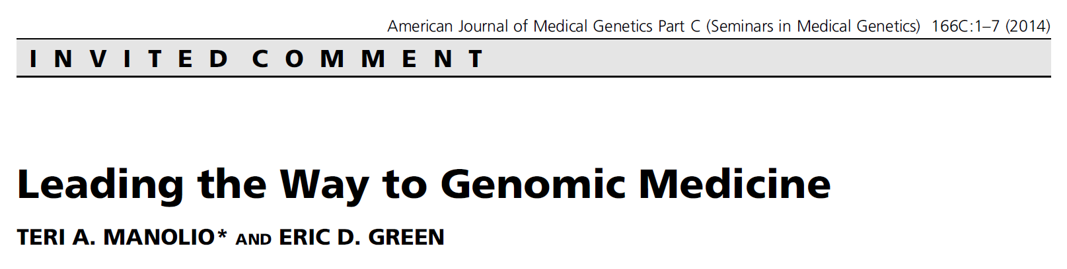
Special Issue:
American Journal of Medicine Genetics
Document 16
Notes:
In March, a special issue of the American Journal of Medical Genetics was published that focused on the implementation of genomic medicine.
This special issue was guest edited by Marc Williams (a member of this Council’s Genomic Medicine Working Group), and included a number of articles of particular relevance to NHGRI. The cover of the special issue featured this nifty graphic that incorporates the double-helical light bulb image that is associated with NHGRI’s 2011 strategic plan.
* This special issue included an invited commentary written by Teri Manolio and me (shown here), as well as well articles highlighting relevant aspects of our CSER, IGNITE, and ClinGen programs.

Slide 30
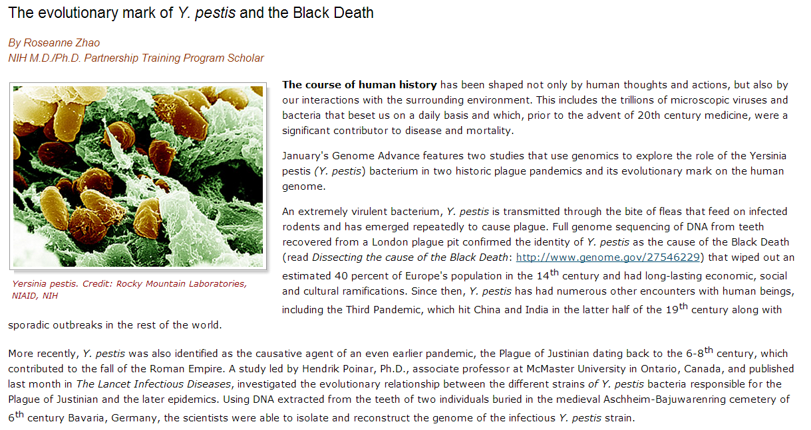
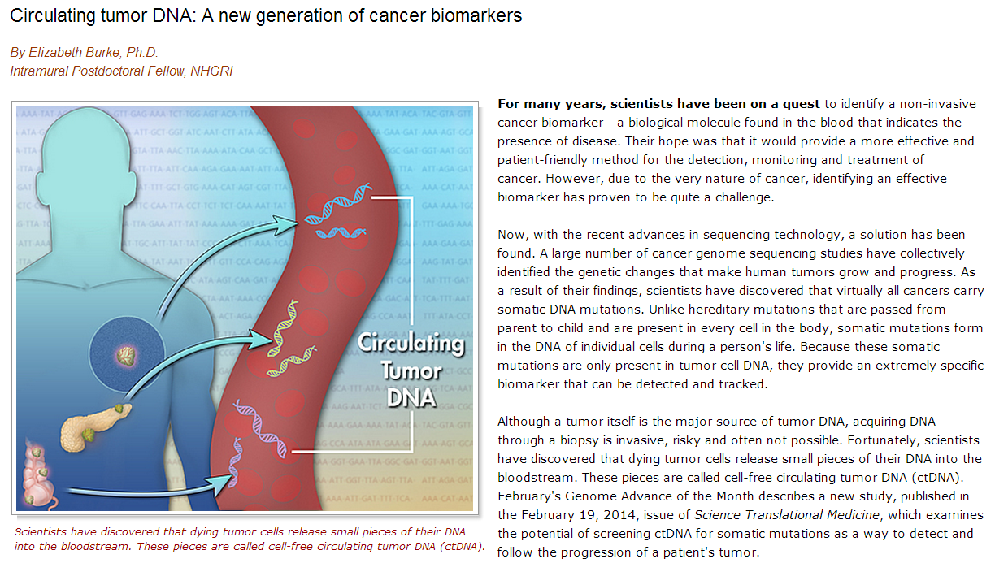
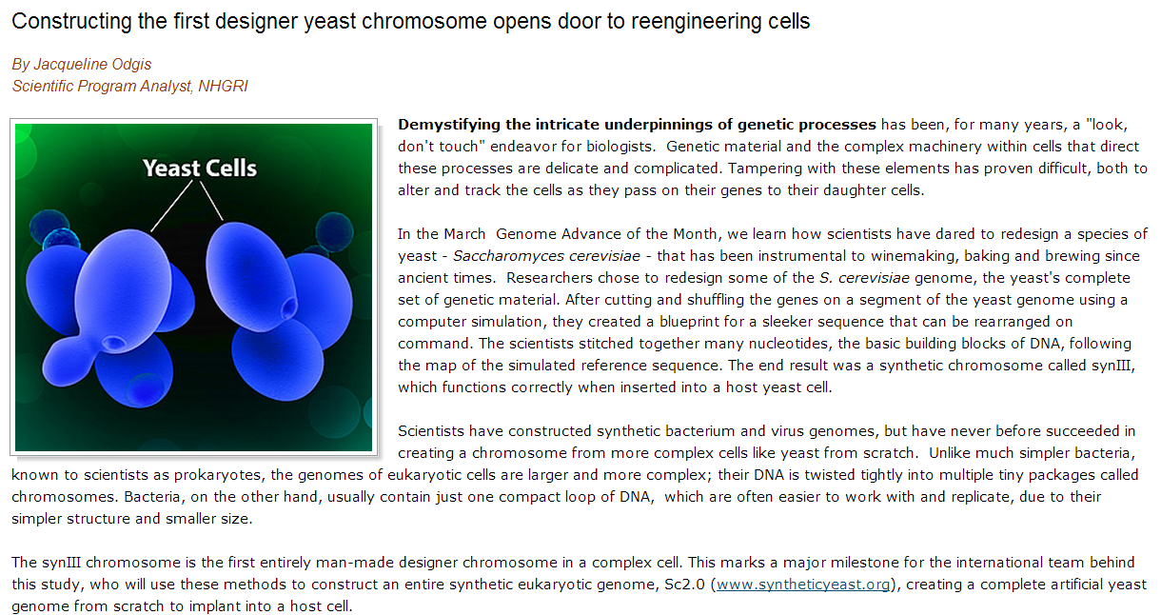
NHGRI Genome Advance of the Month
Document 17
Notes:
Featured as an NHGRI Genome Advance of the Month since the last Council meeting have been publications describing * Y. pestis genome (famous for the Black Death), * the identification of a cancer biomarker— specificially, circulating tumor DNA, and * the construction of the first designer yeast chromosome (and its implications for synthetic genomics).

Slide 31


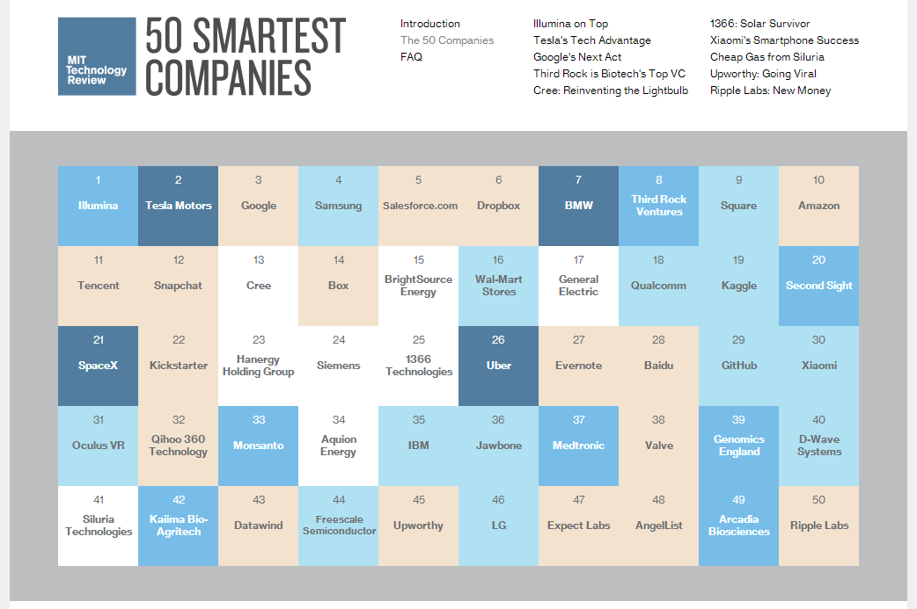
Genomics In The News…
1
Illumina
39
Genomics England
Document 18
Notes:
Moving on to Genomics in the News…
Recently, MIT Technology Review picked their 50 ‘smartest’ companies. * Illumina was ranked 1st, and * Genomics England was ranked 39th.

Slide 32


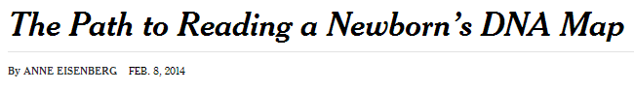
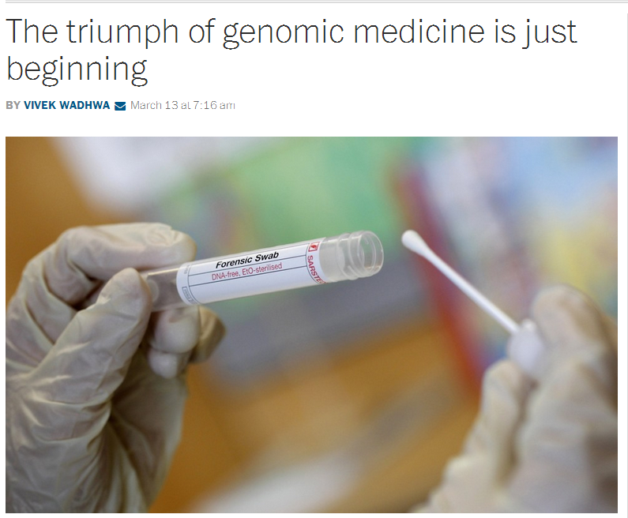
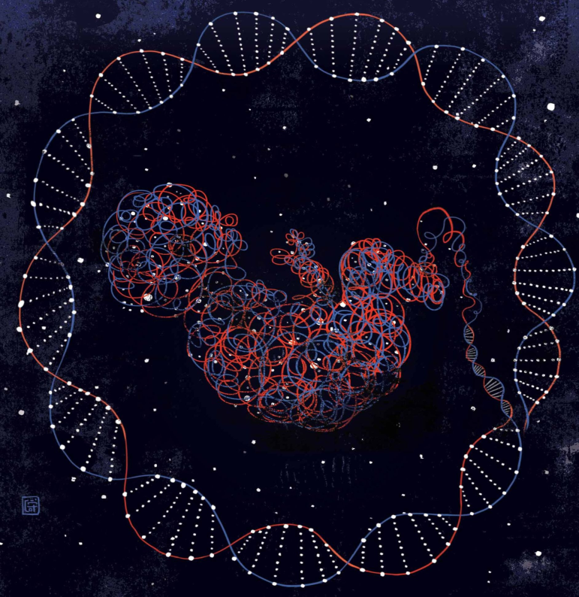
Genomics In The News…
Document 18
Notes:
Other recent major genomic news stories included * an article in the New York Times about newborn sequencing and * an article in the Washington Post about genomic medicine.

Slide 33
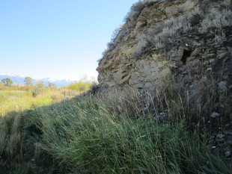



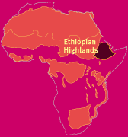
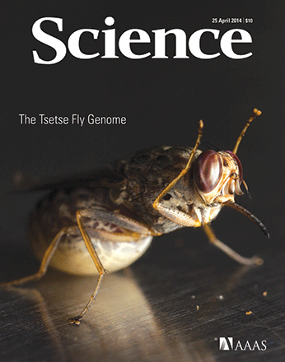






Genomes In The News…
Document 19
Notes:
And in terms of Genomes in the News, there have been a number of newly generated genome sequences reported since the last Council meeting.
The first ancient North American human genome has been sequenced. * There is an NHGRI connection to this story; the DNA sample was recovered from a bone taken from property owned by the family of a former NHGRI employee—Sarah Anzick. Sarah was in the NHGRI Intramural Research Program for many years, and she was heavily involved in this genome sequencing project. This picture is the burial site where the sample was found on the Anzick land.
In addition, there have been recent reports about the sequencing of the following genomes : * duckweed, * Ethiopian highlander, * hot pepper, * loblolly pine, * black grouse, * sesame, * rainbow trout, * golden eagle, * peanut, * tsetse fly, and finally the social velvet spider and the * tarantula.

Slide 34
Director’s Report Outline
General NHGRI Updates
General NIH Updates
General Genomics Updates
NHGRI Extramural Research Program
NIH Common Fund/Trans-NIH
NHGRI Division of Policy, Communications, and Education
NHGRI Intramural Research Program

Slide 35

Large-Scale Genome Sequencing
and Analysis Centers
  Major Projects Include:
  Alzheimer’s Disease Sequencing Project (with NIA)
  T2D-Genes (with NIDDK)
  TCGA (with NCI)
Document 20
Notes:
The Large-Scale Sequencing and Analysis Centers (the biggest component of our flagship Genome Sequencing Program) seek to address major biomedical questions by conducting very large genome-sequencing projects; most of their efforts are directed at identifying mutations implicated in cancer and variants underlying common disease, where sufficient scale is needed to gain sufficient power to enable discovery.
I will briefly touch on * three of their major, ongoing projects: * the Alzheimer’s Disease Sequencing Project, being performed in collaboration with the National Institute on Aging; * the T2D-Genes diabetes multiethnic cohort project, being conducted with the National Institute of Diabetes and Digestive and Kidney Diseases; and * The Cancer Genome Atlas, being conducted with the National Cancer Institute.

Slide 36

Alzheimer’s Disease Sequencing Project
  584 whole-genome sequences from affected families (sequencing complete, analysis ongoing)
  10,000 case/control whole-exome sequences (~4,500 completed to date)
  Replication study of up to 40,000 individuals (samples identified)
  NIA data-analysis RFA to be funded in May
Document 20
Notes:
The Alzheimer’s Disease Sequencing Project represents NHGRI’s contribution to the 2012 Presidential Initiative to fight Alzheimer’s disease.
This effort aims to identify genomic variants that increase risk for late-onset Alzheimer’s disease or that confer protection from late-onset Alzheimer’s disease. The design includes * generating nearly 600 whole-genome sequences from families affected with late-onset Alzheimer’s disease. That sequencing is now complete, and the consortium is in the process of analyzing the data (which is also available to the community through NIA’s Genetics of Alzheimer's Disease Data Storage Site as well as through dbGaP).
* The project’s design also includes generating 10,000 case/control whole-exome sequences (of which almost half have been completed to date). * There will then be a replication study of up to 40,000 individuals for which samples have been identified
* Finally, NIA will be funding a data-analysis RFA in May.

Slide 37
Type 2 Diabetes Multiethnic Genetic Consortium (T2D-Genes)
  NIDDK initiated, with NHGRI providing genome sequencing capacity
  Whole-exome sequences from 5000 cases/ controls from five ancestry groups
  Whole-genome sequences from over 600 members of 20 Mexican-American pedigrees
  Multiethnic GWAS analysis published
  Follow up (GWAS and targeted DNA sequencing) in up to 50,000 cases/controls
Document 20
Notes:
Another major project for the Large-Scale Sequencing and Analysis Centers is the Type 2 Diabetes Multiethnic Genetic Consortium (also called the T2D-Genes project), which was * initiated by the National Institute of Diabetes and Digestive and Kidney Diseases, but with sequencing capacity provided by NHGRI.
Genome sequencing and genotyping studies are essentially complete. These include * whole-exome sequences from 5000 cases/controls from five ancestry groups, and * whole-genome sequences from over 600 members of 20 Mexican-American pedigrees. Many analyses of the data are also complete.
* The T2D-Genes Consortium, in collaboration with other diabetes research consortia examining sequence and GWAS data from over 150,000 multiethnic participants, published a paper in March reporting that loss-of-function variants in a zinc transporter gene (SLC30A8) confer protection from type 2 diabetes, thereby suggesting that the functional allele is a promising target for therapy.
* Additional follow up involving GWAS and targeted DNA sequencing will now be performed in up to 50,000 cases/controls.

Slide 38

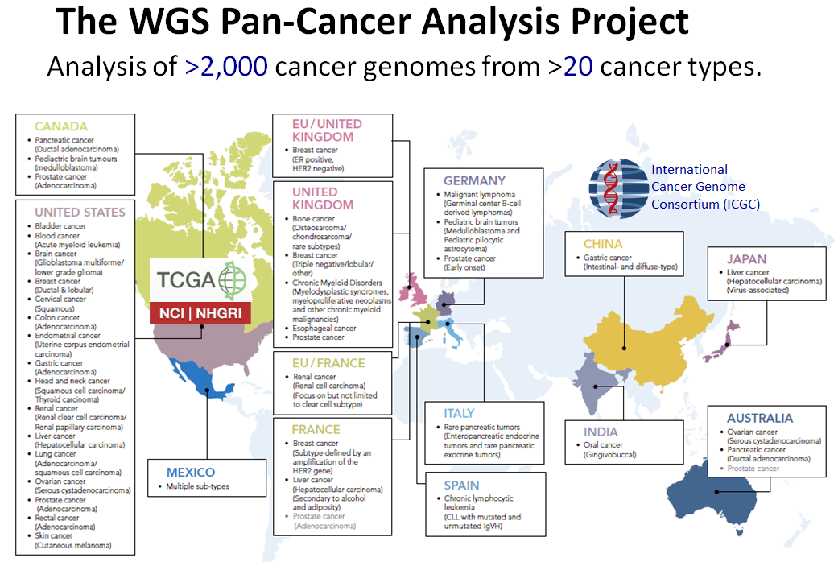
Document 20
Notes:
The Cancer Genome Atlas (TCGA) is a comprehensive and coordinated effort to better understand the molecular basis of cancer. TCGA has joined forces with the International Cancer Genome Consortium (ICGC) on a PanCancer analysis project, the goal of which is to perform whole-genome sequence analyses on ~2,000 tumor/normal pairs. The project leads are meeting this coming week as part of the ICGC scientific workshop in Beijing, China. Over 150 investigators from around the globe are participating in analyses in topic areas including: transcriptome and genome integration, novel somatic mutation-calling method development, evolution and heterogeneity, and germline cancer genome variation.
Tumor-specific analyses remain a major focus of TCGA. Sample accrual ended in late December, with the project qualifying over 10,000 cases from 33 tumor types. The TCGA global analysis papers for lung adenocarcinoma and stomach adenocarcinoma were accepted for publication in Nature in February and May, respectively.
Finally, the 3rd annual TCGA Scientific Symposium took place last week at NIH. This meeting included presentations on tumor-specific analyses, cross-tumor analyses, biological validation, actionable clinical insights, and the integration of analysis tools. Videos of the symposium talks will be made available on GenomeTV channel of YouTube.

Slide 39

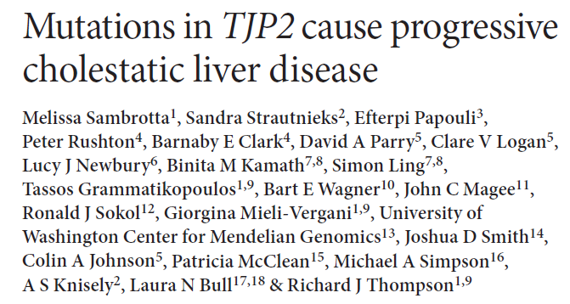
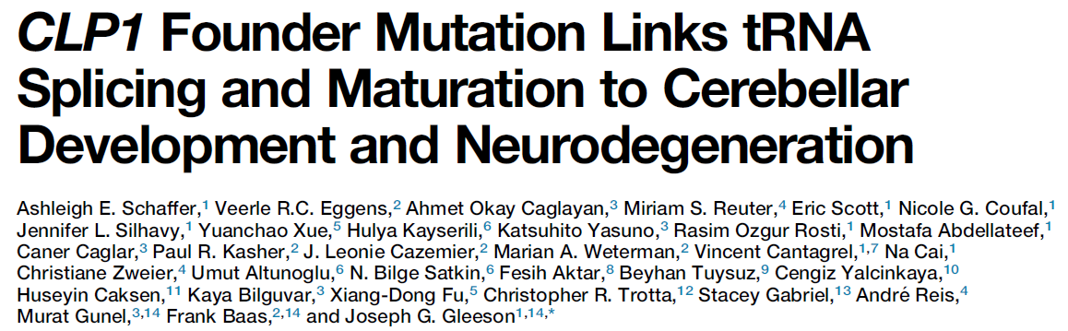
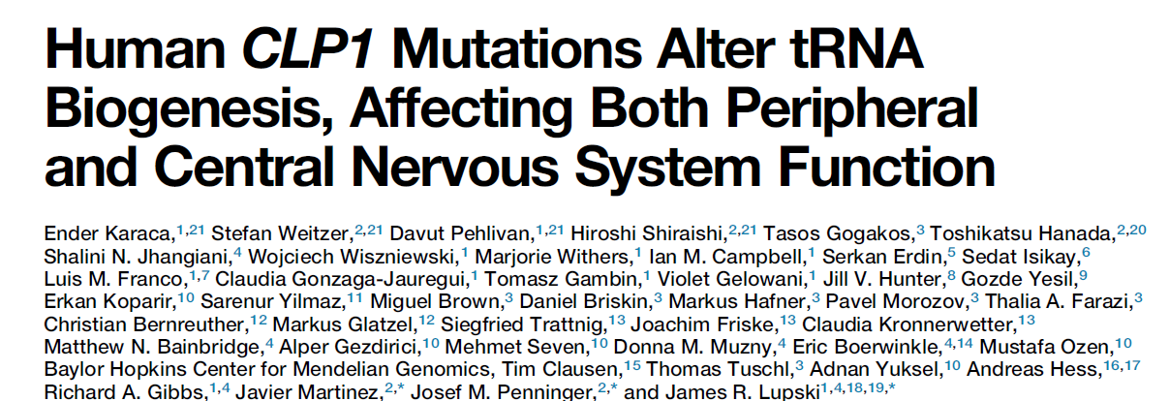
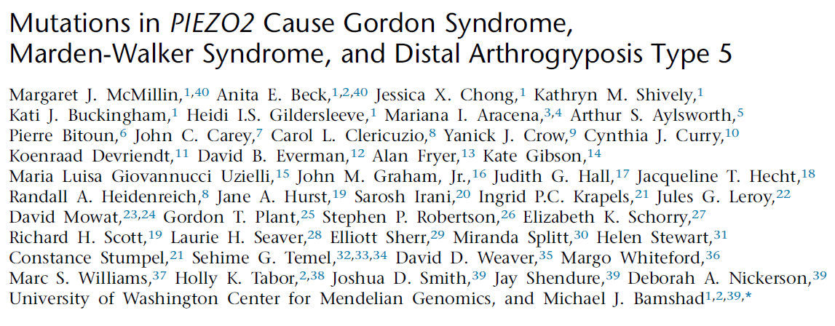

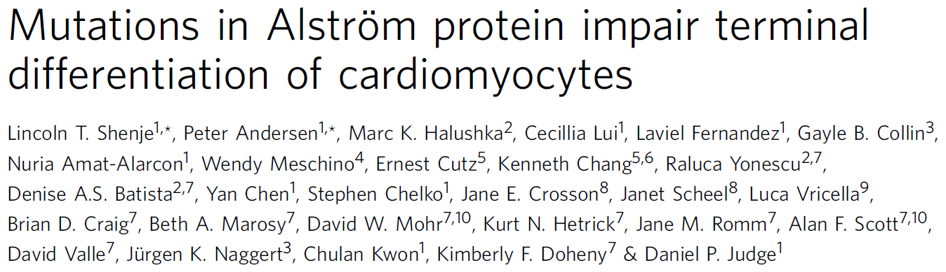
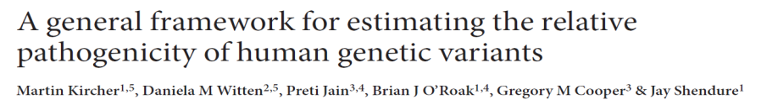
CMG Network: >410 investigators, 33 countries
~80 publications
Document 21
Notes:
The Centers for Mendelian Genomics (aka, the CMGs) aim to contribute to solving most of the remaining unsolved Mendelian diseases using genome-sequencing approaches. Since inception of the program 2.5 years ago, * the CMGs have collaborated with over 410 investigators in 33 countries, studying over 800 diseases.
* To date, the CMGs have produced over 80 publications reporting genomic alterations underlying a variety of rare diseases and methods and resources for making disease-gene discovery. Shown here is a subset of recent papers co-authored by the CMGs and their collaborators. Clockwise from the bottom left are papers reporting genes associated with cardiac development, nervous system function, liver function, and Gordon syndrome and related diseases, respectively, and a methods paper.

Slide 40
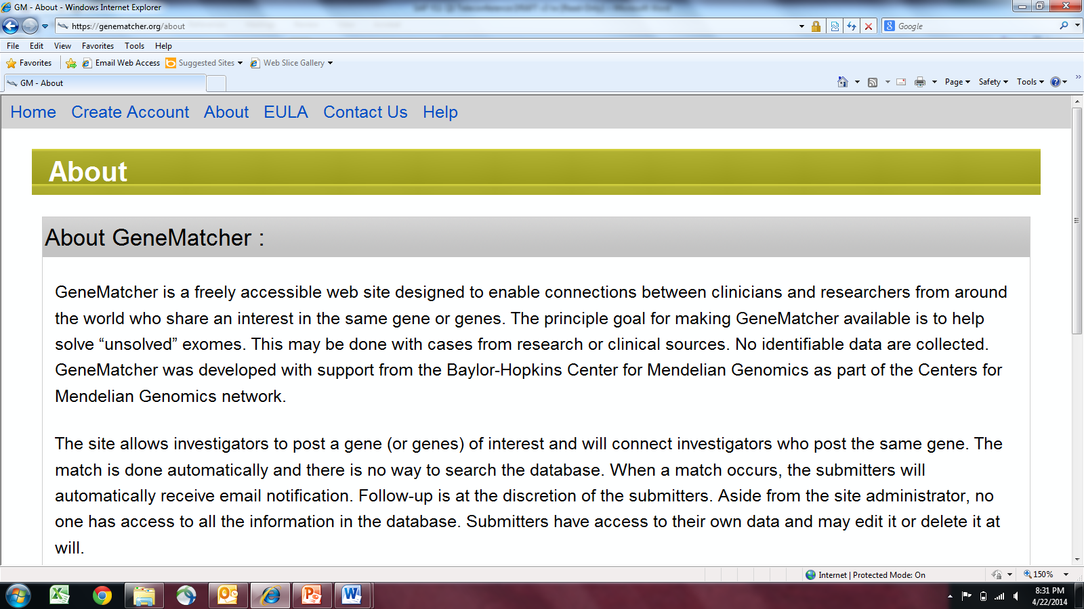
Used by geneticists from ~ 30 countries
Document 21
Notes:
The Centers have multiple ways to reach out to the community of researchers and clinicians in an effort to enable and accelerate Mendelian disease gene discovery. For example, the recently launched GeneMatcher is a freely accessible website designed to enable connections between clinicians and researchers from around the world who share an interest in the same gene or genes. The principle goal for making GeneMatcher available is to help solve ‘unsolved’ diseases. The site allows investigators to post genes of interest, and it then connects investigators who post the same gene.
This site is currently being used by geneticists in over 30 countries.

Slide 41

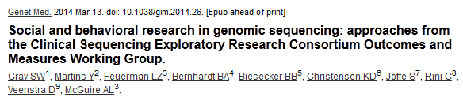





CSER Steering Committee meeting | May 13-14, 2014
    Streamlining variant pathogenicity annotation
    Best practices for clinical genomics implementation
Document 22
Notes:
The Clinical Sequencing Exploratory Research (or CSER) Program focuses on the integration of genome sequencing into the clinical workflow.
Recent CSER papers were published from the * Outcomes and Measures Working Group and the Pediatrics Working Group. * A manuscript from the Actionability-Return of Results Working Group in collaboration with the eMERGE Return of Results Working Group was also accepted for publication in the American Journal of Human Genetics.
Other recent publications include * Parents’ Preferences for Return of Results in Pediatric Genomic Research * Return of Results: Ethical and Legal Distinctions Between Research and Clinical Care, and * Traditional Roles in a Non-Traditional Setting: Genetic Counseling in Precision Oncology.
* Last week, the CSER Steering Committee met in the DC area. In addition to convening the expanded advisory panel for the first time, the meeting featured talks from genetic counselors on the front line of clinical genome sequencing, a comparison of annotation methods for streamlining variant pathogenicity annotation, and best practices for clinical genomics implementation.

Slide 42

Document 22
Notes:
Also, the CSER Coordinating Center at the University of Washington recently launched the CSER twitter account. Follow @hail_CSER for announcements and news regarding clinical genome sequencing research.

Slide 43






Genome Sequencing Informatics Tools
BreakDancer
SV caller using paired-end sequencing data
Turnkey Variant Analysis Project
Pindel
Indel caller using pattern growth
VarScan
Germline & somatic SNV & CNV caller
  GS-IT projects are putting iSeqTools in the cloud
  Genomics tools in cloud are more readily accessible by wider range of users
  iSeqTools Network workshop on ‘De-Mystify the Cloud’ at 2014 ASHG meeting
Document 23
Notes:
The Genome Sequencing Informatics Tools (GS-IT) Program is known publicly by the name “iSeqTools.” As a reminder, the program comprises six projects that are developing approaches to provide ‘researcher friendly’ sequence-analysis tools. The primary audience is the community of users outside of large genome-sequencing centers.
* GS-IT projects are putting iSeqTools in the cloud to * democratize access for the many researchers who are located outside of institutions with large computing infrastructure. The Washington University’s Turnkey Variant Analysis Project is one example. Tools from this project (such as BreakDancer, Pindel, and VarScan) have been wrapped in a user-configurable pipeline for use in the cloud.
* The iSeqTools Network will be presenting a workshop at this year’s American Society of Human Genetics meeting entitled: “iSeqTools to ‘De-Mystify’ the Cloud and Genomics Analysis for Researchers Seeking Ways to Analyze High-Throughput DNA Sequencing Data.” This workshop will demonstrate how researchers can use iSeqTools in the cloud to level the playing field for genome-sequence analysis.

Slide 44






ENCODE
  ENCODE Outreach Activities:
    ENCODE Workshop at HUGO Meeting (April 2014)
    ENCODE Workshop at ESHG Conference (June 2014)
  ENCODE Consortium Meeting (July 2014)
  PNAS Perspective:
  “Defining functional DNA elements in the human genome”
Document 24
Notes:
The goal of the Encyclopedia of DNA Elements (or ENCODE) project is to create a catalog of all functional genomic elements, and to make that catalog freely available as a resource to the biomedical community.
In terms of ENCODE outreach activities, * the Sanger Institute recently held a workshop on working with ENCODE data at the 2014 HUGO Human Genome Meeting in Geneva. The workshop had over 80 participants, and the materials for the workshop are available on the Sanger Institute website.
* There will be a satellite workshop at the 2014 European Society for Human Genetics meeting that will describe approaches for conducting analyses using ENCODE data.
* An ENCODE Consortium Meeting will soon take place in Stanford, California. The data production centers, data analysis and coordination centers, computational analysis groups, and technology development groups will present updates on their progress, hear how ENCODE data are being used by the community, and explore potential additional collaborations.
* A perspective written by ENCODE investigators entitled “Defining functional DNA elements in the human genome” was recently published online in PNAS. It outlined the differing definitions of genome ‘function’ among various fields, and the implication of these definitions for annotating genomes.

Slide 45

ENCODE Publications
Document 24
Notes:
We continue to compile information about publications emanating directly from the ENCODE project and indirectly from the use of ENCODE data.
ENCODE-funded publications (shown in purple) include 26 publications by the mouse ENCODE group, over 321 publications by the ENCODE production centers, and over 148 publications by the modENCODE project. In terms of community publications reflecting the use of ENCODE data (shown in blue), there are at least 479 publications by non-ENCODE authors that used ENCODE data and at least 149 publications by non-modENCODE authors that used modENCODE data.

Slide 46

Centers of Excellence in Genomic
Science (CEGS) Program
  CEGS program announcement published in the NIH Guide: PAR-14-195
  Application receipt dates:
    July 2, 2014 | May 20, 2015 | May 20, 2016
Document 25
Notes:
Turning to our Centers of Excellence in Genomic Science (or CEGS) Program, * the new CEGS program announcement was published in late April. * Applications are due this year on July 2, and on May 20 in 2015 and 2016.
As always, we encourage those who are considering submitting an application to contact members of our extramural staff well in advance of preparing an application, so as to get feedback about the program and their project ideas. A synopsis about the CEGS program is available on the program’s website, which provides a summary of features of the CEGS program that should be helpful for potential applicants.

Slide 47





ClinGen
CSER
Progress in Developing Curated Sequence Variant Content in NCBI’s ClinVar Database
Making Genomic Data Accessible: Building Shared Genomic Resources
Moving the Field Forward: Sharing Data to Better Interpret Genomic Variation and Obtain Comprehensive Phenotypes
One Year Later: ACMG Recommendations for Reporting of Incidental Findings in WES/WGS
Quality of Clinical Sequence Data for Relevant Targets
Actionable, Pathogenic Incidental Findings in 6500 Subjects’ Exomes
Courtesy of Gail Jarvik
Document 26
Notes:
The American College of Medical Genetics and Genomics held its annual meeting in March in Nashville. Both NHGRI’s CSER and ClinGen programs were prominently featured at this meeting.
Major talks from * ClinGen included * a presentation on efforts to standardize data submission to ClinVar and curation of sequence variants, * a talk on the benefits of data sharing within the consortium, and * a plenary session highlighting several key ClinGen components as illustrated in this * ClinGen systems map.
Events featuring * CSER investigators included * a panel discussing implications of the ACMG recommendations for reporting incidental findings— one year later, * a comparative analysis of coverage of medically relevant genomic regions from the Sequencing Standards Working Group, and * an assessment of the rate of pathogenic findings based on the Exome Variant Server. As a highlight from this last talk, * shown here is an update on the rate of returnable mutations based on data from >6500 individuals in the Exome Variant Server database, which provides a more precise estimate of the frequency of pathogenic variants in an adult population of European and African ancestry. In total, pathogenic, likely pathogenic, or novel disruptive variants were identified in 2.3% of individuals of European ancestry and 1.5% of African ancestry.

Slide 48

Genomics and Society Working Group
  Third in-person meeting held April 2014
  Key topics discussed included:
    Training
    GSWG progress and future directions
  Annual report planned for September Council
  Council member Arti Rai joining the Working Group
Document 27
Notes:
The Genomics and Society Working Group of this Council * held their third in-person meeting in this very room in April. The meeting included presentations from Karen Helmers of the Center for Scientific Review about the review of ELSI research grants and Sara Hull about the NHGRI Bioethics Core and the NIH Clinical Center’s Department of Bioethics.
* Key topics then discussed at the meeting included mechanisms for training utilized by the ELSI Research Program and progress made thus far by the Working Group and future directions for upcoming meetings.
* The current Working Group chair, Pamela Sankar, will present an annual report from the Working Group at the September Council meeting.
* Finally, I would like to personally thank Council member Arti Rai, who has agreed to join the Working Group and will attend future meetings.

Slide 49

ELSI Research Program
  CEER Annual Meeting (March 2014)
      Mock grant review for trainees
      ELSI ‘horizon scanning’
  Upcoming Re-Issuance of ELSI Program Announcements
      Shorter, more streamlined format
      Input from Genomics and Society Working group and NIH partners
      Scheduled release: August 2014
Document 28
Notes:
The Centers of Excellence in ELSI Research (or CEER) program * held its annual meeting in March. This meeting brought together all currently funded Centers, including the new P50 and exploratory P20 Centers funded last year. This year’s meeting included a mock grant review for the CEER trainees that was led by Rudy Pozzatti as well as an evening session led by Jeff Botkin devoted to scanning the horizon for new and emerging ELSI issues (and discussions about new ELSI research models).
* The ELSI Research Program is currently revising its program announcements for the R01, R03, and R21 mechanisms. The new announcements will use a shorter, more streamlined format, and will incorporate input from the Genomics and Society Working Group and from our NIH partner institutes and centers. As the announcements are being revised, Larry Brody and ELSI Research Program staff have been actively seeking input to stimulate greater NIH interest in supporting ELSI research and to increase the number of institutes and centers that sign onto the announcements. The revised program announcements are scheduled to be released in August.

Slide 50
Director’s Report Outline
General NHGRI Updates
General NIH Updates
General Genomics Updates
NHGRI Extramural Research Program
NIH Common Fund/Trans-NIH
NHGRI Division of Policy, Communications, and Education
NHGRI Intramural Research Program

Slide 51


Knockout Mouse Phenotyping Project (KOMP2)
  IMPC evaluating CRISPR technology
    KOMP centers to make and phenotype ~100 knockout strains testing the CRISPR method
    Plan to award $3M in supplemental funds provided by Common Fund
Document 29
Notes:
The Knockout Mouse Phenotyping Project (KOMP2) is jointly funded by the Common Fund and 18 other NIH institutes and centers. It was launched in 2011 with the goal of making and phenotyping 2,500 mouse knockout strains over five years.
* The International Mouse Phenotyping Consortium (IMPC) is evaluating the CRISPR technology in a high-throughput production environment. In pilot experiments, CRISPR is so efficient that homozygous null alleles are recovered in pups following 1-cell embryo injections.
* The KOMP centers will make and phenotype about 100 knockout strains in order to test the CRISPR method (in addition to completing regular production of ES cell-derived mice). * The Common Fund in providing $3 million of supplemental funds as a one-time provision in order to support this work.

Slide 52

    Scale-up phase underway
        >650 donors enrolled
        ~11,500 RNA-Seq studies
    Biospecimen Access Policy implemented
    2nd GTEx Community Scientific Meeting in June
Document 30
Notes:
The Genotype-Tissue Expression (GTEx) Project aims to study human gene expression and regulation in multiple tissues through genomic analyses of rapid autopsy samples. The goal is to gain key insights into the mechanisms of gene regulation and, in the future, its disease-related perturbations.
After a successful pilot, * GTEx has now entered its scale-up phase, and donor enrollment is ramping up. Thus far, over 650 (of a projected 900) donors have been enrolled, and roughly 11,500 (of a projected 25,000) RNA-Seq studies have been completed.
* Additionally, the GTEx Biospecimen Access Policy has now been implemented, and three requests for outside investigators to access the samples have already been approved.
* GTEx will hold its 2nd Community Scientific Meeting at the Broad Institute in June, with a poster session taking place the evening before. Presentations from both GTEx and non-GTEx investigators will demonstrate the wide range of analyses that can be performed using GTEx data. To register, please visit the 2014 GTEx Community Scientific Meeting website.

Slide 53

  LINCS Pilot Phase wrapping up
  LINCS Phase 2 begins this summer
    Phase 2 Data and Signature Generation Centers will be discussed in Closed Session
    BD2K-LINCS Data Integration and Coordination Center (RFA HG-14-001) applications will be reviewed in July and go to NHLBI Council
Document 31
Notes:
The Library of Integrated Network-based Cellular Signatures (or LINCS) Program aims to create a network-based understanding of biology by cataloging changes in gene expression and other cellular processes that occur when cells are exposed to a variety of perturbing agents. LINCS uses computational tools to integrate this diverse information into a comprehensive view of normal and disease states that can be applied for the development of new biomarkers and therapeutics.
* The LINCS pilot phase is wrapping up by focusing on an internal collaborative project and on how to transition the data and tools generated in Phase 1 to Phase 2.
* LINCS Phase 2 will begin this summer with a meeting in Bethesda that will focus on collaborations with other programs (like ENCODE and the Common Fund’s Epigenomics program) as well as on coordinating common cells and perturbations. * The Phase 2 Data and Signature Generation Centers will be discussed in Closed Session.
* Applications for the BD2K-LINCS Data Integration and Coordination Center have been received, the review will be held in July, those applications will then go to the NHLBI Council, and the Center will be funded by the end of this Fiscal Year.

Slide 54

H3Africa
  Biorepositories scale-up: Administrative review to be discussed in Closed Session
  Marker paper (“Enabling African Scientists for the Genomic Revolution”) in press at Science
  >5,000 samples accrued as of March 31
  H3ABioNet accrediting nodes
  4th Consortium Meeting moved from Uganda to Cape Town (to be held in late May)
    Companion Workshops: Cardiovascular Diseases, Ethics, and Genome Analysis and Data Management
Document 32
Notes:
The goal of the Human Heredity and Health in Africa (H3Africa) Project is to develop a sustainable and collaborative African genetics and genomics research enterprise. In terms of updates, * proposals from the pilot biorepository groups to scale up have been received, and the results of an administrative review be discussed in the Closed Session. * An H3Africa ‘marker paper’ (entitled “Enabling Africa Scientists for the Genomic Revolution”) is now in press at Science. A related concept paper will also appear in the CardioVascular Journal of Africa.
Most H3Africa grantees have received ethics approval for their studies, and sample accrual is ongoing at over half of the collection sites— with over 5,000 samples accrued as of March 31. * The H3ABioNet (the bioinformatics component of H3Africa) has embarked on a program of accrediting the individual nodes that will carry out specific data analyses.
The 4th H3Africa Consortium meeting was scheduled to be in Kampala, Uganda. But after Uganda’s President signed the Uganda Anti-Homosexuality Act, the meeting was moved to Cape Town, South Africa. * Topics of companion workshops being held in conjunction with the meeting include Cardiovascular Diseases in Africa, Ethics (involving ethics chairs from across the continent), and Genome Analysis and Data Management.

Slide 55

Big Data to Knowledge (BD2K)
  Phil Bourne started as NIH Associate Director for Data Science in March
  Status of BD2K Components:
    Centers of Excellence (Closed Session)
    LINCS-BD2K Perturbation Data Coordination and Integration Center (NHLBI Council in September)
Document 33
Notes:
There are a number of updates about the Big Data to Knowledge (BD2K) initiative. As a reminder, BD2K is a trans-NIH initiative aimed at enabling scientists to capitalize on Big Data for advancing biomedical research. BD2K consists of four subareas, focusing on facilitating broad use of data, data analysis methods and software, enhancing training, and establishing Centers of Excellence.
* Phil Bourne started as the NIH Associate Director for Data Science in March. He is making the rounds at NIH and other agencies, and is formulating his ideas for an NIH approach to creating a National Bioinformatics Framework. Jennie Larkin of NHLBI is on detail to assist both Phil Bourne and Mark Guyer, who continues to work extensively on BD2K.
* In terms of individual BD2K components, the first BD2K FOA aims to establish investigator-initiated Centers of Excellence. A large number of applications were received, and these were reviewed in April. A second-level review will be held by this Council later in the Closed Session, and then programmatic input will be provided by a newly-formed Multi-Council Working Group (which I will describe shortly). * The LINCS-BD2K Perturbation Data Coordination and Integration Center is the first NIH-initiated BD2K Center, and represents a collaboration between the LINCS and BD2K programs. As I mentioned earlier, it will be going to the NHLBI Council in September.

Slide 56

Big Data to Knowledge (BD2K)
  Status of BD2K Components (con’t):
    Training:
      K01s & R25s (NHGRI Council in September)
      T32s: new and supplements (FOAs issued)
  Data Discovery Index (NHLBI Council in September)
  Targeted Software Development (June receipt date)
Document 33
Notes:
In terms of other updates, * three sets of applications were received for BD2K training grants. These will all come to this Council in September. The K01 grants are for Mentored Career Development in Biomedical Big Data. Then there are R25 grants for Courses for Skills Development in Biomedical Big Data and R25 grants for Open Educational Resources for Biomedical Big Data.
* Some new BD2K training FOAs were just released for Pre-doctoral Training in Biomedical Big Data Science. The new T32s are due this July, and a second round will be due in July 2015. Requests for supplements to existing T32s have also been released, and have the same due dates. All of these will eventually come to this Council.
* An FOA for forming the Data Discovery Index Coordination Consortium has been released, with the applications going to the NHLBI Council in September. This Consortium will not create the NIH Data Discovery Index, but will engage stakeholders and the community about how such an index should be set up and will fund some small pilot projects.
* The Targeted Software Development FOA has been released, and applications are due in June. Those applications will come to this Council in February 2015.

Slide 57

BD2K Multi-Council Working Group
  BD2K and the envisioned NIH Office of Data Science cannot issue FOAs
  Because BD2K is a trans-NIH initiative, a trans-NIH approach to obtaining input has been devised
  Multi-Council Working Group: representative from each council that wishes to participate and has relevant expertise
  First meeting in July
Document 33
Notes:
Another important development relates to getting broad trans-NIH input for BD2K.
* BD2K and the envisioned NIH Office of Data Science cannot issue FOAs on their own, but rather require a ‘lead institute or center’ to issue them. That institute or center is not ‘in charge’ of the FOA, but rather serves as a proxy for BD2K. Many BD2K initiatives, including the Centers of Excellence program, have NHGRI as the lead institute.
* To fit the trans-NIH nature of BD2K, an approach has been devised for obtaining trans-NIH input— rather than limiting that input to the lead institute or center. * This approach involves the creation of a Multi-Council Working Group, which consists of a representative from each institute or center council that wishes to participate and has relevant expertise. This group will provide programmatic input about BD2K applications. Jill Mesirov has graciously agreed to be this Council’s representative on this BD2K Multi-Council Working Group.
* The first meeting of this Working Group will occur in July, at which time they will be discussing the BD2K Centers of Excellence applications, the Data Discovery Index Coordination Consortium applications, and the first round of BD2K training grants.

Slide 58
Director’s Report Outline
General NHGRI Updates
General NIH Updates
General Genomics Updates
NHGRI Extramural Research Program
NIH Common Fund/Trans-NIH
NHGRI Division of Policy, Communications, and Education
NHGRI Intramural Research Program

Slide 59



Effective Strategies for Engaging Communities Around Genomic Medicine
Notes:
In February, NHGRI’s Education and Community Involvement Branch held a day-long meeting with patient advocates and representatives of community-based groups about the future of genomic medicine. The goal of the meeting was to facilitate a conversation with representatives of grassroots communities on the implications of genomic medicine for the communities they work with and represent. The conversation and activities centered around effective and appropriate ways to engage with communities, organizations, and patient populations around genomics research and literacy.
The meeting attendees represented healthcare practitioners, community health advocates, tribal health liaisons, researchers, policy advocates, and cancer support advocates. Building upon the great interest and conversations started in February, NHGRI is continuing to work in partnership with meeting attendees by exploring what resources, tools, and approaches might be beneficial to the public and their respective communities.
A summary of the meeting is forthcoming, and the suggestions and feedback collected will inform the Branch and the Division of Policy, Communications, and Education as a whole in developing future public engagement strategies and activities.

Slide 60




2014 USA Science and Engineering Festival (USASEF) and DNA Day 2014
Document 34
Notes:
The 2014 USA Science and Engineering Festival took place in late April at the Washington DC Convention Center. More than 650,000 members of the public attended this event— three times the number of attendees compared to 2012. For even more perspective, the Festival is one of only two events to have completely rented out the entire DC Convention Center, and more than 750 organizations participated in this year’s event. NIH had a significant footprint at the festival, and NHGRI was one of the Institutes that had a booth with more than 40 volunteers.
The Festival held a Sneak Peek Friday event on April 25, which happened to also be DNA Day 2014. Sneak Peek Friday was a special event for school groups, homeschoolers, and military families. Over 30,000 participants were able to preview and experience the Festival’s exhibits before it officially opened to the public and to enjoy the NHGRI DNA Day activities, which included working with the genetic trait wheel and extracting DNA from strawberries.

Slide 61


Communications Staff Departure
Larry Thompson
Jeannine Mjoseth
Notes:
Earlier this month, * Larry Thompson left his position as Chief of our Communications and Public Liaison Branch for a job at the company Johnson & Johnson. Larry’s 14-year tenure at NHGRI has been associated with the growth and maturation of NHGRI’s communications program. He was instrumental in seeing it expand into new areas, while at the same time having our communications group keep up with NHGRI’s (and genomics’) frenetic pace that needed to be covered on a routine basis. On behalf of many, I want to thank Larry for his myriad contributions and successes at NHGRI, and wish him all the best in his new professional endeavors.
* Jeannine Mjoseth, who has been our Deputy Chief for Communications since October 2010, has agreed to serve as the Acting Chief while a search is conducted. That search will launch in the very near future, and if any of you know of good candidates to suggest for this very important Institute position, please contact me or Laura Rodriquez.

Slide 62
Director’s Report Outline
General NHGRI Updates
General NIH Updates
General Genomics Updates
NHGRI Extramural Research Program
NIH Common Fund/Trans-NIH
NHGRI Division of Policy, Communications, and Education
NHGRI Intramural Research Program

Slide 63



NHGRI Intramural Research Program: Reorganization Update
Appointment of New Branch Chiefs:
  Charles Rotimi: Metabolic, Cardiovascular, and Inflammatory Diseases Branch
  Pam Schwartzberg: Genetic Disease Research Branch
  Julie Segre: Translational and Functional Genomics Branch
Document 35
Notes:
At the last Council meeting, you heard an update about the Institute’s Intramural Research Program from our Scientific Director, Dan Kastner. At that time, Dan discussed how he was in the midst of reorganizing the Intramural Research Program to modernize its structure, similar in some ways to how I reorganized the Institute more broadly about 1.5 years ago.
That reorganization of our Intramural Research Program has now largely been implemented. Among the new elements of that Program has been the creation of several new branches, the reconfiguration of some existing branches, and the * appointment of three new branch chiefs: specifically, * Charles Rotimi, Chief of the new Metabolic, Cardiovascular and Inflammatory Diseases Branch; * Pam Schwartzberg, Chief of the reconstituted Genetic Disease Research Branch; and * Julie Segre, Chief of the new Translational and Functional Genomics Branch.

Slide 64

Document 35
Notes:
Shown here is an overview of the new structure for the NHGRI Intramural Research Program, which consists of ~45 research and clinical investigators and a ~550-person staff. The main organization elements include 9 research branches and an Office of the Clinical Director. The leaders of these major elements are also highlighted in picture form on this schematic.
Some additional organizational elements (such as offices and centers) within our Intramural Research Program are listed below.

Slide 65


Intramural Investigator Departures
Colleen McBride, Ph.D.
Fabio Candotti, M.D.
Notes:
There are other changes occurring to our Intramural Research Program, in this case in the form of investigator departures.
* Colleen McBride is leaving NHGRI to join Emory's Rollins School of Public Health as the Rollins Professor and Chair of the Department of Behavioral Sciences and Health Education. Colleen has served as the founding Chief of NHGRI’s Social and Behavioral Research Branch for ten years
* Fabio Candotti is also leaving NHGRI to take a position at the CHUV University Hospital of Lausanne (Switzerland) in June. Fabio has been a leader in the study of inherited immunodeficiency diseases at the NIH for many years, and a pioneer in developing gene therapy for his patients at the NIH Clinical Center.
Colleen and Fabio have been terrific and highly productive members of NHGRI’s Intramural Research Program, and I wish them both the best of luck in their new endeavors.

Slide 66


Dedication of John Edward Porter Neuroscience Research Center
Document 36
Notes:
The newest addition to the NIH campus, the John Edward Porter Neuroscience Research Center, was recently dedicated. The building is named in honor of long-time NIH champion and former congressman for 20 years, John Porter.
The Porter building represents an ‘experiment’ in space allocation in the NIH Intramural Research Program, whereby the entire building is dedicated to a single scientific theme (neuroscience) rather than an institute or group of institutes. Such clustering of neuroscience researchers from across the NIH facilitates trans-disciplinary collaborations. NHGRI has two of its intramural investigators’ laboratories in the building.
Construction of the building has a somewhat complicated history, in that the first half of the building was built and occupied in 2004. But budgetary constraints prevented the building from being completed until ARRA (Recovery Act) funds were provided to complete this important building project.
Now dedicated and occupied, the full building houses ~800 neuroscientists within 85 research groups from 10 NIH institutes in its 500,000 square feet of space. The facility’s MRI suite houses one of the largest MRI devices in the world.

Slide 67

NIH Clinical Center Genomics Opportunity
Sponsors: NIH Office of Intramural Research, NHGRI, and NIH Clinical Center
Goals:
  Infrastructure for clinical genomics at the NIH Clinical Center
  Develop capabilities within institutes for using genomic data in clinical research and care
1,000 whole-exome sequences
Document 37
Notes:
NHGRI has been instrumental in creating a novel clinical genomics opportunity for the broader NIH Intramural Research Program. Specifically, * the NIH Office of Intramural Research, NHGRI, and the NIH Clinical Center are co-sponsoring a joint genomics venture to enhance the clinical research enterprise within the NIH Clinical Center. This program, entitled the “Clinical Center Genomics Opportunity,” has as its goals * to build a robust infrastructure for clinical genomics in the NIH Clinical Center and to develop capabilities within institutes for using genomic data in clinical research and care.
The ideal studies for the program will be led by investigators who are knowledgeable in genetics, but who do not currently have a major research program in clinical genomics. Les Biesecker and Teri Manolio co-chair the committee that will review study proposals, which are expected to involve the generation of 50-300 whole-exome sequences to be derived from samples ascertained over a 1-2 year period. * Funds are available for generating a total of 1,000 whole-exome sequences from NIH Clinical Center patients, with the sequencing to be performed at the NIH Intramural Sequencing Center via a CLIA-compliant pipeline.

Slide 68

Johns Hopkins Society of Scholars
Andy Baxevanis, Ph.D.
Document 38
Notes:
Andy Baxevanis, Head of the Computational Genomics Unit and the Bioinformatics and Scientific Programming Core, has been inducted into the Johns Hopkins Society of Scholars. This honor is given to former postdoctoral fellows, postdoctoral degree recipients, house staff, and junior or visiting faculty who have served at least one year at Johns Hopkins and thereafter gained marked distinction elsewhere in the fields of physical, biological, medical, social, or engineering sciences, or in the humanities.

Slide 69




NHGRI Intramural Research Highlights
  Early-Onset Stroke and Vasculopathy Associated with Mutations in ADA2
Global Analyses of Human Immune Variation Reveal Baseline Predictors of Postvaccination Responses
Glycosylation, Hypogammaglobulinemia, and Resistance to Viral Infections
Document 39
Notes:
Finally, research highlights from the NHGRI Intramural Research Program since the last Council meeting include:
* A team led by Dan Kastner identified gene variants that cause a rare syndrome of sporadic fevers, skin rashes, and recurring strokes beginning early in childhood. They call the new syndrome deficiency of ADA2 (or DADA2). Their paper was published in the New England Journal of Medicine.
* In April, Cell published a study by Pam Schwartzberg and colleagues that described an approach for modeling and predicting human immune responses to influenza vaccination based on the state of the immune system before immunization. These findings provide a conceptual framework for identifying factors that influence immune responses in people, which potentially can be used to optimize treatment.
* And a team that includes members of the Undiagnosed Diseases Program reported in a New England Journal of Medicine paper that a rare genetic disease that depletes patients of infection-fighting antibodies may actually protect them from certain severe or recurrent viral infections.

Slide 70
To receive The Genomics Landscape,
go to list.nih.gov
Search for NHGRILANDSCAPE
Past issues can be accessed at: genome.gov/27527308
Document 40
Notes:
Before ending my Director’s Report, I would like to point out that anyone wishing to receive my monthly email update (called “The Genomics Landscape”) can simply go to list.nih.gov and then search for “NHGRILANDSCAPE.” Over 1000 people are now signed up to receive this email update from me each month.

Slide 71


Thanks!
Special Thanks!
Notes:
Finally, a personal thanks to all of the various NHGRI staff (probably over 50-60 of you) who helped pull together the slides and information that I just reviewed. Such a group effort is essential for getting this large amount of information conveyed to you efficiently at each Council meeting.
An additional thanks to the NHGRI communications group and web team for making my Director’s Report into an electronic resource.
* And special thanks to Kris Wetterstrand (shown here volunteering at the recent USA Science and Engineering Festival), who serves as the ‘ring leader’ in coordinating material development, and who directly helps me produce the final Powerpoint file.

Slide 72

Advancing human health
through genomics research

