Slide 1

DIRECTOR’S REPORT National Advisory Council for Human Genome Research September 2011 Eric Green, M.D., Ph.D. Director, NHGRI

Slide 2



Remembering 9-11-01
Notes:
Yesterday was the 10th anniversary of 9-11 tragedies.
I am sure we all reflected on where we when those horrible events occurred 10 years ago.
I, for one, was in my office working away and meeting with members of my lab on what seemed like a calm morning.
Just a two-minute walk from my office was Natcher Conference Center, where NHGRI’s Council was convened for day two of their September meeting.
I am told that Francis Collins was handed a note with information about the events, and shortly after that the meeting ended earrly.
However, Council members were then stranded in Bethesda for days to come.
For our collective sanity, let’s hope no one passes me any notes during this Council meeting.

Slide 3
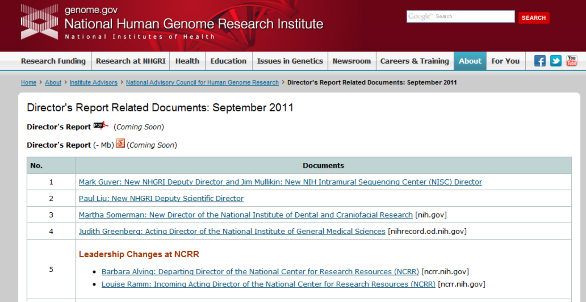
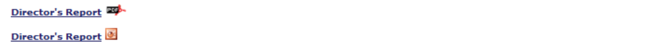
genome.gov/DirectorsReport
Document #
Notes:
Open Session of Council meeting is being Webcast live and will be Web-archived as well.
For new Council members and also for ad hoc members, I want to make you aware that there is an ‘electronic resource’ associated with my Director’s Report.
* This is like the supplemental materials associated with a published paper, and can be found at this URL.
My slides themselves are also available electronically at this site– * both as a PDF and a Powerpoint file.
* For slides associated with relevant documents or Web sites, there is a Document # indicated on the bottom right.
This entire site, including all linked documents, will be permanently archived on NHGRI’s Web site as a future reference.
3

Slide 4
General NHGRI Updates
General NIH Updates
Genomics Updates
NHGRI Extramural Program
NIH Common Fund Programs
NHGRI Office of the Director
NHGRI Intramural Program
Notes:
7 Areas of Director’s Report.
Has proven to be a good framework for reviewing relevant topics.
4

Slide 5
Open Session Presentations
NHGRI Office of Policy, Communications, and Education
Laura Lyman Rodriguez
Chicago Genomic Medicine Meeting
Teri Manolio & Geoff Ginsburg
Notes:
In addition to my Director’s Report, there will be other presentations in the Open Session of this Council meeting.
My Director’s Report is tailored around these presentations, meaning that I will touch lightly on the other topics covered in Open Session.
* Laura Rodriguez
* Teri Manolio and Geoff Ginsburg
5

Slide 6
Open Session Presentations
Program Updates:
H3Africa
Jane Peterson
GTEx
Jeff Struewing
Large-Scale Genome Sequencing Program
Adam Felsenfeld
Notes:
* Three program updates (two Common Fund program ** and one NHGRI program *).
6

Slide 7
General NHGRI Updates
General NIH Updates
Genomics Updates
NHGRI Extramural Program
NIH Common Fund Programs
NHGRI Office of the Director
NHGRI Intramural Program
Notes:
7

Slide 8

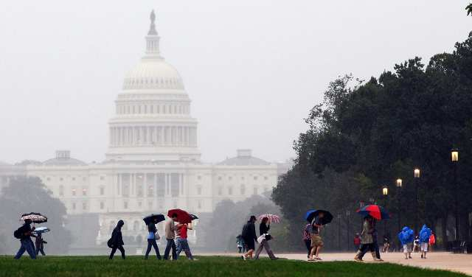



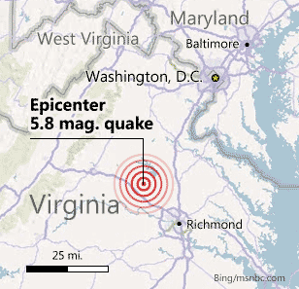

More Episodes of Nature’s Wrath
Notes:
Last year: blistering heat, power-outing winds, and an even a tiny little earthquake.
* This year: a ‘real’ earthquake (not that I felt it). There was very minor damage on and off the NIH campus.
Then a few days off.
* And then Hurricane Irene.
These two natural disasters were really just a test of our ‘emergency preparedness’ for the next disaster to be faced: the upcoming budget showdown (but more on that later).
8

Slide 9
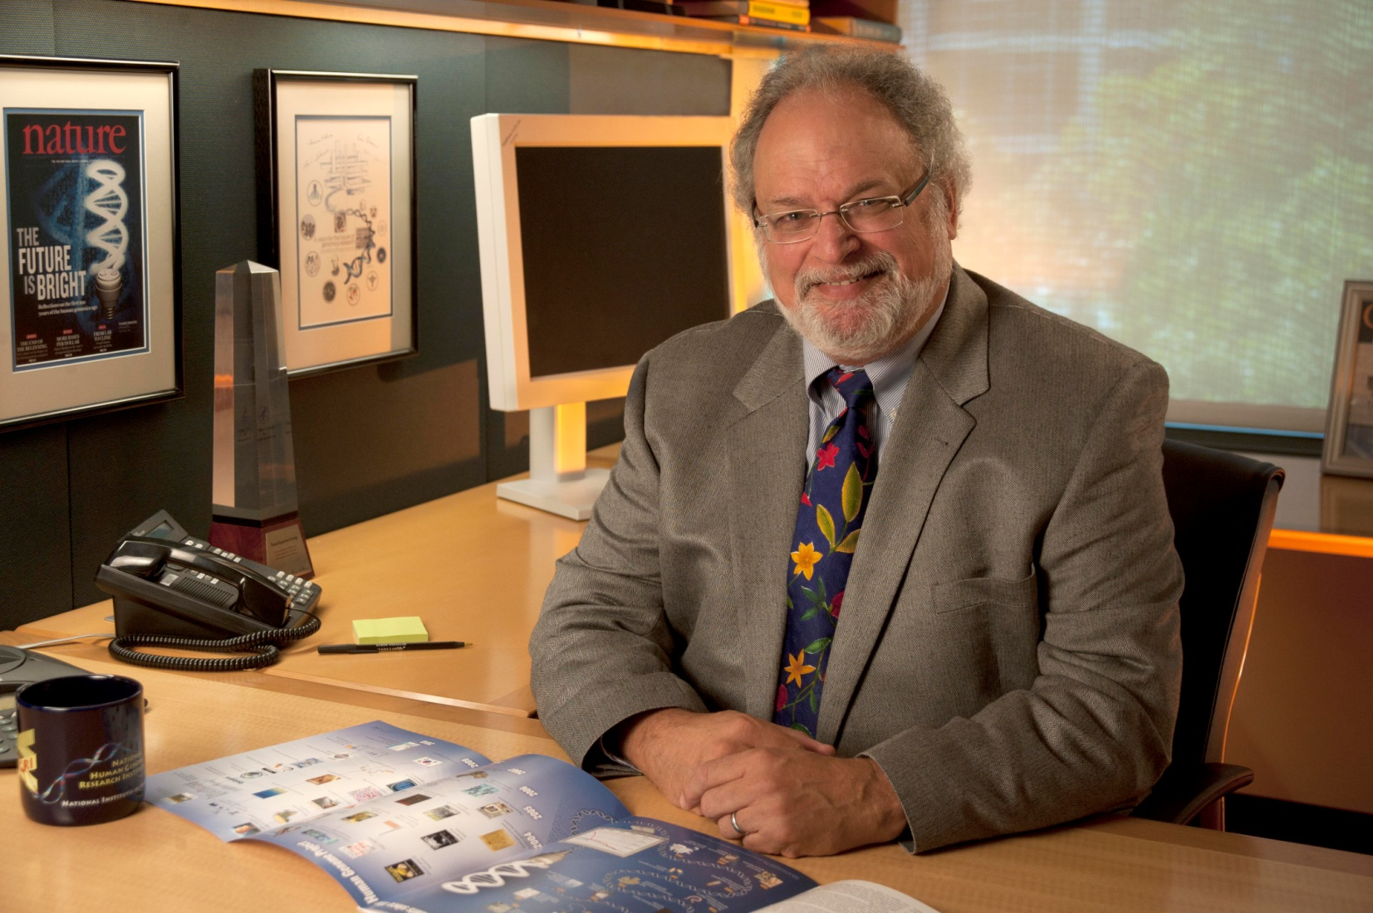
New NHGRI Deputy Director
Mark Guyer, Ph.D.
Document 1
Notes:
Member of Institute since 1988 (employee #4).
Almost decade-long Director of NHGRI’s Extramural Research Program.
Has been Acting Deputy Director since December 2009.
Will now serve as Acting Director of NHGRI’s Extramural Research Program while longer-term leadership plans are formulated.
9

Slide 10
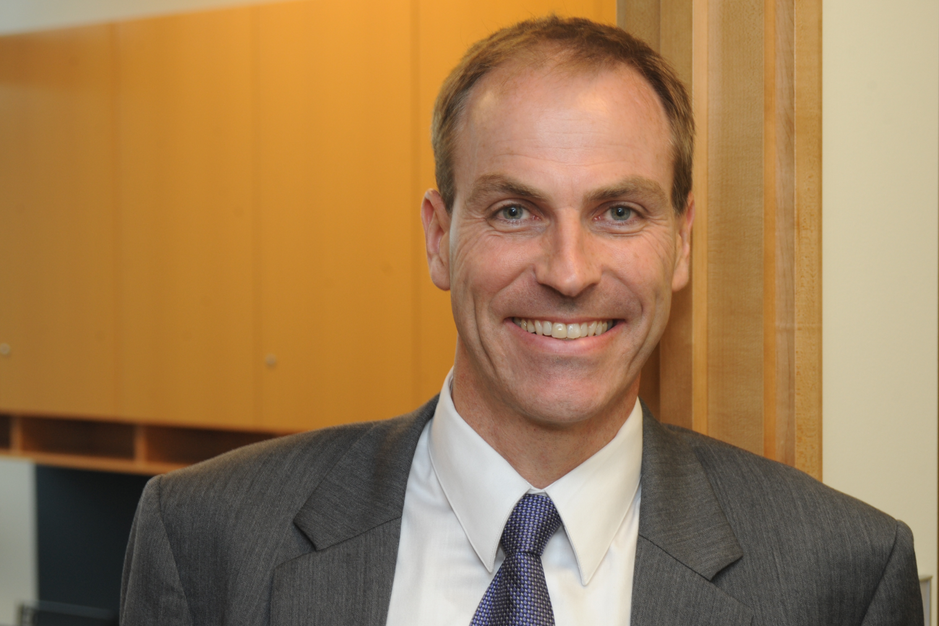
New NHGRI Policy and Program Analysis Branch Chief
Derek Scholes, Ph.D.
Notes:
As mentioned during the staff introductions, Dr. Derek Scholes (‘Skoles’) recently joined NHGRI as the new Chief of the Policy and Program Analysis Branch within our Office of Policy, Communications, and Education.
Derek received his doctoral training at the University of Liverpool in the U.K., before coming to Albany, New York for postdoctoral training at the Wadsworth Center.
Derek is an alumnus of the NHGRI-ASHG Public Policy Fellowship program [which we also just heard now has on board its newest fellow, Dr. Cristina Kapustij (‘Kah-Poo-Stee’)].
During his fellowship with NHGRI, Derek spent a few months with our Policy and Program Analysis Branch, and that was followed by a year-long stint in the late Senator Edward Kennedy’s office.
Derek comes to us from the American Heart Association, where he advocated for legislation supporting health and biomedical research, including significant contributions to the efforts to see GINA passed and to help the implementing regulations get drafted, as well as substantial work on the Family Smoking Prevention and Tobacco Control Act.
10

Slide 11
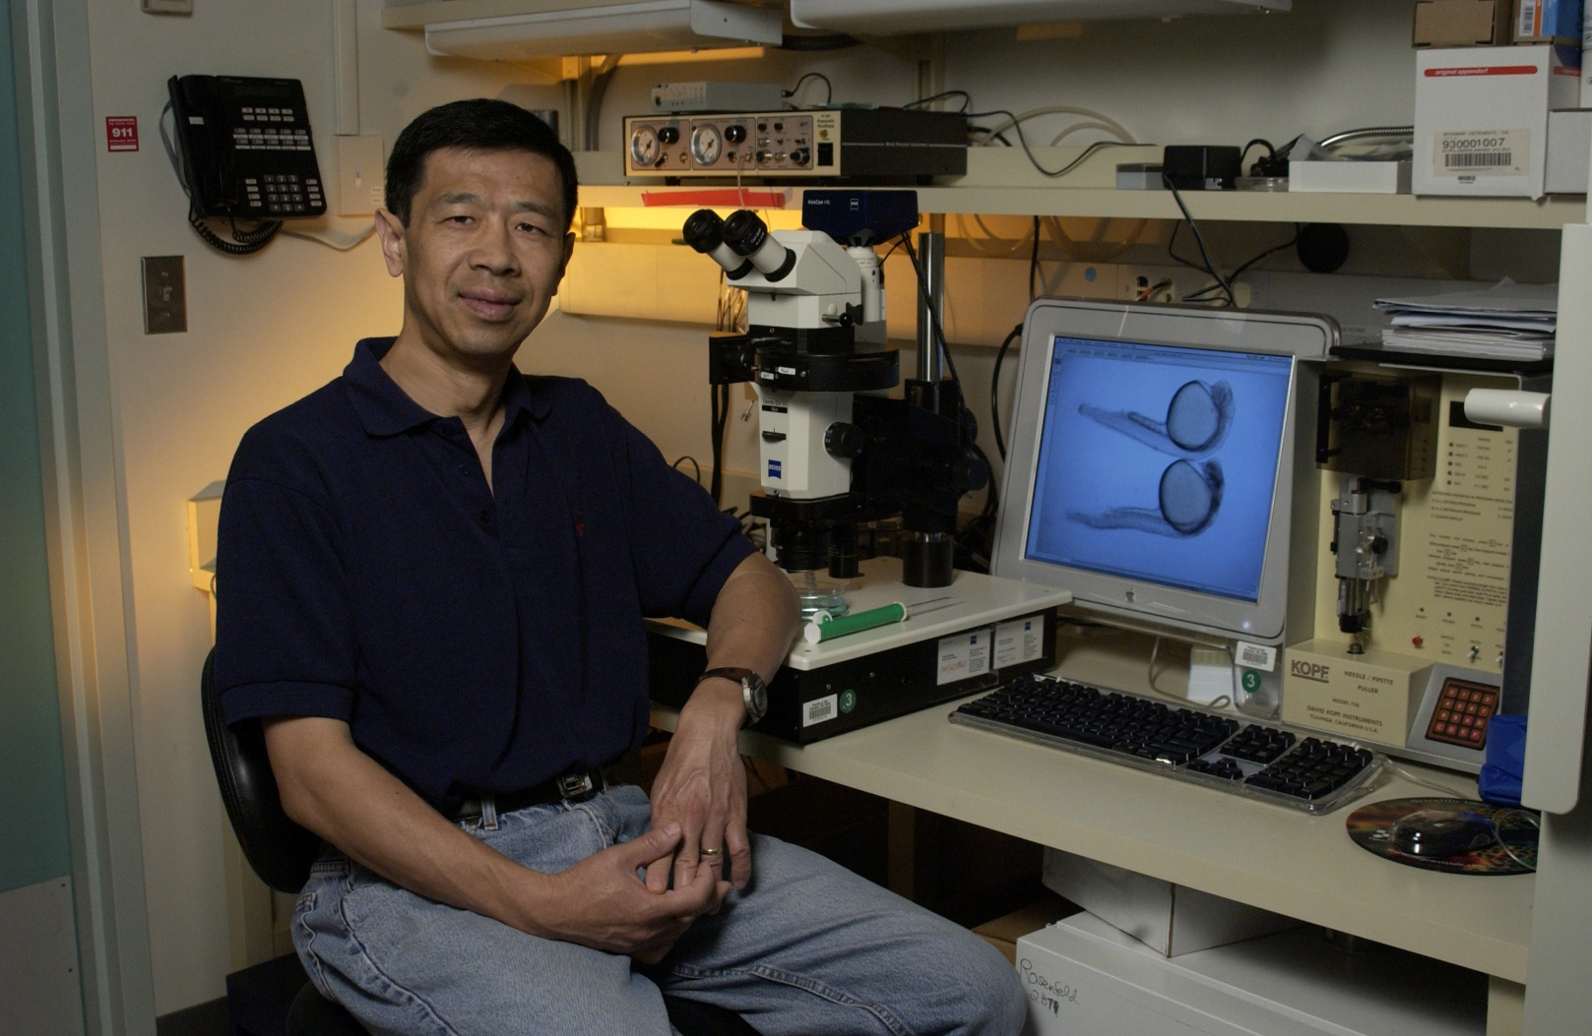
New NHGRI Deputy Scientific Director
P. Paul Liu, M.D., Ph.D.
Document 2
Notes:
Early this summer, Dr. Paul Liu was named the NHGRI Deputy Scientific Director by Dan Kastner (the NHGRI Scientific Director).
Dr. Liu, a tenured Senior Investigator, came to NIH and NHGRI in 1993 at the inception of NHGRI’s Intramural Research Program.
A world expert in the onset, development, and progression of leukemia, Dr. Liu also heads the Oncogenesis and Development Section within NHGRI's Genetics and Molecular Biology Branch.
The Deputy Scientific Director position became available because our previous and long-standing Deputy Scientific Director, Dr. Andy Baxevanis, accepted a new NIH-wide position within the NIH Office of Intramural Research (led by Michael Gottesman). In this new position, Andy will provide leadership in the area of bioinformatics and information technology for the entire NIH Intramural Program; in addition, he will continue his research role within NHGRI.
11

Slide 12
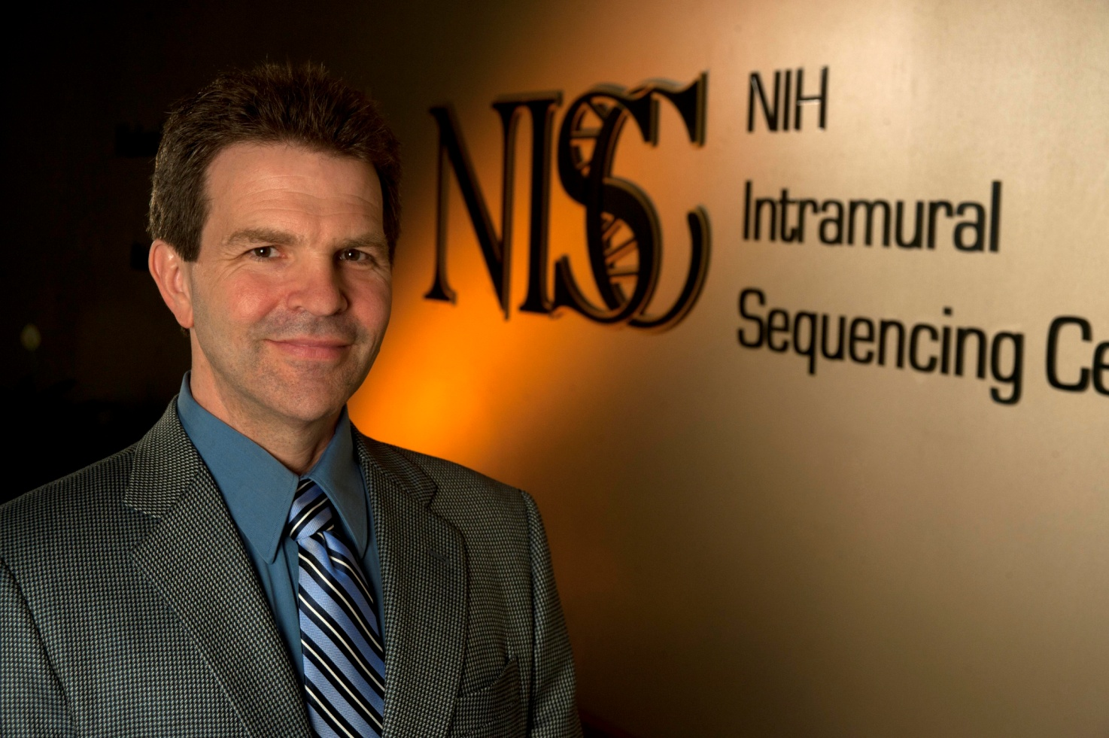
New NIH Intramural Sequencing Center (NISC) Director
Jim Mullikin, Ph.D.
Document 1
Notes:
Last week, Dan Kastner announced the appointment of Jim Mullikin as the Director of NISC.
Jim is an outstanding genomics researchers, bringing many years of high-level experience to this position (starting at the Sanger Institute and now for many years at NHGRI).
I admittedly took particular interest in this search and eventual appointment, as the person that founded NISC in 1997 and was its Director for over 12 years.
I was extremely comfortable handing over the Acting Director reins to Jim Mullikin 21 months ago, but am now really delighted to see him selected to be NISC’s permanent Director.
12

Slide 13
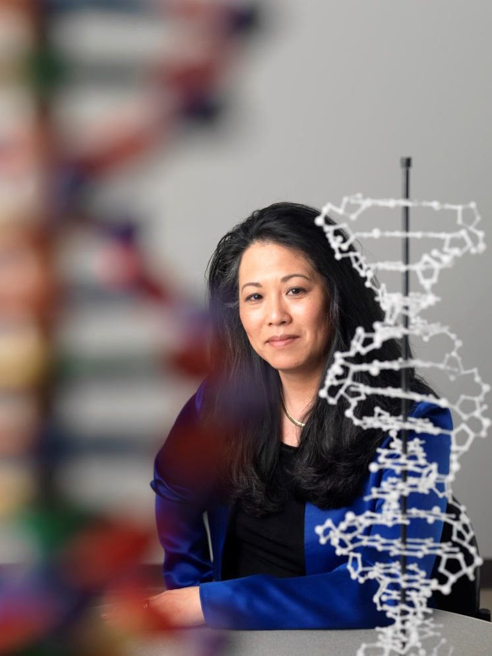
Elected Fellow by the American Psychological Association
Vivian Ota Wang, Ph.D.
Notes:
Vivian Ota Wang, a Program Director in our Extramural Research Program, was elected a Fellow in the American Psychological Association.
Fellow status is an honor bestowed upon Members of this association who have shown evidence of unusual and outstanding contributions or performance, and it requires evidence of national impact on the field of psychology.
13

Slide 14
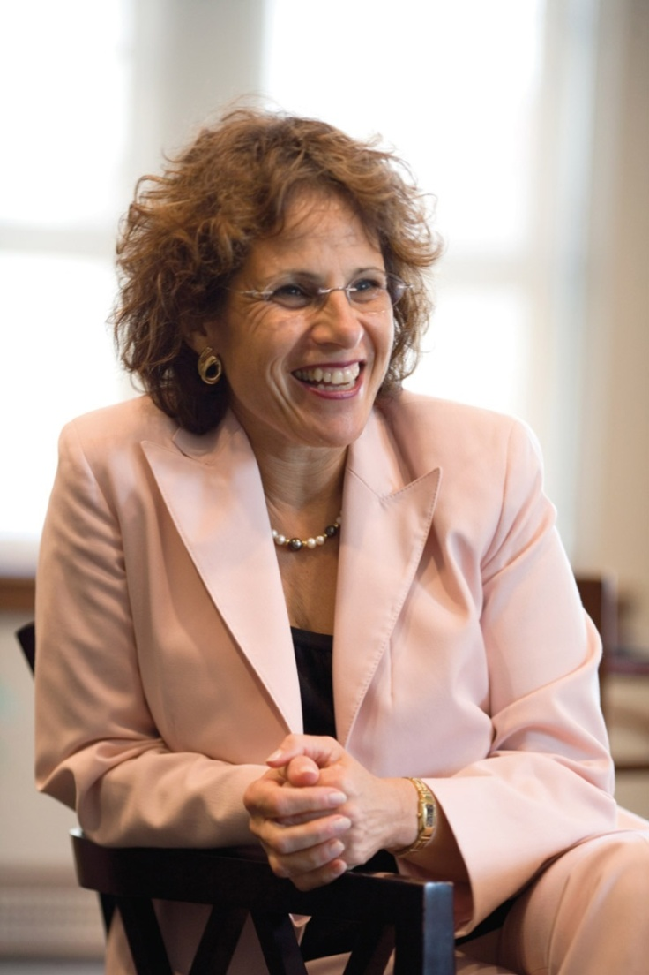
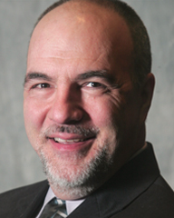
Special Advisors to NHGRI Director
Karen Rothenberg,
J.D., M.P.A.
Marc Williams,
M.D.
Notes:
Two Special Advisors to me are now on board at NHGRI (both mentioned previously at Council meetings).
* Karen Rothenberg is taking a one-year sabbatical from the University of Maryland Law School to work full time at NHGRI. She is working jointly at NHGRI and the Department of Bioethics at the NIH Clinical Center. During this year, Karen will be pursuing multiple projects including: (1) leading an effort to take a rigorous and thoughtful examination of our ELSI Program and other NHGRI components that will expand and integrate into the vision for the Genomics and Society section of our recently published strategic plan; (2) co-authoring some scholarly papers in areas such as regulation of genomic research and the return of research results and incidental findings encountered in whole-genome sequencing studies; and (3) exploring how theatre vignettes can enhance our understanding of ELSI issues in genetics and innovation in science.
* Dr. Marc Williams is now spending a week per month at NHGRI as a special advisor in the area of genomic medicine. Marc is the Director of the Intermountain Healthcare Clinical Genetics Institute in Salt Lake City, Utah. Among his various efforts, Marc is particularly active in working to help us enhance our programs related to genomics and electronic health records as well as the development of clinical genomics information systems. For the latter, he is co-chairing a workshop in December that I will be mentioning later in my talk.
14

Slide 15
General NHGRI Updates
General NIH Updates
Genomics Updates
NHGRI Extramural Program
NIH Common Fund Programs
NHGRI Office of the Director
NHGRI Intramural Program
Notes:
15

Slide 16
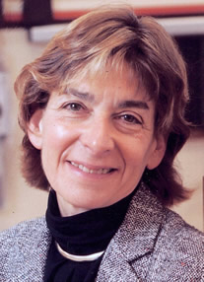
New Director of the National Institute of Dental and Craniofacial Research
Martha Somerman, D.D.S., Ph.D.
Document 3
Notes:
Dr. Martha Somerman has arrived as the new Director of the National Institute of Dental and Craniofacial Research.
Dr. Somerman was Dean of the University of Washington School of Dentistry, a position she had held since 2002.
An internationally known researcher and educator, her research has focused on defining the key regulators controlling development, maintenance, and regeneration of oral-dental-craniofacial tissues.
16

Slide 17
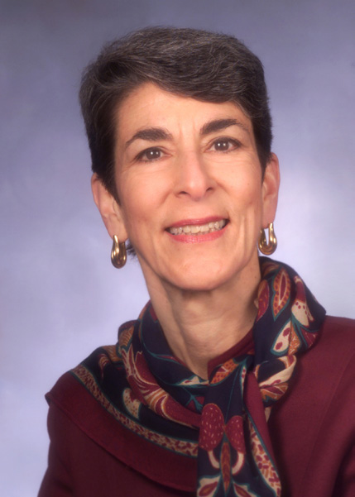
Acting Director of the National Institute of General Medical Sciences
Judith Greenberg, Ph.D.
Document 4
Notes:
Dr. Judith Greenberg is now in place as the Acting Director of the National Institute of General Medical Sciences. This follows the departure of the previous Director, Jeremy Berg.
Dr. Greenberg is a developmental biologist and has been Director of the NIGMS Division of Genetics and Development Biology since 1988; this Division has an annual budget $566 million.
She has served previously as NIGMS’s Acting Director from May 2002 to November 2003.
17

Slide 18
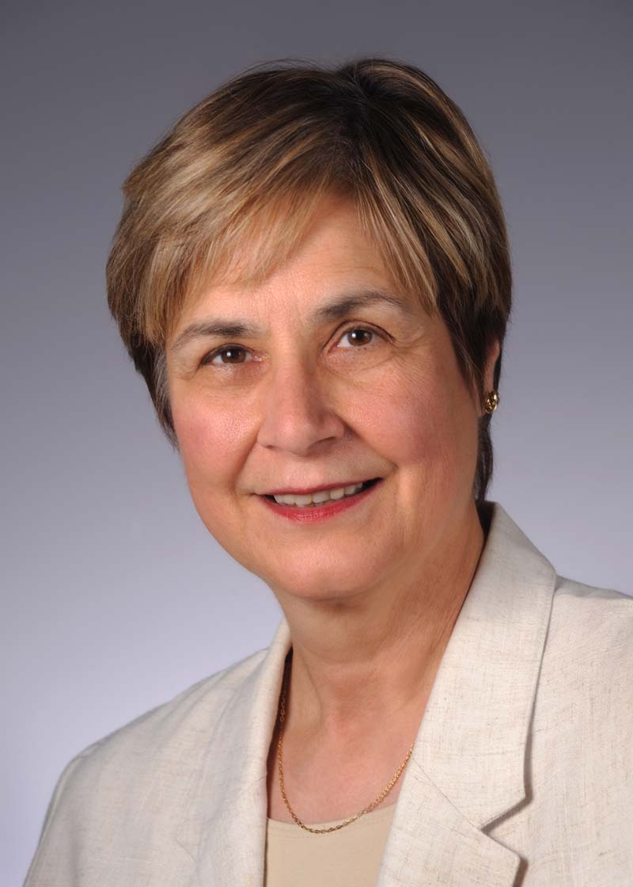
Departing Director of the National Center for Research Resources (NCRR)
Barbara Alving, M.D.
Document 5
Notes:
Barbara Alving, Director of the National Center for Research Resources (NCRR), will be leaving the NIH at the end of this month.
Dr. Alving became the Director of NCRR in 2007. She also served as Deputy and Acting Director of the National Heart, Lung, and Blood Institute and also headed the Women's Health Initiative before she came to NCRR.
18

Slide 19
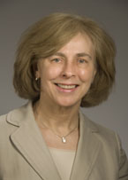
Incoming Acting Director of the National Center for Research Resources (NCRR)
Louise Ramm, Ph.D.
Document 5
Notes:
Dr. Louise Ramm, who is the Deputy Director and the Director of Extramural Activities for NCRR, has agreed to be Acting Director for NCRR starting October 1.
Dr. Ramm received her Ph.D. in microbiology at the University of Virginia in 1974, and was a faculty member at the Johns Hopkins School of Medicine in the Microbiology Department. She joined NCRR, in 1987 as a Health Scientist Administrator in the Biological Models and Materials Program and subsequently became the Director of that Program in 1994.
19

Slide 20
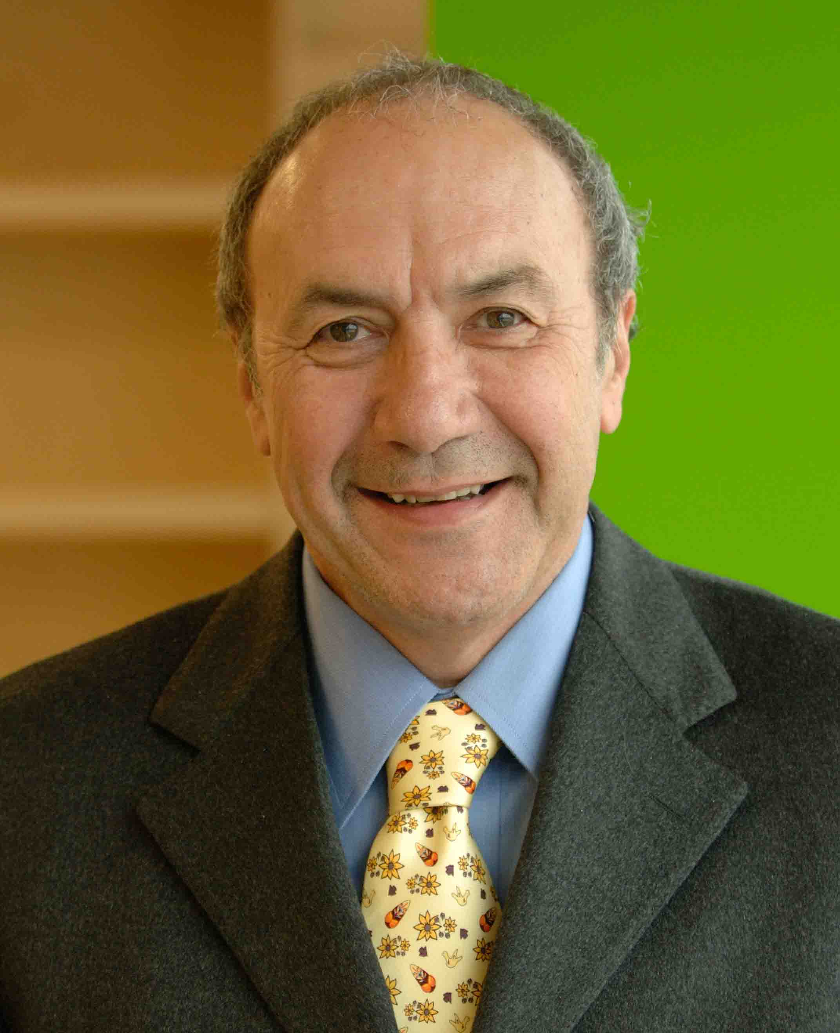
Departing Director of the NIH Center for Scientific Review (CSR)
Antonio Scarpa, M.D., Ph.D.
Document 6
Notes:
Dr. Toni Scarpa is departing the Directorship of the NIH Center for Scientific Review later this month; he has held this position since 2005.
During his tenure, Dr. Scarpa implemented the trans-NIH Enhancing Peer Review changes, which included the new scoring system.
He also saw NIH through the review of 40,000 American Recovery and Reinvestment Act applications two years ago.
20

Slide 21
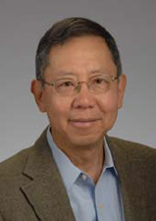
Incoming Acting Director of the NIH Center for Scientific Review (CSR)
Richard Nakamura, Ph.D.
Document 6
Notes:
Following Dr. Scarpa’s departure and while NIH conducts a national search for a new Director, Dr Richard Nakamura will serve as Acting Director of CSR.
Dr. Nakamura has served in leadership positions at the National Institute of Mental Health, as both Scientific Director and Deputy Director of the Institute, and also Acting Director of the Institute from 2001 to 2002.
21

Slide 22
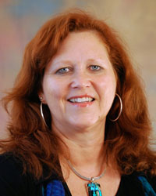
New Director of the NIH Center for Information Technology (CIT)
Andrea Norris, M.B.A.
Notes:
In October, Andrea Norris will become the new Director of the Center for Information Technology (CIT) and Acting Chief Information Officer of NIH.
Ms. Norris comes from the National Science Foundation (NSF), having been there for ten years and most recently as the Acting Chief Information Officer and Director of the organization responsible for providing agency-wide information technology systems, services, and supporting infrastructure.
22

Slide 23

Interim Director for NCI Center for Cancer Genomics
Barbara Wold, Ph.D.
Notes:
Dr. Barbara Wold has begun her stint as Interim Director for NCI’s Center for Cancer Genomics (while on sabbatical from CalTech).
Dr. Wold is the Bren Professor of molecular biology and Director of the Beckman Institute at Caltech.
She is well-known to NHGRI, where she has served in numerous advisory roles and is also a grantee.
23

Slide 24

Mourning the Loss of Bernadine Healey
Document 7
Notes:
Dr. Bernadine Healy, former Director of the NIH, passed away in August.
During her tenure as the first female NIH Director, Dr. Healy started the Women's Health Initiative, recruited Francis Collins to come lead NHGRI, and created the NHGRI Intramural Research Program.
She also ran the Red Cross in the late 1990s.
24

Slide 25

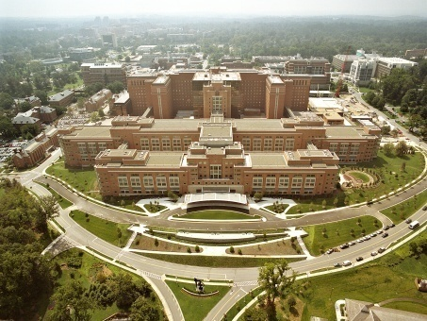
Mourning the Loss of Senator Mark Hatfield
Document 8
Notes:
Senator Mark Hatfield, visionary supporter of medical research, passed away in August.
As chair of the Senate Committee on Appropriations, he served as a strong and principled advocate for the needs of those who are less fortunate.
He also consistently defended the importance of NIH-funded research and its importance to our society.
* Appropriately, the NIH Clinical Research Center bears his name.
25

Slide 26
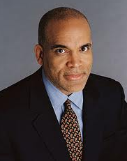
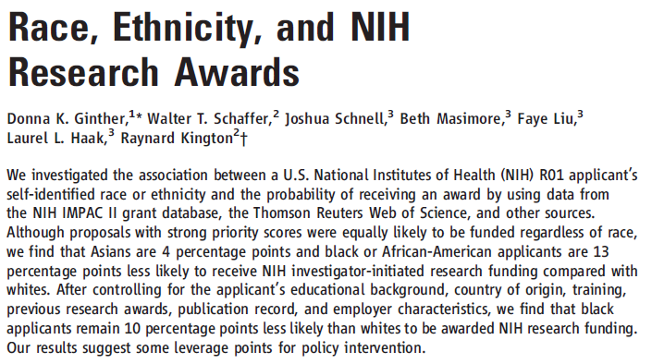
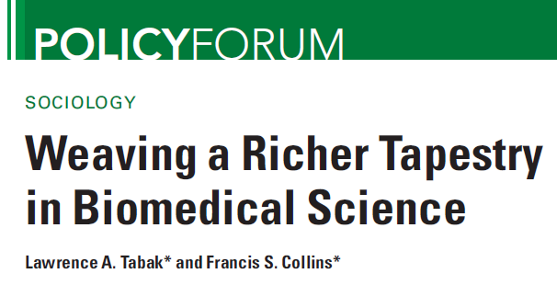
Science Articles on Race & Ethnicity
Influence on NIH Awards
Document 9
Notes:
As part of an ongoing effort to examine and improve the diversity of the scientific workforce, NIH has commissioned several studies.
* Once such study, led by former NIH Deputy Director Raynard Kington, was recently published in Science.
The study analyzed the probability of securing first-time NIH R01 funding (during 2000-2006) based on race and ethnicity, controlling for observable characteristics such as NIH training, research experience, and institution.
Even after controlling for factors that influence the likelihood of success, black applicants were found to be 10% less likely than white applicants to receive a Type 1 R01 award.
* Drs. Tabak and Collins provide a perspective piece that outlines NIH’s commitment to a diverse biomedical workforce and future plans to address this issue.
26

Slide 27

Revised NIH Regulations on
Financial Conflict of Interest (FCOI)
Major Changes to Previous Policy:
Significant Financial Interest (SFI) Definition
Investigator Disclosure
Reporting to NIH
Public Accessibility to Information
Investigator Training
>>>Implementation by August 24, 2012
PI
Institution
NIH
Document 10
Notes:
The U.S. Department of Health and Human Services has issued a final rule that amends the Public Health Service regulations on “Responsibility of Applicants for Promoting Objectivity in Research for which PHS Funding is Sought and Responsible Prospective Contractors.”
This is a revision of the 1995 guidelines, and reflects a tightening of the rules.
* Major changes to previous policy:
* Lower the monetary threshold at which significant financial interests (SFIs) require disclosure, generally from $10,000 to $5,000.
* Require investigators to disclose to their institutions all of their significant financial interests related to their institutional responsibilities.
* Require institutions to report to NIH additional information on identified financial conflicts of interest and how they are being managed.
* Require institutions to make certain information accessible to the public concerning identified significant financial interests held by senior/key personnel.
* Require investigators to complete training related to the regulations and their institution’s financial conflict of interest policy.
* Implementation will occur no later than August 24, 2012.
27

Slide 28
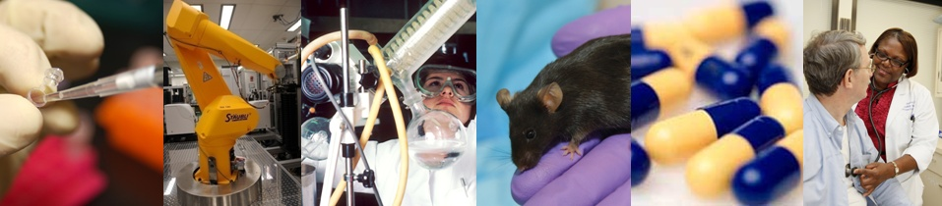
NIH’s Proposed National Center for Advancing Translational Sciences (NCATS)
To advance the discipline of translational science and catalyze the development and testing of novel diagnostics and therapeutics across a wide range of human diseases and conditions
Notes:
A key flagship component of Francis Collins’ plans for NIH as Director is the established of the proposed National Center for Advancing Translational Sciences (NCATS).
There has been considerable effort within NIH to formulate the plans for creating this new Center, and considerable reactions (both positive and negative) in the scientific community about its creation.
* There is now a formulated mission statement for this proposed Center…
The most likely scenario for creating NCATS in FY 2012 will be through an ‘anomaly’ in a Continuing Resolution to fund the Federal government.
In anticipation that NCATS will be created in the coming months, a search for its first Director has begun its work (with the search committee co-chaired by Eric Green and Tom Insel).
NHGRI implications: National Center for Translational Therapeutics (Chris Austin, Scientific Director) has grown up within NHGRI; will depart en block to NCATS, including >100 employees.

Slide 29
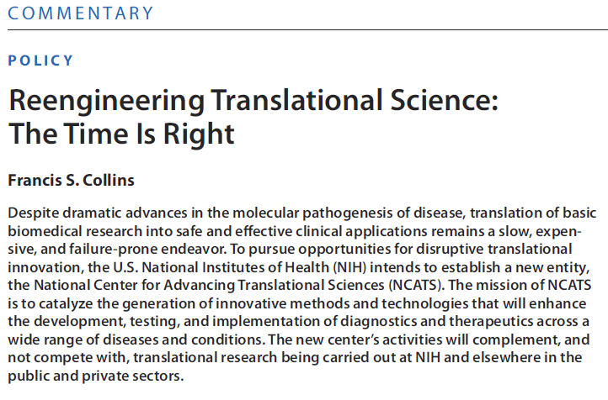

Commentary from the NIH Director about the Proposed NCATS
Document 11
Notes:
The blueprint for the proposed NCATS was recently published by Francis Collins in Science Translational Medicine.

Slide 30
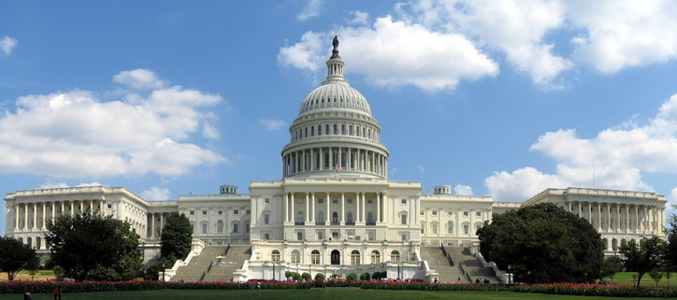
Fiscal Year 2012 Appropriations Update
FY2012 President’s Request:
NIH: $32B (+2.4%)
NHGRI: $525 M (+1.7%)
House: Passed 6 of 12, 3 out of committee, and 3 (including Labor/HHS) without action
Senate: Passed 1 of 12, 3 out of committee, and 8 without action
Continuing Resolution likely
Document 12
Notes:
We are currently in Fiscal Year 2011, operating with a budget that was signed by the President in April amid an imminent threat of a government shutdown. This budget reflected a 1% reduction compared with last year, the first such reduction for NIH in many years, and provided NIH $30.9B and NHGRI $525M.
Since Fiscal Year 2012 begins on October 1, you might have naively expected that Congress would have completed its passage of legislation to fund the government for the next year. But, as we all know, Congressional agreement for funding the government is rarely straightforward, with the debate this year exceptionally complex because of the recent ‘situation’ with the debt deal. I will have more to say about the debt deal in a minute.
* The President’s FY2012 budget requests $32 billion for NIH and $525 million for NHGRI (a 2.4 and 1.7% increase over the current fiscal year, respectively). At this point in time, such an increase seems extremely unlikely considering the larger set of complex circumstances.
Congress needs to pass a number of bills to fund the government.
* So far, the House has passed 6 of 12 such bills, 3 are out of committee, and 3 are without action.
* The Senate is doing worse, having passed only 1 of 12 bills, 3 are out of committee, and 8 are without action.
The one we’re most interested in, which sets funding levels for NIH, is the one crafted by the Labor, HHS, Education, and Related Agencies Appropriations Subcommittees in the House and Senate, colloquially known as the Labor-HHS bill. Neither House nor Senate has passed a Labor-HHS bill this year, or even debated draft legislation. So at this point in time, we still don’t know what the funding levels for NIH or NHGRI will be.
* It is unlikely that Congress will pass appropriations bills by the end of this month, so we are most surely looking toward a Continuing Resolution to keep the government functioning in the interim until a final agreement is reached for the rest of the year. The most likely scenario at this point is a Continuing Resolution authorizing operations through the holidays to allow the debt deal processes to work their way through the system.
Predictions about NIH funding for next year are quite varied, depending on who you ask and when you ask. It would seem that best case would be flat, most realistic is something like -2%, and worst case would be something like -5%. In the meantime, keep your seatbelts firmly buckled because it might turn out to be a wild and turbulent ride.
30

Slide 31
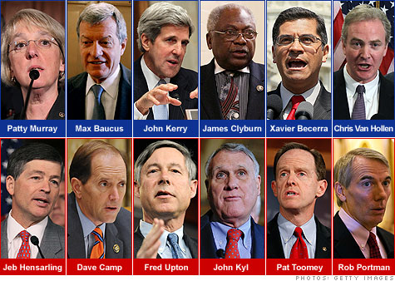
The Debt Deal … Waiting for the Cuts
Caps established for appropriations over the next decade
Super Committee must propose deficit reduction through ≥$1.2 trillion of more cuts by Nov. 23
Substantial reductions possible for FY2013
Document 13
Notes:
Getting to the real elephant in the room in terms of appropriations… a major reason why Congress has not yet completed its appropriations work is because of the strong disagreements among Congressional members regarding the role and size of government programs. This most recently manifested itself as a debate over the size of the government’s debt that, had it not been temporarily resolved, would have lead to the government defaulting on its debt for the first time in its history. As you all know, a debt deal was struck at the eleventh hour, and a default was avoided in dramatic fashion.
The not-so-good news about this is that the terms of the deal are almost certain to effect NIH funding levels in a bad way for several years to come.
The so called “Debt Deal” comes in two parts. * Part one is a cap on the total funds that Congress can appropriate for each year going into the next decade. This part of the deal only sets a cap on total spending across the government, so there’s no reason to assume that all agencies will be equally impacted. It is difficult to predict how NIH may fare compared with other agencies, but it is clear that all budgets will be under extreme pressure.
* Part two of the Debt Deal established a ‘Joint Select Committee on Deficit Reduction’, more commonly referred to as the ‘Super Committee’, to identify additional ways to reduce the federal deficit. By November 23rd, this group is charged with crafting a bill to reduce the deficit by at least $1.2 trillion by 2021, and ideally to identify up to $1.5 trillion in total reductions. Each Chamber of Congress is then required, through a simple up-or-down vote, to approve the Super Committee proposal by December 23rd.
The Committee proposal may include reductions in spending, such as further reductions to agency funding or entitlement programs, as well as ways to increase revenues through changes in the tax code.
A very important detail is what happens if the Super Committee fails to agree upon a proposal, or if Congress does not pass their proposal by the end of the year. A failure in either regard will trigger an across-the-board cut to Federal agencies in 2013 to equal the $1.2 trillion they were supposed to identify. This substantial degree of cuts will likely have a significant effect on the NIH.
What does this all mean for NIH and NHGRI? While the debt ceiling agreement is not expected to substantially diminish FY2012 funding, it very well may result in significant cuts in 2013 and beyond. In fact, we are being asked to prepare for various scenarios for FY 2013, including cuts of 5% and 10%.
31

Slide 32
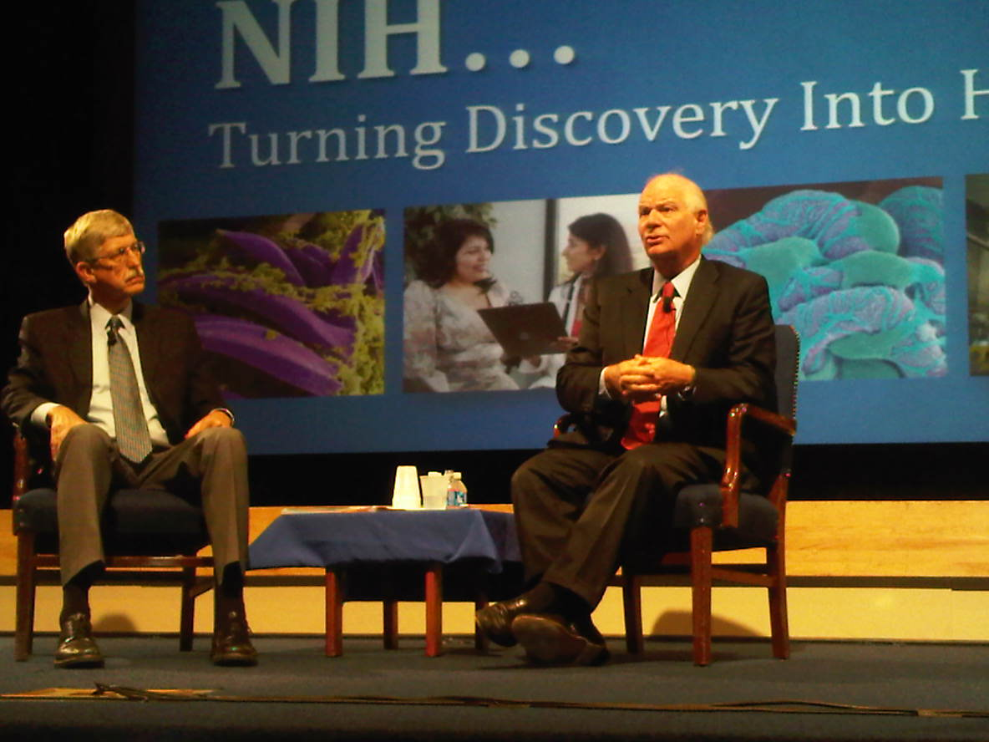
Senator Ben Cardin Visits NIH
Notes:
And you might imagine, such budgetary scenarios cause grave concerns for NIH employees, both because of their own job situations and because of the programs that they work hard to support.
Senator Ben Cardin (the junior Senator from Maryland) held a town hall with NIH employees on August 31, which was preceded by a private meeting with the group of Institute/Center Directors.
In both venues, he talked passionately about the state of the economy, the complex situation with the current Federal budget, and his concerns about the impact on Federal workers.
He is a strong NIH supporter, as you might imagine, and promised a good fight to preserve (and perhaps improve) our budget. But he also admitted being involved in the strangest political situation he has faced in his long and distinguished career. In the end, he expressed a cautiously optimistic message, but also stressed the need to be realistic about the likely difficult times we will face over the next 2-5 years.
32

Slide 33
General NHGRI Updates
General NIH Updates
Genomics Updates
NHGRI Extramural Program
NIH Common Fund Programs
NHGRI Office of the Director
NHGRI Intramural Program
Notes:
33

Slide 34


2011 Gruber Genetics Prize The Peter and Patricia Gruber Foundation
Ron Davis, Ph.D.
Document 14
Notes:
Ron Davis has won the Gruber Genetics Prize, which is awarded for his pioneering work in biotechnologies that advance the fields of molecular genetics and genomics.
Davis, who has been Director of the Stanford Genome Technology Center since 1994, will receive the $500,000 award for developing DNA mapping methods, for his studies of ways to sequence genomic variants in humans and other animals, for his contribution in developing the first microarray technologies, and the work his lab has done in sequencing yeast chromosomes, part of the E. Coli genome, and several other genomes.
34

Slide 35
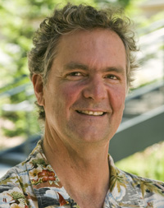

2011 Weldon Memorial Prize University of Oxford
David Haussler, Ph.D.
Document 15
Notes:
David Haussler, a Professor of biomolecular engineering at the University of California, Santa Cruz, has been awarded the 2011 Weldon Memorial Prize by the University of Oxford.
The prize is awarded for contributions to the development of mathematical or statistical methods to be applied to problems in biology.
Haussler is Director of the California Institute for Qualitative Biosciences. He and his team's work has focused on using bioinformatics to understand the human genome, for example by analyzing data from the Cancer Genome Atlas, by developing the Cancer Genomics Browser, and by founding the Genome 10K project.
35

Slide 36
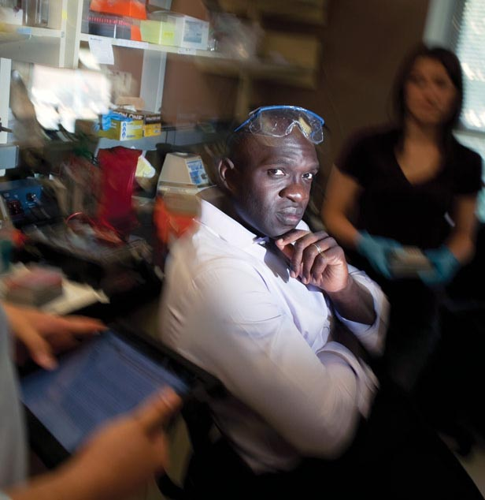

Technology Review’s Annual List of 35 Innovators Under 35
Yemi Adesokan, Ph.D.
Document 16
Notes:
Yemi Adesokan has been recognized by MIT’s Technology Review magazine by being among their 35 Innovators under 35 honorees for 2011.
He was honored for his work in the application of next-generation sequencing to clinical diagnostics.
Specifically, Adesokan founded a company called Pathogenica, which aims to develop sequencing technologies to diagnose infectious disease.
He is an alumnus of the Diversity Action Plan-supported SMART summer undergrad research program at the Baylor College of Medicine Genome Sequencing Center.
The TR35 list (as it is called) recognizes the world’s top innovators under the age of 35, and includes those in a range of fields spanning energy, medicine, computing, communications, nanotechnology, and other emerging areas.
36

Slide 37

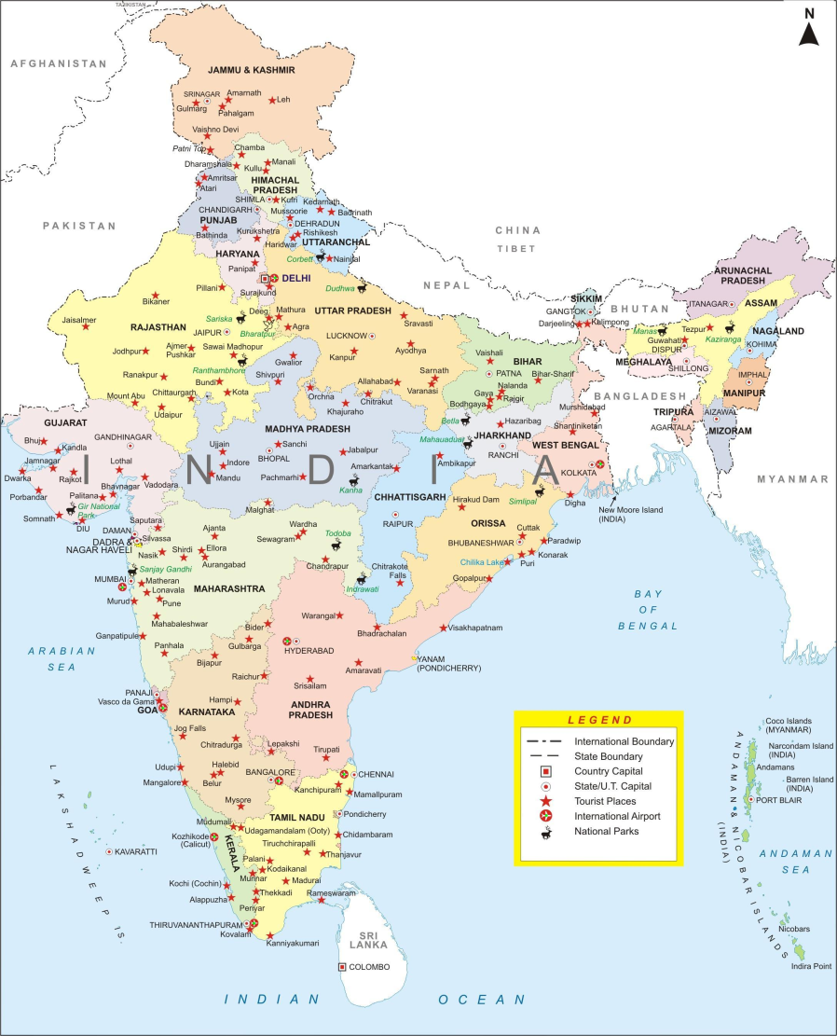
Notes:
In August this year, I traveled to India on a genomics tour (of sorts) on behalf of NHGRI.

Slide 38
Purpose of Trip
Invited to be Keynote Speaker at Founders Day Celebration of National Institute for Biomedical Genomics
New Institute outside Kolkata
Advisory role in 2008
Significant development for genomics in India
Used opportunity to tour other genomics research facilities in India
Notes:
* The initial purpose of my trip was to be the Keynote Speaker at a Founder’s Day Celebration commemorating the first anniversary of establishing the National Institute for Biomedical Genomics.
* New institute just outside Kolkata
* I had some history with this Institute, providing some advisory input about its potential creation in 2008.
* This Institute does represents a significant development for genomics research in India.
* As long as I was traveling to India, I used the opportunity to tour several other genomics research facilities in India, selecting the specific places based on some valuable input from Aravinda Chakravarti.

Slide 39

Bangalore
Kolkata
Delhi
Notes:
It was a rapid-fire trip, involving my visits to four research facilities in three cities over five days.
Specifically, I went to two places in Bangalore, one in Kolkata, and one in Delhi.

Slide 40
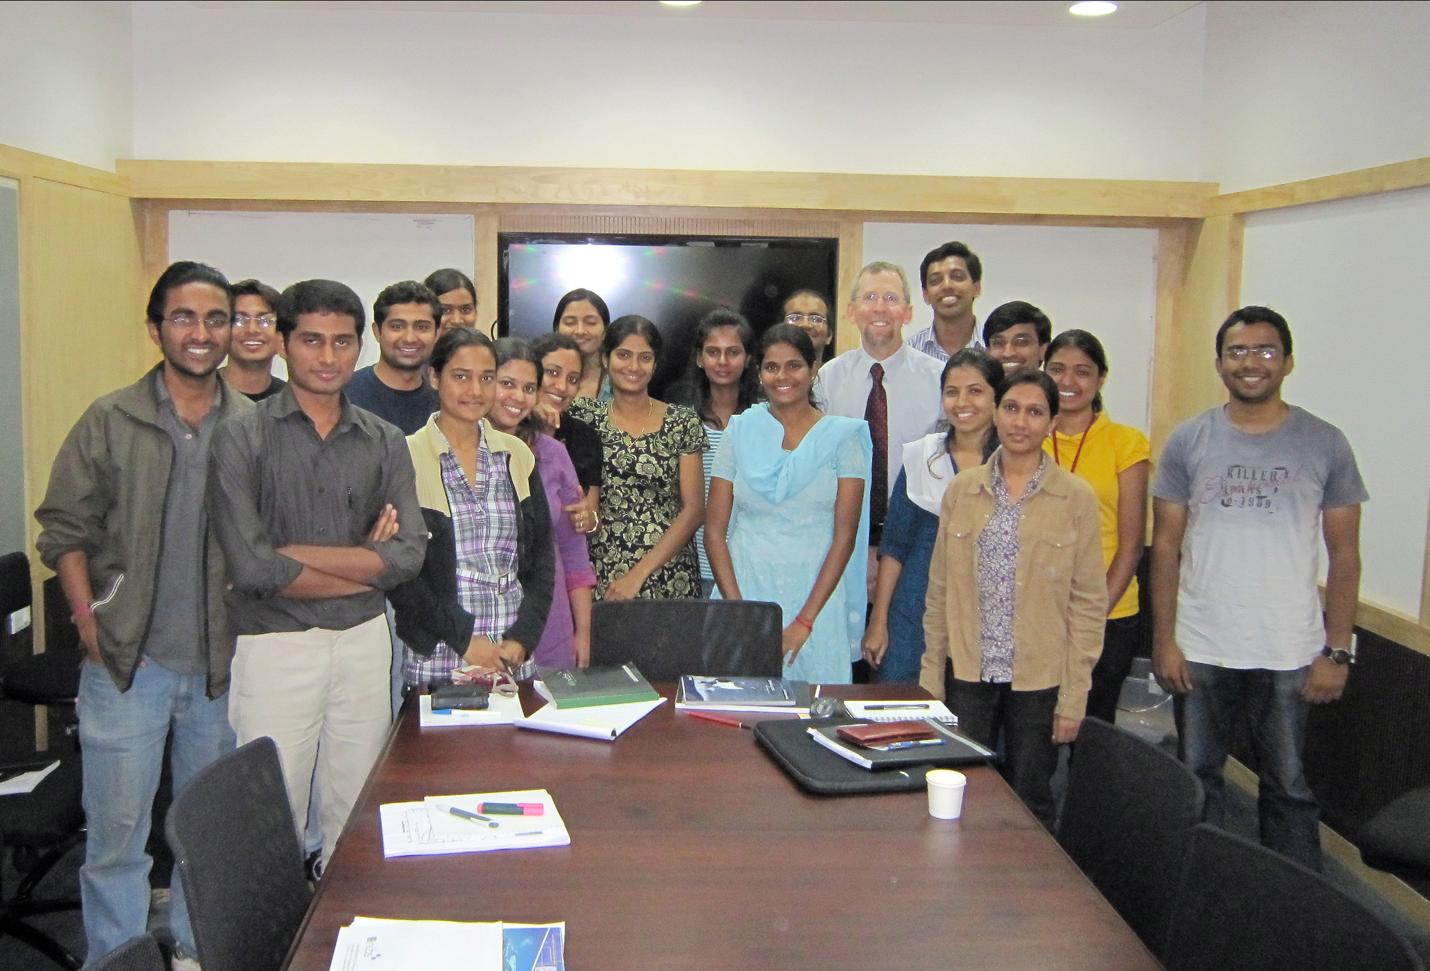
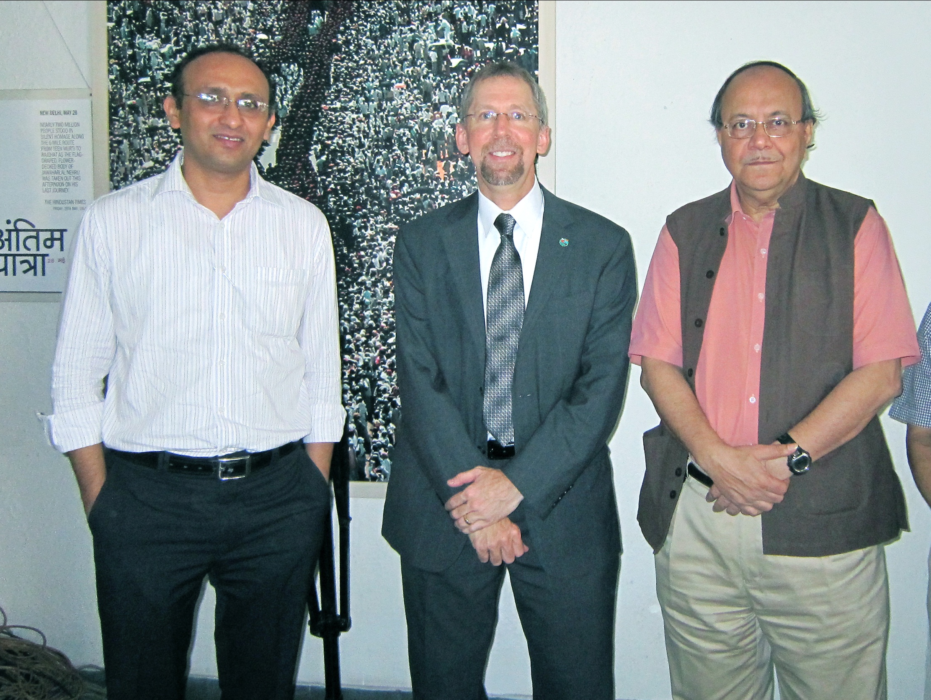
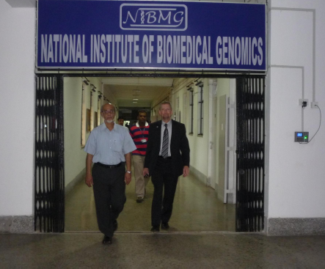
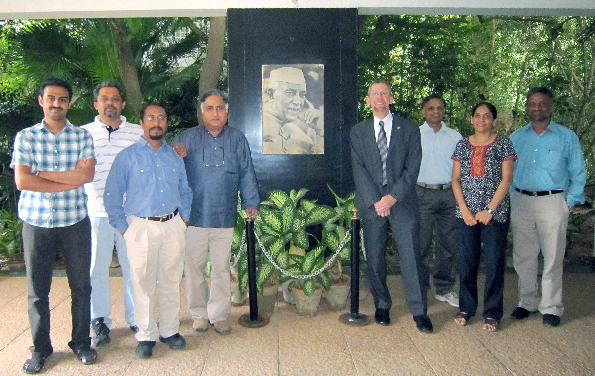
Notes:
In that short time, I met with many, many investigators, students and trainees, and government officials.
I could spend a long time describing my various findings and remaining questions.
But to be brief, my most notable observations would be as follows: (1) India is making a significant investment in research infrastructure, especially in genomics; (2) Indian researchers are getting access to cutting-edge genomic technologies (e.g., next-gen sequencing instruments at each of four research institutes/centers that I visited); (3) their research funding situation is improving quickly, and doesn’t seem to be the major rate-limited factor for Indian researchers; and (4) they are suffering from the same computational and bioinformatics bottleneck that we have in the U.S., despite training many students in computer science (the great majority of which to into the private sector where the salaries are sky high compared to what can be offered at genomics research institutions).

Slide 41


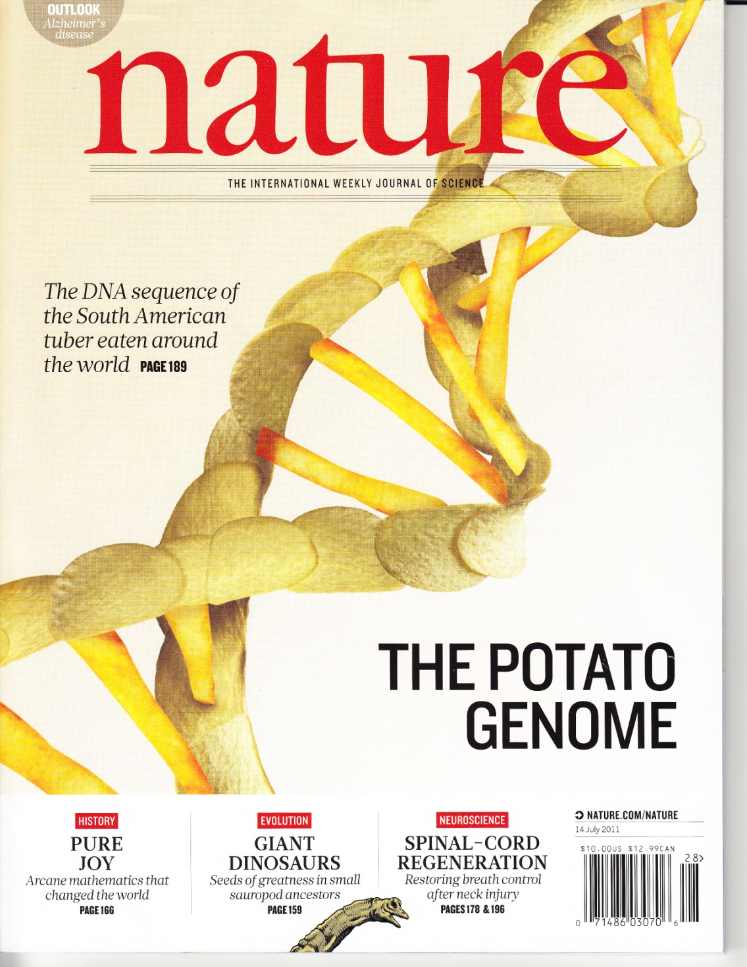

Genomics In The News…
Document 17
Notes:
New feature for Director’s Report: Genomics in the News (real but fun).
Aim to highlight several recent genomics news features at each Council meeting.
To start off this new feature is * the sequencing and analysis of the potato genome, as recently featured by this awesomely wonderful cover of Nature. The use of potato-based food objects to create a double helix was simply a work of genius.
More seriously, potato is the world's third most important food crop. And analysis of the genome sequence data revealed that the potato genome contains at least 39,000 protein-coding genes, far more than the human genome (in part explaining the brilliance of Mr. and Mrs. Potato Heads).
I personally found this to be a ‘spud-tacular’ genomic advance.
41

Slide 42






Genomics In The News…
CORAL
NOT CORAL
Document 17
Notes:
Notably interesting creatures to have their genomes sequenced lately include:
* The Tasmanian Devil.
* The branching coral Acropora digitifera.
* The tammar wallaby.
There is actually great science behind each of these genomic studies. But I put these three scientific stories ‘in the news’ because they are simply fun-- * being serious forays into the sequencing of creatures that are heavily featured in cartoons.
42

Slide 43

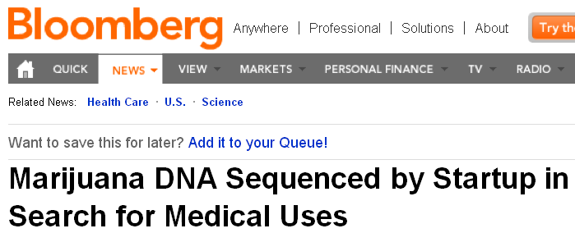
Genomics In The News…
Document 17
Notes:
Another major genomics story relates to the significant * news coverage about the sequencing of the marijuana genome.
Specifically, a new company called Medicinal Genomics announced in August that it has generated a draft genome sequence of the * marijuana plant, Cannabis sativa.
Company scientists became convinced to pursue the research after seeing papers published in academic journals about the plant’s tumor-shrinking effects in rats.
I have heard that if this company goes public, they might offer ‘reefer options’ instead of ‘stock options’ (but that might just be a rumor).

Slide 44


Genomics In The News…
Document 17
Notes:
And now my favorite genomics news story from the past 4 months…
* CNN reported that a New Hampshire apartment complex is mandating that residents submit their dog’s DNA sample (via simple mouth swabs) if they want to have a dog in their apartment
They are then analyzing the DNA in any dog waste found on their premises, and then using a proprietary ‘PooPrints program’ (I kid you not) to match DNA in unclaimed dog waste to the DNA provided for each dog in their complex.
Successful matches would indicate the guilty residents.
The program is currently assisting similar complexes in multiple states, with increasing interest as far away as Canada and Germany.
Advanced genome technology– saving lives and keeping the environment clean!
For the record, note how I stayed away from any ELSI jokes– although I thought of a few good ones, especially related to incidental findings and also surprising paternity evidence. But I will leave those to your imagination.

Slide 45

Genomics In The News…
Note: Just kidding,
NHGRI Director Humor
Notes:
My last Genomics in the News item relates to the fact that baseball players are not the only ones getting high-priced salaries due to free agency.
The growing interest in genomics has caused an exciting growth in the pursuit of super-star free-agent genomicists.
It turns out that the biggest free-agency signing since the last Council meeting was * Council Member David Valle, who was lured to the Broad Institute for a lucrative contract and a big office next Eric Lander’s office.
* Just kidding; picture of aberrant name placard prepared for David at a recent NHGRI genomics meeting in Chicago. But I bet the picture did give you pause for an instant.

Slide 46
General NHGRI Updates
General NIH Updates
Genomics Updates
NHGRI Extramural Program
NIH Common Fund Programs
NHGRI Office of the Director
NHGRI Intramural Program
Notes:
46

Slide 47

Large-Scale Genome Sequencing
Program Renewal
Genome Sequencing
& Analysis Centers
Mendelian Disorders
Genome Centers
Clinical Sequencing
Exploratory Research
Informatics Tools for
High-Throughput
Sequence Data Analysis
Document 18
Notes:
The most active issues associated with NHGRI’s Extramural Program relate to the renewal of our Large-Scale Genome Sequencing Program.
This Program represents just over 1/3 of the NHGRI Extramural Program in terms of total budget.
In renewing the program, we issued four RFAs in the indicated areas:
Adam Felsenfeld will be giving a presentation about the history of our Large-Scale Genome Sequencing Program and provide additional details about these RFAs. Discussion about the review of the applications that responded to these RFAs will then be discussed in detail during our Closed Session starting later today.

Slide 48

Large-Scale Genome Sequencing Program: Comparative Genomics
Characterization of SNP variation in Rhesus Macaques (Macaca mulatta)
Document 19
Notes:
In terms of recent accomplishments by our Large-Scale Genome Sequencing Program, one highlight was in the area of comparative genomics.
Using the draft genome sequence, researchers at the Baylor College of Medicine published a genome-wide SNP resource for Indian-origin rhesus monkeys, one of the most widely studied non-human primate model in biomedical research, and identified many potentially harmful non-synonymous coding SNPs.
48

Slide 49


Large-Scale Genome Sequencing Program: Comparative Genomics
Genome sequence of the first lizard, the North American green anole (Anolis carolinensis)
Document 19
Notes:
Another comparative genomics highlight wasIBroad Institute’s recent sequencing and analyzing the genome of the N. American green anole (‘a-know-lee’).
Their study found (1) that the anole genome contains 17,500 protein-coding genes, 4,000 of which are also found in human; (2) that around 30% of the genome is comprised of mobile elements; and (3) that genome contains 12 microchromosomes.
They also identified the lizard’s sex chromosomes, which appear to be XX and XY, with the X chromosome being one of the lizard’s microchromosomes.
49

Slide 50


Large-Scale Genome Sequencing Program: Medical Sequencing
Major analyses underway for projects studying:
Diabetes/metabolic syndrome (n=13,000)
Autism (n=2000)
Lipid levels (n=1000)
Tumor sequencing (n=1000 T/N pairs)
Document 20
Notes:
In the area of medical sequencing, our Large-Scale Genome Sequencing Program continues to be quite active and, in fact, * there are some large and impressive studies reaching mature stages in terms of analysis.
Specifically, these include studies of:
* Diabetes/metabolic syndrome
* Autism
* Lipid levels
* Tumor sequencing (outside of TCGA)

Slide 51

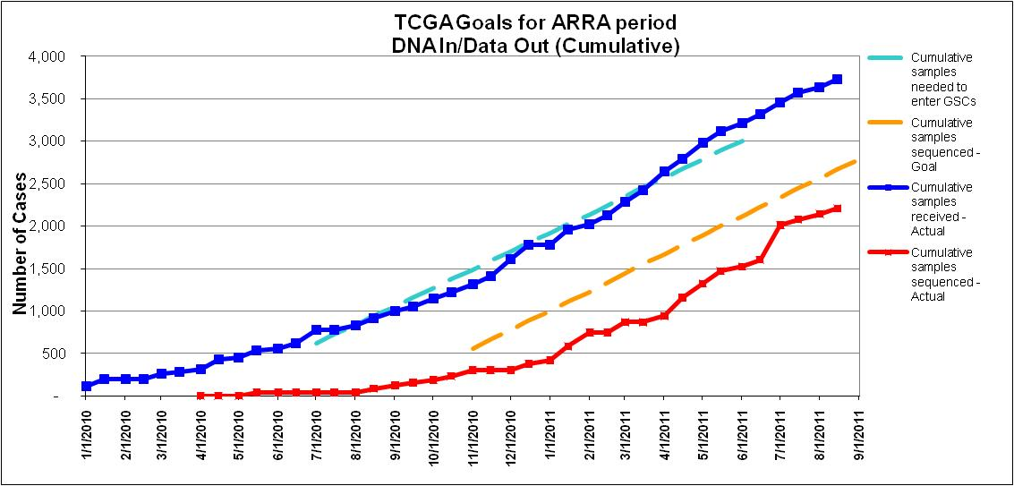
Glioblastoma
Ovarian
Acute Myeloid Leukemia
Colon/rectum carcinoma
Breast
Lung Squamous Cell
Lung Adenocarcinoma
Renal Clear Cell Carcin.
Renal papillary
Uterine (endometrial)
Low grade glioma
Gastric Carcinoma
Prostate
Bladder
Cervical
Head and neck
Liver
Melanoma
Sarcoma
Thyroid
Lymphoma
Pancreas
22 tumor projects in progress
TCGA achieves goal of accruing and characterizing 3,000 tumor/ normal pairs in 2 years
3,000
Document 21
Notes:
The Cancer Genome Atlas (TCGA) program continues to make great strides towards its ambitious goals. With the economic stimulus investment 2 years ago, TCGA was named an NIH Signature project and announced its intent to initiate 20 new tumor projects, following the pilot efforts on glioblastoma and ovarian cancer, and to accrue and characterize specimens from 3,000 cancer cases by September of 2011.
* The list on the right shows the active 22 projects in TCGA today. Accrual has actually closed for glioblastoma, ovarian, colorectal, and renal clear cell carcinoma, meaning the goal of 500 cases qualified for these projects has been achieved.
* The graph shows in blue the cumulative shipment of samples (not including the pilot projects) from Jan 1, 2010 to Aug. 15 this year. As of that date, >3,700 cases had been shipped to Centers. The red line shows the generation and availability of genome sequence files as a measure of “data out”. Even with the challenges of data management, TCGA will achieve the goal for the September deadline.

Slide 52
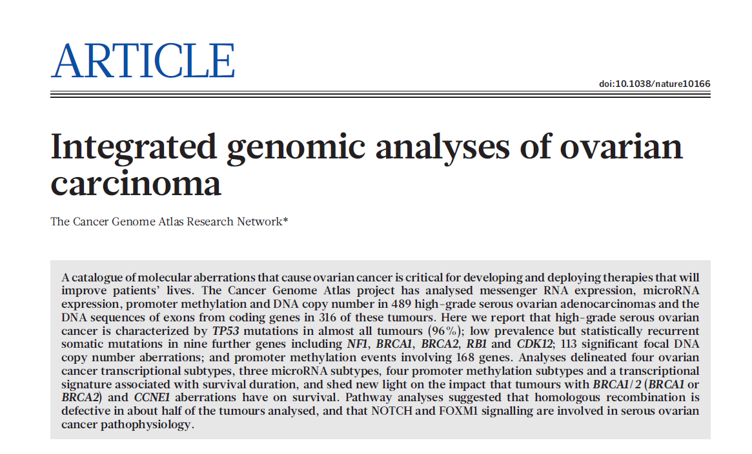
Nature 474: 609–615, 2011
Most extensive and comprehensive cancer genome study to date
#5 most highly ranked article in molecular biology by The Scientist
Several upcoming manuscripts-- colorectal carcinoma, acute myeloid leukemia, and breast carcinoma
Document 21
Notes:
Representing the type of reports expected from TCGA, the research Network published the findings from the ovarian carcinoma project earlier this year.
The study included analyses of copy number, gene expression, and promoter methylation on 489 high grade carcinomas plus exome sequence analysis of 316 of the specimens.
* This study represented the most extensive and comprehensive cancer genome study to date.
* And it was the 5th most highly ranked article in molecular biology, as assessed by The Scientist.
* Several upcoming manuscripts to watch for…

Slide 53

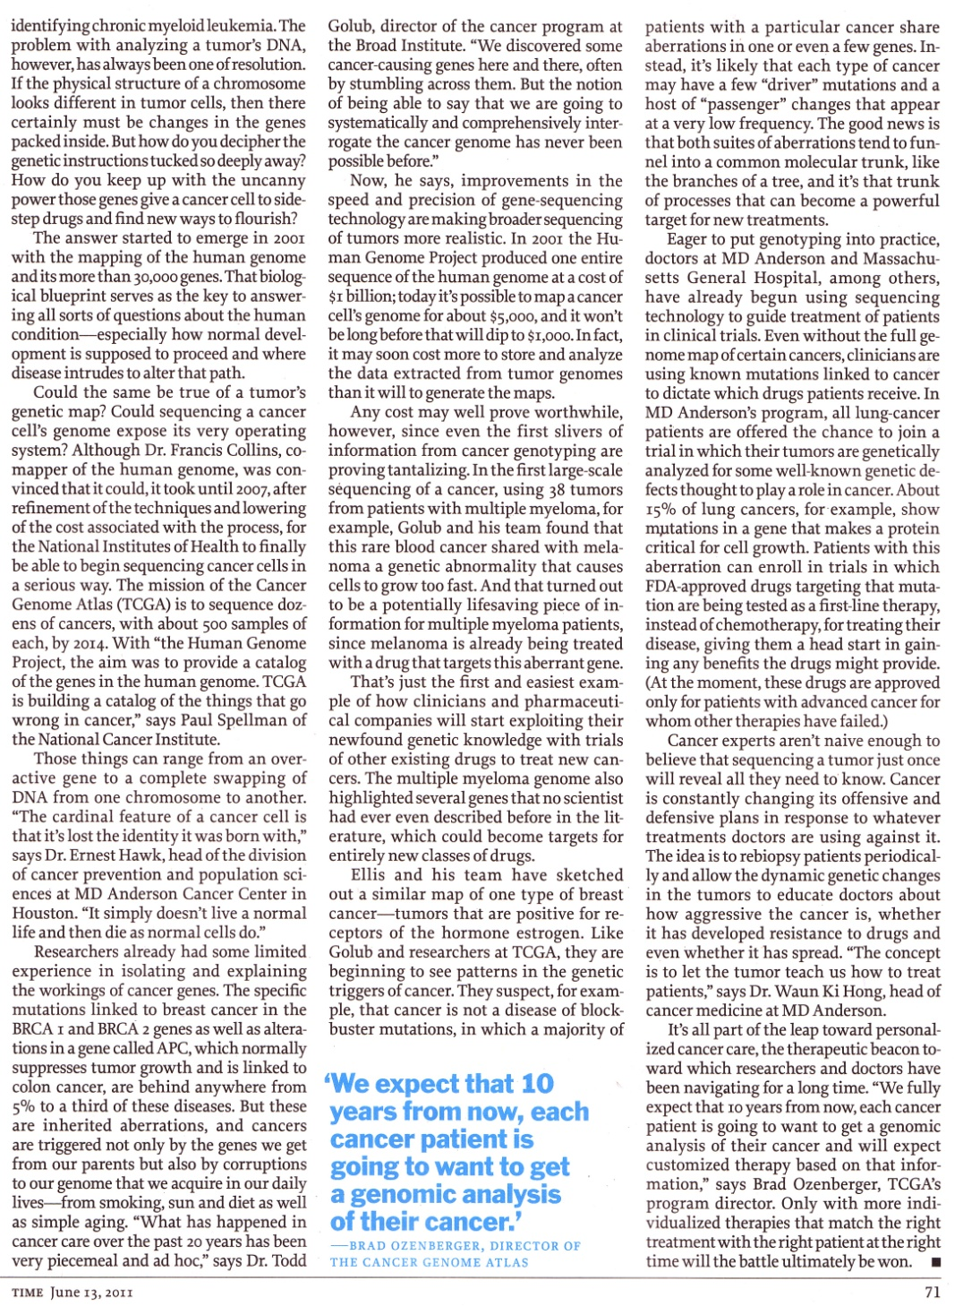
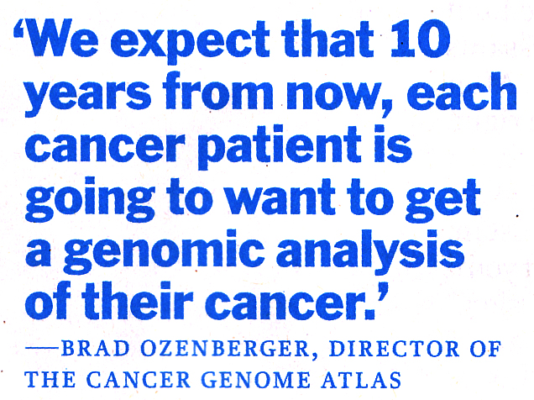
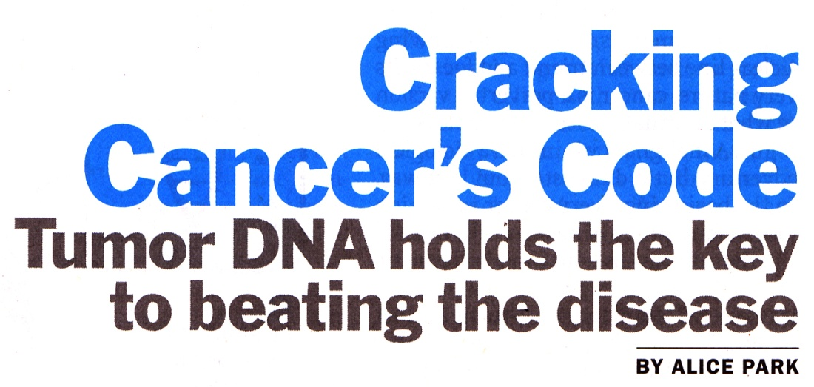
Document 21
Notes:
One notable highlight for TCGA and NHGRI came in the June 13 issue of Time magazine.
Congratulations, Brad.

Slide 54
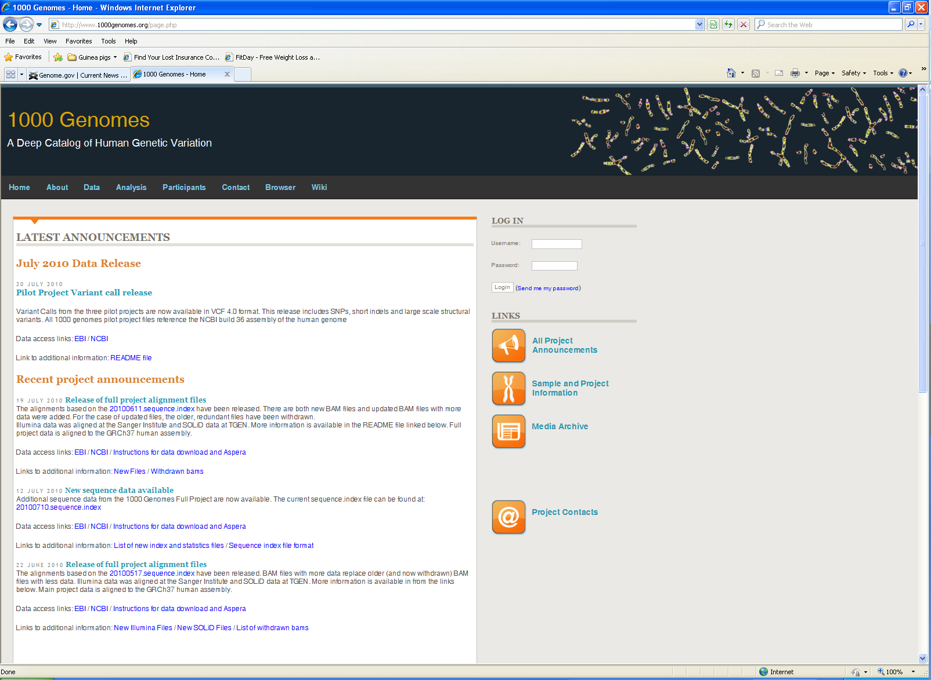
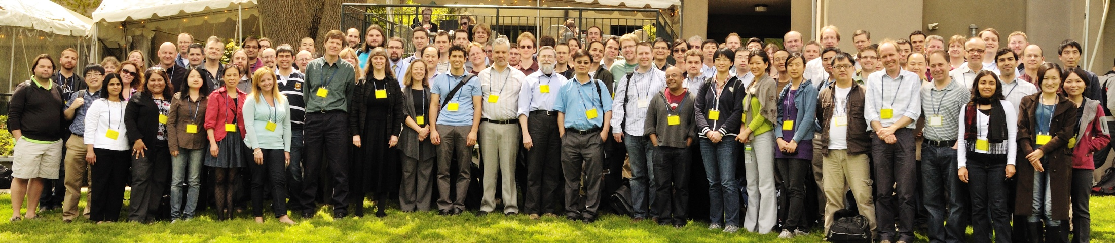
Phase 1 sequence data:
Low-coverage: 1094 samples
Exome: 1128 samples
39 million SNPs, 100,000 indels, 84,000 SVs
Integrated data set to be released in October
Phase 2 sequence data by Fall:
Low-coverage and exome: 1721 samples
Document 22
Notes:
The 1000 Genomes project continues to make great progress towards it goals.
* Phase 1 sequence data and associated numbers: * * * *
* Phase 2 sequence data will be generated by this Fall: *
Next 1000 Genomes Project meeting: October 10-11 before ICHG in Montréal, Canada.
A 1000 Genomes data tutorial will be held during ICHG (this sold out last year with 500 participants, and has received almost 4,000 hits on the web this year)

Slide 55
Possible/Likely NIH-Wide Inventory of Genome Sequencing Projects
Early discussions about desire to develop a trans-NIH inventory of ongoing genome- sequencing projects
Recent fact-finding effort led by Teri Manolio on behalf of the NIH Director
Momentum gathering quickly— likely will discuss at next Council meeting
Notes:
Before leaving discussion about our Large-Scale Genome Sequencing Program, I thought I would mention something that has reached fairly serious strategic discussions.
* Early discussions about desire to develop a trans-NIH inventory of ongoing genome-sequencing projects (initially for target validation to aid therapeutic development efforts, but also for a growing list of desirable aspects of compiling such information and developing such data sets and associated cohorts).
* Teri Manolio was asked to assemble a trans-NIH committee and do an initial analysis of ongoing and planned genome-sequencing projects, revealing some interesting and encouraging facts and figures.
* Significant momentum gathering about such an effort (upcoming workshop, private sector interesting in funding, growing list of potential projects with such data).
NHGRI now asked to be the lead Institute for such an effort, so stay tuned for future updates about this (probably at the next council meeting).

Slide 56
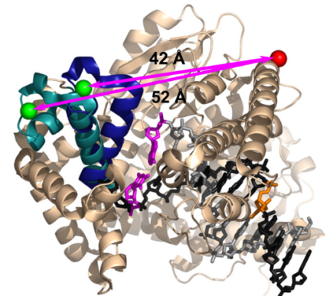
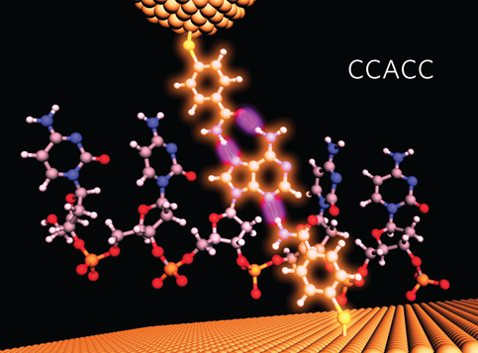
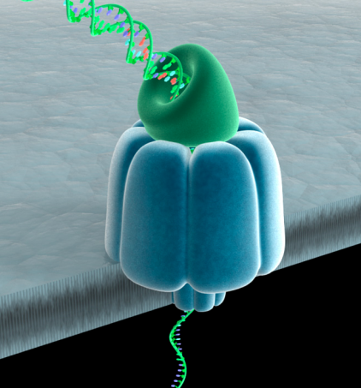
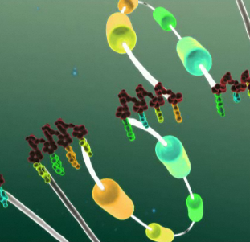
DNA Sequencing Technology Development
9 awards
$14.4M committed
Approaches:
polymerase conformation
protein and solid state nanopores, conductance and tunneling
electron microscopy
nucleotide time-of-flight
template expansion
libraries for contiguity
>>>New applications due 10/18/11
Document 23
Notes:
56
For NHGRI’s program that aims to reduce the cost and increase the rate and quality of DNA sequencing, * nine awards were made for applications discussed at this past May Council.
* The commitment over the life of these grants is $14.4M.
* These projects will explore a diverse set of approaches, including those listed here.
* Meanwhile, new applications for DNA sequencing technology development are due Oct. 18.

Slide 57

Lab to Marketplace: Tools for Biomedical and Behavioral Research
Re-issued Program Announcement (PA-11-335) for Small Business grant mechanisms
NIH-wide program
Translation of technologies for biomedical or behavioral research into the marketplace
>>>Submission by November 5, 2011
Document 23
Notes:
Relevant to technology development, * the NIH has re-issued a Program Announcement for Small Business (SBIR) grant mechanisms (R43/R44) in the area of developing tools for biomedical and behavioral research.
* This is an NIH-wide program through which NHGRI could fund relevant applications.
* The Program Announcement encourages the translation of technologies for biomedical or behavioral research from academic and other non-small business research sectors to the marketplace.
It is important for NHGRI, particularly for the translation of genome sequencing technologies.
* Applications are due in early November.
57

Slide 58


ENCODE & modENCODE
modENCODE Symposium: June 20-21, 2012
Integrated analysis papers
ENCODE
modENCODE – comparison of fly and worm (and human)
Technology development FOA applications received (to be discussed at February 2012 Council)
Document 24
Notes:
58
* NHGRI is in the early planning stages for a modENCODE symposium that will be held on the NIH campus on June 20-21, 2012. The goals of the symposium are to broaden community understanding of model organisms and showcase the contributions of the modENCODE Consortium. The meeting will tie into the upcoming Model Organisms to Human Biology GSA meeting (also scheduled for June 2012 in Washington DC).
* There are integrated analysis papers actively being developed.
Both the * ENCODE and * modENCODE Consortia are currently in the writing phases for integrated analysis papers.
ENCODE will coordinate their publications to feature a main integrative paper, multiple high-profile companion papers, and many companion papers.
modENCODE is working to integrate worm and fly data and, if possible, bring in the human ENCODE data.
* The ENCODE Technology development FOA was released after May Council, and the applications were received in early August. Applications will receive peer review in the fall and then Council review during the February meeting.

Slide 59
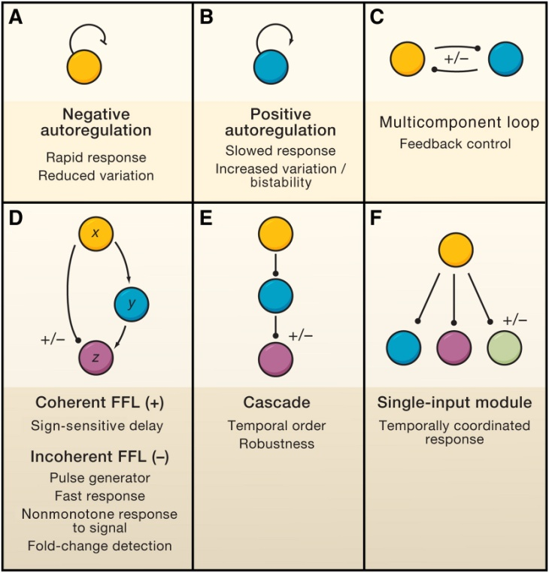
Centers of Excellence in Genomic Science (CEGS)
One new award in Fiscal Year 2011
‘Center for Cell Circuits’
P.I.: Aviv Regev
Broad Institute
Document 25
Notes:
59
For our CEGS program, * one new award was made this year.
* Aviv Regev (and her colleagues at the Broad Institute, Mass General Hospital, and Harvard) will establish a Center for Cell Circuits, and will develop reagents, technologies, algorithms, protocols, and strategies for reconstructing molecular circuits.
They will test these innovations by applying them to two circuits in mammalian cells: (1) transcriptional response to pathogens in dendritic cells, as an example of acute response to environment; and (2) control of chromatin organization and gene expression in mouse embryonic stem cells as an example of circuits that underlie stable cell states.
Dissemination of the tools is an explicit goal of the center.
With the addition of this new CEGS, we currently have 8 active awards in the program, and two centers that are phasing out of the program after their 10 years of support.

Slide 60
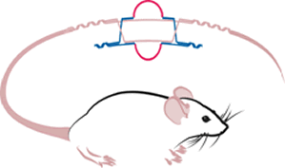
KOMP/KOMP2
KOMP
Ends September
8700 knockouts as of Aug 1
8500 is the goal
KOMP2
Starts this year
$111M over 5 years
2500 is the goal
KOMP Finale, KOMP2 Kickoff, and IMPC
Launch Meeting: September 28-29, 2011
Document 26
Notes:
60
Updates on our mouse knockout projects (KOMP and KOMP2) include the following.
* KOMP (Knockout Mouse Project) winds down at the end of September.
As of August 1, 8700 knockouts had been produced (goal is 8500).
* Recall that KOMP2 is an effort to phenotype knockout strains produced by KOMP.
For KOMP2, awards will be made this fiscal year.
Overall funding for the program is $111M over 5 years.
The goal is to produce and phenotype 2500 strains.
* There will be a major meeting later this month that will reflect the finale of KOMP, the kickoff of KOMP2, and the launching of the International Mouse Phenotyping Consortium (IMPC).

Slide 61

New ELSI Program Announcements
Three New Announcements: Regular Research Grant (R01); Small Research Grant (R03); & Exploratory/Developmental Research Grant (R21)
Based on new Strategic Plan’s Genomics & Society Priority Areas:
Genomic Research
Genomic Health Care
Broader Societal Issues
Legal, Regulatory, & Policy
Issues
Joy
Document 27
Notes:
For our ELSI research program, * three new program announcements were released in July.
The R01 component is designed for medium to large multi-disciplinary studies.
The R03 component is targeted to small, self-contained analytical or conceptual projects that can be done in two years for up to $50,000 per year.
The R21 component is aimed at cutting-edge exploratory or developmental grants that are taking on new or rapidly evolving ethical issues or the implications of emerging or anticipated scientific/technological developments. The R21 component can request up to two years and a total of $275,000 in direct costs.
* The announcements focus on the issues raised in the new strategic plan’s Genomics & Society section, such as those listed here.
A number of other NIH Institutes are participating, including NCI, NIA, NICHD, NIDCD, NIEHS, NINDS.
61

Slide 62

Challenges in Research Ethics and Policy: Perspectives on Data Sharing July 2011
Joy
Organized by the eMERGE Consent & Community Consultation Work Group
Focused on the impact of data sharing policies on researchers, research participants, and community partners
Explored how data on these issues can be used to inform the development of research policy
Speakers included genomics and ELSI researchers, bioinformaticians, policy experts, and community advisors
Notes:
In July, NHGRI held a meeting to discuss data sharing as it relates to research ethics and policy.
* The meeting was organized by the eMERGE Consent and Community Consultation Work Group, and its goal was to explore how ELSI research, in partnership with genomic research studies like eMERGE, can inform the development and implementation of research policy.
* The meeting focused on the impact of data sharing policies on researchers, research participants, and community partners.
* The meeting extensively explored how data on these issues can be used to inform the development of research policy.
* In addition to researchers, bioinformatics, and policy experts and community advisors, meeting participants included NIH, OHRP, CDC, VA, FDA, and IOM program officials, group health, pharmaceutical and biobank representatives, and members of professional societies and patient advocacy groups.
A journal article summarizing the workshop discussions is planned
62

Slide 63

Upcoming Extramural Meetings
Centers of Excellence in ELSI Research (CEERs) Program Meeting: October 3-5, 2011
ELSI Session at the International Congress of Human Genetics (ICHG): October 13, 2011
Centers of Excellence in Genomic Science (CEGS) & Diversity Action Plan (DAP) Program Meeting: October 18-21, 2011
Approaches for Characterizing Genetic Variants for Clinical Use: December 1-2, 2011
Document 28
Notes:
63
There are a number of upcoming Extramural meetings worth mentioning.
* In early October, there will be meeting for our CEERs Program.
* Then, at this year’s International Congress of Human Genetics meeting in Montreal will be session organized by our ELSI Program entitled “Emerging Ethical Issues in Large-Scale International Genomics Research Collaborations.”
* Later in October will be the annual meeting for our CEGS and DAP programs, to be held in Boston.
* Finally, in December, a workshop addressing “Approaches Characterizing Genetic Variants for Clinical Use” will be held here in the DC area. The goal of the Workshop is to identify the resources and pipelines needed to decide on the clinical relevance of genetic variants and how best to disseminate this information to support clinical use. Rex Chisholm and Marc Williams are co-Chairing the Planning Committee for this workshop.

Slide 64
General NHGRI Updates
General NIH Updates
Genomics Updates
NHGRI Extramural Program
NIH Common Fund Programs
NHGRI Office of the Director
NHGRI Intramural Program
Notes:
64

Slide 65
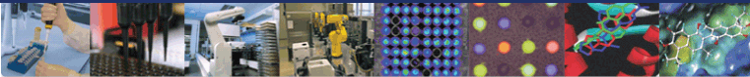
Molecular Libraries Program MLP)
MLP begins Year 4 of its Production Phase
MLP met Year 3 quantitative milestones
To date, the MLP network has:
Accepted 490 HTS assays
Completed >180 chemistry projects
Produced 229 small-molecule probes
Future focus on qualitative milestones
Higher-quality probes
Better-characterized probes
Document 29
Notes:
* On June 1 of this year, the NIH Common Fund’s Molecular Libraries Program began the fourth year of its production phase (the pilot phase plus the production phase to date totals 6 years, so actually beginning the 7th year of the program).
* Meanwhile, it met its annual quantitative goals in Year 3: 20 or more new projects per center; 15 or more active chemistry projects per center; 10-12 approved probes by peer review per year per center.
* Overall, the MLP network has accomplished an impressive set of achievements. * * *
* While there is a future focus on qualitative milestones, these are more difficult to set. Nonetheless, these include aiming to generate * higher-quality probes and * better-characterized probes. Network of centers working together to identify appropriate benchmarks for quality.

Slide 66

MLP: Probes by Health Area
Aging 4
Mental
Health 16
Heart Lung
Blood 23
Infectious
Diseases 38
Drug
Abuse 14
Basic
Research 22
Cancer 50
Diabetes
Digestion
Kidney 30
Arthritis
Muscle
Skin 18
Neurological
Disorders 20
Notes:
In terms of areas being served by the MLP effort, shown here is the distribution of health areas for which projects have been or are being pursued.
This demonstrates the diverse and balanced portfolio of projects assigned in the MLP.
The project portfolio contains a good distribution of biological targets of interest to most NIH Institutes/Centers.

Slide 67

MLP: First IND Filing on MLP Probe
Scripps Probe ML007: Sphingosine 1-Phosphate Receptor 1 Antagonist for Multiple Sclerosis
Notes:
Here is a nice highlight of the MLP.
* A lead compound was discovered in the Molecular Libraries Small Molecule Repository by the Scripps Screening Center in first year of the MLP; this was approved as probe ML007 in February 2007.
* In only five years, Scripps was able to complete lead optimization and preclinical testing of analogues of ML007, and submit an IND in January 2011 for the treatment of multiple sclerosis.
The compound remains in phase I testing, but the results have not been disclosed.
This is the first probe from the molecular libraries to have an IND filing.

Slide 68



NIH Center for Translational Therapeutics
Document 29
Notes:
Another recent highlight of the MLP was accomplished by the NCTT program within NHGRI, led by Chris Austin, and was * featured on the August 5 issue of Science. The project reflects a major collaboration with investigators at NIAID and Columbia University.
They used a combination of quantitative high-throughput screening and genome-wide association analysis to identify 32 highly active anti-malarial compounds and genetic loci associated with differential responses to those drugs.
These findings give both new leads for anti-malarial treatments and insights into mechanisms of resistance to current drugs.
This paper is a tour de force of chemical genomics – that is, the combination of chemistry and genomics to discover fundamentally new insights in biology and disease.

Slide 69

Human Microbiome Project
108 publications
in PubMed cite
HMP support
Two major papers from the HMP Consortium near completion
Anticipated submission in Fall 2011
Document 30
Notes:
Significant progress continues with the Common Fund HMP.
* To date, 108 publications in PubMed cite HMP support.
* There are two major papers from the HMP Consortium nearing completion: an HMP ‘resource’ paper and an HMP ‘analysis’ paper on the 300-subject healthy adult microbiome cohort study.
* Anticipated submission of these papers this Fall.

Slide 70

Genotype-Tissue Expression (GTEx)
Recruitment well underway
Laboratory analysis ongoing
External Scientific Panel met during June 2011 meeting
Presentation by Jeff Struewing later in Open Session
Document 31
Notes:
The pilot phase of the Genotype-Tissue Expression (GTEx) project is now out of the gates.
* While initially slow, recruitment is now well underway, with two dozen post-mortem donors enrolled.
* Laboratory analysis is ongoing.
* And we had the first in-person meeting of the External Scientific Panel this past June.
* That is all I will say for now since Jeff Struewing will make a presentation about GTEx later in the open session.
70

Slide 71


Library of Integrated Network-based Cellular Signatures (LINCS)
Fall Consortia Meeting: October 2011
Eight UO1 applications will be awarded in September 2011
Production Center public websites now live
Document 32
Notes:
* On October 27-28th, the LINCS program will hold a Fall Consortia Meeting in the DC area that will involve members of the production centers as well as newly awarded collaborative supplement, technology development, and computational tool awardees.
* Reviews were conducted this summer for U01 applicants in computational tool and advanced technology development. We expect to fund 8 awards from the applicant pool based on final feedback by NHLBI and NCI’s September Councils.
* The LINCS Production Centers at Harvard Medical School and the Broad Institute have created public websites to inform the community about released data through its data browser, discuss current experimental components of the program, and update users on new developments in the LINCS program.

Slide 72

Protein Capture Reagents Program
Production and Technology Development U54 awards to be discussed during Closed Session
Protein Capture Consortia Meeting planned for Winter 2011
Document 33
Notes:
For the relatively new NIH Common Fund Protein Capture Reagents Program, * applications for the production and technology development components will be discussed later in the Closed Session of Council.
* Meanwhile, there will be a Consortia meeting with all newly funded grantees and current members of the program in Winter 2011 in the DC area.

Slide 73


Human Heredity and Health in Africa (H3Africa)
Presentation by Jane Peterson later in Open Session
Document 34
Notes:
This an exciting period for science in Africa, as featured on the cover of this recent issue of Nature.
Meanwhile, * the NIH Common Fund, in partnership with the WT, launched H3Africa, an initiative that supports population-based genomics projects to study diseases relevant to African people, performed by African scientists in Africa.
* As you likely recall, NHGRI is the lead Institute for H3Africa, and much has happened of late with this project. So, Jane Peterson will be giving an update about H3Africa later in the Open Session.

Slide 74



New Common Fund Initiatives
Innovation Brainstorm Meeting
NHGRI Proposals
Disruptive Proteomics Technologies
Molecular Phenotypes for Genome Function and Disease
Comment Period open until September 14, 2011.
Document 35
Notes:
By design, Common Fund projects will sunset or at least scale back over time, allowing new Common Fund project to be launched. There is thus a regular process for identifying and developing possible new programs that will be supported by the Common Fund.
* In May, there was an Innovation Brainstorm Meeting. For this meeting, Institute Directors nominated very junior investigators to participate; attendees familiar to NHGRI (although not all nominated by NHGRI) included: Goncalo Abecasis, Brad Bernstein, Manolis Kellis, and Brad Malin. Among the topics rigorously discussed at this meeting was the possibility of a new microbiome-oriented program.
In addition to somewhat broad ideas that emanated from the Brainstorm Meeting, each Institute and Center was invited to submit up to 2 new Common Fund ideas for further consideration.
* NHGRI’s two proposals were in the area of disruptive proteomic technologies (somewhat modeled after our DNA sequence technology development program) and molecular phenotype for genome function and disease (very much oriented towards a post-GWAS effort at understanding the molecular basis of disease phenotypes).

Slide 75
General NHGRI Updates
General NIH Updates
Genomics Updates
NHGRI Extramural Program
NIH Common Fund Programs
NHGRI Office of the Director
NHGRI Intramural Program
Notes:
75

Slide 76









RFA HG-11-022 for Pediatric eMERGE Centers Released 7/6/11, Applications due 9/13/11
Coordinating Center
Document 36
Notes:
The Office of Population Genomics oversees the Electronic Medical Records and Genomics (eMERGE) network. This project has wrapped up its first phase, which included the efforts of * 5 investigative sites, * 2 genotyping centers, and * an administrative coordinating center within the Vanderbilt site.
The network entered its Phase II with 7 awards: * 5 to the phase I sites, 2 to new investigative sites, and one award to a * Coordinating Center at Vanderbilt.
The goals of eMERGE II are to demonstrate that patients’ genetic information linked to disease or clinical manifestations in their electronic medical records can be used to improve their care.
Because eMERGE II has no pediatric sites, * an RFA to solicit pediatric sites was released in July with applications due tomorrow.

Slide 77


NHGRI Catalog of Published Genome-Wide Association Studies (GWAS)
Exponential Growth in GWAS Publications
1000 Publications, Sept 6th 2011!
Document 37
Notes:
The Office of Population Genomics continues it excellent curation of the GWAS catalog.
* There continues to be exponential growth in the number of publications reporting GWAS findings, which means our GWAS catalog continues to grow at an exponential rate.
* The latest complete summary goes through the end of Q1 2011, and reflects 862 publications with 1,319 associations at p<=5x10-8 for 221 traits.
* Remarkably, our catalog has surpassed the 1000 publications mark on Sept 6th, 2011.

Slide 78




PhenX Program
NHGRI-NIDA collaboration to expand substance use measures in Toolkit
NIDA provided $730,000 for project
Working Groups to focus on: Substance Use, Intermediate Phenotypes, Risk Factors (psychosocial, Cognitive, community), Co-Morbid Conditions
Kick-off meeting for 7 PIs using PhenX measures
Validating PhenX measures and evaluating usefulness of Toolkit
Document 38
Notes:
The last update from the Office of Population Genomics relates to the PhenX project, which * published a paper describing the design of the PhenX Toolkit in the August issue of the American Journal of Epidemiology.
* PhenX also published a paper in the May issue of the American Journal of Preventive Medicine on adoption of standard measures in biomedical research.
* PhenX has now teamed up with NIDA for a one-year project to expand substance use measures in the Toolkit, for which NIDA is providing $730,000. This will involve convening three working groups of substance abuse and addiction experts, who will be tasked with identifying measures that will expand the scope of the Toolkit to include additional substance use and addiction measures to promote data harmonization within the NIDA and NIAAA grantee community.
* The PhenX administrative supplement program had their kick-off meeting earlier this month. Investigators are adding a variety of PhenX measures to existing studies.
* This supplement program will also help us evaluate the overall usefulness of the PhenX Toolkit. We expect the work to be completed in Fall 2012.

Slide 79
General NHGRI Updates
General NIH Updates
Genomics Updates
NHGRI Extramural Program
NIH Common Fund Programs
NHGRI Office of the Director
NHGRI Intramural Program
Notes:
79

Slide 80

Blue Ribbon Panel Review of NHGRI Intramural Research Program
David Page, M.D. (Chair)
Rick Myers, Ph.D. (NACHGR)
Bruce Korf, M.D., Ph.D. (BSC)
Wylie Burke, M.D., Ph.D
Nancy Cox, Ph.D
Bob Waterston, M.D., Ph.D
Huda Zoghbi, M.D.
Notes:
Besides the two senior appointments mentioned earlier (Paul Liu and Jim Mullikin), the most significant recent development with the NHGRI Intramural Research Program relates to a major review of the Program that I am arranging.
Blue Ribbon Panel reviews of Institute Intramural Programs were started by Harold Varmus when he was NIH Director.
Such reviews aim to provide high-level assessment of the complete Program, augmenting the detailed reviews of individual investigators that occur every 4 years.
Blue Ribbon Panel reviews are conducted by the Institute Director in collaboration with NIH Director every 10 years.
For a number of reasons, I decided to conduct such a Blue Ribbon Panel review over the next 9 months (e.g., last review in 2001, new leadership, new strategic plan, new opportunities, tight budgets).
* I was pleased to recruit a star-studded Panel (truly Blue Ribbon in stature) for this review.
Francis Collins will not be involved; Michael Gottesman instead.
Report will be brought to Council when finalized.
80

Slide 81


NHGRI Intramural Research Highlights: Proteus Syndrome Gene Discovered
Document 39
Notes:
In terms of recent research highlights from our Intramural Research Program, one of the most notable ones is the discovery of a the gene mutated in Proteus Syndrome, a rare disorder that causes tissue and bone to grow out of proportion to the body.
After a 15-year search, an NHGRI research team led by Les Biesecker discovered that mutations in the AKT1 gene cause Proteus Syndrome, a result that they reported in The New England Journal of Medicine.
Molecular insights from these findings may help establish the cause of the so-called Elephant Man's severe disfigurement

Slide 82











NHGRI Intramural Research Highlights
Document 40
Notes:
Other recent highlights from NHGRI’s Intramural Research Program include the following:
* Charles Venditti annd colleagues published a study which whole-exome sequencing led to finding the gene for combined malonic and methylmalonic aciduria, increasing the likelihood of diagnosing the rare metabolic disorder.
* NHGRI researchers led by Meral Gunay-Aygun published a study reporting that mutations in NBEAL2 cause the bleeding disorder known as Gray Platelet Syndrome.
* Two studies led by Kan Cao and Francis Collins provide new insights about Hutchinson-Gilford progeria syndrome. One reported that cells from progeria patients respond to treatment with rapamycin, which flushes accumulation of the toxic protein progerin from the cell. In a separate study, these researchers showed that progerin is activated in normally aging cells as telomeres are degraded.
* A collaboration to generate a gene-expression map of the mouse cerebral cortex between researchers from the Margulies group at NHGRI and the Ponting group at Oxford University, led by their joint graduate student Grant Belgard (shown here), was recently published as well.

Slide 83

Special Thanks!
Notes:
Special thanks to Kris Wetterstrand.
Also, to Larry Thompson, Judy Wyatt, and the Web team.
Finally, thanks to many other NHGRI staff members who contributed slides and summaries– a real group effort!

Slide 84

Notes:
Questions?

