Slide 1
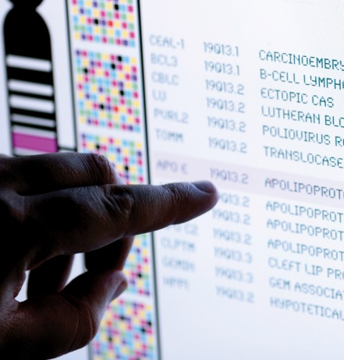
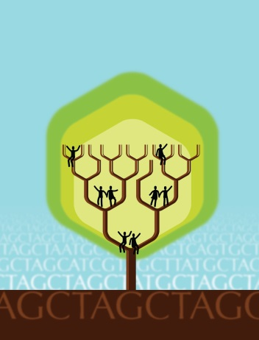
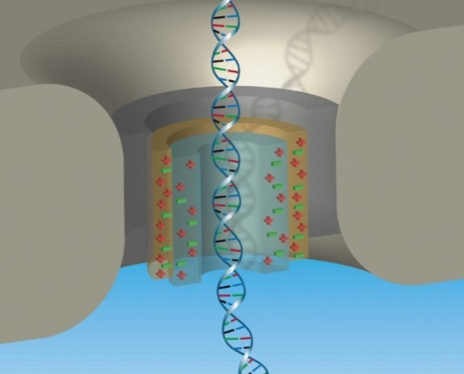


National Advisory Council for Human Genome Research
September 2016
Eric Green, M.D., Ph.D.
Director, NHGRI
DIRECTOR’S REPORT
Notes:
As is now NHGRI’s routine, the entire Open Session of this National Advisory Council for Human Genome Research meeting is being webcast live, including my Director’s Report.
The Open Session is also being videotaped, and those recordings will be made available as a permanent archive on NHGRI’s website (genome.gov), including the presentations themselves and the various associated documents.

Slide 2
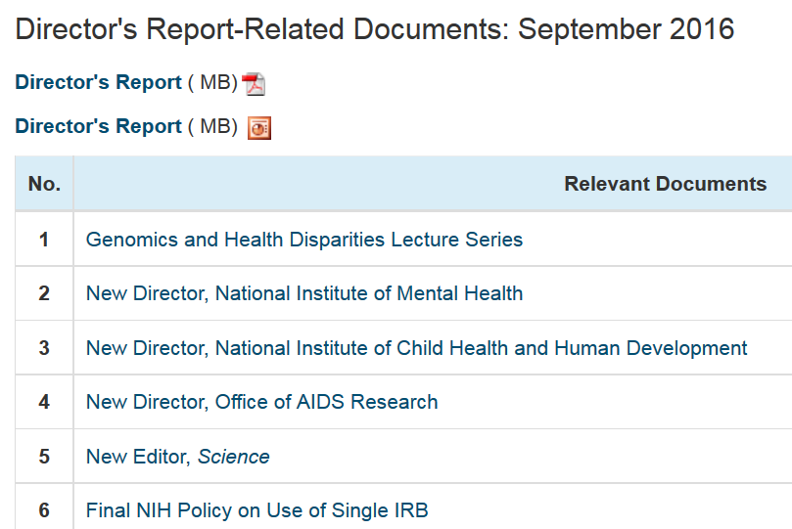
genome.gov/DirectorsReport
Document #
Notes:
For those new to our Council meetings, I want to make you aware of an ‘electronic resource’ associated with my Director’s Report. Analogous to supplemental materials of a published paper, this resource can be accessed at the URL shown here.
The slides that I will show during my Director’s Report are also available electronically at this site – * both in PDF and PowerPoint formats.
* When there are associated documents or relevant web sites associated with a particular slide, you will find a ‘Document #’ indicated on the bottom right of that slide; that ‘Document #’ references materials that can be accessed and/or downloaded at the web page shown here.
In addition to the video archive, this web page and all linked documents will be archived on genome.gov as a historic record of this meeting.

Slide 3
Open Session Presentations
  Seizing Unprecedented Opportunities: NHLBI
  Trans-Omics in Precision Medicine (TOPMed)
    Gary Gibbons
  Opportunities for Synergy between the NHGRI
  Genome Sequencing Program and TOPMed
    Adam Felsenfeld
Notes:
There will be several other presentations during the Open Session of this Council meeting. My Director’s Report is tailored around these presentations, and I will not discuss in detail the topics that others will cover.
* After my Director’s Report, Gary Gibbons (Director of the National Heart, Lung and Blood Institute), will give a presentation entitled “Seizing Unprecedented Opportunities: NHLBI Trans-Omics in Precision Medicine (TOPMed).”
* NHGRI’s Adam Felsenfeld will follow with a presentation on the “Opportunities for Synergy between the NHGRI Genome Sequencing Program and TOPMed.”

Slide 4
Open Session Presentations
  Genomic Medicine Working Group
  Teri Manolio
  Genomic Medicine IX Meeting
  Carol Bult
Notes:
After lunch, we will hear two reports.
* One from the Genomic Medicine Working Group of this Council, which will be presented by NHGRI’s Teri Manolio, and * one about the recent Genomic Medicine IX Meeting, presented by Council Member Carol Bult.

Slide 5
Open Session Presentations
  U.S. Precision Medicine Initiative
    Eric Dishman
  23 (Pairs) plus 1 Lessons Learned
    Jeff Schloss
Notes:
Next, * Eric Dishman (the recently arrived Director of the Precision Medicine Initiative Cohort Program) will talk about the U.S. Precision Medicine Initiative.
And the last major component of the Open Session will be a special presentation given by NHGRI’s Jeff Schloss; his talk is entitled “23 (Pairs) plus 1 Lessons Learned.”

Slide 6
Director’s Report Outline
General NHGRI Updates
General NIH Updates
General Genomics Updates
NHGRI Extramural Research Program
NIH Common Fund/Trans-NIH
NHGRI Division of Policy, Communications, and Education
NHGRI Intramural Research Program
Notes:
For the rest of my Director’s Report, I will cover the 7 areas listed here, which reliably provide an effective framework for reviewing the relevant topics.

Slide 7
Director’s Report Outline
General NHGRI Updates
General NIH Updates
General Genomics Updates
NHGRI Extramural Research Program
NIH Common Fund/Trans-NIH
NHGRI Division of Policy, Communications, and Education
NHGRI Intramural Research Program

Slide 8
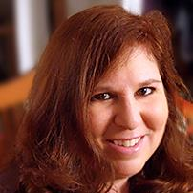
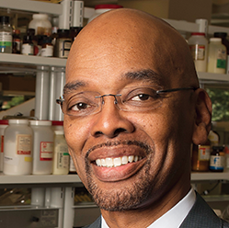

Genomics and Health
Disparities Lecture Series
Sarah Tishkoff, Ph.D.
November 15, 2016
David and Lyn Silfen University Professor
Departments of Genetics and Biology
University of Pennsylvania
Herman Taylor, Jr., M.D., M.P.H.
March 9, 2017
Director, Cardiovascular Research Institute
Professor of Medicine
Morehouse School of Medicine
Mark Cullen, M.D.
June 8, 2017
Director, Stanford Center for Population Health Sciences
Professor of Medicine
Stanford School of Medicine
Document 1
Notes:
As I have mentioned previously, NHGRI is partnering with the National Institute on Minority Health and Health Disparities; the National Heart, Lung, and Blood Institute; the National Institute of Diabetes and Digestive and Kidney Diseases; and the Office of Minority Health at the Food and Drug Administration to hold a Genomics and Health Disparities Lecture Series. These lectures focus on the role that genomics research can have in addressing health disparities and understanding health inequities. Previous speakers have included Carlos Bustamante, Neil Powe, Gerardo Jimenez-Sanchez, and Funmi Olopade.
The series will continue with three more outstanding speakers in the coming months: * Sarah Tishkoff from University of Pennsylvania; * Herman Taylor from Morehouse School of Medicine; and * Mark Cullen from Stanford University.
All lectures in this series are being recorded and archived on NHGRI’s GenomeTV channel of YouTube.

Slide 9
Director’s Report Outline
General NHGRI Updates
General NIH Updates
General Genomics Updates
NHGRI Extramural Research Program
NIH Common Fund/Trans-NIH
NHGRI Division of Policy, Communications, and Education
NHGRI Intramural Research Program

Slide 10


New Director,
National Institute of Mental Health
Joshua Gordon, M.D., Ph.D.
Document 2
Notes:
Joshua Gordon has been named the new Director of the National Institute of Mental Health (or NIMH). Dr. Gordon is a psychiatrist and neuroscientist, with extensive experience in mental health research and practice. He comes to NIH from New York City, where he is currently Associate Professor of Psychiatry at Columbia University Medical Center and Research Psychiatrist at the New York State Psychiatric Institute. His research focuses on the analysis of neural activity in mice carrying mutations of relevance to psychiatric disease. He earned his M.D. and Ph.D. degrees from the University of California, San Francisco. Dr. Gordon is expected to join NIH this month.

Slide 11
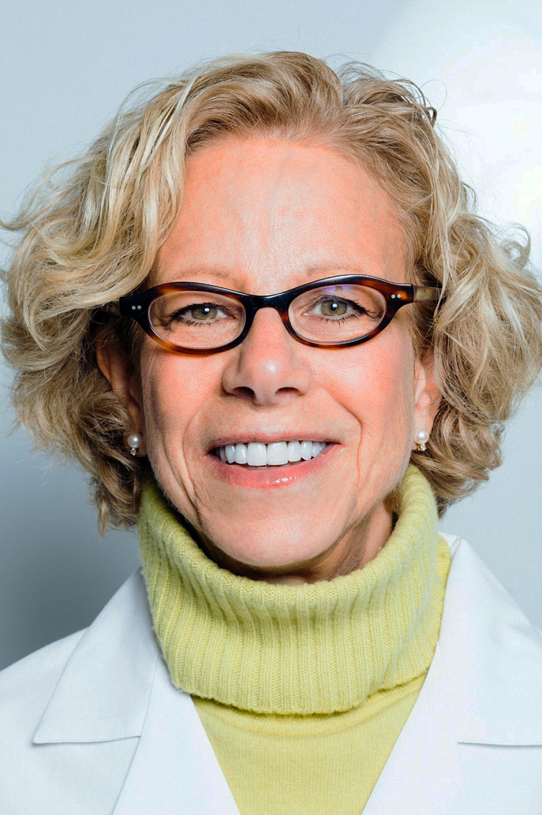

New Director, National Institute of Child Health and Human Development
Diana Bianchi, M.D.
Document 3
Notes:
Diana Bianchi has been named the new Director of the National Institute of Child Health and Human Development (or NICHD). Dr. Bianchi is a prenatal geneticist with clinical and research experience in both pediatrics and obstetrics. She comes to NIH from Boston, where she is the Founding Executive Director of the Mother Infant Research Institute and Vice Chair for Pediatric Research at Tufts University. Her research focuses on prenatal genomics, specifically noninvasive prenatal DNA screening methods and the development of new therapies for genetic disorders that can be administered prenatally. She earned her M.D. from Stanford University School of Medicine.
As an added bonus, Dr. Bianchi’s research laboratory will be housed within NHGRI’s Intramural Research Program, adding another outstanding investigator to that part of our Institute. Dr. Bianchi is expected to assume the role as the new NICHD Director next month, with her laboratory arriving and being established within NHGRI’s Intramural Research Program in early 2017.

Slide 12


New Director, Office of AIDS Research
Maureen Goodenow, Ph.D.
Document 4
Notes:
Maureen Goodenow has been appointed the NIH Associate Director for AIDS Research and Director of the Office of AIDS Research (or OAR). Dr. Goodenow joined NIH in July, bringing nearly 30 years of experience in HIV/AIDS research and advocacy to the position. She was previously at the University of Florida, where she was a Professor of Pathology, Immunology, and Laboratory Medicine, leading a research program in molecular epidemiology, pathogenesis, and vaccines for HIV-1 and related viruses, including viruses that cause cancer. She received her Ph.D. in molecular genetics from the Albert Einstein College of Medicine.

Slide 13
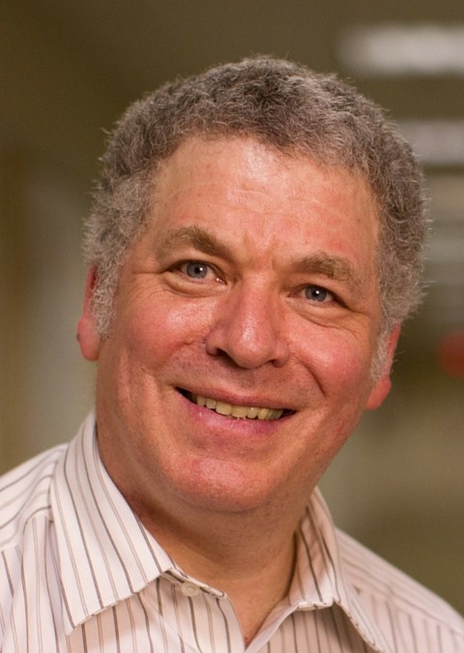

New Editor, Science
Jeremy Berg, Ph.D.
Document 5
Notes:
Jeremy Berg, former Director of National Institute of General Medical Sciences (or NIGMS) and good friend of NHGRI’s, recently assumed the role as Editor of Science magazine. Dr. Berg is currently also a member of the research faculty at the University of Pittsburgh School of Medicine.

Slide 14
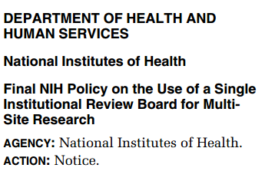
Final NIH Policy on Use of a Single IRB
    Released on June 21, 2016
    All multi-site research funded by NIH must use a single IRB for ethical review
    Intended to promote efficiency while maintaining human subjects protections
Document 6
Notes:
On June 21, * NIH released a new policy on the use of a single Institutional Review Board (or IRB) for multi-site research – research in which more than one site conducts the same protocol involving human participants. This final rule follows a Notice of Proposed Rulemaking released in December 2014, which received 167 comments that were mostly supportive of this idea. * According to the policy, all domestic sites of NIH-funded multi-site work must use a single IRB for the ethical review of research involving human participants.
* This policy is intended to streamline the process of IRB review and promote efficiency while maintaining adequate human subjects protection. Exceptions will only be granted if the designated IRB is unable to meet the needs of specific populations or if local IRB review is required by any federal, tribal, or state laws. The policy will be effective on May 25, 2017.

Slide 15

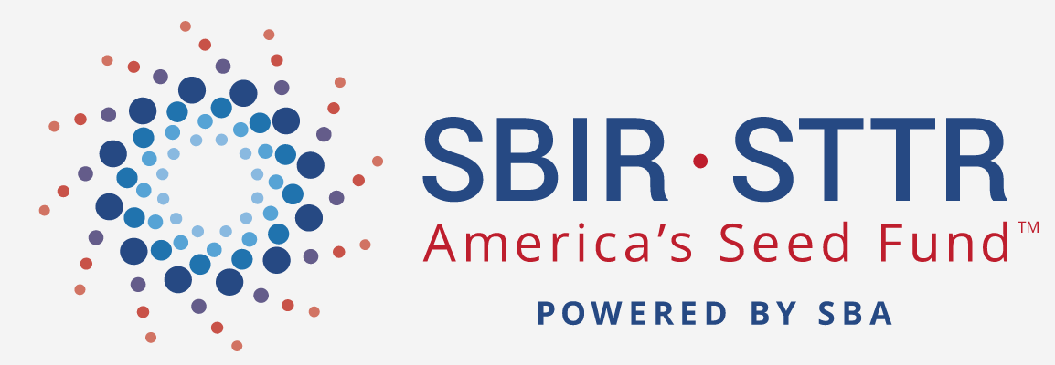
SBIR/STTR Reauthorization
Document 7
Notes:
Both the House and the Senate have introduced bills that would reauthorize the Small Business Innovation Research (or SBIR) and Small Business Technology Transfer (or STTR) Programs. The bills would increase the proportion of Federal research dollars going to small businesses across 11 participating Federal agencies, including NIH. Both programs are financed through a set-aside of each agency’s research budget. The Senate reauthorization bill would increase the set-aside from the current 3% to 6% over the next several years and make the program permanent, rather than requiring reauthorization every 5-6 years. The House version includes smaller increases and fewer program changes.
Biomedical research advocates and several congressmen have expressed concerns about how increasing SBIR/STTR budgets under the proposed legislation might erode the budgets of other extramural research programs. Opponents of the bill propose increasing the overall research budgets of Federal agencies so that all programs (including the SBIR/STTR program) benefit.

Slide 16
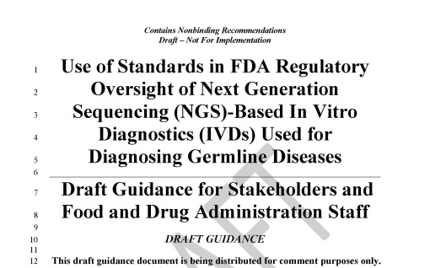
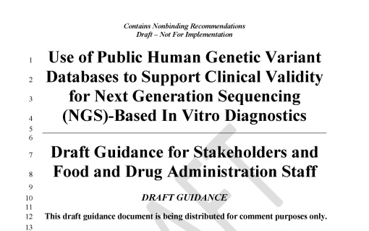
New FDA Draft Guidances on Next-Generation Sequencing (NGS) Tests
    Analytical validity standards for NGS tests used to detect germline diseases
    Use of public genomic variant databases to support clinical validity of NGS tests
    Public comment period closes October 6, 2016
Document 8
Notes:
After holding a series of public workshops last year to discuss Next-Generation Sequencing (or NGS) analytical and clinical validity, FDA released two draft guidances in July. * One guidance, entitled “Use of Standards in FDA Regulatory Oversight of Next Generation Sequencing (NGS)-Based In Vitro Diagnostics (IVDs) Used for Diagnosing Germline Diseases,” proposes analytical validity standards for NGS tests used to detect germline diseases. * The second guidance, entitled “Use of Public Human Genetic Variant Databases to Support Clinical Validity for Next Generation Sequencing (NGS)-Based In Vitro Diagnostics,” proposes a voluntary pathway for using public genomic variant databases to support clinical validity claims of NGS tests.
The FDA has suggested that it will create further guidance on analytical validity standards for NGS tests used outside of detecting germline diseases. NHGRI staff is closely monitoring developments in FDA’s NGS policy-development efforts; in fact, we provided input on the present draft guidances before they were released. Our staff and grantees in the ClinGen Consortium have also been in close contact with the FDA to share best practices about genomic variant databases. * The public comment period for these draft guidances closes October 6. This represents an opportunity for the genomics community to contribute to the development of the regulatory framework that will oversee the implementation of genomic medicine.

Slide 17

New EEOC Rules: GINA and Workplace Wellness Programs
    GINA: Incentives for employees’ spouses’ health information
    ADA: Incentives for employees’ health information
Document 9
Notes:
In May, the U.S. Equal Employment Opportunity Commission (or EEOC) released its final regulations regarding the Genetic Information Nondiscrimination Act (or GINA) and workplace wellness programs. * Now, employers offering wellness programs may provide financial and other incentives in exchange for an employee's spouse providing information about their current or past health status, including genetic information. * A second EEOC rule was also released to clarify the Americans with Disabilities Act (or ADA), now allowing employers to offer incentives to employees participating in voluntary wellness programs in exchange for providing health information. EEOC has also stated that employers cannot use health information acquired through wellness programs to deny benefits to employees.
The American Society of Human Genetics and the Genetic Alliance released statements criticizing EEOC’s rulings on the matter, arguing that these decisions weaken anti-discrimination protections. These groups argued that providing financial incentives, or in some cases imposing penalties for not providing health information to wellness programs, make the decision to provide health information less than voluntary.

Slide 18
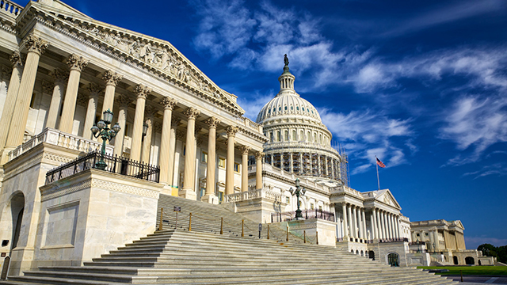
‘Cures’ Legislation Update
    Proposes funding increases for NIH
    Congressional movement hoped for in September
Document 10
Notes:
Over a year has gone by since the House passed the 21st Century Cures Act, a piece of legislation proposing reforms and extra funding to propel biomedical innovation and healthcare interests forward. Since then, the Senate has been working to advance what is known as the ‘Cures’ agenda for their part of the legislative process. * Several of the proposed ‘Cures’ bills would result in funding increases for NIH. Of course, the ‘Cures’ bills must pass the full Senate and House and then receive the President’s signature before becoming law. * Both the House and Senate have been pushing hard for this legislation to pass. There remain several ongoing debates regarding NIH funding and FDA issues, so, despite vocal support, it remains to be seen what will actually happen. At the moment, it seems unlikely that the Senate will have time to take up the ‘Cures’ legislation during the three weeks they are in session before breaking in October. But the House Energy and Commerce Committee Chairman, Rep. Fred Upton (a major proponent of the legislation), is insistent that it will be passed during the lame duck session of Congress at the end of this year.

Slide 19
NIH Appropriations and Budget
 | FY2016 Enacted | FY2017 President Obama Request
NIH NHGRI | $32.3 B | $33.1 B
 | $513.2 M | $513.2 M
Document 11
Notes:
As the end of Fiscal Year 2016 approaches, that is September 30, it is again time for Congress to negotiate the Federal budget and pass a new appropriations bill for Fiscal Year 2017. Last year, Congress engaged in deadlocked debate and barely made deadlines to provide funding for Fiscal Year 2016. However, NIH was fortunate in that the final enacted Fiscal Year 2016 budget resulted in a $2 billion increase for NIH, for a total of $32.3 billion (as reflected in the middle column). Of this amount, $513.2 million was provided to NHGRI.
The numbers for Fiscal Year 2017 are still unknown. President Obama released his proposed budget in February, calling for another increase that would take NIH’s total to $33.1 billion (as reflected in the far-right column), although this did not come with an increase for NHGRI. However, with the impending administration change, Congress is likely to propose an entirely different budget for NIH. Additionally, as of the end of last week, Senate majority and minority leaders were working to pass a Continuing Resolution (or a CR, which is a short-term budget extension) through December 9 at Fiscal Year 2016 spending levels. They hope to bring this to a vote this week, but House conservatives are backing a longer CR that could last as long as six months. So, time will tell how this actually plays out.

Slide 20
Director’s Report Outline
General NHGRI Updates
General NIH Updates
General Genomics Updates
NHGRI Extramural Research Program
NIH Common Fund/Trans-NIH
NHGRI Division of Policy, Communications, and Education
NHGRI Intramural Research Program

Slide 21
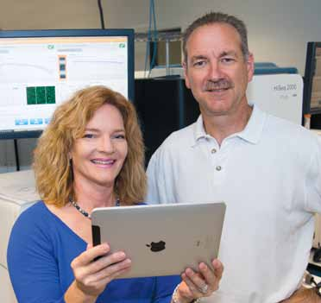

Mardis & Wilson Heading to
Nationwide Children’s Hospital
Elaine Mardis, Ph.D.
Rick Wilson, Ph.D.
Document 12
Notes:
This month, Drs. Elaine Mardis and Rick Wilson will be departing Washington University and heading to Nationwide Children's Hospital in Columbus, Ohio, where they will be establishing a new genomics program. Nationwide Children’s Hospital is one of the nation’s largest not-for-profit freestanding pediatric healthcare networks, providing care for infants, children, and adolescents as well as adult patients with congenital disease. Both Elaine and Rick are long-time NHGRI grantees and colleagues, and Dr. Wilson is former member of this Council.
Interim co-directors of the McDonnell Genome Institute at Washington University will be Drs. Susan Dutcher, Ira Hall and Nathan Stitziel. NHGRI staff are working with them to develop a permanent transition plan.

Slide 22

Global Alliance for Genomics and Health Perspective in Science
Document 13
Notes:
The Global Alliance for Genomics and Health (or GA4GH) recently published a perspective in Science entitled “A Federated Ecosystem for Sharing Genomics, Clinical Data.” This perspective represents an important major publication from GA4GH, articulating the need for a common framework of principles, protocols, and interoperable technical systems to enable responsible and effective data sharing.

Slide 23




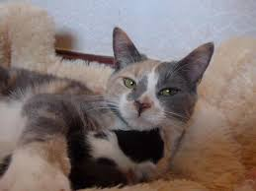






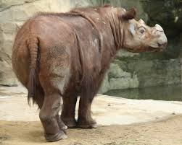


Genomes In The News…
Document 14
Notes:
In terms of ‘Genomes In The News’ – there have been a number of recently generated genome sequences reported since the last Council meeting, including: * carrot, * (more) ancient horses, * giraffe, * rubber tree, * orca, * olive tree, * ancient barley, * manx cat, * calugo (a gliding mammal), * Sumatran rhino, * tobacco hornworm sphinx moth, and * snub-nosed monkey.

Slide 24
Director’s Report Outline
General NHGRI Updates
General NIH Updates
General Genomics Updates
NHGRI Extramural Research Program
NIH Common Fund/Trans-NIH
NHGRI Division of Policy, Communications, and Education
NHGRI Intramural Research Program

Slide 25







Centers for Mendelian Genomics
Genome Sequencing Program
GSP Analysis Centers
GSP Coor. Center
Centers for
Common Disease
Genomics
      New Addition: Analysis Centers
Harvard School of Public Health Broad Institute Brigham and Women’s Hospital |  | Xihong Lin Benjamin Neale Shamil Sunyaev
Stanford University University of California San Francisco Mount Sinai |  | Carlos Bustamante Esteban Burchard Eimear Kenny
Vanderbilt University |  | Bingshan Li Nancy Cox
      ~$11M total over 4 years
Document 15
Notes:
The Genome Sequencing Program (or GSP) aims to understand general principles and features of disease genomics and the genomic variants that influence disease risk. The program has multiple components. The Centers for Mendelian Genomics (or CMGs) investigate rare and Mendelian diseases, while the Centers for Common Disease Genomics (or CCDGs) look at common and complex diseases. The CCDGs have recently released their project plans online at the web site maintained by the GSP Coordinating Center, which provides logistical and scientific support for the GSP.
* We recently announced awards for the fourth component of the GSP, the Analysis Centers. These latest centers aim to conduct novel analyses of the genome sequence data produced by the entire GSP, rather than data from individual projects. Three Analysis Center awards were made, with the associated institutions and PIs listed here. The work proposed by these groups includes multiple approaches to interpret noncoding genomic variants and to use admixture information for improving genomic analyses. * The Analysis Centers will be funded at roughly $11M total over 4 years.

Slide 26



Genome Sequencing Program
      High-Quality Genome Sequences
      ~$8M total over 4 years
University of California Santa Cruz |  | Richard (Ed) Green
Washington University University of Washington |  | Richard Wilson Evan Eichler
Document 15
Notes:
We also recently announced that awards have been made to produce additional very high-quality reference genome sequences for human and non-human primates. This additional component of the GSP aims to address the need for high-quality reference sequences as a resource for the human genomics community; such improved references would aid efforts to interpret human genome sequences for both basic research and clinical implementation of genomics.
Two awards were made. The first award to Dr. Ed Green will use new methods for long-range scaffolding in conjunction with short-read sequence data to assemble 50 human and non-human primate genome sequences. The second award to Drs. Rick Wilson and Evan Eichler will use a multi-tiered approach that includes long-read sequence data, innovative scaffolding technologies, and BAC-end sequence data to close remaining gaps; they aim to apply this to the generation of ~14 genome sequences, split between human and non-human primates.
* These groups will be funded at roughly $8M total over 4 years.

Slide 27

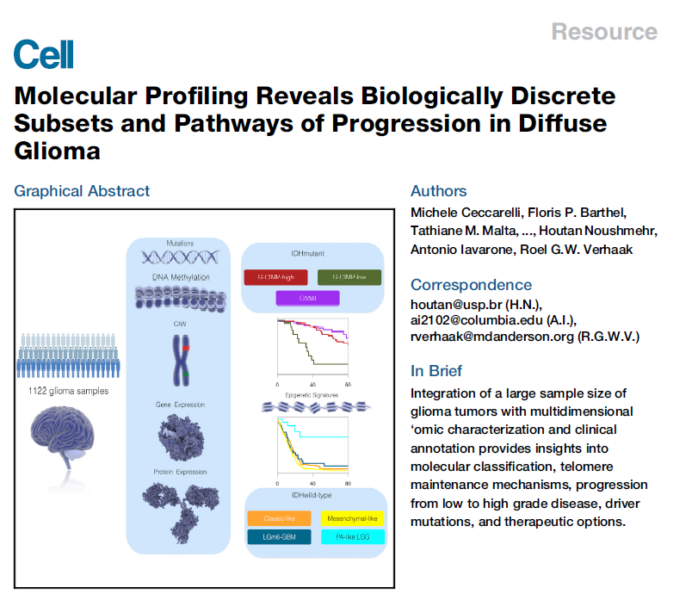
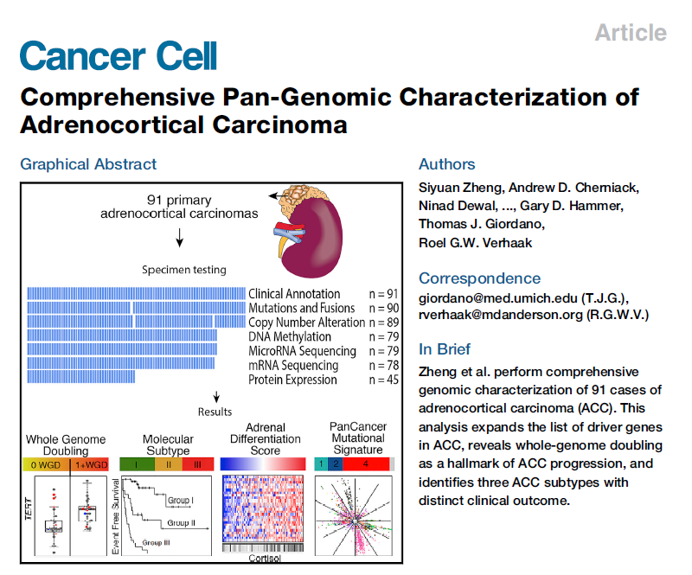
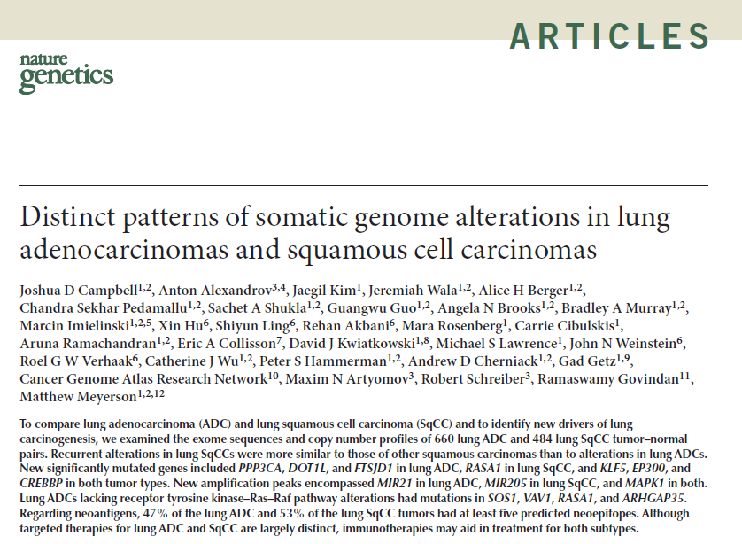
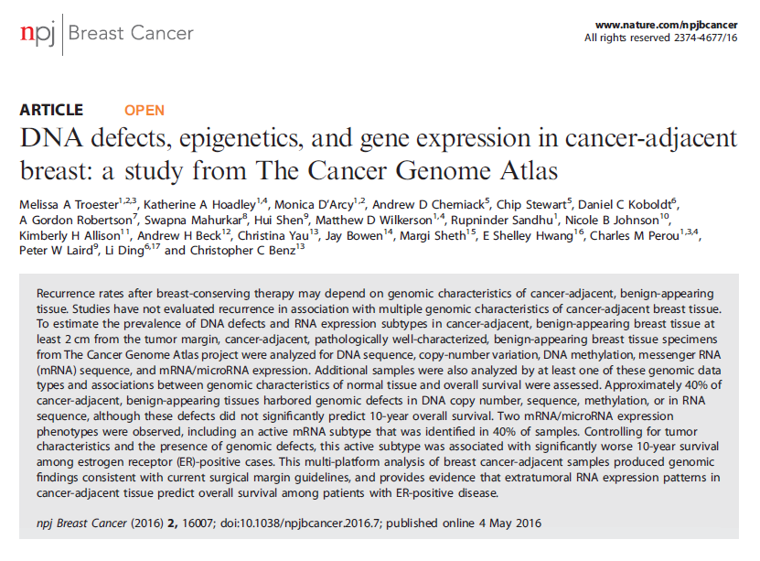
Cell; 2015;164:550-63. doi: 10.1016/j.cell.2015.12.028
Cancer Cell; 2016;29:723-36. doi: 10.1016/j.ccell.2016.04.002
Nat Genet; 2016;48:607-16. doi: 10.1038/ng.3564. Epub 2016.05.9
npj Breast Cancer 2; 2016; pii: 16007 doi:10.1038/npjbcancer.2016.7
Document 16
Notes:
The Cancer Genome Atlas (or TCGA) is a coordinated effort by NHGRI and the National Cancer Institute (or NCI) to better understand the molecular basis of cancer. Genomic data production on over 10,000 tumor/normal pairs has been completed, and TCGA is currently focused on manuscript writing as the project comes to a close this year.
For each of over 30 cancer types, the TCGA Network has published a comprehensive, integrated account of sequence/mutation analysis, copy number variation, gene and micro RNA expression, and promoter methylation. TCGA papers focused on * diffuse glioma and * adrenocortical carcinoma were published in January and May in Cell and Cancer Cell, respectively. The TCGA Network is also coordinating analysis on follow-up papers to the original marker papers. This includes an ongoing pan-cancer analysis of all 10,000 tumors, as well as more focused papers on topics such as comparisons of * lung adenocarcinomas and squamous cell carcinomas and an * investigation of genomic alterations in tumor adjacent breast cancer tissue.

Slide 28
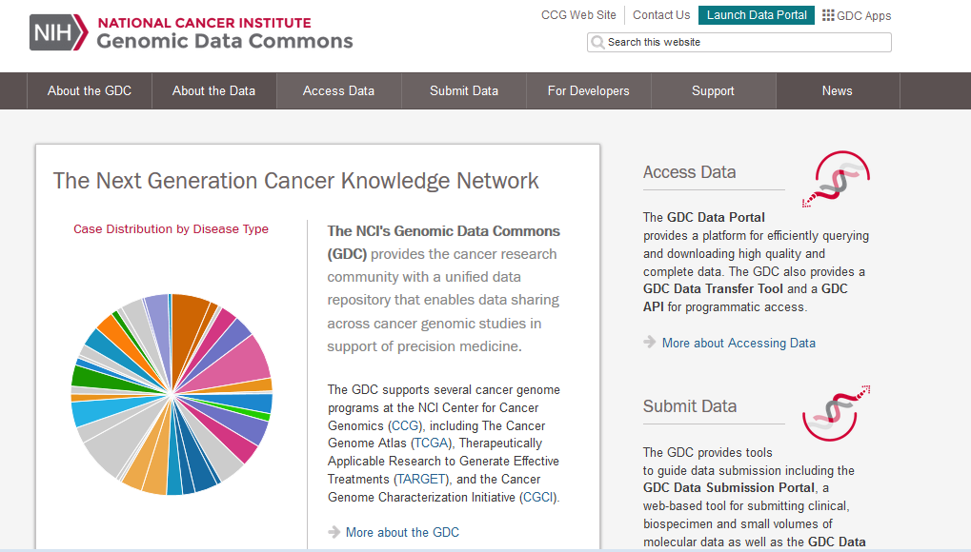
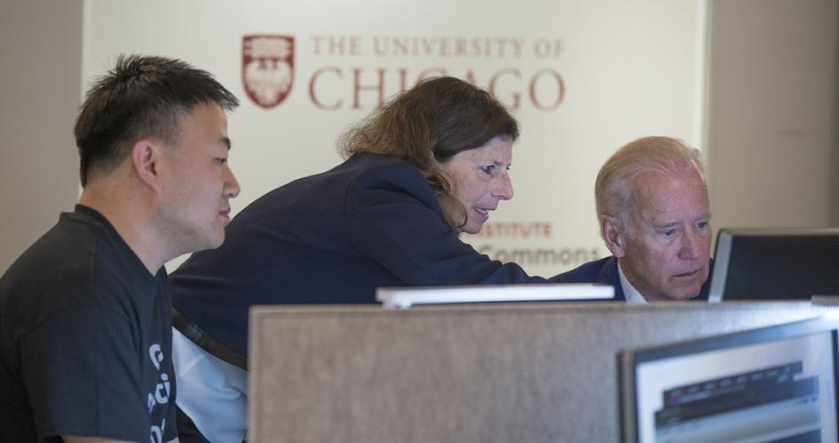
Document 16
Notes:
As an important update for users of TCGA data, NCI recently altered the location for accessing DNA and RNA sequence data from the TCGA project. Rather than being available at CGHub, the data are now centralized, standardized, and made accessible through the Genomic Data Commons (or GDC). The GDC contains over 2 petabytes of data, including data from TCGA and its pediatric equivalent, called Therapeutically Applicable Research to Generate Effective Treatments (or TARGET). In addition, the GDC will accept submissions of cancer genomic and clinical data from researchers around the world who wish to share their data broadly.
* Shown here is Vice President Joe Biden exploring the TCGA data online as part of the GDC launch at the American Society for Clinical Oncology Meeting in June.
As noted, TCGA is officially wrapping up this fall. Our NCI colleagues will continue to lead projects in the large-scale genomic and molecular characterization of cancer. Of note, we plan to give a more formal update about the TCGA project at the February Council meeting.

Slide 29

Technology Development Program
  Novel Nucleic Acid Sequencing Technology Development
  RFA-HG-15-031 (to 33; R01, R21, and R43/44)
  Upcoming due date: June 15, 2017
  Novel Genome Technology Development
  PAR-16-14 (to 17; R01, R21, R43/44, and R44)
  Upcoming due dates: October 31, 2016 and 2017
Document 17
Notes:
NHGRI’s Technology Development Program continues to move forward and has several active funding opportunities that deserve highlighting.
* There are active Requests for Applications for Novel Nucleic Acid Sequencing Technology Development that involve both DNA and direct RNA sequencing. We are in the process of making awards from the first round of applications. The second set of applications has been received and will be coming to the February Council meeting after they are reviewed. There is also an upcoming application due date in June of 2017.
* Program Announcements for Novel Genome Technology Development yielded the first round of applications that will be considered later at this Council meeting. There are also upcoming application due dates in October of 2016 and 2017.

Slide 30

Encyclopedia of DNA Elements (ENCODE)
  ENCODE Outreach
  ENCODE 2016: Research Applications and Users Meeting
  June 8-10: Palo Alto, CA
  Tutorials at 2016 ASHG Meeting
  October 18, 21: Vancouver, BC
  Publications Using ENCODE Data
Document 18
Notes:
The goal of the Encyclopedia of DNA Elements (or ENCODE) project is to create catalogs of all functional elements in the human and mouse genomes, and to make those catalogs available as a resource to the biomedical community.
* ENCODE regularly engages in outreach activities to help a broad range of scientists use ENCODE resources. * For example, the second ENCODE Users Meeting took place in June, modeled after the highly successful 2015 meeting. Over 200 participants from the research community attended. Consortium members led interactive tutorials demonstrating how to access ENCODE data, tools, and resources; ran ENCODE pipelines that uniformly process data; and performed integrative analyses of ENCODE data. In addition, a panel of distinguished researchers not involved in ENCODE explained how ENCODE resources are enabling their own work.
* ENCODE consortium members will lead two tutorials at the upcoming ASHG meeting. These will focus on enabling attendees to utilize 3D genomic data generated by ENCODE and other projects, and on how to use ENCODE data-processing pipelines and tools to assess experimental reproducibility.
* As a result of outreach and collaboration, ENCODE data continue to be heavily used. There are more than 1500 community publications (the pink line) from groups without ENCODE funding but who used ENCODE data for their published work. ENCODE Consortium members have produced more than 550 publications to date (the green line).

Slide 31
Encyclopedia of DNA Elements (ENCODE)
  Applications received and reviewed for these FOAs:
    Expanding the Encyclopedia of DNA Elements (ENCODE) in the Human and Mouse (RFA-HG-16-002)
    Characterizing the Functional Elements in the Encyclopedia of DNA Elements (ENCODE) Catalog (RFA-HG-16-003)
    Computational Analysis of the Encyclopedia of DNA Elements (ENCODE) Data (RFA-HG-16-004)
    ENCODE Data Coordination Center (RFA-HG-16-005)
    ENCODE Data Analysis Center (RFA-HG-16-006)
    Key Dates:
    Scientific Merit Review Summer 2016
    Advisory Council Review September 2016
    Anticipated Start Date February 2017
Document 18
Notes:
As we described at the May Council meeting, NHGRI released five Funding Opportunity Announcements (or FOAs) in functional genomics, all of which will be organized under the general ENCODE umbrella. * Applications for these RFAs have now been received and reviewed.
These FOAs will support functional genomics projects with a variety of goals, including: * expanding the catalog of candidate functional elements in the human and mouse genomes, * developing generalizable approaches for characterizing candidate functional elements in specific biological contexts, * developing new computational approaches for analyzing ENCODE data, * making ENCODE data readily available to the research community through coordinated data management activities, * and supporting the centralized data-analysis needs of the next phase of ENCODE, including developing updated and refined versions of the ENCODE encyclopedia.
* The key dates associated with these FOAs are shown here. Applications were received in March and reviewed for scientific and technical merit this summer. Council will discuss these applications in the Closed Session of this meeting, and the anticipated project start date is in February 2017.

Slide 32
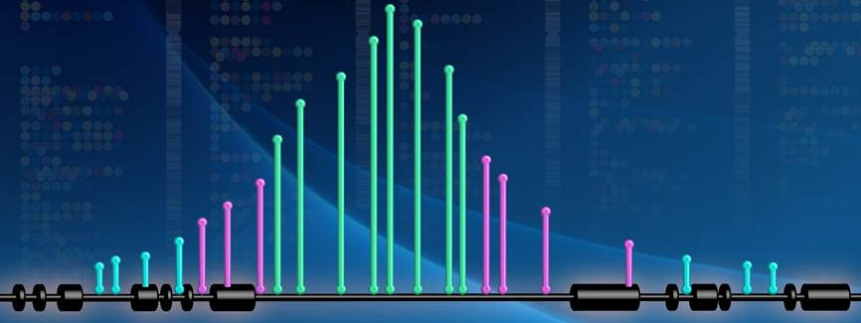
Non-Coding Variants (NoVa) Program
  Develop computational approaches to implicate non- coding genomic variants with phenotypes and test predictions using experimental data
  5 new awards (1 by NCI), joining 6 existing ones
  Autoimmune disorders, cancer, schizophrenia, arthritis, heart disease, and chemotherapy response
Document 19
Notes:
As the number of sequenced human genomes increases, a major bottleneck in using these data is the challenge of knowing which variants influence phenotypes, especially those in non-coding regions. * The Non-Coding Variants (or NoVa) program supports the development of computational approaches that integrate functional datasets to implicate non-coding variants with phenotypes and disease risk. The resulting computational predictions will then be tested using experimental data. All of the data and methods will be released publicly to allow other researchers to use them and to compare methods.
* Five new NoVa awards were made this year (including one funded by NCI), joining the six awards made last year. * These new awards use several diseases as model systems, including autoimmune disorders, cancer, schizophrenia, arthritis, heart disease, and chemotherapy response. The awards use diverse approaches that integrate many types of data and information to address this challenging problem.

Slide 33

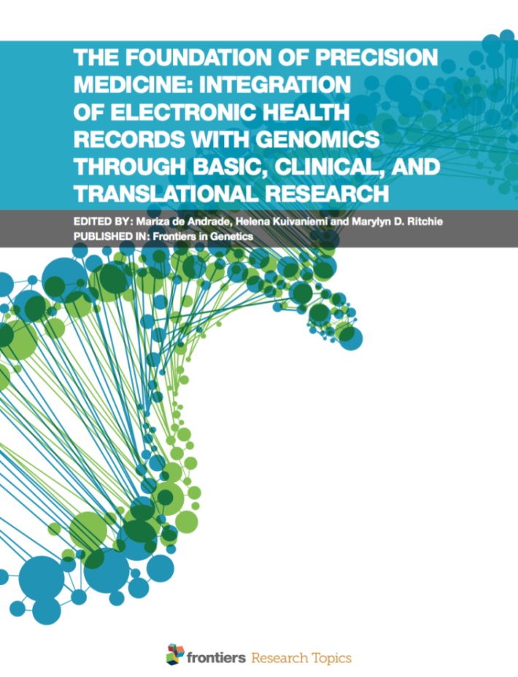
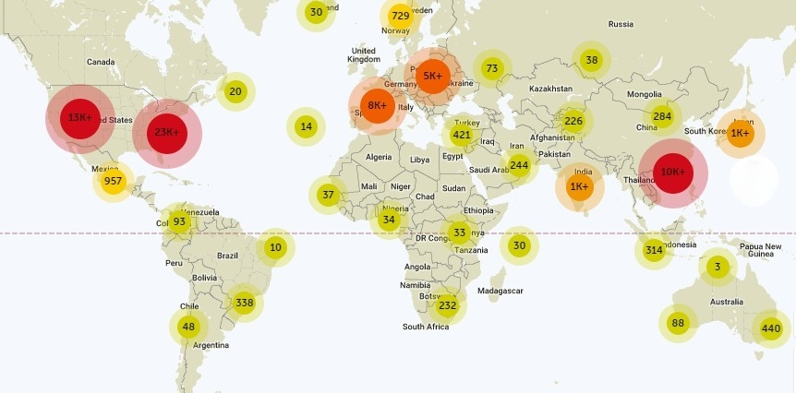
    70,599 total views
    12,379 articles downloaded
eMERGE eBook: Description of the Network’s contribution to genomics
Document 20
Notes:
The Electronic Medical Records and Genomics (or eMERGE) Network conducts genomic discovery and clinical implementation research by leveraging data from large biorepositories linked to electronic medical records.
Last June, eMERGE investigators developed an eBook called “The Foundation of Precision Medicine: Integration of Electronic Health Records with Genomics through Basic, Clinical, and Translational Research” that was published online. This eBook contains 19 articles, presenting topics in basic, clinical, and translational research that are relevant to the integration of electronic health records with genomics. The authors describe the eMERGE network and its contributions to genomics, the results of genetic studies investigating various diseases, complex analyses of genome copy-number variants and epistasis, and the return of genomic results to patients and clinicians for clinical care. The release of this eBook is timely since several countries are now launching major initiatives in precision medicine research.
The eBook has been viewed by people in more than 30 countries, as shown by this map, with * over 70K views in total and * over 12K downloads to date. The circles on the map represent the number of total views in each country or region, with the number of views per region displayed inside the circle. The large red circles indicate regions with over 10K views, with the orange circles reflecting regions with 1-10K views. Outside of the United States, China, United Kingdom, and France were highly interested in eMERGE’s research. The smaller green and yellow circles highlight countries with less then 1K views.

Slide 34

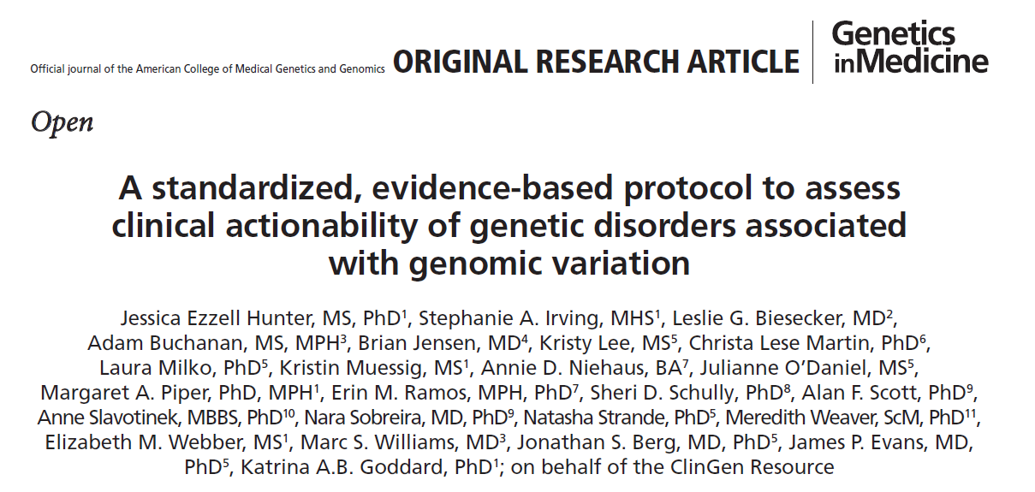



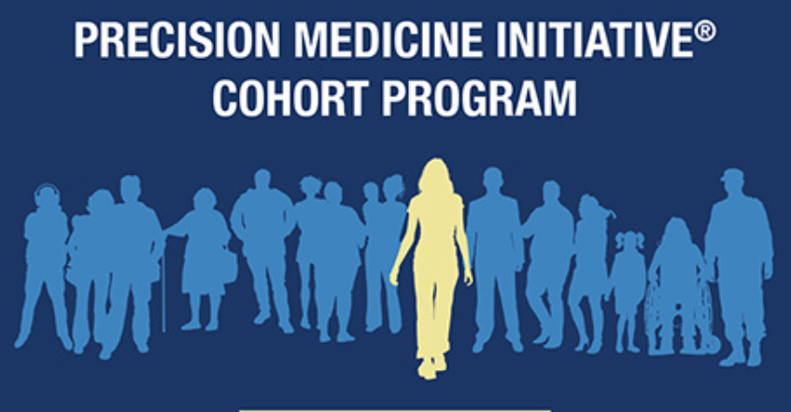

Document 21
Notes:
The Clinical Genome Resource (or ClinGen) is building a resource that defines the clinical relevance of genomic variants for use in precision medicine and research. There has been significant progress during the third year of this highly collaborative program.
* As one example, ClinGen’s Actionability Working Group has developed scores for the clinical actionability of the 56 genes on ACMG’s secondary findings list. The evidence reports and scores are available on ClinGen’s website and were published in Genetics in Medicine in May.
* The three ClinGen sites have received supplemental funds from the Precision Medicine Initiative Cohort Program. This funding will help support new biocurators, an expanded genomic variant curation interface, and efforts to improve the interoperability of ClinGen resources with electronic health records. * ClinGen is also working to develop relationships with other international groups doing similar work. The ClinGen-DECIPHER meeting, entitled “Curating the Clinical Genome” and held at the Wellcome Genome Campus in June, brought together leaders in clinical genomics to discuss the barriers to sharing relevant data internationally as well as to address a need for common standards and best practices.
* Finally, ClinGen will hold a workshop at the 2016 ASHG meeting in Vancouver in October. More information on this workshop and other ClinGen presentations will be available on the ClinGen webpage prior to the meeting.

Slide 35

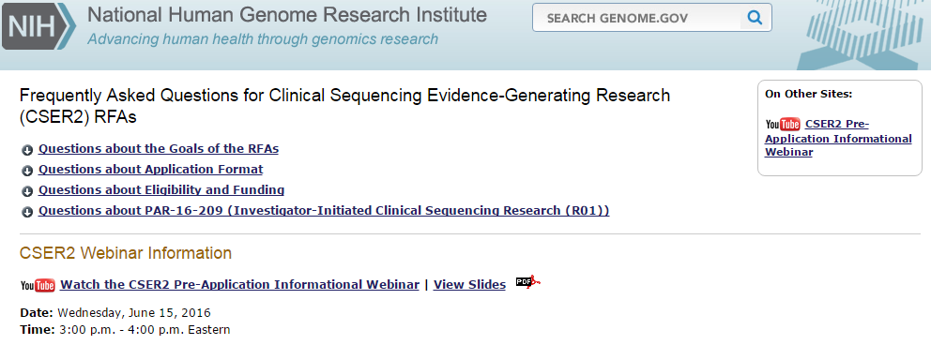
Clinical Sequencing Exploratory Research Program
Enrolled 4,954 adults and 1,261 children
289 publications, 18 working group publications
Document 22
Notes:
The Clinical Sequencing Exploratory Research (or CSER) Program focuses on the integration of genome sequencing into the clinical workflow, including the generation, interpretation, and clinical reporting of genomic information.
* CSER has now enrolled nearly 5,000 adults and over 1,200 children. For nearly 5,000 of these individuals, germline genome sequence data will be generated, and for over 1,000, tumor genome sequence data will be generated. As one measure of overall impact, * CSER has generated 289 publications to date, including 18 cross-CSER working group publications.
As a reminder, the CSER2 Request for Applications (or RFAs) were released in May, and applications were received in August. * A CSER2 pre-application informational webinar was held in June. The webinar included an overview of the CSER2 RFAs and addressed questions from potential applicants. 99 individuals tuned in to the webinar, forecasting a robust response to the RFAs. The webinar has been archived and posted on NHGRI’s web site, genome.gov. The received applications will be reviewed this fall, and those reviews will be discussed at the February Council meeting

Slide 36




Implementing Genomics In Practice (IGNITE) Network
Unifying the Evaluation and
Implementation of Genomic Medicine
  Create a process for providing information on clinical utility of genomic results
  Consider coverage for time spent communicating genomic results
  Consider coverage for periodic re-analysis of genome sequence data
  Ensure genome sequence data follow the patient between insurers
Document 23
Notes:
The Implementing Genomics in Practice (or IGNITE) Network aims to enhance the use of genomic medicine by supporting the development and dissemination of methods for incorporating genomic information into clinical care. In August, the IGNITE Network (led by Toni Pollin from the University of Maryland School of Medicine) hosted a workshop that brought together investigators in genomic medicine, clinical genomics consumers, healthcare providers, and representatives from insurance and biotechnology companies. Meeting attendees discussed the barriers to genomic medicine implementation and strategies to promote genomic medicine sustainability. These issues are important across many NHGRI projects, and this meeting was widely attended by members of other NHGRI consortia.
Key recommendations from the meeting included * creating a process for providing insurance companies with information on the clinical utility of genomic results; * considering reimbursement models to cover provider time in communicating genomic results to patients, in addition to supporting the cost of testing; * considering coverage for the periodic re-analysis of genome sequence data as more information about variants and genes is discovered and patients’ needs evolve; and * ensuring that genome sequence data follow the patient when insurance providers are switched. A manuscript is being drafted based on the discussions at the meeting, including a strategic plan for ongoing efforts to engage stakeholders and address continued challenges in genomic medicine sustainability.

Slide 37
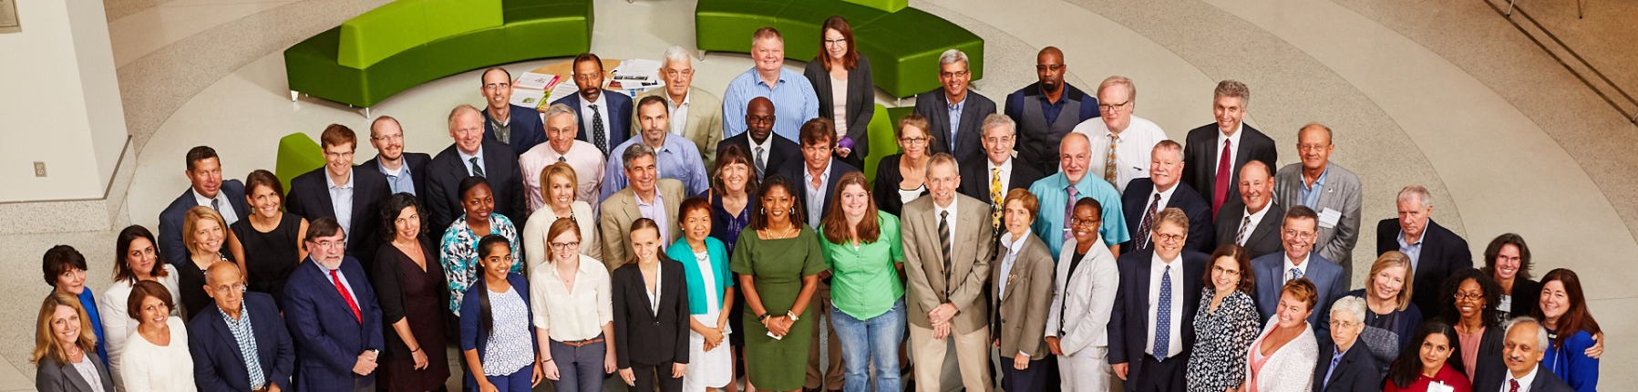
Implementing Genomics In Practice (IGNITE) Network
IGNITE & Beyond: The Future of
Genomic Medicine Implementation
Follow-up single-site studies with larger-scale studies
Collaborate with community centers to increase access in underrepresented and lower socioeconomic populations
Partner with stakeholders throughout study design, conduct, and interpretation phases
Document 23
Notes:
The IGNITE Network has been highly productive, with 113 presentations and publications since its initiation in 2013. In August, NHGRI hosted a program review workshop entitled “IGNITE and Beyond: The Future of Genomic Medicine Implementation.” Several Council members attended this gathering, serving as planning group members, presenters, discussants, and moderators. The workshop evaluated IGNITE’s contributions to genomic medicine and identified the future challenges and opportunities for genomic medicine implementation.
The discussions were lively and productive, with several major recommendations coming out of the meeting. These include * providing flexibility in the program to support follow-up single-site studies with larger-scale studies that aim to confirm findings and decrease bias, * fostering collaboration with community centers to increase access to genomic medicine in underrepresented and lower socioeconomic populations, and * partnering with stakeholders (including payers and technology companies) throughout study design, conduct, and interpretation phases of the studies in order to provide the specific evidence needed for genomic medicine implementation. Of note, we plan to provide a more complete report about this workshop at the February Council meeting.

Slide 38
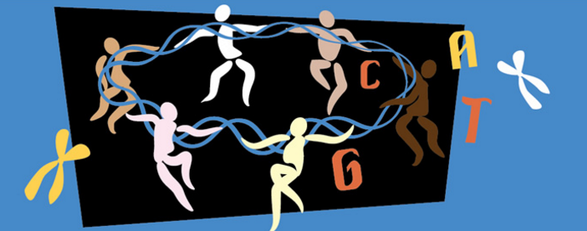
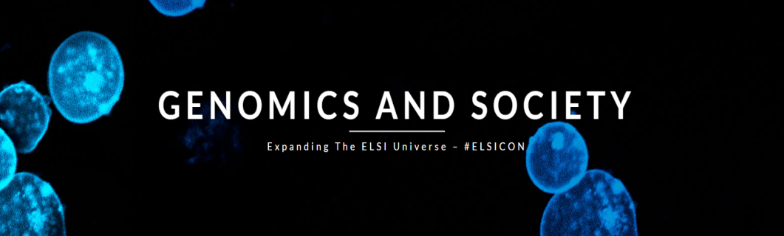
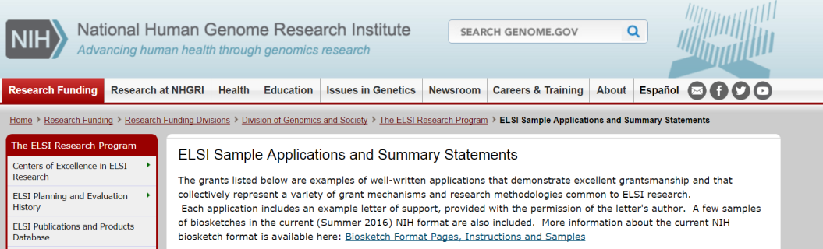
Ethical, Legal, and Social Implications (ELSI) Research Program
    Sample applications and summary statements available on the ELSI website
    4th ELSI Congress – June 5-7, 2017
Document 24
Notes:
The Ethical, Legal, and Social Implications (or ELSI) Research Program supports research on the implications of genomics for individuals, families, and communities.
* The ELSI Research Program recently launched an online resource featuring sample grant applications and summary statements for a variety of grant mechanisms and research methodologies. NHGRI is indebted to the contributing ELSI investigators for their willingness to share their research applications and summary statements with the broader research community.
* The ELSI Research Program will co-sponsor the 4th ELSI Congress, which will be held June 5-7, 2017, on the Jackson Lab campus in Farmington, Connecticut. This will be a major conference on a wide range of ELSI issues, and is the first such meeting since the 2011 ELSI Congress at the University of North Carolina. More information, including details on registration and abstract submission, will be available soon.

Slide 39
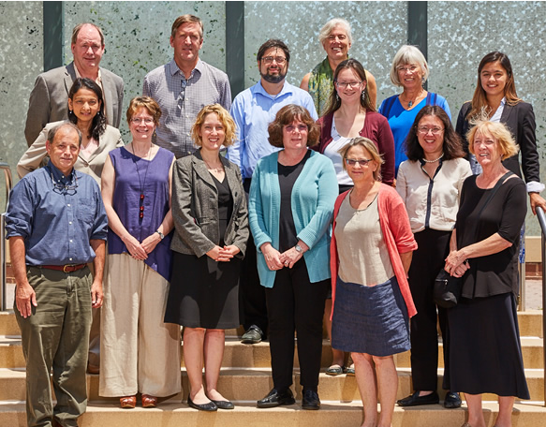
Genomics and Society Working Group
    In-person meeting in June
      ELSI research issues related to precision medicine
      Effectiveness of embedded ELSI research
      Boundary between ELSI research and health services research
    Update at February Council meeting
Document 25
Notes:
The Genomics and Society Working Group of this Council is charged with providing advice on short- and long-range planning and priority setting for the genomics and society activities at the Institute, including our ELSI Research Program.
* This Working Group held its annual in-person meeting in June. Topics of discussion included: * ELSI research issues related to precision medicine, * the effectiveness of embedded ELSI research in larger genomics research projects or initiatives, and * and the boundary between ELSI research and health services research.
* The Working Group Chair, Lisa Parker, will provide an update about these discussions at the February Council meeting.

Slide 40

New Centers of Excellence in ELSI Research (CEERs) Awards
    ELSI for Precision Medicine and Infectious Disease (Johns Hopkins)
    Genetic Privacy and Identity in Community Settings (Vanderbilt University)
    Utah Center of Excellence in ELSI Research (University of Utah)
    Center on American Indian and Alaska Native Genomic Research (University of Oklahoma)
Document 26
Notes:
Four Centers of Excellence in ELSI Research (or CEER) awards were made in May. The grants, totaling approximately $15 million over four years, address a range of forward-looking topics that are highly relevant to the use of genomics in public health and medicine today.
The new Centers were awarded to the following: * Gail Geller and Jeffrey Kahn at Johns Hopkins on the use of genomics in precision medicine and the prevention and treatment of infectious diseases; * Ellen Wright Clayton and Bradley Malin at Vanderbilt University on privacy and the practical risks associated with the use of genomic data to identify individuals; * Jeff Botkin at the University of Utah on better understanding communication among family members regarding prenatal and newborn genomic screening; * Paul Spicer, Amanda Cobb-Greetham, and Cecil Lewis at the University of Oklahoma on how communities and academics can collaborate to develop genomics research that will positively affect Native communities and health.
Meanwhile, the next annual CEERs meeting will be held September 26-27 in Baltimore. The meeting will include the four new CEERs, the continuing CEERs at UNC Chapel Hill and Columbia University, and the transitioning or ‘graduating’ CEERs at Duke, Stanford, Case Western, University of Washington, and UCSF/Kaiser.

Slide 41
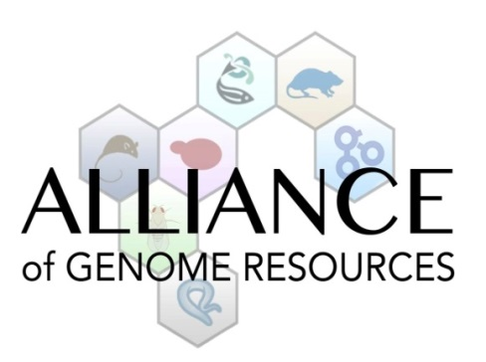
Computational Genomics and
Data Science Program
Reorganization of the Model Organism Databases
New organizational model:
  GO Consortium, MGD, SGD, ZFIN, WormBase, FlyBase
Meetings in May 2015 and May 2016
Supplement request submitted in July 2016 to establish the Alliance of Genome Resources
Document 27
Notes:
The NHGRI Computational Genomics and Data Science Program is * developing a new organizational model for six large genomic data resources, including the GO Consortium, the Mouse Genome Database (or MGD), the Saccharomyces Genome Database (or SGD), the Zebrafish Model Organism Database (or ZFIN), WormBase, and Flybase.
* In May 2015, NHGRI convened a meeting of these large genomic data resources to discuss the factors that affect their efficiency, cost drivers, impact on genomics research, and potential long-term sustainability models. In May 2016, NHGRI convened another meeting of these resources to discuss a new organizational structure that aims to integrate common functions and services of the databases, increase interoperability and efficiency, and therefore facilitate their sustainability.
* In response to NHGRI’s reorganizational goals, the resources submitted a supplement request in July 2016 to establish the Alliance of Genome Resources that aims to provide better support via an integration of shared data, standardization of data models and interfaces, and unified outreach to researchers. This supplement request is currently under review.

Slide 42
Training and Career Development
New T32s – Genomic Medicine
University of Utah – Lynn Jorde
  Vanderbilt University – Josh Denny
  University of Alabama/HudsonAlpha –
  Bruce Korf and Greg Barsh
New T32 – ELSI
  Stanford University – Mildred Cho
Document 28
Notes:
NHGRI’s Research Training and Career Development Program has a long-term commitment to preparing the next generation of genome scientists and scholars.
As of this summer, NHGRI’s training program now includes four new institutional training programs in genomic medicine and ELSI research. * The new genomic medicine training programs will be led by Lynn Jorde at the University of Utah, Josh Denny at Vanderbilt University, and a partnership between Bruce Korf and Greg Barsh at the University of Alabama-Birmingham and HudsonAlpha. These two-year programs will train M.D.’s and Ph.D.’s together, and incorporate a mix of coursework, clinical laboratory rotations, and mentoring.
* Mildred Cho at Stanford University will be leading the new ELSI T32 program. This program, which is the first of its kind, will use a multi-mentorship model drawing on mentors from ten Stanford University schools and departments to train predoctoral and postdoctoral fellows from diverse backgrounds to conduct ELSI research.
These four programs will complement the eleven currently funded genome sciences training grants.

Slide 43

Training and Career Development
2017 NHGRI Research Training and Career Development Meeting
April 12-14, 2017 in St. Louis
Re-issued Diversity Action Plan announcement
    PAR-16-345 published in June 2016
    No longer limited competition
    Expand into genomic medicine and ELSI research
Document 28
Notes:
The 2017 Research Training and Career Development Meeting will take place April 12-14 in St. Louis. In attendance will be Diversity Action Plan (or DAP) and T32 PIs and training coordinators, mentors, NHGRI and coordinating center staff, advisors, invited speakers, and, of course, trainees (supported by either individual or institutional awards). The main focus of the meeting will be to provide an opportunity for trainees to present their research through posters and plenary talks, network with other trainees and scientists, and listen to professional-development and scientific presentations.
* Our DAP program seeks to expose underrepresented minority students to genomic research experiences at the undergraduate, post-baccalaureate, and graduate levels. The DAP’s funding opportunity announcement was re-issued in June. The previous announcement accepted applications from a limited number of NHGRI high-profile genome sciences programs; the major difference with this re-issued announcement is that it no longer is limited to such groups. Since the DAP program started in 1992, many academic and research institutions have emerged with strong research programs in the three broad areas of interest to NHGRI: genome sciences, genomic medicine, and ELSI. The re-issued announcement aims to broaden the DAP participation, including an expansion into genomic medicine and ELSI research.

Slide 44
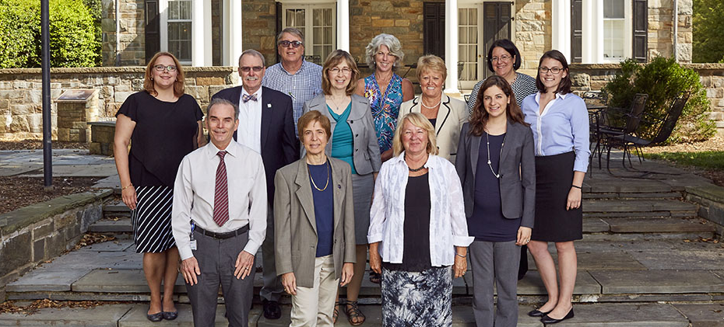
International Genomics Education Meeting
    Genomics training for healthcare providers
    USA, Australia, Canada, England, and Wales
    Certificate and master’s programs
    Coordinated resources including point-of-care
Notes:
Genomic medicine is advancing not just in the United States, but also abroad. Thus, the education of healthcare providers in practice and in training is a goal shared by other countries. In August, the Division of Genomic Medicine and the Division of Policy, Communications, and Education organized a meeting of domestic and international experts who are actively developing and implementing programs designed to fill the gaps in provider genomic literacy. * The 22 participants came from the United States, Australia, Canada, England, and Wales, with many attending via remote conferencing.
* Participants learned about the United Kingdom’s inter-professional certificate and master’s degree programs designed for providers in practice and a master’s program at the University of Florida that is pursued in parallel with residencies. Education programs that are integrated into and dictated by the health systems in the United Kingdom and Australia were described, as well as coordinated educational resource development in Canada, * including point-of-care education options.
Opportunities for synergies, sharing, and overcoming shared challenges were considered, and the participants discussed evaluating the effectiveness of these various educational methods.

Slide 45
Director’s Report Outline
General NHGRI Updates
General NIH Updates
General Genomics Updates
NHGRI Extramural Research Program
NIH Common Fund/Trans-NIH
NHGRI Division of Policy, Communications, and Education
NHGRI Intramural Research Program

Slide 46
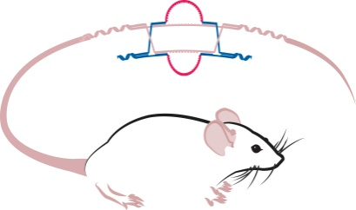

Knockout Mouse Phenotyping Project (KOMP2)
    Entering second 5-year phase of NIH Common Fund support
    Awards issued in August
    Annual Meeting – Oct. 12-14, 2016
    Characterization of embryo lethal strains (Nature, in press)
Document 29
Notes:
The Knockout Mouse Phenotyping Project (or KOMP2) was launched in 2011 with the goal of making and phenotyping 2,500 mouse knockout strains over 5 years. The project is on track to meet its goals in the fall of 2016.
* The project is now entering its second (and final) phase of support by the NIH Common Fund. For this phase, the NIH Common Fund is matching the funds provided by other NIH Institutes, Centers, and Offices; in total, there will be 18 Institutes, Centers, and Offices contributing funds for a total of roughly $100 million of funding over the next 5 years. The funding plan for this phase was discussed with Council in May, and * the awards were issued in August. * The annual KOMP2 meeting will be held October 12-14 in Bethesda.
* Of note, a KOMP2 manuscript describing the characterization of embryo lethal strains is in press at Nature. And finally, * the program is planning to continue broad-based phenotyping of knockout mice in collaboration with our international partners through the International Mouse Phenotyping Consortium.

Slide 47

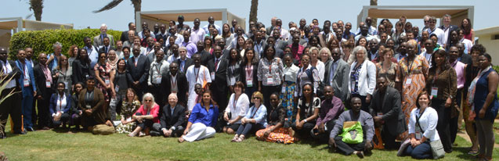
Human Heredity and Health in Africa (H3Africa)
  9th Consortium Meeting in October (Mauritius)
    Opening by Mauritius President Ameenah Gurib
    Ethics workshop – provision of research findings
    Science workshop – HIV co-morbidities
Document 30
Notes:
The central goal of the Human Heredity and Health in Africa (or H3Africa program is to develop a sustainable and collaborative African genetics and genomics research enterprise. * This coming October, H3Africa has the honor of welcoming President Ameenah Gurib to speak at the opening of the 9th Consortium Meeting in her country of Mauritius. President Gurib has been an outspoken supporter of research in Africa; in fact, she wrote a piece in The Guardian last fall entitled “African governments must urgently invest in science and research.” Her Excellency’s interest in H3Africa is encouraging as the consortium continues to work on plans for its long-term sustainability.
* Also of interest, the 9th Consortium Meeting will feature both an ethics and a special topic science workshop. The ethics workshop will tackle the complex issues surrounding the provision of research findings to individuals in an African context, while the special topic science workshop will focus on HIV co-morbidities; the latter workshop will kick-start the newest H3Africa working group, which brings together common interests in HIV/AIDS research from projects throughout the Consortium.

Slide 48
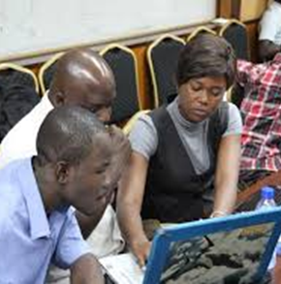
Human Heredity and Health in Africa (H3Africa)
Seven RFAs for second phase (2016-2021)
Applications due November 15, 2016
Research Projects (U01)
Collaborative Centers (U54)
ELSI Research Program (U01)
ELSI Collaborative Centers (U54)
Informatics Network (U24)
Global Health Bioinformatics Training (UR2)
Administrative Coordinating Center
(U24)
Document 30
Notes:
As announced at last the Council meeting, H3Africa has been renewed for a second five-year phase of NIH Common Fund support. And so this past August, seven new RFAs were published. * In addition to renewing the RFAs from the first phase for individual research projects, collaborative centers, and the H3Africa Informatics Network, the second phase adds RFAs aiming to fund four additional components of the future H3Africa Consortium: an Administrative Coordinating Center, Global Health Bioinformatics Training, and dedicated Ethical, Legal, and Societal Implications projects (as either individual research grants or as collaborative centers).
* All the RFAs are open to both previous H3Africa grantees and new applicants, with applications due on November 15.

Slide 49
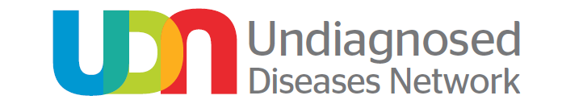
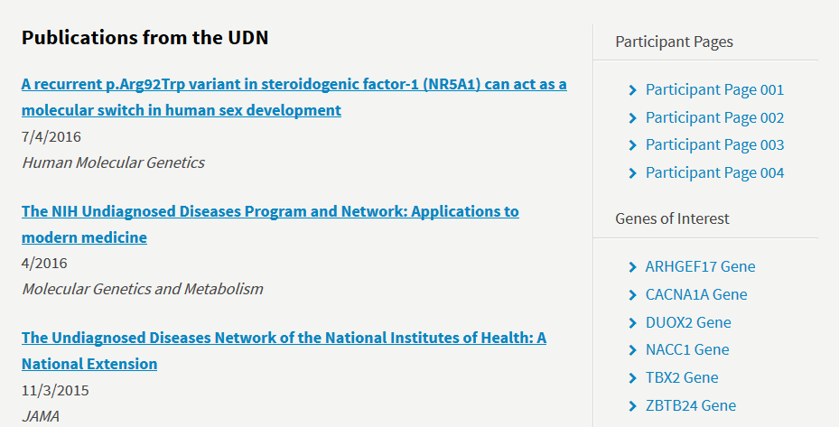

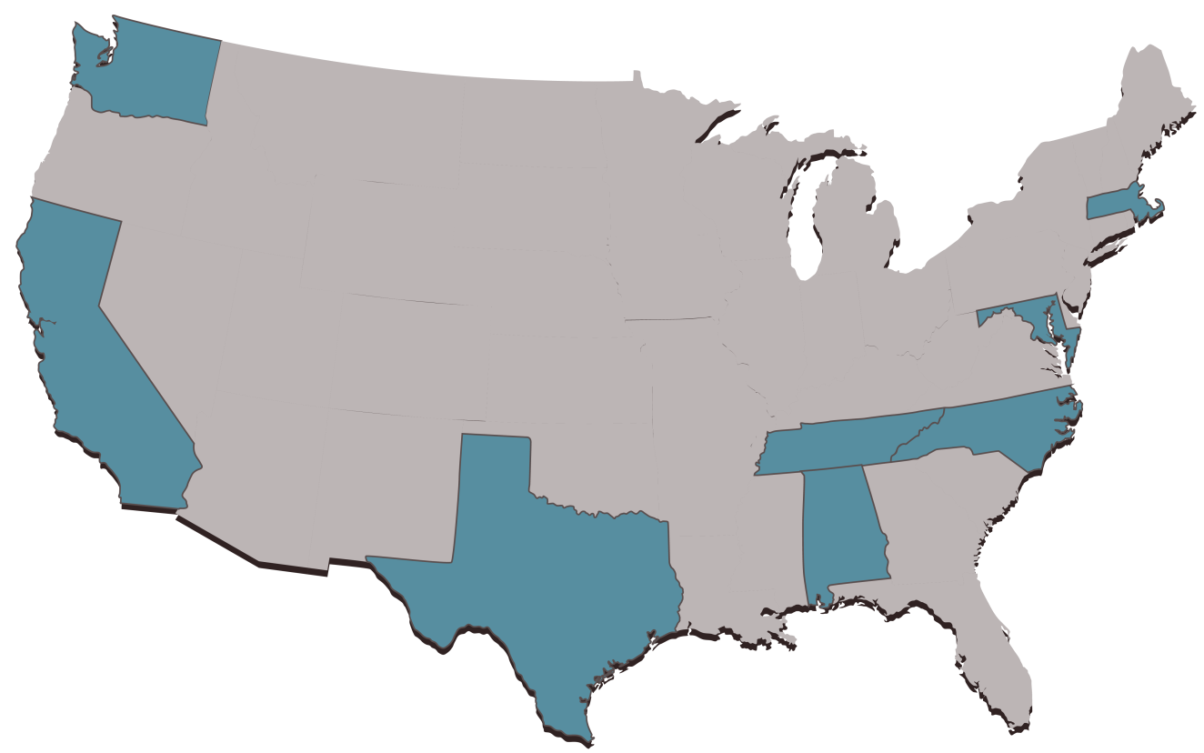




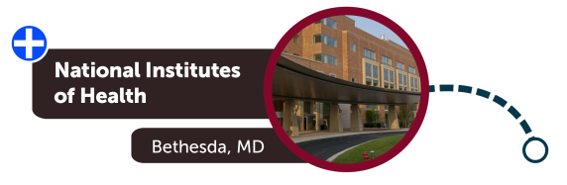

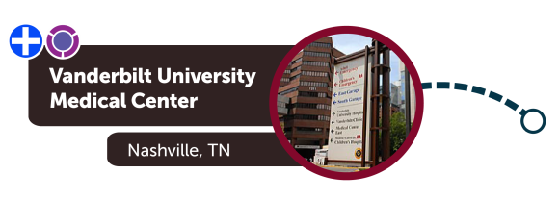



Undiagnosed Diseases Network (UDN)
UDN Site Locations
795 applications
281 acceptances
Document 31
Notes:
The NIH Common Fund’s Undiagnosed Diseases Network (or UDN) aims to improve the level of diagnosis and care for patients with undiagnosed diseases, facilitate research into the etiology of these diseases, and create an integrated and collaborative research community to identify and share improved options for optimal patient management.
* To date, the UDN has received almost 800 applications and accepted 281 patients for evaluation at one of the seven UDN Clinical Sites across the nation. To apply, one simply needs to access the UDN Gateway by * clicking on the “Apply” button on any of the UDN webpages or by going to dedicated website hosted by Harvard University.
* On July 4, the first UDN patient case study was published by the Baylor College of Medicine Clinical Site.
* Information about other UDN genes of interest and participant pages can also be found on the UDN website; such information aids gene function research and patient matching.

Slide 50
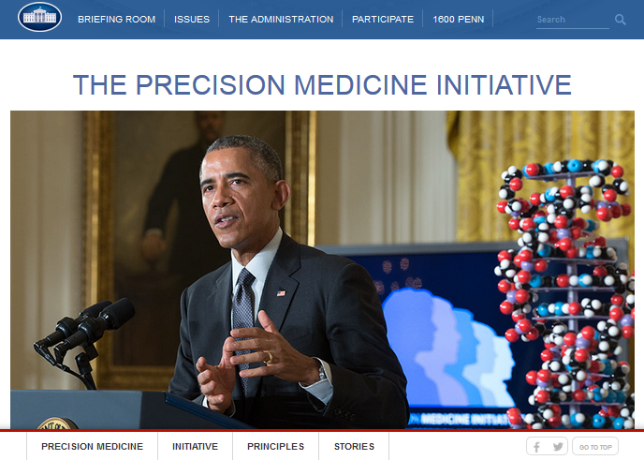
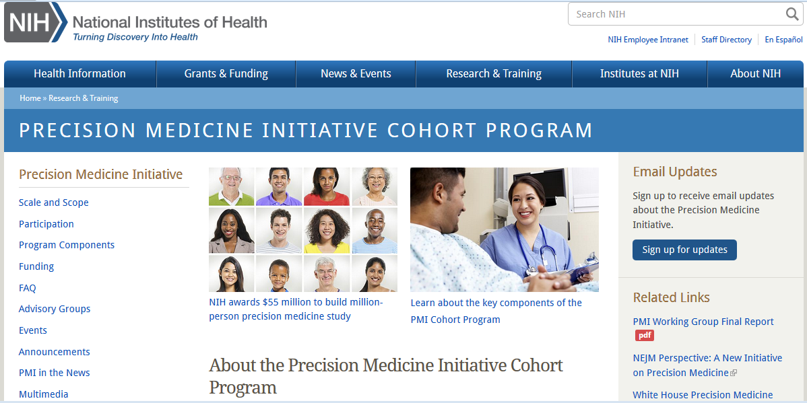
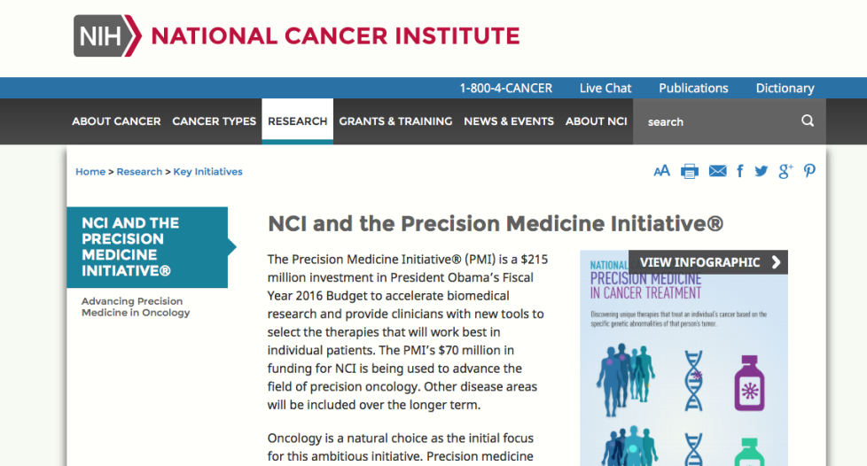
Precision Medicine Initiative (PMI)
Document 32
Notes:
As I have discussed at previous Council meetings, NIH has been heavily involved in implementing the U.S. Precision Medicine Initiative (or PMI), which was first announced by President Obama in January 2015. The Fiscal Year 2016 NIH budget includes * $70 million to the National Cancer Institute to lead efforts in cancer genomics as part of PMI for Oncology as well as * $130 million to the broader NIH to build a national longitudinal research cohort of one million (or more) volunteers through the PMI Cohort Program.
* Information about the PMI Cohort Program is available on this program’s main landing webpage (shown here), and Eric Dishman (Director of the PMI Cohort Program) will be giving a more detailed update about this Program later in the Open Session of this Council meeting. I will now provide some quick PMI highlights that have unfolded over the last few months.

Slide 51
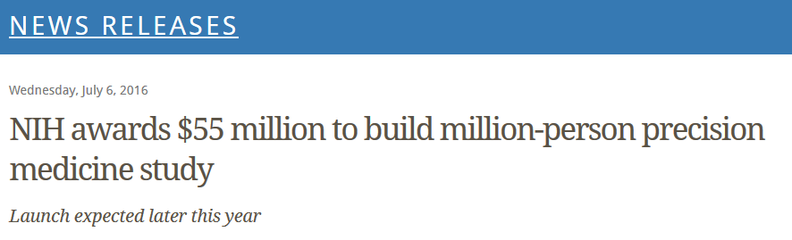
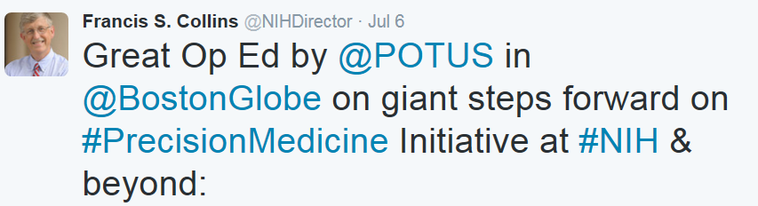

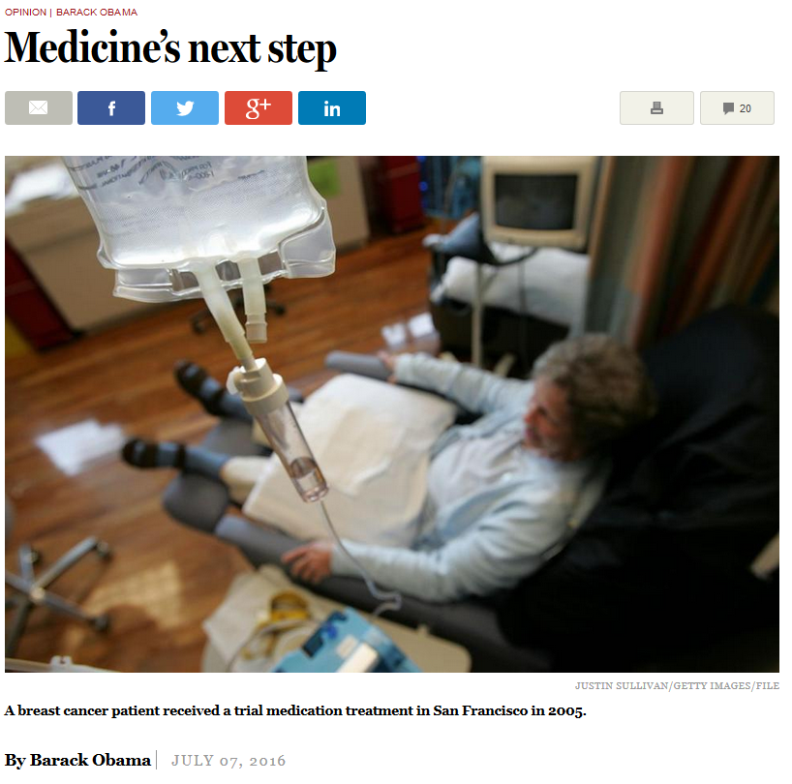
Precision Medicine Initiative (PMI)
PMI Cohort Program Awards Announced
The more we understand about individual differences, the better able we will be to effectively prevent and treat illness.
--- Francis S. Collins, M.D. Ph.D., NIH Director
[Precision medicine is..] one of the greatest opportunities we’ve ever seen for new medical breakthroughs, but it only works if we collect enough information first.”
--- Barak Obama, President of the United States
Document 32
Notes:
For starters, the PMI Cohort Program transitioned from its pilot/planning phase to its full start-up phase with the awarding of a series of cooperative agreement awards; these awards, totally $55 million in direct costs for the first year, were announced in July. The awardees, along with previous awardees that I mentioned at the May Council meeting, will be collaborating to bring together the major components needed to launch the PMI Cohort program later this year.
* The announcement of these awards in July was accompanied by an OpEd piece by President Obama in The Boston Globe, where he noted among other things that precision medicine is “one of the greatest opportunities we’ve ever seen for new medical breakthroughs, but it only works if we collect enough information first.”

Slide 52


Precision Medicine Initiative (PMI)
PMI Cohort Program Components
Mayo Clinic Biobank
Rochester, MN
Community Health Center, Inc.
Middletown, CT
Title: Illinois Precision Medicine Consortium
Chicago, IL
Hudson River Health Care
Peekskill, NY
Columbia/Cornell
/Harlem Hospital Precision Medicine Initiative HPO
New York, NY
Scripps and Vibrent Participant Technologies/ Direct Volunteer Opps
La Jolla, CA
University of Arizona - Banner Health Precision Medicine Initiative Cohort
Enrollment Center
Tucson, Arizona
Cherokee Health Systems
Knoxville, TN
Precision Approach to healthCARE enrollment Site (PA CARES)
Pittsburgh, PA
San Ysidro Health Center
San Ysidro, CA
Eau Claire Cooperative Health Center
Columbia, SC
Jackson-Hinds Comprehensive Health Center
Jackson, MS
Vanderbilt/Broad/Verily Data and Research Support Core
Nashville, TN
Federally Qualified Health Centers
Regional Medical Centers
Recruitment at VA Hospitals
Direct volunteer recruitment nationwide
Biobank
Data and Research Support Core
Participant Technology Center
Document 32
Notes:
The initial set of awards aim to jump start getting that information as quickly as possible. Specifically, the awards include enlisting the first set of regional academic medical centers at the sites shown in red. These groups will build program protocols, engage and enroll participants, and collect health information and biospecimens. A pilot program involving six Federally Qualified Health Centers (or FQHCs) at the sites shown in blue will determine infrastructure needs for FQHCs in the PMI Cohort Program. FQHCs will be critical for reaching underserved participants, families, and communities. Additional enrollment centers will be added over time.
* Recruitment will also take place at Veterans Administration (or VA) Hospitals and by a direct volunteer recruitment nationwide. * The Mayo Clinic Biobank will collect, store, and distribute biospecimens, while * the Data and Research Support Center (awarded to Vanderbilt University, the Broad Institute, and Verily Life Sciences) will be the central hub for collecting and organizing the data and making it securely available. The latter groups will also provide analysis tools to enable interested researchers and citizen scientists to use the data.
* Finally, The Scripps Research Institute and Vibrent Health will develop and maintain mobile and web platforms for enrollment, consent, and the collection of data from and communication with participants. They will also support the enrollment of direct volunteers. Together, these efforts put the PMI Cohort Program on a trajectory to begin recruitment in the near future.

Slide 53
Director’s Report Outline
General NHGRI Updates
General NIH Updates
General Genomics Updates
NHGRI Extramural Research Program
NIH Common Fund/Trans-NIH
NHGRI Division of Policy, Communications, and Education
NHGRI Intramural Research Program

Slide 54

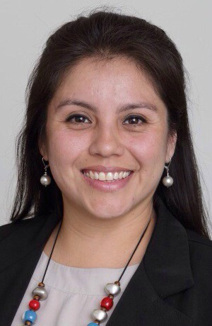
New ASHG-NHGRI Fellows
Christa Wagner, Ph.D.
Genetics and Public Policy Fellow
Teresa Ramirez, Ph.D.
Genetics and Education Fellow
Document 33
Notes:
NHGRI’s Division of Policy, Communications, and Education partners with the American Society of Human Genetics (or ASHG) in sponsoring two fellowships.
The Genetics and Public Policy Fellowship program provides fellows with an opportunity to work in NHGRI’s Policy and Program Analysis Branch, at ASHG, and in Congress. * This year’s fellow is Christa Wagner. Dr. Wagner earned her Ph.D. in Cellular and Molecular Medicine from Johns Hopkins University School of Medicine.
The Genetics and Education Fellowship program provides fellows with an opportunity to work in NHGRI’s Education and Community Involvement Branch and at ASHG in developing educational programs for a wide range of audiences; the fellow may also rotate to a public or private organization involved in genetics and genomics education. * This year’s fellow is Teresa Ramirez. Dr. Ramirez earned her Ph.D. in Molecular Pharmacology and Physiology from Brown University and then completed a post-doctoral research fellowship at the National Institute of Alcohol Abuse and Alcoholism.

Slide 55

NHGRI IDE and Genomics Workshop
    Meeting report and video available on genome.gov
    White paper offering points for investigators to consider now being drafted
Document 34
Notes:
In June, NHGRI’s Policy and Program Analysis Branch held a public educational workshop on ‘Investigational Device Exemptions (or IDEs) and Genomics’ to help investigators and institutional review board members learn more about the Food and Drug Administration’s (or FDA’s) IDE regulations and to understand how these regulations apply to genomics research. As a reminder, the FDA may require researchers to apply for an IDE before beginning a clinical research study involving the use of investigational devices. The FDA considers tests performed using next-generation DNA sequencing platforms to be investigational devices. If an investigational device study poses a significant level of risk to participants, investigators must apply for and receive an IDE before enrolling participants.
Speakers at the workshop represented the research, institutional review board, and FDA perspectives, providing advice on how to determine when an IDE is necessary, how best to communicate with the FDA about possible IDE submissions, and what information the FDA needs in order to review an IDE application. * A meeting report and a video of the meeting is available on genome.gov. * In order to provide additional resources about IDEs to the research community, Branch staff are now drafting a white paper offering points for investigators to consider based on what was learned at the workshop.

Slide 56

Workshop on Sharing Aggregate Genomic Data
Document 35
Notes:
This past May, NHGRI convened a two-day workshop to initiate a renewed dialog about the risks and benefits related to sharing aggregate-level information from genomic research studies. Under the current NIH Genomic Data Sharing Policy, this aggregate-level information is only available through controlled access, although it has long been acknowledged that the privacy risk posed by the information is very small.
It became clear through the discussions at the workshop that there were different understandings among the participants. Workshop participants recommended using the term “genomic summary statistics” to clarify that the information is the statistical results from a study based on many individual participants’ genotypes, and that it does not include individual-level data.
Participants also recommended that NHGRI work to pursue policy changes that enable genomic summary statistics to be made available through unrestricted access in dbGaP, with appropriate exceptions for studies associated with particular sensitivities. It was also recommended that NHGRI work with the research community and public stakeholders to inform research participants more effectively about the benefits of sharing genomic summary statistics and to articulate the privacy risks and mitigation steps taken. A report from the workshop is now available on genome.gov.

Slide 57

Mobile Friendly Genome.gov
Document 36
Notes:
The NHGRI website (genome.gov) was recently upgraded to a new mobile friendly design, which means the site is now easier to browse on a variety of mobile devices like iPhones, Androids, and tablets. It is notable that roughly one-third of genome.gov’s total traffic comes from mobile devices – and that number is expected to increase as mobile devices become more prevalent. This update will ensure that people can readily and quickly access important information about NHGRI research, programs, and other activities from a more diverse set of devices.

Slide 58


History of Genomics Program Lecture Series
David Bentley, D.Phil.
Document 37
Notes:
The NHGRI History of Genomics Program recently completed a lecture series commemorating the 25th anniversary of the launch of the Human Genome Project. The series, entitled “A Quarter Century after the Human Genome Project’s Launch: Lessons Beyond the Base Pairs,” began in December 2015 and concluded in May with a talk by Dr. David Bentley from Illumina. You can now find video recordings of all six lectures on NHGRI’s GenomeTV channel of YouTube.

Slide 59

Genome: Unlocking Life’s Code Exhibition
Travel Schedule
2016
  May 21-September 5
  Natural History Museum of Utah
  Salt Lake City, UT
  September 30-January 1
  Exploration Place
  Wichita, KS
2017
  January 28-May 29
  Peoria Riverfront Museum
  Peoria, IL
Document 38
Notes:
The Genome: Unlocking Life’s Code exhibition will make several more stops across North America as it continues its ‘road show’ over the next two years. The exhibition closed last week at the Natural History Museum of Utah in Salt Lake City, and it will open at the Exploration Place in Wichita, Kansas on September 30. It will then travel to the Peoria Riverfront Museum in early 2017.
In August, I gave an evening lecture to about 600 people at the Natural History Museum of Utah on human genomics, precision medicine, and advancing human health. The following day, I met with medical students, faculty, and researchers from the University of Utah and their healthcare partners.
Please continue to check the exhibition’s website (unlockinglifescode.org) and follow it on social media for the most up-to-date program information.

Slide 60

Smithsonian’s Pulse on Modern Medicine
Document 39
Notes:
In partnership with the Smithsonian Associates, NHGRI has co-developed a five-part public lecture series that features NIH Institute directors and scientific and medical experts discussing with the public what is currently ‘hot’ in biomedical research – and what it means for our health and medical treatment today and in the future. The series is entitled “The Pulse on Modern Medicine: Insights from NIH Experts.” To prime the attendees for each session, each lecture is preceded by an brief introductory talk that offers fundamental background science and information for the evening’s general topic.
Last week, I kicked off the series giving a talk entitled “From the Human Genome Project to Precision Medicine: A Journey to Advance Human Health.” Dr. Larry Brody provided the introductory talk, reviewing the general basics of genetics and genomics.
Also speaking in the series from NHGRI is Dr. Bill Gahl on undiagnosed and rare diseases and Dr. Julie Segre on the microbiome.

Slide 61

Partnership for Community Outreach and Engagement in Genomics
NHGRI
Partnership for
Community Outreach &
Engagement in Genomics
Notes:
NHGRI’s Partnership for Community Outreach and Engagement in Genomics held its annual in-person meeting in August in Salt Lake City, Utah. The night before the meeting, many of the participants attended my talk at the Natural History Museum of Utah (that I mentioned earlier).
NHGRI established the Partnership for Community Outreach and Engagement in Genomics in 2014 as a way to bring together community liaisons, health advocates, and health practitioners representing diverse populations to discuss efforts to increase genomic literacy in their communities, and as a forum for NHGRI to gain a better understanding of community needs and concerns related to genomics.
The Partnership’s dedication to promoting public understanding of genomics has been steadfast, and the group used this meeting to invite new voices into the discussion, as well as to articulate their vision and priorities for the next two years.

Slide 62



Local Community Outreach Programs
Notes:
In addition to their national outreach programs, NHGRI’s Education and Community Involvement Branch regularly organizes activities for students, teachers, and organizations visiting the NIH campus. This summer was particularly busy, with many of these visits extending over several days and involving extensive programming.
For example, in July, the Branch hosted a group of 10th and 11th grade students from the Prince George’s County Youth County Connect Program for a week. The students heard presentations from NHGRI staff; toured various NIH facilities; and participated in several hands-on activities.
In late July, the Branch hosted five students from the Smithsonian’s National Museum of Natural History’s Youth Engagement in Science (or YES!) program. The students toured a zebrafish laboratory, heard about careers in genomics, and attended the NIH Summer Internship Program’s poster session.
Finally, NHGRI staff also had the opportunity to meet with seven National Congress of American Indians health scholars during their week-long visit to the Washington, DC area. The scholars heard about training opportunities and about the Institute’s engagement with and outreach to American Indians and Alaska Natives.

Slide 63

NHGRI 2016 Short Course in Genomics
Document 40
Notes:
In August, the Education and Community Involvement Branch held its annual Short Course in Genomics. This year’s course welcomed 24 faculty members who teach at middle schools, high schools, community colleges, and tribal colleges from places as far away as Puerto Rico, California, and rural North Dakota. These educators came to NIH for three days to hear lectures and receive teaching resources from leading NHGRI and NIH researchers, clinicians, and staff; to discuss ways to incorporate genomics content into their classrooms; and to participate in tours of NIH facilities. Topics discussed during the course ranged from undiagnosed and rare diseases, bioinformatics, CRISPR/Cas9, cancer genomics, ethical issues in genomics research, and health disparities, among others.

Slide 64


Short Course in Genomics: Nurse, Physician Assistant, and Faculty Track
    Enhance genomics education of health professionals to aid integration of genomics into practice
    Nurse and physician assistant educator participants
    Genomics primer, competencies, resources, curriculum strategies, and integration into clinical practice
    Website and ‘Community of Practice’ listserv
Document 40
Notes:
Several years ago, the Genomic Healthcare Branch began hosting a second ‘track’ of the NHGRI Short Course focused on nurses and nurse educators, providing them a similar opportunity to learn about cutting-edge genomic advances from NHGRI experts. * The aim of this track is to enhance genomics education of health professionals so as to facilitate the integration of genomics into practice. * This year, the program was expanded to include an interdisciplinary focus, and participants included 21 nurses and 9 physician assistant educators.
Over the three days of the course, enlisted experts presented lectures, participated in panel discussions, and performed one-on-one mentoring with attendees. * Topics included a genomics primer, genomic competencies, educational resources, and strategies for integration of genomics into health-provider curricula and into clinical practice. Best practices were shared by nationally recognized nurse and physician assistant genomic educators, and panel discussions exemplified an emphasis on cross-disciplinary interaction.
* To extend the reach and impact of this track of the Short Course, the slide presentations have been made available on the public course website, and a ‘Community of Practice’ listserv has been created to facilitate further communications among these genomics educators.

Slide 65

Webinars for Health Insurers and Payers: Understanding Genetic Testing
    Webinar series for medical staff in insurance industry
    Goal: Prepare insurers to understand genetic testing strategies, interpretation, outcomes, and patient care
    Live monthly audiences consisted of ~70 participants
    Recorded webinars available for continuing education
Document 41
Notes:
To address the growing need of medical staff in the insurance industry to understand genetic testing, the Genomic Healthcare Branch collaborated with the Blue Cross Blue Shield Association to produce an educational webinar series on genomic medicine topics. * The specific goal was to prepare insurers to understand genetic testing strategies, interpretations, outcomes, and patient care needs, so that they are able to use that understanding in making decisions regarding the healthcare activities of their company’s insured.
* Starting in June 2015, thirteen live monthly webinars were produced by volunteer experts in genetic and genomic medicine, and all had 70 or more online participants. * Each session was recorded and is now publicly available on the NHGRI website (genome.gov) for continuing education.
This effort arose from the Insurer Education Working Group of NHGRI's Inter-Society Coordinating Committee for Practitioner Education in Genomics (or ISCC).

Slide 66





Family Health History Tool Meeting
    14 tool developers/vendors (4 NHGRI-funded)
    Data standards, EHR integration, and clinical decision support
Document 42
Notes:
Family health history is often called ‘the cheapest genetic test’ – yet its usage in clinical practice is far lower than its potential. Today’s family health history tools are computer programs that help collect and organize the health histories of an individual’s family members, and, in some cases, estimate inherited risk for diseases like breast cancer, diabetes, and colon cancer.
* This past June, the Genomic Healthcare Branch convened a meeting to explore the family health history tool field and identify opportunities at this dynamic period in its development. * The conference provided 14 tool developers and vendors (4 of which are NHGRI-funded) a forum to demonstrate their tools and to highlight their approaches to enhancing clinical workflows to address gaps in most current electronic health records (or EHRs).
* Discussions on data format standards, EHR integration, and the use of clinical decision support provided evidence of progress. Some surprising lessons were learned, including key clarifications relating to federal privacy laws. The meeting resulted in strong interest for collaboration to solve remaining barriers to optimal use of family health history in healthcare, and the Branch is working to sustain and build on the meeting’s momentum.

Slide 67
Director’s Report Outline
General NHGRI Updates
General NIH Updates
General Genomics Updates
NHGRI Extramural Research Program
NIH Common Fund/Trans-NIH
NHGRI Division of Policy, Communications, and Education
NHGRI Intramural Research Program

Slide 68





NHGRI Intramural Research Highlights
Will Precision Medicine Move Us Beyond Race?
nature
The Genetic Architecture of Type 2 Diabetes
A New Glucocerebrosidase Chaperone Reduces α-Synuclein and Glycolipid Levels in iPSC-Derived Dopaminergic Neurons from Patients with Gaucher Disease and Parkinsonism
Document 43
Notes:
The NHGRI Intramural Research Program has once again been quite productive since the last Council meeting. * In a perspective published in the New England Journal of Medicine in May, Mr. Vence Bonham and colleagues discussed whether a precision medicine approach will reduce or eliminate the role that race plays in prescribing drugs and in healthcare overall. The paper highlighted the importance of genomic knowledge and a precision medicine approach in moving us beyond the use of crude racial and ethnic categories in the care of individual patients.
* Research by NHGRI Senior Investigator Dr. Francis Collins and an international team of more than 300 scientists conducted a comprehensive investigation of the underlying genetic architecture of type 2 diabetes. Their findings, published in Nature in July, suggest that most of the genetic risk for type 2 diabetes can be attributed to common shared genomic variants - each contributing a small amount to an individual's overall risk for the disease.
* And Dr. Ellen Sidransky and her colleagues identified and tested a molecule that shows promise as a possible treatment for Gaucher disease and the more common Parkinson's disease. The findings demonstrate how insights from a rare disorder can have direct relevance to the treatment of common disorders. The findings were published in The Journal of Neuroscience in July.

Slide 69

Changes at the NIH Clinical Center
    Themes of ‘Red Team’ Recommendations:
      Culture of safety and quality
      Leadership for care, oversight, and compliance
      Sterile processing procedures and facilities
Document 44
Notes:
And finally, I thought I should say a few things about a set of issues affecting the broader NIH Intramural Research Program, specifically related to the NIH Clinical Center. As you may have heard in the news, there have been several unfortunate developments within the NIH Clinical Center in recent months, and these prompted NIH Director Francis Collins to establish a working group of his Advisory Committee to the Director. The working group, also referred to as the ‘Red Team,’ was charged with examining the organization, financing, and management of the NIH Clinical Center. * In April, the Red Team released its report and recommendations, * which grouped into three broad themes: culture of safety and quality, leadership for care, oversight, and compliance (aiming to align authority with responsibility and to enhance accountability), and sterile processing procedures and facilities (this last theme being particularly relevant to the events underlying the Red Team’s creation).
Dr. Collins accepted these recommendations and announced immediate actions to begin addressing them, including the formation of a hospital board constituted with external experts in patient care and oversight of hospital operations, the creation of a central compliance office within the NIH Clinical Center, and a change in the leadership structure for the NIH Clinical Center.

Slide 70

Enhancing Accountability & Consistency
      Clinical Center Research Hospital Board held first meeting in July
      Clinical Practice Committee to review standards for patient care and further enhance patient safety and quality
      Town meetings and focus groups to engage Institute and Clinical Center communities on next steps
Document 44
Notes:
In an effort to provide more accountability and consistency in the operation of the NIH Clinical Center, a number of specific measures are being aggressively implemented. * A new Clinical Center Research Hospital Board, led by chairperson Dr. Laura Forese of New York-Presbyterian Hospital, was created and held its first meeting in July. The Board is charged with advising NIH leadership about the Clinical Center's performance, including management, finances, and quality; requirements for hospital leadership and gaps in expertise; and policies and organizational approaches that promote quality and patient safety. The Board is expected to meet four times a year, and will operate under the same open committee procedures as this Council to ensure the transparency of its work.
* Additionally, a Clinical Practice Committee is being formed to review standards for patient care and further enhance patient safety and quality. This group will carry out continuous surveillance of all clinical activities in the Clinical Center, providing ‘real-time’ input to leadership on patient care and safety issues. Performance metrics will also be created or enhanced for the clinical programs of individual Institutes and also the Clinical Center departments, so as to enhance accountability.
* As NIH moves forward with these efforts, a series of town meetings and focus groups are being conducted to engage with Institute and Clinical Center communities on next steps and opportunities going forward.

Slide 71



NIH Clinical Center Leadership Updates
Recruiting a Clinical Center CEO
John Gallin, M.D.
Associate Director for Clinical Research
Andy Griffith, M.D., Ph.D.
Acting Director, Office of Research Support and Compliance
Document 44
Notes:
The Red Team also called for changes to the leadership structure of the NIH Clinical Center, and various of these changes are also being implemented. * To begin with, a new position of Clinical Center CEO has been created, and that recruitment is now ongoing. This individual will have authority over everyone working within the NIH Clinical Center and all aspects of the Center’s facilities.
* In late August, the current Clinical Center Director, Dr. John Gallin, was appointed the NIH Associate Director for Clinical Research and the Clinical Center’s Chief Scientific Officer. In this role, Dr. Gallin will oversee all research activities within the Clinical Center, being responsible for contributing to the systematic distribution of Clinical Center resources, helping to prioritize clinical research conducted in the Center, and overseeing the scientific review of all clinical protocols.
* Meanwhile, Dr. Andy Griffith (the Scientific Director of the National Institute of Deafness and Other Communication Disorders) has agreed to be the Acting Director of the Office of Research and Support and Compliance, which was created last spring as part of the initial response to the Red Team report.
I will aim to keep Council updated about the major additional leadership changes at the Clinical Center that are anticipated to happen in the coming months.

Slide 72

To receive The Genomics Landscape,
go to list.nih.gov
Search for NHGRILANDSCAPE
Past issues can be accessed at: genome.gov/27527308
Document 45
Notes:
Before ending my Director’s Report, I would like to (as always) put in a plug and say that anyone wishing to receive my monthly email update (called The Genomics Landscape) can simply go to list.nih.gov and then search for “NHGRILANDSCAPE.” I should note that our total external subscription base for The Genomics Landscape will hopefully soon surpass the 1000 mark.

Slide 73


Thanks!
Special Thanks!
Notes:
Finally, a personal thanks to the 50-60 NHGRI staff members who contributed slides and information that I just reviewed. As always, such a group effort is essential for getting this large amount of information conveyed efficiently at each Council meeting.
An additional thanks to the NHGRI communications group and web team for making my Director’s Report into an electronic resource.
And * special thanks to the usual ‘ring leader’ for preparing my Director’s Report each time, Kris Wetterstrand. Shown here is Kris at a DC bar’s ‘Nerd Nite’ in the summer, presenting a talk about the Human Genome Project.

Slide 74

s
Advancing human health
through genomics research

