Slide 1
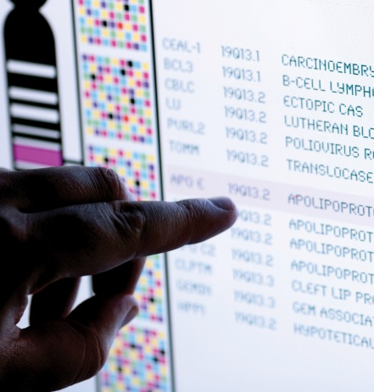

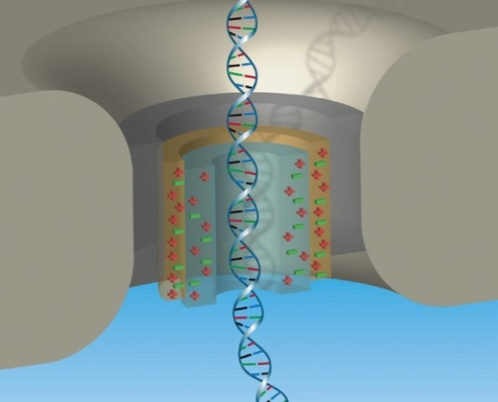


National Advisory Council for Human Genome Research
September 2017
Eric Green, M.D., Ph.D.
Director, NHGRI
DIRECTOR’S REPORT
Notes:
As is NHGRI’s routine, the entire Open Session of this National Advisory Council for Human Genome Research meeting is being webcast live (including my Director’s Report), and so I would like to personally welcome all of you joining us remotely.
The Open Session is also being videotaped, and those recordings will be made available as a permanent archive on NHGRI’s website (genome.gov), including the presentations themselves and the various associated documents.

Slide 2
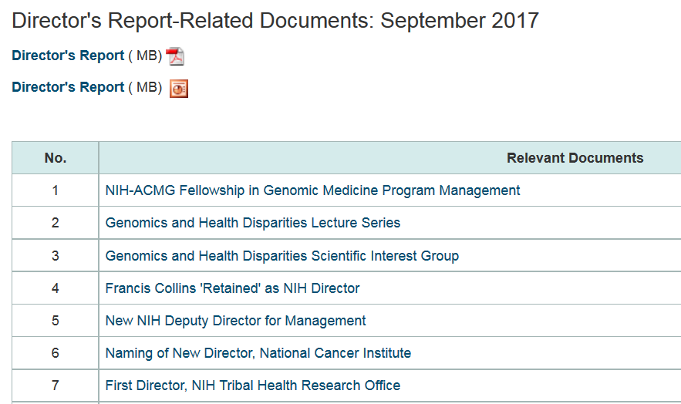
genome.gov/DirectorsReport
Document #
Notes:
For those new to our Council meetings, I want to make you aware of the ‘electronic resource’ that has been developed for my Director’s Report. Analogous to supplemental materials of a published paper, this resource can be accessed at the URL shown here.
The slides that I will show during my Director’s Report are also available electronically at this site – * both in PDF and PowerPoint formats.
* When there are documents or relevant web sites associated with a particular slide, you will find a ‘Document #’ indicated on the bottom right of that slide; that ‘Document #’ references materials that can be accessed and/or downloaded from the web page shown here. This web page and all linked documents will be archived on genome.gov as a historic record of this meeting.

Slide 3
Open Session Presentations
  Next Generation Researchers Initiative
  Larry Tabak
  Report: Update on the eMERGE Network
  Rex Chisholm
  Report: The Cancer Genome Atlas (TCGA): A Decade of Discovery
  Carolyn Hutter
Notes:
There will be a number of other presentations during the Open Session of this Council meeting. My Director’s Report is tailored around those presentations, and I will not discuss in detail the topics that others will cover.
* After my Director’s Report, Larry Tabak (NIH’s Principal Deputy Director) will be here to give an update about the Next Generation Researchers Initiative.
Then after lunch, we will have a series of reports.
* The first will be from Rex Chisholm, who will provide an update on the eMERGE Network.
* The second will be from Carolyn Hutter, who will discuss “The Cancer Genome Atlas (TCGA): A Decade of Discovery.”

Slide 4
Open Session Presentations
  Report: NAM Report on Evidence Framework
  for Genetic Testing
  Wendy Chung
  Report: Genomic Medicine Working Group Activities in 2017
      Teri Manolio
  Report: Update on the NSIGHT Program
      Anastasia Wise
Notes:
Next, we will hear in succession from:
* Wendy Chung, who will talk about the National Academy of Medicine (or NAM) Report on Evidence Framework for Genetic Testing; * Teri Manolio, who will provide a summary about the Genomic Medicine Working Group Activities in 2017; and finally * Anastasia Wise, who will provide an update on the NSIGHT Program.

Slide 5
Director’s Report Outline
General NHGRI Updates
General NIH Updates
General Genomics Updates
NHGRI Extramural Research Program
NIH Common Fund/Trans-NIH
NHGRI Division of Policy, Communications, and Education
NHGRI Intramural Research Program
Notes:
For the rest of my Director’s Report, I will cover the 7 areas listed here, which reliably provide an effective framework for reviewing the relevant topics.

Slide 6
Director’s Report Outline
General NHGRI Updates
General NIH Updates
General Genomics Updates
NHGRI Extramural Research Program
NIH Common Fund/Trans-NIH
NHGRI Division of Policy, Communications, and Education
NHGRI Intramural Research Program

Slide 7
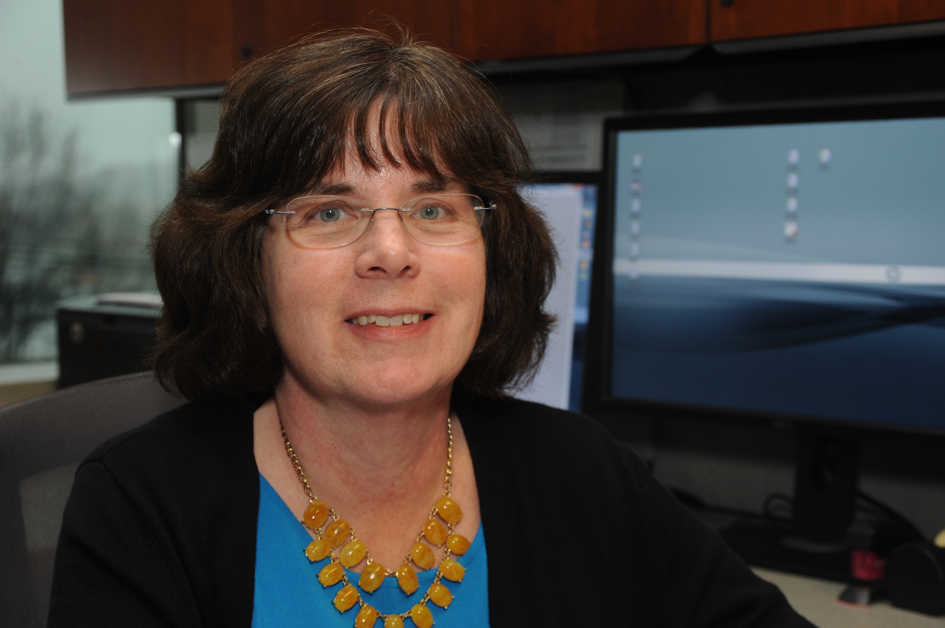
Retirement of NHGRI Program Director
Jean McEwen, J.D., Ph.D.
Notes:
Long-time NHGRI program director Jean McEwen will soon retire from federal service. Jean came to NHGRI in 1999 (about 18 years ago) following a career practicing law, teaching, and performing research. At NHGRI, she has masterfully managed a grant portfolio within our ethical, legal, and social implications (or ELSI) research program, focusing on legal, regulatory, and public policy issues (including those related to race and genetics, behavioral genetics, and prenatal testing).
Jean has been a true ELSI pioneer, creating and coordinating ELSI components within a number of trans-NHGRI and trans-NIH genomic programs, including the International HapMap Project, 1,000 Genomes, the Human Microbiome Project and, most recently, the Clinical Sequencing Exploratory Research (or CSER) Consortium.
Jean played a key role in shaping the ELSI Research Program and influenced many other NHGRI research efforts. Her vision and leadership will be missed, but she leaves as her legacy a vibrant community of ELSI scholars. We all wish her well in the next phase of her life, which begins in Minneapolis (where she recently relocated).

Slide 8
NIH-ACMG Fellowship in Genomic Medicine Program Management
  Increase pool of physicians who can manage research and implementation programs in genomic medicine
  First fellow (Jennifer Krupp) started this month
  Applications for 2018 fellowship due December 1; two-year fellowship begins July 2018
Document 1
Notes:
Under NHGRI’s leadership, NIH and the American College of Medical Genetics and Genomics (or ACMG) recently established a fellowship in Genomic Medicine Program Management, a two-year opportunity for qualified physicians to acquire credentials and experience for leading genomic medicine research and implementation programs at the NIH, major medical centers, and other organizations. * The goal of the program is to increase the pool of physicians who can manage research and implementation programs in genomic medicine.
The fellowship involves working with genomic medicine research and implementation programs within the participating NIH organizations (specifically, NHGRI; the National Institute on Minority Health and Health Disparities; the National Heart, Lung, and Blood Institute; the National Institute of Mental Health; and the All of Us Research Program) and with similar programs at the ACMG. In addition, time is provided for clinical genomic activities at NIH or nearby hospitals as well as approved electives tailored for each fellow. * The first fellow (Jennifer Krupp) started this month.
Up to two fellows will be selected each year. Qualified applicants must have graduated from medical or osteopathic school, be a U.S. citizen, and be licensed to practice medicine in the United States. * Applications for the 2018 fellowship will be due on December 1; new fellows will begin in July 2018.

Slide 9
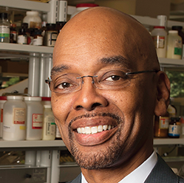


Genomics and Health Disparities Lecture Series
Herman Taylor, Jr., M.D., M.P.H
September 19, 2017
Director, Cardiovascular Research Institute
Morehouse School of Medicine
Richard Cooper, M.D.
November 7, 2017
Professor and Chair, Public Health Sciences
Loyola University Medical School
Jose Florez, M.D., Ph.D.
February 22, 2018
Chief, Diabetes Unit and Investigator, Center for Genomic Medicine
Massachusetts General Hospital
Harvard Medical School
Document 2
Notes:
The Genomics and Health Disparities Lecture Series continues this month and into 2018 with three outstanding speakers - * Herman Taylor from Morehouse School of Medicine, * Richard Cooper from Loyola University Medical School, and * Jose Florez from the Massachusetts General Hospital and Harvard Medical School. These lectures focus on the role that genomics research can have in addressing health disparities and understanding health inequities.
All lectures in this series are broadcast live on NHGRI’s GenomeTV channel, and are later available for replay on the Genomics and Health Disparities’ Program page. The series is co-sponsored by NHGRI; the National Institute on Minority Health and Health Disparities; the National Heart, Lung, and Blood Institute; the National Institute of Diabetes and Digestive and Kidney Diseases; and the Office of Minority Health at the Food and Drug Administration.

Slide 10

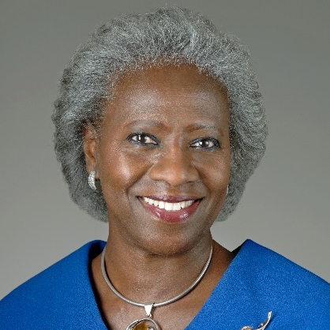

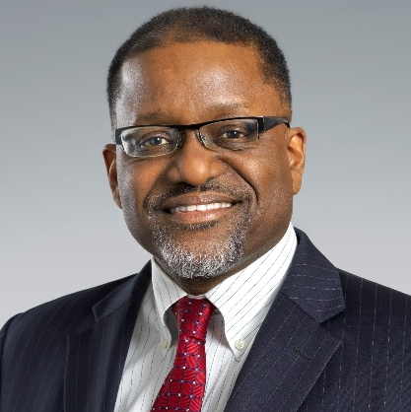

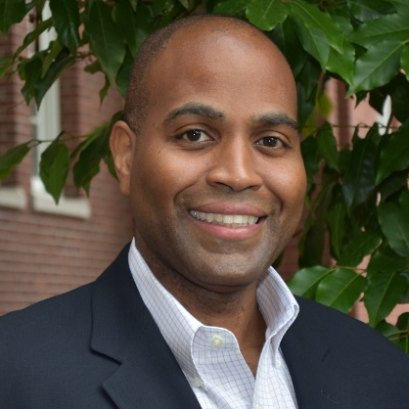
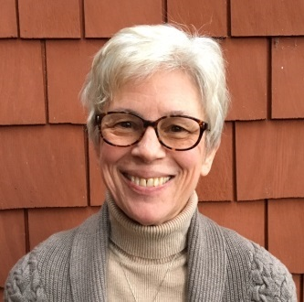
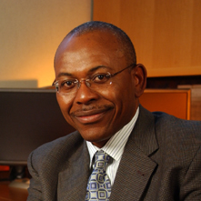
Genomics and Health Disparities Scientific Interest Group
Vence Bonham, J.D.
NHGRI
Hannah Valantine, M.D.
NIH OD and NHLBI
Sara Hull, Ph.D.
NIH Clinical Center and NHGRI
Gary Gibbons, M.D.
NHLBI
October 11, 2017 at 3:00 pm EST
Rasika Mathias, Ph.D.
Johns Hopkins University
Timothy Thornton, Ph.D.
University of Washington
Wylie Burke, M.D., Ph.D.
University of Washington
Charles Rotimi, Ph.D.
NHGRI
Document 3
Notes:
NHGRI recently expanded discussions about scholarly topics that involve both genomics and health disparities with the creation of a new scientific interest group. This group connects individuals from different disciplines across the NIH and the local research community to facilitate discussions about current research and to provide opportunities for professional development, social networking, and community engagement.
* This year, the interest group has featured the individual shown here as speakers, with quite a diversity of topics covered (such as transplantation genomics, bioethics, and bioinformatics). * On October 11, in partnership with the National Cancer Institute’s Division of Cancer Control and Population Sciences and the CDC’s Office of Public Health Genomics, the group will be hosting a public webinar featuring Wylie Burke and Charles Rotimi in a virtual panel discussion entitled “Precision Medicine and Health Disparities: the Promise and Perils of Emerging Technologies.”

Slide 11


Genomic Data Science Working Group
  Eric Boerwinkle Current Council Member
  Lon Cardon Former Council Member
  George Hripcsak
  Trey Ideker Current Council Member
  Gail Jarvik
  Mark Johnston Current Council Member
  Nancy Cox
  Michael Boehnke Former Council Member
  Anthony Philippakis
Notes:
Because of the many, many complex issues at the interface between genomics and data science that are increasingly being faced by NHGRI and this Council, I recently established a fourth standing Working Group of the National Advisory Council for Human Genome Research. The Genomic Data Science Working Group has been charged with providing input to me (as the NHGRI Director) and other Institute leaders about NHGRI data-science programs and issues as well as relevant programs and issues that arise at the NIH level (for which NHGRI is frequently called upon for leadership and expertise).
The general remit is deliberately broad, with the intent of having the Working Group poised to consider the full spectrum of data-science challenges (from data management to data usage, including policy-related elements) as they relate to all areas of genomics (from basic science to genomic medicine implementation).
The initial membership of the Working Group is shown here, with both current and former Council members deliberately selected to populate the group. The Working Group has had two teleconferences since June, with more planned for this fall. We will bring summaries and discussions coming from the Working Group to the full Council, as appropriate.

Slide 12
Director’s Report Outline
General NHGRI Updates
General NIH Updates
General Genomics Updates
NHGRI Extramural Research Program
NIH Common Fund/Trans-NIH
NHGRI Division of Policy, Communications, and Education
NHGRI Intramural Research Program

Slide 13

Francis Collins ‘Retained’ as NIH Director
Francis Collins, M.D., Ph.D.
Document 4
Notes:
In June, President Trump officially decided to ‘retain’ Francis Collins as the NIH Director, and so he will remain in this important position as part of the Trump administration. Prior to that, he had been ‘held over’ from the Obama Administration (reflecting a more temporary status). NHGRI is, of course, delighted with this development, and continue to appreciate his outstanding leadership of NIH.

Slide 14
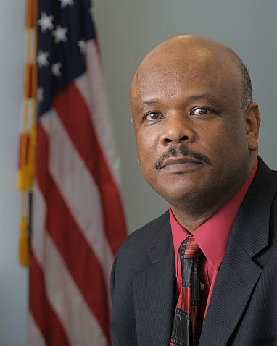
New NIH Deputy Director for Management
Alfred Johnson, Ph.D.
Document 5
Notes:
Alfred Johnson was recently appointed the new NIH Deputy Director for Management. Since 2006, Dr. Johnson has served as the Director of the NIH Office of Research Services, where he planned and directed service programs for public safety, security operations, scientific and regulatory support, and a wide variety of other services that enrich the NIH community. He has held many other scientific and administrative positions since coming to NIH in 1985.

Slide 15
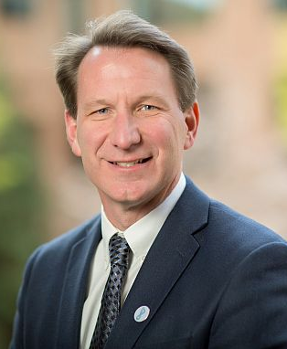

Naming of New Director,
National Cancer Institute
Norman Sharpless, M.D.
Document 6
Notes:
In June, President Trump named Norman “Ned” Sharpless to be the new Director of the National Cancer Institute (or NCI). Dr. Sharpless was most recently the Director of the Lineberger Comprehensive Cancer Center and the Wellcome Distinguished Professor in Cancer Research at the University of North Carolina. He is a practicing oncologist caring for patients with leukemia, and leads a research group studying the cell cycle and its role in cancer and aging. He earned his undergraduate and medical degrees from the University of North Carolina at Chapel Hill. It is not yet known when he will actually start in the NCI Director position.

Slide 16
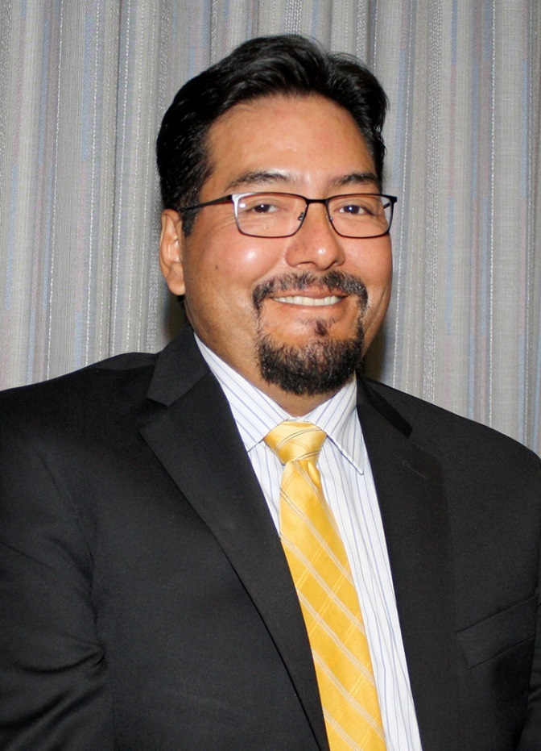
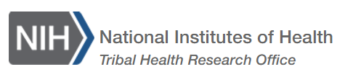
First Director,
NIH Tribal Health Research Office
David Wilson, Ph.D.
Document 7
Notes:
David Wilson has been appointed the first Director of the NIH Tribal Health Research Office. In this role, Dr. Wilson will bring together representatives from across the NIH to leverage resources and build collaborations to address tribal health concerns. He comes to the NIH from the Department of Health and Human Services Office of Minority Health, where he served as Public Health Advisor and the American Indian/Alaska Native Policy Lead. Dr. Wilson has a Ph.D. in molecular and cellular biology from Arizona State University.

Slide 17
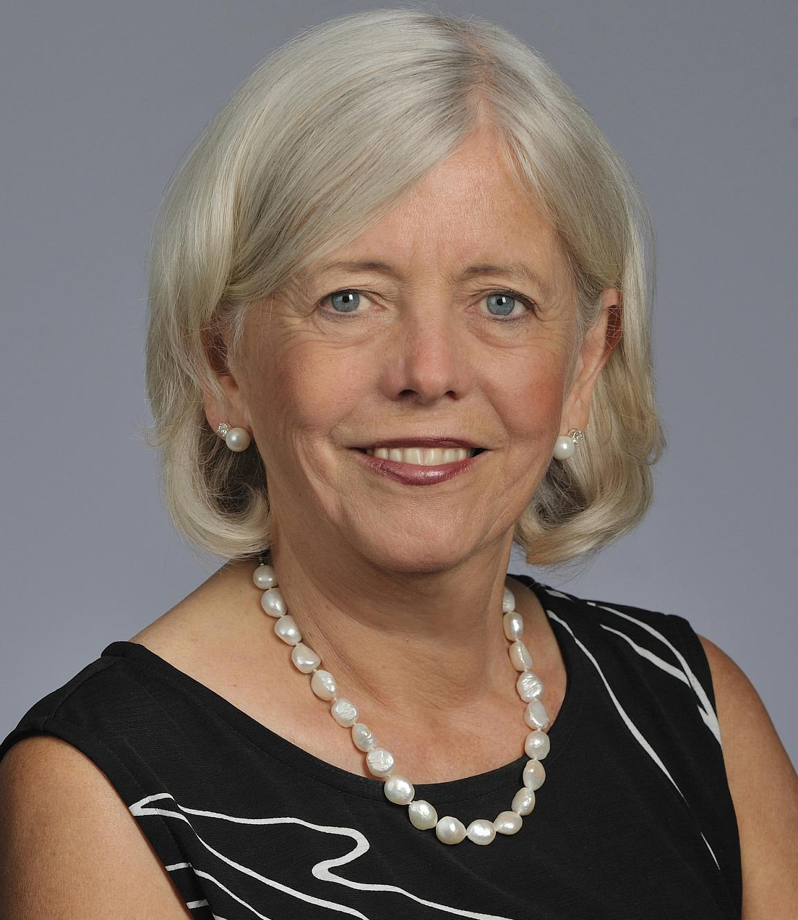

Josie Briggs Departs as Director,
National Center for Complementary and Integrative Health
Josephine Briggs, M.D.
Document 8
Notes:
Later this fall, Josie Briggs will be leaving her position as Director of the National Center for Complementary and Integrative Health (or NCCIH). After departing, she will become the Editor-in-Chief of the Journal of the American Society of Nephrology.
In addition to serving as NCCIH Director for a number of years, Josie contributed her leadership for a number of major NIH efforts, including the standing up of the National Center for Advancing Translational Sciences (or NCATS) and the U.S. Precision Medicine Initiative.
Following Josie’s departure and while NIH searches for a new NCCIH Director, David Shurtleff will serve as the Center’s Acting Director.

Slide 18
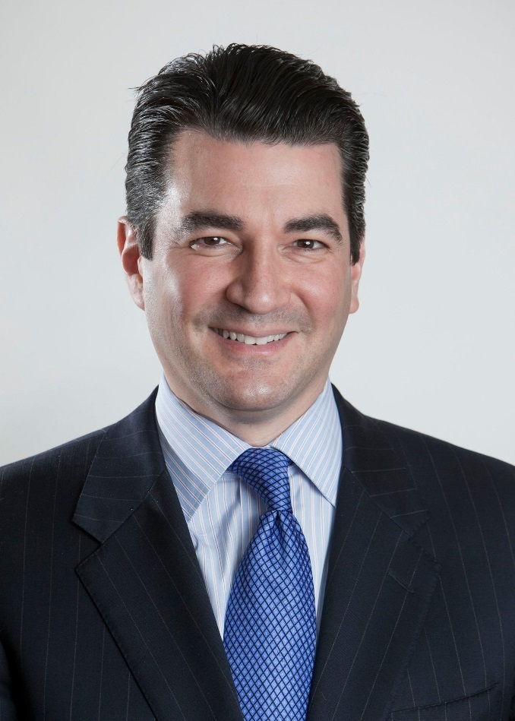

New Commissioner,
U.S. Food and Drug Administration
Scott Gottlieb, M.D.
Document 9
Notes:
Scott Gottlieb was confirmed as the new Commissioner of the U.S. Food and Drug Administration (or FDA) in May, shortly after our last Council meeting. Dr. Gottlieb trained as an internist, and previously served as FDA’s Deputy Commissioner under President George W. Bush and a Senior Adviser at the Centers for Medicare and Medicaid Services. Since assuming the position of FDA Commissioner, Dr. Gottlieb has worked on a range issues, including the opioid crisis, the need for a digital health strategy, and ways to increase generic drug competition.

Slide 19
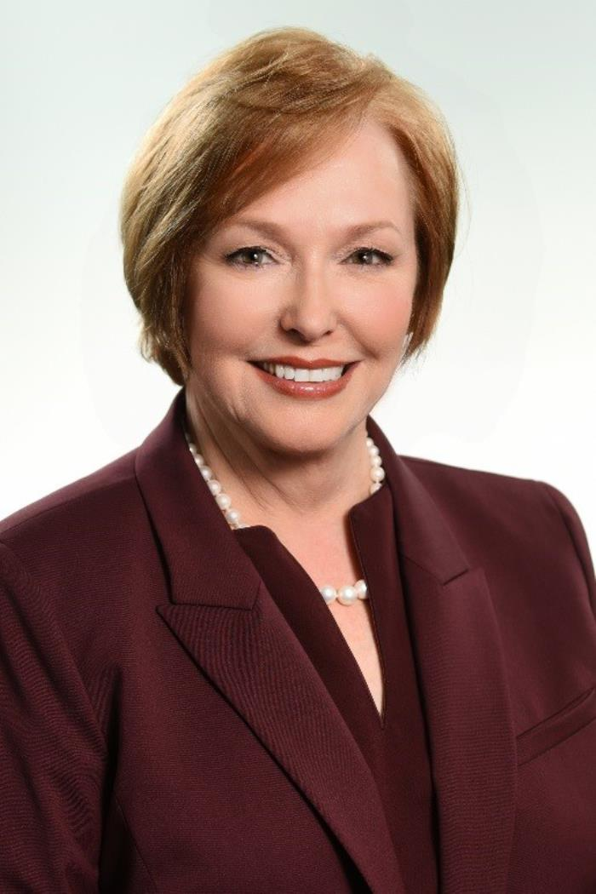

New Director, U.S. Centers for
Disease Control and Prevention
Brenda Fitzgerald, M.D.
Document 10
Notes:
In July, Health and Human Services Secretary Tom Price named Brenda Fitzgerald the 17th Director of the U.S. Centers for Disease Control and Prevention (or CDC). Dr. Fitzgerald is an obstetrician-gynecologist, who has been the Georgia Public Health Commissioner since 2011. In that role, she oversaw various state public health programs and directed the state’s 18 public health districts and 159 county health departments.

Slide 20
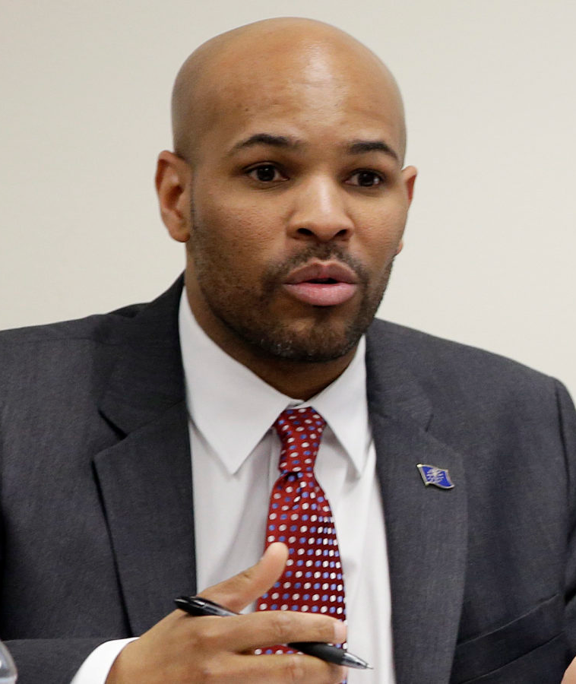

New U.S. Surgeon General
Jerome Adams, M.D.
Document 11
Notes:
After being nominated by President Trump and confirmed by the Senate in early August, Dr. Jerome Adams was sworn in as the U.S. Surgeon General on September 5. Dr. Adams, an anesthesiologist by training, previously served as the Indiana State Health Commissioner. He succeeds Dr. Vivek Murthy, who left the post in April. Rear Admiral Sylvia Trent-Adams had been serving as Acting Surgeon General during the interim period.

Slide 21
Alberto Gutierrez Retiring as Director,
FDA Office of In Vitro Diagnostics and Radiological Health
Alberto Gutierrez, Ph.D.
Document 12
Notes:
After 25 years with the FDA, Alberto Gutierrez (Director of the Office of In Vitro Diagnostics and Radiological Health) will be retiring at the end of this month. This Office regulates in-home and laboratory diagnostic tests and also administers the Clinical Laboratory Improvement Amendment (or CLIA).
During his tenure as Director, Dr. Gutierrez provided leadership for the agency to publish draft guidelines on demonstrating analytical validity for germline next-generation sequencing tests as well as proposing the use of public genomic variant databases to establish clinical validity of next-generation sequencing tests. He also worked extensively on the issue of regulating laboratory-developed tests. The Office’s current Associate Director, Don St. Pierre, will become Acting Director until a replacement is appointed. Dr. Gutierrez and I have worked together in recent years to strengthen FDA and NHGRI interactions and collaborations, and I wish him well in his future endeavors.

Slide 22
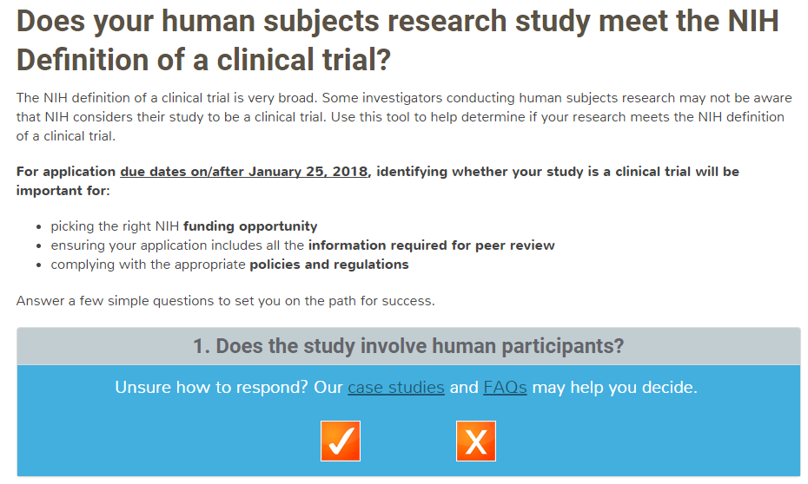
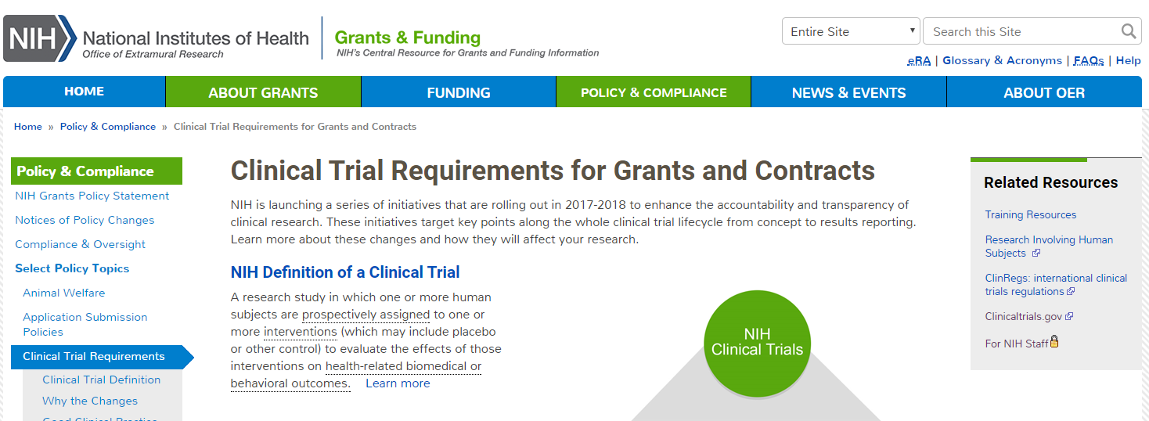
Upcoming Changes to
NIH Clinical Trials Policies
    Upcoming policy changes aim to improve stewardship of NIH-funded clinical trials
    New requirements go into effect for applications due on or after January 25, 2018
Document 13
Notes:
On August 11, all NIH grantees, contractors, researchers, and research administrators were notified about upcoming changes to NIH clinical trial policies. * The upcoming policy changes aim to improve the stewardship of NIH-funded clinical trials by clarifying and broadening the definition of a clinical trial. * Specifically, there are a number of new expectations for clinical trials that will come into effect for applications due on or after January 25, 2018. These changes are part of an ongoing effort to improve transparency and oversight of NIH-funded clinical trials; in 2014, NIH first clarified and broadened the definition of a clinical trial as part of this process.
* NIH has developed a new Clinical Trial Requirements web page to provide all the information that investigators need to ensure that they are complying with the new policies. The web page includes case studies, FAQs, and an interactive tool for determining whether a study meets the definition of a clinical trial.

Slide 23
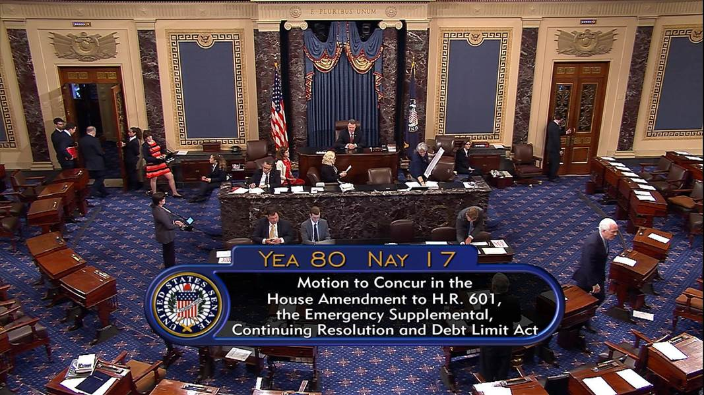
Budget Update
Notes:
Last week, in an unexpected turn of events, President Trump cut a deal with the Democratic leadership to address several issues in one fell swoop. Following that, the House and Senate passed a bill that provides disaster relief funds for those impacted by Hurricane Harvey. In that same bill, the debt ceiling was lifted for three months, and the Federal Government was also funded via a Continuing Resolution (or CR) through December 8. So, we will not face a government shutdown on October 1!
While the government remains open during this interim period, the House and Senate will be working on negotiating and finalizing all of the appropriations that will comprise the Fiscal Year 18 budget. So these three months give us a brief reprieve, but we will still have to wait and see if we face the threat of a government shutdown in December, if Congress will approve another short-term Continuing Research, or if a Fiscal Year 18 budget gets passed by December 8 – so stay tuned.

Slide 24
NIH Appropriations
 | Fiscal Year 2017 Budget | Fiscal Year 2018 Senate Appropriations Labor-HHS Spending Bill
NIH | $34.1 B | $36.1 B
NHGRI | $528 M | $547 M
Document 14
Notes:
Speaking of appropriations, last week was a busy one here in DC. On Thursday, the Senate Appropriations Committee approved the Labor-HHS bill that outlines funding for NIH, among many other things. Importantly, the bill includes a proposed $2-billion increase for NIH (that would raise NIH’s total budget to $36.1 billion). Several initiatives were specifically appropriated funds from this $2 billion, including $414 million for Alzheimer’s disease research, $140 million for the BRAIN Initiative, $50 million for combatting antibiotic resistance, and $60 million for the All of Us research program. In the Senate bill, NHGRI’s Fiscal Year 2018 budget would be $547 million, reflecting a 3.5% increase over Fiscal Year 2017.
Earlier in the summer, the corresponding House committee approved a bill that would also give a nice increase to the NIH budget, although the House mark was not quite as high as the Senate’s. Both the Senate and the House bills include a prohibition on capping the funds provided for Facilities and Administrative, also known as indirect costs. This is one of twelve appropriations bills that will be part of the final Fiscal Year 18 budget package that the full House and Senate will eventually need to pass and send to the President for his signature. So, the bottom line is that if we eventually get an actual Fiscal Year 18 budget, then it is will likely come with an increase to the NIH and NHGRI budgets (so fingers crossed).

Slide 25
Director’s Report Outline
General NHGRI Updates
General NIH Updates
General Genomics Updates
NHGRI Extramural Research Program
NIH Common Fund/Trans-NIH
NHGRI Division of Policy, Communications, and Education
NHGRI Intramural Research Program

Slide 26

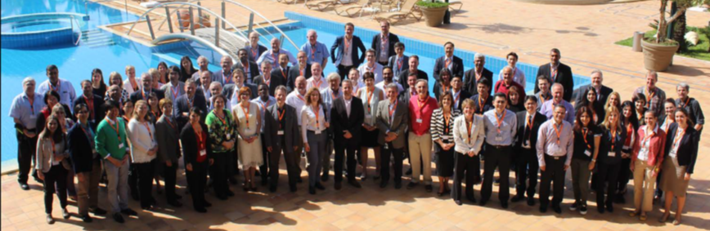
Global Genomic Medicine Collaborative (G2MC)
Athens, April 2017
Arose from 6th Genomic Medicine Meeting as ‘action collaborative’ of IOM/NAM
Independent non-profit co-located with GA4GH, acting as implementation partner
>120 delegates, nearly 50 countries; developing projects in variant interpretation, case conferences, & policy
Leading effort to convene major large-scale cohort studies and promote interoperability and sharing
Meeting planned for early 2018
Document 15
Notes:
The Global Genomic Medicine Collaborative (or G2MC), a product of this Council’s Genomic Medicine Working Group, held its third meeting in April. * G2MC arose from the 6th Genomic Medicine Meeting in 2014, with a focus on genomic medicine implementation efforts internationally. It began as an ‘action collaborative’ with the Institute of Medicine, now the National Academy of Medicine, * and has since evolved into an independent non-profit organization that is co-located and sharing staff with the Global Alliance for Genomics and Health (or GA4GH). G2MC can be considered the ‘implementation partner’ of the data and research efforts of the GA4GH, and has been focusing on extending novel implementation models to other countries and medical systems.
* This year’s meeting in Athens welcomed over 120 delegates from nearly 50 countries, including first-time participants from South America and Africa. From the meeting, collaborative projects in genomic variant interpretation, online case conferences, and policy are under development. * The G2MC was recently commissioned by the Heads of International Research Organizations (or HIROs) group to convene major large-scale cohort studies around the world to promote data standardization, interoperability, and sharing. Eligible cohorts will be those with 100,000 or more participants, with biological samples and prospective follow-up information or the capability of collecting samples and follow-up. * The first meeting for such international cohorts is planned for early 2018.

Slide 27
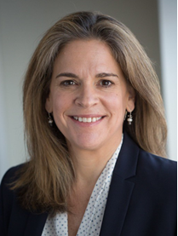

New Executive Director,
American Society of Human Genetics
Mona Miller, M.P.P.
Document 16
Notes:
Mona Miller was appointed the new Executive Director of the American Society of Human Genetics (or ASHG) in late July. Ms. Miller holds a master’s degree in public policy from the Harvard University Kennedy School of Government. She comes to ASHG from the Society for Neuroscience, where she served as the Deputy Executive Director for Programs and Finance and as the Senior Director of Communications. Prior to that, she served as a Senior Officer of Public Affairs at the Pew Charitable Trusts and as Communications Director for former Senator Barbara Mikulski.
Mona replaces Joe McInerney, who will remain as a consultant to Ms. Miller until his retirement at the end of 2017. We look forward to working with Ms. Miller and continuing the strong, synergistic ties between ASHG and NHGRI.

Slide 28
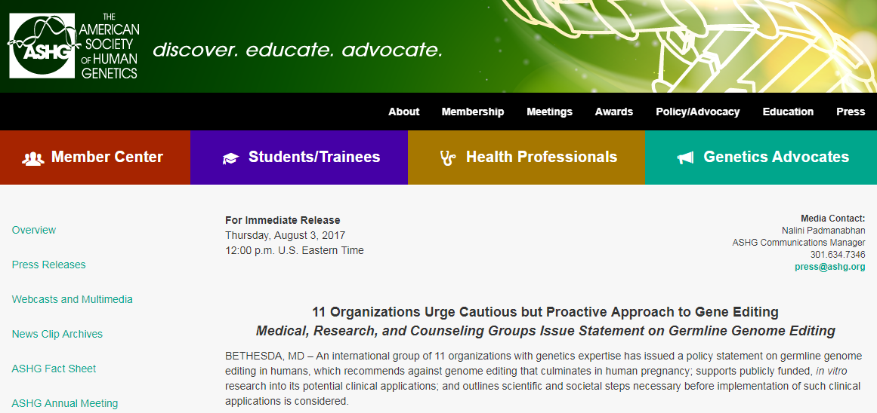
ASHG Position Statement:
Human Germline Genome Editing
Recommends against the use of germline gene editing that would result in pregnancy
Asserts that in vitro studies of germline gene editing should continue without restriction of public funds
Document 17
Notes:
In August, ASHG and 10 other international and domestic organizations issued a statement about human germline genome editing. * The statement, which was developed by a working group comprised of scientists, genetic counselors, bioethicists, health services researchers, and lawyers, recommends against the use of germline gene editing that would result in pregnancy, * but asserts that in vitro studies of germline gene editing should continue without restriction of public funds. Currently, the Dickey-Wicker amendment prohibits the use of federal funds for research that involves the creation or destruction of embryos, and NIH does not fund any use of gene editing in human embryos.
In alignment with an earlier report by the National Academy of Sciences and the National Academy of Medicine, the statement also sets forth that clinical applications of human germline genome editing should only proceed if there is “a compelling medical rationale,” “an evidence base that supports its clinical use,” “an ethical justification,” and “a transparent public process to solicit and incorporate stakeholder input.”

Slide 29

Albany Medical Center Prize in Medicine and Biomedical Research
Document 18
Notes:
The five researchers pictured here - Emmanuelle Charpentier from the Max Planck Institute for Infection Biology, Jennifer Doudna from the University of California-Berkeley, Luciano Marraffini from Rockefeller University, Francisco Mojica from the University of Alicante, and Feng Zhang from the Massachusetts Institute of Technology - received this year's Albany Medical Center Prize in Medicine and Biomedical Research for their work on gene editing. They are being honored for their contributions to the development of the CRISPR/Cas9 gene-editing technology.

Slide 30
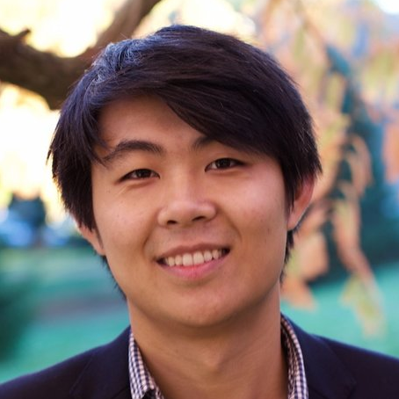


Allen Distinguished Investigator Awards
Fei Chen, Ph.D.
Jason Buenrostro, Ph.D.
Document 19
Notes:
The Paul G. Allen Frontiers Group awards the Allen Distinguished Investigator grants to researchers conducting pioneering research in epigenetics, aging, and evolution. This year, current NHGRI grantees Fei Chen and Jason Buenrostro of the Broad Institute received these awards for their work in technologies to directly visualize the architecture of the genome and sequence individual regulatory elements within cells.

Slide 31
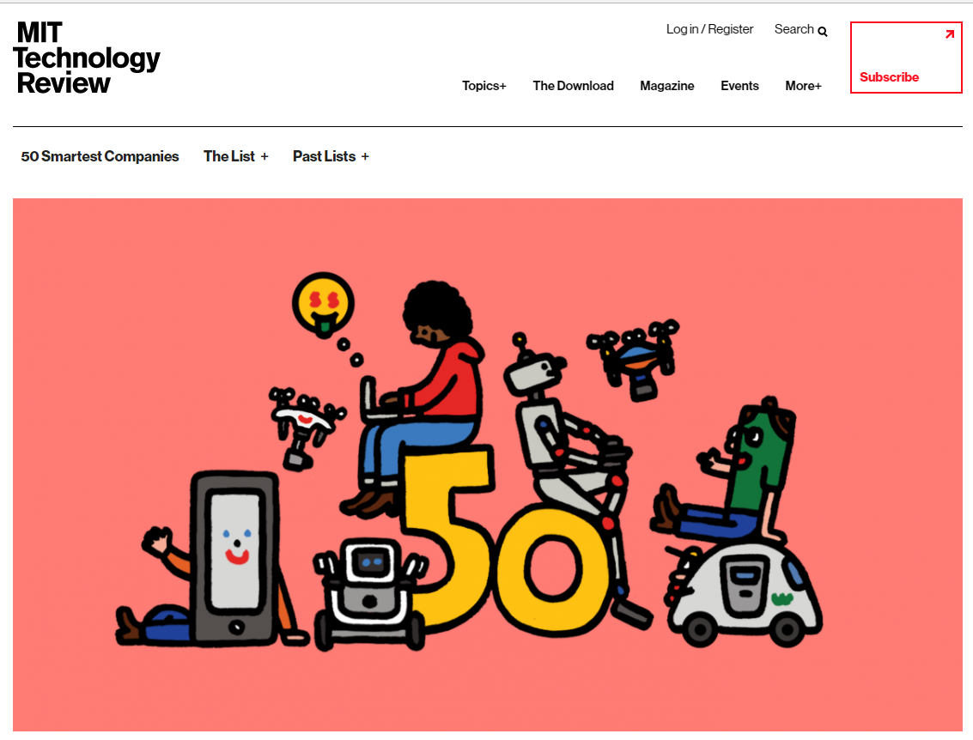
MIT Technology Review:
50 Smartest Companies
Document 20
Notes:
The MIT Technology Review recently announced its 50 ‘smartest companies.’ Among this group were eight related to genomics and genetics. Fourth on the list goes to direct-to-consumer genetic testing company 23andMe. Also included were: Merck at number 17, Ionis Pharmaceuticals at number 20, Illumina at number 22, Sophia Genetics at number 30, Oxford Nanopore at number 32, Bluebird Bio at number 37, and Veritas Genetics at number 45.

Slide 32


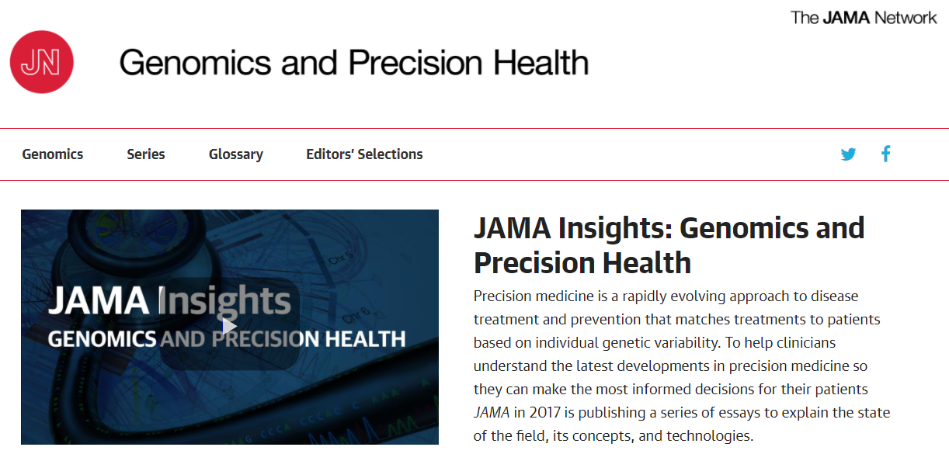
Genomics In The News…
Document 21
Notes:
Moving to ‘Genomics in the News’ – there is one item to bring to your attention.
The Journal of the American Medical Association (or JAMA) has launched a website to highlight a new series, called “JAMA Insights: Genomics and Precision Health.” This site will feature brief articles intended to explain contemporary clinical genetics and genomic technologies to non-specialists.
The articles will cover a wide range of topics, including cutting-edge precision health technologies as well as those that are in common use.

Slide 33

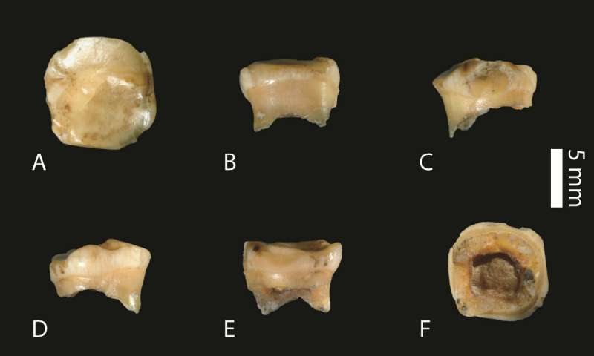


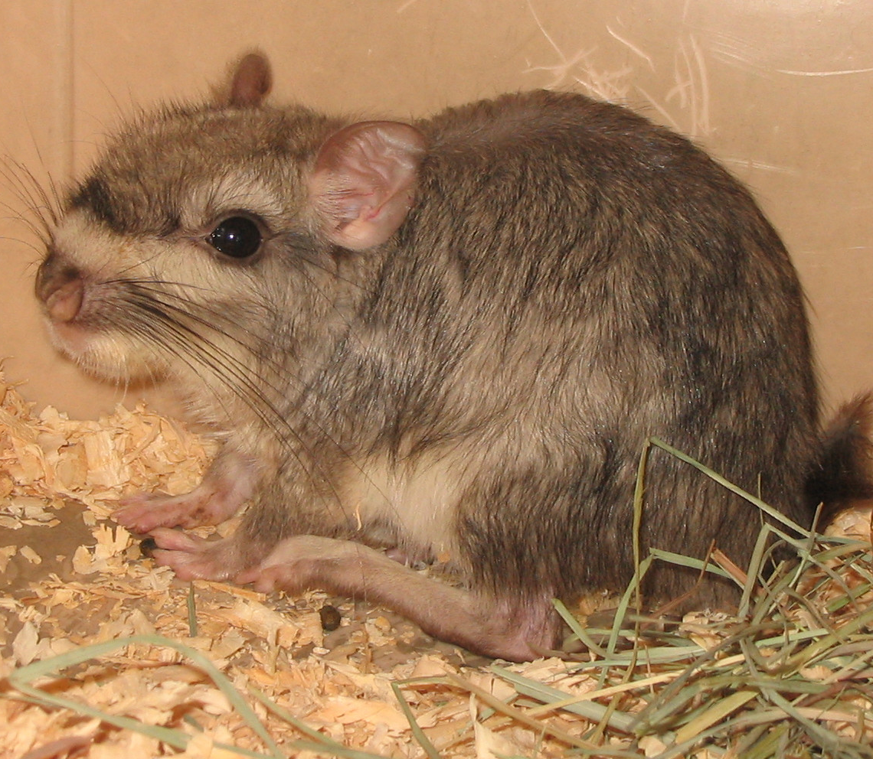
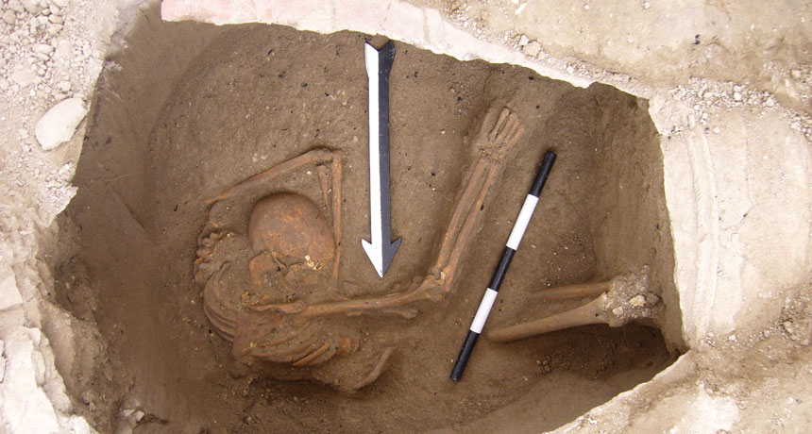

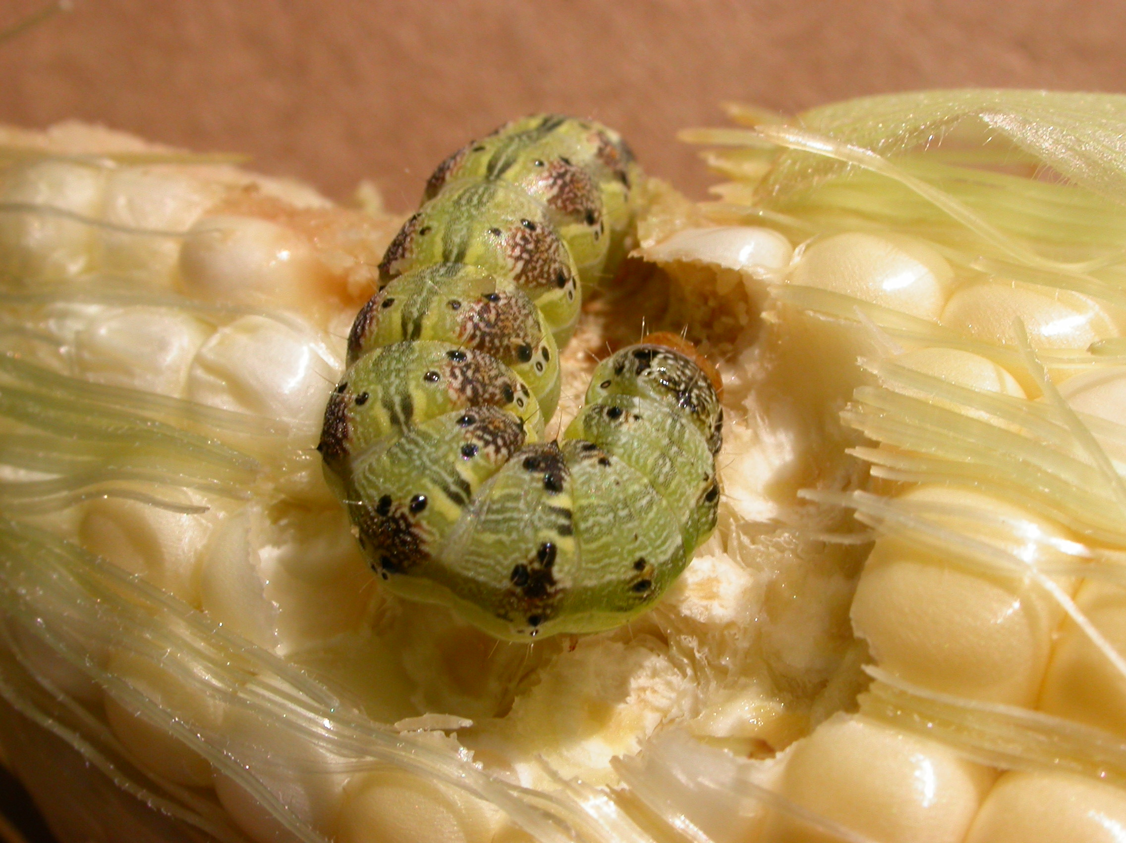

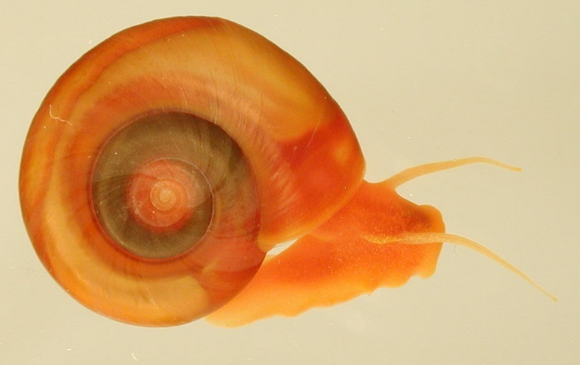
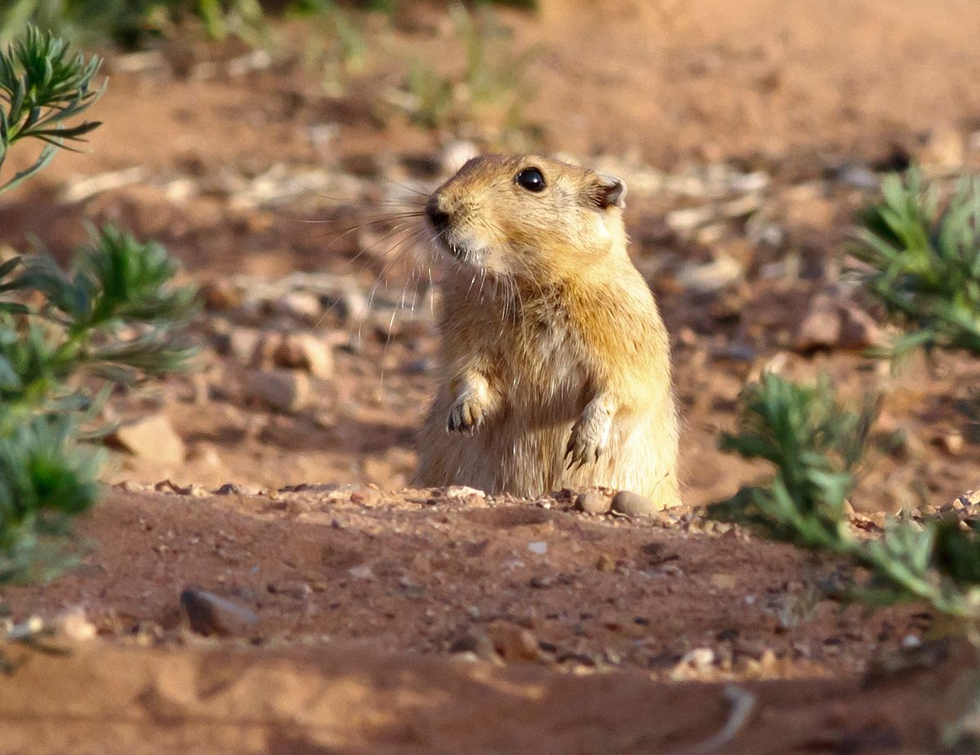

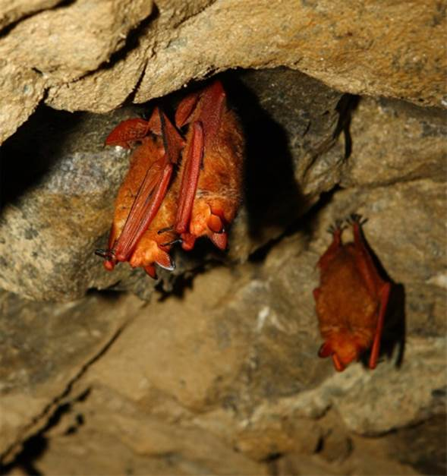

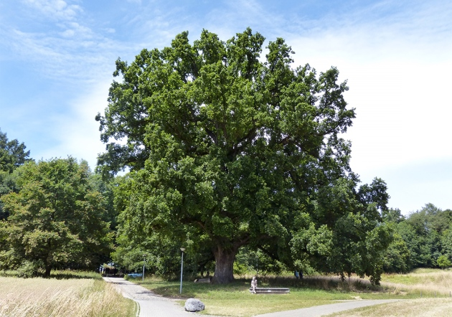


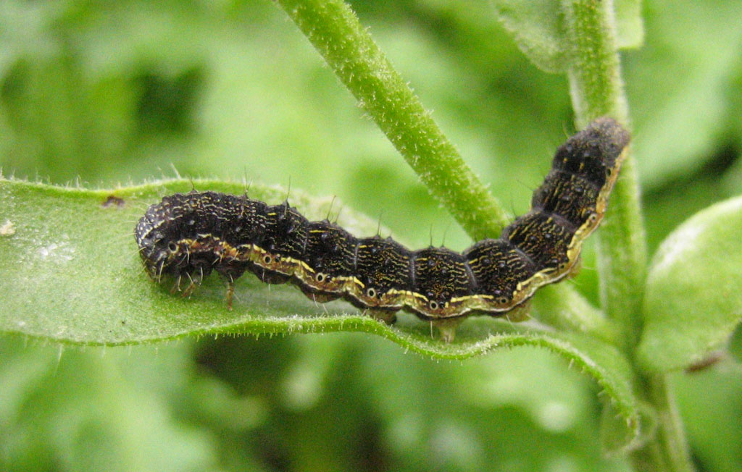
Genomes In The News…
Document 22
Notes:
In terms of ‘Genomes in the News’ – there have been a number of recently generated genome sequences reported since the last Council meeting, including: * Tea Tree, * Golden Orb Weaver, * Silver Birch Tree, * Sunflower, * a Freshwater Snail, * Desert Tortoise, * Galapagos Cormorant, * Old (234 years) Oak Tree Leaves, * Wild Wheat, * A Fourth Denisovan, * Sand Rat, * Jaguar, * Golden Bat, * 3700 Year-Old Canaanite, * 117 Diverse Apples, * Cotton Bollworm, * Corn Earworm, and * Red Vizcacha Rat.

Slide 34
Director’s Report Outline
General NHGRI Updates
General NIH Updates
General Genomics Updates
NHGRI Extramural Research Program
NIH Common Fund/Trans-NIH
NHGRI Division of Policy, Communications, and Education
NHGRI Intramural Research Program

Slide 35
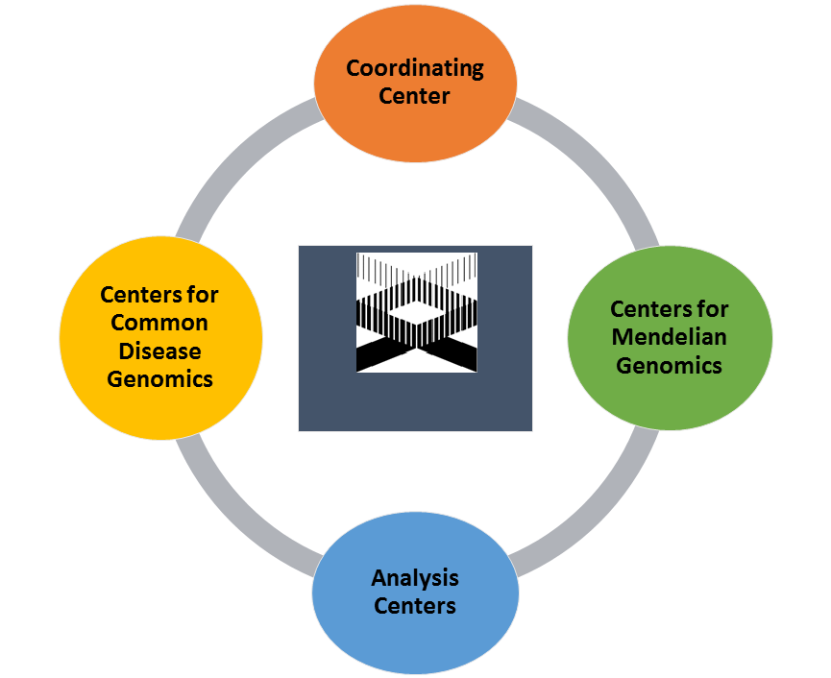




Genome Sequencing Program
Genome Sequencing Program
Document 23
Notes:
The overall aim of NHGRI’s Genome Sequence Program is to use genome sequencing to identify genes and genomic variants underlying the full spectrum of human inherited disease.
The Genome Sequence Program is comprised of a coordinating center, four analysis centers, four Centers for Common Disease Genomics, and four Centers for Mendelian Genomics. * This program is also supported by other institutes, including the National Heart, Lung, and Blood Institute; the National Institute on Aging; and the National Eye Institute. For example, the Centers for Common Disease Genomics’ autism efforts are co-funded by the Simons Foundation. The Centers for Common Disease Genomics Alzheimer’s disease efforts are co-funded by the National Institute on Aging’s Alzheimer’s Disease Sequencing Project. Additionally, the Genome Sequencing Program works closely with the National Heart, Lung, and Blood Institute’s Trans-Omics for Precision Medicine (or TOPMed), particularly, for joint data calls and analyses.

Slide 36
Genome Sequencing Program
      Centers for Common Disease Genomics
Disease Category | Sequence Type | Sequenced Samples | Approved Samples
Cardiovascular | Genomes | 22,729 | 46,300
 | Exomes | 10,861 | 21,000
Immune-Mediated | Genomes | 5,383 | 25,000
 | Exomes | 0 | 2,000
Neuropsychiatric | Genomes | 9,366 | 15,300
 | Exomes | 11,450 | 32,000
TOTAL |  | 59,789 | 141,600
Document 23
Notes:
The Centers for Common Disease Genomics are using large-scale genome sequencing to discover genomic variants underlying common diseases, to learn about disease architectures and study designs, and to identify rare risk and protective genomic variants. These Centers are in their 2nd year of funding, and have sequenced over 59,000 samples across three disease categories. Shown here is a table summarizing that sequence production, broken down for each disease category and also for whole-genome versus whole-exome sequences.
* Out of the 141,600 approved samples, * over 33,000 have been sequenced for the study of cardiovascular diseases, including early onset coronary artery disease, early onset atrial fibrillation, and stroke. * Over 5,000 samples have been sequenced for immune-mediated diseases, including asthma, inflammatory bowel disease, and type 1 diabetes. * Finally, over 20,000 samples have been sequenced for the study of neuropsychiatric diseases, including Alzheimer’s disease, autism, and epilepsy.
In addition to sequence-production goals, the centers are developing collaborative analysis and technology development plans.

Slide 37
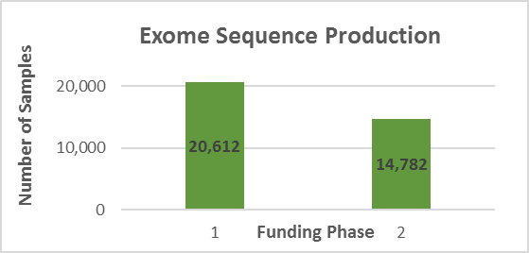
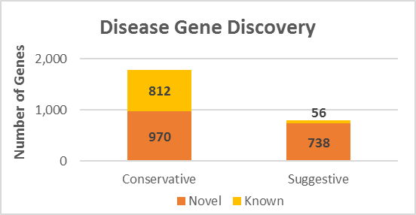
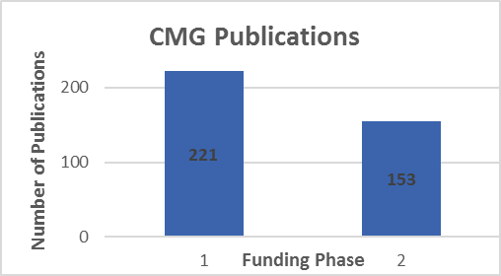
Genome Sequencing Program
      Centers for Mendelian Genomics
Document 23
Notes:
The Centers for Mendelian Genomics program is halfway through its second funding cycle. The program aims to use genome sequencing and analysis to discover the genomic basis underlying as many Mendelian diseases as possible, and to accelerate gene discovery by disseminating methods and results.
* The four Centers have to date generated genome sequences for over 35,000 individuals, mostly by whole-exome sequencing. About 42% of that sequencing was performed during the current funding cycle. * The Centers have found about 1,800 disease genes by ‘conservative’ criteria; 970 of those represent novel gene-phenotype associations. Additionally, about 800 disease genes have been identified by ‘suggestive’ criteria; most of those potentially represent novel associations. * The Centers have published over 370 papers, with 153 published so far in the current funding cycle. These papers report on disease gene discoveries, method and tool development, collaborations with disease groups, choices made by research participants, and future perspectives.
* In addition to publications, the Centers also publicly share appropriately consented genomic data. Matchmaker Exchange is one of the data-sharing venues being used; this is a federated network of databases facilitating case matching based on phenotypic and/or genotypic profiles. The Centers have been among the leaders to develop the network since its launch in late 2013, * and currently contribute to three nodes, as highlighted here.

Slide 38

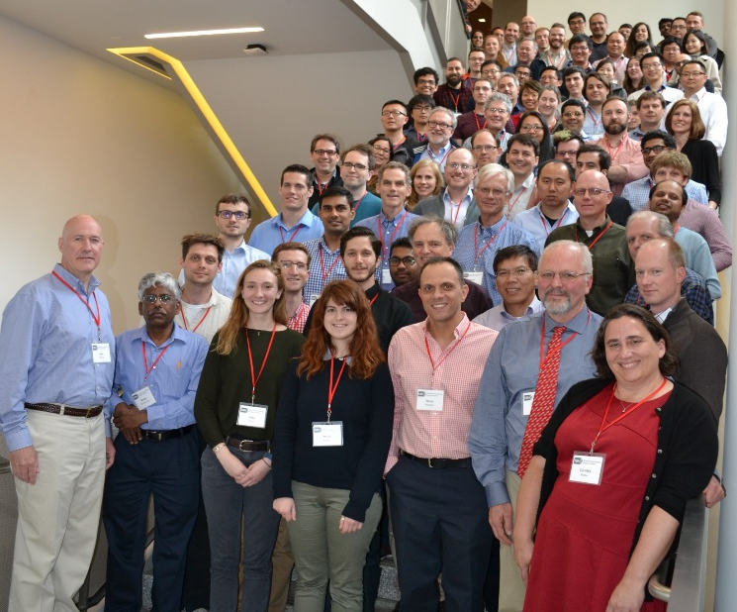
Technology Development Program
  Advanced Genomic Technology Development Meeting - May 2017
  Novel Genomic Technology Development
    PAR-16-14 (R01, also linked R21 and R43/44)
    Next due date: October 31, 2017
Document 24
Notes:
NHGRI’s Technology Development Program continues to move forward, paving the way to develop new and improved technologies to enable genomic discoveries and facilitate adoption of genomics in medicine.
* An Advanced Genomic Technology Development Meeting was held at Northeastern University in May. Novel nucleic-acid sequencing and genomic-technology grantees from the program met over several days to facilitate communication, collaboration, and interaction. An adjacent public meeting allowed broader community participation. Grantee and community feedback was very favorable, and we are working on the next meeting of this group planned for May 2018.
One upcoming funding opportunity deserves mentioning. * Program announcements for Novel Genomic Technology Development are resulting in a wide breadth of submitted applications and funded grants, ranging from advanced tools and critical reagents to the development of epigenomic and genomic-profiling assays. The next application due date for this is in late October.

Slide 39


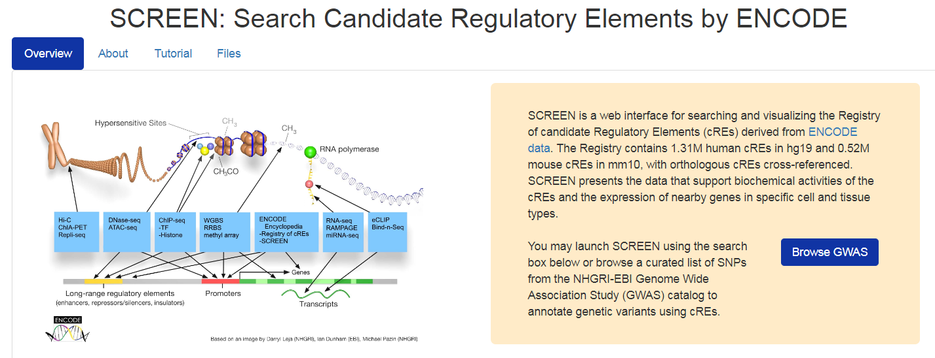
ENCyclopedia Of DNA Elements (ENCODE)
Document 25
Notes:
The goal of the Encyclopedia of DNA Elements (or ENCODE) project is to create catalogs of all functional elements in the human and mouse genomes, and to make those catalogs available as a resource to the biomedical community.
* At this year’s American Society of Human Genetics meeting, a workshop will be held dedicated to teaching users how to navigate the ENCODE encyclopedia using the newly created online visualization tool, SCREEN (or Search Candidate Regulatory Elements by ENCODE). SCREEN was developed by the ENCODE’s Data Analysis Center to allow for seamless navigation through ENCODE’s extensive encyclopedia. The workshop will provide training on navigating the annotated genomes available through this resource.

Slide 40
ENCyclopedia Of DNA Elements (ENCODE)
Document 25
Notes:
ENCODE data are being widely used. There are now more than 2,000 community publications (the pink line) from groups without ENCODE funding but who used ENCODE data for their published work. ENCODE Consortium members have produced more than 600 publications (the green line). The use of these data attests to the value of the resources provided by ENCODE, and we expect these numbers to increase as more data becomes available in ENCODE.

Slide 41
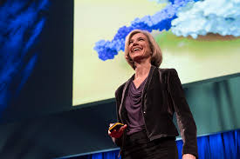
Centers of Excellence in
Genomic Science (CEGS) Program
Center for Genome Editing and Recording
PI - Jennifer Doudna
Create methods to detect, alter, and record the sequence and output of the genome in individual cells and tissues
Document 26
Notes:
The Centers of Excellence in Genomic Science (or CEGS) program supports interdisciplinary research teams to develop highly innovative approaches to address genomic problems.
* A new award was made recently for establishing a Center for Genome Editing and Recording. Jennifer Doudna at the University of California-Berkeley is the Principal Investigator, with collaborators at University of California-San Francisco, the Broad Institute, and Massachusetts General Hospital. * Building on the CRISPR-Cas9 genome-engineering technology, this center aims to create methods to detect, alter, and record the sequence and output of the genome in individual cells and tissues.

Slide 42


eMERGE and Beyond: The Future of EHR and Genomics Workshop
October 30, 2017
Evidence generation for genomic medicine
Identification of novel & disruptive opportunities
Electronic phenotyping
EMR integration of genomic results
Document 27
Notes:
The Electronic Medical Records and Genomics (or eMERGE) network conducts genomic discovery and clinical implementation research by leveraging data from large biorepositories linked to electronic medical records. * On October 30, NHGRI will be hosting a program review workshop entitled “eMERGE and Beyond: The Future of EHR and Genomics” – as eMERGE Phase III will end in June 2019. This workshop will bring together eMERGE principal investigators, the eMERGE External Scientific Panel, NHGRI Council members, external experts in key areas of genomic medicine, and patient representatives to review the current goals and accomplishments of eMERGE as well as design future directions for a possible continuation of eMERGE.
The workshop goals include identifying gaps, discussing challenges, and defining future opportunities in genomic medicine research and implementation. The workshop will focus on the following four main topics: * evidence generation for genomic medicine, * identification of novel and disruptive opportunities in genomic medicine, * electronic phenotyping for genomic research, and * Electronic Medical Records (or EMR) integration of genomic results and automated decision support. The meeting will be webcast live and archived on NHGRI’s GenomeTV channel of YouTube.

Slide 43
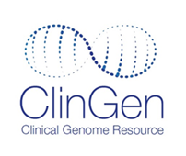

Clinical Genome Resource (ClinGen)
Clinical Laboratories Meeting Minimum Data Sharing Requirements
Ambry
ARUP
Athena
a
U. Medical Centre Ljubljana
Children’s Mercy Hospital
Counsyl
EGL Genetics
GeneDx
Illumina
Invitae
Partners Healthcare LMM
Quest Diagnostics
University of Chicago
Save the Date!
May 23-25, 2018
Wellcome Genome Campus
Hinxton, England
List as of Sept. 5, 2017
Document 28
Notes:
The Clinical Genome Resource (or ClinGen) considers the sharing of genomic variant interpretations as essential for quality assurance and for accurate genetic and genomic testing. * As such, they developed a list of clinical laboratories who meet a minimum standard of data sharing and encourage other laboratories to apply for this status through the ClinGen website.
* ClinGen continues to educate the research and clinical communities about their resource and tools. During the June 2017 Curating the Clinical Genome meeting (which was co-organized with DECIPHER), the ClinGen team led a training session on their curation tools that was attended by more than 200 researchers and clinicians. * Next year’s meeting will be May 23-25 in Hinxton, England.

Slide 44

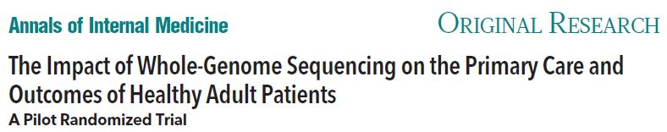
Clinical Sequencing
Exploratory Research Program
Enrolled 5,477 adults and 1,434 children
345 total publications, 21 working group publications
Vassy, et al. PMID 28654958
Demonstrated feasibility of returning genomic results by primary care providers
Discovered monogenic disease risk in 22% of patients
Recommended new clinical actions for 34% of patients
Document 29
Notes:
The Clinical Sequencing Exploratory Research (or CSER) Program focuses on the integration of genome sequencing into the clinical workflow, including the generation, interpretation, and clinical reporting of genomic information. * Having formally ended over the summer, CSER enrolled over 5,400 adults and over 1,400 children, with germline genome sequence data generated for over 5,400 of these individuals and tumor sequence data for over 1,400 of these individuals. * As one measure of overall impact, CSER generated 345 total publications to date, including 21 cross-CSER working group publications.
* A recent highlight from CSER comes from the MedSeq Project, and an effort to study the impact of whole-genome sequencing on the outcomes of healthy adult patients. Investigators conducted a study of 100 healthy participants randomized to receive a family history report alone or in combination with an interpreted whole-genome sequence report. * The study demonstrated the feasibility of returning genomic results by primary care providers rather than genetic counselors or other genetics specialists. * The results showed that primary care physicians discovered genomic variants indicative of monogenic disease risk in 22% of patients, * and recommended new clinical actions for 34% of the patients whose genome had been sequenced (compared to 16% of the patients that received only the family history report). The study was accompanied by a commentary written by NHGRI’s Teri Manolio, and the paper’s primary author Jason Vassy was featured on NPR’s All Things Considered.

Slide 45

Clinical Sequencing Evidence- Generating Research Program
Phase II of CSER: Clinical Sequencing Evidence-generating Research Program
  Clinical Sites:
  Baylor College of Medicine
  HudsonAlpha Institute of Biotechnology
  Kaiser Foundation Research Institute
  Icahn School of Medicine at Mount Sinai
  University of California, San Francisco
  University of North Carolina, Chapel Hill
  Coordinating Center:
  University of Washington
Document 29
Notes:
Transitioning to Phase II of CSER (or the Clinical Sequencing Evidence-generating Research program), new awards were announced in July.
Phase II of the CSER Consortium will involve * six clinical sites and * one coordinating center. Phase II of CSER aims to generate evidence related to the clinical utility of genome sequencing, with a major emphasis on recruiting ancestrally diverse and underserved populations. Much of the work produced in Phase II of CSER will be built upon CSER’s progress to date, and we are excited to welcome these seven sites to this new phase of the program.

Slide 46

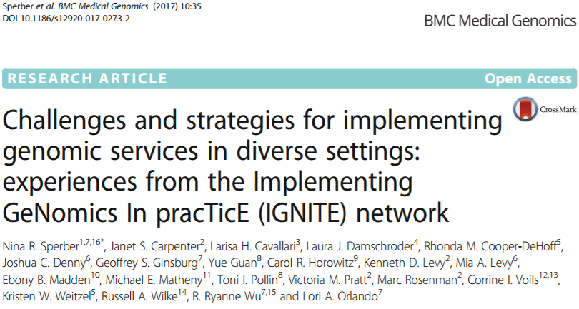
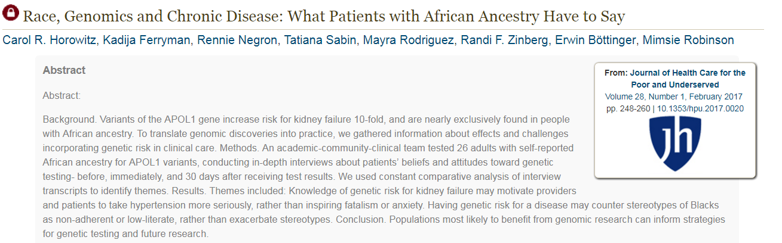
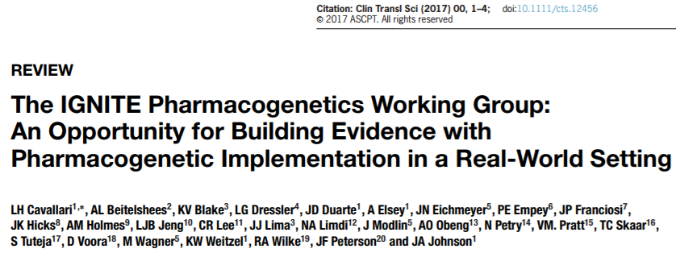
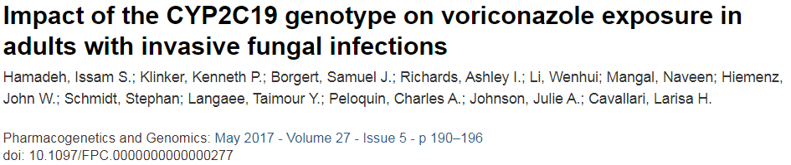

Implementing Genomics In Practice (IGNITE) Network
Current Procedural Technology Coding Change
AMA CPT Editorial Panel
CCP application
CMS
APPROVED
Clinical Lab Fee Schedule
Physician Fee Schedule
NOT APPROVED
Comparable test exists
CMS Relative Value Scale
IGNITE RFAs released: RFA HG-17-008, -009, -010
YES
NO
Receipt date: November 3, 2017
Gapfill
Crosswalk
Document 30
Notes:
The Implementing Genomics in Practice (or IGNITE) Network works to enhance the use of genomic medicine by supporting the development of methods for incorporating genomic information into clinical care. * To date, IGNITE research has led to the publication of more than 100 papers, a small subset of which are shown here.
* Looking towards the future, the Requests for Applications (or RFAs) for the next phase of IGNITE (reflecting the concept approved by this Council in May) have now been released. * Applications for all three RFAs are due on November 3, 2017.

Slide 47

Computational Genomics and
Data Science Program
  NHGRI Genomic Data Science Analysis, Visualization, and Informatics Lab-space (AnVIL)
  RFA-HG-17-011 release: July 17, 2017
  Application due date: November 9, 2017
Document 31
Notes:
In February, the Computational Genomics and Data Science Program brought a concept to this Council to establish an NHGRI genomic data commons. This concept has now been developed into a Request for Applications for the NHGRI Genomic Data Science Analysis, Visualization, and Informatics Lab-space (or AnVIL).
NHGRI plans to establish the AnVIL as a resource to democratize genomic data access, sharing, and computing. The resource will leverage scalable cloud-based infrastructure to co-locate data storage and computing capacity with commonly used tools for analyzing and sharing genomic data. It is also expected to provide access to unrestricted and controlled-access data and metadata from NHGRI- funded programs.
* The Request for Applications was released this past July, and the applications are due on November 9, 2017.

Slide 48
Ethical, Legal, and Social Implications (ELSI) Research Program
  Genomics and Society Working Group annual meeting
  ELSI Program Announcements:
    Genomic Research, Genomic Healthcare, and Broader Legal, Policy, and Societal Issues
    Participating Institutes and Centers: FIC, NCI, NIA, NIAID, NICHD, NIDCD, NIEHS, NIMHD, NINDS
  Centers of Excellence in ELSI Research (CEER) RFA:
    Letter of Intent Due: September 30, 2017
    Application Due Date: October 31, 2017
Document 32
Notes:
The Ethical, Legal, and Social Implications (or ELSI) Research Program supports research on the implications of genomics for individuals, families, and communities. * The Genomics and Society Working Group of this Council provides guidance to the Institute about the ELSI Research Program. At their recent in-person meeting, this Working Group heard updates from a number of NHGRI divisions before brainstorming ideas for the future directions of ELSI research.
* This summer, the ELSI Research Program re-issued its three core Program Announcements covering investigator-initiated research. These program announcements invite applications for ELSI research in three cross-cutting domain areas: genomic research, genomic healthcare, and broader legal, policy, and societal issues. * Nine other NIH institutes and centers (listed here) have agreed to participate in at least one of the announcements and have provided information on their specific interests.
* Meanwhile, the Program also released a Request for Applications (or RFAs) for Centers of Excellence in ELSI Research (or CEERs). This RFA is seeking applications to support the establishment of sustainable trans-disciplinary research centers. Information about existing centers in the CEER program is available on the NHGRI website.* Letters of Intent are due on September 30, 2017, and * applications are due on October 31, 2017.

Slide 49
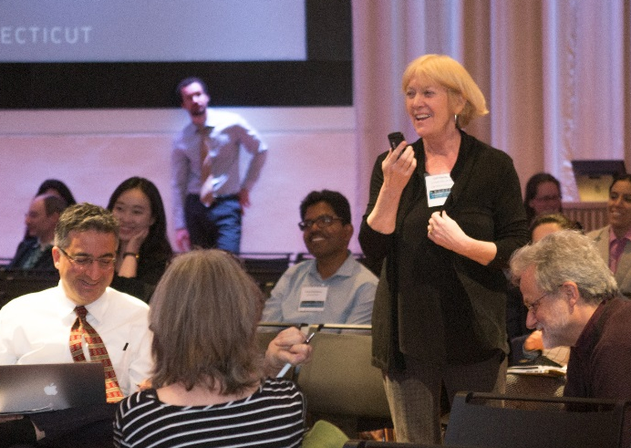

4th ELSI Congress
Expanding the ELSI Universe #ELSICon
  June 2017
  Jackson Laboratory, CT
  300+ attendees
  Videos of plenary presentations available on ELSICon website
Document 32
Notes:
The ELSI Research Program recently co-sponsored the 4th ELSI Congress, which was held in June at the Jackson Laboratory in Farmington, Connecticut. This was the first such meeting to be held since the 2011 ELSI Congress at the University of North Carolina.
* Over 300 people attended the conference, which drew people from across the U.S. and a number of other countries. Keynote speakers included Stephanie Devaney (from NIH All of Us Research Program), Alondra Nelson, (from Columbia University), and former Council members Wylie Burke, James Evans, and Pearl O’Rourke. Their talks covered a variety of ELSI topics, including issues of precision medicine, ancestry, and identity, and the use of genome sequencing for clinical care.
* Videos of the plenary presentations and abstracts from concurrent sessions are available on the ELSI congress website.

Slide 50


Training and Career Development
    2017 Meeting in St. Louis
    2018 Meeting: March 18-20 in Los Angeles
Document 33
Notes:
NHGRI has a long-term commitment to preparing the next generation of genomic scientists and scholars, and continues to enhance our investment in research training and career development programs.
In April, the NHGRI Research Training and Career Development Program held its 2nd annual meeting in St. Louis, Missouri. The meeting once again provided a venue for all trainees supported by NHGRI programs to present their research and to form collaborations with other trainees and established investigators. Pictured on the left are the meeting attendees. Of the 244 attendees, 179 were trainees; these trainees are associated with the Diversity Action Plan (or DAP) programs, the T32 training programs, the Centers of Excellence in ELSI Research program, the NHGRI Intramural Research Program, and individual fellowship and career-development awards. Pictured on the right are the poster award winners, which included trainees from the undergraduate, post-baccalaureate, graduate, and post-graduate career levels.
* The next annual meeting will be held on March 18-20, 2018 in Los Angeles.

Slide 51


Training and Career Development
    Three new T32 programs:
        Duke University (PI: Geoffrey Ginsburg)
        Genomic Medicine
        U. of Pennsylvania (PI: Katherine Nathanson)
        Genomic Medicine
        U. of Pennsylvania (PI: Steven Joffe)
        ELSI Research
Document 33
Notes:
NHGRI’s training programs continue to grow and evolve. Three new institutional training programs in genomic medicine and ELSI research were awarded this summer. We refer to these awards as “T32’s” based on the grant mechanism used. These new programs will complement the 15 currently funded NHGRI T32 programs.
* Geoffrey Ginsburg at Duke University and Katherine Nathanson at the University of Pennsylvania will lead two new T32 programs in genomic medicine. These programs will train both M.D.’s and Ph.D.’s, and will incorporate a mix of coursework, clinical laboratory rotations, and mentoring that will teach practical skills for disease-gene discovery, patient genome-sequence interpretation, and big data management in research and clinical settings.
* Steven Joffe at the University of Pennsylvania will lead a new T32 program in ELSI research. This postdoctoral program will combine mentored original research and targeted coursework that will lead to a Master of Science in Medical Ethics (or MSME) degree. You will note that we have funded two new T32 programs at the University of Pennsylvania. The training goals of these two programs are distinct, but they will capitalize on synergies to strengthen cross-disciplinary mentoring, improve recruitment and oversight, and foster interactions and collaboration among the trainee groups.

Slide 52
Director’s Report Outline
General NHGRI Updates
General NIH Updates
General Genomics Updates
NHGRI Extramural Research Program
NIH Common Fund/Trans-NIH
NHGRI Division of Policy, Communications, and Education
NHGRI Intramural Research Program

Slide 53


Knockout Mouse Phenotyping Project (KOMP2)
    Annual IMPC Meeting – Athens, November 2017
    Sexual dimorphism paper published in Nature Communications
    Human disease models paper published in Nature Genetics
    Deafness paper in press in Nature
Document
Document 34
Notes:
The NIH Common Fund’s Knockout Mouse Phenotyping Project (or KOMP2) will create and phenotype 3,000 strains of knockout mice using CRISPR technology between 2016 and 2020. The project is on track to meet its Fall 2017 goals. This program is part of the larger International Mouse Phenotyping Consortium (or IMPC). * This year’s annual IMPC meeting with the Panel of Scientific Consultants will be held in Athens, Greece in mid-November.
* A KOMP paper describing the prevalence of sexual dimorphism in mammalian phenotypic traits was published earlier this year in Nature Communications, and * another KOMP paper describing 360 new disease models and providing the first functional annotation of 1,092 genes was published earlier this year in Nature Genetics. * Finally, a manuscript demonstrating the large and unexplored genetic landscape involved in deafness (including the identification of 52 null alleles in genes not previously associated with hearing loss) is in press in Nature.

Slide 54



Human Heredity and Health in Africa (H3Africa)
  Last Consortium meeting for Stage I in May 2017 Guest speaker: Eric Green, NHGRI Director
  Awards for Stage II anticipated soon
  First Consortium meeting for Stage II in March 2018
Document 35
Notes:
The Human Heredity and Health in Africa (or H3Africa) project’s central goal is to develop a sustainable and collaborative African genetics and genomics research enterprise. * This past May, H3Africa held its last Consortium meeting for Stage I in Gaborone, Botswana; this meeting featured the progress from the first five years of the program and charted a course for its future. I was fortunate to be a guest speaker at this meeting, and found that the gathering nicely showcased the remarkable accomplishments of the H3Africa Consortium to date.
* We anticipate issuing awards for Stage II of H3Africa before the end of this month, and * then welcoming new and returning grantees to the first Consortium meeting for Stage II in March 2018.
Additionally, this coming November, the African Society for Human Genetics will be hosting its 10th annual meeting in Cairo, in partnership with H3Africa and the Egyptian National Society of Human Genetics. A number of current and former H3Africa grantees will be presenting, and it will be an opportunity to expand the human genetics outreach of H3Africa on the African continent. Lastly, we are proud to announce that the H3Africa Consortium recently surpassed the 100-publications mark.

Slide 55



Undiagnosed Diseases Network (UDN)
UDN Applications and Acceptances
1,606 applications,
~71 per month
639 acceptances, ~28 per month
~50% Accepted
~25% Diagnosed
93 Diagnoses
Document 36
Notes:
The NIH Common Fund’s Undiagnosed Diseases Network (or UDN) aims to improve the level of diagnosis and care for patients with undiagnosed diseases, facilitate research into the etiology of these diseases, and create an integrated and collaborative research community to identify and share improved options for optimal patient management.
To date, the UDN has received over * 1,600 applications (about 71 per month), accepted * 639 participants for evaluation at the seven UDN Clinical Sites across the nation (about 28 per month), and made * 93 diagnoses. Also shown here are the accepted and diagnosed percentages for the program to date. To apply to the UDN, access the UDN Gateway by * clicking on the “Apply” button, which appears on all the UDN webpages.

Slide 56

Undiagnosed Diseases Network (UDN)
Phase II FOAs
Clinical Sites: 8-10, RFA-RM-17-019
Coordinating Center: 1, RFA-RM-17-018
Model Organisms Screening Center(s): 1-2, RFA-RM-17-017
Sequencing Core(s): 1-2, RFA-RM-17-016
Metabolomics Core(s): 1-2, RFA-RM-17-015
All Applications Due November 2, 2017
Document 36
Notes:
Recently, five new Funding Opportunity Announcements (or FOAs) for Phase II of the UDN were announced. This includes FOAs for an anticipated 8-10 clinical sites, 1 coordinating center, and 3-6 UDN core laboratories (including 1-2 model organisms screening centers, sequencing cores, and metabolomics cores).
In Phase II of the program, the UDN will continue accepting participants with unsolved medical conditions as well as study the components required for network sustainability once Common Fund support ends. * All applications are due on November 2, 2017.

Slide 57

Gabriella Miller Kids First Pediatric Research Program
23 cohorts (>18,000 samples) available
Genome sequencing:
    BCM & WashU ($12.6M, 2015)
      Broad Institute & HudsonAlpha/St. Jude ($31M, 2016-2019)
      ~9,000 samples sequenced to date
Data resource center:
CHOP ($15M, 2017-2022)
Data analysis
Document 37
Notes:
The Gabriella Miller Kids First Pediatric Research Program (or Kids First) is a 10-year NIH Common Fund program initiated in 2015 with a $12.6 million annual budget. Kids First aims to develop a data resource for the pediatric research community with well-curated phenotypic and genomic variant data that will facilitate identification of genetic pathways underlying childhood cancer and structural birth defects.
* To date, 23 cohorts associated with over 18,000 DNA samples from patients with pediatric cancer and structural birth defects have been obtained using the X01 mechanism. * Genome sequencing of these samples was jumpstarted in 2015 at the NHGRI-funded sequencing centers at the Baylor College of Medicine and Washington University with a $12.6M supplement. In September 2016, designated Kids First sequencing centers were funded: one at the Broad Institute and the other as a collaboration between the HudsonAlpha Institute for Biotechnology and St. Jude Children’s Research Hospital. These designated centers will receive $31M from 2016-2019. To date, genome sequencing has been performed with about 9,000 of the available samples. * In June of this year, the Children's Hospital of Philadelphia was selected as the data resource center, and will be provided $15M of funds from 2017-2022; it will serve as the data resource portal, data coordinating center, and administrative coordinating center. * Finally, several NIH institutes started soliciting small research grants last year to support the analyses of Kids First data that will be submitted to the data resource center; the initial set of such awards were made earlier this year.

Slide 58




NIH Data Commons Pilot Phase
Other Transactions (OT) Research Opportunity Announcement
(RM-17-026)
TOPMed
    Data Commons Pilot Phase Consortium
    Datasets: GTEx, TOPMed, AGR
    Stage 1: Develop prototypes & implementation plan
      Kickoff meeting: Fall 2017 (Bethesda)
    Stage 2: Full implementation
Document 38
Notes:
The recently conceived NIH Data Commons is a comprehensive vision for an interoperable, multi-cloud platform for storing, sharing, accessing, and computing biomedical data. All aspects of the Data Commons aim to facilitate making biomedical research data FAIR (that is, Findable, Accessible, Interoperable, and Reusable). * Awards will be made under an Other Transactions (or OT) Research Opportunity Announcement to support the establishment of the NIH Data Commons Pilot Phase Consortium.
* The NIH Data Commons will initially be populated with datasets from the Common Fund Genotype-Tissue Expression (or GTEx) project, the NHLBI-funded Trans-Omics for Precision Medicine (or TOPMed) Program, and the newly-formed, NHGRI-funded Alliance for Genome Resources [or AGR; also known as the Model Organism Databases (or MODs) Consortium]. The entire NIH Data Commons Pilot Phase is expected to last four years and encompass two stages.
* Stage 1 will last six months, during which consortium investigators will develop working prototypes as proofs of concept for the architecture of the Data Commons, and also develop an implementation plan. * This stage will kickoff with a meeting of the initial consortium in Bethesda sometime this Fall.
* Stage 2 will involve having the funded investigators fully implement the successful pilot activities.

Slide 59









All of Us Research Program
Document 39
Notes:
The NIH All of Us Research Program aims to gather data from one million or more people living in the United States to accelerate research and improve health. By taking into account individual differences in lifestyle, environment, and biology, researchers will uncover paths toward delivering precision medicine.
Key All of Us activities in the past few months have included: * starting enrollment of participants as beta testers of the program; * finalizing and posting the initial institutional review board-approved research protocol; and * funding four community partners (FiftyForward, the National Alliance for Hispanic Health, Delta Research and Educational Foundation, and The San Francisco General Hospital Foundation). These awardees will raise awareness about All of Us among seniors, Hispanics and Latinos, African Americans, and the LGBTQ community.
All of Us has also: * established a Trans-NIH Liaisons Coordinating Team to provide input on scientific opportunities, and to share information with all the NIH Institutes and Centers (note that Carolyn Hutter is the NHGRI representative to this group and also serves as its co-chair); and * initiated the Child Enrollment Scientific Vision Working Group of its Advisory Panel, which is detailing the kinds of research projects that would be enabled by having children of diverse backgrounds included in the All of Us Research Program.

Slide 60

All of Us Research Program
Document 39
Notes:
Finally (and of particular interest to this Council), All of Us has established a Genomics Working Group of its Advisory Panel. This Working Group is co-chaired by Debbie Nickerson and former Council member Lon Cardon, and is charged with the important task of guiding the development of an All of Us comprehensive genomics strategy. I am a member of this Working Group, as are Council members Jay Shendure and Wendy Chung. Deliberations by this Working Group only began this past summer, but I anticipate being able to report to Council in February more details about the initial genomics plan for the All of Us Research Program.

Slide 61
Director’s Report Outline
General NHGRI Updates
General NIH Updates
General Genomics Updates
NHGRI Extramural Research Program
NIH Common Fund/Trans-NIH
NHGRI Division of Policy, Communications, and Education
NHGRI Intramural Research Program

Slide 62

ASHG-NHGRI Genetics and
Public Policy Fellow
Nikki Meadows, Ph.D.
Notes:
NHGRI’s Division of Policy, Communications, and Education partners with the American Society of Human Genetics (or ASHG) to sponsor the Genetics and Public Policy Fellowship each year. This program provides the selected fellow with an opportunity to work in the Executive Branch with NHGRI’s Policy and Program Analysis Branch, at ASHG, and in Congress, thereby providing robust exposure to policy development from each vantage point.
This year’s fellow is Nikki Meadows. Dr. Meadows earned her Ph.D. in human genetics from McGill University. While at McGill, she studied how genetic and nutritional perturbations in folate metabolism altered the outcome of malarial infection. Nikki just recently arrived at NHGRI, and we look forward to working with her during her fellowship.

Slide 63


New Web Resources for
Investigators and General Public
    For Investigators: Points to Consider Regarding the FDA’s Investigational Device Exemption Regulations
    For General Public: Genome Editing
Document 40
Notes:
The NHGRI Policy and Program Analysis Branch published two new web resources for stakeholders on our web site (genome.gov) this summer. * The “Points to Consider Regarding the FDA’s Investigational Device Exemption Regulations” site is an updated version of a resource that NHGRI provided in the past to help investigators understand the requirements of the Investigational Device Exemption (or IDE) regulation. As this Council has previously discussed, the IDE regulation applies to some clinical genomics research involving the use of genomic tests that are not FDA-approved or FDA-cleared. This new resource is based on a workshop that we held last year, and is intended to provide greater clarity for genomics researchers who are facing this regulation for the first time.
* Additionally, to meet the spike in interest in genome-editing technologies, we created a new web resource for the general public that describes the technical aspects of various technologies as well as the ethical and social issues surrounding their use. The goal of this resource is to introduce this topic to students and lifelong learners in a fashion that gives appropriate attention to the state of the science and the basic research applications of genome editing, rather than just focusing on technologies’ clinical potential.

Slide 64

Genomics Imagery on Flickr
Document 41
Notes:
In June, NHGRI’s Communications and Public Liaison Branch launched a publicly available image gallery on the website Flickr. This NHGRI image gallery provides free access to a curated selection of high-quality scientific illustrations, infographics, and photographs. Such a convenient site now enables the public to freely use NHGRI’s genomics graphics and imagery in work presentations, school projects, news reports, and so forth. The gallery currently contains 123 elements that have been viewed over 145,000 times since the launch, with plans to regularly add elements and to grow the available collection.

Slide 65



NHGRI History of Genomics Program
Database users meeting
NHGRI History of Molecular Biology and Genomics Lecture Series
Document 42
Notes:
The NHGRI History of Genomics Program * recently held a database users meetings, at which a number of top scholars from both the United States and abroad provided feedback on the current state of our growing genomics history resource. The meeting also provided the opportunity for participants to discuss how various upcoming coordinated publications could leverage the NHGRI archive.
* In addition, the Program continues to bring history scholars to NHGRI to make presentations as part of a History of Molecular Biology and Genomics Lecture Series. Since the last Council meeting, two such history scholars have visited, one giving a talk about the reconceptualization of 20th century biology as the century of the genome (rather than just the gene) and another giving a talk about the history of genetic linkage analysis.

Slide 66

Genome: Unlocking Life’s Code Exhibition
Travel Schedule
2017
  June 12-September 11
  Health Museum
  Houston, TX
  September 30-January 1
  Science North
  Sudbury, Ontario, Canada
  2018
  January 28-April 24
  Rochester Museum and Science Center
  Rochester, NY
Document 43
Notes:
The NHGRI-Smithsonian Genome: Unlocking Life’s Code exhibition concludes its stay in Houston today, and will make its international debut in Canada at the end of September. In fact, I will be traveling to Sudbury, Ontario in early October to participate in a public symposium associated with the exhibition’s opening. In early 2018, the exhibition will return to the United States, with a stop in New York at the Rochester Museum and Science Center.
Please continue to check the exhibition’s website and follow it on social media for the most up-to-date program information.

Slide 67

NHGRI-Youth Career Connect
High School Summer Program
Notes:
For the second year in a row, NHGRI’s Education and Community Involvement Branch hosted a two-week summer program for ten high school students in collaboration with Prince George’s County Economic Development Corporation’s Youth Career Connect Program. Prince George’s County is implementing programming designed to support college readiness and workplace-skills development for secondary students.
The summer program included lectures from NHGRI experts on a variety of current topics in genomics and featured hands-on activities. Following two weeks at NIH, the students spent two additional weeks at Prince George’s Community College to continue their studies. Based on the topics they learned about, students prepared group presentations on topics of their choosing, including cystic fibrosis, HeLa cells, asthma, and progeria.

Slide 68



The Immortal Henrietta Lacks
Educator Workshop and Curriculum
Notes:
In June, NHGRI and the Smithsonian’s National Museum of African American History and Culture held an educator workshop on Henrietta Lacks and the HeLa cell line for middle school and high school history, social studies, and science teachers. The event took place at the museum, and educators had the opportunity to hear lectures about the era of segregation during the life of Henrietta Lacks, the history of race and American medicine, HeLa cells and DNA (and the ‘secrets’ within), and current U.S. health disparities. Participants also had the opportunity to converse with Jeri Lacks, the granddaughter of Henrietta Lacks, and Shirley Lacks, the daughter-in-law of Henrietta Lacks.
The workshop served as the kickoff event for the development of resources for history and science teachers on Henrietta Lacks and HeLa cells. Four high school teachers (two history and two science teachers) are working with NHGRI and the museum to develop a set of lesson plans, which are slated for debut in April 2018 – just in time for DNA Day 2018.

Slide 69


NHGRI Short Course in Genomics
Middle/High School, Community College, and
Tribal College Educators
Document 44
Notes:
In late July spilling over into early August, NHGRI’s Education and Community Involvement Branch held its annual Short Course in Genomics for middle school, high school, community college, and tribal college educators. This year, 25 teachers came to NIH from across the United States to listen to lectures and to receive teaching resources.
NHGRI and NIH researchers, clinicians, and staff taught at the course, providing approaches and resources to incorporate genomics content into the teachers’ classrooms. The course also included tours of the NIH Intramural Sequencing Center and the National Library of Medicine. Over the course of four days, the teachers furthered their professional development in the areas of complex genetic diseases, CRISPR/Cas9, bioinformatics, the human microbiome, and ELSI research, among other topics. This annual course provides a unique opportunity for NHGRI investigators to work with teachers to bring the latest genomics advances and techniques into secondary, community college, and tribal college classrooms.

Slide 70


NHGRI Short Course in Genomics
Nurse, Physician Assistant, and Faculty
Document 44
Notes:
In August, NHGRI’s Genomic Healthcare Branch held its 2017 Short Course in Genomics for Nurses, Physician Assistants, and Faculty to enhance their knowledge of genomics and to provide ways to integrate genomics into clinical practice and curriculum. This year, 50 participants from as close as Bethesda to as far away as South Africa attended the course. Featured speakers included NIH experts discussing genetic counseling, ethical and legal issues of genomic medicine, equity in treatment and health disparities, pharmacogenomics, and the integration of genomics into the NIH Clinical Center. In addition, nationally recognized champions in genomics education provided lectures and one-on-one consultations, discussing best practices for incorporating genomics into coursework as well as clinical practice.
An “Alumni Healthcare Genomics Education ListServ” for participants has been established to create a network of inter-disciplinary healthcare professionals who will continue to share best practices and resources.

Slide 71

Inter-Society Coordinating Committee for Practitioner Education (ISCC)
Document 45
Notes:
The Inter-Society Coordinating Committee for Practitioner Education in Genomics (or ISCC) aims to improve practitioner genomic literacy and to enhance the practice of genomic medicine through sharing of educational approaches and identification of educational needs.
The ISCC is overseen by an external co-chair and an NHGRI co-chair. Richard Haspel is the new external co-chair. Rich is the Director of Medical Education in the Department of Pathology at Beth Israel Deaconess Medical Center and an Associate Professor of Pathology at Harvard Medical School. With the departure of Bob Wildin from NHGRI, Teri Manolio has taken on the role as the NHGRI co-chair.
Coincidentally, Rich and Teri had already been co-chairing ISCC’s Innovative Approaches Working Group, whose charge is to develop novel ways to teach genomics, building on the highly successful 'Training Residents in Genomics (or TRIG) approach developed through the American Society of Clinical Pathologists. This Working Group just developed and released a new education resource, called The Universal Module Workshop Instructor’s Handbook and Toolkit. The toolkit is now available and is intended serve as a resource with global reach to improve physician genomics education.

Slide 72

Method for Introducing a New Competency: Genomics (MINC)
Document 46
Notes:
The NHGRI Genomic Healthcare Branch recently established a new website to capture the experiences gained through a grant program implemented a few years ago. The Method for Introducing a New Competency: Genomics project, otherwise known as MINC, integrates genomics into clinical practice through Magnet® Hospital sites and through this website. In addition, administrators and educators offer their experiences to the nursing and broader practitioner community through videos, resources, and downloadable documents. The resources and shared experiences are designed to prepare practicing nurses to be competent in caring for patients undergoing genetic and genomic testing and treatments. This site launched in mid-July, and we are eagerly seeking feedback.

Slide 73
Director’s Report Outline
General NHGRI Updates
General NIH Updates
General Genomics Updates
NHGRI Extramural Research Program
NIH Common Fund/Trans-NIH
NHGRI Division of Policy, Communications, and Education
NHGRI Intramural Research Program

Slide 74


2017 Rare Impact Award,
National Organization for Rare Disorders
Cynthia Tifft, M.D., Ph.D.
Document 47
Notes:
Cynthia Tifft, NHGRI’s Deputy Clinical Director, recently received the 2017 Rare Impact Award from the National Organization for Rare Disorders (or NORD). Cyndi received this honor for her work to solve some of the nation’s toughest medical mysteries. As the Director of the pediatric component of the NIH Undiagnosed Diseases Program, she and her team strive to meet the unmet needs of children with disorders that have not yet been diagnosed. Congratulations to Cyndi for this honor.

Slide 75


New President-Elect,
American Society of Human Genetics
Les Biesecker, M.D.
Document 48
Notes:
Les Biesecker, Senior Investigator and Chief of the Medical Genomics and Metabolic Genetics Branch in the NHGRI Intramural Research Program, was recently elected as the 2019 President of the American Society of Human Genetics. Les will serve as ASHG’s President following the terms of Nancy Cox (in 2017) and then David Nelson (in 2018). Congratulations to Les for this honor.

Slide 76






NHGRI Intramural Research Highlights
Social influence on 5-year survival in a longitudinal chemotherapy ward co-presence network
A defect in myoblast fusion underlies Carey-Fineman-Ziter syndrome
Staphylococcus aureus and Staphylococcus epidermidis strain diversity underlying pediatric atopic dermatitis
Document 49
Notes:
Investigators in NHGRI’s Intramural Research Program have again been quite productive since the last Council meeting.
* Chris Marcum in Laura Koehly’s group and colleagues discovered that social influence in cancer patients undergoing chemotherapy can make a difference in their long-term survival. Their study suggested that cancer patients were more likely to survive for five years or longer after chemotherapy if they interacted with other patients during chemotherapy who also survived for five years or longer.
* Francis Collins, Irini Manoli, and colleagues identified genomic mutations responsible for Carey-Fineman-Ziter syndrome. The researchers found that that this syndrome is caused by mutations in the gene MYMK, which encodes the protein myomaker. This discovery will improve physicians' ability to diagnose this disease and offer families accurate genetic counseling and treatment options.
And finally, * Julie Segre and colleagues published a paper reporting the microbial strain diversity underlying childhood atopic dermatitis. Using metagenomic sequencing approaches, the researchers pinpointed the presence of unique strains of Staphylococcus aureus in patients with severe eczema. These results suggest that not all Staphylococcus can be considered equal when it comes to the pathogenesis of eczema.

Slide 77

To receive The Genomics Landscape,
go to list.nih.gov
Search for NHGRILANDSCAPE
Past issues can be accessed at: genome.gov/27541196
Document 50
Notes:
Before ending my Director’s Report, I would like to (as always) put in a plug and say that anyone wishing to receive my monthly email update (called The Genomics Landscape) can simply go to list.nih.gov and then search for “NHGRILANDSCAPE.”

Slide 78






Thanks!
Special Thanks!
Notes:
Finally, a personal thanks to the 50-60 NHGRI staff members who contributed the slides and associated materials that I just reviewed as part of my Director’s Report. As always, such a group effort is essential for getting this large amount of information conveyed efficiently at each Council meeting.
An additional thanks to the NHGRI communications group and web team for making my Director’s Report into an electronic resource.
And * a special thanks to the usual ‘ring leader’ for preparing my Director’s Report each time, Kris Wetterstrand. Shown here is Kris amongst a group of enthusiastic eclipse watchers at the top of a parking garage on the NIH campus. * Parking garages were eclipse-watching ‘hot spots’ for NHGRI staff, as illustrated by this additional photo from here atop the Twinbrook parking garage.

Slide 79

s
Advancing human health
through genomics research

