Slide 1
Gene-Environment Interactions
David Hunter
Nuffield Department of Population Health
University of Oxford
Harvard TH Chan School of Public Health
Channing Laboratory, Brigham and Women’s
Hospital
Broad Institute of MIT and Harvard

Slide 2
Differences in rates of most diseases between countries (and over time within countries) are due to differences in environmental and “lifestyle” risk factors – not genetic differences

Slide 3
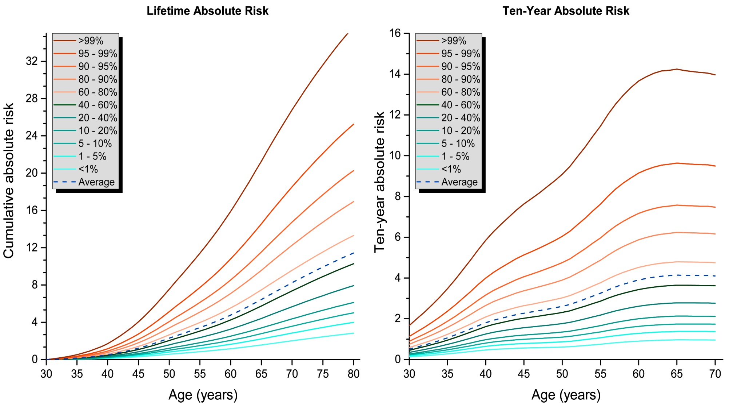
Post-GWAS Polygenic Risk Scores are predictive – Breast Cancer
Maas, Chatterjee et al. JAMA Oncol 2016

Slide 4
Differences in individual risk of most diseases within countries are due to differences in both genetic and environmental and “lifestyle” risk factors.
We need to measure both.
How do they “interact”?

Slide 5
RATIONALES FOR STUDY OF
Gene-Environment INTERACTION
Explain more of the variance in disease risk
Define susceptible sub-population in order to strengthen environmental association
Provide individualized prevention
advice

Slide 6
PHARMACOGENETICS
the study or clinical testing of genetic variation that gives rise to differing response to drugs
minimal exposure misclassification
obvious practical utility

Slide 7
Lauschke et al.
The AAPS Journal 2018

Slide 8
Lauschke et al.
The AAPS Journal 2018

Slide 9
“Interaction of nature and nurture”
Haldane JS, 1938

Slide 10
Multiple Comparisons Problem?
Multiple (genes and genetic models),
Multiple environment (risk factors, risk factor definitions),
Multiple models of interaction
Comparisons Problem
Solution: Multiple, large studies
Criteria: Strength of association
Biologic Plausibility
Consistency of findings

Slide 11
Gene-Environment Interaction
Relative Risk
1.0(ref)
Exposure
Genotype

Slide 12
Gene-Environment Interaction
Relative Risk
1.0(ref)
Exposure
Genotype

Slide 13
Gene-Environment Interaction
Relative Risk
1.0(ref)
Exposure
Genotype

Slide 14
How common are env-env interactions?
Smoking/alcohol in esophageal cancer
BMI/menopausal status in breast cancer
PMH/BMI in breast cancer
Aflatoxin/HBV in liver cancer
Radiation/young age in breast cancer
Radiation/smoking in lung cancer
Skin type/UV and skin cancer
Interactions that depart from the multiplicative model are the exception not the rule

Slide 15
Despite interest in GxE, there are few agreed-upon successes where the effect of exposure differs across genotypes (and vice versa).
McAllister et al.

Slide 16
Despite interest in GxE, there are few agreed-upon successes where the effect of exposure differs across genotypes (and vice versa).
McAllister et al.
Why so few supra- or sub-multiplicative interactions?
Poor measurement of genes?
Low power of studies
Poor measurement of environment?
There aren’t many to find?

Slide 17
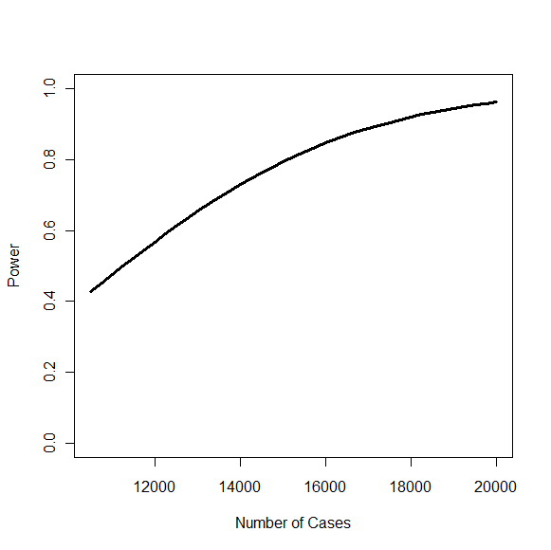
OR_{G} = 1.00
OR_{E} = 1.50
Pr(E) = 0.33
α = 10⁻⁷
OR_{GE} = 1.35
Sample sizes needed are large

Slide 18
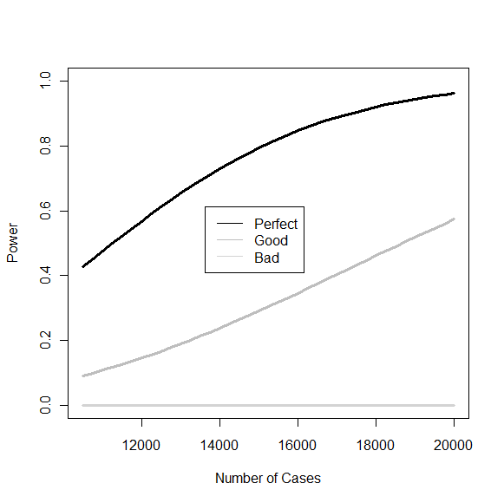
“Good”
Sensitivity=77%
Specificity=99%
“Bad”
Sensitivity=30%
Specificity=50%
Misclassification of exposure degrades power
Lindstrom et al. (2009)

Slide 19
Risk of alcoholic liver cirrhosis
Danish Cancer, Diet and Health cohort
Adj. smoking, education, waist circumference
Askgaard et al. J Hepatol. 2015

Slide 20
BMI
Vs Mortality
Global BMI
Mortality
Collaboration
Lancet 2016

Slide 21
BMI
Vs Mortality
Global BMI
Mortality
Collaboration
Lancet 2016

Slide 22

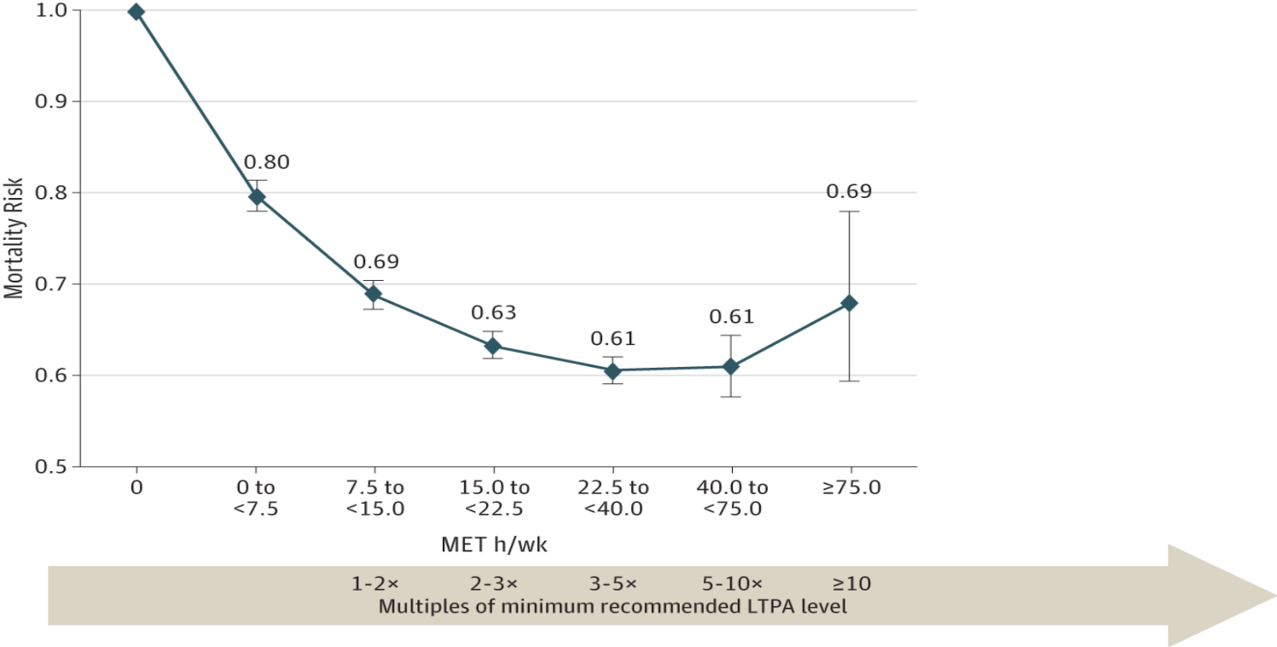
From: Leisure Time Physical Activity and MortalityA Detailed Pooled Analysis of the Dose-Response Relationship
JAMA Intern Med. 2015;175(6):959-967. doi:10.1001/jamainternmed.2015.0533
Hazard Ratios (HRs) and 95% CIs for Self-reported Leisure Time Moderate- to Vigorous-Intensity Physical Activity and Mortality
Date of download: 3/15/2018
Copyright © 2015 American Medical Association. All rights reserved.

Slide 23
Triaxial accelerometer-measured PA vs Mortality in the WHI
0.73
0.56
Tertile of Accelerometer PA
Womens’ Health Initiative, n=6,382, 450 deaths. LaMonte et el. J Am Geriatr Soc. 2017

Slide 24
MODELLING GENE-ENVIRONMENT INTERACTIONS
DO CLASSIC BREAST CANCER RISK FACTORS SYNERGIZE WITH GWAS SNPS?
16,285 BC cases and 19,376 controls
39 GWAS-assoc SNPS x 8 “Env” Risk Factors
AAM
Parity
AAMeno
Height
BMI
FH
Smoking
Alcohol
“After correction for multiple testing, no significant [multiplicative] interaction
between SNPs and established risk factors...was found.”
Campa et al, JNCI 2011, Barrdahl et al, BPC3, HMG 2014

Slide 25
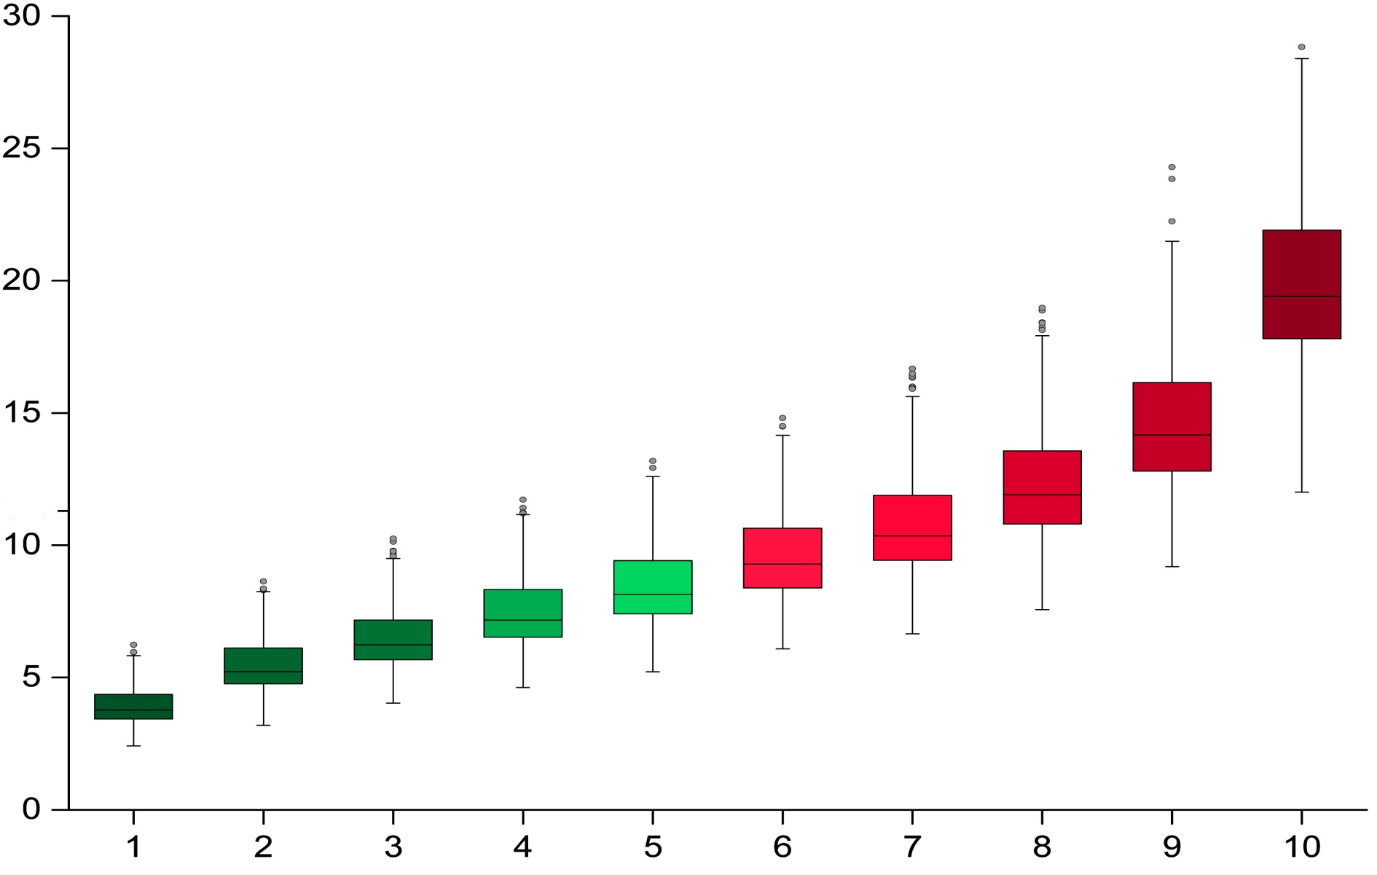
RISK OF BREAST CANCER “ENV” by PRS
Risk Factors high
Absolute Risk (%)
Risk Factors low
Decile of Non-Modifiable (PRS) Risk
Maas, Chatterjee et al. JAMA Oncol, 2016

Slide 26
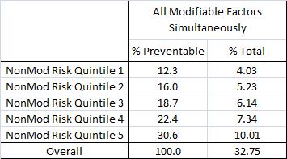
MORE BREAST CANCERS COULD BE PREVENTED IN HIGH RISK STRATA
Percentage preventable breast cancers by removal of modifiable risk-factors (overall and in categories of non-modifiable
risk quintiles)
Maas, Chatterjee et al. JAMA Oncol, 2016
Notes:
http://publications.nice.org.uk/familial-breast-cancer-cg164/terms-used-in-this-guideline
Estimated risks only account for differences in G, not E—would expect even more discrimination when including E. Our focus was on G:
Polygenic models used in disease risk prediction have generally assumed
multiplicative joint effects of SNPs on the absolute risk scale. We find that a
multiplicative model for the joint effects of multiple risk SNPs is substantially better than
an additive model. This provides some support for the use of a multiplicative model
based on individual-SNP marginal ORs, as has been suggested in the context of risk
screening and implemented by several consumer genetics companies (24, 50-53).

Slide 27
PRS, Lifestyle and CHD
Khera et al. NEJM 2016

Slide 28
With some exceptions (e.g. drug idiosyncracies) genetic and environmental and “lifestyle” risk factors are independent and the risks multiply.

Slide 29
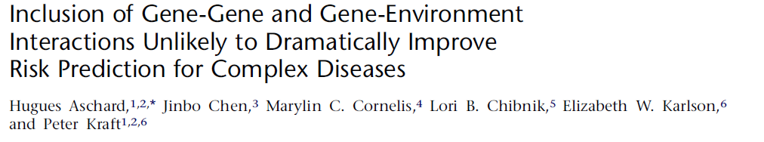

Slide 30
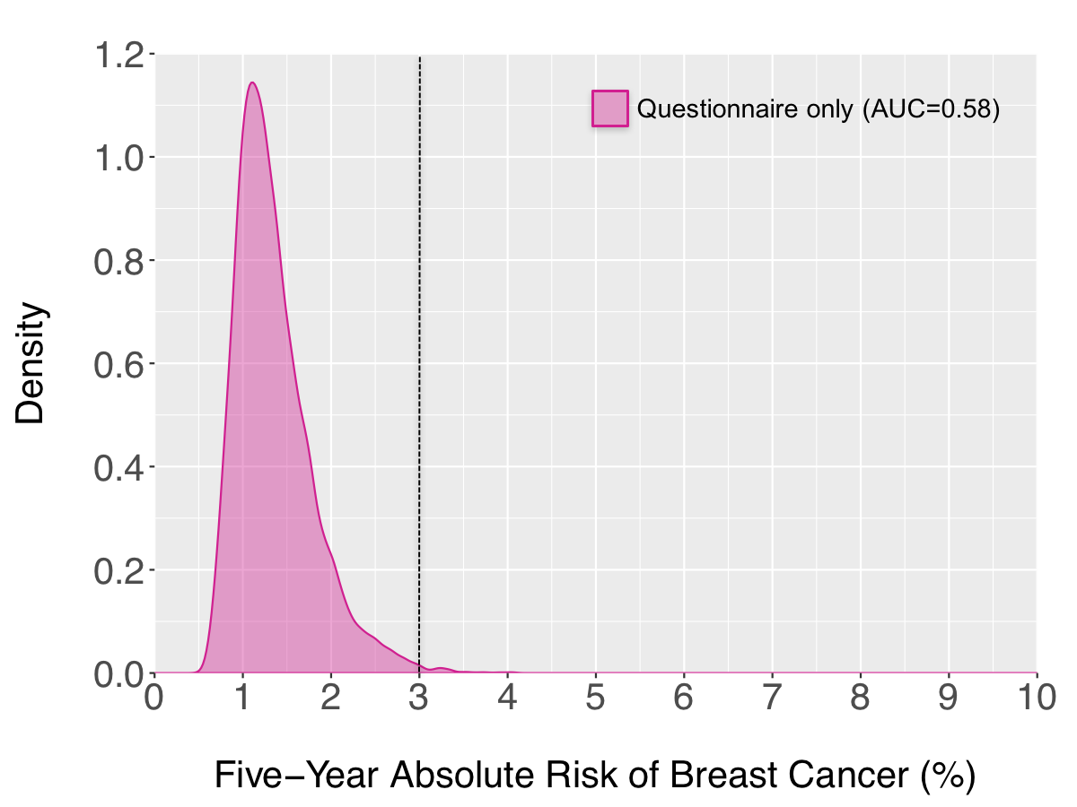
Five-year absolute risk projection for US Caucasian women aged 50
“Women with an estimated 5-year risk of 3% or greater are, on the basis of model estimates, more likely to benefit from tamoxifen or raloxifene.”
Chatterjee,
Garcia-Closas
Submitted
Notes:
This shows distribution of 5-year absolute risk for US women aged 50 based in the iCARE model including only questionnaire-based risk factors.
The line is at 3% risk since this is the level of risk used by the task force for preventive treatment.

Slide 31
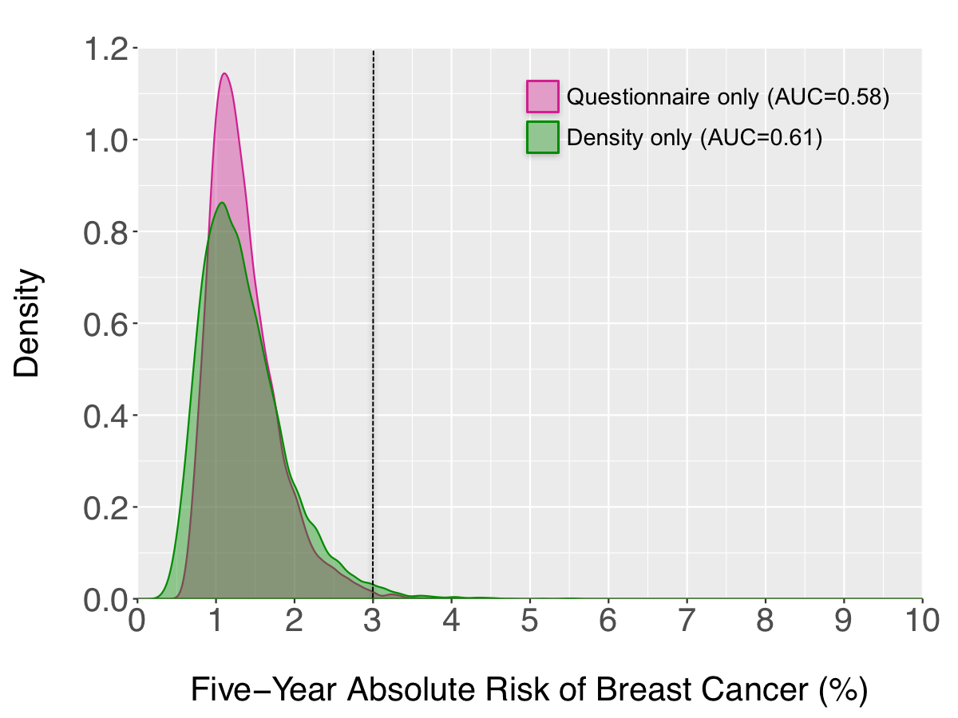
Five-year absolute risk projection for US Caucasian women aged 50
Chatterjee,
Garcia-Closas
Submitted
Notes:
A model based only on density has a wider distribution than only risk factors

Slide 32
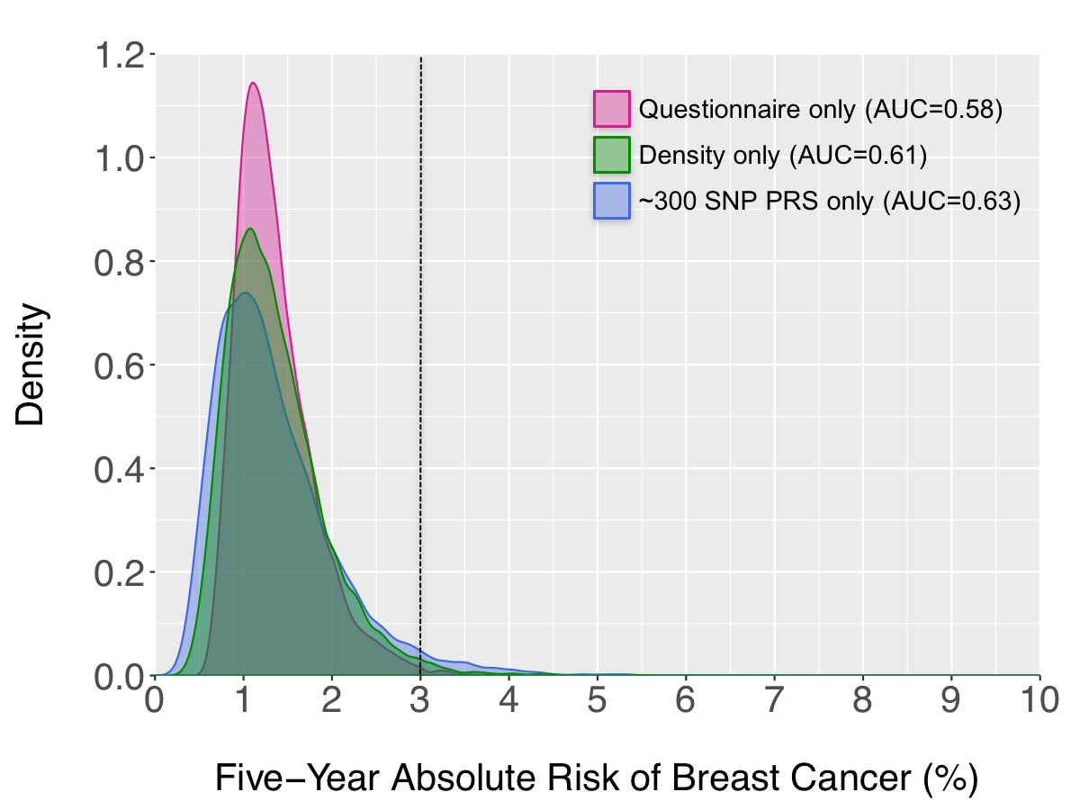
Five-year absolute risk projection for US Caucasian women aged 50
Chatterjee,
Garcia-Closas
Submitted
Notes:
And a model with only a PRS based on 300 SNPs that we have developed using the latest OncoArray data provides an even wider distribution

Slide 33
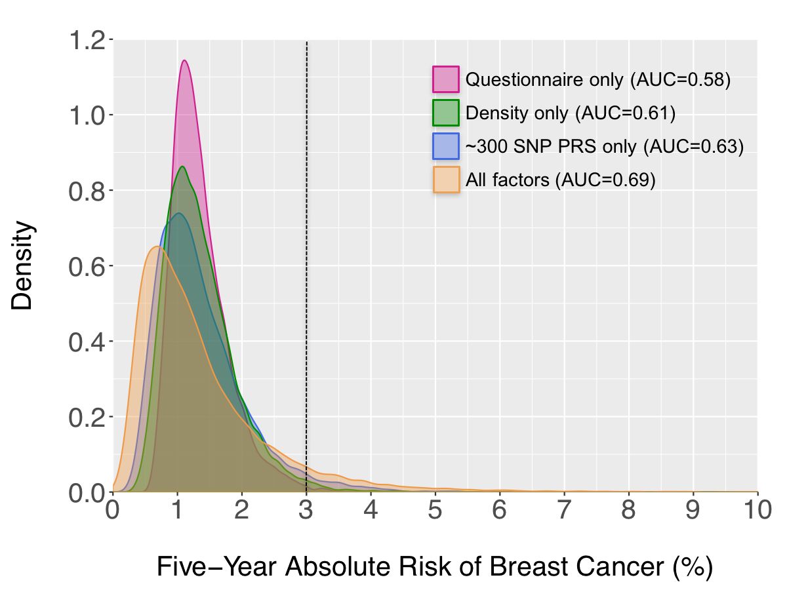
Five-year absolute risk projection for US Caucasian women aged 50
Chatterjee,
Garcia-Closas
Submitted
Notes:
The risk stratification improves further when we integrate all these risk factors into a single model.
Based on these predictions, the full model will be able to identify 7% of 50 year old women crossign the 3% threashold, and 22% of all cases in the population would be expected to occur in this group of women

Slide 34
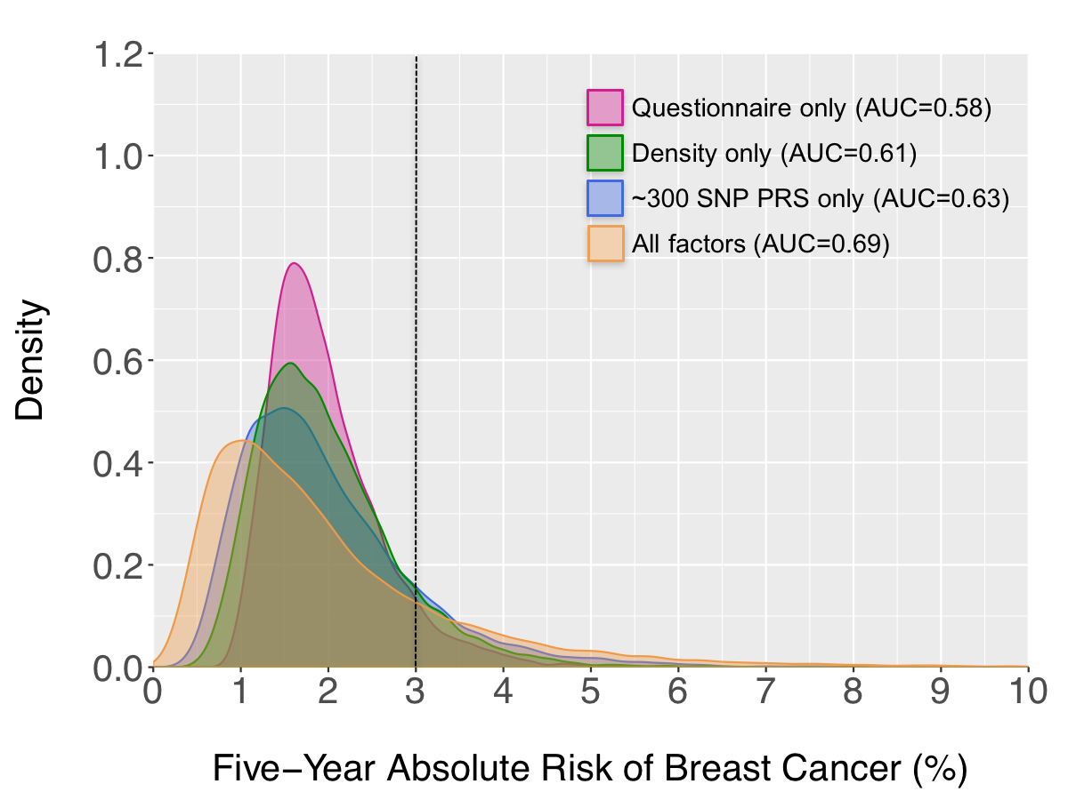
Five-year absolute risk projection for US Caucasian women aged 60
18% of US women 60 years or older
41% of breast cancer cases
Notes:
The risk distributions for older women are swifted towards higher risks just because of the increasing incidence with age, resulting in higher percentage of women being identified at moderate to high risk.
It is important to note that as models improve, we are also able to identify more women a lower level of risk, which might benefit from less frequent screening.

Slide 35
SUMMARY
In ten more years we have discovered few examples of synergy between genes and environment
Gene variants that dramatically alter drug metabolism can dramatically alter drug SFX and efficacy
Most genetic and environmental risk factors conform to the multiplicative model
This is good news! It makes risk prediction algorithms more stable
The multiplicative model implies that environmental risk reduction in those at high genetic risk prevents more cases
It conforms to our new understanding of highly polygenic risk and complex environmental causation

Slide 37
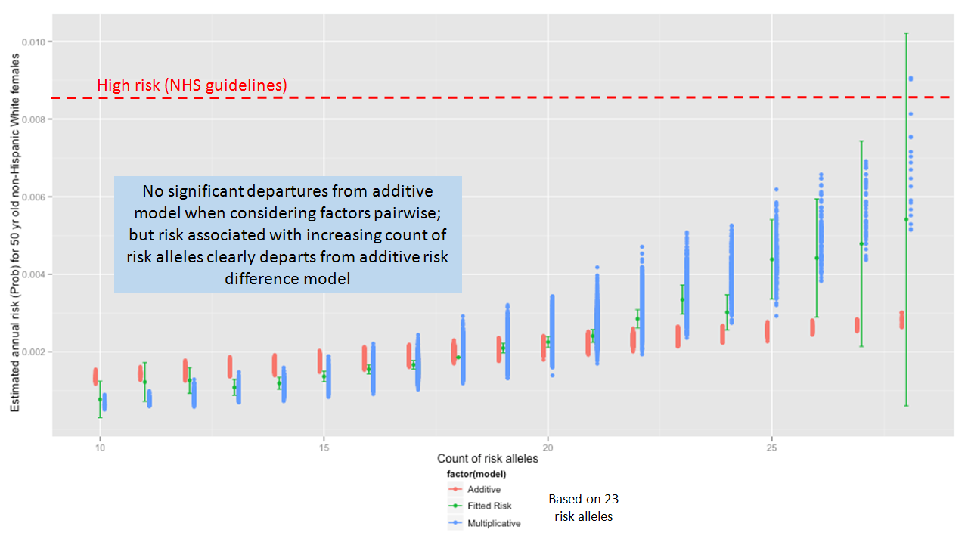
SNP-SNP risks simply multiply
Joshi et al, AJE 2014
!
Notes:
http://publications.nice.org.uk/familial-breast-cancer-cg164/terms-used-in-this-guideline
Estimated risks only account for differences in G, not E—would expect even more discrimination when including E. Our focus was on G:
Polygenic models used in disease risk prediction have generally assumed
multiplicative joint effects of SNPs on the absolute risk scale. We find that a
multiplicative model for the joint effects of multiple risk SNPs is substantially better than
an additive model. This provides some support for the use of a multiplicative model
based on individual-SNP marginal ORs, as has been suggested in the context of risk
screening and implemented by several consumer genetics companies (24, 50-53).

