Slide 1
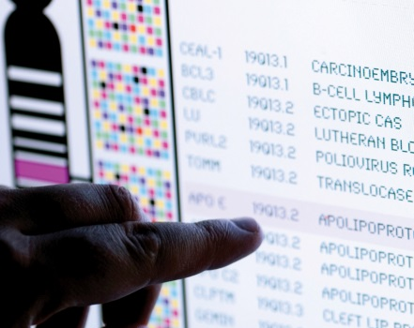
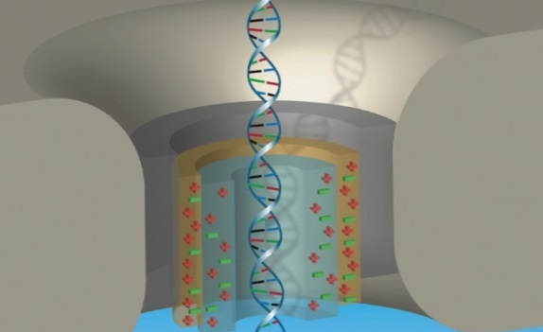
DIRECTOR’S REPORT
Eric Green, M.D., Ph.D.
Director, NHGRI
May 2019
Document #
Notes:
Once again, I would like to welcome all of you to this Open Session of the National Advisory Council for Human Genome Research meeting, both those of you in the room and those of you joining us remotely by live webcast.
As a reminder, my Director’s Report presentation is being videotaped, and that recording will be made available as a permanent archive on NHGRI’s website (genome.gov).
1

Slide 2
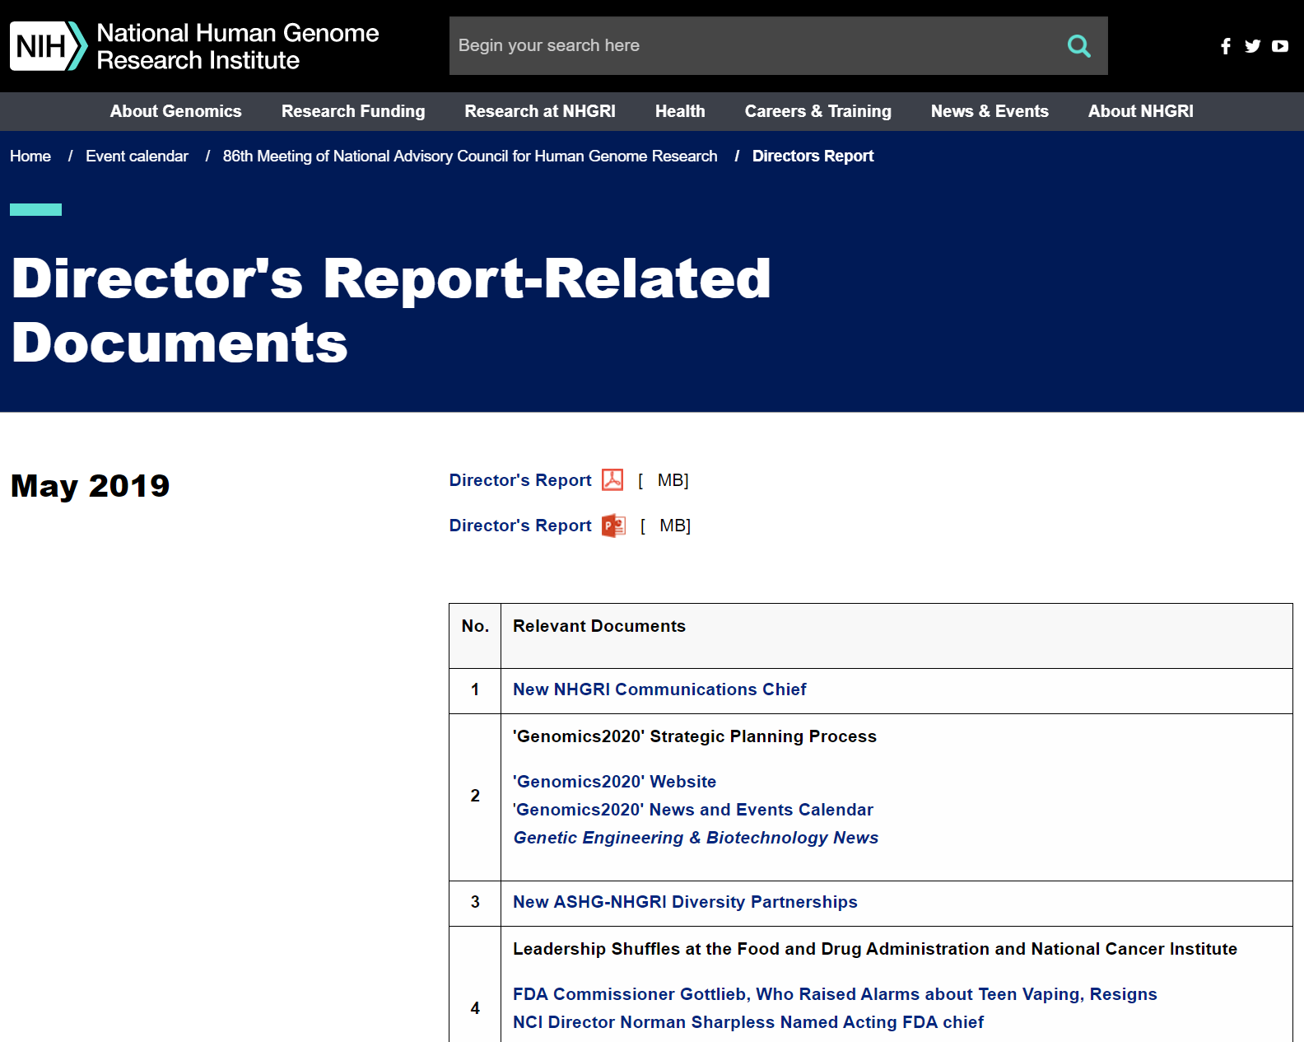
genome.gov/DirectorsReport
Document #
Notes:
For those who are new to our Council meetings, I want to make you aware of the ‘electronic resource’ that is developed for my Director’s Report. Analogous to the supplemental materials of a published paper, this resource can be accessed at the URL shown here.
The slides that I will show during my Director’s Report are also available electronically at this site – * both in PDF and PowerPoint formats.
* When there are documents or relevant websites associated with a particular slide, you will find a ‘Document #’ indicated on the bottom right of that slide; that ‘Document #’ references materials that can be accessed and/or downloaded from the web page shown here. This dedicated web page and all linked documents will be archived on genome.gov as a historic record of this meeting.
2

Slide 3
Open Session Presentations
Report: ENCODE Project Update
Brenton Graveley
Concept Clearance: Diversity Action Plan Renewal
Tina Gatlin
Report: NHGRI Strategic Planning Workshop “From Genome to Phenotype – Genomic Variation Identification, Association, and Function in Human Health and Disease”
Sharon Plon
Notes:
There will be a number of other presentations during the Open Session of this Council meeting. My Director’s Report is tailored around those presentations, and I will not discuss in detail the topics that others will cover.
* Immediately after my Director’s Report, Council member Brent Graveley will present a report that will serve as an ENCODE Project update.
* After lunch, NHGRI’s Tina Gatlin will present a concept clearance on the Diversity Action Plan renewal.
* And finally, Council member Sharon Plon will present a report about the recent NHGRI Strategic Planning Workshop entitled “From Genome to Phenotype – Genomic Variation Identification, Association, and Function in Human Health and Disease.”
3

Slide 4
Director’s Report Outline
General NHGRI Updates
General NIH Updates
General Genomics Updates
NHGRI Extramural Research Program
NIH Common Fund/Trans-NIH
NHGRI Division of Policy, Communications, and Education
NHGRI Intramural Research Program
Notes:
For the rest of my Director’s Report, I will cover the 7 areas listed here, which reliably provide a nice framework for reviewing the relevant topics.
4

Slide 5
Director’s Report Outline
General NHGRI Updates
General NIH Updates
General Genomics Updates
NHGRI Extramural Research Program
NIH Common Fund/Trans-NIH
NHGRI Division of Policy, Communications, and Education
NHGRI Intramural Research Program
Notes:
5
And I will start with some general NHGRI updates.

Slide 6
Departure of NHGRI Communications Chief
John Ohab, Ph.D.
Notes:
After almost four years as Chief of NHGRI’s Communications and Public Liaison Branch, John Ohab will be departing the Institute next month. During his time as NHGRI’s Communications Chief, John led efforts to modernize the Institute's communications program, including revamping NHGRI’s branding and visual identity and developing our new mantra, The Forefront of Genomics. In addition to streamlining many of the Institute’s communications products, he led the recent redesign and launch of NHGRI’s website, genome.gov.
I want to personally thank John for his many contributions to NHGRI. We wish him all the best in his future pursuits.

Slide 7
New NHGRI Communications Chief
Sarah Bates, M.S.
Document 1
Notes:
With John’s upcoming departure, NHGRI recently completed a search for a new Communications Chief, and I am pleased to report that we have recruited Sarah Bates to this important position. Sarah comes to NHGRI from the National Science Foundation (or NSF). At NSF, she was the communications lead for the Engineering Directorate and NSF’s portion of the BRAIN Initiative. In addition, Sarah covered a number of high-profile areas for NSF, including gravitational waves, disaster relief, and sexual harassment.
Previously, Sarah worked at the Society for Neuroscience, where she led the planning and launch of BrainFacts.org, a collaborative effort among several global nonprofit organizations dedicated to advancing brain research. She has a Master of Arts in Journalism, a Master of Science in Astronomy, and a Bachelor of Arts in Physics and English.
I am very excited to have Sarah join NHGRI as our new Communications Chief.

Slide 8
Retirement of Extramural Program Director
Lisa Brooks, Ph.D.
Notes:
Long-time NHGRI extramural program director, Lisa Brooks, will retire at the end of June. Lisa came to the Institute in 1997, initially to manage the Informatics Program and the Genetic Variation Program. Since then, she has played an integral role in the leadership of multiple initiatives, including the HapMap Project, the 1000 Genomes Project, the Genomic Resources Program, the Centers of Excellence in Genome Sciences (or CEGS) Program, and the Genomic Innovator Award Program. Along with these named programs, Lisa has managed numerous investigator-initiated grants related to genomic variation, population genetics, and statistical analysis of genome variation, function, and disease.
On behalf of NHGRI, I want to thank Lisa for her 22 years of service to the Institute and wish her well in retirement. For the near term, Lisa will remain affiliated with NHGRI as a volunteer, so people can still reach out to her with questions.
8

Slide 9
New Extramural Program Director
Shurjo Sen, Ph.D.
Notes:
Shurjo Sen recently joined NHGRI’s Extramural Research Program as a program director in the Division of Genome Sciences. In addition to managing an investigator-initiated grant portfolio and training programs in genome sciences, he will be working on initiatives related to genome informatics and cloud-based platforms for genomic data.
Prior to coming to NHGRI’s Extramural Research Program, Shurjo worked in our Institute’s Intramural Research Program (in part for yours truly) as a postdoctoral fellow and then a research fellow. His scientific background combines experimental genomics and bioinformatics with applications to cardiovascular disease. After finishing his research fellowship, Shurjo joined the National Cancer Institute, where he led the development of microbiome sequencing and informatics platforms.
We are pleased to welcome Shurjo back at NHGRI, now as a program director.
9

Slide 10
‘Genomics2020’ Strategic Planning Process
NHGRI Research Training and Career Development Annual Meeting (St. Louis, MO)
American Medical Informatics Association 2019 Informatics Summit Meeting (San Francisco, CA)
Grand Challenges in Genomics: An NHGRI and Wellcome Trust Strategy Meeting (London, England)
Cold Spring Harbor Laboratory Biology of Genomes Meeting
Document 2
Notes:
NHGRI’s ‘Genomics2020’ strategic planning process continues to move forward. To date, the Institute has held 33 events to gather input from various groups en route to developing our new strategic plan, which will be published in October 2020.
* Recent events have included sessions at the NHGRI Research Training and Career Development Annual Meeting in St. Louis and * at the American Medical Informatics Association 2019 Informatics Summit Meeting in San Francisco. * In collaboration with our colleagues at the Wellcome Trust in the UK, we also held a joint strategic planning workshop in London entitled “Grand Challenges in Genomics: An NHGRI and Wellcome Trust Strategy Meeting.” * Earlier this month, NHGRI staff presented a poster at the Cold Spring Harbor Laboratory Biology of Genomes Meeting.
As we move past the half-way point of our strategic planning process, NHGRI has begun to pivot from gathering open input from the community to seeking feedback on the general themes and ideas that are emerging from the process. Later in 2019, we will be holding focused workshops and meetings to hone in on specific aspects of the emerging strategic ideas, including a Town Hall in the Boston area scheduled for July 17.
10

Slide 11
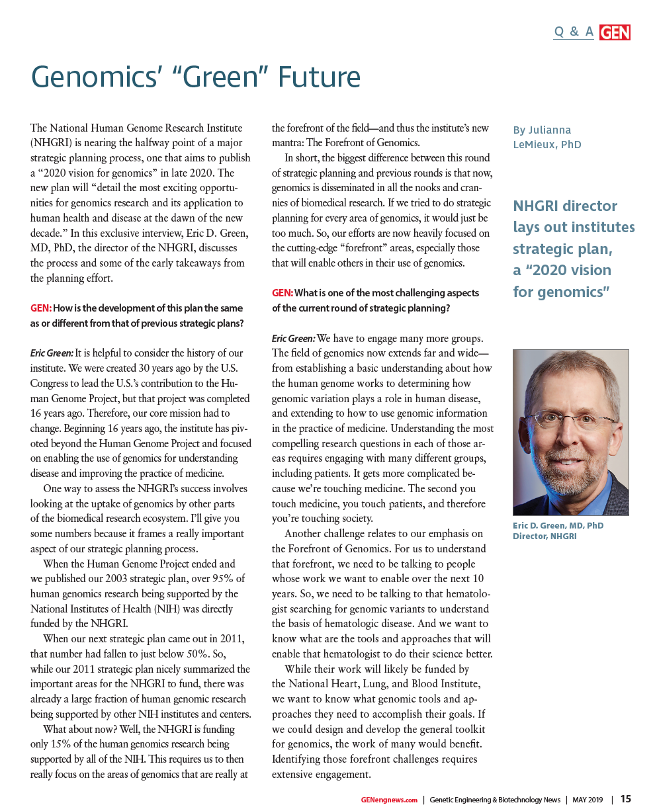
‘Genomics2020’ Strategic Planning Process
GEN 39: 15-16, 2019
Document 2
Notes:
I discussed many of the key aspects of our ‘Genomics2020’ strategic planning process in an interview that was published this month in Genetic Engineering & Biotechnology News. This interview captured some of my reflections on the differences between this round of NHGRI strategic planning and the previous processes that led to the Institute’s 2003 and 2011 strategic plans.
11

Slide 12
New ASHG-NHGRI Diversity Partnerships
Developing Country Awards Program
Human Genetics Scholars Initiative
Document 3
Notes:
NHGRI is partnering with the American Society of Human Genetics (or ASHG) to create two new initiatives aimed at increasing diversity in the genomics workforce.
* The first initiative will add 25 awards to ASHG’s annual Developing Country Awards Program. The new awards will enable genetics and genomics trainees and/or early- to mid-career investigators from Africa to attend the ASHG 2019 Annual Meeting, which will take place this October in Houston, Texas.
* The second initiative is the Human Genetics Scholars Initiative, a multi-year program that will increase and support workforce diversity in the human genetics and genomics research community. The program will provide up to 40 U.S. trainees and early-career scientists from underrepresented backgrounds with mentoring programs, skill building, travel, and professional support during a two-year, intensive program. The initiative will also offer a broader community-building and learning program for up to an additional 200 diverse young researchers.
We look forward to working with our ASHG partners on these two programs.

Slide 13
Director’s Report Outline
General NHGRI Updates
General NIH Updates
General Genomics Updates
NHGRI Extramural Research Program
NIH Common Fund/Trans-NIH
NHGRI Division of Policy, Communications, and Education
NHGRI Intramural Research Program
Notes:
Moving on to general NIH updates.
13

Slide 14
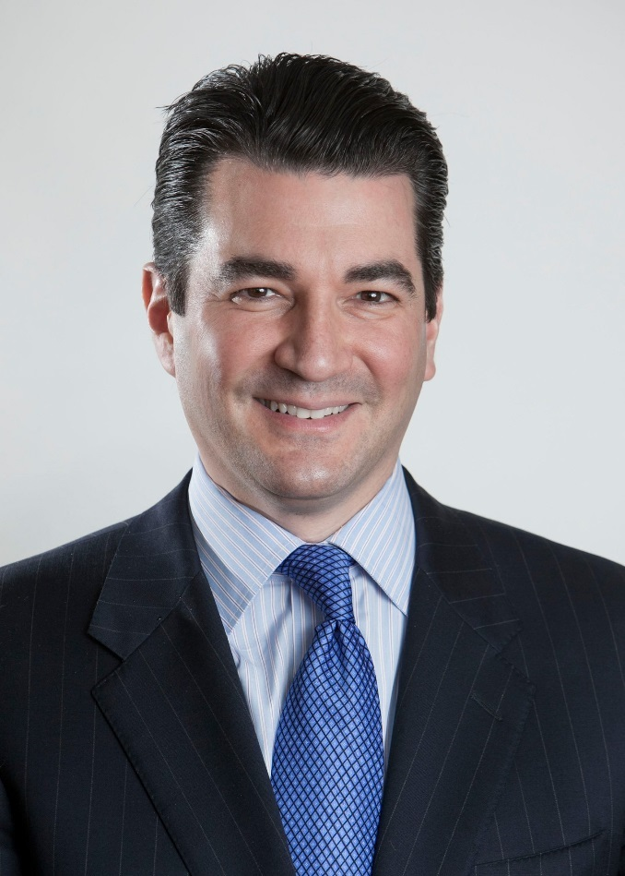
Leadership Shuffles at the Food and Drug Administration and National Cancer Institute
Scott Gottlieb, M.D.
Ned Sharpless, M.D.
Doug Lowy, M.D.
Document 4
Notes:
Scott Gottlieb recently resigned as the Commissioner of the U.S. Food and Drug Administration (or FDA). As a result, * Ned Sharpless, who was appointed by President Trump to be Director of the National Cancer Institute (or NCI), was asked to slide over and serve as Acting FDA Commissioner while the administration works to identify a permanent FDA Commissioner. To address the void left by Ned’s shift over to FDA, * Doug Lowy, NCI Deputy Director, has once again been asked to serve as NCI Acting Director.

Slide 15
New Director, NIH Center for Scientific Review
Noni Byrnes, Ph.D.
Document 5
Notes:
In February, Noni Byrnes was appointed Director of NIH’s Center for Scientific Review (or CSR), where she had served as Acting Director since May 2018. Noni, who started at CSR in 2000, will now oversee the Center’s annual budget of roughly $130 million and more than 500 scientific, support, and contract personnel. CSR handles the peer review of ~75% of grant applications received by NIH, in addition to managing the receipt and referral of all grant proposals for NIH and other parts of the U.S. Department of Health and Human Services, including the Centers for Disease Control and Prevention and the Food and Drug Administration.

Slide 16
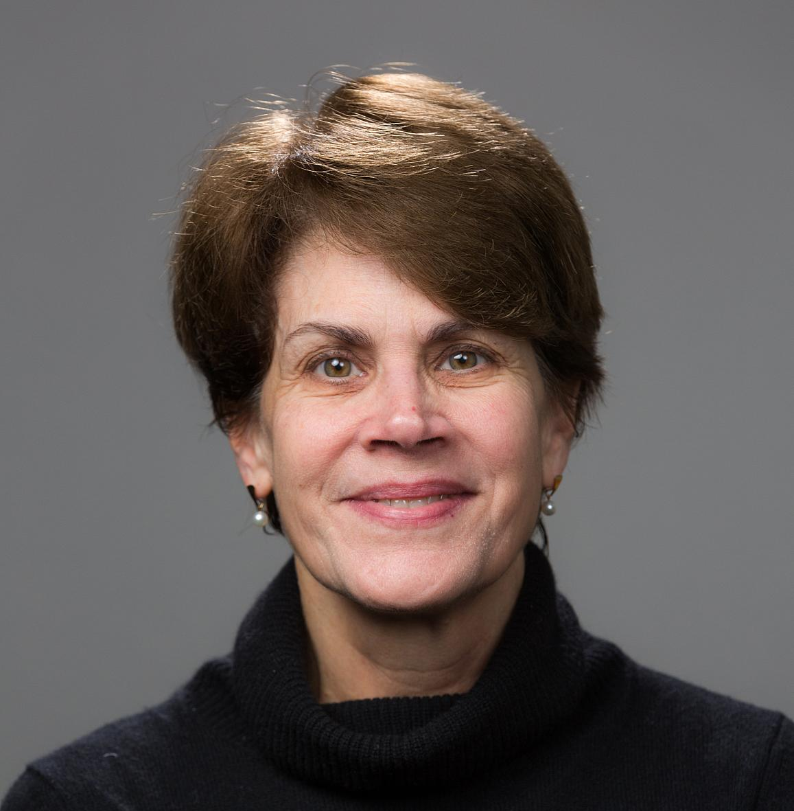
New Director, National Institute on Deafness
and Other Communication Disorders
Debara L. Tucci, M.D.
Document 6
Notes:
Earlier this month, Debara Tucci was named the new Director of the National Institute on Deafness and Other Communication Disorders (or NIDCD). Debara will be coming to NIH from Duke University, where she is a Professor of Surgery and Director of the Cochlear Implant Program in the Division of Head and Neck Surgery & Communication Sciences. She will oversee NIDCD’s annual budget of approximately $459 million and lead the Institute’s research and training programs in hearing, balance, taste, smell, voice, speech, and language. She is expected to officially join NIDCD in September.

Slide 17
Fiscal Year 2020 Appropriations Process
 | Fiscal Year 2019 Labor-HHS Appropriation | Fiscal Year 2020 House Labor-HHS Subcommittee Appropriation | $ Increase | % Increase
NIH | $39.1 B | $41.1 B | ~$2.0 B | ~5.1%
NHGRI | $575 M | $603 M | ~$28 M | ~4.9%
Document 7
Notes:
It is May; that means it is appropriations season, as lawmakers on Capitol Hill draft bills in an attempt to have a budget in place prior to the beginning of the next fiscal year on October 1.
As I reported to you in February (and as shown in the second column from the left), the final NIH appropriation for Fiscal Year 2019 was ~$39.1 billion, with NHGRI receiving ~$575 million. Last month, the House Labor-HHS Subcommittee approved a $41.1 billion Fiscal Year 2020 appropriation for NIH, with NHGRI proposed to receive $603 million (as shown in the third column from the left). As shown in the far-right two columns, such an increase would provide an additional ~$2.0 billion to NIH and ~$28 million to NHGRI compared to this fiscal year, corresponding to a 5.1% and 4.9% increase, respectively.
Note that this bill needs to be sent to the full committee and then to the entire House for approval, all while the Senate works on their version of the Labor-HHS appropriations bill. As always, we will be following these budget developments very closely, so stay tuned.
17
17

Slide 18
Director’s Report Outline
General NHGRI Updates
General NIH Updates
General Genomics Updates
NHGRI Extramural Research Program
NIH Common Fund/Trans-NIH
NHGRI Division of Policy, Communications, and Education
NHGRI Intramural Research Program
Notes:
Moving on to general genomics updates.
18

Slide 19
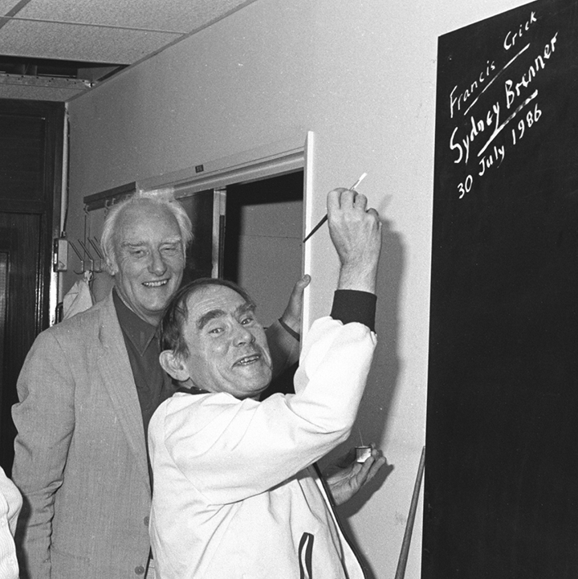
Mourning the Loss of Sydney Brenner
Document 8
Notes:
Last month, the world lost a genetics pioneer, Sydney Brenner. Sydney’s contributions to molecular biology and genetics included the determination that DNA is read as a triplet code, the existence of messenger RNA, and the establishment of the roundworm, C. elegans, as a model system for genetics and development.
Sydney was awarded the Nobel Prize in Physiology or Medicine in 2002 along with Bob Horvitz and John Sulston "for their discoveries concerning genetic regulation of organ development and programmed cell death.” He is pictured here on the right with the late Francis Crick, a long-time collaborator, signing the blackboard that they used during the twenty years that they shared an office in the Cavendish Laboratory at the University of Cambridge.
19

Slide 20
Elected to National Academy of Sciences
Jennifer Graves
Mike Lenardo
Timothy Ley
Elaine Ostrander
Aviv Regev
Kári Stefánsson
David Williams
NATIONAL ACADEMY OF SCIENCES
Document 9
Notes:
The National Academy of Sciences recently announced their newly elected members. Of particular relevance to the genomics community and to NHGRI are the individuals listed here. We extend our heartfelt congratulations to these colleagues.
20

Slide 21
National Academy of Sciences Awards
Document 10
Notes:
Meanwhile, the National Academy of Sciences also honored 18 individuals with awards in recognition of their extraordinary scientific achievements in a wide range of fields spanning the physical, biological, and medical sciences. There are two that I would like to highlight.
* David Reich of Harvard Medical School received the National Academy of Sciences Award in Molecular Biology for his studies of ancient DNA and human migration.
* Former Council member Jay Shendure of the University of Washington received the Richard Lounsbery Award for his pioneering work in the second wave of genomics.
21

Slide 22
ASHG Position Statement: Responsibility to Recontact
12 recommendations and a pathway for considering the responsibility to recontact research participants
Recommendations fill a gap in guidance for when and how to recontact research participants with updated variant knowledge
Provide principles for use by IRBs when determining whether and how to recontact research participants
Document 11
Notes:
Last month, the American Society of Human Genetics (or ASHG), along with several co-signing organizations, published a position statement about the responsibility to recontact research participants after reinterpretation of genetic and genomic research results.
* This position statement included 12 recommendations and a ‘pathway’ for considering the responsibility to recontact research participants. As is implied by the term ‘recontact,’ these recommendations are intended only for studies in which the return of research results has already occurred.
* These recommendations were developed in response to a gap in guidance for when and how to recontact research participants in light of updates about the knowledge associated with genomic variants, which often changes with genomic research advances.
* The ASHG position statement and recommendations provide a set of principles for use by Institutional Review Boards (or IRBs) and advisory boards when determining whether and how to recontact participants in genetic and genomic research settings.
22

Slide 23
Genomics In The News…
Document 12
Notes:
In terms of ‘Genomics in the News’ – there were several recent publications of broad interest that I wanted to bring to your attention.
* Some of the major initial results of the NASA Twins Study was recently published in Science. The NASA Twins Study followed astronaut Scott Kelly (who spent a year on the International Space Station) and his identical twin brother Mark Kelly (a retired astronaut, who remained on Earth). Researchers found that extended time in space leads to changes in gene expression, telomere length, and other physiological features. Most of these changes returned to normal upon Scott’s return to Earth.
In another area of interest, * an important Comment was published in Nature regarding genome editing. Specifically, Eric Lander and colleagues called for an international moratorium on clinical uses of human germline editing until guidance on its use is first developed. * This was followed by an accompanying piece from NIH Director Francis Collins and NIH Office of Science Policy Director Carrie Wolinetz, who gave strong support for the proposed moratorium.
23

Slide 24
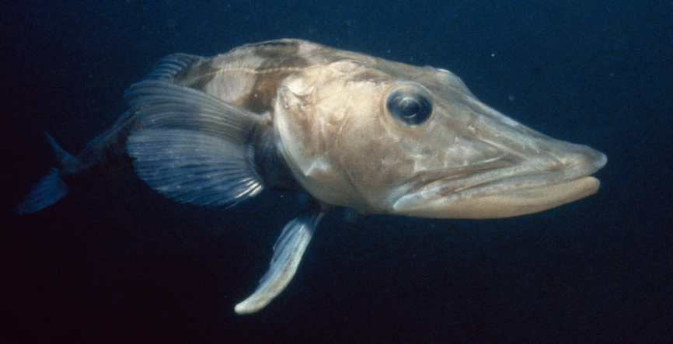
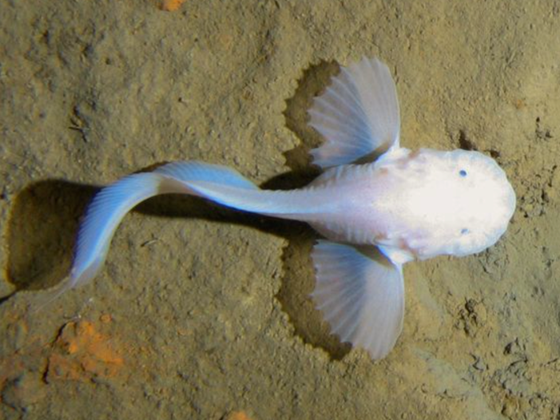
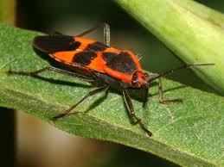
Genomes In The News…
Document 13
Notes:
Moving then to ‘Genomes in the News’ – there have been a number of recently generated genome sequences reported since the last Council meeting, including: * Coast Redwood, * Giant Sequoia, * Walnut, * Peanut, * Strawberry, * two Cotton genomes, * Durum Wheat (for pasta), * a Superfood Seaweed, Ito-Mozuku, * Milkweed Bug, * Snailfish, * Antarctic Blackfin Icefish, * Narwhal, * Great White Shark, * Red Lionfish, and * the Internet-Famous Cat, LilBub.
24

Slide 25
Director’s Report Outline
General NHGRI Updates
General NIH Updates
General Genomics Updates
NHGRI Extramural Research Program
NIH Common Fund/Trans-NIH
NHGRI Division of Policy, Communications, and Education
NHGRI Intramural Research Program
Notes:
Moving on to the NHGRI Extramural Research Program.
25

Slide 26
Centers for Common Disease Genomics
Genome Sequencing Program
Document 14
Notes:
The Genome Sequencing Program consists of four components: a Coordinating Center, Centers for Common Disease Genomics, Centers for Mendelian Genomics, and Analysis Centers. The program is also supported by other organizations, including: the National Heart, Lung, and Blood Institute; the National Institute on Aging; the National Eye Institute; and the Simons Foundation.
The Centers for Common Disease Genomics have sequenced roughly * 80,000 whole genomes and * 81,000 exomes across three disease areas: * cardiovascular, * immune-mediated, and * neuropsychiatric. The centers estimate that they will produce over * 140,000 whole-genome sequences and over * 250,000 exome sequences by the time the program concludes.
26

Slide 27
Genome Sequencing Program
Centers for Mendelian Genomics
Document 14
Notes:
The Centers for Mendelian Genomics have obtained samples from over * 61,000 participants, and have made over * 1,700 novel disease gene discoveries, with just over 600 meeting conservative (or ‘Tier 1’) criteria and 1,100 meeting suggestive (or ‘Tier 2’) criteria. In addition to discovering new genes, * the centers have also made over 450 discoveries in which they expanded the phenotypes associated with known disease genes, using the same tiers for conservative and suggestive criteria.
The Centers for Mendelian Genomics are committed to sharing these discoveries with the broader community, and they do this through multiple means. * First, the centers have submitted over 125,000 entries to the Matchmaker Exchange Network – a federated platform that helps researchers, clinicians, families, and participants identify matches between rare disease patients with similar genotypes and phenotypes. * Second, the centers have contributed information about over 3,000 genomic variants to ClinVar (which is an aggregate database for genomic variants with clinical significance) and submitted additional data on rare genomic variants to Geno2MP (a node of Matchmaker Exchange). Finally, the CMGs have published 522 manuscripts since the program’s inception in 2012.
27

Slide 28
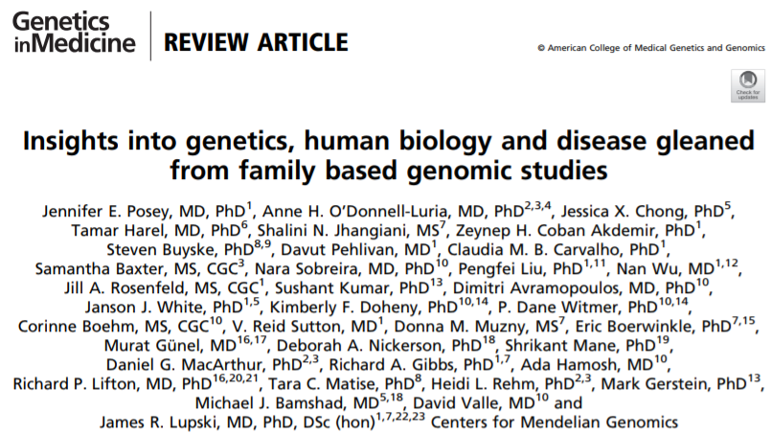
Genome Sequencing Program Publications
Document 14
Notes:
As a whole, the Genome Sequencing Program has published over 650 papers to date. Notable publications since the February 2019 Council meeting include:
* The Liu et al. paper, which represents a collaboration between the Harvard Analysis Center and the Baylor Center for Common Disease Genomics, highlighted ACAT, an aggregated association test that can be used to boost power in rare-variant analyses from genome-sequencing studies. This paper also demonstrates use of the method in the Atherosclerosis Risk in Communities study.
* The Posey et al. paper represents the latest review of the Centers for Mendelian Genomics program, highlighting their collaborative discoveries to date. This paper also discusses opportunities for future work, including elucidating disease-causing genomic variants using phenotypic expansion; developing new methods, allelic series, and analysis tools; and exploring more complex modes of inheritance.
* The Lappalainen et al. paper, which represents a collaboration between the Centers for Common Disease Genomics at the New York Genome Center and Washington University, explores how DNA-sequencing technologies are changing the landscape for genomic variant discovery, genotyping, and functional analyses in studies of both common and rare diseases.
28

Slide 29
Technology Development Program
Novel Nucleic Acid Sequencing Technology Development
RFA-HG-18-001 (R01, also linked R21 and R43/44)
Next due date: June 27, 2019
Advanced Genomic Technology Development Meeting at Northeastern University
Grantee meeting: May 29-30, 2019
Public meeting: May 31, 2019
Document 15
Notes:
NHGRI’s Technology Development Program continues to develop new and improved technologies to enable genomic discoveries and facilitate the adoption of genomics in medicine.
* Applications for the Novel Nucleic Acid Sequencing Technology Development Request for Applications are due on June 27.
* Meanwhile, this year’s Advanced Genomic Technology Development Meeting will be held next week at Northeastern University. * On May 29 and 30, novel nucleic acid sequencing and genomic technology development grantees will present their work, collaborate, and interact. * Then on May 31, there will be a public meeting, at which the broader community can hear selected presentations on topics such as spatial transcriptomics, genomic medicine, and protein engineering. The public meeting attendees will also have the opportunity to participate in a ‘Genomics2020’ strategic planning session.
29

Slide 30
ENCyclopedia Of DNA Elements (ENCODE)
Multiple competitive rounds
Research and Applications Users Meeting (July 8-11, 2019 in Seattle)
ENCODE data are now as an Amazon Web Services Public Data Set
Document 16
Notes:
The goal of the Encyclopedia of DNA Elements (or ENCODE) project is to create catalogs of all functional elements in the human and mouse genomes and to make those catalogs available as a resource to the biomedical research community.
* The first ENCODE Imputation Challenge was launched this year by members of the ENCODE Consortium in an effort to challenge the scientific community to compare methods for imputing data produced by various types of genomic assays. There are multiple competitive rounds in this challenge that will allow the participants to initially compete as separate groups and then to come together to collaborate on lessons learned throughout the challenge.
* In another example of ENCODE community outreach, the ENCODE Consortium will hold its third Research and Applications Users Meeting this July in Seattle. The meeting will feature hands-on workshops demonstrating how to navigate, analyze, and integrate ENCODE data into research projects. An announcement for the meeting will be available on genome.gov soon.
* Finally, ENCODE data are now available as an Amazon Web Services Public Data Set. This is an exciting development that allows researchers to directly access ENCODE data in the cloud.
30

Slide 31
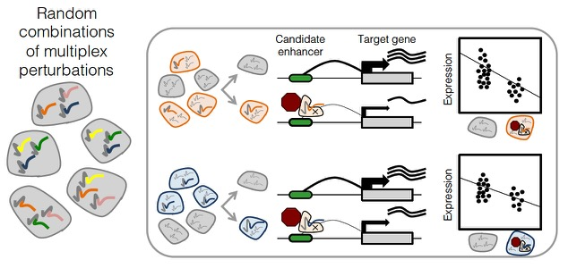
ENCyclopedia Of DNA Elements (ENCODE)
Document 16
Notes:
A recent study published by a group of investigators at the University of Washington, funded in part by the ENCODE project and by an NHGRI T32 award, developed an improved approach to characterize candidate regulatory regions in a high-throughput fashion.
Specifically, this gene-editing approach utilized new methods to test multiple perturbations per cell, detect gene expression using single-cell RNA-seq, and use eQTL-like analyses to connect perturbations with changes in gene expression. Overall, this approach dramatically increased the number of regulatory elements and genes that could be tested in a single experiment; it also identified the target genes corresponding to the regulatory elements being studied.
31

Slide 32
Phenotypes and Exposures (PhenX) Toolkit
Pediatric Development
Cancer Outcomes and Survivorship
Genomic Medicine Implementation
Social Determinants of Health
Document 17
Notes:
The Phenotypes and Exposures Toolkit (or PhenX) is a catalogue of consensus protocols for measuring phenotypes and exposures in biomedical research.
The PhenX Steering Committee recently selected three additional areas of focus that are now in various stages of development, specifically: * pediatric development, * cancer outcomes and survivorship,* and genomic medicine implementation. We anticipate standard protocols for these areas will be available in the toolkit by the end of 2019.
* In addition, the National Institute on Minority Health and Health Disparities provided PhenX with supplemental funding to develop a social determinants of health working group. Examples of protocols being considered in this area address food insecurity, access to health services, and community resilience. These standard measures will be a valuable addition to the PhenX Toolkit, and the research community will be encouraged to use them for their minority health and health disparities-focused studies.
32

Slide 33
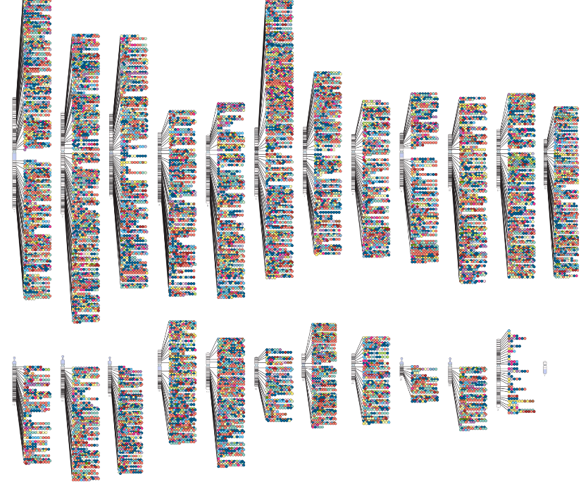
NHGRI-EBI GWAS Catalog
Justification for diverse populations in human genetics research
Majority (52%) of GWAS studies conducted in European populations
Need to include ancestrally diverse populations
>100,000 curated SNP- trait associations
Now accepting summary statistics
Document 18
Notes:
The NHGRI-EBI Genome-Wide Association Studies (or GWAS) Catalog is an online resource providing curated results from GWAS papers and user-provided summary statistics. Launched 11 years ago, the Catalog now features curated GWAS results from over 3,800 peer-reviewed publications.
* This past quarter, GWAS Catalog curators reached the notable milestone of having curated >100,000 SNP-trait associations. * Also, the Catalog is now accepting summary statistics for eligible GWAS publications; currently, summary statistics are available for 197 (5%) of the publications in the GWAS Catalog.
* GWAS Catalog data were also prominently featured in a recent commentary in Cell by Sarah Tishkoff and colleagues. * The commentary addressed the theoretical and empirical justification for studying diverse populations in human genetics research. * Using GWAS Catalog data available through January, the researchers reported that the majority (52%) of GWAS studies are still conducted using European populations. * Examples from other studies reinforce the need to include ancestrally diverse populations in human genetics studies.
33

Slide 34
Document 19
Notes:
The Electronic Medical Records and Genomics (or eMERGE) network conducts genomic discovery and clinical implementation research by leveraging data from large biorepositories linked to electronic medical records.
* Recently, eMERGE investigators published a paper reporting an electronic health record-based phenome-wide association study (or PheWAS) that described the pleiotropic effects of genomic variants in three lipoprotein metabolism genes (PCSK9, APOB, and LDLR). Using high-density genotype data, these researchers tested the associations of variants in the three genes with 1,232 electronic health record-derived binary phecodes in 51,700 European-ancestry individuals and 585 phecodes in 10,276 African-ancestry individuals.
* The figure shows the process of selecting the genomic variants for the primary analyses. Collectively, individuals in the discovery cohort contained the number of variants shown for PCSK9, APOB, and LDLR. These variants were analyzed by various quality-control filters and other selection measures, including those based on * imputation quality, * minor allele frequency, * lipoprotein-cholesterol (LDL-C) association at the given thresholds for each ancestry groups, and * linkage disequilibrium. * The genomic variants passing these filters were used in the primary analysis. In this large-scale PheWAS, the investigators did not find LDL-C-related variants in PCSK9, APOB, and LDLR to be associated with non-lipid-related phenotypes, including diabetes, neurocognitive disorders, or cataracts.

Slide 35
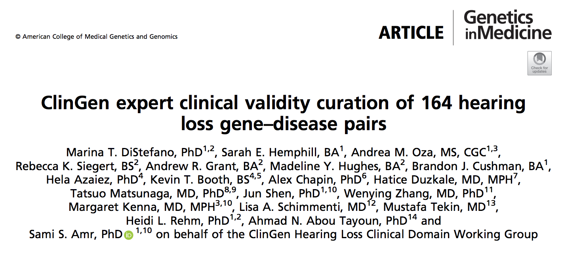
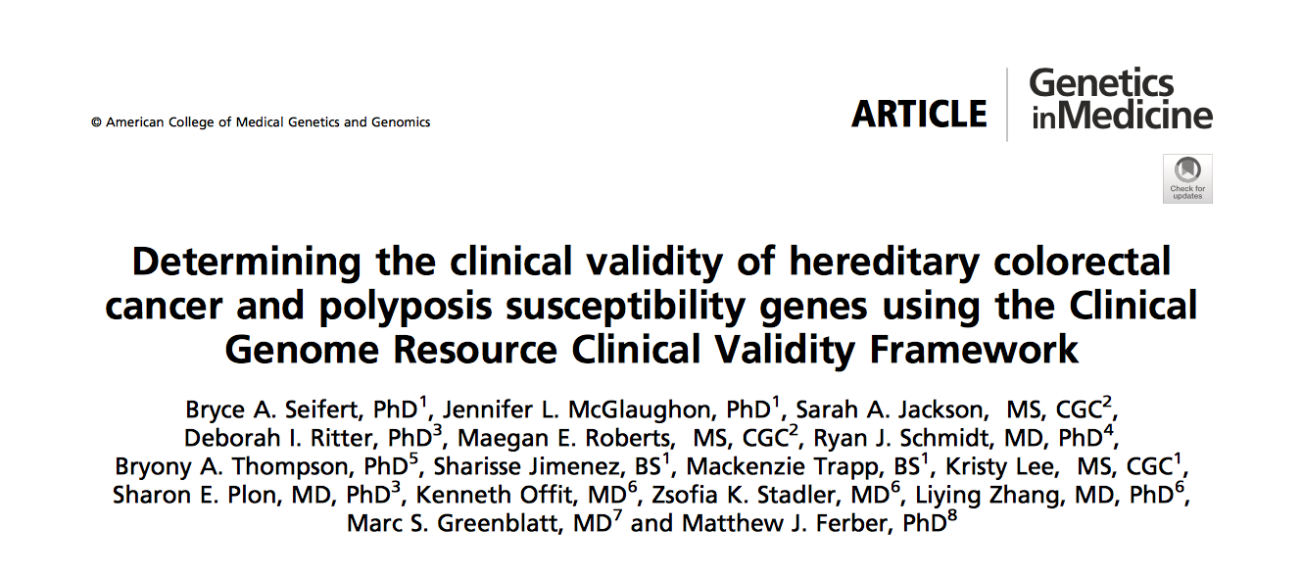
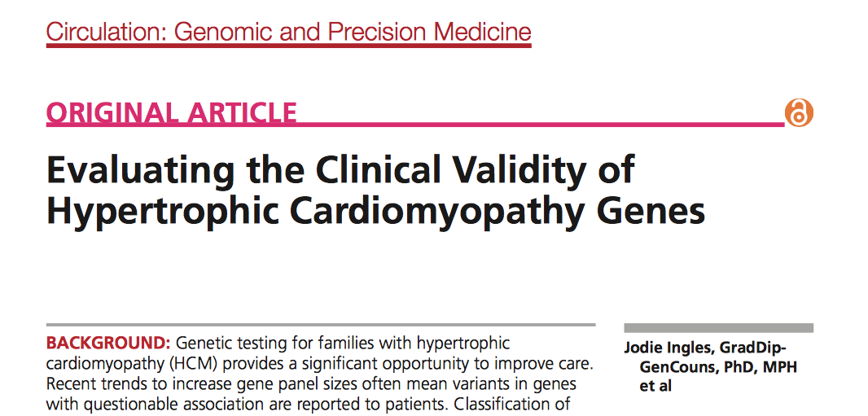
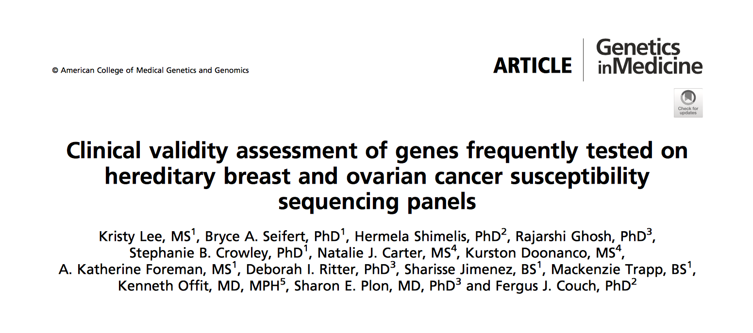
Clinical Genome Resource (ClinGen)
Document 20
Notes:
The Clinical Genome Resource (or ClinGen) evaluates and disseminates the clinical relevance of genes and genomic variants for use in precision medicine and research. In my Director’s Report at the February Council meeting, I highlighted work of the Brugada Syndrome gene curation panel that showed only 1 of 21 genes commonly included in clinical testing panels had definitive evidence for clinical validity. That finding spurred some testing laboratories to remove the genes with insufficient evidence from their multi-gene panels.
Since then, four additional ClinGen gene curation panels published their findings. These panels focused on hereditary hearing loss, hypertrophic cardiomyopathy, colon cancer, and breast and ovarian cancer. Approximately 30-65% of the assessed gene-disease pairs evaluated across these panels had limited, disputed, or no evidence of association with the disease being evaluated.
* For example, the hearing loss panel reviewed 164 gene-disease pairs and found only 94 genes (57%) had strong or definitive evidence of clinical validity. Through these efforts, ClinGen is providing valuable information to the community as they decide which genes are relevant for clinical evaluation. Results from all ClinGen panels are available on the ClinGen website.
35

Slide 36
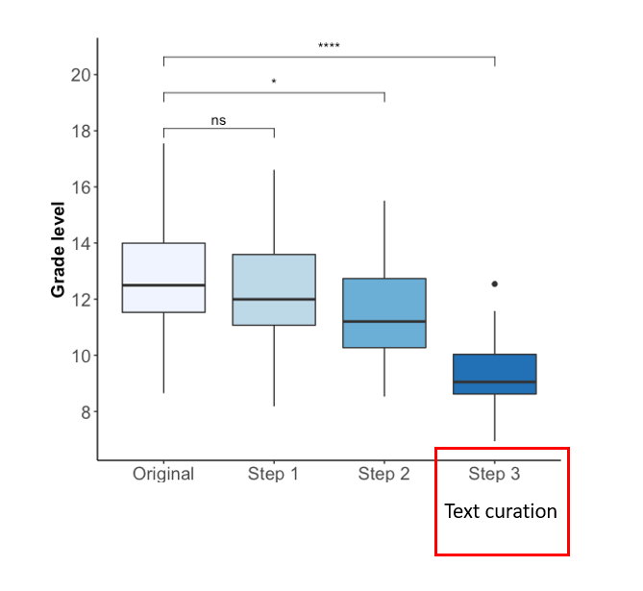
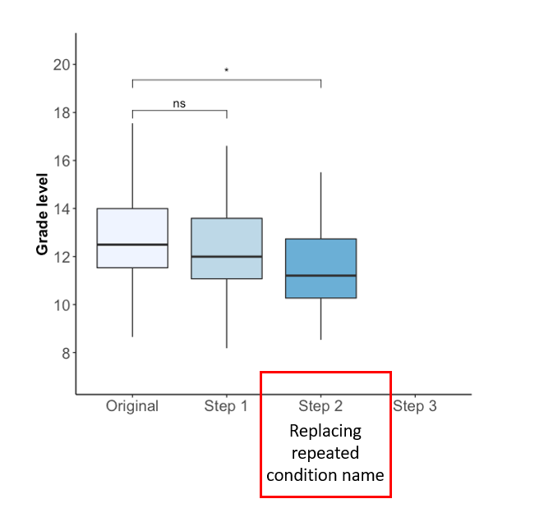
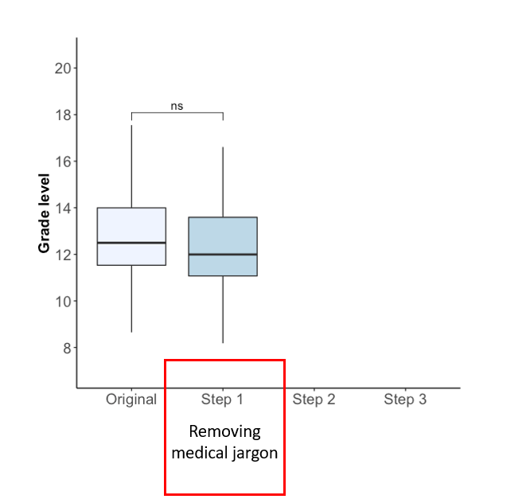
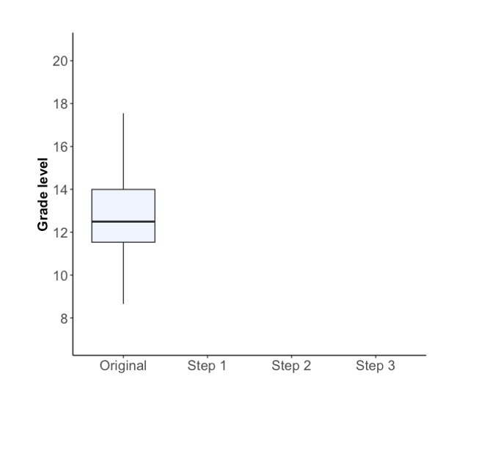
Clinical Sequencing Evidence- Generating Research Program
Simplifying Readibility for the Genetics Home Reference:
ACMG 2019 Meeting:
Featured Workshop: Addressing Literacy and Language to Equitably Deliver on the Promise of Precision Medicine
1 platform & 15 poster presentations
Figures courtesy of the J. Shieh lab
Document 21
Notes:
The Clinical Sequencing Evidence-Generating Research (or CSER) program aims to generate evidence related to the clinical utility of genome sequencing, with a major emphasis on recruiting ancestrally diverse and medically underserved populations.
CSER research was featured at the American College of Medical Genetics and Genomics (or ACMG) 2019 meeting in April. This included a featured workshop on “Addressing Literacy and Language to Equitably Deliver on the Promise of Precision Medicine,” which showcased work from both the CSER and the IGNITE consortia. CSER investigators also presented a one platform and fifteen poster presentations.
Among the CSER presentations was a study on optimizing genetics online resources for diverse readers. These CSER investigators determined that, compared to the 8th grade reading level for the average American, the average Genetics Home Reference entry is at a 13th grade reading level. They then applied several text processing steps, such as * removing medical jargon, * replacing repeated condition names, and * text curation into a common template to bring down the average reading level from 13th grade to 9th grade. Not shown here, but further reducing complexity, the authors are also developing standard infographic templates to visually communicate clinical information.
36

Slide 37
Implementing GeNomics In pracTicE (IGNITE) II: Pragmatic Clinical Trials
5435 AA adults with hypertension
First IGNITE trial to launch:
Genetic Testing to Understand Renal Disease Disparities in the U.S.
Aim: Effect of knowing positive APOL1 status in treating systolic blood pressure (SBP)
Sub-Study: Effect of Pharmacogenetic- guided therapy on SBP
Primary Outcome: SBP at 3 months
Largest NHGRI PCT in an entirely minority population
ADOPT PGx trial coming soon
1:1
Delayed
Intervention
Intervention
APOL1 & PGx Testing
APOL1 pos
N=462
APOL1 Pos
APOL1 Neg
1:1
APOL1 ROR only
APOL1 ROR only
APOL1 & PGx ROR
3 mo Study Visit
3 mo Study Visit
6 mo Study Visit
No ROR
6 mo Study Visit &
PGx ROR
6 mo Study Visit
No ROR
APOL1 & PGx Testing
APOL1 pos & PGx ROR N=462
APOL1 Pos & PGx ROR
APOL1 Neg & PGx ROR
Document 22
Notes:
The Implementing GeNomics In practice (or IGNITE) Network is excited to launch their first pragmatic clinical trial. The Genetic Testing to Understand Renal Disease Disparities in the U.S. (or GUARDD-US) trial will begin recruiting over 5,400 African-American adults with hypertension this fall. The investigators aim to determine the effect of knowing positive APOL1 status in treating systolic blood pressure. They will also be studying the effect of a Pharmacogenetic-guided antihypertensive therapy on systolic blood pressure.
* The trial participants will be randomized into a ‘delayed intervention’ group and an ‘immediate intervention’ group. * The delayed group will receive testing at the six-month follow-up appointment, while the immediate intervention group will receive testing at their first visit. * After determining each patients’ APOL1 status, * those negative for APOL1 will be randomized again for a pharmacogenetics sub-study. * To assess the primary outcome, the investigators will be comparing the APOL1-positive individuals in the delayed and immediate intervention groups.
* Notably, this will be NHGRI’s largest clinical trial to be implemented in an entirely minority population and could lead to a greater understanding of a high-risk genomic variant in a historically understudied population. * IGNITE’s second trial, A Depression and Opioid Pragmatic Trial of PGx (or ADOPT PGx), will launch later in 2020.
37

Slide 38
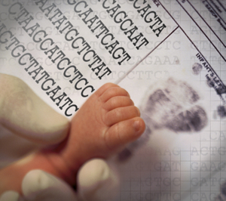
Newborn Sequencing In Genomic medicine
and public HealTh (NSIGHT)
NSIGHT Public Webinar – June 24, 2019
For disorders currently screened for in newborns, how can genomic sequencing replicate or augment known newborn screening results?
What knowledge could genomic sequencing provide about conditions not currently screened for in newborns?
What additional clinical information could be learned from genomic sequencing relevant to the clinical care of newborns?
Document 23
Notes:
The Newborn Sequencing in Genomic Medicine and Public Health (or NSIGHT) program, funded jointly with the Eunice Kennedy Shriver National Institute of Child Health and Human Development, explores in a limited but deliberate manner the implications, challenges, and opportunities associated with the possible use of genomic sequence information for the care of newborns. As the program comes to an end, the NSIGHT investigators will be presenting their findings in a public webinar on June 24. The framework for the webinar will be providing answers to the three key research questions shown here. More information about the webinar can be found on the NSIGHT webpage.
S
38

Slide 39
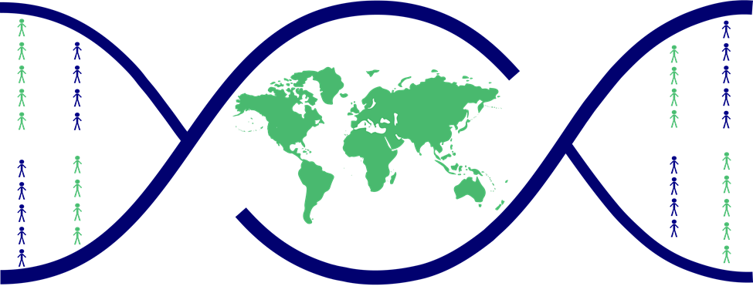
International 100K+ Cohort Consortium (IHCC)
To create a global network for translational research that will utilize large cohorts to enhance the understanding of the biological and genetic basis of disease and improve clinical care and population health.
Created by Global Alliance for Genomics and Health (GA4GH)
Selection of Cohorts:
100K+ participants
Disease-agnostic
Available biospecimens
Longitudinal follow-up
Document 24
Notes:
The International 100K+ Cohort Consortium (or IHCC) was established in 2018 at the request of the Heads of International Research Organizations through a collaboration between the Global Genomic Medicine Collaborative (or G2MC) and the Global Alliance for Genomics and Health. The IHCC aims to create a global network for translational research that will utilize large cohorts to enhance the understanding of the biological and genetic basis of disease and improve clinical care and population health.
* This map shows the distribution of IHCC cohorts around the world. The dark red dots indicate cohorts with at least 25,000 individuals who had genotyping or genome-sequence data. The red dots indicate cohorts that are actively collecting samples. Lastly, the pink dots reflect countries that are currently planning national cohorts.
* Cohorts have been selected based on four criteria: having >100,000 participants, being disease-agnostic, having available biospecimens, and having at least the potential for longitudinal follow-up of participants.

Slide 40
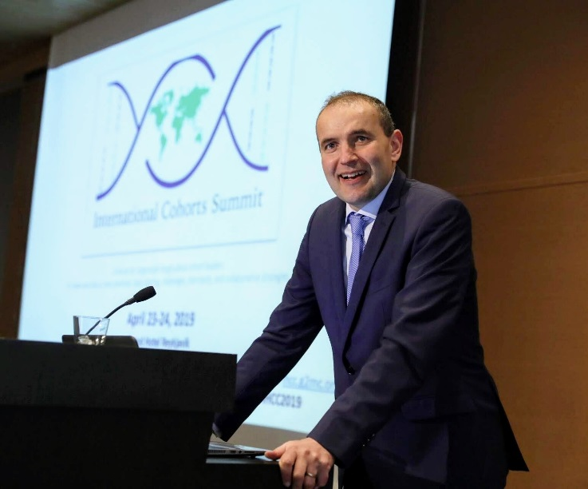
International 100K+ Cohort Consortium (IHCC)
IHCC’s 1st International Cohorts Summit (2018)
IHCC’s 2nd International Cohorts Summit (2019)
Identify cross-cohort research projects and identify international collaborators to organize and participate in them
Develop an IHCC scientific agenda to bring forward to research funders
President of Iceland
Guðni Thorlacius Jóhannesson
Document 24
Notes:
IHCC hosted its 1st International Cohorts Summit in 2018 at Duke University. That meeting brought together roughly 100 investigators from 24 countries that together represented 60 cohort studies with >25 million participants at their current sizes (and >36 million participants based on future recruitment targets).
* Last month, IHCC hosted its 2nd International Cohorts Summit in Iceland. * The objectives of this 2nd summit were to identify scientifically meritorious cross-cohort research projects and identify international collaborators willing to organize and participate in them; and * to develop an IHCC scientific agenda to bring forward to research funders. 117 people from 29 countries representing 67 cohort studies attended last month’s summit. * That meeting began with a welcoming address from the President of Iceland and ended with plans for next steps. A meeting summary is currently in preparation.

Slide 41
Computational Genomics and Data Science Program
Analysis, Visualization, and
Informatics Lab-space (AnVIL)
Approved NIH-Designated Data Repository
Established External Consultant Committee
Public launch at the end of 2019
Document 25
Notes:
The NHGRI Computational Genomics and Data Science Program supports research and development of data science methods, resources, and tools that maximize the integration of genomic data into biomedical research. In September 2018, the program established the Analysis, Visualization, and Informatics Lab-space (or AnVIL). AnVIL is a cloud-based infrastructure and software platform that will provide a shared analysis and computing environment as part of a federated genomic data commons ecosystem.
* In March, I approved AnVIL to be an NIH Designated Data Repository. As a result, AnVIL is authorized to make controlled-access genomic and associated phenotypic data available to the broader scientific community.
* NHGRI has also recently established an AnVIL external consultant committee. This committee is a multidisciplinary group of experts who will assist NHGRI in assessing AnVIL’s operations, scientific progress, datasets, analysis tools for users, and management of ethics concerns and participant- protection practices.
* AnVIL is gearing up for an initial public launch at the end of 2019. This launch will include access to datasets, such as those associated with the recently re-sequenced 1000 Genomes samples and the Genotype Tissue Expression (or GTEx) Project; this launch will also include access to common analysis tools and packages, such as Bioconductor and Jupyter Notebooks.

Slide 42
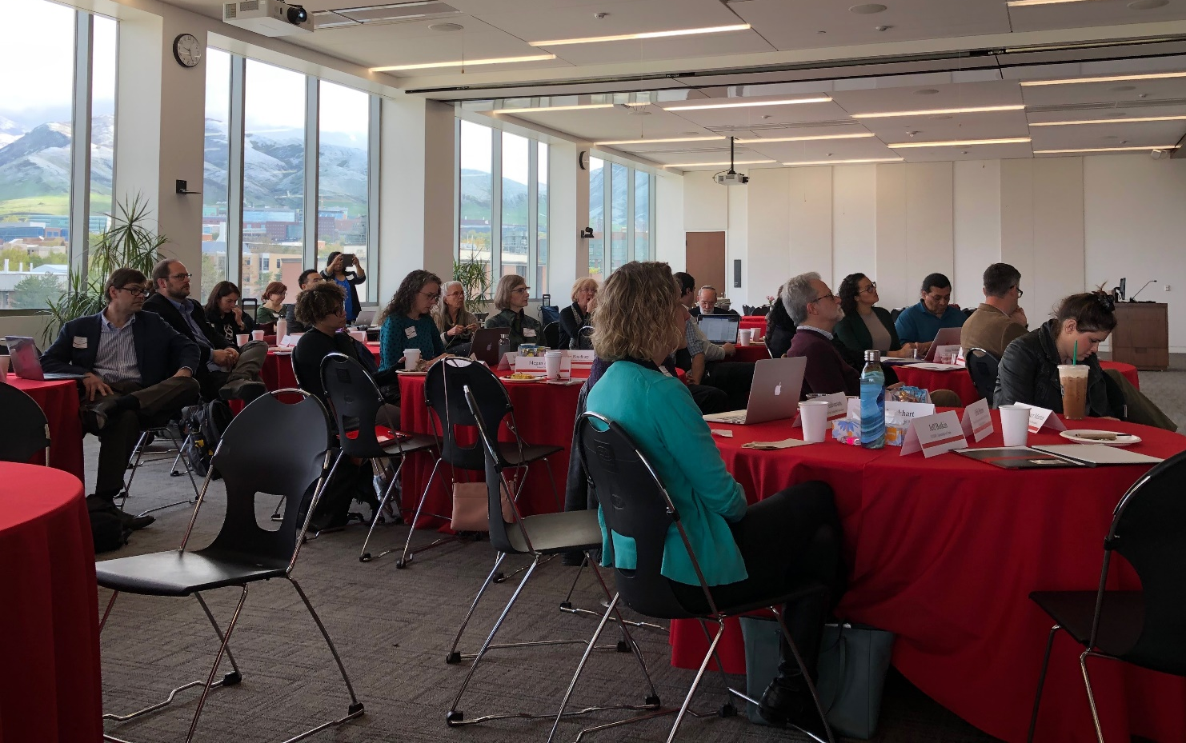
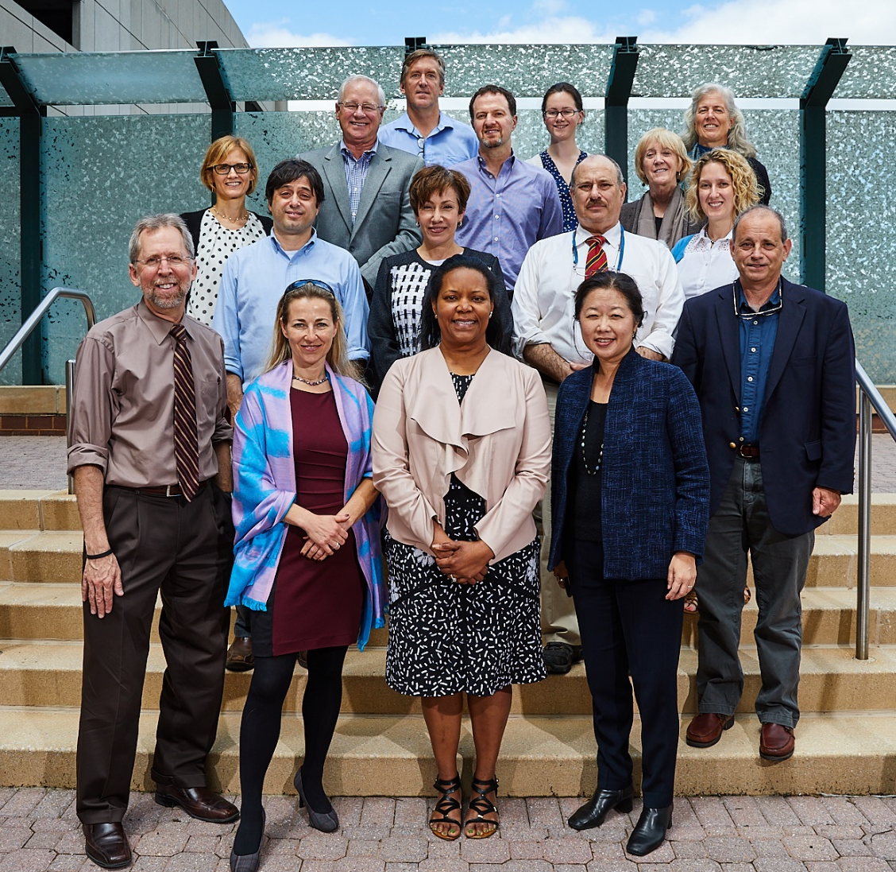
ELSI Research Program
CEER Annual Meeting
GSWG Annual Meeting
Document 26
Notes:
NHGRI’s Ethical, Legal, and Social Implications (or ELSI) Research Program supports research that anticipates, explores, and addresses the implications of genomics for individuals, families, and communities.
The Centers for Excellence in ELSI Research (or CEERs) program had their annual meeting this past April in Salt Lake City. In addition to plenary presentations and panels, roundtable discussions featured topics such as precision medicine, return of genomic testing results, and privacy. This format emphasized transdisciplinary dialogue and trainee interactions. A ‘Genomics2020’ strategic planning session was also held.
* The Genomics and Society Working Group of Council provides guidance about the ELSI Research Program. Earlier this month, this working group held a two-day meeting that included presentations on ELSI research in Canada, the NHGRI History of Genomics Program, measuring the impact of ELSI research, and a discussion on ‘Genomics2020’ strategic planning.

Slide 43
SBIR/STTR Programs
SBIR Grantees Win Product Awards
Genomenon “Mastermind” Genomic Search Engine wins Best in Show at Bio-IT World for insight into diseases, genes, and genomic variants
Duality Technologies wins 2nd place in Innovation Sandbox at RSAC 2019 for SecurePlus encryption for GWAS
Document 27
Notes:
NHGRI funds about $15 million each year in small business grants through Small Business Innovation Research (or SBIR) and Small Business Technology Transfer (or STTR) awards. Illumina received SBIR funding as a startup in 2009 and was named to the Small Business Innovation Research Hall of Fame in 2017.
* This year, two small-business grantees won awards in trade shows for products developed with NHGRI funding.
* Genomenon Inc., a genomic information search company funded by an NHGRI SBIR Fast Track grant, was awarded Best of Show for their Mastermind Genomic Search Engine at the Bio-IT World Conference and Expo. Genomenon’s Mastermind provides insight into published genomic research for all diseases, genes, and genomic variants.
* Duality Technologies, a cryptography and data science company funded by an NHGRI Phase 1 SBIR grant, was awarded 2nd place in the Innovation Sandbox at the 2019 RSA Conference. The RSA Conference is the world’s leading information security venue. Duality’s SecurePlus encryption for GWAS enables secure and privacy-preserving calculations using homomorphic encryption.
43

Slide 44
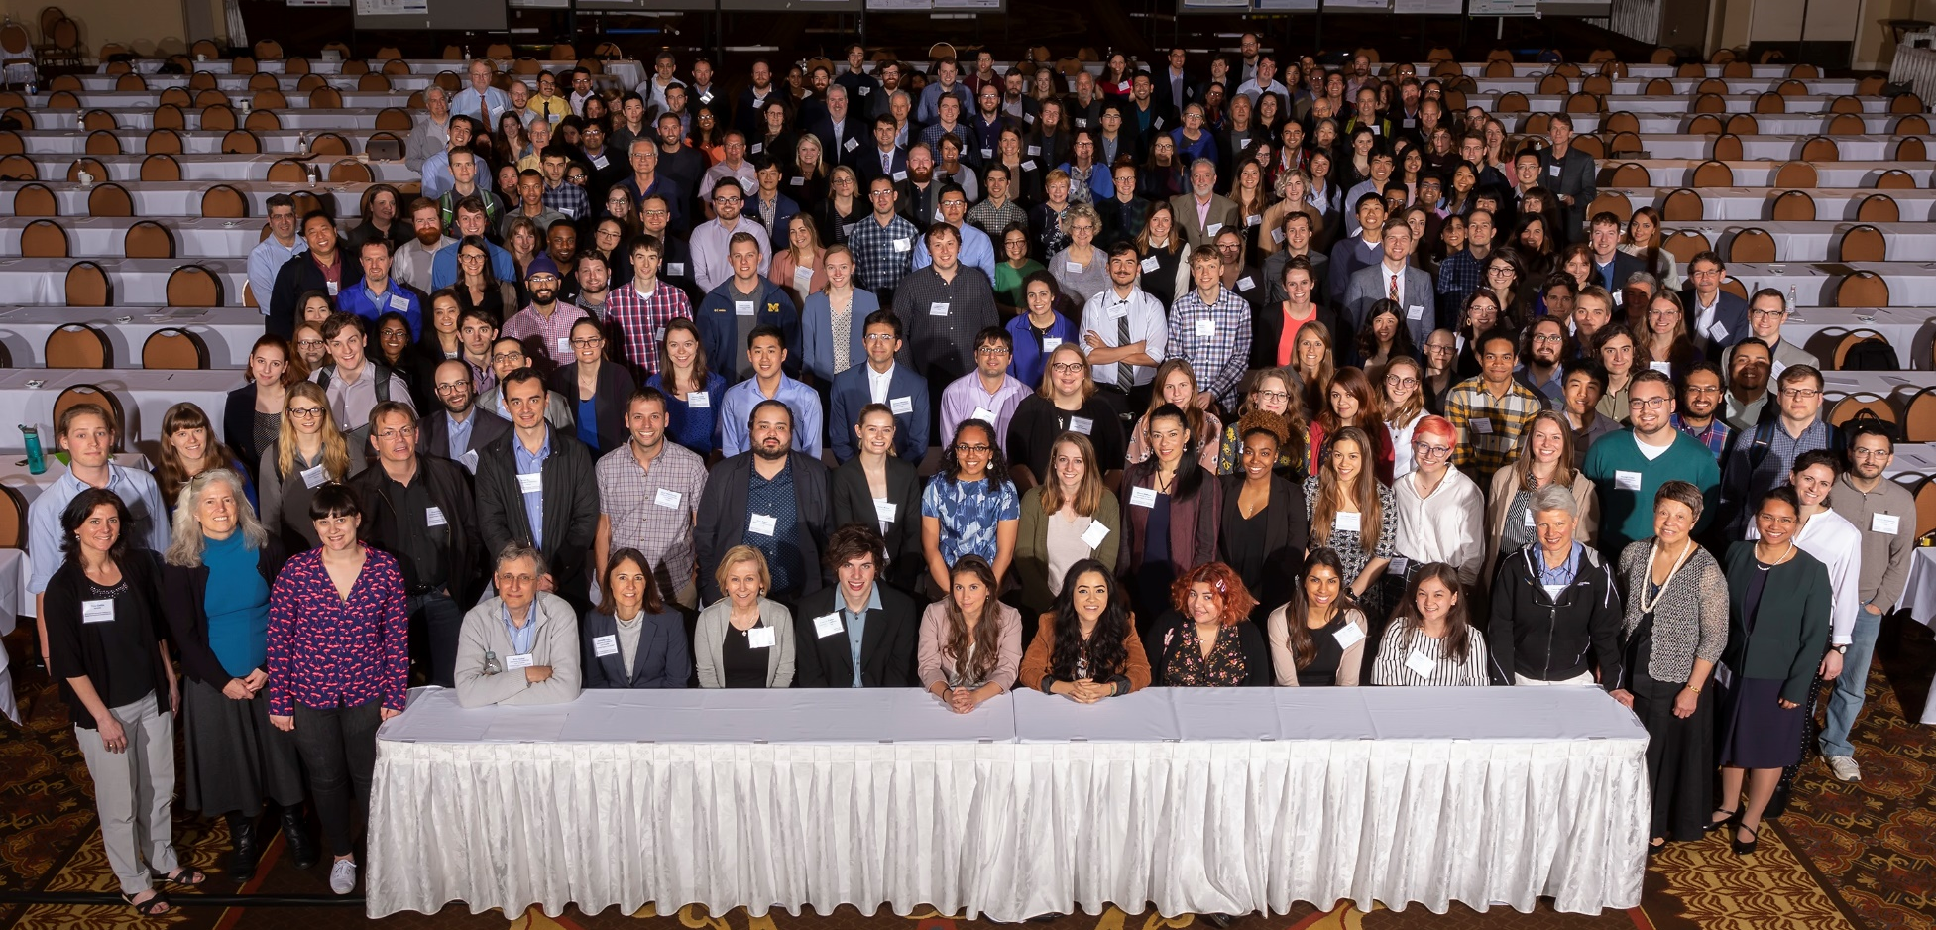
Training and Career Development
2019 Meeting (St. Louis)
2020 Meeting: March 30-April 1 @ UPenn
Document 28
Notes:
NHGRI offers training and career development support and opportunities through a variety of mechanisms, including individual fellowship and career development awards; institutional awards; and diversity and re-entry supplements. Our programs offer opportunities at the undergraduate, postbaccalaureate, graduate, postdoctoral, and faculty levels.
The Training and Career Development Program’s 4rd Annual Meeting was held last month in St. Louis. Trainees included those from the Diversity Action Plan programs, the T32 training programs, Centers of Excellence in Ethical, Legal, and Social Implications Research program, and individual awardees of fellowship and career-development awards. Of the 289 attendees, over 150 trainees presented abstracts as either a poster, lightning talk, or oral-platform presentation. Other highlights of the meeting included a ‘Genomics2020’ strategic planning session, a mock review panel, and networking lunches.
* The 2020 meeting will be held from March 30 to April 1 at the University of Pennsylvania.

Slide 45
Training and Career Development
Mentored Clinical Scientist Research Career Development Awards (K08)
NHGRI focus: Genomic Medicine
Awardees to date:
Jennifer Posey, MD, PhD
Baylor College of Medicine
Amit Khera, MD
Massachusetts General Hospital
Anandi Krishnan, PhD
Stanford University
Dustin Baldridge, MD, PhD
Washington University, St. Louis
Document 28
Notes:
The * Mentored Clinical Scientist Research Career Development Award (or K08 award) is an NIH funding opportunity that NHGRI has decided to now use. Like all K awards, the K08 award provides protected research support and time to aid in junior investigators transition to an independent research career.
* NHGRI’s focus with the K08 award program is genomic medicine research. * To date, NHGRI has funded four K08 awards, specifically to: Jennifer Posey, Amit Khera, Anandi Krishnan, and Dustin Baldridge.

Slide 46
Extramural Investigator-Initiated Highlights
Document 29
Notes:
Finally, I would like to provide some highlights from NHGRI’s investigator-initiated grant portfolio.
* The first highlighted paper from Khera et al. describes a genome-wide polygenic risk score that quantifies inherited susceptibility to obesity. The score integrates information from 2.1 million common genomic variants to identify adults at risk for severe obesity. When the researchers compared those having an inherited risk for obesity and those who did not, they found there was a 30-pound weight difference and 25-fold difference in rates of severe obesity between those with high versus low scores. The paper also highlights the importance of developing healthy eating habits in young children to reduce inherited predisposition to obesity.
* The next highlighted paper from Verma et al. describes the use of phenome-wide association studies (or PheWAS) as a tool for testing associations between genomic variation and multiple complex traits or diagnoses. These investigators created a network of associations from a large PheWAS of electronic health record-derived phenotypes. By using a single source of electronic health record data, the authors were able to gain a bird’s-eye view of disease connections characterized by underlying genetic associations. This method allows for examination of co-morbidities and pleiotropy and identified multiple unexpected disease connections.

Slide 47
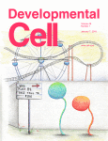
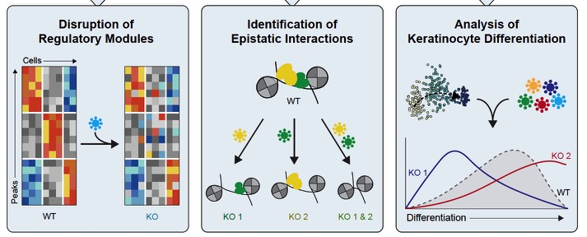
Extramural Investigator-Initiated Highlights
Document 29
Notes:
This paper by * Gupta et al. highlights single-cell RNA sequencing as a powerful method for studying changes in small sub-populations of cells that would be missed using traditional bulk analysis methods, which average results across a large number of cells. This study focuses on a generalizable approach for studying transient cell states through single cell RNA-seq and uses this method to trace the developmental trajectory of hair follicles. NHGRI supported the development of the computational framework used to predict these cellular and molecular changes from extremely large RNA-seq datasets.
* The paper by Rubin et al. describes a recent study to develop an improved, generalizable approach to map the dynamics and epistatic relationships of regulatory networks in cell-fate decisions. This approach makes it possible to place the regulatory factors into a gene network using a high-throughput CRISPR-based perturbation screens and single-cell epigenomic profiles. Epistatic interactions of the regulators were also identified through the analysis of pairs of perturbations. Lastly, it was possible to identify the cell states affected by the perturbations when applied to the dynamic process of keratinocyte differentiation.

Slide 48
Extramural Investigator-Initiated Highlights
Document 29
Notes:
Finally, * the paper by Sabatello et al. represents the first systematic survey of the attitudes of people with disabilities about participation in large-scale precision medicine research. Among the 1,294 respondents with at least one disability, 95% thought that precision medicine research should go forward, with 90% saying they would participate if asked. Nearly all respondents identified at least one major barrier to their participation, but the majority also felt that several specific strategies could help overcome these barriers.

Slide 49
Director’s Report Outline
General NHGRI Updates
General NIH Updates
General Genomics Updates
NHGRI Extramural Research Program
NIH Common Fund/Trans-NIH
NHGRI Division of Policy, Communications, and Education
NHGRI Intramural Research Program
Notes:
Moving on the NIH Common Fund and other trans-NIH efforts.
49

Slide 50
Human Microbiome Project (HMP)
Document 30
Notes:
The second phase of the ten-year Human Microbiome Project (or HMP), known as ‘integrative HMP,’ ended in 2016. This second phase was designed to collect and integrate molecular multi-omic properties from both the microbiome and host in three longitudinal cohort studies of typical microbiome-associated conditions: preterm birth, inflammatory bowel disease, and prediabetes. The project also developed the HMP ‘toolbox’ of research resources.
* This past February, a ten-year NIH-wide extramural microbiome grant portfolio analysis and a 2017 NIH-wide workshop report were published in the journal Microbiome as a part of an overall assessment of HMP and of human microbiome research more generally. A key finding of the portfolio review is that extramural human microbiome research is currently supported by 21 of the 27 NIH institutes and centers.
50

Slide 51
Knockout Mouse Phenotyping Project (KOMP2)
INFRAFRONTIER – IMPC Meeting: Helsinki (June 3-5)
Genomic Variation, Big Data, and Aging
KOMP2 Community Workshop: Bethesda (June 27)
Document 31
Notes:
The Knockout Mouse Phenotyping Project (or KOMP2) will create and phenotype 3,000 strains of knockout mice using CRISPR technology between 2016 and 2021. The project is on track to meet its goals for the fall of 2019. This program is part of the larger International Mouse Phenotyping Consortium (or IMPC).
* In early June, there will be a joint meeting between IMPC and INFRAFRONTIER, which is the European research infrastructure for phenotyping and archiving model mammalian genomes. This meeting will be focused on understanding the role of human genomic variation and its functional analysis in the context of big data; it will also focus on understanding the aging process and diseases associated with aging using mouse models.
* Since KOMP is nearing the end of its 10 years of support by the Common Fund, NIH is organizing a community workshop in late June. This workshop will solicit input from a representative group of biomedical scientists, with a focus on critically evaluating goals and opportunities for mouse phenotyping given the current scientific landscape.
51

Slide 52
Human Heredity and Health in Africa (H3Africa)
H3Africa supports 48 projects across 34 African countries
13th Consortium Meeting in Tunisia
Document 32
Notes:
The central goal of the Human Heredity and Health in Africa (or H3Africa) program is to develop a sustainable and collaborative African genomics research enterprise. Currently in its seventh year, the H3Africa consortium now involves 48 projects across 34 African countries, with >54,000 research participants enrolled to date.
* In early April, H3Africa held its 13th Consortium Meeting in Tunisia. A grant writing workshop was led by staff from the NIH, Wellcome Trust, and African Academy of Sciences, and was attended by >120 participants. There were also many discussions concerning genomic data sharing policies and sustainability efforts, which are key topics of consideration as the program nears the end of its NIH Common Fund support.
52

Slide 53
Human Heredity and Health in Africa (H3Africa)
Christian Happi
Guida Landoure
Jantina De Vries
H3Africa announced as a driver project for the Global Alliance for Genomics and Health
Several H3Africa members received recent recognitions
Document 32
Notes:
This past February, H3Africa was announced as a driver project for the Global Alliance for Genomics and Health (or GA4GH). H3Africa will work to develop and pilot GA4GH standards for sharing genomic and health-related data in a Pan-African context.
* Several H3Africa investigators recently received international recognitions. Christian Happi received the 2019 HUGO Africa Prize Award and was a presenter at the Human Genome Organization meeting in South Korea; Guida Landoure was interviewed on the BBC about his H3Africa project; and Jantina De Vries developed a video that was broadcast by the national South African media.
53

Slide 54
Undiagnosed Diseases Network (UDN)
The UDN website now has information in Spanish!
How to apply
Frequently asked questions
Video
Download the application
You can call or email the Helpdesk at the UDN Coordinating Center to find out more. We speak Spanish.
Document 33
Notes:
The NIH Common Fund’s Undiagnosed Diseases Network (or UDN) aims to improve the level of diagnosis and care for patients with undiagnosed diseases, facilitate research into the etiology of these diseases, and promote an integrated and collaborative community to investigate these difficult-to-diagnose diseases.
Recently, the UDN added information in Spanish to the UDN website.
54

Slide 55
La Red de Trabajo de Enfermedades No Diagnosticadas
¡El sitio web de la UDN ya tiene información en español!
Forma de hacer un solicitud
Preguntas frecuentes
Video
Descargar la solicitud
Usted puede llamar o mandar un correo electrónico al Centro de Coordinación de la UDN para conocer más. Se habla español.
Document 33
Notes:
The UDN website now has information on how to apply to the UDN and answers to frequently asked questions – all available in Spanish. Visitors can also watch an informational video and download a UDN application, again all in Spanish.
You can also call or email the helpdesk at the UDN Coordinating Center to find out more.
55

Slide 56
Information on All of Us program data and tools:
Data Snapshots
Data Browser
Survey Explorer
Document 34
Notes:
The All of Us Research Program is building a national biomedical resource of one million or more participants, reflecting the diversity of the United States. By gathering data on environment, lifestyle, genomics, and clinical outcomes, All of Us aims to accelerate research and improve the health of the U.S. population.
On May 6, the program hosted a symposium featuring NIH Director Francis Collins and All of Us Director Eric Dishman to commemorate the one-year anniversary of the program’s official launch. The live-videocast event chronicled the program’s progress as well as lessons and information that has been learned to date.
* During the symposium, there was an unveiling of the program’s Research Hub website. The goal of the Research Hub is to provide access to * information on All of Us program data and tools. Currently, All of Us data include physical measurements, survey data, and information from electronic health records. Key features now available through the Research Hub include: * data snapshots, which give a broad overview of the program’s enrollment and metrics; * the data browser, which is an interactive tool that allows researchers and members of the general public to delve into the available data; and * the survey explorer, which provides source information about the collection tools used for participant-provided information.
56

Slide 57
Director’s Report Outline
General NHGRI Updates
General NIH Updates
General Genomics Updates
NHGRI Extramural Research Program
NIH Common Fund/Trans-NIH
NHGRI Division of Policy, Communications, and Education
NHGRI Intramural Research Program
Notes:
Moving on to NHGRI’s Division of Policy, Communications, and Education.
57

Slide 58
NHGRI Redesigns genome.gov
Document 35
Notes:
Last month, NHGRI launched a redesigned version of its public website, genome.gov.
Whether using a desktop or mobile device, users will now experience an entirely new look and feel, and have more ways to find information about NHGRI’s research, funding opportunities, and public outreach initiatives. Beneath the surface, the site has a modernized technical environment supported by a cloud-hosting service and the open-source platform Drupal. Together, these elements both provide more flexibility for our web developers and content creators as well as improve the stability and security of the website.

Slide 59
NHGRI History of Genomics Program
JHB Special Issue
Oral Histories
Speaker Series
Perspectives on the Human Genome Project and Genomics
Document 36
Notes:
NHGRI’s History of Genomics Program continues their efforts to capture the history of genomics and NHGRI.
* The Journal of the History of Biology (or JHB) recently released a special issue that includes six publications on the historical legacy of the Human Genome Project and genomics. This issue resulted from our History of Genomics Program’s workshop entitled “Capturing the History of Genomics” that was held in April 2015.
* The History of Genomics Program has also continued to conduct oral histories to capture the perspectives and experiences of NHGRI staff and leaders in genomics research. There are now 15 such oral histories available for public viewing, including the recently released edited oral history given by the late U.S. Representative Louise Slaughter.
* The History of Genomics Program has also continued its Speaker Series that brings historians, philosophers, and sociologists to NIH to give talks. Shown here is William deJong-Lambert, a recent speaker who discussed the history of Drosophila genetics in Thomas Hunt Morgan’s ‘Fly Room.’
* Lastly, in November 2018, the History of Genomics Program held a workshop at NIH entitled ”Perspectives on the Human Genome Project and Genomics,” at which scholars of genomics met with NHGRI program staff to discuss the history of the Human Genome Project.

Slide 60
American Sign Language Film: Genetic Testing for Breast Cancer
Document 37
Notes:
NHGRI partnered with students and researchers at Gallaudet University (in Washington, DC) to create a short educational film about genetic testing for breast cancer that was signed in American Sign Language. The purpose of this language-accessible film is to increase awareness about preventative genetic screenings and communicating with genetic counselors. Creating such accessible educational content will help to increase engagement among communities that are historically underserved. This new film is available on NHGRI’s GenomeTV channel of YouTube.

Slide 61
2019 National DNA Day
Document 38
Notes:
April 25 is National DNA Day, and every year, NHGRI hosts celebrations to mark the occasion. * To kick off this year’s National DNA Day events, David Kong, a synthetic biologist at MIT’s Lincoln Lab and co-creator of Biota Beats, gave the 2nd annual Louise M. Slaughter National DNA Day Lecture. Biota Beats is a project that translates the human microbiome into music. David also spoke about connecting the life sciences with diverse communities; his talk was held on April 23 and broadcast through Facebook Live so that teachers, students, and members of the public could participate.
* Next, on April 24, NHGRI hosted an “Ask Me Anything” session on the popular online discussion forum Reddit. Prominent researchers from the NIH Intramural Research Program and the University College London answered questions posed by the public.
* To close out the National DNA Day celebrations, NHGRI partnered with the Smithsonian National Museum of Natural History in hosting NHGRI’s Erin Ramos for a Human Origins Today (or HOT) Topic talk about human genetic variation for precision medicine.
* Lastly, NHGRI’s National DNA Day event map for this year highlighted over 77 National DNA Day events across the U.S. as well as at eight international sites.

Slide 62
Genome: Unlocking Life’s Code Exhibition Travel Schedule
September 12 – January 2, 2020
Turtle Bay Exploration Park, Redding, CA
January 17 – April 12, 2020
Museum of Science & History, Jacksonville, FL
Document 39
Notes:
The NHGRI-Smithsonian exhibition Genome: Unlocking Life’s Code will make several more stops across North America as it continues to travel in 2019 and into 2020. The exhibition completed its stay at the Orange County History Museum in Florida in early January. The exhibition was most recently at the McWane Science Center in Birmingham, Alabama, closing yesterday. * It will be opening this fall at Turtle Bay Exploration Park in Redding, California and remain there until the start of 2020. * Following that, the exhibition will make its way back to the east coast to Jacksonville, Florida.
Please continue to check the exhibition’s website and follow it on social media for the most up-to-date program information.

Slide 63
Inter-Society Coordinating Committee for
Practitioner Education in Genomics (ISCC)
Document 40
Notes:
The Inter-Society Coordinating Committee for Practitioner Education (or ISCC) aims to improve practitioner genomic literacy and to enhance the practice of genomic medicine through the sharing of educational approaches and joint identification of educational needs. The ISCC is now led by Co-Chairs Richard Haspel (from the Beth Israel Deaconess Medical Center) and Carla Easter (Chief of NHGRI’s Education and Community Involvement Branch). Donna Messersmith serves as the ISCC Project Group Coordinator.
In February, the ISCC held its annual in-person meeting at NIH. Eliseo Pérez-Stable, Director of the National Institute on Minority Health and Health Disparities, gave the keynote address and discussed genomics education, minority health, and health disparities. In addition, five ISCC project groups met to discuss their work.
Since last year’s in-person meeting, 50 new members have joined the ISCC, and 2 new project groups were created. A compendium of genomics educational resources and activities can be found on the ISCC webpage.

Slide 64
Director’s Report Outline
General NHGRI Updates
General NIH Updates
General Genomics Updates
NHGRI Extramural Research Program
NIH Common Fund/Trans-NIH
NHGRI Division of Policy, Communications, and Education
NHGRI Intramural Research Program
Notes:
64
And finally, moving on to NHGRI’s Intramural Research Program.

Slide 65
Elected to National Academy of Sciences
Elaine Ostrander, Ph.D.
Document 41
Notes:
While I briefly touched on this earlier, let me embellish the news about a great honor for one of NHGRI’s outstanding intramural researchers.
Elaine Ostrander, Chief of NHGRI’s Cancer Genetics and Comparative Genomics Branch, was recently elected into the National Academy of Sciences. I recruited Elaine to NHGRI’s Intramural Research Program shortly after I became the Institute’s Scientific Director, and we have been incredibly proud of her ever since. At NHGRI, Elaine has continued her amazingly productive program in comparative genomics and cancer research. She is regarded as one of the top leaders in dog genomics, having initiated the Canine Genome Project in 1993. Her work is regularly featured on the covers of major scientific journals, such as the two examples shown here. She has published over 350 papers and won numerous awards, with election into the National Academy of Sciences being the most recent. Congratulations to Elaine.
65

Slide 66
Health and Human Services Career Achievement Award
Dan Kastner, M.D., Ph.D.
Document 42
Notes:
Earlier this month, Dan Kastner, NHGRI’s Scientific Director and Director of the Institute’s Intramural Research Program, received yet another honor, this time the prestigious Health and Human Services Career Achievement Award. This award reflects Dan’s remarkable and long-term career in government service, starting when he arrived at NIH in the 1980s. His pioneering work on the genetics of autoinflammatory diseases has brought him many well-deserved accolades over the years, including this one. Congratulations to Dan.
66

Slide 67
NHGRI Intramural Research Highlights
Researchers create the largest global catalog of variations in the dog genome
Researchers uncover gene regions that affect cholesterol levels in smokers
Linking genes to ADHD by mapping connections in the brain
Document 43
Notes:
The NHGRI Intramural Research Program has once again been very productive since the last Council meeting. A few of their research highlights include:
* Elaine Ostrander and colleagues have generated the largest catalog of genomic variants associated with physical traits for domesticated dog breeds and wild canids, demonstrating and expanding the utility of companion animal systems for the study of mammalian growth and biology.
* Amy Bentley and colleagues identified new gene regions that influence cholesterol levels, some of which affect people differently if they are smokers or former smokers. The study further demonstrates the importance of including diverse populations, stressing that careful consideration of ancestry could be of particular importance for gene-by-environment interactions, with ancestry playing a proxy role for both genomic and environmental contexts.
* Philip Shaw and colleagues found that polygenic risk for attention-deficit/hyperactivity disorder (or ADHD), but not inattention, was associated with symptoms of hyperactivity-impulsivity and white-matter microstructure. This work begins to reveal the interconnection between genetic risk, brain structure, and ADHD symptoms.

Slide 68
Document 44
Notes:
Before ending my Director’s Report, I would like to (as always) put in a plug and say that anyone wishing to receive my monthly email update (called The Genomics Landscape) can simply go to the NHGRI website (genome.gov) and subscribe under “Email Updates.”
68

Slide 69
Thanks!
Special Thanks!
Notes:
Finally, a personal thanks to the 50-60 NHGRI staff members who contributed the slides and associated materials that I just reviewed in my Director’s Report. As always, such a group effort is essential for getting this large amount of information conveyed efficiently at each Council meeting.
An additional thanks to the NHGRI communications group and web team for making my Director’s Report into an electronic resource.
And * a special thanks to the usual ‘ring leader’ for helping to prepare my Director’s Report each time, Kris Wetterstrand. Here, Kris is spearing one of the horribly invasive-in-the-Caribbean lionfish, whose genome was recently sequenced (as I mentioned earlier).
69

Slide 70
Notes:
70

