Slide 1
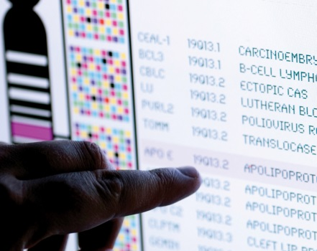
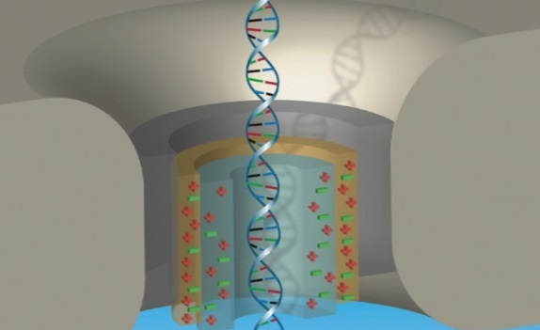
DIRECTOR’S REPORT
Eric Green, M.D., Ph.D.
Director, NHGRI
May 2020
Document #
Notes:
Once again, I would like to welcome all of you to this Open Session of the National Advisory Council for Human Genome Research meeting. While I would normally have an in-person audience for my Director’s Report, the current situation with the COVID-19 pandemic has caused me to make this presentation while sitting alone in my conference room. In addition (and to accommodate an overall shorter Council meeting), we decided to shorten my Director’s Report considerably. Nonetheless, we retained what I think are a useful assortment of updates that we wanted to share with you.
As with the rest of the Open Session, my Director’s Report presentation is being videotaped, and that recording will be made available as a permanent archive on NHGRI’s website (genome.gov).
1

Slide 2
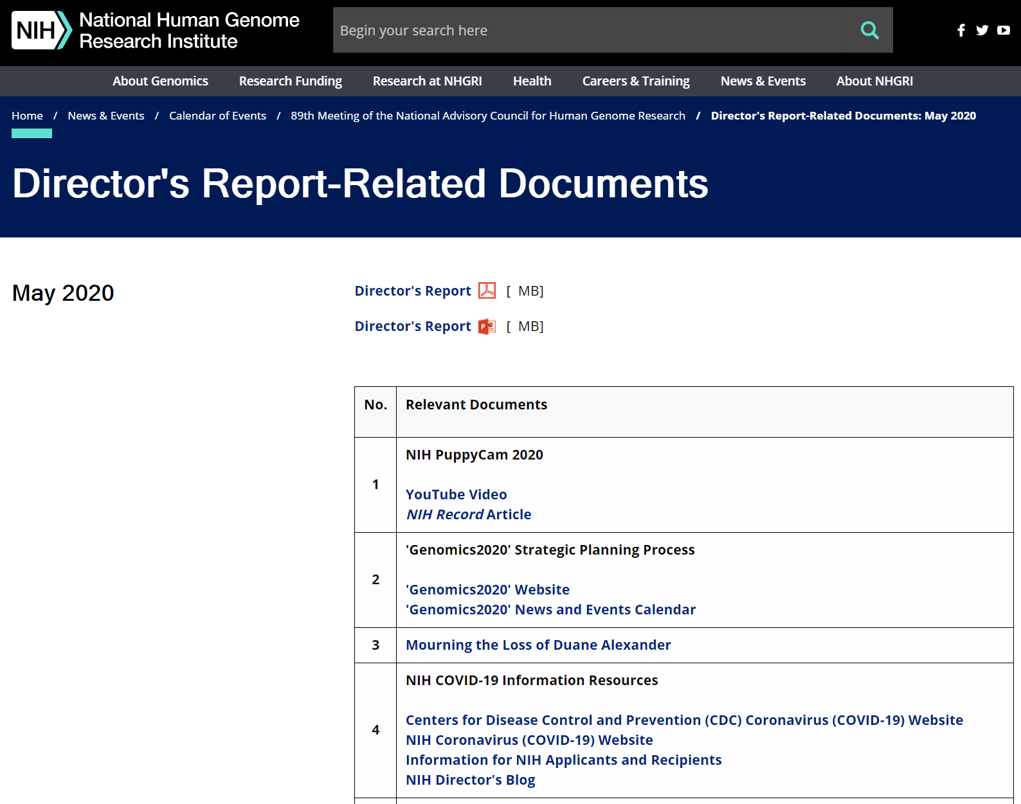
genome.gov/DirectorsReport
Document #
Notes:
For those who are new to our Council meetings, I want to make you aware of the ‘electronic resource’ that is developed for my Director’s Report. Analogous to the supplemental materials of a published paper, this resource can be accessed at the URL shown here.
The slides that I will show during my Director’s Report are also available electronically at this site – * both in PDF and PowerPoint formats.
* When there are documents or relevant websites associated with a particular slide, you will find a ‘Document #’ indicated on the bottom right of that slide; that ‘Document #’ references materials that can be accessed and/or downloaded from the web page shown here. This dedicated web page and all linked documents will be archived on genome.gov as part of the historic record for this Council meeting.
2

Slide 3
Open Session Presentations
Concept Clearances:
Research Experiences in Genomic Research for Genetic Counselors
Luis Cubano
Research Experiences in Genomic Research for Data Scientists
Luis Cubano
Technology Development for Single-Molecule Protein Sequencing
Tina Gatlin
Investigator-initiated Research on Genetic Counseling Processes and Practice
Ebony Madden
Notes:
There will be a number of other presentations during the Open Session of this Council meeting. My Director’s Report is tailored around those presentations, and I will not discuss in detail the topics that others will cover.
* Following my Director’s Report, there will be four concept clearances presented by staff of the Institute’s Extramural Research Program.
Luis Cubano will describe two related training proposals, * one on “Research Experiences in Genomic Research for Genetic Counselors” and one on * “Research Experiences in Genomic Research for Data Scientists.”
* The third concept on “Technology Development for Single-Molecule Protein Sequencing” will be presented by Tina Gatlin.
* And the fourth concept on “Investigator-initiated Research on Genetic Counseling Processes and Practice” will be presented by Ebony Madden.
3

Slide 4
Director’s Report Outline
General NHGRI Updates
General NIH Updates
General Genomics Updates
NHGRI Extramural Research Program
NIH Common Fund/Trans-NIH
NHGRI Division of Policy, Communications, and Education
NHGRI Intramural Research Program
Notes:
For the rest of my Director’s Report, I will cover the 7 areas listed here, which reliably provide a nice framework for reviewing the relevant topics.
4

Slide 5
Director’s Report Outline
General NHGRI Updates
General NIH Updates
General Genomics Updates
NHGRI Extramural Research Program
NIH Common Fund/Trans-NIH
NHGRI Division of Policy, Communications, and Education
NHGRI Intramural Research Program
Notes:
5
And I will start with some general NHGRI updates.

Slide 6
Genomics on Capitol Hill
Rep. Eric Swalwell (CA-15) and
NHGRI Director Dr. Eric Green
Notes:
Back in February and immediately after we ended the second day of the February Council meeting, I had the opportunity to travel (well, Uber) to Capitol Hill to meet with several Congressional members and their staffs. The photograph shown here was taken at the end of a productive and engaging meeting with Representative Eric Swalwell of California’s 15th District. We had a wide-ranging discussion about genomics, precision medicine, and the future of healthcare. I can report to you that Representative Swalwell is extremely interested and informed about genomics and its many promising developments. Part of our work at NHGRI is to inform Congress and to respond to their questions about the science that taxpayers’ dollars are funding, and I was pleased to have this opportunity to fulfill that part of my job.

Slide 7
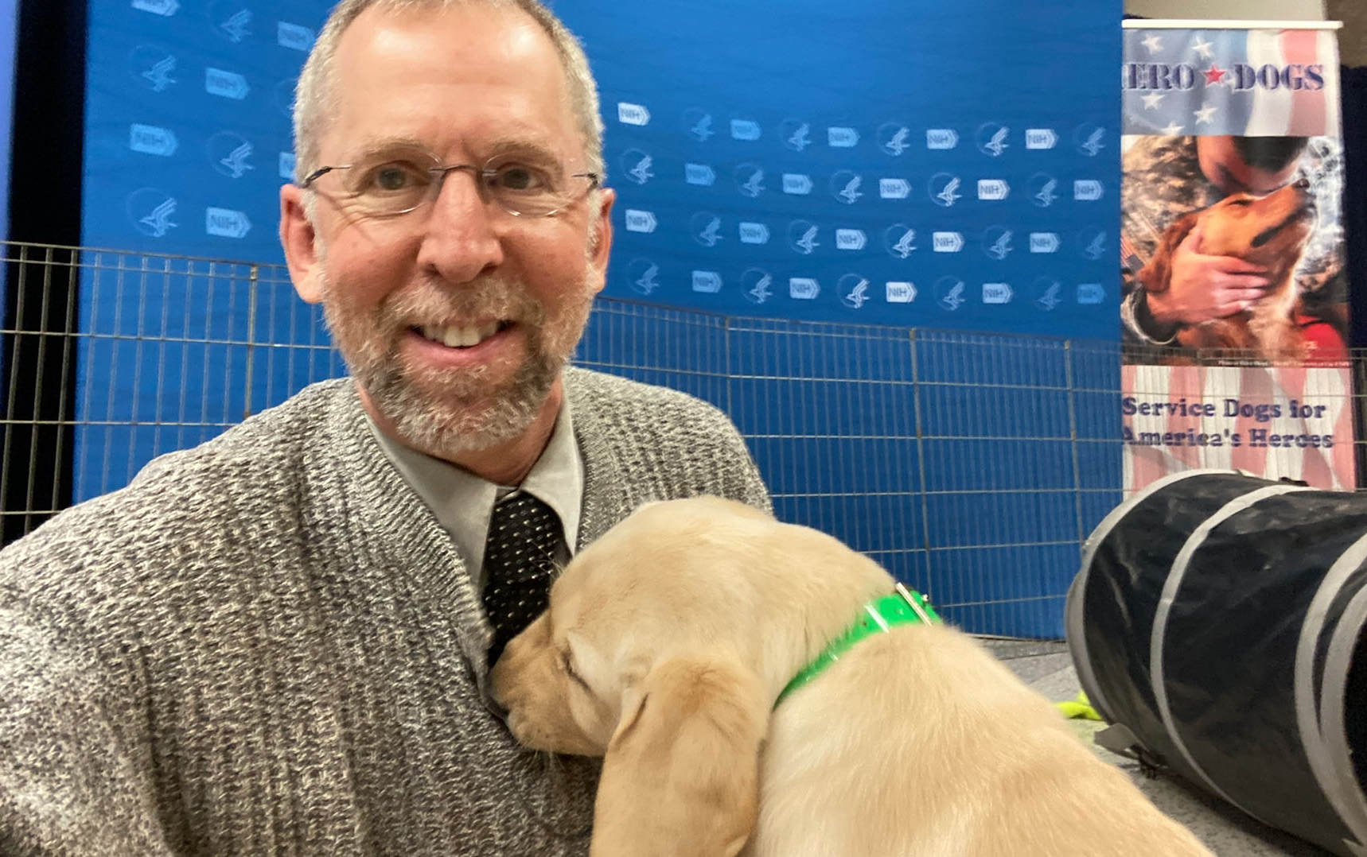
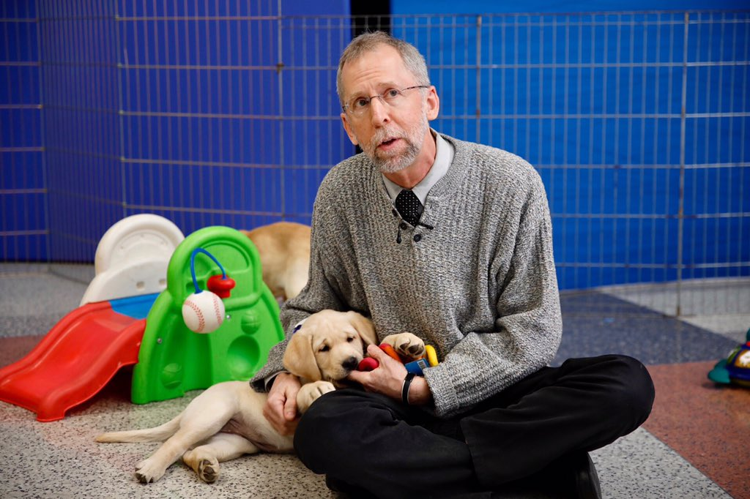
NIH PuppyCam 2020
Document 1
Notes:
While meeting with Representative Swalwell was enjoyable and productive, my favorite appointment since the last Council meeting occurred a couple days later, * when I had a spirited encounter with eight energetic yellow Labrador Retriever puppies as part of the NIH PuppyCam 2020. This event showcased the important role that dogs play in various aspects of human health, such as serving as support and therapy animals, stress relievers, and companions.
NIH PuppyCam 2020 was live-streamed and starred a set of puppies who were in-training to become support dogs. Throughout the day, various NIH staff, including some senior leaders, were asked to hang out with the puppies while being interviewed. I can tell you from first-hand experience that this sounds easier than it is, especially knowing that the interview is being live-streamed and when you have a puppy laser-focused on eating your lapel microphone (as you can see on the right). Nonetheless, I survived this tough assignment and was able to talk about the importance of dogs in my life (and even provide some facts about the dog genome).
NIH PuppyCam 2020 was a huge success on social media, with almost 50,000 views on Twitter and over 170 million impressions of the various tweets from NIH staff.

Slide 8
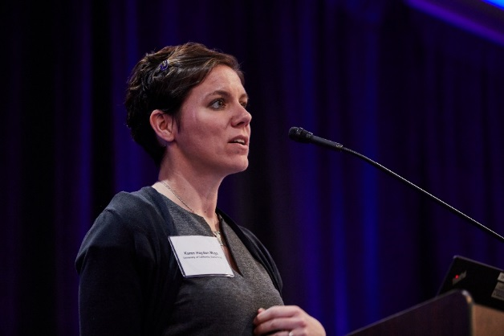
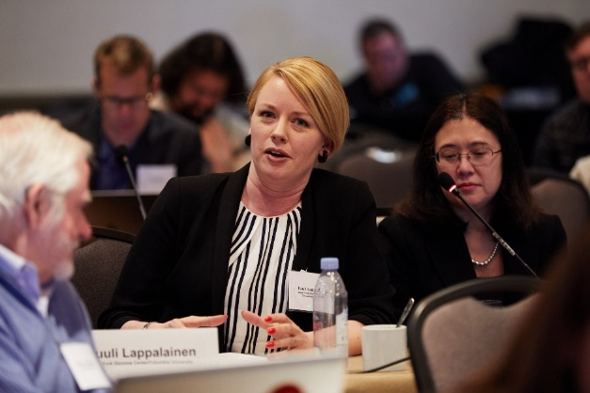
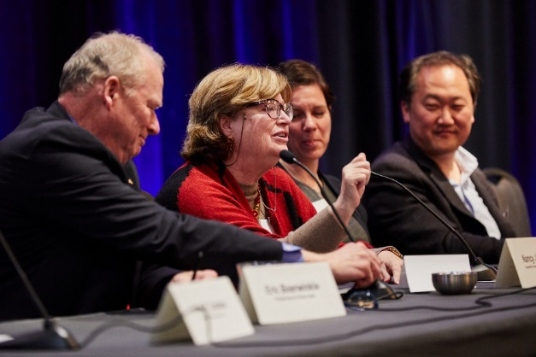
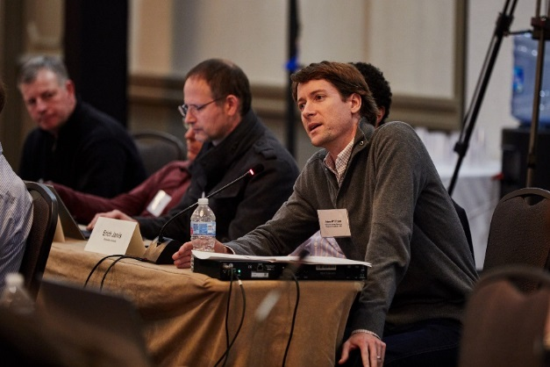
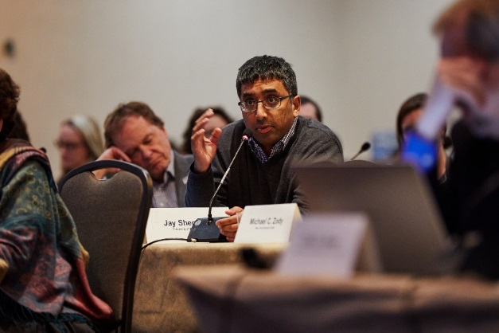
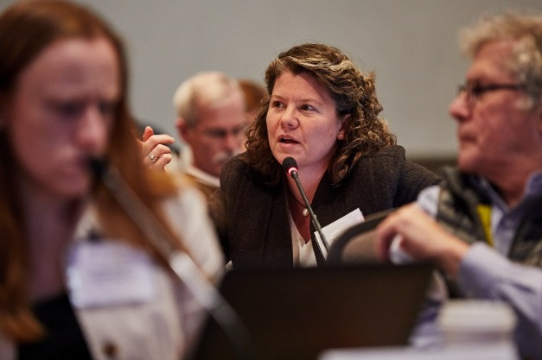
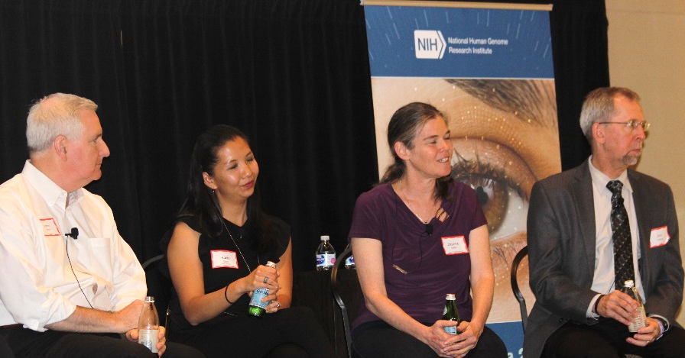
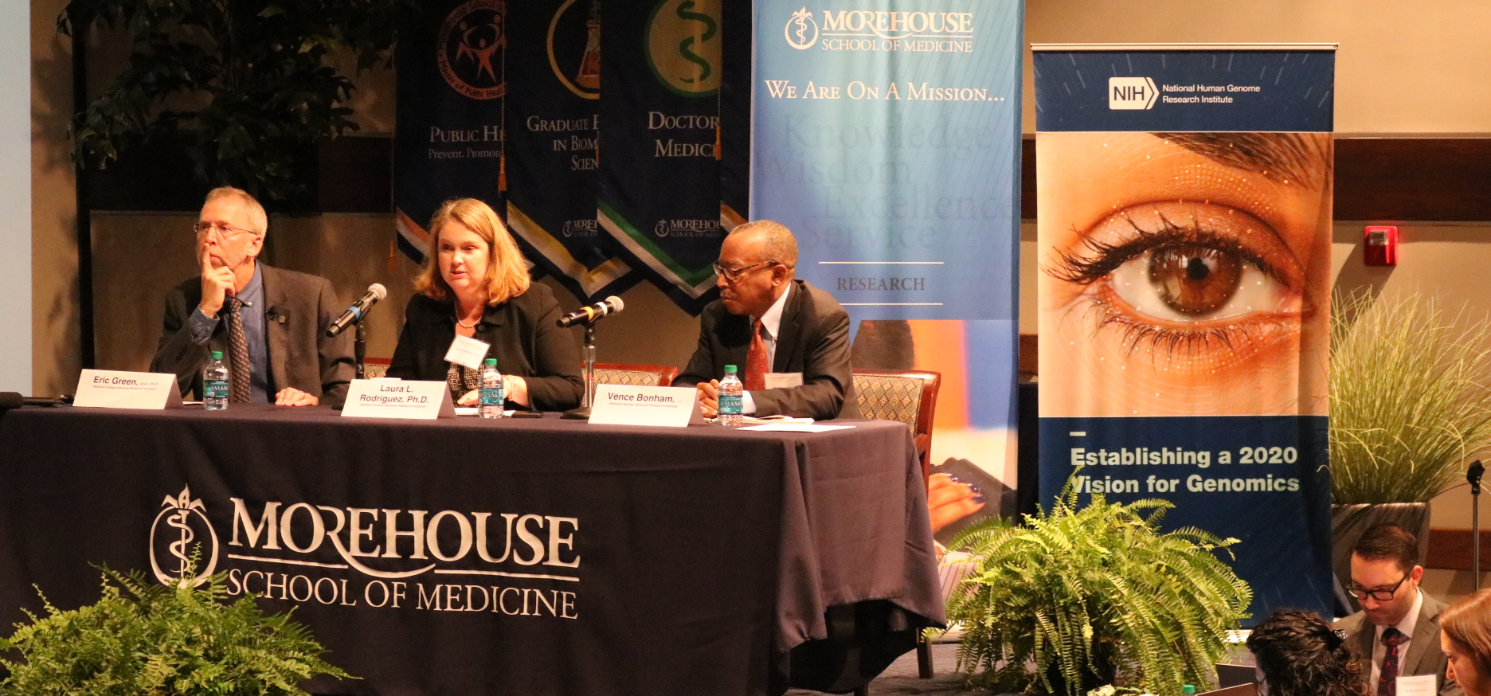
‘Genomics2020’ Strategic Planning Process
October 2020 Publication
Document 2
Notes:
NHGRI’s ‘Genomics2020’ strategic planning process is now well into its homestretch en route to developing the Institute’s new strategic plan, which will be published in October 2020.
To date, ‘Genomics2020’ has been associated with over 50 events that gathered input and feedback from the research, healthcare, education, policy, and diverse public communities; these events have included town halls, workshops, meeting sessions, advisory committee discussions, webinars, and poster sessions, among others.
A draft version of the strategic plan was made available for comment last month, with feedback received through various means. We are now actively synthesizing that feedback and finalizing the strategic plan, which will be submitted for publication in the early summer.
8

Slide 9
Director’s Report Outline
General NHGRI Updates
General NIH Updates
General Genomics Updates
NHGRI Extramural Research Program
NIH Common Fund/Trans-NIH
NHGRI Division of Policy, Communications, and Education
NHGRI Intramural Research Program
Notes:
Moving on to general NIH updates.
9

Slide 10
Mourning the Loss of Duane Alexander
Document 3
Notes:
Duane Alexander, former Director of the Eunice Kennedy Shriver National Institute of Child Health and Human Development (or NICHD), passed away in February. He was 79 years old. As NICHD Director from 1986 to 2009, Duane led efforts to improve the health of mothers and children through research and its translation into practice. He presided over efforts that led to the near elimination of maternal-to-child transmission of HIV in the United States, the prevention and correction of neural tube defects (such as spina bifida), and the identification of the genetic bases for Fragile X and Rett syndromes.
10

Slide 11
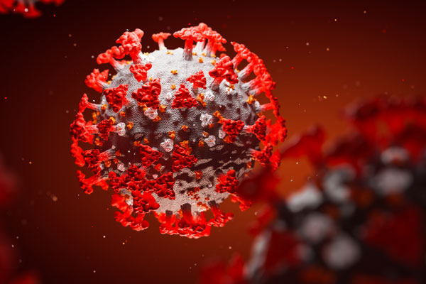
NIH COVID-19 Information Resources
Document 4
Notes:
The rapidly changing situation with the COVID-19 pandemic is raising many questions by many people. Several government websites are available that provide relevant information about the virus and the disease that it causes, such as those at the Centers for Disease Control and Prevention (or CDC) and the NIH.
For NIH grantees and applicants, a new COVID-19 resource is now available on the NIH Grants and Funding website. In addition, NIH regularly issues news releases regarding COVID-19-related funded research and scientific findings. Finally, NIH Director Francis Collins’s blog provides another good source of updated information.
11

Slide 12
Funding for COVID-19 Research
Document 5
Notes:
Needless to say, NIH is aggressively tackling the biomedical research challenges associated with COVID-19. These efforts include developing programs and mechanisms for funding research grants related to COVID-19. For example, a number of NIH Institutes and Centers have issued Funding Opportunity Announcements (or FOAs) to solicit research proposals related to COVID-19.
Recognizing the interest and opportunities in the genomics community to contribute to COVID-19 research, NHGRI has issued a Notice of Special Interest (or NOSI) regarding the opportunity for making urgent competitive revisions to existing research grants. Specifically, this NOSI invited current NHGRI grantees to submit proposals for adding research elements to their existing grants. These elements needed to address scientific questions of direct and immediate relevance to the COVID-19 pandemic. Applications in response to this NHGRI NOSI were due on May 15.
12

Slide 13
Fiscal Year 2020 Appropriations
 | Fiscal Year 2019 Labor-HHS Appropriation | Fiscal Year 2020 Labor-HHS Appropriation | $ Increase | % Increase
NIH | $39.1 B | $41.7 B | ~$2.6 B | ~6.6%
NHGRI | $575 M | $606 M | ~$31 M | ~5.4%
Document 6
Notes:
In May, we typically provide an update about the activities on Capitol Hill related to appropriations, as lawmakers are usually drafting bills to try to have a budget in place prior to the beginning of the next fiscal year on October 1. In fact, we typically would have seen the first versions of the appropriations bills being voted on and would have a sense of the possible budgetary numbers for the Department of Health and Human Services and perhaps even the NIH. However, as you can appreciate, this is not a typical year.
Nonetheless, even in the midst of all the legislative work related to COVID-19, staffers are also simultaneously drafting budgets for Fiscal Year 2021. We hope to see those numbers sometime soon but, as with many things at the moment, we will have to wait and see what happens next.
Meanwhile, and as a reminder, for Fiscal Year 2020, the final NIH appropriation was $41.7 billion, with NHGRI receiving around $606 million (as seen in the middle column). This reflected a roughly $2.6 billion increase for NIH and a $31 million increase for NHGRI (as seen in the second column from the right). Overall, this made NIH’s increase about 6.6% and NHGRI’s increase about 5.4% (as seen in the far-right column).
13
13

Slide 14
Director’s Report Outline
General NHGRI Updates
General NIH Updates
General Genomics Updates
NHGRI Extramural Research Program
NIH Common Fund/Trans-NIH
NHGRI Division of Policy, Communications, and Education
NHGRI Intramural Research Program
Notes:
Moving on to general genomics updates.
14

Slide 15
Mourning the Loss of Ken Paigen
Document 7
Notes:
Kenneth Paigen, a geneticist who served as Director of the Jackson Laboratory (or JAX) from 1989 to 2003, died in February. He was 92 years old and actively conducted research until shortly before his death. His research spanned investigating the molecular mechanisms of gene regulation to studying recombination hotspots in the human and mouse genomes. He was also an early advocate for mapping and sequencing the human genome.
According to a statement from the JAX, “Ken was a brilliant scientist, a treasured colleague and mentor, and a towering figure in JAX’s history. He will forever be remembered for the indelible impact he had on JAX, including his leadership in rebuilding the Lab following the devastating fire of May 1989.”
15

Slide 16
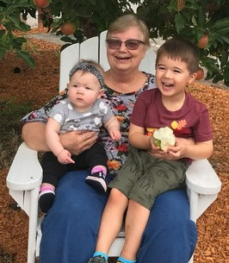
Mourning the Loss of Mary Shimoyama
Document 8
Notes:
Mary Shimoyama, Associate Professor of Biomedical Engineering at the Medical College of Wisconsin, Principal Investigator (or PI) of the Rat Genome Database, and one of the leaders and major contributors to the NHGRI Alliance of Genome Resources, passed away in February. Mary also served as a co-PI of the Somatic Cell Gene Editing Consortium’s Dissemination and Coordination Center. She was a strong proponent of the use of model organism data and bioinformatic methods to support research into human diseases.
16

Slide 17
Mourning the Loss of James Taylor
Document 9
Notes:
James Taylor, Professor of Computer Science and Biology at Johns Hopkins University, passed away in April. James was one of the founders and developers of the Galaxy Project, an open-source platform for data-intensive genomics research with an international community of users and developers. A strong advocate for open genomic data science and reproducible research, his work in biomedical data science education and training for the Galaxy Project inspired and benefited many scientists around the world. He was also a lead investigator for the NHGRI AnVIL platform.
James made numerous other significant contributions to NHGRI and genomics, starting with his work on the ENCODE Pilot Project as a graduate student at Penn State University. He also had a commendable record of serving on NHGRI and other NIH review panels.
17

Slide 18
Elected to National Academy of Sciences
Brenda Andrews
Hugo Bellen
Bonnie Berger
Howard Chang
Arul Chinnaiyan
Victor Corces
Adrian Krainer
Kerstin Lindblad-Toh
Molly Przeworski
Mark Stoneking
NATIONAL
ACADEMY
OF SCIENCES
Document 10
Notes:
The National Academy of Sciences recently announced their newly elected members. Of particular relevance to the genomics community and to NHGRI are the individuals listed here. We extend our heartfelt congratulations to these colleagues (with a special shout out to Howard Chang, one of our new Council members).
18

Slide 19
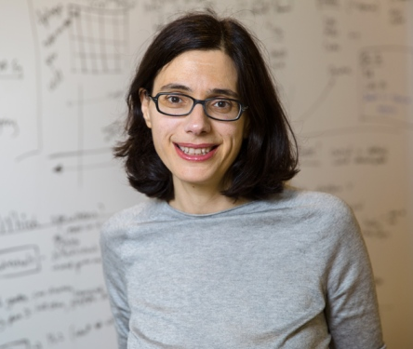
New Executive Vice President of Genentech Research and Early Development
Aviv Regev, Ph.D.
Document 11
Notes:
In breaking news from last week, former Council member Aviv Regev will leave the Broad Institute of MIT and Harvard later this summer to join Genentech as the new Executive Vice President of Genentech Research and Early Development (or gRED). In her new role, Aviv will continue her research spanning cell circuits, tissue circuits, and human biology and disease, including translational work involving patient biology and therapies. She will be moving to the San Francisco Bay Area in August, but her laboratory will continue at the Broad Institute for one more year.
19

Slide 20
Director’s Report Outline
General NHGRI Updates
General NIH Updates
General Genomics Updates
NHGRI Extramural Research Program
NIH Common Fund/Trans-NIH
NHGRI Division of Policy, Communications, and Education
NHGRI Intramural Research Program
Notes:
Moving on to the NHGRI Extramural Research Program.
20

Slide 21
ICGC/TCGA Pan-Cancer Analysis
Publication of Nature Collection with 24 papers, data portals, and datasets
Cross-tumor analysis of >2600 cancer genomes
Discovery of fundamental cancer biology
Innovations in large-scale cloud-based data sharing
Document 12
Notes:
The Cancer Genome Atlas (or TCGA) was a coordinated effort between NHGRI and the National Cancer Institute (or NCI). Although this project completed data generation in 2016, its data and resources continue to be used for studying the molecular basis of cancer. TCGA partnered with the International Cancer Genome Consortium (or ICGC) for the Pan-Cancer Analysis of Whole Genomes (or PCAWG) Project, and the major findings from this project were published in Nature and Nature journals in February.
The PCAWG Nature Collection includes * 24 papers with relevant links to data portals and datasets. * The cross-tumor analysis involved over 2600 cancer genome sequences and their matching normal genome sequences across 38 tumor types enabled * scientific discoveries of fundamental cancer biology, including the ability to infer the order of cancer-driving mutations that may have happened decades ago.
* Innovations in large-scale data sharing among international partners in a cloud-based environment was an essential part of this project’s success.

Slide 22
Mendelian Genomics Research Consortium Receipt Dates Extended
Applications are now due July 15, 2020
Document 13
Notes:
NHGRI has extended the receipt dates related to the two new funding opportunities for a Mendelian Genomics Research Consortium.
* As I mentioned in my February Director’s Report, NHGRI intends to fund research centers that will discover novel associations in Mendelian conditions as well as develop and apply approaches to discover causal genomic variants in known Mendelian conditions for which a candidate gene was not identified by exome sequencing.
* NHGRI will also fund a Data Coordination Center that will manage data release and disseminate findings; coordinate program logistics and administrative duties; and oversee an Opportunity Fund for follow-up functional studies of discoveries made by the research centers.
* Applications for the research centers and data coordination center are now due on July 15, 2020. All applicants are encouraged to submit letters of intent by June 15, 2020.

Slide 23
Human Genome Reference Program
Genome Reference Representations:
Heng Li
Mark Chaisson
Hanlee Ji
Document 14
Notes:
The Human Genome Reference Program (or HGRP) represents NHGRI’s continued commitment to refining and maintaining the human genome reference sequence. Specifically, HGRP is a multi-component effort that aims to improve the human genome reference sequence and foster its long-term sustainability. At the February Council meeting, I announced the first two components of this program, which were awarded last fall: specifically, a Human Genome Reference Center at Washington University and a High-Quality Human Reference Genomes Sequencing Center at University of California, Santa Cruz.
* This spring, awards were made for a third component, the Genome Reference Representations. This component will focus on research and development for establishing next-generation genome reference representations that capture human genome variation and enable research on the full diversity of populations. Awards were made to Heng Li at the Dana-Farber Cancer Institute, Mark Chaisson at the University of Southern California, and Hanlee Ji at Stanford University. These new projects will seed an open-source model that encourages the integration of community-based tool development for genomics, epigenomics, function, and clinical research into the HGRP.

Slide 24
Technology Development Program
Funding Opportunity Announcements:
Novel Synthetic Nucleic Acid Technology Development
R01 (RFA-HG-20-014) and linked R21, R43/R44
Due date: June 24, 2020
NHGRI Technology Development Coordinating Center
U24 (RFA-HG-20-019)
Due date: June 24, 2020
Novel Nucleic Acid Sequencing Technology Development
R01 (RFA-HG-18-001) and linked R21, R43/R44
Due date: June 26, 2020
Document 15
Notes:
NHGRI is expanding our successful Genome Technology Program to include two new components.
* First, we have released a series of related funding announcements focused on technology development to improve the quality, capabilities, and efficiency of nucleic acid synthesis and synthetic constructs at decreased costs. * Second, we have released a funding announcement for a coordinating center to help integrate and accelerate our genomic technology development efforts. The coordinating center will be responsible for facilitating collaborations, sharing program advances, promoting standards, and managing an opportunity funds program. Applications for both these initiatives are due on June 24, 2020.
* In addition to these new activities, NHGRI continues to fund novel nucleic acid sequencing technology development work to decrease nucleic acid sequencing costs, develop nucleic acid sequencing methods, and increase throughput. Applications for these areas are due on June 26, 2020. We also continue to fund nucleic acid sequencing technology and genomic technology through the NIH parent funding announcements.
24

Slide 25
Phenotypes and Exposures (PhenX) Toolkit
Domains:
Symptoms
Knowledge and attitudes
Adherence to mitigation behaviors
Social impacts
Economic impacts
Document 16
Notes:
The Phenotypes and Exposures Toolkit (or PhenX) is a catalog of consensus protocols for measuring phenotypes and exposures in biomedical research.
In response to the COVID-19 pandemic, NHGRI and the PhenX team (led by Carol Hamilton at RTI International) have collaborated with a trans-NIH working group (co-led by the National Institute of Aging and the Office of Behavioral and Social Sciences Research) to create a catalog of available measurement protocols for COVID-19 research. The goal of this resource is to facilitate collaboration and data integration.
* Domains include COVID-19 symptoms, knowledge and attitudes, adherence to various mitigation behaviors, social impacts, and economic impacts.
25

Slide 26
Clinical Genome Resource (ClinGen)
Genomic Expert Curation Panels PAR-20-101
Curate genes and variants associated with high-priority diseases
Use ClinGen curation frameworks and tools
Deposit assertions into ClinVar
NCI
NEI
NICHD
NIMH
NINDS
Application due dates:
May 27, 2020; May 27, 2021; May 27, 2022
Document 17
Notes:
The Clinical Genome Resource (or ClinGen) evaluates and disseminates the clinical relevance of genes and genomic variants for use in precision medicine and research.
In January, the Eunice Kennedy Shriver National Institute of Child Health and Human Development (or NICHD) issued a Funding Opportunity Announcement to establish ClinGen expert panels for curating genes and genomic variants associated with diseases or conditions of high priority to NICHD’s mission. In addition to NICHD, the National Cancer Institute (or NCI), the National Eye Institute (or NEI), the National Institute of Mental Health (or NIMH), and the National Institute of Neurological Disorders and Stroke (or NINDS) have also signed onto this funding opportunity.
* These Expert Curation Panels will be required to utilize ClinGen curation frameworks and tools to determine the clinical significance of the selected genes and genomic variants. * The final assertions and supporting evidence generated by each Expert Curation Panel will be deposited into ClinVar. * There will be annual application due dates, the first one being on May 27 of this year.
26

Slide 27
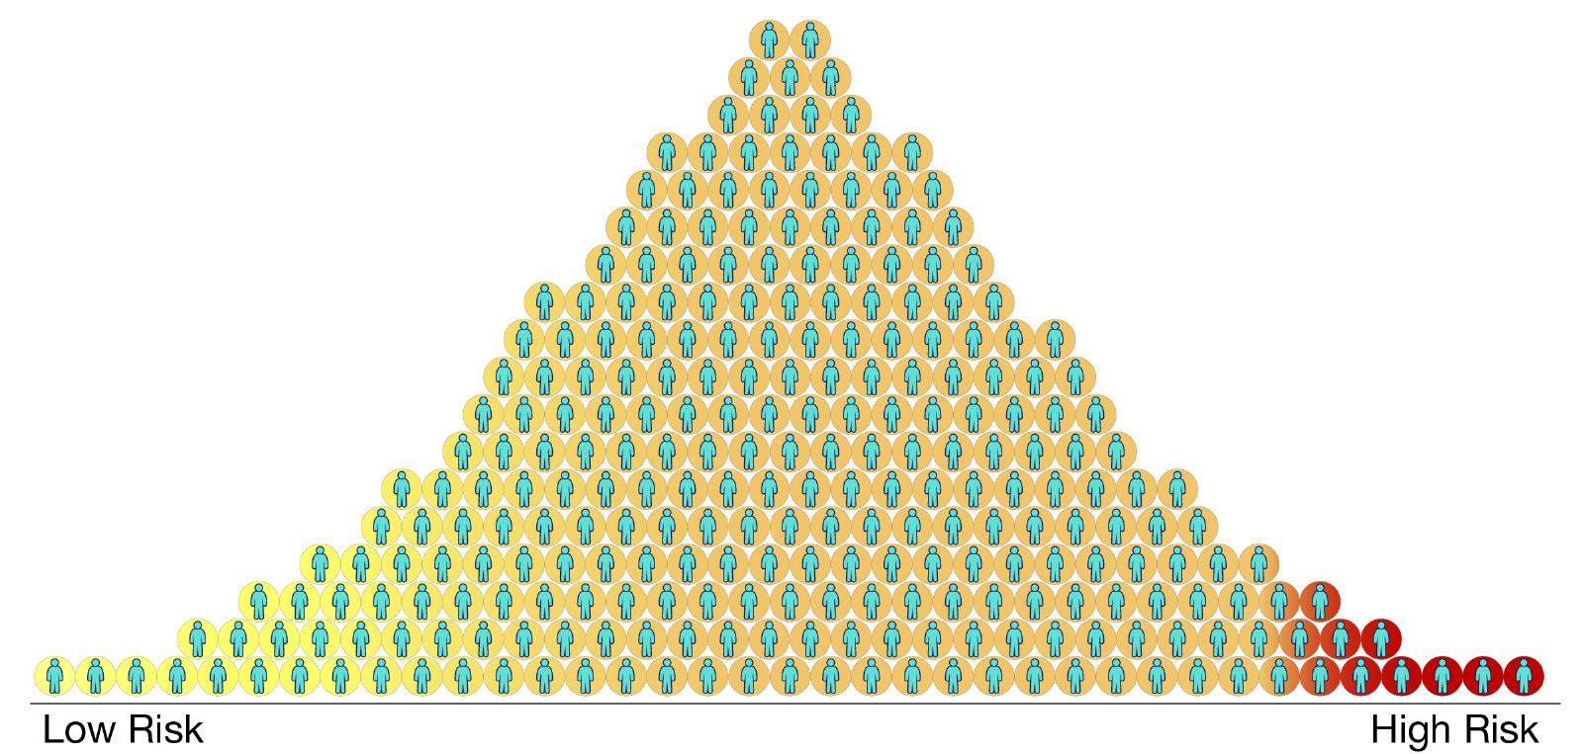
Polygenic Risk Score Diversity Consortium Funding Opportunity Announcements
Applications due on June 23, 2020
Document 18
Notes:
NHGRI has issued two new Funding Opportunity Announcements for a Polygenic Risk Score (or PRS) Diversity Consortium. This Consortium will study the known poorer PRS-based prediction of health and disease risk in non-European populations (compared to European ancestry populations) using existing datasets that are genetically diverse and have broad phenotype information. For the first funding opportunity, grantees will harmonize phenotypes, develop PRS methods, and collaboratively generate and refine PRSs for populations of diverse ancestry and a range of complex diseases and traits. For the second funding opportunity, a Coordinating Center will be established for the Consortium and will focus on data integration, methods development, analysis, and dissemination of PRS models and data to the broader scientific community.
* Applications for both funding opportunities are due on June 23, 2020.

Slide 28
Stakeholder Engagement Supplements
September 2019 Strategic Planning Workshop
on Genomics in Medicine and Health
Document 19
Notes:
The September 2019 Strategic Planning Workshop on Genomics in Medicine and Health recommended the engagement of patients, providers, and communities as partners in genomic medicine research.
To address this recommendation, NHGRI offered a supplement opportunity for stakeholder engagement in genomic medicine research. These supplements will support partnerships between genomics researchers and relevant stakeholders, such as professional societies, payers, public health and regulatory agencies, communities, patients, patient groups, primary care providers, and caregivers. The goal of these research partnerships is to enhance the translation of genomics into improved clinical care and public health. The deadline for responding to this supplement opportunity was last week.
28

Slide 29
Training and Career Development
February 2020 Report from Training and Education Task Force
Document 20
Notes:
The February 2020 Report from this Council’s Training and Education Task Force recommended the expansion of opportunities for individuals to obtain training in genomics research. NHGRI has moved quickly to developed supplement opportunities to fund research training for * genetic counselors * and data scientists.
The Task Force also recommended the development of training modules and the training of healthcare providers. In response to these recommendations, we are collaborating with the * National Center for Advancing Translational Sciences to provide support for the development of training modules in genomic medicine and the * National Institute of Nursing Research for genomics training of nurses.
The submission deadlines for these supplement opportunities have now passed. Of note, we plan to follow these short-term, one-time funding opportunities with long-term programs to address the needs identified by the Task Force.
29

Slide 30
Extramural Meeting Schedule Changes
H3Africa Consortium Meeting: Virtual – March 2020
AnVIL and Interoperability of NIH Cloud-based Platforms: Virtual – March 2020
AnVIL and NIH Cloud-based Platforms: Virtual – April 2020
NIH Sustainability and Future Directions of Undiagnosed Diseases Network Workshop: Virtual – April 2020
IGNITE II Steering Committee Meeting: Virtual – April 2020
Genome Sequencing Program Meeting: Virtual – April 2020
Document 21
Notes:
In order to manage the COVID-19 pandemic realities related to travel limitations, stay-at-home orders, and social distancing routines, many NHGRI and NIH meetings have been canceled, re-scheduled, and/or held virtually. Since this is a shortened Director’s Report, we decided to provide simple lists about the fate of various meetings. As you can see here, H3Africa, AnVIL, UDN, IGNITE, and the Genome Sequencing Program have all held virtual meetings over the past few months.
30

Slide 31
Extramural Meeting Schedule Changes
Advanced Genomic Technology Development: Virtual – May 26-29, 2020 (tentative)
CSER Spring 2020 Meeting: Virtual – May 29, 2020
GWAS Catalog Summary Statistics Workshop: Virtual & Re-scheduled – June 1-2, 2020
AnVIL/GSP Jamboree: Virtual – June 11-12, 2020
ELSI Virtual Forum: New – June 15-16, 2020
5th ELSI Congress: Re-scheduled – March 22-24, 2021
GM XIII: Genomics and Public Health Meeting: Postponed – TBD
Curating the Clinical Genome: Postponed – TBD
Document 21
Notes:
Meanwhile, the Advanced Genomic Technology Development Program, CSER, the GWAS Catalog, and the AnVIL with the GSP will hold virtual meetings over the next couple of months.
* The ELSI Virtual Forum will be held on June 15-16, 2020. This will be a free online event featuring keynote and plenary speakers as well as panel presentations over the course of two days; registration is required by June 10. The 5th ELSI Congress, originally scheduled for June 2020, has been re-scheduled to March 22-24, 2021.
* Lastly, both the GM XIII: Genomics and Public Health and the Curating the Clinical Genome meetings have been postponed, with the new dates to be determined.
31

Slide 32
Director’s Report Outline
General NHGRI Updates
General NIH Updates
General Genomics Updates
NHGRI Extramural Research Program
NIH Common Fund/Trans-NIH
NHGRI Division of Policy, Communications, and Education
NHGRI Intramural Research Program
Notes:
Moving on the NIH Common Fund and other trans-NIH efforts.
32

Slide 33
Human Heredity and Health in Africa (H3Africa)
H3Africa investigators guiding African response to COVID-19
Christian Happi (Nigeria) and African Center of Excellence for Genomics of Infectious Diseases:
Sequenced first African SARS-CoV-2 genome
Sequencing samples from all COVID-19 patients in African Union
Christian Happi
Additional H3Africa investigators involved in international and domestic response to COVID-19:
Mogomotsi Matshaba, Lynn Morris, Ambroise Wonkam, & Elizabeth Mayne (South Africa)
Seydou Doumbia (Mali)
Leon Mutesa (Rwanda)
Dwomoa Adu (Ghana)
Document 22
Notes:
The central goal of the Human Heredity and Health in Africa (or H3Africa) program is to develop a sustainable and collaborative African genomics research enterprise.
* As COVID-19 continues to affect global populations, H3Africa investigators are guiding the response to the pandemic on the African continent.
* In March, H3Africa investigator Christian Happi and his team at the African Center of Excellence for Genomics of Infectious Diseases led the effort to sequence the first African SARS-CoV-2 genome in coordination with the Nigerian Centers for Disease Control and other Nigerian research organizations. In addition, Dr. Happi and his Center have been tasked to sequence samples from all COVID-19 patients in the African Union for the duration of the pandemic.
* Several additional H3Africa investigators are now involved in larger roles related to the international and domestic response to the COVID-19 pandemic, such as serving on Presidential Task Forces, providing guidance to their respective Ministries of Health, and coordinating institutional responses to COVID-19. These investigators (such as those listed here) have been and will continue to be influential in guiding the response to the pandemic as well as shaping the future research priorities in their respective countries.
33

Slide 34
Director’s Report Outline
General NHGRI Updates
General NIH Updates
General Genomics Updates
NHGRI Extramural Research Program
NIH Common Fund/Trans-NIH
NHGRI Division of Policy, Communications, and Education
NHGRI Intramural Research Program
Notes:
Moving on to NHGRI’s Division of Policy, Communications, and Education.
34

Slide 35
Ken Burns Presents The Gene: An Intimate History
Document 23
Notes:
For almost three years, NHGRI has been working in partnership with the Washington, DC local Public Broadcasting System affiliate WETA in support of developing the film The Gene: An Intimate History. The four-hour, two-part documentary from Ken Burns and Barak Goodman aired on April 7 and April 14 and was adapted from the award-winning book of the same name by Sid Mukherjee. The documentary wove together science, history, and personal stories in describing a historical biography of the human genome, while exploring breakthroughs for diagnosis and treatment of genetic diseases and the associated complex ethical questions.
NHGRI was the major education and outreach partner associated with the film and assisted with the development of engaging educational animations, lesson plans, and a do-it-yourself (or DiY) version of the Smithsonian’s National Museum of Natural History-NHGRI exhibition Genome: Unlocking Life’s Code. Information about these resources can be found on the PBS Learning Media website and the National Museum of Natural History’s DiY exhibition website.

Slide 36
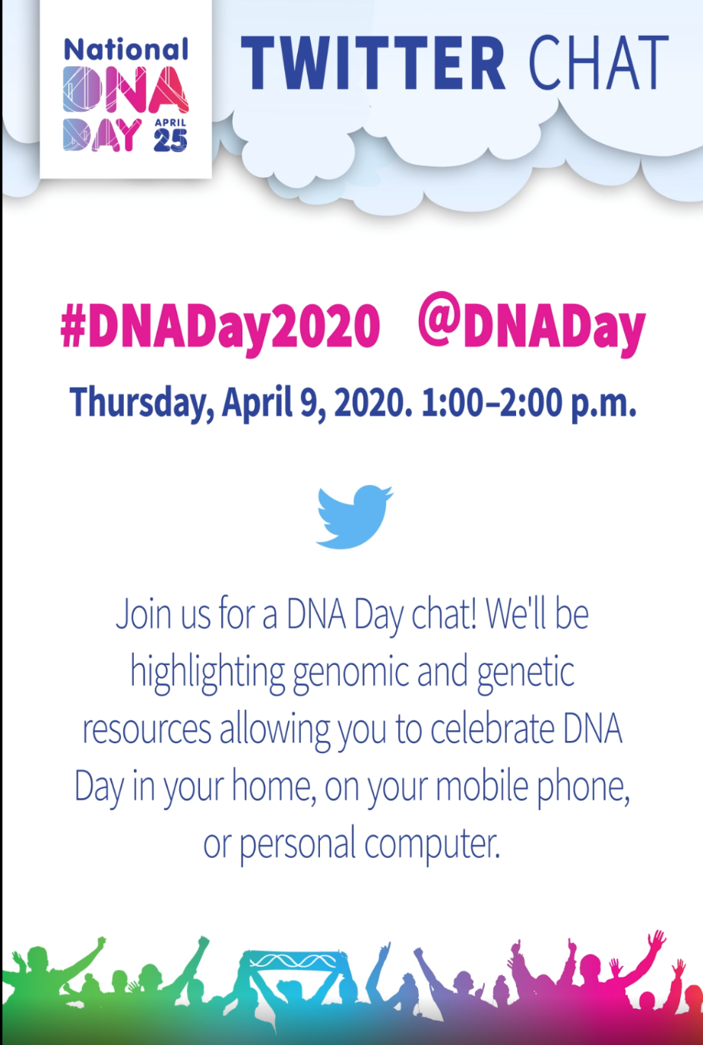
National DNA Day 2020
Document 24
Notes:
April 25 is National DNA Day and every year, NHGRI hosts programs and offers educational resources to mark the occasion. This year, DNA Day was celebrated throughout April using virtual formats.
* A Twitter Chat was held on April 9 highlighting genetic, genomic, and general STEM resources available to families celebrating DNA Day at home.
* Then, on April 16, NHGRI partnered with H3Africa grantee Nicki Mulder and her team to host a DNA Day virtual speaker exchange. Ayo Doumatey of NHGRI’s Center for Research on Genomics and Global Health and H3Africa trainee Jorge da Rocha each presented their research findings to a global audience.
* Finally, on April 23, NHGRI’s Genomics and Health Disparities Interest Group hosted a DNA Day 2020 virtual presentation by speaker Janina Jeffs, who spoke about using bioinformatics and podcasting to advance precision medicine initiatives in diverse populations.

Slide 37
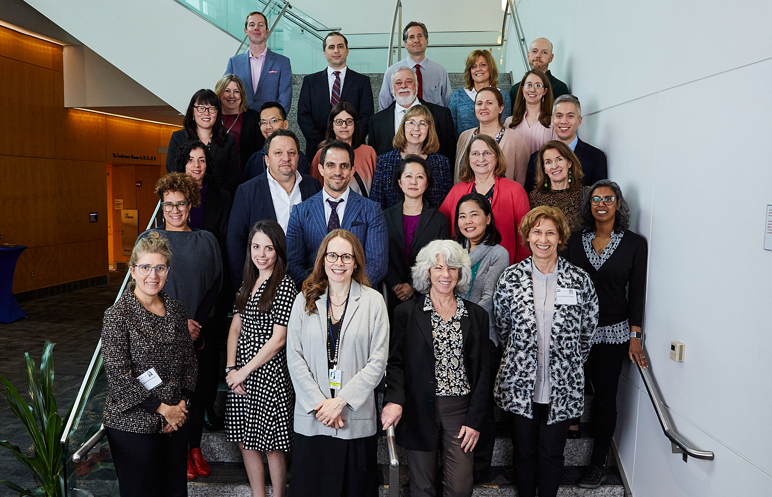
Inter-Society Coordinating Committee for
Practitioner Education in Genomics
Document 25
Notes:
The Inter-Society Coordinating Committee for Practitioner Education in Genomics (or ISCC-PEG) aims to improve practitioner genomic literacy and enhance the practice of genomic medicine through the sharing of educational resources and identification of educational needs. ISCC-PEG membership includes over 180 representatives from professional organizations and societies, NIH institutes and centers, and industry, as well as individuals with expertise in medical education. This year’s in-person meeting was held back in February. This meeting included a keynote talk by Council member Jeff Botkin and updates about funding opportunities from NHGRI extramural program staff.

Slide 38
Director’s Report Outline
General NHGRI Updates
General NIH Updates
General Genomics Updates
NHGRI Extramural Research Program
NIH Common Fund/Trans-NIH
NHGRI Division of Policy, Communications, and Education
NHGRI Intramural Research Program
Notes:
38
And finally, moving on to NHGRI’s Intramural Research Program.

Slide 39
HHS Career Achievement Award
Bill Gahl, M.D., Ph.D.
Document 26
Notes:
Bill Gahl, Senior Investigator in NHGRI’s Medical Genetics Branch and Founding Director of the NIH Undiagnosed Diseases Program, was honored with the 2019 U.S. Department of Health and Human Services Career Achievement Award. This award recognizes employees in the Department with ten or more years of service for their dedication and accomplishments.
* Bill was also recently featured in MIT Technology Review – a very impressive achievement as well.
39

Slide 40
Document 27
Notes:
Before ending my briefer-than-usual Director’s Report, I would like to (as always) put in a plug and say that anyone wishing to receive my monthly email update (called The Genomics Landscape) can simply go to the NHGRI website (genome.gov) and subscribe under “Email Updates.”
40

Slide 41
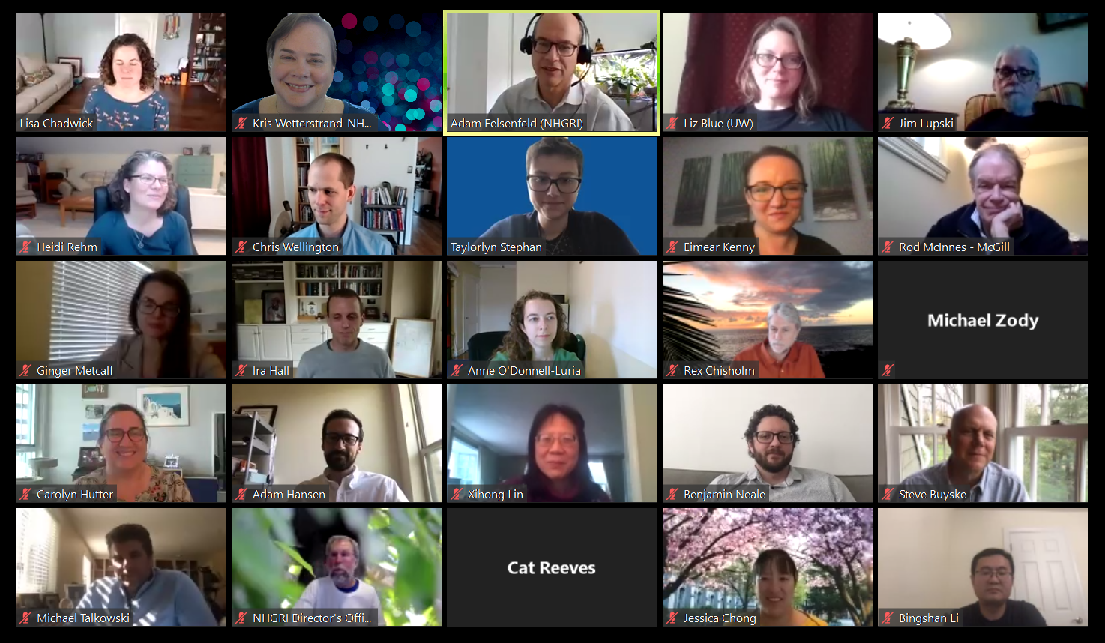
Thanks!
Special Thanks!
Notes:
Finally, a personal thanks to the many NHGRI staff members who contributed the slides and associated materials that I just reviewed in my Director’s Report. As always, a group effort is essential for getting such a large amount of information conveyed efficiently at each Council meeting.
An additional thanks to the NHGRI communications group and web team for making my Director’s Report into an electronic resource.
And * a special thanks to the usual ‘ring leader’ for helping to prepare my Director’s Report each time, Kris Wetterstrand (shown here on the top row, second from the left). This is one of the Zoom-based virtual group photos for the last-ever meeting of the Genome Sequencing Program.
41

Slide 42
Notes:
42

