Slide 1
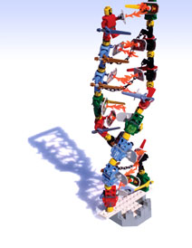
Missing heritability at 10: reviewing the origin and impact of concepts and publications
Orli G. Bahcall, PhD
Senior Editor for
Genetics & Genomics
Nature
o.bahcall@us.nature.com
Twitter: @obahcall
NHGRI missing heritability meeting
May 1, 2018

Slide 2
GWAS, the early years
AJHG, Volume 101, Issue 1, p5–22, 6 July 2017.

Slide 3
GWAS, reviewing the early years

Slide 4
A few metrics

Slide 5
A few metrics

Slide 6
Our views on impact of a Review
Resource: Comprehensive, accurate, balanced summary of the primary research in the field.
Educational: Clear explanation of concepts to a broad scientific readership.
Representing genetics: Central highlights for press and public readership.

Slide 7
Impact of the ‘so-called missing heritability problem’
Perception and impact within the genetics community?
Within broader scientific community?
How has this influenced research directions?
How has this influenced public perception of human genetics?

Slide 8
A few related Reviews

