Slide 1
Common variants and their contribution to heritability
(“GWAS and heritability”)
peter.visscher@uq.edu.au

Slide 2
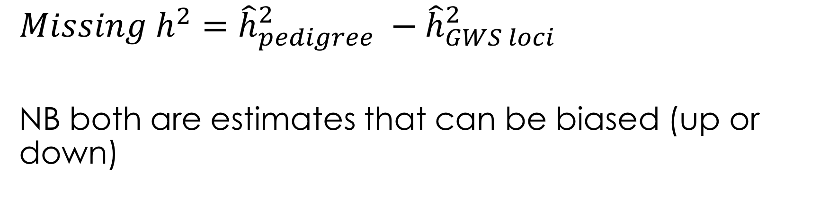
The original definition of ‘missing heritability’
$$Missing h^{2}={\hat{h}}_{pedigree}^{2} −{\hat{h}}_{GWS loci}^{2}$$
NB both are estimates that can be biased (up or down)

Slide 3
My 2009 presentation
Theory and applications of quantitative genetics: heritability, estimation and prediction
Estimation of heritability using DNA markers:
  Using segregation within families
  Using GWAS data on “unrelated” individuals (unpublished data that became Yang et al. 2010 NG)

Slide 4
Yang et al. 2010 NG: SNP-heritability
Estimation, not hypothesis testing
Variance explained by all genotyped SNPs ~ 45% for height
Contrast 45% with 5% from GWS SNPs (Manolio 2009)
Larger GWAS sample size → discovery of more GWS loci
‘Infinite’ sample size → 45% of variance explained by GWS SNPs; prediction R² → 45%

Slide 5
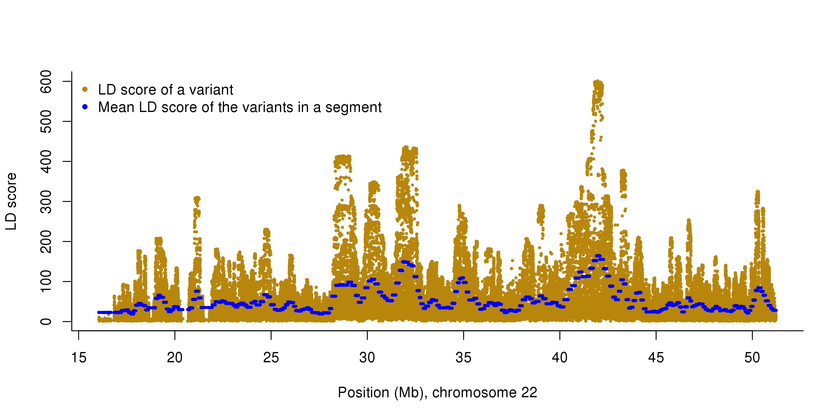
Robust estimation from imputed variants by accounting for LD and MAF
Totals
57% for height
27% for BMI
Yang et al. 2015 (Nature Genetics)

Slide 6
Re-reading Manolio et al. 2009
“Many explanations for this missing heritability have been suggested, including
much larger numbers of variants of smaller effect yet to be found;
rarer variants (possibly with larger effects) that are poorly detected by available genotyping arrays that focus on variants present in 5% or more of the population;
structural variants poorly captured by existing arrays;
low power to detect gene–gene interactions;
and inadequate accounting for shared environment among relatives.”

Slide 7
“much larger numbers of variants of smaller effect yet to be found”
Cumulatively, common variants explain ~1/3 to ~2/3 of heritability (GREML and LD Score regression methods)
Much larger numbers of variants have indeed been found e.g.
  from 40 to 3000+ for height
  8 to 700+ for BMI
  0 to 1000+ for educational attainment / IQ
  1 to 250 for schizophrenia
  32 to 200 for inflammatory bowel disease
  18 to 150 for Type 2 diabetes

Slide 8
“rarer variants (possibly with larger effects)“
Evidence for natural selection: rare(r) variants associated with complex traits have larger effects
  height
  BMI
  disease
But cumulatively, rare variants contribute a small amount of heritability
  T2D
  Height, BMI

Slide 9
New definitions of ‘heritability’ since 2009…
Missing
Phantom
Pedigree
SNP
Hiding
Genomic
etc.

Slide 10
New data since 2009
GWAS summary statistics
More and ever-larger GWAS
Transcriptional and epigenetic resources
Fully sequenced reference panels
  imputation accuracy down to MAF = 0.5%
Large single cohort studies, e.g. UK Biobank
Contributions from commercial companies e.g. 23andMe

Slide 11
New methods since 2009
GREML (Yang 2010, 2015 NG; 2011 AJHG)
LD score regression (Bulik-Sullivan 2015 NG 2x)
Prediction methods (Purcell 2009 Nature; Zhou-Stephens 2012 PLOS Genetics, 2013 NG; Moser 2015 PLOS Genetics; Turley 2017 NG; Maier 2018 Nat Comms)
Causal inference (MR, SMR, GSMR, PrediXcan, MetaXcan)

Slide 12
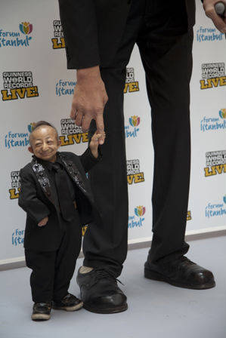

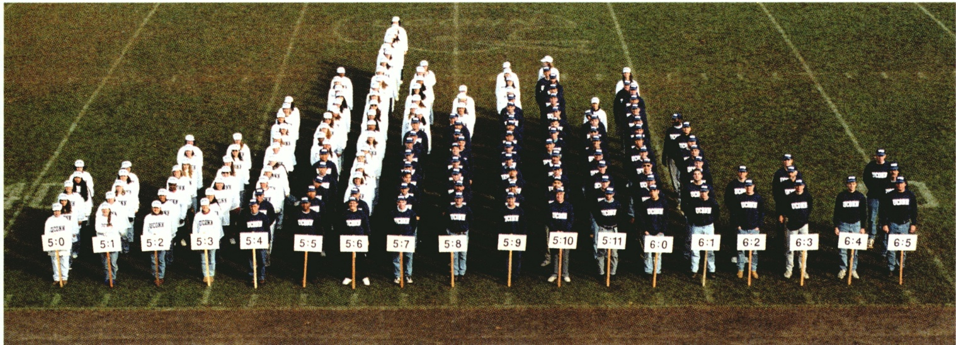
Mendelian forms of “tallness” and “shortness” exist, but most variation is polygenic

Slide 13
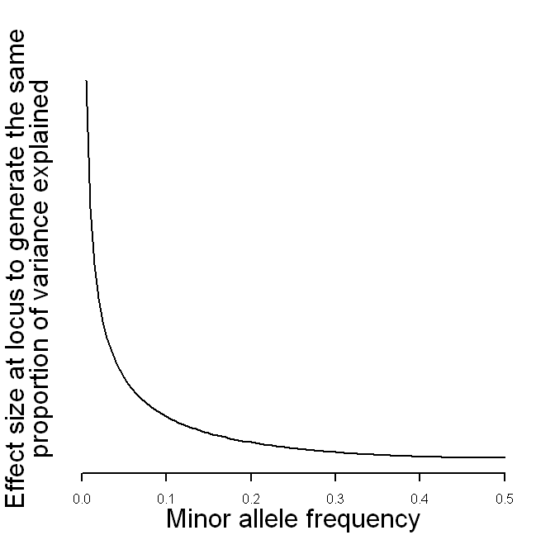
The combination of allele frequency and effect size determines the contribution to heritability
FBN1
[Marouli 2017 Nature]
HMGA2

Slide 14
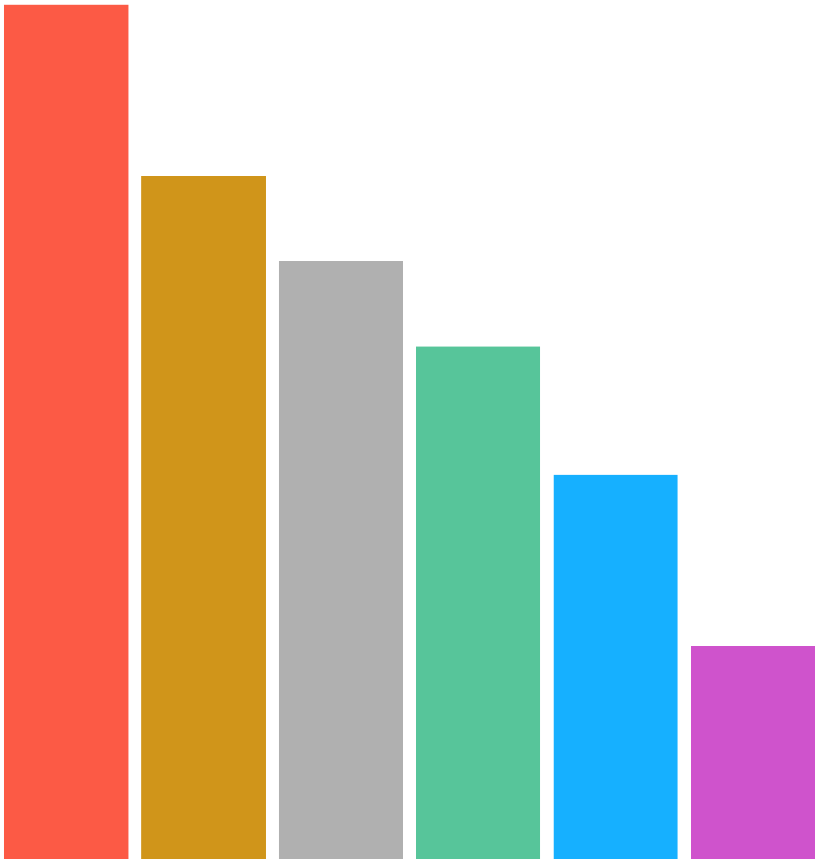
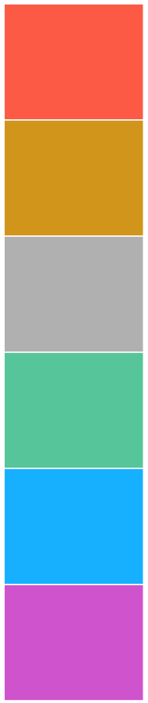
Partitioning variance of height 2018
100 %
80 %
70 %
60 %
Prediction R² is approaching 40%
Variance explained by WGS unknown
45 %
25 %
Total variance
Heritability (based on Twin or family studies)
Within-family estimates
SNP heritability from imputation to sequenced reference
SNP-heritability (variance explained by all genotyped SNPs on the Chip)
Variance explained by genome wide significant SNPs
Notes:
hidden h2: if SNP-h2 estimates correct: caused by lack of power
still missing h2: h2 overestimation; untagged variants; disease heterogeneity

Slide 15
Variance explained for BMI
Twin studies
Non-twin family studies
Within-family segregation
Whole-genome imputation
HapMap3 SNPs
GWS loci
70-80%
40-50%
40%
27%
22%
5%

Slide 16
Difference between within-family and population estimates of SNP effects
Population stratification
G-E correlation (Nature of Nurture)
Assortative mating
Ratio within to population estimates
  Height ~0.9
  Educational attainment ~0.5
[Lee Nature Genetics 2018 in press; Kong Science 2018]

Slide 17
Non-additive genetic variance from GWAS data
Few examples from GWS loci
  but loci detected from additive models
Greater loss of information due to imperfect LD
  r⁴ vs r²
Estimation of dominance variance
  3% from 79 traits on N = 6700 (Zhu 2015 AJHG)
  <1% from 20 traits on N = 350,000 (Rohart 2018 unpublished)
Lack of power to detect AxA variance
Confounding with non-genetic effects from family data

Slide 18
Prediction
Prediction from DNA sequence (or imputed SNP array) is limited by
  how much phenotypic variance is captured by all variants
  how well the effects of all variants are estimated

Slide 19
Imprecision Medicine

Slide 20
Past natural selection determines genetic architecture today
[Eyre-Walker 2010 PNAS; Visscher 2013 Mol Psych]

Slide 21
Evidence for association effect size and allele frequency among common variants
[Yang 2015 Nature Genetics]
[Marouli 2017 Nature]

Slide 22
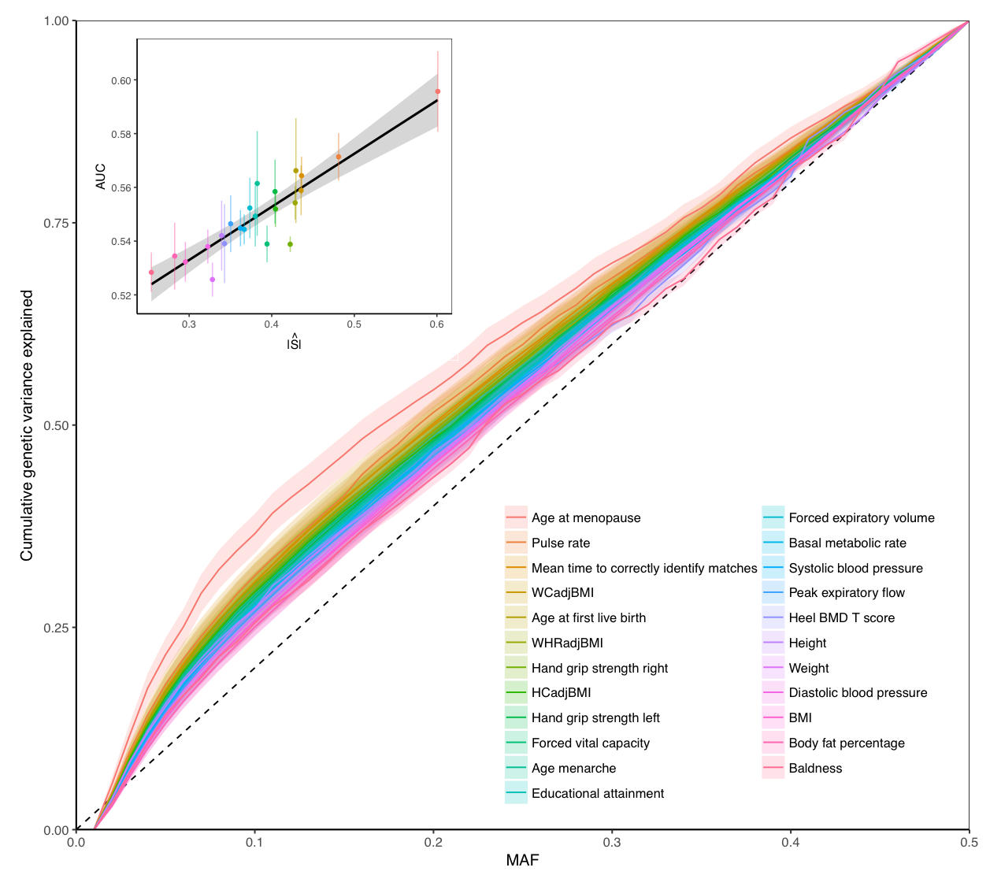
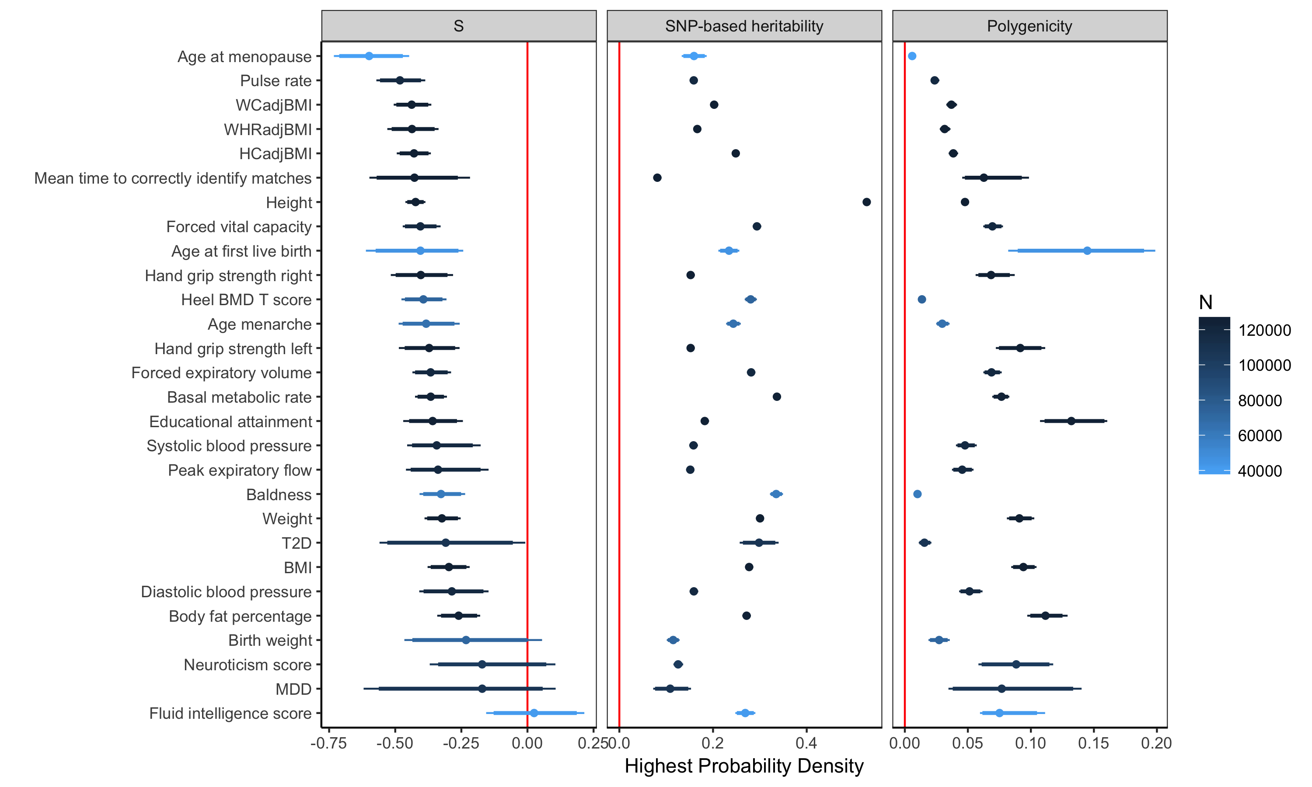
Genetic architecture, selection and heritability
[Zeng et al. 2018 Nature Genetics]

Slide 23
Known unknowns
Can we recover pedigree heritability from WGS data in a random sample from the population?
How much trait variation is due to structural variation not captured by SNP chips and imputation?
How much heritability is contributed by the X-chromosome?

Slide 24
Feasible studies in the near future
Estimate and partition genetic variation using WGS with large sample sizes (> 50,000)
  e.g. TOPMed, others
Estimate genetic variance due to non-SNP variation
Estimate genetic variance on the X chromosome
Large family-based designs (e.g. 100,000 sibpairs; Young-Kong bioRxiv 2017)

Slide 25
Conclusions
Complex traits are highly polygenic and pleiotropic
Substantial proportion of genetic variance captured by SNPs arrays + imputation
Not all traits are equal
Evidence for selection on trait-associated loci
WGS in combination with large sample sizes will provide currently missing information
Large family studies needed to tease apart between and within family effects

