Slide 1
Quantifying (missing) heritability for common disease
AKA – everything is much harder in a binary trait
Naomi Wray

Slide 2
Missing heritability psychiatric disorders
 | N cases | N loci | h² | SNP-h²
Schizophrenia | 67K | 245 | 80 | 26
Bipolar Disorder | 20K | 30 | 75 | 21
Autism SD | 18K | 5 | 80 | 12
ADHD | 20K | 12 | 80 | 22
Major Depression | 130K | 44 | 40 | 9

Slide 3
If missing heritability is greater for disease than for QT despite same technology ….
Assumptions of methodology not upheld
Technical artefacts
Genetic architecture

Slide 4
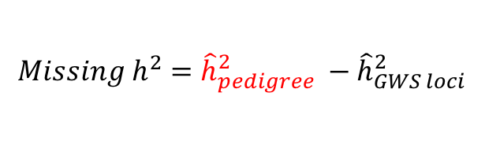
Assumptions of methodology not upheld
Estimate of heritability from family data
Estimate of SNP heritability – metholodogy
Estimate of SNP heritability –application
$$Missing h^{2}={\hat{h}}_{pedigree}^{2} −{\hat{h}}_{GWS loci}^{2}$$

Slide 5
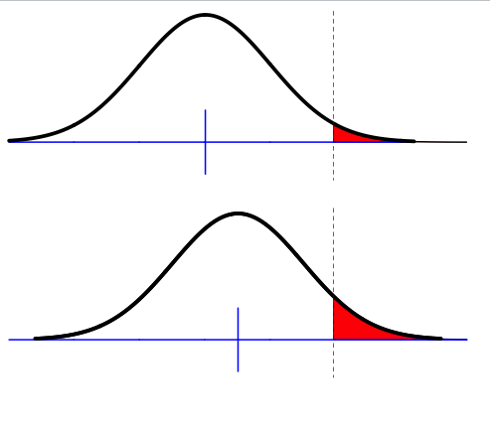
How to get from observed risks to relatives to heritability? Falconer (1965)
Phenotypic liability of a sample from the population
Proportion K affected
Relationship of relatives to affected individuals a_{R}
Phenotypic liability of relatives of affected individuals
Proportion K_{R} affected
Using normal distribution theory what percentage of the variance in liability is attributable to genetic factors given K, K_{R} and a_{R}

Slide 6
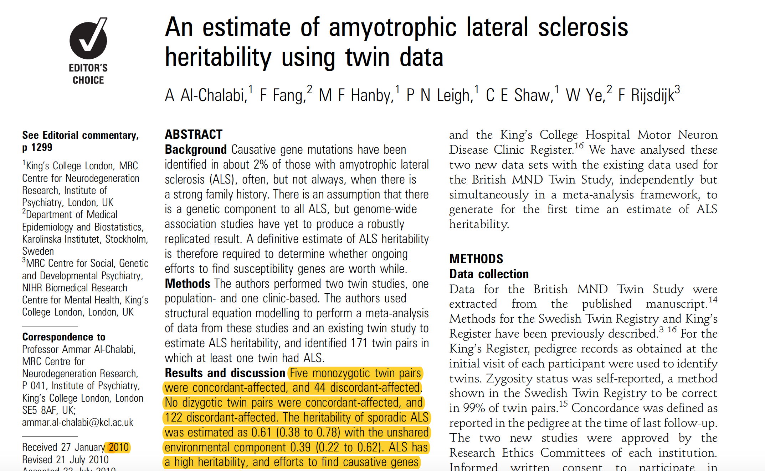
Estimation of heritability of ALS
Used Lifetime risk 1/740 = 0.1%
(these days use 0.3%)
5 MZ concordant
44 MZ discordant
122 DZ all discordant
Estimate of heritability 61%

Slide 7
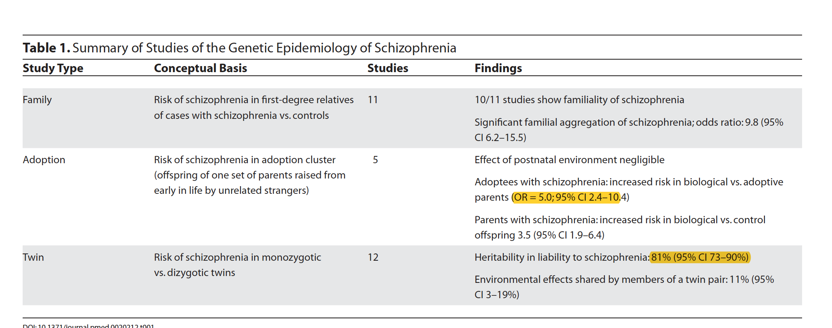
Heritability of schizophrenia

Slide 8
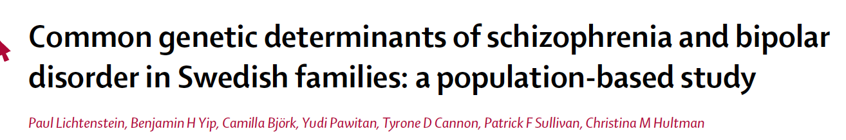
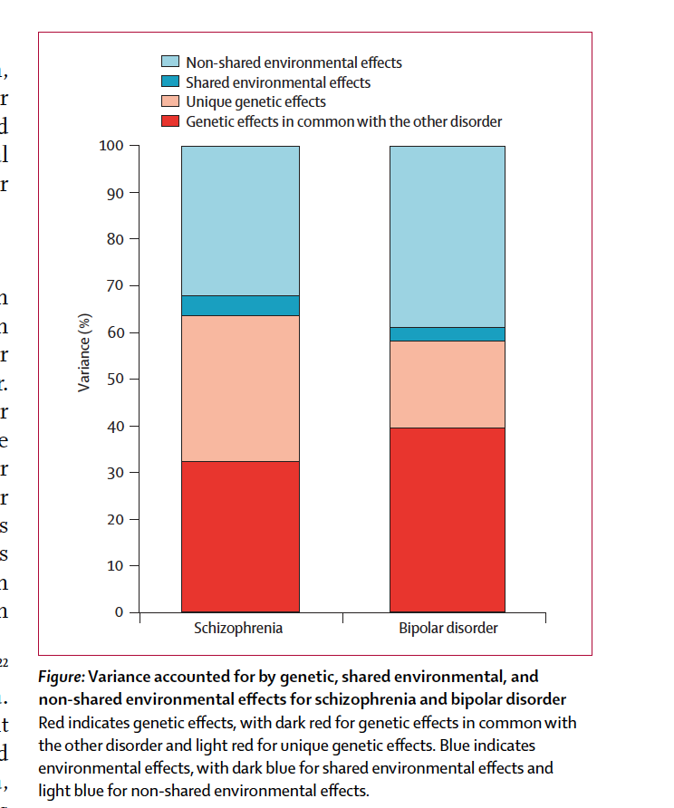
9M national records
36K schizophrenia
40K Bipolar disorder
Two hospitalisations with the disorder code
Parent-offspring
Full-sibs
Maternal half-sibs
Paternal half-sibs
Heritability schizophrenia: 64%
Heritability bipolar disorder: 59%
67%
62%
Wray & Gottesman Based on National Sum Stats from Denmark

Slide 9
Assumptions of methodology not upheld
Estimate of heritability from family data
Estimate of SNP heritability – methodology
Estimate of SNP heritability –application

Slide 10

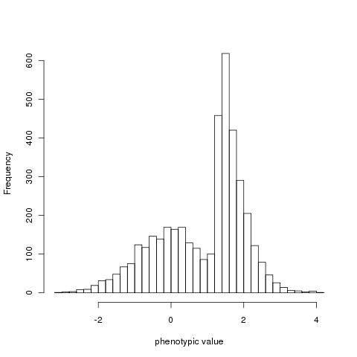
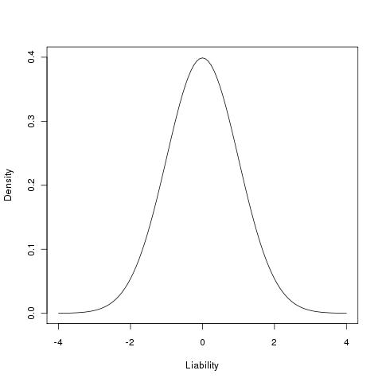

Estimate of SNP heritability in case-control studies
Estimate of proportion of variance explained by SNP between cases and controls
z
x
t
Unaffected (1-K)
affected (K)
Control (1-P)
Case (P)
Robertson (1950)
Appendix of Dempster and Lerner (1950)
Lee et al (2011) Estimating Missing Heritability for Disease from Genome-wide Association Studies AJHG
Zhou & Stephens (2013) Polygenic Modelling with Bayesian Sparse Linear Mixed Models PLoSG
Golan et al (2014) Measuring missing heritability: Inferring the contribution of common variants PNAS
Requires estimate of lifetime risk (K)

Slide 11
Impact of estimates of lifetime risk
For h² estimate from case-control sample = 0.2
Liability scale
Unscreened controls
Impact of K=1% vs 2% small
Impact of K=10% vs 20% big
Accounting for unscreened controls more important for common disease
Screened controls
---- P=0.3
---- P=0.5

Slide 12
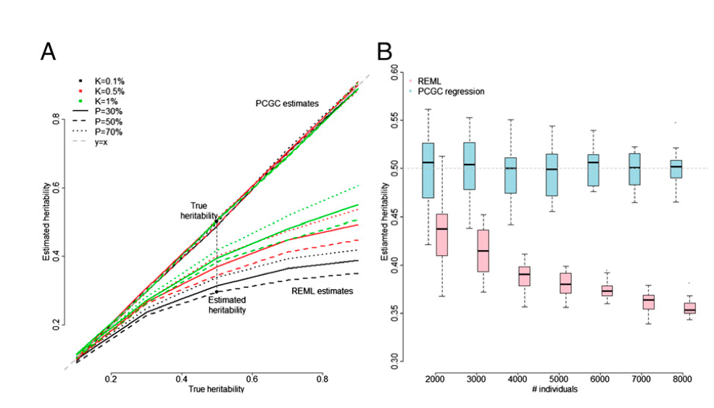
Golan et al (2014) Measuring missing heritability: Inferring the contribution of common variants PNAS
High ascertainment of cases generates a GxE correlation
For high true SNP-heritability as sample sizes increase
Estimates from GREML will be biased downwards
Haseman-Elston estimates have high s.e, but remain unbiased
Simulations vs real data

Slide 13
Assumptions of methodology not upheld
Estimate of heritability from family data
Estimate of SNP heritability – methodology
Estimate of SNP heritability –application

Slide 14
Estimate of SNP-heritability schizophrenia
Purcell et al (2009) – simulation 32%
Lee et al (2012) – GREML 32%
Dudbridge (2013)- Conversion from out of sample prediction polygenic risk score 29 %
Bulik-Sullivan et al (2015)- LD Score regression PGC-SCZ 2014
From association summary statistics 25%
Purcell et al (2009) Common polygenic variation contributes to risk of schizophrenia and bipolar disorder. Nature.
Lee et al (2012) Estimating the proportion of variation in susceptibility to schizophrenia captured by common SNPs. Nature Genetics
Dudbridge (2013)Power and Predictive Accuracy of Polygenic Risk Scores. PLoS Genetics

Slide 15
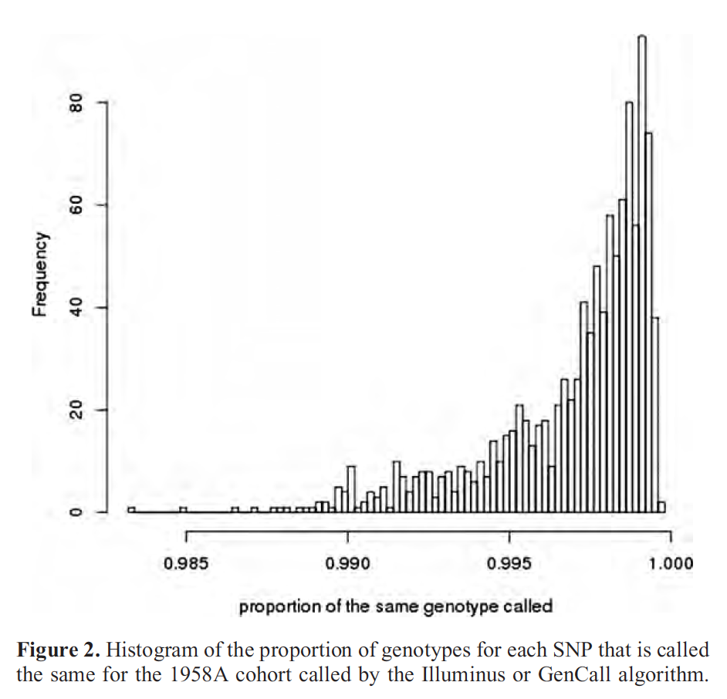
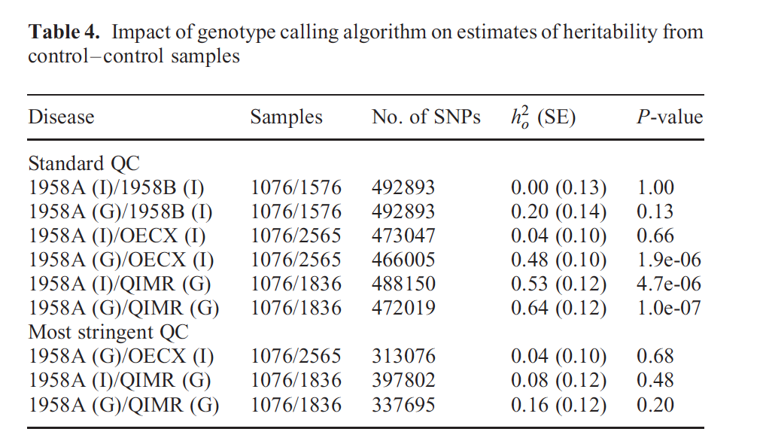
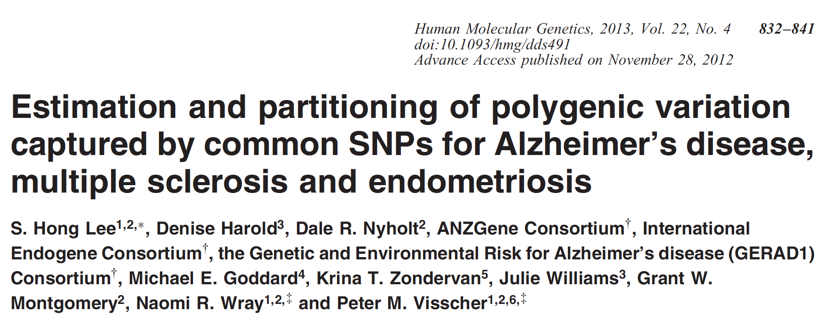
Real data….everything more difficult in a binary traits

Slide 16
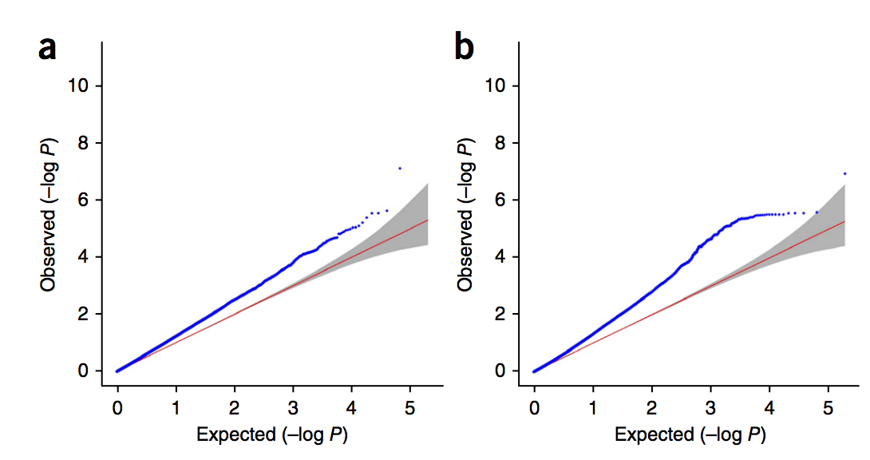
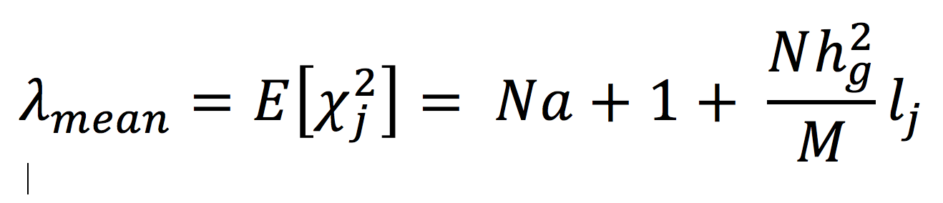
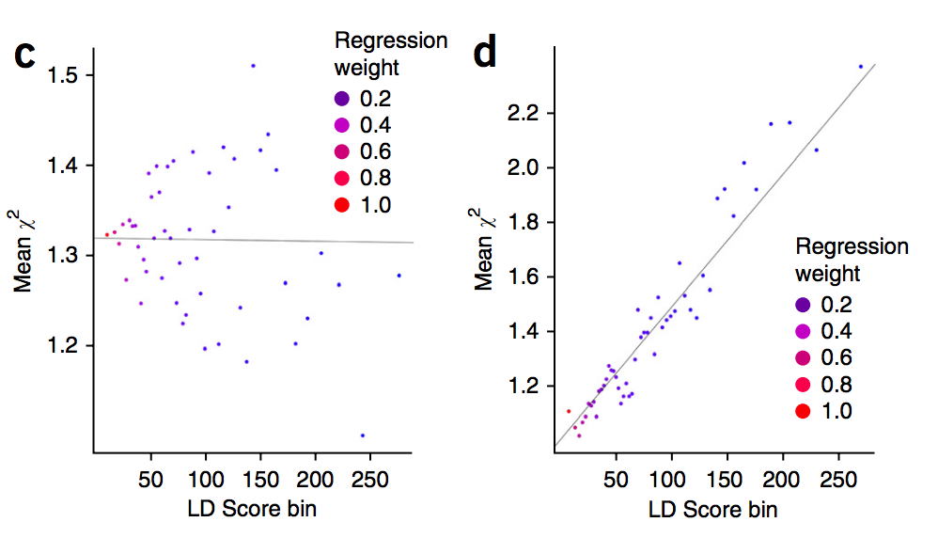
LD Score Regression
Expected Value of Summary Stats
Separating h_{g}² and population stratification
GWAS QQ Plot
Population
Stratification factor
Polygenicity
Regression of association X² statistic on LD score
regression
intercept
slope
Bulik-Sullivan, et al. NG 2015
Notes:
Method used in PGC-SCZ, Nature, 2014

Slide 17
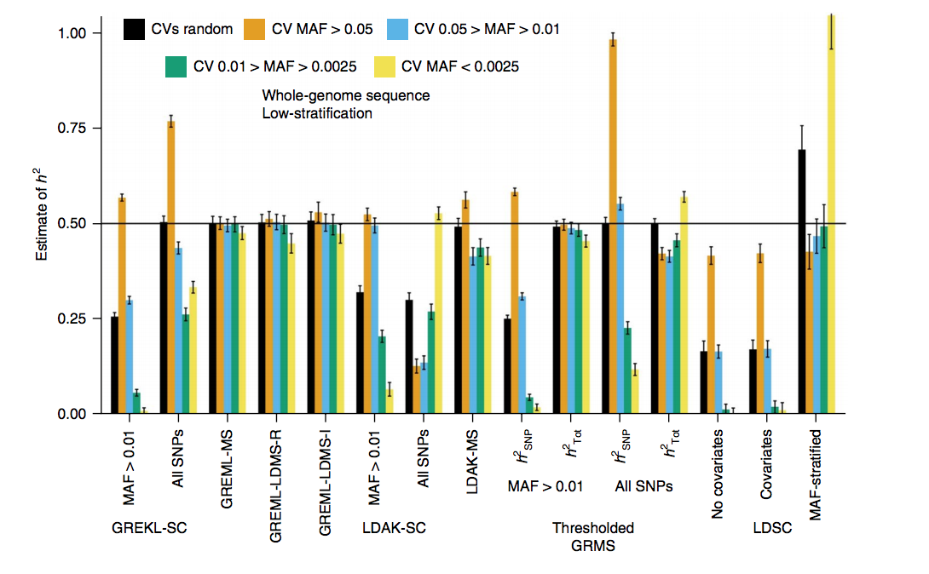
LDSC regression may underestimate
For disease traits
Ease and speed of application
Given assumptions of methodology
Given reality of disease data sets
A quick benchmark estimate is in line with the nature of the data
…until we get massive individual disease data sets
Evans et al (2018) Comparison of methods that use whole genome data to estimate the heritability and genetic architecture of complex traits. Nature Genetics

Slide 18
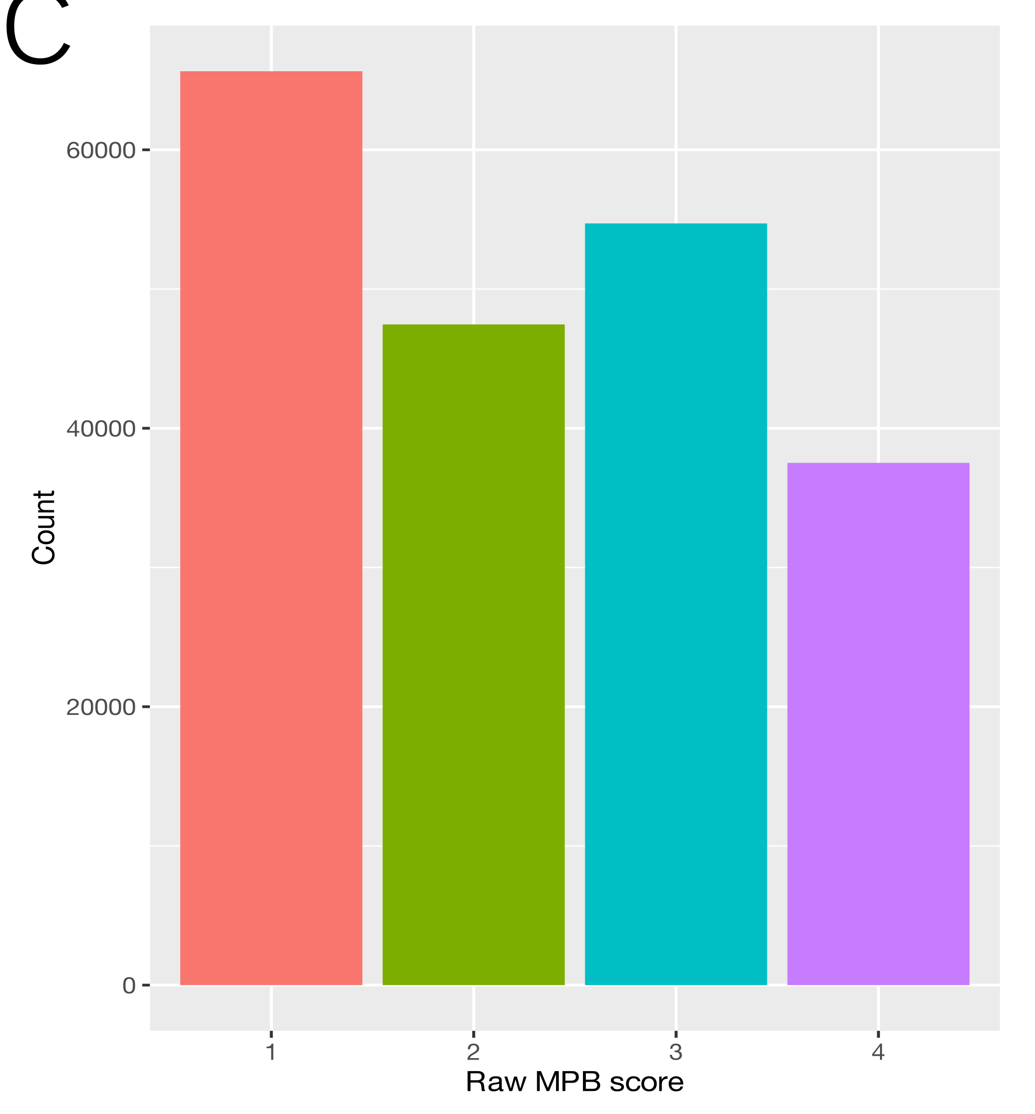
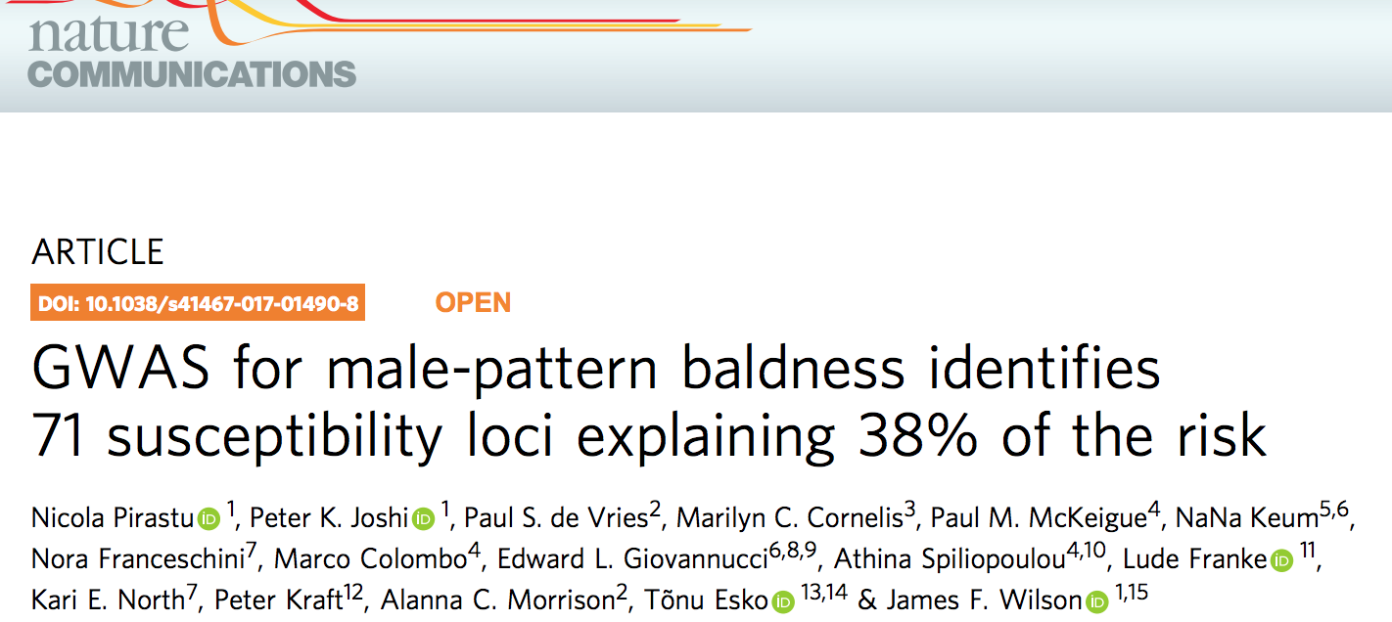
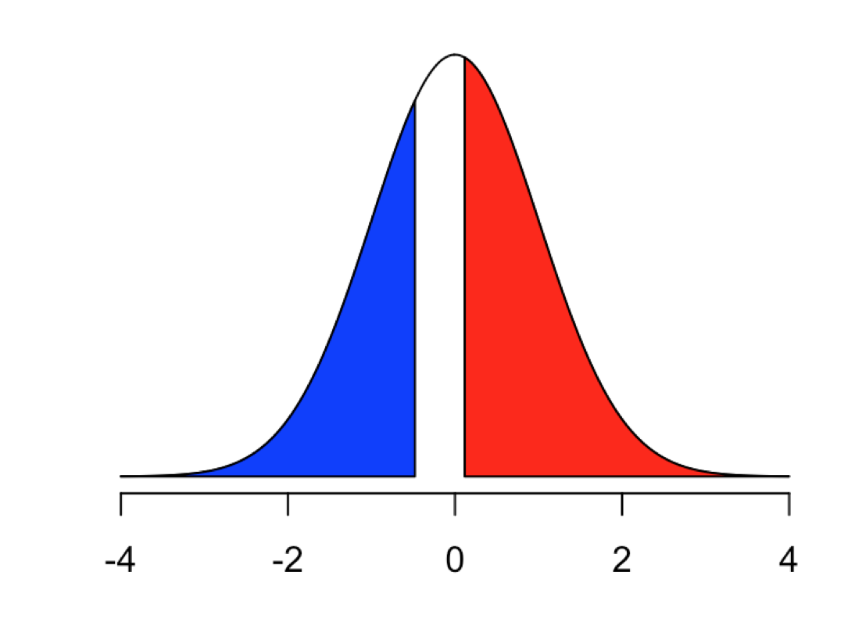
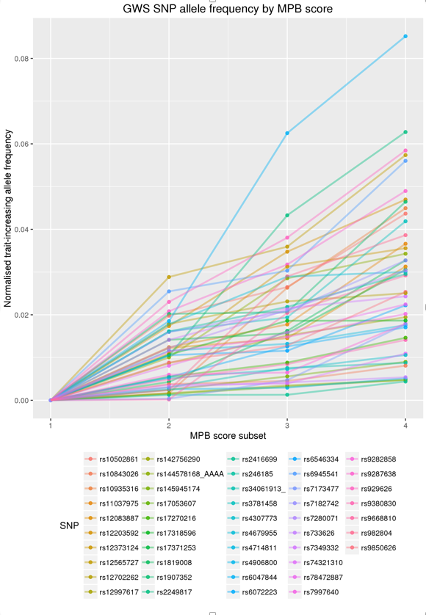
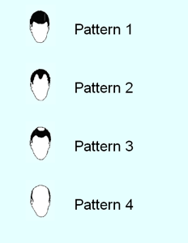
Ascertainment in real data
20,000 UKB
SNP-heritability 94%
Excluded “rather dubious baldness cases” group 2.
Controls
Exclude
Cases
45% of population
59% analysed sample
SNP-heritability: 64%

Slide 19

Impact of environment on heritability?
Estimate heritability of milk production in low production environment
Estimate heritability of milk production in high production environment
Estimate heritability in environment of self-reported childhood trauma
Estimate heritability in environment of no self-reported childhood trauma

Slide 20
Assumptions of methodology not upheld
Estimate of heritability from family data
Estimate of SNP heritability – methodology
Estimate of SNP heritability –application
Technical Artefacts
Binary traits/small cohort sample size
Variability between cohorts (may not be an artefact!)

Slide 21
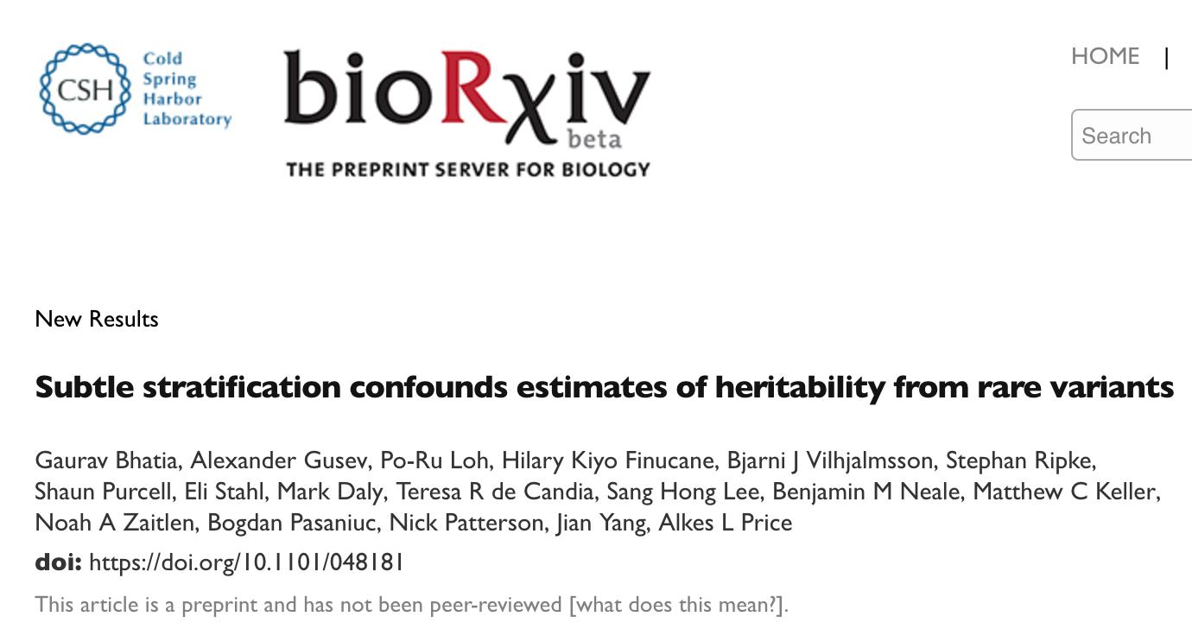
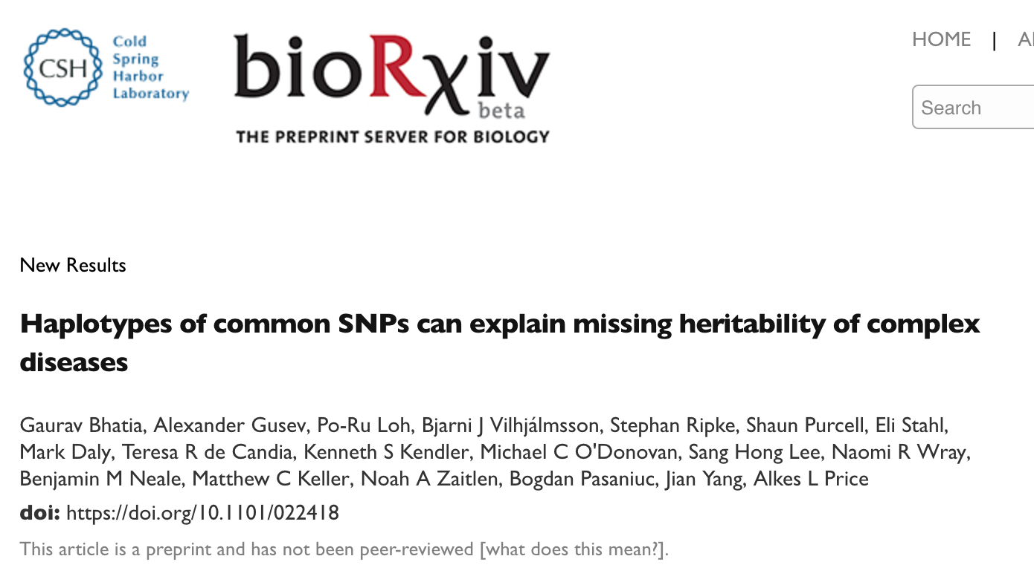
Challenges of Disease Data

Slide 22
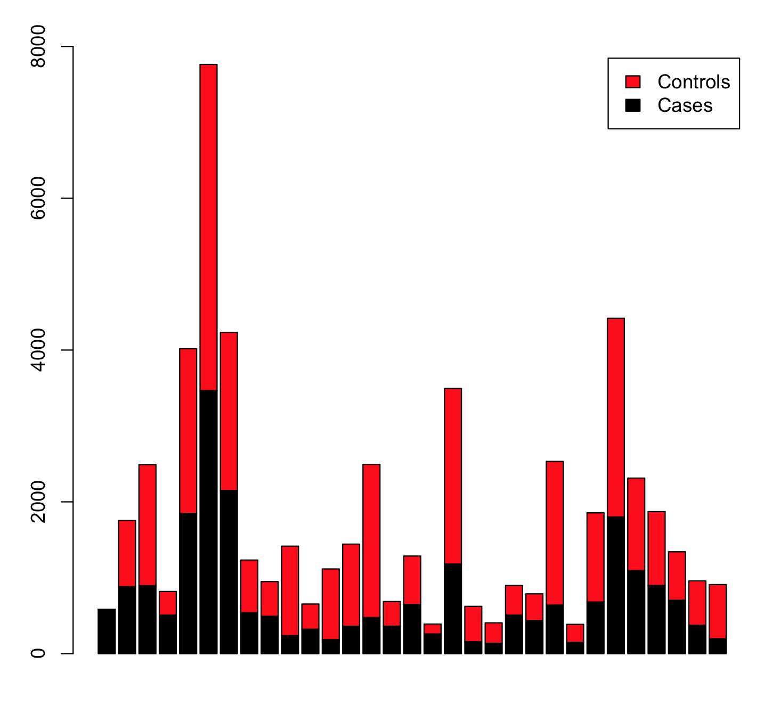
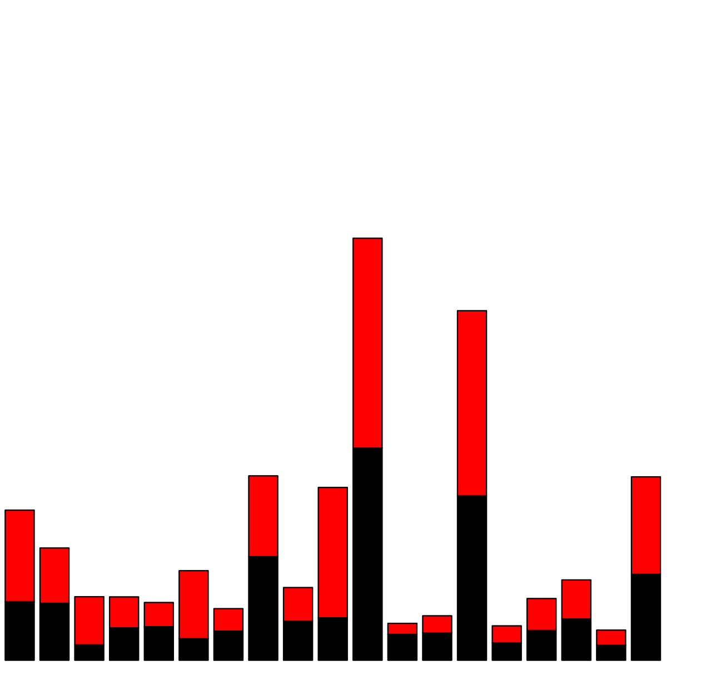
Reality of disease data sets - SCZ
Illumina platforms
Affymetrix platforms
PGC-SCZ (2014) 108 loci

Slide 23
Reality of disease data sets - ALS
Van Rheenan et al (2016) Genome-wide association analyses identify new risk variants and the genetic architecture of amyotrophic lateral sclerosis. Nat Gen

Slide 24
Assumptions of methodology not upheld
Estimate of heritability from family data
Estimate of SNP heritability – methodology
Estimate of SNP heritability –application
Technical Artefacts
Binary traits/small cohort sample size
Variability between cohorts (may not be an artefact!)

Slide 25
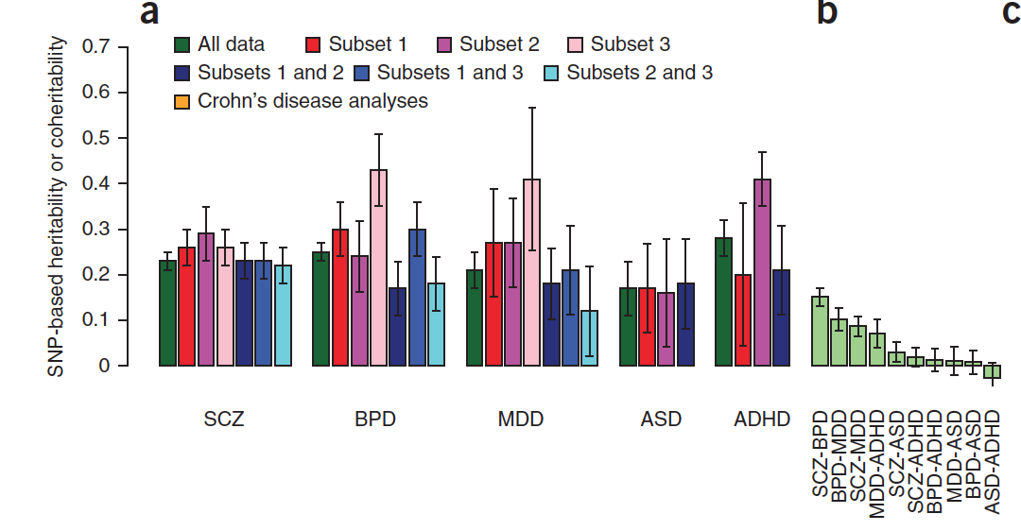
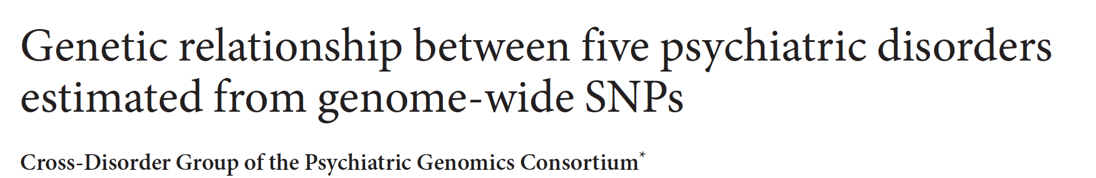
Smaller SNP-h2 between cohorts than within
rg: SCZ/BPD 0.68
Genetic correlations
r_{g}
0.79-0.89
0.55-0.88
0.38-0.65
0.71
1.17

Slide 26
Major depression – 7 large studies
Mean genetic correlation 0.76
What lifetime risk to use?
44 loci. Nat Gen 2018

Slide 27
Assumptions of methodology not upheld
Estimate of heritability from family data
Estimate of SNP heritability – methodology
Estimate of SNP heritability –application
Technical Artefacts
Binary traits/small cohort sample size
Variability between cohorts (may not be an artefact!)
Genetic Architecture
Evidence for differences in genetic architecture between disorders
What is a disease???

Slide 28
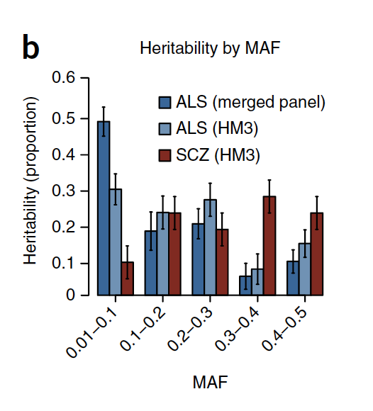
Comparative Genetic architecture
Allele Frequency spectrum: SCZ vs ALS
Van Rheenen et al (2016) Genome-wide association analyses identify new risk variants and the genetic architecture of amyotrophic lateral sclerosis. Nature Genetics

Slide 29

Comparative Genetic architecture
Effect size distribution
Big-small
Medium-small
Small-small
Moser et al 2015 Plos Genetics
Gerhard Moser

Slide 30
Assumptions of methodology not upheld
Estimate of heritability from family data
Estimate of SNP heritability – methodology
Estimate of SNP heritability –application
Technical Artefacts
Binary traits/small cohort sample size
Variability between cohorts (may not be an artefact!)
Genetic Architecture
Evidence for differences in genetic architecture between disorders
What is a disease???

Slide 31
Comparative Genetic architecture
Effect size distribution
Big-small
Medium-small
Small-small
Moser et al 2015 Plos Genetics
Gerhard Moser

Slide 32
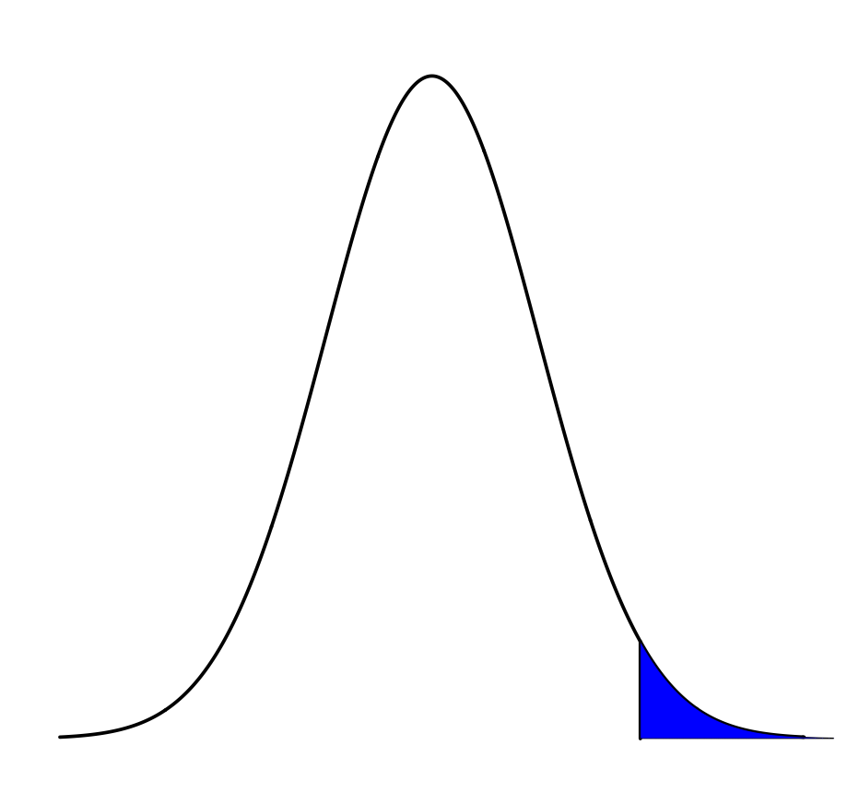
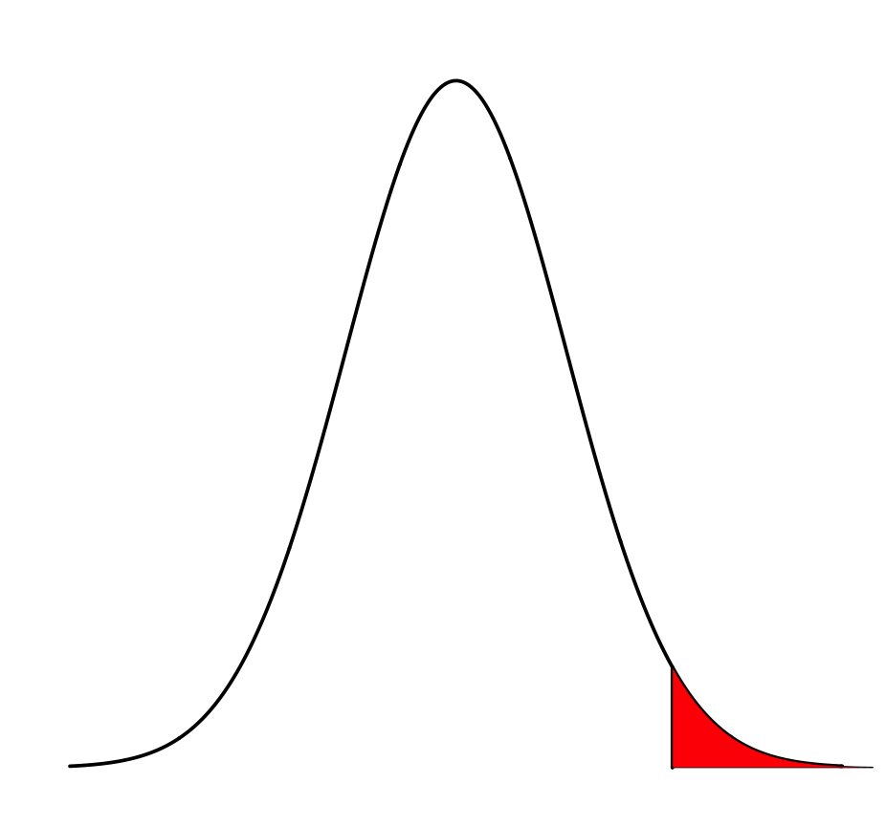
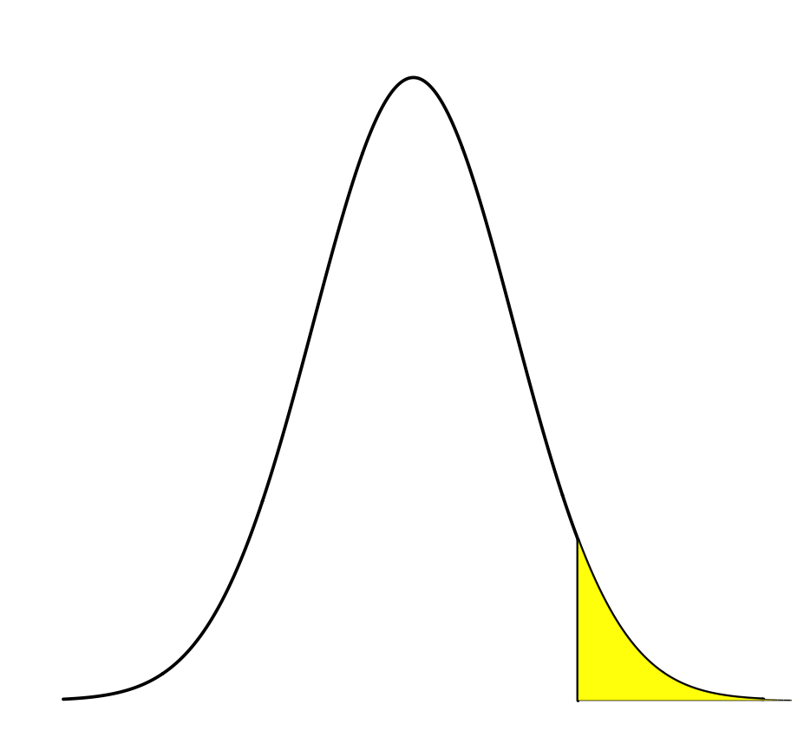
Explore – toy example of heterogeneity
Lifetime risk: 0.5%
Heritability: 80%
Estimate SNP-heritability from unrelated individuals: 30%
Two biologically distinct disorders
But phenotypically indistinguishable disorders
Reduced power and smaller effect sizes in GWAS
Lifetime risk: 1%
Estimate heritability from risk to 1st degree relatives: 65%
Estimate SNP-heritability from unrelated individuals: 15%
Wray & Maier (2014) Current Epidemiology Reports

Slide 33
If missing heritability is greater for disease than for QT despite same technology ….
Assumptions of methodology not upheld
  Pedigree heritability over-estimated
  General tendency to over-interpret at a greater level of accuracy than the data deserve
  Use methodology given data is a benchmark
Technical artefacts
  Residual pop strat confounding between case and control?
  Analysis of rare variants limited by cohort sample size
Genetic architecture
  Evidence for disease specific architectures
  Heterogeneity vs polygenicity unknown
Larger samples & more than binary phenotypes will help

Slide 34

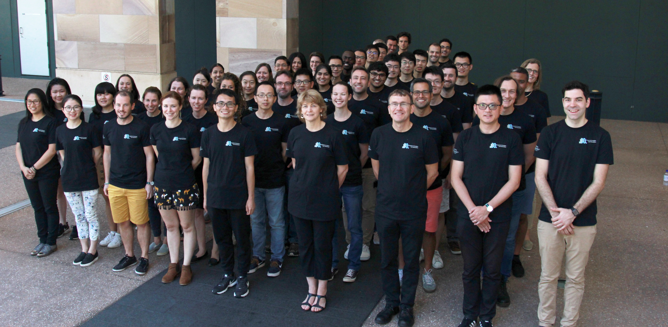



Acknowledgements
Plan Ahead!
International Congress of Quantitative Genetics
Brisbane June 2020
Peter Visscher Jian Yang
Hong Lee, Mike Goddard

