Slide 1
Clinical Sequencing for Rare Disease
Trio exome sequencing
Identify qualifying genotypes
Genetic diagnosis
Genetic candidate

Slide 2
DIAGNOSTIC ANALYSIS FRAMEWORK
Identify rare and functional genetic variation in genes that have previous known association with disease. We look for variants that are
High quality
MQ>40, QD>2, QUAL>30
Extremely rare
Variants that are represented maximally up to 5 time across internal and external (EVS, ExAC) controls
Present in KnownVar - ClinVar, HGMD
Previously reported pathogenic
At same or adjacent genomic sites
LoF in genes in KnownVar
LoF - Nonsense, splice donor/acceptor, frameshift
Haploinsufficient gene
Clinvar reported pathogenic LoF variants
ClinGen classification of haploinsufficient
LoF in LoF Depleted genes
pLI score > 0.9

Slide 3
A remarkably successful clinical test
Study | Journal | N | Ascertainment | % resolved
Need 2012 | J Med Genet | 12 | Mixture | 50%
Yang 2013 | NEJM | 250 | 80% Neuro | 25%
Calvo 2012 | Sci Transl Med | 42 | Mitochondrial | 24%
DeLigt 2013 | NEJM | 100 | Severe ID | 16%
Zhu 2014 | Genetics in Medicine | 119 | Mixture | 24%
Srivastava 2014 | Annals of Neuro | 78 | Neuro | 41%
Yang 2014 | JAMA | 2,000 | Mixture | 25%
Lee 2014 | JAMA | 814 | Mixture | 26%
Soden 2014 | Sci Transl Med | 119 | Neuro | 45%
Combined | - | 3,534 | Mixture | 26%

Slide 4
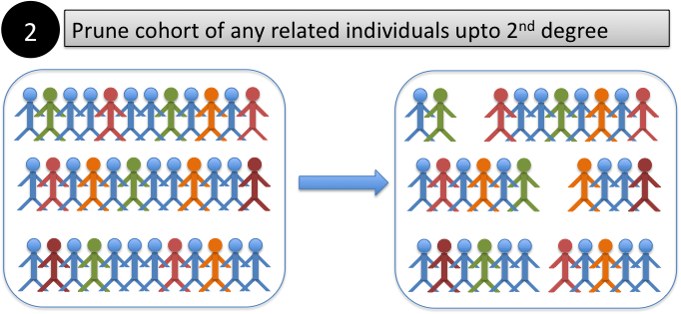
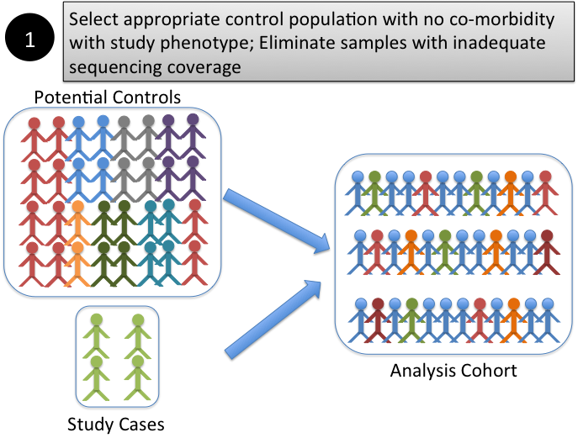
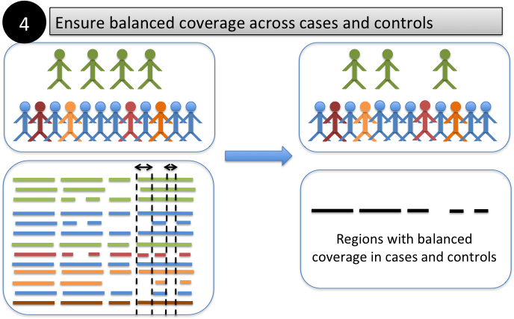
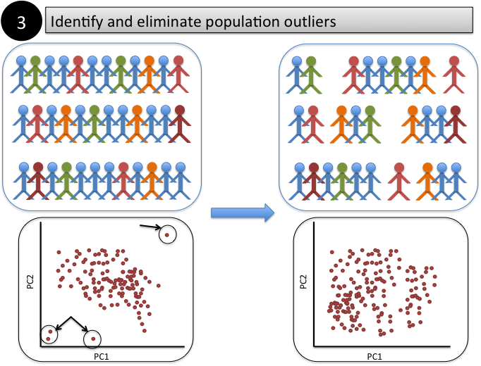
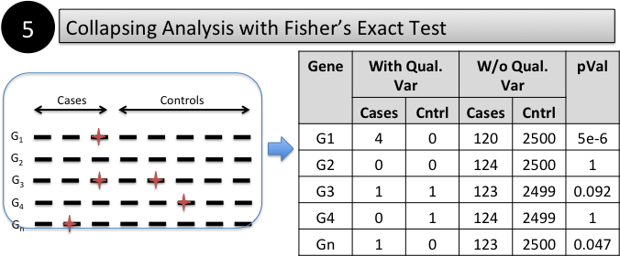

Slide 5
Datasets
N = 650 GGE with epilepsy family history
N = 1,213 Non-acquired focal epilepsies (NAFE) N = 543 NAFE with epilepsy family history
N = 3,422 IGM controls Controls have not been ascertained for epilepsy, neuropsychiatric, neurodevelopmental or undiagnosed congenital disorders
Analyses restricted to individuals of European genetic ancestry
Above summaries include only samples passing sequence and bioinformatic QC, known and cryptic
relatedness testing, and have >85% of the CCDS sequence (~33Mb) covered at least 10-fold

Slide 6
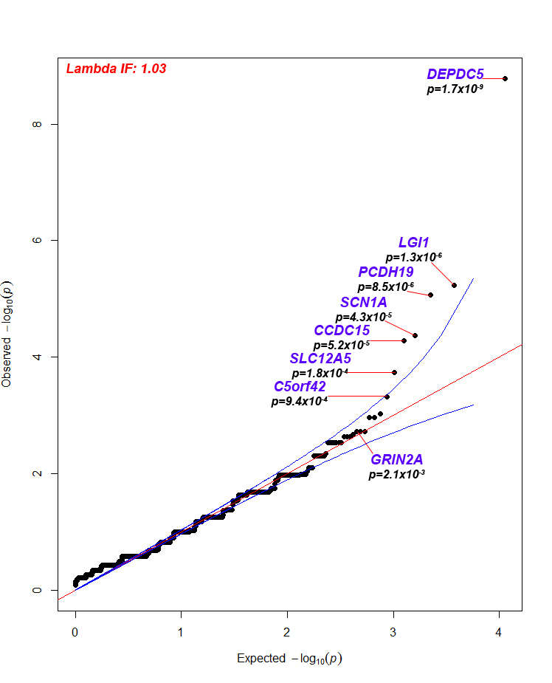
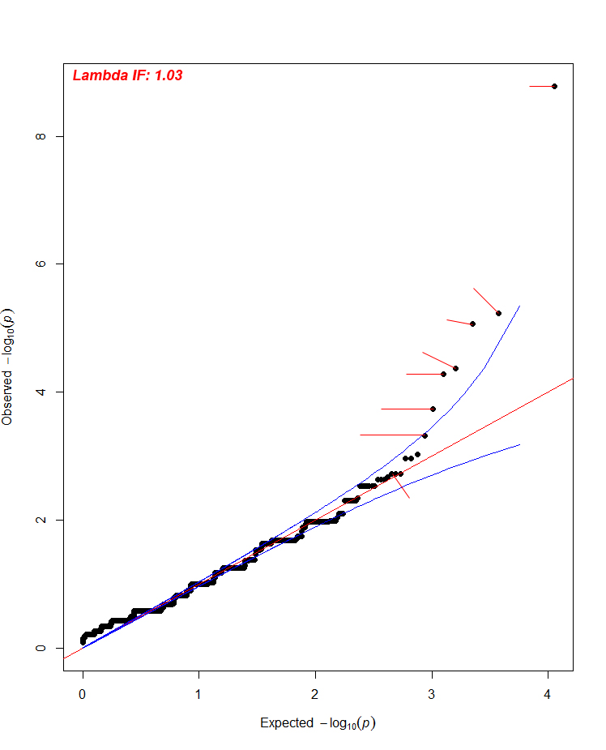
NAFE Fam Hx + (586 vs 3,503)
Do patients with epilepsy have more ‘qualifying variants’ in gene X than general controls?
*
HGNC | RVIS% | Qual Case | Case Freq | Qual Ctrl | Ctrl Freq | FET p- value
DEPDC5 | 6.6% | 18 | 3.1% | 10 | 0.3% | 1.7x10⁻⁹
LGI1 | 14.4% | 8 | 1.4% | 1 | 0.03% | 1.3x10⁻⁶
PCDH19 | 10.4% | 6 | 1.0% | 0 | 0% | 8.5x10⁻⁶
SCN1A | 4.0% | 11 | 1.9% | 10 | 0.3% | 4.3x10⁻⁵
CCDC15 | 16.0% | 6 | 1.0% | 1 | 0.03% | 5.2x10⁻⁵
SLC12A5 | 4.5% | 6 | 1.0% | 2 | 0.06% | 1.8x10⁻⁴
C5orf42 | 19.9% | 7 | 1.2% | 6 | 0.2% | 9.4x10⁻⁴
TRPM5 | 11.3% | 6 | 1.0% | 4 | 0.1% | 0.001
ADCY10 | 83.8% | 6 | 1.0% | 4 | 0.1% | 0.001
C9orf3 | 45.6% | 4 | 0.7% | 1 | 0.03% | 0.002
Known gene
MGI Seizure
*
*
Gene | OR [95%CI]
DEPDC5 | 11.1 [4.8 – 27.0]
LGI1 | 48.4 [6.5 – 2125]
PCDH19 | >36.2 [7.1 – >1651]
SCN1A | 6.7 [2.6 – 17.6]
GRIN2A | 7.2 [1.8 – 30.1]
*
*
*
*
*
*
Summary:
Four of the 30 known genes occupy genome-wide ranks [1-4], p=6x10⁻¹²
Interpretation:
Compelling evidence of lower locus heterogeneity for NAFE, relative to GGE. This suggests potentially better genetic tractability for focal epilepsies.
*
*
Qualifying variant:
High confidence variant call
LoF / Polyphen “Probably” prediction
Singleton & absent among ExAC (i.e., ~ <0.0008% MAF)
Notes:
30 known genes. Probability of seeing 4/30 known genes among the top 4 positions is 6x10-12 (Hypergeometric)
8.4% cases (49 cases) observed.. 92% excess qualifying mutations across these five genes.

Slide 7
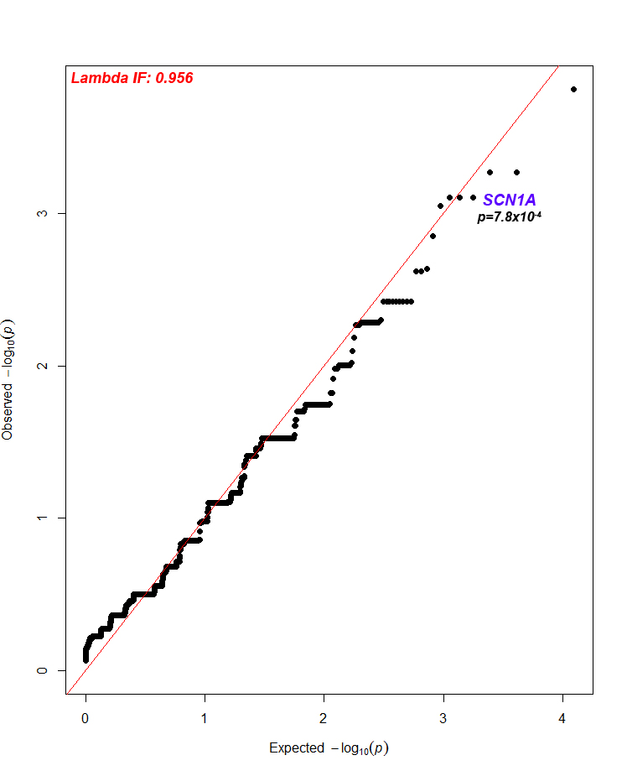
IGE/GGE (733 vs 3,503)
Do patients with epilepsy have more ‘qualifying variants’ in gene X than general controls?
HGNC | RVIS% | Qual Case | Case Freq | Qual Ctrl | Ctrl Freq | FET p-value
RTFDC1 | 28.9% | 5 | 0.7% | 0 | 0% | 1.5x10⁻⁴
COPB1 | 6.7% | 6 | 0.8% | 2 | 0.06% | 5.4x10⁻⁴
PNPLA1 | 93.6% | 6 | 0.8% | 2 | 0.06% | 5.4x10⁻⁴
SCN1A | 4.0% | 10 | 1.4% | 10 | 0.3% | 7.8x10⁻⁴
CACNA1B | 3.0% | 7 | 1.0% | 4 | 0.1% | 7.8x10⁻⁴
WDR83 | 33.2% | 5 | 0.7% | 1 | 0.03% | 7.9x10⁻⁴
SLC1A7 | 24.7% | 4 | 0.6% | 0 | 0% | 8.9x10⁻⁴
PARD3B | 62.8% | 6 | 0.8% | 3 | 0.09% | 0.001
FAT4 | 21.8% | 15 | 2.1% | 25 | 0.7% | 0.002
ATXN1 | 20.9% | 5 | 0.7% | 2 | 0.06% | 0.002
Summary:
No single gene is genome-wide significant:
Adjusted alpha p=4x10⁻⁶
Interpretation:
Single genes do not account for a high proportion of GGE risk. Likely due to high genetic and/or phenotypic heterogeneity.
Qualifying variant:
High confidence variant call
LoF / Polyphen “Probably” prediction
Singleton & absent among ExAC (i.e., ~ <0.0008% MAF)
Notes:
<0.001% (less than 1 in 130K)

Slide 8
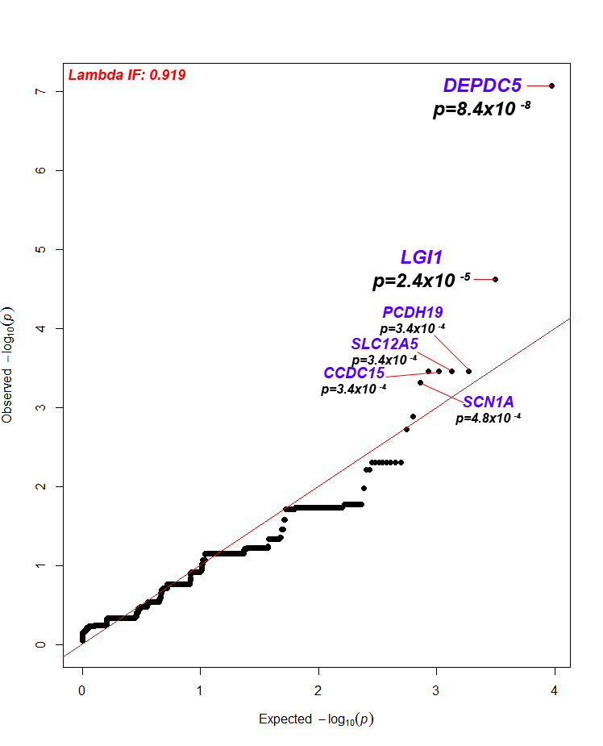
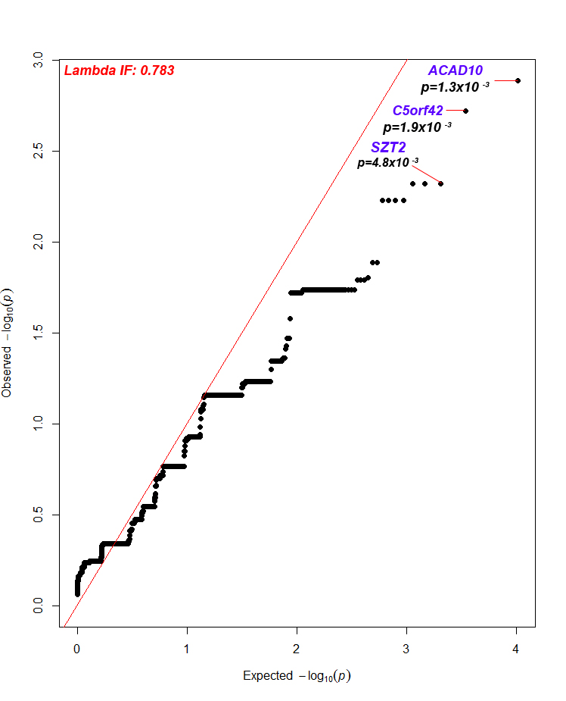
Family History (586 vs 1,621)
Sporadic NAFE (658 vs 1,882)
Notes:
Probability of observing a qualifying variant in any given sample in any given gene is ~0.0009 (aka 0.09%)
C5orf42 is ranked 20th among familial cases and 2nd among sporadic

Slide 9
Enrichment of qualifying variants among 43 known epilepsy genes
Ultra-rare
p=1.7x10⁻⁷
0.005% MAF – Ultra-rare
(conditional)
p=0.59
GGE
0.1% MAF – Ultra-rare
(conditional)
p=0.49
p=0.63
Neutral/Benign
Odds Ratio
Ultra-rare
p=7.5x10⁻¹⁸
0.005% MAF – Ultra-rare
(conditional)
p=0.53
0.1% MAF – Ultra-rare
(conditional)
p=0.81
NAFE
Neutral/Benign
p=0.99
Odds Ratio

Slide 10
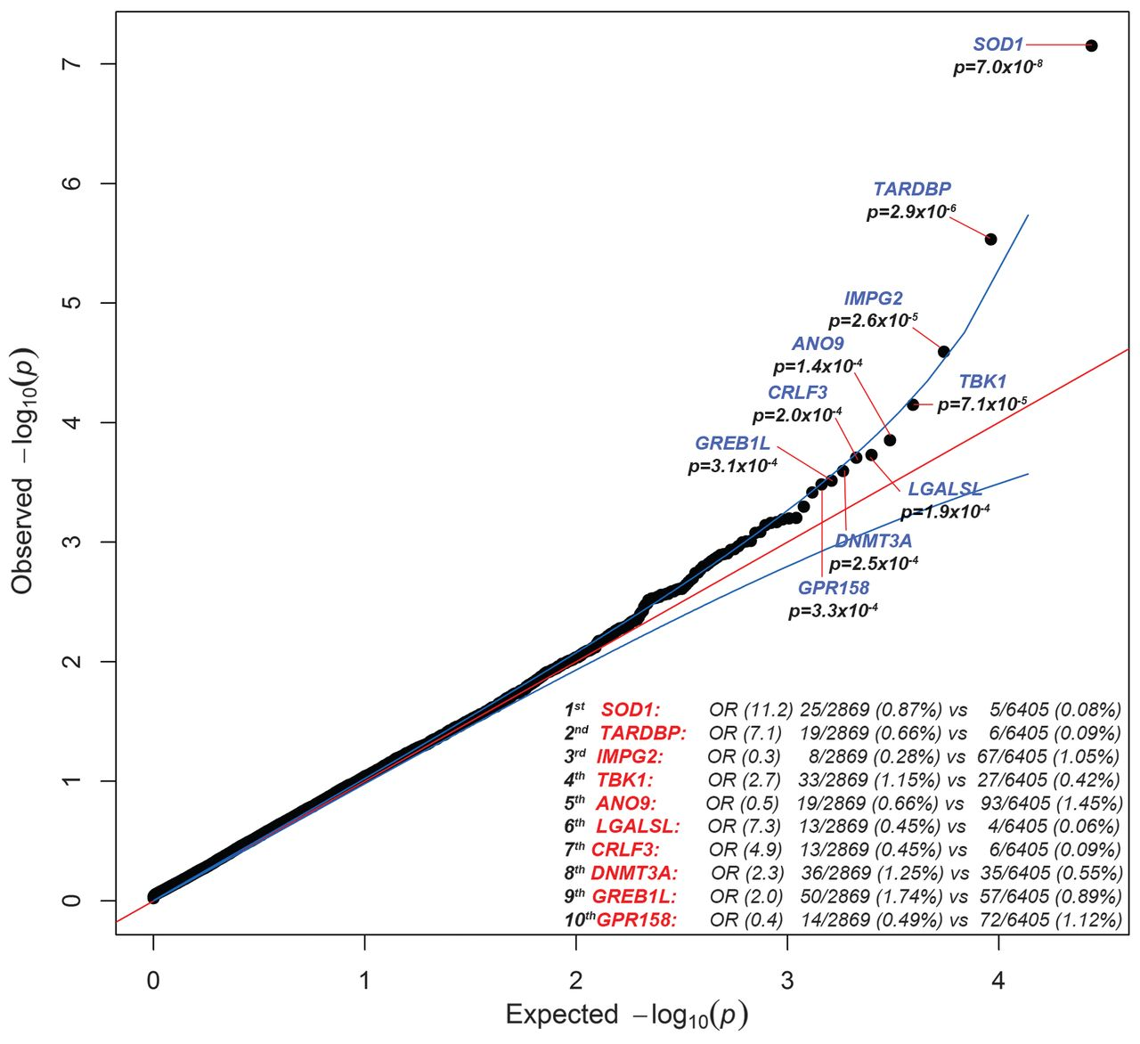
Fig. 1 Quantile-quantile plot of discovery results for dominant coding model.Results for the analysis of 2869 case and 6405 control exomes are shown; 16,491 covered genes passed quality control with more than one case or control carrier for this test.
Elizabeth T. Cirulli et al. Science 2015;347:1436-1441
Notes:
Quantile-quantile plot of discovery results for dominant coding model.Results for the analysis of 2869 case and 6405 control exomes are shown; 16,491 covered genes passed quality control with more than one case or control carrier for this test. The genes with the top 10 associations are labeled. The genomic inflation factor λ is 1.060. The association with SOD1 passed correction for multiple tests.

Slide 11
Sample Comparison
Acknowledgements
Duke cases
Scott Palmer
CUMC cases
Dave Lederer
Purnema Madahar
01/17 Petrovski Paper
262 IPF cases (Duke)
4,141 Controls
Updated Results
372 IPF cases (110 new CUMC cases)
8,168 Controls

Slide 12
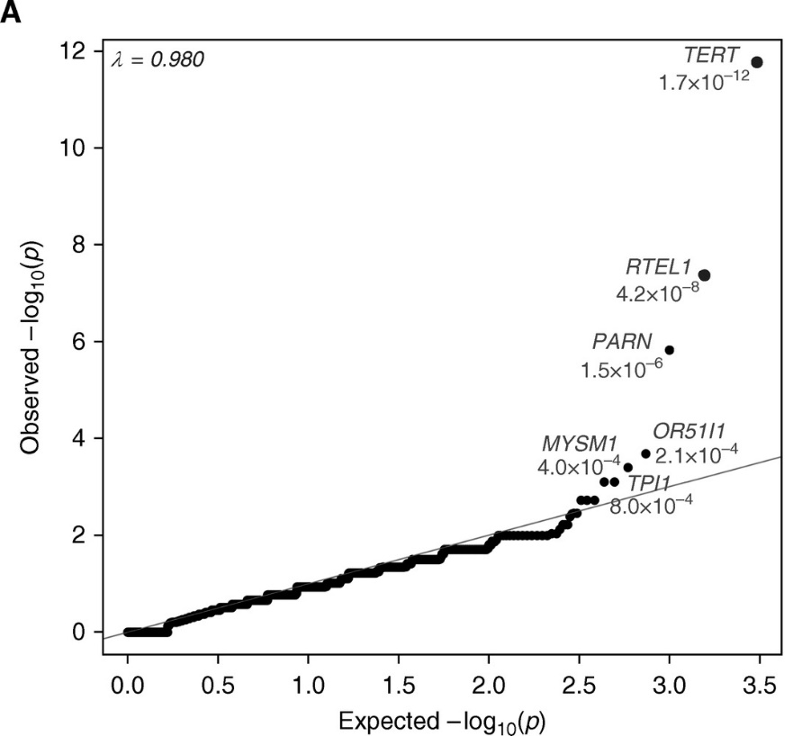
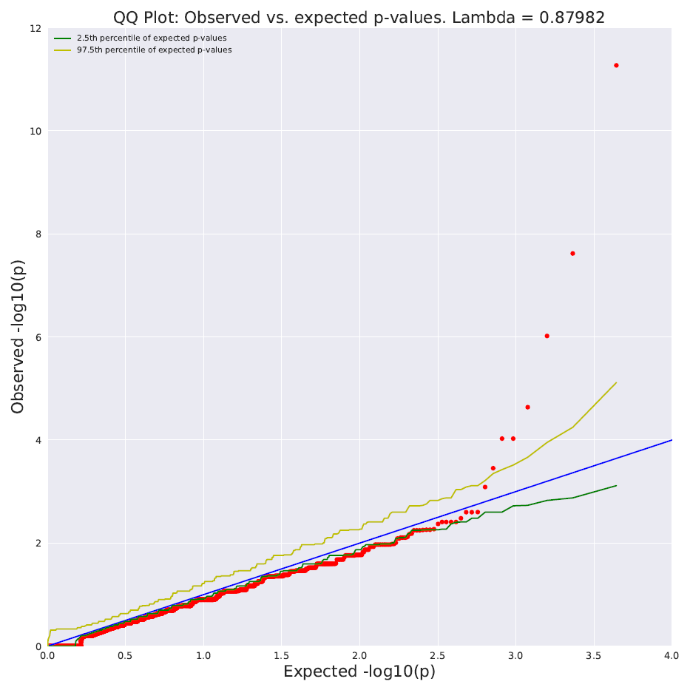
Functional Model Comparison
Loo AF = 0.05%, ExAC AF = 0, EVS AF = 0
Polyphen Humdiv probably damaging
01/17 Petrovski Paper Results
Updated Results
TERT 5.4 x 10⁻¹²
RTEL1 2.4 x 10⁻⁸
PARN 9.6 x 10⁻⁷
NFX1
OTUD7A
MYSM1 9.4 x 10⁻⁵
CPEB3
ARRDC2
Gene | P-value | Unique Variants | Qualified case freq | Qualified ctrl freq
'TERT' | 5.36E-12 | 27 | 3.76% | 0.20%
'RTEL1' | 2.40E-08 | 33 | 2.96% | 0.23%
'PARN' | 9.56E-07 | 16 | 2.15% | 0.15%
'NFX1' | 2.31E-05 | 24 | 2.15% | 0.26%
'OTUD7A' | 9.38E-05 | 11 | 1.34% | 0.09%
'MYSM1' | 9.38E-05 | 12 | 1.34% | 0.09%
'CPEB3' | 3.52E-04 | 20 | 1.61% | 0.21%
'ARRDC2' | 8.17E-04 | 13 | 1.34% | 0.16%
Gene0 | P-Value | Qualified case freq | Qualified ctrl freq
‘TERT' | 1.7E-12 | 5.0% | 0.1%
'RTEL1' | 4.2E-08 | 2.3% | 0%
‘PARN’ | 1.5E-06 | 2.7% | 0.1%

Slide 13
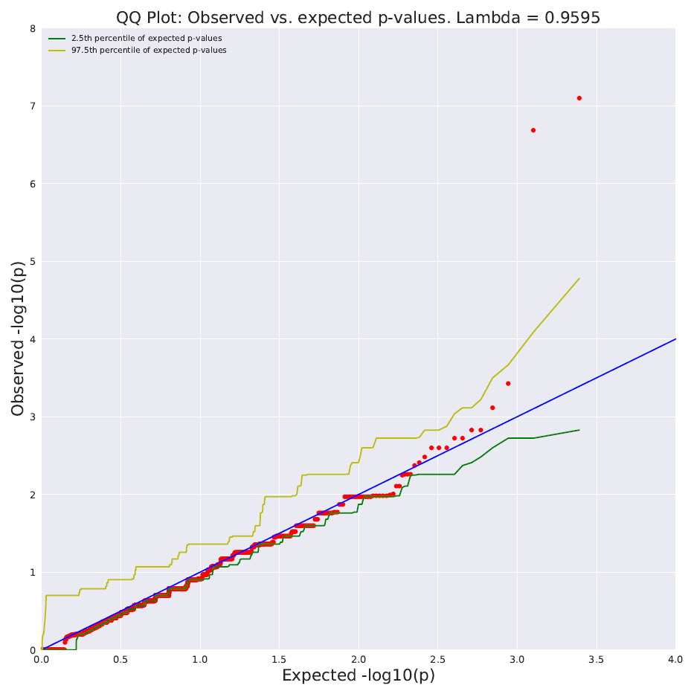
Lof Model Comparison
Loo AF = 0.1%, ExAC AF = 0.1% EVS AF = 0.1%
01/17 Petrovski Paper Results
Updated Results
PARN 8 x 10⁻⁸
RTEL1 2 x 10⁻⁷
MYSM1 3.8 x 10⁻⁴
PROKR1 7.7 x 10⁻⁴
Gene | P-value | Unique Variants | Qualified case freq | Qualified ctrl freq
‘PARN' | 7.99E-08 | 6 | 1.93% | 0.02%
‘RTEL1' | 2.07E-07 | 10 | 2.21% | 0.06%
'MYSM1' | 3.75E-04 | 5 | 1.10% | 0.02%
'PROKR1' | 7.68E-04 | 4 | 0.83% | 0.02%
Gene | P-Value | Qualified case freq | Qualified ctrl freq
'PARN' | 2.5E-09 | 2.7% | 0%
'RTEL1' | 2.8E-07 | 2.3% | 0.02%

Slide 14
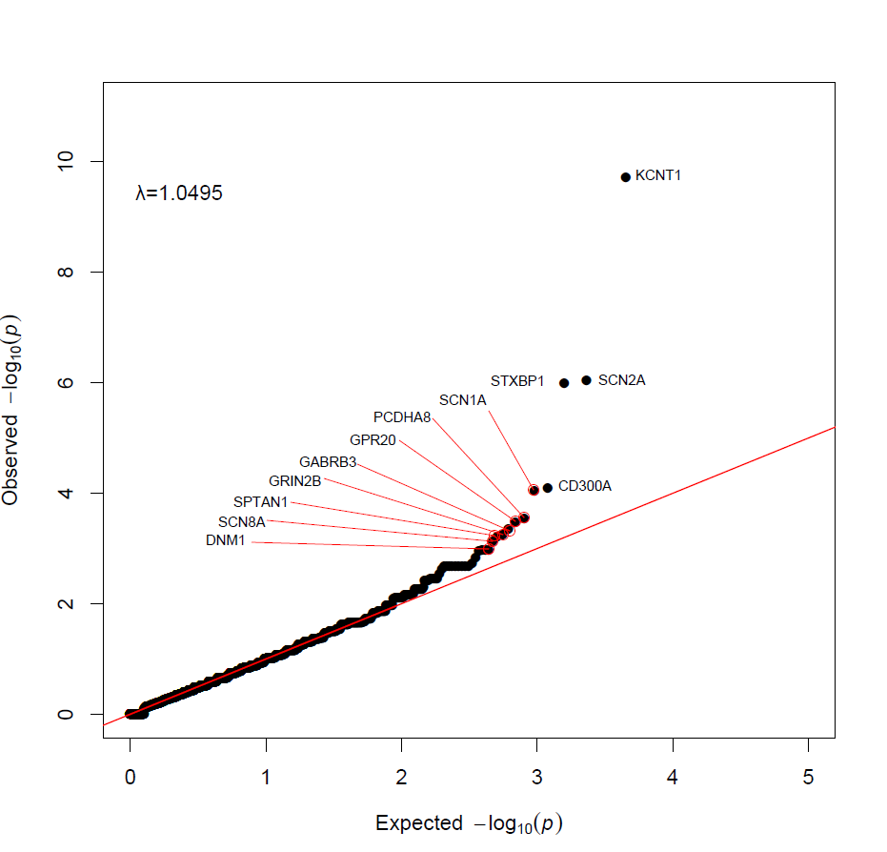
509 vs. 9866
Probably damaging missense + LoF
(IGM cases only; FET)
Top 20 | Fet P
KCNT1 | 1.88E-10
SCN2A | 8.99E-07
STXBP1 | 1E-06
CD300A | 7.94E-05
SCN1A | 9.2E-05
PCDHA8 | 0.000291
GPR20 | 0.000342
GABRB3 | 0.000453
GRIN2B | 0.000555
SPTAN1 | 0.000617
SCN8A | 0.000757
DNM1 | 0.0011
MYT1 | 0.0011
RASGRP3 | 0.0011
CUL4A | 0.0011
RGS14 | 0.0014
LENG8 | 0.0018
FBXO33 | 0.0021
ACAP3 | 0.0021
GABBR2 | 0.0021
.

Slide 15
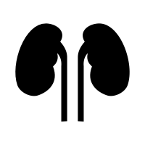
Sequencing in Kidney Diseases
9%
2,187
65/2,187 genetic diagnosis of Alport Syndrome, only 42% were clinical recognized as having Alport Syndrome
51 year old Male with "CKD of unknown etiology”
Causal variant in CLCN5, resulting in a genetic diagnosis of Dent disease 1
Genetic diagnosis led to targeted therapy (thiazide diuretics and high citrate diet to help decrease hypercalciuria) and informed family counseling and testing of male relatives with CKD

Slide 16
Sequencing in Liver Diseases
Participation in this study was credited for saving his life by the committee overseeing the research study
Physician taking care of this patient: “I had a feeling that I was missing something with this kid but I didn’t know what more to do…”
Example: 14.5 year old male with high liver enzymes
Clinically diagnosed with Non-Alcoholic Fatty Liver Disease (NAFLD) after biopsy
Genetics revealed a diagnosis of Wilson Disease
Patient immediately treated with D-penicillamine

Slide 17
What does it all mean?
Missing heritability
Architecture (rare and common variation not part of a continuum?)
Implications for disease biology ?
Open questions
What modifies the large effect mutations?
What is the explanation for the widespread signals throughout the genome?

