Slide 1
“Monogenic” contributions to complex traits: scaling pleiotropy
Judy H. Cho, M.D.
Ward-Coleman Professor of Translational Genetics
Director, Charles F. Bronfman Institute for Personalized Medicine
Icahn School of Medicine at Mount Sinai
March 1, 2018

Slide 2
The Short-term Challenge for BioMe

Slide 3
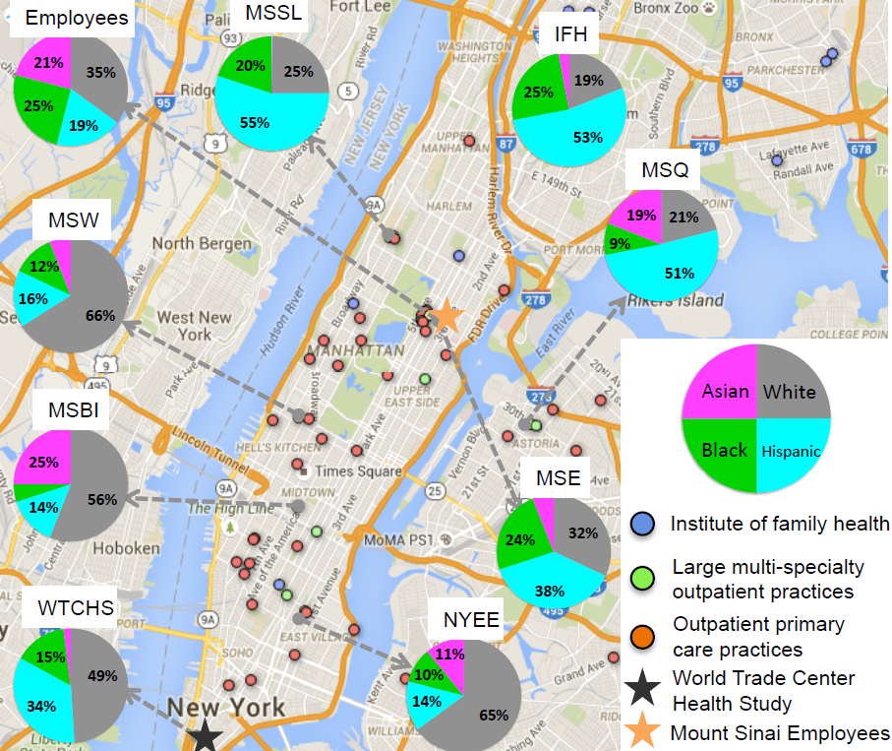


The Mount Sinai BioMe – EMR-linked Biobank
Founded in September 2007 (by Dr. Erwin Bottinger),
an ongoing, consented EMR-linked bio- and data repository, additional data from questionnaire
A longitudinal design, including past, current and future records,
enrolls participants non-selectively from MSMC’s patient population of 80,000 inpatient and 700,000 outpatient visits annually
Currently 41,000 participants,
participants are 40% Hispanic, 35% European, 25% African-American
recall based on phenotype or/and genotype for in-depth follow-up studies,
Ruth Loos, Ph.D.
Eimear Kenny, Ph.D.

Slide 4
Advantages to Health-System based Biobanks
“Case” vs. “control” status is overly-simplistic
Health Systems have enormous “phenotype” data: labs, radiology, pathology data
Development of disease is time-dependent
Flipping the genetic paradigm
Phenotype
Genes & genotypes
Genes & genotypes
Phenotype
Redefining human health & disease through a much deeper study of human traits

Slide 5
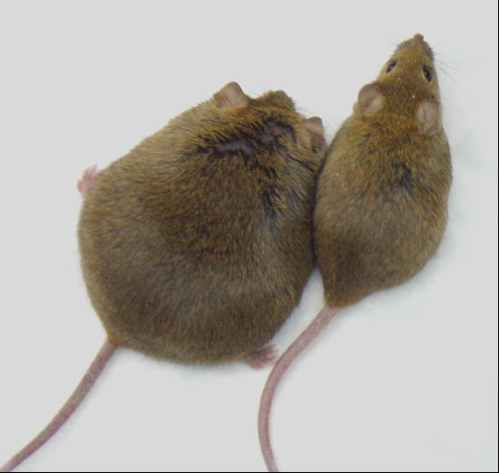
Regeneron exome sequencing the entire BioMe Biobank: 32K sequences back
Large non-European ancestry cohorts linked to a health system biobank
Identifying new loss-of-function mutations, never before identified in humans (Human Knockout Project)
Studying humans with naturally occurring gene knockouts identified by sequencing
Safety information for targeting/blocking a pathway
Identifying drug targets for protective, loss-of-function variants—GPCRs, kinases, channels
Leptin knockout
Phenotypes for actionable variants: penetrance estimates, phenotypic variability

Slide 6

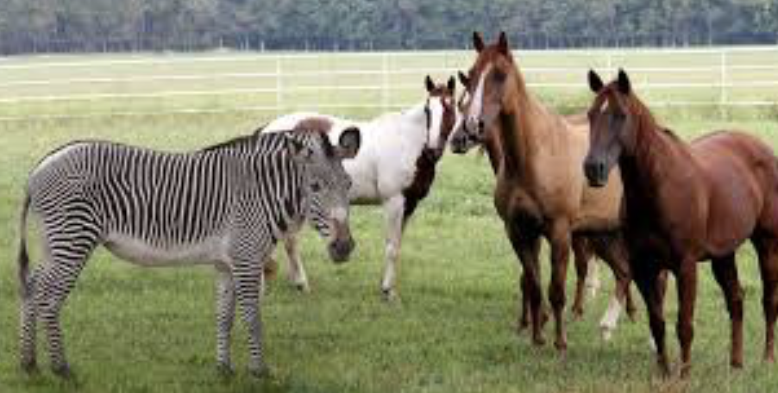
Of horses and zebras

Slide 7
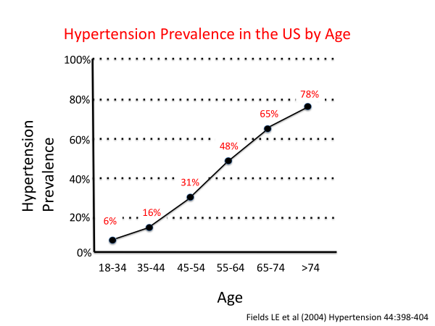
I. Age-dependent prevalence of hypertension
Typical definition: >140/90
New definition: >130/80
“Monogenic” forms of hypertension: estimated 3-5% of all cases. Genetics first approach to identify early cases

Slide 8
II. Primary Immunodeficiencies: under-diagnosed diseases?
Infections are very common—viral, bacterial
Likely continuum of genetic differences in the capacity to fight infections—major evolutionary selection
Crucial time element: decreased immune capacities at age extremes (newborns, elderly)
For consideration: protocols to alert health care providers re risk factors for immunodeficiences—e.g.
  Two major infections
  In a non-alcoholic
  Below the age of 50
Chronic granulomatous diseases: NADPH oxidases, infections and increased risk for IBD

Slide 9


III. Scaling rare disease discovery within health systems through machine learning
~ 6,000 rare diseases that are known
Most of these diseases are not diagnosed precluding appropriate therapy
Training Set of Confirmed Cases
Feature Extraction
Machine Learning
Identify Features
Features Describing Patients
Deploy algorithm
Testing Set of Unselected Patients
Girish Nakardni, M.D.
This will enable us to set up automated disease surveillance programs so that rare diseases are promptly diagnosed

Slide 10
“Expected” & “Unexpected” Pleiotropy

Slide 11
IL23R is an IBD (Crohn’s disease & ulcerative colitis) gene
Crohn’s disease (CD) and ulcerative colitis (UC)
Multiple independent alleles, notably a protective, LOF minor allele Arg381Gln (2-3 fold protection)
IL-23 immune pathway: key role in Th17 cells, Tc17, ILC
Majority of IBD loci show similar trends between CD vs. UC
Science 2006; 314: 1461-3

Slide 12
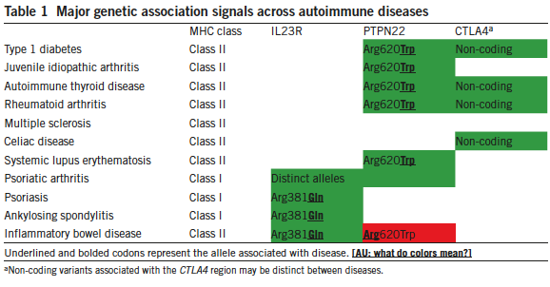
Across autoimmunity: a) MHC class I vs. II; b) PTPN22 Arg620Trp, and c) IL23R
IL23R-associated diseases respond to blocking IL-23 pathway
Cho and Feldmann, Nature Medicine 2015; 730

Slide 13
Cystic fibrosis: poly-organ recessive Mendelian disease—chloride channel defect
Organ manifestations
Lung: frequent infections
Male infertility
Frequent pancreatic insufficiency requiring enzyme replacement
Heterozygous CFTR carriers present with recurrent pancreatitis phenotypically distinct from CF patient manifestations
Large, collaborative biobank studies: Systematic evaluation of heterozygous carriers of (AR) Mendelian diseases

Slide 14
Mendelian diseases co-segregating with IBD
67 million U.S. patients EHR
Organ manifestations
Han et al., IBD Journal 2018, 471

Slide 15
Ashkenazi Jews with a three-fold higher prevalence of IBD vs. non-Jewish Europeans
Manny Rivas
Dermot McGovern
Mark Daly
In press, Plos Genetics

Slide 16
NOX1 (NADPH oxidase 1) D360N: present in both AJs and non-AJ EA, higher effect sizes in AJs
 | Case allele freq | Control allele freq | Odds ratio | P-value
All AJ UC | 2.2% | 0.9% | 2.44 | 0.005
AJ UC males | 3.4% | 0.8% | 4.2 | 0.001
AJ UC females | 1.5% | 1.0% | 1.5 | 0.34
Non-AJ UC males | 3.7% | 2.8% | 1.3 | 0.1
Non-AJ UC females | 3.1% | 2.7% | 1.2 | 0.2
NOX1 is X-linked: Male > female effects
Hayes et al., CMGH 2015; 489
Holm Uhlig
Very early onset mutation: identifies NOX1 variants with much greater functional effects than D360N
Schwerd et al., Mucosal Immunology 2018; 562

Slide 17
“Unexpected” Pleiotropy

Slide 18
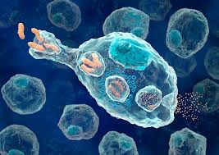

Jewish-predominant mutations: One gene (LRRK2), two diseases, risk and protective gene domains
Risk
Protective
Crohn’s disease
Parkinson’s disease
Intestine
Disease onset: 15-30
Episodic inflammation
Brain
Late onset: 50’s & above
Inexorable degeneration
LRRK2 mutations: alterations in tissue-based phagocytes
Hui et al., Sci Trans Med, 2018
Inga Peter

Slide 19
Uncommon risk alleles of innate immunity: Cytof terminal ileal biopsies from resected tissues
Monocytes, macrophages & dendritic cells
B cells & plasma cells
T cells

Slide 20
At-risk populations with higher disease prevalences
Higher polygenic/all common variant risk scores: different effect sizes for uncommon alleles?
Disease prevalences estimates across populations
challenges of Hispanic definitions.
Sample size limitations & under-study of non-European populations
U.S. populations & CDC-based estimates of disease prevalence

Slide 21
“Monogenic” genes in complex traits: Conclusions & next steps---continua of allele, gene effects
1. Gene-centric view of disease pathogenesis
2. Systematic analysis of biobank-based genetic data will provide specific biologic/medical context to phenotypic variability of monogenic/high-effect genetic variants
3. Population differences: rare/uncommon variant differences & disease prevalence. Domain-based sequence annotation
4. Emerging recognition of the ubiquity of pleiotropy: defining causality & age/time-based factors
5. “Phenome coverage more limiting than genome coverage”–Visscher & Yang 2016, Nature Genetics, 707

