Slide 1
Structural and multi-allelic variation
Steve McCarroll
Harvard Medical School
Broad Institute

Slide 2
Structural variation
Large CNV mutations – fairly easy to detect, imp. for some cases, usu. de novo (not large component of heritability)
Common, diallelic structural alleles –
  WGS data + new analysis methods have led to far better data resources
  Today part of VCFs etc. from 1000 Genomes Project
  Routinely imputed into GWASs and meta-analyses
Structurally unstable loci
  have rearranged multiple times among human ancestors
  many structurally and functionally distinct alleles
  more challenging to analyze

Slide 3
Loci with recurring structural mutations and many functionally distinct alleles
recurring deletions
Haptoglobin (HP)
Boettger, et al., ...Nat Genet 2016
Complement component 4 (C4)
Sekar, et al., Nature 2016
AMY1 / AMY2
Usher, et al., Nat Genet 2015
17q21.1 / MAPT
Boettger, et al., Nat Genet 2012
Notes:
With these approaches, we identified the allelic structures that generate most of the diversity at many loci.
As we hoped, they are allelic series of functionally distinct alleles –
alleles that change the copy numbers and structures of the affected genes.
And we’ve found that they contribute to many human phenotypes.
For example, in the Haptoglobin gene, deletions of exons that encode a multimerization domain
are recurring in every human generation – and protect against high cholesterol.
But I’m going to tell you more about C4, because it taught us something about schizophrenia.

Slide 4
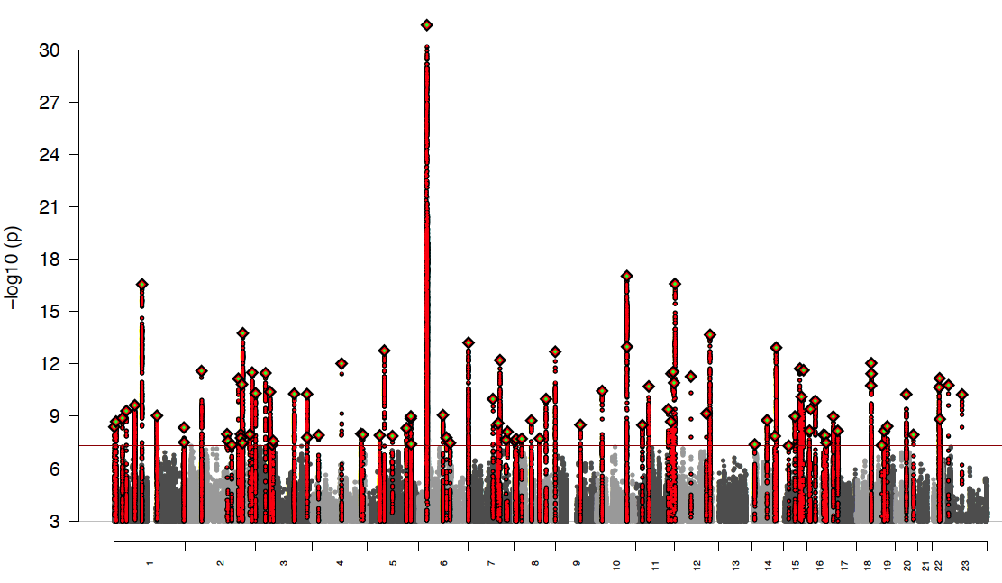
Strongest association in schizophrenia is to the MHC locus
MHC
p < 10⁻³⁰
Association with schizophrenia
(-log10(p))
Chromosome
Notes:
This is the kind of illness for which one might look to human genetics for leads.
But one of the strongest genetic hints was actually confusing:
The strongest signal in both association and linkage studies was always in the MHC locus on chromosome 6.
But years of work had failed to find the responsible genes and alleles,
and had exhausted conventional genetic explanations for this.

Slide 5
Several cohorts share a curious association peak
Sweden
England
Ireland
Scotland
8
8
8
8
6
6
6
6
Schizophrenia association (-log₁₀ [p])
Schizophrenia association (-log₁₀ [p])
Schizophrenia association (-log₁₀ [p])
Schizophrenia association (-log₁₀ [p])
4
4
4
4
2
2
2
2
0
0
0
0
26
28
30
32
34
26
28
30
32
34
26
28
30
32
34
26
28
30
32
34
Position (Mb) on chr6
Position (Mb) on chr6
Position (Mb) on chr6
Position (Mb) on chr6
Doesn’t correspond to the linkage disequilibrium around any known variant
Notes:
A potential lead comes from several large cohorts we have genome-scanned here,
which seem to show peak associations in the same place – a gene-dense region at about 32 Mb on the physical map.
Even here though, the association signal is curious and puzzling,
As it doesn’t correspond to the linkage disequilibrium around any known variant.

Slide 6
Complement component 4 (C4) genes
Paralogous genes
encoded proteins opsonize material for elimination,
bind to different sites in tissues
Ancient retroviral insertion
brain-specific enhancer
Notes:
So this was a place to look for unconventional explanations. And we found one.
At the complement component 4 locus – which is within the MHC region –
there are two paralogous genes – C4A and C4B.
The encoded proteins both opsonize debris for elimination by phagocytic cells –
but they bind to different sites in tissues.
There’s also an ancient retroviral insertion, which we found acts as a brain-specific enhancer.
We found that this locus exists in many different forms in different people.
We inherit different numbers of C4A and C4B genes, due to these common and rare alleles.
And this enhancer is on some copies and not others.
So it’s a functionally salient allelic series.

Slide 7
C4 structures form haplotypes with SNPs
If C4 affected phenotype,
could generate
unconventional patterns
of association across SNPs.
2. Might be possible to
analyze C4 structures
by imputation from
existing SNP data.
Sekar, et al., Nature 2016
Notes:
Key insights:
Clearly nonrandom relationship to SNPs. Might cause associations to nearby SNPs. BUT
Complex relationship to any individual SNP. No SNP proxies.
Could this cause the

Slide 8
Imputing C4 alleles reveals two association peaks in the MHC – one at C4
Sekar, et al., Nature 2016

Slide 9
Multiple effects at MHC locus
Third signal (just outside MHC) at SYNGAP1
All three effects significant in a joint model.
No remaining effects.

Slide 10
Associations to specific C4 alleles
The more C4A RNA expression an allele generates...
... the more schizophrenia risk it confers
Sekar, et al., Nature 2016
Notes:
across this allelic series,
The more C4A expression an allele generates in the brain,
the greater the risk of schizophrenia it confers.
But the level of risk is generally not shaped by the SNP haplotype on which a C4 allele is segregating.
This finding indicated that an over-active complement system, rather than an adaptive immune response, was generating risk from the MHC locus.

Slide 11
Recurring exon deletions in haptoglobin (HP) and blood cholesterol
Deletions (in fact, reversions of an ancient duplication)
of two exons that encode a multimerization domain
Recur in every generation
• A few common alleles (due to old mutations)
• Also many rare alleles (due to new mutations)
Cause HP to circulate in the blood as a dimer (rather than a trimer)
The dimer is a more-efficient antioxidant for ApoE
Reduce blood cholesterol by 2.1 mg/dl
Explain GWAS associations near this locus
Act together with a nearby SNP (1.5 mg/dl effect)
that regulates HP expression level
recurring deletions
lowers LDL
Haptoglobin (HP)
Boettger, et al., ...Nat Genet 2016

Slide 12
An imputed HP2/HP1 predictor associates much more strongly than any SNP near HP does
p = 2.8x10⁻¹¹
Boettger, et al., ...Nat Genet 2016

Slide 13
The amylase locus: many alleles, multiple views
One study reported an extremely large effect
of AMY1 copy number variation on obesity/BMI
Falci, Froguel, et al., Nat Genet 2014
We didn’t see such an effect.
We also concluded (based on partial though low LD of AMY1 CN to nearby SNPs)
that it’s unlikely that such a large effect would leave no footprint
in GWAS of the size that have been pursued for BMI (n > 100k)
Usher, et al., Nat Genet 2015
Amylase (AMY1/2A/2B)

Slide 14
How much “missing heritability” is explained?
Across the genome, very small contribution, because only 0-1 loci with complex variation (that we know of) implicated in any given disease (smaller-scale VNTRs could contribute also though)
At individual loci,
  locus explained 2-4 times more variance than the “lead SNP” did (may be true at many other loci also)
    individual SNPs only partially correlated with the full spectrum of allelic influences at the locus
  value not from ∂h² but from series of alleles with interpretable effects

Slide 15
Acquired mutations, clonal expansions, and missing heritability
Really?

Slide 16
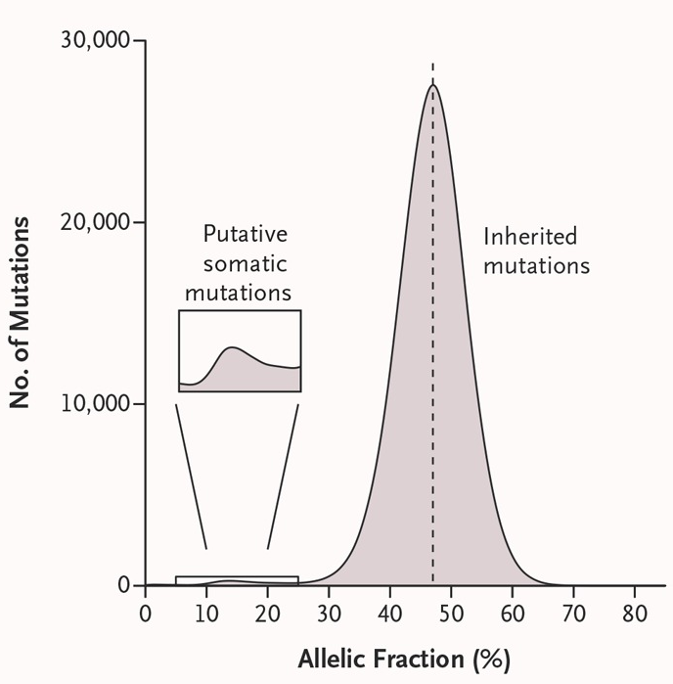
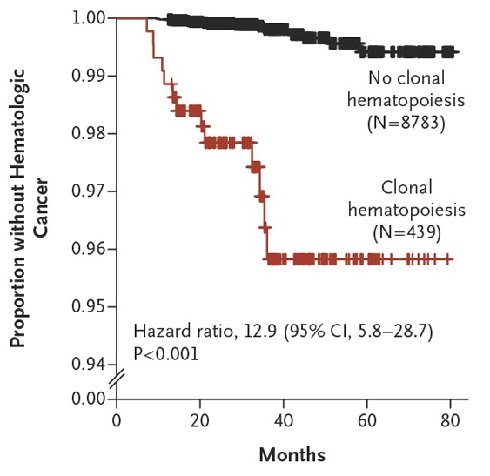
Common clonal expansions of blood cells with mutations
Allelic ratio 1:1
(inherited variants)
Somatic mutations
concentrated in blood-cancer genes
(TET2, AXSL1, DNMT3A)
Model:
acquired mutation
+ clonal expansion
12x increased risk for later blood cancer
Genovese, ...., McCarroll. NEJM 2015
discovered independently by Jaiswal, ... Ebert. NEJM 2015
Also strongly affects cardiovascular disease risk
(Jaiswal, Kathiresan, Ebert, et al., 2017)
Notes:
But we uncovered something much more surprising and translationally important… about cancer.
As in most human genetic studies, we were analyzing data from blood-derived DNA.
To find somatic mutations, we looked for sequence variants that were present at low allelic fractions – consistent with their being present in some but not all of a person’s cells.
We found thousands of somatic mutations in these cohorts.
X
And the mutations did concentrate in specific genes – but they were blood-cancer genes.
X
We found that this is a common state in which a blood stem cell or progenitor has acquired a mutation and then clonally expanded until its progeny are a substantial fraction of a person’s blood cells.
This creates a large reservoir of pre-cancerous cells,
X
any of which might acquire follow-on mutations that drive it toward frank malignancy.
X
People in whose DNA we had uncovered this condition went on to develop blood cancer at about 12 times the normal rate.
Ben Ebert, who discovered this independently, will tell you even more exciting things about it this afternoon.

Slide 17
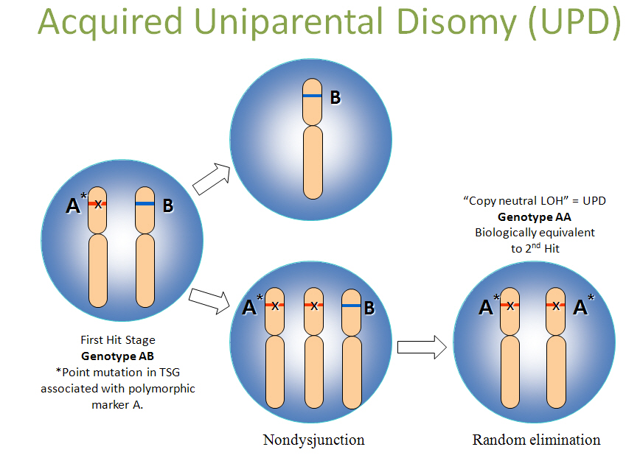
A subset of acquired mutations affect entire segments or chromosomes
Loss / deletion
Gain / duplication
All affect
allelic ratios
along a genomic segment
CNN-LOH
(copy-number-neutral
loss of heterozygosity)

Slide 18
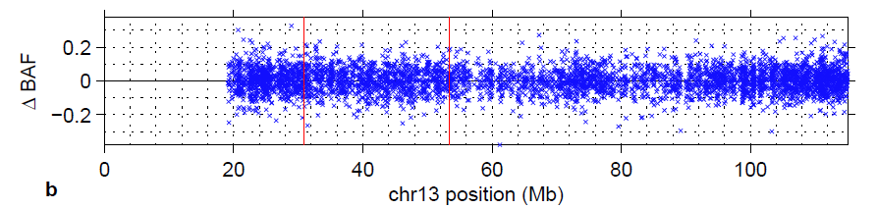
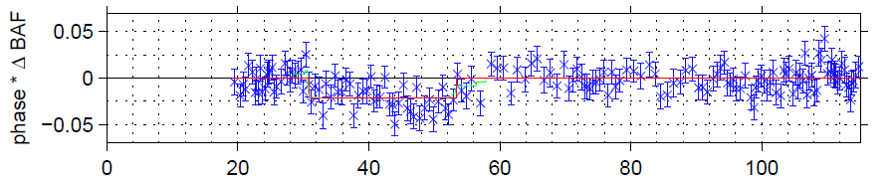

Knowing the chromosomal phase of heterozygous SNPs helps detect mosaic segmental mutations
???
Unphased
Phased
Mean shift

Slide 19
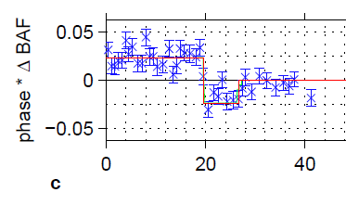
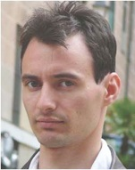


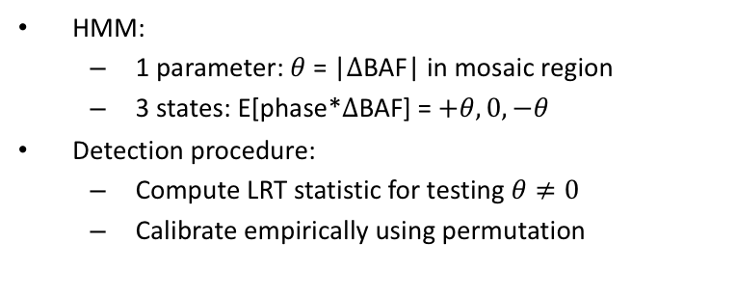







Phasing without relatives is imperfect, but this can be addressed computationally
$$+θ$$
$$+θ$$
$$+θ$$
$$0$$
$$0$$
$$0$$
Phase switch error
$$−θ$$
$$−θ$$
$$−θ$$
HMM:
  1 parameter: $θ$ = |$Δ$BAF| in mosaic region
  3 states: E[phase*$Δ$BAF] = $+θ, 0, −θ$
Detection procedure:
  Compute LRT statistic for testing $θ≠0$
  Calibrate empirically using permutation
Giulio Genovese

Slide 20
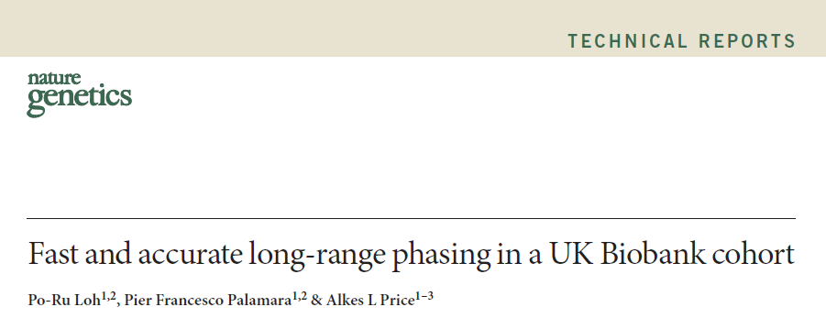
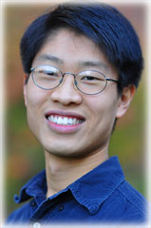
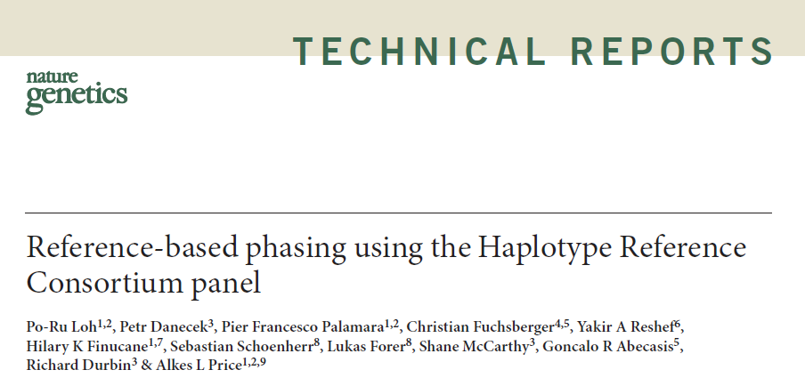
Recent innovations allow population-scale phasing
Po-Ru Loh
Alkes Price

Slide 21
Finding clones in the vast UK Biobank cohort
SNP data from 150k people
We identified >8,000 mosaic segmental mutations (at allelic fractions 1% and up)

Slide 22
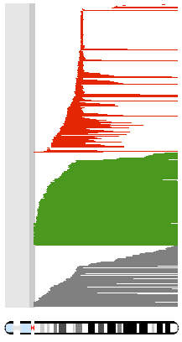
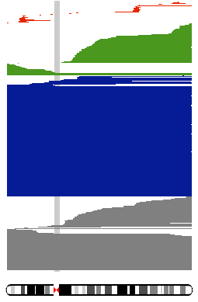
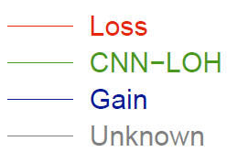
Mosaic mutations cluster in genomic hotspots
Pileups of detected events (indicated with horizontal lines):
Acquired
13q deletion
Acquired
trisomy 12
Chromosome 12
Chromosome 13
cf. Solimini et al., 2012 Science,
Jacobs et al. 2012 Nat Genet, Laurie et al. 2012 Nat Genet
Machiela et al. 2015 AJHG, Vattathil & Scheet 2016 AJHG
Notes:
I'll start with a birds-eye view of the event calls. This slide shows pileups of events called on chromosomes 12 and 13. Horizontal lines correspond to individual event calls and are color-coded according to copy number: red lines indicate mosaic losses, green lines indicate CNN-LOH events, and blue lines indicate gains. You'll immediately see that chromosomes 12 and 13 behave very differently: chromosome 12 is dominated by whole-chromosome duplications, while chromosome 13 is dominated by focal deletions. These two events are the most common aberrations in chronic lymphocytic leukemia, which provides a sanity-check of our approach.

Slide 23
Can inherited variation shape our risk for developing clones with specific somatic mutations during our lifetime?
We treated recurring mutations (at the same locus) as a phenotype,
then did a GWAS on each such phenotype (for each locus).
Power limited by modest number of “cases” (10s-100s for most loci)
Still, found cis- associations (and causal alleles) at many loci
• Causal variants are low-frequency (0.05 – 0.5%)
but large odds ratios (19-700)

Slide 24
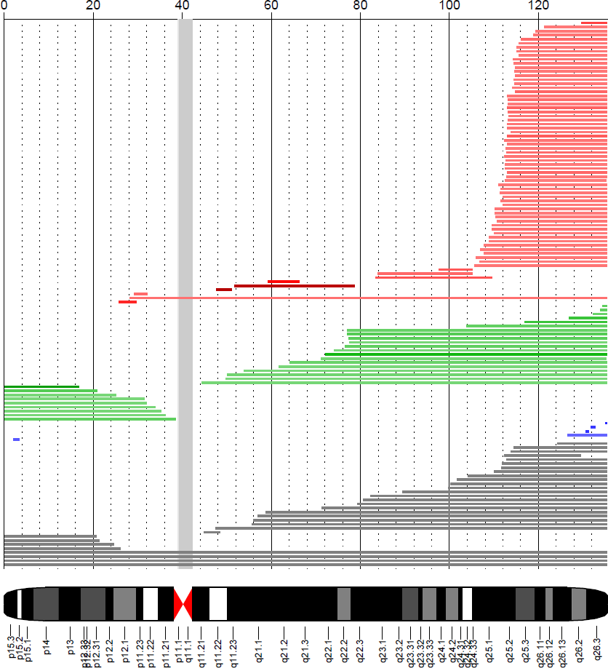
Example locus: chr10q deletions
Observed in 60 people
All 60 have the minor allele of rs118137427 (MAF 5%) (p < 10⁻⁴¹)
rs118137427
@ 113 Mb
The haplotype with the minor allele
is always the one that is deleted
Loh, Genovese, Handsaker et al., submitted

Slide 25
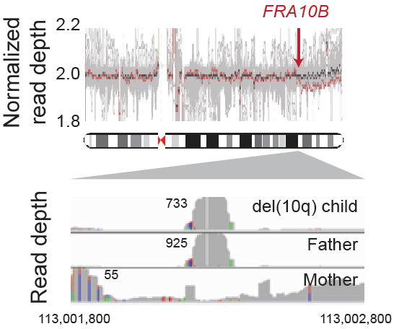
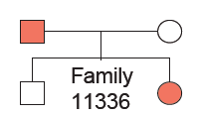
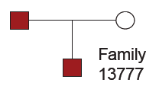
Mechanism: An inherited allele makes a “fragile site” much more fragile
A genomic “fragile site” (VNTR)
close to the deletion breakpoint
In WGS data, we see that
people with acquired
10q deletions appear to have an
expanded FRA10B site.
The mutation phenotype
segregates in families,
together with the repeat expansion
Loh, Genovese, Handsaker et al., submitted

Slide 26
A lesson from clonal hematopoiesis
Dichotomy between inheritance (heritable, firm, predictable) and acquired mutations (capricious, random) is not as firm as we had thought

Slide 27
Lessons from multi-allelic variation and clonal hematopoiesis
Interesting sources of unexplained heritability, but what was essential in studying them were SNP data from vast numbers of people and new ways to think about old data types
  Imputation and IBD analyses become every more enabling and powerful as data sets expand; likely to allow many new kinds of analyses

Slide 28
Legacies of “missing heritability” mania
Reminder that there is much to be learned
Antidote to smugness
Encourage exploration of new ideas
Too-easy excuse to abandon patient, consistent application of any one form of genetic analysis (SNP arrays ... WES ... ) and lurch to new, glamorous technology instead
Although we are finding sources of missing heritability,
the most useful data in the above studies has been SNP data,
because it is available for so many people

Slide 29
Legacies of “missing heritability” mania
Reminder that there is much to be learned
Antidote to smugness
Encourage exploration of new ideas
• Too-easy excuse to abandon patient, consistent application of any one form of genetic analysis (SNP arrays ... WES ... ) and lurch to applying new, glamorous expensive technology at small n
Although we are finding sources of missing heritability,
what enabled the above studies was large, widely available SNP data sets
because • it is available for so many people
• imputation and IBD become so much more powerful with sample size

Slide 30
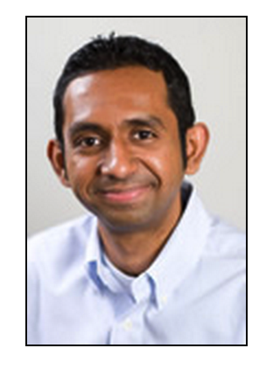



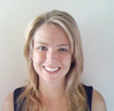
Acknowledgements
Heritable influences on clonal expansions
Complex and multi-allelic genome variation
Aswin
Sekar
Katy
Tooley
Po-Ru Loh
Giulio Genovese
Nolan
Kamitaki
Linda Boettger
Bob Handsaker
Alkes Price
Support: NGHRI ( 2 R01 HG006855 )

