Slide 1
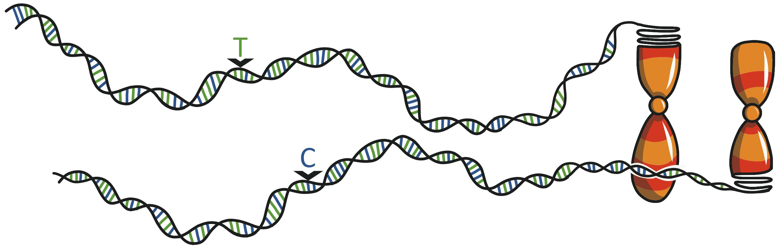

Omnigenic architecture of human complex traits
Jonathan Pritchard
Departments of Genetics & Biology, & HHMI
Stanford University
Joint work with Evan Boyle, Yang Li, Xuanyao Liu
ok
Missing Heritability Workshop,
NIH, May 2018
Henry Stewart Talks

Slide 2
Questions:
1. Why do the lead hits for any given trait contribute so little heritability?
2. Why does so much of the genome contribute to heritability?

Slide 3
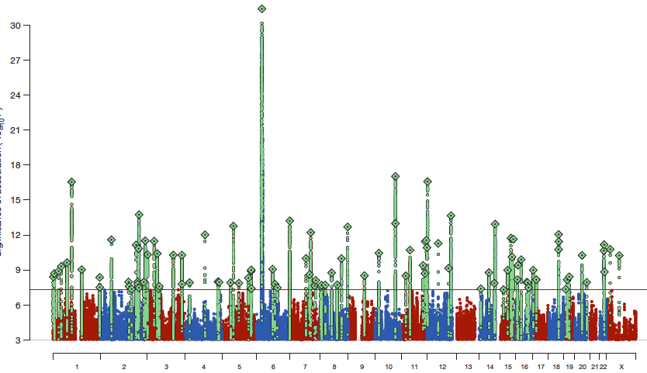
Example #1: Schizophrenia
108 genome-wide significant loci so far (Ripke 2014)
Responsible for ~10% of explained variance
(Shi…Pasaniuc 2016)
We have estimated that ~half of all SNPs have non-zero association effect sizes (unpub)
-log(p)
chromosome
See key work on polygenic models and heritability by Visscher, Yang, Pasaniuc, Price, and many others

Slide 4
Example #2:
What about a potentially simpler trait: lipid levels?
(LDL, HDL and triglycerides)

Slide 5
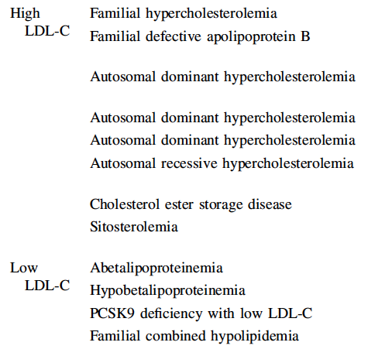
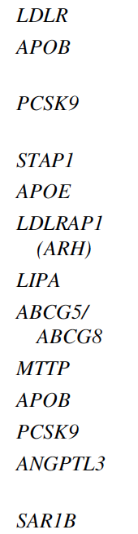
Monogenic lipid disorders
~2 dozen major effect loci
Modified from Dron et al 2016

Slide 6
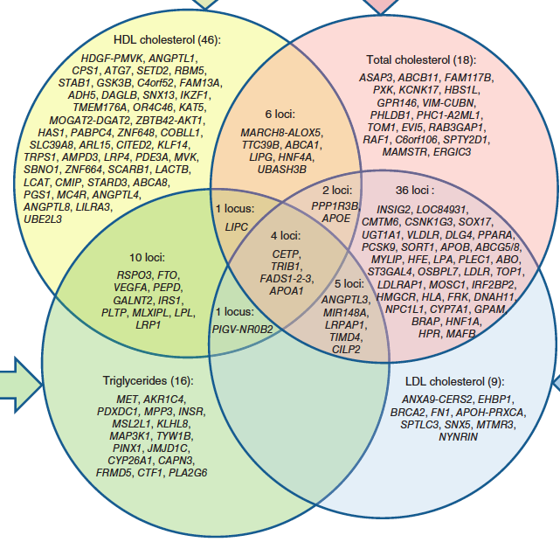
Common Variation: GWAS of Lipid Levels
57 genome-wide significant loci (Willer et al 2013)
Monogenic genes for LDL
HDL cholesterol
Total cholesterol
The significant loci only explain ~20%
of heritability of LDL
All loci together explain about ~80%
(Shi…Pasaniuc 2016)
Triglycerides
LDL cholesterol
Modified from: Willer et al 2013,
Dron et al 2016

Slide 7
For a wide variety of traits and diseases:
Heritability is spread extremely widely across the genome
Genes with trait-relevant functions only contribute a small fraction of the total disease risk
Low frequency-large effect variants often have clearer enrichment in relevant gene sets
Contributing variants are highly concentrated in regions that are active chromatin in relevant tissues
(Implies that most effects mediated through gene regulation)

Slide 8
So how should we conceptualize the molecular links from genetic variation to complex traits?

Slide 9
Our model to describe the data:
The “omnigenic” model
3 types of genes:
Tier 1: Core genes: direct roles in disease
Tier 2: Peripheral genes: essentially all other expressed genes can trans-regulate core genes
Tier 3: Genes not expressed in the “right” cell types do not contribute to heritability
Most phenotypic variance is due to regulatory variation in peripheral genes

Slide 10
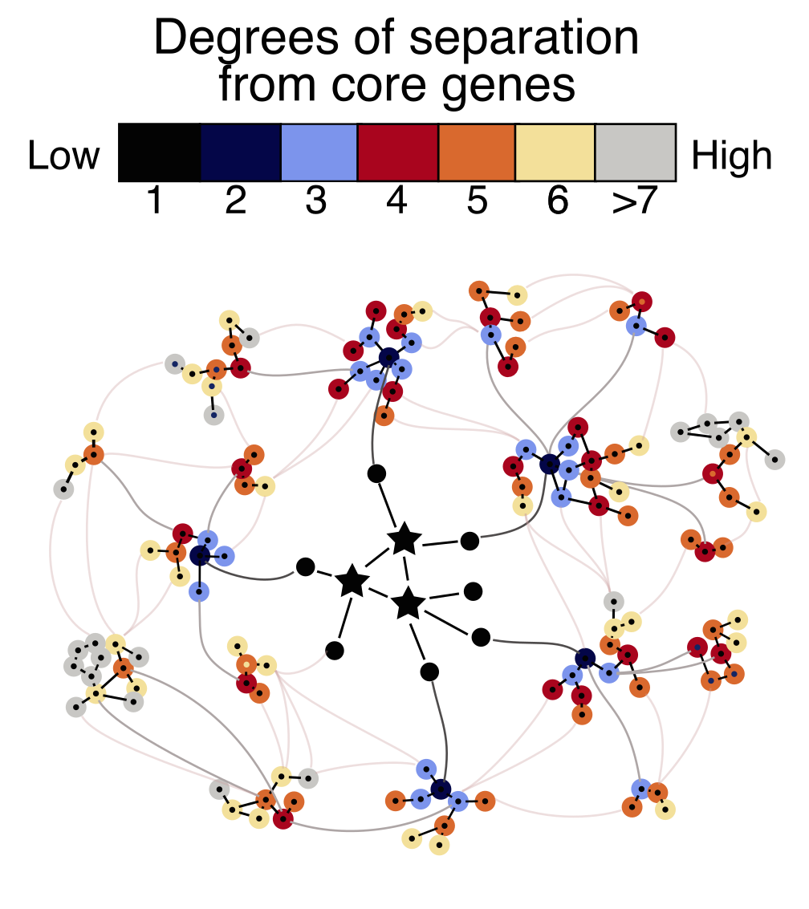
Hypothesis: Peripheral genes outnumber core genes by ~100:1, and likely dominate the phenotypic variance through weak effects rippling through gene networks

Slide 11

cis and trans regulation of core genes
core gene
peripheral genes
Notes:
Trans effects may also act on protein levels, PTMs, protein localization/export etc

Slide 12
cis and trans regulation of core genes
core gene
peripheral genes
Notes:
Trans effects may also act on protein levels, PTMs, protein localization/export etc

Slide 13
cis and trans regulation of core genes
Trans effects
[peripheral genes]
core gene
Notes:
Peripheral gene effects presumably also include regulatory effects on protein levels and function
Trans effects may also act on protein levels, PTMs, protein localization/export etc

Slide 14
How much of expression variance is due to cis vs trans effects?

Slide 15
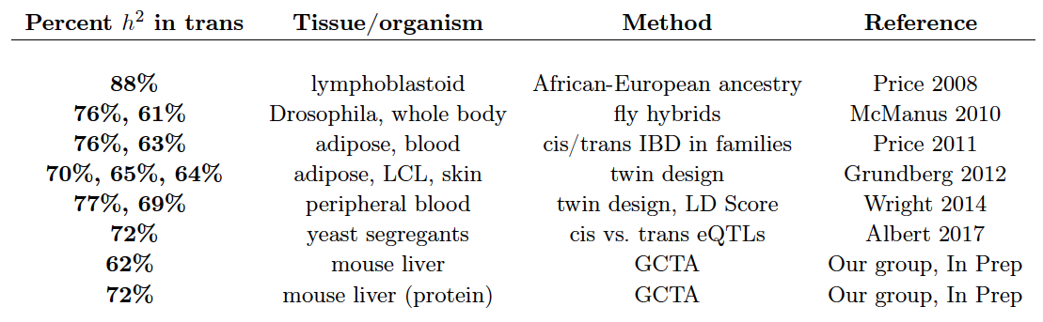
Literature review: genetic variance in gene expression
~70% in trans

Slide 16
cis and trans regulation of core genes
peripheral genes
~70% of heritability in trans
~30% of mRNA heritability in cis
core gene
Notes:
Peripheral gene effects presumably also include regulatory effects on protein levels and function
Trans effects may also act on protein levels, PTMs, protein localization/export etc

Slide 17
But trans eQTLs have very small effect sizes compared to cis

Slide 18
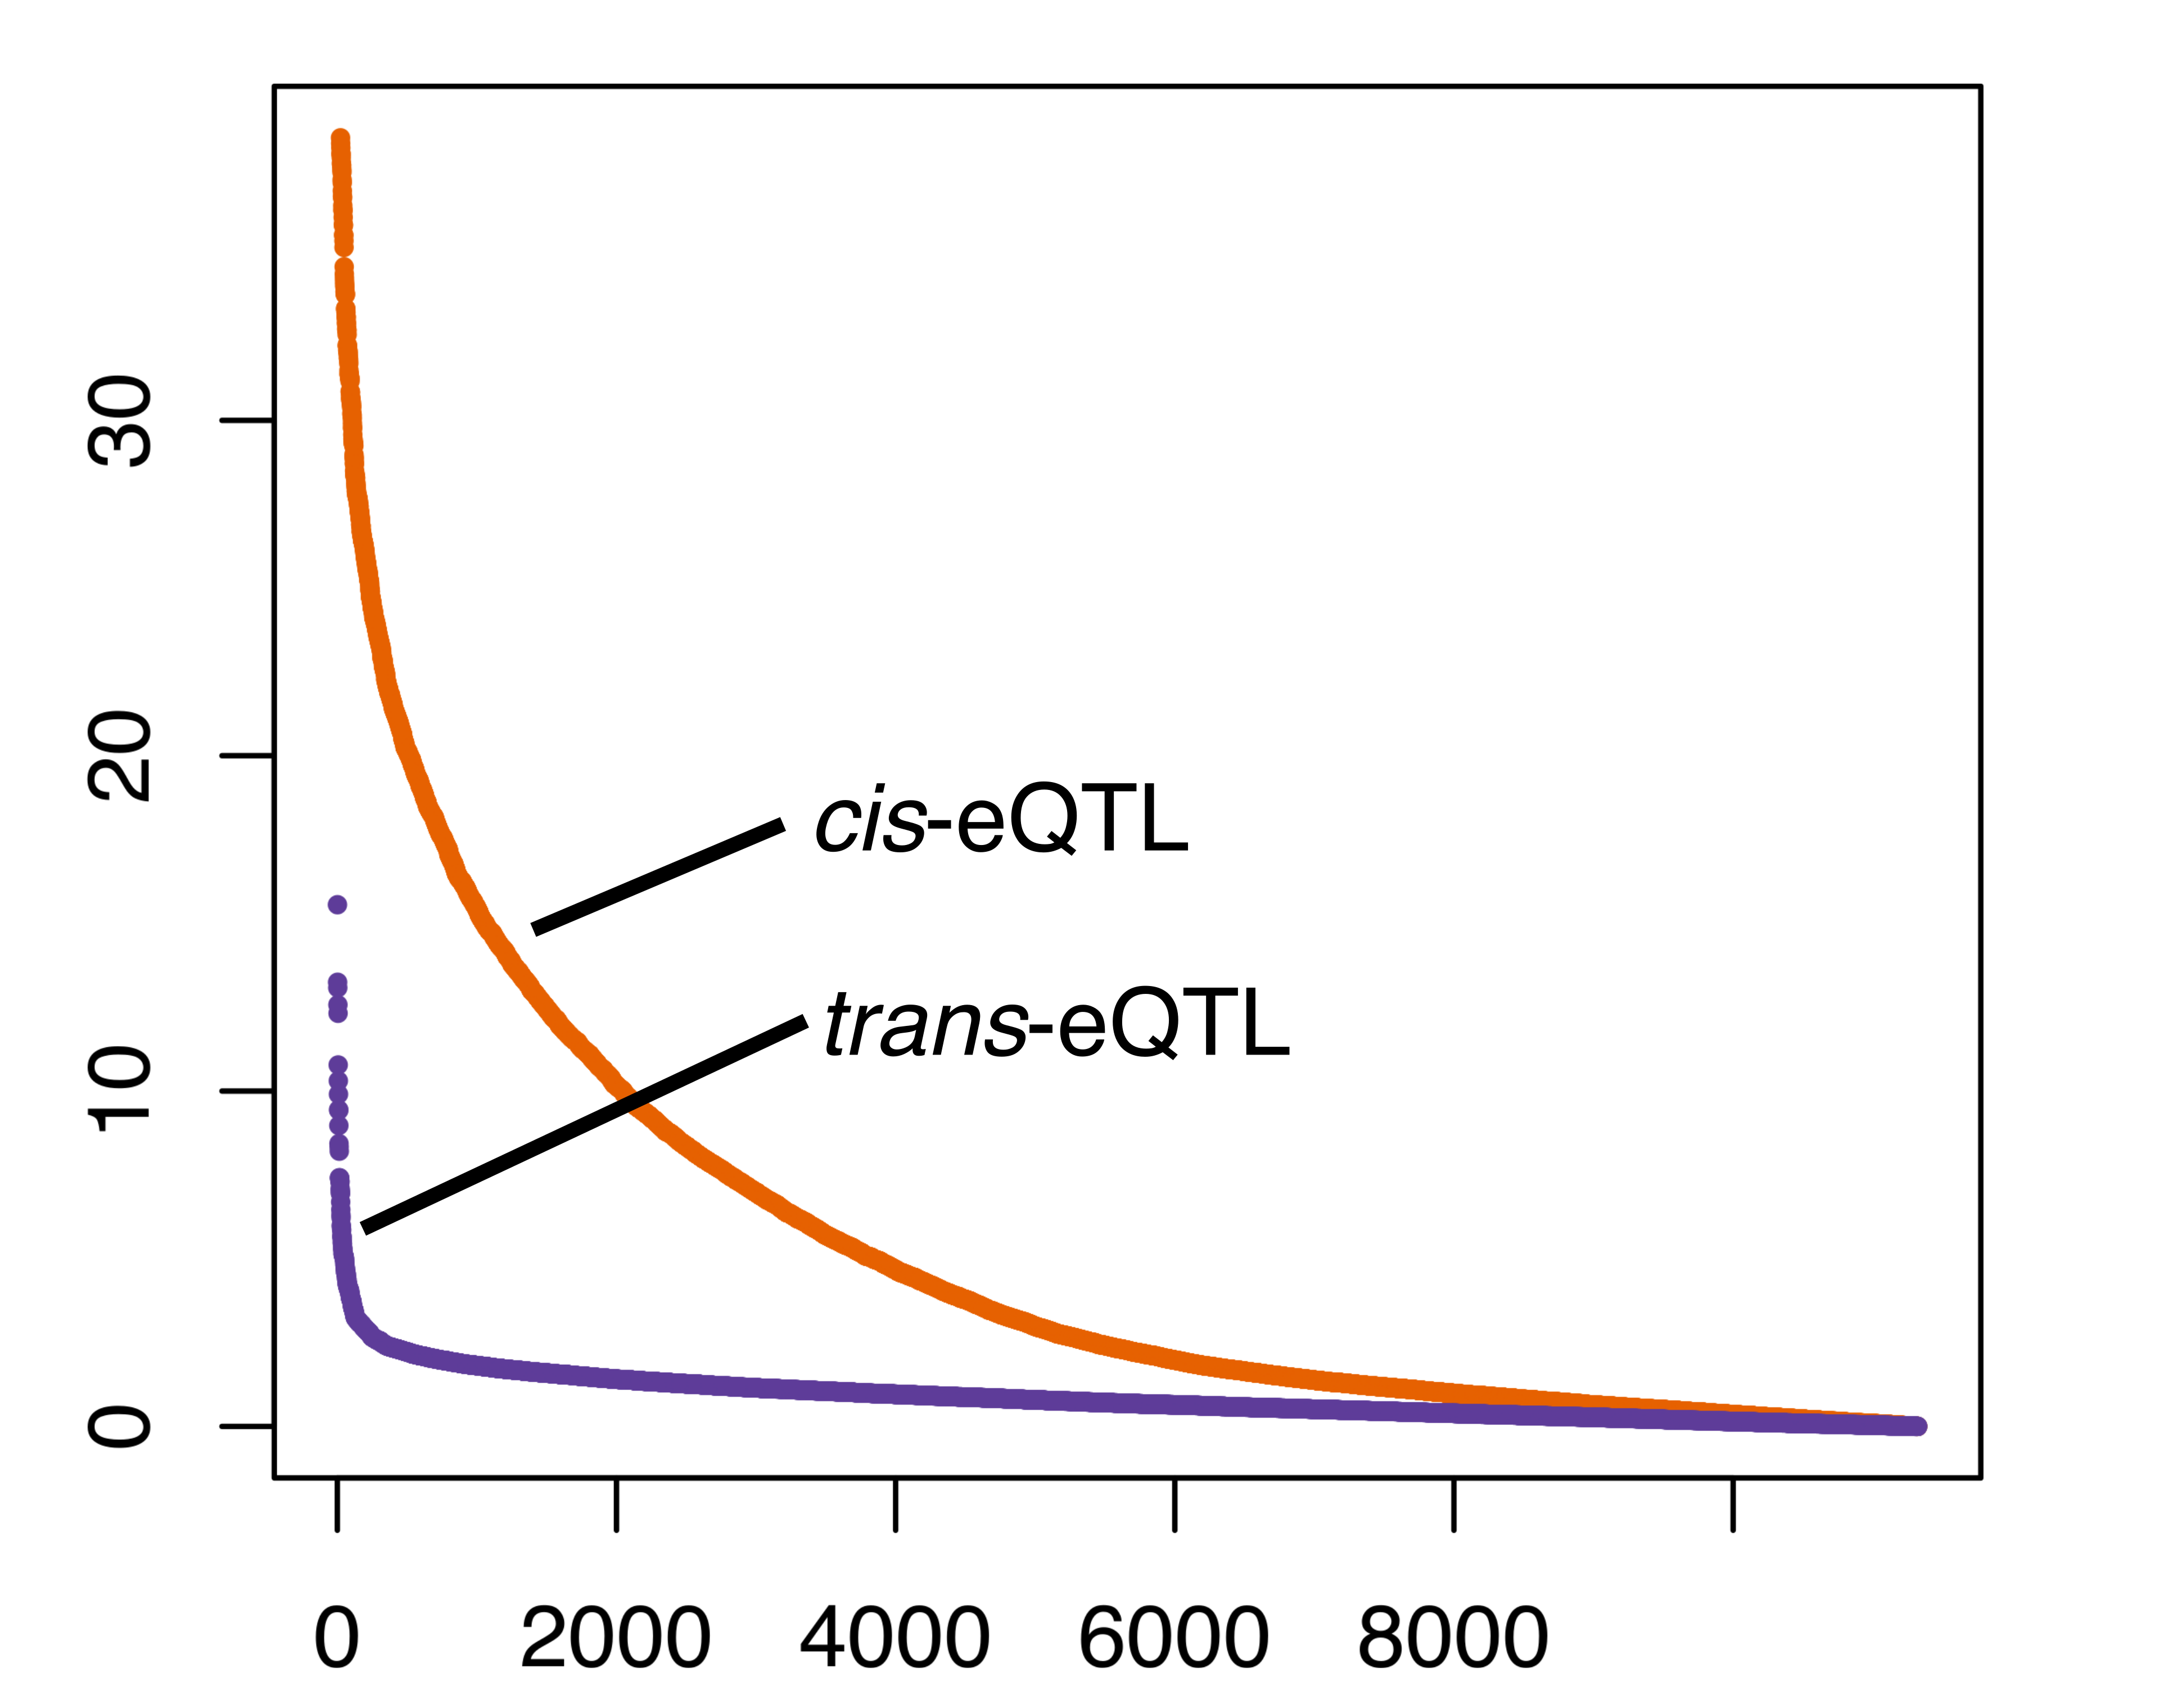
Distribution of cis vs trans effect sizes
Effect sizes of SNPs on expression
(|Z| scores)
This difference is even more dramatic for
(effect size)²
Distribution of effect sizes for top hits, cis and trans
Xuanyao Liu, unpub’d.
Plot shows replication effect sizes of strongest cis and trans signals from NTR into DGN

Slide 19
Together these observations imply that a typical gene must have huge numbers of weak trans-regulators
~70% of variance in trans
Cis associations much bigger than trans
Xuanyao Liu, unpub’d
Notes:
And in fact the effects on variance are proportional to the y-axis squared, so the bias is even bigger than you can see here

Slide 20
Together these observations imply that a typical gene must have huge numbers of weak trans-regulators
~70% of variance in trans
So assuming > tens of core genes, this model explains why such a large fraction of the genome can contribute to any given complex trait
Xuanyao Liu, unpub’d

Slide 21
One last question: why do core genes contribute so little heritability to any given trait?

Slide 22
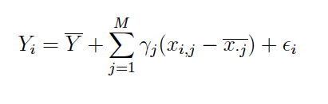
A simple phenotype model based on expression of core genes
Phenotype in individual i
Sum over M core genes
γ: mean effect of expression of gene j on phenotype
ε: Random error
Expression of gene j in individual i minus mean
Average phenotype

Slide 23
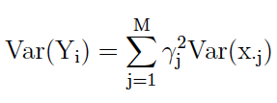
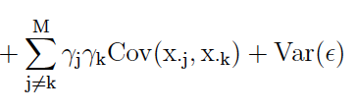
Expression variance:
~1/3 cis, 2/3 trans.
M of these terms
Phenotypic variance
Expression covariance:
Dominated by trans effects (peripheral genes)
Nearly M² of these terms

Slide 24
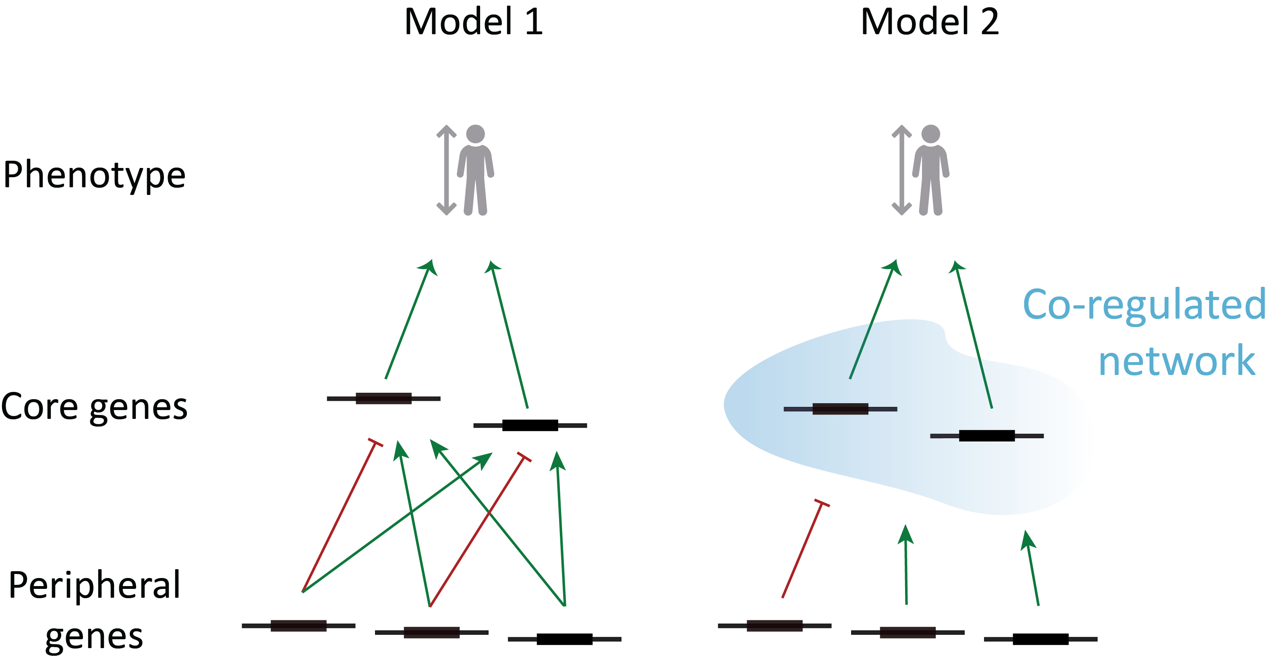
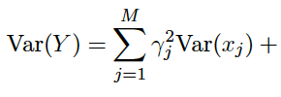

Two versions of core gene model yield divergent predictions
Model 1:
Expression covariances of core genes low
~30% of expression variance in cis
~70% of expression variance in trans
~30% of heritability cis to core genes

Slide 25
Two versions of core gene model yield divergent predictions
Model 2:
Expression covariances of core genes high
cis effects independent for each core gene
Trans effects often shared across core genes
Most of the heritability transferred to peripheral genes

Slide 26
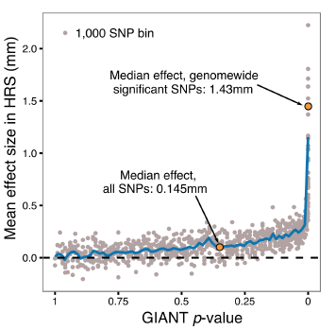
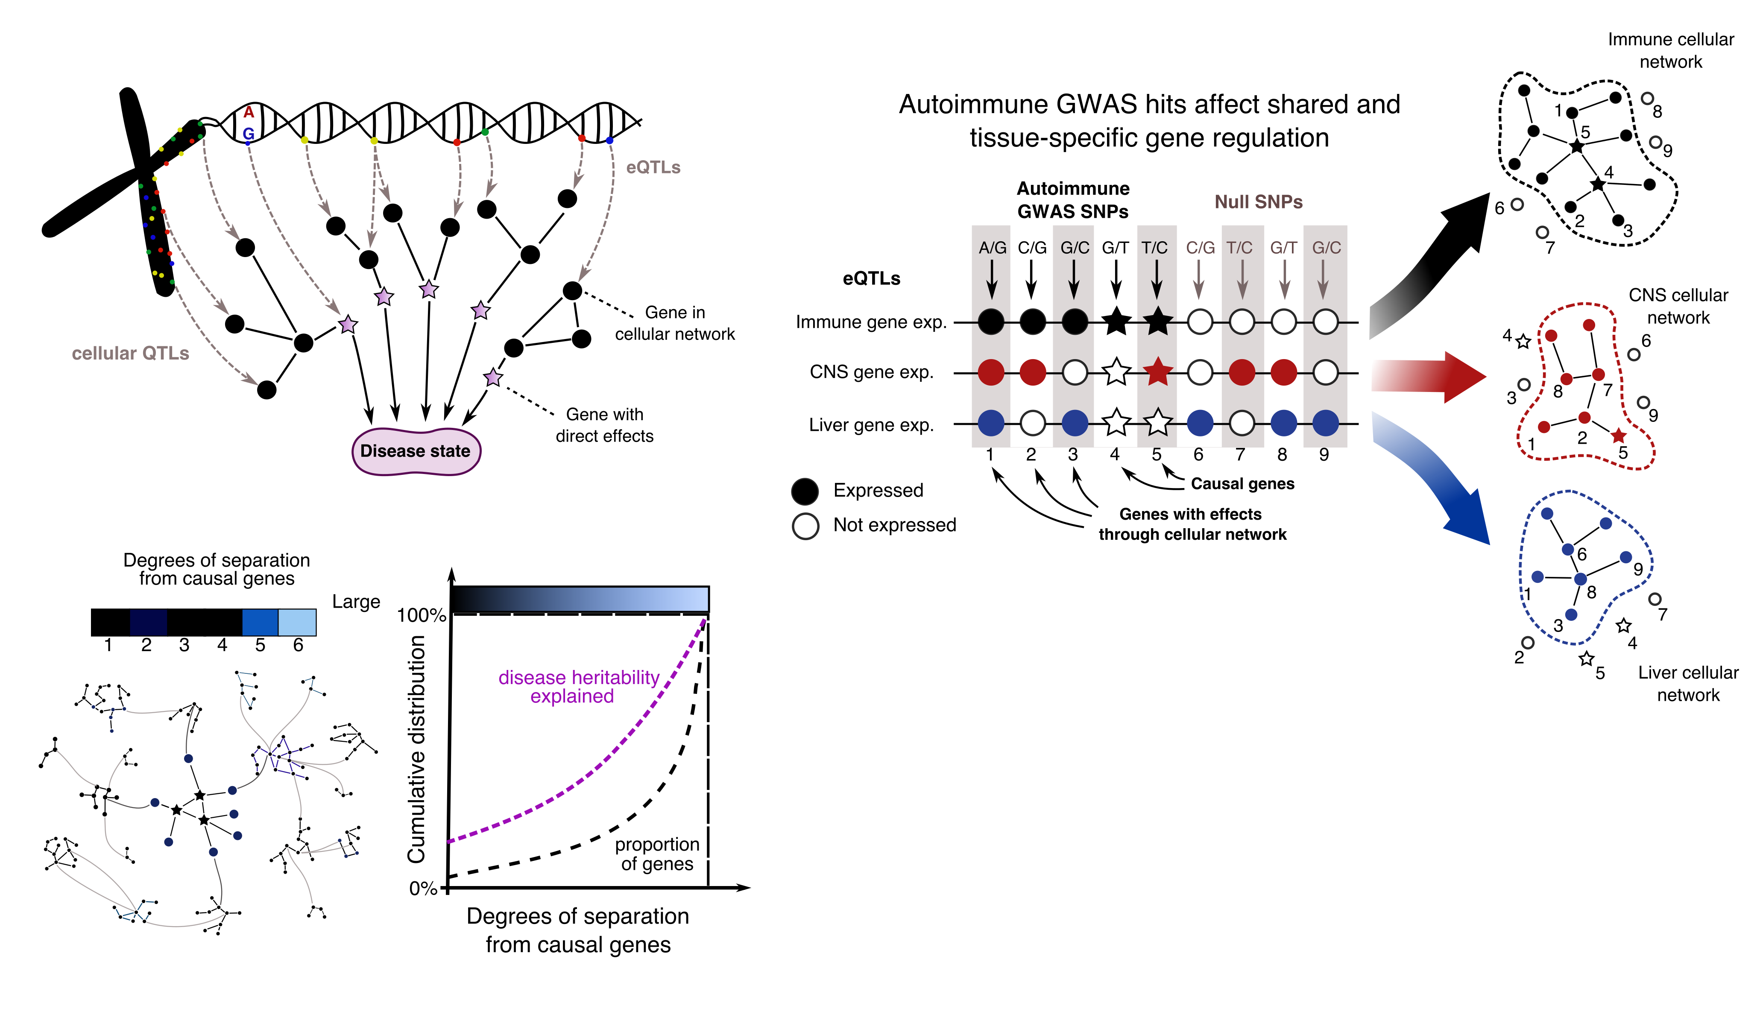
Boyle, Li & Pritchard
Cell 2017
Conclusions (1)
We propose that gene regulatory networks are sufficiently interconnected that
all genes expressed in disease-relevant cells are liable to affect the functions of core disease-related genes
most heritability is due to SNPs outside core pathways.
We refer to this hypothesis as an ‘‘omnigenic’’ model.

Slide 27
Boyle, Li & Pritchard
Cell 2017
Conclusions (2)
This model is consistent with known properties of cis- and trans-eQTLs
trans-variation is responsible for ~70% of expression heritability
But effect sizes are nearly uniformly tiny
Co-regulated gene networks act as amplifiers for peripheral variation

Slide 28




Thanks to many colleagues for great discussions; NIH & HHMI for funding.
We have a draft in prep on the new work (goal: end of May). Please email me if you would like a pre-preprint
pritch@stanford.edu
Evan Boyle
Yang Li
Xuanyao Liu
Lab Reunion 2016

Slide 30
Boyle, Li & Pritchard
Cell 2017
Conclusions (3)
Gene-mapping serves two main goals
Genetic prediction
For this, GWAS is essential
Identification of core genes and pathways
  Some combination of deep exome sequencing to find rare variants with large effects with more GWAS + methods for network inference
Importance of studying long-range network effects of variation

