Slide 1
The role of gene expression in complex trait heritability
Alexis Battle

Slide 2
Motivation and introduction
How can we use gene expression and epigenetics to help us understand complex trait genetics?
Majority of trait-associated variation is non-coding.
Common hypothesis is that most of these function by altering gene expression.
SNP
A

Slide 3
Motivation and introduction
Using expression and epigenetic data to inform missing heritability:
Quantify contribution of this important component of trait heritability?
Explain mechanism?
Increase power to detect trait-associated variants (or build good predictors)?

Slide 4
1. Genetics of gene expression

Slide 5
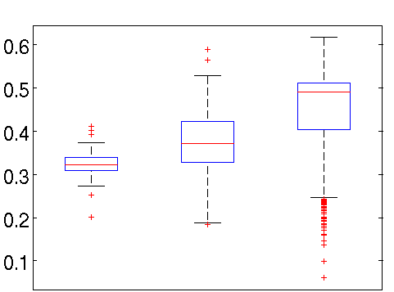
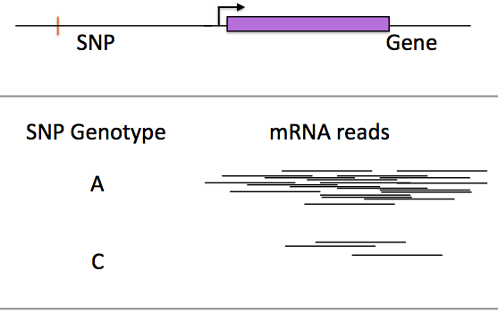
Genetic variants affect gene expression
eQTL (expression Quantitative Trait Locus) analysis:
Association between genotype and RNA expression levels
Expression of gene IKZF1
CC CA AA
SNP genotype at chr20: 5177528
Notes:
One approach for finding regulatory variants is to perform an eQTL study. For *common* genetic variants, we can simply look across a sample of individuals and directly test for association between genotype at the variant and expression of nearby genes, or even all genes.

Slide 6
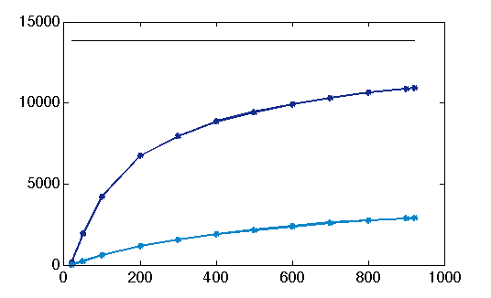
Prevalence of eQTLs
Cis-eQTLs have now been identified for nearly every human gene, with numerous large studies available
cis eQTLs
10,914
cis-sQTLs
Number of genes with
eQTL identified
6,738
2,851
1,158
200
400
600
800
1000
Cohort size
Battle, Genome Research, 2014

Slide 7
Large-scale eQTL analyses
DGN: 922 whole blood RNA-seq
GEUVADIS: 462 LCL RNA-seq
MUTHER: 850, several tissues, microarray and later RNA-seq
Wright et al, 2014: 2,752 twins, whole blood microarray
Westra et al, 2013: meta-analysis of 5,311 whole blood microarray samples

Slide 8
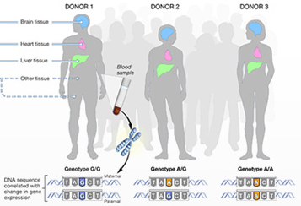
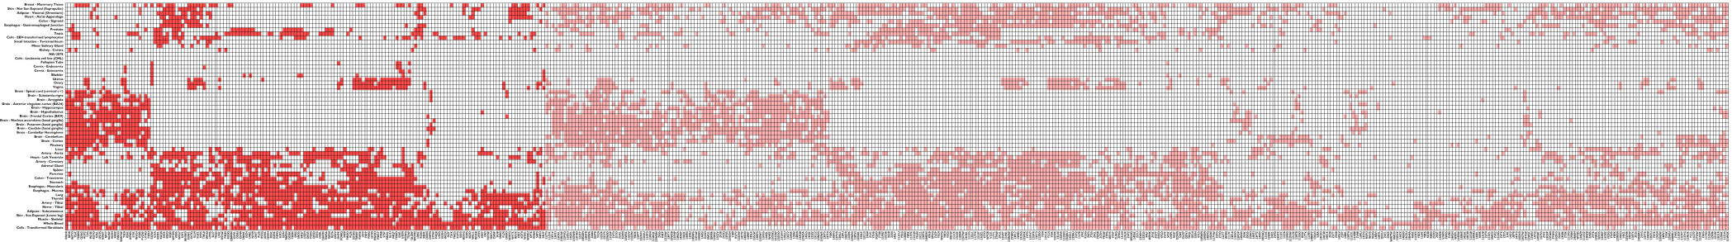
GTEx Project
GTEx Consortium v6p data
449 genotyped donors
7051 gene expression samples
42 post-mortem tissues
  31 solid-organ tissues
  10 brain subregions
44 tissues
116 individuals (WGS)
449 individuals (RNA-seq + genotype)
The GTEx Consortium, Nature 2017
Notes:
Since then, even more ambitious projects have evaluated the impact of genetic variation on gene expression in larger and more targetted studies.
I have been involved in the GTEx project for a number of years and recently co-led the analysis of eQTLs in the v6 release…

Slide 9
Genetic effects across human tissues
Total unique eQTL genes:
Cis: 19,725 (FDR 5%)
Trans: 93 (FDR 10%)
Most cis per tissue:
8,087 Tibial nerve (N=256)
Most trans per tissue:
35 Testis (N=157)
The GTEx Consortium, Nature 2017

Slide 10
Characterizing eQTLs across tissues
Cis-eQTL variants fall in tissue-specific regulatory elements (from Roadmap Epigenomics)
The GTEx Consortium, Nature 2017

Slide 11
Trans-eQTLs
GTEx
Large studies:
Westra et al (N=5,311, using GWAS variants only)
ALSPAC (N=869)
MUTHER (N=850)
DGN (N=922)
Framingham (N=5257)
Studies report wildly different # hits (10s–10000s)
Replication and validation remains poor
We remain underpowered at current sample sizes

Slide 12
Challenges for trans-eQTL detection
Power
False positives from many sources e.g. over and under correcting confounders (Dahl et al, 2017)
Mapping error (similar to probe cross-hybrid.)
True positive cis-eQTL
Slide adapted from Yuan He

Slide 13
Heritability of gene expression
Despite eQTLs being pervasive, estimates for heritability of gene expression are modest
Average over genes ranging from 0.09 to 0.3 (Price et al, 2008/2011, Wright et al 2014, Wheeler et al 2016, MUTHER)
Informs need for greater power to detect trans-eQTLs
Figure from Wright et al NG 2014
Notes:
Add figVarying estimates ()
h2 = 0.150 for blood and h2 = 0.234 adip – price et al
0.101 from Wright et al, with some genes up to 0.9
.149 haky
.16 - .26 MUTHER
ure from one of the studies

Slide 14
Heritability of gene expression
Trans effects contribute much more to gene expression heritability than cis
h²_{cis}/ h² estimates range from 10-40%
  Price et al 2011
  Wright et al 2014
  Grundberg et al 2012
Varies by tissue, population, power, method
h²_{cis} sparse (Wheeler et al 2016), trans often mediated by cis effects
Notes:
Add figure from one of the studies

Slide 15
2. Connecting expression and epigenetics to complex traits

Slide 16

eQTLs and complex disease genetics
Help interpret GWAS variants (especially non-coding):
understand mechanism
guide interventions
Gene 1
Gene 2
C
DNA
RNA
protein
?
?
Notes:
To understand the approach

Slide 17
eQTLs and complex disease genetics
Help interpret GWAS variants (especially non-coding):
understand mechanism
guide interventions
Gene 1
Gene 2
eQTL
C
DNA
RNA
drug
protein
?
Notes:
To understand the approach

Slide 18
Most SNPs are eQTLs
But…most of these just tag functional variants
Need to evaluate whether underlying causal variants are actually shared (co-localization)
Slide adapted from Casey Brown, UPenn

Slide 19
Most SNPs are eQTLs
Co-localization analysis:
But…most of these just tag functional variants
Need to evaluate whether underlying causal variants are actually shared (co-localization)
Slide adapted from Casey Brown, UPenn

Slide 20
eQTLs and complex disease genetics
~50% of genetic variants associated with human disease co-localize with an eQTL
compared to 92% simply associated p < 0.05/44 (still enriched over background)
The GTEx Consortium, Nature 2017

Slide 21
Deciphering mechanism
53% of co-localized GWAS loci have > 1 target gene, ambiguity remains
Slide adapted from Casey Brown

Slide 22
eQTL data informs heritability
GE co-score regression indicates cis-eQTLs explain mean 21% of h² across a set of complex traits
O’Connor et al. bioRxiv, 2017

Slide 23
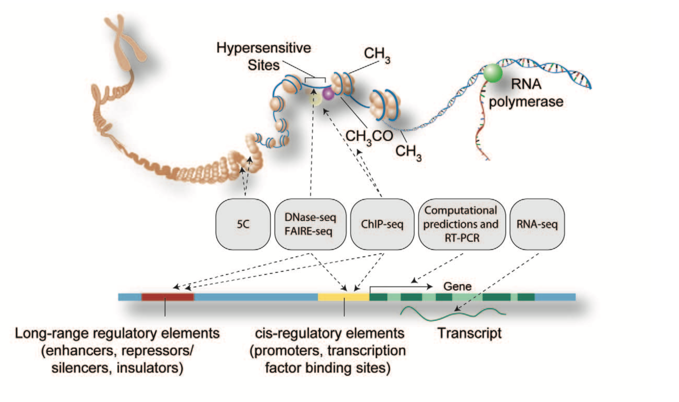
Epigenetic data
ENCODE, Roadmap Epigenomics
Regulatory elements: promoters, enhancers
Transcription factor binding sites
CpG sites
ChromHMM
ENCODE Project Consortium. Plos Biology 2011.

Slide 24
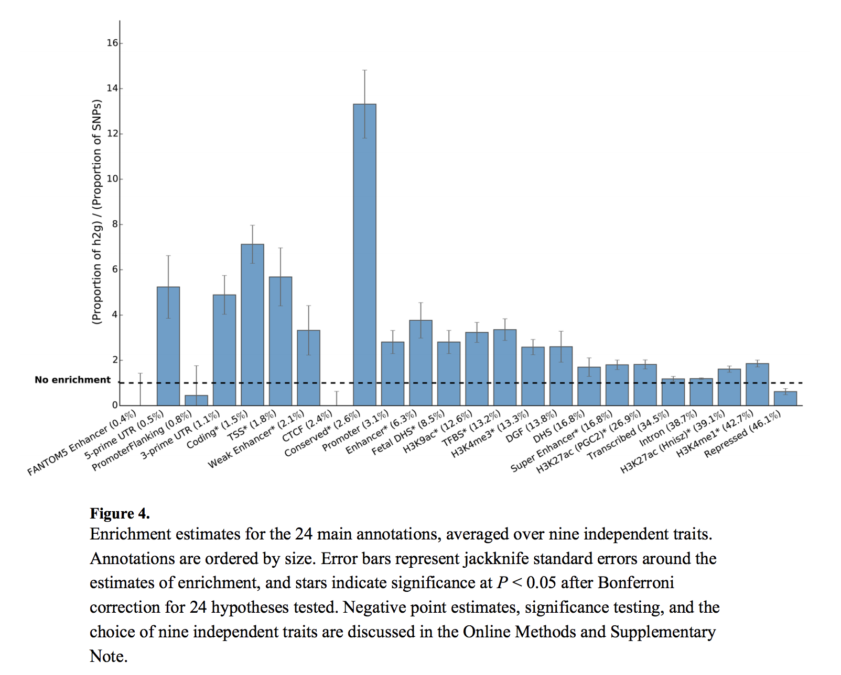
Epigenetic data informs heritability
LD score regression, related approaches partition h²
Large scale epigenetic data (Roadmap, ENCODE) enable analysis, indicate contribution of gene regulation
Figure from Finucane, NG, 2015

Slide 25
Ommigenic model
Most/all expressed genes in disease-relevant cell types affect trait
Highlights potential role of eQTLs, trans effects
Boyle et al., Cell, 2017

Slide 26
3. Complex effects of genetic variation on gene expression

Slide 27
What are we missing?
Most studies are done on steady-state total expression measurements at a single adult or post-mortem time point
Disease-relevant states include different developmental stages, environmental exposures, cell types
Other variant classes and regulatory effects

Slide 28

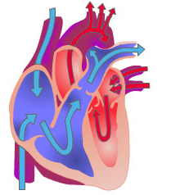
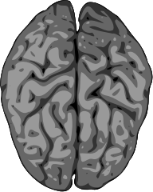
Context-specificity
Many factors can modulate regulatory effects
Altered transcription factor abundance
Epigenetic changes

Slide 29
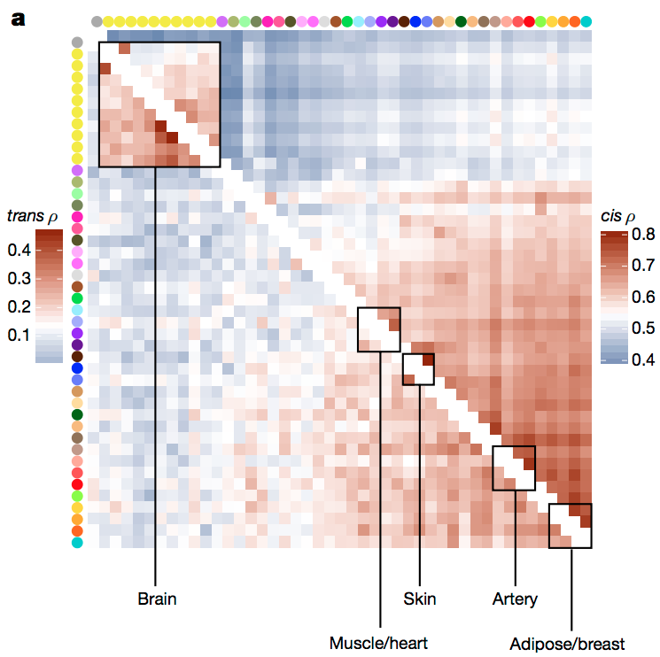
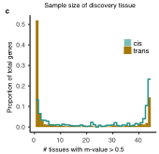
GTEx tissue-specificity of cis and trans
Trans eQTLs appear more highly tissue-specific than cis-eQTLs
The GTEx Consortium, Nature 2017
Notes:
Add trans plot too

Slide 30
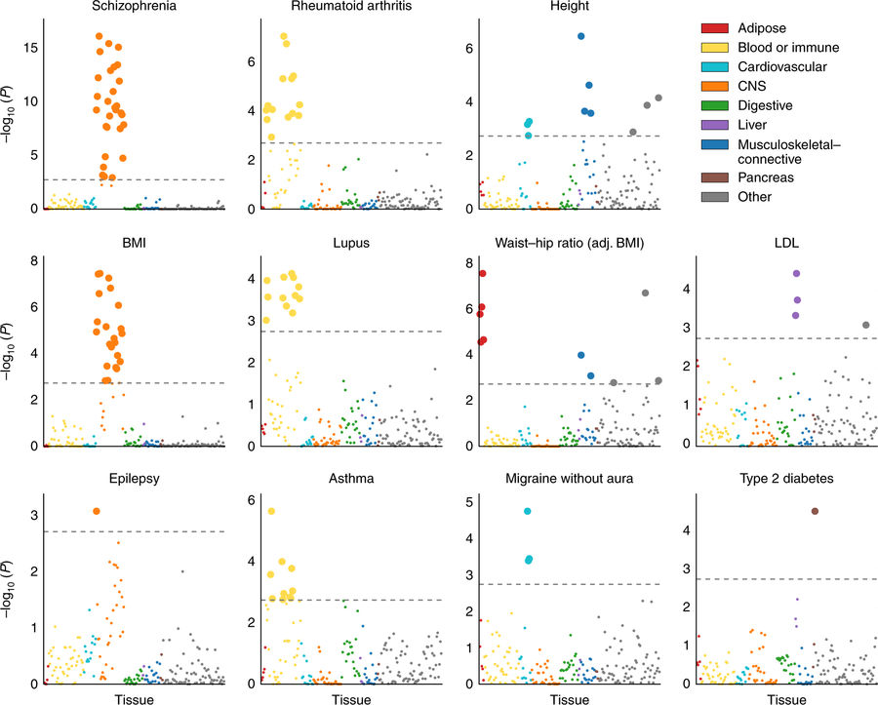
Tissue specificity and heritability
From Finucane et al, NG, 2018

Slide 31
Detecting context-specific QTLs
Many other contexts beyond tissue:
Recent work explores QTLs in diverse environments, such as infection response
  Fairfax et al, Science 2014
  Lee, Science 2014
Methods for identifying allelic response from RNA-seq data
BP meds and NPRL3: related to genes involved in homeostasis of fluid volume
Knowles et al, NM, 2017

Slide 32
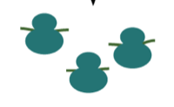
Diverse variants and readouts
Diverse genetic variant classes, enabled by improved variant calling and methods
  Structural variants
  Repeats
Diverse molecular phenotypes important to h²:
  Alternative splicing (Li et al, Science 2016)
  Translation, protein abundance (Wu et al, 2013 and Battle et al,2015)
  Epigenetic changes including chromatin accessibility, histone modifications, methylation, etc (McVicker 2013, Grubert 2015, Banovich 2014…)

Slide 33
4. Further possibilities

Slide 34
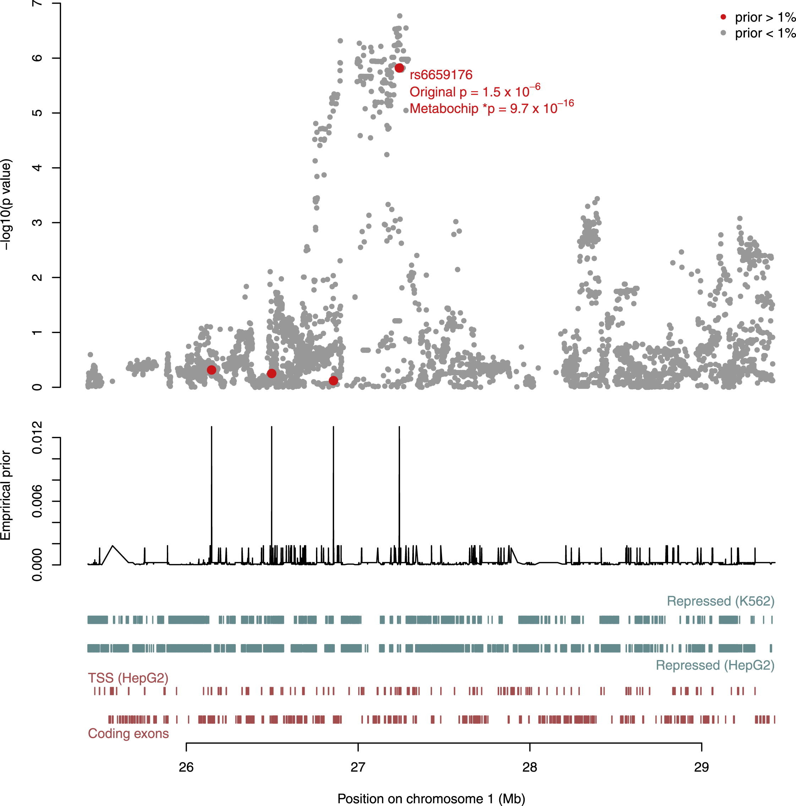
Detecting more?
Can expression and epigenetic data help detect more variants or explain more heritability?
New methods integrate diverse data to learn and apply priors to GWAS analysis and prediction scores
Pickrell AJHG 2014 estimates 5% increase in loci detectable
Marigorta NG 2017
Pickrell, 2014

Slide 35
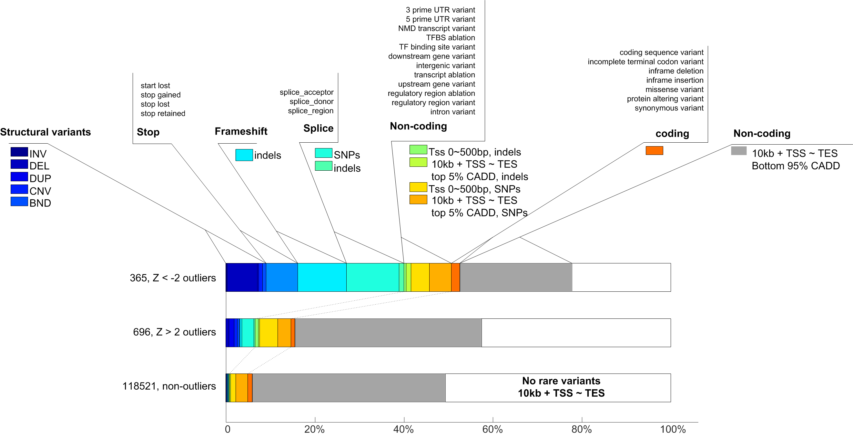
Rare variants
Recent work emphasizes importance of rare variation in driving extreme expression levels
Li et al, Nature, 2017

Slide 36
Rare variants
Preprint (Hernandez et al 2017) suggests rare variants explain a large fraction of heritability of gene expression

Slide 37
5. Conclusions

Slide 38
Progress – what we’ve learned
Genetics of gene expression:
  Prevalence of genetic variants affecting gene expression
  Large catalogs of cis-QTLs, diverse contexts, variants, mol phenotypes
Connections to complex traits:
  Better data and methods provide better estimate of contribution of expression to h², and interpretation of individual variants (MR, etc)
  Current estimates indicate gene expression contribute sizeable but not majority fraction to trait h²
Contribution of expression, epigenetic data to explaining missing h²?
  Modestly improved power for identifying individual GWAS hits through informed priors, potential for better prediction
Improved interpretation and mechanism

Slide 39
Why delve deeper into expression?
Help determine when and how much to invest in WGS, expression, epigenetic data
To continue understanding implicated
  Genes
  Tissue and cell types
  Epigenetic and other regulatory mechanisms
Challenges and caveats
  Ambiguity: many variants affect multiple genes
  Interpretability: missing relevant cell types
  Power: trans-eQTLs also require large sample sizes

Slide 40

Ongoing effots
Scaling up eQTL studies, finding trans:
eQTLGen: meta-analysis of all available whole blood expression data including over 30,000 samples
GTEx v8: 1,000 individuals, WGS, over 50 tissues
Environment and dynamic QTLs
Single cell analysis - Human Cell Atlas, etc
Integrated analysis connecting epigenetic and expression data for improved resolution, disambiguation, power
Methods
…
…

Slide 41

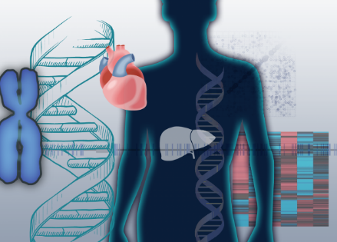

Acknowledgements
GTEx Consortium
Casey Brown
Barbara Engelhardt
Stephen Montgomery
Ira Hall
Collaborators
David Knowles
Jonathan Pritchard
Yoav Gilad
Funding sources
NIH, NHGRI, NIMH
R01 HG008150 R01 MH101814
Searle Scholar Fund
Notes:
Pictures/emblems?
Add grant numbers

Slide 42
Cis-eQTLs remain to be discovered

Slide 43
GTEx trans-eQTLs
Trans-eQTL often coincide with cis-eQTLs
Tissue-specific mechanisms identified
The GTEx Consortium, Nature 2017
Notes:
Remove?

Slide 44
Multiple independent SNPs per gene

Slide 45
Variants associated with many genes
Cis-eQTL variants have multiple gene targets, particularly once considering multiple tissues

Slide 46
Progress – what we’ve learned
Genetics of gene expression:
  Understand prevalence of cis-eQTLs
  Improved eQTL catalogs based on larger studies
  Complexity: context-specificity, allelic heterogeneity, multiple gene targets
  Coverage of diverse variant classes and molecular phenotypes including alternative splicing
  Rare variant effects on gene expression

Slide 47
Progress – what we’ve learned
Connections to complex traits:
  Better epigenetic data and eQTL catalogs provide better estimate of contribution of expression to h²
  Improved methods:
    Co-localization, fine-mapping
    Mendelian randomization approaches
    LD-score regression and related approaches tailored for utilizing expression and epigenetic data
  Current estimates indicate gene expression contribute sizeable but not majority fraction to trait h²

Slide 48
Progress – what we’ve learned
Contribution of expression and epigenetic data to explaining missing h²?
  Modestly improved power for identifying individual GWAS hits through informed priors
  Potential improvements for prediction
Improved interpretation and mechanism
  Identified target genes of individual GWAS hits
  Identified relevant tissues and cell types in aggregate

Slide 49
Challenges and caveats
Ambiguity – many variants affects multiple genes in cis, in multiple tissues
When missing the relevant cell types, genes, or environments current methods are not always interpretable
Trans-eQTLs should be major component, but they are largely uncharacterized due to power

Slide 50
Key questions?
How much heritability is explained by expression
How much heritability is explained by epigenetics?
  And is that all reflected in expression if measured in right tissue, right time point, right context?
Limitations of current data?
Limitations of current methods?
Can expression/epigenetic data HELP explain missing heritability
Notes:
LD score regression can be biased when missing causal category

