Slide 1
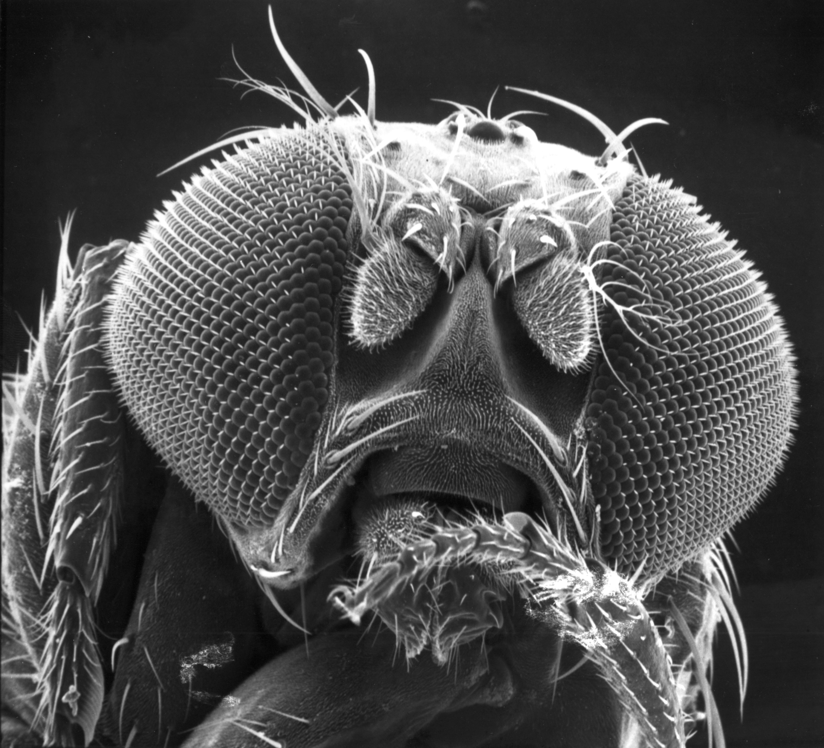
Context Dependent Effects of Alleles Affecting Quantitative Traits: Insights From Drosophila
Trudy F. C. Mackay
Department of Biological Sciences
Program in Genetics
W. M. Keck Center for Behavioral Biology
Comparative Medicine Institute
North Carolina State University
Raleigh, NC 27695 USA

Slide 3
Why are Effects of Variants Affecting Human Complex Traits so Small?
h² overestimated using twin studies
“SNP Chips” have limitations:
SNPs disproportionately in coding regions
Not all common variants represented
No rare variants represented
Cannot detect copy number variants, insertions and deletions
Human genome has limitations:
SNPs located in LD blocks
Associated SNPs may not be casual, but in LD with true causal variant, reducing estimated effect size
True causal variant may be common or rare
Analytical methods have limitations:
Low power to detect gene-gene interactions (epistasis)
Low power to detect gene-environment interactions
Need very large samples to detect truly additive variants with very small effects
Missing heritability may be due to:
SNPs in non-coding regions
Large effect rare variants in LD with Chip SNP
Large effect common variants in LD with Chip SNP
Large effect undetected structural variants
Common variants with truly small effects

Slide 4
Why are Effects of Variants Affecting Human Complex Traits so Small?
Genotype by sex interaction (genetic variation in sexual dimorphism)
Genotype by environment interaction (genetic variation in environmental plasticity)
Genotype by genetic background interaction (epistasis)

Slide 5
Genetic Interactions
A₁A₁
A₂A₂
Lifespan
A₂A₂
Lifespan
A₁A₁
Female
E1
B₁B₁
Male
E2
B₂B₂
Female
E1
B₁B₁
Male
E2
B₂B₂
Change of variance
Effect may be large in one context only
Change of rank order
Opposite effects in different contexts
(“Antagonistic pleiotropy”)
Do these phenomena occur?

Slide 6
Needed:
Whole genome sequences
Minimal Local LD
Controlled environments
Power to detect individual variants associated with quantitative variation
Power to detect gene-environment interaction
Power to detect epistasis
Drosophila fulfills many of these needs

Slide 7
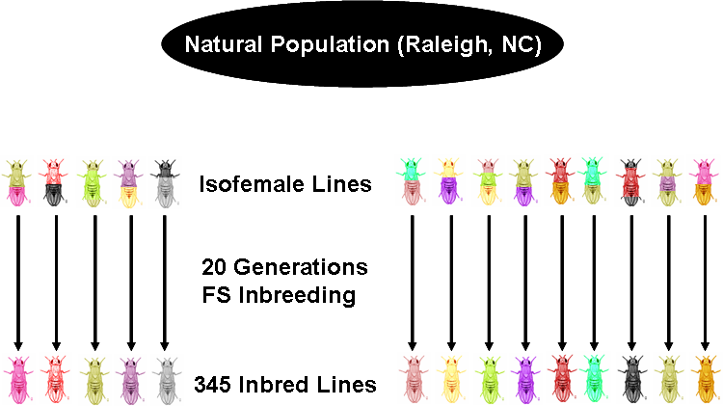
Drosophila melanogaster Genetic Reference Panel (DGRP)
Natural Population
Raleigh NC, USA
Isofemale Lines
20 Generations
FS Inbreeding
205 Inbred Lines
Illumina genome sequences (27X)
Highly polymorphic
Rapid decay LD with physical distance
Increased genetic variance compared to outbred population (cov_{G} = 2V_{A} + 4V_{AA} + 8V_{AAA} +…)
Replicated genotypes:
High heritability (H² = V_{G}/(V_{G} + V_{E}/n), for n individuals per genotype
Multiple environments
Mackay et al. 2012, Nature 482: 173; Huang et al. 2014, Genome Res. 24: 1193
Notes:
Build on success of previous community resources for QTL mapping: reference panel of 192 sequenced lines derived from a single natural population for genome wide association mapping in a scenario where ALL variants are known.

Slide 8
Variation for Lifespan in the DGRP
F
18°
25°
28°
M
18°
25°
28°
200 DGRP Lines
2 sexes
3 thermal environments
72 flies/sex/environment
~70,000 flies

Slide 9
Variation for Lifespan in the DGRP
Source of Variation | P-Value | σ²
Sex (S) | 7.67e-10 | Fixed
Temperature (T) | 5.80e-163 | Fixed
DGRP Line (L) | 1.94e-13 | 59.78
S×T | 4.59e-14 | Fixed
S×L | 2.22e-5 | 8.72
T×L | 6.72e-56 | 93.08
S×T×L | 1.14e-241 | 32.59
Rep(T×L) | 5.07e-29 | 16.34
S×Rep(T×L) | 7.32e-92 | 32.40
Residual |  | 295.72
H² = 0.39
r_{SE} = 0.31
Sex dimorphism
Environmental plasticity
Genetic variation
Genetic variation in sex dimorphism (genotype by sex interaction, GSE)
Genetic variation in environmental plasticity (genotype by environment interaction, GEI)
Genetic variation in sex dimorphism varies with thermal environment (GSEI)

Slide 10
Genetic Interactions
A₁A₁
A₂A₂
Lifespan
A₂A₂
Lifespan
A₁A₁
Female
E1
Male
E2
Female
E1
Male
E2
Change of variance
Sex or environment-specific
Change of rank order
Sex or environment antagonistic pleiotropy
GSI 18°
25°
28°
0.5%
1.0%
0.4%
99.5%
99.0%
99.6%
Female GEI 18°, 25°
18°, 28°
25°, 28°
33.7%
48.8%
13.1%
66.3%
51.2%
86.9%
Male GEI 18°, 25°
18°, 28°
25°, 28°
33.8%
51.4%
16.8%
66.2%
48.6%
83.2%

Slide 11
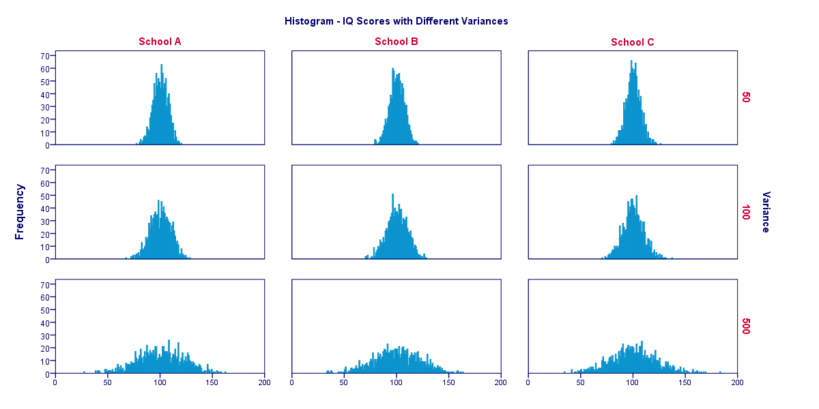
“Micro-Environmental Plasticity” for Lifespan
σ_{E}² = 50
DRGP Line 1
Frequency
σ_{E}² = 100
DRGP Line 2
Frequency
σ_{E}² = 500
DRGP Line 3
Frequency
Frequency
Lifespan (days)

Slide 12
Variation for Micro-Environmental Plasticity of Lifespan in the DGRP
Source of Variation | P-Value | σ²
Sex (S) | 9.289E-01 | Fixed
Temperature (T) | 4.682E-164 | Fixed
DGRP Line (L) | 1.353E-11 | 0.0241
S×T | 3.620E-03 | Fixed
S×L | 5.037E-03 | 0.0037
T×L | 6.804E-27 | 0.0318
S×T×L | 6.462E-19 | 0.0149
Error |  | 0.0282
H² = 0.73
r_{SE} = 0.32
Sex dimorphism
Environmental plasticity
Genetic variation
Genetic variation in sex dimorphism (genotype by sex interaction, GSE)
Genetic variation in environmental plasticity (genotype by environment interaction, GEI)
Genetic variation in sex dimorphism varies with thermal environment (GSEI)

Slide 13
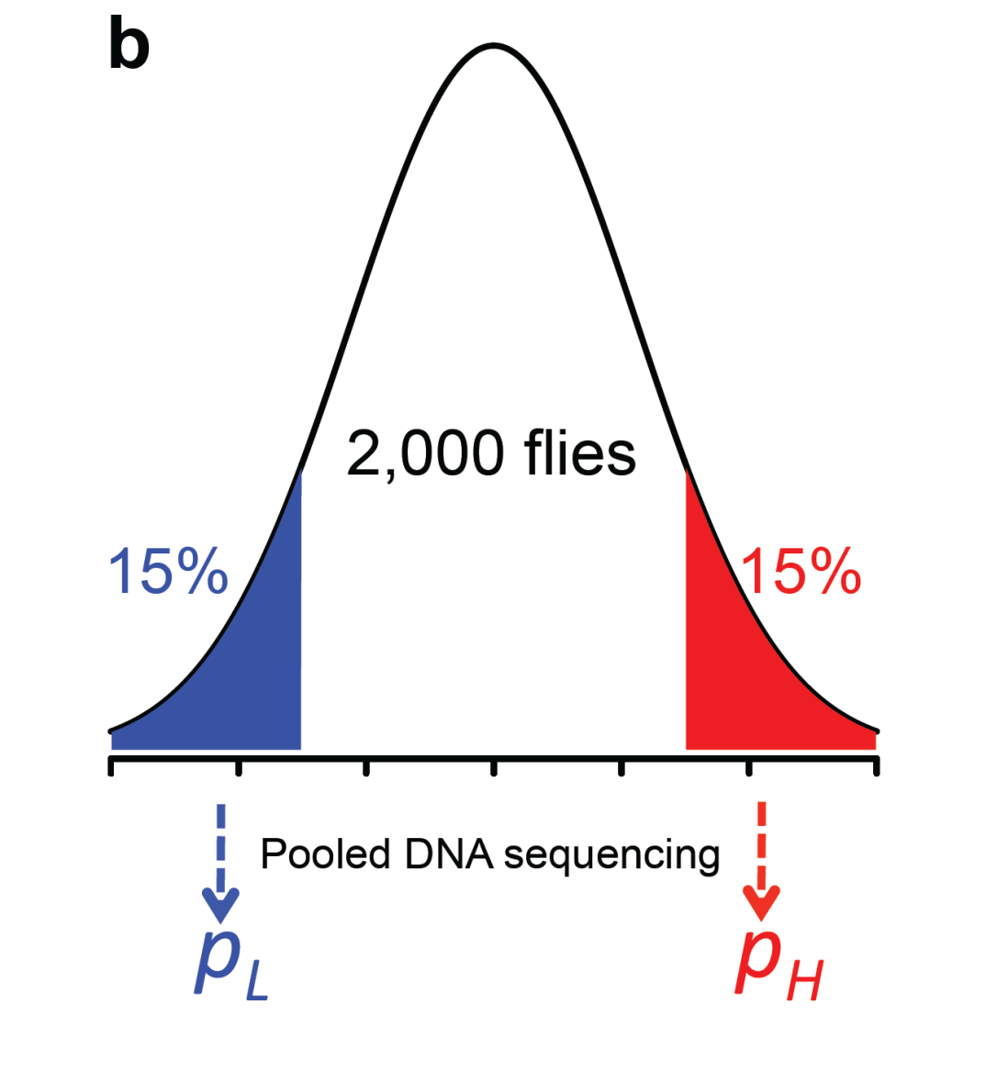
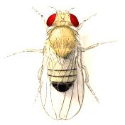
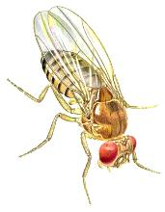
Advanced Intercross Populations
AIP
Extreme QTL Mapping
xQTL
Round robin mating
40 DGRP lines
Random mating
170 generations
N= 800/generation
Huang et al. 2012, PNAS 109: 15553

Slide 14
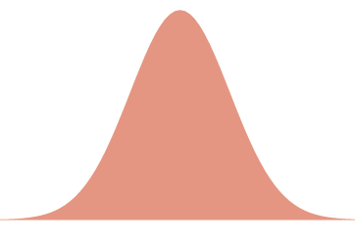
Variation for Lifespan in the AIP
F
18°
25°
28°
M
18°
25°
28°
~2000 flies
2 sexes
3 environments
2 replicates/sex/environment
~24,000 flies

Slide 15
GWAS for Lifespan in the AIP
F
M
2,065 SNPs in or near 1,326 genes significant at P < 10⁻⁷
Only 14 variants overlap between sexes, thermal environments
All other variants had sex- and environment-specific effects
Massive GSI, GEI

Slide 16
GWAS for GSI, GEI Lifespan in the AIP
2,368 SNPs associated with GSI (P < 10⁻⁵)
1,619 SNPs associated with GEI (P < 10⁻⁷)
ALL have opposite effects between sexes or temperatures
Antagonistic pleiotropy pervasive
Females 18°
Males 18°

Slide 17
Take Home Message
Allele Frequency Difference (All Other Contexts)
Allele Frequency Difference (One Context)

Slide 18
Comparison of Allelic Effects
in AIP and DGRP
None of the top variants in the AIP are significant when tested in the DGRP in the same context
Effects of top AIP variants are large within each context
Adequate power to detect effects this large in DGRP

Slide 19
Comparison of Allelic Effects
in AIP and DGRP
None of the variants (P < 10⁻⁷) in the AIP are significant when tested in the DGRP in the same context
This could happen if all AIP and DGRP GWAS hits are false positives – not likely for AIP GWAS analyses
This could also happen if there is pervasive epistasis and allele frequencies of interacting alleles are different between the DGRP and AIP – and they are by design

Slide 20
Combine AIP and DGRP Data to Derive Genetic Interaction Networks
18°
25°
28°
18°
25°
28°
Inferred epistatic interactions networks sex- and temperature specific
None of the inferred interactions individually significant

Slide 21
Top Epistatic Interactions
in Each Context
All interactions exhibit change of rank order in different genetic backgrounds
This type of interaction generates no additive genetic variance when alleles at both interacting loci are common
The difference in genetic variance components between the DGRP and outbred populations derived from it may enhance ability to detect epistasis if it exists

Slide 22
Induced Mutations Also Exhibit Epistatic Interactions
1
2
3
Magwire et al. 2010, PLoS Genetics 6: e1001037
×

Slide 23
Induced Mutations Also Exhibit Epistatic Interactions
Males
Females
CG10990
CG10990
crol
BG00817
crol
BG00817
BG00297
BG00004
BG00297
BG00004
mub
CG9238
mub
CG9238
pyd
esg
pyd
esg
CG31531
CG31531
Sex-specific epistasis
Magwire et al. 2010, PLoS Genetics 6: e1001037

Slide 24
Induced Mutations Also Exhibit Epistatic Interactions
Magwire et al. 2010, PLoS Genetics 6: e1001037

Slide 25
The genetic architecture of Drosophila lifespan is dominated by sex- and environment-specific variants as well as epistasis
These variants have small effects on lifespan, averaged over both sexes and all environments and may account in part for missing heritability
Effects of variants will not replicate between populations with different allele frequencies
These variants may also ‘hide’ from natural selection in natural populations experiencing heterogeneous environments, leading to maintenance of variation for lifespan in natural populations

Slide 26


THANK YOU!
Lifespan Measurements
Terry Campbell
Liz Jones
Kirsty Ward
Lizzy Russell
DNA Sequencing
Mary Anna Carbone
Statistical and Bioinformatic Analyses
Wen Huang
Financial Support
R01 GM45156
R01 AG43490

Slide 27
Epistasis: Effects at One Locus Depend on Allele Frequency Interacting Locus(i)
B₁B₁
Phenotype
B₂B₂
Effect of Locus A
A₁A₁
A₂A₂
0
0.5
1
Frequency of B₁
B₁B₁
Phenotype
B₂B₂
Effect of Locus A
A₁A₁
A₂A₂
0
0.5
1
Frequency of B₁
B₂B₂
Phenotype
Effect of Locus A
0
B₁B₁
0
0.5
1
A₁A₁
A₂A₂
Frequency of B₁

