Slide 1
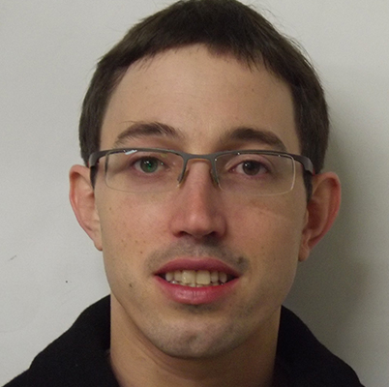
The population genetic underpinnings of missing heritability
Guy Sella
Columbia University
Yuval Simons
Jeremy Berg
Notes:
I’d like to tell you about work we’ve been doing to connect GWAS findings with the population genetic processes that underlie variation in complex traits. For the purpose of this meeting, I will focus on the implications about missing heritability.
Most of this work was done by Yuval Simons, an incredibly talented graduate student, where toward the end I’ll touch upon recent work by Jeremy Berg, a brilliant postdoc.

Slide 2
Missing heritability is largely about genetic architecture
Data from Wood et al. 2014 Nat. Genetics
Notes:
With the risk of stating the obvious, I’ll begin with the fact that missing heritability is largely about genetic architecture.
Specifically, by genetic architecture I am referring to the joint distribution of minor allele frequencies and effect sizes of loci that contribute to heritable variance.
When we look at GWS associations in these terms, for height in this case, we find that nearly all of them fall above a curve representing the study’s power.
The curve corresponds to a threshold contribution to genetic variance, where loci that exceed this contribution are detected and others are not.
This threshold is proportional to the total variance in the trait divided by the study’s sample size, which together measure the background noise for identifying the contribution of individual loci.
When the sample size increases this threshold decreases, allowing larger studies to identify loci with smaller contributions.
In genotyping studies, power also has a frequency threshold, below which imputation becomes unreliable.
So a straightforward explanation for missing heritability in a GWAS of a given trait, is that much of the genetic variance arises from loci with MAFs and effect sizes that fall below the study’s power thresholds. I will focus primarily on the variance threshold but will revisit the genotyping frequency threshold toward the end.

Slide 3
Missing heritability is largely about genetic architecture
Threshold
2a²pq > v* ~ V_{p}/n
Data from Wood et al. 2014 Nat. Genetics
Notes:
With the risk of stating the obvious, I’ll begin with the fact that missing heritability is largely about genetic architecture.
Specifically, by genetic architecture I am referring to the joint distribution of minor allele frequencies and effect sizes of loci that contribute to heritable variance.
When we look at GWS associations in these terms, for height in this case, we find that nearly all of them fall above a curve representing the study’s power.
The curve corresponds to a threshold contribution to genetic variance, where loci that exceed this contribution are detected and others are not.
This threshold is proportional to the total variance in the trait divided by the study’s sample size, which together measure the background noise for identifying the contribution of individual loci.
When the sample size increases this threshold decreases, allowing larger studies to identify loci with smaller contributions.
In genotyping studies, power also has a frequency threshold, below which imputation becomes unreliable.
So a straightforward explanation for missing heritability in a GWAS of a given trait, is that much of the genetic variance arises from loci with MAFs and effect sizes that fall below the study’s power thresholds. I will focus primarily on the variance threshold but will revisit the genotyping frequency threshold toward the end.

Slide 4
Missing heritability is largely about genetic architecture
Genotyping
Threshold
2a²pq > v* ~ V_{p}/n
Data from Wood et al. 2014 Nat. Genetics
Notes:
With the risk of stating the obvious, I’ll begin with the fact that missing heritability is largely about genetic architecture.
Specifically, by genetic architecture I am referring to the joint distribution of minor allele frequencies and effect sizes of loci that contribute to heritable variance.
When we look at GWS associations in these terms, for height in this case, we find that nearly all of them fall above a curve representing the study’s power.
The curve corresponds to a threshold contribution to genetic variance, where loci that exceed this contribution are detected and others are not.
This threshold is proportional to the total variance in the trait divided by the study’s sample size, which together measure the background noise for identifying the contribution of individual loci.
When the sample size increases this threshold decreases, allowing larger studies to identify loci with smaller contributions.
In genotyping studies, power also has a frequency threshold, below which imputation becomes unreliable.
So a straightforward explanation for missing heritability in a GWAS of a given trait, is that much of the genetic variance arises from loci with MAFs and effect sizes that fall below the study’s power thresholds. I will focus primarily on the variance threshold but will revisit the genotyping frequency threshold toward the end.

Slide 5
Missing heritability is largely about genetic architecture
50k
100k
250k
Threshold
2a²pq > v* ~ V_{p}/n
Data from Wood et al. 2014 Nat. Genetics
Notes:
To learn more about the effect of the variance threshold, we can use the results of current GWASs and the relationship between the threshold and sample size, to infer how much heritability we would have explained with smaller sample sizes.

Slide 6
The distribution of variance among loci largely explains what we see in GWAS
Threshold variance
(in units of 10⁻⁴ V_{P})
Threshold variance
(in units of 10⁻⁴ V_{P})
Explained heritability (%)
Number of loci
Height
Height
BMI
BMI
Study size (in thousands)
Study size (in thousands)
To understand missing heritability and why it differs among traits, we need to understand how architectures are shaped.
Data from Wood et al. 2014 Nat. Genetics & Locke et al. Nature 2014
Notes:
Doing so draws a picture, whose general features have been seen in GWASs for many traits.
When study sizes are small, almost nothing is discovered, but once a certain size is exceeded, both the heritability explained and number of associations discovered begin to increase rapidly.
The threshold study size and rate of increase vary among traits. And as a result, for studies of similar size, the explained heritability and number of loci for BMI are substantially lower than for height.
These differences reflect differences in genetic architecture and specifically in how genetic variance is distributed among loci.
So to understand missing heritability and why it differs among traits, we would like to understand how architectures are shaped.

Slide 7
Notes:
Let’s begin with a cartoon. From the outset, the architecture of a trait arises from genetic and population genetic processes.
New mutations affecting a trait arise at a rate that depends on its mutational target size.
Once they arise, the population frequencies these mutations will reach are affected by demographic processes and by natural selection acting on them.
If, for example, mutations are deleterious, then those under stronger selection will reach lower frequencies.
Architecture further depends on whether selection on mutations result from their effect on the trait under consideration or from their pleiotropic effects on other traits.
In one extreme, in which the trait has no effect on fitness, but mutations are selected because of their independent, pleiotropic effects on other traits, we might expect no relationship between an allele’s effect size and frequency.
In the other extreme, when mutations are selected primarily for their effect on the trait in question, these effect would determine the strength of selection, and we would therefore expect a strong relationship between effect size and frequency.
This way, direct and pleiotropic selection shape the joint distribution of allele frequencies and effect sizes. So what do we know about selection on complex traits?

Slide 8
stronger selection
Notes:
Let’s begin with a cartoon. From the outset, the architecture of a trait arises from genetic and population genetic processes.
New mutations affecting a trait arise at a rate that depends on its mutational target size.
Once they arise, the population frequencies these mutations will reach are affected by demographic processes and by natural selection acting on them.
If, for example, mutations are deleterious, then those under stronger selection will reach lower frequencies.
Architecture further depends on whether selection on mutations result from their effect on the trait under consideration or from their pleiotropic effects on other traits.
In one extreme, in which the trait has no effect on fitness, but mutations are selected because of their independent, pleiotropic effects on other traits, we might expect no relationship between an allele’s effect size and frequency.
In the other extreme, when mutations are selected primarily for their effect on the trait in question, these effect would determine the strength of selection, and we would therefore expect a strong relationship between effect size and frequency.
This way, direct and pleiotropic selection shape the joint distribution of allele frequencies and effect sizes. So what do we know about selection on complex traits?

Slide 9
stronger selection
Notes:
Let’s begin with a cartoon. From the outset, the architecture of a trait arises from genetic and population genetic processes.
New mutations affecting a trait arise at a rate that depends on its mutational target size.
Once they arise, the population frequencies these mutations will reach are affected by demographic processes and by natural selection acting on them.
If, for example, mutations are deleterious, then those under stronger selection will reach lower frequencies.
Architecture further depends on whether selection on mutations result from their effect on the trait under consideration or from their pleiotropic effects on other traits.
In one extreme, in which the trait has no effect on fitness, but mutations are selected because of their independent, pleiotropic effects on other traits, we might expect no relationship between an allele’s effect size and frequency.
In the other extreme, when mutations are selected primarily for their effect on the trait in question, these effect would determine the strength of selection, and we would therefore expect a strong relationship between effect size and frequency.
This way, direct and pleiotropic selection shape the joint distribution of allele frequencies and effect sizes. So what do we know about selection on complex traits?

Slide 10
Direct and pleiotropic selection are key determinants of architecture
stronger direct
selection
stronger selection
Notes:
Let’s begin with a cartoon. From the outset, the architecture of a trait arises from genetic and population genetic processes.
New mutations affecting a trait arise at a rate that depends on its mutational target size.
Once they arise, the population frequencies these mutations will reach are affected by demographic processes and by natural selection acting on them.
If, for example, mutations are deleterious, then those under stronger selection will reach lower frequencies.
Architecture further depends on whether selection on mutations result from their effect on the trait under consideration or from their pleiotropic effects on other traits.
In one extreme, in which the trait has no effect on fitness, but mutations are selected because of their independent, pleiotropic effects on other traits, we might expect no relationship between an allele’s effect size and frequency.
In the other extreme, when mutations are selected primarily for their effect on the trait in question, these effect would determine the strength of selection, and we would therefore expect a strong relationship between effect size and frequency.
This way, direct and pleiotropic selection shape the joint distribution of allele frequencies and effect sizes. So what do we know about selection on complex traits?

Slide 11
Some observations to guide modeling
genetic architecture:
Often under stabilizing selection.
Often highly pleiotropic.
Dominated by many loci of small additive effects.
Notes:
Multiple lines of evidence suggest that many traits are under stabilizing selection, meaning selection that favors an intermediate trait value.
Here you can see a famous example: in which there is an optimal birthweight, and infant mortality increases when the weight is lower or higher.

Slide 12
Some observations to guide modeling
genetic architecture:
Often under stabilizing selection.
Often highly pleiotropic.
Dominated by many loci of small additive effects.
Notes:
Other lines of evidence and theory suggest that pleiotropy is pervasive.
Notably, many of the loci discovered in human GWAS have been found to be associated with multiple traits.
And more generally, the extent of pleiotropy revealed appears to be increasing rapidly with improvements in the power and methodology to detect it.

Slide 13
Some observations to guide modeling genetic architecture:
Often under stabilizing selection.
Often highly pleiotropic.
Dominated by many loci of small additive effects.
Notes:
Lastly, GWAS findings suggest that heritable variance in many traits arises predominantly from many loci with small additive effects.

Slide 14
trait 2
trait 1
Notes:
With these consideration in mind we model the genetic architecture of a complex trait by extending a model that traces back to Ronald Fisher.
In the model, an individual’s phenotype is described by a vector in a multi-dimensional space, in which each dimension represents a trait.

Slide 15
bmi
height
Notes:
For example, the first dimension may correspond to height and the second to BMI.
Meaning that these individuals are tall and bulky, and these are short and skinny.
We will focus on the architecture of one trait, say height, where the total number traits will parameterize the degree of pleiotropy.

Slide 16
trait 2
trait 1
Notes:
Stabilizing selection is introduced by assuming that some phenotype is optimal, say the one at the origin, and that fitness declines with distance from this optimum.
The specific form of this fitness function turns out not to matter and the environmental contribution to the phenotype can be absorbed into the fitness function.

Slide 17
trait 2
trait 1
Notes:
We assume that mutations affecting the phenotype arise at some rate per generation, where we choose their size and direction from some distribution.
The specific form of this distribution turns out not to matter much as well.

Slide 18
trait 2
trait 1
Notes:
An individual’s phenotype is then determined by summing up the vector effects over all its alleles. This is the multi-dimensional version of the additive model.
Lastly we make the standard population genetic assumptions:
Namely, that we have a finite diploid population of such individuals, where in each generation their chances of reproduction depend on their fitness, and the genotypes of their offspring result from recombination, mutation and Mendelian segregation.
This is a generative model: it starts from the underlying genetic and population genetic processes, rather than making arbitrary assumptions about how to describe variables of interest.
Another important feature is that the model’s solution turns out to be robust to variations on many of its underlying assumptions, suggesting that the results may hold quite generally.
In the interest of time I skip directly to what the model tells us about GWAS.

Slide 19

Connecting the model with GWAS
% explained heritable variance
threshold 1/n
$$∝$$
threshold contribution to variance
Notes:
To connect the results with GWAS, recall that a given study will capture loci, whose contribute to phenotypic variance exceed some threshold.
So here I plotted, the threshold contribution to variance on the x-axis, and the proportion of the heritable variance that arises from loci above the threshold on the y-axis.

Slide 20
A simple distribution of genetic variances
among loci
% explained heritable variance
threshold contribution to variance
Notes:
Here I show you our model’s prediction for this distribution in the highly pleiotropic case with strong selection.
It turns out that when the degree of pleiotropy, namely the effective number of traits, is sufficiently high, and when selection is sufficiently strong, this distribution is insensitive to the specific degree of pleiotropy or strength of selection.
Moreover, the distribution depends on a single parameters: the expected contribution of a strongly selected locus to genetic variance. On the x-axis and henceforth, I measure variance in units of this expectation, noting that this parameter is tantamount to measuring variance natural units.

Slide 21
A simple distribution of genetic variances
among loci
% explained heritable variance
Effectively neutral
threshold contribution to variance
Notes:
It also turns out that weakly selected loci contribute much less to variance.
So as we increase a GWAS’s sample size and thus decrease the threshold, moving from right to left, strongly selected loci would be identified first, and only when study sizes become very large, we will begin to pick up weakly selected loci.
It therefore seems likely that at the moment we are seeing only loci that are strongly selected.
So with more than 700 associations for height and 80 for bmi, we should be able to infer the single parameter of this distribution and still have ample power to test whether our theory fits the data.

Slide 22
The theory fits the data
Data
Model
+ 95% CI
% heritable variance
KS p=0.22
KS p=0.67
Height
BMI
Threshold variance
(in unit of v_{s})
Data from Wood et al. 2014 Nat. Genetics & Locke et al. Nature 2014
Notes:
So that’s what we did.
As before, on the x-axis is the threshold contribution to variance and on the y-axis is the proportion of heritable variance from loci that contribute that much or more.
The darker curves correspond to the data, the lighter ones correspond to the fits, and the grayish sleeves are CI based on bootstrap.
Using a variation on the KS test, we find that we cannot reject our model with these data, which in this case mind you is a good thing.
Specifically, the fact that the model fits well allows us to make inferences about evolutionary parameters.
In particular, by extrapolating these curves to lower thresholds, we can predict the explained heritability and number of loci expected in larger studies.
RESULTS WITH 95% CI:
HEIGHT: vst=1.8e-4 (1.5e-4 – 2.3e-4); 2NU=2250 (1750– 2900)->L~4.5E6 (3.5E6 – 6E6); % of var=41 (37-45)
BMI: vst=2.3e-4 (1.3e-4 4e-4); 2NU=505 (230– 1580)->L~1E6 (0.5E6 – 3E6); % of var=12 (8-19)

Slide 23
Predictions for future GWAS
Data
Model
+ 95% CI
Simons et al. PLoS Biology 2018
Notes:
Here you see these predictions for height and bmi.
These are likely underestimates, because our extrapolation is based on the range of selection effects that are currently visible in GWAS, and this range will expand as sample sizes increase.
These results are robust to many variations on our model’s assumptions, including, for example, the presence of major loci and polygenic adaptation.
They are, however, sensitive to historical changes in population size in the population under consideration, as these are known to substantially affects allele frequencies.

Slide 24
Demographic history affects the range of selection effects seen in GWAS
height
from Schiffles & Durbin Nat Genet 2014
Notes:
We therefore consider the effects of historical changes in population size in Europeans, in which the GWASs for height and bmi were performed.
The result on the right, show the the proportion of explained heritability for loci with different selection coefficients, with parameters adjusted to match the GWAS for height.
In contrast to the case with constant population size, where we were similarly powered to capture loci under sufficiently strong selection, European demography acts like a band pass filter, allowing GWASs to capture loci with selection effects between 10^-2.5– 10^-3.5.
This has several implications, including revising our predictions for future GWAS upwards; we are now working on these revised predictions.

Slide 25
Genotyping effects on missing heritability
Constant population size
European demography
Parameters adjusted for the GWAS of height
Notes:
Another implication has to do with the effect of genotyping on explained heritability.
On the left you see the expectation for a constant population size, where as before, parameters are adjusted to match the GWAS of height.
With resequencing, the heritability explained is approximately constant as long as selection is sufficiently strong, in line with the results I’ve shown you.
The limitations of genotyping kick in only when selection is vary strong, on the order of 1%, because then the corresponding MAFs become very low.
Under European demographic history, loci under very strong selection are expected to contribute much less to the variance observed in GWAS, and therefore the effects of genotyping are expected to be minor.
Let me end with something completely different.

Slide 26
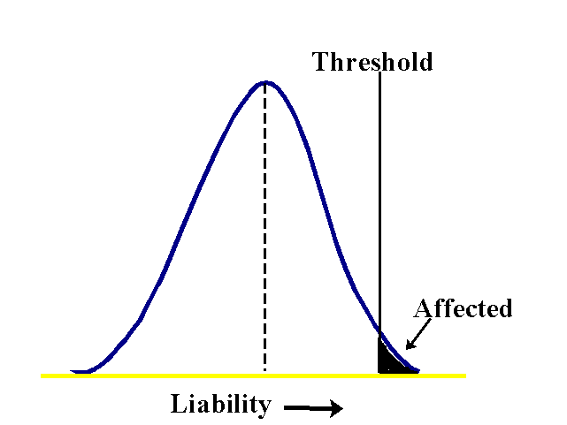
Some complex diseases may be subject to directional (purifying) selection
affected
liability
Notes:
While some diseases may arise from an underlying phenotype subject to stabilizing selection, others may be subject to directional (purifying) selection.
To see how this would work, consider the liability threshold model for complex diseases, in which we assume that liability is an additive quantitative trait (the distribution of which is shown here) and that individuals with liabilities above a threshold are inflicted with the disease.
To turn this into an evolutionary model, assume that mutation is biased toward increasing liability, and is balanced by purifying selection that decreases liability, due to the fitness cost of the disease.
In this case allele frequencies will be determined by a polygenic form of mutation-selection-drift balance.

Slide 27


Some complex diseases may be subject to directional (purifying) selection
Mutation increases liability ($ΔU$)
Selection (on disease) decreases liability ($ΔS$)
affected
liability
Polygenic mutation-selection-drift balance (MSDB)
Notes:
While some diseases may arise from an underlying phenotype subject to stabilizing selection, others may be subject to directional (purifying) selection.
To see how this would work, consider the liability threshold model for complex diseases, in which we assume that liability is an additive quantitative trait (the distribution of which is shown here) and that individuals with liabilities above a threshold are inflicted with the disease.
To turn this into an evolutionary model, assume that mutation is biased toward increasing liability, and is balanced by purifying selection that decreases liability, due to the fitness cost of the disease.
In this case allele frequencies will be determined by a polygenic form of mutation-selection-drift balance.

Slide 28
Missing heritability differs markedly under MSDB and stabilizing selection
Re-sequencing
Genotyping
Parameters adjusted (roughly) for Schizophrenia
Notes:
Explained heritability behaves differently under this model:
In contrast to the case with stabilizing selection, a strongly selected locus’s contribution to variance in disease risk increases linearly with the strength of selection, or equivalently, with its effect size.
Given that allele frequency also decreases as selection becomes stronger, the difference between genotyping and re-sequencing can become much larger.
I’ll happily provide some intuition about this during questions.
Of course demography and other factors will also affect this difference, where for Europeans it is likely to be smaller than presented here, but may still be greater than under stabilizing selection.

Slide 29

Moving forward
Understanding how evolution shapes architecture helps explain missing heritability.
Improving inferences about traits specific evolutionary forces and parameters should allow better predictions and inform study design.
Yuval Simons
Jeremy Berg
Notes:
In summary, I hope I managed to convince you that understanding how evolution shapes genetic architecture helps explain missing heritability.
Such an understanding should allow us to make inferences about the mode of selection and about the parameters that shape variation in specific complex traits.
In turn, these inferences should allow us to predict the explained heritability under different study designs, such as genotyping and re-sequencing, and thus inform future mapping efforts.

Slide 30
Demographic history affects the range of selection effects seen in GWAS
height
from Schiffles & Durbin Nat Genet 2014
Notes:
The results I’ve shown you so far are robust to many variations on model assumptions, including for example the presence of major loci and polygenic adaptation.
They are, however, sensitive to the demographic history of the population under consideration. Specifically they are sensitive to historical changes in population size, as these have substantial effects on allele frequencies.
We therefore consider changes in population size in European populations in which the GWAS for height and bmi were performed, as inferred by Schiffles and Durbin using MSMC.
The resulting effects are shown on the right, in terms of the proportion of explained heritability corresponding to loci with different selection coefficients. In contrast to the case with constant population size, in which we are about equally powered to capture loci under sufficiently strong selection, European demography acts like a band pass filter, such that GWASs are well powered to capture loci with selection effects between 10^-3.5– 10^-4.5.
This has several implications, including revising our predictions for future GWAS upwards, which we are now working on.

Slide 31
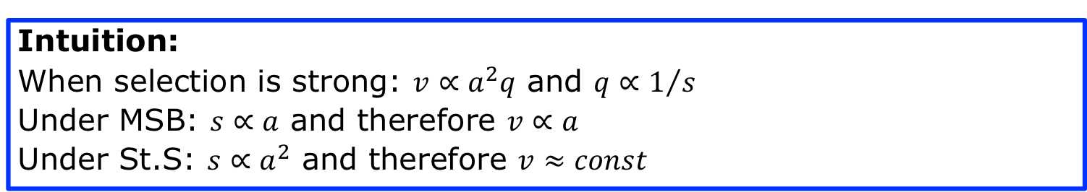
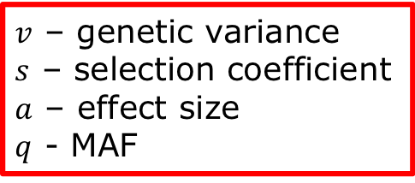
Missing heritability differs markedly under MSB and stabilizing selection
Intuition:
When selection is strong: $v∝a^{2}q$ and $q∝1/s$
Under MSB: $s∝a$ and therefore $v∝a$
Under St.S: $s∝a^{2}$ and therefore $v≈const$
$v$ – genetic variance
$s$ – selection coefficient
$a$ – effect size
$q$ - MAF
Notes:
Explained heritability behaves very differently under mutation-selection balance:
In contrast to the case with stabilizing selection, a strongly selected locus’s contribution to variance in disease risk increases linearly with the strength of selection, or equivalently, with its effect size.
Given that allele frequency also decreases as selection becomes stronger, the difference between genotyping and re-sequencing is potentially much more extreme.
Of course demography will also affect this difference, where for Europeans the difference is likely to be smaller than presented here, but still greater than under stabilizing selection.

