Slide 1
Phenotypic characterization:
Refining the denominator
David Valle, MD
McKusick-Nathans Institute of Genetic Medicine
1 May 2018
dvalle@jhmi.edu

Slide 2
Phenotype: a medical genetics viewpoint
For even the strongest variant, nearly all phenotypes exhibit variation in expressivity
For nearly all phenotypes, heterogeneity of etiology is the rule
Informed, rigorous, iterative phenotyping yields best data
For all these reasons and more, phenotyping is difficult!

Slide 3
Box 1: Research strategies using rare, low frequency variants and structural variants*
# 3 - Using targeted sequencing judiciously, focusing on people with extreme or unusual phenotypes
# 5 - Focusing discovery efforts on well-phenotyped groups, accessible families with large sibships, and families that allow return to family members for iterative phenotyping
* Manolio et al., Nature, 2009

Slide 4
Centers for Mendelian Genomics
Goal: Identify all genes with high penetrance variants to produce
a map of genotype/phenotype relationships for all genes in the genome – “integrative, whole organism phenotypes”
Strategy:
Recruit well-phenotyped probands and families or cohorts from around the world
Perform WES or WGS on relevant family members
Use family relationships, allele frequency data, functional predictions, model organism results and functional studies to identify the responsible genes and variants
Notes:
Eric, Aravinda, Lynn Jorde, Kim et al
Highly educational

Slide 5
CMGs: current progress (6yrs)
Start date 1 Dec 2011
 |  | Total | Novel | Known
Gene discovery | Tier 1 | 2197 | 1251 | 946 (~50% Pheno Exp)
 | Tier 2 | 1000 | 933 | 67
437 publications
5250 unique authors
74 countries

Slide 6
Data directly
from submitted
quarterly reports
Shalini N Janghani
Donna M. Muzny
Corinne Boehm

Slide 7
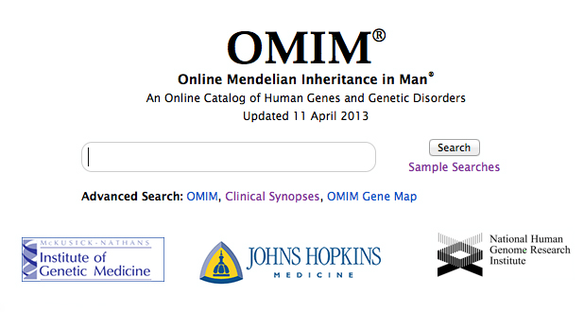
Mendelian disease: current scorecard
OMIM.org
Updated 1 May 2018
Mendelian phenotypes ~8,500
Genes with phenotypes ~3,894 (~19% of total)
Explained phenotypes ~6,187
Unexplained phenotypes ~2,500
~300 new phenotypes/yr

Slide 8
Some lessons learned
Heterogeneity extensive
Allelic often with different phenotypes
Locus
Atypical phenotypes - Multi-Mendels
Genome/epigenome interactions
Penetrance

Slide 9
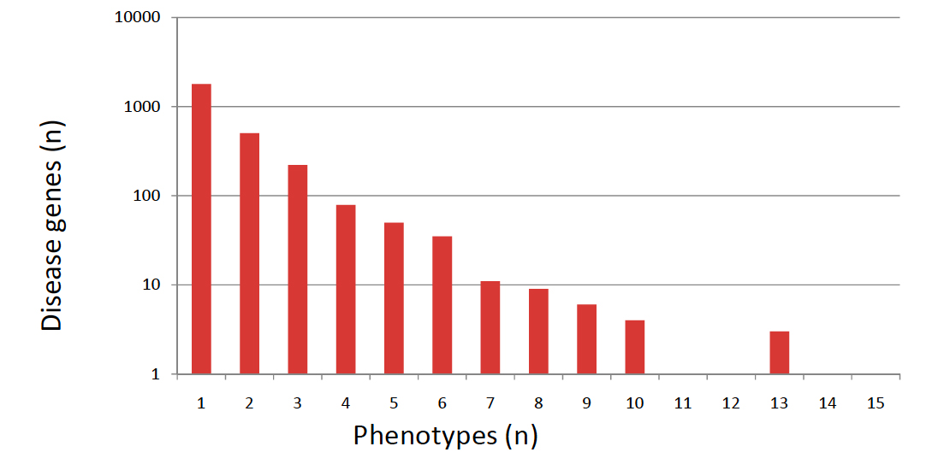
Allelic heterogeneity and the Phenotype/Gene relationship*
Disease genes = 2779
Phenotypes = 4631
Phenos/dz gene = 1.67
* OMIM
Notes:
Highly educational; e.g. see

Slide 10
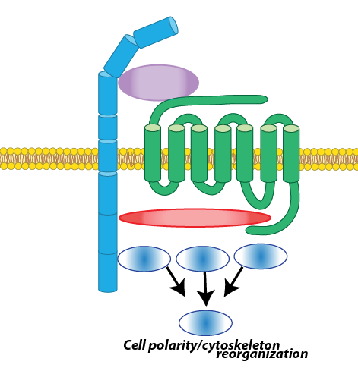
Locus heterogeneity: Robinow syndrome and the Wnt-PCP pathway (Lupski et al.)
ROR2
BHCMG
Internal Robinow database
WNT5A
FZD2
Robinow Gene | Contribution
ROR2-recessive | 3/34: 9%
WNT5A | 1/34: 3%
DVL1 | 9/34: 26%
DVL3 | 6/34: 18%
FZD2 | 5/34: 15%
Gene in differential | 4/34: 12%
DVL1,DVL3
RAC3
DAAM1
RhoA
JNK
 | Gene | Role in PCP pathway | Clinical evidence
Robinow-associated genes | WNT5A | Noncanonical Wnt ligand | Person et al. Dev Dyn. (2010)
 | ROR2 | Co-receptor for WNT5A ligand | Afzal et al. Nat. Genet. (2000)
 | DVL1 | Mediates canonical & noncanonical signals | White et al. Am J Hum Genet. (2015)
 | DVL3 | Mediates canonical & noncanonical signals | White et al. Am J Hum Genet. (2016)
 | FZD2 | Co-receptor for WNT5A ligand | 5 families (current)
 | RAC3 | Downstream GTPase effector | 1 de novo variant identified
Notes:
Although I haven’t found anything in DVL2 yet
DVl3 has a very similar story to DVl1
6 total pathogenic variants which are tightly clustered within 100nt of each other
Contrary to DVl1 the variants are also located in the final exon and includes two splice acceptors mutations
But all are still -1 framesifting and escape from NMD

Slide 11
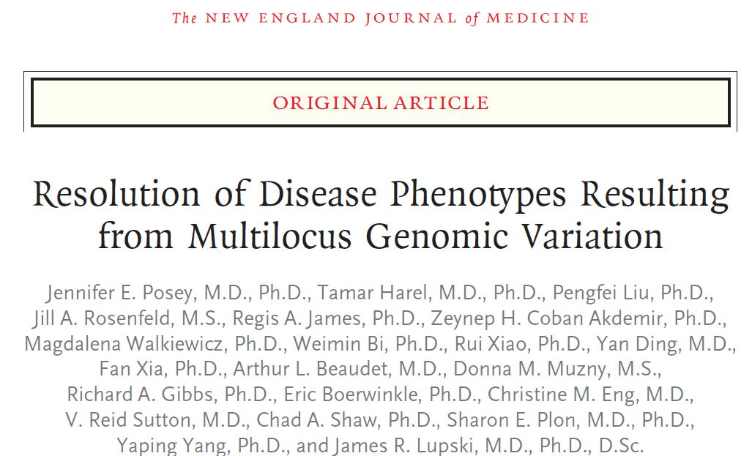
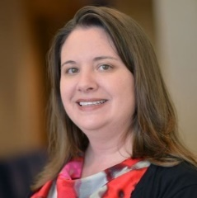
Multi-Mendels
Recognition informs diagnosis, treatment, recurrence risk
Jennifer Posey
2017
Notes:
Our lab was the first to report the occurrence of dual molecular diagnoses resulting in a blended phenotype.
Has implications for clinical care, as these dual diagnoses may not be ascertained clinically, and thus without WES may never be properly diagnosed.
Recognition of dual diagnosis is important as it informs recurrence risk counseling and may also inform management and surveillance recommendations, such as the example above (mexiletine for MC).

Slide 12
Epigenome Patterns in Kabuki Syndrome *
Kabuki syndrome
ID, growth retardation, dysmorphic features
KMT2D (~65%), KDM6A (4%)
Sequencing in 27 KS probands
12 with variants in KMT2D
6 with likely pathologic variants in other genes incl. KMT2A, HCFC1, ZBTB24, KMT2B, DNMT3B
* Sobreira, ….Bjornsson, EJHG, 2017

Slide 13
How do histone alterations produce disease in KS? *
Examine DNA methylation patterns in 9 KS probands and 9 age, sex matched controls to identify differentially methylated regions (DMRs)
Whole blood DNA samples
Infinium HumanMethylation 450 Bead Chip
* Sobreira, ….Bjornsson, EJHG, 2017
Notes:
ICF syndrome, DNMT3B, ZBTB24
2 probands with LOF in KMT2A, gene for Wiedemann-Steiner

Slide 14
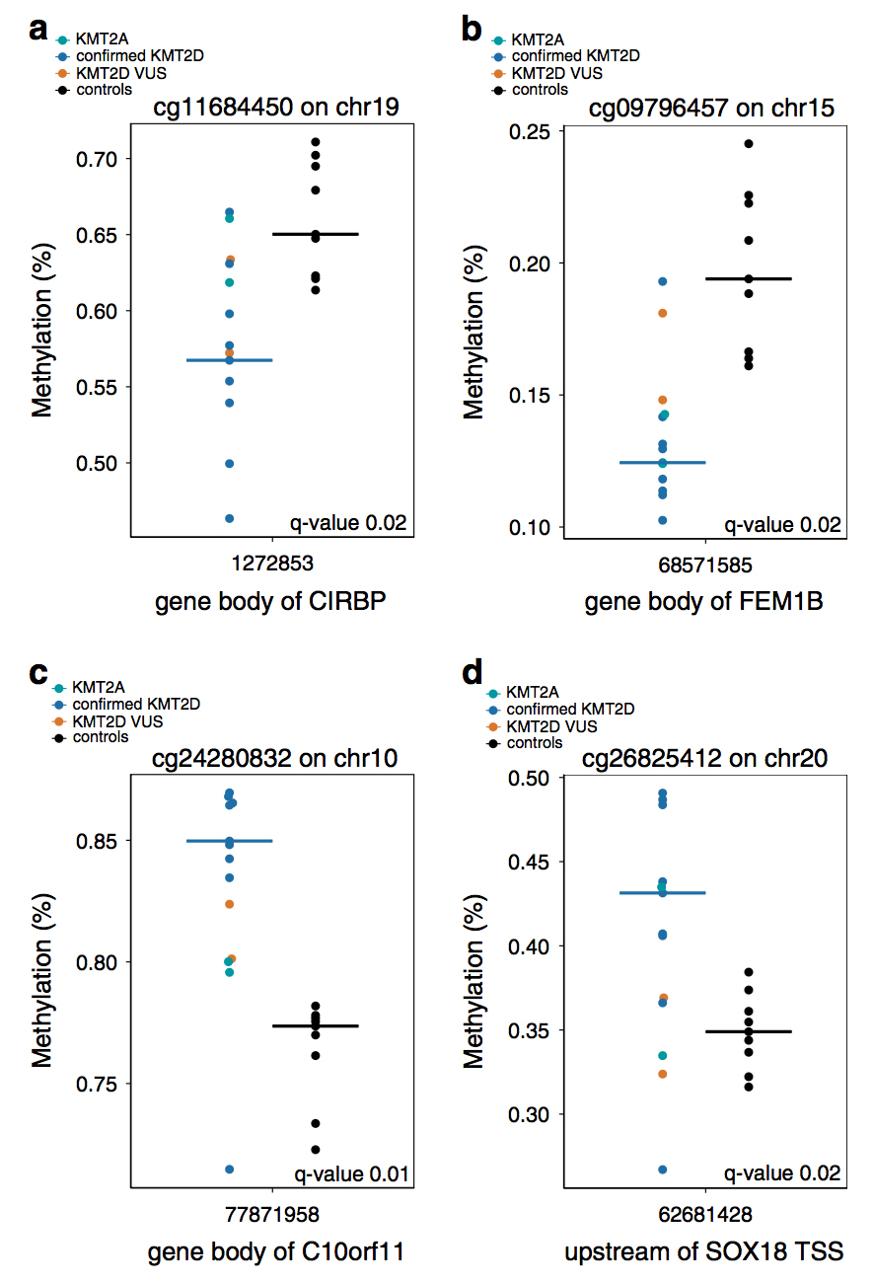
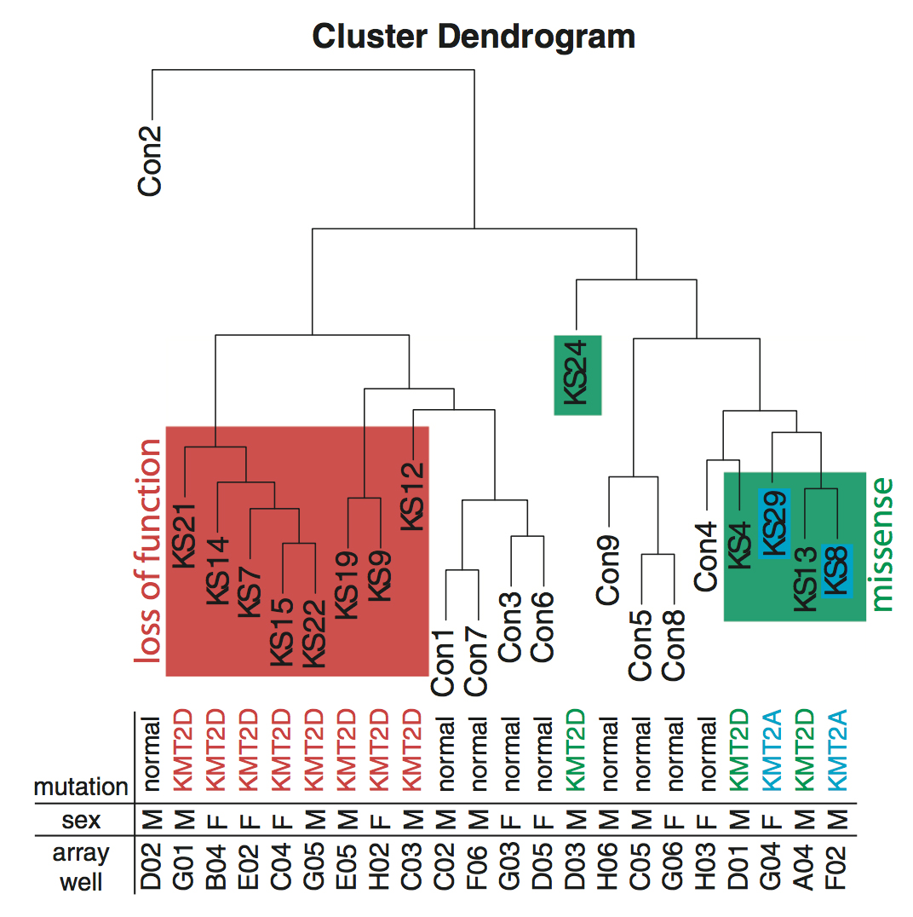
DNA methylation patterns in KS? *
* Sobreira, ….Bjornsson, EJHG, 2017
Notes:
590 DMR at FDR <0.05; 414 in genes and 176 outside of genes
6 genes with 5 or more intragenic DMR – ESR1, TSPAN4, GARS, MYO1F, SOX18 and AGAP2; several located 5’ of TJP1

Slide 15
How do histone alterations produce disease in KS? *
Alterations in patterns of DNA methylation secondary to defects in genes encoding histone modifying enzymes
Suggests “cross talk” between epigenome changes in histones and DNA methylation
Patterns similar in KS secondary to KMT2D, KDM6A and to KMT2A (Wiedermann-Steiner) suggesting similar phenotype derives from similar epigenetic pattern
Results point to a set of downstream genes that may be important for pathogenesis
* Sobreira, ….Bjornsson, EJHG, 2017
Notes:
In addition to new disease assoc alleles in known KS genes and molecular sorting of disorders with overlapping phenotypic features
Similar results by Weksberg and her colleagues

Slide 16
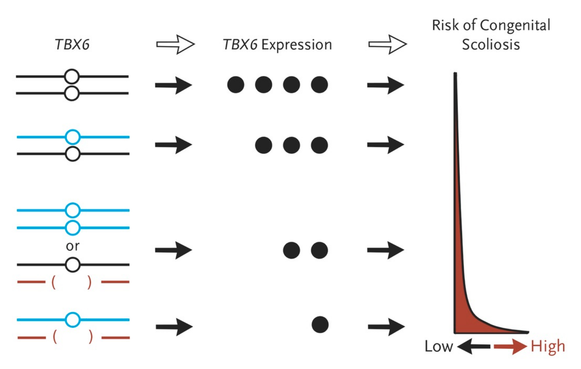
NEJM, 2015

Slide 17
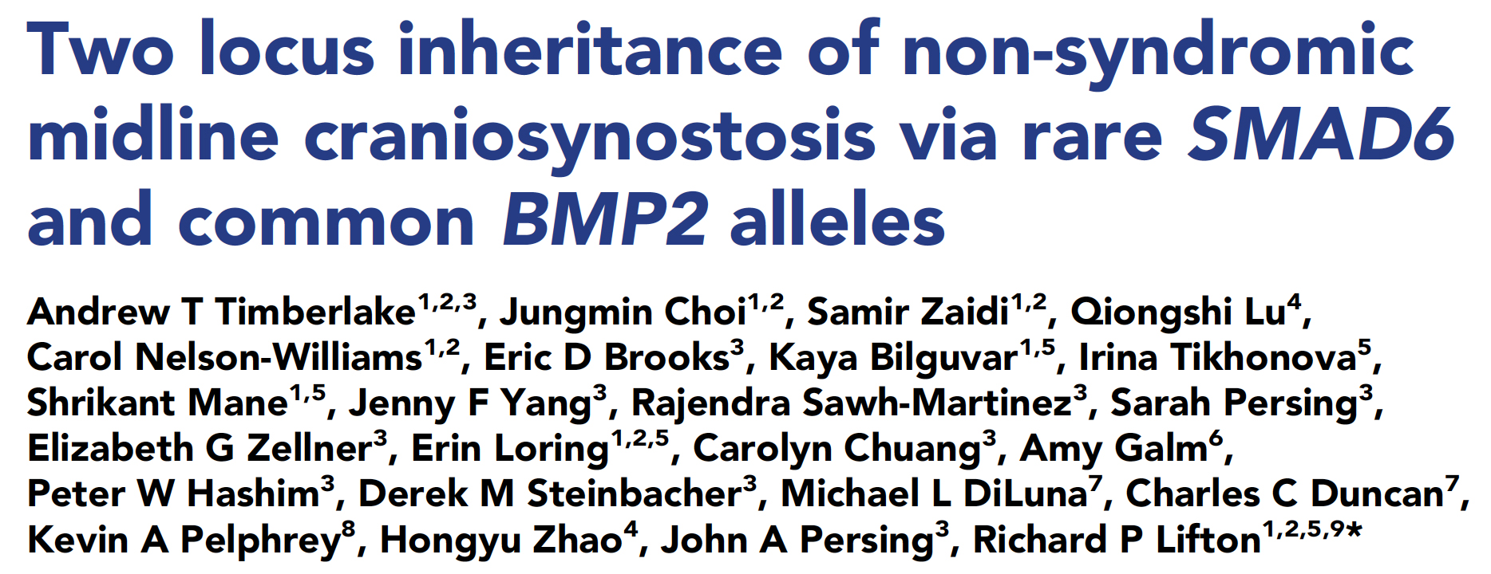
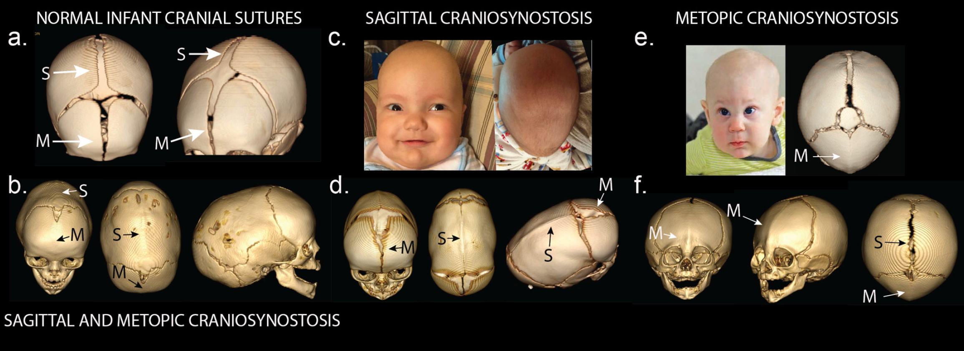
Yale CMG
Timberlake et al., eLIFE, 2016

Slide 18
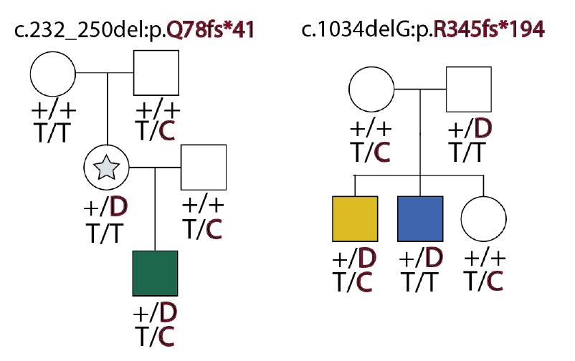
Craniosynostosis: Two locus model*
WES of a cohort of 191 (132 trios, 59 additional probands)
13 (7%) rare damaging de novo or transmitted variants in SMAD6
SMAD6 variants showed ~60% incomplete penetrance
Previous GWAS identified common variant (allele frequency of 0.35) 345 kb downstream of BMP2
SMAD6/BMP2 | Synostosis + | Synostosis -
SMAD6 +/BMP2 risk + | 14 | 0
SMAD6 +/BMP2 risk - | 3 | 13
SMAD6 -/BMP2 risk + | 0 | 18
Timberlake et al., eLIFE, 2016
Notes:
SMAD6 encodes a BMP-induced osteoblast differentiation
BMP2 downstream variant – C is the risk; T is the protective
Different colors = different sutures
NEXT – SOME QUESTIONS

Slide 19
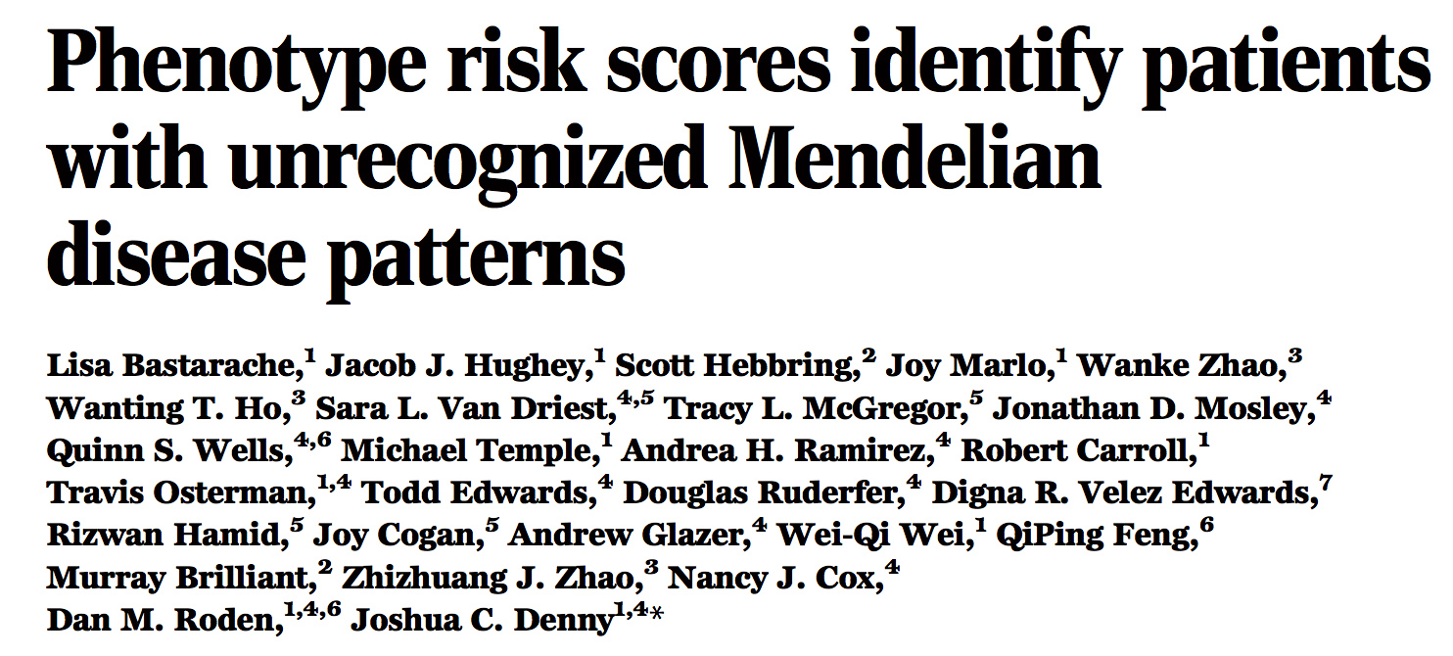
Science, 2018
Phenotype risk scores (PheRSs) for > 1200 Mendelian traits from EHR
Map back to ~21,000 genotyped individuals at Vanderbilt
Identify associations with rare variants suggesting candidate responsible gene and variants

Slide 20
Thanks for your attention!
Acknowledgements:
CMGs and especially BHCMG colleagues

