Slide 1
Mind the (diversity) gap: contributions of diverse populations to common disease studies
Lucia A. Hindorff, PhD, MPH
Program Director, Division of Genomic Medicine
Missing Heritability Workshop – May 2, 2018

Slide 2
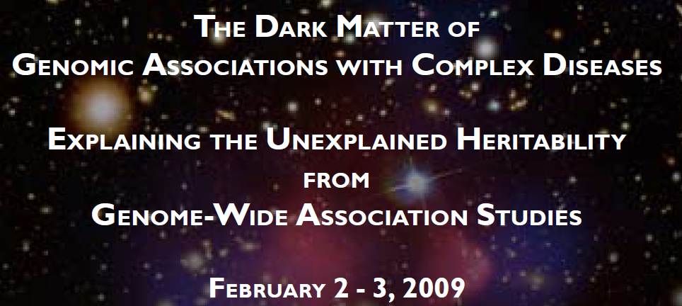
2009
2018
What have we learned from GWAS in diverse populations?
  Landscape of GWAS
  Evolution of GWAS arrays
  Enhancing GWAS analyses

Slide 3
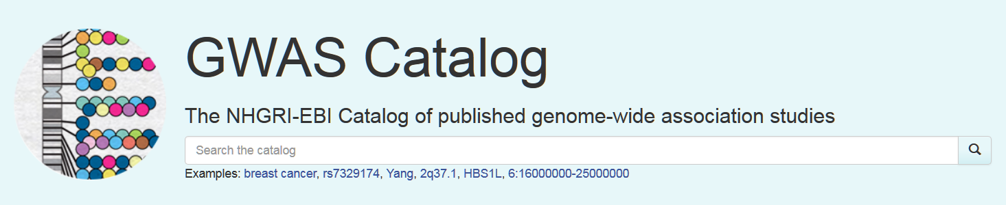
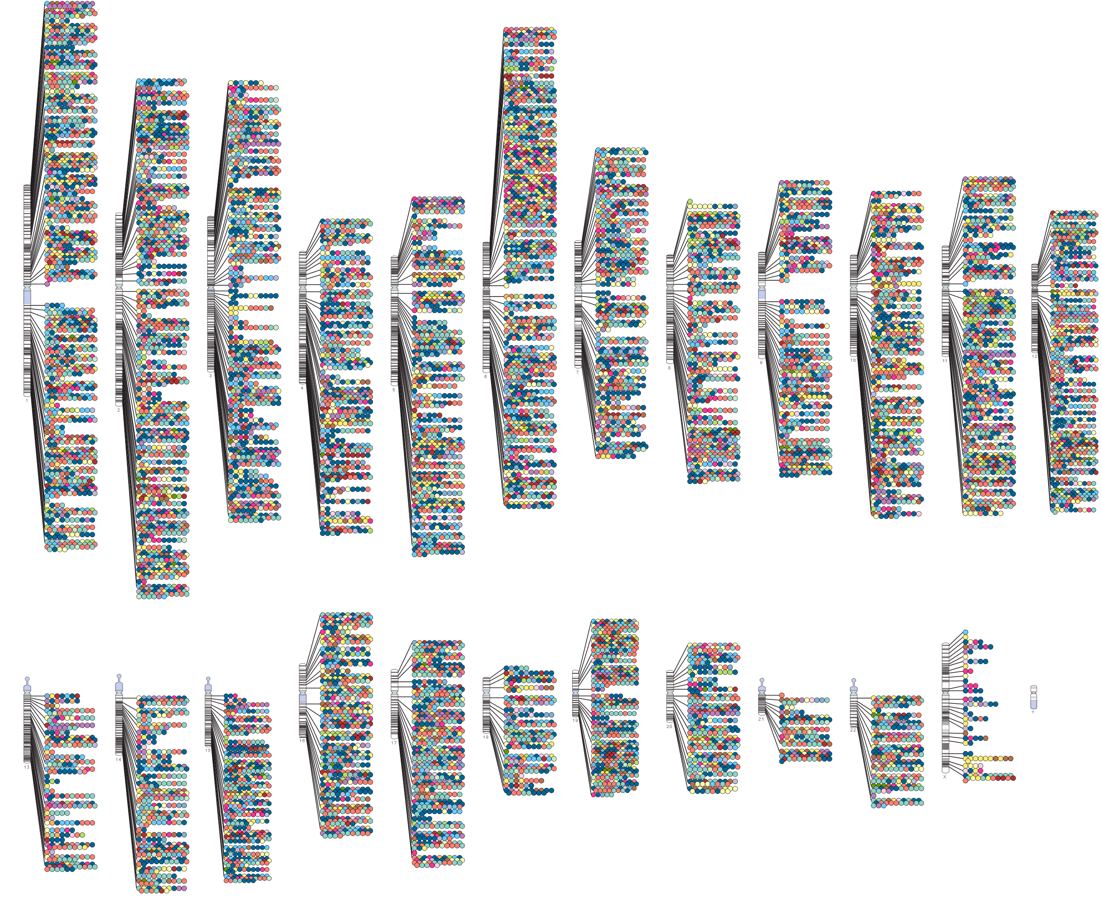
April, 2018:
3,349 publications
59,967 unique SNP-trait associations
https://www.ebi.ac.uk/gwas/
Notes:
Although NGS is being done at scale as we’ve heard, still a lot to learn from GWAS…

Slide 4
Evolving landscape of GWAS
Studies and associations
Associations, by MAF
Associations, by ancestry

Slide 5
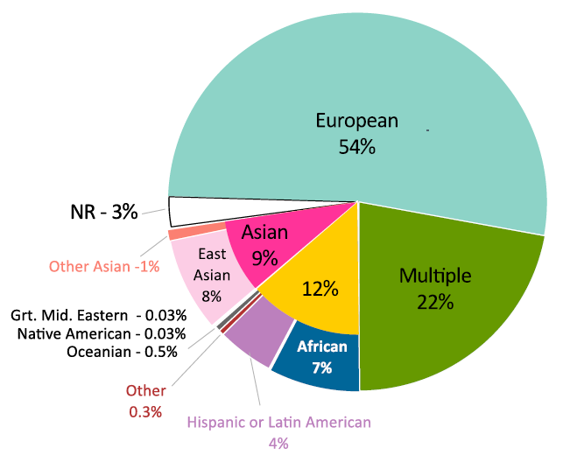
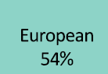
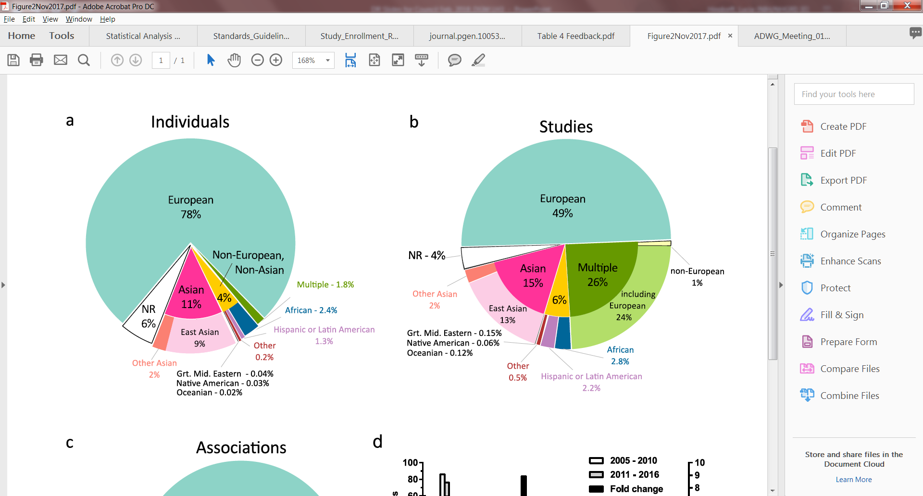
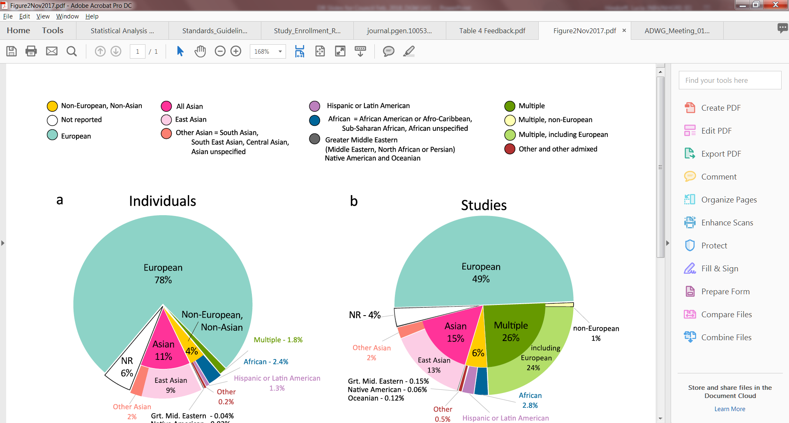
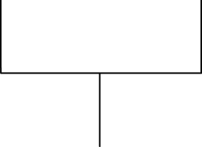
Studies vs. associations
Individuals
Legend
Associations
Non-European, Non-Asian
Not reported
European
Not reported – 3%
All Asian
East Asian
Other Asian
Hispanic or Latin American
Mid. Eastern – 0.03%
Native American – 0.03%
Oceanian – 0.5%
Not reported
6%
African
Middle Eastern
Mid. Eastern – 0.04%
Native American – 0.03%
Oceanian – 0.02%
Multiple
Multiple, non-European
Non-European
22%
Multiple, including European
Non-European
46%
Other and other admixed
Morales, et al. Genome Biology 2018. PMID 29448949
Notes:
Non-EA contribute disproportionately high number of associations relative to EA

Slide 6
Morales, et al. Genome Biology 2018. PMID 29448949
Notes:
This figure displays the top ten most common traits in the GWAS Catalog and the percentage of individuals from each ancestry category. The traits with the greatest representation of ancestrally diverse individuals, based on number of ancestry categories represented, are anthropometric traits (BMI and Body Height) and common diseases (Type 2 Diabetes and Heart Disease). The Catalog-wide bias towards inclusion of European ancestry individuals is also observed in all traits analyzed (aqua and green).

Slide 7
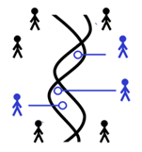
Population Architecture using Genomics and Epidemiology (PAGE)
Multi-cohort study
  MEC
  WHI
  SOL
  MSSM BioMe
~50,000 individuals
Depth and breadth of phenotype information
Ancestry | N
African-American | 17,299
Asian-American | 4,680
Hispanic/Latino | 22,216
Native Hawaiian | 3,940
Native American | 652
Other | 1,052
Total | 49,796
Notes:
45% H/L, 34% AA

Slide 8
PAGE Multi-ethnic Genotyping (MEGA) Array
PAGE-related traits
Custom content
Exome sequences from 36K multiethnic individuals
ClinVar, OMIM
1000 Genomes Project
Existing
Multiethnic Exomic Variants
Functional Variants
GWAS Scaffold
1.7M
SNPs
African Diaspora Power Chip
Human Core
Human Exome
Bien, et al. PLoS One 2016. PMID 27973554
Notes:
Improve ability to identify important genetic variation
The Population Architecture using Genomics and Epidemiology (PAGE) program focuses on identifying and characterizing genomic variants associated with common disease in ancestrally diverse populations.
PAGE investigators, in collaboration with Illumina and the Consortium on Asthma in African-Ancestry Populations in the Americas consortium, recently designed the large-scale, 1.7 million marker “Multi-ethnic Genotyping”, or ‘MEGA’ array that facilitates discovery of genetic variants in multiethnic populations. * Further building upon the African Diaspora Power Chip and previous Human Core and Human Exome arrays, PAGE investigators added * a more robust multiethnic GWAS scaffold based on the 1000 Genomes Project, * functional variants drawn from databases such as ClinVar and OMIM, * new exomic variants based on 36,000 multiethnic exome sequences, and * additional custom content around loci relevant to PAGE-related traits.
Eimear will talk more about the functional variants, which include P/LP variants from ClinGen and will allow for analyses of CRV and sharing of pop-level allele frequencies

Slide 9
GWAS scaffold tags common and low frequency variants
Info scores from PAGE MEGA array data, imputed to 1000 Genomes
Wojcik, Graff, Kenny, Carlson, et al. Updated from https://www.biorxiv.org/content/early/2017/09/15/188094
Notes:
Imputation. In order to increase coverage, and thus improve power for fine-mapping loci, all PAGE individuals who were 46 successfully genotyped on MEGA were subsequently imputed into the 1000 Genomes Phase 3 data release. Genotype data which passed 48 the above quality control filters was phased with SHAPEIT and imputed to 1000 Genomes Phase 3 reference data using IMPUTE version 2.3.2.
Excluded: segments of the genome which were known to harbor gross chromosomal anomalies, sites were excluded if the IMPUTE info score was les than 0.4.
A total of 39,723,562 imputed SNPs passed quality control measures.

Slide 10
Multiethnic data complement and add to prior GWAS results
 | Largest GWAS catalog discovery population |  |  |  | PAGE | Novel Loci (count) | Residual Loci (count)
Phenotype | European | East Asian | African | Hispanic/ Latino
HDL | 99,900 | 12,545 | 7,917 | 4,383 | 33,063 | 2 | 5
LDL | 94,595 | 12,545 | 7,861 | 4,383 | 32,221 | 0 | 2
TG | 96,598 | 12,545 | 7,601 | 4,383 | 33,096 | 1 | 2
TC | 100,184 | 8,344 | 6,480 | 4,383 | 33,185 | 1 | 3
Wojcik, Graff, Kenny, Carlson, et al. Updated from https://www.biorxiv.org/content/early/2017/09/15/188094
Notes:
Slice of a table, focused just on lipids-related phenotypes
Additional of PAGE samples substantially adds to the existing large-scale GWAS
Promises to identify additional novel loci (not previously identified) and residual loci (ability to identify secondary signals or fine mapping)

Slide 11
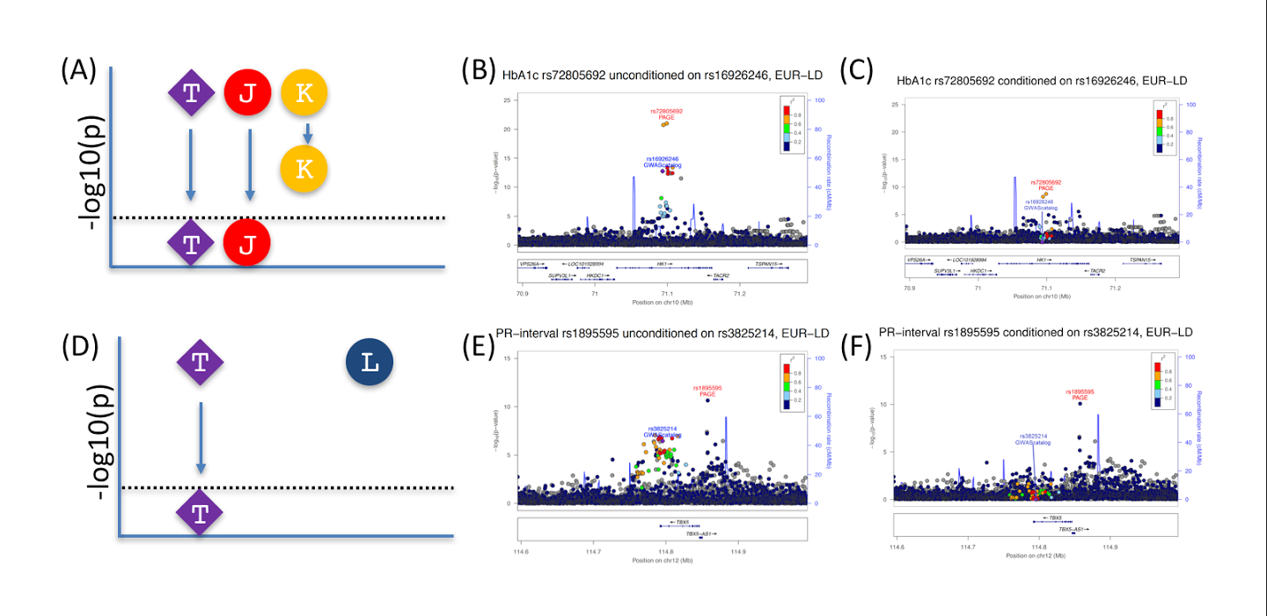
Residual signal: fine mapping
Wojcik, Graff, Kenny, Carlson, et al. Updated from https://www.biorxiv.org/content/early/2017/09/15/188094
Notes:
If you adjust for the known GWAS tagSNP (T), does the signal remain genome-wide significant?
See attenuation but still GWS – have narrowed down the region with putative causal SNP

Slide 12
Residual signal: secondary allele
Wojcik, Graff, Kenny, Carlson, et al. Updated from https://www.biorxiv.org/content/early/2017/09/15/188094
Notes:
Identification of secondary allele – no attenuation

Slide 13
What additional information is gained from diverse participants?
“Why not just add 50K more Europeans?”
Meta-analysis of GIANT+PAGE vs. GIANT+50K UKBB
FINEMAP over both datasets with weighted LD matrices
Compare: credible set size, posterior probabilities
Notes:
Credible set = SNPs nearby to a GWAS variant likely to include the putative causal SNP. (All variants with posterior probability exceeding a threshhold.)

Slide 14
Comparing credible sets for height
P=3.46x10⁻³⁶
366 index loci
Credible set sizes are significantly smaller for height in meta-analysis of GIANT + PAGE, compared to GIANT + 50K UKBB Europeans
Courtesy G. Wojcik
Notes:
Median 9 in UKBB vs. 4 in PAGE
Analysis still in progress: similar trend with other traits?

Slide 15
Comparing posterior probability
366 index loci
Top ranked SNP has higher posterior probability in meta-analysis of GIANT + PAGE, compared to GIANT + 50K UKBB Europeans
Courtesy G. Wojcik
Notes:
Analysis still in progress: similar trend with other traits?

Slide 16
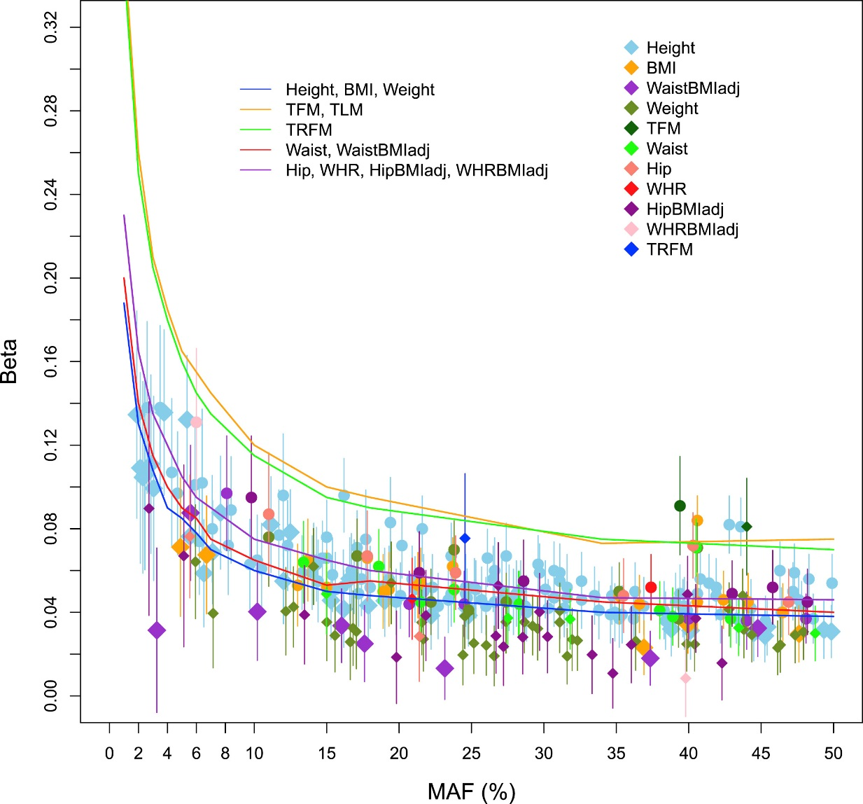
Towards rare variant association studies
WGS with deep imputation in up to 267,616 individuals
12 anthropometric traits
106 novel signals
  6 not implicated with related traits
  28 independent signals at previously reported regions
  72 previously reported signals for different traits
All European ancestry
Tachmazidou, AJHG 2018; PMID 28552196
Notes:
WGS in 3781 from UK10K cohorts; GWAS data in 57K with in silico FU in 210K
Effect sizes (beta in SD units) and 95% confidence intervals as a function of MAF Diamonds = newly reported variants; circles = previously reported variants are denoted in circles.
The curves indicate 80% power at p<5.3x10-8, for five representative sample sizes of the discovery stage: (1) height,
BMI, weight; (2) TFM, TLM; (3) TRFM; (4) waist circumference, waist circumference adjusted for BMI; (5) hip circumference, waist to hip ratio, hip circumference adjusted for BMI, waist to hip ratio adjusted for BMI. The sample size for height (blue line) had 80% power to detect associations down to 0.1% MAF for betas R 0.19 standard deviations (0.36 and 0.23 for TFM [orange] and waist to hip ratio [purple], respectively; not plotted).

Slide 17
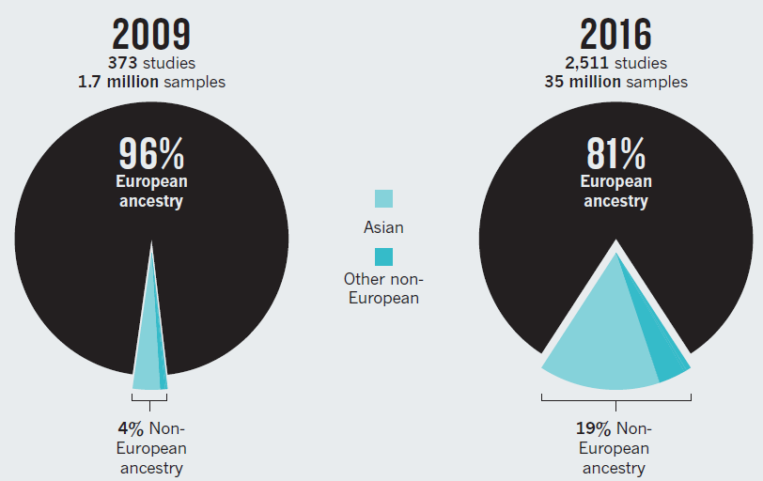
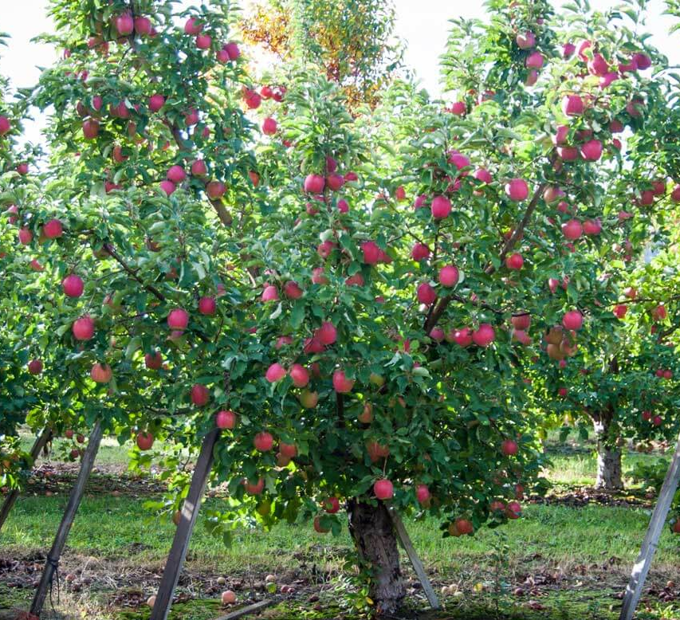

Information disparity
Missing heritability: lack of scientific information
Lack of information likely to differ among groups (eg, racial/ethnic minorities)
To address this information disparity, need to look beyond the low-hanging fruit
Popejoy and Fullerton, Nature 2016. PMID 27734877

Slide 18
Acknowledgments
GWAS Catalog - EBI
Jackie MacArthur
Joannella Morales
Helen Parkinson
Paul Flicek
Fiona Cunningham
Tony Burdett
Annalisa Buniello
Maria Cerezo
Laura Harris
Emma Hastings
Xin He
Cinzia Malangone
Aoife McMahon
Annalisa Milano
Zoe Pendlington
Trish Wetzel
PAGE
Stephanie Bien
Chris Carlson
Sinead Cullina
Chris Gignoux
Misa Graff
Jeffrey Haessler
Heather Highland
Eimear Kenny
Katie Nishimura
Yesha Patel
Gen Wojcik
Steve Buyske
Chris Haiman
Charles Koopberberg
Loic Le Marchand
Ruth Loos
Kari North
Tara Matise
Ulrike Peters
CIDR/UW investigators
Many PAGE co-investigators
NHGRI
Heather Colley
Maggie Ginoza
Peggy Hall
Teri Manolio
Ken Wiley
NIMHD
Regina James

