Slide 1

Missing heritability
Contributions from genomic studies in African ancestry populations
Charles N. Rotimi, PhD
Director: Center for Research on Genomics and Global Health
Chief: Metabolic, Cardiovascular and Inflammatory Disease Genomics Branch
May 1&2, 2018

Slide 2
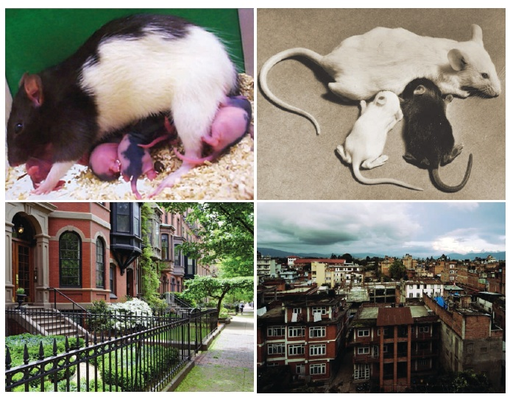
Questions we are not asking
Disease influencing variables we are not measuring
Are these too difficult to measure?
    Neighborhoods
    Schools attended (strong correlation with educational attainment, income, etc)
    Tax policies
    Living under perpetual state of stress (epigenetics?)
Different upbringings: Being raised by a nurturing (top left) or a lackadaisical (top right) mother can cause epigenetic differences that affect a rat pup’s behavior later in life.
Whether similar differences occur in people raised in wealthy (bottom left) or impoverished (bottom right) neighborhoods remains an open question.
www.sciencemag.org SCIENCE VOL 329 2 JULY 2010

Slide 3
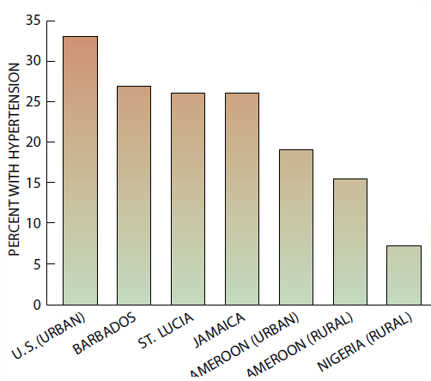
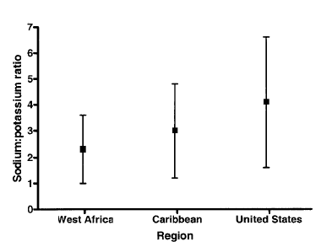
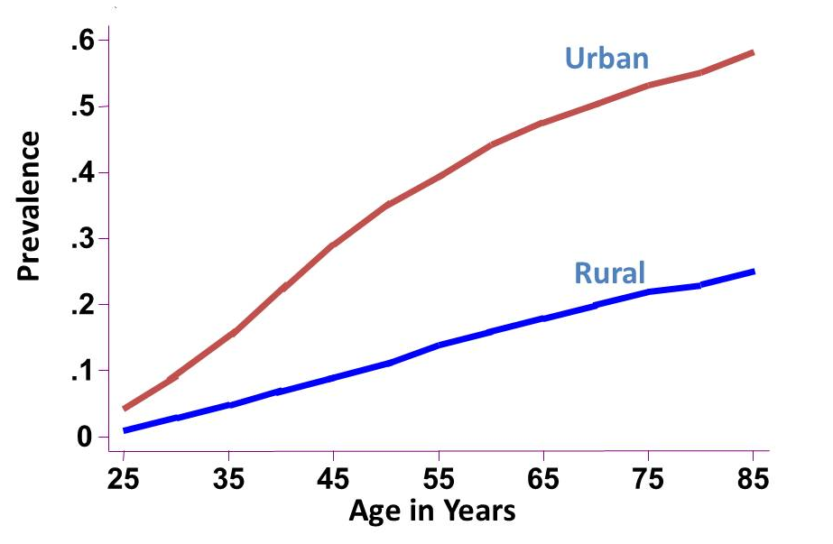
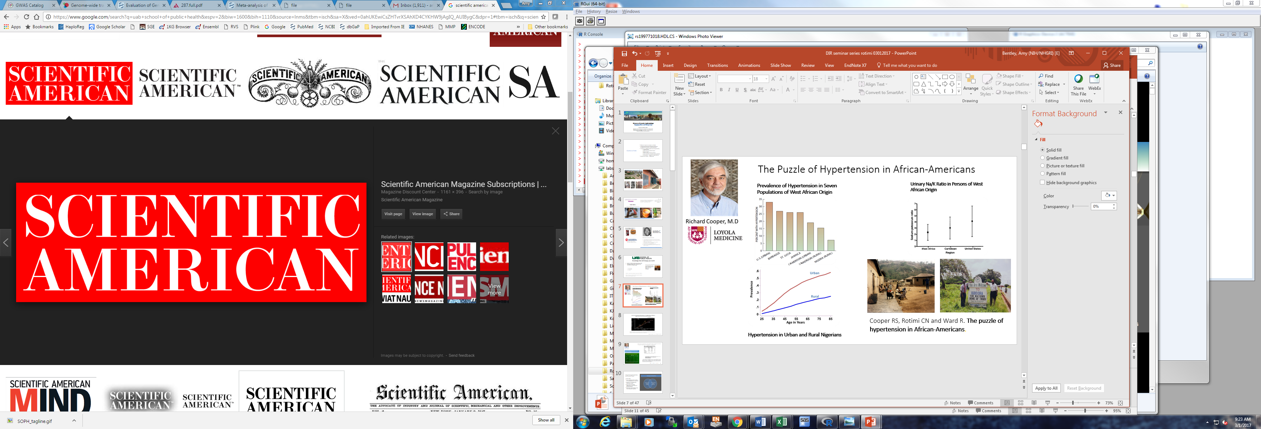
The Puzzle of Hypertension in African-Americans
Prevalence of Hypertension in Seven Populations of West African Origin
Urinary Na/K Ratio in Persons of West African Origin
Am J Public Health. Feb1997
N >10,000
Na/K ratio
CA
CA
West Africa
Caribbean
USA
Genes are often invoked to account for why high blood pressure is so common among African-Americans. Yet rates are lower in rural Africans. This discrepancy demonstrates how genes and the environment interact
Cooper RS, Rotimi CN and Ward R. The puzzle of hypertension in African-Americans.
Hypertension in Urban and Rural Nigerians
1999
Notes:
Genes are often invoked to account for why high blood pressure is so common among African-Americans. Yet the rates are low in Africans. This discrepancy demonstrates how genes and the environment interact

Slide 4
Hypertension prevalence ranged
From 27 to 55% for European ancestry
From 14 to 44% for African ancestry populations

Slide 5
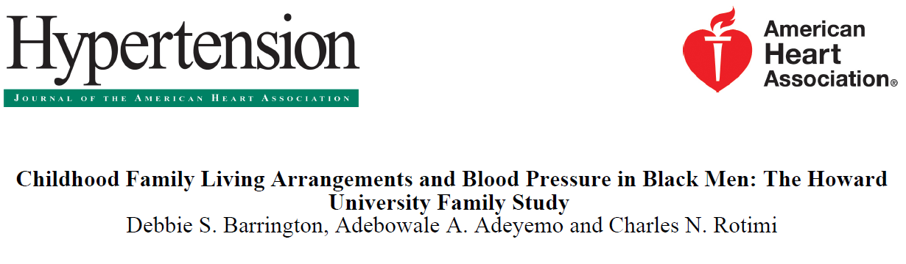
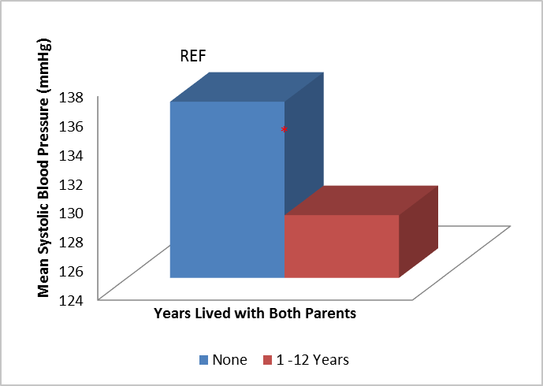
Men who lived with both parents between 1-12 years:
  6.5 mmHg lower SBP
  43% lower odds of HTN compared to never lived with both parents
* P-value = 0.0067

Slide 6

The Death Gap – David A Ansell, MD
---- He reveals the profound inequalities, particularly racial inequalities, that generate tremendous differences in lifespan and well-being across neighborhoods, and he provides powerful patient anecdotes that provide a human face to otherwise abstract challenges.” Harold Pollack, University of Chicago
85
Location, Location, Location – real estate
These are also the three most important words in understanding health and wealth inequality in America
72
69 83
Life Expectancy varies greatly by neighborhoods in Chicago
Neighborhoods | Income | Life expectancy | comments
The Loop | $80,000 | 85yrs | Affluent downtown
North Lawndale | $25,000 | 72yrs | 91% AA (5miles from the Loop)
Hyde Park | $40,000 | 83yrs | Racially diverse
Washington Park | $22,000 | 69yrs | Almost entirely AA
AA – African Americans
Notes:
Lifespan in flies – Trudy Mackay

Slide 7
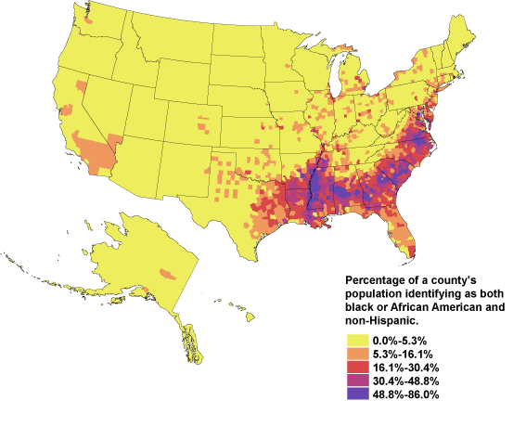
In the US, states with greater inequality in the distribution of income
  have higher rates of unemployment, incarceration, and higher proportion receiving income assistance
  Greater % of people without medical insurance.
  Spend less per person on education.
  Greater proportion of babies born with low birth weight; higher rates of homicide, violent crime; persons unable to work because of disabilities
  Have higher costs per-person for medical care
This population is concentrated largely in the southern states and urban areas.
http://www.censusscope.org/us/print_map_nhblack.html
http://www.huppi.com/kangaroo/Inequality&Health.htm

Slide 8
Surveyed 26 quantitative traits to estimated proportion of variance explained by local ancestry in African Americans.
Linear mixed models; genetic similarity defined in terms of local ancestry rather than genotype in ARIC and HUFS
Local ancestry at major (WBC) and polygenic effect genes can explain up to 20 and 8% of phenotypic variance, respectively.
WBC is remarkably different from other phenotypes in that the DARC promoter-null polymorphism is essentially fixed between West Africans and Europeans.
Put another way, a GWAS for WBC in Europeans would not identify DARC, nor would a GWAS in Africans. The effect size is more in the realm of Mendelian genetics than complex disease genetics.
Manhattan plot from admixture mapping for white blood cell count in ARIC. WBC regressed on local ancestry, adjusted for age, global ancestry, sex, and center.
Front Genet. 2015 Oct 29;6:324.

Slide 9
Findings provide evidence that
  most additive genetic variance is explained by genetic markers undifferentiated by ancestry
  results inform proportion of health disparities due to genetic risk factors
  and the magnitude of error in association studies not controlling for local ancestry.
  Adjusting for global ancestry, e.g., using PCA, does not control for the effects of local ancestry.
  Local ancestry effects are not limited to African Americans or Latinos.
  However, since genetic differentiation between West Africans and Europeans is at the high end of the scale (in terms of Fst), the amount of phenotypic variance explained by local ancestry in African Americans is at the high end
Manhattan plot from admixture mapping for white blood cell count in ARIC. WBC regressed on local ancestry, adjusted for age, global ancestry, sex, and center.
Front Genet. 2015 Oct 29;6:324.

Slide 10
Discovery and refinement of genome-wide associated loci for serum uric acid in Africans
Heritability is 35.4% in (HUFS - African Americans), 39.9% in (NHLBI Family Heart Study - European families), 34.0% in Sardinians, and 36% in Icelanders. For some unknown reason, the Framingham Heart Study yielded 63% (data from the 1970s). Question – distortion of the range of heritability
Performed first GWAS for uric acid in Africans (n = 4,126); replication in African Americans (n = 5,007)
Identified two signals in SLC2A9 (evidence for allelic heterogeneity) and one signal in SLC22A12
Single candidate causal variant at SLC22A12 - low frequency in AFR but monomorphic in EUR (must be other causal variants in Europeans, therefore also evidence for allelic heterogeneity)
The three signals account for 4.3% of variance of serum uric acid, or 12% of heritability
Compared to 7.0% in GWAS of European-ancestry individuals (N > 140,000) that identified 26 loci (Kottgen A et al. Nat Genetics 2013)
Under review 2018

Slide 11
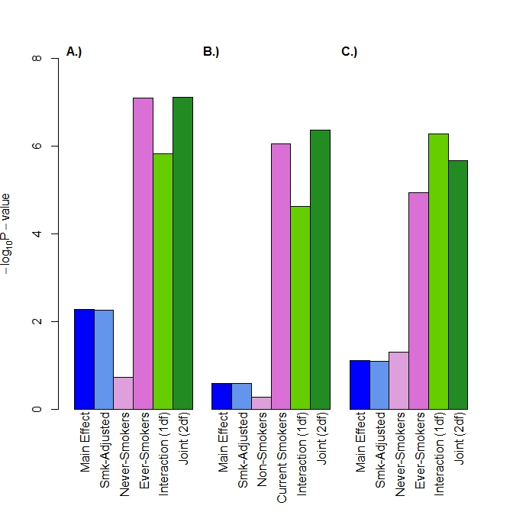
CHARGE Gene-Lifestyle Interactions Working Group: Gene × Smoking Status on Serum Lipids
Model
Stage 1 + 2
Interaction Model (1df, Joint 2df): Y = β₀ + β_{C}C + β_{E} E + β_{G} SNP + β_{GE} E × SNP
Samples
EUR
n=237,483
AFR
n=30,970
ASN
n=94,688
HISP
n=20,490
TRANS¹
N=387,283
TG
LDL
13 novel loci p < 5 × 10⁻⁸
Main Effect Model: Y = β₀ + β_{C}C + β_{G} SNP
Smoking-Adjusted Model: Y = β₀ + β_{C}C + β_{E} E + β_{G} SNP
Main Effect Model (STRATIFIED E=0): Y = β₀ + β_{C}C + β_{G} SNP
Main Effect Model (STRATIFIED E=1): Y = β₀ + β_{C}C + β_{G} SNP
Interaction Model (1df): Y = β₀ + β_{C}C + β_{E} E + β_{G} SNP + β_{GE} E × SNP
Interaction Model (Joint 2df): Y = β₀ + β_{C}C + β_{E} E + β_{G} SNP + β_{GE} E × SNP
Identified loci which would not have been identified in a standard GWAS model or with adjustment for smoking.
C: Covariates; E: Environmental Exposure (Smoking Status)
Bentley AR et al, Nat Genet, under review
Notes:
These variants reached GWAS statistical significance upon replication. Data not shown here because didn’t have the series of models in replication individuals.

Slide 12
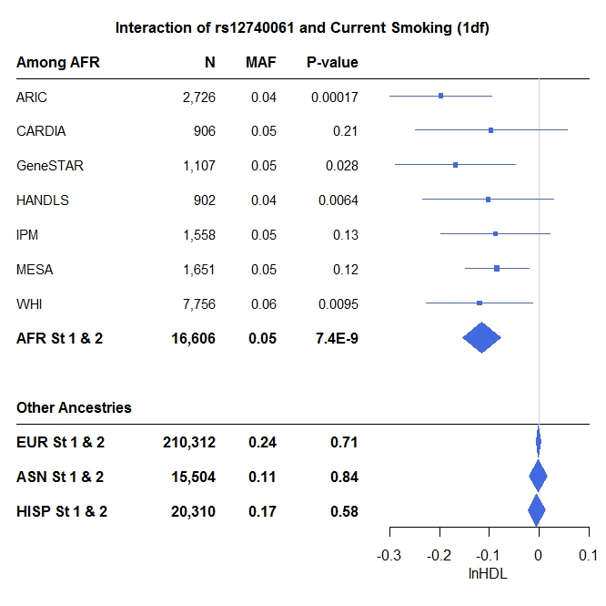
Interethnic Differences in Interactions
Interaction of chr 1 locus with Current Smoking Status
6 of 14 novel signals only statistically significant in AFR or in Trans-ancestry meta-analyses included AFR
Interethnic allele frequency differences contribute:
  4 of 6 of these are absent among EUR
  But 2 of these variants are in higher frequency among other studied populations with no association
Shown variant is a trans-eQTL for TAS1R1, which has been found to influence taste receptors, notably affecting cigarette smoking habits (Choi J-H, Mol Nutr & Food Res, 2016).
Bentley AR et al, Nat Genet, under review

Slide 13
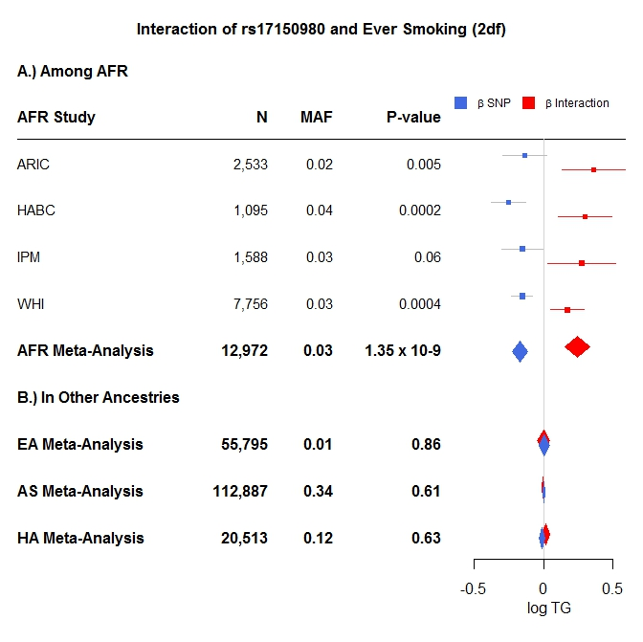
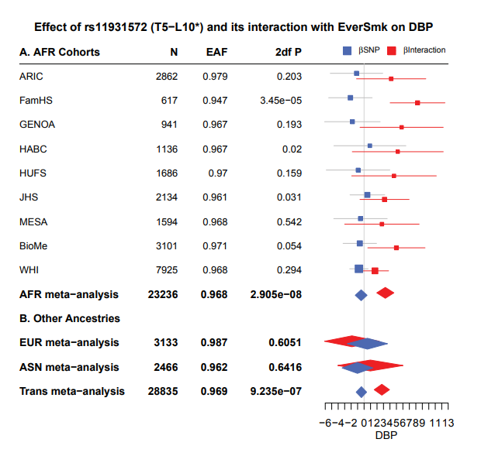
Interethnic Differences in Interactions
Another example using a 2 degree of freedom joint test of the interaction and main effect
Such findings also observed in similar meta-analysis of Gene × Smoking Status on blood pressure measures
Bentley AR et al, Nat Genet, under review
Sung YJ et al, AJHG, March 2018

Slide 14
Interactions Minor Contribution to % Variance Explained
Trait | Ancestry | Study (N) | Known Lipids Variants | Novel Variants
 |  |  |  | From novel variants | From interactions
HDL | European | WGHS (23,141) | 10.1 | 0.08 | 0.02
 |  | ARIC (9,052) | 9.8 | 0.05 | 0.1
 |  | Airwave study (14,002) | 11.9 | 0.1 | 0.03
 | African | ARIC (2,479) | 14.9 | 1.0 | 1.1
 |  | JHS (1,988) | 14.7 | 1.5 | 2.0
 | Asian | GenSalt (1,813) | 17.6 | 0.6 | 0.3
 |  | SiMES (2,541) | 14.3 | 0.3 | 0.2
 |  | SINDI (2,496) | 16.8 | 0.5 | 0.4
 |  | SCES (1,853) | 16.4 | 0.5 | 0.7
 | Hispanic | SOL (10,091) | 11.4 | 0.3 | 0.2
Bentley AR et al, Nat Genet, under review
Trait | Ancestry | Study (N) | Known BP Variants | Novel Variants
 |  |  |  | From novel variants | From interactions
SBP | European | WGHS (22,983) | 3.1 | 1.2 | 0.4
 |  | ARIC (9,645) | 3.2 | 1.1 | 0.3
 |  | UK Biobank (137,426) | 1.9 | 0.5 | 0.1
 |  | Airwave study (14,002) | 1.6 | 0.7 | 0.5
 | African | JHS (2,134) | 2.5 | 1.2 | 1.4
 | Asian | GenSalt (1,835) | 2.6 | 0.4 | 0.4
 |  | SiMES (2,531) | 2.5 | 0.7 | NA
 |  | SINDI (2,491) | 1.6 | 1.2 | NA
 |  | SCES (1,848) | 2.8 | 1.1 | NA
 | Hispanic | SOL (10,294) | 1.1 | 0.2 | 0.5
Sung YJ et al, AJHG, March 2018

Slide 15
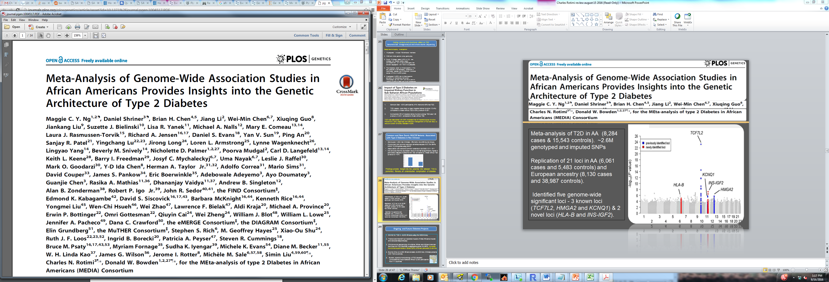

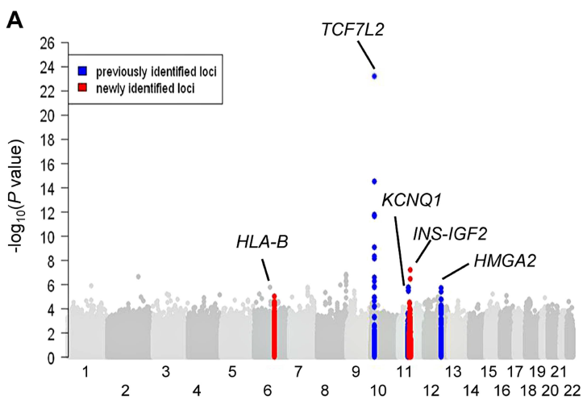
…
Meta-analysis of T2D in AA (8,284 cases & 15,543 controls). ~2.6M genotyped and imputed SNPs
Replication of 21 loci in AA (6,061 cases and 5,483 controls) and European ancestry (8,130 cases and 38,987 controls).
Identified five genome-wide significant loci - 3 known loci (TCF7L2, HMGA2 and KCNQ1) & 2 novel loci (HLA-B and INS-IGF2).

Slide 16
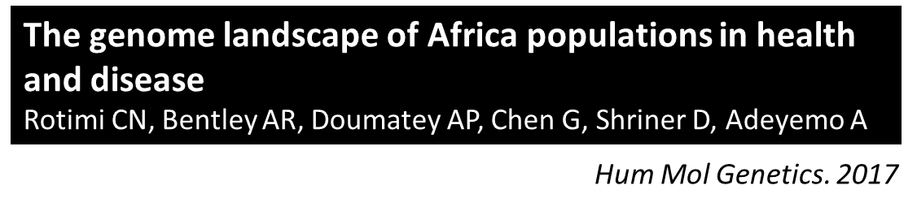
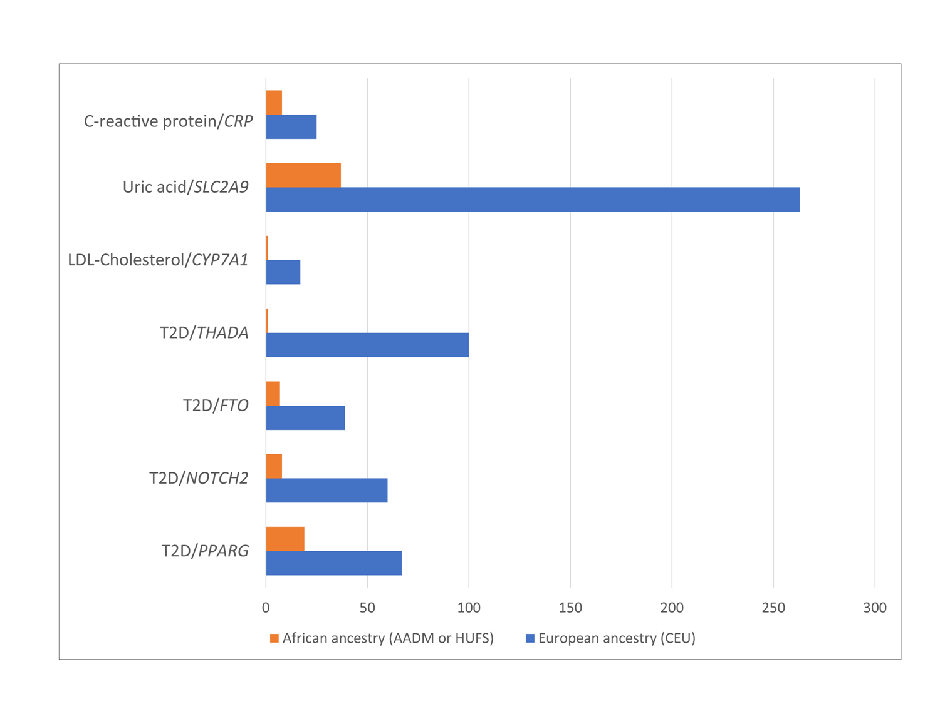
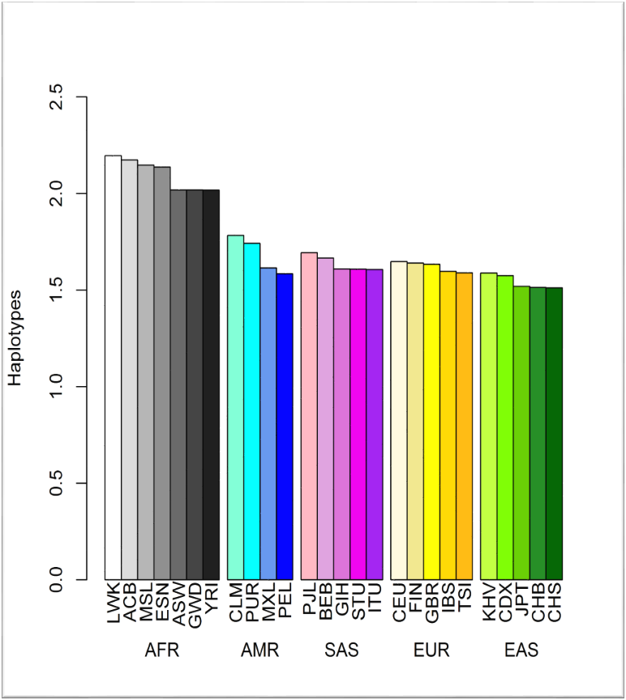
Uric Acid/SLC2A9
Haplotype diversity
Fine-Mapping - smaller haplotype blocks in African ancestry populations refined genome-wide significant loci

Slide 17
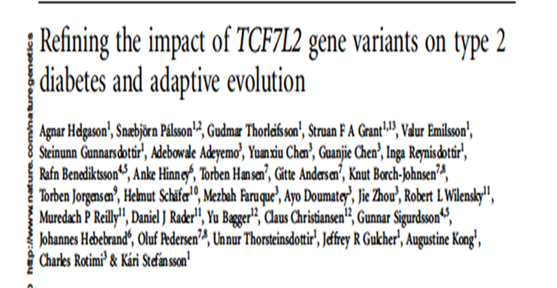
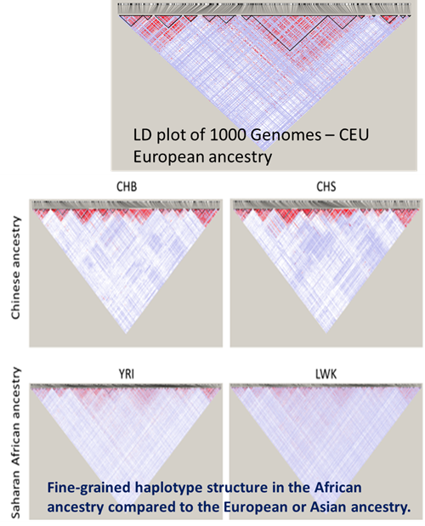
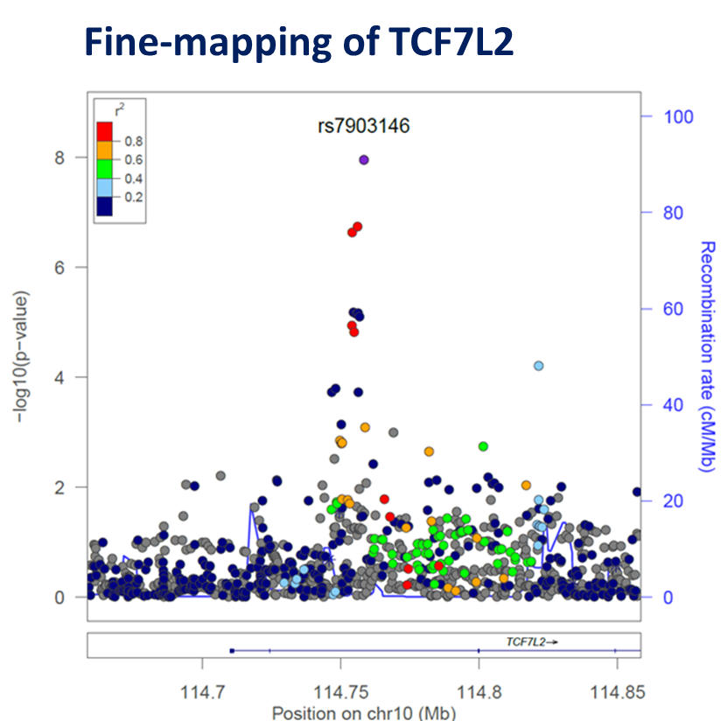
New meta-analysis of two relatively large cohorts from West, East and South Africa
Fine-mapping of the TCF7L2 locus - T2D association signal shared between Europeans and Africans (indexed by rs7903146). Detected a distinct, African-specific signal.
We detected one novel signal, MAF = 9.5%; monomorphic in Europeans and Asians.

Slide 18

Obesity. 2017 Apr;25(4):794-800
Serum levels - obese vs non-obese (p < 0.0001)
In this first GWAS of BMI in West Africans
Discovered that ~ 1% of West Africans and African Americans carry a genetic variant that increases their risk of obesity
Carrier of the risk allele in the semaphorin-4D (SEMA4D) gene were ~6 Ibs heavier than those without the genetic variant
Would not have been found in GWAS of Europeans and Asians: variant is monomorphic
C
T
Mean BMI by alleles (p = 0.0007)

Slide 19
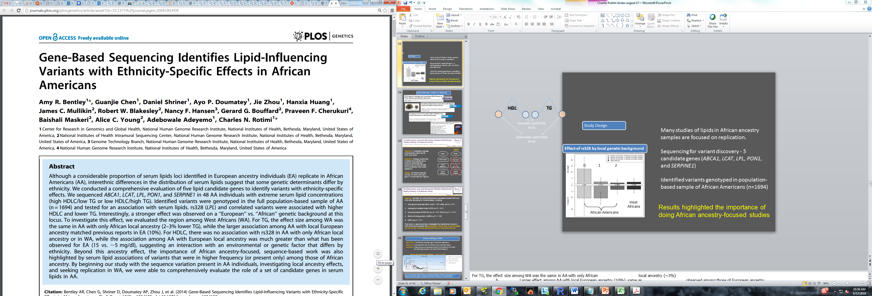
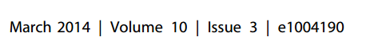
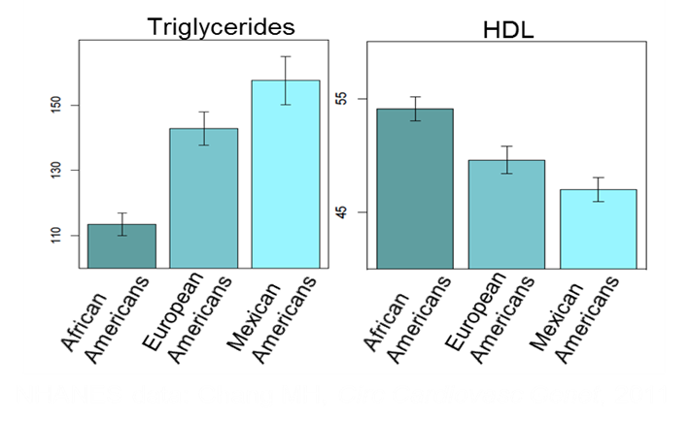
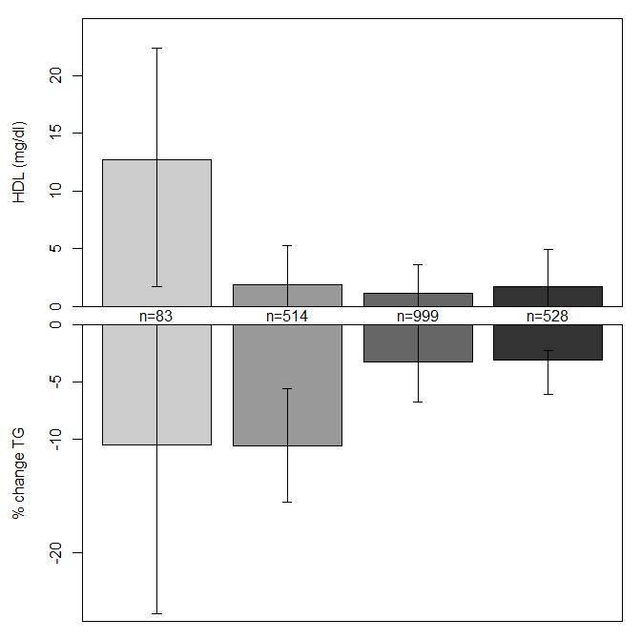
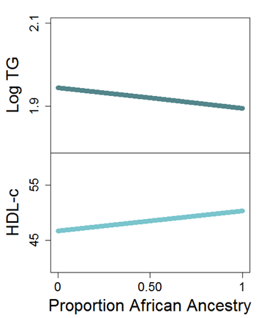

Sequenced 5 genes (ABCA1, LCAT, LPL, PON1, and SERPINE1) for variant discovery in African Americans with extreme lipids.
Follow-up in population-based sample of African Americans (n=1694)
# African Ancestry alleles
0 1 2
Association of LPL variants (rs328) depended on ancestry at that locus.
African
Americans
West
Africans
Notes:
For TG, the effect size among WA was the same in AA with only African local ancestry (~3%)
b. Larger effect among AA with local European ancestry (10%), same as observed among those of European ancestry.
c. For HDLC, no association with rs328 in AA with only African local ancestry or in WA
d. Association among AA with European local ancestry was much greater than what has been observed for EA (13 vs. ~ 5 mg/dl), suggesting an interaction with an environmental or genetic factor that differs by ethnicity

Slide 20

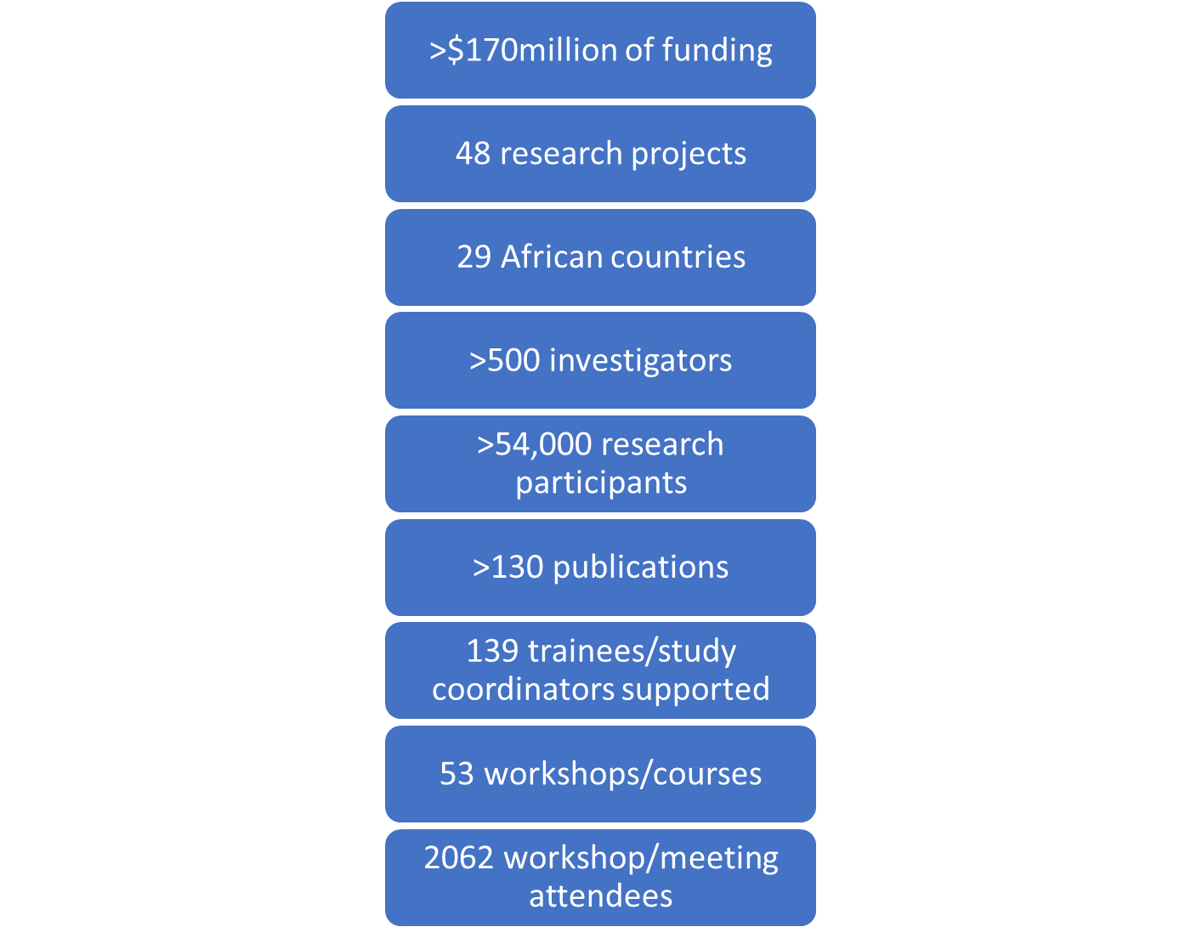
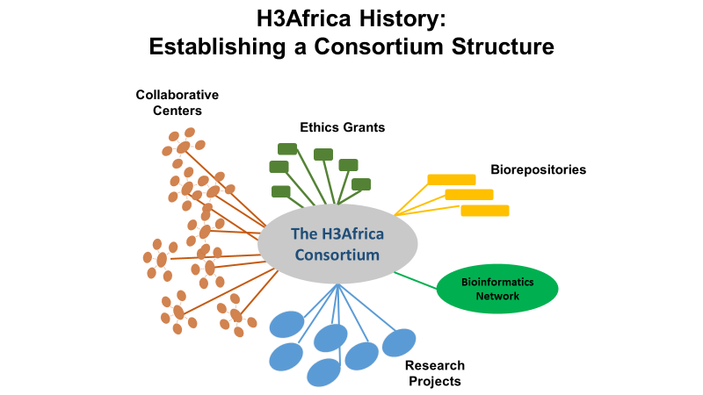
Nigeria
Uganda
S Africa
32 nodes; 15 countries
https://h3africa.org/

Slide 23
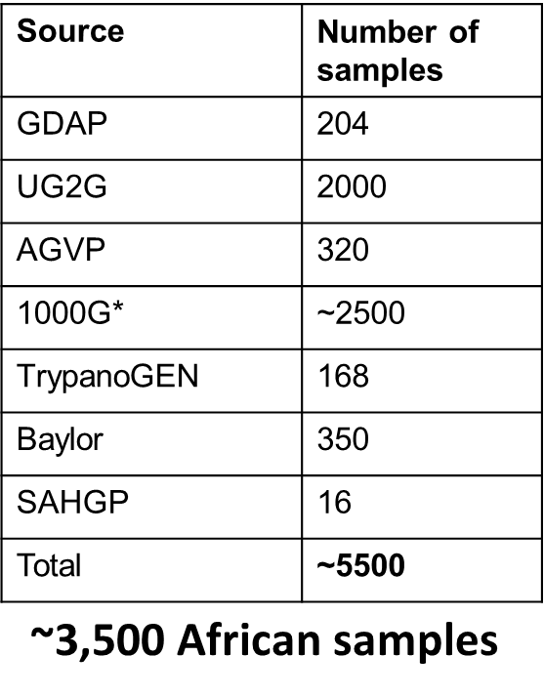
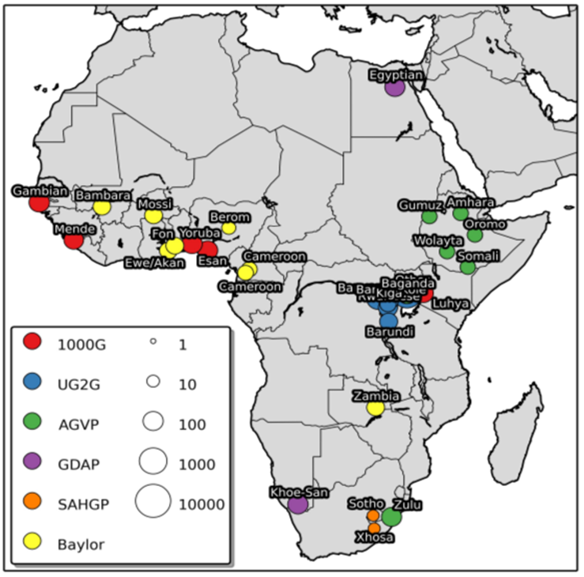
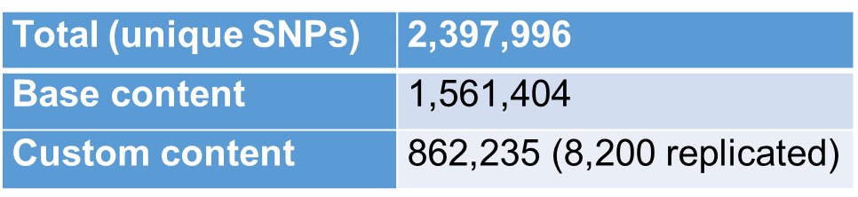
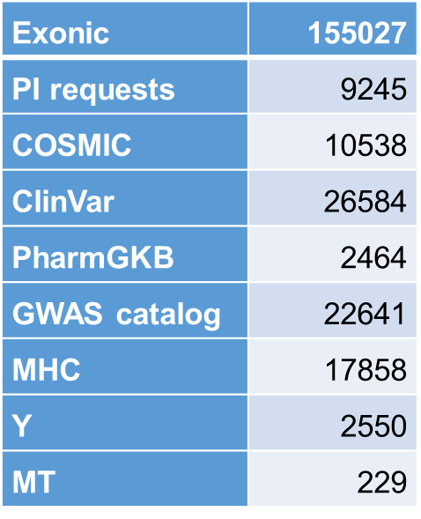
H3Africa Consortium Array
Whole genome datasets used
Chip content

Slide 24
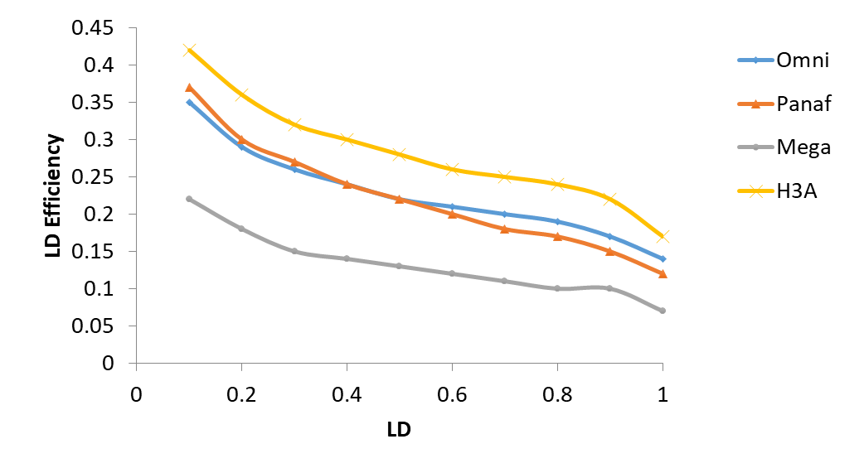
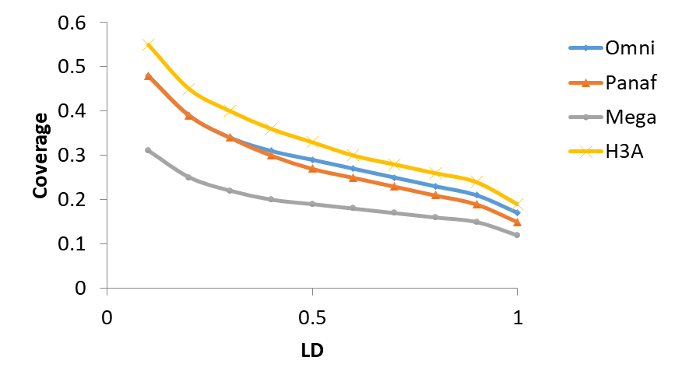
Chip evaluation –LD efficiency
Chip evaluation –coverage

Slide 25
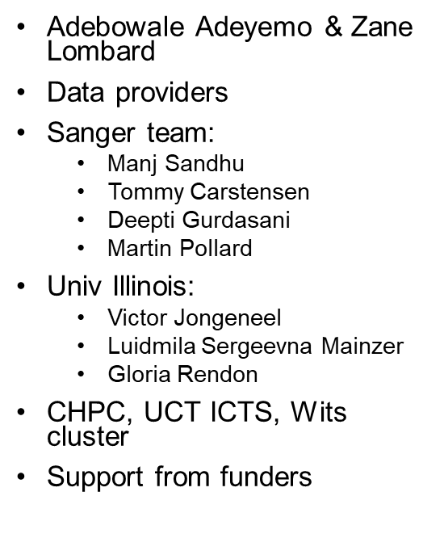
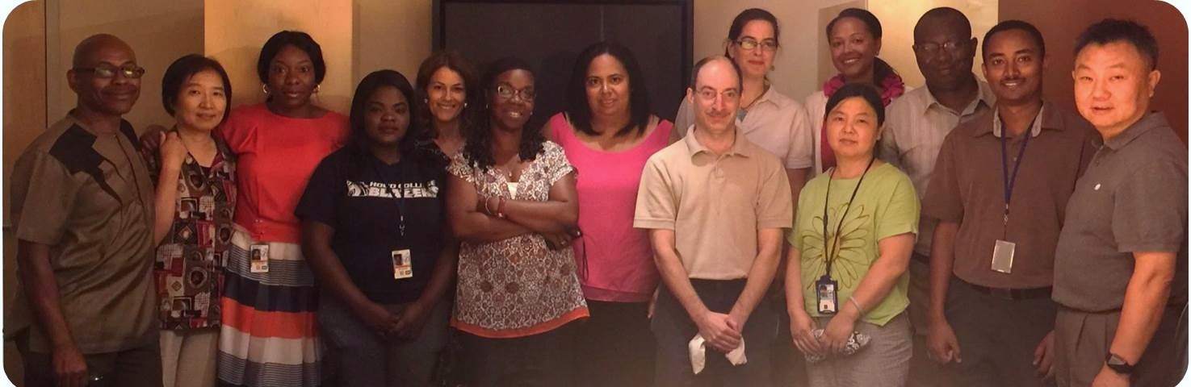


H3Africa Consortium Array
CRGGH lab folks

