Slide 1


Contributions of diverse populations and expanded catalogues of human variation to our understanding of low frequency and rare variants
Missing Heritability Ten Years On
Eimear Kenny, PhD
The Charles Bronfman Institute of Personalized Medicine
Icahn School of Medicine at Mount Sinai
2018.05.02
eimear.kenny@mssm.edu
@EimearEKenny

Slide 2
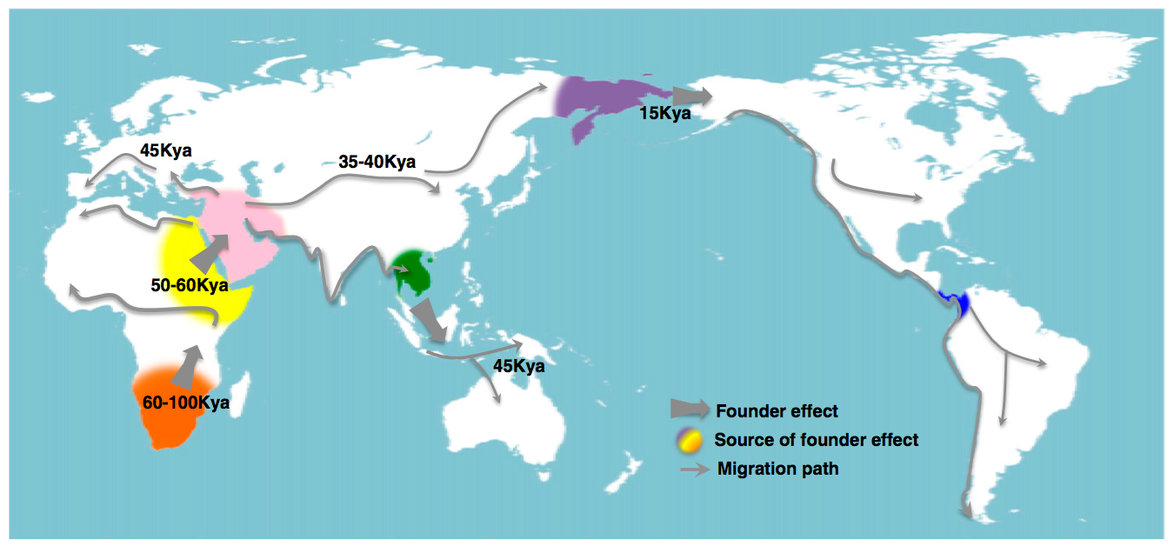
Human Genetic History is Complex!
And has changed dramatically recently:
Henn, Cavalli-Sforza, Feldman, PNAS 2012

Slide 3
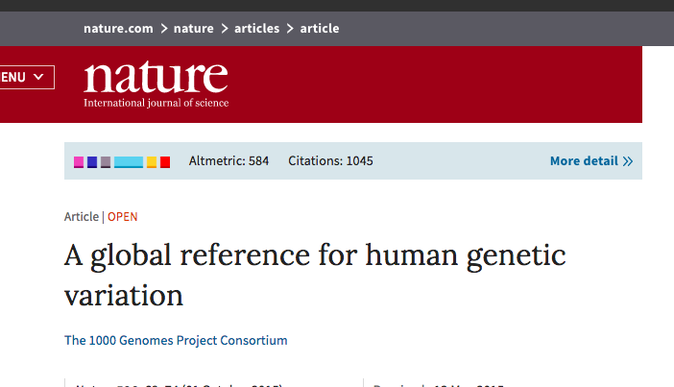
Genes mirror geography: lessons from the Thousand Genomes Project
Notes:
Ancient dispersal patterns of modern humans during the past 100,000 y. This map highlights demic events that began with a source population in southern Africa 60 to 100 kya and conclude with the settlement of South America approximately 12 to 14 kya. Wide arrows indicate major founder events during the demographic expansion into different continental regions. Colored arcs indicate the putative source for each of these founder events. Thin arrows indicate potential migration paths. Many additional migrations occurred during the Holocene (11).

Slide 4
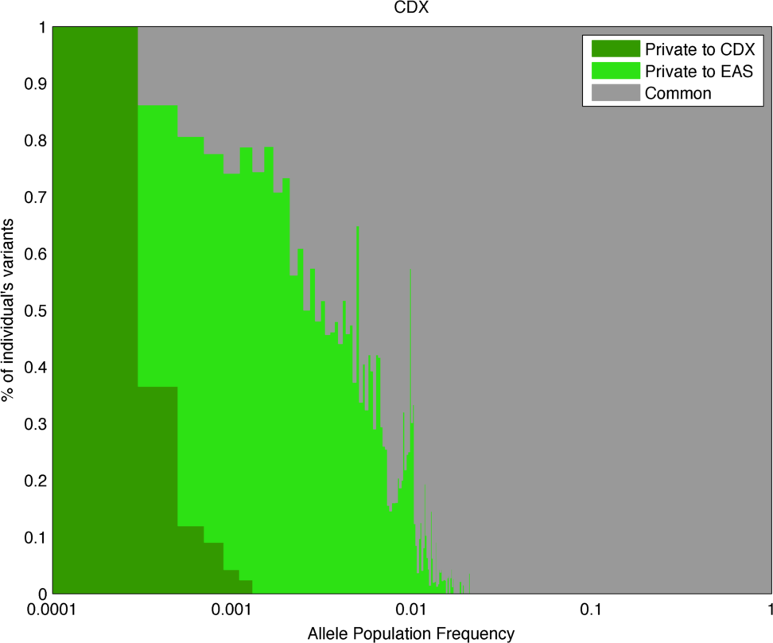
Common variants are shared globally
Chinese Han
East Asia
Globally shared

Slide 5
Rare variants are geospatially restricted
Chinese Han
East Asia
Globally shared

Slide 6
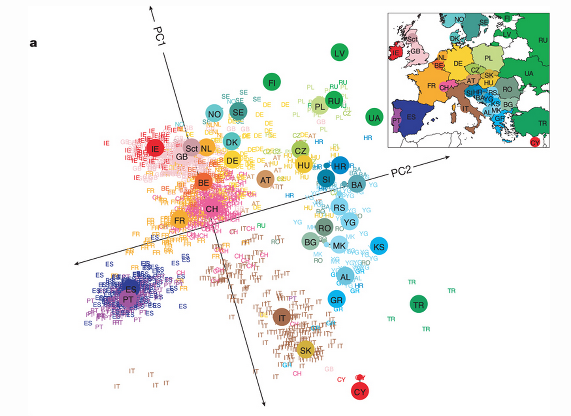
Common variants reveal population structure in Europe
Novembre et al “Genes mirror geography in Europe” Nature (2008)

Slide 7
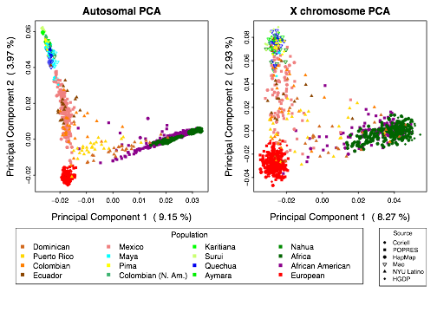
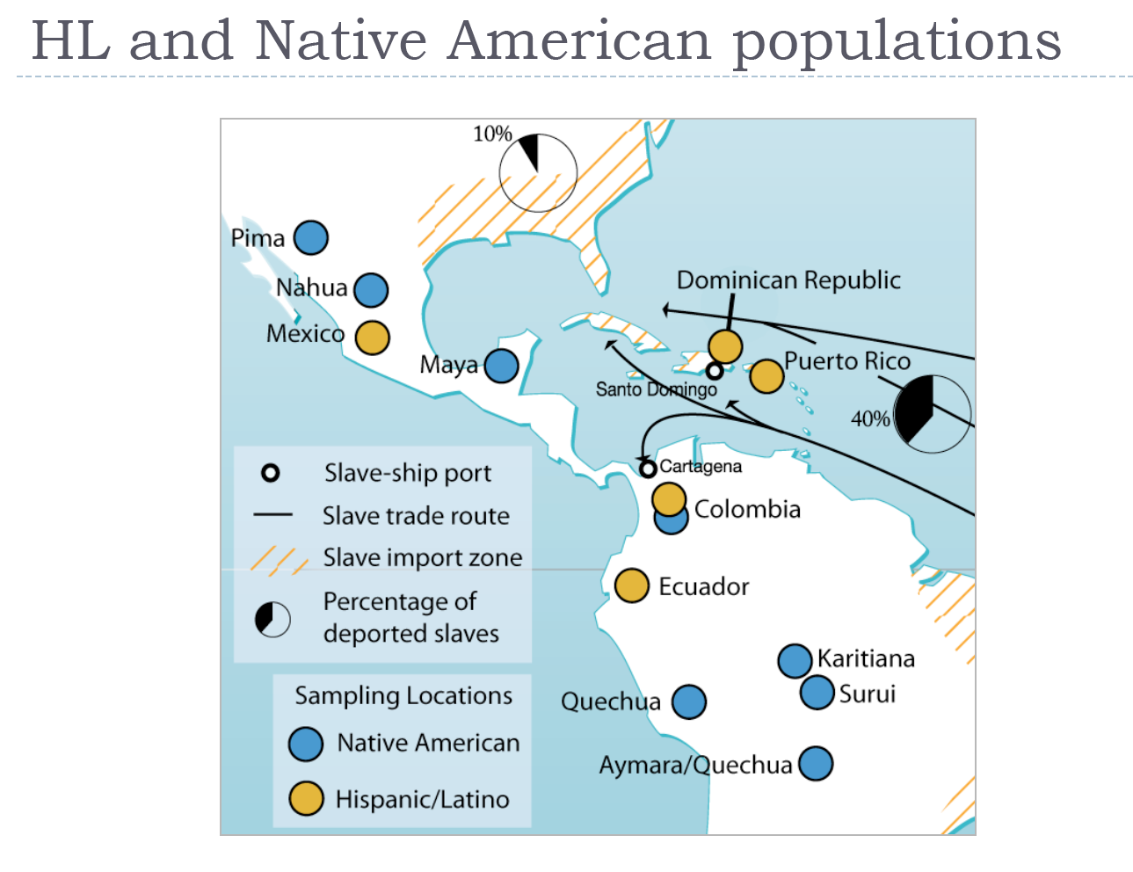
Latin America genetic diversity show signatures of European, African and Native American ancestry
N. American
Mexican
Colombian
African
Af. Amer.
European
7

Slide 8
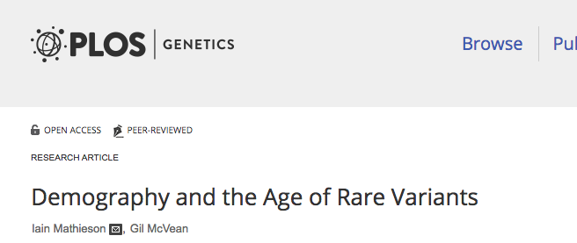
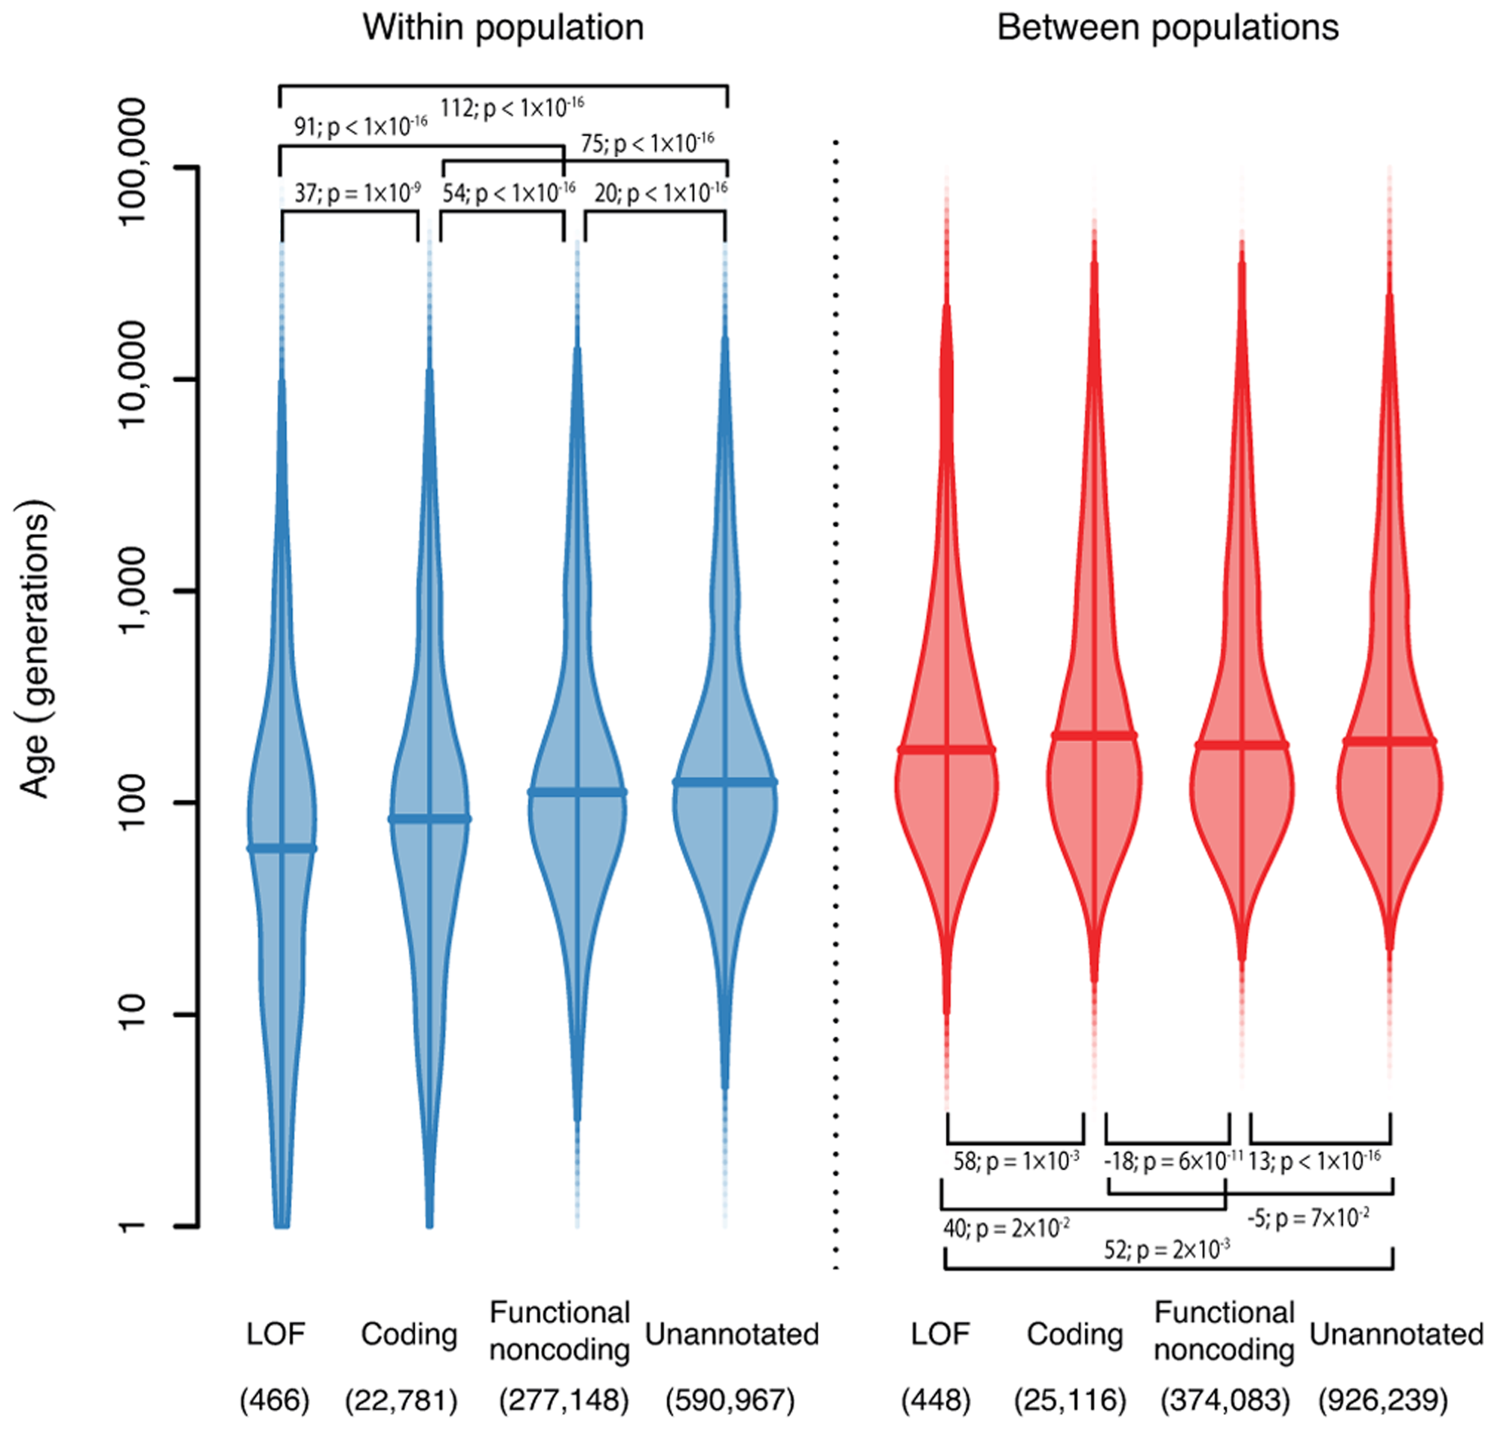
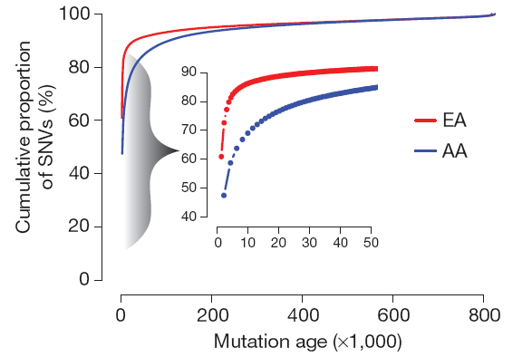
Fu et al “Analysis of 6,515 exomes reveals the recent origins of most human protein-coding variation” Nature (2013)

Slide 9
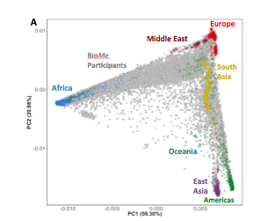
Recent demography expected to play a considerable role in rare variant mapping
PCA (common SNPs)

Slide 10
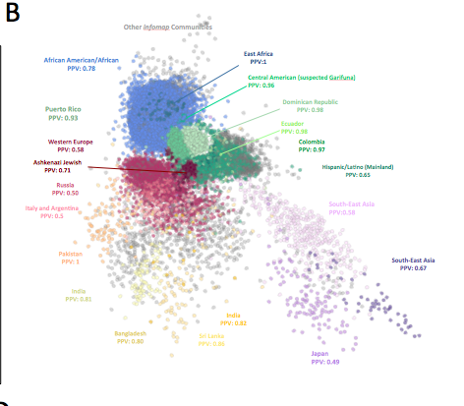
Recent demography expected to play a considerable role in rare variant mapping
24K New Yorkers (BioMe Biobank)
PCA (common SNPs)
IBD-network
(rare haplotypes)

Slide 11
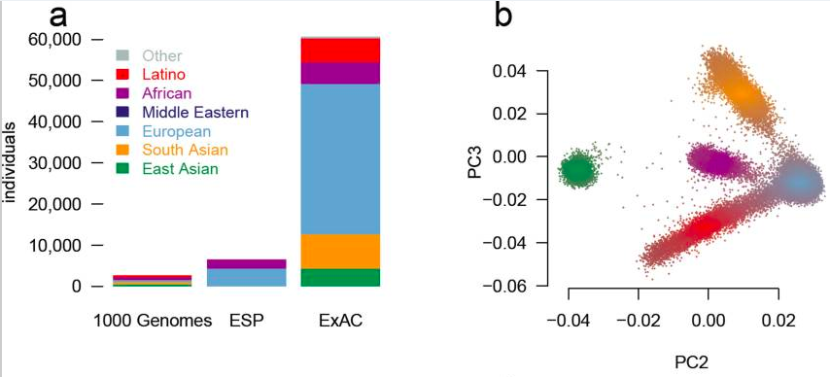
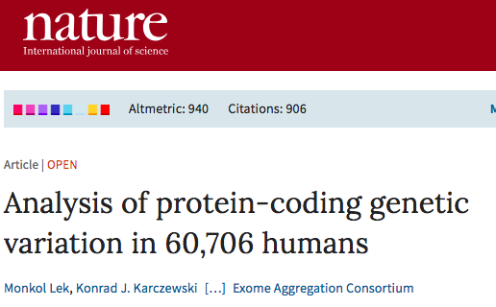
Large and increasingly diverse reference sequence databases

Slide 12

NHGRI Population Architecture using Genomics and Epidemiology (PAGE) Study
www.pagestudy.org
African-American
Native American
Mexico
Japan
Native Hawaiian
India
Puerto
Rico
Cuba
Dominican
Republic
52K participants
200+ phenotypes (+ 1 Biobank)
1 genetic platform
Wojcik et al. “Genetic diversity turns a new PAGE in our understanding of complex traits” (2017) biorXiv
Notes:
*Take your time*
PAGE is Study of 52K participants predominantly non-white
Represent world-wide diversity across 7 continents and subcontinental regions
Dense sampling in the Americas and global reference panels
>100 fine-grain pops, linked to >200 phenotypes, all assayed on a single platform.

Slide 13
Over 30,000 segregating clinical variants from medical databases
 |  | PAGE | ExAC | 1000 Genomes
Study Populations
Sample Size (N) |  | 51,698 | 60,706 | 2,504
Population Labels |  | 99 | 5 | 26
Phenotypes (Yes/No) |  | Yes | No | No
Clinical content (Total, polymorphic)
Overall |  | 63,902 (36,247) | 234,585 (101,203) | 237,620 (41,386)
ClinVar | Total | 21,720 (15,793) | 131,325 (62,350) | 132,238 (30,519)
 | Pathogenic | 7,186 (2,276) | 45,180 (9,779) | 44,230 (1,643)
 | Likely pathogenic | 623 (320)
 | Uncertain significance | 4,133 (3,805) | 51,852 (24,705) | 52,822 (8,473)
 | Benign/Likely benign | 6,483 (6,411) | 33,306 (27,201) | 34,077 (19,844)
 | Conflicted | 1,702 (1,567) | 310 (294) | 299 (216)
 | Other | 423 (351) | 667 (371) | 810 (343)
 | Not provided | 1,172 (1,063)
 | Within ACMG genes | 2,496 (1,477) | 42,023 (10,358) | 43,580 (4,302)
HGMD |  | 16,381 (10,445) | 146,304 (32,208) | 145,240 (12,279)
Predicted loss-of-function |  | 38,950 (16,233)
ACMG-59 genes |  | 2,740 (1,596)

Slide 14
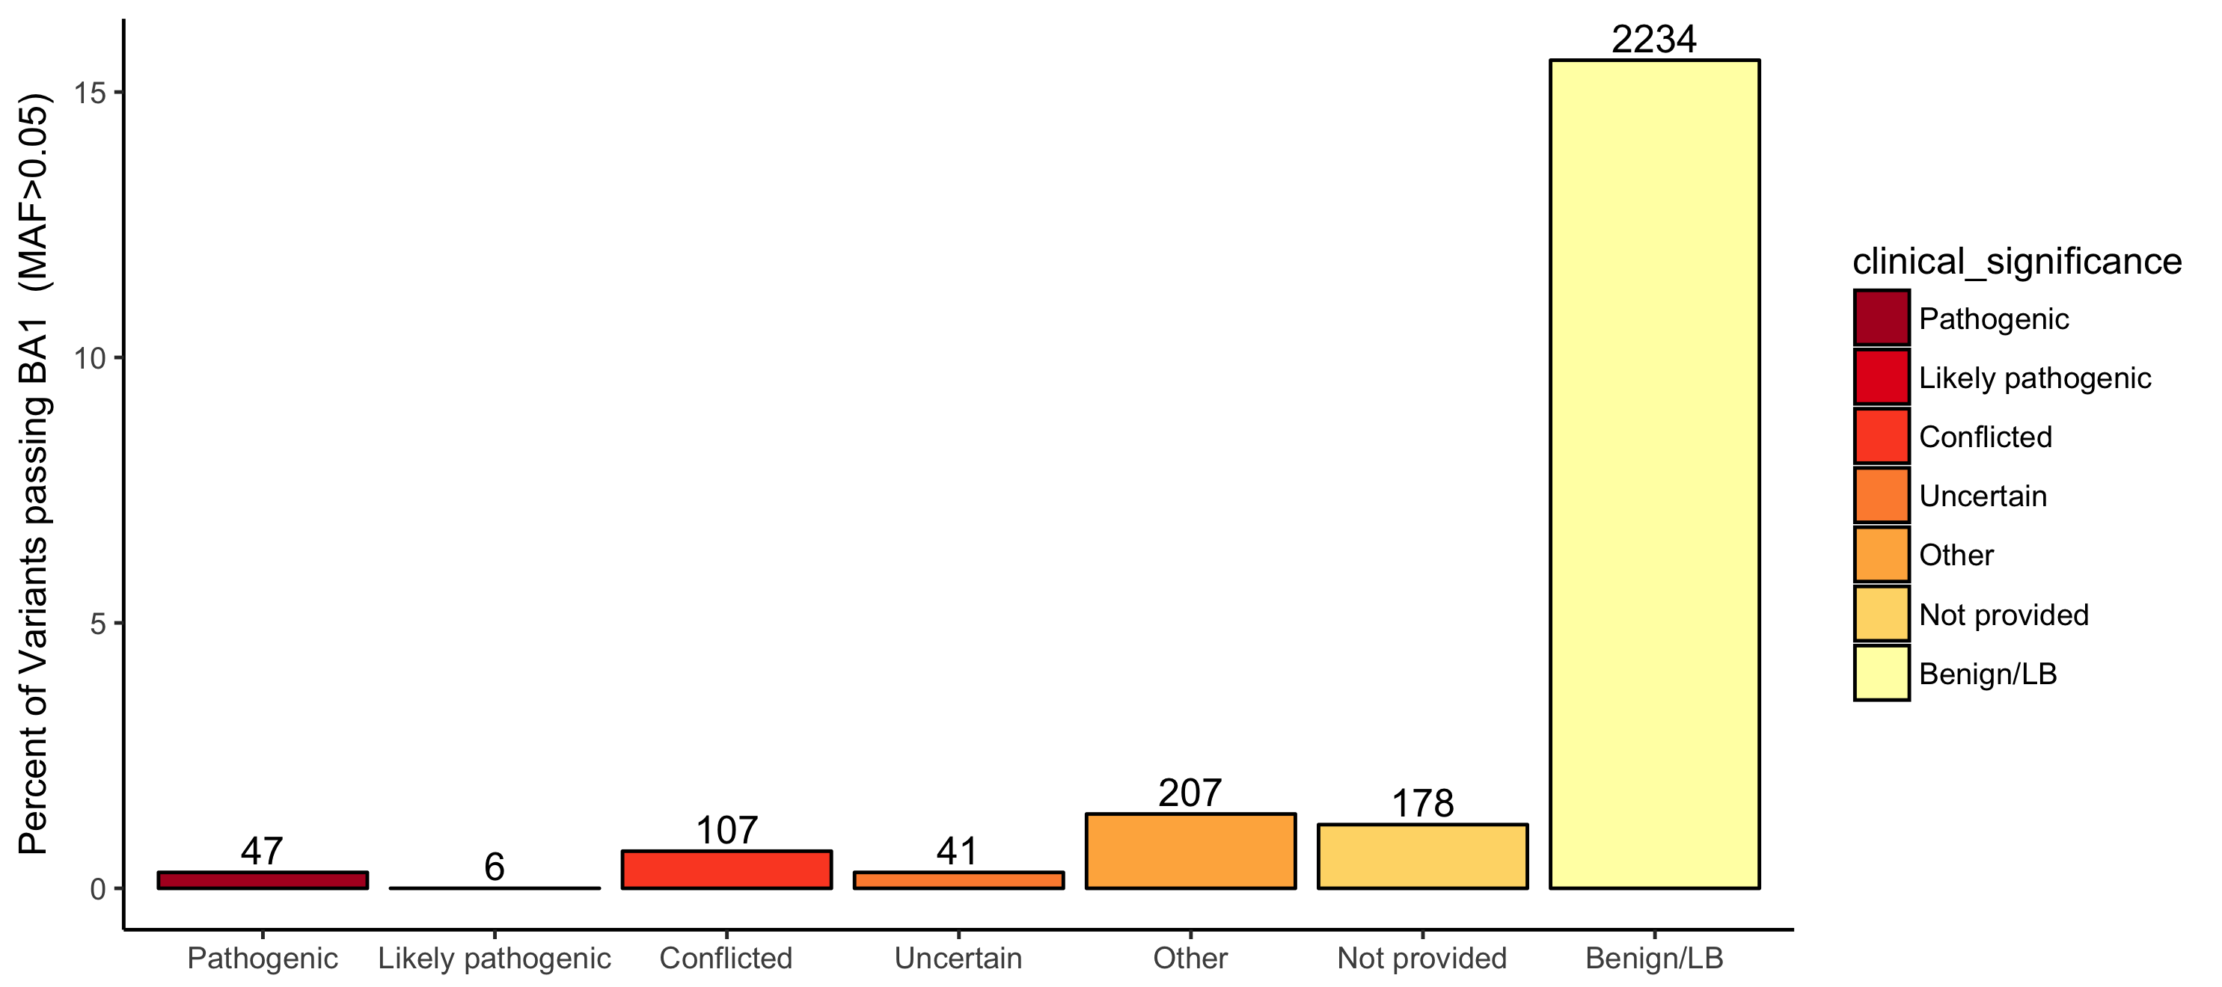
Applying ACMG criteria to PAGE populations reveals 2,820 variants with MAF>0.05
Clinical assertion
586 variants
26% (n=153) not in other databases

Slide 15
Worldwide frequencies of ClinVar conflicted variant SCN5A.pV195L
African American
Native American
Asian American
13 Subpopulations
Bari, Chile, Colombia, HGDP Colombian,
Ecuador, El Salvador, Honduras,
Peru, Pima, Puno,Yukpa, Zapotec
Risk allele frequencies in gnomAD
Latino=0.04
African=0.003
East Asian=0.0029
South Asian=0.0018
European=0.0003
South American
MAF= 0.0595
95% CI: 0.0499-0.0702
LongQT syndrome, autosomal dominant Current status on ClinVar: Conflicted
Risk allele is allele shown here: A
Notes:
Let’s look at some of the things we’re finding out.
This is a conflicted variant in SCN5A, a gene associated with a dominant Mendelian disease, that is close to 5% in ExAC Hispanic/Latinos, but we’re seeing this variant well above 5% in South Americans, and PAGE data gets you the resolution to see where else the variant segregates specifically within South America,
e.g. Chile, Peru, Ecuador and Colombia

Slide 16
Worldwide frequencies of ClinVar conflicted TNNT2.c5564G>A splice variant
African American
Native American
Asian American
Native Hawaiian
MAF=0.028
95% CI: 0.022-0.032
Papua New Guinea MAF=0.058
95% CI: 0.016-0.191
- Gene is associated with autosomal dominant cardiomyopathy
- Current status on ClinVar: Conflicted
- Risk allele is allele shown here: T
Only seen 5 copies in gnomAD
South Asian MAF=0.0001
Notes:
Let’s take a look at a variant that’s a more extreme example, that’s actually very rare around the world
For example this variant is >5% in Papua New Guineans from the reference panel and >2% in Native Hawaiians in PAGE, showing a variant that is found only in Oceanian pops
But more so in one of the fine-grain populations than large populations.
If we didn’t have that 1 out of 99 pops, wouldn’t see this. How many times does that happen?

Slide 17
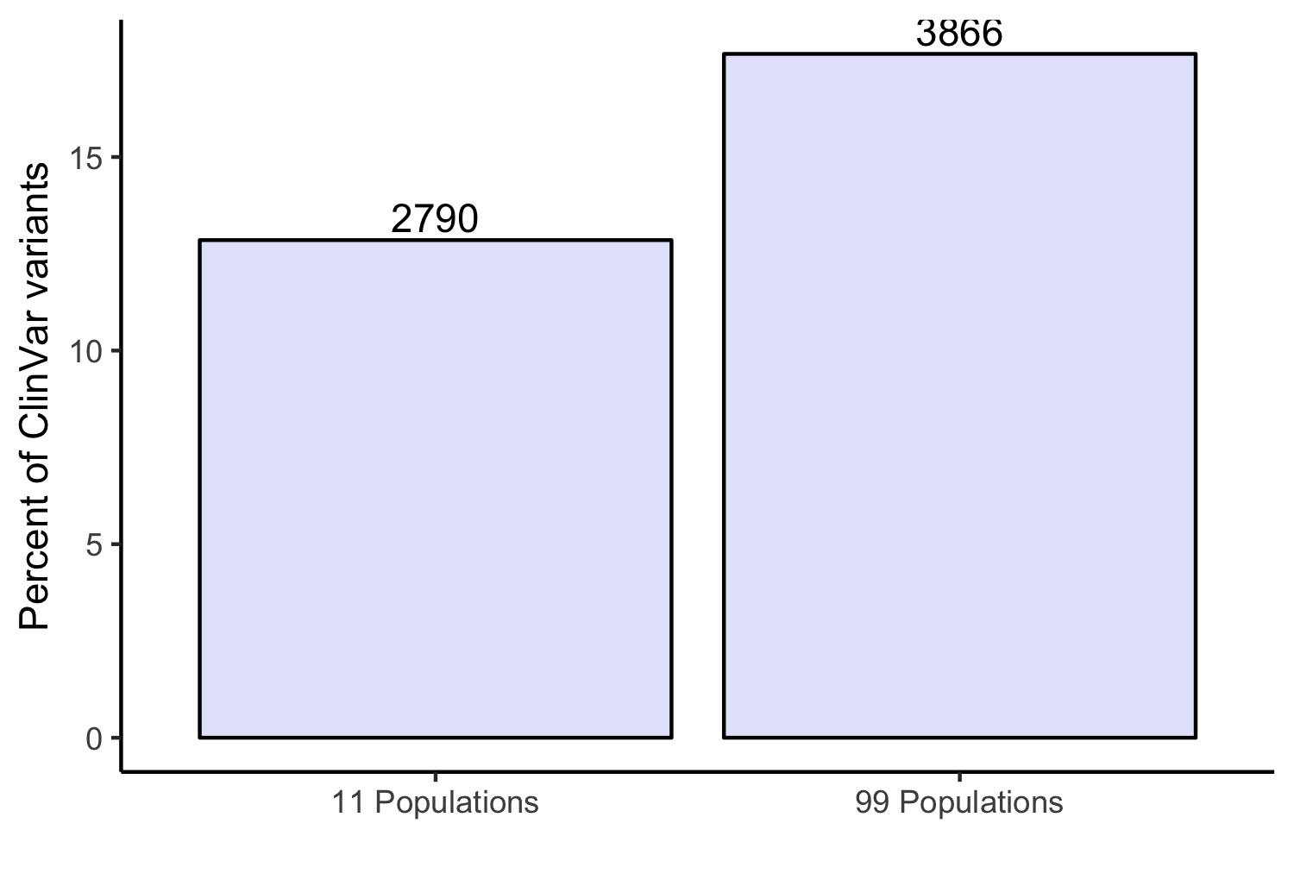
Additional 40% variants above 5% MAF using fine-grained population labels in PAGE
3866*
40%
*To account for differences in sample size, we include only those variants where the lower bound of 95% confidence interval of risk allele frequency > 0.05
2790*
Percent ClinVar Variants
Sub-continental level
population labels
(N=11)
Country/Region-of-origin population labels
(N=99)
PAGE 52K participants
Notes:
To quantitate the value of granular populations while accting for diffs in pop sizes, we calc 95% conf interval for these ClinVar variants and then count variants where the whole interval is above 5% in any of these pops. It happpens quite a bit, as you can see when we add in country of origin and granular labels we can adjudicate about 40% more variants even when accounting for some the small sample sizes
Quantitation of the value added from considering fine-grain populations in addition to sub-continental level designations.

Slide 18
Understanding genetic ancestry can help reduce false positives
Mean pathogenic count

Slide 19
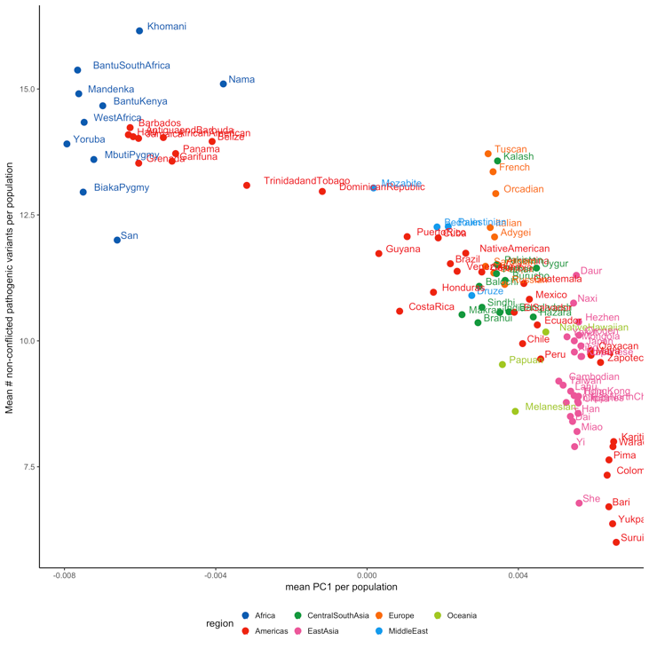
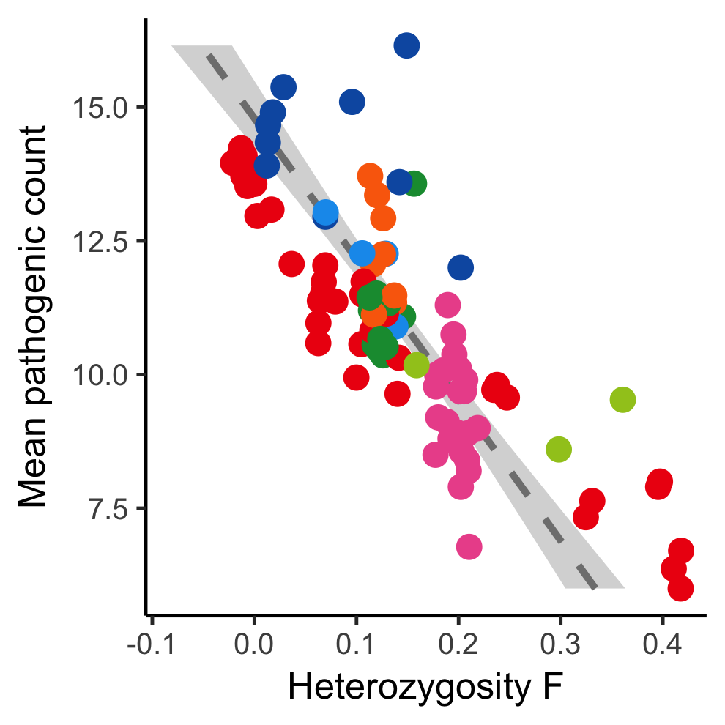
Understanding genetic ancestry can help reduce false positives
Mean pathogenic count
In a linear model,
Counts_{pathogenic} ~ PC1 + F
PC1 and F coefficient together explain ~36% of the variance in pathogenicity counts
Z >20, p<10e-16
Mean PC1 per population

Slide 20
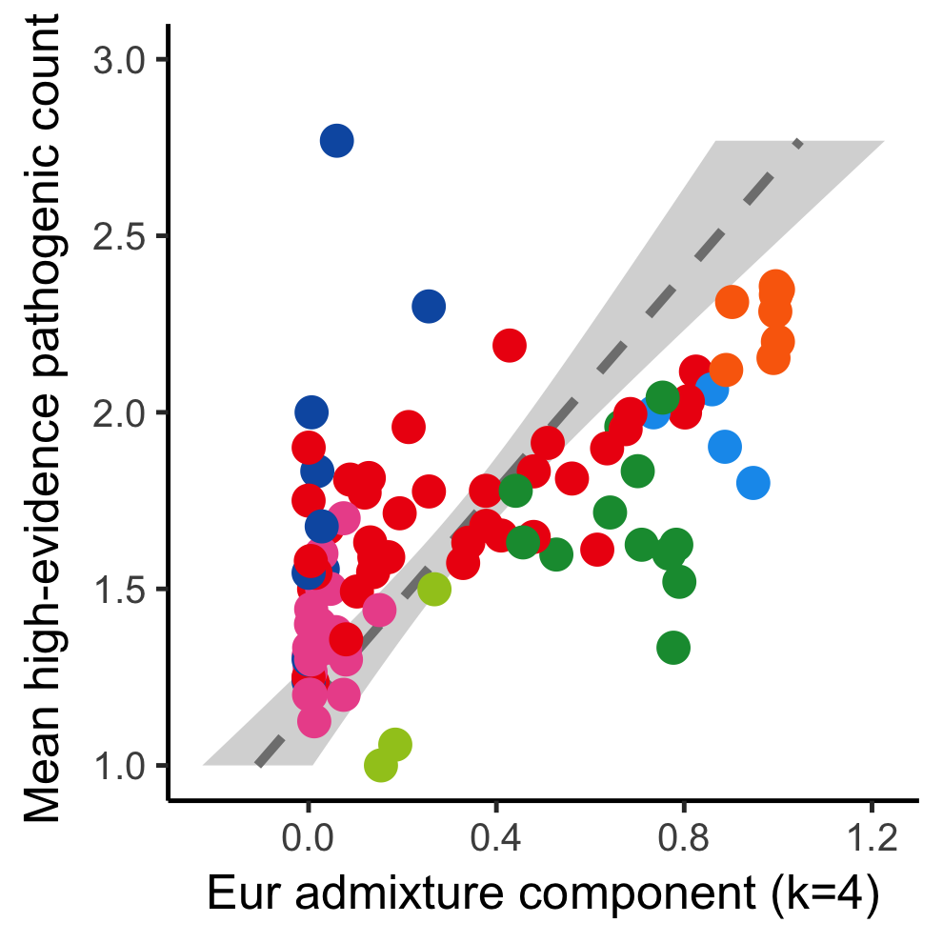
Understanding genetic ancestry can help reduce false positives
Non-Europeans more likely to have VUS and false positive pathogenics

Slide 21
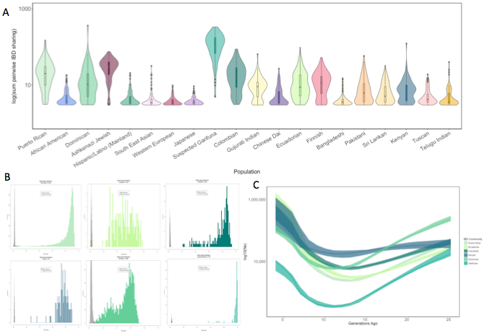
Founder populations can be hidden in plain sight
24K New Yorkers (BioMe Biobank)
PCA (common SNPs)
IBD-network
(rare haplotypes)
IBD-demography

Slide 22
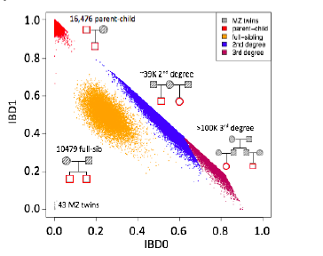
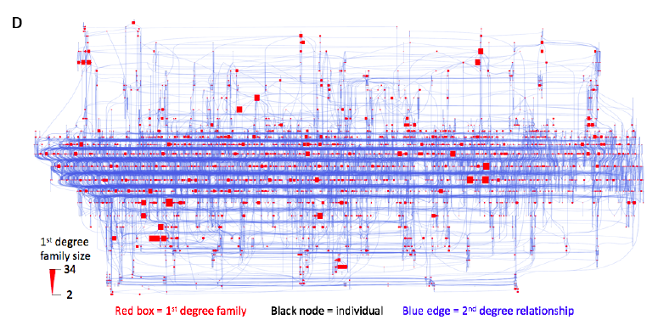

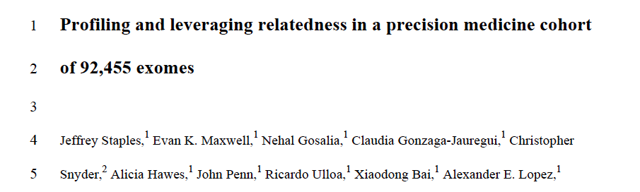
22% Geisinger cohort in large connected pedigree

Slide 23
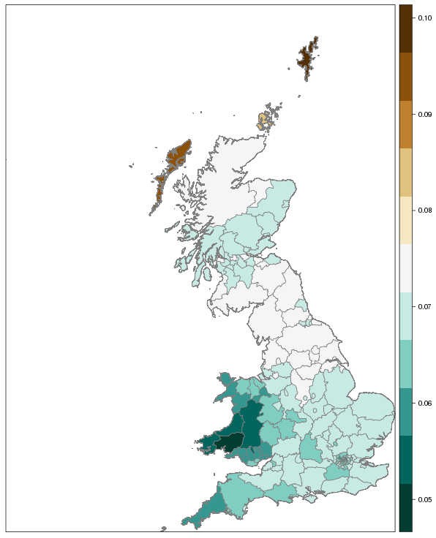
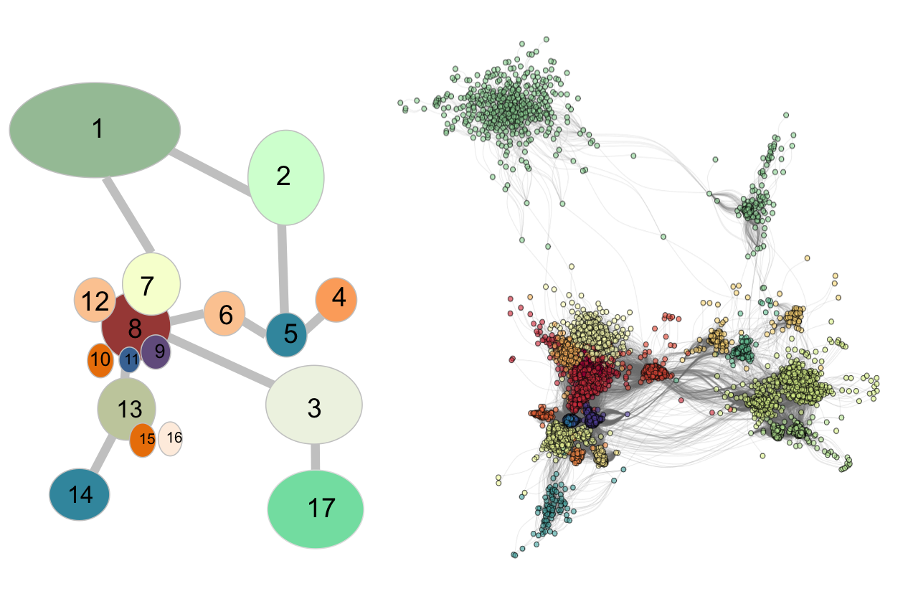
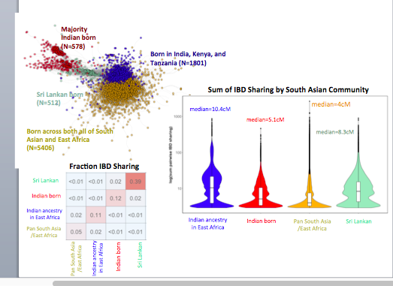
Recent demography expected to play a considerable role in rare variant mapping
Norway versus UK Region
14,181,681,196 IBD tracts present in 487,409 UK Biobank participants
Norway versus UK Region
Shetland Isles (0.1)
Orkney (0.085)
Outer Hebrides (0.09)
Median Degree of Sharing
Median Degree of Sharing

Slide 24

Acknowledgements
Icahn School of Medicine at Mount Sinai
Gillian Belbin
Sinead Cullina
Stephane Wenric
Hannah Poisner
Muh-Ching Yee
Jackie Odgis
Institute of Personalized Medicine
Noura Abul-Husn
Girish Nadkarni
Tielman Van Vleck
Amanda Merkelson
Bernadette Liggayu
Patrick Shanley
Ruth Loos
Erwin Bottinger
Judy Cho
Stanford University
Genevieve Wojcik
Elena Sorokin
the Bustamante lab
Carlos Bustamante
PAGE-II Collaborators
Lucia Hindorff (NHGRI)
Kari North (UNC)
Chris Carlson (Fred Hutch)
Charles Kooperberg (Fred Hutch)
Chris Haiman (MEC)
Ruth Loos (MSSM)
Tara Matise (Rutgers)
Steve Buyske (Rutgers)
Jose-Luis Ambite (USC)
Funding NIH/NHGRI/NHLBI
U01HG109391
U01HG009080
X01HL134588
University of Colorado
Chris Gignoux

