Slide 1
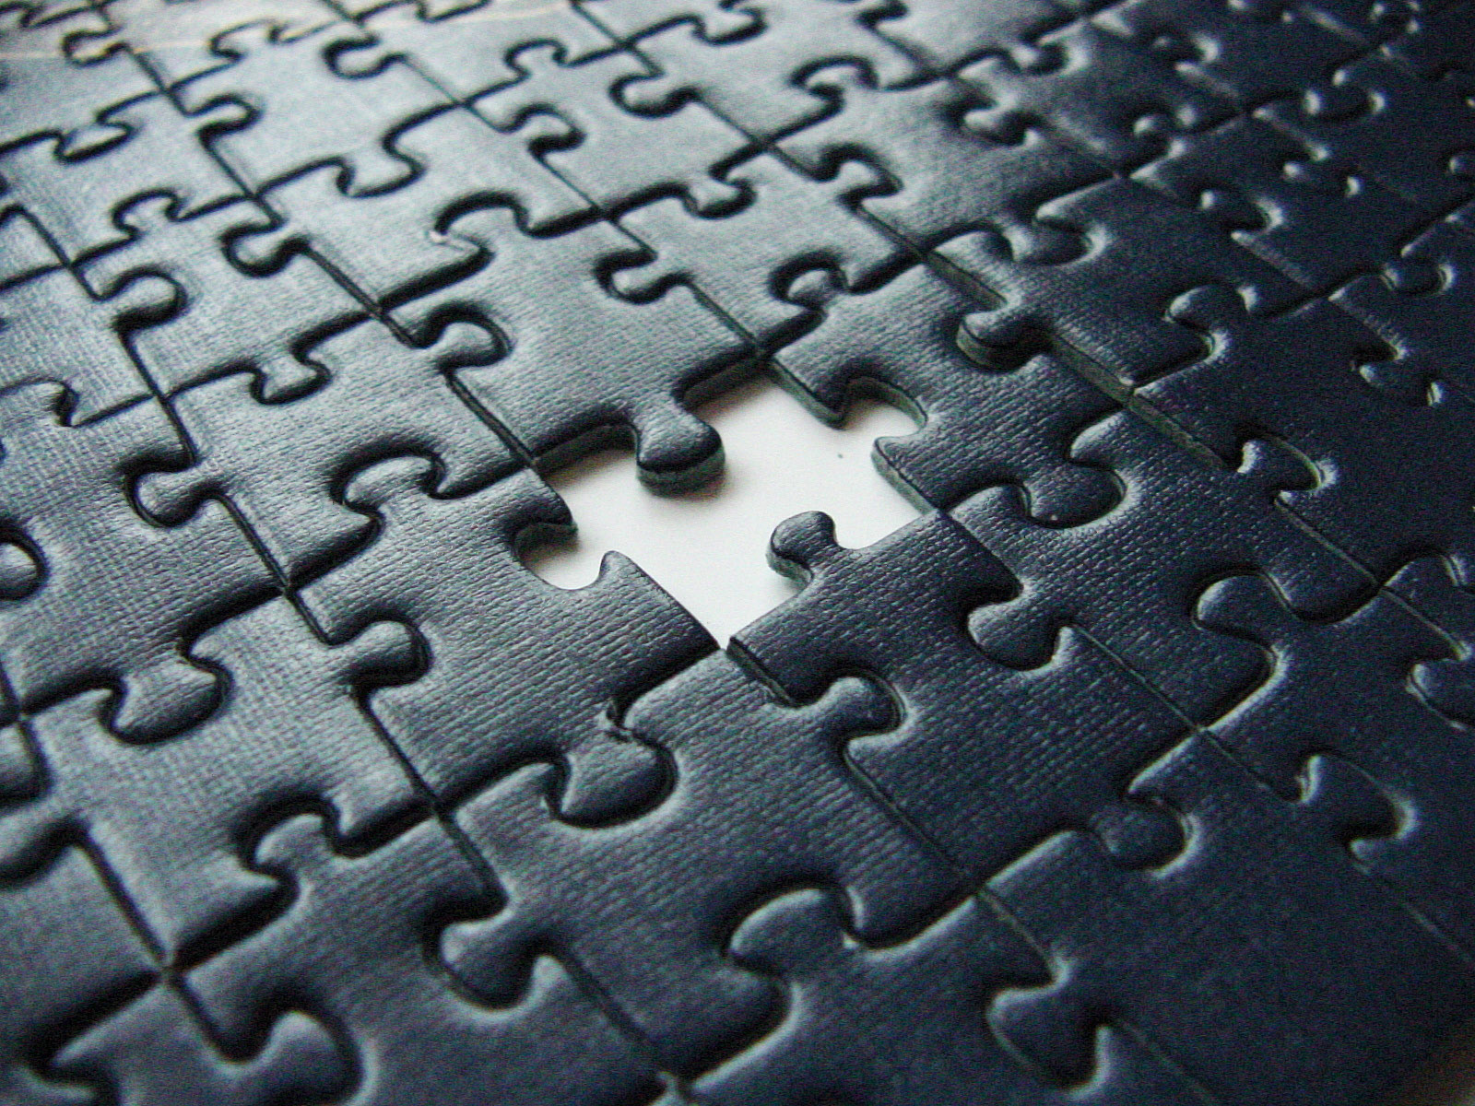
missing epistasis
Andrew G Clark
Cornell University
Missing Heritability II
1-2 May 2018 – Silver Spring, MD

Slide 2
Objectives
There can be pervasive epistasis and yet additive models fit the data well.
Gene-gene interaction can be strong and still generate little epistatic variance.
The Infinitesimal model – is clearly silly, but it still has great utility.
Infinitesimal epistatic model does not improve fit.
Individual prediction that accommodates gene-gene interaction and GxE may yet be useful.

Slide 3
Epistasis in Manolio et al. (2009)
“Narrow-sense heritability estimates in humans can be inflated if family resemblance is influenced by non-additive genetic effects (dominance and epistasis, or gene–gene interaction), shared familial environments, and by correlations or interactions among genotypes and environment.”
“Box 2: To investigate missing heritability using family studies, the following measures are required: ….(8) Identify gene–gene interactions by positive correlation between family-specific logs odds ratio (lod) scores or evidence of linkage disequilibrium among unlinked loci.”
“Box 3: The following steps can be used to make the most of existing and future GWAS: …. (7) Investigate gene–gene interactions, including dominance and epistasis.”

Slide 4
Gene-gene interaction without epistatic variance
Consider a multi-locus model for a quantitative trait:
Mäki-Tanila & Hill 2014 Genetics 198:355

Slide 5
Additive variance has epistatic terms
The average effect of an allele can be written as:
And the additive variance is the sum of the squared effects weighted by frequencies:
Kojima 1959 Genetics 45: 984
Mäki-Tanila & Hill 2014 Genetics 198: 355

Slide 6
Gene-Gene interactions contribute to V_{A}
Punchline: A substantial portion of variation that is caused by epistatic interaction ends up in the additive variance (contributing to heritability).
“a rather mundane theoretical finding”
Mäki-Tanila & Hill 2014 Genetics 198:355

Slide 7
Fisher’s Infinitesimal Model
Very large number of unlinked loci, each with very small effect.
Assume HW and linkage equililbrium.
Phenotype is obtained as the sum of allelic effects, and is normally distributed.
Barton, Etheridge & Véber 2017 Theor Pop Biol

Slide 8
Fisher’s Infinitesimal Model: results
Variance of offspring does not depend on trait values of the parents.
Selection produces negligible change in allele frequency (or variance).
The Breeder’s Equation (R = h²s) follows.
The model can accommodate epistasis.
Consequences of stabilizing selection, inbreeding and assortative mating are easily derived.
Barton, Etheridge & Véber 2017 Theor Pop Biol

Slide 9
Infinitesimal model of epistasis
Suppose each pairwise interaction is small.
Only very few are genome-wide significant.
But there are O(n²) such pairwise interactions.
So in aggregate, perhaps they can contribute to genotype-phenotype association.
Can we fit this model, just as Yang et al. (2010) did for additive effects?
Barton, Etheridge & Véber (2017) – deviation from infinitesimal model is $1/{\sqrt{M}}$, where M is the number of loci.

Slide 10
Extending the infinitesimal model to data on the whole genome…
“… regression of a trait on sequence can significantly improve predictions of breeding value, even when individual loci cannot be identified: this is the basis of ‘‘genomic selection’’ (Meuwissen et al., 2013).
It may be that natural selection is in just the same position as a breeder: selection may change the mean rapidly and predictably, even when the probability distribution of any particular allele frequency is hardly perturbed.”

Slide 11
Pairwise epistasis from GWAS
Type 2 Diabetes
Body Mass Index
Bell et al. 2011 Ann Hum Genet
Okada et al. 2012 Nature Genet

Slide 12
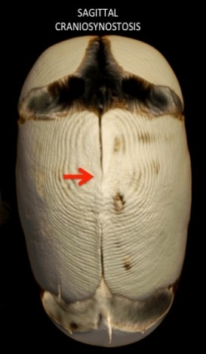
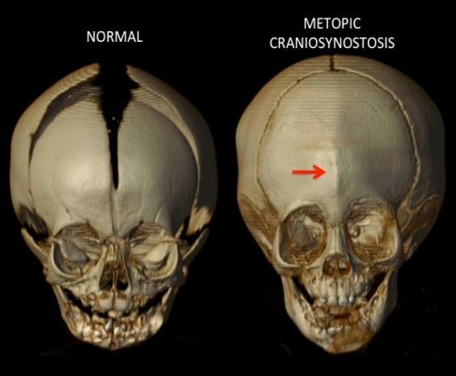
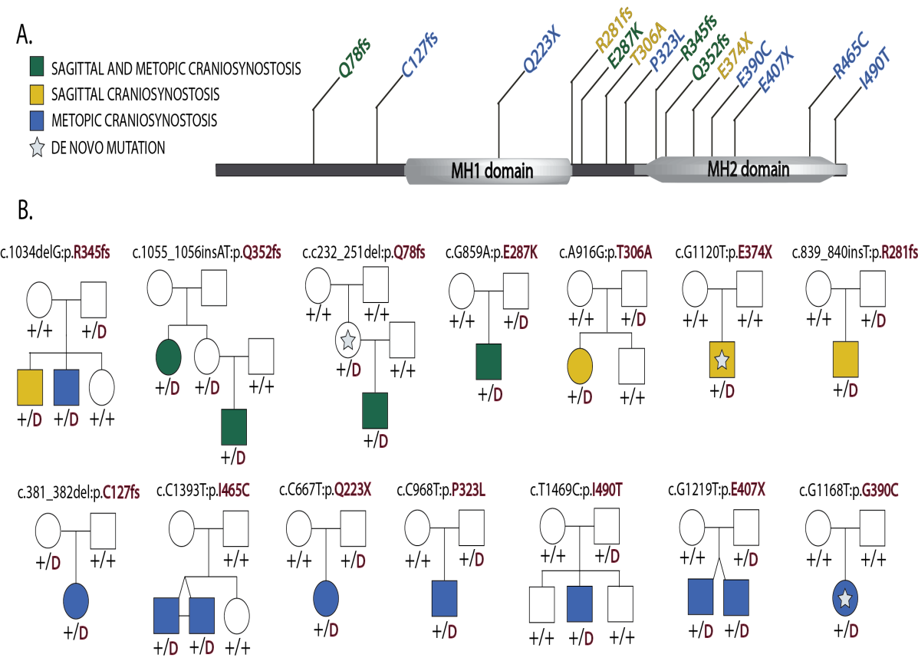
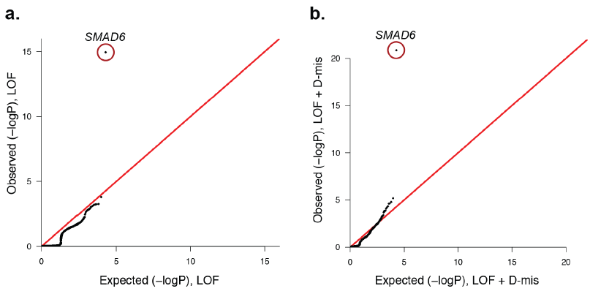
Pairwise epistasis from Mendelian disorders
Non-syndromic midline craniosynostosis
Phenotypically normal carrier parents of the dominant Smad6 mutation all have common variants in BMP2.
Timberlake et al. 2016 eLife
Notes:
Figure 2. Segregation of SMAD6 mutations and BMP2 SNP genotypes in pedigrees with midline craniosynostosis. (a) Domain structure of SMAD6
showing location of the MH1 and MH2 domains. The MH1 domain mediates DNA binding and negatively regulates the functions of the MH2 domain,
while the MH2 domain is responsible for transactivation and mediates phosphorylation-triggered heteromeric assembly with receptor SMADs. De novo
or rare damaging mutations identified in craniosynostosis probands are indicated. Color of text denotes suture(s) showing premature closure. (b)
Pedigrees harboring de novo (denoted by stars within pedigree symbols) or rare transmitted variants in SMAD6. Filled and unfilled symbols denote
individuals with and without craniosynostosis, respectively. The SMAD6 mutation identified in each kindred is noted above each pedigree. Below each
symbol, genotypes are shown first for SMAD6 (with ’D’ denoting the damaging allele) and for rs1884302 risk locus downstream of BMP2, (with ’T’
conferring protection from and ’C’ conferring increased risk of craniosynostosis). All 17 subjects with craniosynostosis have SMAD6 mutations, and 14/
17 have also inherited the risk allele at rs1884302, whereas only 3 of 16 SMAD6 mutation carriers without the rs1884302 risk allele have craniosynostos

Slide 13
So does epistasis matter in evolution?
Genes exist in networks and epistasis at the molecular level is pervasive.
And yet, the infinitesimal model fits the data.
Paixão & Barton (2016) compare a purely additive model to one with epistasis.
If selection is weak (Ns < 1), drift dominates and variance components are unchanged (infinitesimal model of nonadditive effects).
If selection is strong (Ns > 1), allele frequencies change, and the genotype-phenotype map matters more than variance components.
Paixão & Barton 2016 PNAS

Slide 14
Heritability vs. Individual prediction
Genomic prediction is for Breeding Value (mean phenotype of many offspring).
GxG and GxE may perturb each individual from this expectation.
The ideal individual prediction could accommodate GxG and GxE, if only we could estimate them …

Slide 15
Machine Learning to the rescue ??

Slide 16
Reasons for missing epistasis
Markers are in imperfect LD with causal variants.
Rapid population growth → rare alleles.
Curse of dimensionality (power).
Small effect size (power).
Embedding in higher dimension gene-gene interactions (epistasis appears as additive variance)
Embedding in gene x environment interactions.
Population substructure (heterogeneous embedding).

