Slide 1

National Advisory Council for Human Genome Research
February 2014
Eric Green, M.D., Ph.D.
Director, NHGRI
DIRECTOR’S REPORT
Notes:
The Open Session of this meeting of the National Advisory Council for Human Genome Research is being webcast live.
And as a reminder, the Open Session of all Council meetings are videotaped and made available as a permanent archive on the web, including the presentations themselves and the various associated documents.

Slide 2
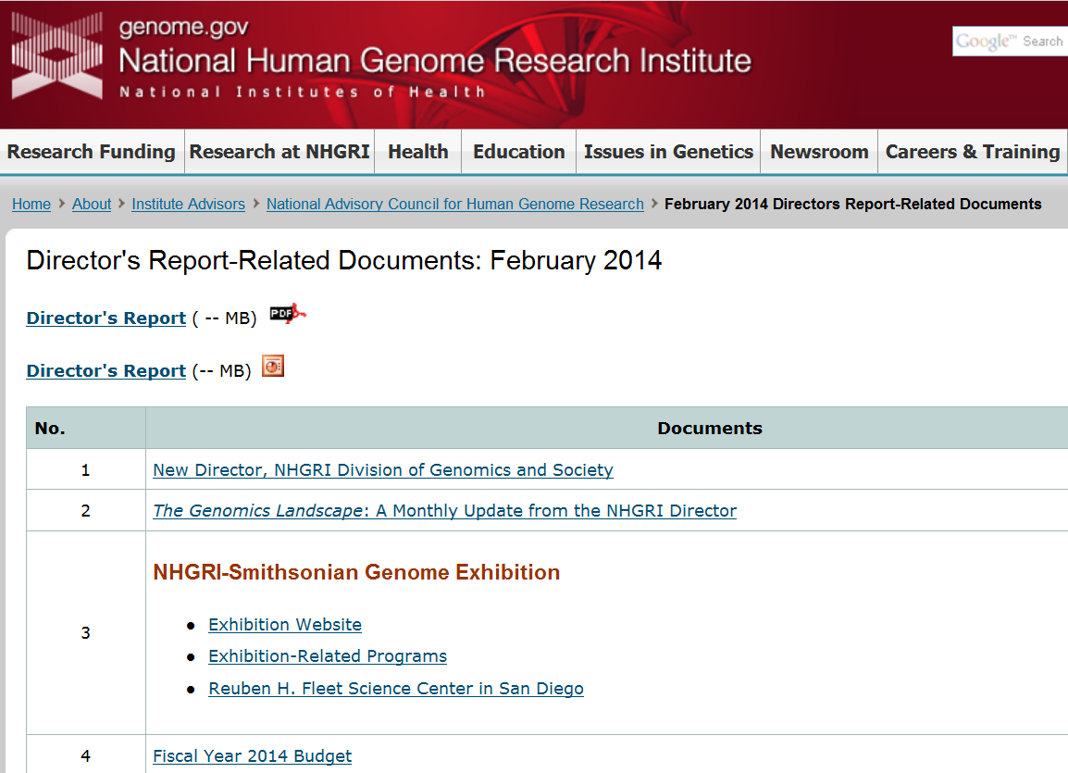
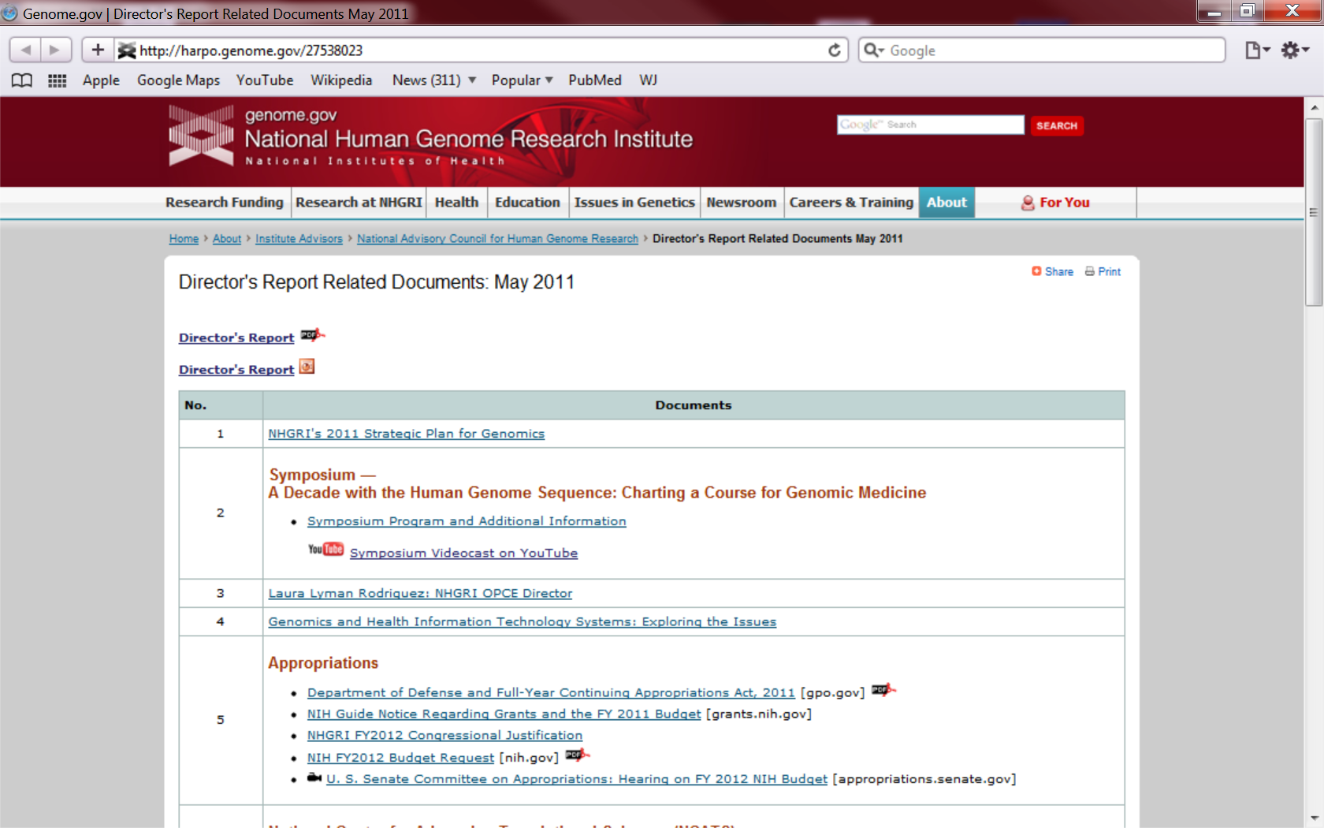
genome.gov/DirectorsReport
Document #
Notes:
For anyone new to our Council meetings, I want to make you aware that there is an ‘electronic resource’ associated with my Director’s Report. This is analogous to the supplemental materials that are often made available with a published paper, and can be accessed at the URL shown here.
The slides that I am showing during my Director’s Report are also available electronically at this site– * both as PDF and Powerpoint files.
* For slides associated with specific documents or relevant web sites, there is a ‘Document #’ indicated on the bottom right, which references materials that can be accessed at the web site shown here.
In addition to the video archive that I mentioned earlier, this web page and all linked documents will be archived on NHGRI’s web site (genome.gov) as a permanent historic resource.

Slide 3
Open Session Presentations
  Major Presentations:
  NHGRI Intramural Research Program
    Dan Kastner
  National Center for Advancing Translational Sciences (NCATS)
    Chris Austin
Recent NHGRI Meeting:
  Genomic Medicine VI Meeting
      Teri Manolio
Notes:
There will be multiple other presentations during the Open Session of this Council meeting. My Director’s Report is tailored around these presentations, and I will not discuss in detail the topics that others will cover later.
* For starters, later this morning, you will get an update on the NHGRI Intramural Research Program from its Director, Dan Kastner.
* After lunch, Chris Austin, Director of the National Center for Advancing Translational Sciences (NCATS), will tell us about activities at that NIH Center.
* And that will be followed by a report about the recent Genomic Medicine VI meeting by Teri Manolio.

Slide 4
Open Session Presentations
      Project Update:
  H3Africa Initiative
      Jane Peterson
  Major Presentation:
  NHGRI Large-Scale Sequencing and Analysis Centers
    Richard Gibbs
    Eric Lander
    Richard Wilson
Notes:
There will also be a project update later today * from Jane Peterson about the H3Africa Initiative.
* And then the last part of the Open Session will involve a presentation from the Directors of the three NHGRI-funded Large-Scale Sequencing and Analysis Centers; specifically, Richard Gibbs, Eric Lander, and Rick Wilson.

Slide 5
Director’s Report Outline
General NHGRI Updates
General NIH Updates
General Genomics Updates
NHGRI Extramural Research Program
NIH Common Fund/Trans-NIH
NHGRI Division of Policy, Communications, and Education
NHGRI Intramural Research Program
Notes:
For the rest of my Director’s Report, I will cover the 7 areas listed here, which together provide a good framework for reviewing the relevant topics.

Slide 6
Director’s Report Outline
General NHGRI Updates
General NIH Updates
General Genomics Updates
NHGRI Extramural Research Program
NIH Common Fund/Trans-NIH
NHGRI Division of Policy, Communications, and Education
NHGRI Intramural Research Program
Notes:
And we will start with some General NHGRI Updates.

Slide 7
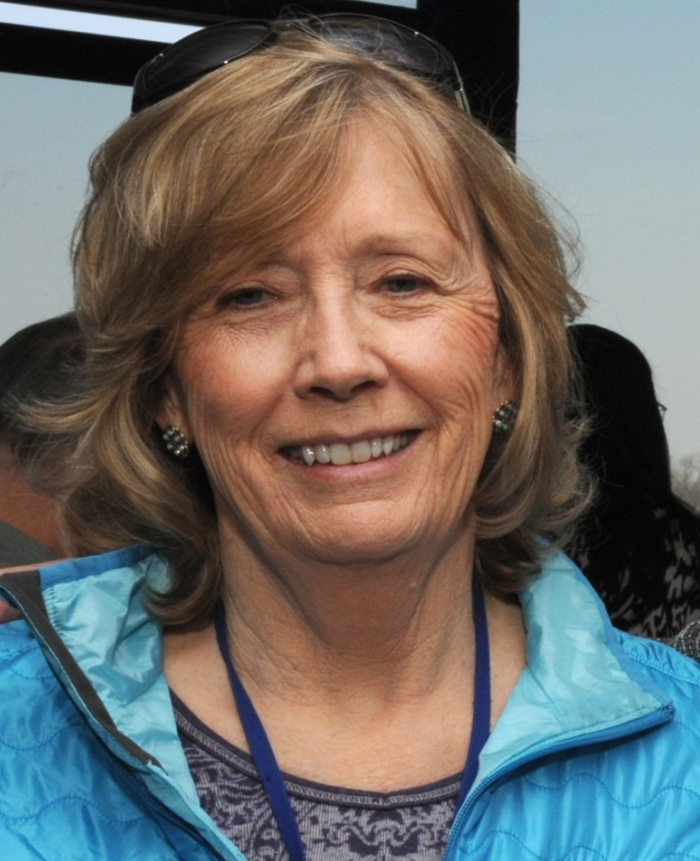
Extramural Staff Departure
Jane Peterson, Ph.D.
Notes:
It is truly the end of an era as NHGRI says goodbye to one of its founding members– Jane Peterson. After just shy of 25 years at the Institute, Jane officially retired from government service on January 17. She is currently working part-time with us through March in transition mode. Starting later this spring, Jane will become the CEO for the Keystone Symposia and move to Colorado, where she will be closer to her granddaughter and closer to the ski slopes.
Jane came to our Institute from NIGMS. She was there at the beginning of the Human Genome Project, and saw the Project through the mapping and sequencing phases, the debate about BAC-by-BAC vs. whole-genome shotgun sequencing, and the multiple completions– the draft human genome sequence (in 2000) and then its publication (in 2001), the finished human genome sequence and the whole Human Genome Project (in 2003), and then publication of the finished human genome sequence (in 2004).
Jane’s scientific acumen, administrative creativity, and ‘outside-the-box’ thinking benefited the Human Genome Project enormously. After the Project ended, Jane play major leadership roles in establishing a number of successful programs, including the Knockout Mouse Program, The Cancer Genome Atlas, the Human Microbiome Project, and Human Heredity and Health in Africa Initiative. She has seen the Institute through different phases, having worked with all of its Directors and Acting Directors: James Watson, Michael Gottesman, Francis Collins, Alan Guttmacher, and now me. And I can tell you that every one of those individuals deeply appreciated Jane’s remarkable contributions to NHGRI. It is an understatement to say that Jane will very much be missed, but at the same time, we wish her all the best in her new pursuits with Keystone Symposia. And as I mentioned earlier, you will get a chance to hear directly from Jane when she provides an update about H3Africa later today.

Slide 8
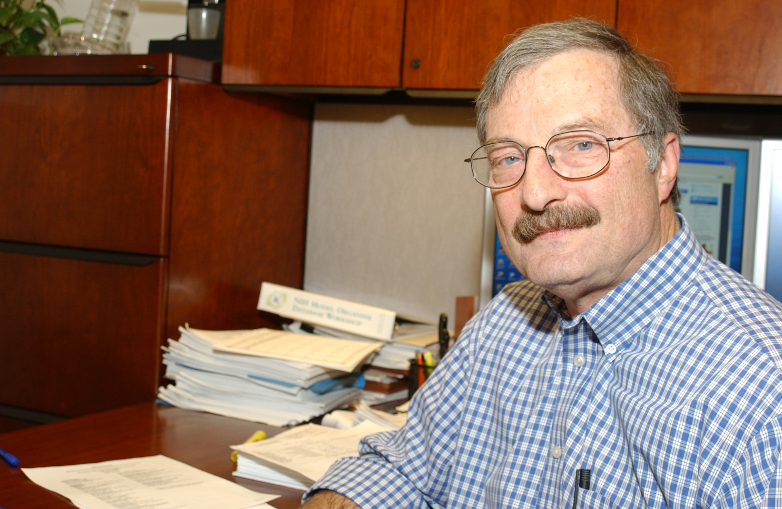
Extramural Staff Departure
Carson Loomis, Ph.D.
Notes:
Carson Loomis has also moved on from NHGRI, but he has not gone far. Having helped the Institute and the NIH run the Common Fund Molecular Libraries Program for a number of years, Carson has moved to NCATS to continue related projects.

Slide 9
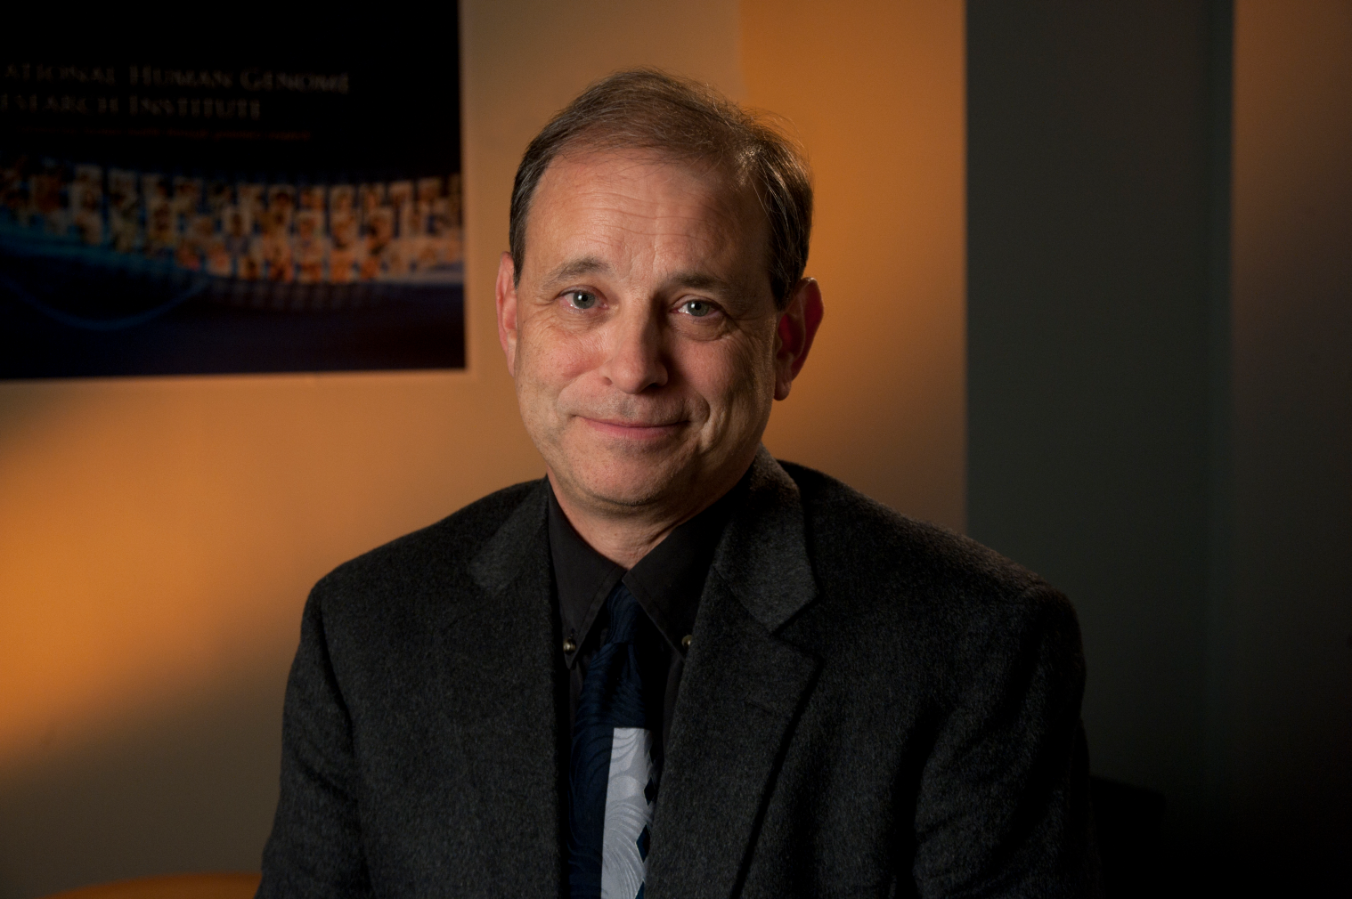
New Director,
NHGRI Division of Genomics and Society
Larry Brody, Ph.D.
Document 1
Notes:
The major new appointment that I am delighted to report represents the final key piece of the reorganization of NHGRI’s Extramural Research Program that I implemented in late 2012. I am pleased to say that Dr. Larry Brody is now the Director of the NHGRI Division of Genomics and Society.
The extensive search process for this important leadership position ended up finding the optimal candidate on the other side of the Institute, in our Intramural Research Program, where Larry has been a genetics and genomics researcher for over two decades. He brings to the Division Director position a unique combination of credentials that I am convinced will make him highly successful in leading the important pursuits of that Division. I can also tell you that in the few short months since assuming this new position, Larry is also making important leadership contributions to both the Extramural Research Program and the Institute as a whole.

Slide 10
  October 2013: Welcome Fiscal Year 2014! - Or Not?
  November 2013: Announcing the First Director of NHGRI's Division of Genomics and Society
  December 2013: Jumping into the Deep End of Genomic Medicine
  January 2014: A Decade of the NHGRI Social and Behavioral Research Branch
  February 2014: The Big Data to Knowledge Initiative
Document 2
Notes:
Encouraged by this Council and others to increase regular communications with NHGRI stakeholders, I started a monthly email message late last year, called The Genomics Landscape. Each month, this communication aims to disseminate information from me to the broader genomics community and others interested in knowing about developments at NHGRI.
Each month, I highlight two to four topics, typically featuring one in greater detail. * In October, I highlighted the complex budget situation. In the following four months, I highlighted * Larry Brody’s appointment as a Division Director, * the recently-initiated genomic medicine programs, * the anniversary of the NHGRI Intramural Social and Behavioral Research Branch, and lastly * the Big Data to Knowledge Initiative.
I certainly hope these messages are found to be informative to those receiving them, and my staff and I certainly welcome feedback about them (including topics to cover in the future).

Slide 11

Genome: Unlocking Life’s Code Exhibition
  More than 1.6 million visitors have seen the exhibition since its opening in June
  More than 70 NIH scientists have volunteered within the exhibition
Document 3
Notes:
The NHGRI-Smithsonian exhibition, Genome: Unlocking Life’s Code, has now been open at the National Museum of Natural History for more than seven months— and it continues to be a raging success (I say in a parentally biased fashion). * The most recent estimates indicate that more than 1.6 million visitors have seen the exhibition so far, with confidence that we will easily surpass the 3-million-visitor mark before the exhibition leaves the Museum in September. To assess what visitors think about the exhibition, survey and interview data have been gathered by the Smithsonian Institution’s Office of Policy and Analysis; those data are currently being analyzed.
* Among the many subcomponents of the exhibition, I am delighted to tell you that more than 70 NIH scientists have volunteered to participate in different outreach programs within the exhibition, such as our “The Genome Scientist Is In” and the “Genome Geeks” programs.

Slide 12
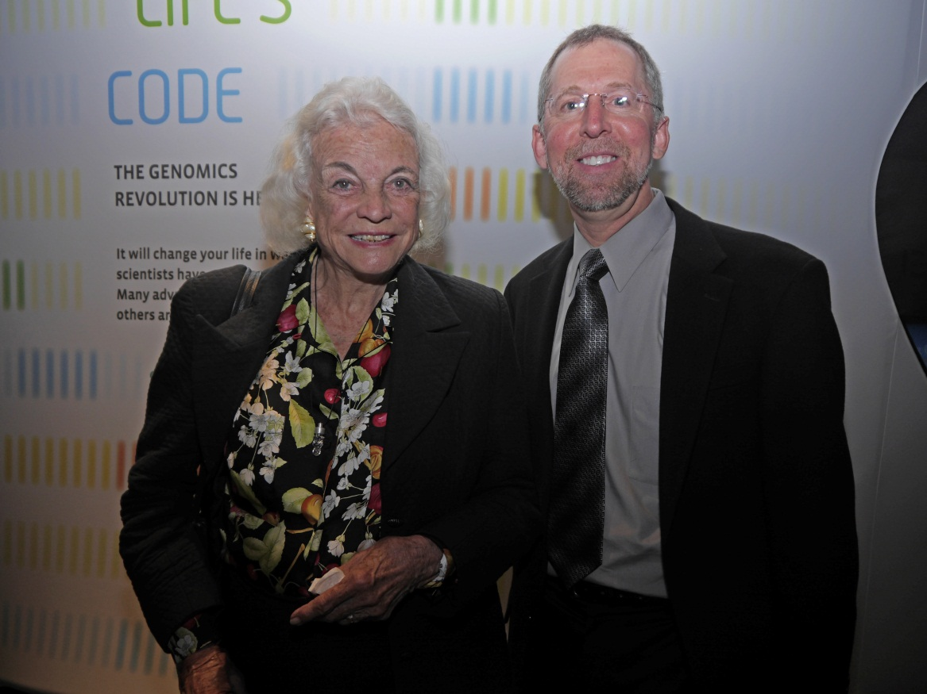
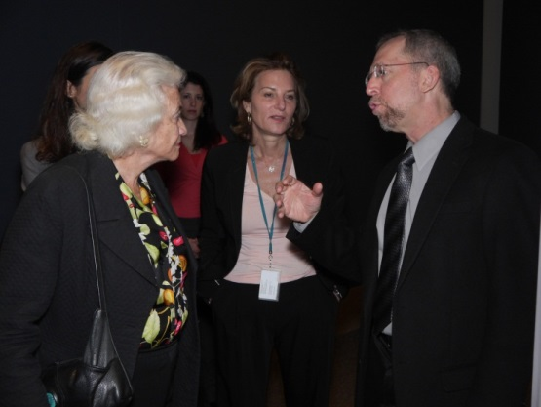
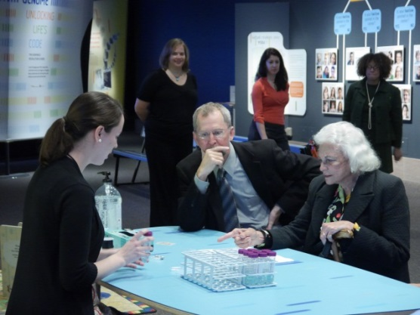
Genome Exhibition Attracting VIP Visitors
Notes:
As I have mentioned previously, the exhibition has also been a great place to showcase genomics to VIP visitors. Some of these opportunities are truly thrilling.
* For example, late last year, I had the honor to give a private tour of the exhibition to former Supreme Court Justice Sandra Day O’Connor, who is actually a member of the Board for the National Museum of Natural History. That visit included having the Justice purify her own DNA (shown on the bottom right), one of the most popular hands-on activities featured in the exhibition.

Slide 13
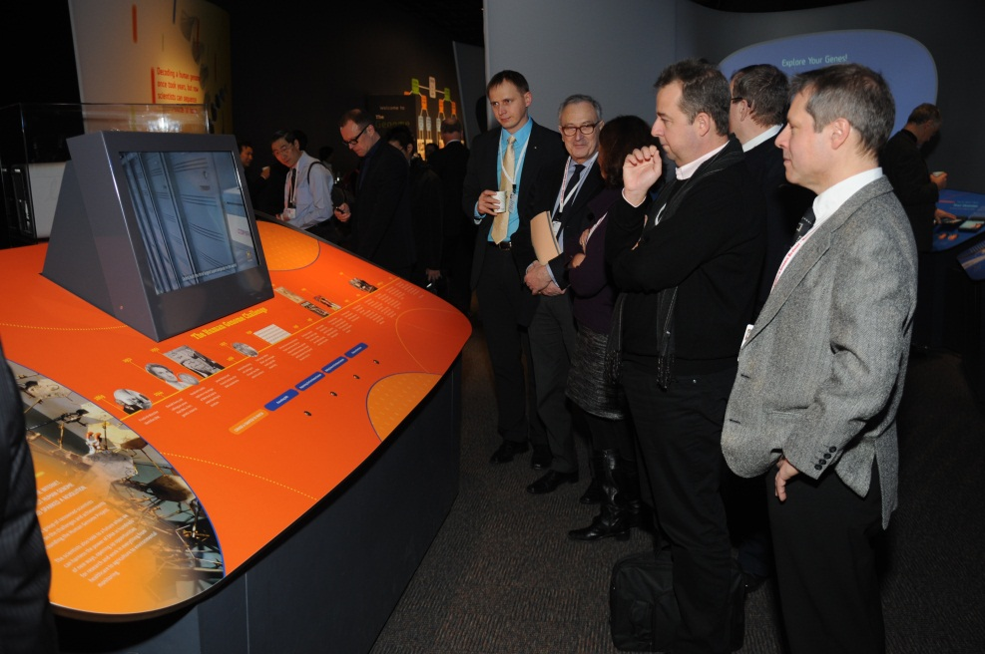
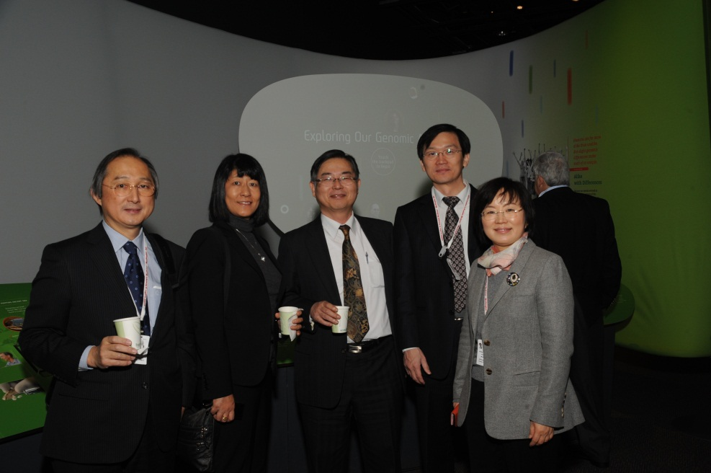
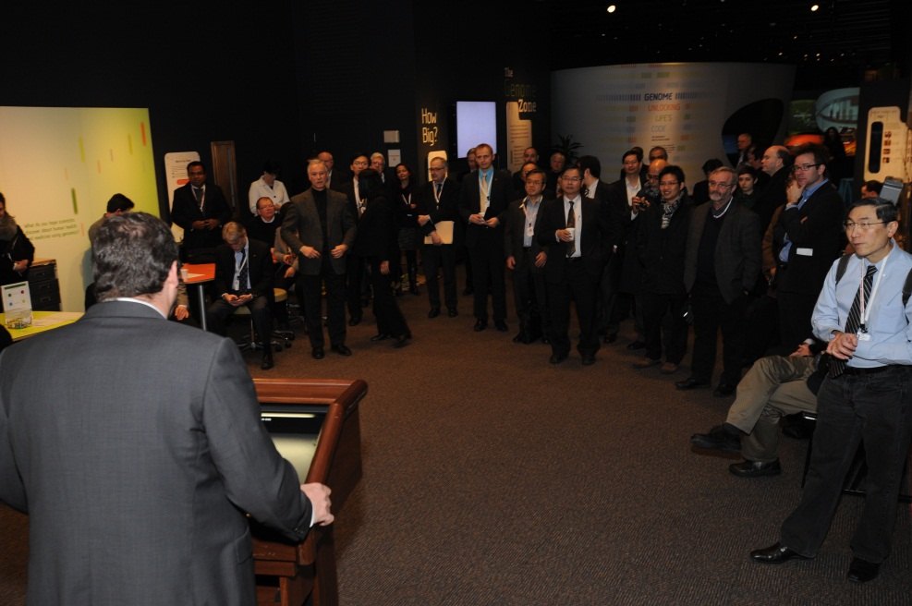
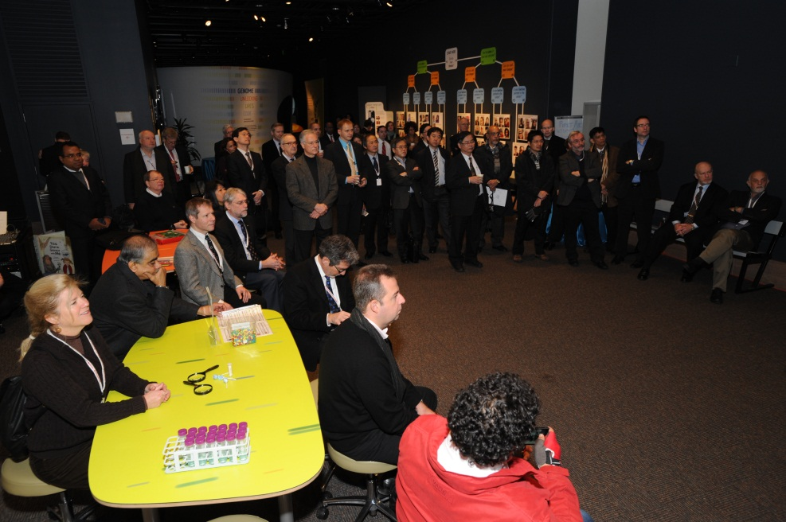
Genome Exhibition Attracting VIP Visitors
Notes:
We are also sharing this venue with our own dignitaries, such as the attendees of last month’s internationally-focused Genomic Medicine VI meeting (that Teri Manolio will be telling you more about later today). This group of international genomic researchers enjoyed a private tour of the exhibition prior to the start of the second day of their meeting. I will note that there continues to be discussions about the possibility of replicating and translating the exhibition so that it could travel to other countries.

Slide 14

Genome Exhibition Programs
Document 3
Notes:
Beyond the exhibition itself, we are involved in other partnerships that are organizing associated genomics programs.
For example, we are working extensively with the Smithsonian Associates to produce a series of public programs that feature various topics related to genomics. Most of these occur in the evening down at the Smithsonian, and most of these are being videotaped by the Institute and made available on our GenomeTV channel of YouTube.
In addition, NHGRI has been working closely with staff from the National Museum of Natural History’s new Q?rius Learning Center, which opened this past December. This brand-new center brings ‘science to life’ for students and their families. For example, last Saturday, NIH staff gave a presentation on family history, and in March, NHGRI’s Elaine Ostrander will speak about dog genomics. And then in April, Francis Collins and I will be giving a joint presentation on genomics and what it means for human health. All of these Q?rius programs will also be videotaped by the Institute and made available on our GenomeTV channel of YouTube.

Slide 15

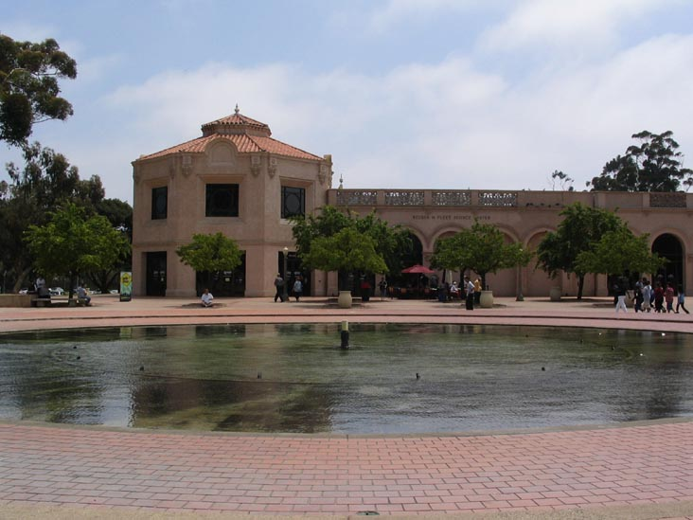
Genome Exhibition Travel
  Reuben H. Fleet Science Center
  September 24, 2014 to January 4, 2015
Document 3
Notes:
The Genome Exhibition will not be staying here in D.C. forever. Rather, it will travel to other sites around North American starting in September, * with its first stop being the Reuben H. Fleet Science Center in San Diego, where it will be resident until very early next year.
This timing happens to coincide with the annual American Society of Human Genetics (ASHG) meeting, which will be held in San Diego in October. Plans are being formulated to take advantage of the exhibition’s presence in San Diego during the ASHG meeting.
The Smithsonian and Science North – the company hired to travel the exhibition— are in the process of finalizing other travel locations for the exhibition through 2018.

Slide 16
Director’s Report Outline
General NHGRI Updates
General NIH Updates
General Genomics Updates
NHGRI Extramural Research Program
NIH Common Fund/Trans-NIH
NHGRI Division of Policy, Communications, and Education
NHGRI Intramural Research Program

Slide 17


Government Shutdown 2013
Notes:
The most significant development for NIH since the last Council meeting relates the Fiscal Year 2014 budget– or lack thereof when it came to starting up the new fiscal year. * This, of course, resulted in a lengthy shutdown of the federal government, including NIH. There are many things that could be said about this unfortunate circumstance, most probably better left unsaid. Needless to say, it was really awful and really complicated and really something that you hope will never happen again (but of course, it might).
In my typical fashion, I tried to find some humor to keep me sane during the shutdown. * This was my favorite piece– featuring President Obama and some poor soul at a help desk.
I will tell you that the NHGRI staff were truly terrific before, during, and after the shutdown— whether they were allowed to work or not. I deeply appreciate their tolerance and resilience.

Slide 18
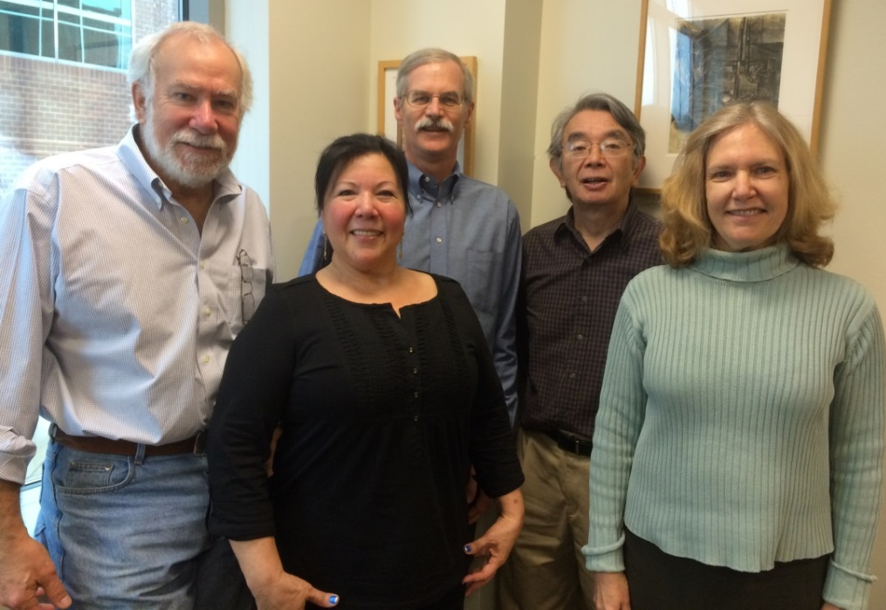

Special ‘Shout Out’ to
NIH Scientific Review Officers
  Government shutdown required rescheduling of many review meetings
  Center for Scientific Review and institute Scientific Review Officers quickly rescheduled meetings
  Summary statements prepared over holiday season
Notes:
Relevant to this Council, I would like to give a special ‘shout out’ to the entire community of NIH scientific review officers. * One very apparent casualty of the shutdown was the cancellation of approximately 450 peer-review meetings affecting the Center for Scientific Review and all the institutes and centers.
* All of these meetings were re-scheduled by the heroic efforts of review staff members across NIH, thereby avoiding the loss of one review cycle for thousands and thousands of grant applications.
I want to give a special thanks to the NHGRI Scientific Review Branch (shown on the bottom left), who had to reschedule their October meetings into December, replace ‘lost’ panel members, and * write summary statements right through the holidays. Kudos to them and all their review colleague across NIH!

Slide 19
Fiscal Year 2014 Budget
  Congressional deal avoided Fiscal Year 2014 sequestration
  Congress passed Fiscal Year 2014 omnibus bill in January
 | FY2011 | FY2012 | FY2013 | FY2014
NIH | $30.7 B | $30.7 B | $29.2 B | $30.1 B (3.4%)
NHGRI | $511 M | $513 M | $483 M | $498 M (3.0%)
Document 4
Notes:
Well, the shutdown did finally end, and we all came back to do our jobs. Eventually, the Congress did their job as well. * First, in December, Congress passed legislation that increased the cap on total federal spending previously set for Fiscal Year 2014, removing the imminent threat of an additional sequestration cut this year. * Then, last month, when Congress passed an omnibus appropriations bill funding all government agencies, we were provided a Fiscal Year 2014 budget for NIH and NHGRI.
* As shown in the far-right column, this year NIH is funded at $30.1 billion, an increase of approximately 3.4% over Fiscal Year 2013. Of this, NHGRI is allocated $498 million, an increase of around 3.0% over last year. Basically, this budget undoes about half of last year’s sequester cut, and thus still keeps us noticeably lower than where we were in Fiscal Year 2012, for example. Nonetheless, we seem to have turned the corner with respect to budget decreases.
These numbers thus start to give us some clarity on what our final budgetary situation will be for this fiscal year, which will end in a little over 7 months. So our eyes now quickly go to the Fiscal Year 2015 budget. We expect that the President will submit his Fiscal Year 2015 budget proposal to Congress in the coming weeks.

Slide 20
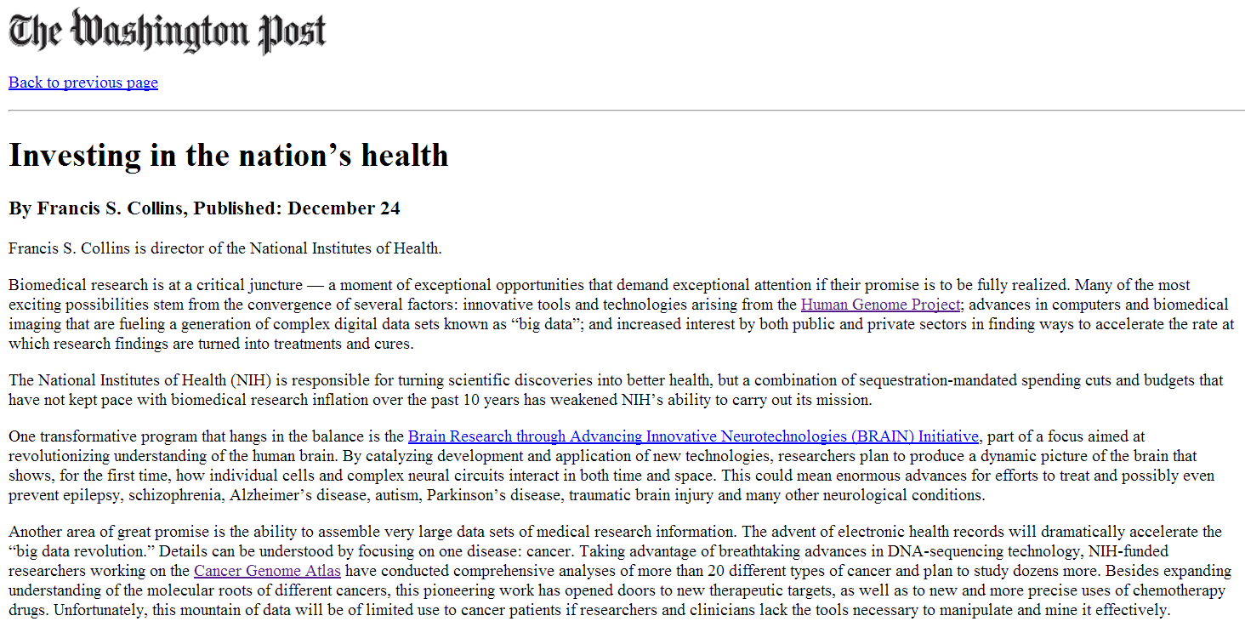
Francis Collins Editorial
Document 5
Notes:
I can tell you that this year’s increase to the NIH budget came following an extensive amount of effort by NIH leadership to explain the importance of the NIH mission to the general public and to the Congress.
* For example, late in December, Francis Collins published this editorial about ‘investing in the nation’s health’ in the Washington Post. I can also tell you that Francis Collins has now had more contact hours with members of Congress than any other Director in the history of NIH. His efforts have truly been remarkable in terms of engendering support for all of NIH during these tough budgetary times.

Slide 21


C-SPAN’s Washington Journal: NIH Feature
Document 6
Notes:
Meanwhile, others of us have also worked to stress the importance of NIH to the general public. A fairly unusual (but really great) opportunity presented itself in December, * when C-SPAN came out to NIH to do a 2.5-hour Washington Journal program. It was actually broadcast from within my office suite.
The show consisted of a series of half-hour interviews of the NIH leadership that included Francis Collins and then four Institute Directors: Tony Fauci, Harold Varmus, Tom Insel, and your truly. We each spoke and answered questions about the impact of sequestration and other reductions to the NIH budget on cancer, HIV/AIDS, mental health research, genomics, and other health areas.

Slide 22
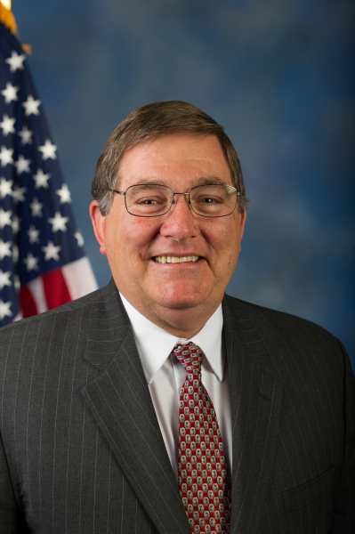

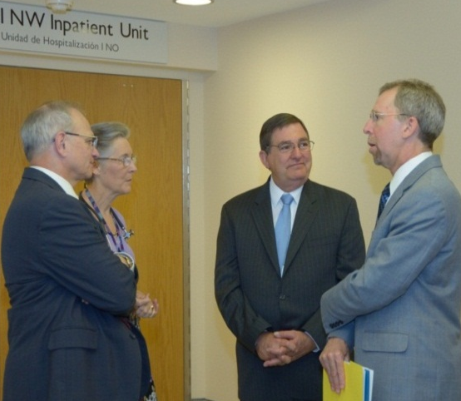
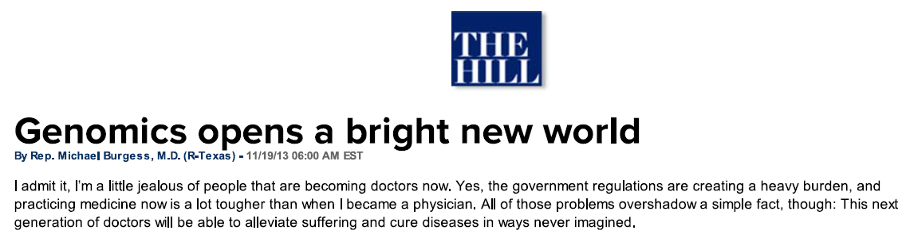
Representative Michael Burgess, M.D. (R-TX)
November, 2013
“The true transformation comes with how these [genome] sequences are starting to change the way that doctors treat patients and the extraordinary therapies that could result… This is just the start of a new golden age in medicine.
Document 7
Notes:
And before I move on from politics, the budget, the Congress, and so forth, NHGRI was very pleased to see a piece written by Representative Michael Burgess, a practicing physician for three decades before becoming a member of Congress in 2003. Representative Burgess is a good friend of NHGRI’s, someone I have met with on multiple occasions, including last year when he visited NIH (as shown here).
* In November, Representative Burgess wrote this article in a publication called The Hill, entitled “Genomics opens a bright new world.” * He opens the article by saying “I admit it, I’m a little jealous of people that are becoming doctors now.” Later in the article, he goes on to say “The true transformation comes with how these [genome] sequences are starting to change the way that doctors treat patients and the extraordinary therapies that could result… This is just the start of a new golden age in medicine.”
Those are pretty cool words (and a great vision) coming from a member of the U.S. Congress.

Slide 23
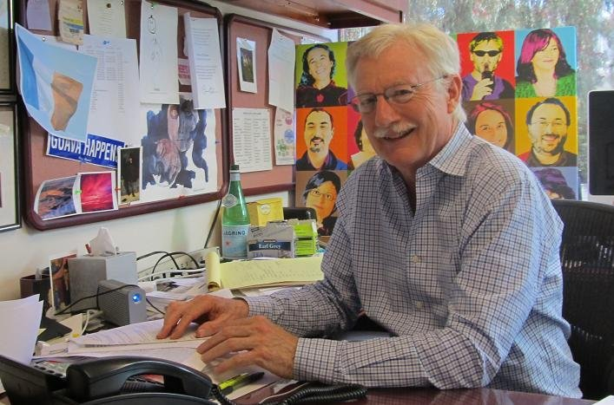
New Director, National Institute of Alcohol Abuse and Alcoholism
George Koob, Ph.D.
Document 8
Notes:
Moving on to new additions to the NIH leadership ranks, Dr. George Koob is now in place as the Director of the National Institute of Alcohol Abuse and Alcoholism. Coming from the Scripps Research Institute, Dr. Koob arrived at NIH last month.

Slide 24

First NIH Associate Director
for Data Science
Philip Bourne, Ph.D.
Document 9
Notes:
In December, Francis Collins announced the selection of Dr. Philip Bourne as the first NIH Associate Director for Data Science. As this Council has heard about for a couple of years, NIH is tackling the ‘big data’ problem in multiple ways, including the creation of a new NIH leadership position in data science.
Phil comes to NIH from the University of California, San Diego, where he is currently the Associate Vice Chancellor for Innovation and Industry Alliances and a Professor in the Department of Pharmacology and the Skaggs School of Pharmacy and Pharmaceutical Sciences. He is also the Associate Director of the Research Collaboratory for Structural Bioinformatics Protein Data Bank.
Of particular relevance to NHGRI and this Council, Phil will assume the leadership of the Big Data to Knowledge (or BD2K) Initiative, taking over that responsibility from Mark Guyer and myself. As you may recall, I have been serving as the Acting Associate Director for Data Science, and I am both eager and pleased to pass that baton to Phil when he arrives next month. Several of us at NHGRI (myself, Mark Guyer, Laura Rodriquez) have been working closely with Phil to help him transition into his new position, and I expect extensive interactions with him for many years to come.

Slide 25
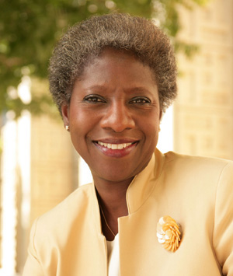
First NIH Chief Officer for Scientific Workforce Diversity
Hanna Valantine, M.D.
Document 10
Notes:
For another leadership position newly created by Francis Collins, Dr. Hanna Valantine has been selected to be the first NIH Chief Officer for Scientific Workforce Diversity. The position and Dr. Valantine’s recruitment stems from a recommendation by the Biomedical Research Workforce Diversity Working Group of the Advisory Committee to the NIH Director that called for the establishment of an NIH leadership position entirely dedicated to diversity. Dr. Valantine is expected to begin her new role this spring.

Slide 26


Surgeon General Nomination
Vivek Murthy, M.D.
Document 11
Notes:
Dr. Vivek Murthy has been nominated by President Obama to serve as the 19th Surgeon General of the United States. Dr. Murthy is co-founder of Doctors for America, which focuses on advocating for affordable healthcare to all Americans. If confirmed by the U.S. Senate, he will succeed the current Acting Surgeon General, Dr. Boris Lushniak.

Slide 27
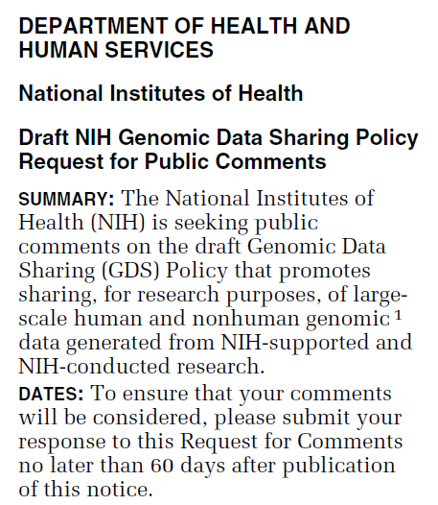
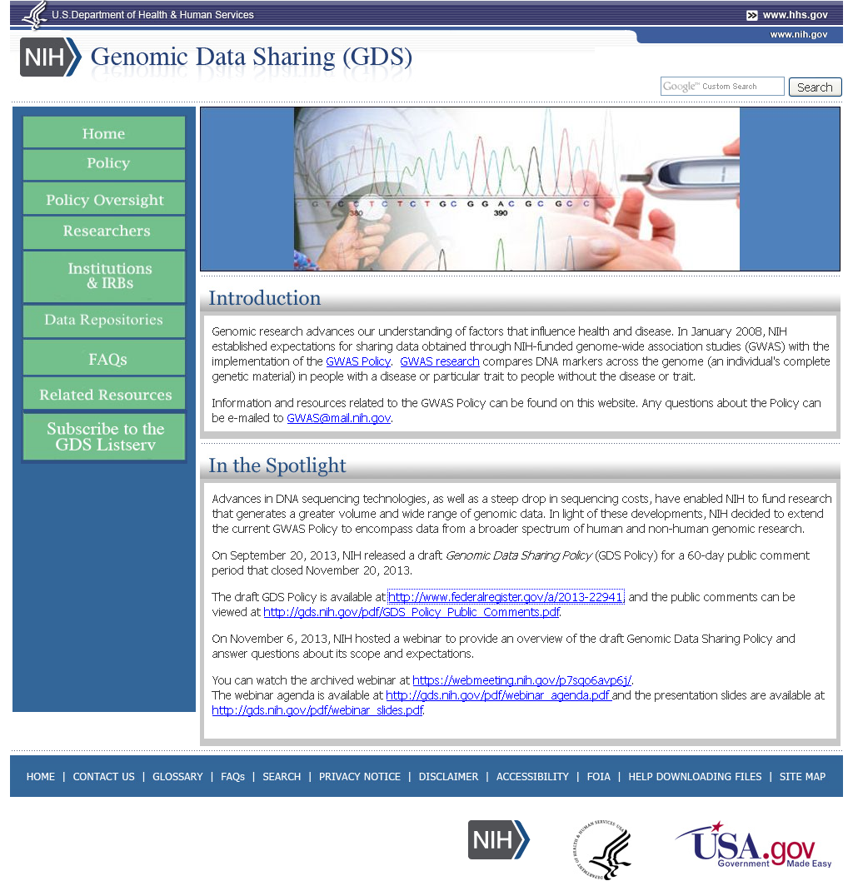
NIH Genomic Data Sharing Policy
Document 12
Notes:
As some of you may have seen, a request for public comment on the long-awaited draft NIH Genomic Data Sharing Policy was published in the Federal Register on September 20. This was the much-talked-about update to the 2007 GWAS Data Sharing Policy.
The comment period closed on November 20, and a total of 107 public comments were received from academic institutions, research organizations, professional societies, industry, commercial organizations, advocacy groups, and other organizations, as well as some individuals. The comments were generally supportive of the draft policy’s principles of data sharing, participant protections, and intellectual property. Some comments raised concerns about the possibility of adverse consequences from the implementation of the policy, such as increased burden and decreased research participation and collaboration. There were also requests for greater guidance in various areas of the policy.
The NIH Office of Science Policy is analyzing the comments, and NHGRI staff remain actively involved in this process. For example, I serve as co-chair of the internal NIH oversight committee for the policy. We hope to have a response to the public comments and a final policy publically released by this spring.

Slide 28
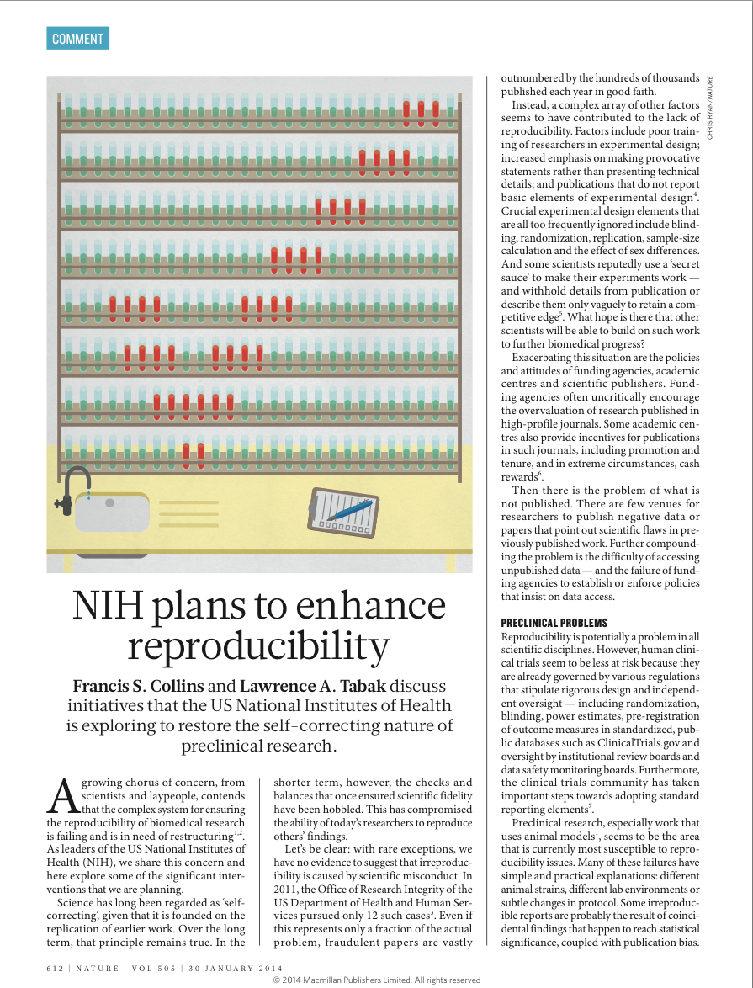
NIH Plan to Enhance Reproducibility
Document 13
Notes:
For the past few years, the biomedical research community has been growing increasingly aware of the problem of data reproducibility. Billions of dollars of both public and private money are spent on biomedical research each year, but this investment is only of value if the generated results can be reproduced. Unfortunately, that is often not the case. In separate efforts, studies from the companies Amgen and Bayer found that as few as a third to a tenth of ‘landmark’ publications in oncology and cardiovascular biology could be reproduced. While very few cases of irreproducible research are thought to be acts of intentional fraud or misconduct, systemic factors abound in the research enterprise that contribute to the problem, from poor training of researchers in experimental design to incentives from funding agencies, academia, and publishers that encourage over-valuation of findings published in so-called high-impact journals.
* Those are the conclusions of a commentary written by Francis Collins and NIH Deputy Director Larry Tabak, which was published in Nature last month. Discussing both the problem and NIH’s plans to tackle it, this commentary outlines some of the proposals being implemented at NIH, which include new training for postdoctoral fellows, extra scrutiny of applications during peer review, and sharing of raw datasets.

Slide 29
Director’s Report Outline
General NHGRI Updates
General NIH Updates
General Genomics Updates
NHGRI Extramural Research Program
NIH Common Fund/Trans-NIH
NHGRI Division of Policy, Communications, and Education
NHGRI Intramural Research Program

Slide 30

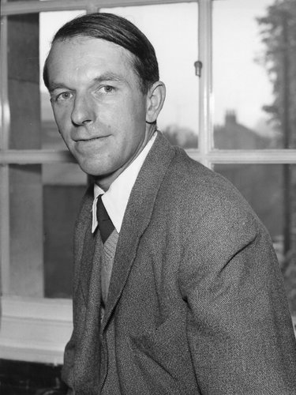
Mourning the Loss of Fred Sanger
Document 14
Notes:
Fred Sanger, biochemist extraordinaire and two-time winner of the Nobel Prize, passed away in November. He was 95. One of his Nobel Prizes was awarded for Fred’s development of ‘Sanger Sequencing,’ the method of DNA sequencing used by the Human Genome Project to generate the first human genome sequence. He can easily be credited with the start of the genomic revolution. Our field has truly lost a scientific pioneer.

Slide 31
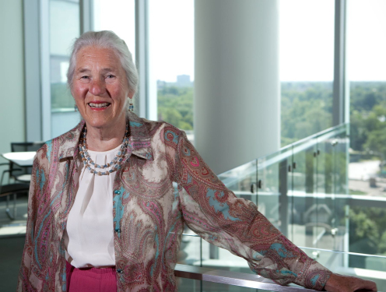
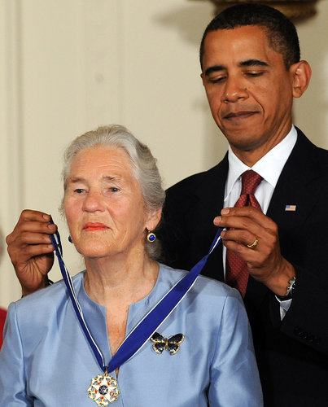
Mourning the Loss of Janet Rowley
Document 15
Notes:
I am also saddened to report that NHGRI has lost a good friend and colleague, Dr. Janet Rowley. Janet died in December at the age of 88. In addition to being a great friend and mentor to many of us at the Institute, she was a wise and valued advisor, serving on our Board of Scientific Counselors at the very beginning of our Intramural Research Program and later on this Council. The genetics and genomics community has lost a legend.

Slide 32
The International Foundation for Greece Greek Postage Stamp
Ari Patrinos, Ph.D.
Document 16
Notes:
Ari Patrinos, Deputy Director for Research at New York University’s Center for Urban Science and Progress and a good friend of NHGRI, is one of this year’s recipients of the International Foundation for Greece Award, a tribute to those of Greek decent living beyond its borders with outstanding accomplishments in the areas of science, art, entrepreneurship, film and theater, media, and philanthropy.
To celebrate Ari’s accomplishments as this year’s science honoree, the commemorative postage stamp shown here has been issued. Congratulations to Ari.

Slide 33



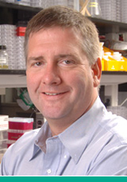
Awards at 2013 ASHG Annual Meeting
Aravinda Chakravarti, Ph.D.
William Allan Award
John Moran, Ph.D.
Curt Stern Award
Document 17
Notes:
The American Society of Human Genetics (ASHG) gave awards to two members of our community at their 2013 meeting in Boston.
* First, Aravinda Chakravarti was the 2013 recipient of the William Allan Award for substantial and far-reaching scientific contributions to human genetics.
* Second, John Moran was the 2013 recipient of the Curt Stern Award for significant scientific contributions during the past decade.
Congratulations to Aravinda and John.

Slide 34
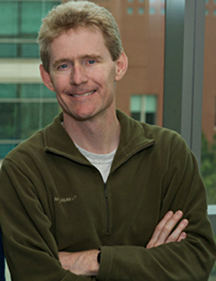
2014 NAS John J. Carty Award
for the Advancement of Science
Joe DeRisi, Ph.D.
Document 18
Notes:
Joseph DeRisi, Howard Hughes Medical Investigator and faculty member at the University of California, San Francisco, is the recipient of the 2014 John J. Carty Award for the Advancement of Science. Dr. DeRisi is being honored for developing new genomic technologies and using those methods to make discoveries in virology that are of fundamental and practical importance.

Slide 35

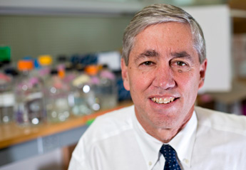
2014 Breakthrough Prize in Life Sciences
Rick Lifton, M.D., Ph.D.
Document 19
Notes:
The Breakthrough Prize in Life Sciences recognizes excellence in research aimed at curing intractable diseases and extending human life.
One of the 2014 recipients of this award is Rick Lifton, Howard Hughes Medical Investigator and faculty member at Yale University. Rick was given this award for his discovery of genes and biochemical mechanisms that cause hypertension. Rick is a former Council member, former advisor for our Genome Sequencing Program, and current Center for Mendelian Genomics grantee.

Slide 36


Elected to the Institute of Medicine
David DeMets
Judy Garber
Richard Kolodner
Brendan Lee
Pamela Sklar
Chris Walsh
Document 20
Notes:
The Institute of Medicine recently announced their newly elected members. Of relevance to our community, those new members include David DeMets, Judy Garber, Richard Kolodner, Brendan Lee, Pamela Sklar, and Chris Walsh.

Slide 37

Elected to AAAS
James Broach
Frederic Bushman
Peter Cherbas
Harold Craighead
Job Dekker
David Goldstein
Robert Grossman
Kent Lloyd
Carole Ober
Bing Ren
Shankar Subramaniam
Document 21
Notes:
Similarly, a number of genetics and genomics researchers were recently elected to be Fellows of AAAS, with their names listed here. Congratulations to these colleagues as well as those elected to the Institute of Medicine.

Slide 38

NCHPEG Transitions to The Jackson Laboratory
The Jackson Laboratory plans to expand healthcare professional continuing education
Shared opportunity with key former NCHPEG members moving to JAX to create new curricula and programs
Will temporarily maintain NCHPEG education programs and website at nchpeg.org
Document 22
Notes:
As you may have heard, soon after I reported to this Council in September that NCHPEG (the National Coalition for Health Professional Education in Genetics) had closed its operations and that ASHG had thankfully stepped in to host its resources on the ASHG website on an interim basis, an announcement came out that NHCPEG (and all of its resources) has found a new home at The Jackson Laboratory.
* In line with The Jackson Laboratory’s new Genomic Medicine initiative (JAX Genomic Medicine), the Laboratory plans to expand their education activities to include healthcare professional continuing medical education in genetics and genomics.
* This shared opportunity to create new curricula and programs will benefit from the expertise of key former NCHPEG employees, who have moved from NCHPEG to The Jackson Laboratory’s education group.
* The Jackson Laboratory will temporarily maintain current NCHPEG education programs and website at nchpeg.org, and then materials will transfer over to the The Jackson Laboratory’s website.

Slide 39
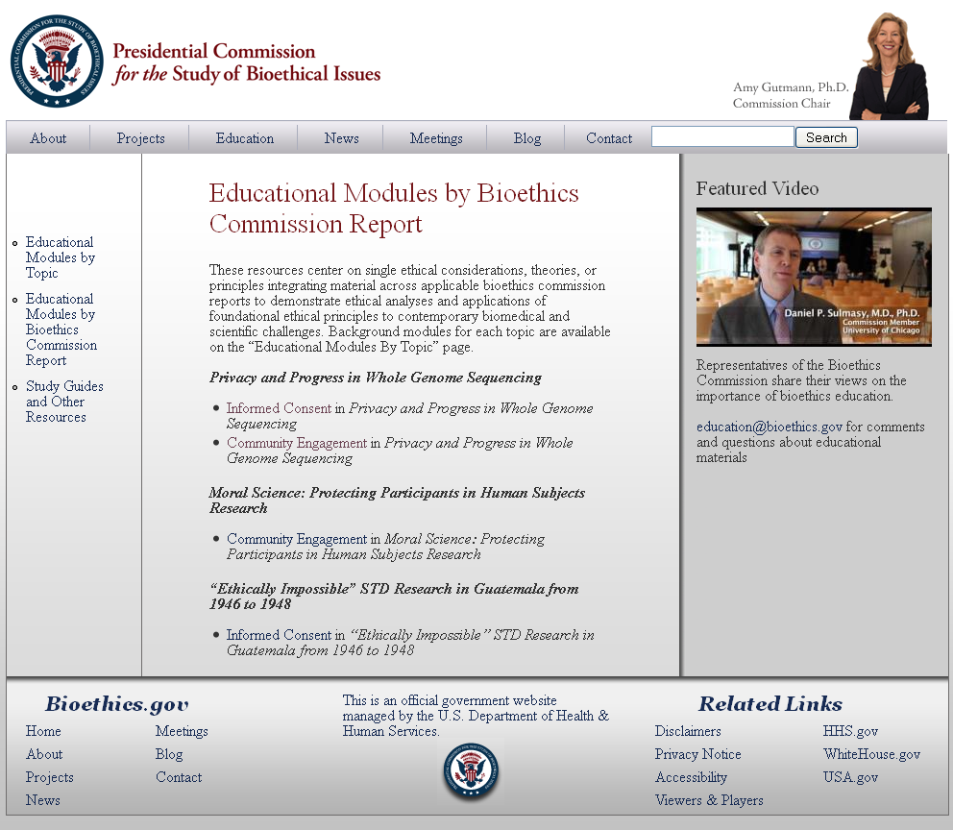
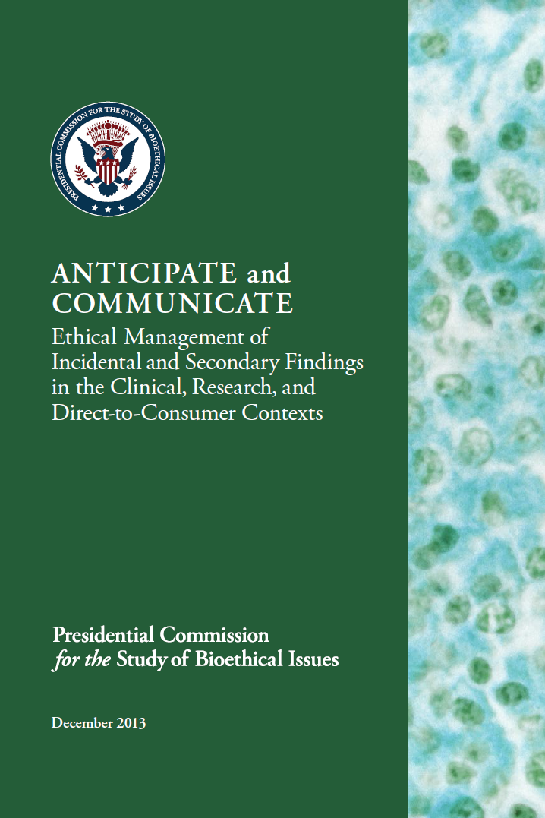
Presidential Commission for the
Study of Bioethical Issues
Document 23
Notes:
As you may recall, the Presidential Commission for the Study of Bioethical Issues released its fourth report, Privacy and Progress in Whole Genome Sequencing, in October 2012. * This past September, the Commission released two educational modules relating to the report, one on informed consent and one on community engagement.
In December, the Commission released its sixth report, Anticipate and Communicate (shown on the right), making recommendations about the return of incidental findings. To develop the report, the Commission held four public meetings; requested public comment on issues related to incidental findings; and consulted relevant experts as well as recipients of incidental findings.
The Commission issued 17 recommendations. The report is not restricted to genomics, and is intended to provide high-level guidance for a variety of fields. The Commission’s recommendations are not revolutionary, but they may spur progress in addressing the challenges posed by incidental findings by giving the clinical and research communities a foundation on which to develop their own policies and best practices.
NHGRI is (and has been) in conformance with the Commission’s recommendations for funders in terms of their support for research that might involve incidental and secondary findings. And, we are also actively exploring through both research and policy-related discussions how to manage the generation and return of incidental genomic findings.

Slide 40
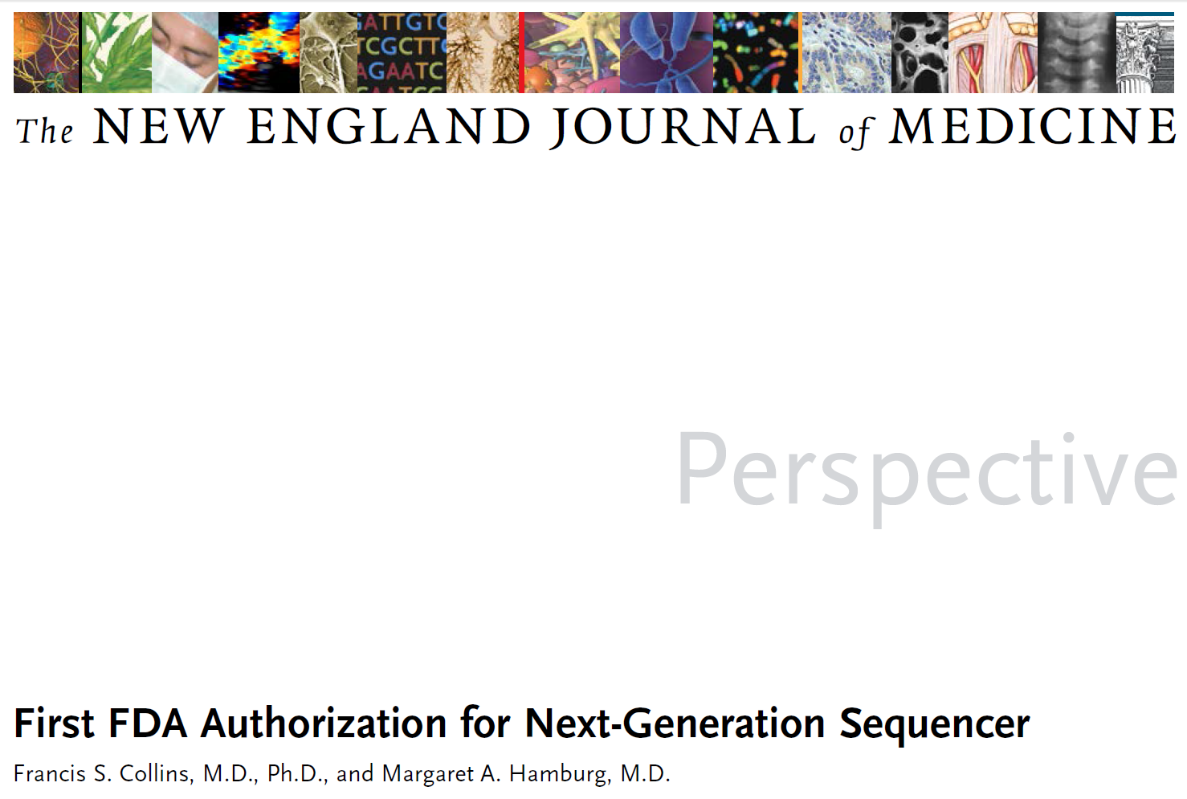


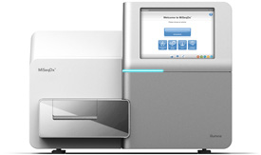
FDA and Genomics
NEJM (2013)
Document 24
Notes:
Understanding how to regulate genomics is not just a question for researchers, it is also on the mind of policy makers. The past few months has seen a flurry of genomics-related activity in the regulatory arena.
* First, at the end of October, the Food and Drug Administration (FDA) published a report, Paving the Way for Personalized Medicine, which lays out how the regulatory agency is responding to and anticipating scientific developments in therapeutics and diagnostics.
* Less than a month later, the agency announced that it had cleared for clinical use the Illumina’s MiSeq DX DNA sequencing platform, a universal kit of reagents, and two cystic fibrosis-specific assays for that sequencing platform. Illumina sought and obtained what is known as 510k clearance from the FDA, who then classified the sequencer and universal reagent kits in a way that lays the foundation for other platforms to do so in a straightforward fashion.
* FDA’s announcement of this clearance was accompanied by this perspective in the New England Journal of Medicine written by Francis Collins and FDA Commissioner Peggy Hamburg.

Slide 41

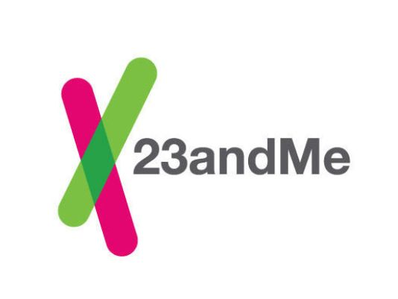

FDA and FTC Focus on Genomics
Document 25
Notes:
A mere three days after the Illumina MiSeq clearance, the FDA reminded others in the genomics industry of their power as a regulator. * The agency ordered 23andMe, the California-based personal genomics company, to cease and desist marketing their Personal Genome Service until it receives approval as a medical device. As stated in the FDA’s warning letter, 23andMe earlier applied for 510k clearance for their Personal Genome Service, which the company has been marketing as providing health reports on a multitude of diseases and conditions, but communications with the FDA had ceased (although requests for more information had been made).
In an analogous development, last month, * the Federal Trade Commission (FTC) announced it had reached a settlement with GeneLink and its former subsidiary, foru, over deceptive advertising claims made to promote genetically tailored nutritional supplements and skincare products. As part of the proposed settlement, the companies would be barred from making claims that their products prevent, treat, or reduce the risk of any disease unless it is demonstrated to be true and backed up by at least two well-controlled studies.

Slide 42
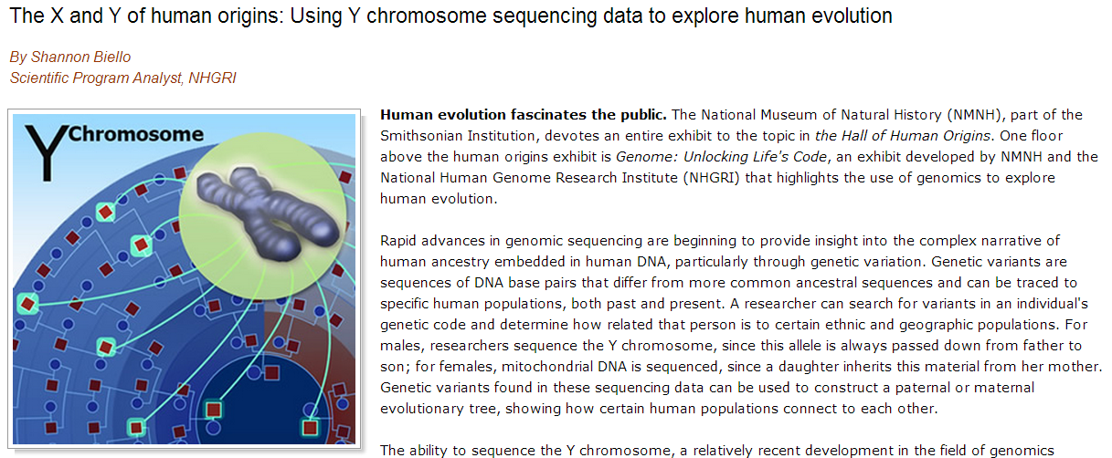
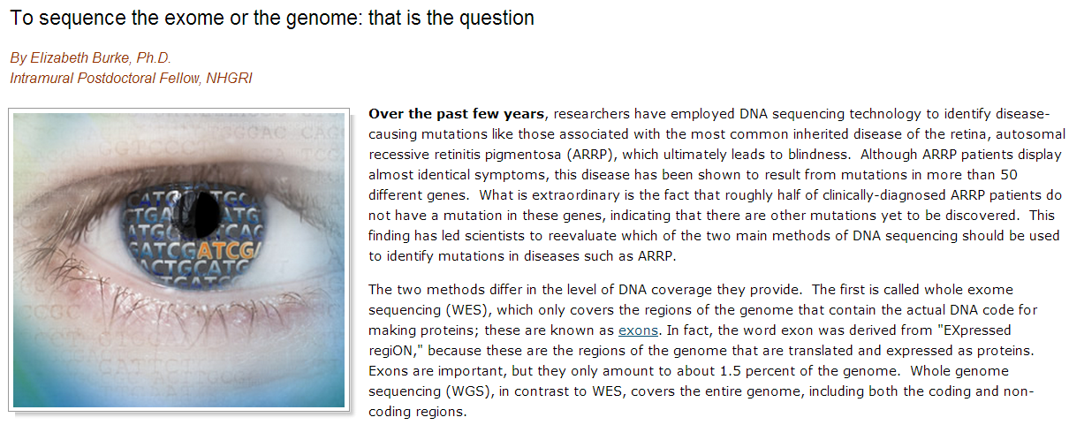
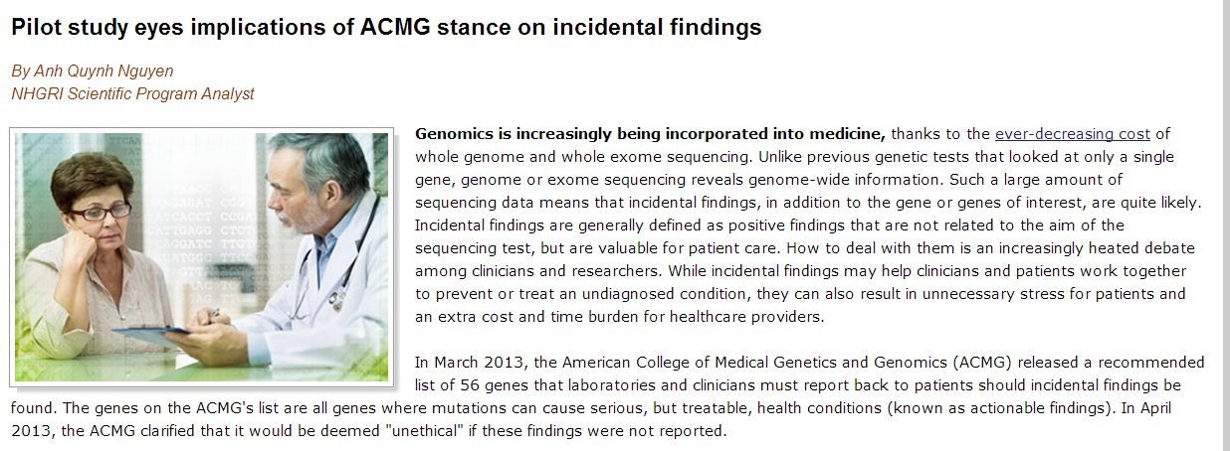
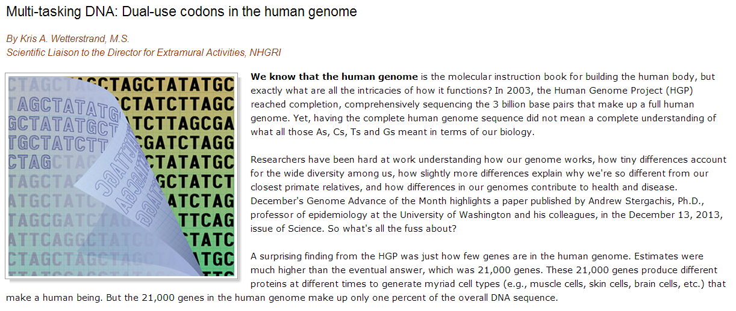
NHGRI Genome Advance of the Month
Document 26
Notes:
Featured as an NHGRI Genome Advance of the Month since the last Council meeting included publications describing * Y chromosome evolution, * exome- versus whole-genome sequencing, * the American College of Medical Genetics and Genomics stance on incidental genomic findings, and * dual-use codons in the human genome.

Slide 43
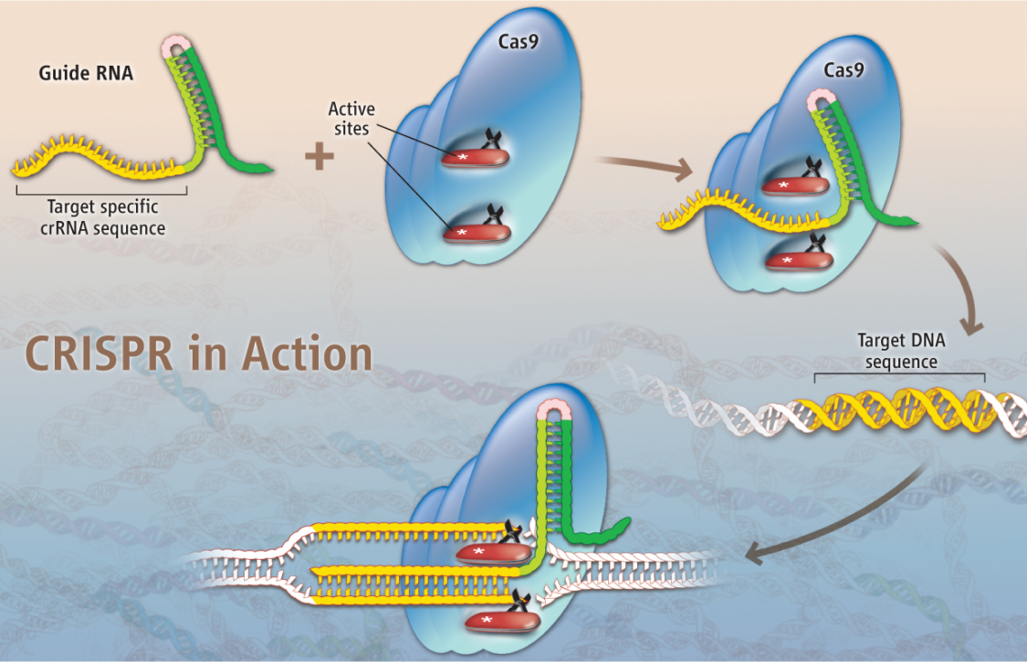
Two groups fostering this revolution:
  Centers of Excellence in
  Genomic Science
  George Church
Large Scale Sequencing
& Analysis Center
Eric Lander
Document 26
Notes:
Moving on to year-end accolades, the gene-editing technique CRISPR was named as a runner-up for Science’s 2013 Breakthrough of the Year.
CRISPR/Cas9 is a molecular mechanism that operates in bacteria, protecting cells against invading viruses. It has been adapted to manipulate specific gene sequences in eukaryotes. The method has several advantages over other genome-engineering methods (such as zinc finger nucleases and TALENS), both of which require designing new proteins to wield the molecular scalpel. The CRISPR method instead uses short RNAs to specify the genomic targets for manipulation, and has been demonstrated to be faster and easier to deploy.
* Two NHGRI grantees (George Church and Eric Lander) are among an elite group of investigators fostering this revolution. The method has great potential to be used in studies ranging from correlating the contribution of specific disease-related gene variants with particular phenotypes to revolutionizing the ways in which the Knock-out Mouse Phenotyping Project generates its collection of mice.

Slide 44



People and Things to Watch in 2014
…Areas to Watch in 2014
Clinical Genomics
Gordon Sanghera
Chief Executive, Oxford Nanopore
Document 28
Notes:
In addition to the annual breakthroughs, both Science and Nature featured other accolades worth mentioning.
* Science named ‘Clinical Genomics’ as an ‘Area to Watch in 2014’ for potential advances in patient care.
* Nature named Gordon Sanghera, Chief Executive of Oxford Nanopore, as one of ‘Five to Watch in 2014’ for the potential of the company’s MinION DNA sequencer.

Slide 45


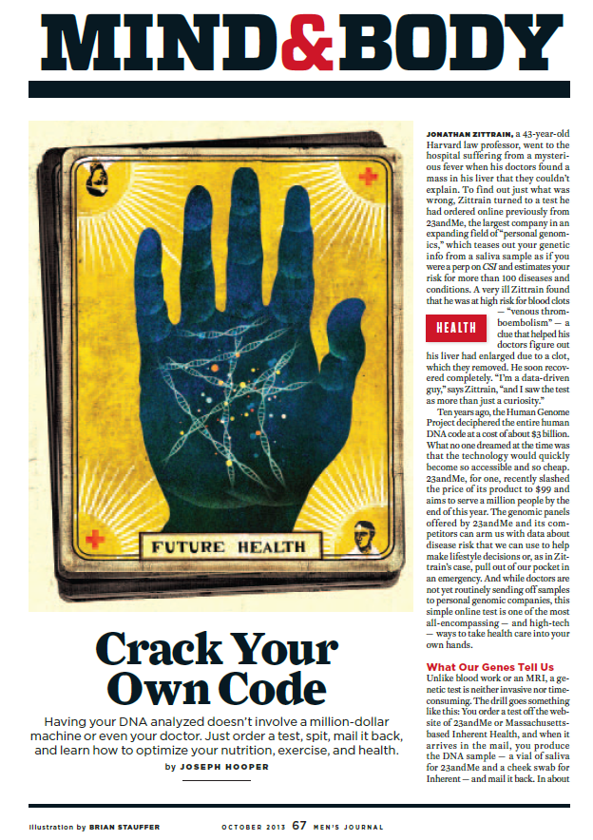
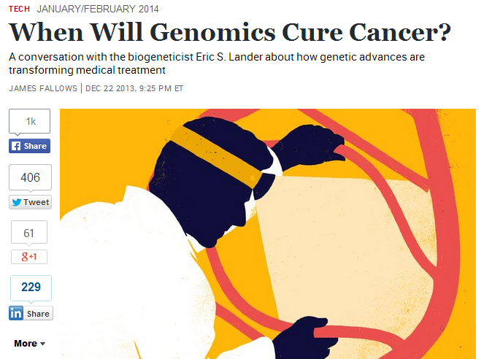


Genomics In The News…
Document 29
Notes:
Other recent examples of Genomics in the News include:
* The Atlantic published a conversation with Eric Lander about how genomic advances are transforming medical treatment in the article “When Will Genomics Cure Cancer?”
* You can read about personal genome sequencing in the Men’s Journal article “Crack Your Own DNA Code.” Our own Larry Brody provided background for this article.
* The latest Consumer's Digest features the article “Genetic Testing: Promises & Problems.”
* Lastly, I should mention that PCR turned 30 this past year, and that milestone was featured in a number of articles.

Slide 46


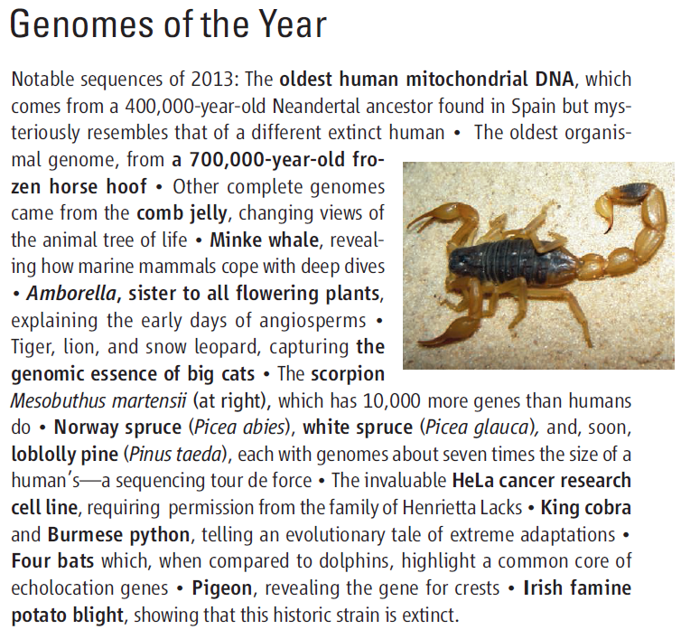
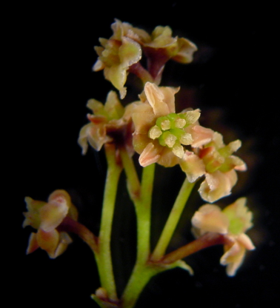

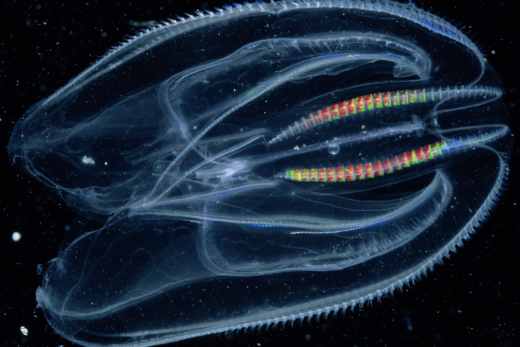


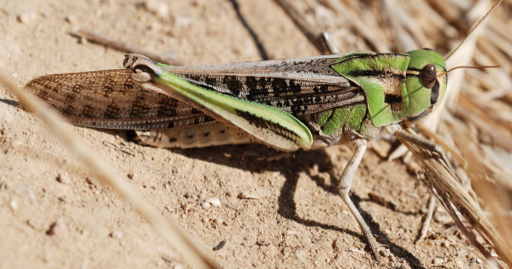




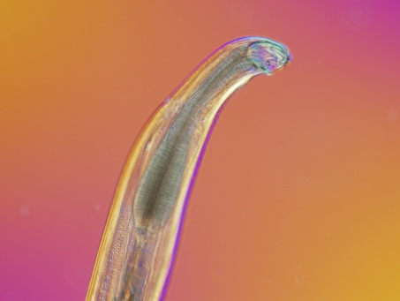
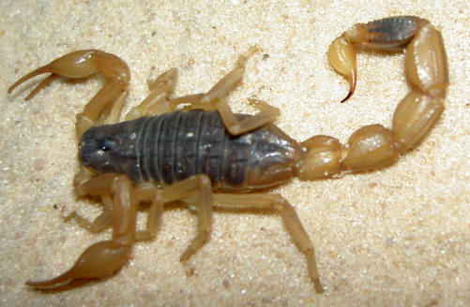
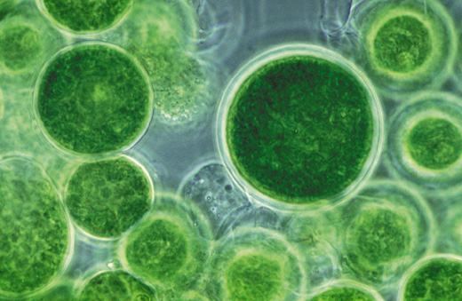

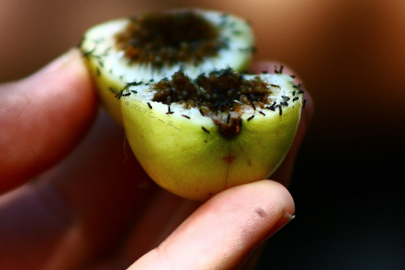
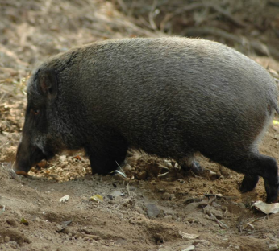



Genomes In The News…
Document 30
Notes:
And in terms of Genomes in the News, there have been reports of a number of newly generated genome sequences since the last Council meeting.
These include the genomes of * Amur tiger, * white Bengal tiger, * African lion, * white African lion, * snow leopard, * mulberry tree, Pyronema confluens (a filamentous fungal species), * cucumber, * Tibetan boar, * minke whale, * Amborella (sister lineage to all other flowering plants), * elephant shark, * Burmese python, * king cobra, * oil-producing microalgae, * Neandertal, * migratory locust, * hookworm, * fig wasp, * scorpion, and * comb jelly.
And some of these even made * Science’s list of ‘Genomes of the Year.’

Slide 47




Genomics In Video…
Document 31
Notes:
And since the last Council meeting, there have been a number of new Genomics in Video pieces that have become available.
* You can watch me in a series of video clips at the Big Think web site discussing genomics, the Human Genome Project, and the Smithsonian Genome Exhibition.
* I was also interviewed at EMBO about the advances in human genomics since the Human Genome Project, and the challenges in the implementation of genomic medicine.
* And through TEDMED Great Challenges, I hosted a chat about “Genomics and Medicine: Where Promise Meets Clinical Practice.” For that event, I was joined by Sharon Terry and Council members Jim Evans (shown here), Carlos Bustamante, and Amy McGuire.

Slide 48
Director’s Report Outline
General NHGRI Updates
General NIH Updates
General Genomics Updates
NHGRI Extramural Research Program
NIH Common Fund/Trans-NIH
NHGRI Division of Policy, Communications, and Education
NHGRI Intramural Research Program

Slide 49

Large-Scale Genome Sequencing
and Analysis Centers
  32 new papers in the most recent quarter
  Alzheimer’s Disease Sequencing Project:
    Initial data freeze and release in December 2013
    Whole-genome sequence data from 410 individuals (89 families)
Document 32
Notes:
The Large-Scale Sequencing and Analysis Centers (the biggest component of our flagship Genome Sequencing Program) seek to address major biomedical questions by performing high-throughput genome-sequencing projects.
* These Centers have published or submitted 32 new papers in the most recent quarter on topics ranging from heterozygous mutations in pediatric diabetes, to computational approaches for the detection of functional variants in cancer genomes, to patterns of retrotransposition in mammals.
* In December, the Alzheimer’s Disease Sequencing Project (a very large effort being carried out by these Centers) had its first data freeze and release of whole-genome sequence data; this was comprised of data generated from 410 individuals from 89 families. The entire family study component, totaling 586 whole-genome sequences, has been submitted to dbGaP. The second phase of the project, involving the generation of whole-exome sequences for 10,000 cases and controls, is well underway.

Slide 50

NHGRI
  Currently ~90 million variants in 2535 samples
    ~76 million SNPs
    ~7 million indels
    ~7 million structural and other complex variants
  Final release of variants by Fall 2014
  Final 1000 Genomes Project Meeting and Community Meeting: June 24-26 in the U.K.
Document 33
Notes:
Another major project for the Large-Scale Sequencing and Analysis Centers is the 1000 Genomes project.
* That project is in its final phase, with about ~90 million genomic variants found to date in 2535 samples (from 26 populations). These include about 76 million single-nucleotide polymorphisms (SNPs), 7 million indels, and 7 million structural variants and other complex variants.
* Further analysis is ongoing, with a final release of variants expected by Fall 2014. The last Analysis Group meeting and tutorial were held in conjunction with the October ASHG meeting.
* Lastly, the final 1000 Genomes Project and Community will take place in late June in the U.K.

Slide 51


Pan-cancer analysis
  Nature Genetics feature: 27 papers and 5 thematic threads
  ICGC/TCGA whole-genome pan-cancer analysis project
Sample accrual is completed
Document 34
Notes:
Another major effort of our Large-Scale Sequencing and Analysis Centers is The Cancer Genome Atlas (TCGA). * This project reported its ‘pan-cancer’ analysis of over 5,000 cases from 12 tumor projects as a Nature Genetics feature that includes 27 papers and 5 thematic threads. * As shown in the figure, the integrative and cross-tumor analyses reveal insights on the rate and spectrum of mutations associated with different carcinogenic etiologies; categories of significantly mutated genes across tumor types; patterns of co-occurring and mutually exclusive mutations; and genes associated with clinical features and with clonal architecture.
* TCGA is joining forces with the International Cancer Genome Consortium (ICGC) for a pan-cancer analysis project. The goal is to perform whole-genome sequence analyses on ~2,000 tumor/normal pairs, many of which also have transcriptome, DNA methylation, and other molecular or clinical data.
Tumor-specific analyses remain a major TCGA focus. A second TCGA glioblastoma manuscript was published in Cell in October, and the first bladder cancer paper was just published in Nature.
* Sample accrual is now complete, and TCGA reached its target; overall, the project expects to characterize over 11,000 cases from 33 tumor types by the end of 2015.

Slide 52

>10,000 exome sequences, >862 diseases
>467 disease genes (202 novel) for >273 diseases
>70 publications: disease-gene discoveries, methods, resources, and practices of data sharing
Disease-gene discovery publications
  Novel disease genes/pathways and disease biology
  Phenotypic expansion
  Levels of penetrance
  Heterogeneity
  Other
Document 35
Notes:
The Centers for Mendelian Genomics were started two years ago, aiming to elucidate the genetic basis of as many Mendelian diseases as possible using whole-exome sequencing as their main approach.
* In terms of disease-gene discovery, the Centers have collectively generated more than 10,000 exome sequences in studying over 862 rare diseases. * While analyses are not yet completed, so far these efforts have resulted in the discovery of over 467 disease genes that underlie more than 273 diseases; 202 of these genes are novel.
* In terms of publications, to date the Centers have produced more than 70 publications. Most of these (more then 61) report on disease-gene discoveries; other are on development of methods and resources and on practices of data sharing.
* The disease-gene discovery publications offer insights about novel disease genes and regulatory pathways, and disease biology; phenotypic expansion of known disease genes; low to high levels of penetrance of mutant alleles; locus and allelic heterogeneity of mutations causing the same disorder; and other novel mechanisms such as oligogenic inheritance in Mendelian phenotypes, somatic mosaicism, and non-exonic variation.

Slide 53

CMG Network: >414 investigators, 200 institutions, 33 countries
Coordination: public disorder list, GeneMatcher
IRDiRC
  Develop diagnostic tests for most rare disorders
  New treatments for 200 rare disorders by 2020
NHGRI participation in IRDiRC
  Executive Committee
  Working groups on phenotypic data collection, sequencing standards, and disease prioritization
Document 35
Notes:
In terms of the broader network and its outreach, * the Centers have thus far collaborated with over 414 investigators from 200 institutions in 33 countries.
* As a way to coordinate with other discovery efforts, the list of disorders under investigation by the Centers is posted on the program’s website and regularly updated. Furthermore, the GeneMatcher website has been launched to help solve ‘unsolved’ cases; this freely accessible website allows investigators to post candidate genes of interest, which allows them to connect with investigators who post the same genes.
* The International Rare Diseases Research Consortium aims to develop diagnostic tests for most rare disorders and new treatments for 200 or more rare disorders by the year 2020. * As members of this Consortium, NHGRI and the Centers actively serve on the Executive Committee and a number of working groups, respectively. Specifically, the centers have been playing significant roles in identifying common needs and coordinating projects in the working groups on phenotypic data collection and comparison, research and clinical sequencing standards, and disease prioritization. For example, GeneMatcher and the similar programs developed by other Consortium members are being connected to allow broad coordination of disease-gene discovery efforts.

Slide 54






Clinical Sequencing Exploratory Research (CSER) Program
  Collaborations with other NHGRI consortia:
  eMERGE, CMG, ClinGen
Document 36
Notes:
The Clinical Sequencing Exploratory Research (or CSER) Program focuses on the integration of genome sequencing into the clinical workflow. CSER has now enrolled over 1,100 participants and sequenced the genomes of nearly 500 patients.
* Two recent CSER papers were published from the Actionability Working Group and the Electronic Medical Records Working Group.
Other recent publications include * recommendations for returning genomic incidental findings in response to the recent ACMG recommendations, * classification of actionable incidental findings in NHLBI Exome Sequencing Project participants, * the implementation of a clinical sequencing pipeline, and * the identification of activating mutations in the estrogen receptor in breast cancer patients on anti-estrogen therapy.
* CSER investigators have recently initiated a number of informal collaborations with other NHGRI consortia, such as eMERGE, the Centers for Mendelian Genomics, and the ClinGen consortium. These informal interactions should promote important synergies.

Slide 55

Clinical Sequencing Exploratory Research (CSER) Program
Document 36
Notes:
Also, the CSER Coordinating Center at the University of Washington * recently launched the CSER website. This website includes information on the various CSER grantees and their current projects.

Slide 56




Genome Sequencing Informatics Tools
  GS-IT has released SG ADVISER to annotate and filter genomic variants
  Used to solve clinical case of 15-year-old girl
  iSeqTools Portal: “The search for what’s wrong with Lilly”
Document 37
Notes:
The Genome Sequencing Informatics Tools (GS-IT) program is known publicly by the name “iSeqTools.” As a reminder, the program comprises six projects that develop approaches to provide ‘researcher friendly’ sequence-analysis tools. The primary audience is the community of users outside of large genome-sequencing centers.
* GS-IT has released the SG ADVISER web too, which is a user-friendly and secure web-based tool developed to annotate and filter genomic variants based on information about inheritance, population, and coding-impact. * SG ADVISER was recently used to solve a clinical case involving a 15-year-old girl who has a serious motion disorder. Researchers were able to pick out a de novo gain-of-function mutation in the ADCY5 gene by using SG ADVISER to sift through variants from her whole-genome sequence. The same de novo mutation has now been seen in two other cases.
* The iSeqTools Portal now contains the article “The search for what’s wrong with Lilly,” which describes this interesting research story.

Slide 57


DNA Sequencing Technology Development
  Sequencing of epigenetic modifications using biological nanopores
  Developing error models for nanopore sequencing
Document 38
Notes:
The past few months have brought a remarkable flurry of developments in the DNA sequencing technology space. The next few slides illustrate some of these developments.
* Results reported in recent back-to-back PNAS papers by two NHGRI-supported groups showed that cytosine, its methylated form, and the hydroxy-methylated form can be distinguished from each other by using nanopore sequencing. * DNA strands were translocated through an engineered MspA pore. Phi29 DNA polymerase was used as a stepper motor to draw DNA through the pore one nucleotide at a time. Measurements rely on differential ion transport through the pore, depending on the identity of nucleotides in the narrow constriction at the bottom of the pore, as shown in this figure.
* This figure from Jens Gundlach’s group, shows ionic current levels from two experiments superimposed on each other. The red trace shows average current values for a DNA sequence context in which methyl-C is at the position shown in red, and the black trace shows the data when there is a C in that position. * More than 2800 measurements were made from 16 different sequence contexts for the 4 nucleotides shown in the green box, with a C, a methyl-C, or a 5-hydroxymethyl-C at the third position. The pattern for a particular context was always very different for methyl vs. hydroxymethyl-C.
* A base-calling algorithm was developed from the data, and the average accuracy was 97%. For some contexts, the base call was uniformly consistent. Work continues to improve the base-calling method.

Slide 58

DNA Sequencing Technology Development
  Sequencing of epigenetic modifications using biological nanopores
  Developing error models for nanopore sequencing
Document 38
Notes:
Experiments of a similar design were reported by Mark Akeson’s group. * They tested several different statistical models on 3300 translocation measurements to define decision boundaries. Error rates for single-pass detection ranged from 1.7 to 12.2%, depending on the sequence context, leading to a conclusion that even using these preliminary methods, Q40 values for methylation status calls could be made by reading a single molecule 5-19 times.

Slide 59



DNA Sequencing Technology Development
  Need to control DNA translocation rate in solid- state nanopores
Document 38
Notes:
Many people believe that more robust and less expensive DNA sequencing systems will ultimately be developed from solid-state nanopores. Just as protein nanopores require an enzyme as a stepper motor to control the rate of DNA movement through the pore, * methods are also needed to slow the DNA moving through solid-state pores if they are to used as DNA sequencing sensors; this is because DNA on its own would move through the nanopore too quickly to enable high-quality base calls. In the past few months, several groups have taught us how to do this using different approaches in various solid-state pores. * A group at Boston University showed how to slow DNA by coating silicon nitride pores with a layer of amine groups and modifying the pH of the surrounding solution.
* The same group could demonstrate DNA slowing when the side of the nanopore facing the DNA sample chamber is coated with a layer of hydrophobic nanofiber mesh.
* An Arizona State University group showed that by modifying a platinum electrode that lies atop a silicon nitride pore (with recognition molecules that transiently hydrogen-bond to DNA), translocation is slowed by about 10-fold.
* And a group at Northeastern University showed that nanopores in hafnium oxide, which is a material that may be more stable than silicon nitride under conditions needed for nanopore sequencing, transport both double-stranded and single-stranded DNA more slowly than do the silicon nitride pores.

Slide 60

DNA Sequencing Technology Development
  Need to control DNA translocation rate in solid- state nanopores
Document 38
Notes:
Dynamic control of the DNA translocation rate may also be possible. A group at the University of Illinois demonstrated by computer modeling that local heating can be used to control the stretching and motion of single-stranded DNA through a silicon nitride nanopore, and that heating can be controlled dynamically if produced by shining a laser beam on the edge of the pore.
* And a Boston University group showed that shining low-power laser light on a nanopore changes the charge relationships at the metal surface and slows by about 10-fold the rate of DNA translocation through the pore. Further, the effect is completely reversible by switching the laser on and off.
These last few slides show examples of the research NHGRI is supporting to stimulate the development of what we anticipate may become an entirely new way to sequence DNA, one that may overcome some of the shortcomings of current methods.

Slide 61


DNA Sequencing Technology Development
Document 38
Notes:
That said, even the current set of DNA sequencing methods have seen truly remarkable advances and changes over the last few months.
* One vendor announced the imminent release of a new suite of systems that are claimed will further lower the cost and dramatically increase the throughput of genome sequencing.
* One of the world’s largest DNA sequencing and analysis organizations acquired a major DNA sequencing service provider.
* Two companies announced new chemistries for improved performance.
* And one company has announced an access program for their new technology.
Needless to say, it is far from ‘sleepy times’ in the world of DNA sequencing technologies, and that is good for everything that NHGRI is interested in pursuing.

Slide 62


ENCODE
  ENCODE Outreach Activities:
    ASHG Tutorial
    Tutorial at CHARGE Consortium Meeting
  Publications using ENCODE Data
Document 39
Notes:
The goal of the Encyclopedia of DNA Elements (or ENCODE) project is to create a catalog of all functional elements in the genome, and to make that catalog freely available as a resource to the biomedical community.
* ENCODE continues to pursue various important outreach activities. A tutorial on how to use ENCODE and the NIH Roadmap Epigenomics data was held at the annual ASHG meeting in October and the Cohorts for Heart and Aging Research in Genomic Epidemiology (or CHARGE) Consortium meeting in January. The ASHG tutorial was attended by about 120 people, with the slides and handouts available on the genome.gov website. Approximately 200 researchers attended the CHARGE-ENCODE tutorial, which familiarized the CHARGE Consortium with the ENCODE resource and provided an opportunity to discuss new collaborations between ENCODE and CHARGE investigators; a slidecast will be developed to broadly share information presented at the CHARGE-ENCODE workshop with the wider research community.
* The number of publications using ENCODE data continues to grow at an impressive pace, as shown here. ENCODE-funded papers now include 23 publications by the mouse ENCODE group, over 250 publications by the ENCODE production groups, and over 140 publications by the modENCODE project. In addition, there are at least 390 publications by non-ENCODE authors that use ENCODE data and at least 80 publications by non-modENCODE authors that use modENCODE data.

Slide 63
Centers of Excellence in Genomic
Science (CEGS) Program
  CEGS investigators met in October
  CEGS renewed at Dana Farber Cancer Institute
  New CEGS applications are under consideration
Document 40
Notes:
Turning to our Centers of Excellence in Genomic Science (or CEGS) Program, * CEGS investigators gathered in Madison, Wisconsin in October for their annual meeting; unfortunately, NIH staff were unable to join them because of the government shutdown.
* The CEGS at Dana Farber Cancer Institute was renewed since our last Council meeting. The goal of this CEGS is to interpret how human genomic variations affect local and global properties of cellular networks to induce disease.
* New CEGS applications are under consideration and will be discussed during the closed session.

Slide 64


Global Leaders in Genomic Medicine Meeting
Global Leaders in Genomic Medicine
2014
  6th Genomic Medicine Meeting
  Focused on international projects and potential collaborations
  Several fertile areas identified
  Meeting summary to be presented by Teri Manolio
Document 41
Notes:
This Council’s Genomic Medicine Working Group continues to expand its portfolio of activities surrounding the implementation of genomic medicine.
* The 6th Genomic Medicine Meeting, entitled “Global Leaders in Genomic Medicine,” was held in early January at the Institute of Medicine facilities in downtown Washington, D.C.
* The meeting focused on international projects, potential collaborations, idea-sharing, and synergy-building for genomic medicine implementation. The meeting brought together over 50 international experts in genomic medicine from over 25 countries, as well as a number of leading U.S. investigators.
* Similar to our very first Genomic Medicine Meeting (at which we identified a host of implementation projects already in the field), the level of implementation activity going on internationally was impressive and actually a bit intimidating.
* You will hear a full summary about this meeting and the opportunities it opens up from Teri Manolio later in this Open Session.

Slide 65



Inter-Society Coordinating Committee for Practitioner Education in Genomics
  Met in person in September
  Next meeting April 2014
Document 42
Notes:
The Inter-Society Coordinating Committee for Practitioner Education in Genomics, born out of our 4th Genomic Medicine Meeting on physician education in genomics, continues its very active role in enhancing the efforts of professional societies to work together in promoting genomic education among their clinicians.
* The group held its first in-person meeting in September, and focused on drafting materials from several working groups. It has also fostered relationships with specialty societies willing to incorporate these educational materials and content into their board exams.
* A white paper describing the gaps in clinician education and the potential for professional societies to address them is in press in Genetics in Medicine.
* A competencies document is nearly finalized and will be submitted for publication * as will a case study template. Additionally, the group has begun to explore the development of funding streams that will enable it to become self-sustaining.
* The Committee continues to add member societies and NIH Institutes, and will meet again in April pending appropriate approvals.

Slide 66




eMERGE Network
Genetics in Medicine Special Issue
Methods development and discovery
eMERGE in the news
eMERGE workshop: Future of eMERGE
Document 43
Notes:
The goal of the eMERGE Network is to explore and disseminate the best approaches to incorporate genomic variant data into electronic medical records for use in clinical research and ongoing clinical care. * Last October, eMERGE published a special issue of Genetics in Medicine; articles in this issue drew upon the extensive experience of the eMERGE network informatics investigators and shared lessons learned in clinical implementation.
* In November, eMERGE’s new approach for genomic discovery was published in Nature Biotechnology. eMERGE investigators observed that an EMR-based, phenome-wide association study may increase the speed and efficiency of genetic exploration and may uncover pleiotropy. Following this publication, news of eMERGE’s novel methods were highlighted in * The New York Times, brining eMERGE findings into the public eye.
* eMERGE held a workshop in late January, gathering eMERGE investigators and external leaders in genomic medicine to provide their expert insight and to suggest future directions for the eMERGE Network. A concept clearance for a possible eMERGE Phase III will be presented at the May Council meeting.

Slide 67
Clinical Genome (ClinGen) Resource
  Goal: Create a centralized repository and inter- connected resources of clinically relevant variants
  Standardize clinical assessment of variants & deposition into ClinVar
  Develop a consensus approach to identify clinically relevant variants
  Facilitate use of genomic information in clinical care and research
Standards & Data Deposition
(Rehm/Martin)
ClinVar: Variant Data Archive
(Sherry/Maglott)
ClinGen
Informatics, Analysis & Dissemination
(Bustamante/Plon)
Curation, Actionability, EHR Integration
(Berg/Watson)
Document 44
Notes:
The * goal of the Clinical Genome (ClinGen) Resource is to create a centralized repository and interconnected resources of clinically relevant variants, something that is critically needed by the clinical and research communities.
Shortly after the September Council meeting, we issued three cooperative agreements as part of ClinGen. * Together, the investigators listed here, along with many other co-investigators and the NCBI ClinVar database team, make up the ClinGen consortium.
* ClinGen will standardize clinical assessment of variants, agree on data standards, and develop tools to assist clinical labs with depositing variants into ClinVar. * It will also develop a consensus approach to identify clinically relevant variants, and disseminate this information. The first two clinical curation working groups will focus on cardiovascular disease and germline cancer.
* Close collaboration with professional organizations will be critical to ensure ClinGen is useful in informing the development clinical practice guidelines, so as to facilitate the use of genomic information in clinical care and research. The ClinGen Steering Committee will meet again later this month to continue the development of this important resource.

Slide 68

Genomics and Society Working Group
  2nd in-person meeting: November 2013
  Topics discussed included:
    Priority Setting
    Funding Mechanisms
    Boundaries of ELSI Research
  Next in-person meeting: April 2014
Document 45
Notes:
The * Genomics and Society Working Group of this Council held their second in-person meeting in November 2013.
* This meeting included discussion of three critical aspects of the genomics and society research efforts at NHGRI.
* First, determining research priorities— what are appropriate criteria for establishing research priorities for the ELSI research program?
* Second, the scope of funding approaches and mechanisms across the ELSI research program— what are the strengths and weaknesses of various mechanisms and what is the appropriate balance among these mechanisms?
* Third, the establishment of boundaries of ELSI Research— which research areas are within the scope of the ELSI Research Program and which are not?
* The Working Group will continue to examine these and other topics at their next in-person meeting in April.

Slide 69

New NHGRI Training Notices
    T32 Programs Focused on Genomic Science (NOT-HG-14-016)
    T32 Postdoctoral Training Programs Focused on Genomic Medicine (NOT-HG-14-017)
New
Document 46
Notes:
As a follow up to discussions at Council meetings last year, NHGRI has issued two new T32 training notices.
* The T32 in Genomic Science will support pre-doctoral and post-doctoral trainees, with a greater focus on quantitative sciences, bioinformatics, and technology development.
* The T32 in Genomic Medicine will focus on training postdoctoral MD’s and PhD’s. This program will support two career paths: (1) a genomic medicine focus for basic research, and (2) a genomic medicine focus for clinical research (but not for clinical care).

Slide 70
New NHGRI Training Notices
    Research Scientist Development K01 Award
    (NOT-HG-14-018)
    Clinical Investigator K08 Award (NOT-HG-14- 019)
Document 46
Notes:
In addition, NHGRI has issued two new career development training notices. These programs will support a mentored career development experience for individuals who wish to acquire additional, multi-disciplinary expertise to enable them to become independent genomics researchers.
* The K01 program for research scientists will support two career paths: (1) a genomic science focus, and (2) an ethical, legal, and social implications focus.
* The K08 program for clinical investigators will focus on genomic medicine, and is open to those who wish to transition their research efforts into genomic medicine.

Slide 71
Director’s Report Outline
General NHGRI Updates
General NIH Updates
General Genomics Updates
NHGRI Extramural Research Program
NIH Common Fund/Trans-NIH
NHGRI Division of Policy, Communications, and Education
NHGRI Intramural Research Program

Slide 72

Human Microbiome Project (HMP)
  Phase 2: Fiscal Year 2013 to 2015
  Create integrated multi-‘omics dataset of microbiome and host properties
  A Common Fund initiative with co-funding from other ICs, $22.1M total
    (NIDDK, NCCAM, ORWH, ODS)
  HMP2 Consortium:
    Preterm birth and microbiome: Buck
    IBD and microbiome: Xavier/Huttenhower
    Diabetes and microbiome: Snyder/Weinstock
Document 47
Notes:
HMP is now in * Phase 2, which goes through Fiscal Year 2015. The goal of this effort is to create the * first-ever integrated multi-’omic dataset of microbiome and host properties. These will include genomics, proteomics, and metabolomics data types as well as clinical metadata from both the microbiome and the host. Together, these will be used to evaluate which data types or combinations of data types provide the most insight into the role of the microbiome in disease.
* Three awards were made in September 2013 with Common Fund support and with co-funding from the indicated other groups, for a total of $22.1M.
* The HMP2 Consortium is made up of 3 projects: * preterm birth and the microbiome; * IBD and the microbiome; and * diabetes and the microbiome, with the major investigators for each listed here.

Slide 73



Knockout Mouse Phenotyping Project (KOMP2)
  Halfway into the project and production is on track
  Major focus on phenotype data upload and quality control; roll out of PhenoDCC web interface
  IMPC launched pilot to evaluate the application of CRISPR technology
Document 48
Notes:
The Knockout Mouse Phenotyping Project (KOMP2) is jointly funded by the Common Fund and 18 other institutes and centers. It was launched in 2011 with the goal of making and phenotyping 2,500 mouse knockout strains over five years.
* We are halfway into the project, and production is on track. The graph shows production of genotype-confirmed founder knockout mice (in blue) versus production goals (in yellow). The subsequent milestone of phenotype-ready Cre-deleted mouse strain production is shown in purple. We plan to complete mouse production in 2015 in order to have time to phenoptype the mice before the project ends in 2016.
* Our major focus is now on phenotype data upload and quality control in preparation for roll out of the PhenoDCC web interface. The screenshot on the lower right shows the web interface for quality control of the phenotyping data. The data upload system allows for sophisticated analysis of the uploaded data; it also tracks problems and communications among KOMP2 investigators.
* Finally, the International Mouse Phenotyping Consortium (IMPC) has launched a pilot project to evaluate CRISPR technology in a high-throughput production environment.

Slide 74

    Scale-up phase underway
      600/900 donors enrolled
      10K/25K RNA-Seq studies
      Seven “Enhancing GTEx” U01 awards made
    Biospecimen Access Policy live
    2nd GTEx Community Scientific Meeting in June 2014 in Boston
Document 49
Notes:
The Genotype-Tissue Expression (GTEx) Project aims to study human gene expression and regulation in multiple tissues through genomic analyses of rapid autopsy samples. The goal is to gain key insights into the mechanisms of gene regulation and, in the future, its disease-related perturbations.
* After a successful pilot, GTEx has now entered its scale-up phase, and donor enrollment is ramping up. Thus far, 600 (of a projected 900) donors have been enrolled, and over 10,000 (of a projected 25,000) RNA-Seq studies have been completed.
* Seven U01 awards were made in early 2014 in response to an RFA to ‘enhance GTEx’ with additional molecular assays. * Additionally, the GTEx Biospecimen Access Policy is live, and three requests for outside investigators to access the samples have already been approved.
* In response to the successful GTEx Community Meeting in 2013, GTEx will hold a second Community Scientific Meeting in June. Over 250 people attended the first meeting, and presentations from both GTEx and non-GTEx investigators demonstrated the wide range of analyses that can be performed using GTEx data.

Slide 75


  Protein Capture Data Portal went live in October
  3rd Annual Consortium Meeting in December
Document 50
Notes:
The goal of the Protein Capture Reagents Program is to pilot a community resource of low-cost, high-quality, renewable affinity reagents for human proteins, and to develop technologies for next-generation platforms.
* The Protein Capture Data Portal went live this past October. The scientific community can now browse all available protein capture affinity reagents generated by the Program; clicking on appropriate links brings you to distributor pages for reagent purchasing.
* The Protein Capture Reagents Program held its 3rd Annual Consortium Meeting this past December. Program investigators presented their research and progress to date, and the consortium discussed future plans to improve network structure, with the aim of positioning the Program for a second phase.

Slide 76

  Applications for Data and Signature Generation Centers (RM13-013) received; review in April
  BD2K-LINCS Data Integration and Coordination Center RFA (HG-14-001) released; due in March
  LINCS Symposium held at Broad Institute in November
Document 51
Notes:
The Library of Integrated Network-based Cellular Signatures (or LINCS) Program aims to create a network-based understanding of biology by cataloging changes in gene expression and other cellular processes that occur when cells are exposed to a variety of perturbing agents. LINCS uses computational tools to integrate this diverse information into a comprehensive view of normal and disease states that can be applied for the development of new biomarkers and therapeutics.
The pilot phase of LINCS is wrapping up by focusing on an internal collaborative project and on how to transition the data and tools generated in Phase 1 to Phase 2. Phase 2 will begin this summer. * Applications for new Data and Signature Generation Centers have been received (and will be reviewed in April), and an RFA for a BD2K-LINCS Data Integration and Coordination Center has been released (with applications due in March).
* A LINCS Symposium took place at the Broad Institute in November. The meeting featured introductory workshops on LINCS resources, workshops for experienced users of LINCS resources, and a variety of presentations from the community on current uses of LINCS data and the potential use of LINCS data and tools. All of the workshops and the main session were oversubscribed, demonstrating increasing community interest in LINCS.

Slide 77

H3Africa Initiative
  3rd Consortium Meeting held in Johannesburg in October (without NIH staff)
  Policy documents in final stages of approval
  H3Africa marker paper submitted
  Many grantees have received ethics approval
  Sample collection underway
  4th Consortium Meeting in Uganda in late May
Document 52
Notes:
H3Africa’s central goal is to develop a sustainable and collaborative African genetics and genomics research enterprise.
* In October, the 3rd H3Africa Consortium Meeting was held in Johannesburg. NIH staff members were unable to attend because of the government shutdown. The meeting was reported to be highly successful, with various Consortium policies agreed on.
* Since October, H3Africa Working Groups have been incorporating the feedback from the Johannesburg meeting and finalizing their documents. Policy documents on data sharing, samples, and publications are in final stages of approval by the H3Africa Steering Committee.
* The H3Africa marker paper has been submitted to Science for publication. * Many H3Africa grantees have received ethics approval for their studies , * and sample collection is underway at some sites.
* The 4th H3Africa Consortium Meeting will be held in Uganda in late May. That meeting will be accompanied by three satellite meetings, including a cardiovascular workshop, an ethics committee meeting, and a session on genome analysis.

Slide 78


Undiagnosed Diseases Network (UDN)
  Harvard Medical School awarded the UDN Coordinating Center (RFA-RM-12-020)
  Clinical Site (RFA-RM-13-004) applications have been received and are under review
Document 53
Notes:
Among the newest Common Fund projects is the Undiagnosed Diseases Network (UDN), which is being established to increase the capacity for and use of genomic data in the diagnosis of rare and new diseases. The Network also hopes to aid in the development of management strategies for patients with such disorders.
* In December 2013, the UDN Coordinating Center was awarded to Harvard Medical School. The Coordinating Center will play an important role in facilitating collaboration among laboratory and clinical researchers across multiple clinical sites, and sharing data from cases throughout the scientific community. Currently, the Coordinating Center is working closely with the NIH Undiagnosed Diseases Program to draft a network-wide manual of operations.
* Applications for the UDN Clinical Sites have also been received, and are under review. A total 5-7 awards are anticipated.

Slide 79

Big Data to Knowledge (BD2K)
  Several FOAs issued following:
    RFIs – data catalog, training, software needs
    Workshops – training, data catalog, frameworks for standards, research use of clinical data
  Three workshops planned in Fiscal Year 2014
Document 54
Notes:
There are a number of updates about the trans-NIH Big Data to Knowledge (BD2K) initiative. While we await Phil Bourne’s arrival, staff from various institutes and centers (including NHGRI) are forging ahead to get BD2K up and running.
* Several initiatives have been developed to the point of issuing FOAs after obtaining community input through * three Requests for Information (RFIs) regarding data catalog development, training, and software needs, and then * four workshops regarding training, data catalog development, frameworks for standards, and research use of clinical data.
There are * three additional BD2K workshops planned in Fiscal Year 2014.

Slide 80
Big Data to Knowledge (BD2K)
  Investigator-Initiated BD2K Centers of Excellence
  First-round applications submitted November 2013
  April 2014 review; May 2014 Council
  Awards September 2014
  Second-round applications in Fiscal Year 2015
  BD2K-LINCS-Perturbation Data Coordination and Integration Center
  Released December 2013; due in March 2014
  Co-funded by BD2K and NIH Common Fund
  Awards late Fiscal Year 2014
Document 54
Notes:
* The first BD2K FOA issued was for “Investigator-Initiated BD2K Centers of Excellence.” There was a great deal of interest. We had a technical information webinar with 512 phone lines available, but that was not enough, and the webinar was oversubscribed. Applications for this first round of centers were due in November, and the response was robust. These applications will be reviewed in April and brought to this Council in May. Awards are expected to be made in September. A second round of applications is planned in Fiscal Year 2015.
* The first NIH-initiated BD2K center FOA was released in December 2013, with applications due in March. This program will be co-funded by BD2K and the NIH Common Fund’s LINCS project. It is the first instance of a co-funding arrangement with BD2K, and we hope that will provide a model for additional collaborations with BD2K. Awards will be made in late Fiscal Year 2014.

Slide 81
Big Data to Knowledge (BD2K)
Data Catalog
  Data Discovery Index
  RFA “Development of an NIH BD2K Data Discovery Index Coordination Consortium (U24)”
  RFA issued in December 2013
  Applications due in early March 2014
  Awards in late Fiscal Year 2014
  Co-funded by BD2K and NIH Common Fund
Document 54
Notes:
The Data and Informatics Working Group of the Advisory Committee to the NIH Director originally recommended development of an NIH Data Catalog (and an analogous NIH Software Catalog). * A major recommendation of the BD2K Data Catalog Workshop held last year was to conceptualize this as a Data Discovery Index (indexing of distributed data sources) rather than as a Data Catalog (a centralized resource).
* An RFA was conceptualized to develop an NIH BD2K Data Discovery Index Coordination Consortium. This is envisioned as involving efforts to conduct outreach, fund small pilot projects, manage communication with stakeholders, constitute and coordinate task forces to study relevant questions related to access, discoverability, citation for all biomedical data, and assure community engagement in the development, testing, and validation of an NIH Data Discovery Index.
* The RFA was issued in December with * applications due in early March. * Awards will be made in late Fiscal Year 2014. * This will also be co-funded by BD2K and the NIH Common Fund.

Slide 82
Big Data to Knowledge (BD2K)
  Training
  Three training FOAs issued:
    K01 for mentored career development awards
    R25 for short courses for skills development
    R25 for open educational resources
    Applications due in early April
    Awards in Fiscal Year 2014
  Three other FOAs directed at long-term training opportunities; Fiscal Year 2015 funding
Document 54
Notes:
Finally, in terms of BD2K’s training efforts, * three training FOAs have been issued: * one for mentored career development awards, * one for short courses for skills development, and * one for open educational resources.
* Applications are due in early April, and * awards will be made this fiscal year.
* Three other FOAs, directed at long-term training opportunities, are still under development. These will be funded in Fiscal Year 2015.

Slide 83
Director’s Report Outline
General NHGRI Updates
General NIH Updates
General Genomics Updates
NHGRI Extramural Research Program
NIH Common Fund/Trans-NIH
NHGRI Division of Policy, Communications, and Education
NHGRI Intramural Research Program

Slide 84

2014 USA Science and Engineering Festival (USASEF)
  April 25-27 at the Washington Convention Center
  250,000 attendees in 2012
  Expect to exceed this number in 2014
  >300 new organizations participating in 2014
  NHGRI will have a booth
Document 55
Notes:
The * 2014 USA Science and Engineering Festival will take place April 25-27 at the Washington Convention Center. The Festival has reserved the entire Washington Convention Center space, and is only 1 of 2 events to have ever done this in the history of that Convention Center.
* In 2012, the Festival hosted 250,000 attendees, and * organizers are expecting to far exceed this number in 2014.
* Over 300 new organizations are participating in 2014. The Festival will hold its Sneak Peek Friday event on April 25. Sneak Peek Friday is a special event for school groups, homeschoolers, and military families. Participants will be able to preview and experience the Festival’s exhibits before it officially opens to the public.
* NHGRI will be at the Festival all three days, and is planning to work with the educators at the National Museum of Natural History to highlight some of the hands-on activities from the Genome Exhibition.

Slide 85





Genomics in Medicine Lecture Series
Series culminates in 2014 with a focus on genomics and neurology & psychiatry
Maximilian Muenke, M.D.
Kenneth H. Fischbeck, M.D.
Francis J. McMahon, M.D.
Kathleen R. Merikangas, Ph.D.
Document 56
Notes:
The Genomics in Medicine Lecture Series will culminate this year with four lectures on the relevance of genomics in neurology and psychiatry. The lecture series, which is a collaboration between NHGRI, Suburban Hospital, and Johns Hopkins University, was launched in 2011, and 25 lectures will have been delivered by June 2014.
The lecture series has aimed to educate healthcare professionals about the increasing role of genomics in clinical care, and it has included lectures on genomics and oncology, ophthalmology, autoimmune disease, and infectious disease, among other topics. The speakers are experts in their fields from NHGRI, other NIH Institutes and Centers, and Johns Hopkins University.
The lecture series has been very successful, with lectures attended in person by an average of 80-100 practicing physicians. In addition, video recordings of all lectures are available on the GenomeTV channel of YouTube.

Slide 86

Pharmacist Resources on G2C2
Thanks To:
Grace M. Kuo, PharmD, MPH, PhD, FCCP
Mary W. Roederer, Pharm.D., BCPS
James M. Hoffman, PharmD, MS, BCPS
Reginald F. Frye, Pharm.D., Ph.D., FCCP
Document 57
Notes:
The latest installment of resources on the Genetics and Genomics Competency Center (or G2C2) website recently became available. Educational resources for pharmacists on pharmacogenetics and pharmacogenomics are now available through this free, online repository for use in genetics and genomics education.
A special thanks to the pharmacists listed on this slide, who solicited, peer-reviewed, and selected the resources to be included on the site. We are indebted to them for their substantial time and commitment to getting the job done.
We anticipate that through the work of the Inter-Society Coordinating Committee for Practitioner Education in Genomics, which you heard about earlier, the next G2C2 installment will be for physicians.

Slide 87

ASHG-NHGRI Genetics & Public Policy
and Genetics & Education Fellowships
Document 58
Notes:
NHGRI and the American Society of Human Genetics (ASHG) are now accepting applications for the 2014 Genetics and Public Policy Fellowship and for the new Genetics and Education Fellowship.
The Genetics and Public Policy fellowship is designed as a bridge for genetics professionals wishing to transition to a policy career.
The new Genetics and Education Fellowship is designed for genetics professionals with an advanced degree who are early in their careers and interested in developing their expertise in national genetic and genomic literacy efforts, science education policy, and program development.
NHGRI and ASHG will accept applications for both fellowships through April 25.

Slide 88
Director’s Report Outline
General NHGRI Updates
General NIH Updates
General Genomics Updates
NHGRI Extramural Research Program
NIH Common Fund/Trans-NIH
NHGRI Division of Policy, Communications, and Education
NHGRI Intramural Research Program

Slide 89

Federal Employee of the Year Award
Document 59
Notes:
Last fall, a team of intramural scientists from NHGRI and clinical researchers from the NIH Clinical Center were awarded the "Federal Employee of the Year" for their dedication and innovation in the face of daunting conditions. This award represents the highest honor given as part of the Samuel J. Heyman Service to America Medals program (or SAMMIES), which are presented annually by the nonprofit, nonpartisan Partnership for Public Service to celebrate excellence in our federal civil service.
Honorees are chosen based on their commitment and innovation, as well as the impact of their work in addressing the needs of the nation. Of the 2.1 million federal workers, the group shown here was honored as the Federal Employee of the Year; that group consisted of Julie Segre and Evan Snitkin from NHGRI and Tara Palmore and David Henderson from the NIH Clinical Center (also shown in this group is ABC News political correspondent Cokie Roberts, second from the right).
In the summer of 2011, this NIH team creatively used genome sequencing to track an antibiotic-resistant bacterial outbreak that killed seven patients in the NIH Clinical Center, bringing the outbreak under control. That accomplishment was reported in a number of high-profile news stories, illustrating the role of genome sequence to track infectious outbreaks. Congratulations to this group for this remarkable honor.

Slide 90







NHGRI Intramural Research Highlights
Childhood Family Living Arrangements and
Blood Pressure in Black Men
The genome of the ctenophore
Mnemiopsis leidyi and
its implications for cell type evolution
A Polymorphism in IRF4 Affects Human Pigmentation through a Tyrosinase-Dependent MITF/TFAP2A Pathway
Document 60
Notes:
Other highlights from the NHGRI Intramural Research Program since the last Council meeting include:
* Charles Rotimi co-authored a paper published in Hypertension reporting the first study that documents an association between childhood family structure and blood pressure in an African-American population.
* Andy Baxevanis and his group reported in Science their findings from sequencing the genome of comb jelly, challenging the long-held view of its position on the evolutionary tree.
* And Bill Pavan and Stacey Loftus co-authored a paper published in Cell that reported on a GWAS of an Icelandic population, which identified a variant in the genome common in people with less pigment in their skin, hair, and eyes, predisposing them to blue eyes, brown hair, and freckles.

Slide 91

10th Anniversary of the NHGRI
Social and Behavioral Research Branch
Document 61
Notes:
And finally, last month, intramural researchers, trainees, and staff of the NHGRI Social and Behavioral Research Branch— and their many guests— convened at NIH for a symposium to celebrate the Branch’s 10th anniversary.
The symposium featured two invited talks by Richard Street and Robert Green, in addition to numerous posters and other exhibits.

Slide 92


Thanks!
Special Thanks!
Notes:
Finally, a personal thanks to all the various NHGRI staff (probably over 50-60 of you) who helped pull together the slides and information that I just reviewed. Such a group effort is critical for getting all this information conveyed to you efficiently at each Council meeting.
Thanks to NHGRI communications group and web team for making my Director’s Report into an electronic resource.
* And special thanks to Kris Wetterstrand, who serves as the ‘ring leader’ in coordinating material development, and who directly helps me produce the final Powerpoint file.

Slide 93

Advancing human health
through genomics research

