Slide 1

National Advisory Council for Human Genome Research
February 2015
Eric Green, M.D., Ph.D.
Director, NHGRI
DIRECTOR’S REPORT
Notes:
As is always the case, the Open Session of this meeting of the National Advisory Council for Human Genome Research is being webcast live.
It is also being videotaped, and those recordings will be made available as a permanent archive on the internet, including the presentations themselves and the various associated documents.

Slide 2
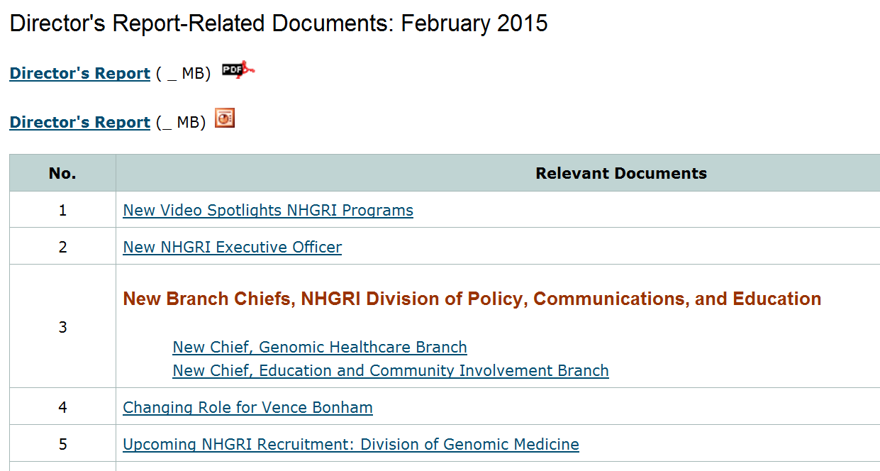
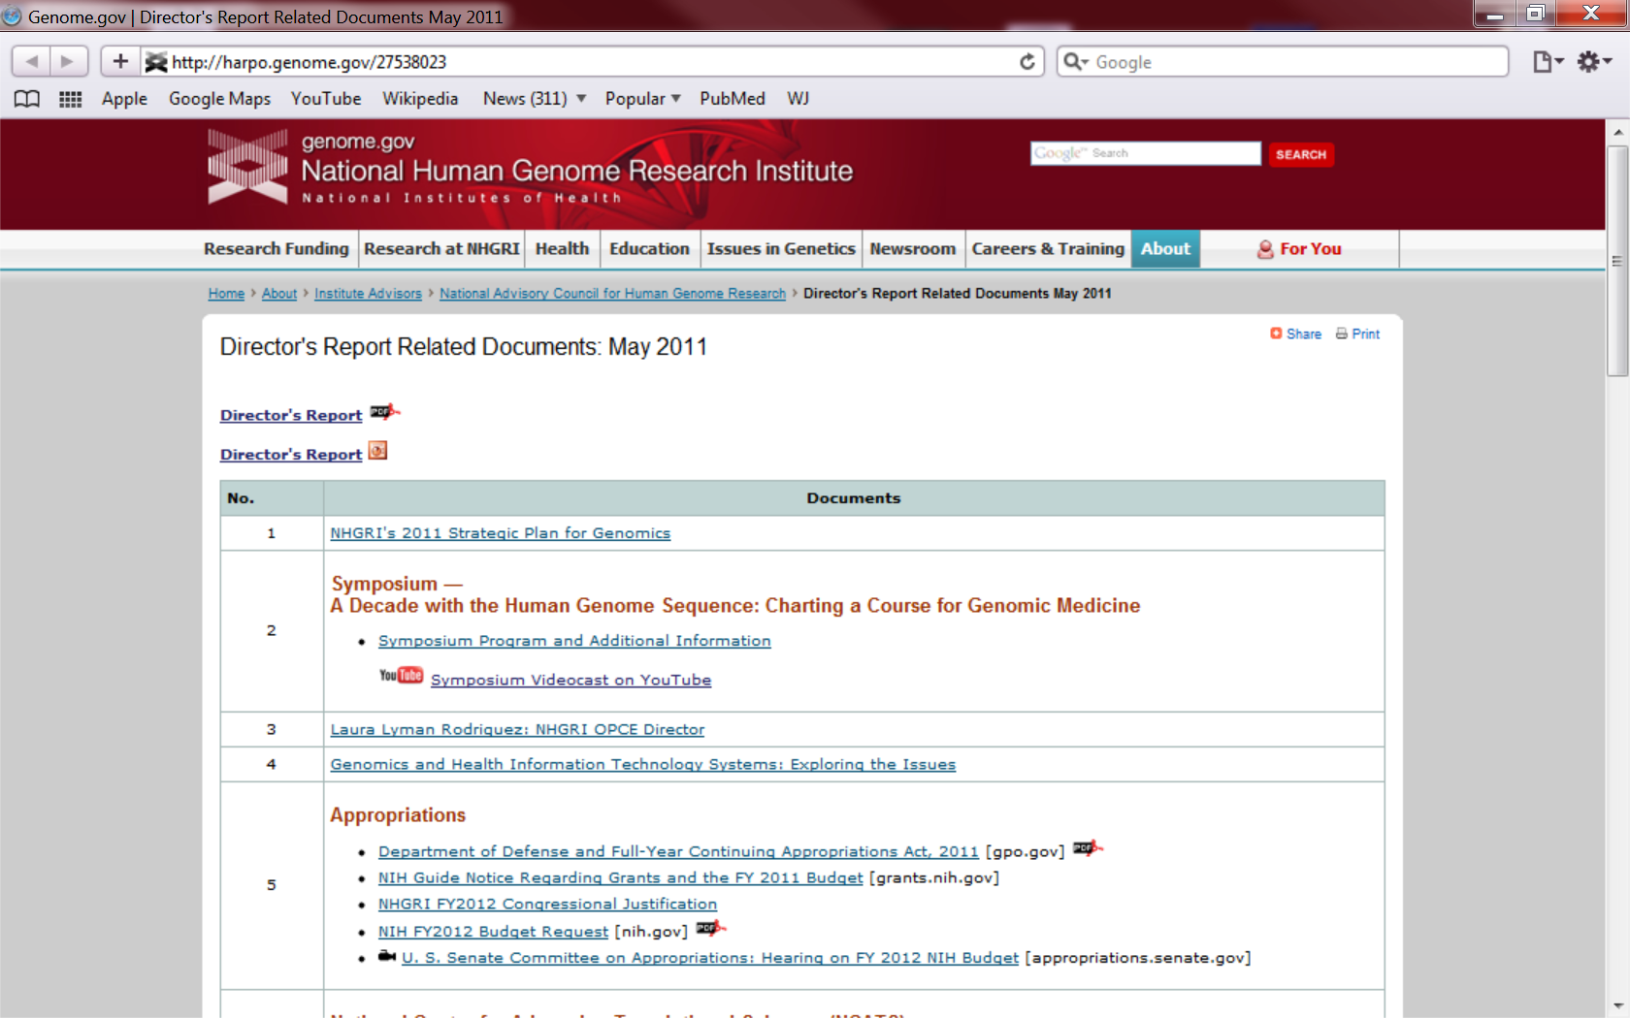
genome.gov/DirectorsReport
Document #
Notes:
For anyone new to our Council meetings, you should be aware that there is an ‘electronic resource’ associated with my Director’s Report. This is analogous to supplemental materials of a published paper, and can be accessed at the URL shown here.
The slides that I will show during my Director’s Report are also available electronically at this site– * both as PDF and Powerpoint files.
* For slides associated with specific documents or relevant web sites, there is a ‘Document #’ indicated on the bottom right, which references materials that can be accessed and/or downloaded at the website shown here.
In addition to the video archive, this web page and all linked documents will be archived on NHGRI’s website (genome.gov) as a permanent historic record of this meeting.

Slide 3
Open Session Presentations
  Update on the Genomic Medicine Working Group
    Teri Manolio
  The Alzheimer’s Disease Sequencing Project
    Eric Boerwinkle
  Concept Clearance:
  Centers of Excellence in ELSI Research
    Joy Boyer
Notes:
There will be several other presentations during the Open Session of this Council meeting. My Director’s Report is tailored around these presentations, and I will not discuss in detail the topics that others will cover.
* To begin with, later this morning, Dr. Teri Manolio will present an update on the Genomic Medicine Working Group of this Council.
* After lunch, Dr. Eric Boerwinkle will give a presentation on the Alzheimer’s Disease Sequencing Project.
We will then shift our attention to a number of Concept Clearances. * First, Joy Boyer will present a Concept Clearance for the renewal of the Centers of Excellence in ELSI Research program.

Slide 4
Open Session Presentations
  Concept Clearances:
  Genome Sequencing Program Analysis Satellites
  Genome Sequencing Program Coordinating Center
  High-Quality Human and Primate Genomes as Foundational Resources
  Comparative and Evolutionary Genomics
    Adam Felsenfeld
Notes:
* This will then be followed by the presentation of four Concept Clearances by Dr. Adam Felsenfeld, all relating to the renewal of the NHGRI Genome Sequencing Program and collectively representing a continuation of the discussion of this renewal from the September 2014 Council meeting.
* Specifically, these concepts will relate to: Genome Sequencing Program Analysis Satellites, a Genome Sequencing Program Coordinating Center, High-Quality Human and Primate Genomes as Foundational Resources, and Comparative and Evolutionary Genomics.

Slide 5
Open Session Presentations
  Biennial Report on the Inclusion of Women and Minorities in NHGRI-Supported Research
    Rongling Li
    Jacqueline Odgis
  Review of the Statement of Understanding between NACHGR and NHGRI
    Rudy Pozzatti
Notes:
We will then have two final presentations. * Dr. Rongling Li and Jacqueline Odgis will give a Biennial Report on the Inclusion of Women and Minorities in NHGRI-Supported Research.
* And then Rudy Pozzatti will go over the Review of the Statement of Understanding between NACHGR and NHGRI.

Slide 6
Director’s Report Outline
General NHGRI Updates
General NIH Updates
General Genomics Updates
NHGRI Extramural Research Program
NIH Common Fund/Trans-NIH
NHGRI Division of Policy, Communications, and Education
NHGRI Intramural Research Program
Notes:
For the rest of my Director’s Report, I will cover the 7 areas listed here, which together provide an excellent framework for reviewing the relevant topics.

Slide 7
Director’s Report Outline
General NHGRI Updates
General NIH Updates
General Genomics Updates
NHGRI Extramural Research Program
NIH Common Fund/Trans-NIH
NHGRI Division of Policy, Communications, and Education
NHGRI Intramural Research Program

Slide 8
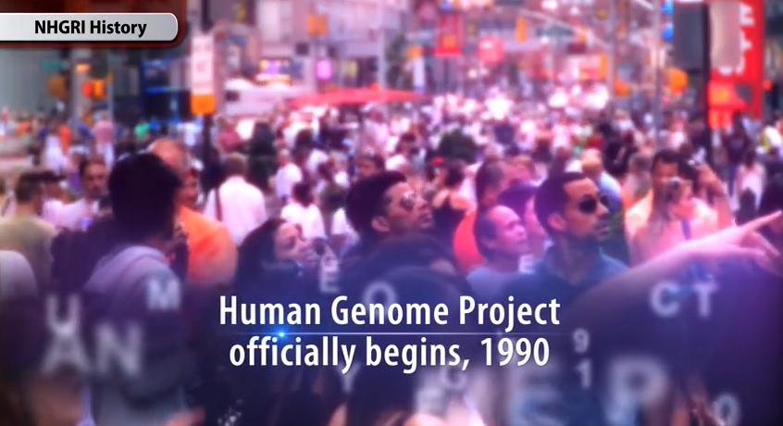
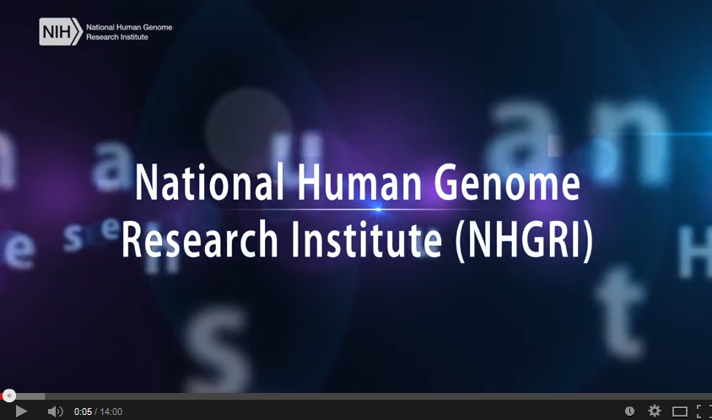
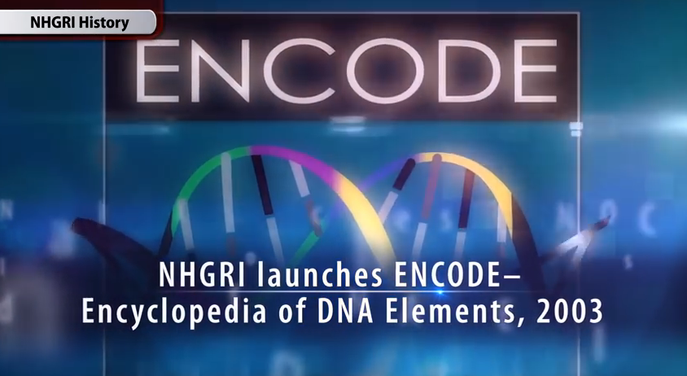
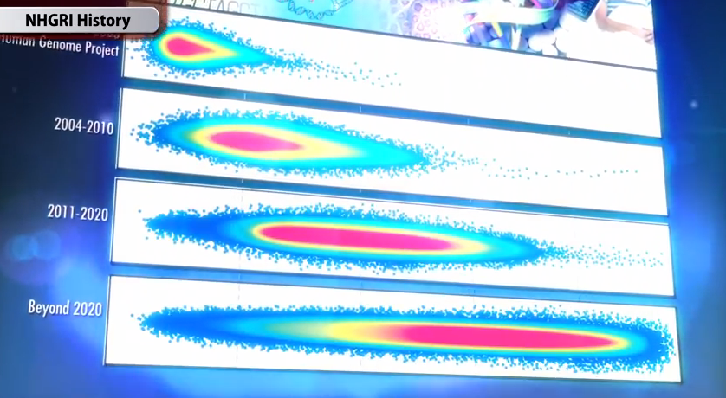
New Video Spotlights NHGRI Programs
Document 1
Notes:
I would like to call your attention to a new feature on NHGRI’s website, genome.gov. As you know, we have a very talented communications group at the Institute, and a priority area for them is the use of video for telling NHGRI’s story to the public and to the research community. One example of that is the routine videocasting and videoarchiving of the Open Session of these Council meetings.
But another important project that they recently completed was debuted at this past fall’s American Society of Human Genetics Meeting. Specifically, it is a slick new 15-minute video that tells NHGRI’s story from the beginning through today. In silent form, it spotlights the Institute’s major programs and research areas across all divisions, and introduces the various components of the Institute.
This fast-paced video incorporates rarely seen archival videos and photographs, and honors the pioneers and leaders that have contributed to the development and growth of our Institute. It is readily updateable, which is something that we plan do as major programs end and new ones launch. I encourage you to view this video when you have some time.
I would also like to give a special shout out and thanks to Alvaro Encinas (our Institute’s videographer), who led a team of individuals to create this video-based story about NHGRI.

Slide 9
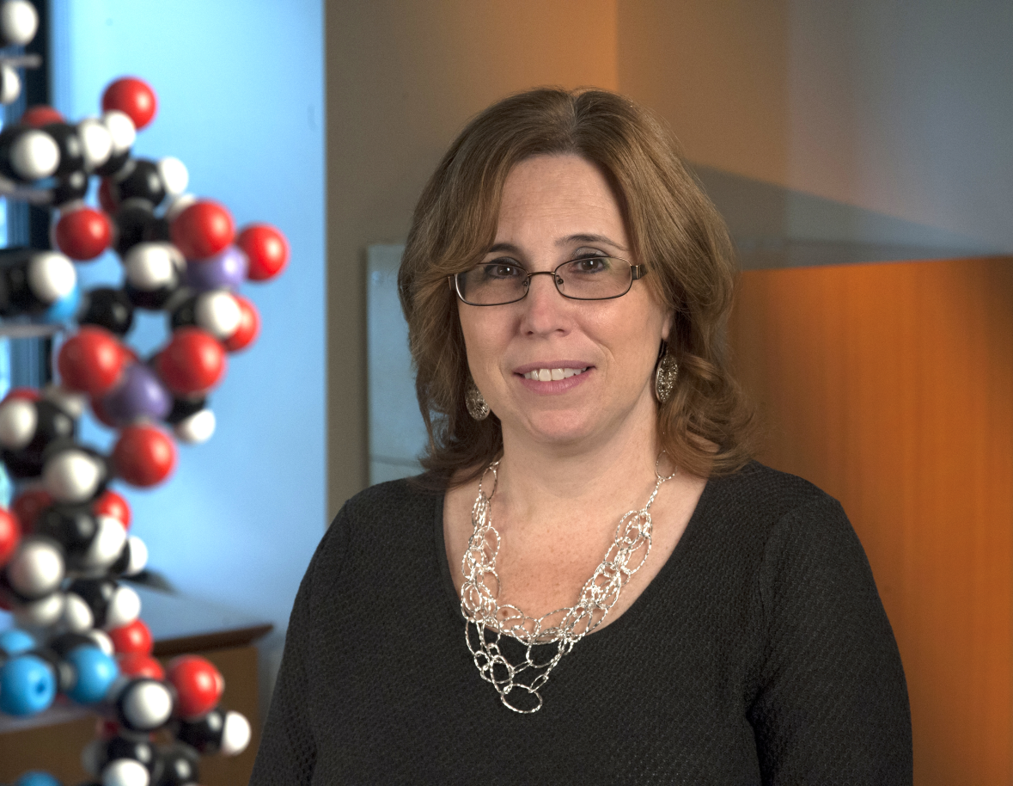
New NHGRI Executive Officer
Ellen Rolfes, M.A.
Document 2
Notes:
In October, Ellen Rolfes was appointed the NHGRI Executive Officer and Director of the Institute’s Division of Management (one of the Institute’s seven Divisions). This appointment followed a rigorous national search. In this position, Ellen oversees all aspects of administrative management within NHGRI, including management analysis and evaluation, financial management, information technology, and human resources; she also serves as NHGRI’s Deputy Ethics Counselor.
Over her impressive career at NIH (including 18+ years at NHGRI), Ellen has worked in a variety of administrative management positions, most recently serving as our Deputy Executive Officer. While perhaps less known to members of this Council, Ellen is incredibly well-known and well-liked among the NHGRI staff because it is widely appreciated that she works tirelessly and effectively to ensure that NHGRI is the best administratively managed Institute at NIH.

Slide 10
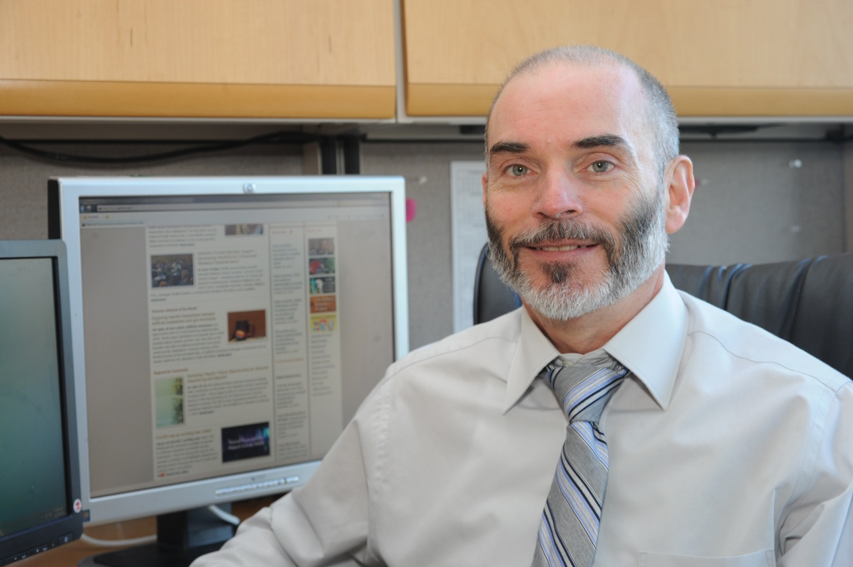
New Chief, Genomic Healthcare Branch
Bob Wildin, M.D.
Document 3
Notes:
There have been several changes with regard to leadership positions within the Division of Policy, Communications, and Education.
* The first is the appointment of Dr. Bob Wildin as Chief of the Genomic Healthcare Branch. Prior to joining NHGRI, Bob practiced clinical genetics in the Pacific Northwest in both private and hospital-based settings. In addition to his tenure as a medical faculty member at several hospitals, Bob has experiences as a consultant on biomedical informatics software and as a medical director of a clinical molecular diagnostics laboratory, which should provide with him a unique perspective through which to advance the activities of the Branch.
We look forward to Bob’s leadership in expanding NHGRI’s support of educational resources and outreach to engage healthcare professionals and the public in genomics.
This was a long search process, and I want to thank Dr. Jean Jenkins for her efforts during this time to ensure that the Branch’s initiatives were not only maintained, but expanded in both scope and visibility.

Slide 11
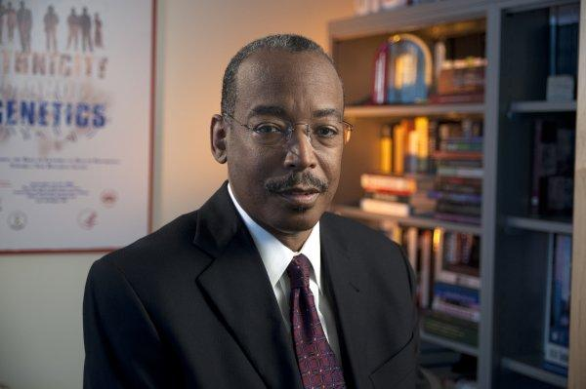
Changing Role for Vence Bonham
Vence Bonham, Jr., J.D.
Document 4
Notes:
Meanwhile, a valuable member of my leadership team has changed his role slightly. Vence Bonham was the Founding Chief of the Education and Community Involvement Branch, a role in which he brilliantly led the Branch for 10 years. But Vence recently stepped down as Chief of this Branch so that he could focus more of his time on two other major roles at the Institute.
Specifically, for the next phase of his NHGRI career, Vence will spend more time on his own research with the Intramural Research Program’s Social and Behavioral Research Branch as well as devote more attention to his role as my Senior Advisor for Genomics and Health Disparities. For the latter responsibility, he will assist me in steering NHGRI’s research in the areas of health disparities and minority health, in particular by building bridges with other NIH Institutes (as well as the extramural and intramural research communities), and by promoting genomics and ELSI research in the study of issues that are important to health disparities and minority health.

Slide 12
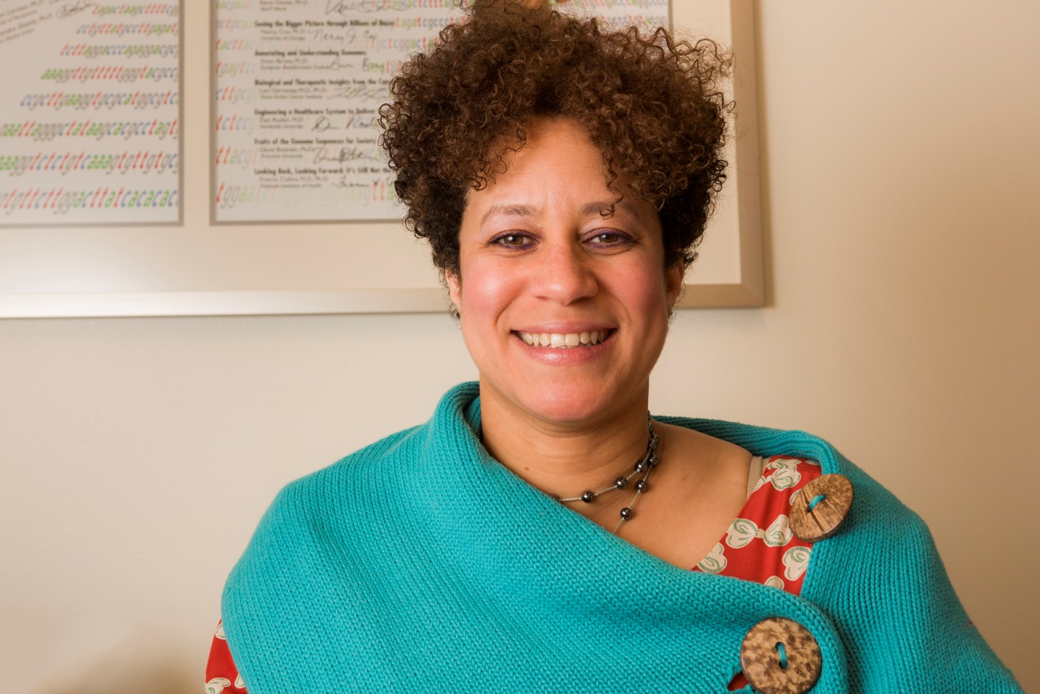
New Chief, Education and Community Involvement Branch
Carla Easter, Ph.D.
Document 3
Notes:
With the shift in Vence Bonham’s role at NHGRI, we quickly launched a search for a successor to oversee the vibrant portfolio of activities underway in our Education and Community Involvement Branch.
I am very pleased to report that last month, we announced the selection of Dr. Carla Easter as the new Chief of this Branch. Carla served as the Deputy Chief of the Branch for the last two years, and has had an impressive career working with schools and teachers in developing science outreach programs for many years. As Deputy Chief, Carla was instrumental to the successful development, launch, and ongoing tour of the Genome: Unlocking Life’s Code exhibition with the Smithsonian's National Museum of Natural History. We are delighted to have Carla now leading this important Branch of the Institute, and are confident that she will simply ‘rock’ in this leadership role.

Slide 13

Upcoming NHGRI Recruitment
Chief, Communications and Public Liaison Branch
Division of Policy, Communications, and Education
Contact: Dr. Laura Lyman Rodriguez laura.rodriguez@nih.gov or 301-594-7185
Notes:
Finally in terms of major NHGRI leadership positions, I want to make you aware of an important ongoing NHGRI recruitment— specifically, for the Chief of the Communications and Public Liaison Branch, also part of our Division of Policy, Communications, and Education.
This Branch Chief serves as the overall ‘communications director’ for NHGRI, working closely with Laura Rodriguez and myself in dealing with all aspects of the Institute’s communications programs. The Chief manages and leads communications and media relations activities across the institute, as well as contributes to trans-NIH communications initiatives. This position is critical to achieving the Institute’s aim to disseminate, explain, and highlight genomics research to the broader research community and to the public. With this mandate, this individual works in close collaboration with almost all other parts of NHGRI and across NIH and the Department of Health and Human Services.
* This is a very important recruitment for me and for the Institute, so if you have suggestions for outstanding candidates or wish to provide more information to colleagues, please let me or Laura know as soon as possible (and here is the relevant contact information for Laura).

Slide 14





Upcoming NHGRI Recruitment
Medical Officer
Division of Genomic Medicine
Vacancy opening soon:
Feb. 16 – Feb. 25, 2015
Contact: Dr. Teri Manolio manolio@mail.nih.gov or 301-402-2915
Document 5
Notes:
Another important ongoing NHGRI recruitment— specifically, for a Medical Officer in the Division of Genomic Medicine— aims to help the Institute foster the application of genomics for clinical care.
This Medical Officer will work closely with Teri Manolio, Director of the Division of Genomic Medicine, to identify evidence gaps and research needs critical to the integration and application of genomic information to clinical care. Current programs closely associated with this Division are familiar to this Council, and include the eMERGE network, the CSER Consortium, the ClinGen Resource, the Undiagnosed Diseases Network, and the IGNITE Consortium. Upcoming opportunities are being identified in collaboration with the NHGRI Genomic Medicine Working Group. Future programs are under development in areas such as pharmacogenomics and evidence generation.
The job ad will hit our website and USA Jobs on February 16, but you can already view ads in * the New England Journal of Medicine, * Cell, * JAMA, and the * American Journal of Medical Genetics. * If you have suggestions for outstanding candidates or need more information, please let me or Teri know as soon as possible (and here is the relevant contact information for Teri).

Slide 15

NHGRI Implementation of
NIH Genomic Data Sharing Policy
    January 25 is effective date for policy
    Consistent implementation across NHGRI portfolio
    Coordinating with NIH-wide implementation
Document 6
Notes:
For the last general NHGRI update, I want to remind you that at the September Council meeting, I pointed out that the final NIH Genomic Data Sharing Policy was published on August 26, 2014. * As of January 25, just two weeks ago, all NIH intramural research projects as well as grant or contract applications that include funding for the generation of genomic data are expected to meet the expectations within the policy.
As the Chair of the internal NIH oversight committee for this policy and as the Director of the institute that has been a leader in data sharing since the earliest days of the Human Genome Project, I am committed to ensuring that NHGRI is a leader in implementing the Genomic Data Sharing Policy. * So, over a year ago, I asked my staff and senior leadership team to begin planning and preparing for the consistent and fair implementation of the policy across our Extramural Research Program and our Intramural Research Program.
* In addition to working on implementation of the policy within NHGRI, our Institute staff members are coordinating with other NIH Institutes and Centers and participating in NIH-wide implementation activities, so as to share our experiences in establishing processes, to learn from others, and to leverage agency-wide developments. This will be an ongoing and, at times, challenging process, but one that I regard as a very high priority for the Institute.

Slide 16
Director’s Report Outline
General NHGRI Updates
General NIH Updates
General Genomics Updates
NHGRI Extramural Research Program
NIH Common Fund/Trans-NIH
NHGRI Division of Policy, Communications, and Education
NHGRI Intramural Research Program

Slide 17
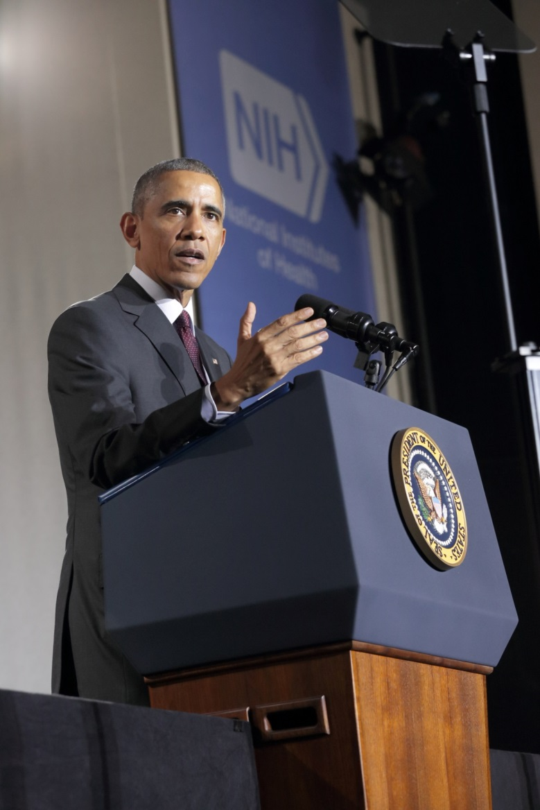
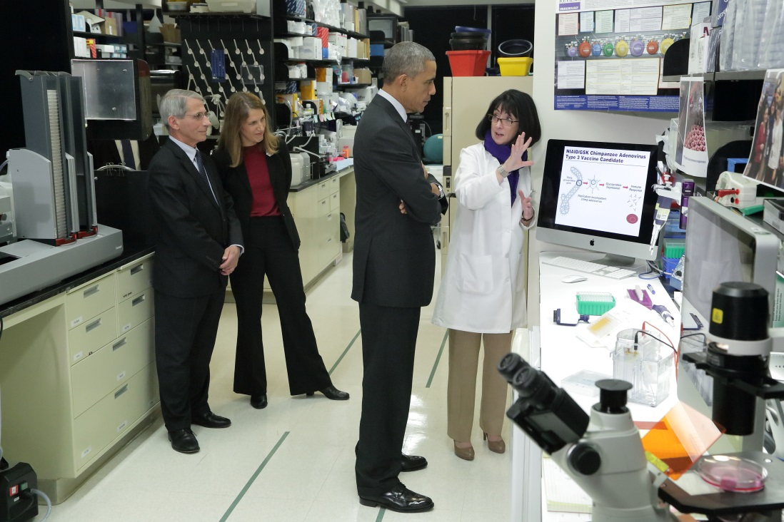
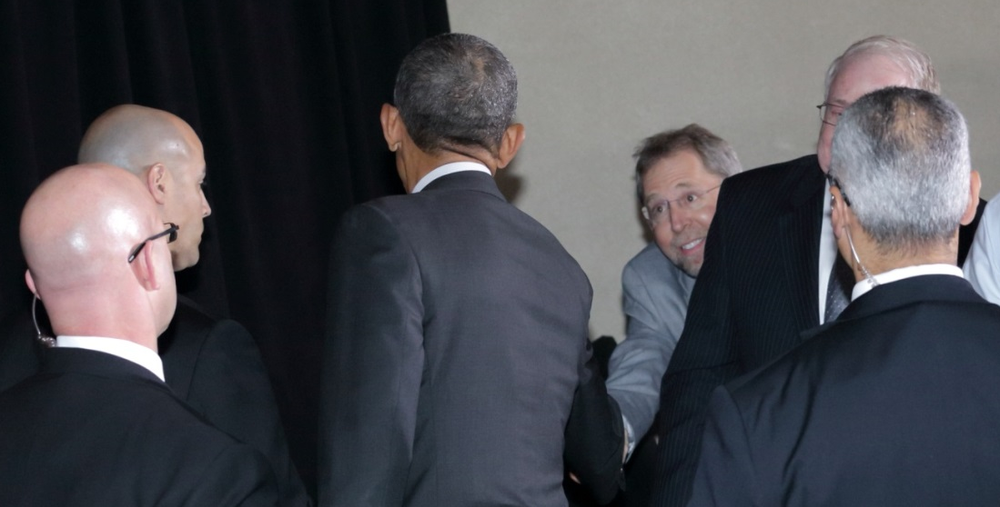
President Obama Visits NIH
Document 7
Notes:
It has been a very busy and exciting few months since the last Council meeting with respect to the attention paid to NIH by high-level government leaders.
In December, President Obama visited NIH for the second time during his presidency, * touring the NIH Vaccine Research Center and * giving a speech to a packed audience. In his remarks, the President praised the contributions of NIH staff in dealing with the ongoing Ebola crisis, including the care of Ebola-infected patients at the NIH Clinical Center.
Unlike his previous speech at the NIH, the President ‘worked the front of the room’ after his remarks concluded. * While I was sitting in the second row, there was no way I was going to miss the opportunity to shake his hand. Fortunately, what I lack in a truly athletic build, I make up for with really long arms– which really helps in situations like this.

Slide 18
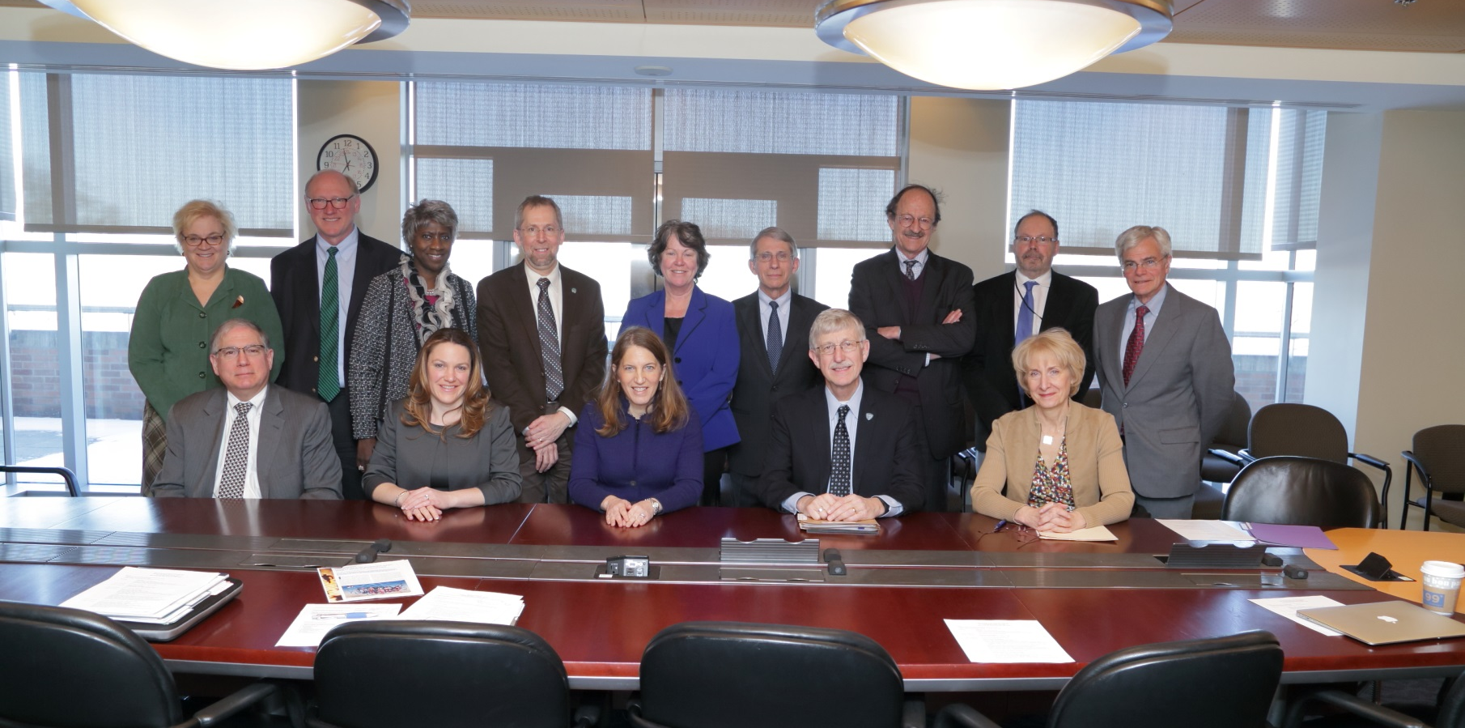
Secretary Burwell Visits NIH
Notes:
Then, just two weeks ago, Department of Health and Human Services Secretary Sylvia Burwell came to NIH to meet with a small group of NIH leaders (including me, as shown here) to discuss a few particular topics of interest, including clinical applications of genomics. While at NIH, the Secretary also toured the NIH Clinical Center, met with patients, and participated in a Town Hall meeting with NIH staff.
But, by far, the most exciting development relating to high-level government leaders and the NIH relates to a major new initiative recently announced by President Obama. Because of the importance of this initiative (especially for NHGRI), I thought that it was worth dedicating some my Director’s Report to describing the story behind the announcement and the current plans for this effort.

Slide 19
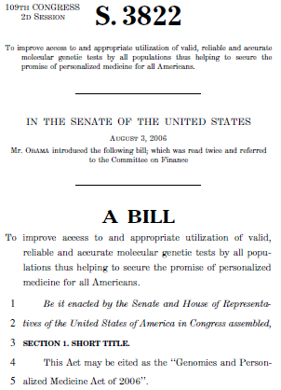
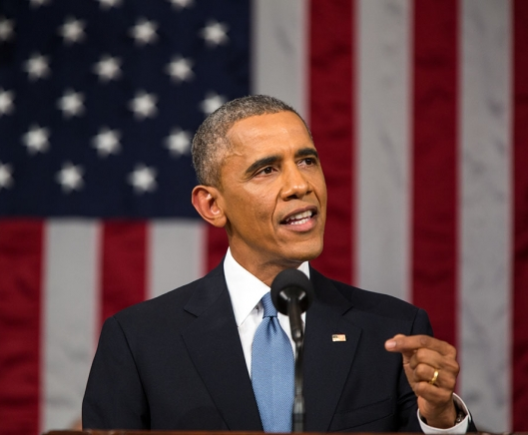
President Obama:
A Long-Standing Interest in Genomics
Senator Obama, 2006
Notes:
To begin with, it is important to remind you that President Obama has a long-standing interest in biomedical research, but, in particular, genomics. * For example, in 2006, then Senator Obama introduced a piece of legislation in the Senate entitled the “Genomics and Personalized Medicine Act.” While this bill was never passed, it in many ways is emblematic of a genuine interest that the President has in genomics and the opportunities to individualize approaches to medicine.
Throughout his Presidency, his interest in genomics has grown. This, of course, has been nurtured by people that he interacts with on scientific topics, such as NIH Director Francis Collins and Eric Lander, a Co-Chair of the President's Council of Advisors on Science and Technology. For a number of reasons, this greatly intensified early last summer, eventually leading to a request from the President to bring to him a plan for a bold, new initiative that he could launch during the remaining two years of his Presidency.

Slide 20

A broader context for ‘individualizing’ medical care to advance human health
Notes:
The President’s interests have, in fact, broadened beyond genomics, and so we were asked to formulate our plan around the notion of precision medicine. * This broader context aimed to consider all elements that are relevant for ‘individualizing’ medical care, with the goal of advancing human health.
As you will see, NIH was not alone among federal agencies in developing such a plan. That said, a modest number of us from NIH worked quietly and diligently throughout the summer and into the early fall developing a scientific plan for a possible Presidential initiative in precision medicine.

Slide 21


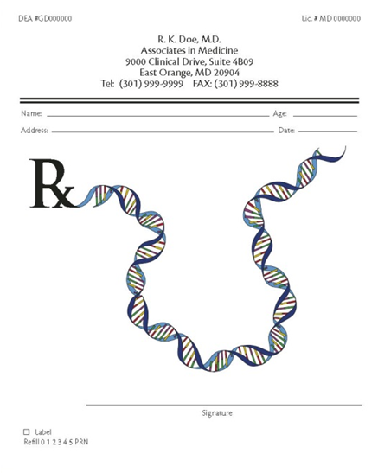
Precision Medicine
Today: most medical care based on expected response of the average patient
Tomorrow: medical care based
on individual in genomic,
environmental, and lifestyle
differences that enable more precise
ways to prevent and treat disease
How do we get from today to tomorrow?
Notes:
Our fundamental thinking about precision medicine was fairly simple– and familiar to many of you. * Today, we tend to deliver medical care based on the expected response of the average patient, and yet we know that this is far from perfect. * Eventually, meaning tomorrow, we want to deliver medical care based on individual genomic, environmental, and lifestyle differences that enable more precise ways to prevent and treat disease.
In developing a plan for a ambitious initiative in precision medicine, we focused on research areas that needed to be accelerated * to help get us from today to this new tomorrow.
And so a number of us developed such a plan by the early fall, and it was presented to the President– who very much embraced it. It then went into the process of being readied for inclusion in the President’s Fiscal Year 2016 budget and for its announcement by the President. We were told to expect some mention of the initiative by the President in his January 20 State of the Union Address, but we had no idea exactly what he would say. We were delighted to hear more than we had anticipated...

Slide 22
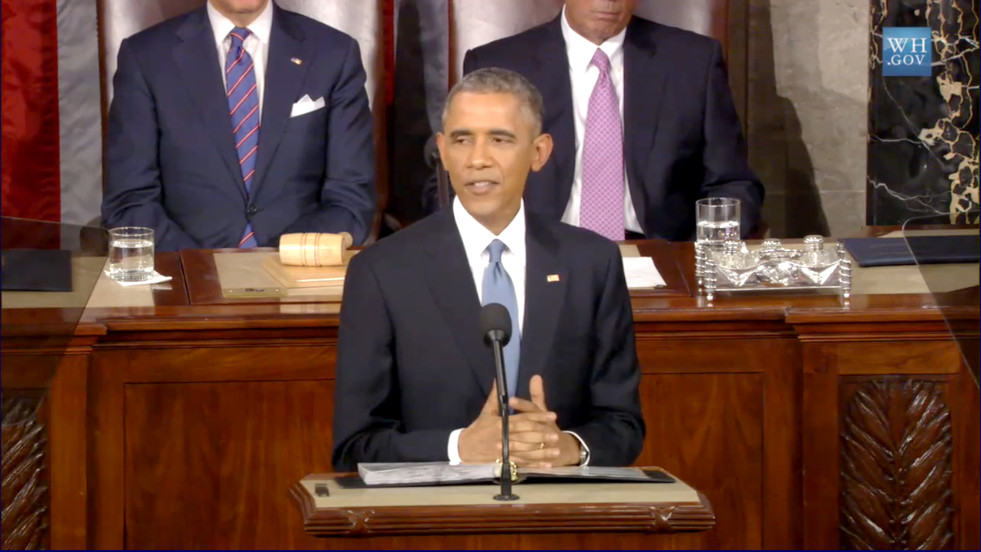
President Obama’s State of the Union Address: January 20, 2015
Document 8

Slide 23
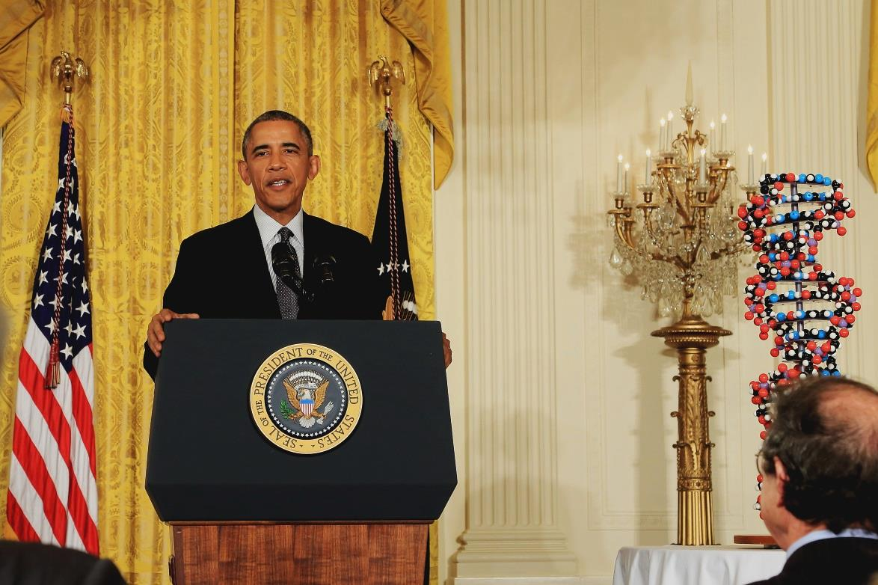

“And that’s why the budget I send this Congress on Monday will include a new Precision Medicine Initiative that brings America closer to curing diseases like cancer and diabetes, and gives all of us access, potentially, to the personalized information that we need to keep ourselves and our families healthier.”
President Barack Obama
January 30, 2015
Notes:
Then, 10 days later (on January 30), a couple hundred guests were invited to the East Room of the White House for the formal announcement by President Obama.

Slide 24

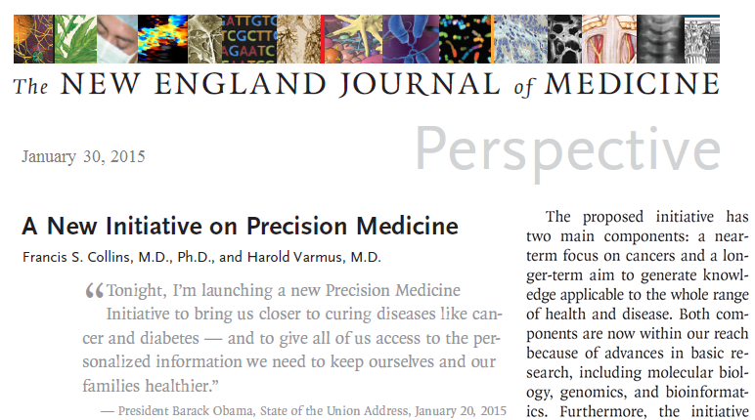

January 30, 2015
Notes:
Just as the President was announcing plans for the Precision Medicine Initiative on January 30, * the New England Journal of Medicine published online this perspective, co-authored by Francis Collins and Harold Varmus. This paper provides an excellent summary of the scientific rationale and the initial plans for the Initiative.

Slide 25

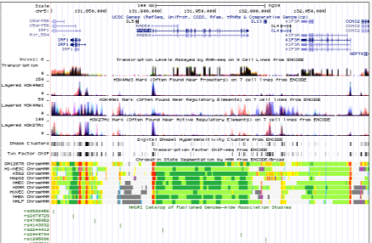


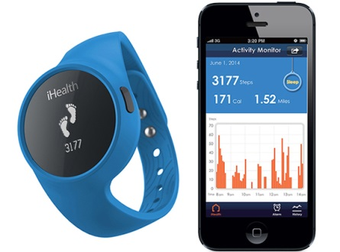





Genomics
EHRs
Technologies
Data Science
Patient Partnerships
Notes:
It is worth stressing that the Precision Medicine Initiative largely reflects ideas that have been considered before; however, it frames them in a new light due to some key developments that have occurred over the last decade.
In my thinking, there are five major areas where significant advances and changes have been realized in the past roughly decade, and together these provide the underpinnings for the early plans of the Initiative. Those five areas include: * (1) genomics; * (2) electronic health records (and notably, the increase in EHR usage by healthcare providers in the United States over the past decade); * (3) technologies (e.g., mHealth devices and smartphones); * (4) data science; and * (5) patient partnerships (e.g., existing cohorts, citizen science movement, and crowdsourcing efforts).

Slide 26
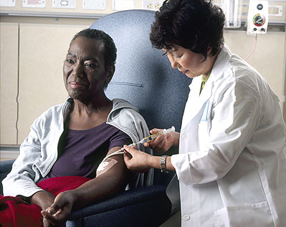
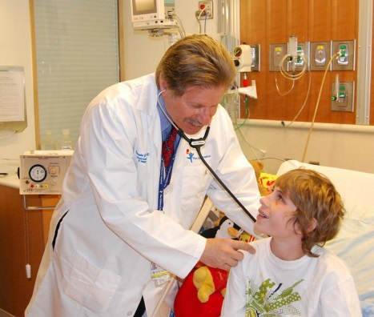
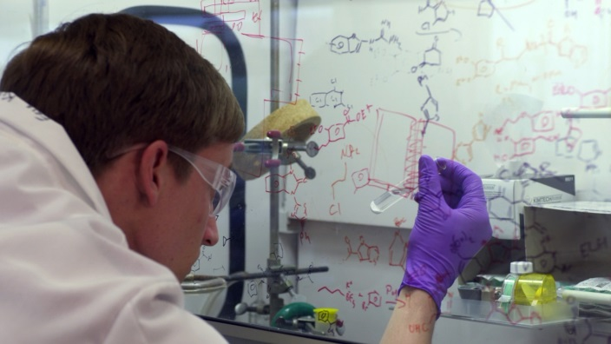

Precision Medicine Initiative: The Vision
NEAR TERM: Cancer as a Model of Precision Medicine
  Leading edge of precision medicine, yet more to learn
  Ramp up current efforts to include more cancer types
LONGER TERM: Expanding the Model to Other Diseases
  Create national research cohort of >1 million volunteers
  Generate knowledge base for precision medicine
POLICY CHANGES: Remove Barriers to Clinical Implementation
  Update federal rules protecting research participants
  Advance FDA oversight of precision medicine products
Notes:
The Precision Medicine Initiative is currently envisioned as having three major areas of focus.
* First, a near-term effort in cancer. * Second, a longer-term effort that expands beyond cancer and involves the creation of a U.S. national research cohort. And * third, some policy changes needed to remove barriers to precision medicine implementation.

Slide 27
Precision Medicine Initiative:
Proposed Fiscal Year 2016 Funding
Agency | $ Million
National Institutes of Health | $200
Food and Drug Administration | $10
Office of the National Coordinator for Health Information Technology | $5
TOTAL | $215
Notes:
As I mentioned earlier, the timing of the President’s announcement was tied to the roll out of his Fiscal Year 2016 budget, which includes $215M of new funding for the Initiative. The proposed amounts for the relevant three federal agencies are shown here.
One of the most gratifying and motivating aspects of the Precision Medicine Initiative, which was told to those of us involved in planning it for the past 6-8 months over and over again, is President Obama’s strong and personal interest in the Initiative and the fields of study that it represents. We had heard about this directly from Francis Collins on multiple occasions, but it was particularly interesting to hear Secretary Burwell describe this during her recent visit to NIH. Specifically, at her Town Meeting that day, she was asked, based on her close working relationship with President Obama, to describe a couple of things about the President that would be of particular interest to the NIH staff.

Slide 28
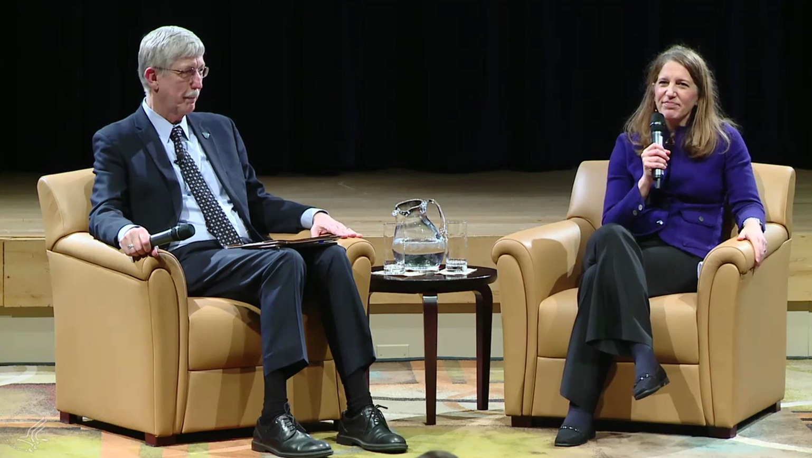
Secretary Burwell Speaks Candidly at NIH

Slide 29
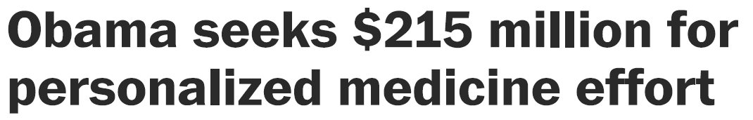
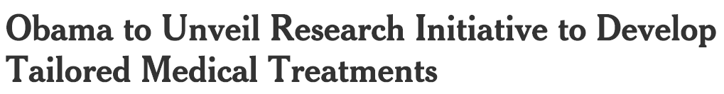
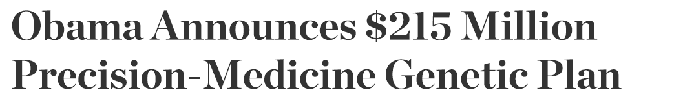
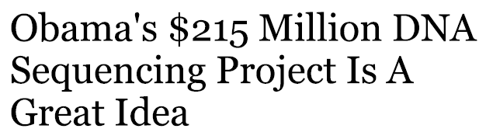
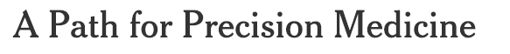
Washington
Post
New York
Times
Wall Street
Journal
Forbes
New York
Times
NBC News
Notes:
Not surprisingly, there has been considerable press coverage about the President’s announcement, with examples from the popular press shown here.

Slide 30



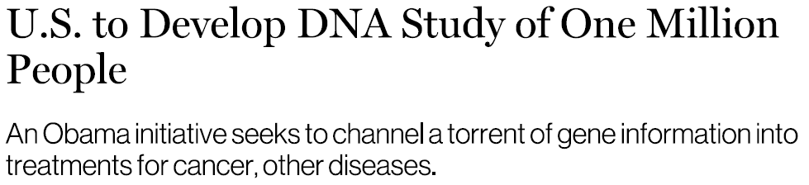
Science
The
Scientist
Nature
MIT Tech
Review
Notes:
Similarly, there have already been multiple stories published about the Initiative in the scientific press.

Slide 31
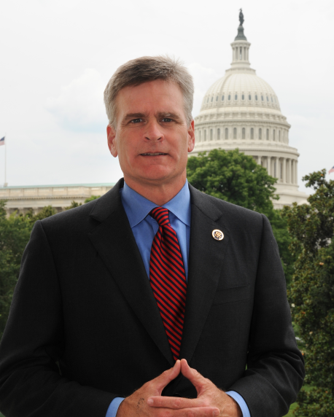
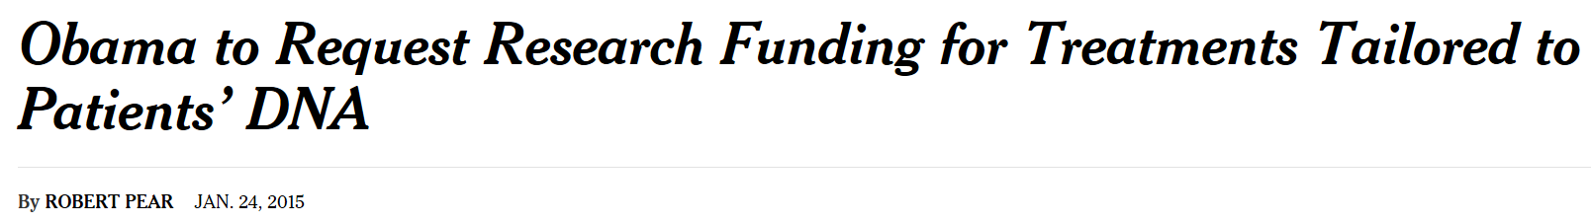
Senator Bill Cassidy (R-LA)
“This is an incredible area of promise,” said Senator Bill Cassidy, Republican of Louisiana and a gastroenterologist. “There will be bipartisan support.”
New York Times
Notes:
It has also been important and gratifying to see early evidence that the Precision Medicine Initiative, while announced by the President, will hopefully engender bipartisan support. For example, Senator Cassidy, a republican from Louisiana, was quoted in the New York Times in a fashion that signals bipartisan support.

Slide 32
Precision Medicine Initiative: The Vision
NEAR TERM: Cancer as a Model of Precision Medicine
  Leading edge of precision medicine, yet more to learn
  Ramp up current efforts to include more cancer types
LONGER TERM: Expanding the Model to Other Diseases
  Create national research cohort of >1 million volunteers
  Generate knowledge base for precision medicine
POLICY CHANGES: Remove Barriers to Clinical Implementation
  Update federal rules protecting research participants
  Advance FDA oversight of precision medicine products
Notes:
Among the major elements of the Initiative, * NHGRI expects to be directly involved in this second area.

Slide 33
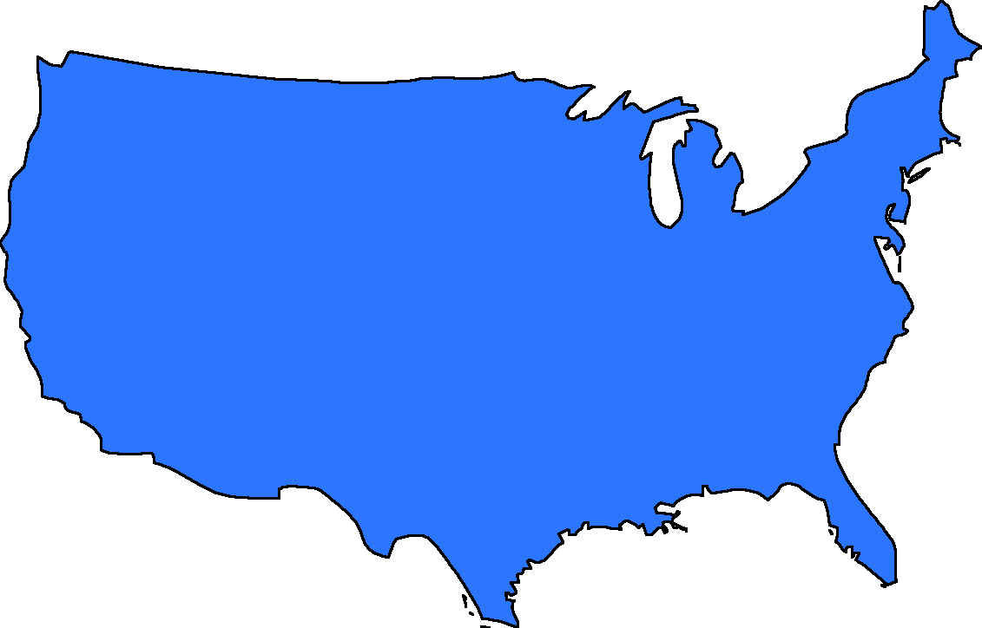

National Research Cohort
>1 million U.S. volunteers
  Numerous existing cohorts (many funded by NIH)
  New volunteers
Participants to share genomic data, lifestyle information, biological samples – all linked to their EHRs
Provide scientists with a ready platform for myriad new studies to propel understanding of health and disease
Forge new model for ‘doing science’ that emphasizes engaged participants and open, responsible data sharing with strong privacy protections
Document 9
Notes:
The Precision Medicine Initiative’s national research cohort is currently envisioned as having the following characteristics.

Slide 34
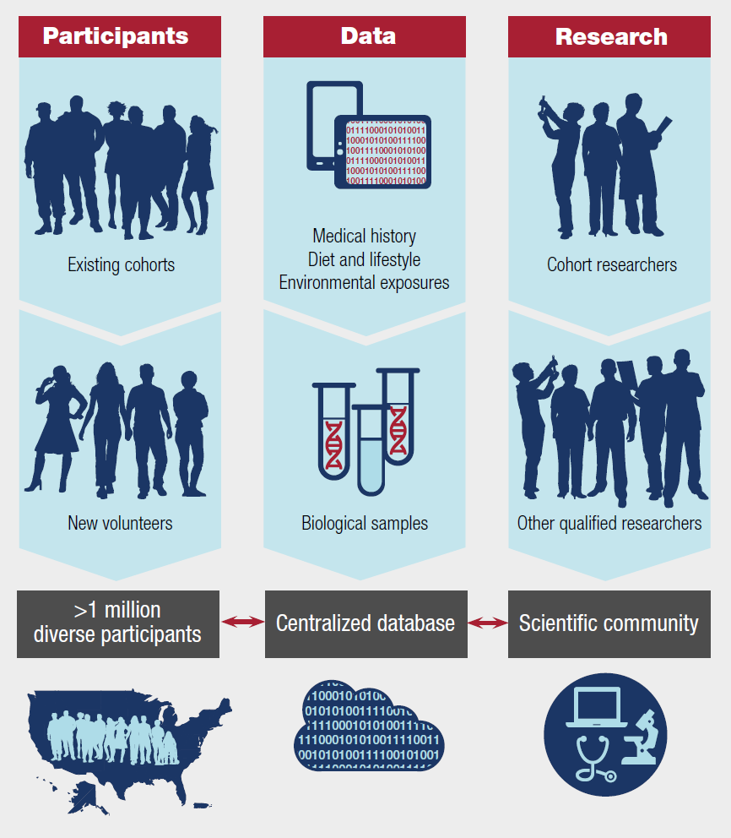
National Research Cohort: Components
Notes:
From the earliest discussions in planning for developing such a research cohort, it was recognized that new thinking and new ideas would be needed with respect to the participants, the data, and the research itself.
For the participants, the Initiative will aim to develop new models for consent and for recruitment of participants. With respect to data, the data science opportunities created by the establishment of such a centralized database with the cohort (especially in areas like data integration) will be spectacular, albeit also challenging. And finally for the research itself, one can readily envision building a new multidisciplinary scientific community centered on the cohort (including both basic-oriented disease discovery research and more medically-oriented studies related to clinical management).
I would also point out that in each of these areas, we are well-aware of significant private sector interest in the Initiative. Hopefully, this will become a fertile area for new public-private partnerships and collaborations as well.

Slide 35

Building a Large U.S. Cohort for Precision Medicine Research
  NIH workshop to be held February 11-12, 2015
  Representatives from a wide variety of fields
  Major areas of discussion:
  Cohort identification and participant recruitment
  Participant engagement, data privacy, and novel ways of returning information to participants
  Data collection, including mobile technologies
  Informatics and electronic health records
Document 9
Notes:
With the Precision Medicine Initiative now announced, the real work begins. NHGRI staff will be directly involved in the research cohort component of the Initiative. In fact, a number of us have been involved for many weeks behind the scenes organizing an important NIH workshop on this topic.
* Specifically, on February 11 and 12, NIH will hold a workshop focused on building a large U.S. cohort for precision medicine research. * The workshop will involve representatives from a wide variety of fields and domains, including genomics, data science, electronic health records, mobile technologies, policy, ethics, law, epidemiology, patient groups, industry, government, and healthcare.
Discussions will aim to elicit strategic thinking about a number of major areas, including * cohort identification and participant recruitment; * participant engagement, data privacy, and novel ways of returning information to participants; * data collection, including mobile health technologies; and * informatics and electronic health records.
For those interested, the workshop will be videocast live and also videoarchived for future viewing. Starting with this workshop, I can assure you that I will be providing this Council regular updates about the Precision Medicine Initiative and its various developments in the months to come.

Slide 36
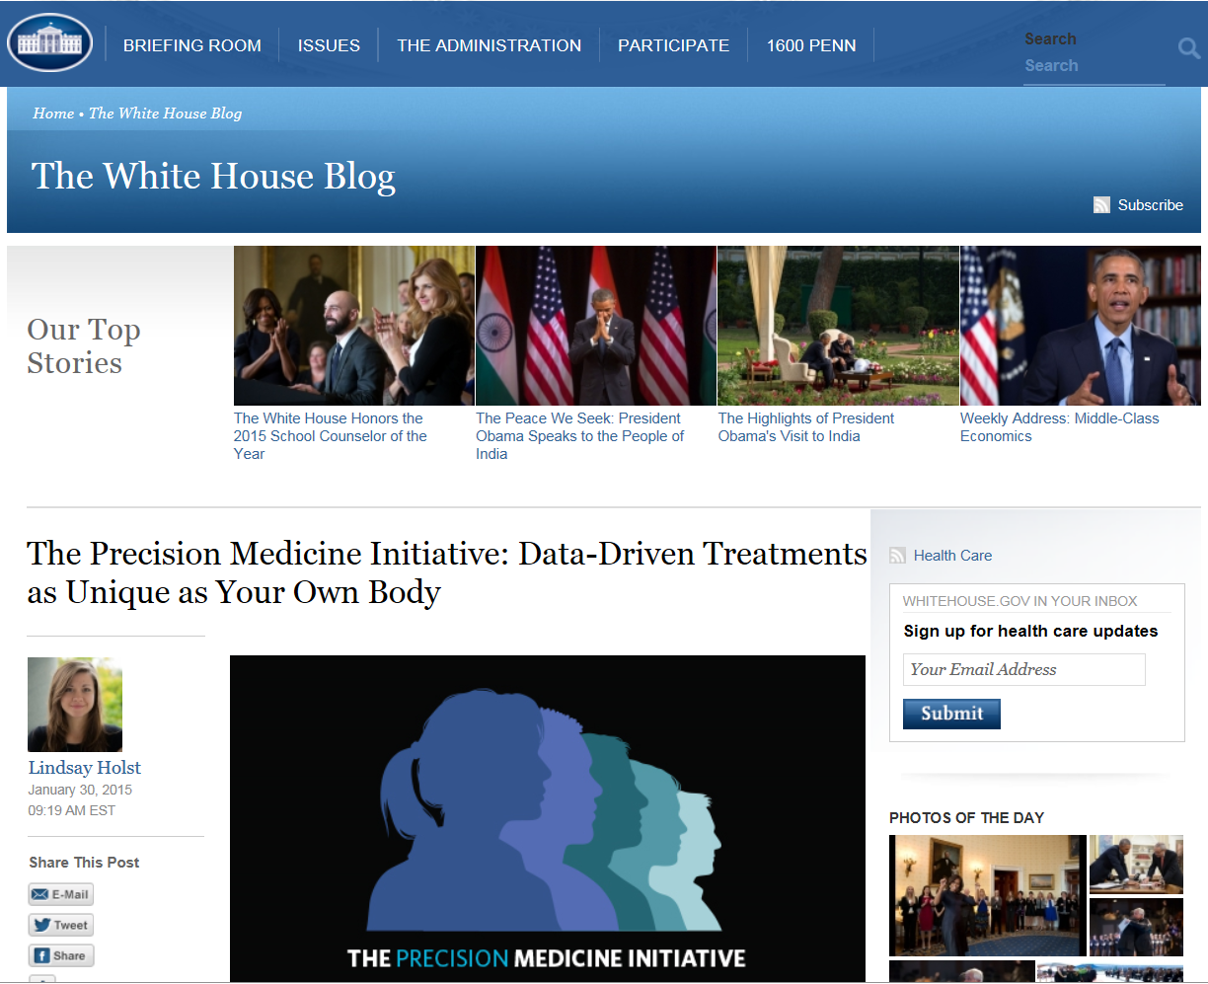
www.whitehouse.gov/precisionmedicine
Document 9
Notes:
There is now a dedicated website for the Precision Medicine Initiative at the White House.

Slide 37
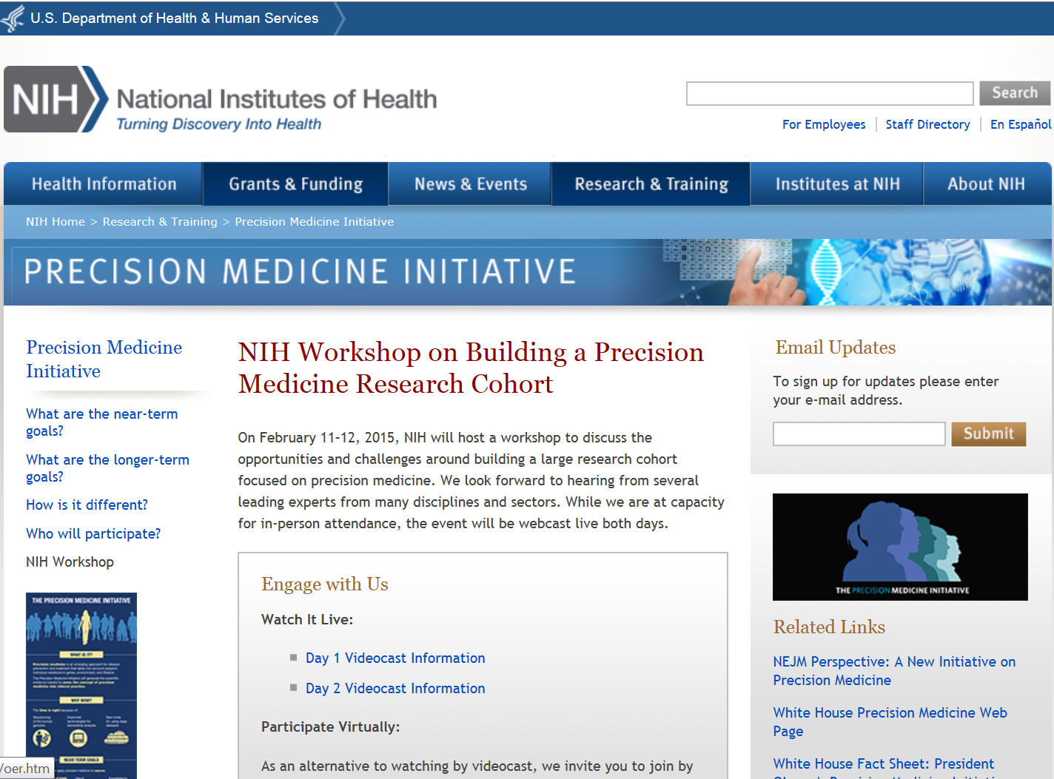
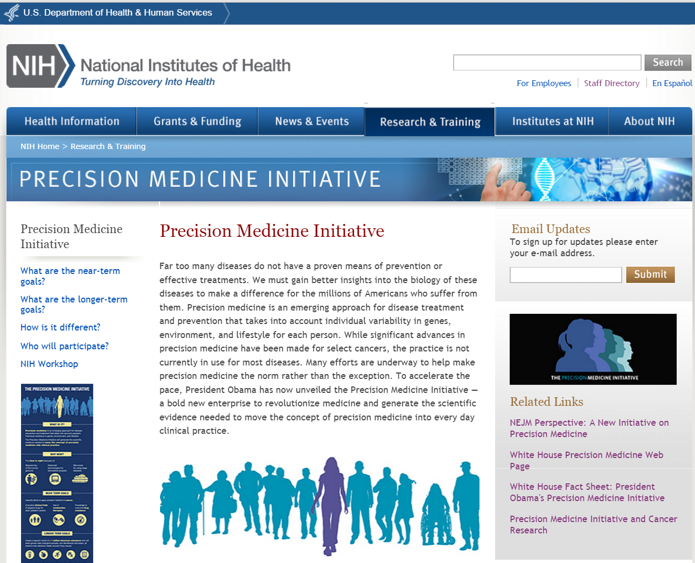
www.nih.gov/precisionmedicine
Document 9
Notes:
And there is also a dedicated NIH website for the Precision Medicine Initiative.
* That page now has a link for this week’s workshop on building a precision medicine research cohort, * with that linking taking you to a page that provides all sorts of information about the workshop (including details about accessing the proceedings through the planned videocast and posted white papers that will be discussed during the workshop).

Slide 38


New U.S. Surgeon General
Vivek Murthy, M.D.
Document 10
Notes:
Dr. Vivek Murthy has been confirmed and is now serving as the 19th Surgeon General of the United States. Dr. Murthy was co-founder of Doctors for America, which focuses on advocating for affordable healthcare for all Americans. He succeeds the current Acting Surgeon General, Dr. Boris Lushniak.

Slide 39
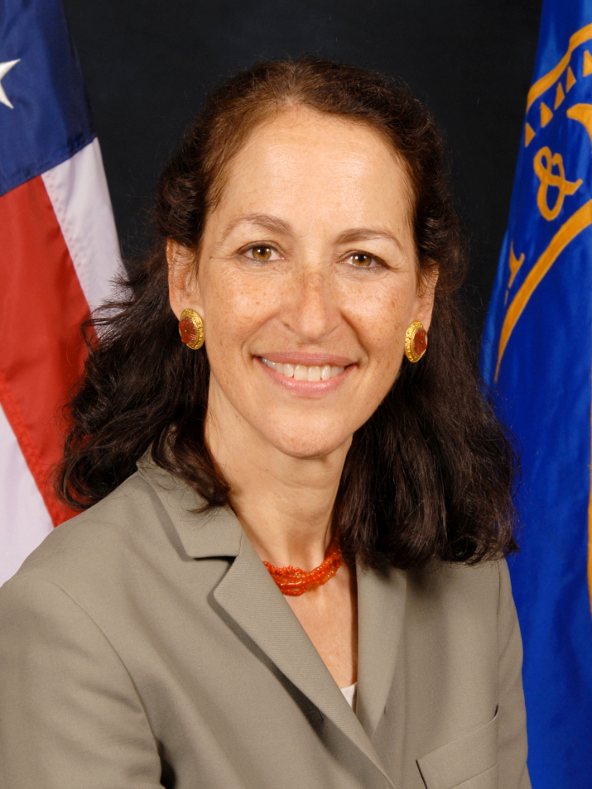

U.S. FDA Commissioner to Step Down
Margaret Hamburg, M.D.
Document 10
Notes:
Last week, the FDA announced that Dr. Margaret Hamburg, the U.S. FDA Commissioner, is stepping down at the end of March after six years of heading the FDA and overseeing public health initiatives ranging from tobacco control and food safety to personalized medicine and drug approvals.
Dr. Hamburg’s public health focus has been a hallmark of her career, a constant champion for patients’ health. During her time as FDA Commissioner, Dr. Hamburg was committed to fostering the growth of science and innovation across the agency, and changing how the FDA and industry collaborate. Dr. Hamburg leaves a strong legacy of accomplishment at the FDA.
Dr. Stephen Ostroff, the FDA’s Chief Scientist, will serve as Acting FDA Commissioner. NHGRI will continue watching with keen interest FDA’s involvement in genomics and its movement into the clinical sphere.

Slide 40
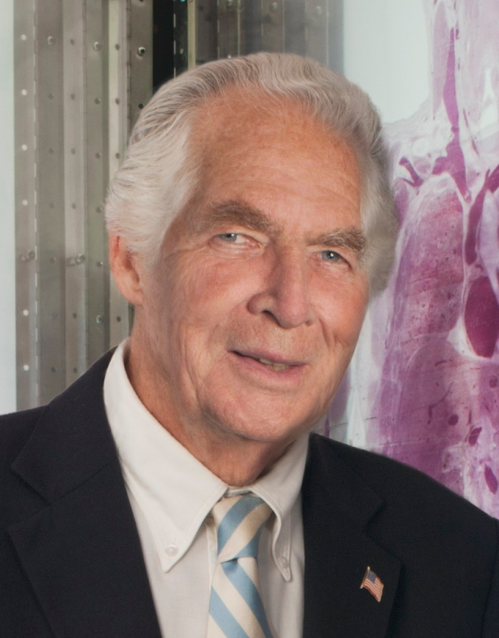
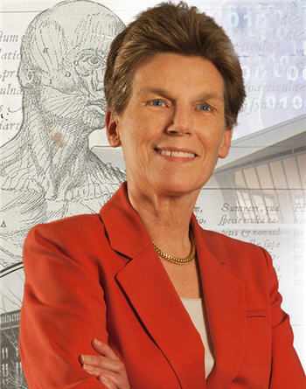

Retirement of Donald Lindberg
Donald Lindberg,
M.D.
Betsy Humphreys,
M.L.S.
Document 11
Notes:
Late last year, Don Lindberg announced that he would be retiring from federal service at the end of March 2015. Don has served as Director of the National Library of Medicine for more than 30 years. During his tenure, he led the Library’s transition into the electronic informatics age and oversaw numerous landmark projects, including the launching of the MEDLINE database via PubMed, ClinicalTrials.gov, the Unified Medical Language Systems, and, of particular relevance to the field of genomics and NHGRI, the National Center for Biotechnology Information.
When Don departs NIH, Deputy Director Betsy Humphries will step up to serve as Acting Director of the National Library of Medicine.
Meanwhile, Don Lindberg leaves behind an icon of an organization at NIH. The National Library of Medicine (or NLM) has been a center of information innovation since its founding in 1836, and has been at the forefront of how biomedical and health information is collected, shared, and analyzed. However, as information resources shift from print to digital media and biomedical research transitions to a data-intensive era, NLM’s role needs to evolve to continue meeting the many challenges in information and data science.

Slide 41
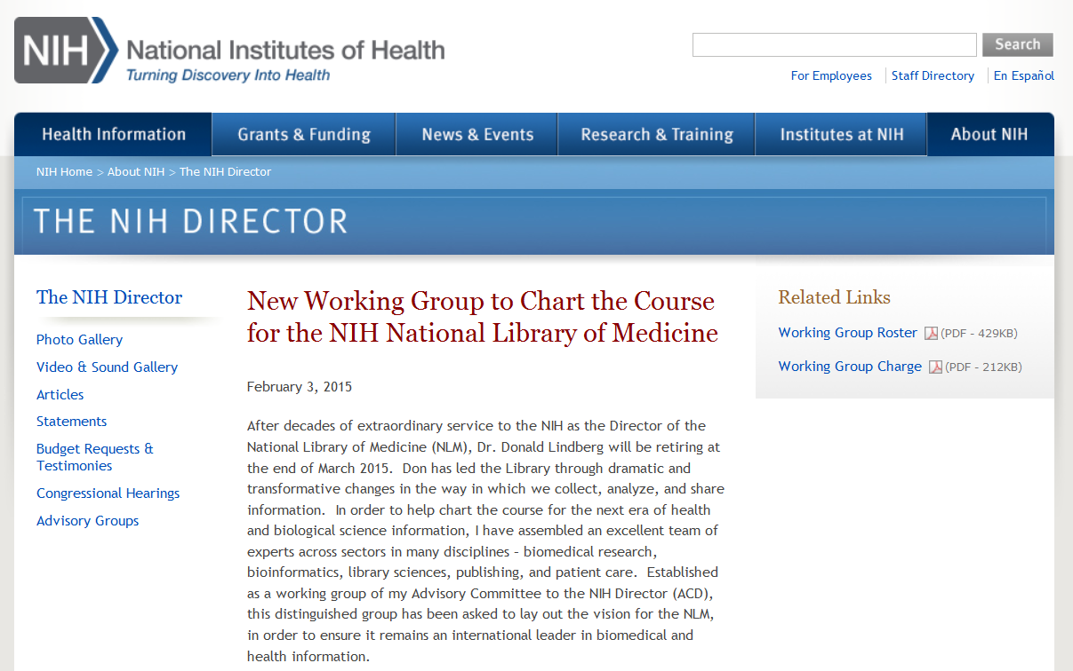

National Library of Medicine Working Group
  Co-Chairs: Eric Green & Harlan Krumholz
  Charge:
  Review mission, organization, and programmatic priorities
  Articulate a strategic vision for NLM
  Report Due Date: June 2015 ACD Meeting
Document 11
Notes:
Rather than immediately launch a search for a new Director of NLM, NIH Director Francis Collins has decided to first pause and strategically consider the role that NLM should play in the current and future biomedical research enterprise. To carry out such a renewed visioning process, he has established a working group of his Advisory Committee to the Director (or ACD).
* I was asked to co-chair this working group along with ACD member Harlan Krumholz of Yale University. * The working group is charged with reviewing the mission, organization, and programmatic priorities of the NLM, and articulating a strategic vision for the NLM in order to ensure its continued leadership in the field of biomedical and health information. Specifically, the working group will address how the NLM should continue to meet the rapidly evolving scientific and technological needs of the biomedical community by developing and adopting information technologies, promoting open access models, maximizing usefulness and cost-efficiency of NLM archival resources, and interfacing with NIH’s broader efforts to address major data science challenges facing the biomedical research enterprise.
* The working group will present its final report for consideration at the June meeting of the ACD. * A website has been established that will contain all the relevant information about the efforts and products of this Working Group.

Slide 42

Cessation of the National Children’s Study
Document 12
Notes:
Another working group of the Advisory Committee to the NIH Director recently finished its evaluation of the National Children’s Study— a longitudinal, observational study examining the effects of a broad range of environmental and biological factors on children’s health and development. The study was envisioned to follow 100,000 children from the womb to age 21.
The working group concluded that “the overall goals of examining how environmental factors influence child health and development are meritorious and should continue to be a priority for future scientific support, but the National Children’s Study as currently designed is not feasible.” The NIH Director has agreed with this assessment, and had moved forward with the cessation of the National Children’s Study. Data and resources produced from early pilot efforts will be made available to the research community.

Slide 43
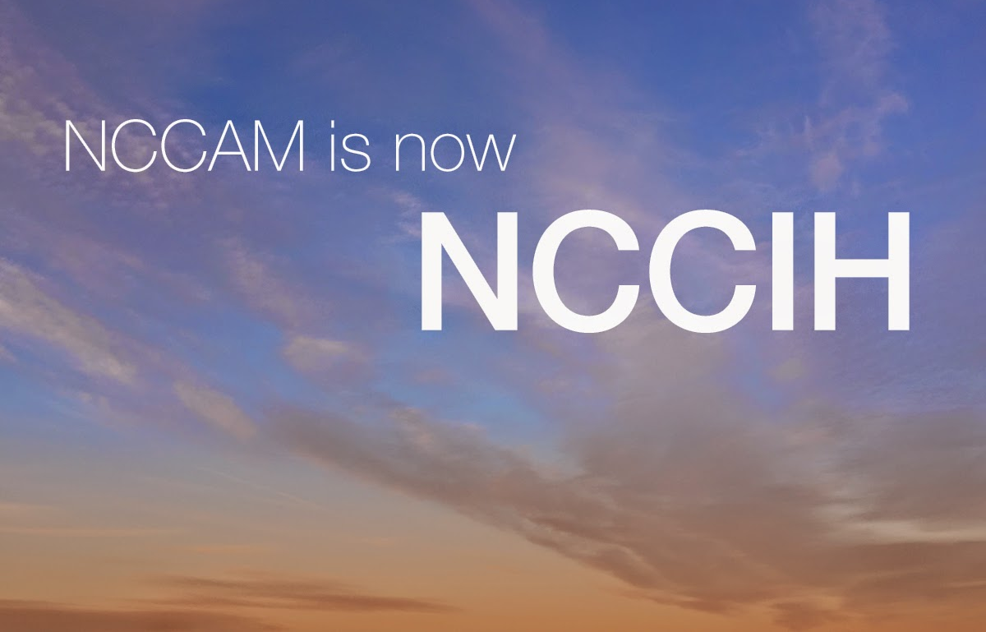

Renaming of an NIH Center: NCCIH
Document 13
Notes:
One of the 27 NIH Institutes and Centers recently underwent a name change. Per language included in the Fiscal Year 2015 budget, the National Center for Complementary and Alternative Medicine (NCCAM) was changed to the National Center for Complementary and Integrative Health (NCCIH). The new name more accurately reflects the Center’s mission and research agenda.

Slide 44
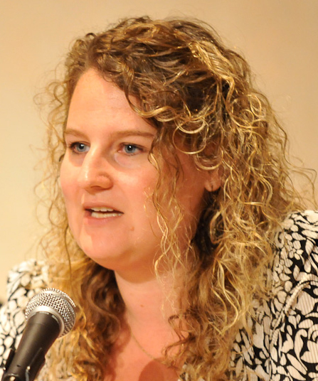

New Associate Director for Science Policy, NIH
Carrie Wolinetz, Ph.D.
Notes:
Dr. Carrie Wolinetz has been appointed the new NIH Associate Director for Science Policy and Director of the NIH Office of Science Policy. Dr. Wolinetz comes to NIH from the Association of American Universities, where she served as Deputy Vice President for Federal Relations— primarily working to coordinate advocacy on funding and policy issues relating to NIH and biomedical research. She also serves as the current President of United for Medical Research and is an Adjunct Assistant Professor at Georgetown University.
Carrie takes over from Dr. David Shurtleff, who took on the role of the acting Associate Director for Science Policy after Dr. Amy Patterson became the Associate Director for Biosecurity and Biosafety Policy. Dr. Wolinetz will start her new position later this month.

Slide 45
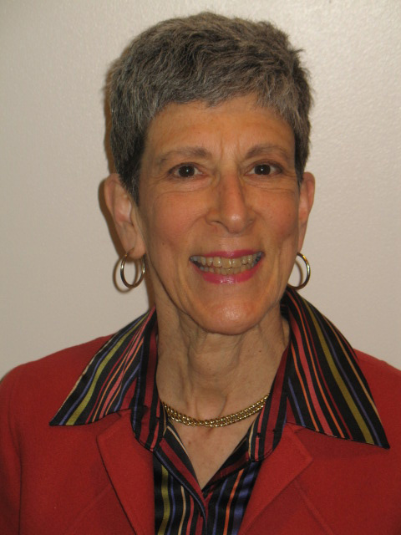

New Deputy Director, National Institute of General Medical Sciences
Judith Greenberg, Ph.D.
Document 14
Notes:
A good friend of NHGRI’s, Judith Greenberg, was recently appointed the Deputy Director of the National Institute of General Medical Sciences (NIGMS). Judith has a long record of dedicated service to NIGMS and NIH, including two extended stints as Acting Director of NIGMS.

Slide 46
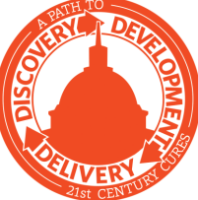
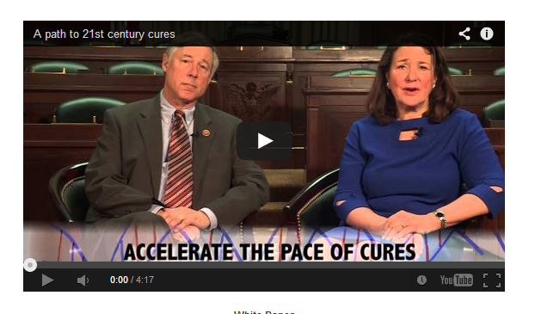
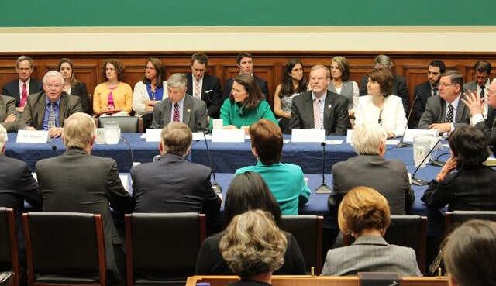
21st Century Cures Act
Document 15
Notes:
In my September Director’s Report, I described how the Energy and Commerce Committee of the House of Representatives, led by Chairman Fred Upton and Rep. Diana DeGette, had launched the 21st Century Cures initiative in June 2014. I also noted that the Committee held multiple roundtables and hearings, one of which I participated in in Colorado, to solicit suggestions about the role that Congress could play in accelerating the pace of scientific discoveries and their translation to treatments and cures.
The Committee had previously indicated it would introduce legislation based on the feedback received and, accordingly, on January 27, it released a discussion draft of legislation entitled “The 21st Century Cures Act.”
The draft bill, at nearly 400 pages, contains numerous provisions affecting NIH. Specific to genomics, there are placeholder sections called “precision medicine” and “modernizing regulation of diagnostics,” but no proposed bill language. While the draft bill was released by Chairman Upton, it does not yet appear to have bipartisan support based on a number of news stories. Nonetheless, committee Democrats continue to express their hope for a bipartisan consensus on the bill.

Slide 47
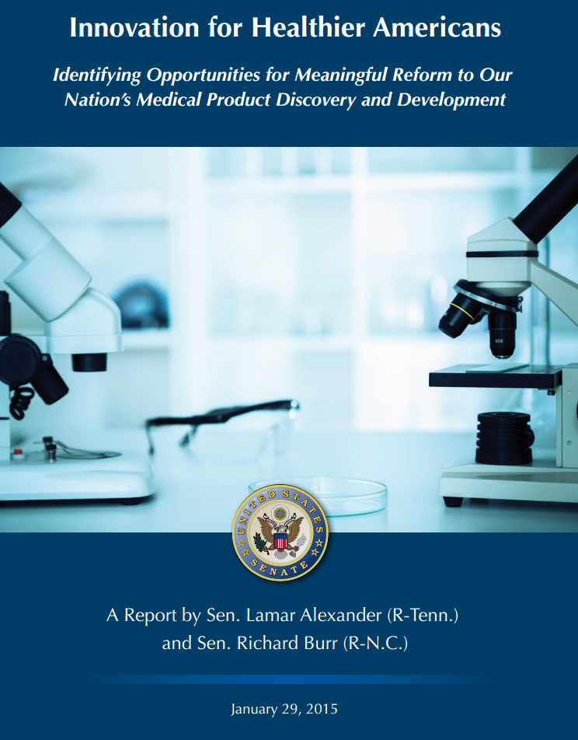
Health, Education, Labor, and Pensions (HELP) Committee Report
Document 16
Notes:
On the Senate side of Congress, the Senate Health, Education, Labor, and Pensions (HELP) Committee Chairman Lamar Alexander and Senator Richard Burr recently released a report detailing their plans to assess the impact and efficiency of the FDA and NIH. Entitled “Innovation for Healthier Americans,” the report details their perceptions of the inefficiencies of the integration of new medical discoveries into patient care. The senators will be soliciting feedback on the report, including through a series of hearings, as they begin to examine the time and cost currently involved with the drug and medical device discovery and development processes as well as how public policies could be better aligned to support medical innovation.
The jurisdiction of the Senate HELP committee is similar to that of the House Energy and Commerce Committee, and there are many similarities between this report and the issues that the 21st Century Cures Initiative is seeking to address. To become law, the 21st Century Cures Act will have to be approved by both chambers of Congress. This report from the HELP Committee is a way for the Senate to contribute its own proposals to the discussion.
Representative Upton has set the goal of Congress sending a bill to the President by the end of 2015; however, Senator Alexander has not indicated whether he shares this goal or not. We are obviously watching all of this very closely because of it obvious potential impact on the Precision Medicine Initiative specifically and the NIH more generally.

Slide 48
Annual Appropriations
 | Fiscal Year 2014 | Fiscal Year 2015 | Fiscal Year 2016 President’s Budget
NIH | $30.2 B | $30.3 B | $31.1 B
NHGRI | $498 M | $499 M (+0.3%) | $515 M (+3.2%)
  ‘CRomnibus’ passed, establishing NHGRI Fiscal Year (FY) 2015 funding
  On February 2, President’s Fiscal Year 2016 budget sent to Congress
Document 17
Notes:
Moving on to budget matters, * with the passage of an appropriations package dubbed the “CRomnibus” bill in December, we now know NIH’s and NHGRI’s Fiscal Year 2015 budget (shown in the middle column). Out of NIH’s $30.3 billion, NHGRI has a little over $499 million, an increase of 0.3% over Fiscal Year 2014 (shown in the left column).
* The focus now turns to establishing funding for next fiscal year. Accordingly, last week, the President sent his Fiscal Year 2016 budget proposal to Congress. As shown in the right column, the President’s budget requests $31.1 billion for NIH, including $200 million for the Precision Medicine Initiative. NHGRI would receive $515 million, which would reflect a 3.2% increase over the current year. Of note, NHGRI’s Congressional Justification (or CJ as we wonks refer to it) is available on genome.gov, with the direct link provided under Document 17. Within the CJ, you can find both a narrative explanation for the major NHGRI programs as well as a break down of how the Institute anticipates allocating the dollars requested by the President, if received.
Congressional groups will now examine this proposal through hearings, but it will be some time before we know NIH’s or NHGRI’s final Fiscal Year 2016 budget. However, looking at all the recent attention and interest at the highest levels of the Administration and in both chambers of Congress about the opportunities for genomics to improve health, it is clear that genomics will be a significant part of the conversation in Washington this year.

Slide 49
Director’s Report Outline
General NHGRI Updates
General NIH Updates
General Genomics Updates
NHGRI Extramural Research Program
NIH Common Fund/Trans-NIH
NHGRI Division of Policy, Communications, and Education
NHGRI Intramural Research Program

Slide 50


Mourning the Loss of Mary Lyon
Document 18
Notes:
A genetics legend, Mary Lyon, passed away in December. Mary developed the idea of X-chromosome inactivation, a process that came to be known as “lyonization” in honor of her theory.

Slide 51



National Medal of Science and National Medal of Technology and Innovation
Douglas Lowy, M.D. and
John Schiller, Ph.D.
Bruce Alberts, Ph.D.
Document 19
Notes:
Late last year, President Obama awarded the * National Medal of Science to Bruce Alberts and the * National Medal of Technology and Innovation to NCI’s own Douglas Lowy and John Schiller. These awards are our Nation’s highest honors for achievement and leadership in advancing the fields of science and technology, and these honorees are good friends of NHGRI’s.

Slide 52


Lasker~Koshland Special Achievement Award in Medical Science
Mary-Claire King, Ph.D.
Document 20
Notes:
Another good NHGRI friend, Mary-Claire King, was recently awarded the Lasker~Koshland Special Achievement Award in Medical Science for “bold, imaginative, and diverse contributions to medical science and human rights.” Mary-Claire played an instrumental role in the discovery of the BRCA1 gene associated with hereditary breast and ovarian cancer and deployed DNA strategies to reunite missing persons or their remains with their families.

Slide 53




Awards at 2014 ASHG Annual Meeting
David Valle, M.D.
Gonçalo Abecasis, D.Phil.
Mark Daly, Ph.D.
Document 21
Notes:
The American Society of Human Genetics (ASHG) gave awards to three members of our community at their 2014 annual meeting in San Diego.
* First, David Valle was the 2014 recipient of the Victor A. McKusick Leadership Award for professional achievements that have fostered and enriched the development of human genetics as well as its assimilation into the broader context of science, medicine, and health.
* Second, Goncalo Abecasis and Mark Daly were 2014 recipients of the Curt Stern Award for significant genetics and genomics scientific contributions during the past decade.

Slide 54

2015 Breakthrough Prize in Life Sciences
Document 22
Notes:
The Breakthrough Prize in Life Sciences recognizes excellence in research aimed at curing intractable diseases and extending human life. Of relevance to genetics and genomics, the 2015 Breakthrough Prize in Life Sciences was awarded to * Jennifer Doudna and Emmanuelle Charpentier for their work on CRISPR/Cas9. In addition, * Gary Ruvkun and Victor Ambros were honored for their exploration of microRNA-based gene regulation.

Slide 55


Elected to the Institute of Medicine
Goncalo Abecasis
Todd Golub
Julie Johnson
Harry Orr
Joe Takahashi
Document 23
Notes:
The Institute of Medicine recently announced their newly elected members. Of relevance to our community, the new members include Goncalo Abecasis, Todd Golub, Julie Johnson, Harry Orr, and Joe Takahashi.

Slide 56

Elected to AAAS
Nancy Allbritton
Russ Altman
Steven Benner
Lon Cardon
A. Chakravarti
Ronald DePinho
Geoffrey Duyk
Irene Eckstrand
Sean Eddy
Jeffrey Friedman
Dan Graur
Chuan He
Trey Ideker
Christine Keating
Bruce Korf
David Landsman
David Ledbetter
Brendan Lee Joseph Loscalzo
Karen Mohlke
Jeffrey Murray
David Nelson
Michael Snyder
William Talbot
Document 24
Notes:
Similarly, an impressive number of genetics and genomics researchers were recently elected to be Fellows of the American Association for the Advancement of Science (or AAAS), with their names listed here. Congratulations to these colleagues as well as those elected to the Institute of Medicine.

Slide 57


New Director, Woods Hole Marine Biological Laboratory
Huntington Willard, Ph.D.
Document 25
Notes:
Tracking the movements of genomics notables…
Hunt Willard was recently appointed the new Director of the University of Chicago Woods Hole Marine Biological Laboratory.

Slide 58


New Executive VP of Global Research and
Chief Scientific Officer, Vertex
David Altshuler, M.D., Ph.D.
Document 26
Notes:
And David Altshuler has joined Vertex Pharmaceuticals as Executive Vice President of Global Research and Chief Scientific Officer.

Slide 59


Opening of the Jackson Laboratory of
Genomic Medicine
Document 27
Notes:
Moving from people to institutions, last October, I was invited by Ed Liu and Charles Lee to participate in the ceremonial opening and ribbon cutting for the Jackson Laboratory of Genomic Medicine. I also spoke at their opening scientific symposium.
The Jackson Laboratory for Genomic Medicine is a nonprofit research center that identifies the precise genetic causes of diseases and spurs the development of individualized plans of treatment and prevention. With 150 employees hired to date, the 183,500-square-foot facility expects to house 300 biomedical researchers, technicians, and support staff within 10 years. It is an impressive facility, and it was fun to participate in their opening events.

Slide 60






The Scientist’s Top Ten Innovations 2014
DRAGEN Bio-IT Processor • Edico Genome
MiSeqDx • Illumina
HiSeq X Ten • Illumina
IrysChip V2 • BioNano Genomics
RainDrop Digital PCR System
• RainDance Technologies
Document 28
Notes:
When The Scientist came out with its Top Ten Innovations of 2014, genomic technologies dominated the list. In fact, each of the top five innovations on their list involve some aspect of the process of genome sequencing.
These include * the DRAGEN Bio-IT Processor by Edico Genome, * Illumina’s MiSeqDx, * Illumina’s HiSeq X Ten, the * IrysChip V2 by BioNano Genomics, and * the RainDrop Digital PCR System by RainDance Technologies.

Slide 61





NHGRI Genome Advance of the Month
Document 29
Notes:
Featured as an NHGRI Genome Advance of the Month since the last Council meeting have been publications describing * the genomic origins of the 2014 Ebola outbreak, * artificial sweeteners and the gut microbiome, * genetic adaptation of the human circadian clock, * supercentenarian genomics, and * DNA testing to detect cancer precursors in blood.

Slide 62












Genomics In The News…
Foundation Medicine Reimbursement Progress Marked by Google
Document 30
Notes:
Recent prominent genomics news stories include * a Forbes article about cancer genome testing, * an article in the New York Times about the funding climate for young scientists, * a Wall Street Journal piece on newborn genome sequencing, * a report at Genome Web regarding Google’s plans to cover cancer genome testing for its employees, and, lastly, * an article in The Scientist about council member David Page and his remarkable research career studying the Y chromosome.

Slide 63















Genomes In The News…
Document 31
Notes:
And in terms of Genomes in the News, there have been a number of newly generated genome sequences reported since the last Council meeting, including: * the oxytricha germline genome, * Glanville fritillary butterfly, * gibbon, * 16 Anopheles species, * house fly, * a modern human man who lived in Siberia 45,000 years ago, * snub-nosed monkey, * koala, * ferret, * orchid, * centipede, * four species of mudskippers, bowhead whale, multiple cat genomes, and a literal flock of different birds.

Slide 64
Director’s Report Outline
General NHGRI Updates
General NIH Updates
General Genomics Updates
NHGRI Extramural Research Program
NIH Common Fund/Trans-NIH
NHGRI Division of Policy, Communications, and Education
NHGRI Intramural Research Program

Slide 65
Genome Sequencing Program
  Two RFAs released in mid-December 2014:
    Centers for Common Disease Genomics (UM1): RFA-HG-15-001
    Centers for Mendelian Genomics (UM1): RFA- HG-15-002
  Applicant information webinar on February 18
  Submission deadline for both RFAs is April 7
Document 32
Notes:
Following the discussion at the September Council meeting about renewal of the NHGRI Genome Sequencing Program and the approval of two initial concepts, * NHGRI released two RFAs in mid-December. One RFA is for the new Centers for Common Disease Genomics program, while the other is for a continuation of the Centers for Mendelian Genomics program. These are the first two RFAs associated with what will be the new NHGRI Genome Sequencing Program.
* For these two published RFAs, NHGRI will host an applicant information webinar on February 18, and then * the submission deadline for both RFAs is April 7.
Later in this Open Session, you will be hearing additional concepts presented that reflect several additional proposed components of the new NHGRI Genome Sequencing Program.

Slide 66
Large-Scale Genome Sequencing
and Analysis Centers
    54 new papers in most recent quarter
    Microbiome
    Comparative Genomics
    Inherited Disease
    Cancer
    Technology Development
Document 33
Notes:
In terms of recent developments with our current program, the Large-Scale Sequencing and Analysis Centers (the largest component of the current NHGRI Genome Sequencing Program) seek to address major biomedical questions by conducting very large genome-sequencing projects.
* The Centers published or submitted 54 new papers in the most recent quarter reflecting projects across a range of areas, including the * microbiome, * comparative genomics, * inherited disease, * cancer, and * technology development.
One of their larger recent projects is the Alzheimer's Disease Sequencing Project, which Council member Eric Boerwinkle will be making a presentation about later in this Open Session.

Slide 67


TCGA Exome Sequencing Progress
TCGA Tumor Publication Status
Cancer Type | Status | Year
Glioblastoma Multiforme 1 | Nature | 2008
Ovarian Carcinoma | Nature | 2010
Breast Cancer | Nature | 2012
Colorectal Adenocarcinoma | Nature | 2012
Lung Squamous Cell Ca | Nature | 2012
Acute Myeloid Leukemia | NEJM | 2013
Uterine Corpus Endometrial Ca | Nature | 2013
Kidney Renal Clear Cell Ca | Nature | 2013
Glioblastoma Multiforme 2 | Cell | 2013
Bladder Urothelial Carcinoma | Nature | 2014
Lung Adenocarcinoma | Nature | 2014
Stomach Adenocarcinoma | Nature | 2014
Chromophobe Renal Cell Ca | Cancer Cell | 2014
Papillary Thyroid Carcinoma | Cell | 2014
Head and Neck Squamous Ca | Nature | 2015
Brain Lower Grade Glioma | Submitted
Skin Cutaneous Melanoma | Submitted
Document 34
Notes:
Another major focus of these large Centers’ attention has been finishing up the The Cancer Genome Atlas (TCGA). * Exome-sequence data production was completed in January 2015; however analysis continues, and the project is scheduled to officially end in Spring 2016. The graph on the left shows the number of tumor/normal pairs with exome-sequencing data, broken down by cancer type. This sequencing data was generated with over 10,000 tumor/normal pairs, and is publically available at the Cancer Genomics Hub (CGHub). The other genomic characterization data is available through the TCGA Data Coordinating Center.
* Tumor-specific analyses remain a major TCGA focus. For each of over 30 cancer types, the TCGA Network’s plan is to publish a comprehensive, integrated analysis of genome-sequence and mutation data, copy-number variation, gene and miRNA expression, and promoter methylation. The table on the right shows the status of TCGA publications. There are currently an additional 15 Analysis Working Groups actively involved in preparing publications. The TCGA paper on papillary thyroid carcinoma was published in Cell in October, and the * head and neck squamous cell carcinoma manuscript was published and featured on the cover of Nature in January.

Slide 68



    Discovery
    Discovery of over 600 causal genes for Mendelian conditions
    Over 125 publications
    Public Project List
    Downloadable project list
    Annotation – OMIM #, project site, interested in additional cases or not
    About 1000 Mendelian disorders currently listed
Document 35
Notes:
Another major component of our Genome Sequencing Program, the Centers for Mendelian Genomics, was established 3 years ago with the aim of finding the genomic cause of as many Mendelian conditions as possible.
* To date, these Centers have been responsible for the discovery of over 600 causal genes for Mendelian conditions, with * some of those discoveries reported in over 125 publications.
* These Centers also undertake a number of activities to facilitate project coordination and collaboration, and to avoid unnecessary duplication of efforts. For example, they publically post their joint project list at the program’s website (an example of which is shown on the right) and update that list regularly. The list is downloadable, and includes the Mendelian conditions that have been investigated and the conditions that are being investigated by the Centers and their collaborators. * It is annotated with OMIM numbers, the Center site at which the project is being performed, and whether or not the Center is interested in getting additional cases or not. * The list currently includes close to 1,000 Mendelian conditions.

Slide 69



Launched in December 2013
Document 35
Notes:
Another service offered by the Centers for Mendelian Genomics program aims to enable connections between clinicians and researchers from around the world who share an interest in the same gene(s), particularly when a gene-phenotype relationship is not yet completely established. Towards that end, the Baylor-Hopkins Center has developed the software tool GeneMatcher, which has been freely available since December 2013. At this site, investigators can post information about genes of interest, and in turn be connected with other investigators who post information about the same gene.
GeneMatcher has been used by a rapidly growing community of researchers since its launch. * This bar graph shows the numbers of submitted genes, submitting investigators, submitting countries, and successful matches made by last August 2014 (in the darker color) and also by January 2015 (in the lighter color). For example, by January, 108 matches have been made out of the 1,493 genes that were submitted by 251 investigators from 29 countries. It is expected that many of these matches will lead to productive collaborations on finding causal genes for Mendelian conditions.

Slide 70

Clinical Sequencing Exploratory Research (CSER) Program
Enrolled 3,058 adults, 707 children;
  2,661 germline, 510 tumor sequences
Amendola, et al., Genome Res. 2015; Jan. 30
Genome Sequenced
Return ACMG list of IFs
+IF identified
No Ifs identified
Do not return IFs
+IF (unknown)
-IF (unknown)
Project life expectancy & lifetime costs
Project life expectancy & lifetime costs
Project life expectancy & lifetime costs
Project life expectancy & lifetime costs
Bennette et al. , Genetics in Medicine, 2014
Document 36
Notes:
And yet another major component of our Genome Sequencing Program, the Clinical Sequencing Exploratory Research (or CSER) Program, focuses on the integration of genome sequencing into the clinical workflow, including the generation, interpretation, and reporting of genomic information. * CSER has enrolled over 3000 adult and over 700 children as participants, over 2,600 of whom have had germline genome sequence data generated and over 500 of whom have had tumor genome sequence data generated.
Two recent papers highlight the diversity of data being generated by CSER investigators. * In a Genome Research paper that is just out online, CSER’s Actionability-Return of Results Working Group reviewed the interpretations of 663 genomic variants from 6,503 individuals and concluded that the rate of secondary findings in individuals is about 1-2%, depending on ancestry. This work highlights future opportunities to improve genomic variant interpretation. In a second paper, * investigators at the University of Washington developed a decision-modeling framework (shown here) for assessing the clinical and economic impact of returning secondary findings. Incremental cost-effectiveness ratios ranged from $45,000 to $115,000 per quality-adjusted life year gained depending on the clinical context. The CSER Outcomes and Measures Working Group is expanding work on the cost-effectiveness of clinical sequencing and organizing cross-site analyses.

Slide 71


Clinical Sequencing Exploratory Research (CSER) Program
Examples of recent impact:
>130 publications, 9 working group publications
>200 presentations/posters
Document 36
Notes:
As one measure of overall impact, * CSER has generated over 130 publications, including 9 working group publications. To date, CSER work has been featured in over 200 presentations and posters, including at several recent national meetings and roundtables.
* CSER was prominently featured at both the American Society of Human Genetics and * the American Society of Bioethics and Humanities in October in San Diego. In total, there were 30 CSER posters and 19 CSER talks at these two meetings.
* In addition, the Institute of Medicine held their 20th roundtable meeting on Translating Genomic-based Research for Health in January in Washington, DC. At that meeting, CSER investigators reported on incidental findings and evidence assessments for returning results from genome sequencing.

Slide 72

Genome Sequencing Informatics Tools
  iSeqTools provides GKNO pipelines that integrate results from multiple variant or mutation callers
  Uses graph realignment to make best call
  IOBIO ‘apps’ for rapid, easy, visual analysis of data
1.
2.
3.
Document 37
Notes:
The final component of the current Genome Sequencing Program, the Genome Sequencing Informatics Tools (GS-IT) Program, is known publicly by the name “iSeqTools.” The program is comprised of six projects that develop approaches to provide ‘researcher friendly’ sequence analysis tools.
The program has developed a method to combine and evaluate multiple variant calls produced by different prediction tools, making this challenging task easy and reliable for users. Specifically, * iSeqTools provides GKNO (pronounced “know”) pipelines that integrate results from multiple variant or mutation callers, * specifically by performing graph realignment of the various calls to resolve the different predictions. This allows users to take advantage of the strengths of multiple variant prediction methods and converge on the most reliable results. In this example, a unified prediction is made from Washington University, Broad, University of Utah, and University of Michigan variant callers. Variant calls from Pindel, GATK, and Freebayes are (1) combined, (2) realigned to a graph reference, and (3) recalled more robustly. The same approach can be applied to mutation calls.
* Easy-to-use genome analysis tools are also being provided as visualization ’apps’ on the web, similar to apps on a smartphone. A growing collection of these apps (called “IOBIO apps”) are available for easy, real-time visual analysis of genomic data.

Slide 73

DNA Sequencing Technology Development
  Grantee meeting and public meeting in May 2015
Sequencing Technology Grantees
Document 38
Notes:
Following a one-year break from an annual gathering, * the Advanced DNA Sequencing Technology Development Program will hold a grantee meeting in San Diego in May. After the one-day grantee meeting, there will be a meeting open to the public. Participants will share their latest progress in DNA sequencing technology development and ongoing challenges to further reduce the time and cost of sequencing whole genomes while improving data quality.

Slide 74

ENCyclopedia Of DNA Elements (ENCODE) Project
  Planning workshop: “From Genome Function to Biomedical Insight: ENCODE and Beyond”
    March 10-11, 2015; NIH Campus
  Annual ENCODE Consortium Meeting
    March 14-17, 2015; Cold Spring Harbor Laboratory
  ENCODE User’s Meeting with hands-on workshops
    June 29-July 1, 2015; Bolger Center, Potomac, MD
Document 39
Notes:
The goal of the Encyclopedia of DNA Elements (or ENCODE) project is to create a catalog of all functional elements in the human and mouse genomes, and to make those catalogs available as a resource to the biomedical community. * NHGRI will be holding a small planning workshop entitled “From Genome Function to Biomedical Insight: ENCODE and Beyond” in March. The goal of this workshop is to obtain community input on possible future scientific directions in the area of genome function following the conclusion of the current phase of ENCODE in 2016. The outcomes of this workshop will be discussed at the May meeting of this Council.
* The annual ENCODE Consortium Meeting will also be held in March. At that gathering, consortium members will present updates on their projects and discuss ENCODE publication plans, emphasizing the importance of releasing high-quality data to the community in the form of an ‘encyclopedia’ of candidate functional elements. And * ENCODE is planning a community User’s Meeting, which will take place in late June. Consortium members will lead hands-on workshops on how to use ENCODE data, while community members will be invited to make presentations on how they are using ENCODE data. The User’s Meeting is open to any scientists interested in using ENCODE data, although registration is not yet open.

Slide 75


ENCyclopedia Of DNA Elements (ENCODE) Project
  ENCODE Publications →
  Mouse ENCODE integrative and companion papers published in late 2014
Document 39
Notes:
To date, the * ENCODE-funded publications include over 370 papers by the ENCODE Consortium participants and over 148 publications by the modENCODE Consortium participants (collectively depicted by the purple part of these bars). There are at least 686 ‘community’ publications from groups using ENCODE data but without ENCODE funding and at least 165 ‘community’ publications from groups using modENCODE data but without modENCODE funding (collectively depicted by the blue part of these bars).
* Mouse ENCODE was funded as a separate entity, initially with ARRA funds, from 2009-2012. This group published an integrative paper in Nature in November comparing DNA elements in the mouse and human genomes. An additional 9 companion papers have also been published in a number of journals, including Nature, Genome Research, PNAS, and Science.

Slide 76

Genomics of Gene Regulation Project
  Goal: To learn how to derive predictive gene regulatory networks starting from genomic data
  Five awards issued in January 2015
  Biological systems include immune system, skin, and nuclear hormone receptor response
Document 40
Notes:
The goal of the * Genomics of Gene Regulation (or GGR) project is to learn how to derive predictive gene regulatory networks starting from genomic data.
* In January, NHGRI issued 5 awards totaling more than $28 million over 3 years.
* With these new grants, researchers will study gene networks and pathways in different biological systems, including the immune system, skin, and nuclear hormone receptor response. The resulting insights into the mechanisms controlling gene expression may ultimately lead to new avenues for developing treatments for diseases affected by faulty gene regulation.

Slide 77

Centers of Excellence in Genomic
Science (CEGS) Program
  Two new CEGS awards:
  Stanford University, Center for Personal Dynamic Regulomes
  Harvard Medical School, Neuropsychiatric Genome- Scale and RDoC Individualized Domains (N-GRID)
Document 41
Notes:
Moving on to our Centers of Excellence in Genomic Science (or CEGS) Program, * two new CEGS awards have been made. * The goal of the CEGS at Stanford University is to develop technologies to interrogate interactions of the genome with its regulatory proteins and noncoding RNAs, integrating variations in DNA sequences and chromatin states over time and across individuals, and using small samples to capture genome-wide information in a clinical workflow.
* The new CEGS at Harvard Medical School will build from an existing neuropsychiatric biobank to develop and use bioinformatic and cellular neurobiology tools, along with assessment of cognition and other phenotypes, to understand the cross-disorder mechanism of action of disease liability genes. This CEGS is being largely funded by our CEGS partner, the National Institute of Mental Health.
* The CEGS annual grantee meeting was hosted in October by Aviv Regev and colleagues at the Broad Institute; this was another productive gathering of CEGS grantees.
Finally, recent CEGS grant applications will be discussed later during the Closed Session of this Council meeting. New CEGS applications are due in May, and it is not too early for potential applicants to contact program staff.

Slide 78

GAIN Data Access Committee
GAIN DAC retired in late 2014 and all GAIN datasets transferred to relevant NIH DACs
Nearly 1,700 project requests from 878 investigators over the course of 8 years
Document 42
Notes:
After nearly 8 years of service, * the trans-NIH Genetic Association Information Network Data Access Committee (called the GAIN DAC) has been retired, and the 10 datasets have been moved to the relevant other NIH DACs. The GAIN DAC was one of the first NIH Data Access Committees established, and it played a significant role in helping to shape the implementation of the GWAS Data Sharing Policy and the dbGaP access process.
* During its 8 years of service, the GAIN DAC received nearly 1700 project requests from 878 U.S. and international investigators from academic institutions, non-for profit organizations, and companies. The cumulative pace of such requests since 2007 is shown in this bar graph.
For all of their hard work, we are extremely grateful to the members to the GAIN DAC team, including the Chair for the past 6 years, Erin Ramos, all former and current committee members, Katya Vaydylevich for serving as the program analyst, and the entire dbGaP team.

Slide 79






GWAS Catalog
  15,000th variant
  2,100th paper
Document 43
Notes:
The NHGRI GWAS Catalog is a curated, downloadable, user-friendly resource that catalogs the findings from published genome-wide association studies. Produced in collaboration with the European Bioinformatics Institute, this past quarter the GWAS Catalog team catalogued its * 15,000th variant and 2,100th paper. Beginning in March, the GWAS Catalog content and search interface will migrate to the European Bioinformatics Institute under the leadership of Helen Parkinson and Paul Flicek, recipients of a recent U41 grant to make further informatics and curation improvements to this widely used resource.
* Catalog users are being alerted to this transition on the NHGRI GWAS Catalog homepage, and can sign up to receive email updates about the transition.
* The EBI GWAS Catalog page is currently under development, and will be linked to the NHGRI GWAS Catalog homepage as soon as it is available.

Slide 80


AMIA 2014 Distinguished Paper & Homer R. Warner Awards
Development and validation of an electronic phenotyping algorithm for chronic kidney disease
Girish N. Nadkarni, Omri Gottesman, James G. Linneman, Herbert Chase, Richard L. Berg, Samira Farouk, Rajiv Nadukuru, Vaneet Lotay, Steve Ellis, George Hripcsak,
Peggy Peissig, Chunhua Weng, Erwin P. Bottinger
SOEMPI: A Secure Open Enterprise Master Patient Index Software Toolkit for Private Record Linkage
Csaba Toth, Elizabeth A. Durham, Murat Kantarcioglu, Yuan Xue, Bradley Malin
Document 44
Notes:
Investigators in the eMERGE Network leverage data from large biorepositories linked to electronic medical records to conduct genomic discovery and clinical implementation research. In the final year of its second phase, the Network is actively disseminating its products and best practices among the broader scientific community.
* As part of the eMERGE-PGx project, investigators are collecting sequence data for 82 pharmacogenomic genes from a target cohort of 9,000 subjects. The Network has been cataloguing variants and their related information on its publically available web-based resource, SPHINX. To date, SPHINX includes information about nearly 5,000 unique samples and nearly 26,000 variants associated with 60 pathways and relevant for 515 drugs.
* At the American Medical Informatics Association (AMIA) Symposium in November, eMERGE investigators received a Distinguished Paper Award for electronic phenotyping and the Homer R. Warner Award for their exportable software that protects biobank participant privacy. eMERGE will also lead two panel discussions and three workshops at the upcoming AMIA Translational Bioinformatics and Clinical Research Informatics Summit to be held in March 2015.

Slide 81



    NIMH suicide and PTSD measures released in December 2014
    New NHLBI funding for sickle cell disease
    PhenX protocols released in REDCap
Ethnicity
Record ID | 100001
Do you consider yourself Hispanic/Latino? [Where did your ancestors come from?] | Yes No Refused Don’t Know
Please give me the number of the group that represents your Hispanic origin or ancestry. Please select 1 or more of these categories. | Puerto Rican Dominican Mexican/Mexicano Mexican American Chicano Cuban Cuban American …
Document 45
Notes:
The consensus measures of Phenotypes and eXposures (PhenX) project has produced an online resource of standard measures related to common diseases, phenotypic traits, and environmental exposures. Use of PhenX measures facilitates combining data from a variety of studies, and makes it easy for investigators to expand a study design beyond the primary research focus.
* As a result of an NIMH-funded supplement to this U41 cooperative agreement, PhenX developed a new collection of measures focused on suicide and post-traumatic stress disorder. These measures were released in the Toolkit in December 2014.
The interest in the PhenX process and Toolkit continues to grow. * NHLBI has provided funds to launch a new sickle cell disease working group; the working group is just getting off the ground, and measures will be developed over the next year.
* Lastly, PhenX has worked closely with Vanderbilt’s REDCap database team to make the standard protocols from three PhenX domains available in RedCap. The group plans to make five monthly releases in 2015 for the remaining 18 domains. The PhenX library will have a total of 429 protocols, and is expected to become the biggest library in REDCap.

Slide 82

PAGE Multi-Ethnic Genotyping (MEGA) Array
PAGE-related Traits
Custom Content
36,000 Multiethnic Exomes
ClinVar, OMIM
1000 Genomes Project
Existing
Multiethnic Exomic Variants
Functional Variants
GWAS Scaffold
African Diaspora
Power Chip
Human Core Array
Human Exome Array
Document 46
Notes:
The Population Architecture using Genomics and Epidemiology (PAGE) program focuses on identifying and characterizing genomic variants associated with common disease in ancestrally diverse populations.
PAGE investigators, in collaboration with Illumina and the Consortium on Asthma in African-Ancestry Populations in the Americas Consortium, recently designed a large-scale, 1.7-million marker Multi-Ethnic Genotyping (or ‘MEGA’) array that facilitates discovery of genomic variants in multiethnic populations. * Building upon existing resources (such as the African Diaspora Power Chip and previous Human Core and Human Exome Arrays), PAGE investigators added * a more robust multiethnic GWAS scaffold based on the 1000 Genomes Project data, * functional variants drawn from databases such as ClinVar and OMIM, * new exomic variants based on 36,000 multiethnic exome sequences, as well as * additional custom content around loci relevant to PAGE-related traits.
The array is being made available to the scientific community for improved characterization of non-European ancestry samples at a cost of about $75 apiece.

Slide 83



Standardizing clinical assessment of genomic variants and their deposition into ClinVar
GenomeConnect:
ClinGen’s Patient Portal
ClinGen-DECIPHER Public Meeting in May 2015
Document 47
Notes:
The purpose of the Clinical Genome Resource (ClinGen) is to create a centralized repository and interconnected resource of clinically relevant genomic variants for both the clinical and research communities.
ClinGen investigators are working closely with NCBI and clinical laboratories to * standardize the clinical assessment of genomic variants and the process of submitting them into the ClinVar database. As shown here, there has been a steady increase in submissions to ClinVar; in fact, as of January 2015, there are over >129,000 genomic variants represented in ClinVar.
* ClinGen recently launched a patient portal, called GenomeConnect. Patients enter phenotypic information and genetic testing reports to GenomeConnect through the PatientCrossroads registry platform, and have the option to connect with researchers and other families/individuals with same genomic variant(s).
* In May 2015, ClinGen will co-host a large public meeting with the Sanger Institute’s group that oversees DECIPHER (Database of Chromosomal Imbalance and Phenotype in Humans using Ensembl Resources). ClinGen is looking forward to forging an international collaboration focused on the curation of genomic variants.

Slide 84








Newborn Sequencing In Genomic Medicine and Public HealTh (NSIGHT)
Harvard Hospitals
UCSF
Boston, MA
San Francisco, CA
Children’s Mercy
Kansas City, MO
UNC – Chapel Hill
Chapel Hill, NC
Document 48
Notes:
The Newborn Sequencing in Genomic Medicine and Public Health (NSIGHT) program will explore, in a limited but deliberate manner, the implications, challenges, and opportunities associated with the possible use of genomic sequence information for the care of newborns.
The four sites held the inaugural NSIGHT Steering Committee Meeting in September, at which key personnel from each of the sites discussed progress and network-wide projects.
* Additionally, in December, investigators from the Children’s Mercy Hospital site published a paper in Science Translational Medicine describing their experience in using exome and genome sequencing to diagnose neurodevelopmental disorders in children, including newborns within their Neonatal Intensive Care Unit. In nearly 50% of the cases, a change in clinical care or impression of the pathophysiology was reported.

Slide 85


Genomics and Society Working Group
  Next in-person meeting in April 2015
  Outgoing members: Tim Caulfield, Jeff Long, Andrea Patenaude, and David Williams
  New members: Chanita Hughes-Halbert, Barbara Bernhardt, and David Veenstra
  Change in leadership:
Pamela Sankar, Ph.D.
University of Pennsylvania
Lisa Parker, Ph.D.
University of Pittsburgh
Document 49
Notes:
The Genomics and Society Working Group of this Council is charged with providing advice on short- and long-range planning and priority setting for the genomics and society activities at the Institute. * The Working Group will hold its next in-person meeting in April.
* As the Working Group enters its third year, the founding members are starting to reach the end of their terms. I would like to thank outgoing members Tim Caulfield, Jeff Long, Andrea Patenaude, and David Williams. I greatly appreciate their service to the Institute.
* And I would also like to thank and welcome Council member Chanita Hughes-Halbert, Barbara Bernhardt of the University of Pennsylvania, and David Veenstra of the University of Washington, all of whom will be joining the Working Group.
* Finally, after successfully leading the Working Group since its inception in 2012, Pamela Sankar will be stepping down from her role as Chair, and current Working Group member Lisa Parker has agreed to serve as the next Chair. My thanks to both Pamela and Lisa for their continued contributions to this important Working Group.

Slide 86

ELSI Research Program
  New ELSI NRSA Institutional Training Grant (T32) mechanism
  Centers of Excellence in ELSI Research (CEER):
    First Regional CEER Networking Meeting February 23-24, 2015
    Annual CEER Investigator Meeting March 16-18, 2015
    New CEER RFA Concept Clearance
Document 50
Notes:
In December, * NHGRI issued a notice announcing an expansion of its participation in the Ruth L. Kirschstein National Research Service Award (NRSA) Institutional Training Grant program, so as to accept applications focused on training the next generation of ELSI Researchers. The goal of this initiative is to support training experiences that provide an opportunity for predoctoral and postdoctoral trainees to develop the multi-disciplinary conceptual and methodological skills necessary to pursue independent careers as ELSI researchers. The first applications for this are due in late May for possible funding in the Spring 2016.
* In terms of our Centers of Excellence in ELSI Research (or CEER) program, * the First Regional CEER Networking Meeting for trainees and investigators is being held at the University of Washington in late February. The purpose of this meeting is to provide a more sustained training and networking experience for trainees associated with CEERs in the Western half of the country, many of whom are unable to travel to the annual meetings on the East Coast. * The next Annual CEER Investigator Meeting will be held in March in Baltimore Maryland.
* Finally, a concept clearance for the next Request for Applications (RFA) for the CEER program will be discussed later in the Open Session of this council meeting.

Slide 87
Director’s Report Outline
General NHGRI Updates
General NIH Updates
General Genomics Updates
NHGRI Extramural Research Program
NIH Common Fund/Trans-NIH
NHGRI Division of Policy, Communications, and Education
NHGRI Intramural Research Program

Slide 88

Human Microbiome Project (HMP)
  HMP Phase 2: ‘integrative HMP’ (iHMP)
  iHMP marker paper (open access)
  iHMP Data Coordination Center
  2nd iHMP Consortium Meeting
    June 2015
    Bethesda
  5th International Human Microbiome Consortium Congress
    March 2015
    Luxembourg
Document 51
Notes:
Phase two of the Human Microbiome Project (HMP) is now known * as ‘integrative HMP’ (or iHMP) to reflect its goals of producing integrated multi-omic data from DNA, RNA, proteins, and metabolites from the host and microbiome, with the resulting datasets serving as a community resource.
* The iHMP marker paper, which describes the data being produced in the three longitudinal cohort studies of preterm birth, inflammatory bowel disease onset, and type 2 diabetes onset, was published as an open access paper in Cell Host & Microbe in the early fall.
* The NIH Common Fund provided an additional $5.75M to support an iHMP Data Coordination Center at the University of Maryland.
* The 2nd annual iHMP Consortium Meeting will be held in June 2015 in Bethesda, while the * 5th International Human Microbiome Consortium Congress will take place in March 2015 in Luxembourg. Over 500 participants are expected at this latter gathering, including 60 invited speakers representing 13 countries from 4 continents.

Slide 89

Knockout Mouse Phenotyping Project (KOMP2)
    International Mouse Phenotyping Consortium annual meeting in November
    Planning for renewal of KOMP2 program
    Sexual dimorphism evident in mutant phenotypes in the KOMP2 database
Document 52
Notes:
The Knockout Mouse Phenotyping Project (KOMP2) is jointly funded by the NIH Common Fund and 18 other NIH institutes and centers. It was launched in 2011 with the goal of making and phenotyping 2,500 mouse knockout strains over five years.
* KOMP2 investigators met with their International Mouse Phenotyping Consortium partners at their annual meeting in November. The meeting was intense, with the first day involving a data update involving ~150 consortium members and the second day involving summary presentations and feedback sessions with the Panel of Scientific Consultants.
* The KOMP2 program team is developing an agenda for a focus group meeting in March to help develop a proposal for renewal of the KOMP2 program for a second five years of Common Fund support.
* In light of the new policy on including sex as a biological variable in research design, the current phenotype data from knockout mice was analyzed for sexual dimorphism. Preliminary analyses reveal that approximately 10% of phenotypes show this effect. The KOMP data was presented to the NIH Office of Research on Women’s Health in November, and is the subject of ongoing analyses.

Slide 90

  Six investigator-initiated LINCS Data and Signature Generation Centers
  One NIH-initiated BD2K- LINCS Data Coordination and Integration Center
  First trans-LINCS meeting in October
    Data/tools release milestones for all centers developed
  Collaborative data science research opportunity announcement published
Document 53
Notes:
LINCS aims to create a network-based understanding of biology by cataloging changes in gene expression and other cellular processes that occur when cells are exposed to a variety of perturbing agents. LINCS uses computational tools to integrate this diverse information into a comprehensive view of normal and disease states that can be applied for the development of new biomarkers and therapeutics.
The LINCS pilot phase has concluded, and Phase 2 awards were made shortly after the September Council meeting. * This included the funding of six Data and Signature Generation Centers, and one NIH-initiated, joint BD2K-LINCS Data Coordination and Integration Center.
* The first trans-LINCS meeting involving investigators in all of these centers was held in October, after which the External Scientific Panel generated a report on the program’s progress. * All of the centers have now developed milestones for release of data and tools.
* Finally, an announcement has now been published about the Data Coordination and Integration Center’s plan to solicit and support several specific, short-term data science research collaborations; these aim to enhance interactions between outside investigators and LINCS as well as to bring in novel expertise and analytical capabilities to the LINCS program.

Slide 91



H3Africa
  5th Consortium Meeting in November (Tanzania)
    Grant Writing Workshop
    Study Coordinators Session
    Sickle Cell Disease Workshop
  Supplement for whole-genome sequencing
  Progress on developing custom genotyping chip
  Supplement for research ethics training
  6th Consortium Meeting in May (Zambia)
Document 54
Notes:
H3Africa’s central goal is to develop a sustainable and collaborative African genetics and genomics research enterprise. * The 5th H3Africa Consortium Meeting took place in November in Tanzania. Highlights included the presence of trainees and study coordinators at the meeting, with a well-attended grant writing workshop and a study coordinator-led discussion session. The meeting was preceded by an NHLBI-sponsored Sickle Cell Disease Workshop that attracted ~145 participants from 18 countries. * H3Africa has been given supplemental funds to perform whole-genome sequencing of more than 300 samples, with resulting data * used to design a pan-African custom genotyping chip that will be put into production by May 2015.
* A supplement was given to develop a genetics and genomics training module for research ethics committees in Africa. Topics will include informed consent, community engagement, and data and sample sharing. Meanwhile, recent H3Africa publications include proceedings from the May ethics meeting * as well as a letter to the editor of The Scientist by Francis Collins and Jeremy Farrar responding to an article critiquing the lack of basic science research funding for African scientists. The Collins/Farrar letter discussed how H3Africa is a prototype example of an effort aiming to address this problem.
* The next H3Africa Consortium Meeting will be held in May 2015 in Zambia, and this will be followed by a Consortium meeting in October 2015 in Washington DC (which will be held immediately after the Annual ASHG Meeting in Baltimore).

Slide 92


Undiagnosed Diseases Network (UDN)
Document 55
Notes:
The NIH Common Fund Undiagnosed Diseases Network (UDN) aims to improve the level of diagnosis and care for patients with undiagnosed diseases, facilitate research into the etiology of these diseases, and create an integrated and collaborative research community to identify and share improved options for optimal patient management.
In September, Baylor College of Medicine and the Medical College of Wisconsin were awarded UDN Sequencing Core grants to provide centralized genome sequencing for the UDN. These two cores will provide CLIA-level exome and genome sequencing data and clinical reports generated from patients and family members. The full set of different network sites is shown here.
The UDN investigators held a Steering Committee meeting in November. Key personnel from each of the 10 network sites were in attendance to ratify new chapters of the network’s Manual of Operations and to establish standardized procedures for genome sequencing prior to the acceptance of the first UDN patient.

Slide 93







Undiagnosed Diseases Network (UDN)
PI Name | Gene | Model | Patient Phenotype
Worley | FRMPD4 | mouse, human male cohort | developmental delay and regression, seizures
Lin | HK1, SUSD4, CCDC89, and BAI2 | zebrafish | neurodegeneration and spastic tetraplegia like syndrome
Antonellis | GARS, AARS, and DARS | yeast, cell culture, zebrafish | recessive disease phenotypes
Graham | ATP1A3, SYNE1, SNAP29, ARHGAP22, KIF4B and XRN1 | patient primary fibroblasts, drosophila | neurological and/or metabolic phenotypes
Chen | 50 genes | zebrafish | many
Slusarski | 15 genes | zebrafish | epilepsy
Document 55
Notes:
Six Gene Function Research R21 awards for the UDN were made in August and September. As you can see from this table, these six studied will investigate the underlying genetics, biochemistry, and/or pathophysiology of newly diagnosed diseases in association with gene variants identified through the UDN– in many cases using model systems.
* Additionally, JAMA published two papers in November by investigators from the Baylor College of Medicine Sequencing Core and the UCLA Clinical Site describing their experiences in using clinical exome sequencing as a diagnostic test.

Slide 94

Big Data to Knowledge (BD2K) Initiative
  Funded BD2K Elements
    Centers of Excellence, Data Discovery Index Coordination Consortium, Short Courses, Open Educational Resources, Mentored Career Development
    Joint kickoff meeting in November
  Recently Reviewed Elements
    Targeted Software Development
    Institutional Pre-Doctoral Training Programs
Document 56
Notes:
The trans-NIH Big Data to Knowledge (BD2K) Initiative aims to enable scientists to use ‘big data’ to advance biomedical research. * The first round of awards was made shortly after the last Council meeting. This included 12 Centers of Excellence and the Data Discovery Index Coordination Consortium, with the associated principal investigators gathering at a kickoff meeting in Bethesda in November. At this meeting, it was emphasized that they were expected to function as a consortium.
Similarly, the first set of BD2K training awards went out at the end of last fiscal year, and these were for short courses, open educational resources, and mentored career development. The associated principal investigators for the open educational resources also attended the November meeting.
* There are a number of recently reviewed BD2K elements that will be funded in the upcoming months. One is for software development in four targeted areas of need: data wrangling, compression, visualization, and provenance. The BD2K Multi-Council Working Group has reviewed these applications. A new version of the RFA with different targeted areas will be released later this year.
In addition, the training program has completed the review of applications for institutional pre-doctoral training programs in biomedical big data science. This RFA has a second receipt date in March.

Slide 95

Future BD2K Efforts
  The Commons
  NIH Standards Information Resource
  Database Sustainability
  Training Coordination Center
  Diversity
Document 56
Notes:
In terms of future BD2K efforts and priorities, * The Commons is one of the biggest. The goal is to have a space where data, software, and completed analyses are co-located in a cloud environment. Small pilot projects, some of which will be driven by the needs of specific NIH institutes and centers, will be started in the coming months.
* The NIH Standards Information Resource will be a resource where existing data standards and associated metadata are gathered together, allowing researchers to choose the best existing standard for a dataset. * Another BD2K group is focused on sustainability of large biological resources. This group will be holding a workshop later this year to gather experts both within and outside of biomedicine to come up with possible solutions to the growing problem of sustaining biomedical data resources.
* The BD2K training group has released an RFA for a Biomedical Data Science Training Coordination Center, which will aim to develop a network of educators, mentors, and trainees and to produce an index for publicly-available training materials. Applications are due in March.
* Finally, BD2K is also focused on creating a diverse biomedical data science workforce. An RFA was posted in January to support creative educational activities that increase diversity, focusing on research experiences and curriculum development.

Slide 96
Genome Privacy Challenge
  iDASH center and collaborators develop solutions to problems in data sharing and privacy protection
  2nd iDASH privacy challenge in March 2015
    Challenge 1: Homomorphic encryption
    Challenge 2: Secure multiparty computing for secure genomic data analysis across institutions
Document 57
Notes:
iDASH is a * Common Fund center funded as part of the National Centers for Biomedical Computing Program and is dedicated to developing innovative solutions to sharing data for analysis in healthcare and genomics while maintaining privacy. NHGRI funded an iDASH collaborating grant to Indiana University to address issues around privacy with genomic data in particular.
* Using this funding, this iDASH collaboration will be holding the 2nd iDASH privacy challenge in March, a workshop to examine security issues related to genome analysis. The two challenge topics for this workshop will be: * (1) homomorphic encryption, and * (2) secure multiparty computing for secure genomic data analysis across institutions.

Slide 97
Director’s Report Outline
General NHGRI Updates
General NIH Updates
General Genomics Updates
NHGRI Extramural Research Program
NIH Common Fund/Trans-NIH
NHGRI Division of Policy, Communications, and Education
NHGRI Intramural Research Program

Slide 98



Inter-Society Coordinating Committee for Practitioner Education in Genomics
Physicians and Dentists
Pharmacists and Nurses
Genetic Counselors
In-person meeting in November 2014
New working groups:
    Physician-patient Communications
    Innovative Approaches to Education
Document 58
Notes:
The Inter-Society Coordinating Committee for Practitioner Education in Genomics (called the ISCC) has continued its work on improving the genomic literacy of healthcare practitioners and enhancing the practice of genomic medicine. * In August, Teri Manolio and Michael Murray published a paper in Genetics in Medicine about the growing role of professional societies in educating clinicians in genomics. * At present, the group’s membership includes individuals from professional societies representing physicians, dentists, pharmacists, nurses, and genetic counselors.
* This past November, the group held its third in-person meeting, where members discussed the group’s progress to date, developed plans for engaging CME representatives from the 51 professional societies and new federal partners, and created new working groups to address physician-patient communications related to genomics and innovative approaches to the development of educational programs (modeled after a successful program for training pathology residents in genomics).
NHGRI’s new Genomic Healthcare Branch Chief, Bob Wildin, will take over for Teri Manolio as the NHGRI Co-Chair of the ISCC. The group’s leaders will continue to explore ways to sustain the ISCC as its scope grows beyond NHGRI’s reach. Finally, you will hear more about the ISCC in the talk by Teri Manolio on the Genomic Medicine Working Group later in the Open Session.

Slide 99







Physician Resources Now on G2C2
Document 59
Notes:
The Genetics and Genomics Competency Center (or G2C2) website is a free clearinghouse for healthcare provider-oriented educational resources. It is managed by an editorial board, and contains competencies for clinical providers from nursing, genetic counseling, physician assistants, and pharmacist disciplines.
* I am now pleased to announce that, with the help of a working group of the Inter-Society Coordinating Committee for Practitioner Education in Genomics (the ISCC), the site now has physician competencies and peer-reviewed resources. This ISCC working group continues to add resources to this, including journal articles, videos, and teaching method information.
* The site has recently been redesigned, so that the searchable educational resources for physicians are linked to discipline-specific competency guidelines developed and published by the ISCC. Providers can now target their educational efforts for competencies that they are lacking.

Slide 100

Newborn Screening Saves Lives Reauthorization Act of 2014
Document 60
Notes:
On December 18, President Obama signed into law the Newborn Screening Saves Lives Reauthorization Act of 2014, which extends programs supporting newborn screening activities through Fiscal Year 2019, and reauthorizes the Secretary’s Advisory Committee on Heritable Disorders in Newborns and Children.
This reauthorization also directs the Department of Health and Human Services to update the Common Rule within two years. And importantly, it requires that, until the Common Rule is updated, parental consent is required for the use of newborn blood spot samples in research. This new consent requirement applies to the research use of blood spots collected after March 18 of this year.

Slide 101




Clinical Trials Policy Update
    New definition of “clinical trial”
    Reporting requirements
    Centralized Institutional Review Boards (IRBs)
Document 61
Notes:
Over the past year, NIH has rolled out a series of policy changes to enhance stewardship of clinical trial investments. * First, in October 2014, NIH issued a new definition of “clinical trial,” which went into affect on January 25. Under the new definition, a clinical trial is a human subjects study that is prospective, interventional, and measures health-related outcomes. The definition is significant because it dictates which studies are subject to specific reporting and monitoring requirements.
* Second, on November 19, NIH proposed changes to reporting policies. The proposed changes are intended to improve transparency and maximize the utility of research investments by expecting that summary data from NIH-funded clinical trials is reported in ClinicalTrials.gov within 12 months of the study’s completion. Previously, some smaller trials and some trials that were not FDA-regulated did not have reporting requirements. We anticipate that clearer requirements will improve the utility of genomics research data; however, implementation of the policy will require input from the community. NIH is accepting public comments through February 19.
* Finally, on December 3, NIH proposed a new policy promoting a single IRB of record for multi-site studies. Having one IRB for a multi-site study is aimed at streamlining review processes and expediting study launch. The public comment period for this proposal closed January 29.

Slide 102


FDA Lab-Developed Test (LDT) Guidance
Document 62
Notes:
The five months since our last Council meeting have seen quite a lot of action with regards to FDA’s decision to exercise oversight over laboratory-developed tests (or LDTs.) Currently, if a molecular diagnostic test is developed and only performed in a single laboratory, it is classified as an LDT and receives no FDA oversight. In contrast, a similar diagnostic test that is marketed as a kit and sold to multiple labs has been subject to FDA oversight for many years. As reported to Council at the September meeting, the FDA recently laid out in draft guidance that aims to level the playing field.
During the 120-day public comment period on the draft guidance, FDA held a two-day workshop to hear public testimony and stimulate discussion. Several NHGRI staff members acted as moderators for panel discussions, and over the course of those two days, the agency heard a wide range of views and opinions from stakeholders.
The debate over the appropriate level of FDA regulation for diagnostics is also being conducted in the literature, including a pair of commentaries published in JAMA at the beginning of January. * One, by Joshua Sharfstein, argues in favor of FDA regulating lab-developed tests, while * a second, written by Council’s own Jim Evans and ACMG’s Mike Watson, argues against such a move.

Slide 103


FDA Workshop on Oversight of
‘Next-Generation’ Genome Sequencing
Public Workshop: Optimizing FDA’s Regulatory Oversight of Next-Generation Sequencing Diagnostic Tests
February 20, 2015
Document 62
Notes:
Although the public comment period for FDA’s LDT guidance is now closed, the community has another opportunity to advise the agency on how best to regulate the use of next-generation DNA sequencing in diagnostic testing. Last year, FDA published a white paper on the challenges of regulating next-generation DNA sequencing assays compared to more traditional in vitro diagnostics that have more clearly defined intended uses. * FDA is now holding a public workshop at NIH on February 20 specifically to explore this topic.

Slide 104

Informed Consent Resource for Genomics
    Discussion of topics essential to genomics research
    Sample language and consent forms
    Relevant regulations and policies
    Email: informedconsent@mail.nih.gov
Document 63
Notes:
NHGRI has for many years maintained an online resource for issues pertaining to informed consent processes for genomic research. An update to this Informed Consent Resource went live on genome.gov last week. The webpage is designed to help researchers and IRBs consider informed consent issues that are specific to the context of genomic science.
* It includes discussion of topics essential to genomics research, such as considerations for families, studies involving children, and broad versus specific consent. * It also includes sample language and consent forms, * as well as discussion of relevant regulations and policies. Some of the new and updated content relates to data repositories and biobanking, whole-genome and whole-exome sequencing, data sharing, and return of results. Thanks to the many reviewers, including some Council members, who provided feedback during development.
We hope that this is a valuable reference for the research community, and we are actively encouraging comments or suggestions; * in fact, there is a dedicated email account for this resource, and we hope to see this become a dynamic area for information exchange and sharing of useful consent language.

Slide 105




Genome: Unlocking Life’s Code Exhibition
Closing Symposium
Document 64
Notes:
As the Genome: Unlocking Life's Code exhibition ended its tenure at the National Museum of Natural History and began its North American tour, a closing symposium was held in September to explore the importance of genomic medicine and what the next decade holds for genomic advances.
More than 300 people filled the Baird Auditorium at the museum to hear a series of panels. * One included me, Anne Wojcicki from 23andMe, and Rick Lifton from Yale; * while another featured Pardis Sabeti from the Broad and Harvard, Charles Rotimi from NHGRI, and Seema Kumar from Johnson and Johnson. Panelists discussed the future of human genomics: where research is headed, the role of the private citizen in genomic testing and research, access to genomic testing, and genomics and global health.
* In the evening, the public was treated to a conversation featuring Washington Post Advice Columnist Carolyn Hax and Barbara Biesecker from NHGRI and David Valle from Johns Hopkins. The panelists answered audience questions about health issues, genetics, and dealing with disease in their personal lives.

Slide 106





Genome: Unlocking Life’s Code Exhibition
Military Family Day
Document 64
Notes:
Realizing that the Genome: Unlocking Life’s Code traveling exhibition would make its first stop in San Diego at the Reuben H. Fleet Science Center, NHGRI was presented with a wonderful opportunity to highlight the exhibition and to work with some of the local organizations that provide on-the-ground support for military families in the San Diego area.
In November, NHGRI partnered with the San Diego Military Family Collaborative to host a Military Family Day at the Fleet Science Center. More than 700 people from military families (ranging from infants in arms to retired military) attended the event. Military families were able to visit the Fleet Science Center at no charge, participate in genomics-focused, hands-on activities with scientists from local universities and organizations, see the Genome: Unlocking Life’s Code exhibition, enjoy complimentary lunch, and receive information from more than 30 San Diego area resource providers.

Slide 107

Genome: Unlocking Life’s Code Exhibition
Travel Schedule
2015
  January 22-April 27:
  The Tech Museum of Innovation
  San Jose, CA
  May 15-September 10
  The Saint Louis Science Center
  St. Louis, MO
  October 2-January 3
  Oregon Museum of Science and Industry
  Portland, OR
2016
  January 18-April 25
  Discovery World Milwaukee
  Milwaukee, WI
Document 64
Notes:
The Genome: Unlocking Life’s Code exhibition now has a busy travel schedule around North America. The first stop at the Reuben H. Fleet Science Center in San Diego concluded on January 2. More than 50,000 people visited the exhibition during its 3-month stay in San Diego. * The exhibition has now traveled north to The Tech Museum of Innovation in San Jose, where it will reside until the end of April. * After San Jose, the exhibition will travel to St. Louis until mid-September, and then on to * Portland, Oregon until early in 2016. * The first destination for the exhibition in 2016 will be Milwaukee.
In each of the locations where the exhibition is headed, NHGRI is working in partnership with science centers, universities, community organizations, and our grantees to develop programs for targeted populations as well as reaching out to local health professionals. As always, check the exhibition’s web site at unlockinglifescode.org for the most up-to-date information on the exhibition as it travels.

Slide 108
Director’s Report Outline
General NHGRI Updates
General NIH Updates
General Genomics Updates
NHGRI Extramural Research Program
NIH Common Fund/Trans-NIH
NHGRI Division of Policy, Communications, and Education
NHGRI Intramural Research Program

Slide 109

Report of the NIH Intramural Research Program Working Group
Document 65
Notes:
In the middle of 2014, Francis Collins established a working group of the NIH Advisory Committee to the Director focused on long-term strategic planning for the broader NIH Intramural Research Program (IRP). The working group was charged with identifying new areas of opportunity for the Intramural Research Program, approaches to capitalize on its uniqueness, and ways to ensure its healthy and productive future. Council member Bob Nussbaum served on this working group.
In December, the working group delivered its report, which contains recommendations for a number of structural and strategic changes, including the creation of a trans-NIH intramural 'innovation fund' and modifications to the external review process. The NIH leadership, including Institute Directors and Scientific Directors, are now working to decide which of the recommended elements will be implemented.

Slide 110

2014 CHANEL-CERIES Research Award
Julie Segre, Ph.D.
Document 66
Notes:
Julie Segre, Senior Investigator and Chief of the NHGRI Translational and Functional Genomics Branch, was selected for the 2014 CHANEL-CERIES Research Award. She received this honor in recognition of her research on the microbiome of human skin.

Slide 111

2014 Rare Voice Award
William A. Gahl, M.D., Ph.D.
Document 67
Notes:
Bill Gahl, NHGRI Clinical Director and Director of the NIH Undiagnosed Diseases Program, received a 2014 Rare Voice Award in the Government Agency category. This award recognizes organizations and individuals who go above and beyond to become policy leaders and political advocates in their state and nation.

Slide 112

2014 NSGC Leadership Award
Natalie Weissberger Paul National Achievement Award
Barbara B. Biesecker, M.S., Ph.D., C.G.C.
Document 68
Notes:
Barb Biesecker, Associate Investigator in the NHGRI Social and Behavioral Research Branch, received the Natalie Weissberger Paul National Achievement Award. This annual award is the most distinguished award given by the National Society of Genetic Counselors, and honors an outstanding individual whose exemplary national achievements and volunteer activities have served the society and the profession.

Slide 113

2014 South African Medical Research Council Scientific Merit Award
Charles Rotimi, Ph.D.
Document 69
Notes:
Charles Rotimi, Chief of the NHGRI Metabolic, Cardiovascular, and Inflammatory Disease Genomics Branch and Director of the NIH Center for Research on Genomics and Global Health, received the 2014 South African Medical Research Council Scientific Merit Award for his seminal scientific contributions. This award reflects his long-standing record of important genetics and genomics research.

Slide 114


2014 AJHG C.W. Cotterman Award
Shurjo Sen, Ph.D.
Document 70
Notes:
Shurjo Sen, formerly a postdoctoral research fellow who was until recently tri-mentored by Les Biesecker, Jim Mullikin, and me, received a 2014 C.W. Cotterman Award from the American Society for Human Genetics. Shurjo’s paper entitled “Integrative DNA, RNA, and Protein Evidence Connects TREML4 to Coronary Artery Calcification” was published in the July 2014 issue of the American Journal of Human Genetics. This paper was selected as one of two publications within the previous year that represent outstanding contributions to the field of genetics, earning Shurjo a 2014 C.W. Cotterman Award.

Slide 115






NHGRI Intramural Research Highlights
Vector design influences hepatic genotoxicity after adeno-associated virus gene therapy
Document 71
Notes:
Highlights from the NHGRI Intramural Research Program since the last Council meeting include:
* Charles Rotimi and colleagues involved in the African Genome Variation Project published the first comprehensive characterization of genomic diversity across sub-Saharan Africa. Their research article was published in Nature.
* Julie Segre and her NCI collaborators published their genomic study of the metagenome of 18 skin sites, revealing the unique microbiota of each. Their research article was also published in Nature.
* And Charles Venditti and colleagues published the results of their study of adeno-associated viral vectors for gene therapy in mouse models of methylmalonic acidemia, describing important factors in gene delivery that are critical to the subsequent development of hepatic cancer. Their paper was published in the Journal of Clinical Investigation.

Slide 116
To receive The Genomics Landscape,
go to list.nih.gov
Search for NHGRILANDSCAPE
Past issues can be accessed at: genome.gov/27527308
Document 73
Notes:
Before ending my Director’s Report, I would like to put in a plug and say that anyone wishing to receive my monthly email update (called “The Genomics Landscape”) can simply go to list.nih.gov and then search for “NHGRILANDSCAPE.”

Slide 117


Thanks!
Special Thanks!
Notes:
Finally, a personal thanks to all of the various NHGRI staff (probably over 50-60 of you) who helped pull together the slides and information that I just reviewed. As always, such a group effort is essential for getting this large amount of information conveyed efficiently at each Council meeting.
An additional thanks to the NHGRI communications group and web team for making my Director’s Report into an electronic resource.
* And special thanks to Kris Wetterstrand, who serves as the ‘ring leader’ in coordinating material development, and who directly helps me produce the final Powerpoint file.

