Slide 1
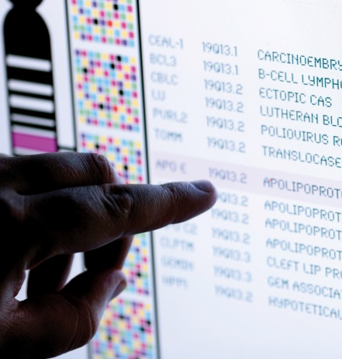
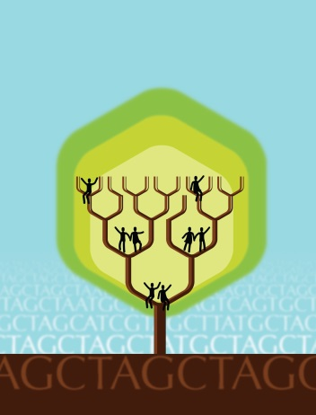
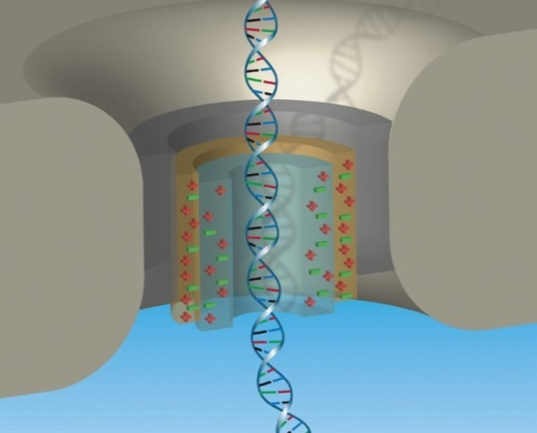


National Advisory Council for Human Genome Research
February 2016
Eric Green, M.D., Ph.D.
Director, NHGRI
DIRECTOR’S REPORT
Notes:
As is always the case, the Open Session of this meeting of the National Advisory Council for Human Genome Research, including this Director’s Report, is being webcast live.
It is also being videotaped, and those recordings will be made available as a permanent archive on the internet, including the presentations themselves and the various associated documents.

Slide 2
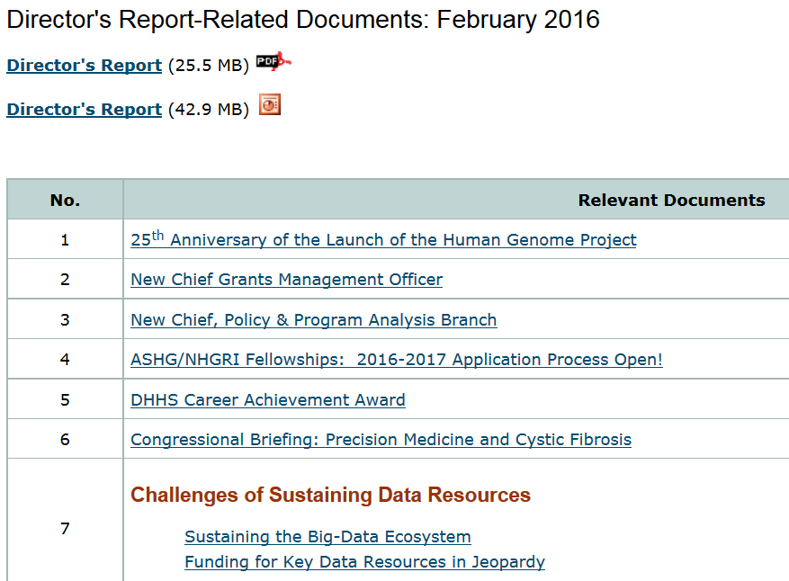
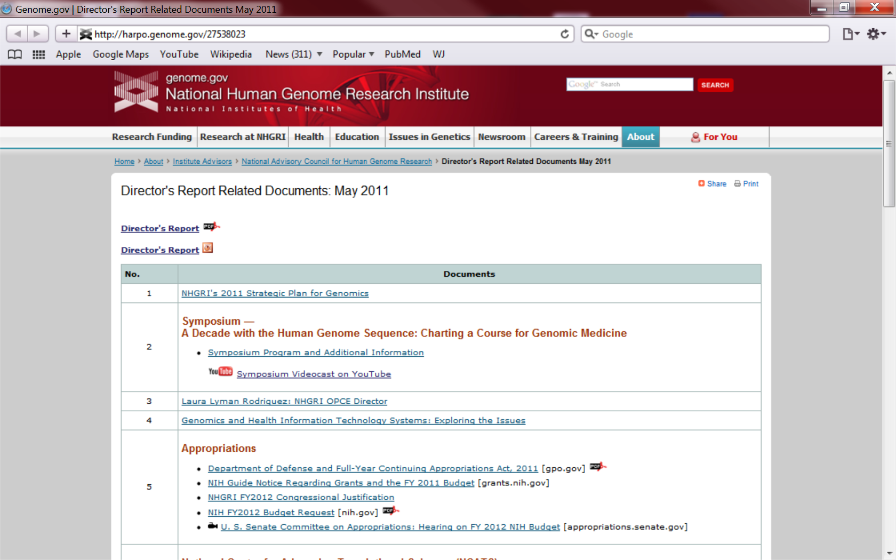
genome.gov/DirectorsReport
Document #
Notes:
For anyone new to our Council meetings, I want to make you aware of an ‘electronic resource’ associated with my Director’s Report. This is analogous to supplemental materials of a published paper, and can be accessed at the URL shown here.
The slides that I will show during my Director’s Report are also available electronically at this site– * both as PDF and PowerPoint files.
* For slides associated with specific documents or relevant web sites, there is a ‘Document #’ indicated on the bottom right, which references materials that can be accessed and/or downloaded at the web page shown here.
In addition to the video archive, this web page and all linked documents will be archived on NHGRI’s website (genome.gov) as a permanent historic record of this meeting.

Slide 3
Open Session Presentations
  Report on the NHGRI Intramural Research Program
    Dan Kastner
  Update on the Human Heredity and Health in Africa (H3Africa) Initiative
    Jennifer Troyer
Notes:
There will be several other presentations during the Open Session of this Council meeting. My Director’s Report is tailored around these presentations, and I will not discuss in detail the topics that others will cover.
* After my Director’s Report, Dr. Dan Kastner (NHGRI’s Scientific Director) will provide an overview and update about the NHGRI Intramural Research Program. * Then after lunch, Dr. Jennifer Troyer will give an update on the Human Heredity and Health in Africa (H3Africa) Initiative.

Slide 4
Open Session Presentations
  Meeting Reports:
  Roundtable on Inclusion and Engagement of Underrepresented Populations in Genomic Research
  Vence Bonham
  Integrating Genomic Sequencing into Clinical Care: CSER and Beyond
    Dan Roden
Notes:
There will then be two meeting reports.
* Mr. Vence Bonham will discuss the recent “Roundtable on Inclusion and Engagement of Underrepresented Populations in Genomic Research” meeting.
* Dr. Dan Roden will then discuss the recent “Integrating Genomic Sequencing into Clinical Care: CSER and Beyond” meeting.

Slide 5
Open Session Presentations
  Concept Clearances:
  Clinical Sequencing Evidence-generating Research (CSER2)
  Investigator-initiated Clinical Sequencing Research (iCSR)
  Lucia Hindorff
Notes:
Finally, there will be two Concept Clearance presentations made to the Council.
* Specifically, one will relate to a proposed Clinical Sequencing Evidence-generating Research program (or CSER2), while the other will relate to a proposed Investigator-initiated Clinical Sequencing Research program (or iCSR).
Both of these will be presented by Dr. Lucia Hindorff.

Slide 6
Director’s Report Outline
General NHGRI Updates
General NIH Updates
General Genomics Updates
NHGRI Extramural Research Program
NIH Common Fund/Trans-NIH
NHGRI Division of Policy, Communications, and Education
NHGRI Intramural Research Program
Notes:
For the rest of my Director’s Report, I will cover the 7 areas listed here, which reliably provide an excellent framework for reviewing the relevant topics.

Slide 7
Director’s Report Outline
General NHGRI Updates
General NIH Updates
General Genomics Updates
NHGRI Extramural Research Program
NIH Common Fund/Trans-NIH
NHGRI Division of Policy, Communications, and Education
NHGRI Intramural Research Program

Slide 8

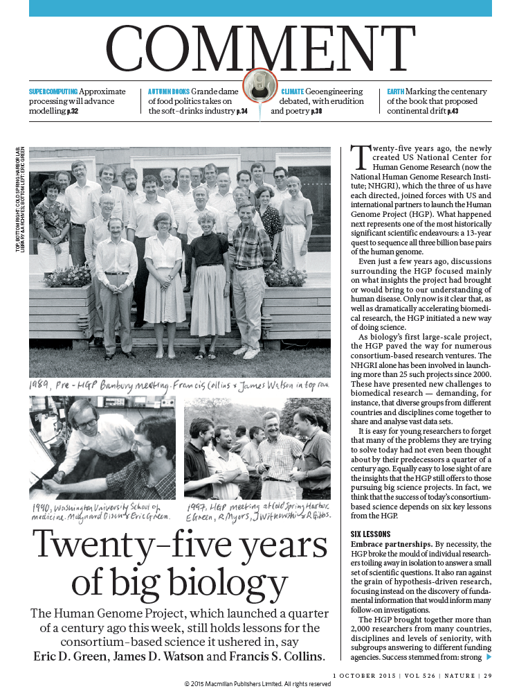


25th Anniversary of the Launch of the Human Genome Project
Document 1
Notes:
Exactly 10 days after the last Council meeting, the field of genomics did indeed witness an important ‘odometer moment.’ * October 1, 2015 marked the 25th anniversary of the launch of the Human Genome Project.
Two things happened at NHGRI to commemorate this historic milestone. First, we launched a six-part monthly seminar series to showcase some of the important historical aspects of the Human Genome Project, which I will be telling you about later in my Director’s Report. * But second, I co-authored a Comment piece in Nature along with the two former NHGRI Directors, Drs. Jim Watson and Francis Collins. This article highlights some of the key legacies of the Human Genome Project beyond the generated data, and discusses how these have influenced ‘big biology’ more broadly over the last 25 years. My motivation for writing this piece was, in part, to remind scientists (especially younger ones) about the important ways in which the Human Genomic Project changed the biomedical research enterprise in a positive way— aspects of the Project that are perhaps underappreciated.

Slide 9
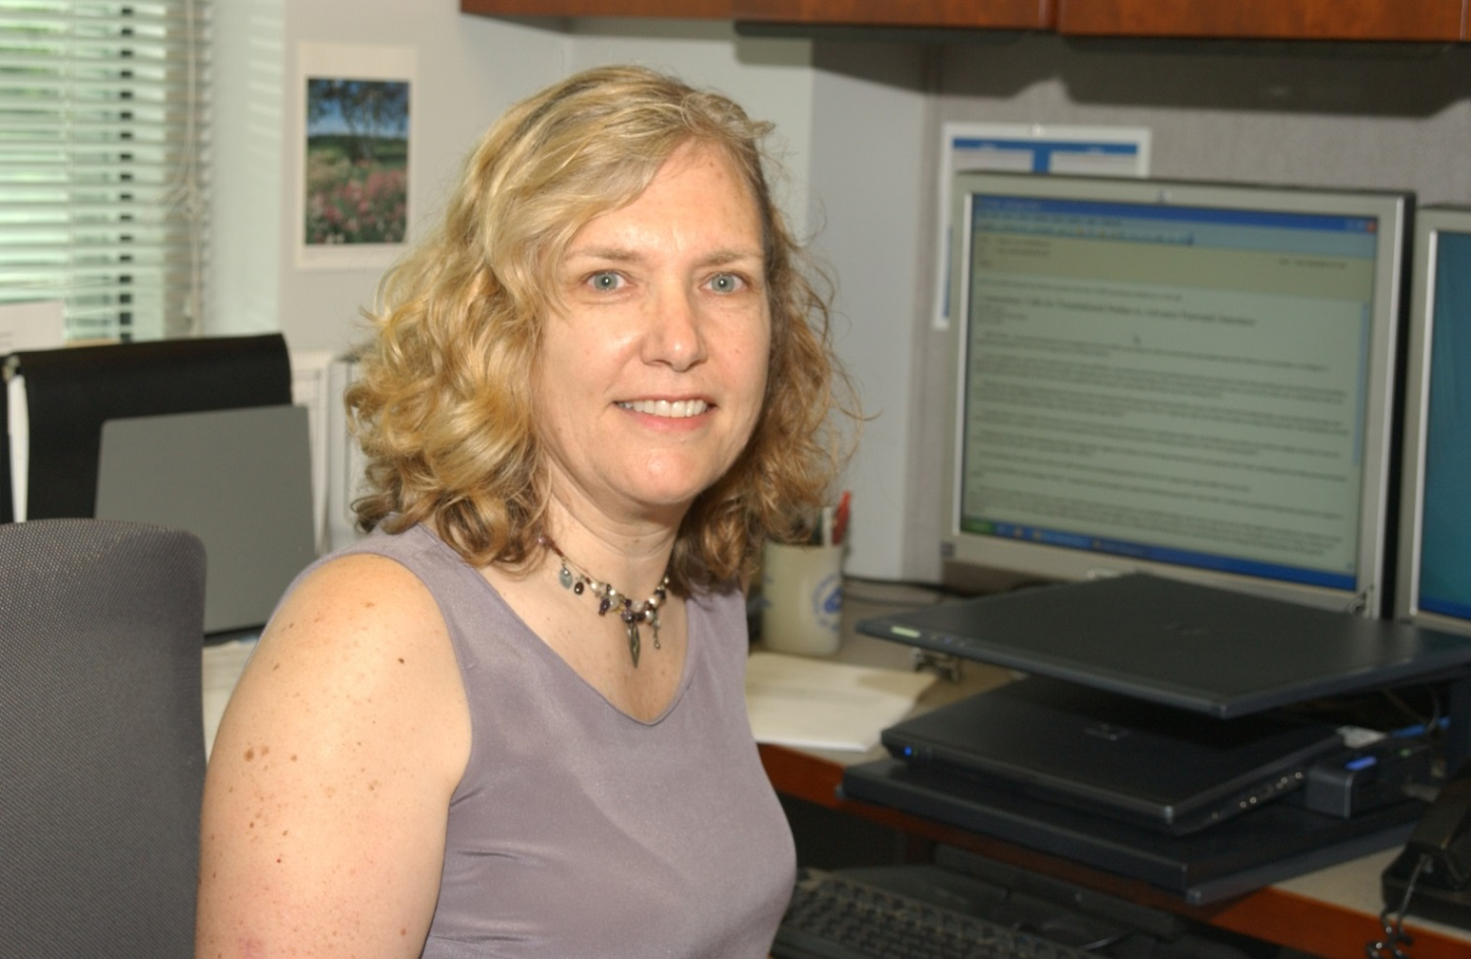
Retirement of Center for Inherited Disease Research (CIDR) Scientific Review Officer
Camilla Day, Ph.D.
Notes:
Last month, Dr. Camilla Day retired from her position as Scientific Review Officer for the Center for Inherited Disease Research (or CIDR). For a number of years, Camilla managed the scientific administrative functions for CIDR, an NIH-wide program administered by NHGRI. The CIDR program provides high-throughput genotyping and DNA sequencing services to qualified projects via a contract with Johns Hopkins University.
Camilla had a long and successful career at NIH, where she managed many study sections covering molecular and cell biology, genetics, and genomics— including the Mammalian Genetics Study Section and the Genomics Computational Biology and Technology Study Section.
We wish Camilla all the best in her post-retirement phase.

Slide 10
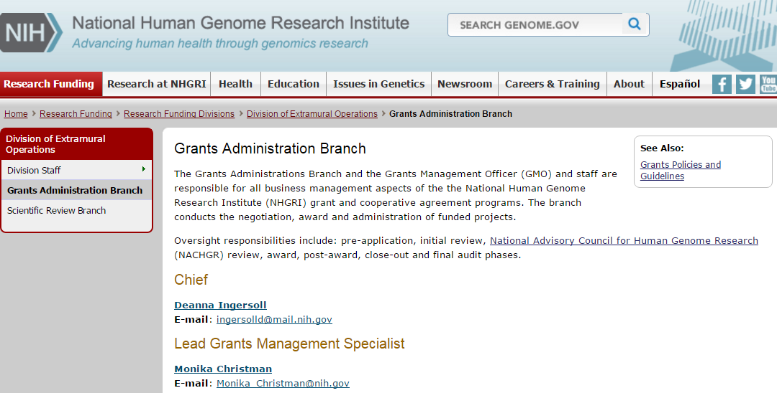
New Chief Grants Management Officer
Deanna Ingersoll
Document 2
Notes:
Last month, Ms. Deanna Ingersoll was appointed the * NHGRI Chief Grants Management Officer. Deanna comes to NHGRI from the National Institute of Allergy and Infectious Diseases, where she served as the Lead Grants Management Specialist for the past 11 years.
In her new role at NHGRI, she will review and award research grants, conduct quarterly audits to ensure compliance with relevant policies, and lead the Grants Administration Branch (whose Web page is shown here). NHGRI is excited to welcome Deanna to NHGRI.
I would like to thank Monika Christman (of NHGRI) and Eddie Myrbeck (of the National Institute on Deafness and Other Communication Disorders), who each served stints as Acting Chief Grants Management Officer while we worked to fill this position.

Slide 11
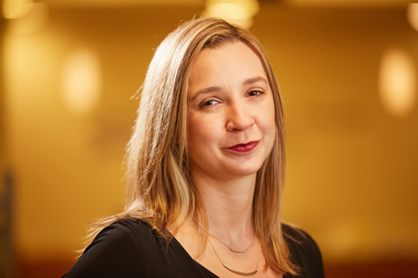
New Chief, Policy & Program Analysis Branch
Cristina Kapustij, M.S.
Document 3
Notes:
This past December, Ms. Cristina Kapustij was appointed the new Chief of the Policy and Program Analysis Branch within the NHGRI Division of Policy, Communications, and Education. In September, I told Council that Christina was made the Acting Chief of this Branch while a formal search was conducted.
Prior to joining NHGRI, Cristina worked as a Program Manager at the Institute for Human Genetics at the University of California, San Francisco, where she developed policy responses to potential changes in state and federal legislation, coordinated activities with the U.S. Food and Drug Administration, and researched the ethical, legal, and social implications related to sequencing the DNA from newborn blood spots. In her new Branch Chief role, she will oversee policy development and analysis, legislative and federal interactions, as well as evaluation of NHGRI research and policy priorities. She is a familiar face to the Institute as an alumnus of the NHGRI/ASHG Genetics and Public Policy Fellowship.

Slide 12


ASHG/NHGRI Fellowships:
2016-2017 Application Process Open!
    Genetics and Public Policy Fellowship
    Genetics and Education Fellowship
    Application Deadline: April 25, 2016
Document 4
Notes:
As I hope you recall, NHGRI’s Division of Policy, Communications, and Education partners with the American Society of Human Genetics (or ASHG) to sponsor two training fellowships— * the well-established Genetics and Public Policy Fellowship and * the recently launched Genetics and Education Fellowship.
To date, these programs have had 15 Genetics and Public Policy fellows and 2 Genetics and Education fellows. We are currently accepting applications for the 2016-2017 fellowship year, which runs from September 2016 to December 2017.
During the year of the fellowship, the fellows complete a series of rotations with NHGRI and ASHG, as well as externally on Capitol Hill or in educational programs. * Applications are due by April 25, 2016. Please share this information with your departments and institutions as well as any individuals who you think might be interested in these exciting opportunities.

Slide 13
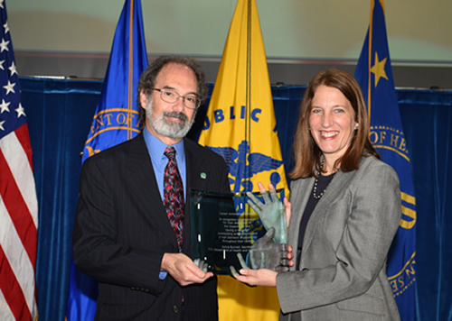
DHHS Career Achievement Award
Jeff Schloss, Ph.D. and
Sylvia Matthews Burwell, DHHS Secretary
Document 5
Notes:
In November, Dr. Jeff Schloss, Director of the Division of Genome Sciences within the NHGRI Extramural Research Program, received a Department of Health and Human Services (DHHS) Career Achievement Award.
For 19 years, Jeff has established and overseen novel initiatives that aim to develop new DNA-analysis technologies. In particular, he has led NHGRI’s signature program in DNA sequencing technology development; the latter has been a key contributor to the remarkable reduction in DNA sequencing costs by nearly a million-fold over the last roughly 15 years. His program is arguably the most successful technology development effort in the history of NIH. In addition, he has promoted interdisciplinary research through multiple trans-NIH and trans-federal programs.

Slide 14
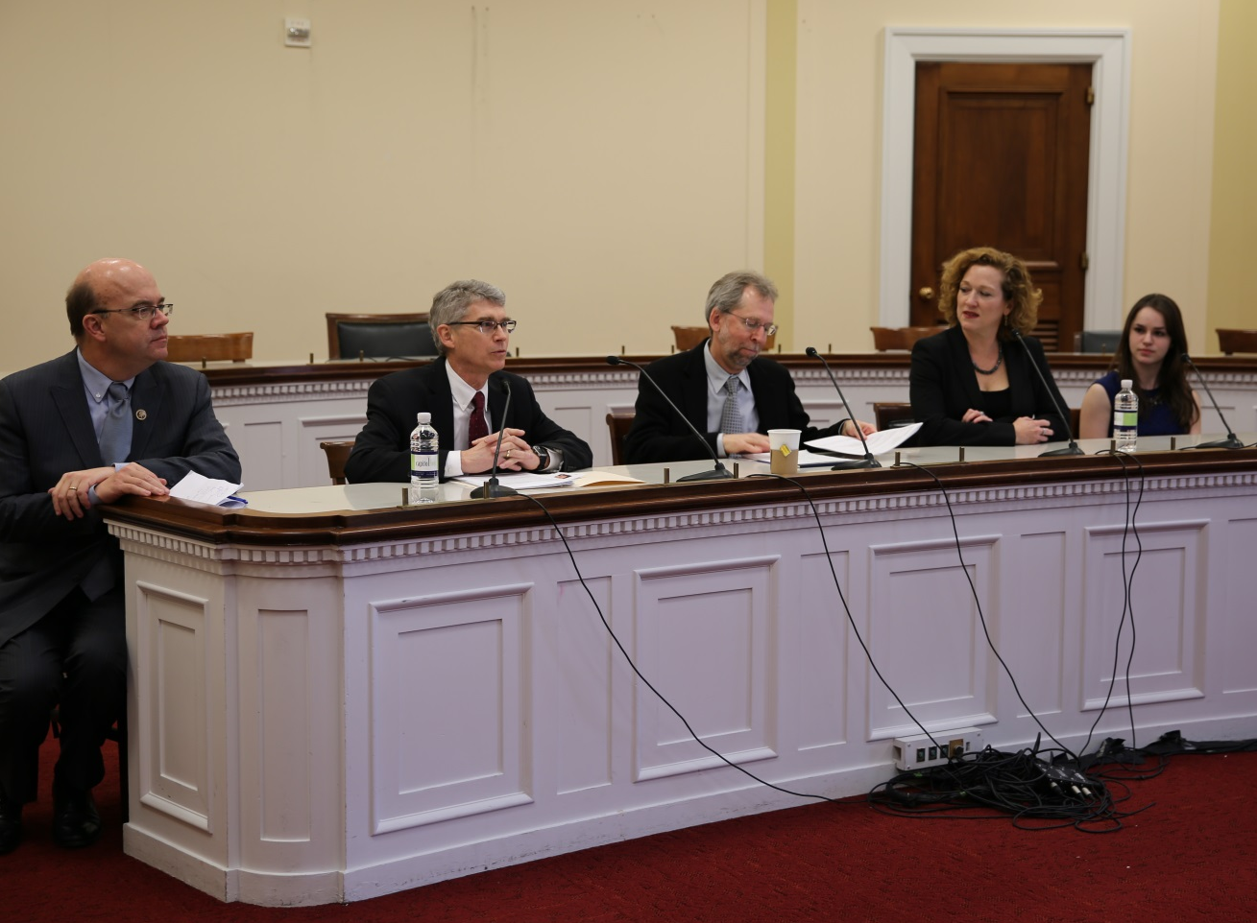
Congressional Briefing:
Precision Medicine and Cystic Fibrosis
Document 6
Notes:
Last December, I participated in a Congressional briefing hosted by the Cystic Fibrosis Foundation. The purpose of the briefing was to inform House members and their staff about precision medicine and cystic fibrosis. I spoke about the potential for genomics and precision medicine generally, while others on the panel discussed the importance of cystic fibrosis from the foundation, research, and patient perspectives.
Our collective remarks all stressed the importance of funding for basic science research. The briefing was well-attended, and the audience included Congressman Jim McGovern (D-MA), co-chair of the Congressional Cystic Fibrosis Caucus, as well as Congressman John Fleming (R-LA), whose grandson has cystic fibrosis.

Slide 15
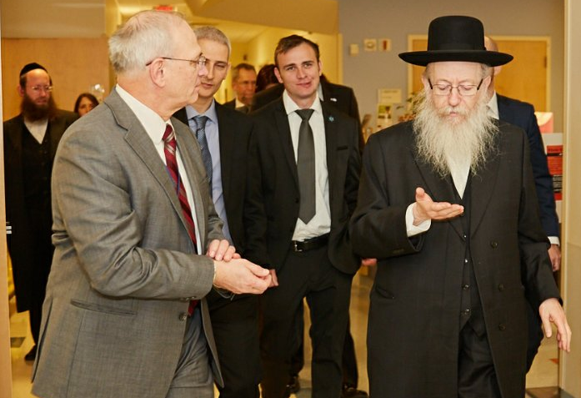
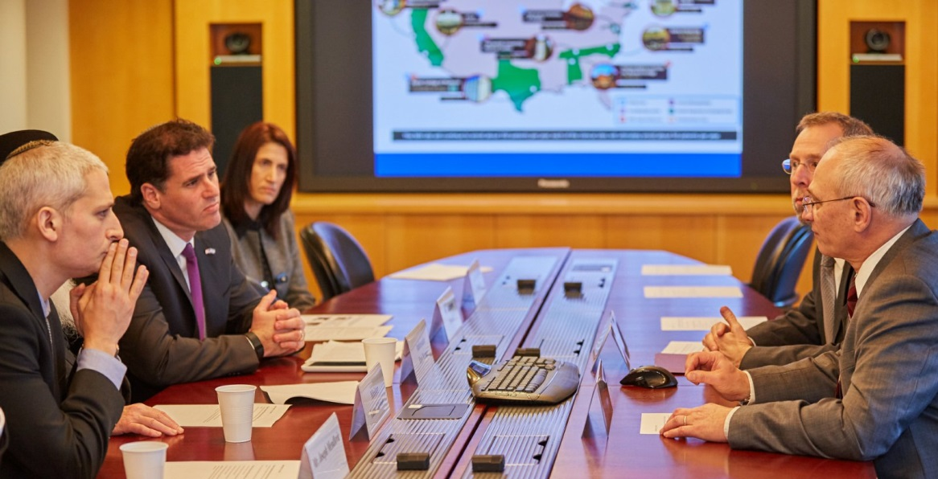
Visit by Israeli Minister of Health
Notes:
In January, NIH was visited by the Israeli Minister of Health, Yaakov Litzman, along with several other Israeli Ministry of Health officials. During this visit, Dr. Bill Gahl (NHGRI’s Clinical Director) and I led the delegation on a tour of the NIH Clinical Center, where we visited a pediatric patient participating in the Undiagnosed Diseases Program.
The Minister was particularly interested in learning more about the Undiagnosed Diseases Network and its potential for collaborating with Israeli researchers and clinicians.

Slide 16
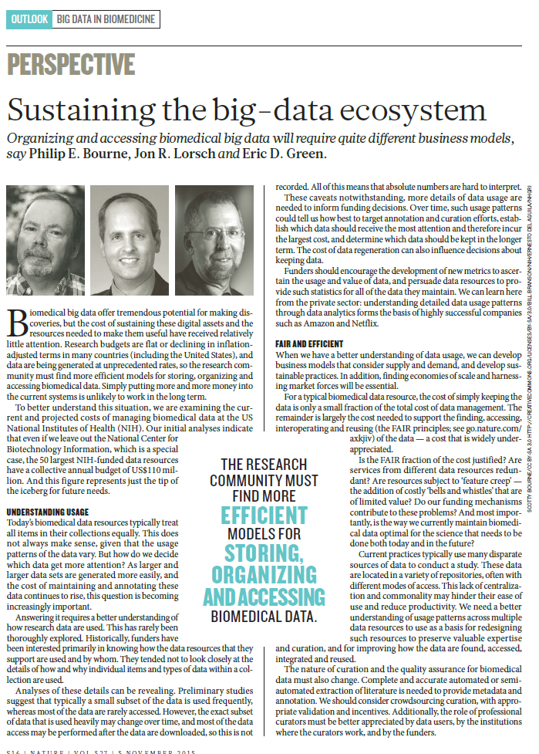
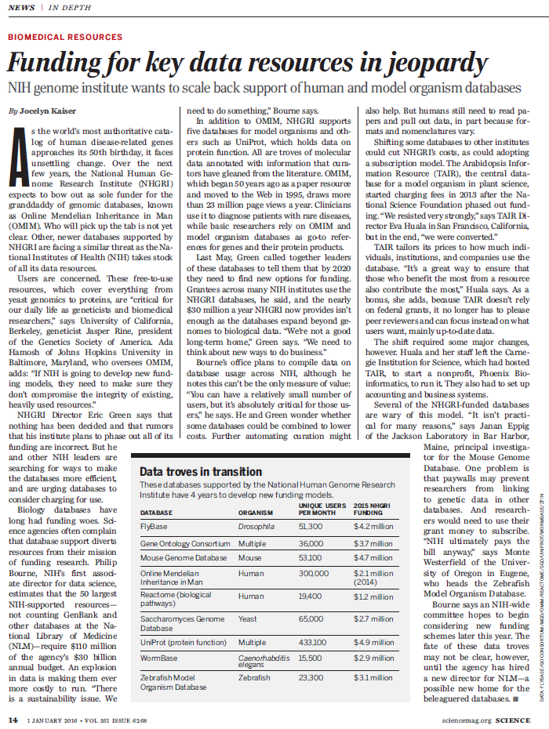
Challenges of Sustaining Data Resources
Document 7
Notes:
One last NIH topic that warrants highlighting relates to something that every one of you is aware of— and that is the growing challenges of Big Data (genomics and otherwise). There are many aspects associated with these Big Data challenges, but one set of problems relates to sustaining data resources, such as large databases. There are multiple active conversations going on about this problem— here at NHGRI, in Dr. Phil Bourne’s Office of the Associate Director for Data Science, at other NIH Institutes who fund data resources, among the NIH leadership, and by other funding agencies (in the U.S. and abroad). I have actively spoken about the data resource sustainability issues, in part because of the challenges that NHGRI is now facing in supporting genomic data resources. Since the last Council meeting, there were two high-profile publications relevant to these conversations.
* In early November, Nature published this Perspective about sustaining the Big Data ecosystem, written by Dr. Phil Bourne, NIGMS Director Dr. Jon Lorsch, and myself. This article details our collective views about major challenges funding agencies face in supporting resources that house biomedical data, and we emphasize the acute need to explore new models for sustaining such data resources. * Related to our Nature publication, a news piece came out in the January 1 issue of Science that discusses how some key data resources are in jeopardy because of funding challenges. The article heavily features the data resources supported by NHGRI, highlighting some hard issues confronted by this Council in recent years.
While I like the article on left (which I co-authored) more than the news piece on the right (in which I was quoted), I am pleased to see these hard issues being discussed prominently in Nature and Science so as to raise the awareness of the larger research community. I am certain that we will continue to discuss these issues with Council in the coming months and years because these challenges will likely only grow with time.

Slide 17
Director’s Report Outline
General NHGRI Updates
General NIH Updates
General Genomics Updates
NHGRI Extramural Research Program
NIH Common Fund/Trans-NIH
NHGRI Division of Policy, Communications, and Education
NHGRI Intramural Research Program

Slide 18
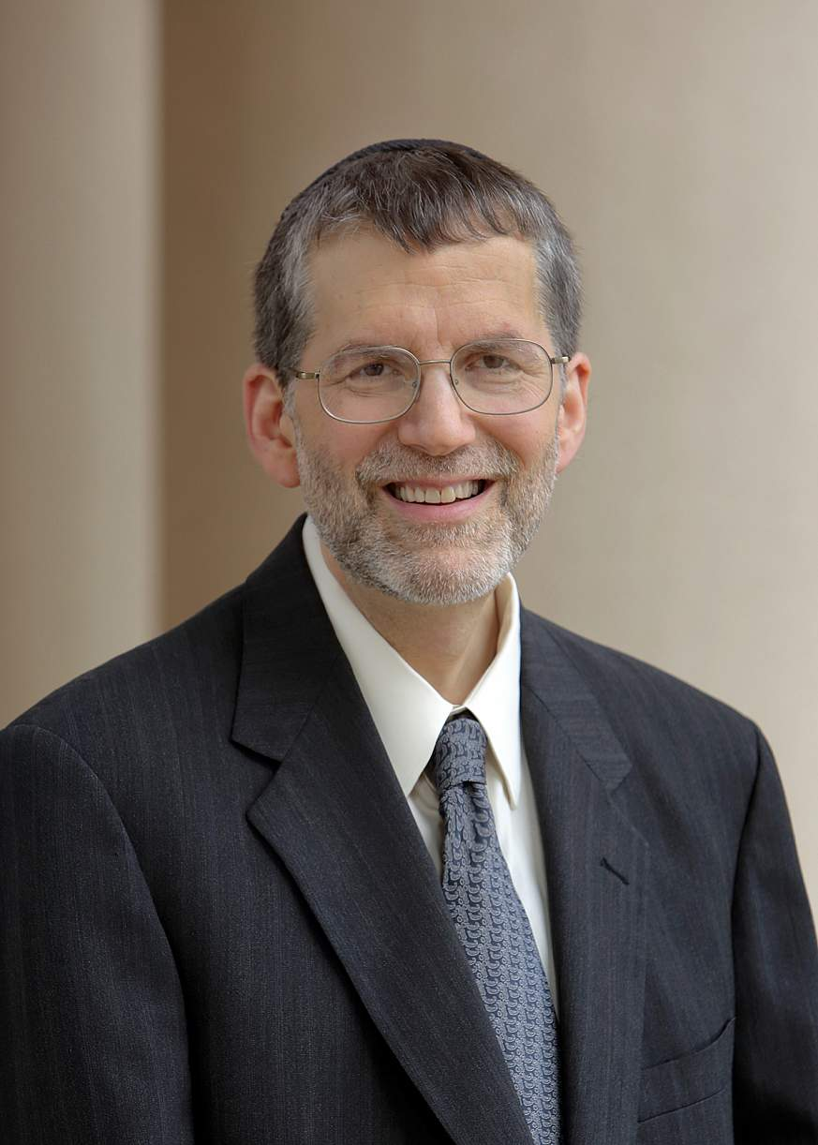

New Deputy Director for Extramural Research
Michael Lauer, M.D.
Document 8
Notes:
A good friend of NHGRI, Dr. Michael Lauer, was recently appointed the new Deputy Director for Extramural Research. Mike came to NIH in 2007 as the Director of the Division of Prevention and Population Science at the National Heart, Lung, and Blood Institute (or NHLBI), and from 2009 until recently, he served as the Director of NHLBI’s Division of Cardiovascular Sciences.

Slide 19
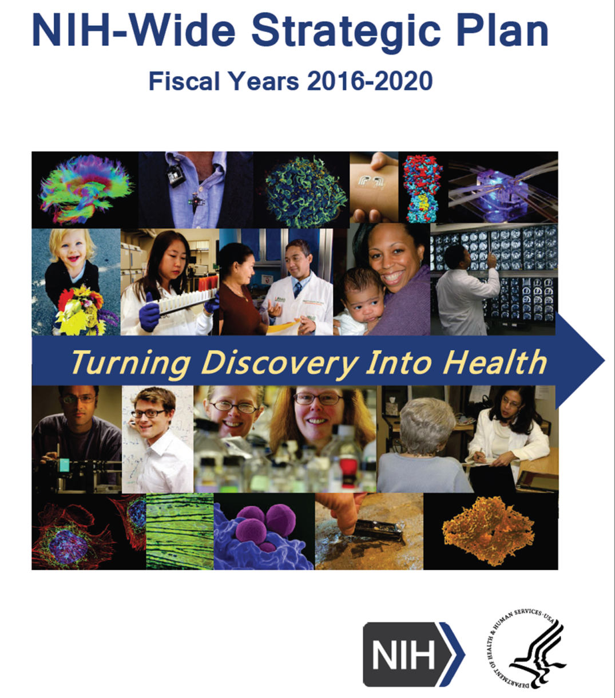
New NIH-Wide Strategic Plan
Document 9
Notes:
As you may remember from my Director’s Report at the September Council meeting, Congress tasked NIH with developing a new five-year strategic plan as part of the Fiscal Year 2015 ‘CRomnibus' appropriation. After an intense effort, the NIH-Wide Strategic Plan for Fiscal Years 2016-2020 was submitted to Congress in December.
This new strategic plan was developed with input from hundreds of stakeholders and scientific advisors, in collaboration with leadership and staff from across NIH. Traditionally, NIH operates as distinct Institutes, Centers, and Offices, most of which develop their own individual strategic plans aligned with their congressionally mandated missions. The new NIH-Wide Strategic Plan complements these individual plans, and outlines a vision for biomedical research that capitalizes on NIH's holistic strengths and capabilities. The Plan focuses on core objectives to help guide NIH's priorities over the next five years, and makes some bold predictions for the future outcomes of NIH research. The full content of this plan is available online, at the URL provided under Document 9.

Slide 20
NIH Appropriations and Budget
Fiscal Year 2016 Appropriations
 | FY15 | FY16 | % Change | Difference
NIH NHGRI | $30.3B | $32.3B | 6.6% Increase | +$2.0B
 | $499M | $519M | 3.9% Increase | +$20M
Document 10
Notes:
After a tumultuous fall with the resignation of former Speaker of the House John Boehner and the installation of Paul Ryan as the new Speaker, a debt ceiling battle, and several continuing resolutions, the Fiscal Year 2016 budget was finally passed in December 2015. This year’s budget contains an equal increase in both defense and non-defense spending, and ultimately gives a meaningful increase in the funding for NHGRI and NIH. In fact, as this played out, it became clear that increasing biomedical research funding was a rallying cry for politicians on both sides of the aisle.
The relevant high-level numbers are shown here. NIH received a 6.6% increase, which amounted to an increase of roughly $2 billion. Because some of these NIH funds were designated to specific programs, such as the Precision Medicine Initiative, the individual institutes received a lower percent increase. Nonetheless, NHGRI did see its budget increased by roughly 3.9%, which amounts to about a $20 million increase. This now places NHGRI’s budget above the $500M mark for the first time since sequestration hit a few years ago.
Of note, President Obama is expected to release his budget proposal for next fiscal year (that is Fiscal Year 2017) on February 9. Afterwards, NIH Director Dr. Francis Collins will hold a public briefing for stakeholders to discuss NIH Fiscal Year 2017 and Fiscal Year 2016 budget matters.

Slide 21
Director’s Report Outline
General NHGRI Updates
General NIH Updates
General Genomics Updates
NHGRI Extramural Research Program
NIH Common Fund/Trans-NIH
NHGRI Division of Policy, Communications, and Education
NHGRI Intramural Research Program

Slide 22
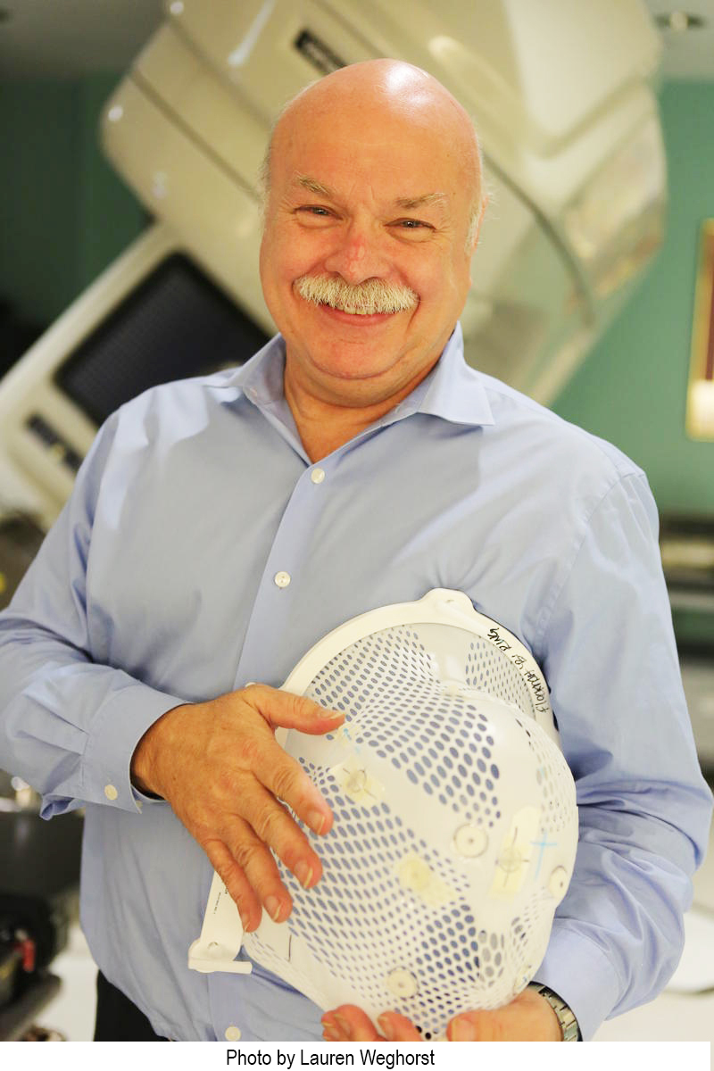
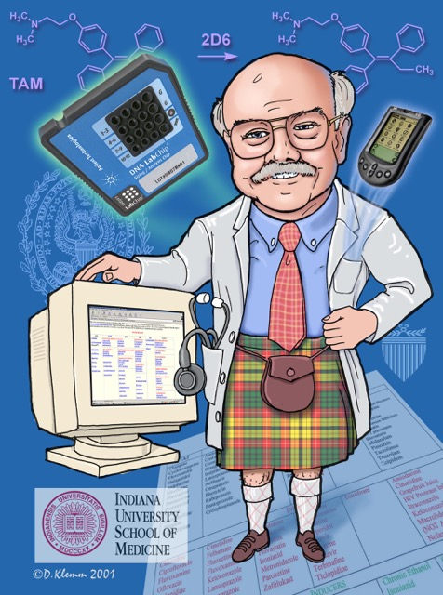
Mourning the Loss of Dave Flockhart
Document 11
Notes:
NHGRI grantee, Dr. Dave Flockhart, passed away in November. Dave was Professor of Molecular and Cellular Biology at Harvard University, and was a Principal Investigator in the Implementing Genomics in Practice (or IGNITE) Network. His pioneering research in pharmacogenomics and drug-drug interactions made him a leader in the field of personalized medicine for over 20 years.
A little over a year before his death, Dave was diagnosed with glioblastoma. Throughout his treatment, he shared his personal experience in a blog. Dave was a driving force in the IGNITE program and a pleasure to work with. He will be missed.

Slide 23
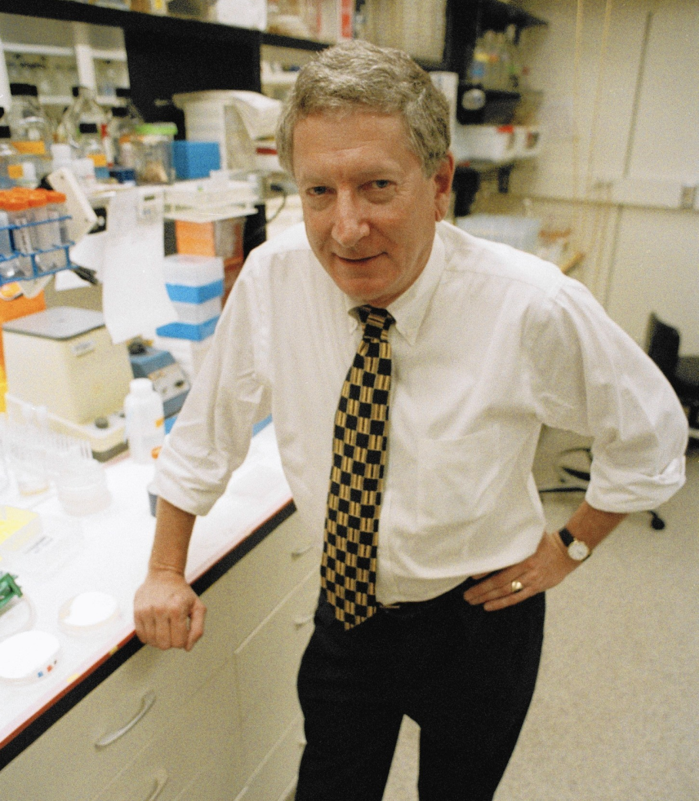
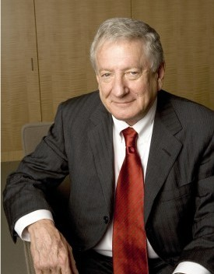
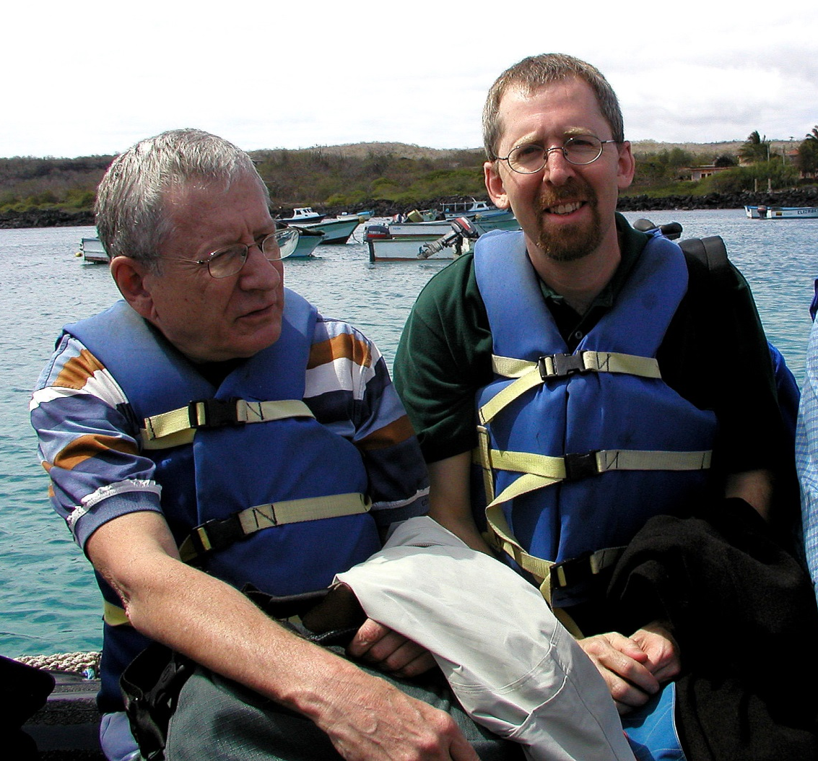
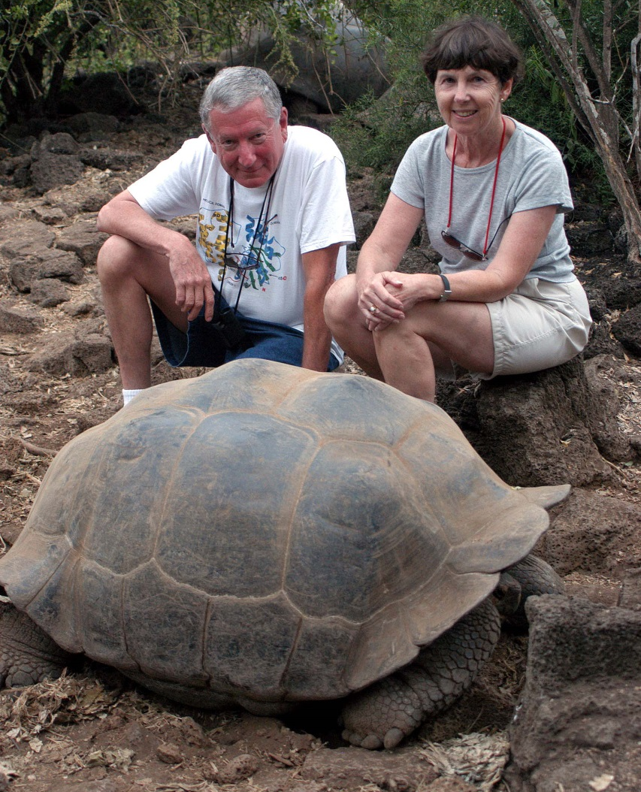
Mourning the Loss of Alfred Gilman
Document 12
Notes:
Dr. Alfred Gilman, a pharmacologist and biochemist, passed away in December. Dr. Gilman shared the 1994 Nobel Prize in Physiology or Medicine with Martin Rodbell for discovering G proteins, research he conducted while at the University of Virginia. He held various positions at the University of Texas Southwestern Medical Center at Dallas from 1981 to 2009. After which, he served as the Chief Scientific Officer at the Cancer Prevention and Research Institute of Texas until 2012. He was also one of the founders of Regeneron, a biotechnology company. Al played an active role in defending science education, and was a strong proponent of research ethics.
At a personal level, I regarded Al as a friend. * We first met in July 2003, when we were both part of a scientific delegation that first participated in a scientific symposium in Ecuador and then toured the Galapagos Islands as a group. These are photos from the Galapagos Islands, with Al and I in a raft going to the shore of one of the Islands (on the left; boy, did I look younger then!), and then Al with his wife and a local large Galapagos resident (on the right). Al was a remarkable scientist and a great person to know; he will be greatly missed by many.

Slide 24
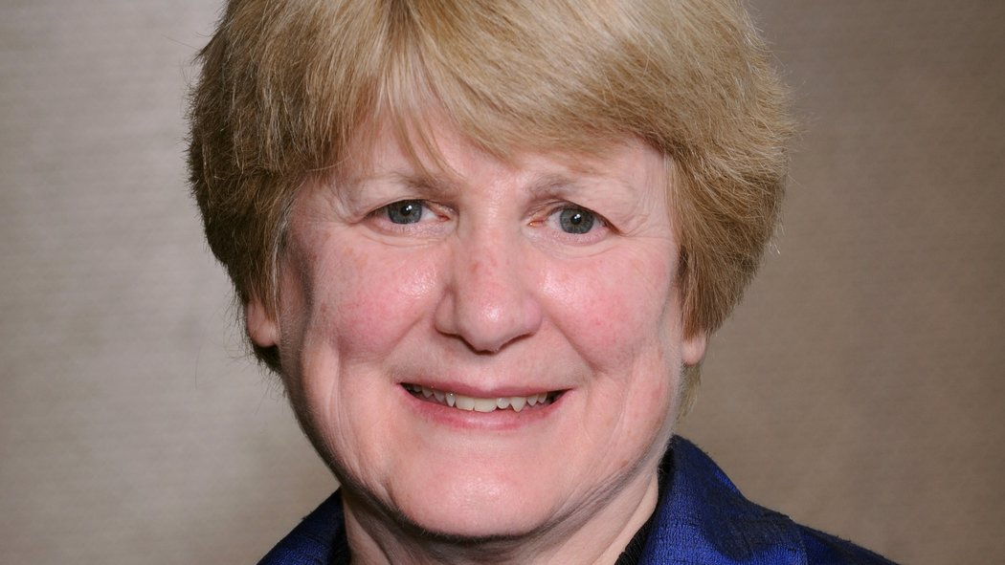
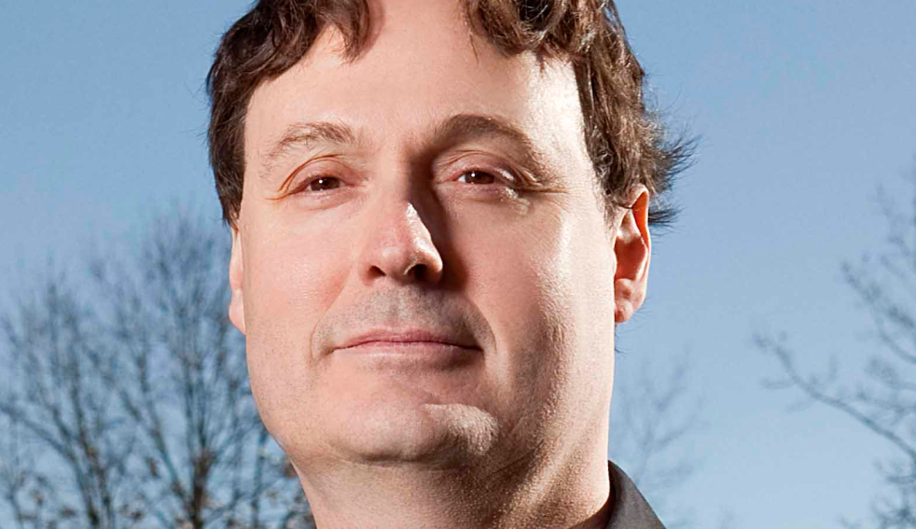

National Medal of Science & National Medal of Technology and Innovation
Mary Claire-King, Ph.D.
Johnathan Rothberg, Ph.D.
Document 13
Notes:
Late last year, President Obama awarded the * National Medal of Science to Dr. Mary Claire-King and the * National Medal of Technology and Innovation to Dr. Johnathan Rothberg. These awards are the Nation’s highest honors for achievement and leadership in advancing the fields of science and technology, and these honorees are good friends and colleagues of NHGRI.

Slide 25



2015 Breakthrough Prize in Life Sciences
John Hardy, Ph.D.
Helen Hobbs, M.D.
Svante Pääbo, Ph.D.
Document 14
Notes:
The Breakthrough Prize in Life Sciences recognizes excellence in research aimed at curing intractable diseases and extending human life. Of relevance to genetics and genomics, the 2015 Breakthrough Prize in Life Sciences was awarded to * Dr. John Hardy for discovering mutations in the amyloid precursor protein gene implicated in early onset Alzheimer’s disease, * Dr. Helen Hobbs for the discovery of human genomic variants that alter the levels and distribution of cholesterol and other lipids, and * Dr. Svante Pääbo for pioneering the sequencing of ancient DNA and ancient genomes.

Slide 26

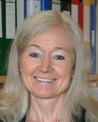
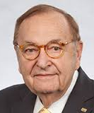




2015 ASHG Awards
Kay Davies,
D. Phil.
R. Rodney Howell, M.D.
Leonid Kruglyak,
Ph.D.
Robert Nussbaum, M.D.
Roderick McInnes,
M.D., Ph.D.
Huntington Willard, Ph.D.
Document 15
Notes:
The American Society of Human Genetics gave awards to six members of our community at their 2015 annual meeting.
* Dr. Kay Davies was awarded the William Allan Award, which recognizes a scientist for substantial and far-reaching scientific contributions to human genetics.
* Dr. Rod Howell was awarded the Advocacy Award (new in 2015), which honors individuals or groups who have exhibited excellence and achievement in applications of human genetics for the common good.
* Dr. Leonid Kruglyak was awarded the Curt Stern Award, which recognizes a genetics and genomics researcher who has made significant scientific contributions during the past decade.
* Drs. Bob Nussbaum (a Council member), Rod McInnes, and Hunt Willard were awarded the Award for Excellence in Human Genetics Education, which was established to recognize those who have made significant contributions of exceptional quality and great importance to human genetics education.

Slide 27
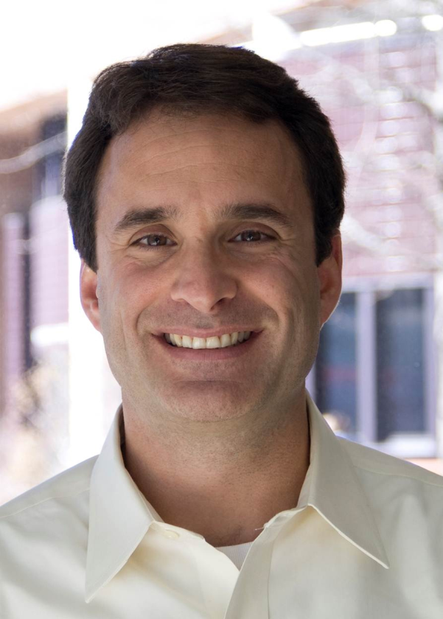
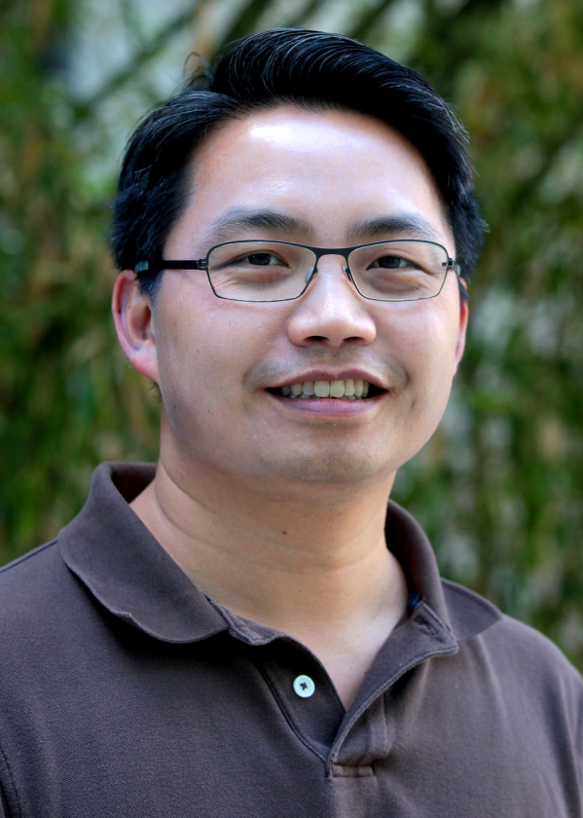

Memorial Sloan Kettering
2015 Paul Marks Prize for Cancer Research
Bradley Bernstein,
M.D., Ph.D.
Howard Chang, M.D., Ph.D.
Document 16
Notes:
Memorial Sloan Kettering named the winners of their 2015 Paul Marks Prize for Cancer Research, an award that recognizes promising young investigators. Given every other year to cancer investigators who are 45 years of age or younger, the prize recognizes contributions to the greater understanding of cancer.
The 2015 winners include * Dr. Brad Bernstein, a principal investigator in the ENCODE Project, and * Dr. Howard Chang, a principal investigator in the Centers for Excellence in Genomics (or CEGS) program.

Slide 28


Elected to the National Academy of Medicine
Chris Austin
Atul Butte
Mario Capecchi
Michael Green
Murat Gunel
Kenneth Kinzler
Walter Koroshetz
Kevin Struhl
Document 17
Notes:
The National Academy of Medicine recently announced their newly elected members. The new members include the eight individuals listed here, who happen to have notable relevance to NHGRI (including two fellow Institute Directors, some grantees, some very distinguished geneticists and genomicists, and even my sibling).

Slide 29

Elected to the AAAS
Robert David Burk
Andrea Califano
Nancy Cox
Gerald Crabtree
Gerald Fink
Helen Hobbs
Cynthia Morton
Robert Moyzis
Alan Scott
Temple Smith
Beth Sullivan
Document 18
Notes:
Similarly, an impressive number of genetics and genomics researchers were recently elected to be Fellows of the American Association for the Advancement of Science (or AAAS), with their names listed here. To my knowledge, none of these individuals are blood relatives. More seriously, congratulations to these colleagues as well as those elected to the National Academy of Medicine.

Slide 30

2015 Breakthrough of the Year
Document 19
Notes:
Moving on to year-end accolades, the gene-editing technique CRISPR was named Science’s 2015 Breakthrough of the Year.
CRISPR/Cas9 is a molecular mechanism operating naturally in bacteria to protect cells against invading viruses, but has been cleverly adapted to manipulate specific DNA sequences in eukaryotes. The uptake of this general methodology in the research community has been rapid and impressive.

Slide 31

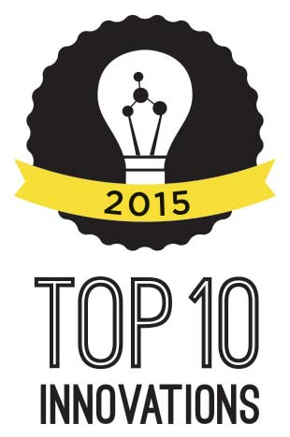




The Scientist’s Top Ten Innovations 2015
GemCode Platform | 10X Genomics
MiSeq FGx Forensic Genomics System | Illumina
Ion S5 & Ion S5 XL | Thermo Fisher Scientific
On Demand Deletions in Human Hap1 Cells | Horizon Discovery
CRISPR Epigenetic Activator | Sigma Aldrich
Document 20
Notes:
When The Scientist came out with its Top Ten Innovations of 2015, genomic technologies once again dominated the list. In fact, five major genomic innovations were included, with four of those taking the top spots. Each of these five innovations involve some aspect of genome sequencing or genome editing (consistent with my comments about CRISPR on the previous slide).

Slide 32
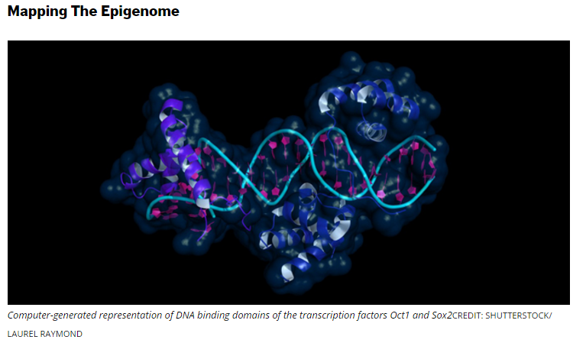

ThinkProgress’s Scientific Breakthrough:
“Prove We’re Already Living In The Future”
Document 21
Notes:
And a final year-end accolade was given by ThinkProgress, an American political news blog. ThinkProgress named the NIH Roadmap Epigenomics Program as one of its Scientific Breakthroughs that “Prove We’re Already Living In The Future.”

Slide 33
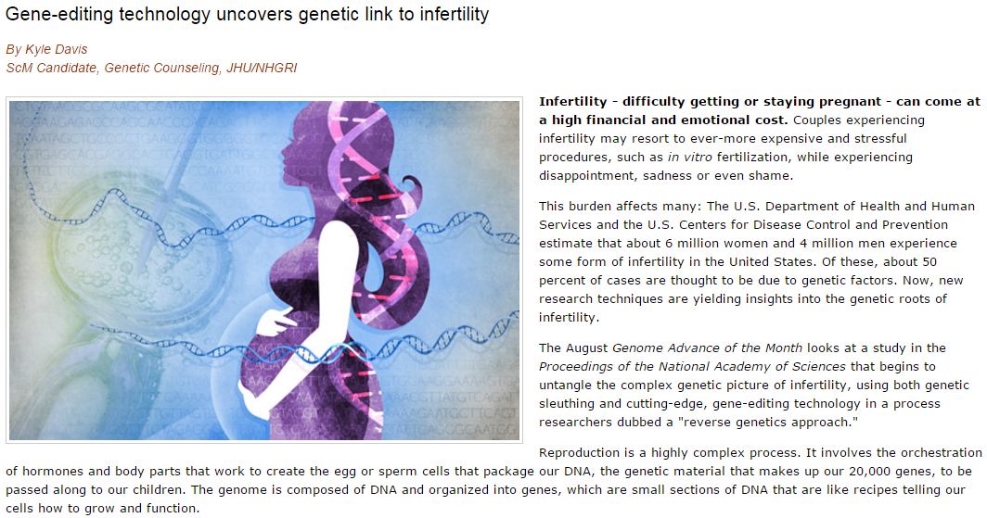
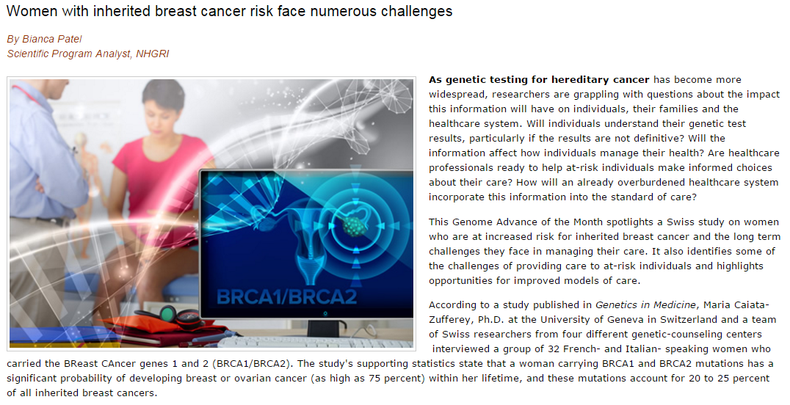
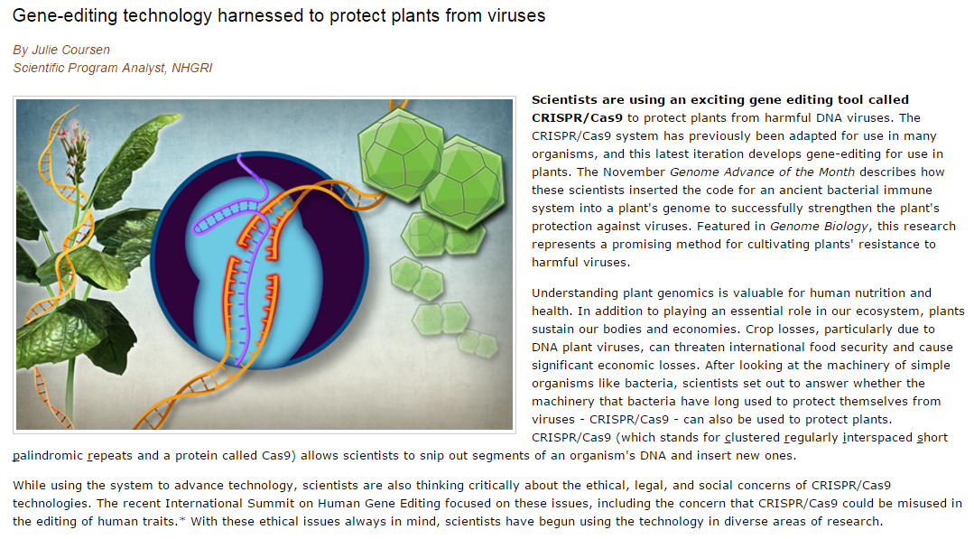
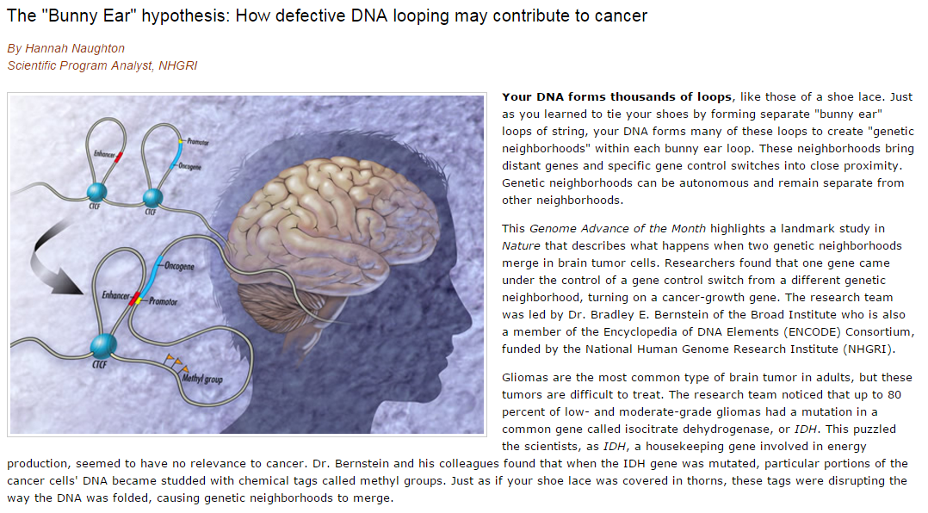
NHGRI Genome Advance of the Month
Document 22
Notes:
The NHGRI Genome Advance of the Month since the last Council meeting has featured publications examining * the complex genetic picture of infertility, * challenges faced by women with inherited breast cancer, * employing gene-editing to protect plants from viruses (yet another CRISPR example), and * the contributions of DNA looping to cancer.

Slide 34




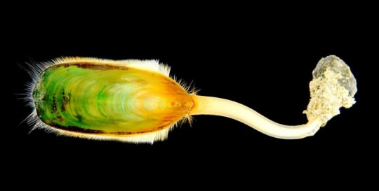
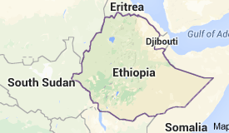
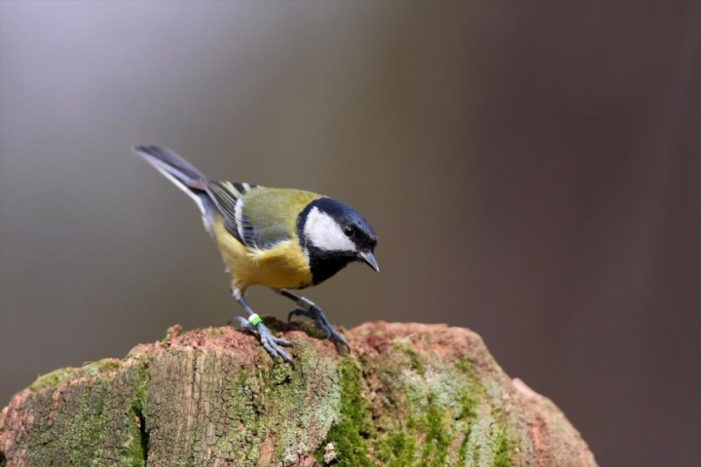

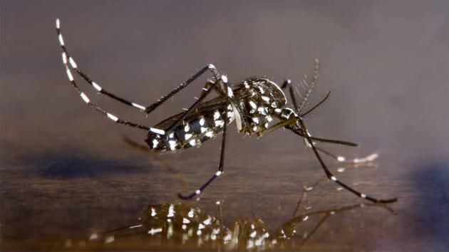



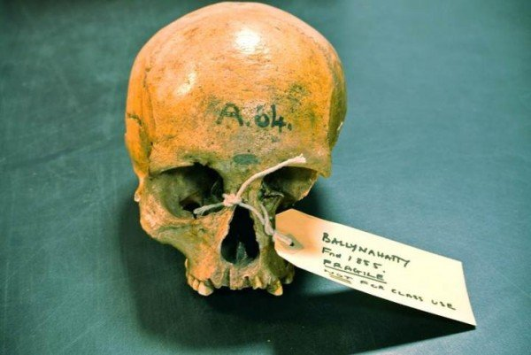
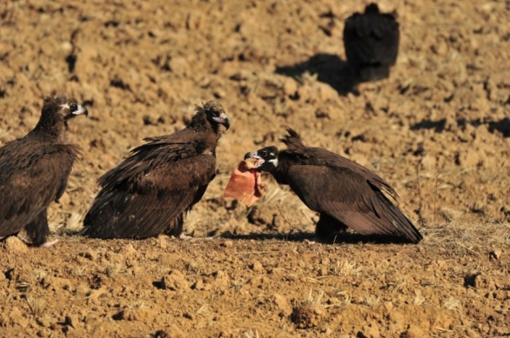
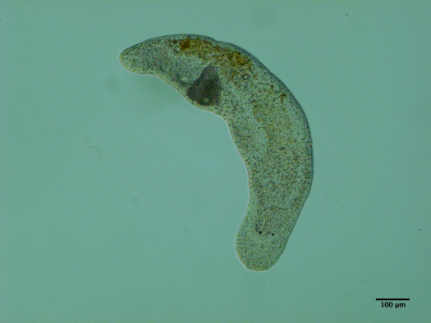
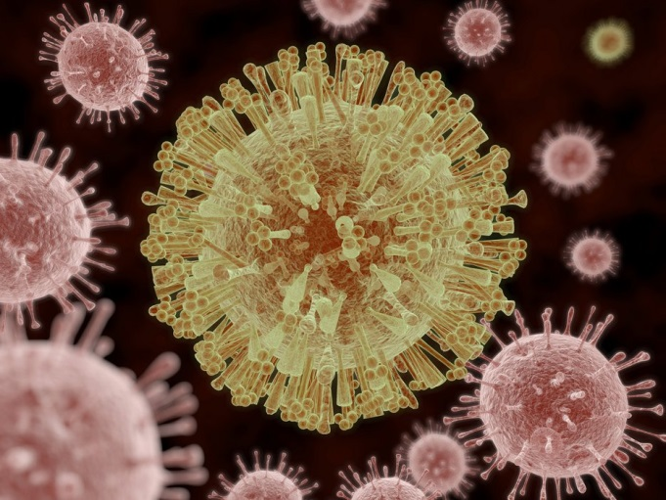

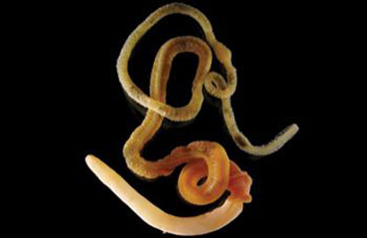



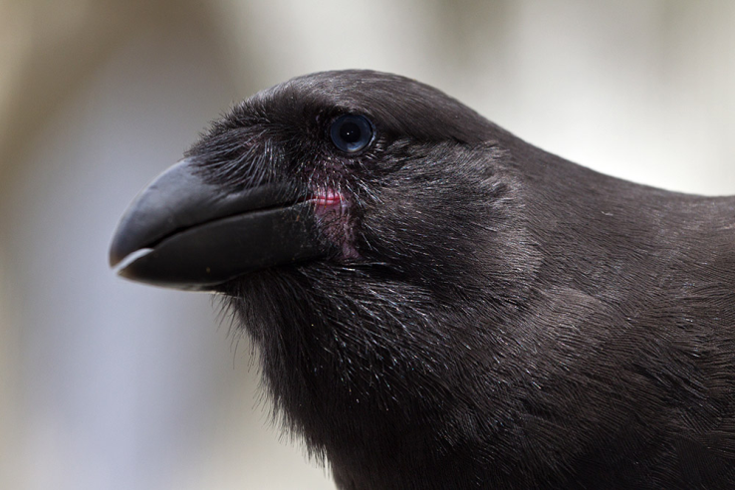

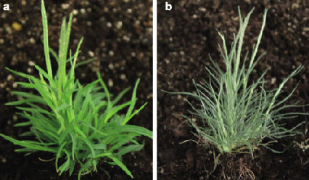
Genomes In The News…
Document 23
Notes:
And in terms of Genomes in the News, there have been a number of recently generated genome sequences reported since the last Council meeting, including: * adzuki bean, * ancient Ethiopian humans, * regenerative flatworm, * Przewalski's horse, * grass, * pineapple, * ancient wild ox, * Eurasian vulture, * lingulid brachiopod, * tiger mosquito, * acorn worm, * Yakutian horse, * tardigrade, * African cheetah, * African turquoise killifish, * California sugar pine, * ancient Irish humans, * eelgrass, * Hawaiian crow, * great tit, * lentil, and the much-in-the-news * Zika virus.

Slide 35
Director’s Report Outline
General NHGRI Updates
General NIH Updates
General Genomics Updates
NHGRI Extramural Research Program
NIH Common Fund/Trans-NIH
NHGRI Division of Policy, Communications, and Education
NHGRI Intramural Research Program

Slide 36



Large-Scale Genome Sequencing and Analysis Centers
      Since 2012: >600 publications and >200 projects
Document 24
Notes:
Before describing the new Genome Sequencing Program, I wanted to point out that the Large-Scale Genome Sequencing and Analysis Centers (or LSAC) Program wrapped up in October 2015. * Since 2012, this program made progress on a number of fronts through both independent projects and large collaborations. The overall sequence-production totals are shown here for projects focused on: comparative genomics (in orange); cancer, including TCGA (in pink); and human genomic variation and disease, including 1000 Genomes, the Alzheimer’s Disease Sequencing Project, T2D-Genes, the Autism Sequencing Project, and others (in green). * The three centers – at Baylor College of Medicine, the Broad Institute, and Washington University – collectively published over 600 papers and completed over 200 projects, ranging from individual reference sequences to large collaborations involving thousands of genomes.

Slide 37
Large-Scale Genome Sequencing and Analysis Centers
>2.8B gigabases produced from 2012-2015
~$1,500 per whole human genome sequence
Start
Document 24
Notes:
In total, those three centers generated almost * 3 billion gigabases (that is ~3 billion billions) of DNA sequence during the 2012 through 2015 interval. Quarterly production figures can be seen on this graph, * with the green arrow indicating the start of the most recent iteration of the program in Fiscal Year 2012. * Costs currently sit at ~$1,500 for a whole human genome sequence, including initial automated analysis through variant calling.
This time interval included too many milestones to list, but highlights include the completion of the 1000 Genomes Project, the end of data production for The Cancer Genome Atlas, and the full implementation of the Illumina HiSeq X Ten systems, with the later clearly evident by the significantly increased sequence production beginning in July 2015. Overall, these accomplishments provide an excellent foundation for the next phase of the Genome Sequencing Program.

Slide 38
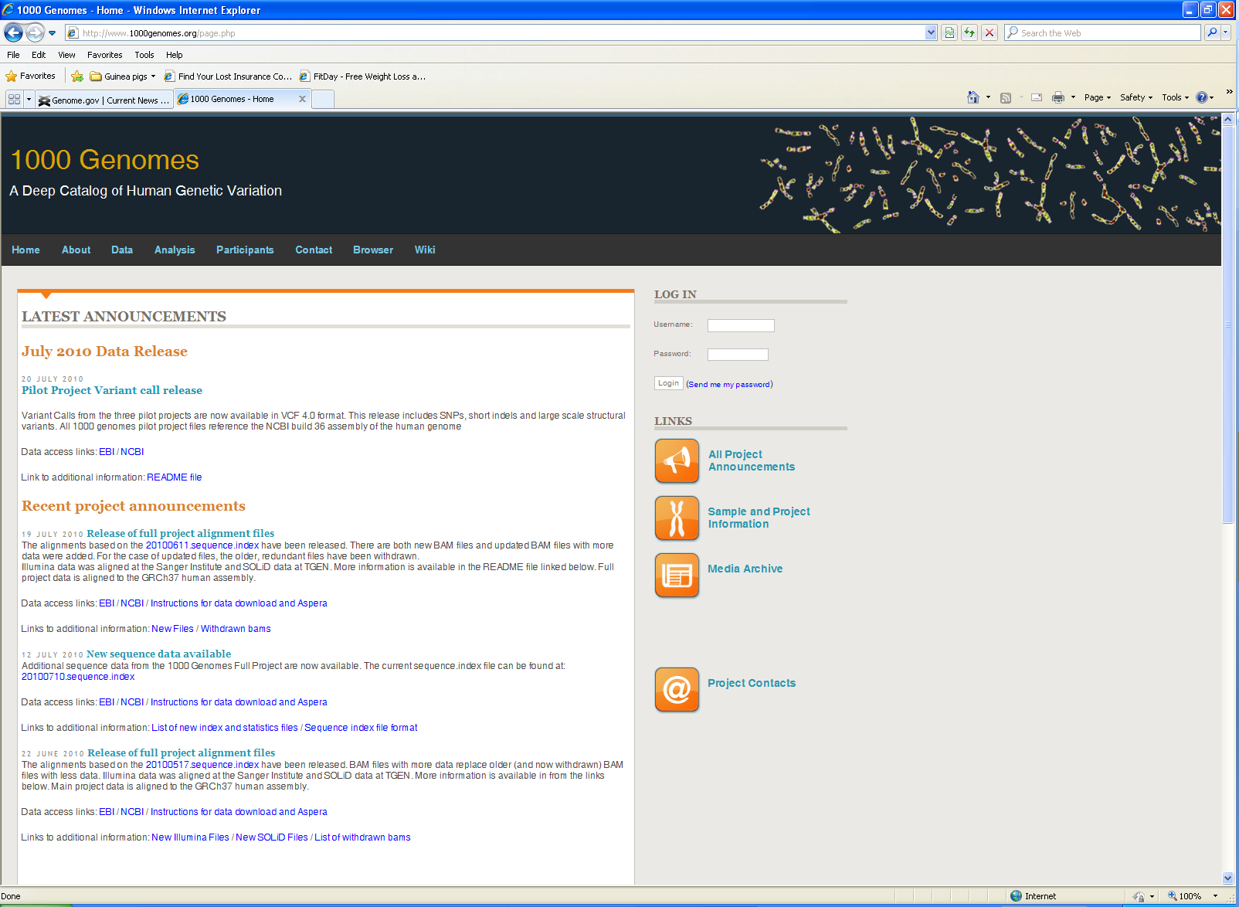
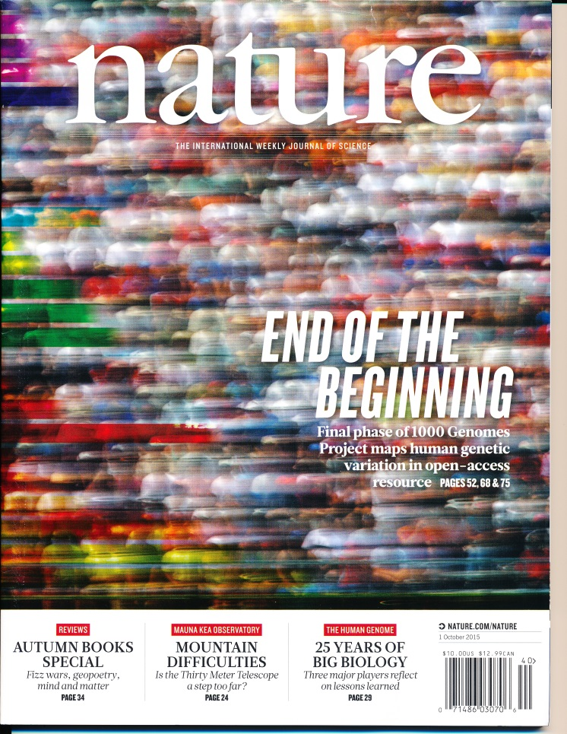
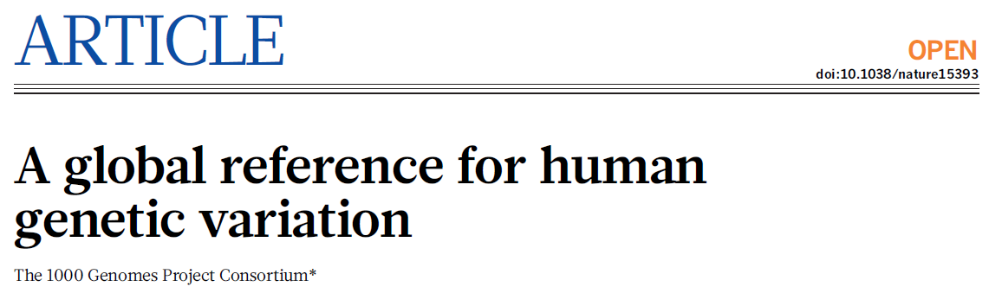
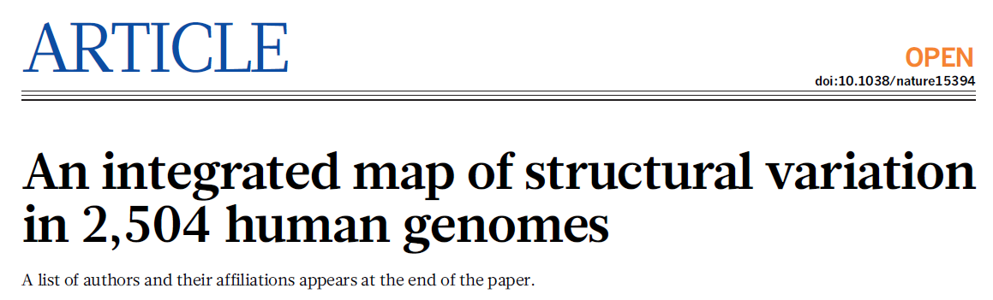


Nature (Oct. 1, 2015)
Nature (Oct. 1, 2015)
Nature Editorial (Oct. 1, 2015)
Nature News & Views (Oct. 1, 2015)
Document 25
Notes:
The 1000 Genomes Project was an international effort to produce a catalog of human genetic variation. The Project published its final summary papers in Nature on October 1. The final papers included: * a global reference for human genetic variation and * an integrated map of structural variation in 2,504 human genomes. * These publications were highlighted on the cover of Nature, in an editorial, and in a News & Views piece.
In the end, 1000 Genomes identified and catalogued more than 88 million variants in the genomes of over 2,500 people from 26 populations. Together, these reflect >99% of common human genomic variants.

Slide 39




Document 26
Notes:
The Cancer Genome Atlas (or TCGA) is a large coordinated effort to better understand the molecular basis of cancer. Data production, involving over 10,000 tumor/normal pairs, has been completed, and TCGA is currently focusing on data analysis and manuscript writing as the project nears its completion in 2016.
For each of over 30 cancer types, the TCGA Network has published a comprehensive, integrated account of sequence and mutation analysis, copy number variation, gene and microRNA expression, and promoter methylation. TCGA papers focused on * primary prostate cancer and * papillary renal-cell carcinoma were published in October and November in Cell and The New England Journal of Medicine, respectively. These papers provide new insights into classification and treatment of these tumors in a clinical setting.

Slide 40

TCGA Project 2015 Service to America Medal People’s Choice Award
Document 26
Notes:
One additional note about the TCGA Project. I reported to you back at the May 2015 Council meeting that TCGA was selected as a finalist for a 2015 Samuel J. Heyman Service to America Medal, nicknamed “The SAMMIES.”
I am happy to report that the TCGA Project Team won the People’s Choice Award during the 2015 Service to America award ceremony. Dr. Jean Claude Zenklusen from NCI and Dr. Carolyn Hutter from NHGRI, who are the leads for the TCGA Project, were presented this distinguished award at a banquet in October.

Slide 41

Long-Term Goal: Find All ‘Causal’ Genes
>20,000 exome sequences
>1,600 causal genes
>200 publications
Tools disseminated:
  PhenoDB, GeneMatcher, and data-analysis methods
Data sharing:
  Sequence, variants, and phenotypes to dbGaP
  Candidate causal gene names pre-publication
Document 27
Notes:
The Centers for Mendelian Genomics component of our Genome Sequencing Program aims to find as many causal genes for Mendelian conditions as possible, and to enable the broader research community to ultimately discover all causal genes.
Since December 2011, * the centers have generated and analyzed over 20,000 exome sequences. * This led to the discovery of over 1,600 genes that are highly likely to be causal for Mendelian conditions that the centers have studied. In the process of making these discoveries, the centers gained a more comprehensive understanding of what it will take to find the causal genes for all Mendelian conditions, making major innovations in areas such as sample accrual, collaboration establishment, study design, genome sequencing, and data analysis. * Many of these discoveries and innovations are reported in the over 200 publications that have come out to date.
* The centers also disseminated relevant tools, such as phenoDB for phenotype collection, storage, and analysis; GeneMatcher for enabling researchers interested in the same genes to quickly connect with one another; and various data-analysis methods. * Data were shared in several ways. Sequence, variants, and phenotypes were deposited in dbGaP. Also, realizing that causal gene information would be of high value for other researchers, last year, the centers started sharing the names of candidate causal genes pre-publication.

Slide 42

Genome Sequencing Program
Document 28
Notes:
As you are aware, we take very seriously the configuration and productivity of NHGRI’s well-known Genome Sequencing Program. As the end of the last grant period approached, we conducted a rigorous strategic planning process to decide how best to position this important component of the Institute’s extramural portfolio. Recall that we had a major program evaluation meeting in late July 2014 that focused on future opportunities for large-scale human genome sequencing, and then the rest of 2014 and all of 2015 brought a number of key steps for implementing the next phase of the Genome Sequencing Program, many of which involved this Council.
After these many important steps, we were happy to finally be able to announce the start of the new Genome Sequencing Program, an event delayed for some months by budgetary uncertainties.

Slide 43




Genome Sequencing Program
      Centers for Common Disease Genomics
      ~$240M + ~$20M (NHLBI) total over 4 years
The Broad Institute |  | Eric Lander, Mark Daly, Stacey Gabriel, Sekar Kathiresan
Washington University in St. Louis |  | Richard Wilson
Baylor College of Medicine |  | Richard Gibbs
New York Genome Center |  | Robert Darnell
Document 28
Notes:
The largest component of the new Genome Sequencing Program, the Centers for Common Disease Genomics (or CCDGs), will seek to undertake comprehensive rare-variant studies for several common, complex diseases. The initial focus of these centers will be on cardiovascular diseases (such as early onset myocardial infarction and hemorrhagic stroke) and neuropsychiatric disorders (such as autism). The program will accomplish their initial goals by sequencing the genomes of ~37,000. Program grantees are already working to identify additional disease areas, including autoimmune/inflammatory diseases and bone diseases. Over the coming months, NHGRI will be assessing opportunities to identify additional disease areas of to potentially tackle.
The four Centers for Common Disease Genomics are located at The Broad Institute, Washington University in St. Louis, Baylor College of Medicine, and the New York Genome Center. * NHGRI will be contributing ~$240M over four years and NHLBI will be contributing ~$20M over the same period; NHLBI’s contributions will serve to coordinate our program with their TOPMed genome-sequencing effort.

Slide 44





Genome Sequencing Program
      Centers for Mendelian Genomics
  ~$40M + ~$8M (NHLBI) + ~$1M (NEI) total over 4 years
    ~$4M total over 4 years
The Broad Institute |  | Daniel MacArthur, Heidi Rehm
University of Washington Baylor College of Medicine |  | Deborah Nickerson, Michael Bamshad, Suzanne Leal
Yale University |  | Rick Lifton, Mark Gerstein, Murat Gunel, Shirkant Mane
Johns Hopkins University Baylor College of Medicine |  | David Valle, James Lupski
  Genome Sequencing Program Coordinating Center
Rutgers University | Tara Matise, Steven Buyske
Document 28
Notes:
We also announced the next phase of the Centers for Mendelian Genomics, which will now consist of four centers. The center at The Broad Institute is new to this program. The three renewing centers are at the University of Washington in collaboration with Baylor College of Medicine, Yale University, and Johns Hopkins University in collaboration with Baylor College of Medicine. * These Centers will receive a total of ~$49M over four years, with ~$40M coming from NHGRI, ~$8M from NHLBI, and ~$1M from NEI.
* Finally, we announced the establishment of a Genome Sequencing Program Coordinating Center, which was awarded to Rutgers University. * The Coordinating Center will be funded at ~$4M total over four years.

Slide 45




Clinical Sequencing Exploratory Research Program
Enrolled 4,205 adults and 1,072 children
244 publications (13 working group publications)
Document 29
Notes:
The Clinical Sequencing Exploratory Research (or CSER) Program focuses on the integration of genome sequencing into the clinical workflow, including the generation, interpretation, and clinical reporting of genomic information. * CSER has now enrolled over 4200 adults and over 1000 children, with over 4000 of those resulting in the generation of germline genome sequence data and over 600 with tumor genome sequence data.
* In total, CSER has thus far produced 244 publications, 13 of which reflect working group publications. For example, a special issue * of the Journal of Law, Medicine, & Ethics was published in the Fall of 2015, with several articles authored by CSER investigators. This special issue focused on ethical, legal, and social implication issues involved in the return of genomic results and incidental findings to family members, including after the death of a research participant.
* The CSER Tumor Working Group recently published a commentary highlighting points for clinical laboratories and physicians to consider when ordering tumor-only genome sequencing. * And the University of Michigan CSER site recently published an analysis integrating tumor DNA and RNA as well as germline DNA sequence data in 91 pediatric patients with rare, relapsed, or refractory cancer. They found that 46% had actionable germline or somatic findings that could influence their clinical management, with RNA sequence data accounting for ~20% of the actionable findings.

Slide 46

Clinical Sequencing Exploratory Research Program
Workshop report available on genome.gov
Document 29
Notes:
Finally, in September 2015, a ‘CSER and Beyond’ program evaluation meeting was held to review the accomplishments of the CSER program and to prioritize research opportunities of relevance for a potential future research program focused on clinical genome sequencing. * The report from that workshop is available on NHGRI’s website, genome.gov.
Council member Dr. Dan Roden will give a presentation about this meeting later in the Open Session, and that will be followed by the presentation of two concept clearances by Dr. Lucia Hindorff.

Slide 47








Genome Sequencing Informatics Tools
    Robust software
    Social engineering
    Innovative use of cloud and ‘app’ frameworks
gene.iobio
Pindel-C
Document 30
Notes:
The Genome Sequencing Informatics Tools (GS-IT) Program, also known as iSeqTools, has had the mission to democratize genome analysis by providing ‘researcher friendly’ sequence analysis tools to users outside of large genome centers.
The GS-IT Program has relied on three approaches: * robust software engineering to make tools reliable and easy to use; * social engineering to engage users with support, documentation, and outreach; and * use of innovative technologies such as the cloud and fast, intuitive ‘app’ frameworks.
The program is ending, but a good foundation has been laid for the future. The six completed iSeqTools projects include some of the most recognized genome analysis toolkits, such * as GATK and gotCloud. Others such as * Genome STRiP have gained rapid adoption in the community. * Pindel has been extended to predict complex indels. * The IOBIO apps have been built into the ICGC Data Portal, and are now being used by busy clinicians. * SG-ADVISER has been used to solve cases of Mendelian diseases, such as for the examples shown here.

Slide 48

Technology Development Program
  Novel Nucleic Acid Sequencing
  RFA-HG-15-031 (to 33; R01, R21, and R43/44)
  RFA-HG-15-039 (Direct to Phase II R44) released
  Upcoming due dates: July 14, 2016 & June 15, 2017
  Novel Genome Technology Development
  PAR-16-14 (to 17; R01, R21, R43/44, and R44) released
  Upcoming due dates: October 31, 2016 & 2017
Document 31
Notes:
NHGRI’s Technology Development Program has active request for applications (or RFAs) and program announcements (or PARs) that are worth highlighting.
* RFAs for Novel Nucleic Acid Sequencing Technology Development for both DNA and direct RNA sequencing were released, yielding the first round of applications that are now under review and will be considered by this Council in May. A Direct to Phase II SBIR solicitation was recently added to this set of announcements. There are also upcoming application due dates in July of this year and in June 2017.
* PARs for Novel Genome Technology Development were released, yielding the first round of applications that are now under review and will by considered by this Council in September. There are also upcoming application due dates in October of 2016 and 2017.

Slide 49

Encyclopedia of DNA Elements (ENCODE)
  ENCODE Outreach Activities
  ENCODE 2016: Research Applications and Users Meeting - June 8-10: Palo Alto, CA
  2016 Keystone Chromatin and Epigenetics Meeting - March 20-24: Whistler, BC
  2016 Society of Toxicology Meeting - March 13-17: New Orleans, LA
  2015 ASHG Workshop - Baltimore, MD (completed)
  Publications Using ENCODE Data
Document 32
Notes:
The goal of the Encyclopedia of DNA Elements (ENCODE) project is to create catalogs of all functional elements in the human and mouse genomes, and to make those catalogs available as a resource to the biomedical community.
* The ENCODE project regularly engages in outreach activities to help a broad range of scientists use ENCODE resources. * For example, the second ENCODE Users Meeting will take place in June, modeled after the highly successful 2015 meeting. At that meeting, Consortium members will lead interactive tutorials demonstrating how to access ENCODE data, tools, and resources; run ENCODE pipelines that uniformly process data; and perform integrative analyses of ENCODE data. In addition, a panel of distinguished researchers not involved in ENCODE will explain how ENCODE resources are enabling their own work. For more details, visit ENCODE2016.org.
* ENCODE consortium members are also leading workshops at the upcoming Keystone Chromatin and Epigenetics meeting and * the Society of Toxicology meeting. * A similar workshop at the 2015 ASHG meeting attracted a sell-out crowd.
* ENCODE data continue to be heavily used. There are now more than 1300 community publications (the pink line) from groups without ENCODE funding but who used ENCODE data for their published work. ENCODE Consortium members have themselves now published more than 500 publications (the green line).

Slide 50
Encyclopedia of DNA Elements (ENCODE)
  New FOAs:
    Expanding the Encyclopedia of DNA Elements (ENCODE) in the Human and Mouse (RFA-HG-16-002)
    Characterizing the Functional Elements in the Encyclopedia of DNA Elements (ENCODE) Catalog (RFA-HG-16-003)
    Computational Analysis of the Encyclopedia of DNA Elements (ENCODE) Data (RFA-HG-16-004)
    ENCODE Data Coordination Center (RFA-HG-16-005)
    ENCODE Data Analysis Center (RFA-HG-16-006)
    Key Dates:
    Application Due Date March 21, 2016
    Scientific Merit Review June 2016
    Advisory Council Review October 2016
    Earliest Start Date December 2016
Document 32
Notes:
Aiming to build on the success of the ENCODE project, NHGRI has released five funding opportunity announcements (or FOAs) in functional genomics, all of which will be organized under the general ENCODE umbrella.
* These FOAs were developed based on recommendations from a program review workshop that NHGRI convened in Spring 2015, and will support functional genomics projects with a variety of goals, including: * expanding the catalog of candidate functional elements through high-throughput mapping in the human and mouse genomes, * developing generalizable approaches for characterizing the role of candidate functional elements in specific biological contexts, * developing new computational approaches for analyzing ENCODE data; * making ENCODE data readily available to the research community through coordinated data management activities, * and supporting the centralized data-analysis needs of the next phase of ENCODE, including developing updated and refined versions of the ENCODE encyclopedia.
* The key dates associated with these FOAs are shown here. Applications are due on March 21, with scientific merit review in June, Council review in October, and the earliest project start dates in December.

Slide 51



JAMA (2016)
Genetics in Medicine (2015)
Document 33
Notes:
The Electronic Medical Records and Genomics (or eMERGE) network, which recently entered its third phase, conducts genomic discovery and clinical implementation research by leveraging data from large biorepositories linked to electronic medical records.
* A paper outlining findings by eMERGE investigators was recently published in JAMA, along with an associated editorial. The study found a low concordance in designating arrhythmia-related genes (specifically, SCN5A and KCNH2) variants as pathogenic across different genetic testing laboratories. The study also reported no significant association between the putatively pathogenic variants and cardiac arrhythmia disorders in an unselected population.
* The eMERGE Consent, Education, Regulation, and Consultation (or CERC) Working Group was established to survey 90,000 individuals on their perspective about broad consent and data sharing. A systematic literature review was completed by this Working Group to prepare for the survey, and the findings from that literature review were recently published in Genetics in Medicine.

Slide 52


Dr. Harris devised and created REDCap, a research data collection and management software platform, and the ResearchMatch program.
Paul Harris, Ph.D.
Donald A.B. Lindberg Award for Innovation in Informatics
(AMIA 2015)
Document 33
Notes:
In addition, Dr. Paul Harris, an eMERGE investigator from Vanderbilt University, was recently honored with the American Medical Informatics Association (or AMIA) Donald A.B. Lindberg Award for Innovation in Informatics, which recognizes an individual who exemplifies Dr. Lindberg’s continuous commitment to the field.
Dr. Harris created REDCap, a research data collection and management software platform that has seen widespread adoption by over 1,600 academic and non-profit institutions in 92 countries. He also created and runs the national program ResearchMatch, which is designed to ‘match’ volunteers wishing to volunteer for studies and scientists recruiting participants for research at any Clinical and Translational Science Award (or CTSA) institution. The ResearchMatch program is currently serving about 83,000 volunteers and 3,200 researchers across 111 academic institutions.

Slide 53

The PhenX Toolkit
PhenX Toolkit use continues to rise
Redesigned web page
Pregnancy measures under development
PhenX Users,
Cumulative (2010-2015)
FOAs Citing PhenX, Cumulative (FY2010-2016)
Document 34
Notes:
The PhenX project, which aims to produce an online resource of standard measures for capturing data on common diseases, phenotypic traits, and environmental exposures, continues to add more features and expand its user base.
* This past October, version 13 of the PhenX Toolkit was released and includes a redesigned web page, making it easier for researchers to find the standard measures and supporting material relevant for their research studies.
* PhenX is assembling a new expert working group to identify valid, low-burden measures for the pregnancy research domain; they expect to add these measures to the Toolkit by late Fall 2016.
* Lastly, use of the PhenX Toolkit continues to rise. The graph on the left shows the cumulative growth of PhenX users. PhenX recently surpassed its 2,000th registered user and has over 5000 ‘my Toolkit reports’ downloaded. The graph on the right shows that by the end of 2015, there were 144 NIH Funding Opportunity Announcements (or FOAs) that encourage or require the use of PhenX measures. This demonstrates the growing number of NIH Institutes/Centers that recognize the value of capturing data with standard methods to facilitate data integration and cross-study analysis.

Slide 54








ClinGen clinical validity framework finalized
Collaborating with the Global Alliance for Genomics and Health (GA4GH) and the Wellcome Trust’s Translational Genomics Initiative
Clinical Validity Results for Genes Commonly Found
In Pancreatic Cancer Genetic Testing Panels
Definitive
Strong
ClinGen publications
Moderate
Limited
Document 35
Notes:
The Clinical Genome Resource (or ClinGen), which aims to build an authoritative central resource that defines the clinical relevance of genes and genomic variants for use in precision medicine and research, has just entered its third year of funding.
* We are pleased to report that version 1 of ClinGen’s clinical validity framework has been finalized. This framework defines the criteria needed to assess the clinical validity of a gene-disease pair, and quantifies the strength of the evidence supporting or refuting the relationship. For example, the ClinGen Hereditary Cancer Working Group used this framework and found that 50% of genes in common clinical testing panels for pancreatic cancer demonstrate only limited evidence for association with the disease.
* Two collaborative activities to note are that ClinGen is: (1) establishing a relationship with the Global Alliance for Genomics and Health (or GA4GH) to align our efforts in somatic cancer variation, and (2) participated in a productive meeting with the Wellcome Trust last week, as they just launched the Translational Genomics Initiative (a project with many points of synergy with ClinGen).
* Lastly, there have been a number of ClinGen publications recently, including papers envisioning the role of ClinGen in precision medicine and the integration of ClinGen with electronic health record systems.

Slide 55




Implementing Genomics In
Practice (IGNITE) Network
Asterisks (*) indicate a principal IGNITE site
Document 36
Notes:
The Implementing Genomics in Practice (or IGNITE) Network strives to develop methods of incorporating genomic information into medical care, and to promote the effective use of genomics in various healthcare settings.
* This year, IGNITE is pleased to announce that its first network-wide paper, entitled “The IGNITE Network: A model for genomic medicine implementation and research”, was published in BMC Medical Genomics in January. This paper describes the organization, methods, and goals of the entire IGNITE Network and of each member project.
* The IGNITE Toolbox is another network-wide product that has generated much excitement and anticipation throughout the program. Intended as a ‘one-stop-shop’ for genomic medicine, the Toolbox is an interactive data repository intended to assist researchers and healthcare institutions in the implementation of genomic medicine. A prototype of the site was released in January.

Slide 56







Newborn Sequencing In Genomic medicine and public HealTh (NSIGHT)
BWH, BC, and BCM
UCSF
Boston, MA
San Francisco, CA
Children’s Mercy
Kansas City, MO
UNC – Chapel Hill
Chapel Hill, NC
Document 37
Notes:
The Newborn Sequencing in Genomic Medicine and Public Health (or NSIGHT) program is exploring, in a limited but deliberate manner, the implications, challenges, and opportunities associated with the possible use of genomic sequence information for the care of newborns.
* Recently, the four NSIGHT groups held a public webinar, at which key personnel from each discussed their progress to date. Video and slides from the presentations can be found on the NHGRI NSIGHT webpage, shown here.

Slide 57
Director’s Report Outline
General NHGRI Updates
General NIH Updates
General Genomics Updates
NHGRI Extramural Research Program
NIH Common Fund/Trans-NIH
NHGRI Division of Policy, Communications, and Education
NHGRI Intramural Research Program

Slide 58

Human Microbiome Project (HMP)
  Integrative HMP (iHMP)
  3rd Annual iHMP Consortium Meeting
    June 2016 (Bethesda)
  2016 iHMP ‘Landmark’ Meetings
    Keystone Symposium “Genomics and Personalized Medicine” (February 2016)
    6th International Human Microbiome Consortium Congress (November 2016)
Document 38
Notes:
The integrative Human Microbiome Project (or iHMP), which is phase two of the Human Microbiome Project, is entering its third year.
* The third annual iHMP Consortium Meeting will be held in June in Bethesda. This is an open meeting.
* As in previous years, the three iHMP projects are presenting their work at ‘landmark’ meetings in 2016. * The first will be at the Keystone Symposium “Genomics and Personalized Medicine” in February. * The second will be at the 6th International Human Microbiome Consortium Congress in November.

Slide 59












  Fast Track Action Committee on
  Mapping the Microbiome (FTAC-MM)
    Chartered by OSTP
    Microbiome research portfolio analysis:
    Fiscal Years 2012-2014
      14 Federal agencies
        $922M total
        NIH: 59%
FTAC
MM
2015
Document 38
Notes:
As I reported at our last Council meeting, * a Fast Track Action Committee on Mapping the Microbiome was chartered by the Office of Science and Technology Policy (or OSTP), with the aims of completing a portfolio analysis of human-, animal-, and environment-associated microbiome research support across the Federal government and of preparing a report for the National Science and Technology Council. The Human Microbiome Project was the catalyst for the formation of this committee.
* The microbiome research portfolio analysis covered * Fiscal Years 2012-2014 and * included 14 federal agencies.* The committee identified a total of $922M in intramural and extramural microbiome research funding. * NIH funding comprised 59% of this total. More information on this analysis can be found in the final report, which was released in November.
* In addition, a paper summarizing the portfolio analysis was published in the inaugural issue of Nature Microbiology in January. A second paper, which focuses on the NIH investment in this emerging field, is currently being prepared.

Slide 60


Knockout Mouse Phenotyping Project (KOMP2)
    Approved for continuation
    Total funds: ~$100M over five years
    FOAs published in November
    Review in March
    Discuss funding plan at May Council meeting
Document 39
Notes:
The Knockout Mouse Phenotyping Project (KOMP2) was launched in 2011, with the goal of producing and phenotyping 2500 mouse knockout strains over 5 years. The project is on track to meet its goal in the fall of 2016.
* The project was approved for continuation by the NIH Common Fund, and thus will proceed with a second five years of support (achieving the maximum 10-year Common Fund project lifespan). The NIH Common Fund will be matching the funds provided by other NIH Institutes, Centers, and Offices; in total, there will be 18 Institutes, Centers, and Offices contributing funds to the next phase of the program for * a total of roughly $100 million of funding over the next 5 years.
* Funding Opportunity Announcements (or FOAs) for the next phase of KOMP2 were published in November, and applications were received in December. * The review of these applications will be conducted in March, * and a funding plan will be discussed with Council at the May meeting.
* The program plans to continue broad-based phenotyping of knockout mice in collaboration with our international partners through the International Mouse Phenotyping Consortium (or IMPC).

Slide 61


Human Heredity and Health in Africa (H3Africa)
  Session at 2015 ASHG Annual Meeting
  7th Consortium Meeting (Washington DC)
    PI presentations at NIH
    Trans-NIH/H3Africa Community Engagement Workshop
  Planning for renewal
Document 40
Notes:
The central goal of the Human Heredity and Health in Africa (or H3Africa) Initiative is to develop a sustainable and collaborative African genetics and genomics research enterprise. * Last October, H3Africa held an ancillary session at the 2015 American Society of Human Genetics (or ASHG) Annual meeting, in which six H3Africa PIs and working group chairs presented to a full room.
* Immediately following that gathering, the 7th H3Africa Consortium Meeting was held here in DC. * In addition to the usual closed sessions for the Consortium meeting, H3Africa also hosted a full day of PI presentations at NIH for a combined audience of well over 300 videocast and live viewers. * Capitalizing on the opportunity to share lessons learned between H3Africa and other NIH groups, several subject area meetings were held, such as a very fruitful trans-NIH/H3Africa Community Engagement Workshop.
* You will hear more about H3Africa progress and plans for renewal in a presentation later in the Open Session.

Slide 62













Undiagnosed Diseases Network (UDN)
UDN Site Locations
Click button on any UDN webpage to apply!
Document 41
Notes:
The NIH Common Fund Undiagnosed Diseases Network (or UDN) aims to improve the level of diagnosis and care for patients with undiagnosed diseases, facilitate research into the etiology of these diseases, and create an integrated and collaborative research community to identify and share improved options for optimal patient management.
This September, the UDN added 3 new Cores: * a Model Organisms Screening Center at Baylor College of Medicine (with the University of Oregon), * a Metabolomics Core at Battelle Pacific Northwest Laboratories (with Oregon Health and Science University), and * a Central Biorepository at Vanderbilt University.
The UDN is now accepting patients at all seven UDN Clinical Sites across the nation. To apply, access the UDN Gateway by * clicking on the “Apply” button, which is located on all of the UDN webpages.

Slide 63

Gabriella Miller Kids First
Pediatric Research Program
NIH Common Fund Program ($12.6M/year for ten years)
Clinical and genome-sequence data resource
Projects identified, genome sequencing underway
Genome Sequencing Center(s) funding opportunity
    RFA-16-011, Applications due April 1, 2016
Document 42
Notes:
The Gabriella Miller Kids First Pediatric Research Act was passed by Congress in March 2014 and signed into law by President Obama in April 2014. This act eliminated taxpayer financing of political conventions, repurposing those funds for a 10-year pediatric research initiative.
* The $12.6 million per year for 10 years are now designated for an NIH Common Fund program (referred to as Kids First). * The program aims to develop a data resource for the pediatric research community of well-curated clinical and genome-sequence data, with easy access and a focus on cancers with an inherited basis and on relapse and treatment-resistant tumors, as well as on structural birth defects.
* Production of whole-genome sequences from up to 6000 samples is underway through a supplement to two of the NHGRI Genome Sequencing Program centers for studies of Ewing’s sarcoma, drug-resistant pediatric osteosarcoma, cleft lip and palate, syndromic cranial dysinnervation disorders, congenital heart defects, congenital diaphragmatic hernia, and disorders of sex development.
* Last month, the program released another Funding Opportunity Announcement for Genome Sequencing Center(s) that calls for applications by groups who will sequence additional samples. The generated data will become a part of the data resource. The deadline for applications is April 1, 2016.

Slide 64

Precision Medicine Initiative (PMI)
Document 43
Notes:
As discussed at several recent Council meetings, NIH has been heavily involved in implementing the U.S. Precision Medicine Initiative (or PMI). NIH’s Fiscal Year 2016 budget includes $70 million for the National Cancer Institute to lead efforts in cancer genomics as part of PMI for Oncology, as well as $130 million to the NIH to build a national longitudinal research cohort of one million or more volunteers through the PMI Cohort Program.
NIH has been doing an excellent job of capturing and disseminating information about PMI Cohort Program planning activities via this dedicated web page. I would urge you to visit this site to get the latest information since it will continue to be ‘the place’ to go for information on meetings, funding opportunities, and so forth.

Slide 65
PMI Cohort Program Funding Opportunities
Type | Title | Year $M | # of awards | Project Period | Application | Award
OTA | Direct Volunteers Pilot Studies | TBD | 1 | 1 yr | Dec. 2015 | Feb. 2016
OTA | Communication Support for the Precision Medicine Initative Research Programs | TBD | 1 | 2 yrs | Dec. 2015 | Feb. 2016
U24 | PMI Cohort Program Biobank | 15 | 1 | 5 yrs | Feb 4, 2016 | July 2016
U2C | PMI Cohort Program Coordinating Center | 21 | 1 | 5 yrs | Feb 17, 2016 | July 2016
UG3/UH3 | PMI Cohort Program Healthcare Provider Organization Enrollment Centers | 28 | <7 | 5 yrs | Feb 17, 2016 | July 2016
U24 | PMI Cohort Program Participant Technologies Center | 8 | 1 | 5 yrs | Feb 17, 2016 | July 2016
Document 43
Notes:
In fact, the first set of funding opportunities for the PMI Cohort Program was announced in November, and these opportunities are summarized in the table shown here.
The first two funding opportunities will use something called Other Transaction Authority (or OTA) to develop a pilot program to inform creation of the direct volunteer enrollment for the cohort, as well as to establish a communication infrastructure. OTA has been used by some other government agencies, and is designed to obtain cutting-edge technology with a high degree of flexibility (often from non-traditional sources). Applications have already been received for these two opportunities, with awards expected to be made this month.
The last four funding opportunities will be traditional cooperative agreements designed to build the infrastructure for the PMI Cohort Program, including a biobank, coordinating center, network of healthcare provider organizations, and participant mobile technologies. Applications for these are due this month, with awards expected this summer.

Slide 66

PMI Cohort Program Advisory Panel
Document 43
Notes:
Also, in November, Dr. Francis Collins announced the establishment of the PMI Cohort Program Advisory Panel, the roster for which is shown here. Note that the Panel includes Council member Dr. Lon Cardon and former Council member Dr. David Williams. Panel members will provide ongoing guidance and oversight of the PMI Cohort, contributing significantly to the evolution of the program’s vision, scientific and clinical goals, and operations. Additional members will be named over time.
Finally, NIH launched a search for a permanent PMI Director. Applications were due in December, with the search process now proceeding in earnest.

Slide 67

NIH Announces ECHO Program
Funding Announcement | Number
Clinical Sites for the IDeA States Pediatric Clinical Trials Network (UG1) | RFA-OD-16-001
Data Coordinating and Operations Center for the IDeA States Pediatric Clinical Trials Network (U24) | RFA-OD-16-002
ECHO Patient Reported Outcomes Research Resource Center Core (U24) | RFA-OD-16-003
ECHO Pediatric Cohorts (UG3/UH3) | RFA-OD-16-004
ECHO Data Analysis Center (U24) | RFA-OD-16-005
ECHO Coordinating Center (U2C) | RFA-OD-16-006
Limited Competition: Exposure Analysis Services for the ECHO Program (Admin Supplement) | PA-16-046
Due Friday, April 15, 2016, 5PM local time
Document 44
Notes:
In December, NIH announced seven Requests for Applications to support the Environmental influences on Child Health Outcomes (or ECHO) program. This seven-year initiative is designed to investigate the longitudinal impact of prenatal, perinatal, and postnatal environmental exposures on pediatric health outcomes with high public health impact. While the goals of ECHO are consistent with those of the former National Children’s Study, the approach is different. ECHO will support multiple, synergistic longitudinal studies using existing study populations to investigate environmental exposures— including physical, chemical, biological, social, behavioral, natural and built environments— on child health and development.
* The seven funding announcements are listed here. The studies will focus on four key pediatric outcome areas that have a high public health impact: upper and lower airway; obesity; pre-, peri-, and postnatal outcomes; and neurodevelopment. The studies will share standardized core data elements managed by a central coordinating center and an associated data analysis center. Applications for these funding announcements are all due on * Friday, April 15 (a seemingly popular date for federal agencies).

Slide 68
Director’s Report Outline
General NHGRI Updates
General NIH Updates
General Genomics Updates
NHGRI Extramural Research Program
NIH Common Fund/Trans-NIH
NHGRI Division of Policy, Communications, and Education
NHGRI Intramural Research Program

Slide 69

Inter-Society Coordinating Committee for Practitioner Education in Genomics (ISCC)
In-person meeting (January)
Theme: Implementation of practical education strategies
Added ‘patient’s voice’ to discussion
Discussion of international partnerships
Document 45
Notes:
The Inter-Society Coordinating Committee for Practitioner Education in Genomics (or ISCC) held their * fifth, day-long, ‘in-person’ meeting in January. The ISCC was formed following Council’s Genomic Medicine Working Group’s January 2013 meeting, with a charge to enhance the practice of genomic medicine through the sharing of educational approaches and joint identification of educational needs.
* The theme for this meeting was implementation of practical education strategies. The participants heard from Jeanette McCarthy (educator and editor of Genome Magazine), Samuel Johnson (from Kaiser Permanente), and Michael Murray (from Geisinger). Jeffrey Weitzel described his 15-year experience with an NIH-funded provider education program in cancer genomics at City of Hope. * A new voice – the patient’s – was added to the meeting, with a thought-provoking presentation by the founder of the Lynch Syndrome advocacy group AliveAndKickn’.
New areas of discussion revealed potential roles for * international partnerships and collaboration within ISCC. Attendees stated their appreciation for a strong consensus and enthusiasm for collaborative education using a diversity of approaches. The speakers’ slides are available on the meeting website.

Slide 70

Nursing Scholarship Award
J Nurs Schol 2013; 45:1, 96–104
International Award for Nursing Excellence “Best of Journal of Nursing Scholarship in World Health”
Web platform in development to disseminate strategies and resources
Document 46
Notes:
A collaborative effort spearheaded by Dr. Jean Jenkins of the NHGRI Genomic Healthcare Branch, Dr. Kathy Calzone of the National Cancer Institute, and Dr. Patricia Grady, Director of the National Institute for Nursing Research (or NINR), has won an International Award for Nursing Excellence for the “Best of Journal of Nursing Scholarship in World Health.” The award recognizes the 2013 publication shown here, A Blueprint for Genomic Nursing Science, authored by the Genomic Nursing State of the Science Panel convened through this collaboration.
The winning article kick-started discussion of research opportunities that build the evidence needed for integration of genomics into nursing practice and regulation, and provided a framework for moving nursing science forward to address research gaps. Recommendations included expanding the capacity of nurse scientists to conduct genomics research.
To activate the blueprint described in the paper, the NIH team convened a follow-up meeting in August 2014, at which working groups formed to develop a genome research consortium, identify common data elements for inclusion in nursing research, and examine nurse-scientist education and training efforts. * To achieve the aims delineated in the Genomic Nursing Science Blueprint quickly, efficiently, and collaboratively, the NHGRI and NINR staff plan a web-based platform to provide access to strategies and resources to further the research agenda.

Slide 71



Summary of Proposed Changes to the Common Rule: New Resource
Document 47
Notes:
As discussed at the last Council meeting, the Department of Health and Human Services announced the Notice of Proposed Rule Making (or NPRM) to revise the ‘Common Rule’— the set of regulations for the Department of Health and Human Services and 16 other federal agencies governing the protection of human subjects in research. NHGRI’s Policy and Program Analysis Branch has created a web-based resource for the community (located on genome.gov) that summarizes the proposed changes included in the NPRM that are relevant for genomics research, including proposed changes to the treatment of biospecimens, informed consent, privacy safeguards, and IRB review.
The resource also contains charts and graphics to clarify the more complex proposals, including * proposals for changing the definition of a human subject and * those for re-defining exclusions and exemptions from the rule. The public comment period for the NPRM was 120 days and closed last month. More than 2100 comments were submitted and can be viewed online at the web site regulations.gov.
We hope that this new resource will be useful to the genomics research community as this regulatory process proceeds, and we welcome any questions or feedback on the information provided or the proposed rule.

Slide 72



NHGRI History of Genomics Program
Oral history interviews (~30 to date)
Seminar series commemorating launch of Human Genome Project 25 years ago
Document 48
Notes:
The NHGRI History of Genomics Program within the Institute’s Communications and Public Liaison Branch * continues to conduct oral history interviews with key staff and members of the genomics research community. To date, 30 such oral histories have been completed. The raw video footage is in the process of being prepared for posting on our GenomeTV channel of YouTube.
* To commemorate the 25th anniversary of the launch of the Human Genome Project, the NHGRI History of Genomics Program is hosting a seminar series entitled * “A Quarter Century after the Human Genome Project’s Launch: Lessons Beyond the Base Pairs.” The first of the six planned seminars was held in December, and featured a panel discussion involving Drs. Elke Jordan and Mark Guyer that I moderated (a photo from which is shown on the right).
The second was a lecture by Dr. Maynard Olson that occurred a couple of weeks ago. The remaining four talks will feature Drs. Ewan Birney, Bob Cook-Deegan, Marco Marra, and David Bentley. Each of the distinguished speakers also participates in an oral history interview while they are at NIH. As is our usual routine, the talks are being videotaped and posted on our GenomeTV channel of YouTube.

Slide 73



National DNA Day 2016
Document 49
Notes:
Each year, NHGRI celebrates DNA Day. This year, our Education and Community Involvement Branch and our Communications and Public Liaison Branch have partnered to expand the reach of our DNA Day programming.
Efforts to support such an expansion include * an updated National DNA Day logo and * an overhaul of the NHGRI DNA Day web pages, including a map highlighting DNA Day activities across the United States, an extensive page highlighting genetics education resources, and the creation of a toolkit to assist other organizations with their DNA Day event planning – all of which are available beginning today on genome.gov.
* Also, in the works are a Twitter Chat and a weeklong “Ask Me Anything” series hosted on the website, Reddit, which will involve the efforts of prominent genomics researchers.
On April 25 – the official National DNA Day – NHGRI will host Dr. Eric Spana from Duke University at our inaugural National DNA Day Lecture for the NIH community. Dr. Spana’s lecture will focus on communicating science to students and the public in creative and relevant ways.

Slide 74

Trans-NIH H3Africa Community Engagement Meeting
Effective Strategies and Practices for Engaging with Communities Around Biomedical Research
Document 50
Notes:
As I mentioned earlier, in October, NHGRI’s Education and Community Involvement Branch in conjunction with the Human Heredity and Health in Africa (H3Africa) Consortium hosted a workshop at NIH on “Effective Strategies and Practices for Engaging with Communities Around Biomedical Research.”
This gathering brought together H3Africa researchers and staff involved in community engagement activities with NIH researchers and staff who work collaboratively with communities underrepresented in biomedical research. The workshop provided a forum to discuss effective community engagement strategies and practices in the United States and internationally. Over the course of the day’s presentations and conversations, several themes and key messages emerged, including ways to increase community participation and involvement, the need for research on the evaluation of effective strategies to facilitate community engagement, understanding different consent models and advisory boards, and the challenges related to sustaining community efforts.

Slide 75

Genome: Unlocking Life’s Code
Exhibition Travel Schedule
2016
  January 23-April 25
  Discovery World
  Milwaukee, WI
  May 21-September 5
  Natural History Museum of Utah
  Salt Lake City, UT
  September 30-January 1
  Exploration Place
  Wichita, KS
2017
  January 28-May 29
  Peoria Riverfront Museum
  Peoria, IL
Document 51
Notes:
The NHGRI-Smithsonian exhibition Genome: Unlocking Life’s Code continues to travel across North America. * On January 23, the exhibition opened in Milwaukee, Wisconsin at Discovery World, and in May, the exhibition will travel * to Salt Lake City and later * onto Wichita, Kansas to close out 2016. * The first stop in 2017 will be at the Peoria Riverfront Museum in Peoria, Illinois. While the exhibition is in these cities, NHGRI staff are partnering with the museums and science centers on programs, docent training, and special community days.
Please continue to check the exhibition’s website (unlockinglifescode.org) and follow it on social media for the most up-to-date program information.

Slide 76

Genome: Unlocking Life’s Code Exhibition
Native American Youth and Family Center Family Night
Document 51
Notes:
As I just mentioned, NHGRI staff are partnering with the museums and science centers who are hosting our genomics exhibition to develop and support community-focused programming. In November, the Native American Youth and Family Center, together with NHGRI and the Oregon Museum of Science and Industry, hosted a family night at the Genome: Unlocking Life’s Code exhibition.
The event was attended by nearly 250 American Indian and Alaska Native people in the Portland area, and offered participants the opportunity to explore the museum, experience the exhibition, and hear from a Native storyteller about ancestry, origins, and identity. In addition to the family night, the Native American Youth and Family Center brought students from their school and after-school programs to the exhibition during the day as part of their curriculum on genetics.

Slide 77

Genome: Unlocking Life’s Code Exhibition
Website Interactive
Document 51
Notes:
In November, a second interactive to support the genomics exhibition debuted on the exhibition’s website (unlockinglifescode.org). “In and Beyond Africa” is an online interactive that allows users to learn about various aspects of human origins and follow a timeline of human migrations out of Africa. This addition significantly expands upon the content found within the exhibition itself.
Through gaming, visitors can learn about prehistoric tool making, the genetic basis of human skin pigmentation, genetic facts about the domestication of crops and animals, and genomics projects about the life of the Neolithic mummy Otzi. The interactive also includes an activity entitled “Deep Future,” with which users can record their predictions about human evolution. This is a fun learning activity, and I encourage you to spend a few minutes taking a look at this new interactive website.

Slide 78
Director’s Report Outline
General NHGRI Updates
General NIH Updates
General Genomics Updates
NHGRI Extramural Research Program
NIH Common Fund/Trans-NIH
NHGRI Division of Policy, Communications, and Education
NHGRI Intramural Research Program

Slide 79

Thomas A. Waldmann Award for Excellence in Human Immunology
Dan Kastner, M.D., Ph.D.
Document 52
Notes:
Dr. Dan Kastner, NHGRI Scientific Director (who you will be hearing from shortly), received the 2015 Thomas A. Waldmann Award for Excellence in Human Immunology. This award is given to an immunologist/cell biologist who has made major contributions directly or indirectly to the understanding of primary immunodeficiency diseases.

Slide 80

2015 Distinguished Alumnus of the University of Texas Graduate School of Biomedical Sciences in Houston
Paul Liu, M.D., Ph.D.
Document 53
Notes:
The University of Texas Graduate School of Biomedical Sciences in Houston named Dr. Paul Liu, NHGRI Deputy Scientific Director, its 2015 Distinguished Alumnus. Dr. Liu, who also heads the Intramural Research Program’s Oncogenesis and Development Section, was recognized for his contributions to the understanding of the molecular mechanisms of leukemia and for the development of targeted treatments.

Slide 81







Molecular Cancer Research
Homologous mutation to human BRAF V600E is common in naturally occurring canine bladder cancer-evidence for a relevant model system and urine-based diagnostic test
NHGRI Intramural Research Highlights
TCF1 Is Required for the T Follicular Helper Cell Response to Viral Infection
Loss-of-function mutations in TNFAIP3 leading to A20 haploinsufficiency cause an early-onset autoinflammatory disease
HLA-DRB1*11 and variants of the MHC class II locus are strong risk factors for systemic juvenile idiopathic arthritis
Document 54
Notes:
As usual, it has been a productive few months for the NHGRI Intramural Research Program:
* Dr. Pam Schwartzberg and her research group published an important study about T cell factor-1, a transcription factor that is essential for the creation and persistence of disease-fighting antibodies. Their findings, published last September in Cell Reports, may help shed light on pathways important for the development of vaccines and immune therapies targeting viral infections.
* Dr. Amanda Ombrello and colleagues have identified a new childhood-onset disorder that they have named Haploinsufficiency of A20. The disease results from a variant of a gene that regulates how the immune system responds to inflammation, infection, and trauma. Their findings were published in the December issue of Nature Genetics.
* And in yet another highlight for him, Dr. Dan Kastner and colleagues have discovered genomic variants that increase the risk for a potentially life-threatening childhood disease, characterized by persistent joint swelling, pain, and stiffness— known as systemic juvenile idiopathic arthritis. That recently reported these findings in the Proceedings of the National Academy of Sciences Early Edition.

Slide 82

To receive The Genomics Landscape,
go to list.nih.gov
Search for NHGRILANDSCAPE
Past issues can be accessed at: genome.gov/27527308
Document 55
Notes:
Before ending my Director’s Report, I would like to (as always) put in a plug and say that anyone wishing to receive my monthly email update (called “The Genomics Landscape”) can simply go to list.nih.gov and then search for “NHGRILANDSCAPE.” I should note that our total external subscription base for The Genomics Landscape is approaching the 1000 mark.

Slide 83


Thanks!
Special Thanks!
Notes:
Finally, a personal thanks to the 50-60 NHGRI staff members who contributed slides and information that I just reviewed. As always, such a group effort is essential for getting this large amount of information conveyed efficiently at each Council meeting.
An additional thanks to the NHGRI communications group and web team for making my Director’s Report into an electronic resource.
* And special thanks to Kris Wetterstrand, who serves as the ‘ring leader’ in coordinating material development, and who directly helps me produce the final Powerpoint file. Kris is shown here at the first seminar in our special History of Genomics Program seminar series that I mentioned earlier.

Slide 84

Advancing human health
through genomics research

