Slide 1



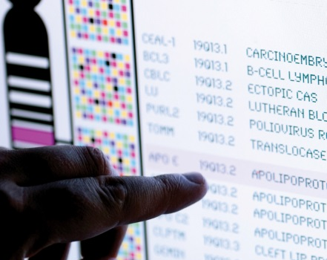
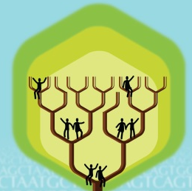
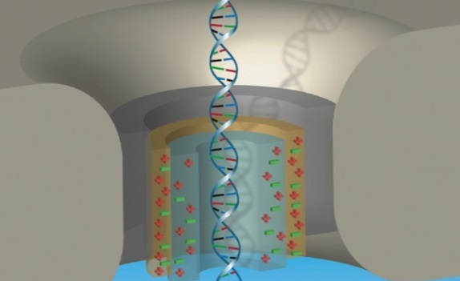


DIRECTOR’S REPORT
Eric Green, M.D., Ph.D.
Director, NHGRI
February 2019
Document #
Notes:
Once again, I would like to welcome all of you to this Open Session of the National Advisory Council for Human Genome Research meeting, both those of you in the room and those of you joining us remotely by live webcast.
As a reminder, my Director’s Report presentation is being videotaped, and that recording will be made available as a permanent archive on NHGRI’s website (genome.gov).
1

Slide 2
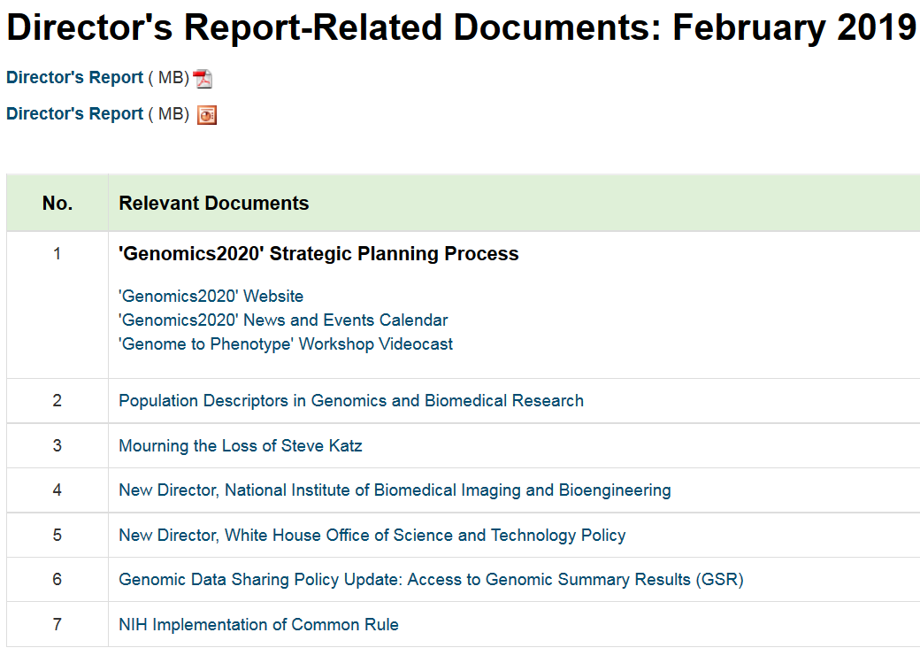
genome.gov/DirectorsReport
Document #
Notes:
For those who are new to our Council meetings, I want to make you aware of the ‘electronic resource’ that is developed for my Director’s Report. Analogous to supplemental materials of a published paper, this resource can be accessed at the URL shown here.
The slides that I will show during my Director’s Report are also available electronically at this site – * both in PDF and PowerPoint formats.
* When there are documents or relevant websites associated with a particular slide, you will find a ‘Document #’ indicated on the bottom right of that slide; that ‘Document #’ references materials that can be accessed and/or downloaded from the web page shown here. This dedicated web page and all linked documents will be archived on genome.gov as a historic record of this meeting.
2

Slide 3
Open Session Presentations
  Presentation: A Clinical Imperative – Genomics, Population Health, and Precision Health at Geisinger
  Hunt Willard
  Concept Clearance: Electronic Medical Records and Genomics (eMERGE) – Comprehensive Genomic Risk Assessment and Management
  Teri Manolio
  Concept Clearance: Centers of Excellence in ELSI Research Joy Boyer
Notes:
There will be a number of other presentations during the Open Session of this Council meeting. My Director’s Report is tailored around those presentations, and I will not discuss in detail the topics that others will cover.
* Immediately after my Director’s Report, we will be joined by Hunt Willard of Geisinger National Precision Health, who will give a presentation entitled “A Clinical Imperative – Genomics, Population Health, and Precision Health at Geisinger.”
* After lunch, Teri Manolio will present a concept clearance on Electronic Medical Records and Genomics (eMERGE): Comprehensive Genomic Risk Assessment and Management.
* Joy Boyer will then present a concept clearance on Centers of Excellence in ELSI Research.
3

Slide 4
Open Session Presentations
  Report: NACHGR Data Science Working Group
  Trey Ideker
  Report: NACHGR Community Engagement in Genomics Working Group
    Gwen Darien
  Report: Clinical Genomics (ClinGen) Resource
  Erin Ramos & Sharon Plon
  Report: NHGRI Triennial Inclusion Report
    Christine Chang
Notes:
Following those two concept clearances, there will be four reports.
* Council member Trey Ideker will present a report from Council’s Data Science Working Group, and * Gwen Darien will then present a report from the Council’s Community Engagement in Genomics Working Group.
* Erin Ramos and Council member Sharon Plon will give a report on the Clinical Genomics (ClinGen) Resource.
* Finally, Christine Chang will present the NHGRI Triennial Inclusion Report.
4

Slide 5
Director’s Report Outline
General NHGRI Updates
General NIH Updates
General Genomics Updates
NHGRI Extramural Research Program
NIH Common Fund/Trans-NIH
NHGRI Division of Policy, Communications, and Education
NHGRI Intramural Research Program
Notes:
For the rest of my Director’s Report, I will cover the 7 areas listed here, which reliably provide a nice framework for reviewing the relevant topics.
5

Slide 6
Director’s Report Outline
General NHGRI Updates
General NIH Updates
General Genomics Updates
NHGRI Extramural Research Program
NIH Common Fund/Trans-NIH
NHGRI Division of Policy, Communications, and Education
NHGRI Intramural Research Program
Notes:
6

Slide 7

Departure of Director, NHGRI Division of Policy, Communications, and Education
Laura Lyman Rodriguez, Ph.D.
Notes:
It is with mixed feelings that I tell you that Laura Rodriguez will be leaving NHGRI and her position as Director of our Institute’s Division of Policy, Communications, and Education in April. Laura will be joining Geisinger National Precision Health to become their Director for Genome Policy and National Engagement. After joining NHGRI in 2002, Laura has held a number of different positions, spearheaded numerous initiatives, and worked closely with several NHGRI Directors, both acting and permanent. As a Division Director, she has worked to develop and implement policies, design communication and outreach strategies, and prepare the public and healthcare professionals for the future of genomic medicine. As a leader in the development of the NIH Policy for Data Sharing in Genome-Wide Association Studies and the follow-on NIH Genomic Data Sharing Policy, Laura helped to shape the agency's approach to sharing NIH-supported genomic research data.
Laura has been a key member of my leadership team for my entire time as NHGRI Director, and I will certainly miss her wide-ranging contributions and her wise advice. Her shoes will not be easily filled; indeed, several of us (specifically, me, Larry Brody, and Vence Bonham) are stepping in to collectively help oversee the Division of Policy, Communications, and Education on an interim basis until permanent leadership is identified. We wish Laura all the best in her role at Geisinger; she will no doubt continue to push the field of genomics forward.

Slide 8
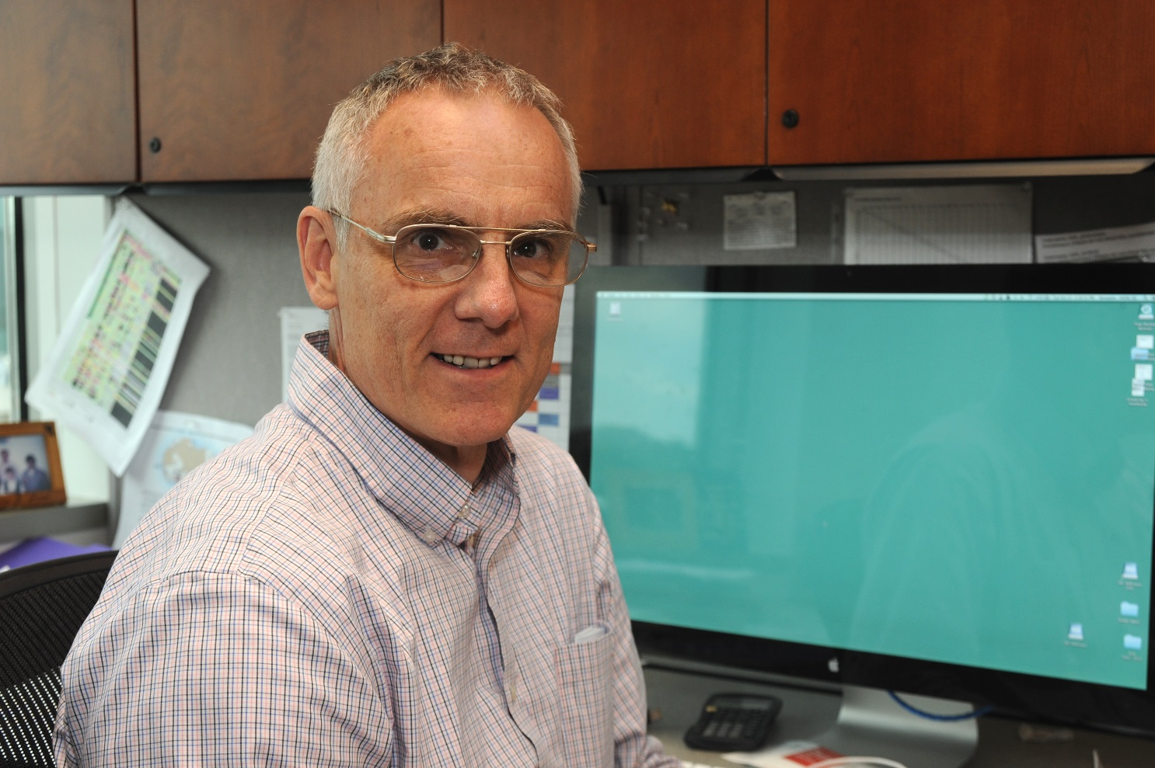
Retirement of NHGRI Program Director
Jeff Struewing, M.D.
Notes:
Jeff Struewing, NHGRI Extramural Program Director, will retire at the end of April. Jeff came to NIH in 1991; he studied inherited factors in cancer first in the Genetic Epidemiology Branch and then in the Laboratory of Population Genetics at the National Cancer Institute. In 2007, Jeff came to NHGRI as a Program Director, at which time he conceived and initiated the Electronic Medical Records and Genomics (eMERGE) Network. He also conceived and helped lead the NIH Common Fund’s Genotype-Tissue Expression (GTEx) project. He has continued to be an influential contributor to a number of NHGRI extramural programs and a valued advisor to both junior and senior staff alike.
While he has threatened to do some ad hoc contract consulting with NIH after retirement, we suspect that he will most enjoy his woodworking and volunteer work with Lumina Studio Theater and Lucky Dog Animal Rescue. We wish Jeff all the best in his retirement.
8

Slide 9
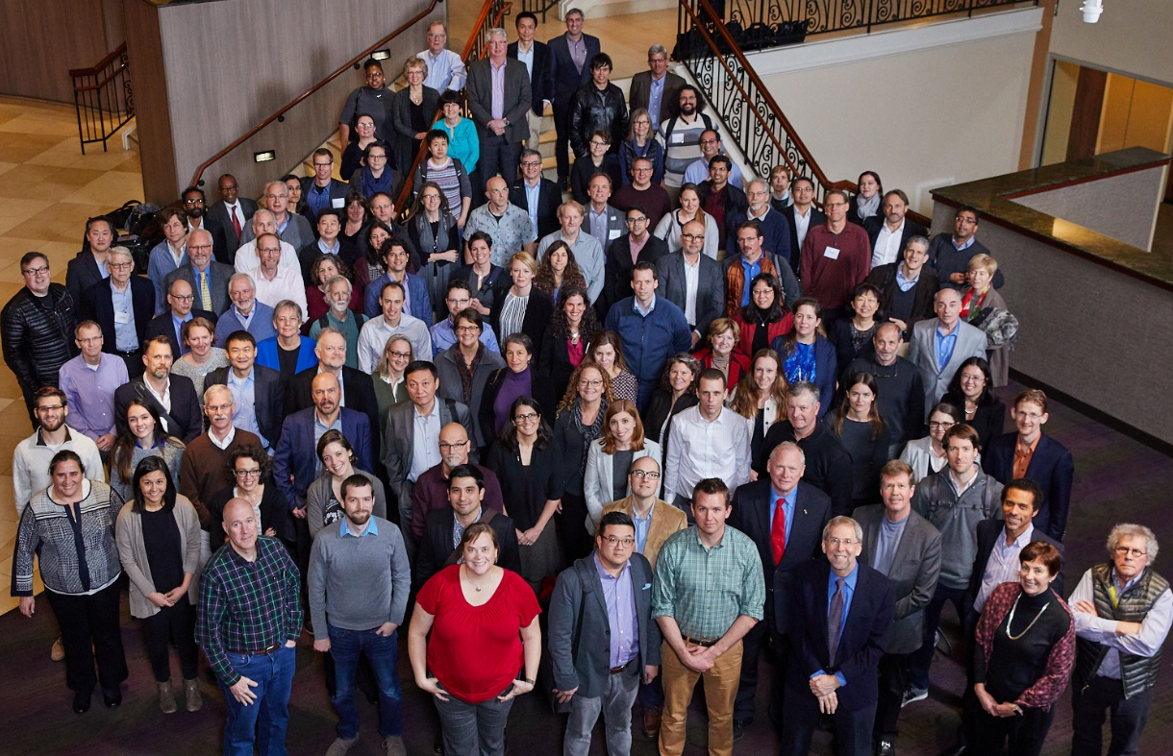
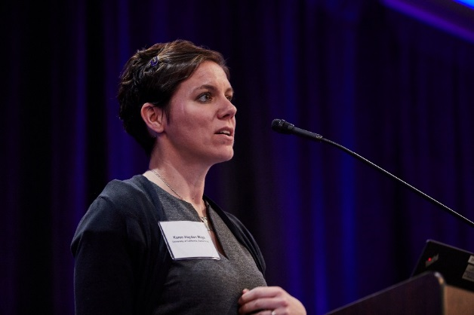
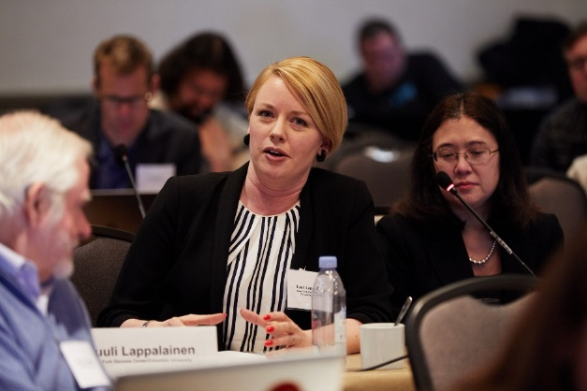
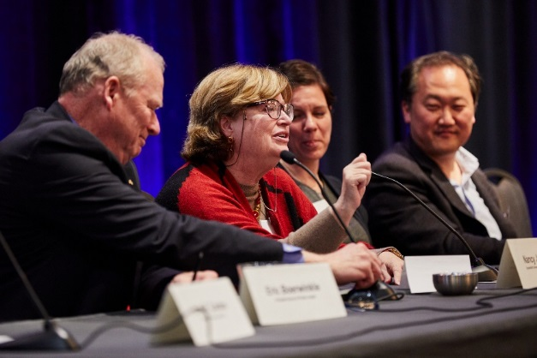
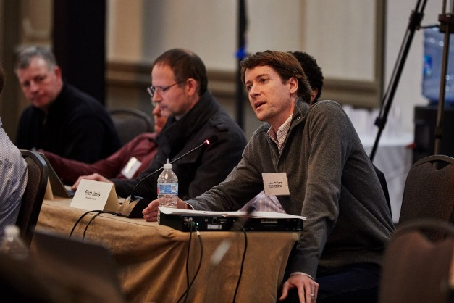
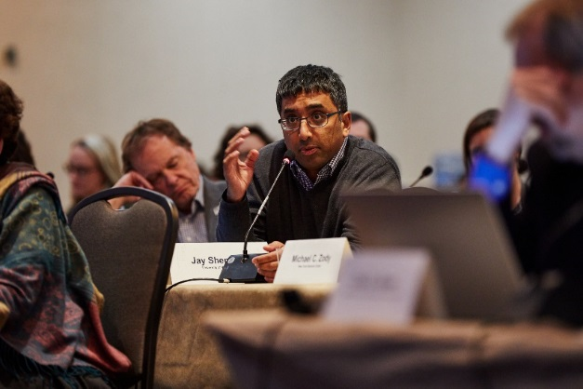
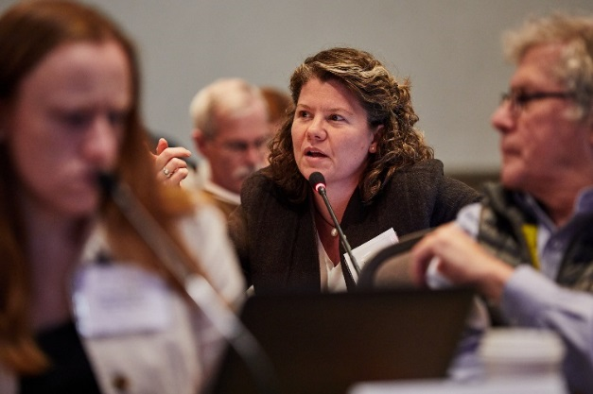
‘Genomics2020’ Strategic Planning Process
    Recent Events:
      Town Hall in Atlanta, GA
      Nine satellite meetings/sessions
        ‘Genome to Phenotype’ Workshop
Document 1
Notes:
As I hope all of you are aware, NHGRI is in the midst of an important ‘Genomics2020’ strategic planning process, one that will yield a new strategic plan in the Fall 2020. To date, NHGRI has held 30 events to gather input from various communities.
Recent events have included a Town Hall at Morehouse School of Medicine in Atlanta, Georgia, and nine satellite meetings and sessions at various annual conferences and consortium meetings. Shown on this slide are photographs from the most recent event, a major workshop entitled “From Genome to Phenotype: Genomic Variation Identification, Association, and Function in Human Health and Disease” that was held three weeks ago. The recorded videocast from that workshop is now available on our GenomeTV channel on YouTube.
As we approach the half-way point of the ‘Genomics2020’ strategic planning process, NHGRI is beginning to pivot from gathering open input from the community to seeking feedback on the general themes and ideas that are emerging from the process. In 2019 and early 2020, we will be holding additional town halls, workshops, and sessions that will aim to gather that feedback and help us craft the new strategic plan.
9

Slide 10
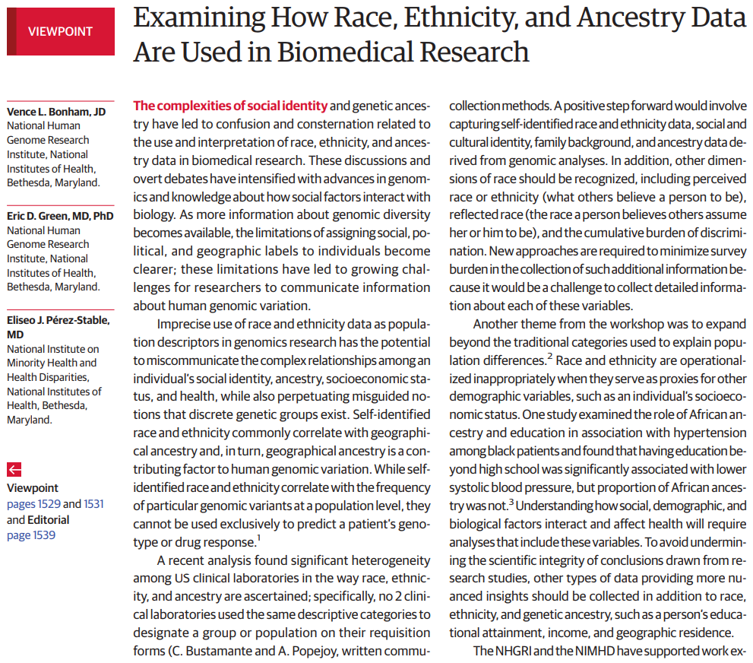
Population Descriptors in Genomics and Biomedical Research
    Increase scientific rigor in collecting data describing participants, especially in clinical settings
    Ensure collected data reflect the multidimensional nature of a person’s identity
    New trans-NIH working group established to identify next steps
Document 2
Notes:
NHGRI and the National Institute on Minority Health and Health Disparities (or NIMHD) are working together to examine and support research into how populations are described in research and how that translates into the scientific literature and ultimately into clinical care. In October 2018, NIMHD’s Director Eliseo Perez-Stable, Vence Bonham, and I co-authored a perspective in the Journal of the American Medical Association on this topic, which summarizes the key discussion that took place at a recent NIH workshop that we convened on this general topic. This published perspective highlights some of the complexities of this area and also calls on researchers to:
* Increase the scientific rigor in collecting data describing participants, especially in clinical settings; and * ensure the collected data reflect the multidimensional nature of a person’s identity (for example, race, ethnicity, socio-economic status, and geographic ancestry).
Emanating from the recent workshop and now this perspective, * NHGRI and NIMHD have embarked on stimulating more conversations on this topic, specifically looking into what NIH Institutes and Centers should do to guide appropriate uses of race and ethnicity as population descriptors in biomedical and genomics research. One step in that direction has been the establishment of a new trans-NIH working group led by NHGRI and NIMHD that will identify next steps and carry this discussion forward in the coming months.

Slide 11
Director’s Report Outline
General NHGRI Updates
General NIH Updates
General Genomics Updates
NHGRI Extramural Research Program
NIH Common Fund/Trans-NIH
NHGRI Division of Policy, Communications, and Education
NHGRI Intramural Research Program
Notes:
11

Slide 12
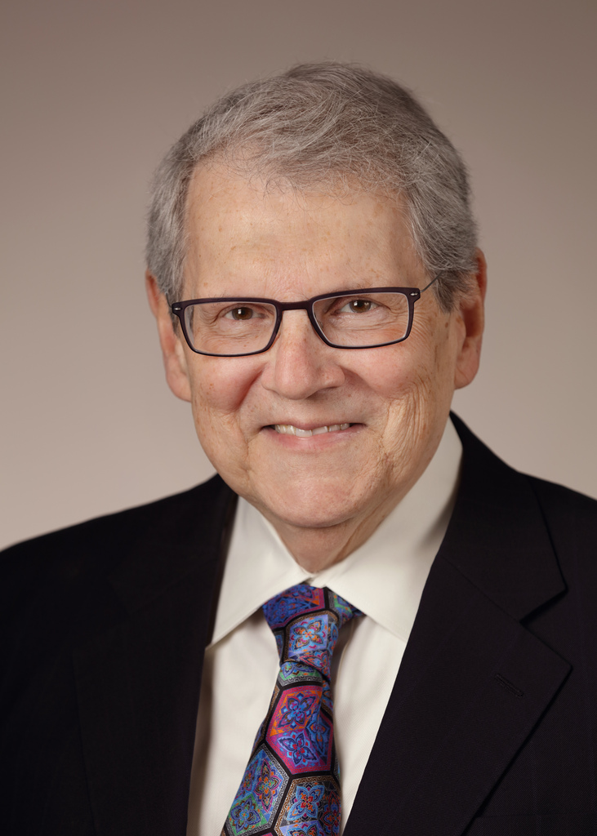

Mourning the Loss of Steve Katz
Bob Carter, M.D.
Document 3
Notes:
In late December, NIH lost one of its most beloved leaders – Steve Katz, the long-time Director of the National Institute of Arthritis and Musculoskeletal and Skin Diseases (or NIAMS). Steve was an outstanding physician, scientist, leader, and NHGRI friend. A world-renowned expert in investigative dermatology, Steve was responsible for training a large number the immunodermatologists now practicing in the United States and around the world.
When I was first appointed NHGRI Director, Steve was assigned the role of serving as my ‘mentor’ (a routine followed for all newly appointed NIH Institute Directors). I recall the valuable insights that Steve provided me during our regular meetings over the ensuing months. He was truly a man of many talents: a distinguished physician scientist, an outstanding administrator, and a devoted public servant. The NIH and biomedical research community have benefited immensely from his many contributions.
* While NIH conducts a search for a new NIAMS Director, the Institute’s Deputy Director, Bob Carter, will serve as Acting Director.
12

Slide 13


New Director, National Institute of Biomedical
Imaging and Bioengineering
Bruce Tromberg, Ph.D.
Document 4
Notes:
In January, Bruce Tromberg became the new Director of the National Institute of Biomedical Imaging and Bioengineering (or NIBIB). Bruce comes to NIH from the University of California at Irvine, where he had dual appointments in the Departments of Biomedical Engineering and Surgery. He was also Director of the University’s Beckman Laser Institute and Medical Clinic, an interdisciplinary research, teaching, and clinical center for optics and photonics in biology and medicine.

Slide 14


New Director, White House Office of Science
and Technology Policy
Kelvin Droegemeier, Ph.D.
Document 5
Notes:
Earlier last month, Kelvin Droegemeier was confirmed by the Senate to lead the White House Office of Science and Technology Policy. A former Professor of Meteorology and Vice President for Research at the University of Oklahoma, he was previously appointed by President George W. Bush (and had his term extended by President Barack Obama) to serve on the National Science Board, which guides the National Science Foundation and advises Congress and the President on policy matters related to science and engineering.
14

Slide 15

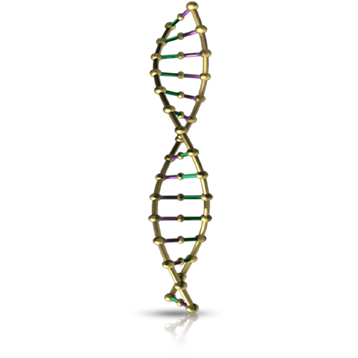

Genomic Data Sharing Policy Update:
Access to Genomic Summary Results (GSR)
    November 2018: NIH updated the access procedures for GSR under the Genomic Data Sharing Policy
    Beginning May 2019: GSR from most genomic studies will be possible through open access
    GSR designated as ‘sensitive’ by the submitting institution will remain in controlled access
Document 6
Notes:
A year ago, I provided an update about the proposed data management update that would change the access procedures for Genomic Summary Results (or GSR). * In November 2018, NIH updated the access procedures for GSR under the Genomic Data Sharing Policy to allow for unrestricted access to GSR from most studies deposited in NIH-designated data repositories [such as the Database of Genotypes and Phenotypes (or dbGaP)]. * This means that beginning in May 2019, GSR from most genomic studies will be possible through open access. * GSR from studies designated as 'sensitive' by the submitting institution will remain in controlled access (as they are currently).
Genomic studies already registered in dbGaP that wish to designate their GSR as ‘sensitive’ have until May 1, 2019 to consult with their Institutional Review Boards and submit an updated Institutional Certification. NIH has made this policy update to provide researchers and other stakeholders (e.g., clinical laboratories) with more proportional controls for access to genomic data in the hope that it will support the advancement of research while continuing to protect participants’ privacy and respect the informed consent.

Slide 16
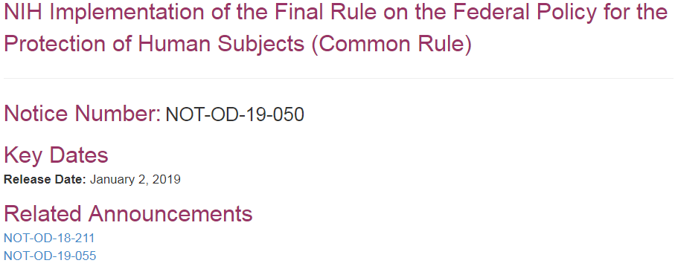
NIH Implementation of Common Rule
    Common Rule implementation began on January 21, 2019
    Changes to IRB review and requirement to post clinical trial informed consent forms
    Evaluate technologies and techniques on whether they generate “identifiable private information”
Document 7
Notes:
NIH released a Guide Notice in early January that provides NIH grantees with guidance on * the implementation of the Common Rule, which began on January 21, 2019. * Provisions that apply to NIH grantees include changes to Institutional Review Board (or IRB) review and a requirement to post clinical trial informed consent forms. * Another provision of the revised Common Rule directs the departments and agencies to, within one year (and subsequently every four years), evaluate technologies and techniques on whether they generate “identifiable private information.” The preamble to the revised Common Rule specifically notes that whole-genome sequencing is expected to be one of the first technologies to be evaluated and is, therefore, an area for NHGRI to monitor.

Slide 17
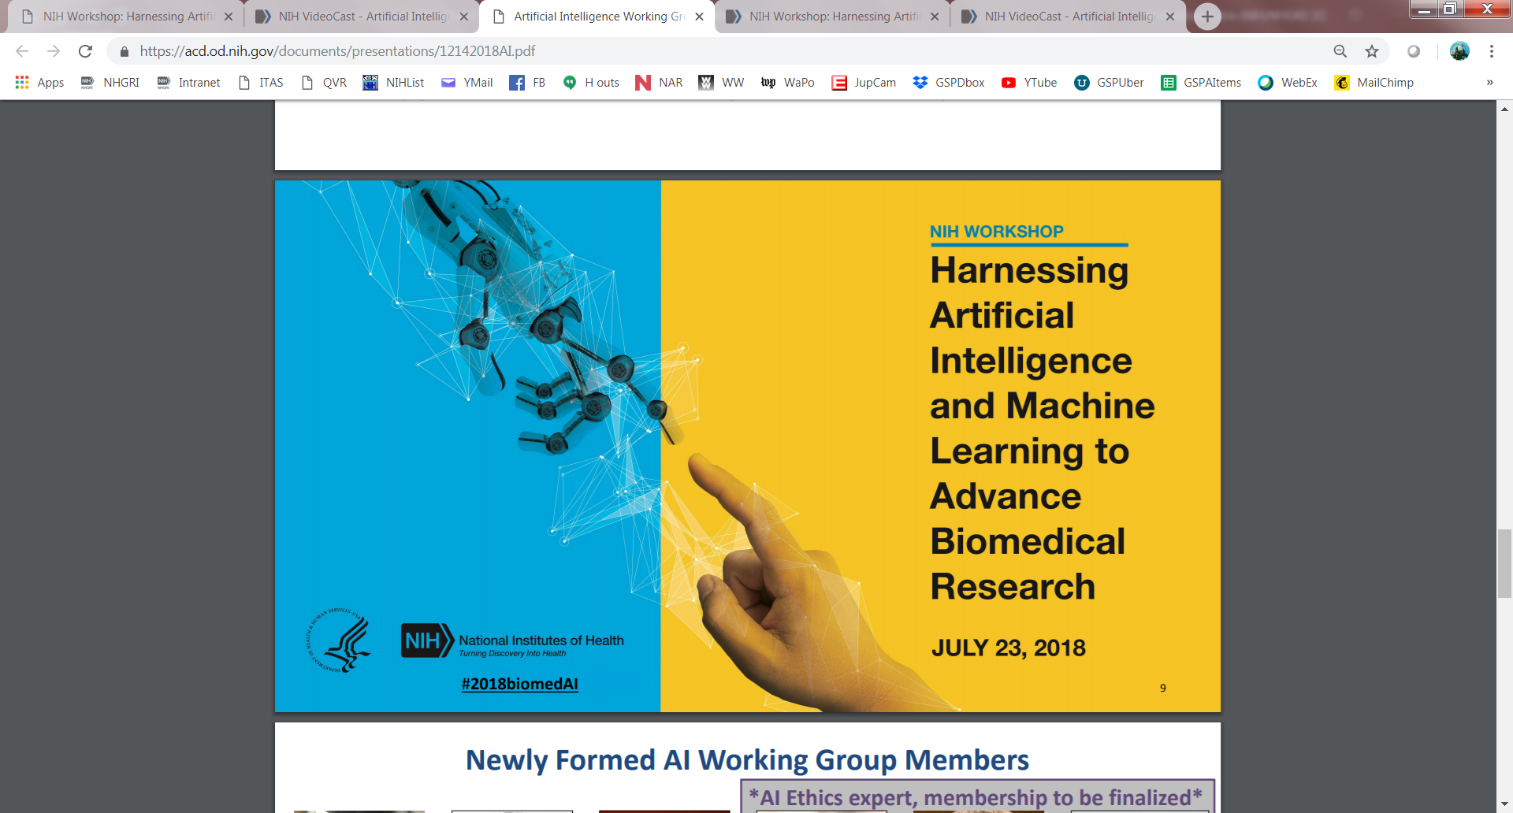
NIH Workshop: Harnessing Artificial Intelligence and Machine Learning to Advance Biomedical Research
Document 8
Notes:
Last Summer, NIH held a workshop that brought together leaders in innovation and science to explore the opportunities for artificial intelligence and machine learning to accelerate medical advances from biomedical research. Recently, a report from workshop, entitled “Harnessing Artificial Intelligence and Machine Learning to Advance Biomedical Research,” was released. One of the presentations at the workshop was made by ENCODE investigator Anshul Kundaje in a talk entitled “Deciphering Genome Function with Functional Genomics and Machine Learning.”
One of the outcomes of this workshop was the establishment of a new Working Group of the Advisory Committee to the NIH Director, specifically focusing on artificial intelligence in biomedical research. I expect that there will be more NIH developments in this area to report about in the coming months.
17

Slide 18
Fiscal Year 2019 Appropriations
 | Fiscal Year 2018 Labor-HHS Appropriation | Fiscal Year 2019 Labor-HHS Appropriation | $ Increase | % Increase
NIH | $37.1 B | $39.1 B | ~$2.0 B | ~5.1%
NHGRI | $556 M | $575 M | ~$19 M | ~3.3%
Notes:
As you are well-aware, part of the government was recently closed. Fortunately, during that time, the vast majority of NIH was open, as it has been since the beginning of Fiscal Year 2019, which started on October 1, 2018.
For Fiscal Year 2019, the NIH appropriation that emanated from the budgeting process resulted in a roughly $2 billion increase over Fiscal Year 2018 (as seen in the second column from the right); of that, NHGRI received a roughly $19 million increase, bringing the Institute’s overall budget to around $575 million. As seen in the far-right column, NIH’s overall increase was about 5.1%, while NHGRI’s increase was about 3.3%. The major reason for the differences in these two percentages is the set aside of around $800 million (of the $2 billion increase) for targeted areas, such as Alzheimer’s disease research, cancer research, the BRAIN Initiative, and the All of Us Research Program.
18
18

Slide 19
Director’s Report Outline
General NHGRI Updates
General NIH Updates
General Genomics Updates
NHGRI Extramural Research Program
NIH Common Fund/Trans-NIH
NHGRI Division of Policy, Communications, and Education
NHGRI Intramural Research Program
Notes:
19

Slide 20

Mourning the Loss of Ray White
Document 9
Notes:
NHGRI was saddened to learn that Ray White passed away in October. Ray (along with David Botstein, Ron Davis, and Mark Skolnick) published a seminal American Journal of Human Genetics paper that proposed the systematic development of human genetic markers and their placement into human chromosomal maps. Later, Ray’s (and others’) genetic markers and maps became valuable assets for the successful completion of the Human Genome Project. His efforts to collect human samples for use in research resulted in the well-known CEPH collection, which has been used by thousands of researchers performing genetics research.
20

Slide 21

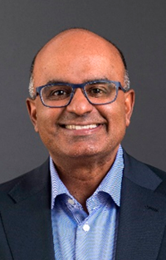




2018 American Society of Human Genetics Awards
Eric
Lander
Sekar Kathiresan
Jim
Lupski
Mary-Claire King
Andy
Adey
Document 10
Notes:
The American Society of Human Genetics (or ASHG) gave awards to five members of the genomics community at its 2018 annual meeting.
* Eric Lander received the William Allan Award, which recognizes a scientist for substantial and far-reaching scientific contributions to human genetics.
* Sek Kathiresan received the Curt Stern Award, which recognizes genetics and genomics researchers who have made significant scientific contributions during the past decade.
* Jim Lupski received the Victor A. McKusick Leadership Award, which recognizes individuals who have fostered and enriched the development of human genetics and its assimilation into the broader context of science, medicine, and health.
* Mary-Claire King received the Advocacy Award, which recognizes individuals or groups who have exhibited excellence and achievement in applications of human genetics for the common good.
* Andy Adey received the Early-Career Award for his contributions to genetics and genomics in the first ten years of his career as an independent investigator.
21

Slide 22

Elected to National Academy of Medicine
Andrea Califano
Bill Gahl
Josh Gordon
Bob Kingston
Brad Malin
Lucila Ohno-Machado
Gene Robinson
Charles Rotimi
Stu Schreiber
Document 11
Notes:
The National Academy of Medicine recently announced the election of new members. Of particular relevance to the genomics community, to NIH, and to NHGRI are the individuals listed here. We extend our heartfelt congratulations to these individuals, especially Bill Gahl and Charles Rotimi from the NHGRI Intramural Research Program.
22

Slide 23

Elected to AAAS
Richard Axel
Andreas Baxevanis
Wayne W. Grody
Pavel Pevzner
Jay Shendure
Document 12
Notes:
Similarly, an impressive group of genetics and genomics researchers as well as NHGRI friends were recently elected to be Fellows of the American Association for the Advancement of Science (or AAAS), with their names listed here. Congratulations to these colleagues as well, especially former Council member Jay Shendure and Andy Baxevanis from the NHGRI Intramural Research Program.
23

Slide 24

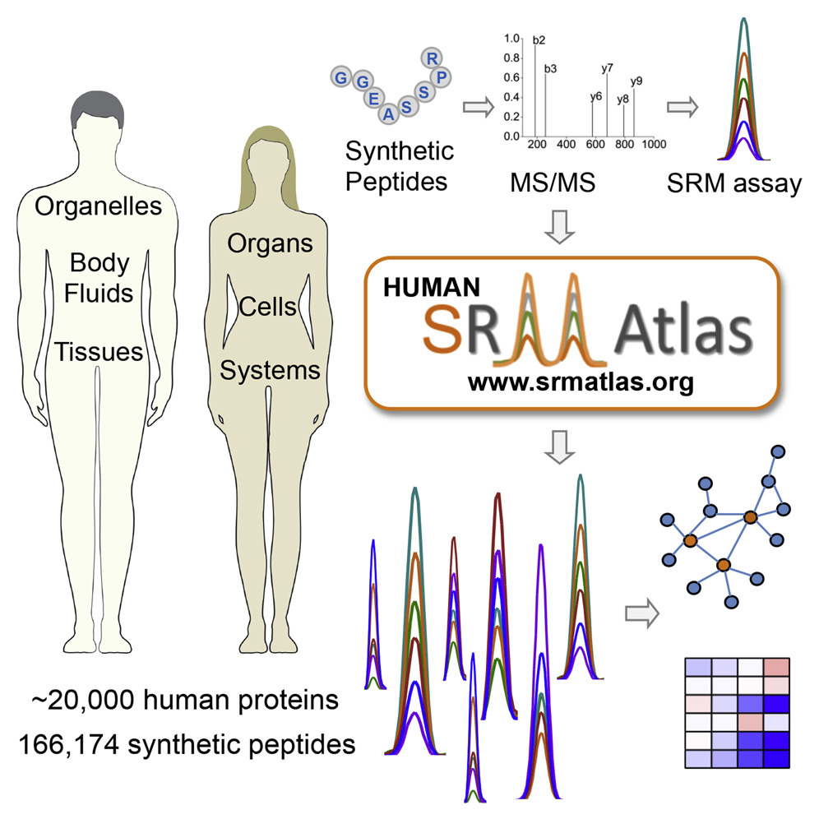

2018 Human Proteome Organization Award
Ulrike Kusebauch, Ph.D.
Document 13
Notes:
The Human Proteome Organization in conjunction with Elsevier have awarded the 2018 Proteomics Discovery Prize to the work of the Human SRMAtlas, which will be given to the lead author Ulrike Kusebauch. The Human SRMAtlas is a comprehensive database of quantitative assays, including selected reaction monitoring (or SRM) assays, for essentially all human proteins; this work was supported by a 2009 American Recovery and Reinvestment Act grant from NHGRI.

Slide 25

Science’s 2018 Breakthrough of the Year Runners Up
Forensic genealogy comes of age
Gene-silencing drug approved
How cells marshal their contents
Document 14
Notes:
Moving on to year-end accolades, three genomics-related efforts were named Science’s 2018 Breakthrough of the Year Runners Up: forensic genealogy comes of age, gene-silencing drug approved, and how cells marshal their contents.

Slide 26
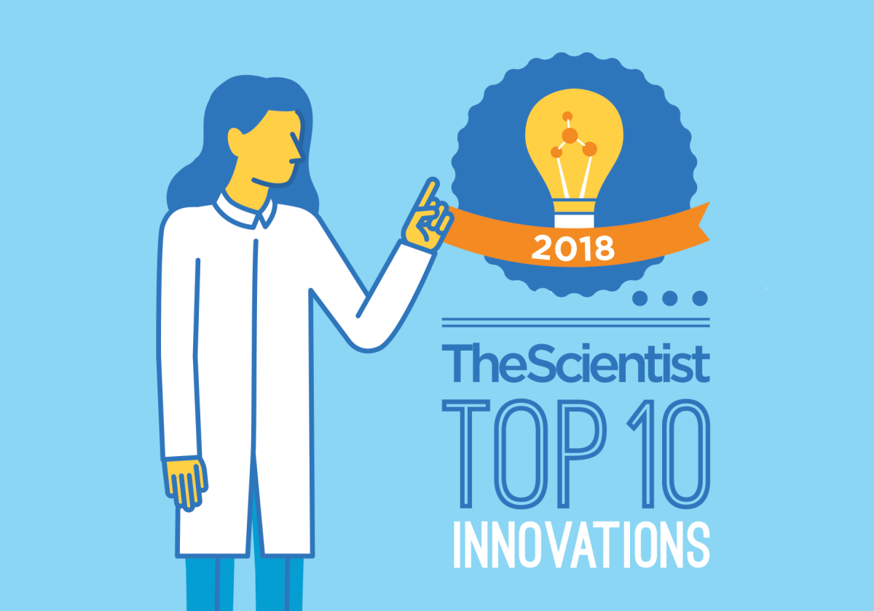
The Scientist’s Top Ten Innovations of 2018
Tapestri Precision Genomics Platform by Mission Bio
Chromium Immune Repertoire Profiling Solution by 10X Genomics
Dharmacon Edit-R Fluorescent Cas9 Nuclease mRNA by Horizon Discovery
MAD7 Enzyme by Inscripta
BD AbSeq Assay by BD Life Sciences
Document 15
Notes:
When The Scientist came out with its Top Ten Innovations of 2018, genomic technologies once again appeared on the list. Five genomic innovations were included, as listed here; each of these innovations involves some aspect of genome sequencing or genome editing.

Slide 27







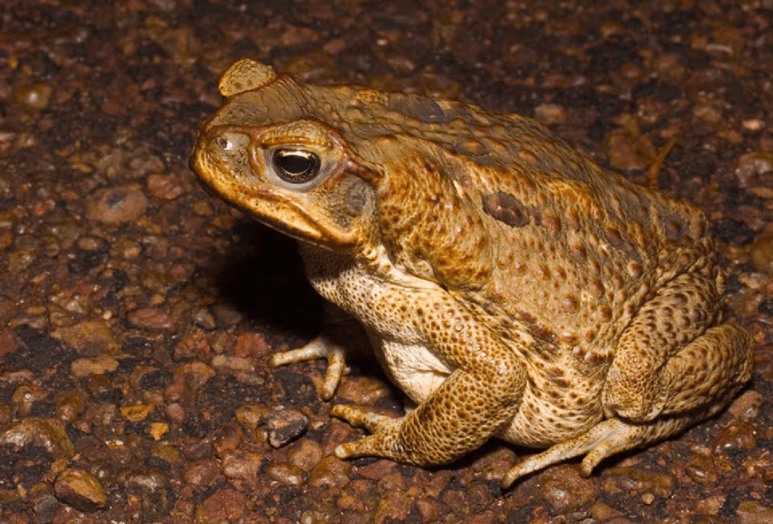



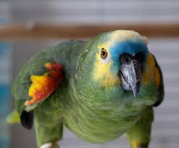
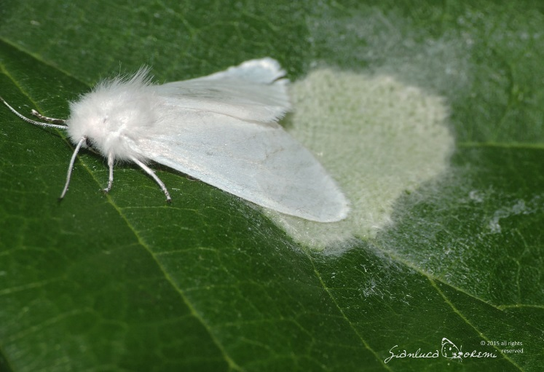

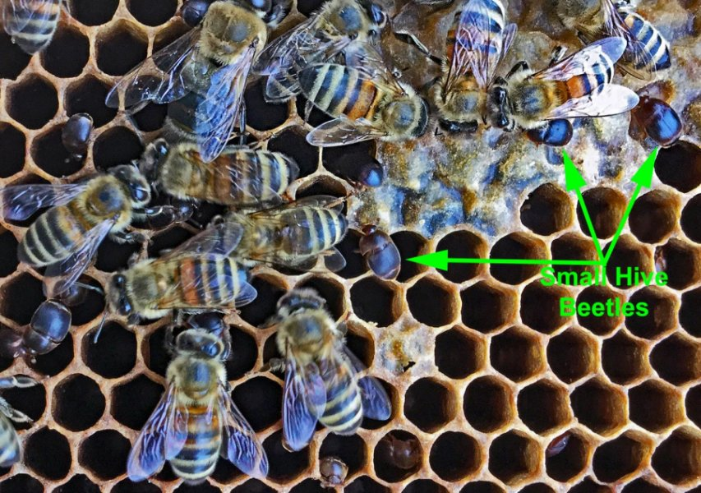

Genomes In The News…
Document 16
Notes:
In terms of ‘Genomes in the News’ – there have been a number of recently generated genome sequences reported since the last Council meeting, including: * Opium Poppy, * Cane Toad, * Fall Webworm, * Gypsy Moth, * Small Hive Beetle, * Snapdragon, * Sugarcane, * Vinous-Throated Parrotbill, * Blue-Fronted Amazon Parrot , * Hawaiian Bobtail Squid, * Sea Lettuce, * Orange Clownfish (like ‘Nemo’), * a Bottlenose Dolphin named Sandy, and * Lonesome George, the last Giant Pinta Tortoise from the Galapagos who died in 2012 (who, by the way, I met in person in 2002).
27

Slide 28
Director’s Report Outline
General NHGRI Updates
General NIH Updates
General Genomics Updates
NHGRI Extramural Research Program
NIH Common Fund/Trans-NIH
NHGRI Division of Policy, Communications, and Education
NHGRI Intramural Research Program
Notes:
28

Slide 29
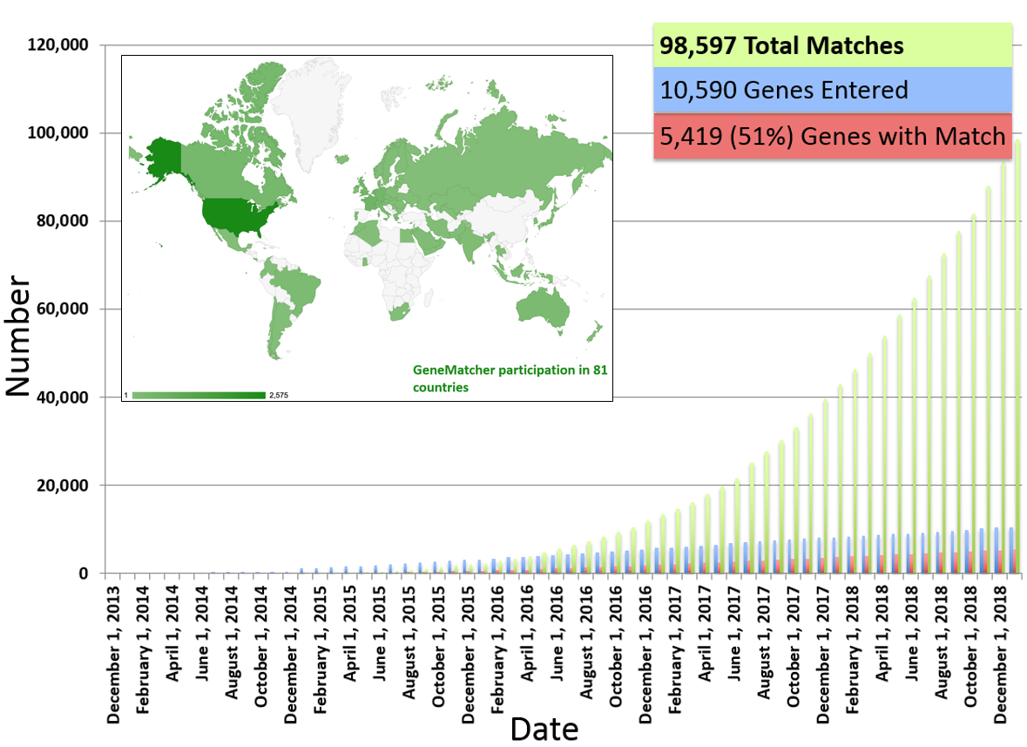
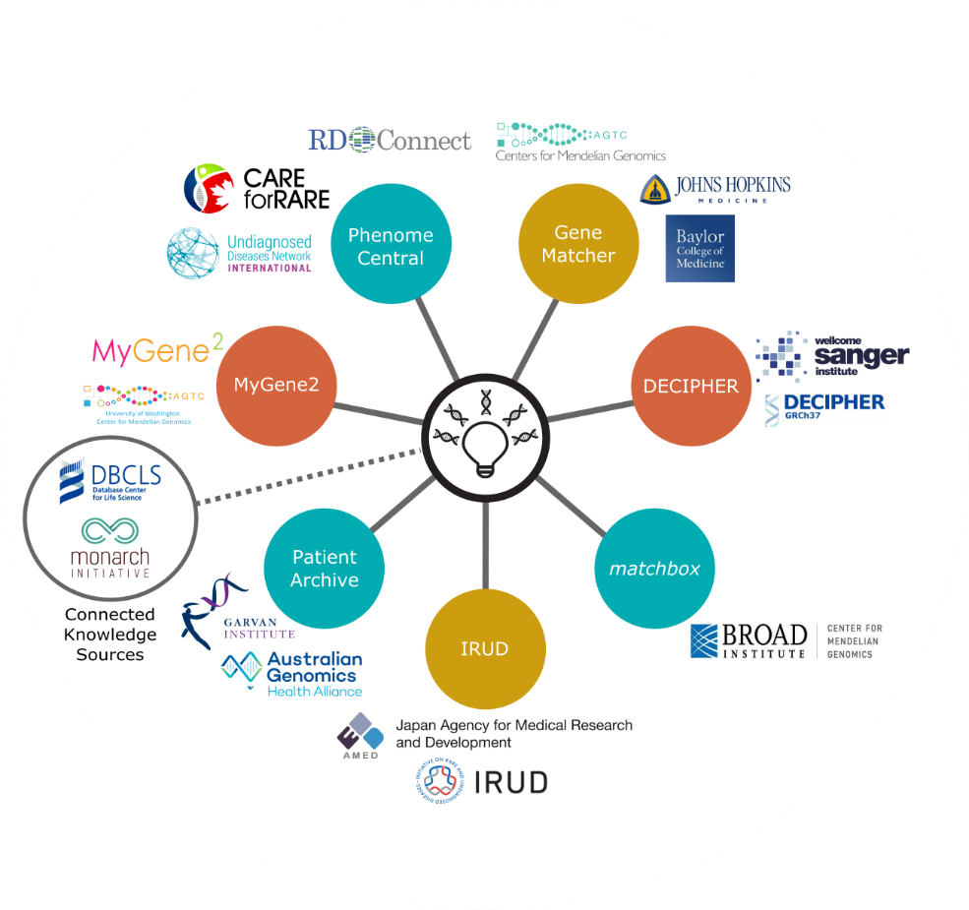
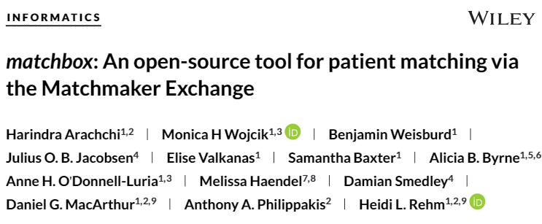
Centers for Mendelian Genomics
Genome Sequencing Program
Document 17
Notes:
The NHGRI Genome Sequencing Program is composed of the Centers for Mendelian Genomics, the Centers for Common Disease Genomics, a Coordinating Center, and several Analysis Centers. The program is supported by other organizations, including NHLBI, NIA, NEI, and the Simons Foundation.
* The Centers for Mendelian Genomics are committed to sharing their discoveries with the broader community. * One way they do this is through the Matchmaker Exchange Network – a federated platform that matches patients, researchers, clinicians, and families that encounter similar genotypes and phenotypes. The centers contribute to three nodes in this network.
* First, the Baylor-Hopkins node, called GeneMatcher, has facilitated over 98,000 matches in 81 countries. A total of 10,590 genes have been entered into GeneMatcher, 51% of which have been matched to other users. * Next, the Broad node recently published a manuscript about their Matchbox program, which functions as an open source, portable bridge that allows any interested researcher to make their data available through Matchmaker Exchange. Matchbox uses Human Phenotype Ontology to record and analyze phenotype data. * Finally, the University of Washington node has developed MyGene2, which also contains the Yale node’s data. MyGene2 is more patient-focused than the other nodes and helps families to obtain genetic diagnoses and to connect with other patients diagnosed with similar conditions.
29

Slide 30

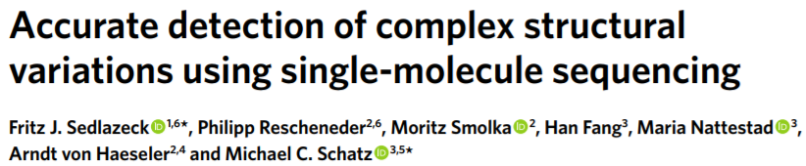

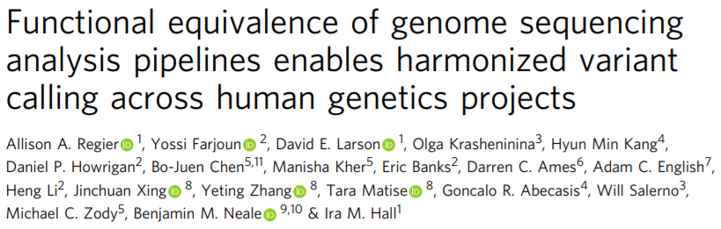
Centers for Common Disease Genomics
Genome Sequencing Program
Document 17
Notes:
The Centers for Common Disease Genomics have sequenced almost 76,000 genomes and 78,000 exomes to date in three disease areas: cardiovascular, immune-mediated, and neuropsychiatric. The centers have plans to generate over 125,000 genome sequences and over 250,000 exome sequences by the time the program concludes in December 2020.
Two recent publications from this program are worth highlighting. * First, Sedlazeck et al. demonstrated that the high error rates in single-molecule, long-read DNA sequencing can be ameliorated by using two open source tools: the NGMLR alignment method and the Sniffles method for identifying structural variants. These tools increase the sensitivity and precision of genomic variant detection, even in complex regions of the genome. Both tools can be used with low-coverage data, so their use has potential to reduce costs for generating long-read sequence data in clinical and research settings. * Second, representatives from this program developed processing standards for whole-genome sequencing, allowing different groups to produce functionally equivalent results. The resulting pipelines yield similar genomic variant calls with less variability than simple replicates; these pipelines will allow for joint genomic variant calling, increasing the statistical power and sample sizes of whole-genome data analysis. Note that the Centers for Common Disease Genomics, NHLBI’s Trans-omics for Precision Medicine (or TOPMed), and NIMH’s Whole-Genome Sequencing in Psychiatric Disorders programs all use this pipeline. Data from the 1000 Genomes, the Haplotype Reference Consortium, and GnomAD are also compatible with this pipeline.
30

Slide 31

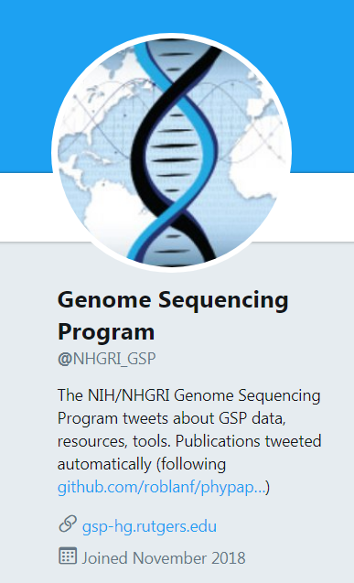


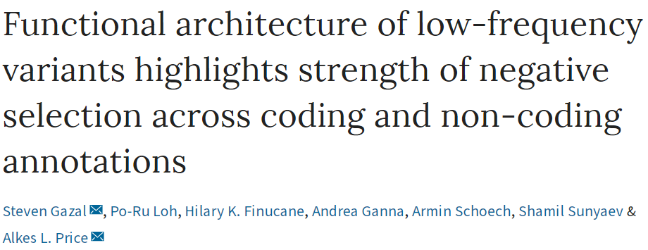
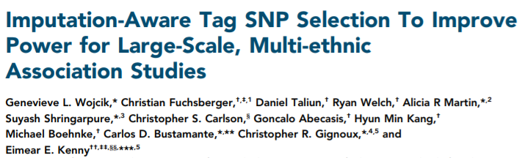

Analysis Centers and Coordinating Center
Genome Sequencing Program
Document 17
Notes:
The Harvard Analysis Center hosted a conference entitled “Biobanks: Study Design and Data Analysis” in November 2018 that focused on how the genomics community might best use biobanks as a resource of genomic, epidemiological, phenotypic, and medical record data. The discussion focused on quantitative issues, including methods and study designs for increasing scale and statistical power.
The Genome Sequencing Program’s Analysis Centers have published two exciting manuscripts in recent months. * Wojcik et al. reported a novel framework for selecting tag single-nucleotide polymorphisms. This method has the potential to increase imputation accuracy for rare variants in large-scale multi-ethnic populations and to inform the development of new single-nucleotide polymorphisms arrays. * Gazal et al. reported their new mathematical models using UK Biobank data and demonstrated negative selection patterns in both coding and non-coding annotations for low-frequency and common variants associated with human diseases and complex traits. These methods can be used to improve the design of rare variant association studies.
* Finally, the Genome Sequencing Program’s Coordinating Center recently created a Twitter account for the program, which provides updates on manuscripts, tools, and upcoming meetings.
31

Slide 32
Human Genome Reference Program
Funding Opportunity Announcements
  HG-19-004: Human Genome Reference Center (U41)
  HG-19-002: High Quality Human Reference Genomes (U01)
  HG-19-003: Research and Development for Genome Reference Representations (U01)
Applications will be accepted from March 2 to April 2, 2019
Webinar: Friday, March 8 from 11:00 AM – 1:00 PM ET
Document 18
Notes:
The Funding Opportunity Announcements for the new Human Genome Reference Program have been released. NHGRI is currently soliciting applications for three components: * a Human Genome Reference Center, * High Quality Human Reference Genomes, * and Research and Development for Genome Reference Representations.
* Applications will be accepted from March 2 to April 2, 2019, and * there will be a webinar addressing frequently asked questions on March 8 from 11:00 to 1:00 PM Eastern Time.
In the meantime, potential applicants are encouraged to reach out to NHGRI’s Adam Felsenfeld and Heidi Sofia with questions.
32

Slide 33

Technology Development Program
    Novel Nucleic Acid Sequencing Technology Development
      RFA-HG-18-001 (R01, also linked R21 and R43/44)
      Applications due June 27, 2019
    Advanced Genomic Technology Development Meeting
      Northeastern University
      Grantee Meeting: May 29-30, 2019
      Public Meeting: May 31, 2019
Document 19
Notes:
NHGRI’s Technology Development Program continues to develop new and improved technologies to enable genomic discoveries and facilitate the adoption of genomics in medicine.
* Applications for the Novel Nucleic Acid Sequencing Technology Development Request for Applications are due on June 27, 2019.
* Meanwhile, an Advanced Genomic Technology Development Meeting will again be held at Northeastern University in late May, at which novel nucleic acid sequencing and genomic technology grantees from the program will meet to communicate, collaborate, and interact. An adjacent public meeting on May 31 will allow for the broader community to participate and interact with NHGRI grantees and staff.

Slide 34


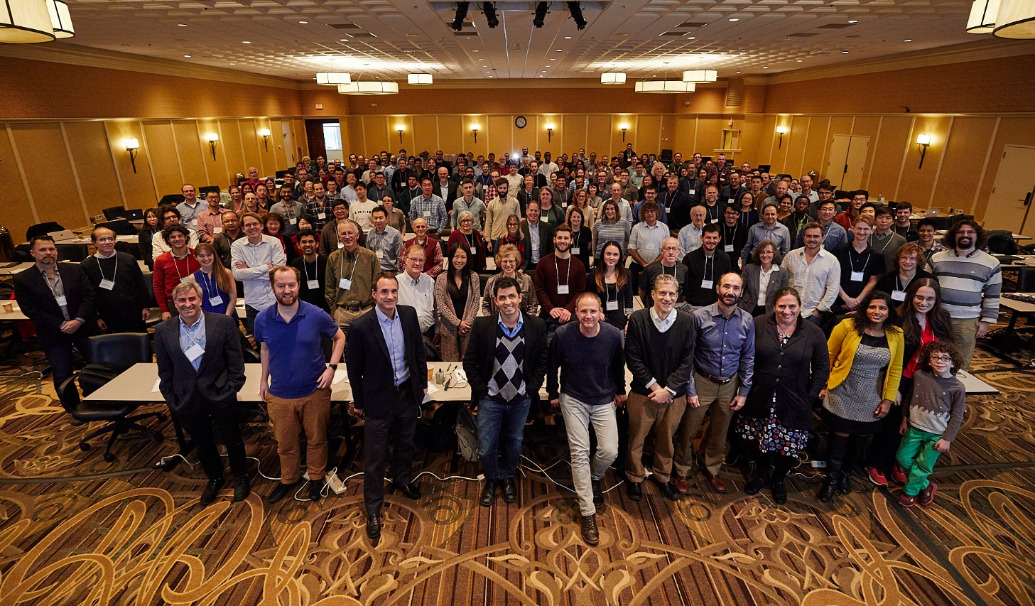
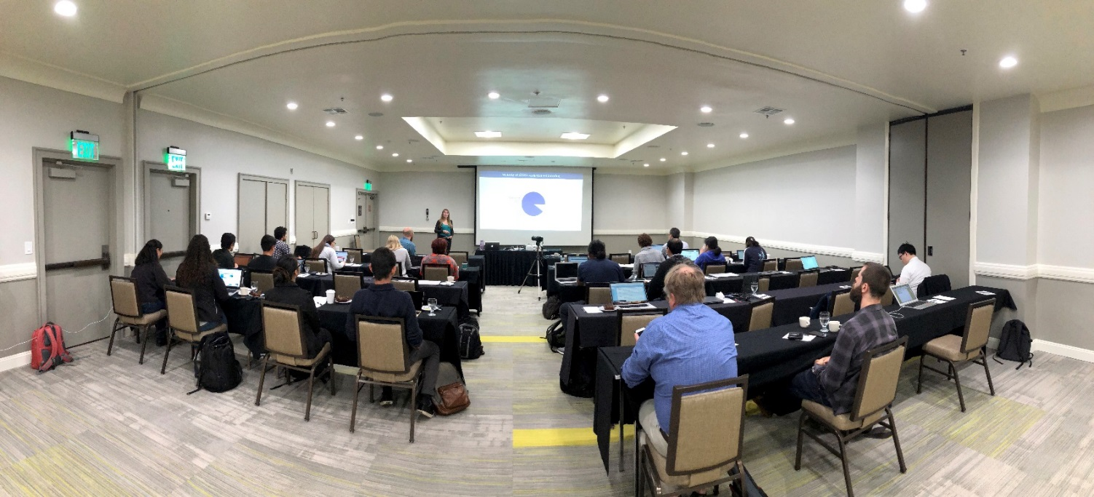
ENCyclopedia Of DNA Elements (ENCODE)
    ENCODE Consortium Meeting (January 2019)
    Accessibility and Utilization of ENCODE Data Workshop at ASHG (October 2018)
    Research and Applications Users Meeting in Seattle (July 2019)
Document 20
Notes:
The goal of the ENCyclopedia of DNA Elements (or ENCODE) project is to create catalogs of all functional elements in the human and mouse genomes and to make those catalogs available as a resource for the biomedical research community.
* The ENCODE Consortium held its annual meeting last month in the DC area. Participants shared scientific progress, discussed challenges and plans to overcome them, and laid out its goals through 2021. The meeting also featured a session on NHGRI’s strategic planning process.
* ENCODE continues to work to make its resource accessible to a wide range of researchers. In October, ENCODE held a half-day workshop as an ancillary event at the American Society of Human Genetics Annual Meeting on the accessibility and utilization of ENCODE data. The workshop included an introduction to the ENCODE project and the resources available for accessing ENCODE data as well as specific research applications that have used ENCODE data.
* This coming July, the ENCODE Consortium will hold its third Research and Applications Users Meeting in Seattle, Washington. The meeting will feature hands-on workshops for learning to navigate, analyze, and integrate ENCODE data into data users’ research. Details about this meeting will be forthcoming on genome.gov.
34

Slide 35

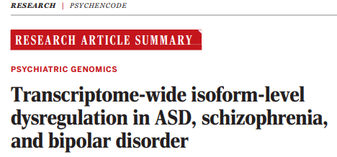
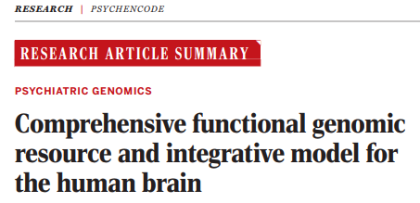
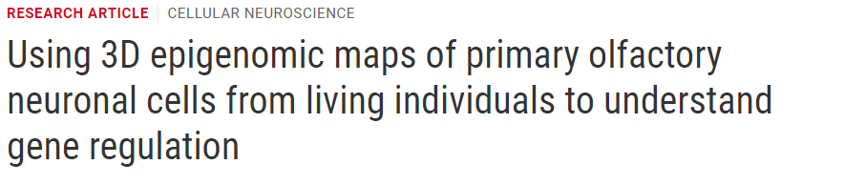
PsychENCODE
Document 20
Notes:
PsychENCODE, a National Institute on Mental Health-funded consortium with ties to ENCODE, is a collaborative effort among 15 research institutions that aims to characterize the functional genome of the human brain. The PsychENCODE project has performed unbiased multi-omic molecular profiling of over 2,000 human postmortem brains across neurodevelopmental time periods and psychiatric disorders, including schizophrenia, autism spectrum disorder, and bipolar disorder.
* A special issue on the PsychENCODE project was recently published in Science along with a series of additional papers published in other Science journals. * The collection of 11 publications, three of which are shown on the right, provide insight into the gene-regulatory architecture driving human brain development and neuropsychiatric disorders.

Slide 36
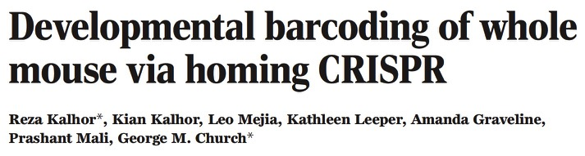
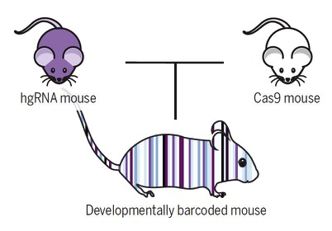
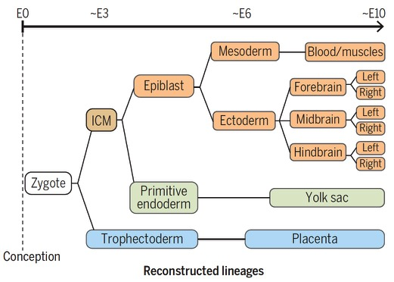
Centers of Excellence in Genomic Science (CEGS)
Document 21
Notes:
The Centers of Excellence in Genomic Science (or CEGS) Program supports interdisciplinary research teams to develop highly innovative approaches in genomics research. Here, I highlight a recent study to develop genomic recorders to track the lineage of cells in a mammal; this work was funded in part by the CEGS Program and the NHGRI Technology Development Program, specifically involving grants to George Church and Prashant Mali.
* These researchers engineered mice with multiple CRISPR homing-guide RNA loci, then crossed those mice with another line expressing Cas9. During development, the Cas9-induced changes at the homing-guide RNA loci functioned as genomic recorders. * DNA from adult mice was sequenced, and the combinatorial recording pattern from single cells was used to infer cell lineage. This is the first time such a feat was achieved in a mammal. This approach has the potential to provide important new insights into the cellular basis of development.

Slide 37

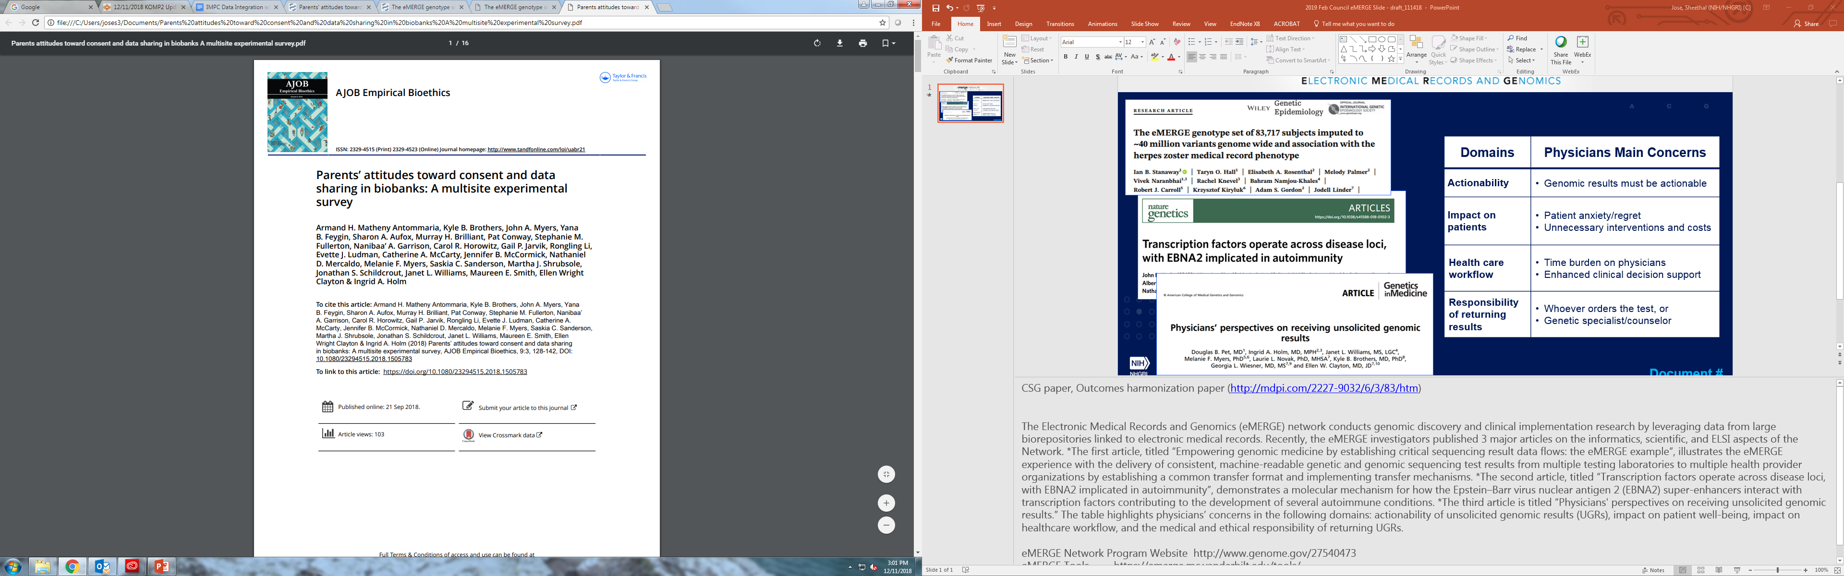
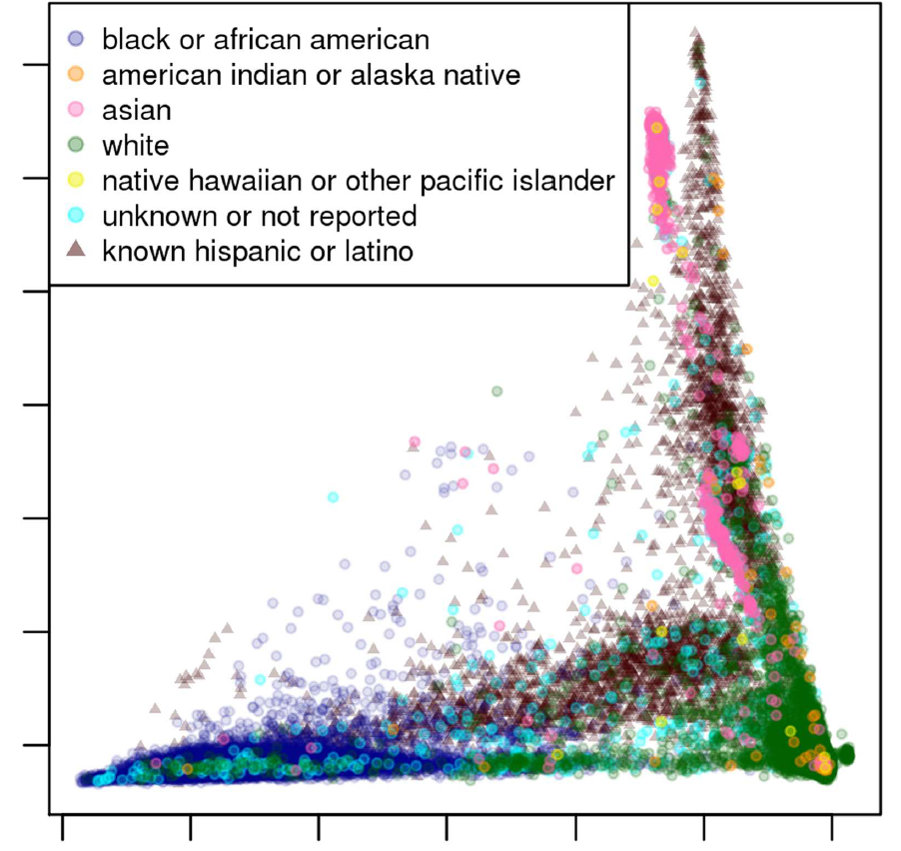
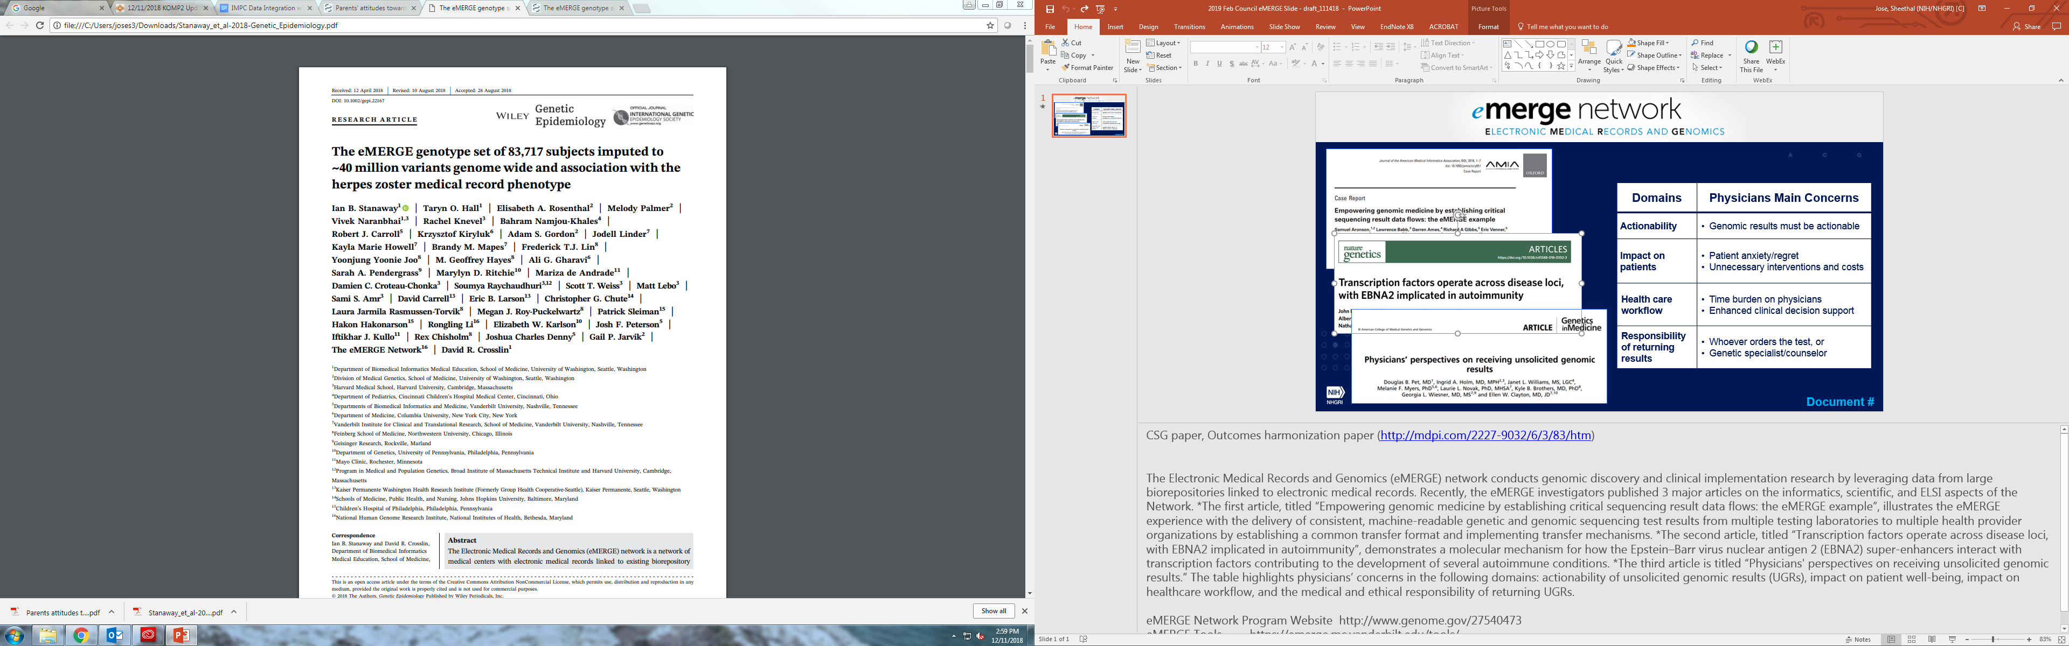
Principal Components Analysis (PCA) Examining Ancestry of eMERGE Phases I-III Imputation
N = 83,717
Joint Ancestry PC 2
Joint Ancestry PC 1
Document 22
Notes:
The Electronic Medical Records and Genomics (or eMERGE) network conducts genomic discovery and clinical implementation research by leveraging data from large biorepositories linked to electronic medical records. Recently, eMERGE investigators published two major articles. * The first article, entitled “Parents' attitudes toward consent and data sharing in biobanks: a multisite experimental survey,” found that 55% of parents were willing to allow their youngest child to participate in a hypothetical biobank. The paper also reported that factors such as lower educational attainment, higher religiosity, lower trust, and worries about privacy were independently associated with less willingness to allow their child to participate.
* The second article, entitled “The eMERGE genotype set of 83,717 subjects imputed to ~40 million variants genome wide and association with the herpes zoster medical record phenotype,” describes the imputation of eMERGE results and methods to create the unified imputed merged set of genome-wide variant genotype data. The graph on the right shows the principal components analysis of 83,717 participants, examining the ancestry of eMERGE Phases I-III imputation. All eMERGE array data were imputed against the Haplotype Reference Consortium reference panel using the Michigan Imputation Server. To test the merged imputed genotype set, the investigators replicated a previously reported chromosome 6 HLA-B herpes zoster association and discovered a novel zoster-associated locus in an epigenetic site near the terminus of chromosome 3.

Slide 38

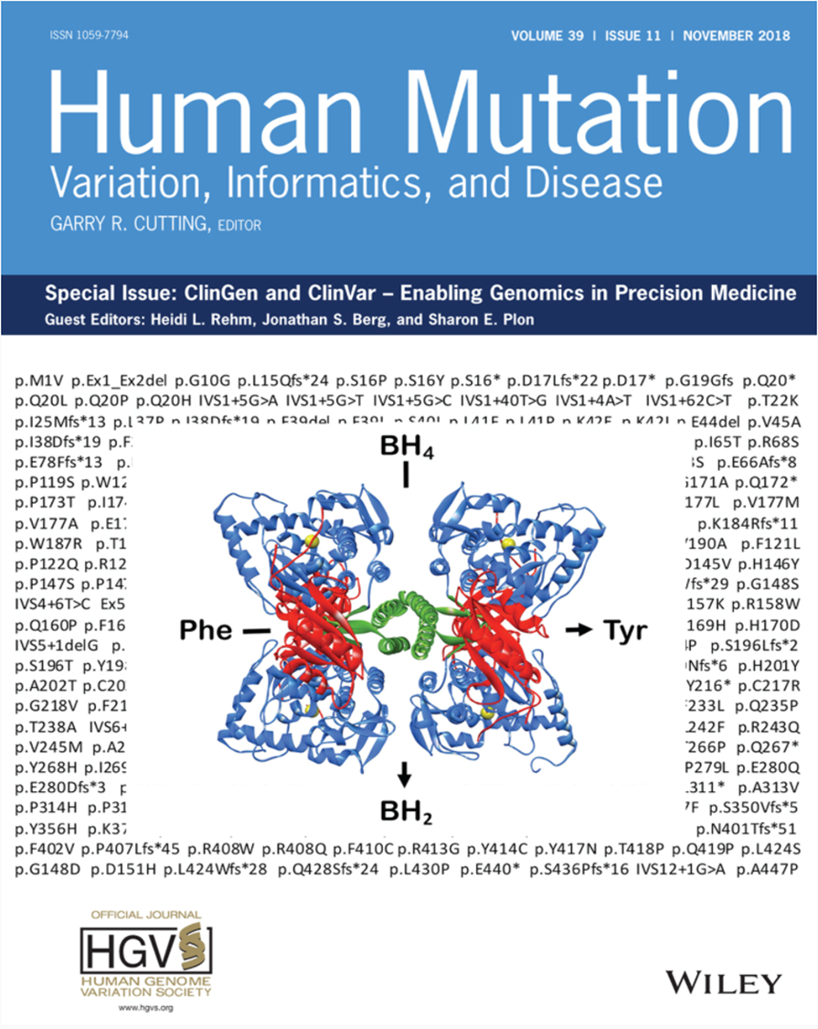
Clinical Genome Resource (ClinGen)
    Human Mutation special issue featured ClinGen and ClinVar
    Published October 11, 2018
    Guest editors: Jonathan Berg, Heidi Rehm, and Sharon Plon
    25 papers
Document 23
Notes:
The Clinical Genome Resource (or ClinGen) evaluates and disseminates the clinical relevance of genes and genomic variants for use in precision medicine and research. * The journal Human Mutation published a special issue highlighting the advances of both ClinGen and the NCBI-led ClinVar. * This special issue was published this past October and * involved the efforts of three guest editors who are all ClinGen Principal Investigators: Jonathan Berg, Heidi Rehm, and Sharon Plon. * The 25-paper issue touched on various relevant topics, including gene and genomic variation curation, clinical actionability, data sharing, and the use of ancestry and diversity data in the context of clinical genomics.

Slide 39

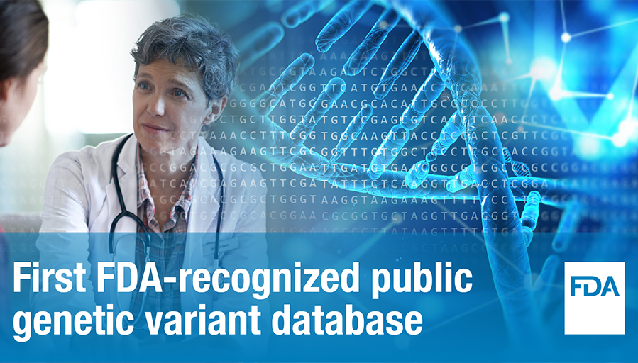

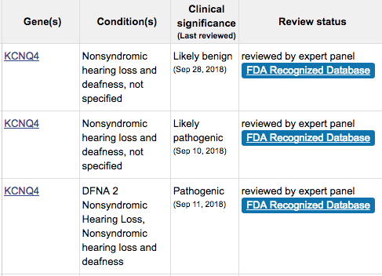
FDA Recognizes ClinGen as Genetic Variant Database
ClinVar
    Announced on December 4, 2018
    First curation effort to be recognized
    FDA-recognized genomic variants available in ClinVar
Document 23
Notes:
In December 2018, * the U.S. Food and Drug Administration (or FDA) announced that they were recognizing ClinGen’s expert-curated genomic variant pathogenicity interpretations through their new Public Human Variant Database Program. The program is part of an FDA effort to provide genetic test developers access to consistent, expert-validated evidence that they can cite when seeking FDA approval of their tests, with the hope of reducing regulatory burdens and spurring advancements in the evaluation and implementation of precision medicine.
* ClinGen is the first curation effort to receive this FDA recognition * and the genomic variant interpretations are available in ClinVar and are identified with the “FDA Recognized Database” label (as shown on the upper right of this slide).
Later this afternoon, Erin Ramos and Sharon Plon will present an update on ClinGen’s activities, during which they will touch on the FDA recognition and also address curation progress, collaborations, and other key aspects of the ClinGen resource.

Slide 40

Clinical Sequencing Evidence-
Generating Research (CSER) Program
Recruitment Update:
Lessons Learned:
Importance of engaging recruiting providers
Potentially lower decline rates than expected
Document 24
Notes:
The Clinical Sequencing Evidence-Generating Research (or CSER) program aims to generate evidence related to the clinical utility of genome sequencing, with a major emphasis on recruiting ancestrally diverse and medically underserved populations. * The six clinical sites are currently working to sequence the genomes of roughly 6,500 participants over the next 2.5 years, reaching recruitment goals of at least 60% of participants from non-European populations, underserved populations, or populations known to experience poorer medical outcomes. CSER participants are being recruited from a variety of clinical settings, including medical centers, intensive care units, outpatient clinics, community hospitals, and a federally qualified health center.
CSER is still early in its recruitment efforts. The focus on increasing diversity comes with unique challenges, and some of the lessons learned during this process include: * the importance of engaging recruiting providers who know their patients well, and * the finding that some but not all sites are reporting potentially lower decline rates than expected, perhaps because of the increased emphasis on recruiting diverse populations.
40

Slide 41

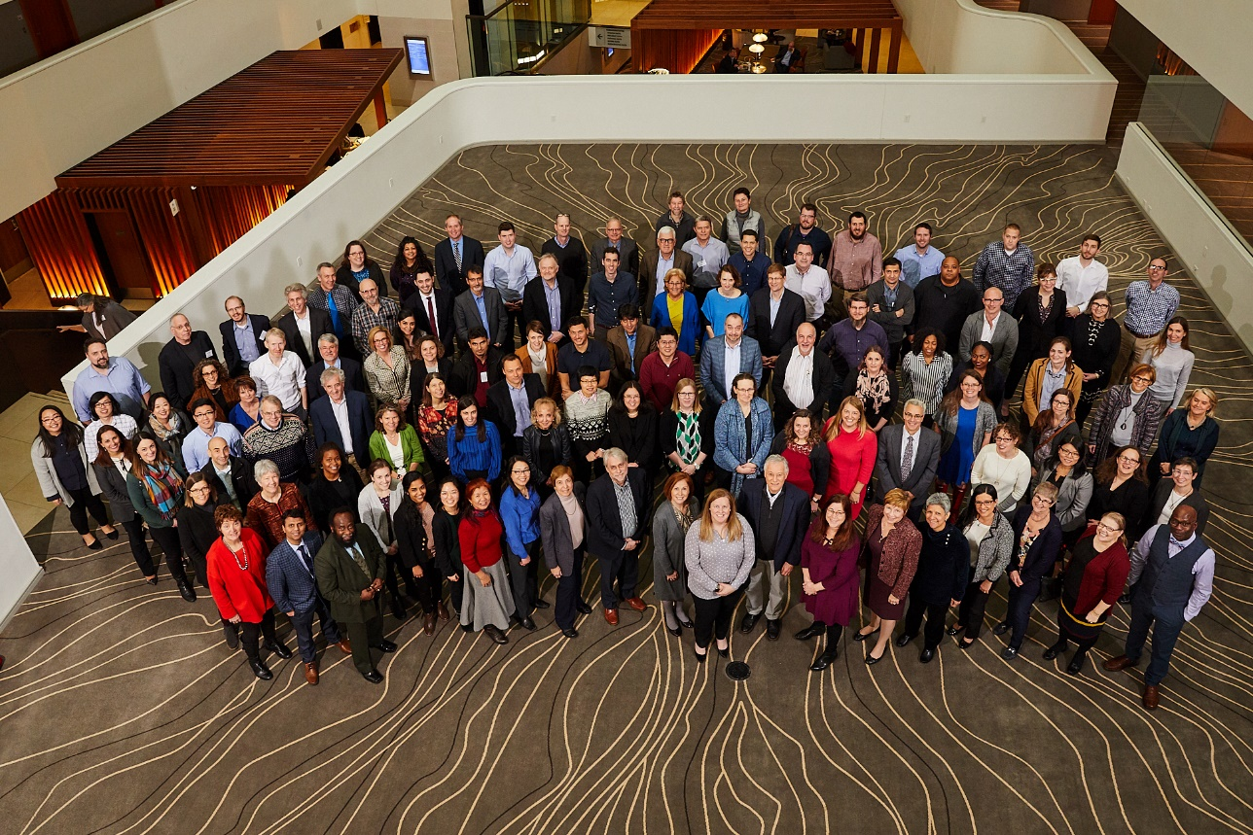
Joint CSER-eMERGE Meeting
Selection and performance of harmonized measures and outcomes
Cascade testing of relatives
Provider engagement
Tools for variant classification
Outcomes and healthcare utilization
Scalable approaches to patient and provider interactions
ELSI issues
Document 24
Notes:
In January, the CSER and eMERGE programs met together for the third time in six years to discuss important topics and identify collaborative opportunities that are relevant to both groups. The investigators discussed topics such as * selection and performance of harmonized measures and outcomes, * cascade testing of relatives, * provider engagement, * tools for variant classification, * outcomes and healthcare utilization, * scalable approaches to patient and provider interactions, and * ELSI issues, among others. As a next step, some of the more promising opportunities, such as an updated variant bake-off, comparing variant classification among CSER and eMERGE groups, will be discussed with the leadership of both consortia.
41

Slide 42

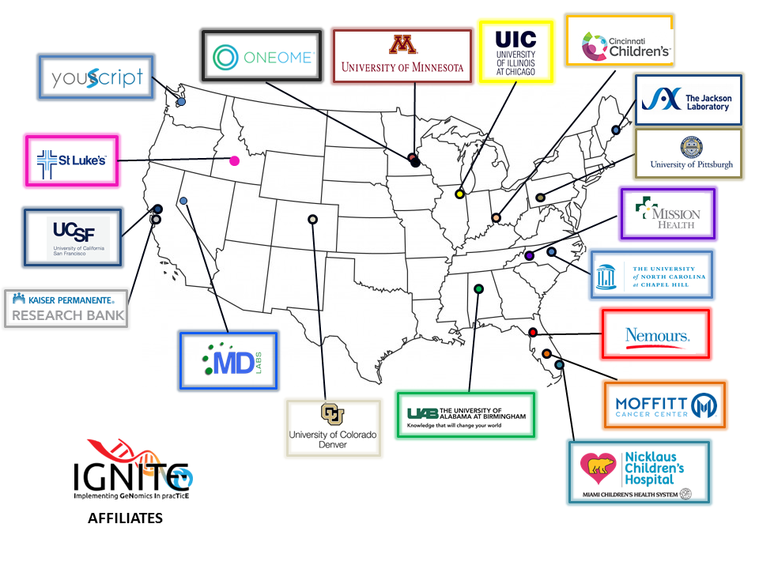
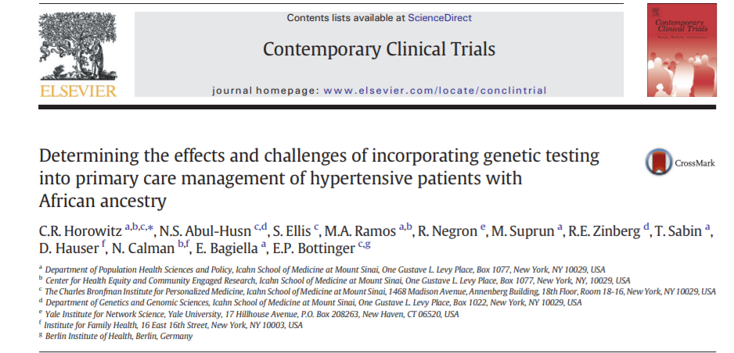
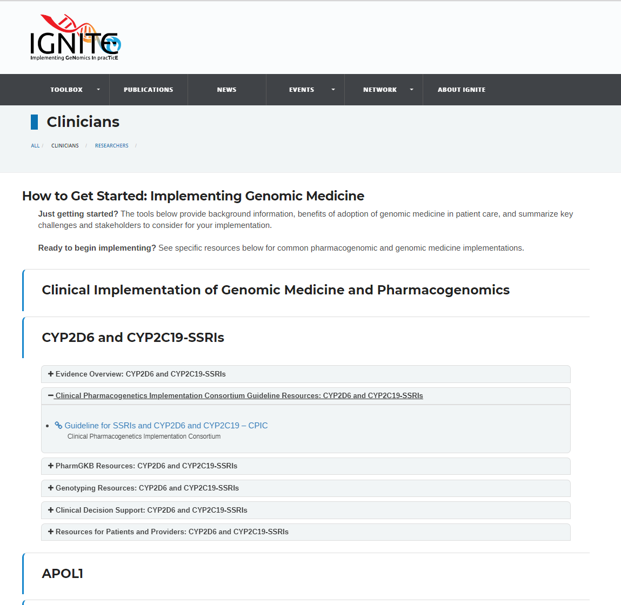



Implementing GeNomics
In pracTicE (IGNITE) I
133 publications
41 manuscripts submitted
Final IGNITE I meeting April 16, 2019
Document 25
Notes:
IGNITE I is the first phase of the Implementing GeNomics In pracTice (or IGNITE) network. As its one-year extension ends, it is a good time to reflect about some of the program’s accomplishments.
The program’s reach has far exceeded the six funded IGNITE I institutions. * This map shows the 18 affiliate institutions (represented by 64 individual members), who have joined and strengthened the network by collaborating with IGNITE I investigators. * To date, IGNITE I has published 133 papers, with an additional 41 manuscripts submitted for publication. * The network has also created the Spark Toolbox, which houses numerous resources for clinicians and researchers working to implement genomic medicine, including a custom implementation guide.
IGNITE I has made great strides in the implementation of genomic medicine, tackling issues such as recruitment, information technology, education, and policy. Their innovations include increased stakeholder engagement, the use of an open standards-based platform for electronic health record interoperability, and pragmatic lessons about reimbursement and genomic medicine test adoption.
* The final in-person steering committee meeting of the IGNITE I network will be held in April.

Slide 43
Implementing GeNomics In pracTicE (IGNITE) II: Pragmatic Clinical Trials
Protocol Review Committee met in October & December 2018
Prioritized Protocols:
  Harmonized PGx Protocol
  GUARDD-US
  GRACE
Next:
  Data Safety Monitoring Board
  Recruitment to begin in mid/late 2019
Indiana University
Duke University
Mount Sinai
Harmonized PGx Protocol
GUARDD-US
Protocol
Coordinating Center: Duke University
GRACE Protocol
Vanderbilt University
University of Florida
Document 25
Notes:
While IGNITE I winds down, the second phase of IGNITE (that is, IGNITE II) is ramping up. In their grant application, each IGNITE II clinical site proposed a protocol for implementing genomics into practice using a pragmatic clinical trial. A Protocol Review Committee, made up of expert stakeholders, met to assess the feasibility and impact of the proposed protocols this past October and then again in December.
NHGRI is proposing to implement one or more of these protocols at all five IGNITE II clinical sites. * The first is a harmonized pharmacogenomics protocol that was proposed jointly by Indiana University, Vanderbilt University, and the University of Florida; it aims to study the clinical utility of pharmacogenomics in patients suffering from depression, chronic pain, or post-surgery acute pain. * The second is the GUARDD-US Protocol (or Genetic testing to Understand Renal Disease Disparities U.S. Protocol) proposed by Mt. Sinai, which aims to study the impact of disclosing APOL1 renal-risk information to African American patients with hypertension and kidney disease. * The third protocol was proposed by Duke University; it aims to Build and Deploy a Genomic-Medicine Risk Assessment Model for Diverse Primary Care Populations (or GRACE).
* NHGRI staff will soon establish a * Data Safety Monitoring Board, which will observe and advise the network for the duration of the program. IGNITE II aims to begin recruitment for the first pragmatic clinical trial in mid to late 2019.

Slide 44



Newborn Sequencing In Genomic medicine
and public HealTh (NSIGHT)
Interpretation of Genomic Sequencing Results in Healthy and Ill Newborns: Results from the BabySeq Project
2019 Jan 3;104(1):76-93
159 newborns (well nursery and NICU recruitment)
9.4% (15/159) revealed risk of childhood-onset disease
5% (8/159) pharmacogenomic and 88% (140/159) recessive childhood-onset disorder carrier status
Document 26
Notes:
The Newborn Sequencing in Genomic Medicine and Public Health (or NSIGHT) program, funded jointly with the Eunice Kennedy Shriver National Institute of Child Health and Human Development, explores, in a limited but deliberate manner, the implications, challenges, and opportunities associated with the possible use of genome-sequence information for the care of newborns.
In January, the BabySeq Project published results from their NSIGHT study of healthy and ill newborns in the American Journal of Human Genetics. Exome sequencing revealed a risk of childhood-onset disease in ~9% of newborns, none of which were anticipated based on the newborns’ known clinical or family histories. Carrier status was also reported for pharmacogenomic variants in ~5% of newborns and recessive childhood-onset disorders in ~88% of newborns.
S

Slide 45

Computational Genomics and Data Science Program
    First round of applications received under PAR-18-844 (R01) and PAR-18-843 (R21)
      Next receipt date: July 16, 2019
    SBIR PAR-19-061 released in December 2018
      Next receipt date: April 5, 2019
Document 27
Notes:
The NHGRI Computational Genomics and Data Science Program supports research and development of data science methods, resources, and tools that maximize the integration of genomics data into biomedical research.
* In November, the program received the first round of applications in response to funding opportunity announcements (or FOAs) for the R01 and R21 grant mechanisms. These FOAs aim to increase the pool of investigator-initiated applications for a broad range of innovative research efforts in computational genomics, data science, statistics, and bioinformatics. The next receipt date for new applications to both FOAs is July 16, 2019.
* In addition, we have released a Small Business Innovation Research (or SBIR) funding opportunity announcement, which aims to support commercial product development in computational genomics, data science, statistics, and bioinformatics. The next receipt deadline for these SBIR applications is April 5, 2019.
45

Slide 46

Computational Genomics and Data Science Program
    Recent Accomplishments
    Common orthology set
    Uniform representations of gene-to-human disease associations
    Display of harmonized gene function, expression, and interactions data
2018 AGR All-Hands Meeting
Document 27
Notes:
The NHGRI Computational Genomics and Data Science Program also supports a number of genomic resources, including the Alliance of Genome Resources (or AGR). The AGR, founded in 2016, is a collaboration among six model organism databases and the Gene Ontology Resource. AGR’s goals are to establish an integrated resource that provides enhanced support for comparative genome biology (including human) and to develop shared modular infrastructure to reduce costs of resource development and maintenance. Following its initial release in 2017, the AGR continues to work on harmonizing model organism data to develop the AGR into a premier comparative genomics resource.
* The AGR consortium held their annual all-hands meeting last November, as shown in this photo. * The meeting highlighted recent accomplishments, with a focus on work products that are available through the AGR web resource. This includes a common orthology set, uniform representations of gene-to-human disease associations across model organisms, and a display of harmonized gene function, expression, and interaction data.
46

Slide 47

Computational Genomics and Data Science Program
    Recent Accomplishments and Current Efforts
    Improved framework for gene function models
    Revision of the GO Resource and improved integration with external ontologies
    GO ribbon: a configurable tool for visualizing GO annotations
Document 27
Notes:
The Gene Ontology (or GO) Resource, one of the founding members of the just-mentioned AGR, recently celebrated its 20th anniversary. This milestone was commemorated by a recent publication in Nucleic Acids Research.
GO provides structured, computable knowledge regarding the functions of genes and gene products and has been widely adopted in the life sciences community. The original GO publication, published in 2000, has been cited over 10,000 times, placing it in the 99.9 percentile of NIH-funded publications.
The 2019 publication shown here outlines some of the current efforts of the GO Resource. These efforts include: * implementing an improved framework for gene function models; * revision of the GO Resource and improved integration with external ontologies; and * development of the GO ribbon: a configurable tool for visualizing GO annotations.
47

Slide 48


5th iDASH Genomic Privacy Challenge
    October 2018 (San Diego)
    Challenge Tasks: (1) Blockchain for distributed data, (2) Secure GWAS using homomorphic encryption, and (3) Secure search of DNA segments in databases
    Third task aims to help protect the privacy of genealogical searches
Document 28
Notes:
The 5th iDASH Genomic Privacy Challenge was held this past October in San Diego. The iDASH Genomic Privacy Challenge brings together leaders in biomedical informatics, computer science, and cryptography to test cutting-edge solutions to work with and share sensitive data while preserving privacy. Now in its fifth year, the challenge has grown to include 64 registered teams and has gained international visibility.
This year, the three challenge tasks included: * (1) Blockchain to create an audit trail for tracking use of distributed genomic data that may be hosted in different places and to ensure that users are complying with policy; (2) secure parallel genome-wide association studies (or GWAS) using homomorphic encryption to protect data during analysis, and (3) secure search of DNA segments in genomic databases.
* The third task aims to help protect the privacy of genealogical searches by reporting relatedness without exposing either the query or the database sequences.

Slide 49




ELSI Research Program
Document 29
Notes:
NHGRI’s Ethical, Legal, and Social Implications (or ELSI) Research Program supports research that anticipates, explores, and addresses the implications of genomics for individuals, families, and communities. ELSI-funded projects have investigated topics such as forensics and gene editing since the founding of the program in 1990.
* Many ELSI-funded publications can be found in an online searchable database, including a number of timely papers by current ELSI-funded investigators. I will now briefly highlight several 2018 ELSI publications. * In June, Marsha Michie and Megan Allyse published an assessment of the views of families with Down syndrome regarding potential gene modification interventions.
* In October, Christi Guerrini and colleagues published preliminary data on individual perspectives on police access to genetic genealogy websites and customer information from direct-to-consumer genetic testing companies.
* Finally, in December, Eric Juengst, Council member Gail Henderson, and colleagues described the need to carefully consider the intersection between prevention and enhancement in the gene-editing context. This last paper was published just as news about the first gene-edited child was being reported.
49

Slide 50


Small Business Program
    ~$15 million dollars in Fiscal Year 2018
    19 Phase I Proof of Principle awards
    5 Phase II Pre-Commercialization awards
      Genturi: device for sizing DNA
      Cell Microsystems: single-cell imaging and RNA-Seq
      JBS Science: urine DNA-isolation kit
      Genomenon: high-throughput computational genomics analysis
      Frameshift Labs: computational genomics access, management, visualization and analysis
Document 30
Notes:
NHGRI’s Small Business Innovation Research (or SBIR) and Small Business Technology Transfer (or STTR) program continues to thrive. * In total, the Institute funded $15 million dollars in small business grants in Fiscal Year 2018.
* Those recent SBIR and STTR grants reflect 19 Phase I Proof of Principle awards and 5 Phase II Pre-Commercialization awards. Of note, these new Phase II awards are supporting work at five companies in the following areas: * development of a device for sizing DNA; * integrated single-cell imaging and RNA-seq analysis; * designing urine DNA-isolation kits; and * two companies generating computational genomics data-analysis technologies.
These small business grants are drawn from an increasingly strong application pool.
50

Slide 51
Research Training and Career Development
New Diversity Action Plan Awardees
Principal Investigator | Institution | NHGRI Area
Joseph Yost | U. Utah | Genomic Science
Maja Bucan and Junhyong Kim | U. Pennsylvania | Genomic Science
Bruce Korf | U. Alabama at Birmingham | Genomic Medicine
Paul Spicer | U. Oklahoma | ELSI
Jeff Botkin and James Tabery | U. Utah | ELSI
Debra Mathews | Johns Hopkins | ELSI
Document 31
Notes:
The NHGRI Research Training and Career Development Program provides a wide range of programs aimed at advancing the professional training and career development of students, health professionals, and research scientists. The Institute funds research training and career development activities through individual and institutional awards; supports a diverse workforce through diversity and re-entry supplements; and supports the reduction of education debt via the Loan Repayment Program. Our programs offer opportunities at the undergraduate, graduate, postdoctoral, and faculty levels.
Since 2002, NHGRI has supported programs focused on exposing underrepresented minority students to research experiences in genomics through our Diversity Action Plan (or DAP) awards. More recently, the DAP program has been open to genomic medicine and ELSI research. In Fiscal Year 2018, NHGRI funded six new DAP programs, doubling the total number of supported programs to 12. Shown in this table are the new programs, specifically at the Universities of Utah, Pennsylvania, Alabama, Oklahoma, and Utah as well as Johns Hopkins University.

Slide 52

Research Training and Career Development
Research supplements promoting diversity
    Supplements must be submitted at least 90 days prior to anticipated need and no later than May 15, 2019
Document 31
Notes:
To further strengthen NHGRI’s efforts to train a diverse workforce, the Institute published a Notice last December that encourages NHGRI grantees to apply for research supplements to promote diversity in health-related research. These supplements provide funds for recruiting and supporting students, postdoctoral fellows, and eligible investigators from diverse backgrounds, including those from groups that have been shown to be underrepresented in health-related research.
The activities proposed in the supplement application must fall within the scope and advance the objectives of the parent grant, as well as support the research training and professional development of the supplement candidate. Applicants are encouraged to provide detailed information and a timeline describing the candidate's expected progression to the next stage in their research career. Funds can be requested for up to two years of support beginning in Fiscal Year 2019.
* These supplements must be submitted at least 90 days prior to anticipated need and no later than May 15, 2019.
52

Slide 53


NHGRI Extramural Research Highlights
Document 32
Notes:
Finally, I would like to provide some highlights emanating from NHGRI’s investigator-initiated awards.
* This first paper by James Hazel and Christopher Slobogin reports on a survey of the privacy policies of 90 direct-to-consumer genetic testing companies operating in the United States. They provide a detailed analysis of whether, and to what extent, those policies inform consumers about how their genetic information will be used and secured, with whom it will be shared, and a host of other issues.
* In this second paper by Elena Kuzmin and colleagues, the investigators studied complex genetic interactions in triple mutants in yeast by measuring fitness. They estimated that the global trigenic interaction network is ~100 times as large as the global digenic network and bridges distant biological processes. This work provides significant insights into higher-order genetic interactions and has implications for interpretation of human genomic variants, understanding genotype to phenotype connections, and explaining missing heritability.
53

Slide 54
Director’s Report Outline
General NHGRI Updates
General NIH Updates
General Genomics Updates
NHGRI Extramural Research Program
NIH Common Fund/Trans-NIH
NHGRI Division of Policy, Communications, and Education
NHGRI Intramural Research Program
Notes:
54

Slide 55



Knockout Mouse Phenotyping Project (KOMP2)
    KOMP2 Collaboration Meeting – October, 2018
    IMPC - INFRAFRONTIER Meeting – December, 2018
Document 33
Notes:
The Knockout Mouse Phenotyping Project (or KOMP2) will create and phenotype ~3,000 strains of knockout mice using CRISPR technology between 2016 and 2021. The project is on track to meet its Spring 2019 goals. KOMP2 is part of the larger International Mouse Phenotyping Consortium (or IMPC).
* In October 2018, NIH staff convened a successful KOMP2 collaboration meeting that included several human disease consortia, including the Centers for Mendelian Genomics, Trans-Omics for Precision Medicine (or TOPMed), Gabriella Miller Kids First, and ClinGen. The meeting focused on the utility of mouse data for human disease research, the challenges in integrating mouse data into clinical settings, and future opportunities for collaborations between KOMP and other human disease consortia.
* In December 2018, there was a joint meeting between IMPC and INFRAFRONTIER, the European Research Infrastructure for the generation, phenotyping, archiving, and distribution of model mammalian genomes. This meeting focused on advancing rare disease research and gene-therapy applications using animal models.
* Recently, the IMPC published a paper reporting the generation of 347 gene-knockouts with eye-related phenotypes. Seventy-five percent of knocked-out genes were not previously associated with eye function.
55

Slide 56

Gabriella Miller Kids First Pediatric Research Program
    Kids First – KOMP2 Collaboration: Precision Modeling of Pediatric Conditions
    Accepting nominations of disease alleles for mouse model production and phenotyping
      Upcoming Due Dates: February 22 and April 5
Document 34
Notes:
The goal of the Gabriella Miller Kids First Pediatric Research (or Kids First) Program is to alleviate suffering from childhood cancer and structural birth defects by fostering collaborative research to uncover the etiology of these diseases and support data sharing within the pediatric research community.
Returning to the theme of collaborations between KOMP2 and human disease consortia, the NIH Common Fund is providing supplemental funding for KOMP2 to collaborate with the Kids First Program. * Specifically, Kids First and KOMP2 are collaborating on a pilot project entitled “Precision Modeling of Pediatric Conditions” that will develop mouse strains to study, phenotype, and validate coding and noncoding genomic variants.
* For this pilot collaborative project, the Kids First program is accepting nominations of disease alleles identified through Kids First genome-sequencing projects. Selected alleles will undergo mouse model production and phenotyping. * Nominations are being accepted on a semi-rolling basis, with the upcoming 2019 due dates listed here. Alleles will be prioritized based on the strength and breadth of the supporting evidence. So far, two human disease alleles have been accepted and will be added to the KOMP2 phenotyping pipeline.
56

Slide 57












Human Heredity and Health in Africa (H3Africa)
H3Africa Biorepository Program
Document 35
Notes:
The central goal of the Human Heredity and Health in Africa (or H3Africa) program is to develop a sustainable and collaborative African genomics research enterprise. Currently in its seventh year, the consortium now supports 48 projects across 34 African countries, involving over 54,000 research participants to date. Samples from more than half of these participants are now deposited in the three H3Africa Biorepositories. Genomic data is stored in the H3ABionet for eventual sharing through the European Genome-Phenome Archive.
* Recent publications include: a 50,000-participant research cohort to study genomic and environmental contributions to cardiovascular disease, insights into recent Lassa virus outbreaks, overall and sex-specific determinants of cardiometabolic disease, and four bioinformatic workflows optimized for genomic data generated on the African continent.
* Additionally, H3Africa investigators have increased the visibility of their consortium by presenting at conferences such as the annual meeting of the American Society of Human Genetics, the 4th Global Genomic Medicine Collaborative Conference, and the 6th Plenary Meeting of the Global Alliance for Genomics and Health. Lastly, H3Africa investigators are looking to build bridges with other NIH initiatives, with various H3Africa Working Groups in discussions with the Undiagnosed Diseases Network, the Centers for Mendelian Genomics, and the PhenX toolkit.
57

Slide 58





Undiagnosed Diseases Network (UDN)
Effect of Genetic Diagnosis on Patients with Previously Undiagnosed Disease
2018 Nov 29;379(22):2131-2139
First 1,519 applicants
35% (132/382) of patients received a diagnosis
31 new syndromes defined
Follow us on social media for real-time research updates at udnconnect and @UDNconnect
Document 36
Notes:
The Undiagnosed Diseases Network (or UDN) aims to improve the level of diagnosis and care for patients with undiagnosed diseases, facilitate research into the etiology of these diseases, and promote an integrated and collaborative community to investigate these difficult to diagnose diseases.
Recently, the UDN published a manuscript in the New England Journal of Medicine describing the first 1,519 applicants to the UDN. For the 382 patients who had a complete evaluation, the diagnosis rate was 35%, with 31 new syndromes defined.
To apply, access the UDN Gateway by * clicking on the “Apply” button, which appears on all the UDN webpages. You can also find real-time research updates by following the UDN on social media at udnconnect.

Slide 59

Human Biomolecular Atlas Program (HuBMAP)
    New NIH Common Fund program
    First all-hands meeting in November 2018
    RFA-RM-19-002 – Rapid Implementation of Technologies (UG3)
      Applications due on March 14
Document 37
Notes:
The Human Biomolecular Atlas Program (or HuBMAP) is a * new NIH Common Fund program that started in late 2018. This program aims to catalyze the development of an open, global framework for comprehensively mapping the human body at cellular resolution. HuBMAP’s premise is that better insights into the principles governing organization-function relationships will lead to better understanding of the significance of inter-individual variability, changes across the lifespan, tissue engineering, and the emergence of disease at the biomolecular level.
* HuBMAP held its first all-hands meeting in November 2018. Outcomes of the meeting included a draft of a manuscript describing the goals and structure of the program.
* In January, HuBMAP released a new Funding Opportunity Announcement (or FOA) aiming to support the rapid implementation of technologies for mapping the human body at high resolution. The goals of this FOA are to broaden and deepen the HuBMAP Consortium's range of technologies and expertise in tissue collection and preservation, implementing new methods for data collection and analysis to supplement existing HuBMAP efforts. This FOA has a focus on the extracellular environment and matrix composition. * Applications are due on March 14.

Slide 60

Somatic Cell Genome Editing (SCGE)
    Kickoff meeting held in December 2018
    Data Coordination Center at Medical College of Wisconsin
    Second round applications under review
Document 38
Notes:
The Somatic Cell Genome Editing (or SCGE) program aims to develop quality tools to perform effective and safe genome editing in human patients. The program elements include improved delivery systems and genome editors as well as in vitro and in vivo assay platforms to test safety and efficacy. The information and materials will constitute a ‘genome editing toolkit’ that will be disseminated through a Data Coordination Center.
* A kickoff meeting for this program was held in December 2018.
* NHGRI is managing the Data Coordination Center, which was awarded to the Medical College of Wisconsin.
* The second round of applications have been received and are now under review. These applications include novel editors and delivery systems, tissue platforms initiatives, and an in vivo cell monitoring initiative.

Slide 61


    3 Genome Centers Funded:
      Baylor College of Medicine, with Johns Hopkins University and University of Texas
      Broad Institute, with Color Genomics and Partner’s HealthCare
      University of Washington
Document 39
Notes:
The All of Us Research Program aims to build a community of 1 million or more participants to gather health information for the acceleration of research and the improvement of healthcare for a variety of conditions affecting the diversity of the populations within the United States. To date, more than 150,000 individuals have registered with the program and over 90,000 people have completed all the requirements for inclusion.
* In September 2018, All of Us awarded funds to three genome centers for generating both array-based genotyping data and whole-genome sequence data using biosamples from the program participants. * The first center is at Baylor College of Medicine in conjunction with the Johns Hopkins University and the University of Texas; * the second center is at the Broad Institute with Color Genomics and Partner’s HealthCare; and * the third center is at the University of Washington.
To handle the return of genomic results in a responsible manner, All of Us solicited applications for a genetic counseling resource. The closing date for applications was earlier this month, with awards expected later this spring.

Slide 62
Director’s Report Outline
General NHGRI Updates
General NIH Updates
General Genomics Updates
NHGRI Extramural Research Program
NIH Common Fund/Trans-NIH
NHGRI Division of Policy, Communications, and Education
NHGRI Intramural Research Program
Notes:
62

Slide 63

New Video Highlight NHGRI Story
Venditti Video
Document 40
Notes:
To continue diversifying how we reach the many important audiences that NHGRI serves, the Communications and Public Liaison Branch has been collaborating with various parts of the Institute on new video projects.
* The first new video project has been posted on our GenomeTV of YouTube and promotes the research of Chuck Venditti, a Senior Investigator in NHGRI’s Intramural Research Program. The video focuses on the experience of a patient afflicted with methylmalonic acidemia (or MMA) and how research by the Venditti laboratory is providing important new insights about this devastating disease at the molecular level. The video will be part of a set of educational materials designed to support upcoming clinical trials to test several new treatments for this disorder.
63

Slide 64



Genome: Unlocking Life’s Code Exhibition
Travel Schedule
    January 19 – May 19, 2019
      McWane Science Center, Birmingham, AL
    Summer 2019
      DaVinci Science Center, Allentown, PA
Document 41
Notes:
The NHGRI-Smithsonian exhibition Genome: Unlocking Life’s Code will make several more stops across North America as it continues to travel in 2019 and into 2020. The exhibition completed its stay at the Orange County History Museum in Florida in early January. It is now open in Birmingham, Alabama for a run at the McWane Science Center. When it leaves Alabama, the exhibition will travel to the DaVinci Science Center in Allentown, Pennsylvania.
Please continue to check the exhibition’s website and follow it on social media for the most up-to-date program information.

Slide 65



NHGRI Outreach Programs
LabX
2019 NBC4 Health
and Fitness Expo
National DNA
Day 2019
Document 42
Notes:
NHGRI’s Education and Community Involvement Branch continues to participate in various public outreach activities that highlight the Institute and current topics in genomics.
* NHGRI is partnering with the National Academies of Sciences’ LabX program to organize programming focused on genomic information, privacy, policing, and social justice. This past December, representatives from community organizations and the science, policy, and criminal justice fields came together to discuss benefits and concerns associated with these issues.
* In January, NHGRI engaged with the Washington, DC community at the free NBC4 Health and Fitness Expo. With 257 exhibitors and more than 70,000 visitors attending (despite an unexpected snow storm), NHGRI staff and genetic counselors from the Genetic and Rare Diseases Program at NIH’s National Center for Advancing Translational Sciences interacted with nearly 200 people. In addition, on the main stage, NHGRI’s Julie Segre participated in a panel discussion about DNA and what it can tell us.
* Finally, this year will mark the 16th anniversary of National DNA Day, which will occur on April 25. NHGRI will be ramping up activities to celebrate the completion of the Human Genome Project and the discovery of the double-helical structure of DNA in the coming months. I encourage you visit the National DNA Day website on genome.gov for more information on the planned events and the resources available for supporting National DNA Day activities.

Slide 66

Genomic Education of Healthcare
Professionals Workshop
    25 healthcare providers
    Recommendations for improving genomics education for providers
    Convene a group to address recommendations
Notes:
In September 2018, NHGRI’s Education and Community Involvement Branch invited * 25 healthcare providers (including physicians, nurses, pharmacists, physician assistants, and genetic counselors) to a meeting at NIH that discussed what is needed to enhance genomics education of healthcare providers.
* The meeting concluded with a set of recommendations for improving genomics education for providers; these included: (1) increasing funding for genomics education; (2) working with underserved communities and increasing the diversity of investigators and providers; (3) continuing to support existing NHGRI tools; (4) fostering genomic and genetic awareness with an ambassador network and/or social media campaign; and (5) providing training opportunities for ‘train-the-trainer’ courses for healthcare professionals
* The Education and Community Involvement Branch will convene a group of providers from this meeting to begin addressing these recommendations.

Slide 67

My Family Health Portrait
    Web-based public tool launched in 2004
    Moved to Centers for Disease Control and Prevention in September 2018
Document 43
Notes:
The My Family Health Portrait is a web-based public tool that was * launched in 2004 by NHGRI in partnership with the Surgeon General and other federal partners, including the Centers for Disease Control and Prevention. Over the past few years, the tool has been updated by NHGRI to improve its use, add functionality, and increase accessibility by the public. NHGRI continues to support family health history initiatives through the Family Health History Day on Thanksgiving each year as well as by hosting bi-monthly calls of clinicians, educators, and industry through the National Family Health History Group.
* To increase exposure and use of the My Family Health Portrait tool by the public, genomics educators, and clinicians, the tool was moved to a new home at the Centers for Disease Control and Prevention this past September. The core capabilities of the tool remain the same – that is, a convenient way to gather family health history as a pedigree or chart to share with family members and providers.

Slide 68
Director’s Report Outline
General NHGRI Updates
General NIH Updates
General Genomics Updates
NHGRI Extramural Research Program
NIH Common Fund/Trans-NIH
NHGRI Division of Policy, Communications, and Education
NHGRI Intramural Research Program
Notes:
68

Slide 69


Dan Kastner Honored as
Federal Employee of the Year
Dan Kastner, M.D., Ph.D.
Document 44
Notes:
In October, Dan Kastner (NHGRI’s Scientific Director) was named the Federal Employee of the Year as part of the 2018 Samuel J. Heyman Service to America Medals program, also known as the "Sammies." The Sammies are a highly respected and highly competitive set of honors given each year to government employees for their outstanding contributions. Dan was recognized for his work to uncover the genomic causes of multiple rare and debilitating autoinflammatory diseases and identifying and treating previously undiagnosed illnesses, efforts that have alleviated the suffering of thousands of patients in the United States and around the world.
69

Slide 70


Charles Rotimi Named 2018 Quartz Africa Innovator
Charles Rotimi, Ph.D.
Document 45
Notes:
Charles Rotimi, a Senior Investigator in NHGRI’s Intramural Research Program and Director of NIH’s Center for Research on Genomics and Global Health, has been named one of the Quartz Africa Innovators of 2018. Each year, this award highlights the work of 30 African leaders that are making an impact on their communities, countries, and ultimately the continent. Charles was recognized for his work in understanding how the information coded in our DNA can shed light on human migration history within and outside of Africa.
70

Slide 71


Bill Gahl Steps Down as NHGRI Clinical Director
Bill Gahl, M.D., Ph.D.
Document 46
Notes:
After ~16 years as Clinical Director within NHGRI’s Intramural Research Program, Bill Gahl stepped down from this important leadership position at the end of 2018. Bill has developed an outstanding track record as both a physician and a scientist, with many accomplishments and many honors. Although he has stepped down as Clinical Director, Bill will remain at NHGRI to focus on his ongoing research program. NHGRI Scientific Director Dan Kastner will serve as Acting Clinical Director while NHGRI launches a search for a new Clinical Director.
71

Slide 72






NHGRI Intramural Research Highlights
A CRISPR focus on attitudes and beliefs toward somatic genome editing from stakeholders within the sickle cell disease community
FGF21 underlies a hormetic response to metabolic stress in methylmalonic acidemia
Whole-genome sequencing of 175 Mongolians uncovers population-specific genetic architecture and gene flow throughout North and East Asia
Document 47
Notes:
The NHGRI Intramural Research Program has, as always, been very productive since the last Council meeting. A few of their highlights include:
* Vence Bonham and colleagues found that patients, parents, and physicians were optimistic about the use of CRISPR-CAS9 to reverse sickle cell disease, but concerned about treatment risks and transparency of the research enterprise.
* Chuck Venditti and colleagues discovered a hormone in a mouse study that can be used immediately to help doctors predict the severity of symptoms in patients with the rare disease methylmalonic acidemia.
* Narisu Narisu and his colleagues found that North Asians, including Mongolians and other Siberian ethnic groups, may be more closely related to Eastern and Northern Europeans (including the people of Finland) than previously thought.

Slide 73


Document 48
Notes:
Before ending my Director’s Report, I would like to (as always) put in a plug and say that anyone wishing to receive my monthly email update (called The Genomics Landscape) can simply go to the NHGRI website (genome.gov) and subscribe under “Email Updates.”
73

Slide 74


Thanks!
Special Thanks!
Notes:
Finally, a personal thanks to the 50-60 NHGRI staff members who contributed the slides and associated materials that I just reviewed as part of my Director’s Report. As always, such a group effort is essential for getting this large amount of information conveyed efficiently at each Council meeting.
An additional thanks to the NHGRI communications group and web team for making my Director’s Report into an electronic resource.
And * a special thanks to the usual ‘ring leader’ for preparing my Director’s Report each time, Kris Wetterstrand. Here at the podium, she is at the recent “Genome to Phenotype” strategic planning workshop, where many heads were put together to develop ideas for the future of genomics.
74

Slide 75
Notes:
75

