Slide 1

DIRECTOR’S REPORT
National Advisory Council for Human Genome Research
May 2012
Eric Green, M.D., Ph.D.
Director, NHGRI
Notes:
I would like to remind you that the Open Session of this meeting of the National Advisory Council for Human Genome Research is being webcast live.
And as we now do routinely, the resulting video archive and various associated documents will be made available as a permanent archive that can be accessed through NHGRI’s web site (genome.gov).

Slide 2
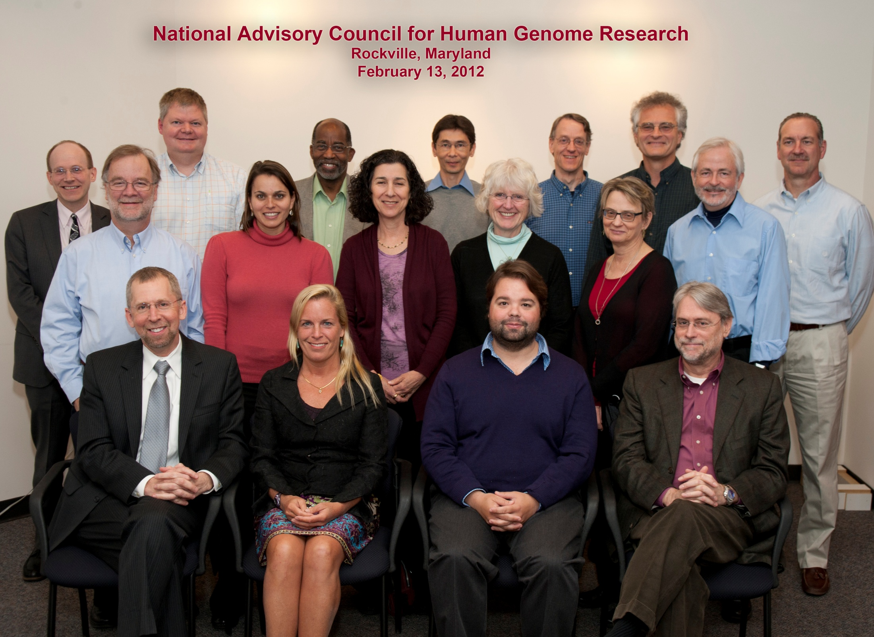
Notes:
Let me start my Director’s Report by personally thanking the outstanding members of our advisory Council. Besides being a great-looking group (as documented in this photograph taken during our February meeting), you continue to be immensely helpful to me and to my staff– both during the actual Council meetings and in various ways that we call on you for your service, both individually and collectively.
As I look at this picture, I am reminded that I have personally had an important conversation with almost every one of you since our last meeting in February; meanwhile, most of you have attended key NHGRI workshops or joined critical conference calls just in the past few months.
In short, you have been and continue to be generous with your time, and your input is incredibly valuable and— I can assure you— much-appreciated.

Slide 3
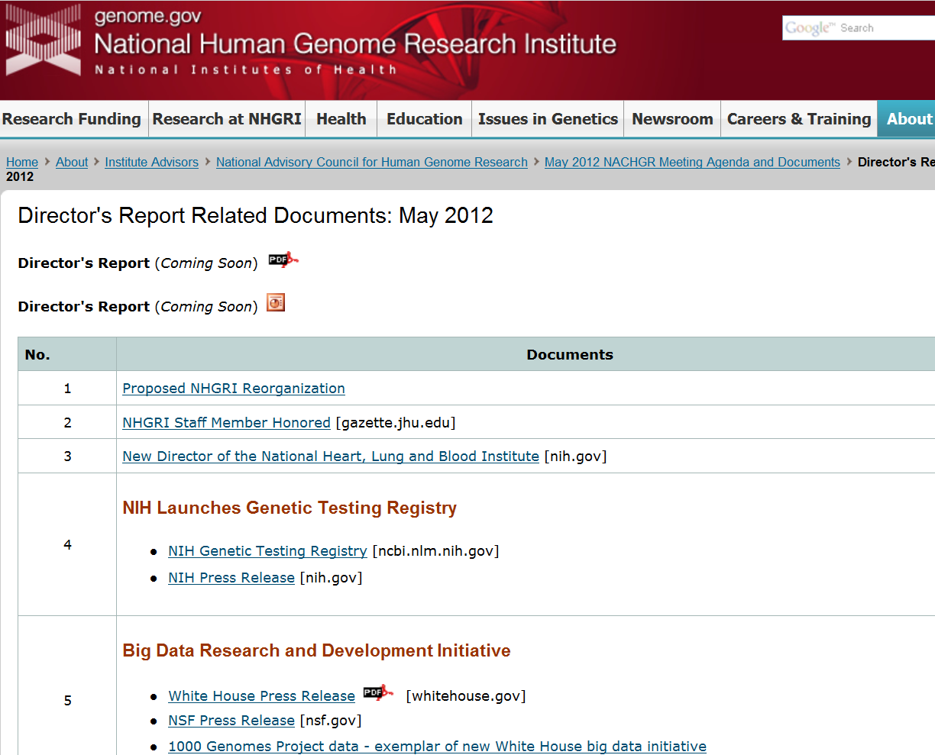
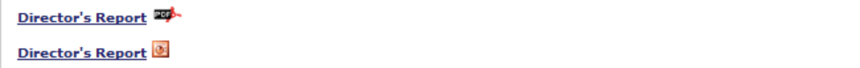
genome.gov/DirectorsReport
Document #
Notes:
For new Council members, visitors, and web viewers of our Council meeting, I want to make you aware that there is an ‘electronic resource’ associated with my Director’s Report.
Available at the URL shown here, this resource is analogous to supplemental materials associated with a published paper.
The slides that I am showing during my Director’s Report are also available electronically at this site– * both as a PDF and as a Powerpoint file.
* For slides associated with specific documents or relevant web sites, there is a ‘Document #’ indicated on the bottom right, which simply references materials that you can access at the web site shown here.
In addition to the video archive that I mentioned earlier, this entire site (including all linked documents) will be archived on NHGRI’s web site as a permanent historic resource.

Slide 4
Open Session Presentations
  NHGRI Training Portfolio
    Bettie Graham
  NIH Policy on Applicants with More than $1.5M in Grant Support
    Bettie Graham
  Update on the X Chromosome Program Notice
    Anastasia Wise
Notes:
There will be multiple other presentations during the Open Session of this Council meeting.
My Director’s Report is tailored around these presentations; by that I mean that I will not discuss in detail the topics that others will be covering in greater depth.
We have several general topics to present during this Open Session, including:
* An update on the NHGRI training portfolio by Bettie Graham
* Information about a new NIH policy on applicants with more than $1.5M in grant support, also by Bettie Graham
* And an update on the X chromosome program notice by Anastasia Wise

Slide 5
Open Session Presentations
Concept Clearances:
  Genomic Sequencing and Newborn Screening Disorders
      Anastasia Wise
  Clinically Relevant Variants Resource
      Erin Ramos
Notes:
In addition, we will have presentations and discussions about two Concept Clearances:
* One on Genomic Sequencing and Newborn Screening Disorders by Anastasia Wise
* And one on a Clinically Relevant Variants Resource by Erin Ramos

Slide 6
Open Session Presentations
Program Updates:
  1000 Genomes Project
      Lisa Brooks
Notes:
* Finally, we will have one program update– that on the 1000 Genomes Project by Lisa Brooks.

Slide 7
General NHGRI Updates
General NIH Updates
Genomics Updates
NHGRI Extramural Program
NIH Common Fund Programs
NHGRI Office of the Director
NHGRI Intramural Program
Notes:
For the rest of my Director’s Report, I will cover the 7 areas listed here; these have proven to be a good framework for reviewing the relevant topics.

Slide 8
General NHGRI Updates
General NIH Updates
Genomics Updates
NHGRI Extramural Program
NIH Common Fund Programs
NHGRI Office of the Director
NHGRI Intramural Program

Slide 9
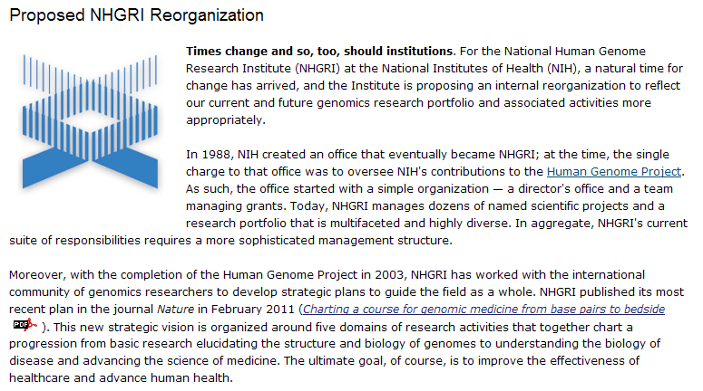
Proposed NHGRI Reorganization
Document 1
Notes:
As we discussed at the last Council meeting, I have proposed to reorganize the NHGRI in a fashion that mostly affects our Extramural Research Program and, to a lessor extent, the Office of the Director.
As a reminder, this is a relatively formal process that involves multiple steps, as stipulated by the NIH Reform Act. That process is proceeding, albeit not at lightening speed.
I can report that the required approvals are now being sought at the Department of Health and Human Services, and we are hopeful that the process might reach its end at some point this summer, after which we would aim to implement the new organizational model as quickly as possible.

Slide 10
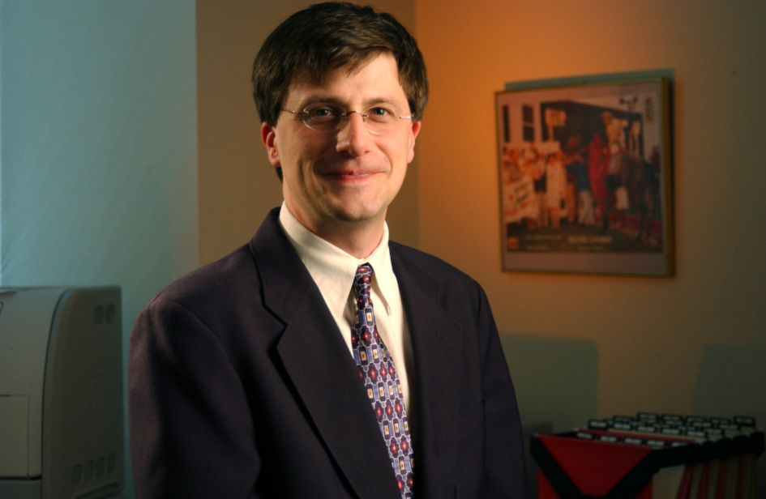
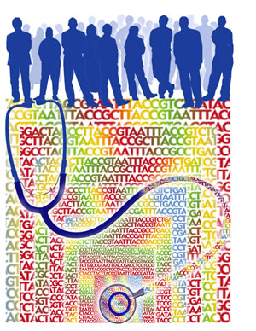




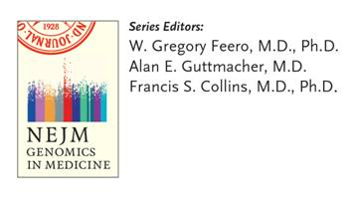
Departure of Greg Feero
Genomic Healthcare Branch
Notes:
As some of you may know, Greg Feero, who was the * founding Chief of our Genomic Healthcare Branch, has been splitting his time for the last two and a half years between working as a practicing family physician and in the family medicine residency program at Maine Dartmouth and at NHGRI on topics related to genomic medicine. Unfortunately for us, beginning in August, Greg will turn his attention full-time to his practice and residency activities.
His accomplishments and contributions to NHGRI have been many since he first arrived in 2006, and have also included * leading the charge on family history through both the expansion of the U.S. Surgeon General’s web-based family history tool and an NIH State of the Science conference on the topic. * He also led the series of reviews in the New England Journal of Medicine on genomics in medicine. And, under his leadership, * the Genomic Healthcare Branch established important tools for health professional education through web-based resources such as the Genetics & Genomics Competency Center (or G2C2) and G3C, a new resource that is generating interactive genomics case studies for use in continuing education across health professional communities.
Greg asked me to express his gratitude for the privilege of working with all of you and for NHGRI over the last 5+ years, and I would like to take this opportunity to thank Greg for his tireless work and his deep commitment to the mission of the Institute and to the work needed to make genomic medicine a reality. One final note, Greg will soon become a Contributing Editor for JAMA in the area of genomics.
10

Slide 11
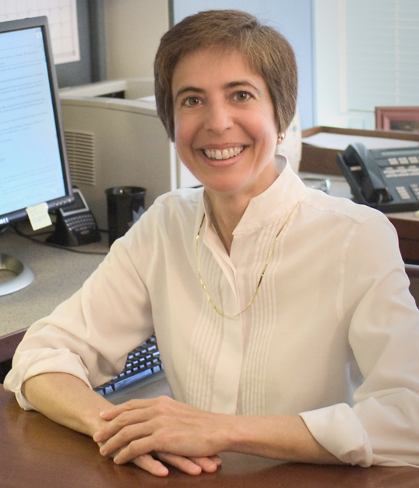


NHGRI Staff Member Honored (x2)
Teri Manolio, M.D., Ph.D.
Document 2
Notes:
I am pleased to report that Teri Manolio (Director of the NHGRI Office of Population Genomics) recently received two prestigious honors.
First, she received the 2011 Department of Health and Human Services Secretary’s Award for Meritorious Service for her exceptional leadership and coordination of the Department’s response in developing a research plan for studying the health effects of the Gulf of Mexico oil spill.
Second, she was elected to the Johns Hopkins Society of Scholars. This honor is given to former Johns Hopkins University students or trainees who have made outstanding contributions to science and new knowledge.
11

Slide 12
General NHGRI Updates
General NIH Updates
Genomics Updates
NHGRI Extramural Program
NIH Common Fund Programs
NHGRI Office of the Director
NHGRI Intramural Program

Slide 13
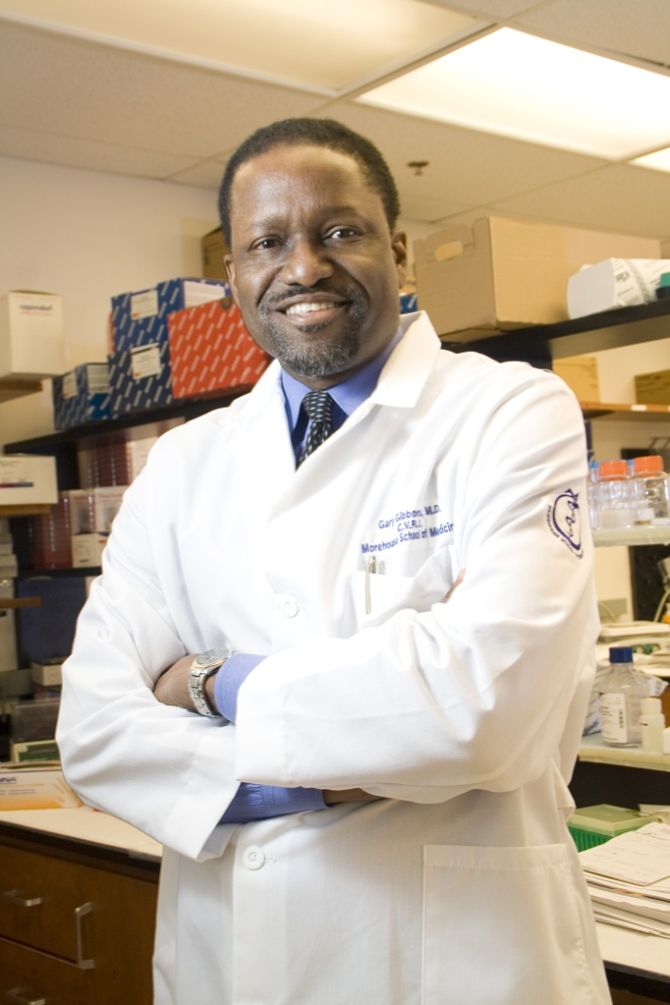
New Director: National Heart, Lung, and Blood Institute
Gary Gibbons, M.D.
Document 3
Notes:
Gary Gibbons as been selected to be the new Director of the National Heart, Lung, and Blood Institute.
Dr. Gibbons is the Founder and current Director of the Cardiovascular Research Institute at Morehouse School of Medicine, where he also serves as Chairman of the Department of Physiology.
Until recently, he served on NHGRI’s Board of Scientific Counselors for our Intramural Research Program. In this capacity, his advice and guidance proved to be quite beneficial to our Intramural investigators.
Dr. Gibbons expects to start at NIH this summer.
13

Slide 14
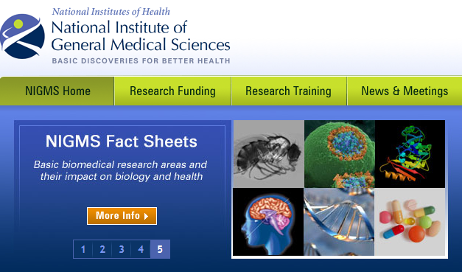
NIGMS Leadership Changes
Notes:
For personal reasons, Chris Kaiser of MIT withdrew from becoming the new Director of the National Institute of General Medical Sciences (NIGMS), a position he had originally planned to begin in mid-April.
As a result, Judith Greenberg will continue to serve as Acting Director of NIGMS.
The search to identify an NIGMS Director will begin again. Previously, I served on the search committee, and I have now been asked to co-chair that committee along with Story Landis (NINDS Director). Especially because of the important collaborative opportunities between NHGRI and NIGMS, I am highly motivated to identify outstanding candidates for this important NIH position, so please send me any ideas you have about individuals that the search committee should contact.
14

Slide 15
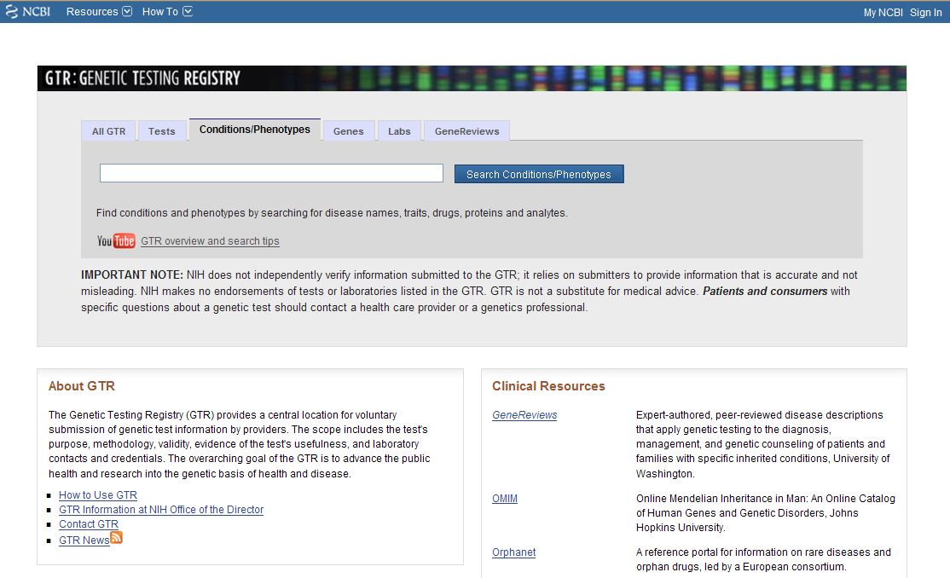
NIH Launches Genetic Testing Registry
Document 4
Notes:
In February, NIH launched the Genetic Testing Registry at the National Center for Biotechnology Information.
This public database aims to catalog and disseminate information about the availability, validity, and usefulness of genetic tests. It operates by voluntary submissions from test providers, capturing information about intended use, target populations, assay limitations, clinical validity, and clinical utility.

Slide 16


‘Big Data’ Research and Development Initiative
Document 5
Notes:
In March, the Obama Administration launched the ‘Big Data’ Research and Development Initiative, which aims to improve the nation’s ability to extract knowledge and insights from large, complex collections of digital data.
Six U.S. government departments and agencies, including NIH, have committed more than $200 million to fund new initiatives.
The National Science Foundation and NIH are participating in a joint solicitation issued in March entitled “Core Techniques and Technologies for Advancing Big Data Science & Engineering.” Through this, NIH is particularly interested in imaging, molecular, cellular, electrophysiological, chemical, behavioral, epidemiological, clinical, and other data sets related to health and disease.
There are 7 NIH Institutes and Centers participating, with the anticipated total annual funding being ~$3M. NHGRI anticipates contributing up to $400K annually to this initiative.

Slide 17

‘Big Data’ Planning at NIH
Data and Informatics Working Group
Co-Chairs: Larry Tabak and David DeMets
  Report to NIH Director in June 2012
  Trans-NIH Subgroup on Molecular Data Co-Leads: NHGRI and NIGMS
  Potential Common Fund initiative in FY2014
Notes:
At the February Council meeting, I reported that a Working Group of the Advisory Committee to the NIH Director had been established to investigate the management, integration, and analysis of large biomedical datasets.
* This so-called “Data and Informatics Working Group, chaired by Larry Tabak (NIH Deputy Director) and David DeMets (U. of Wisconsin), will provide their report to the NIH Director in June.
* In preparation for acting on that report, three trans-NIH subgroups have been established in the areas of molecular, phenotype, and imaging data. NHGRI and NIGMS are co-leading the first group, one focusing on molecular data.
* The ultimate goal is to produce a series of ideas that could be proposed as a new Common Fund initiative in FY2014.

Slide 18

Advisory Committee to the Director
NCBI Working Group
David Ginsburg (Chair)
Robert Gentlemen
Richard Gibbs
Howard Jacob
Jill Mesirov
Deborah Nickerson
Christine Seidman
Paul Sternberg
Marc Vidal
Notes:
Recall that Francis Collins asked that a ‘Needs Assessment’ be performed last summer by an ad hoc committee chaired by David Ginsburg of the University of Michigan. That committee recommended that NCBI be given special dispensation with respect to its annual budget because of its ever-growing responsibilities to assimilate and disseminate biological data, especially genome sequence data. As a result, NCBI has now been guaranteed a budgetary increase each year, regardless of the state of the overall NIH budget.
To ensure appropriate stewardship of this unusual budgetary and programmatic situation, Francis Collins has now established a new working group, called the NCBI Working Group, of his Advisory Committee to the Director. This group will provide advice about NCBI services, especially with respect to their relative priorities in the face of conflicting demands. David Ginsburg will also serve as the chair of this new NCBI Working Group, the membership of which is shown here (and includes Council member Jill Mesirov). Michael Gottesman and I will serve in an ex officio capacity (recall that Michael Gottesman and I co-chair the NCBI Resource Board, an internal NIH group that helps to define the appropriate resource needs of NCBI– again because of NCBI’s unusual service role for the broader scientific community).
It is anticipated that this group will meet a few times a year to assess priorities, but will also be able to give input more rapidly if any acute issues or problems arise.

Slide 19
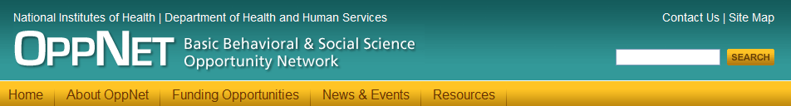
Basic Behavioral and Social Science Opportunity Network (OppNet)
  Mission: Pursue opportunities for strengthening basic behavioral and social science research at NIH
  Collectively funded and managed
    [NHGRI FY2012 contribution: $349K]
  OppNet grants may come to September Council meeting
Document 6
Notes:
Francis Collins established the Basic Behavioral and Social Science Opportunity Network (OppNet) in November 2009. * The mission of OppNet is to pursue opportunities for strengthening basic behavioral and social science research at the NIH, while innovating beyond the existing investments.
OppNet prioritizes activities and initiatives that are relevant to the missions of multiple NIH Institutes and Centers.
* All NIH Institutes and Centers collectively fund and manage OppNet. However, OppNet is separate from the Common Fund. In FY2012, NHGRI contributed $349K to OppNet.
* Grants from the OppNet RFA “Mechanistic Pathways Linking Psychosocial Stress and Behavior” may come to the September Council meeting.

Slide 20
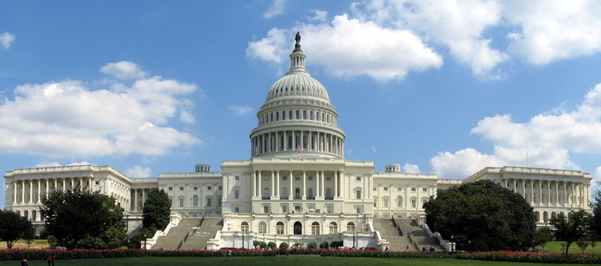
FY2013 NIH Appropriation: Overview
  March 20: House NIH Hearing
  March 28: Senate NIH Hearing
Document 7
Notes:
In terms of NIH updates, I certainly saved the best for last– the situation with the FY2013 NIH appropriation (i.e., the NIH budget for next fiscal year). As you may recall, the President delivered his proposed FY2013 budget to Congress in February, calling for essentially a flat NIH budget relative to the current fiscal year. Congress is now holding various hearings, including those about NIH.
* On March 20, Francis Collins and Tom Insel, Acting Director of NCATS, testified before the House appropriations subcommittee responsible for drafting NIH’s budget each year. There was a strong focus on NCATS and the role of NIH in translational science.
* On March 28, the corresponding committee on the Senate side held a hearing on NIH, with Francis Collins and several institute directors testifying.

Slide 21
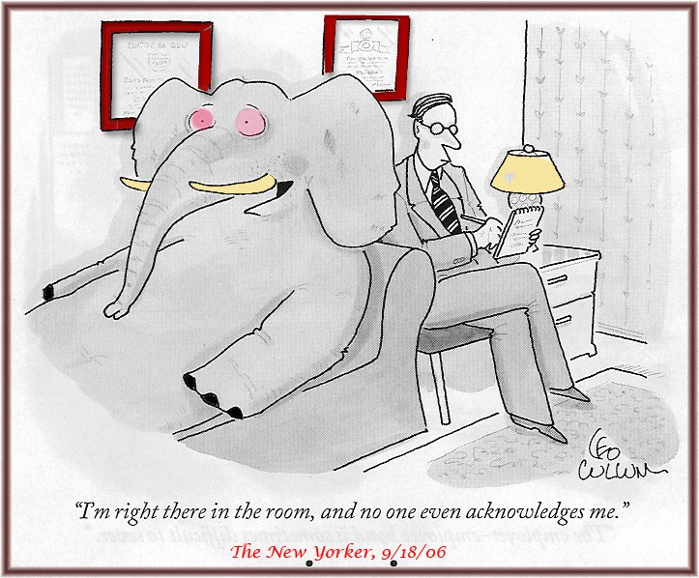
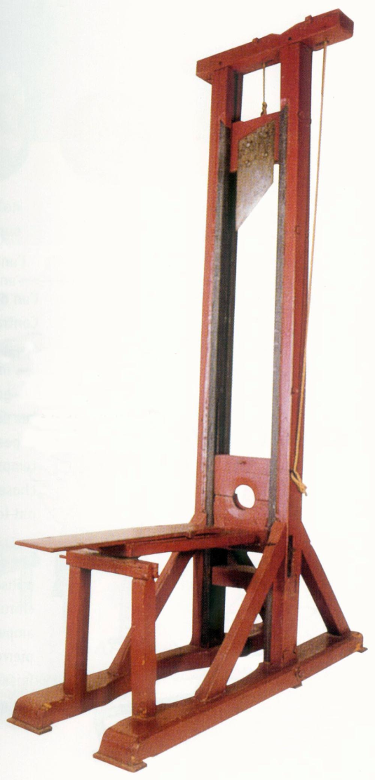
FY2013 NIH Appropriation: Sequestration?
Notes:
Those two hearings took place in the face of some highly unusual circumstances related to the FY2013 NIH budget. For starters, we will certainly not have an agreement about the budget until after the November election. So, whether NIH ever gets the President’s flat budget is completely unknown. We will inevitably start the new fiscal year on October 1 under a continuing resolution, meaning we will be asked to temporarily operate assuming the same budget as the previous year.
* Meanwhile, the elephant in the room relates to last summer’s failed debt deal and the inaction of the not-so-Supercommittee, which now means that an automatic 8-9% budget cut (or ‘sequestration’) will occur in very early January 2013– unless some sort of new debt deal or other compromise is reached.
* Such a sequestration is really more like a guillotine than an elephant. In fact, it is hard to even imagine how NIH would manage such a draconian cut— especially since it would kick in at the 25% point of the fiscal year, but would be applied retroactively for the entire fiscal year. Making this particularly challenging is the November election (and its uncertainties about the next President or the political balance in each chamber of Congress), and the likely scenario that we simply will not know much about the budget until at least December.

Slide 22


Warnings: Sequestration Impact on NIH
“33,000 fewer jobs across the United States”
“11.1% ($2.8 billion) reduction of the extramural budget”
Document 8
Notes:
Meanwhile, advocates are speaking out to express concerns about the potential sequestration.
* Released the day of the Senate hearing, a United for Medical Research report estimates that such a budgetary cut would lead to the loss of 33,000 jobs across the United States, which is described as a massive step backwards for biomedical research in this country.
* A FASEB report released last month estimates such a sequestration will lead to a $2.8B cut to the extramural budget, which would have a devastating effect on medical research.
While various proposed solutions are being debated in Congress to potentially avoid the sequestration (including a recently passed House bill), it is hard to predict if any of them will truly be implemented. So, all we can do is watch and wait.

Slide 23



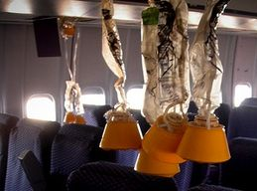
FY2013 NIH Appropriation: Survival Tips
Notes:
So, we certainly find ourselves in a very unusual and uncomfortable circumstance with respect to next year’s NIH budget.
* Between the election and the potential sequestration, it is going to feel like a very turbulent roller coaster ride for the next 6-8 months.
* I, for one, plan to buckle up to avoid getting tossed and turned too badly when I follow the political news each day.
* And I am routinely dosing up heavily with Dramamine to minimize the inevitable nausea that will occur as things unfold.
* And just to be safe, the NIH was kind enough to install oxygen masks in the ceilings of all Institute Directors’ offices, which will drop down for use if the sequestration actually kicks in. We were also given training to be sure that we fastened our masks on securely before placing a mask on any our extramural Program Directors.
So, stay tuned to CNN and GenomeWeb for continuing developments in this insane story…

Slide 24
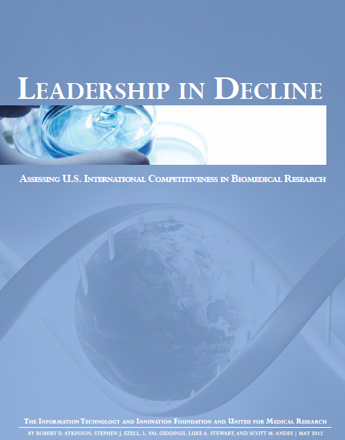
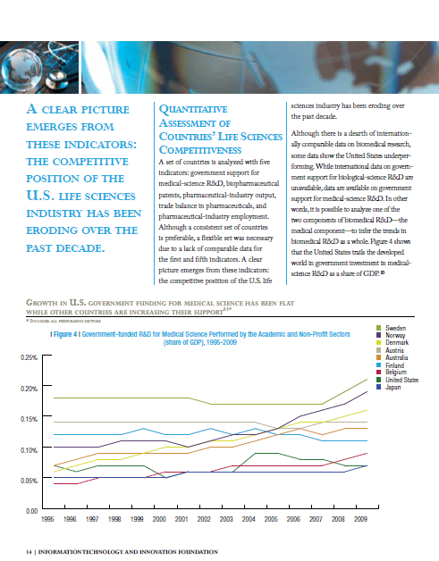
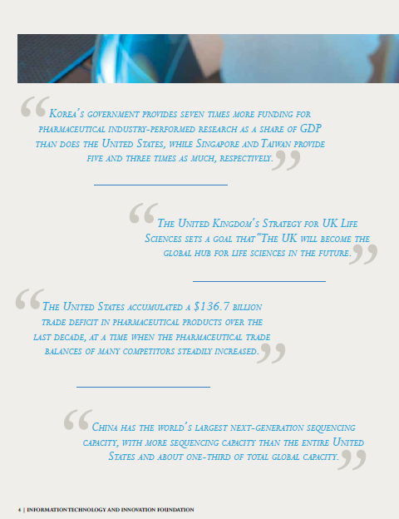
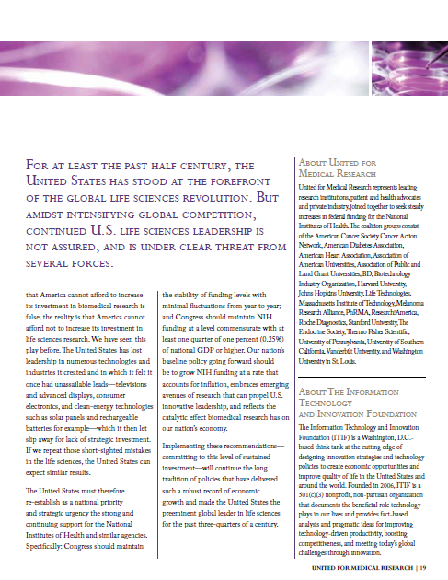
Just Released: Leadership in Decline
Document 8
Notes:
Related to all of this discussion about the FY2013 NIH budget, but more broadly to the turbulent ride we go through every year related to budgetary uncertainties and the lack of a long-term plan to provide life sciences research stable annual funding– * Late last week, The Information Technology and Innovation Foundation and United for Medical Research released a new report entitled Leadership in Decline– Assessing U.S. International Competitiveness in Biomedical Research. This report is highly critical of the U.S.’s commitment to the life sciences, providing evidence of our declining global leadership. The budgetary problems thrust onto the NIH are cited as one of the core reasons for this. * Included are data illustrating how…”A clear picture emerges from these indicators: the competitive position of the U.S. life sciences industry has been eroding over the past decade.”
* Elsewhere, they cite various examples of how we are losing our competitiveness. One that hits close to NHGRI is their point that “China has the world’s largest next-generation sequencing capacity, with more sequencing capacity than the entire United States and about one-third of the total global capacity.” * And finally, the report points out “For at least the past half century, the United States has stood at the forefront of the global life science revolution. But amidst intensifying global competition, continued U.S. life sciences leadership is not assured, and is under clear threat from several forces.”
These are all very sobering conclusions. I strongly encourage Council members and others to download this report and take a careful look at it.

Slide 25
General NHGRI Updates
General NIH Updates
Genomics Updates
NHGRI Extramural Program
NIH Common Fund Programs
NHGRI Office of the Director
NHGRI Intramural Program

Slide 26

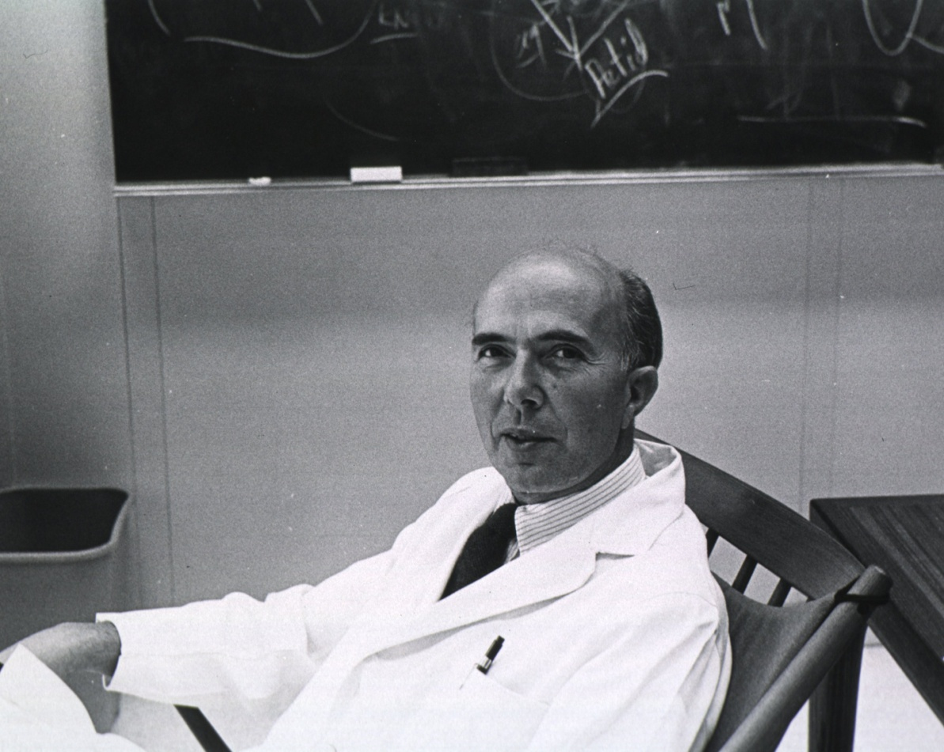
Mourning the Loss of Renato Dulbecco
Document 9
Notes:
Renato Dulbecco passed away this past February. He won the 1975 Nobel Prize for his role in drawing a link between genetic mutations and cancer.
In terms of his genomics connections, in 1986, Dulbecco wrote a heavily-cited commentary in the journal Science entitled “A turning point in cancer research: sequencing the human genome”— in which he proposed that cataloging all human genes by sequencing the human genome would provide the needed insights for understanding cancer. This article was a key part of the growing ‘drum beat’ of support leading up to the launching of the Human Genome Project in 1990.

Slide 27
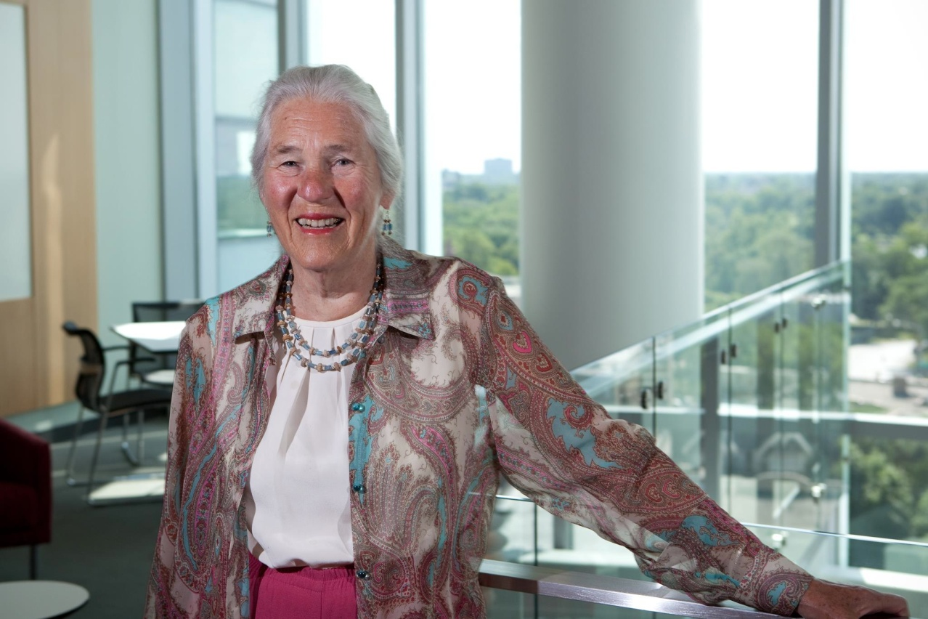

2012 Japan Prize
Janet Rowley, M.D.
Document 10
Notes:
Janet Rowley, a good friend and many times advisor of NHGRI, was awarded the 2012 Japan Prize in the field of Healthcare and Medical Technology.
She will share the award with Brian Druker and Nicholas Lydon for their respective roles in the development of the first genomically targeted anti-cancer drug (Gleevac).
27

Slide 28




2012 Dan David Prize
David Botstein, Ph.D.
Eric Lander, Ph.D.
Craig Venter, Ph.D.
Document 11
Notes:
Well-known to the genomics community, David Botstein, Eric Lander, and Craig Venter were recently awarded the 2012 Dan David Prize, given annually for achievements having an outstanding scientific, technological, cultural, or social impact on our world.
Each year, fields are chosen within three time dimensions: past, present, and future. Botstein, Lander, and Venter were given their award for the future and for genomics research.
28

Slide 29

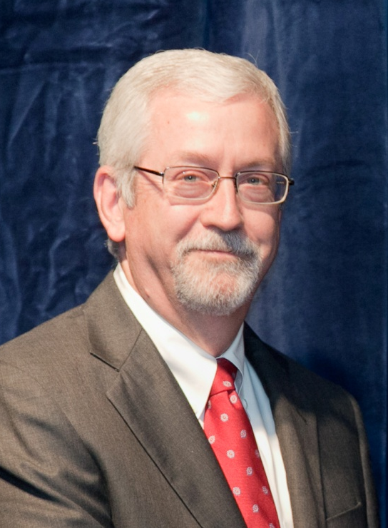
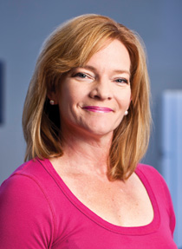
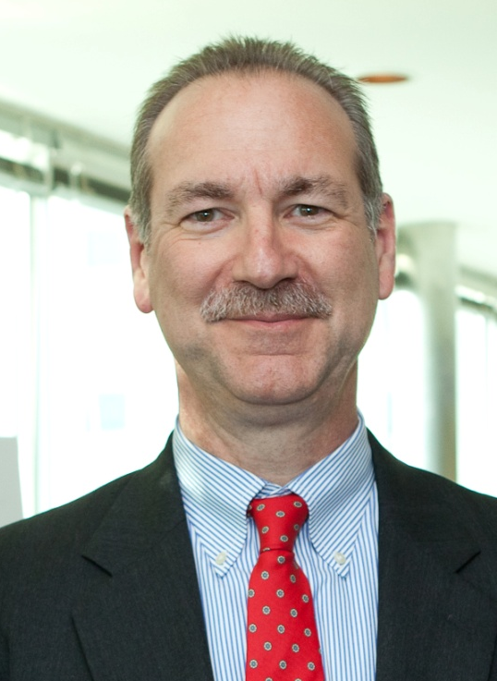
Outstanding St. Louis Scientists Award
Tim Ley M.D.
Elaine Mardis Ph.D.
Rick Wilson Ph.D.
Document 12
Notes:
As someone who keeps a close eye on the various things going on in my home town of St. Louis, I am pleased to report that Tim Ley, Elaine Mardis, and Council member Rick Wilson of the Genome Institute at Washington University recently received the George Engelmann Interdisciplinary Award from the Academy of Science of St. Louis.
This new award recognizes outstanding achievement in science, engineering, or technology that results from collaboration among two or more individuals across disciplinary or institutional boundaries.
In 2008, these three researchers led the team that published a description of the first cancer genome of patient with acute myeloid leukemia.
29

Slide 30

Newly Elected: National Academy of Sciences
Andy Clark
Ron DePinho
Evan Eichler
Greg Hannon
Harris Lewin
Rick Young
Subra Suresh
Document 13
Notes:
Recently, a number of individuals with ties to NHGRI were elected to the National Academy of Sciences. That list included Andy Clark, Ron DePinho, Evan Eichler, Greg Hannon, Harris Lewin, and Rick Young.
In addition, our good colleague and Director of the National Science Foundation, Subra Suresh, was also elected.

Slide 31


Bruce Korf: President of the ACMG Foundation for Genetic and Genomic Medicine
Document 14
Notes:
Bruce Korf has been elected President of the American College of Medical Genetics and Genomics (ACMG) Foundation for Genetic and Genomic Medicine.
He takes over from Rodney Howell, who served as President for nine years.
Bruce is currently serving on the NHGRI’s Board of Scientific Counselors for our Intramural Research Program.

Slide 32
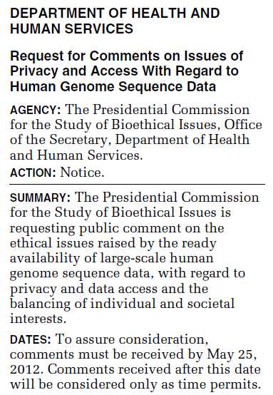
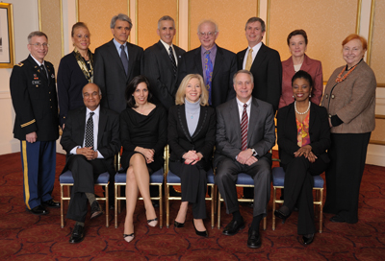

Presidential Commission for the
Study of Bioethical Issues
  info@bioethics.gov
Document 15
Notes:
As you may remember from the February Council meeting, the Presidential Commission for the Study of Bioethical Issues has been considering bioethics issues raised by advances in human genome sequencing.
Specifically, the Commission is focusing on issues related to access to and individual privacy protection for genetic information, with a focus on large-scale human genome sequence data.
As part of the development of this report, the Department of Health and Human Services published a Request for Information on this topic in late March, with a 60-day comment period (as shown on the left).
The Commission is also surveying federal agencies on their relevant statutes, regulations, guidance documents, and policies. NHGRI staff are in close contact with the Commission’s staff, both to serve as a resource and to provide input on the possible ways in which the Commission could be particularly helpful.
Comments about this effort can be submitted to info@bioethics.gov.

Slide 33


DeciBio Report on Research Tools
  Genomics sector:
    From $6.8B in 2011 to $8.9B in 2016
  ‘Next-Gen’ DNA sequencing market:
    From $1.05B in 2011 to $2.25B in 2016
Document 16
Notes:
In April of this year, the life sciences market research firm DeciBio published a report that forecasted the next few years of the life science research tools market. Although they looked at many different research tools areas, they found that genomics is expected to be the fastest-growing segment.
* According to their projections, the genomics sector is poised to grow at 6% annually over the next five years— from $6.8 billion in 2011 to $8.9 billion in 2016.
* Much of that growth is expected in ‘Next-Gen’ DNA sequencing, which they calculate will grow by 16% each year— from $1.05 billion in 2011 to $2.25 billion in 2016.
Interestingly, the report predicts that growth in the overall life sciences research tools market will be fueled by demand from Brazil, Russia, India, and China.

Slide 34

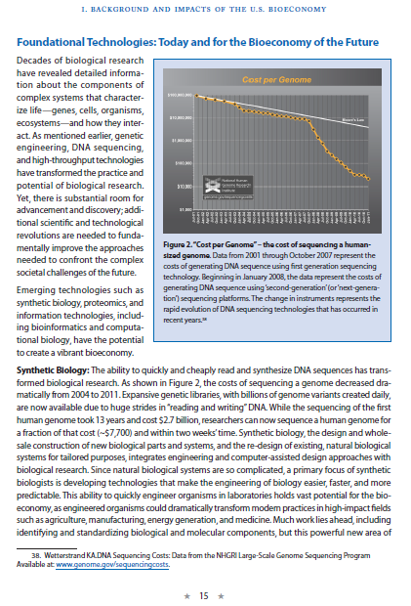
National Bioeconomy Blueprint
Document 17
Notes:
Genomics is also prominently featured in the recently released White House Office of Science and Technology Policy’s National Bioeconomy Blueprint.
This lengthy document points to various ongoing developments in the biological sciences that will likely have important economic impacts for the nation.
Without direct input from NHGRI, they chose to * feature our iconic graph of the plummeting costs of genome sequencing (as shown on the right). It is notable that this report contained very few graphics, making it particularly flattering that they prominently featured NHGRI’s.
The report describes how genomics and bioinformatics are ‘foundational technologies,’ both today and for the future.

Slide 35



Biotech Patents and the Courts
Notes:
In March, the U.S. Supreme Court ended a long-running case between Prometheus Laboratories and Mayo Medical Laboratories over a patent for determining the correct dose of a drug by looking at a patient’s blood metabolite levels. A federal district court previously found that Prometheus was trying to patent a natural phenomenon, which the federal circuit court overturned on appeal. The Supreme Court reached the same conclusion as the district court, finding in favor of Mayo, who was sued by Prometheus in 2004 for offering their own test with slightly different thresholds for changing doses.
We are waiting to see what impact this has on the pending case between the ACLU and Myriad Genetics, but early signs with both diagnostics and software patent disputes show that the lower courts are taking a stronger line on patent eligibility. However, in the Myriad case, the lower courts have all already rejected their genotype-phenotype association claims. This decision may not affect Myriad’s isolated DNA sequence claims (that is, the claims to purified and isolated cDNA with homology to the BRCA-gene sequence), although the Supreme Court’s ruling does cite concern over excessive patent protections holding back biomedical innovation.
Obviously, more to come in this area, and we will aim to keep Council updated about relevant developments, as appropriate.

Slide 36
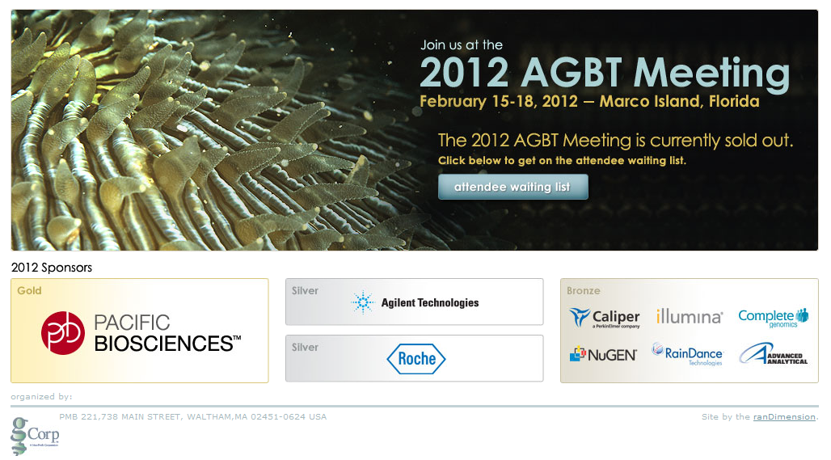
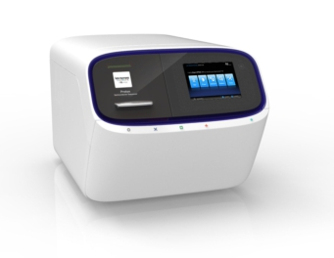
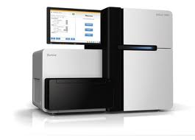
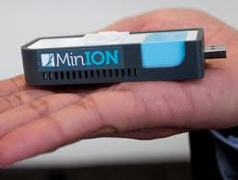
2012 Advances in Genome Biology and Technology Meeting
Document 18
Notes:
In terms of recent genomics meetings, the 2012 Advances in Genome Biology and Technology Meeting took place this past February. Once again, the demand to attend this meeting was far greater than could be accommodated (with a very large waiting list); and once again, companies queued up to unveil their latest achievements.
* Life Technologies and Illumina announced the availability of new DNA sequencing machines later this year, while Oxford Nanopore announced the availability later this year of their USB-sized DNA sequencer, the MinION.

Slide 37
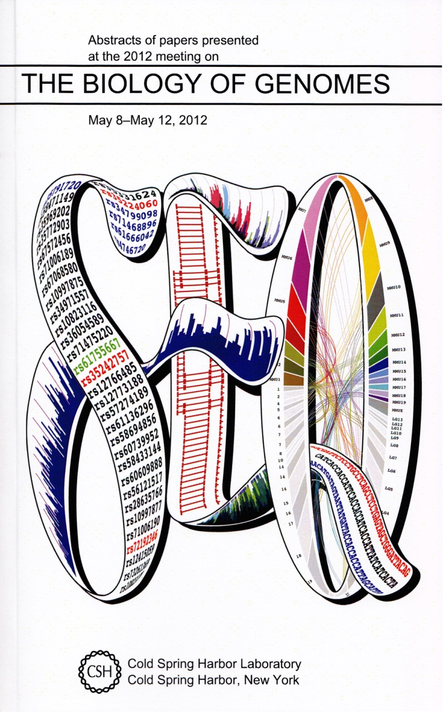

2012 Biology of Genomes Meeting
Cold Spring Harbor Laboratory
Document 19
Notes:
And then two weeks ago, the 2012 Biology of Genomes Meeting was held at CSHL. If my memory and arithmetic are correct, this was the 24th annual CSHL ‘genome’ meeting (as they are called).
Notable highlights from this meeting included several talks on single-cell genomics, impressive updates on cancer sequencing projects, an ELSI panel discussion on genomic literacy, and keynote presentations by Debbie Nickerson and Susan Wessler.

Slide 38
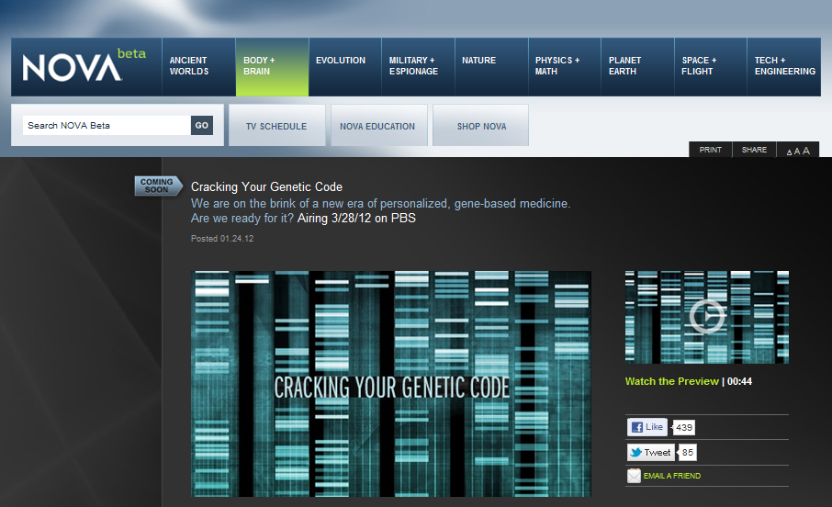
NOVA: “Cracking Your Genetic Code”
Document 20
Notes:
A NOVA special entitled “Cracking Your Genetic Code” debuted on PBS stations in March.
The development of this show was, in part, funded by NHGRI, and numerous familiar faces were featured throughout the one-hour program. The show examines the evolving genomic technologies and research surrounding genetics and genomics-based medicine.

Slide 39
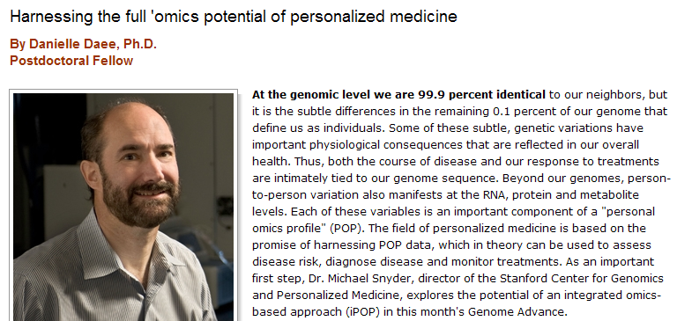
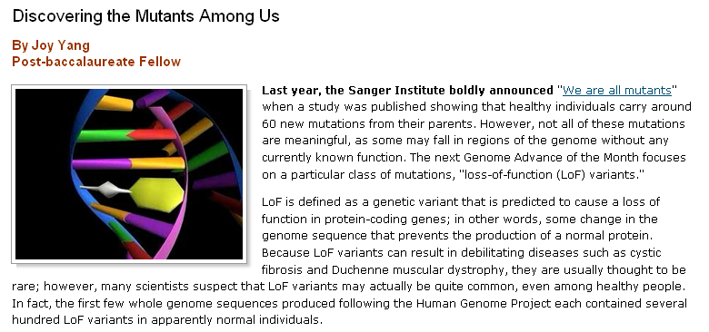
NHGRI Genome Advance of the Month
Document 21
Notes:
NHGRI continues to feature a ‘Genome Advance of the Month’ on our web site, genome.gov.
Two recent publications that were featured since the last Council meeting reported population-level characteristics of loss-of-function variants in the human genome and a personal ‘-omics’ profile approach to personalized medicine.

Slide 40




Genomics In The News…
New insights on
evolution from
the study of sticklebacks
Insights about human evolution from the gorilla genome sequence
Document 22
Notes:
Speaking of regular features… let me move on to the regular ‘Genomics in the News’ portion of my Director’s Report, always filled with notable stories, but also some fun (at least for me).
* Council member David Kingsley and colleagues at Stanford University and the Broad Institute analyzed whole-genome sequences of 21 three-spine sticklebacks chosen from geographic locations around the world. The findings, which appeared an excellent paper published by Nature in April, are helping to identify the regions of the stickleback genomes responsible for notable phenotypic adaptations.
*Meanwhile, Nature also recently published a paper reporting the genome sequence of the gorilla, an effort involving a consortium of investigators including researchers at the Sanger Institute and Council member Rick Wilson. While confirming that our closest relative is the chimpanzee, the team found some interesting results pointing to many regions of the human genome that more closely resembles the gorilla than the chimpanzee genome.

Slide 41
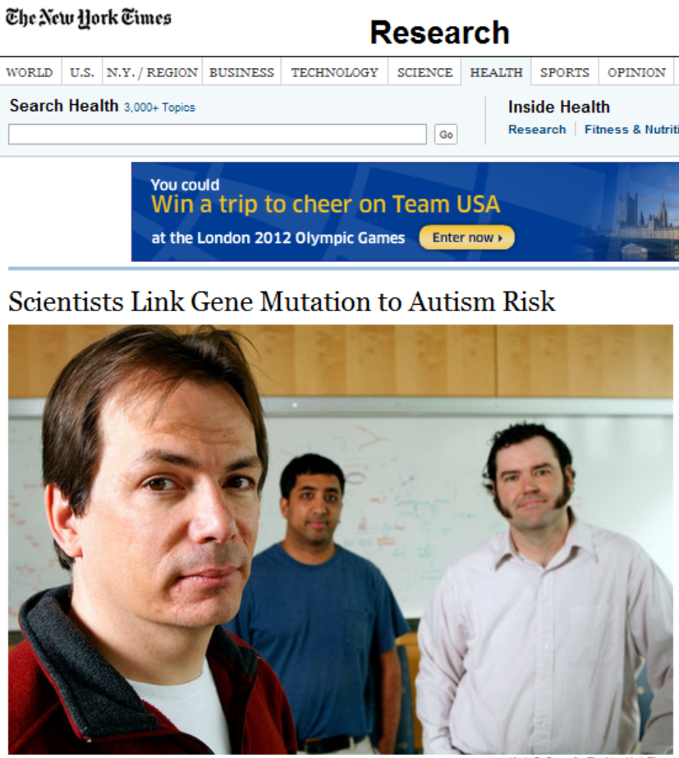
Genomics In The News…
Document 22
Notes:
Three papers reporting new findings about the genetics of autism were published in Nature last month, representing the work led by Evan Eichler, Mark Daly, and Matthew State.
Whole-exome sequencing was performed by all three groups, unveiling interesting patterns of gene mutations in autism. Their results suggest modest roles for hundreds of genes in the development of autism and pinpoint a few specific genes as genuine risk factors.
These findings were reported in the New York Times, in an article that included this photograph of Evan Eichler, Jay Shendure, and Brian O’Roak (all of the University of Washington).

Slide 42


Genomics In The News…
Document 22
Notes:
The Colbert Report has recently become ‘the place’ to catch up on the latest advances in genomics and science in general.
* David Page was recently a guest on The Colbert Report, where he used creative props to discuss the evolution of sex chromosomes. David was in control in the interview when he had the model chromosomes in his hands.
* But all hell broke loose when Colbert got his hands on a chromosome.
* Not to be outdone, Francis Collins appeared on the show two weeks ago (for her third appearance going toe-to-toe with Colbert). In this case, he talked about obesity and the new multi-part HBO series called ‘Weight of the Nation.’ Francis brought with him a 5-lb model of fat; once again, Colbert couldn’t keep his hands off the scientific prop.

Slide 43
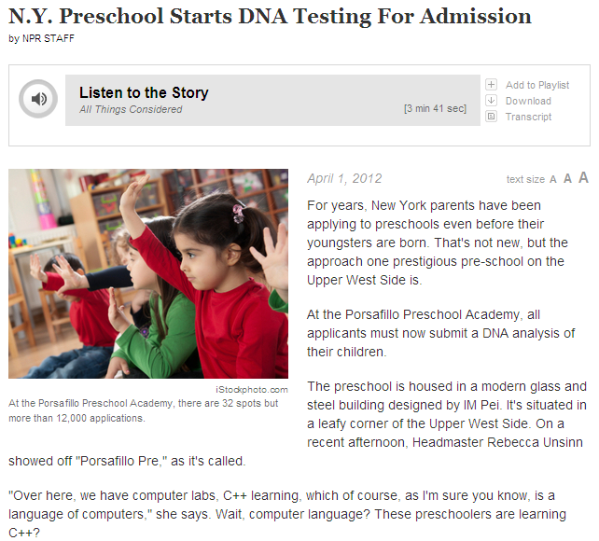
Genomics In The News…
April Fools
Document 22
Notes:
Finally, in early April, NPR ran this story about a preschool academy in New York City, reporting that this school that will now require submission of a DNA sample of each child as part of their application. DNA testing will then be performed as part of the evaluation process “…in order to weed out the kids who have no chance.”
As one might imagine, this story had the potential to bring significant distress and debate in the genomics community. But before ELSI researchers and genomic activists around the world had the chance to self-organize in protest…
* NPR admitted this story, issued on April 1st, was just an April fools joke.
43

Slide 44
General NHGRI Updates
General NIH Updates
Genomics Updates
NHGRI Extramural Program
NIH Common Fund Programs
NHGRI Office of the Director
NHGRI Intramural Program

Slide 45
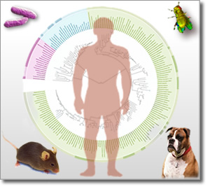
NHGRI Genome Sequencing Program
  Large-Scale Genome Sequencing Centers
  Mendelian Disorders Genome Centers
  Clinical Sequencing Exploratory Research Projects
  Informatics Tools for High- Throughput Sequence Data Analysis
  Meeting involving all components: October 2012
Document 23
Notes:
It seems most appropriate to start with our Genome Sequencing Program. Recall that there are four components of the recently renewed NHGRI Genome Sequencing Program.
* Large-scale genome sequencing centers
* Mendelian disorders genome centers
* Clinical sequencing exploratory research projects
* Informatics tools for high-throughput sequence data analysis
Each of these programs will be discussed further in the following slides. However, it is worth noting, that for the first time, * all four components of our Genome Sequencing Program will get together for a face-to-face meeting in October. In addition to the necessary housekeeping tasks, we hope that the attendees will use this meeting to pursue shared goals together, discuss common obstacles, and engage directly about their different scientific objectives.

Slide 46

Large-Scale Genome Sequencing Centers
  New: Alzheimer’s disease sequencing project
  Recent Publications:
    Autism Sequencing Consortium
    Schizophrenia allele spectrum
    Six Cancer genomics papers
    Gorilla genome
    Macaque Y chromosome
    Stickleback adaptive evolution
    Drosophila population genomics
Document 23
Notes:
The Large-Scale Genome Sequencing Centers are undertaking numerous projects, mostly related to complex disease and cancer.
* Notably, in February, the Obama administration announced new efforts to fight Alzheimer’s disease, including making an additional $50 million of existing NIH funds available for cutting-edge Alzheimer’s research. Accounting for half of those funds, the Large-Scale Genome Sequencing Centers program is in the late planning stages for a significant Alzheimer’s disease genome-sequencing project in collaboration with the National Institute on Aging and its grantees.
* Also worth highlighting are a number of publications emanating from these Centers since the last Council meeting, including those related to autism, schizophrenia, cancer, comparative genomics, and population genomics.

Slide 47

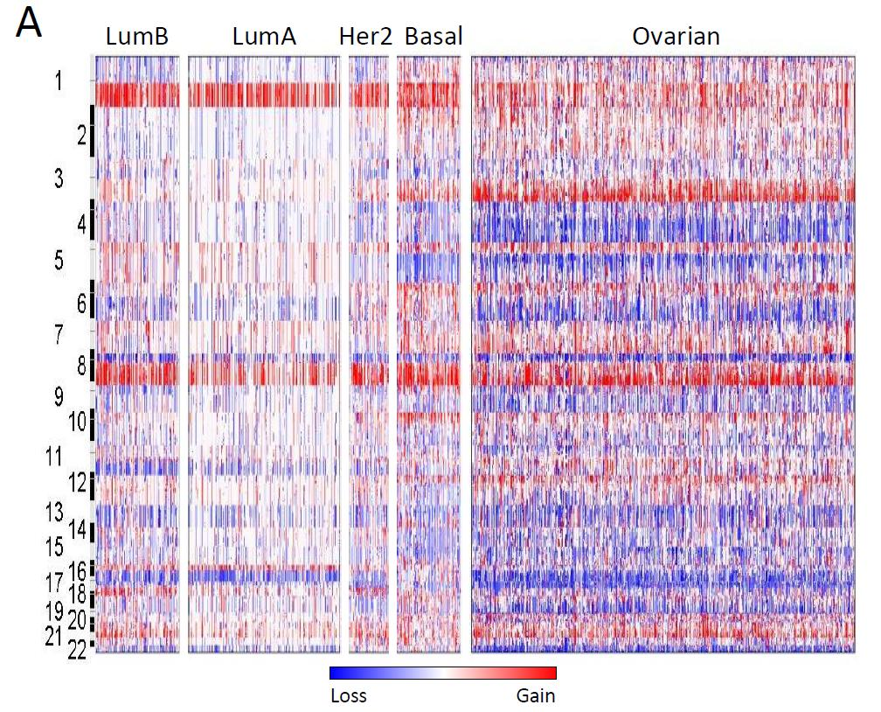
  TGCA papers on three cancers (in press or under review):
    Colorectal Carcinoma
    Breast Carcinoma
    Lung Squamous Cell Carcinoma
  Each paper reports the comprehensive integrative analyses of genome sequences for 100’s of tumors
  Several additional manuscripts are anticipated in 2012
Document 24
Notes:
Additional highlighting is appropriate in the case of The Cancer Genome Atlas (TCGA) program, which also involves our Large-Scale Genome Sequencing Centers.
TCGA has been hard at work on about 20 different tumor types, * and has papers (in press or under review) that report analyses for three major diseases: colorectal carcinoma, breast carcinoma, and lung squamous cell carcinoma.
* Each of these projects will continue the TCGA practice of releasing the largest scale (100’s of tumors) and most comprehensive descriptions to date (in terms of mutations, copy number changes, gene expression, methylation, and clinical data) for each of these important cancers.
* Several additional manuscripts are also anticipated this year.

Slide 48
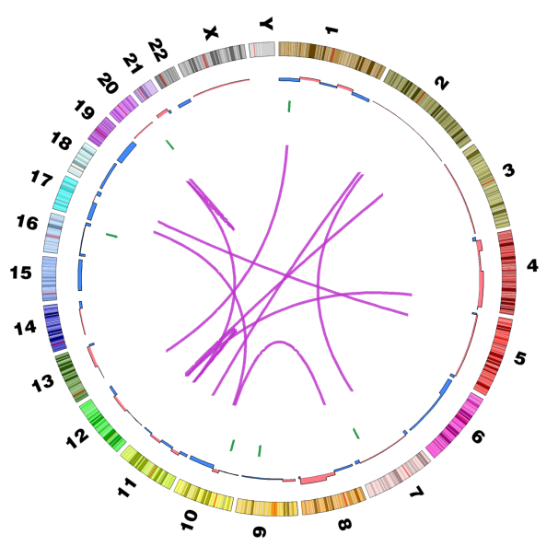
  CGHub (TCGA sequence data repository) opens at UCSC
    New innovations (e.g., BAM slicing) to be implemented soon
    First ‘NIH Trusted Partner’ for redistribution of genome sequence data
  >6,000 tumors analyzed from 20 cancer types; on track to achieve program goals by 2014 target
Document 24
Notes:
In other TCGA news, * CGHub, the new TCGA sequence data repository developed at UC-Santa Cruz, recently opened. CGHub is now the site that investigators can find all TCGA primary sequence files.
* Throughout this year, CGHub anticipates adding new features to make these data more useful, such as being able to slice BAMs (the very large files containing the sequence from a tumor or normal sample), so that an investigator can download only a particular gene or region rather than the entire genome sequence.
* In a non-trivial advance on the policy front, CGHub is the first ‘NIH Trusted Partner’ for archiving and distributing genome sequence data outside of NCBI or EBI. Several more Trusted Partners for NIH projects are being developed. These will each add value to this type of data and make them more useful and accessible to investigators.
* TCGA continues to be on target for its ambitious goal of completing comprehensive analyses of >20 tumor types by 2014. Genomic data on >6,000 cancer cases are available now, with approximately 200 added to the data portal each month.

Slide 49
Implemented pipeline from the Program’s sample solicitation portal through sample assignment to the Centers
Sample Solicitation Portal
Yale
Inquiry Review/ Response
Phenotype Review
Center Assignment
Consent Review
B-H
UW
Coordination Center (UW)
Educational program on Mendelian Genomics at the 2012 Annual ASHG Meeting
Disease gene discovery is ongoing at various stages from sequencing to the identification of disease genes
Document 23
Notes:
The second component of NHGRI’s new Genome Sequencing Program consists of the Mendelian Disorders Genome Centers. The three ‘Centers for Mendelian Genomics’ (as they are called) are co-funded by NHGRI and NHLBI, and they aim to discover the genetic basis of as many Mendelian disorders as possible.
The Programs single sample solicitation web portal has gone live. * A pipeline has been implemented (shown here) that progresses from solicitation through sample assignment to the centers at Yale, Baylor-Hopkins, and the University of Washington. The pipeline is jointly run by the three Centers, with the University of Washington group coordinating all joint activities.
* The Centers have organized an educational program focusing on Mendelian Genomics that will be held at the 2012 Annual Meeting of the American Society of Human Genetics.
* Disease gene discovery is ongoing at the Centers at various stages from sequencing to the identification of disease genes.

Slide 50

Clinical Sequencing Exploratory
Research (CSER) Projects
  First meeting of the CSER Steering Committee and the Return of Results Consortium
  New RFAs released:
  Reissue of original CSER solicitation
  CSER Coordinating Center
Document 23
Notes:
The third component of NHGRI’s new Genome Sequencing Program consists of the Clinical Sequencing Exploratory Research projects.
* The Steering Committee for this Program (called CSER) held its first face-to-face meeting a few weeks ago, a gathering that occurred jointly with the ELSI program’s new Return of Results Consortium.
The CSER investigators are tackling the important regulatory, technical, and psychosocial challenges to bringing genomic medicine to patients. Discussions at the meeting emphasized critical topics such as informed consent, refining definitions of actionability, distinctions between clinical care versus clinical research, and success stories from early implementation of clinical sequencing. Several of our Council members attended this meeting— Jim Evans and Amy McGuire as investigators in the Program and Pamela Sankar representing the Sequencing Advisory Panel.
* There was a great response to the original solicitation for this program, so we reissued the RFA. It is in the NIH Guide now, with an application receipt date of July 26. Accompanying the reissue is also an RFA for a Coordination Center for the Program, which will support the CSER program and the Return of Results Consortium, in addition to contributing to the assimilation and distribution of best practices and empirical evidence for this rapidly advancing area.

Slide 51

Informatics Tools for High-Throughput Sequence Data Analysis
“iSeqTools” Network aims to develop robust and reliable analysis tools for researchers without specialized computational skills
Leveraging NHGRI’s investment in sequencing centers and initiatives (e.g., 1000 Genomes, Galaxy, and others)
Building iSeqTools wiki as a knowledgebase
Notes:
The fourth and final component of NHGRI’s new Genome Sequencing Program consists of grants to support the development of informatics tools for high-throughput sequence data analysis.
Investigators are now using DNA sequencing instruments that are as powerful as entire an genome center was just a few years ago. But only the first step of DNA sequence production can be purchased ‘in a box.’ Investigators are not able to buy a ‘bioinformatics center in a box’ to make sense of the resulting data. That is the challenge this program is attempting to tackle.
* The network of grantees funded as part of this fourth component of NHGRI’s new Genome Sequencing Program has chosen a name to reflect its mission: “iSeqTools” (pronounced “I Seek Tools”). The aim of this network is to develop robust and reliable analysis tools for use by researchers without specialized computational skills.
* For this program, there is an effort to leverage NHGRI’s considerable investment in sequencing centers as well as initiatives such as 1000 Genomes, Galaxy, and others.
* A catalog of tools and strategies is being assembled on the iSeqTools wiki to create a knowledgebase and to identify synergies.

Slide 52
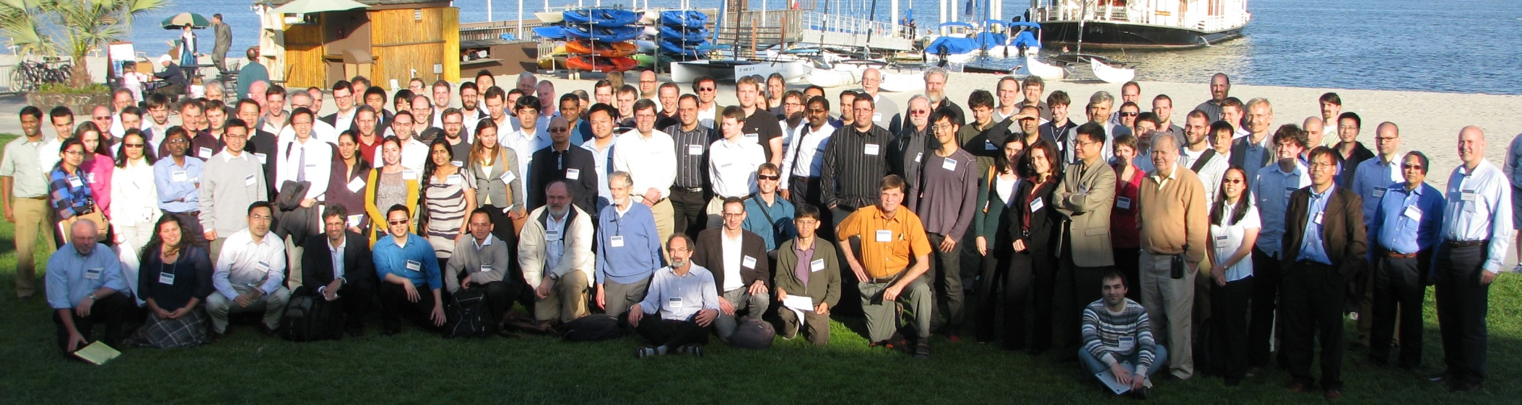
DNA Sequencing Technology Development
  Grantee Meeting (April 2012)
Document 25
Notes:
The DNA Sequencing Technology Development Program held its 8th annual grantee meeting in early April. The meeting was attended by 130 members of grantee laboratories, and they were then joined for an additional day by 40 others who are interested in developing technologies for faster, less expensive, and more accurate DNA sequence generation.
Participants heard updates on technology innovations that ranged from how to achieve higher-quality and longer reads using currently available instruments, to better understanding of how DNA molecules are captured by and interact with nanopores, to approaches for better fabricating and recording from solid-state DNA sequencing devices.

Slide 53
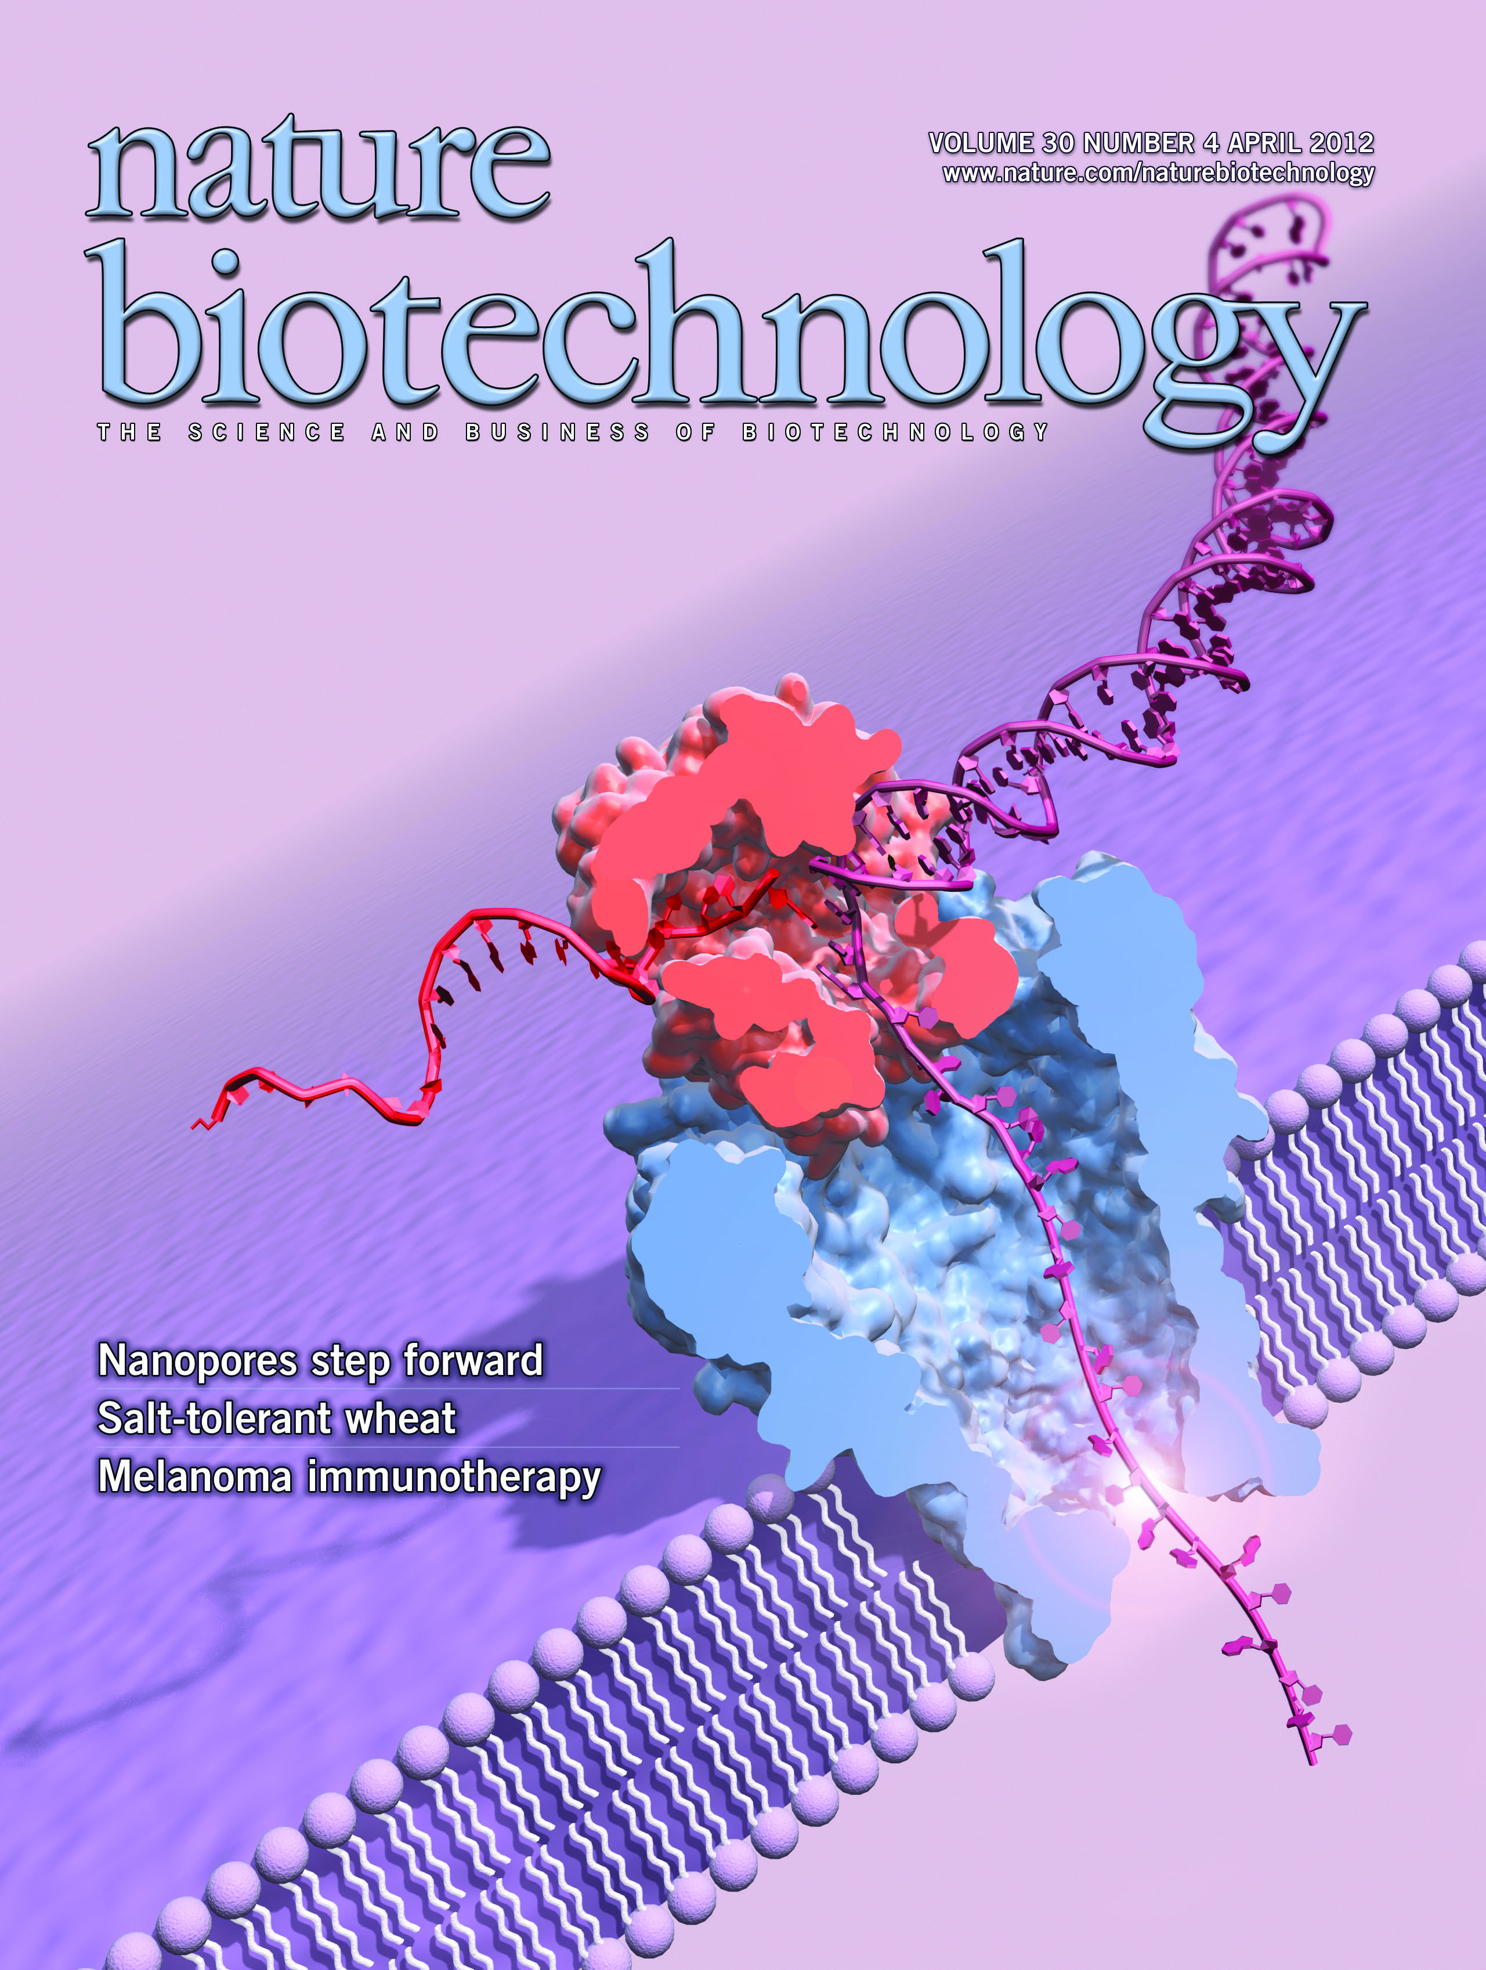
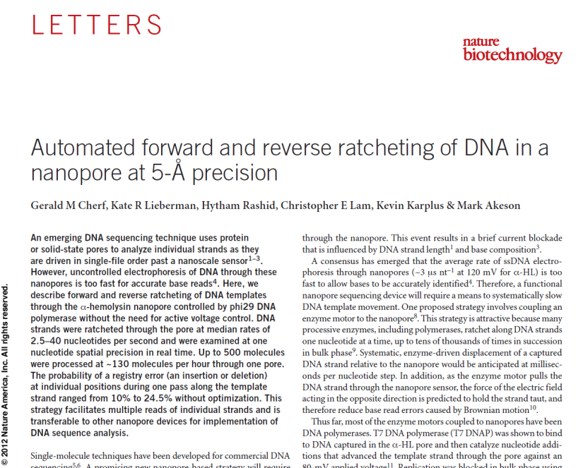
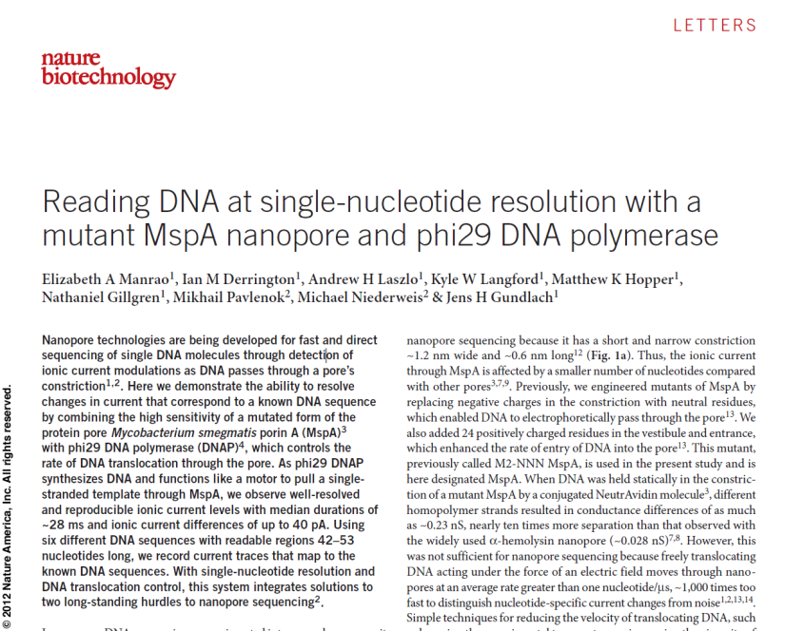
DNA Sequencing Technology Development
Document 25
Notes:
The highlight of the grantee meeting were presentations of two papers published on the second day of the meeting— papers featured on the cover of the April issue of Nature Biotechology. These papers demonstrated reproducible electronic signals corresponding to the sequence of DNA molecules translocating through a nanopore.
This progress represents the end of a 20-year odyssey since the idea was first proposed in 1992.

Slide 54
DNA Sequencing Technology Development
Branton, Deamer, Church
Gundlach Akeson
Manrao Cherf Derrington Lazlo
  Nanopore sequencing demonstrated
Document 25
Notes:
And it was exciting that the three people who conceived of this approach for sequencing DNA were all at the meeting: * Daniel Branton, David Deamer, and George Church.
* The actual papers were published by the laboratories of Jens Gundlach and Mark Akeson, and * several of the members of these groups were also at the meeting.
While this represents the end of an odyssey, in a very real sense this is just the beginning of a journey— with the first commercial device that uses nanopores for sequencing DNA expected to be available commercially later this year, and many opportunities on the horizon to turn this remarkable scientific progress into robust, more accurate, faster, and inexpensive DNA sequencing technologies.

Slide 55


ENCODE & modENCODE
ENCODE Technology Development awards funded this spring
modENCODE Symposium: June 20-21, 2012
Integrative analysis papers planned:
  ENCODE – integrative manuscript submitted along with many companion papers
  modENCODE/ENCODE – comparison of fly, worm, and human
  Mouse – comparison of mouse and human
Document 26
Notes:
55
* Ten ENCODE Technology Development awards were funded in April, and an eleventh award is expected to be funded in May. These projects aim to develop improved methods for identifying functional elements and for validating their biological function.
Meanwhile, three ENCODE RFAs were released in October 2011, and applications were received in December 2011. These RFAs aimed to support research projects that applied high-throughput, cost-efficient approaches to extend ENCODE resources toward as complete of catalogs as is feasible. These applications will be discussed by Council in the Closed Session.
* NHGRI is organizing a modENCODE Symposium to be held in the Natcher Conference Center on the NIH campus on June 20-21. This Symposium is open to the public and registration is encouraged. The meeting is planned to tie into the Genetics Society of America meeting entitled “Model Organisms to Human Biology– Cancer Genetics,” which is scheduled to take place in Washington, DC from June 17-20.
* There are various integrative analysis papers being planned. The ENCODE Consortium has a main integrative paper and many companion papers currently under review, with publication expected to occur in the early fall. The modENCODE and ENCODE Consortiua are currently working to integrate worm, fly, and human ENCODE data. The mouse ENCODE Consortium are currently planning a comparison of human and mouse data.

Slide 56
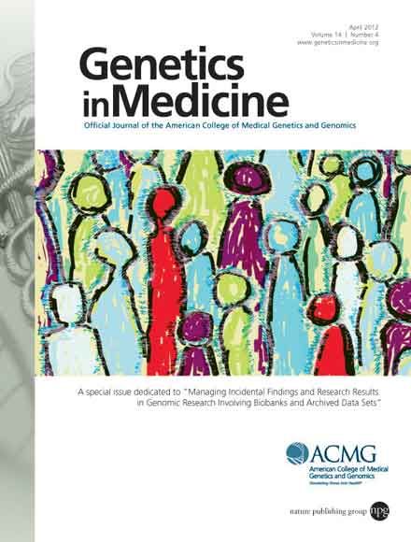
ELSI Program
  New RFAs for Centers of Excellence in ELSI Research (CEER) Program: P20 and P50
  Return of Results Consortium launched
  April 2012 issue of Genetics in
    Medicine focused on return of results and incidental findings, featuring multiple papers by ELSI-funded investigators
Document 27
Notes:
* The ELSI Program issued two RFAs in connection with its Centers of Excellence (or CEER) Program– a P20 RFA to fund up to two exploratory Centers and a P50 RFA to fund up to two additional full Centers. These applications are due in July for review in the fall, with funding after next February’s Council meeting.
* The ELSI Program formally launched its Return of Results Consortium, which consists of investigators on R01 and R21 projects funded through RFAs focused on this topic, as well as the investigators involved in the ethical and psychosocial research components of the Clinical Sequencing Exploratory Research program (that I spoke of earlier) and several others with investigator-initiated projects studying issues related to this topic. As I mentioned already, this Consortium recently held its first face-to-face meeting in conjunction with the CSER Steering Committee. Working Groups have been established dealing with instruments and measures, informed consent, actionability, and special issues relating to returning results in the pediatric context.
* The April 2012 issue of Genetics in Medicine focused on issues relating to return of results and incidental findings. A large number of the papers in that issue are the result of research funded by the ELSI Program, and many of the authors are members of the new Consortium.

Slide 57





Upcoming Planning Meeting
  July 2012 Workshop:
  Integrating Functional Data for Connecting Genotype to Phenotype
Notes:
There is one upcoming planning meeting that is worth mentioning.
* An NHGRI workshop on “Integrating Functional Data for Connecting Genotype to Phenotype” will be held July 30–31. This meeting seeks to explore more deeply some ideas that came out of the planning efforts in the area of ‘basic genomics.’
Specifically, the workshop will address whether there is a practical, systematic way to comprehensively bridge the gap between sequence and phenotype by producing a catalog of multi-level functional annotations of all genomic elements. The workshop will also discuss the utility of potential data types, organization of the information, and integration relative to both translation and the understanding of basic biology.

Slide 58
General NHGRI Updates
General NIH Updates
Genomics Updates
NHGRI Extramural Program
NIH Common Fund Programs
NHGRI Office of the Director
NHGRI Intramural Program

Slide 59

Human Microbiome Project (HMP)
HMP funding ends in FY2012
Two major HMP Consortium papers to be published in Nature; coordinated release of >20 companion papers in PLoS (‘HMP Collection’)
HMP2 proposal submitted to Common Fund
Report at September Council meeting
Document 28
Notes:
* Funding for the Human Microbiome Project ends in FY2012.
* Two major publications of the HMP Consortium have been accepted by Nature and will be published in June. The first describes the community resources developed by HMP; the second is a metagenomic analysis of the 300-subject healthy cohort involving five body sites. The latter focused on the structure and dynamics of the microbial communities and on an analysis of the metabolic capabilities of the microbiomes through an in silico reconstruction of metabolic pathways. These two publications will be accompanied by the release of over 20 companion papers in a PLoS virtual ‘HMP Collection.’
* Over the last four months, a working group of program staff representing 12 NIH Institutes and Centers developed a proposal for a follow-on program to HMP. The proposal for a so-called HMP2 was submitted to the Common Fund in April and is currently being evaluated.
* A full report about HMP and a possible HMP2 will be given at the September Council meeting.

Slide 60
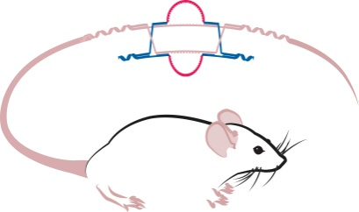
Knockout Mouse Phenotyping Project (KOMP²)
  In 5 years, make 2,500 live mouse strains from knockout ES cells
  Comprehensively phenotype the mouse strains
  Make data and mice available to researchers
  Collaborate with other international projects to achieve a total of 5,000 phenotyped strains through the IMPC
Document 29
Notes:
The Knockout Mouse Phenotyping Project (KOMP²) is the second phase of an initiative that aims to create a public resource comprised of mice containing a null mutation in every gene in the mouse genome.
* In 5 years, KOMP² aims to make 2,500 live mouse strains from knockout ES cells. KOMP2 awards were made in FY2011, with overall funding for the program being $111 million over 5 years. Three centers proposing paired mouse production and mouse phenotyping applications were ultimately funded.
* Final operating protocols for comprehensively phenotyping the knockout mouse strains have been approved and adopted. * In order to make data and mice available to researchers, an application was funded for a Data Coordination Center and Database at the EBI. This Center is now housing a web site that is being actively updated to show status and to eventually display the phenotype data.
* KOMP² has committed to collaborate with other international projects to achieve a total of 5,000 phenotyped strains through the International Mouse Phenotyping Consortium (the IMPC). The IMPC now includes 9 active programs, and KOMP² will be holding joint coordination meetings with this Consortium.

Slide 61
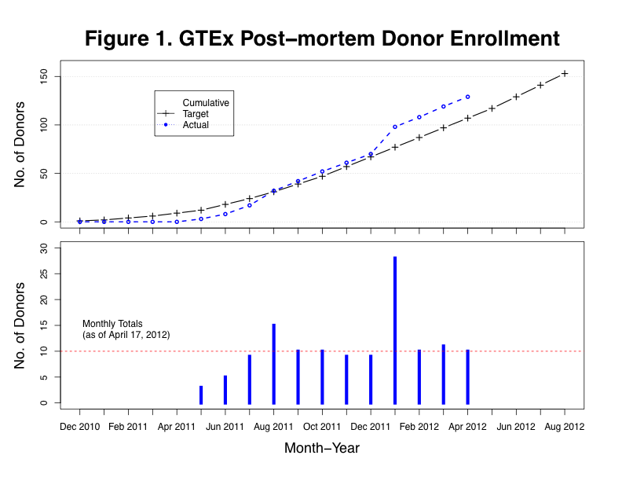
Genotype-Tissue Expression (GTEx)
Pilot goals have been met
Scale-up is under consideration
First dbGaP data release later this month
Document 30
Notes:
* The pilot phase of the Genotype-Tissue Expression (GTEx) Project has been very successful, meeting the projected goals in terms of enrollment and RNA quality.
* For example, the Project has averaged >10 donors/month, with over 130 post-mortem donors enrolled thus far. RIN values (a measure of RNA quality) have been very good, with the RNA from more than a dozen organs having a RIN value >6 for more than 70% of the cases. Preliminary gene expression results look great.
* The Common Fund is now considering a scale-up proposal to enroll and study a total of 900 donors, with a decision expected soon.
* The first dbGaP data release, which will reflect a March ‘data freeze,’ is expected later this month.
61

Slide 62
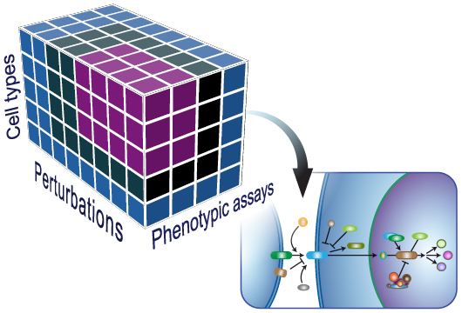
Library of Integrated Network-based
Cellular Signatures (LINCS)
Consortium meeting in November 2012
Request to the Common Fund for a 1-year extension of pilot (FY2013 bridge funds)
Quarterly public release of LINCS data and metadata (started March 2012)
Document 31
Notes:
* The LINCS Program will hold its annual Consortium Meeting in November. Members of the Data Generation, Computational Center, and Technology Development Groups are expected to attend, as well as the Program’s External Scientific Panel.
* The NIH staff overseeing LINCS made a request to the Common Fund for a 1-year extension of the pilot, through provision of FY2013 bridge funds. If approved, this would allow for the more robust development of a plan for LINCS Phase 2 starting in FY2014.
* Acting on a recommendation of the its External Scientific Panel, LINCS has established a schedule for the quarterly release of data, starting this past March. Also, NIH staff is currently finalizing language for a LINCS data release policy.

Slide 63
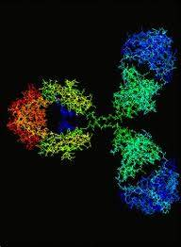
Protein Capture Reagents Program
New working groups:
  Data dissemination
  Validation
  Target list prioritization
Soliciting community input about production of human transcription factor reagents
Document 32
Notes:
The Protein Capture Reagents Program is maintaining communication through several newly developed * working groups— those focused on data dissemination, validation, and target list prioritization. These working groups are chaired by Program investigators, meet regularly, and have made significant progress in moving the Protein Capture Reagents Program forward.
* As part of the Target List Prioritization Working Group, members are seeking community input on priorities for producing human transcription factor reagents. Input will be taken starting June 1 and ending July 31. The Program will then evaluate responses based on rationale and significance. This Working Group has already collected input from the ENCODE Consortium and various other external groups.

Slide 64

Human Heredity and Health
in Africa (H3Africa)
  Applications reviewed in March and April
  A funding plan will be discussed in Closed Session of this Council meeting
  Inaugural H3Africa Research Network meeting will be held in Ethiopia in October 2012
Document 33
Notes:
* The H3Africa project received 57 applications from across the African continent in response to the first set of RFAs; these applications were reviewed in March and April.
* A funding plan based on these reviews will be discussed during the Closed Session of this Council meeting, after which a small group of NIH staff will make site visits to potential grantees.
* Finally, the inaugural H3Africa Research Network Meeting will be held in Ethiopia in October, jointly hosted by the Wellcome Trust (our partners for H3Africa).

Slide 65

Single Cell Analysis
  Three RFAs:
    Evaluate cellular heterogeneity using transcriptional profiling
    Innovative tools and technologies
    Single cell technology validation in clinical setting
  Single Cell Analysis workshop recently held
Document 34
Notes:
Single Cell Analysis is a new Common Fund program, with the goals of: (1) analyzing general principles of cellular heterogeneity via transcriptional profiling; (2) establishing a ‘quantum leap’ in spatiotemporal resolution within tissues; and (3) pursuing extensions and applications in the clinic. * Three RFAs were issued, one for each of these areas, and the submitted applications were reviewed earlier this month.
* In addition, a workshop for this initiative was recently held that focused on identifying gaps and opportunities in single cell analysis.
NHGRI has a particular interest in this program for several reasons. First, we are interested in new technologies that might emerge since we have historically supported awards that aim to perform DNA sequencing at the single cell level. Second, we have an interest in understanding networks and pathways generated from genomic data, and understanding the role of cellular heterogeneity at the single-cell level will be crucial for this. Finally, there is potentially for advancing clinical applications of genomic technologies that focus on single cells.
Programmatically, we will be involved in making funding recommendations and participate in managing the grants for this Common Fund project.

Slide 66
General NHGRI Updates
General NIH Updates
Genomics Updates
NHGRI Extramural Program
NIH Common Fund Programs
NHGRI Office of the Director
NHGRI Intramural Program

Slide 67


  Purpose: To provide a collaborative environment for building and validating electronic phenotype algorithms
Document 35
Notes:
In March, the eMERGE Network released its online phenotype library and tool called PheKB. PheKB is a knowledgebase for discovering phenotypes from electronic medical records.
* The purpose of PheKB is to provide a collaborative environment for building and validating electronic phenotype algorithms. There are now 17 phenotype algorithms in PheKB, including atrial fibrillation, cataracts, Crohn’s disease, Type 2 diabetes, diabetic retinopathy, hypothyroidism, and so forth.
Currently, PheKB has the following functions:
To view existing algorithms
To enter or create new algorithms
To collaborate with others to create or review algorithms
To view implementation details for existing algorithms

Slide 68


eMERGE Testimony to the National Committee on Vital and Health Statistics
  Data collection: community engagement models, community advisory boards, and promotion of research to the community
  Data utilization: data use agreement for sharing data in the consortium
  Data dissemination: de- identified data submitted to dbGaP for sharing data beyond the eMERGE sites
Notes:
On behalf of the eMERGE Consortium, Bradley Malin presented testimony to the National Committee on Vital and Health Statistics (NCVHS) Subcommittee on Privacy, Confidentiality, and Security in April. NCVHS is a major advisory committee to the Secretary of the Department of Health and Human Services.
Brad presented the eMERGE experience in developing, applying, and evaluating policies and technologies for the governance of electronic medical record systems and biobanks through a lifecycle of data management. This included insights about:
* Data collection: community engagement models, community advisory boards, and promotion of research to the community.
* Data utilization: an overarching data use agreement for sharing data in the consortium.
* Data dissemination: de-identified data submitted to dbGaP for data sharing beyond the eMERGE sites.

Slide 69
GENEVA Initiative Complete
  20 datasets posted to dbGaP, all imputed
  50+ publications
  GWASTools website developed
Addiction | Glaucoma | Oral Clefts
Blood Clotting | Heart Disease | Prematurity
Blood Pressure | Lung Cancer | Prostate Cancer
COPD | Maternal Metabolism | Stroke
Dental Carries |  | Venous Thombosis
Diabetes | Melanoma
Document 36
Notes:
The Gene Environment Association Studies (GENEVA) Initiative reaches its conclusion at the end of May.
* 20 datasets have been posted to dbGaP for a wide variety of phenotypes, all of which have also been imputed to a standard 1000 Genomes reference.
* Overall, GENEVA investigators have produced more than 50 publications since 2009.
* Further, they developed a Bioconductor software package called GWASTools for cleaning and analyzing GWAS data.

Slide 70


NIDA provided funds to expand the Toolkit to include additional substance use measures
  43 new measures included in the Toolkit
  Measures selected and vetted by content experts in NIDA extramural community
  Measures address:
    substance use and intermediate phenotypes
    cognitive and psychosocial risk factors
    co-morbidities and health-related outcomes
  NIDA is encouraging all grant applicants proposing human-subjects research to use the PhenX Toolkit
Document 37
Notes:
Progress continues in the growth of the PhenX Toolkit.
* Most recently, the National Institute of Drug Abuse (NIDA) provided funds to expand the Toolkit to include additional substance use measures.
In February, 43 new measures related to substance use and addiction were added to the PhenX Toolkit. The inclusion of these measures resulted from a year and a half long collaboration between NHGRI, NIDA, and the PhenX project team.
The PhenX team used a consensus-based process to select and vet measures that involved content experts in the NIDA extramural community.
A Substance Abuse and Addiction Scientific Panel was convened to oversee the process, and three expert working groups identified measures that addressed substance use and related intermediate phenotypes, cognitive and psychosocial risk factors, and community co-morbidities and health-related outcomes.
NIDA is encouraging all grant applicants proposing human-subjects research to use the PhenX Toolkit to increase researchers' ability to combine studies and gain the much-needed statistical power to identify genes related to substance use and addiction.

Slide 71


NEJM Genomic Medicine Series
Document 38
Notes:
The complete collection of articles on genomic medicine have now been published as part of the New England Journal of Medicine series edited by Greg Feero and Alan Guttmacher.
* Shown here is the last article and a closing editorial, both published since the last Council meeting.

Slide 72


2012 DNA Day Chat Room
    April 20, 8:00 am to 5:00 pm EST
    More than 70 experts answered questions
    Received more than 900 questions and experts answered 764 of the questions
    Questions from 37 states and internationally
Document 39
Notes:
The NHGRI DNA Day Chat Room has been an annual event since 2005.
* This year’s Chat Room was held on April 20 for 9 hours, and * was staffed by more than 70 experts from around the country.
* In total, we received more than 900 questions, of which 764 were answered.
* Questions were received from students from 37 states and outside of the United States. The states sending in the most questions were Indiana, Pennsylvania, California, Georgia, and Nevada. The majority of questions received were from 9th graders, but there were also a significant number of middle school students submitting questions.

Slide 73

USA Science and Engineering Festival
Document 40
Notes:
The 2nd USA Science and Engineering Festival took place in April at the Washington Convention Center in DC.
As with the last festival held in October 2010, NIH was there in force, and NHGRI was among the most involved Institutes. This year we also partnered with the American Society of Human Genetics on joint activities. In total, more than 25 volunteers from the NHGRI participated.

Slide 74





USA Science and Engineering Festival
Notes:
Shown here is a view of the area of the convention center floor where most of the NIH booths were located, many of which had hands-on activities.
* NHGRI’s booth was packed with interested learners all day, every day. Our activity (of course) was purifying DNA from strawberries.
* This made many children happy.
* But it did mean that 20 lb of strawberries sacrificed their cellular existence in pursuit of purified DNA.
* On the second day, we actually ran out of strawberries. Shown here is my 12-year-old daughter, Abbey, frantically working with ‘fruit DNA purifying extraordinaire’ and booth czar, Carla Easter, to see if they could quickly get a protocol involving bananas to work– having unexpectedly run out of strawberries. Following a bit of on-site optimization, a revised protocol emerged and booth visitors were able to purify small amounts of DNA from hunks of banana stolen from peoples’ boxed lunches.

Slide 75
  First Friday of each month, 8-9 AM
  Suburban Hospital Auditorium
June 1, Barbara Biesecker, NHGRI
Genomics in Maternal Child Health
Invited Speakers: July 2012 through January 2013
Paul Sieving, NEI
Dan Kastner, NHGRI
Kenneth Fishbeck, NINDS
Ellen Sidransky, NHGRI
Max Muenke, NHGRI
Document 41
Notes:
NHGRI is collaborating with Suburban Hospital in Bethesda and the Johns Hopkins University School of Medicine to hold a monthly grand rounds-style seminar covering topics in genomic medicine. Greg Feero is leading the planning committee for this series.
* Talks are being held on the first Friday of each month, * with the next one being given by Barb Biesecker in early June.
* We have just invited the next slate of speakers (listed here), who will give talks starting in July and running through next January.
Of particular importance, all of the talks are being videotaped and made available on NHGRI’s GenomeTV channel of YouTube.

Slide 76
General NHGRI Updates
General NIH Updates
Genomics Updates
NHGRI Extramural Program
NIH Common Fund Programs
NHGRI Office of the Director
NHGRI Intramural Program

Slide 77





NHGRI Intramural Research Highlights
Document 42
Notes:
Recent highlights from NHGRI’s Intramural Research Program include the following:
* Charles Rotimi and colleagues in the Center for Research on Genomics and Global Health published a study in the New England Journal of Medicine identifying a genetic association between the HLA class II locus and the tropical disorder podoconiosis. The condition affects 4 million people in 10 poor countries.
* KJ Myung reported in Proceedings of the National Academy of Sciences the development of a molecular screen that detected 22 DNA-damaging antioxidants. These compounds were shown to be lethal to dividing cells, such as those in tumors.

Slide 78

Current Topics in Genome Analysis
  Views to date for 2012 Series: 22,852
  Views for 2010 Series: 202,812
Document 43
Notes:
NHGRI recently completed the 10th iteration of its very popular lecture series called Current Topics in Genome Analysis, which Andy Baxevanis and I started as an educational outreach effort of NHGRI’s Intramural Research Program back in the mid-1990’s.
In recent years, we have moved to posting the videos and Powerpoint presentations from these lectures to our GenomeTV channel of YouTube, and the viewership has been phenomenal.
* For example, there have been over 20,000 views of the lectures from our recently completed 2012 series. But this number will grow substantially if things play out as in previous years.
* For example, the last iteration of this lecture series back in 2010 has resulted in over 200,000 views of the lectures. I routinely hear about interest in watching these archived videos, especially when I travel abroad.

Slide 79

Blue Ribbon Panel Review of NHGRI Intramural Research Program
David Page (Chair)
Rick Myers (NACHGR)
Bruce Korf (BSC)
Wylie Burke
Nancy Cox
Bob Waterston
Huda Zoghbi
Notes:
As I have mentioned at previous Council meetings, the NHGRI Intramural Research Program is currently undergoing a Blue Ribbon Panel review (the last one being in 2001).
Shown here is the Panel’s membership (note that Rick Myers is the representative from Council).
The Blue Ribbon Panel review will be completed this summer. As a result, at the September Council meeting, there will be:
A general presentation about the NHGRI Intramural Research Program by Dan Kastner (the Director of our Division of Intramural Research).
A formal presentation about the Blue Ribbon Panel’s review and report by Rick Myers.

Slide 80


Special Thanks!
Notes:
Special thanks to Kris Wetterstrand.
Also, Larry Thompson, Judy Wyatt, and the NHGRI web team.

Slide 81

Notes:
Questions?

