Slide 1
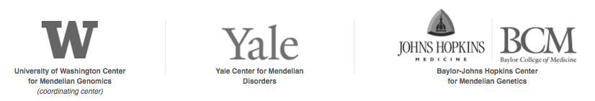
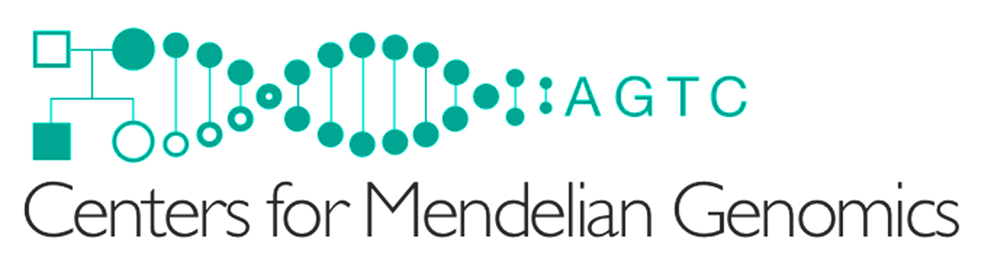
NHGRI Centers for Mendelian Genomics
www.mendelian.org
gmendel@mendelian.org
Goal: Identify and define the causes of all human
monogenic diseases

Slide 2
Importance and impact of Mendelian genetics
Explain human biology
Allow diagnostic testing important for disease prevention, therapy and prognosis
Identify therapeutic targets applicable to general population
  Nav1.7 and pain
  ROMK and blood pressure
  PCSK9 and LDL cholesterol
  Orexin and sleep
  APP and γ−secretase in Alzheimer’s disease
  LRP5/DKK/SOST and high bone mass

Slide 3
Status of Mendelian Genetics
21,000 Protein-coding genes in human genome
3,000 different genes known to be mutated in
4,000 Mendelian phenotypes
Tremendous opportunity for new discovery in coding regions
Non-coding regions have been terra incognita but are an emerging opportunity

Slide 4
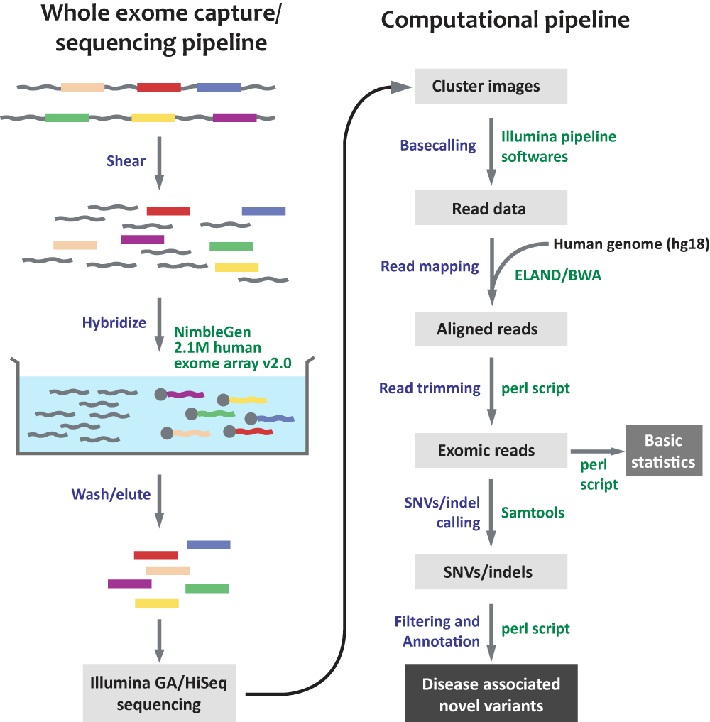
Sequencing the human exome:
21,000 genes, 33 Mb
- 6 exomes/lane on HiSeq instrument
- Median coverage of targeted bases 80x
Sensitivity of heterozygote detection: 96.5%
Specificity of heterozygote calls: 99.8%
- Total cost (including reagents, labor,
amortization of sequencing, data storage
and computing equipment): $500

Slide 5

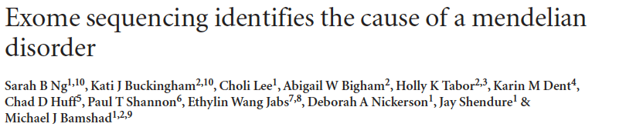

Utility of Exome Sequencing Established in 2009

Slide 6
Where are the ‘missing’ Mendelian traits?
  Unsolved known Mendelian traits
  Unmapped/unrecognized Mendelian loci
  - Extreme phenotypes arising from
  consanguineous union
  - Potential dominant reproductive lethals
  - Diseases caused by somatic mutations

Slide 7
CMG patient recruitment
Predominantly via extensive worldwide networks of collaborators; small contribution via Web portal
> 400 collaborating investigators from > 25 countries on 5 continents
> 17,000 index cases recruited
> 800 disease entities

Slide 8
Progress to date
>12,200 exomes sequenced
84 manuscripts published including gene discovery papers in Nature (1), Science (1), Cell (2), Nature Genetics (6), NEJM (2), AJHG (17), Hum Mol Gen (4)
Published manuscripts include 60 new disease loci and genetic disorders
~200 more new disease genes and traits identified as yet unpublished

Slide 9
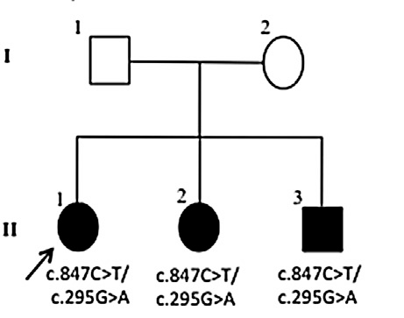
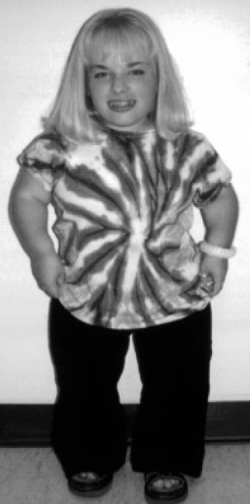
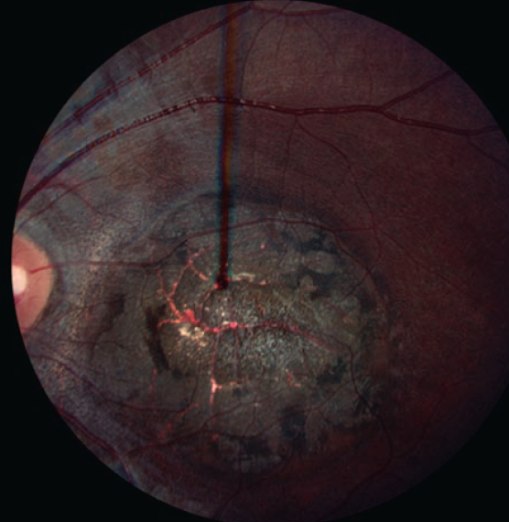
Spondylometaphyseal dysplasia-Cone/Rod dystrophy (SMD-CRD)
Six unrelated SMD-CRD pedigrees, 8 PYCT1A variants (1 nonsense, 1 indel, 6 missense)
PCYT1A encodes CCTα, rate limiting step in synthesis of phosphatidylcholine, a major membrane structural lipid
Excavated macular lesion
CTP
+
Choline phosphate
CDP-choline
Ptd-choline
Hoover-Fong et al., AJHG 94: 105, 2014
Notes:
Pleitropy,
Osteoblasts lack alternative pathway from phosphoethanolamine, photoreceptors ?
Predicts involvement of this pathway in other retinal/skeletal phenotypes

Slide 10
Mutations in PIEZO2 cause Gordon, Marden-Walker and Distal Arthrogryposis type 5 syndromes
13 unique mutations identified in 35 families
  10 missense
  2 frameshift deletions
  1 in-frame deletion
GS : n=10/12 (83%)
DA5: n=24/29 (82%)
MWS: n=1/2 (50%)
Two mutation “hot-spots”
  E2727del (n=10)
  R2686H (n=11)
Significant genotype/phenotype association between R2686H and cleft palate
McMillin et al AJHG (2014)

Slide 11
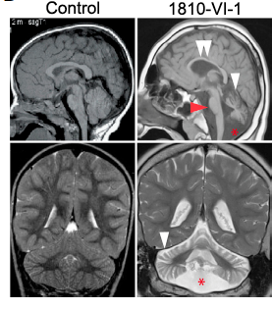
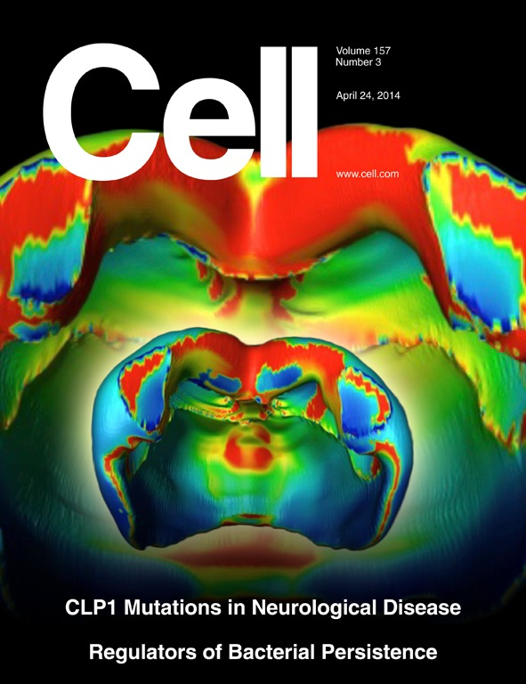
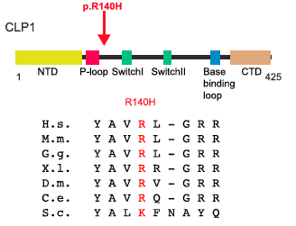
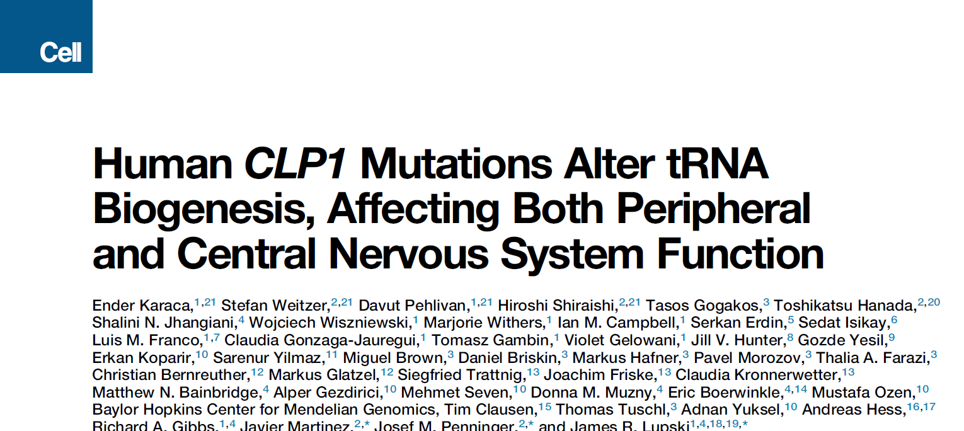
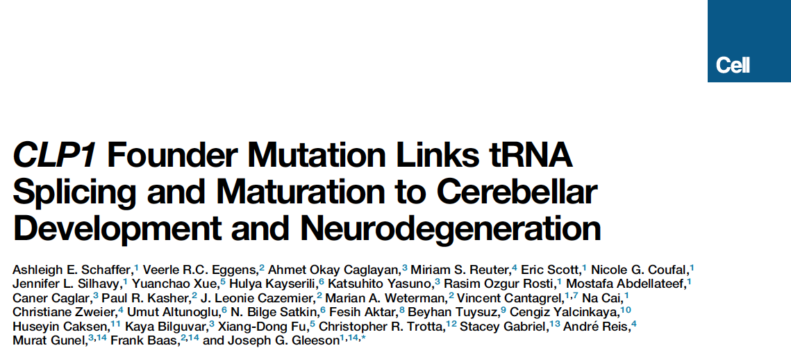
Founder mutation in CLP1, a kinase required for
tRNA splicing, causes abnormal
neurodevelopment and neurodegeneration

Slide 12
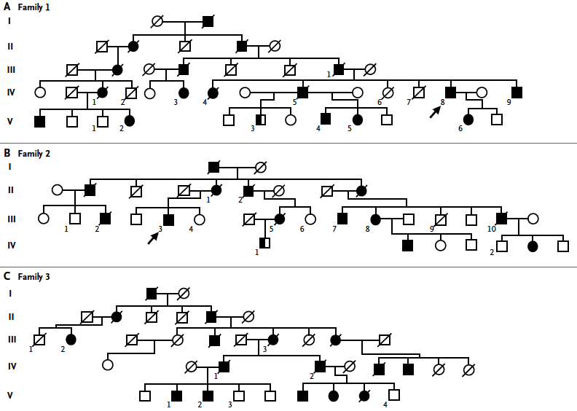
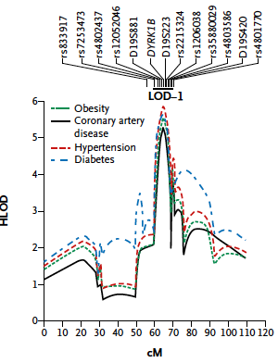
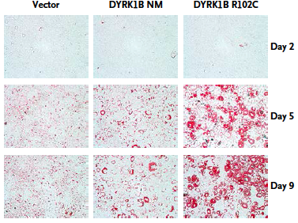
Founder mutation in DYRK1B causes early coronary artery disease, obesity, hypertension and diabetes
Early CAD (mean age onset 44)
Obesity (mean BMI 33)
Diabetes (mean FBS 175 mg/dl)
Hypertension (mean SBP 175 mg/dl)
Keramati et al. NEJM, 2014

Slide 13
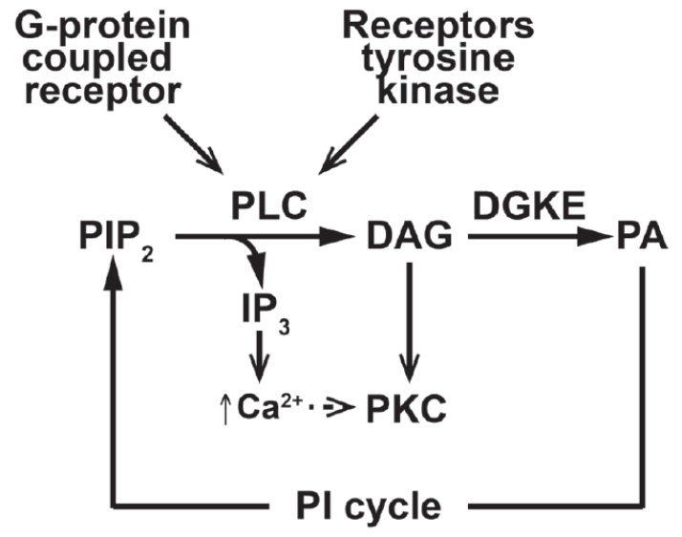
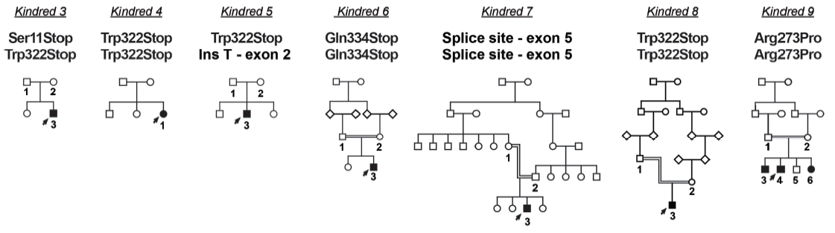
Recessive mutations in Diacylglycerol Kinase ε cause novel hemolytic-uremic syndrome
Patients present in first year with hemolysis,
thrombocytopenia, kidney failure;
episodic recurrences
- Persistent hypertension, proteinuria
- Renal failure common by age 15
- Poor response to anti-complement Rx
- Cured by renal transplant
Nature Genetics, 2013

Slide 14
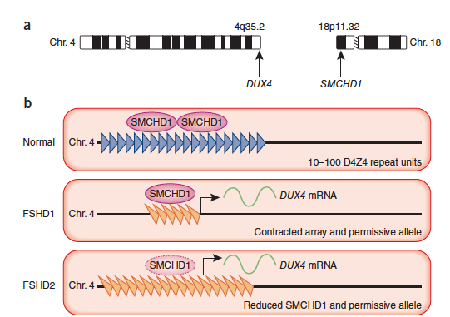
Digenic inheritance of FSHD2
facioscapulohumeral muscular dystrophy types 2 (FSHD2)
weakness of muscles of face, upper trunk (indistinguishable from FSHD1)
DUX4 (homeobox TF) normally expressed only in germline, methylated in somatic tissues. Found in tandem array.
In FSHD1, individuals have a contracted array, resulting in hypomethylation, and DUX4 has a polyadenylation sequence, allowing ectopic expression of DUX4 in skeletal muscle.
In FSHD2, array is of normal length, with polyadenylation signal and hypomethylation. Segregation pattern suggested digenic inheritance
SMCHD1 mutations on chromosome 18 found in 15 families in conjunction with Chr. 4 haplotype.
Lemmers et al. Nature Genetics (2012)

Slide 15
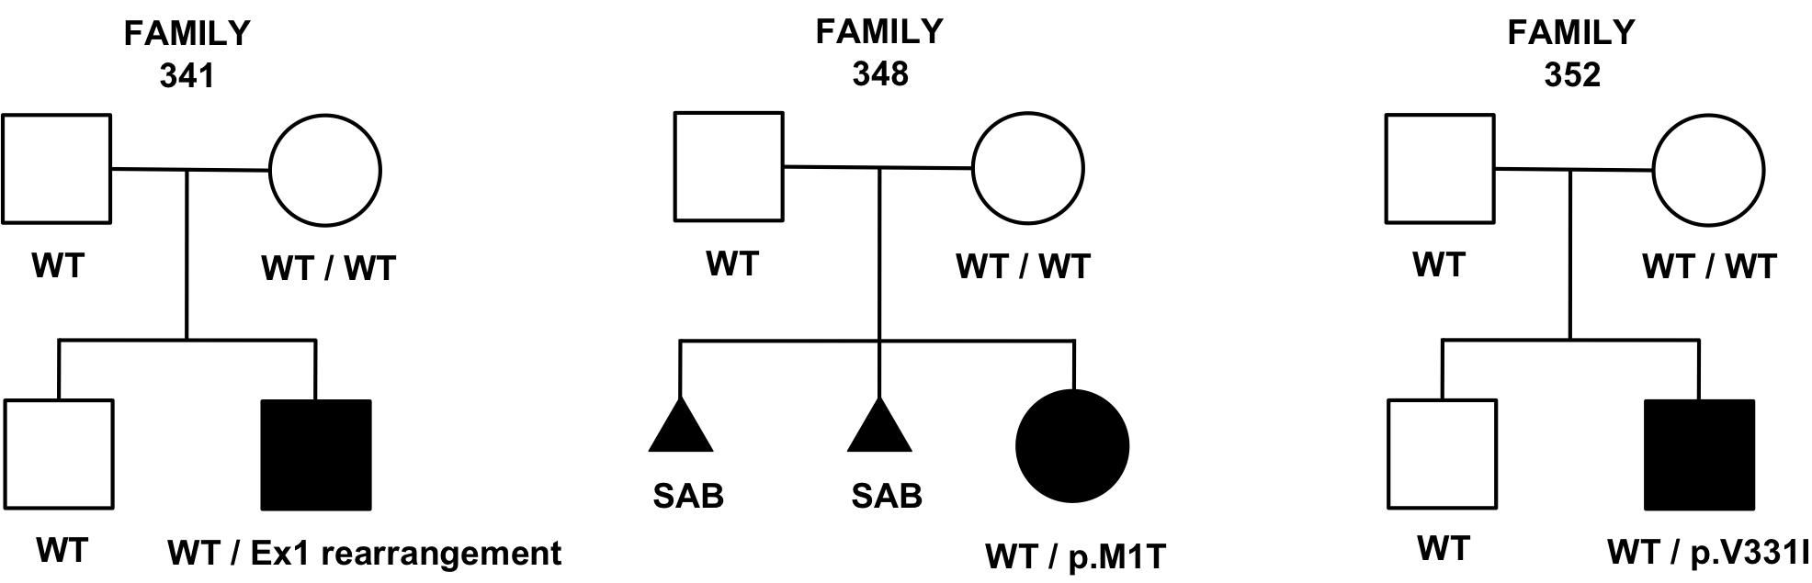
Somatic mosaicism for LOF mutations in UDP galactose transporter SLC35A2 in patients with loss of galactose and sialic acid from multiple branches of complex type N-glycans
intellectual disability, seizures, multiple affected organ systems
highly heterogeneous
SLC35A2 (UDP-galactose transporter)
X-linked
somatic mosaicism in all affected individuals
WT
WT / WT
WT
WT / WT
WT
WT / WT
WT
WT /
c.15_*48delinsA
SAB
SAB
WT / p.M1T
WT
WT / p.V331I
Ng et al. AJHG (2013)

Slide 16
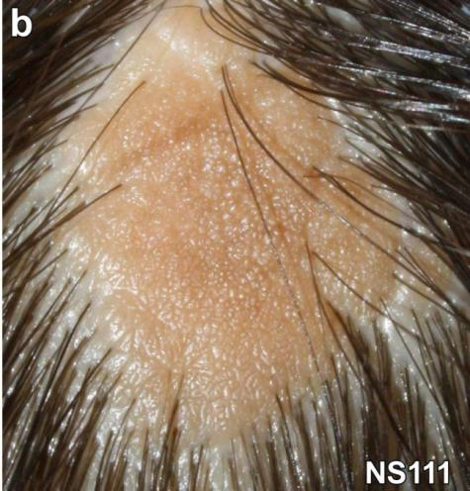
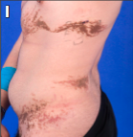
Somatic activating RAS mutations cause nevus sebaceous, wooly hair-epidermal nevus syndrome, and cutaneous-skeletal hypophosphatemia
Nevus Sebaceous
Wooly Hair-Epidermal
Nevus Syndrome
Cutaneous-Skeletal Hypophosphatemia
HRAS G13R (n = 12)
KRAS G12D
KRAS G12V
HRAS G12S (n = 3)
HRAS G13R (n = 2)
HRAS Q61R
NRAS Q61R (n = 2)
Lim et al. Hum Mol Genet, 2014

Slide 17
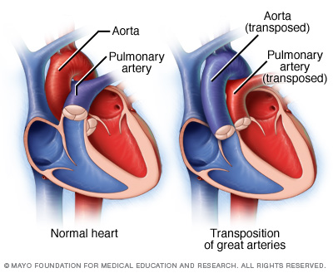
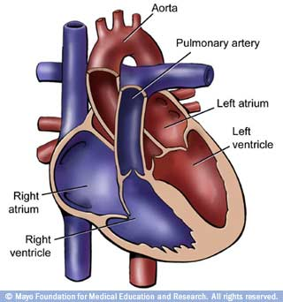
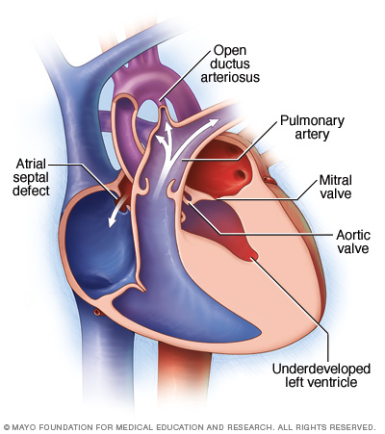
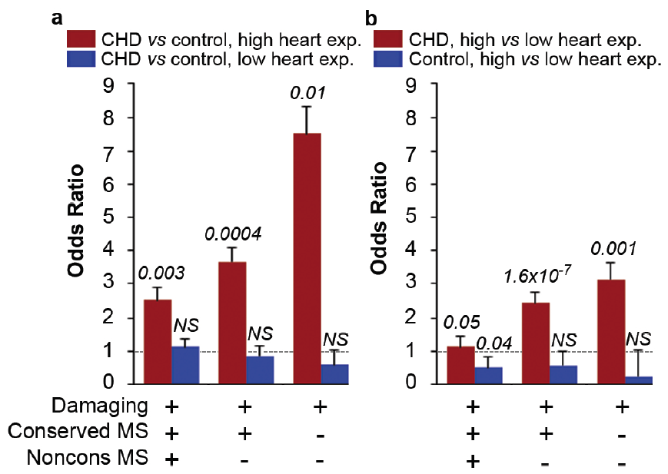
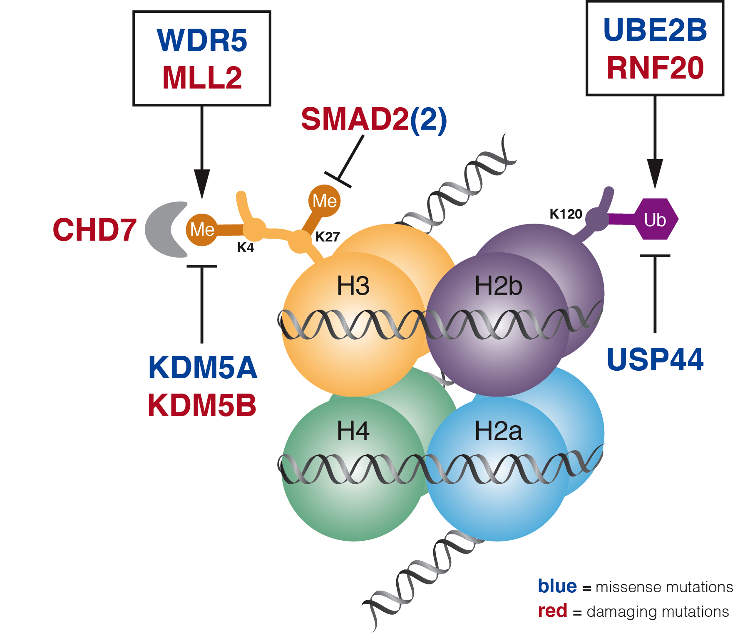
De novo mutations in congenital heart disease: enrichment of mutations in histone-modifying genes
Normal heart
Transposition
Tetralogy of Fallot
Hypoplastic left heart syndrome
Nature, 2013

Slide 18
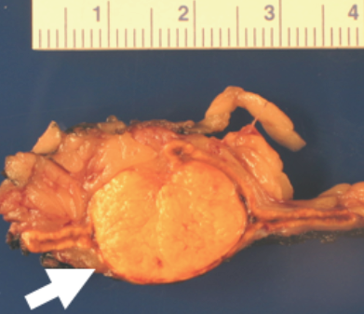
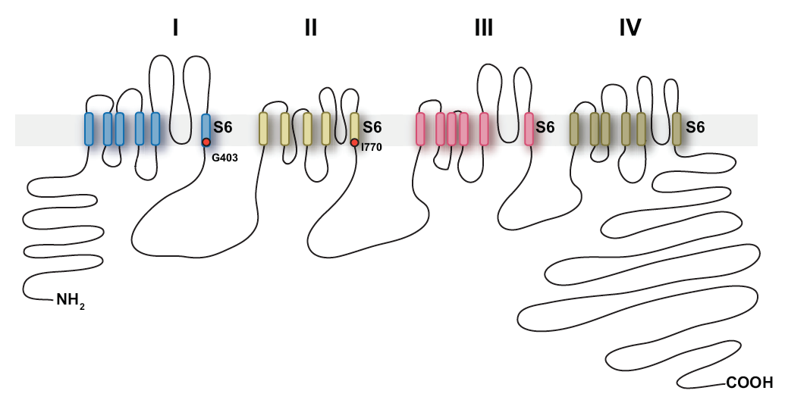
De novo germline mutations in CACNA1D cause hypertension, primary aldosteronism, seizures and a complex neuromuscular disease
Identical somatic mutations in adrenal cortex cause >10% of aldosterone-producing adenomas
+/+
+/+
+/+
+/+
G403D/+
I770M/+
Age dx: 1st day of life
BP: >99th %
Aldo: high
PRA: low
Seizures, Spastic quadriplegia
Profound developmental delay
Nature Genetics, 2013

Slide 19
Human knock-out project:
New genes with homozygous nulls identified with high frequency in offspring of 1st cousins
  Subjects Outbred 1st cousins
  # sequence 1975 536
  # new genes with > 1
  homz LOF mutations 139 713
  # new homz LOF/subject 0.07 1.33
  In addition to these damaging mutations, there are >5x more rare homozygous variants at completely conserved positions that are likely LOF mutations

Slide 20
Lessons emphasized to date
  No substitute for both clinical domain and genetics expertise
  Extreme phenotypes from consanguineous union continues to be fertile ground for discovery of new recessive loci
  Some traits have very high locus heterogeneity
    - Potential opportunity for rapid functional screening in model systems
  Haploinsufficiency due to de novo mutation appears to play a significant role in a number of congenital disorders
  Need for extensive world-wide collaboration and data sharing

