Slide 1

Electronic Medical Records and Genomics (eMERGE) Network Phase III
Concept Clearance
Teri Manolio, M.D., Ph.D. and Rongling Li, M.D., Ph.D.
National Advisory Council for Human Genome Research
May 19, 2014

Slide 3
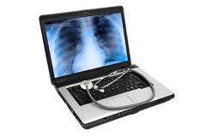

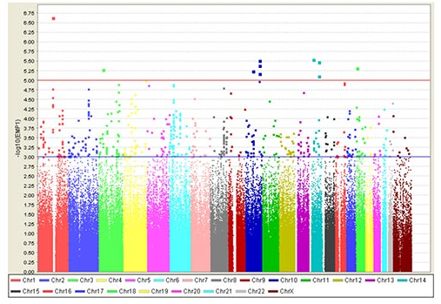











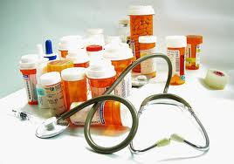

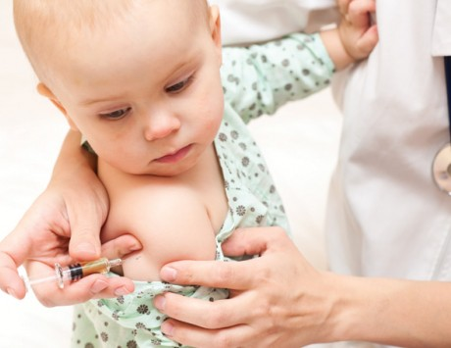

Electronic Medical Records and Genomics (eMERGE) Network
te
Electronic Phenotyping
GWAS Discovery
Consent Methodology
Clinician/Pt Education
Decision Support
Community Consultation
Pharmacogenomics
Data Privacy
Phase I Sites Coord. Ctr. New Phase II Sites Pediatric Sites
Pediatrics
Notes:
Begun in 2007 to determine whether and how EMRs linked to biorepositories could be used for genomic research
Probably the most multidisciplinary and comprehensive program in genomic medicine portfolio

Slide 4
2007 - 2010
eMERGE Phases I and II, 2007 - 2014
Phase I: How can repositories linked to EMRs be used for genomic research?
Phase II: How can genomics linked to EMRs be used for clinical care?
Electronic Phenotyping
GWAS Discovery
Consent Methodology
2011-2014
Clinician/Pt Education
Decision Support
Community Consultation
Pharmacogenomics
Data Privacy
Pediatrics
Notes:
Phase I addressed whether/how
Phase II implementation

Slide 5
EMR-Linked Biorepositories in eMERGE II
Site | Participants | Genotyped Samples
CHOP | 60,000 | 42,920
Cincinnati/Boston | 10,000 | 5,360
Geisinger | 22,000 | 4,191
Group Health/UW | 6,381 | 3,606
Marshfield | 20,000 | 4,693
Mayo | 19,000 | 6,934
Mt. Sinai | 22,000 | 6,290
Northwestern | 11,000 | 4,987
Vanderbilt | 158,514 | 27,173
TOTAL | 328,895 | 105,524
Notes:
Continue emphasis on EMRs
- Cincinnati and Boston single site

Slide 6
eMERGE: A Three-Pronged Strategy
Site | Participants | Genotyped Samples
CHOP | 60,000 | 42,920
Cincinnati/Boston | 10,000 | 5,360
Geisinger | 22,000 | 4,191
Group Health/UW | 6,381 | 3,606
Marshfield | 20,000 | 4,693
Mayo | 19,000 | 6,934
Mt. Sinai | 22,000 | 6,290
Northwestern | 11,000 | 4,987
Vanderbilt | 158,514 | 27,173
TOTAL | 328,895 | 105,524
Discovering clinically relevant variants
Assessing impact of large-scale implementation on cost and quality of care
Enabling discovery and implementation research in other biorepositories
Notes:
The substantial infrastructure, datasets, and tools developed by eMERGE to date, combined with its rare (if not unique) experience in EMR data-mining and clinical implementation, position eMERGE well to continue its three-pronged emphasis

Slide 7
Selected Primary Phenotype-Gene Associations in eMERGE I
Associations between 19 phenotypes and 38 genes
Disease Phenotype | Gene
Cardiac Conduction | SCN5A, SCN10A
Hypothyroidism | FOXE1
LDL Cholesterol | APOE, TRIB1, LPL, ABCA1
Platelet Count & Volume | 5 Chromosomes Associated with PLT & 8 with MPV
Glaucoma, Primary Open-Angle | CDKN2B-AS1
Glaucoma, Optic Nerve Degeneration | CDKN2BAS, SIX1/SIX6
Red Blood Cell Traits, Erythroid Differentiation and Cell Cycle Regulation | THRB, PTPLAD1, CDT1
RBC Traits, Erythrocyte Sedimentation Rate (ESR) | CR1
RBC Traits, Malaria Resistance | HBB, HBA1/HBA2, G6PD
RBC Traits, Peripheral Artery Disease (PAD) | SLC17A1, BLS1/MYB, TMPRSS6, HFE
White Blood Cell Count | DARC, GSDMA, MED24, PSMD3
Courtesy, R Chisholm, Northwestern U

Slide 8

NHGRI’s Genomic Medicine Research Program
Program | Goal | Σ $M | Years
eMERGE II | Use biorepositories with EMRs and GWA data to incorporate genomics into clinical research and care | 25.9 | FY11-14
eMERGE-Pediatrics | Use pediatric biorepositories with EMRs and GWA data for genomic research and clinical care | 5.2 | FY12-14
eMERGE-PGx | Apply PGRN’s validated VIP array for discovery and clinica/l care in ~9,000 patients | 9.0 | FY12-14
eMERGE-OD Ethics | Examine participants’ views on broad consent for sharing their samples and data for future research | 4.1 | FY13-14
eMERGE-All |  | 45.2 | FY11-14
CSER | Explore infrastructure, methods, and issues for integrating genomic sequence into clinical care | 66.5 | FY12-16
ClinGen | Develop and disseminate consensus information on variants relevant for clinical care | 25.0 | FY13-16
IGNITE | Develop and disseminate methods for incorporating patients’ genomic findings into their clinical care | 32.3 | FY13-16
NSIGHT | Explore possible uses of genomic sequence information in the newborn period | 10.0 | FY13-16
UDN | Diagnose rare and new diseases by expanding NIH’s Undiagnosed Diseases Program | 67.9 | FY13-17

Slide 9


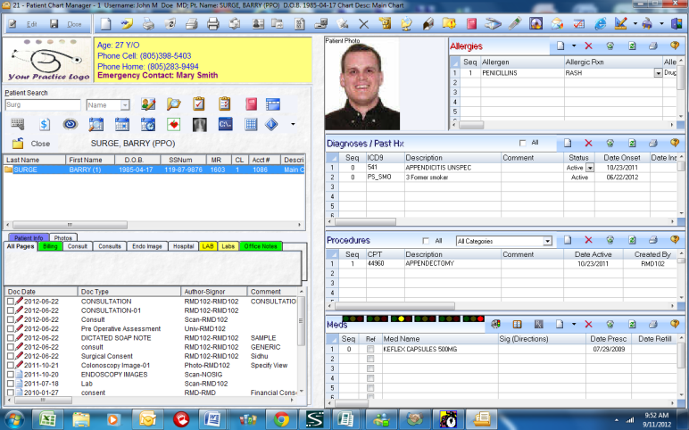
Evolution in Medical Records
http://www.primeclinical.com/specialty-solutions/ehr-emr-software-programs-general-surgeons-surgical-specialists-offices.html
Notes:
9

Slide 10
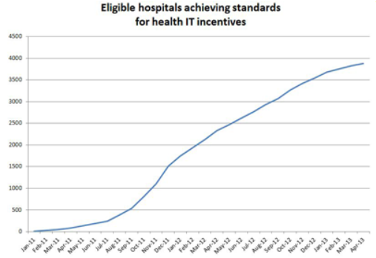
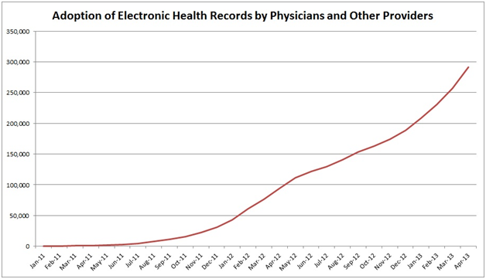
Adoption of Advanced EHR Systems by Hospital and Physicians, 2008- 2013
Eligible Hospitals Achieving Standards for Health IT Incentives
4500
4000
3500
3000
2500
2000
1500
1000
500
0
350,000
300,000
250,000
200,000
150,000
100,000
50,000
0
Adoption of EHRs by Physicians and Other Providers
9% of hospitals in 2008, > 80% in 2013
17% of physicians in 2008, > 50% in 2013
CDC and HHS Press Office, May 2013
Notes:
10
http://www.hhs.gov/news/press/2013pres/05/20130522a.html
According to the Centers for Disease Control and Prevention survey in 2012, the percent of physicians using an advanced EHR system was just 17 percent in 2008. Today, more than 50 percent of eligible professionals (mostly physicians) have demonstrated meaningful use and received an incentive payment. For hospitals, just nine percent had adopted EHRs in 2008, but today, more than 80 percent have demonstrated meaningful use of EHRs.
FOR IMMEDIATE RELEASE
May 22, 2013
Contact: HHS Press Office
(202) 690-6343
Doctors and hospitals’ use of health IT more than doubles since 2012
More than half of America’s doctors have adopted electronic health records

Slide 11
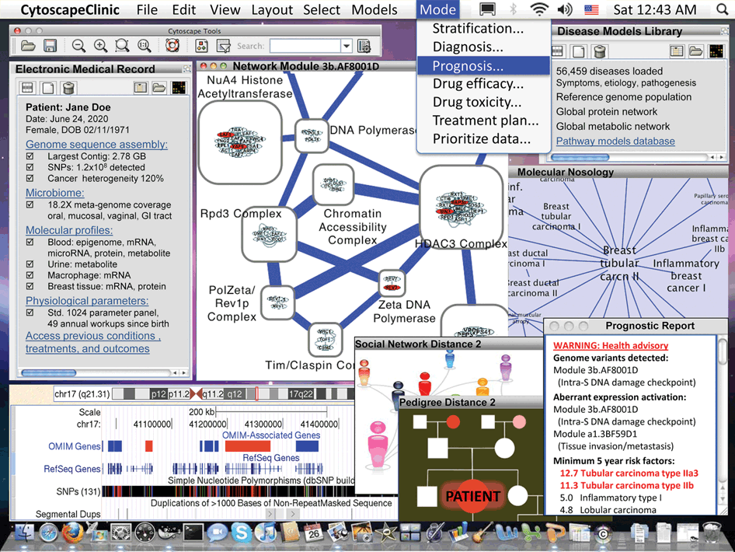
Genomically Enabled Electronic Medical Records
“The future primary care physician may need to cope with a staggering array of integrated patient data including genome sequences and biological networks…”
Friend S, Idenker T. Nature Biotech 2011; 29:215–18.
Notes:
11
for non-disease-specific studies with changing technology and data sharing
Needs for genomically enabled EMRs
Sharing genomic data among providers for clinical care
Updating genomic findings over time
Genomic clinical decision support (CDS)
Quality improvement research in genomics
- Reducing incorrect/redundant ordering
- Rapid learning healthcare systems
Patient education and self-management
Identification of at-risk family members

Slide 12
Critical Needs for EMR in Genomic Medicine
Sharing genomic data among providers, across time for clinical care
Updating genomic findings as knowledge accrues
Genomic clinical decision support (CDS)
Quality improvement research in genomics
  - Reducing incorrect/redundant ordering
  - Rapid learning healthcare systems
Patient education and self-management
Identification of at-risk family members
Notes:
Genomic medicine is exceptionally dependent on robust electronic data systems due to vastness of data and continually changing nature, updating as knowledge accrues
Learning healthcare systems: rapid assessment and feedback for quality improvement, system-wide tracking of clinician actions
“A health care system that collects data from routine care for research and facilitates the use of evidence to improve care has been defined as a learning healthcare system.” in near real time
Pt ed through pt portals like some developed in our programs
Potentially id family members to degree linking is possible, either through EMRs in same system (unlikely), exchange among providers, social network contacts among family members

Slide 13
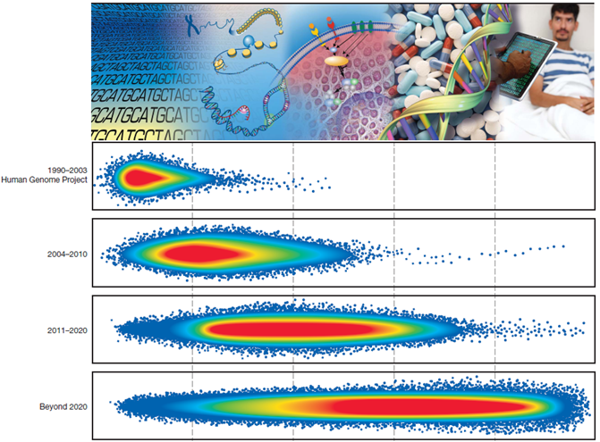

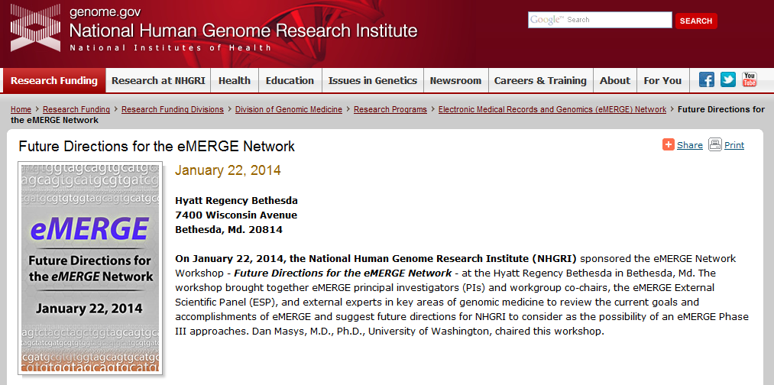
Future Directions for the eMERGE Network January 22, 2014
Structure of Genomes
Science of Medicine
Effective-ness of Healthcare
Biology of Genomes
Biology of Disease
Continue to include discovery and implementation
Conduct research on implementation
Implementation
Discovery
http://www.genome.gov/27555919

Slide 14
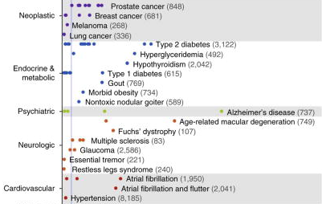
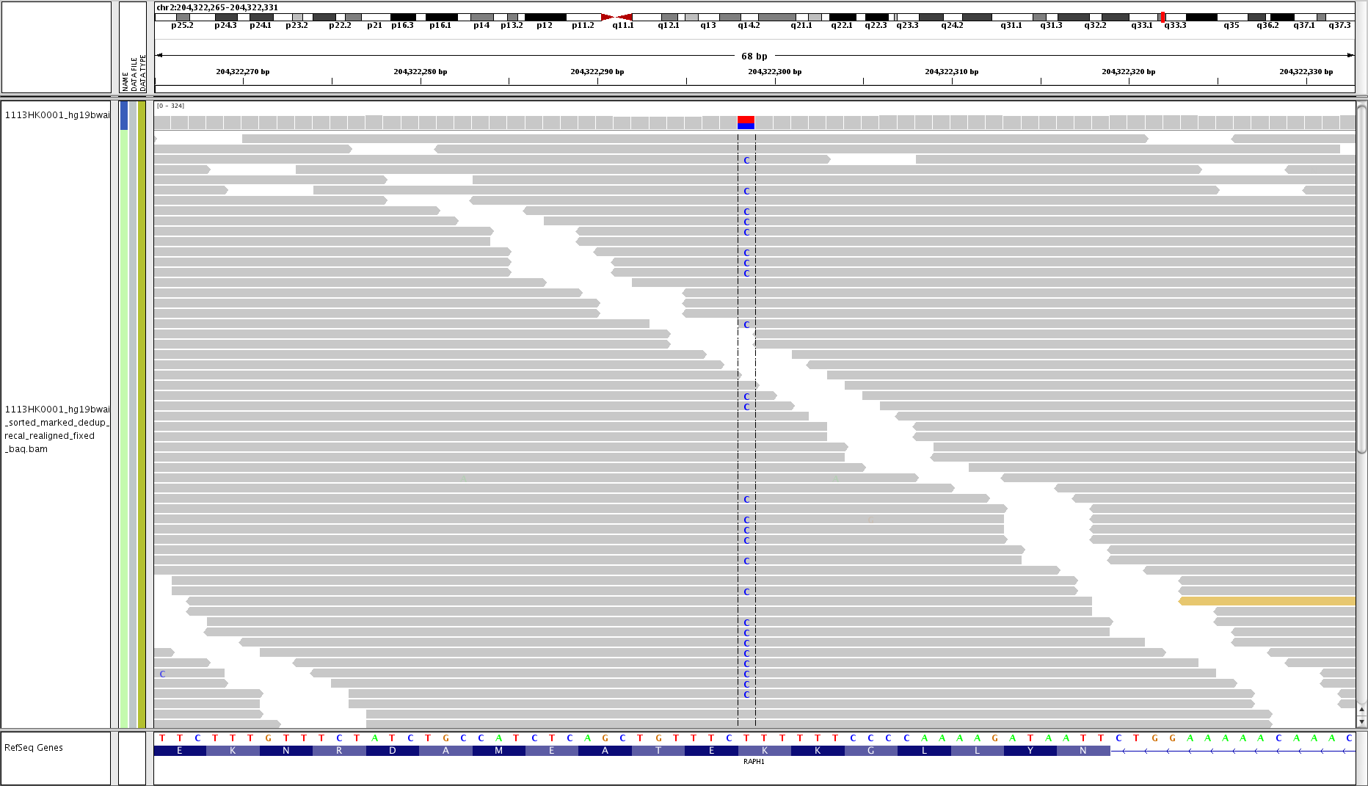
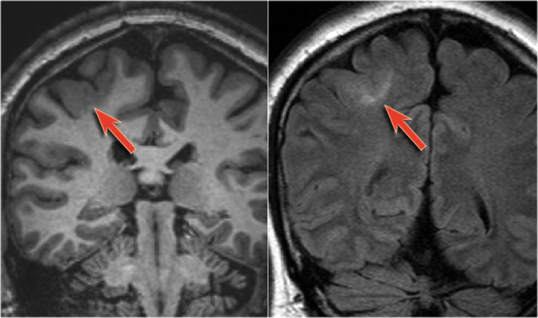
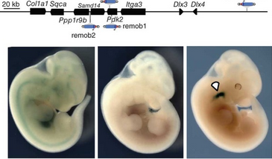
eMERGE III discovery research should…
Leverage rich EMR phenotyping
Use state-of-art genomic techniques
Assess phenotypes of rare variant carriers
Examine functional data for causative variants
Notes:
Leverage rich EMR phenotyping eMERGE has been critical in developing (Denny)
Move beyond GWAS to utilize SoA genomic techniques, specifically genome sequencing (Illumina)
Utilize large populations to identify RV carriers and assess their phenotypes (images)
New perspective suggested-- examine and integrate functional data in bedside back to bench approach

Slide 15
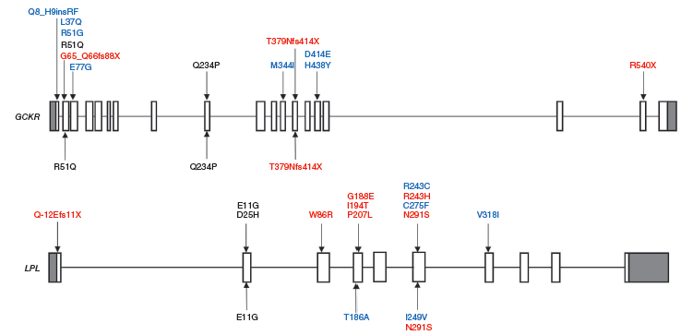

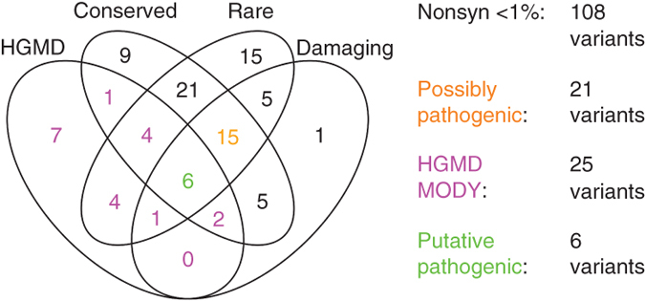

eMERGE III implementation research should…
Johansen C, Nat Genet 2010
    Examine rare but collectively common variants to inform treatment
    Explore differences in implementation across diverse subgroups
    Develop, test approaches to re-annotation and dissemination
    Generate data on efficiency, cost-effectiveness, ease of implementation
Flanick J, Nat Genet 2013

Slide 16
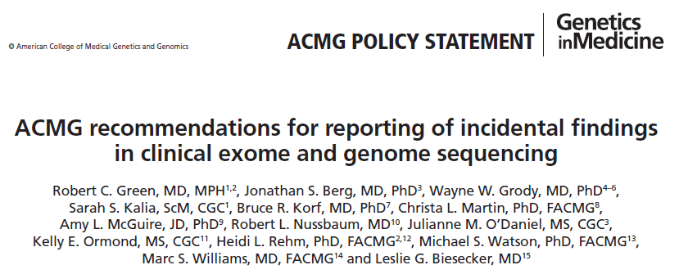
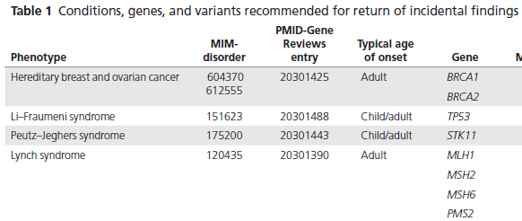
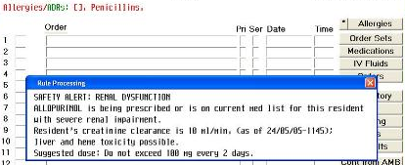
Convergence of Discovery and Implementation in eMERGE III: Utilize Unique Strengths
Notes:
Utilize eMERGE’s unique strengths– sequence highly clinically relevant genes

Slide 17




Integrated ELSI infrastructure should….
Study local differences across IRBs in genomics expertise and promote IRB education
Explore risks of re-identification for use in re-consent and return
Poll patients on what risk/ variant information they want in their records, how to display
Assess what happens long-term after RoR, such as behavior change
Notes:
Found considerable differences across institutions in readiness, willingness to implement
Some related to expertise, some to available infrastructure, concerns about follow-up

Slide 18
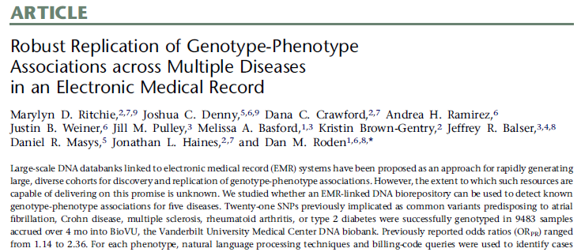
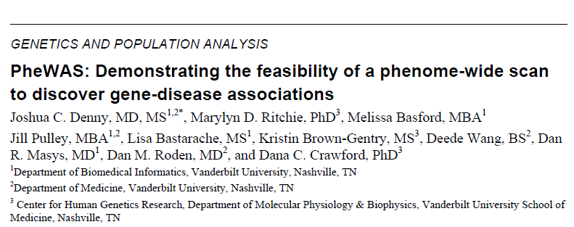
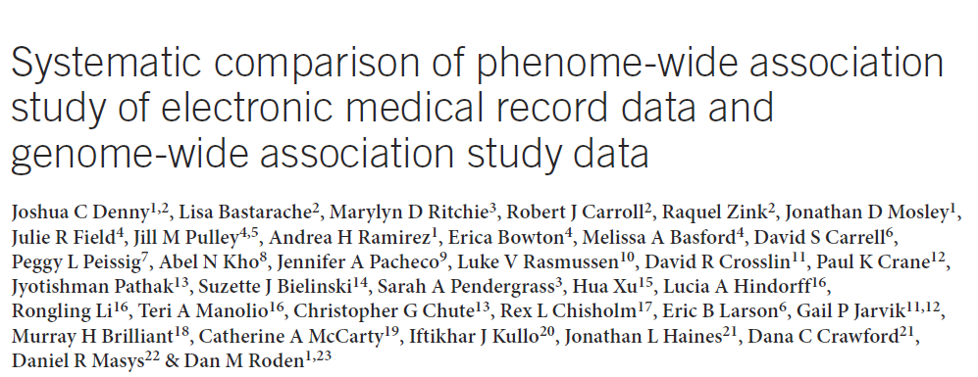
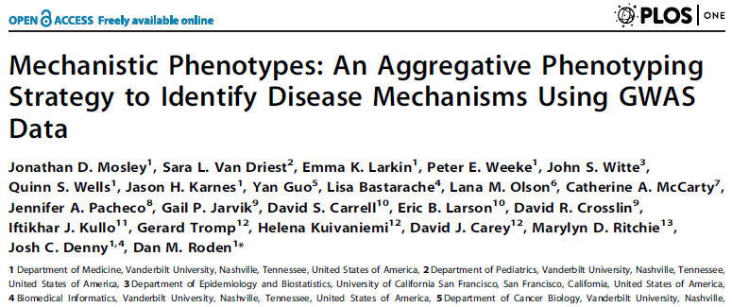
Defining Phenotypes from EMR Data
Ritchie M et al., Am J Hum Genet 2010;86:560-72.
Denny J et al., Bioinformatics 2010;Mar 24.
Denny J et al., Nat Biotechnol 2013;31:1102-10.
Mosley J et al., PLoS One 2013; 8:e81503.
Notes:
18
A single mutation can alter cellular and global homeostatic mechanisms and give rise to multiple clinical diseases. We hypothesized that these disease mechanisms could be identified using low minor allele frequency (MAF<0.1) non-synonymous SNPs (nsSNPs) associated with "mechanistic phenotypes", comprised of collections of related diagnoses.
employed a hypothesis-free ontological enrichment analysis using the sorted nsSNPs to identify functional mechanisms underlying the diagnoses comprising the mechanistic phenotypes. The thrombosis phenotype was solely associated with ontologies related to blood coagulation (Fisher's p = 0.0001, FDR p = 0.03), driven by the F5, P2RY12 and F2RL2 genes. For the cancer phenotypes, the reverse genetics models were enriched in DNA repair functions (p = 2×10-5, FDR p = 0.03) (POLG/FANCI, SLX4/FANCP, XRCC1, BRCA1, FANCA, CHD1L) while the additive model showed enrichment related to chromatid segregation (p = 4×10-6, FDR p = 0.005) (KIF25, PINX1). We were able to replicate nsSNP associations for POLG/FANCI, BRCA1, FANCA and CHD1L in independent data sets. Mechanism-oriented phenotyping using collections of EMR-derived diagnoses can elucidate fundamental disease mechanisms.

Slide 19
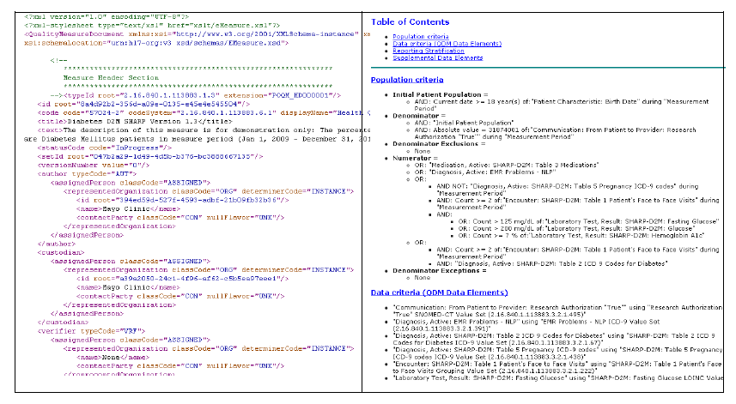
T2DM Phenotyping Algorithm in XML and HTML
Thompson et al., AMIA Annu Symp Proc. 2012;911-20.
Notes:
19
Figure 2. QDM document for the
An Evaluation of the NQF Quality Data Model for Representing Electronic Health Record Driven Phenotyping Algorithms
William K. Thompson, Ph.D.1, Luke V. Rasmussen1, Jennifer A. Pacheco1,
Peggy L. Peissig, M.B.A.2, Joshua C. Denny, M.D. 3, Abel N. Kho, M.D. 1,
Aaron Miller, Ph.D.2, Jyotishman Pathak, Ph.D.4,
In addition to supporting the export of structured XML file descriptors of algorithms, the MAT also allows users to export a style sheet for executing an XSL transform of the XML source into human-readable HTML (Figure 2). The source XML permits the algorithm developer to add structured human-readable visual aids such as tables and lists that become part of the generated HTML, as well as hyperlinks to external images, flowcharts, and other supporting documents. In the eMERGE project we found these types of documentation to be an invaluable means for communicating algorithm logic to external institutions,4 and the ability of the MAT to support this is very welcome.

Slide 20



Phenotype Development Workflow
Tool Support
Create
  Phenotype algorithm and data dictionary are in development
  Share algorithm with project team
  Standardize Phenotype Development
  Standardize data collection
eMERGE RecordCounter
Validate
  Algorithm and Data Dictionary in review by validation site(s)
  Share algorithm with validation team
  Validate algorithm
  Validate Data Dictionary
Share
  Share and implement algorithm and data dictionary for multi-site data collection
  Validate Dataset against Data dictionary
eMERGE RecordCounter
Publish
  Phenotype published and Algorithm is sharable to public
Notes:
eleMAP is a dynamic, free tool that helps researchers harmonize their phenotype data and data dictionaries to existing metadata and terminology standards. eleMAP also houses a downloadable library of harmonized metadata from a variety of existing phenotype studies
PheKB, is a collaborative environment to building and validating electronic phenotype algorithms.
KNIME is open source “graphical workbench” used in developing NLP.

Slide 21
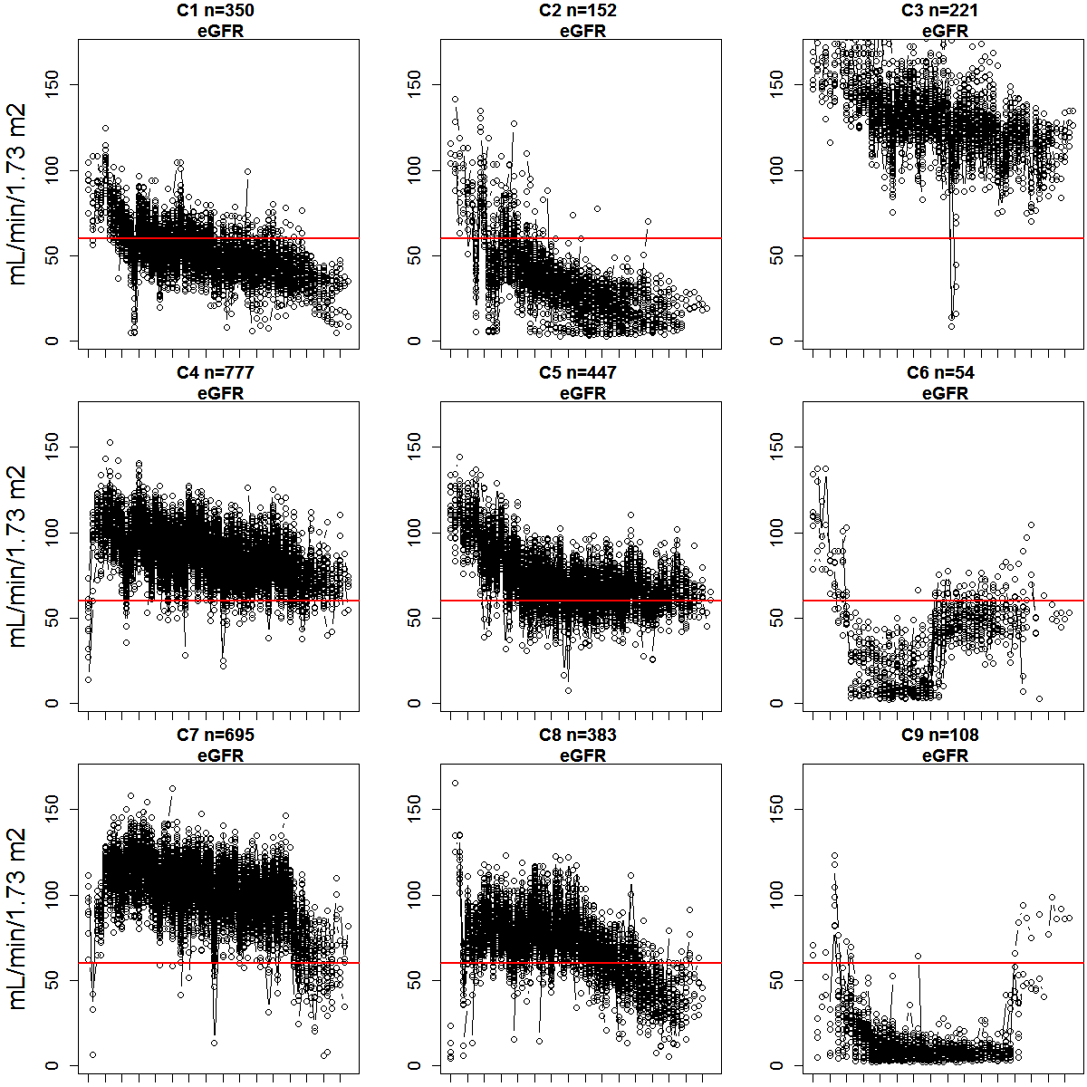
Longitudinal Kidney Function Measures Derived from EMR
Estimated Glomerular
Filtration Rate (eGFR)
mL/min/1.73m²
Normal
Chronic Kidney Disease (CKD)
1
16
years
Courtesy, E Bottinger, Mount Sinai

Slide 22
Clustering and Associations of Longitudinal Kidney Function Measures (eGFR) in African Ancestry Patients
Cluster C4 n=777
Cluster C2 n=152
Age 57±11
Male 35%
Age 65±12
Male 32%
Rapid
Progressive
CKD patients
Normal
eGFR
CKD
Cluster C6 n=54
Cluster C9 n=108
Age 62±13
Male 49%
Age 59±13
Male 55%
Kidney transplantion
recipients
End Stage
Kidney Disease
patients
eGFR
1
years
16
1
16
Courtesy, E Bottinger, Mount Sinai
years

Slide 23
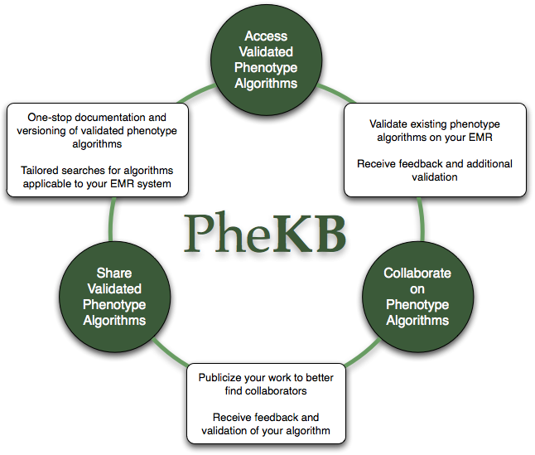
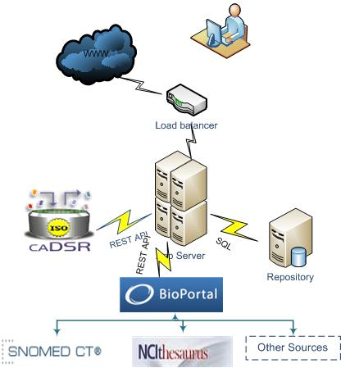
Examples of eMERGE Tools: eMERGE Electronic Phenotyping
eleMAP – Phenotype harmonization tool
PheKB – electronic phenotyping tool
http://www.phekb.org/
https://victr.vanderbilt.edu/eleMAP/
Notes:
PheKB online collaborative repository for building, validating, and sharing electronic phenotype algorithms and their performance characteristics.
eleMAP allows researchers to harmonize their local phenotype data dictionaries to existing metadata and terminology standards such as the caDSR (Cancer Data Standards Registry and Repository), NCIT (NCI Thesaurus) and SNOMED-CT (Systematized Nomenclature of Medicine-Clinical Terms)

Slide 24
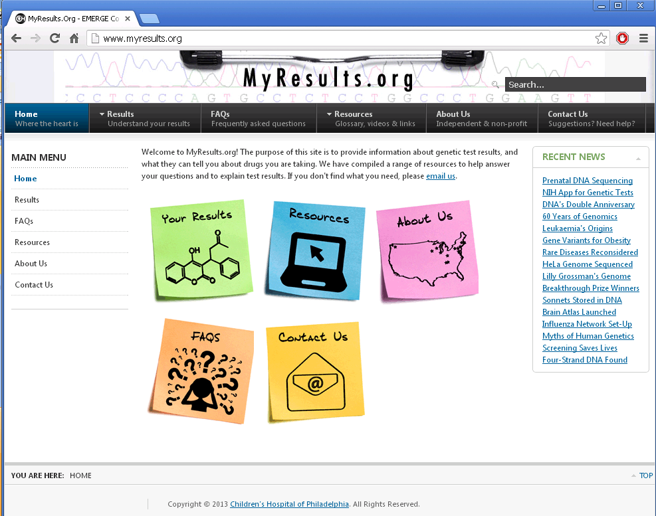
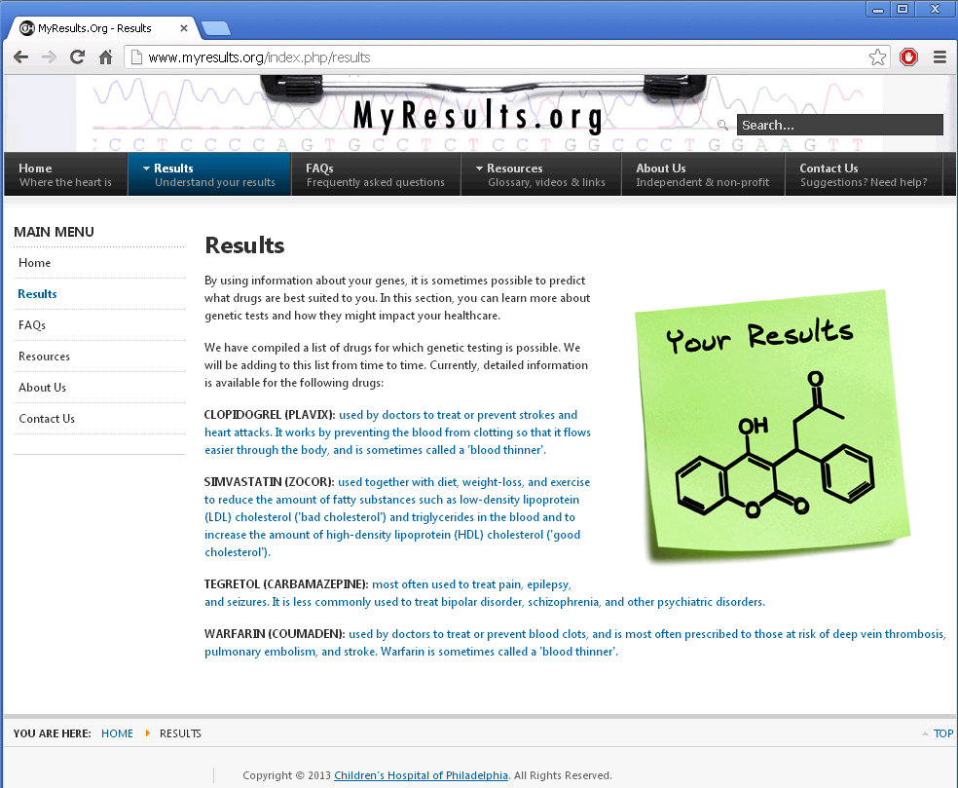

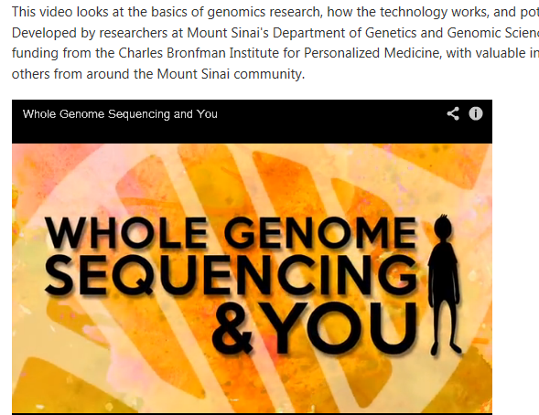
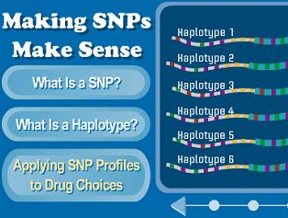
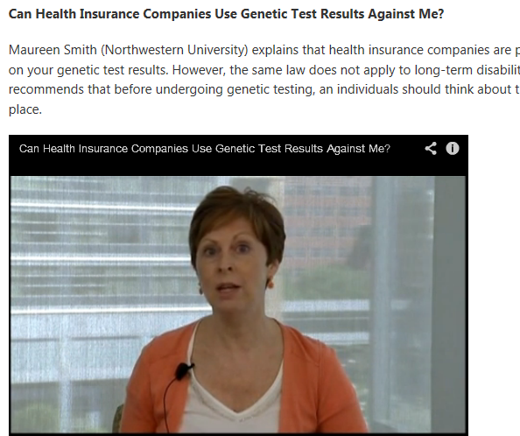
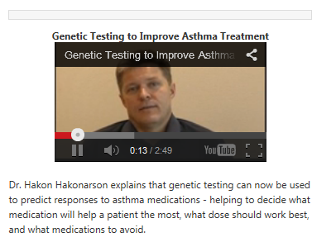
eMERGE Physician-Patient Education
from Learn.Genetics, U Utah
www.myresults.org
Notes:
. Myresults.org (http://myresults.org/) is the eMERGE educational website for both clinician and patients.

Slide 25
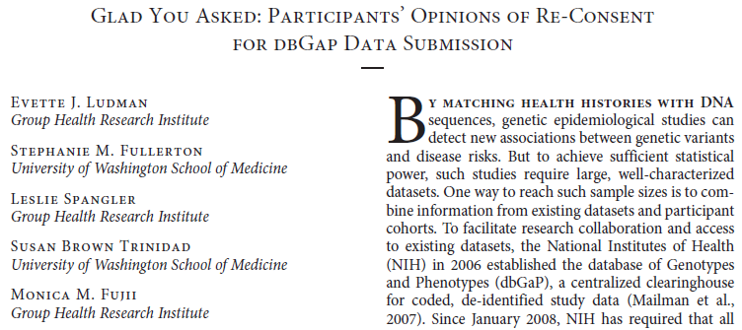
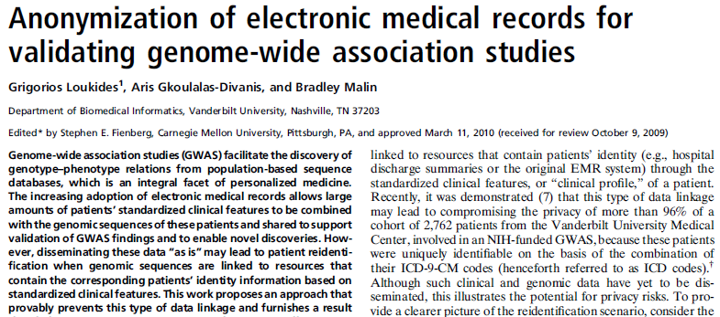
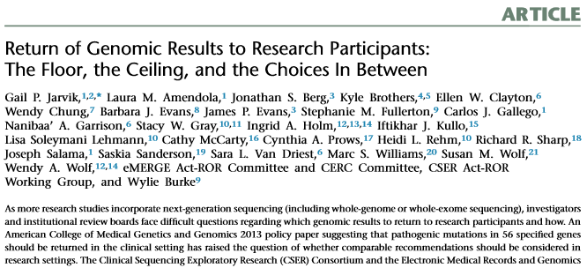
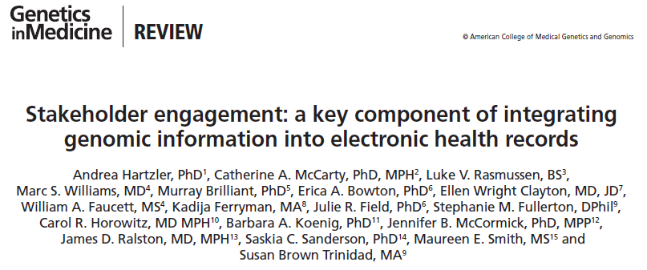
Consent, Privacy and Stakeholder Concerns
J Empir Hum Res Ethics 2010 5:9-16.
PNAS 2010;107:7898-903.
AJHG 2014 May 8; in press.
Genet Med 2013; 15:792-801.
Notes:
25

Slide 26
eMERGE Site-Specific Genomic Medicine Implementation Pilots
Site | Goal
CCHMC | CYP2D6 variants and post-operative opioids
CHOP | βAR variants and β-adrenergic agonists in asthma
Geisinger | IL28B variants and hepatitis C treatment
Marshfield | CFH, ARMS-2, C3, mND2 and risk of AMD, impact on attitudes, behaviors
Mayo | RCT of 42 SNP-genomic risk score for CHD for attitudes, behaviors
Mount Sinai | RCT of APOL1 genotype for hypertensive nephropathy prevention, management
Northwestern | HFE and FVL risk variants on attitudes, behaviors
Vanderbilt | Expanded PGx testing

Slide 27


eMERGE-PGRN Partnership
State of art PGx array
Ability to update
Drug-gene guidelines
CLIA standards and QC
Privacy concerns
Electronic phenotyping
Large pt base
Less PGx-focused labs

Slide 28
Aims and Tasks of eMERGE-PGx
Aim 1: Deploy PGRNseq, NGS platform of 84 known pharmacogenes
Recruit pts likely to be prescribed drugs with relevant pharmacogenes
Obtain PGRNseq targeted sequence on nearly 9,000 pts
Aim 2: Selectively implement PGx genotypes in the EMR
Aim 3: Develop repository for PGx association studies (SPHINX)
Obtain CLIA-validated genotyping
Design EMR results display, deposit genotypes
Deposit variants in PGRNseq, disseminate
Develop, deploy CDS in EMR
Initiate functional and association studies
Assess process outcomes , impact
Courtesy L. Rasmussen-Torvik, Northwestern

Slide 29
Design and Performance of PGRN-Seq Platform
84 “Very Important Pharmacogenes” selected iteratively by PGRN investigators
All coding sequence plus NimbleGen capture of intronic overhang for splice sites
Entire CYP2D6 with introns, CYP3A4 intron 6
2 kb upstream and 1 kb downstream
~750 probes for intronic/noncoding sites on DMET and ADME platforms, 50 bp either side
Average read depth 496x
99.9% concordant with existing SNV data on 32 diverse HapMap trios from 1000 Genomes

Slide 30
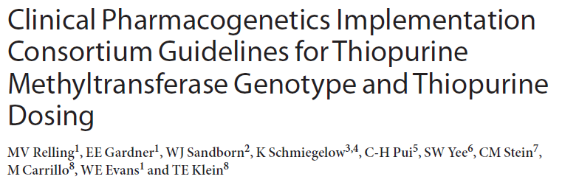
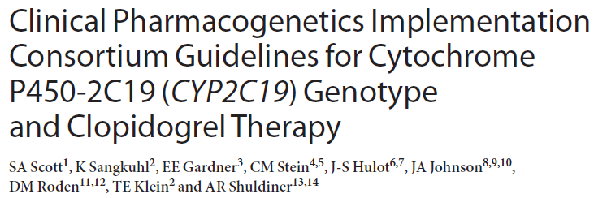
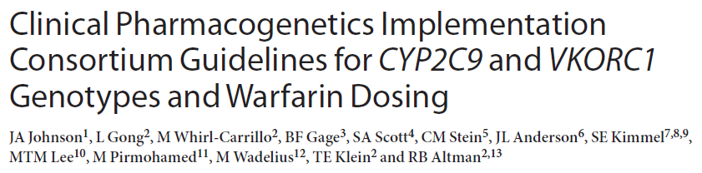
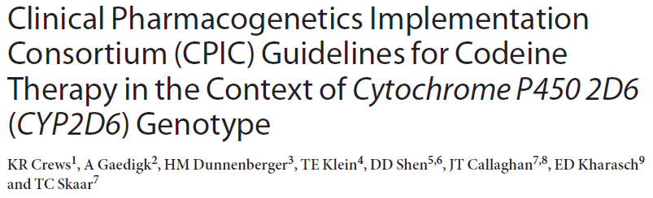
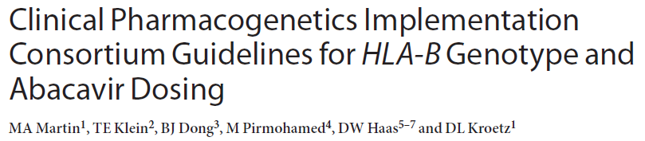
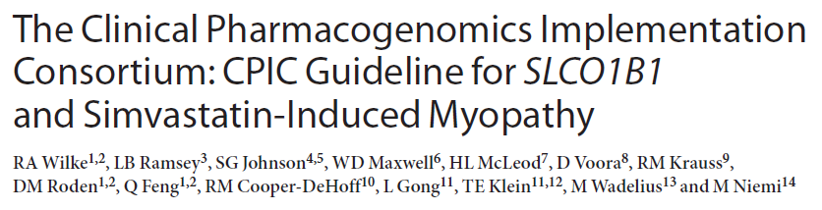
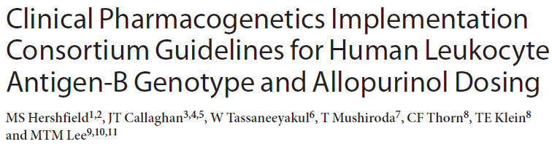
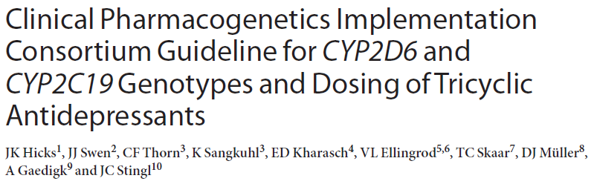
CPIC Gene-Drug Guidelines
Clin Pharmacol Ther 2011-2013

Slide 31
Drugs with PGx Variants Implemented in eMERGE-PGx, by Site
Site | abacavir | carbam azepine | clopid ogrel | cod eine | inter feron | monte lukast | mor phine | ome prazole | ranit idine | simva statin | SSRIsTCAs | tamo xifen | thio purines | tram adol | war farin
BCH |  |  |  |  |  |  |  |  |  |  |  |  | X |  | X
CHOP |  | X |  | X |  | X | X | X | X |  |  |  | X
CCHMC |  |  |  | X |  |  |  |  |  |  | X
Geisinger |  |  | X |  | X |  |  |  |  | X |  |  |  |  | X
GHC/UW | X | X |  | X | irinotecan |  |  |  |  |  |  |  |  |  | X
Marshfield |  |  | X |  |  |  |  |  |  | X |  |  |  |  | X
Mayo | X | X | X |  | X |  |  |  |  | X |  | X | X |  | X
Mount Sinai |  |  | X |  |  |  |  |  |  | X |  |  |  |  | X
NU |  |  | X |  |  |  |  |  |  | X |  |  |  |  | X
Vanderbilt |  |  | X |  |  |  |  |  |  | X |  | tacro limus |  |  | X

Slide 32
Drugs with PGx Variants Implemented in eMERGE-PGx, by Site
Site | abacavir | carbam azepine | clopid ogrel | cod eine | inter feron | monte lukast | mor phine | ome prazole | ranit idine | simva statin | SSRIsTCAs | tamo xifen | thio purines | tram adol | war farin
BCH | X | X | X | X | X | X | X | X | X | X | X | X | X | X | X
CHOP | X | X | X | X | X | X | X | X | X | X | X | X | X | X | X
CCHMC | X | X | X | X | X | X | X | X | X | X | X | X | X | X | X
Geisinger | X | X | X | X | X | X | X | X | X | X | X | X | X | X | X
GHC/UW | X | X | X | X | X | X | X | X | X | X | X | X | X | X | X
Marshfield | X | X | X | X | X | X | X | X | X | X | X | X | X | X | X
Mayo | X | X | X | X | X | X | X | X | X | X | X | X | X | X | X
Mount Sinai | X | X | X | X | X | X | X | X | X | X | X | X | X | X | X
NU | X | X | X | X | X | X | X | X | X | X | X | X | X | X | X
Vanderbilt | X | X | X | X | X | X | X | X | X | X | X | tacro limus | X | X | X
x

Slide 33
Preliminary PGRN-Seq Results
SCN5A and KCNH2 in 2,000 Patients
83 rare (MAF < 1%) in SCN5A, 45 in KCNH2
121/128 MAF < 0.5%, 92 singletons
Three labs assessed known/likely pathogenicity
Of total 40 variants, only 4 called pathogenic by all 3 labs
Lab 1 16/128
4
Lab 2 24/128
Lab 3 17/128

Slide 34
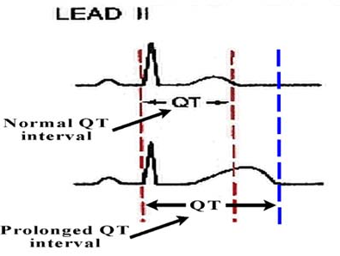
Preliminary PGRN-Seq Results
SCN5A and KCNH2 in 2,000 Patients
48 carriers of 40 variants; EMRs reviewed
  1 AF, 4 bundle branch block
  Hx of long QT or cardiac arrest: 0
  FHx of cardiac arrest: 0
  Measured QT interval: 1 with one measured QTc 500 during hypokalemia
Suspect variant (S1904L) annotation by 3 labs:
  Lab 1: pathogenic
  Lab 2: benign
  Lab 3: unknown significance
12 no recorded ECG in EMR - ? call back

Slide 35
Clinical Implications of Sequence Variation
Variants with presumed detrimental impact on gene function are frequently found
Phenotypic and clinical implications in unselected patients largely unknown
Collective burden of reporting and follow-up will likely overwhelm current systems
Reliable information needed on phenotypic manifestations, requires large numbers
Integration with FHx data highly informative

Slide 36
eMERGE III Goal and Aims
Continue genomic medicine discovery and imple-mentation research utilizing large biorepositories linked to EMRs
Identify rare variants with presumed major impact on function of ~100 clinically relevant genes
Assess phenotypic implications of variants by leveraging well-validated EMR data or re-contact
With appropriate consent and education, report actionable variants to pts, (families), clinicians
Assess impact to pts, clinicians, and institutions on pt outcomes and cost of care

Slide 37
eMERGE I, II, III Continued Aims
Expand and enhance electronic phenotyping
Provide electronic clinical decision support
Enable integration of genomic findings into EMRs for clinical research and care
Engage and educate IRBs, health system leaders, EMR vendors
Disseminate methods, tools and best practices to the scientific community

Slide 38
eMERGE III Proposed Scope
8-12 Clinical Sites, Coordinating Center, 1-2 Genome Sequencing/Genotyping Facilities
2,000-3,000 DNA samples per site sequenced for ~100 target genes in CLIA environment
Genes, seq methods, phenotypes chosen in first year with ESP review; evolve as needed
Explore potential “bedside to bench” functional assessments leveraging existing resources
Expand phenotyping library from 41 to 60-80

Slide 39
eMERGE III Proposed Scope
8-12 Clinical Sites, Coordinating Center, 1-2 Genome Sequencing/Genotyping Facilities
2,000-3,000 DNA samples per site sequenced for ~100 target genes in CLIA environment
Genes, seq methods, phenotypes chosen in first year with ESP review; evolve as needed
Explore potential “bedside to bench” functional assessments leveraging existing resources
Expand phenotyping library from 41 to 60-80

Slide 40
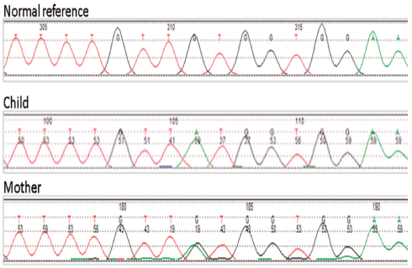
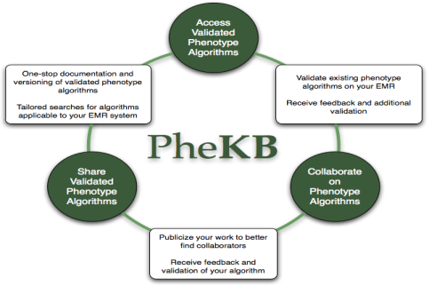
Criteria for Site Selection
    Population diversity, especially under-represented groups
    Availability of high-quality GWAS data in > 3,000 ppts with EMR
    Availability of > 2,000 ppts for CLIA sequencing and return of results
    Completeness of EMR data
    Ability to implement existing eMERGE phenotypes

Slide 41
Criteria for Site Selection (continued)
Broad range of disciplines and expertise:
  Sequencing, genomics
  EMR phenotyping and integration
  Informed consent and genetic counseling
  Clinical, psychosocial outcome assessment
  Health administration, health economics
  Legal implications
New applicants with strengths in population diversity or key expertise encouraged
Smaller biorepositories encouraged to consider partnering with other sites
Existing sites assessed on ongoing productivity and collaborative performance in eMERGE II

Slide 42

NHGRI’s Genomic Medicine Research Program
Program | Goal | Σ $M | Years
eMERGE II | Use biorepositories with EMRs and GWA data to incorporate genomics into clinical research and care | 25.9 | FY11-14
eMERGE-Pediatrics | Use pediatric biorepositories with EMRs and GWA data for genomic research and clinical care | 5.2 | FY12-14
eMERGE-PGx | Apply PGRN’s validated VIP array for discovery and clinica/l care in ~9,000 patients | 9.0 | FY12-14
eMERGE-OD Ethics | Examine participants’ views on broad consent for sharing their samples and data for future research | 4.1 | FY13-14
eMERGE-All |  | 45.2 | FY11-14
CSER | Explore infrastructure, methods, and issues for integrating genomic sequence into clinical care | 66.5 | FY12-16
ClinGen | Develop and disseminate consensus information on variants relevant for clinical care | 25.0 | FY13-16
IGNITE | Develop and disseminate methods for incorporating patients’ genomic findings into their clinical care | 32.3 | FY13-16
NSIGHT | Explore possible uses of genomic sequence information in the newborn period | 10.0 | FY13-16
UDN | Diagnose rare and new diseases by expanding NIH’s Undiagnosed Diseases Program | 67.9 | FY13-17

Slide 43
Spectrum of Genomic Medicine Implementation: Intensity vs. Breadth
Breadth of Implementation
IGNITE
eMERGE
Depth of Patient Characterization
CSER
Evidence Generation
System-Wide Impact
UDN
NSIGHT
Dissemination Diverse Settings
Individual Patient Focus
Testing Multiple Models
Notes:
43

Slide 44
Commonalities and Complementarity of eMERGE and CSER
CSER
3,500 pts, 10 projects
Diverse clinical scenarios
Focus: pt clinical encounter
eMERGE
100K pts, 10 biorepositories
Network phenotypes, genotypes
Focus: system-wide
EMR integration
Clinical impact of RoR
Pediatric actionability
Data sharing concerns
Individualized phenotypes
Phenotype to genotype
Exome/genome sequencing
Standardizing sequencing reports
Broad range phenotypes
Genotype to phenotype
Genotyping, targeted sequencing
Standardizing e- phenotypes

Slide 45
Commonalities and Complementarity of eMERGE and IGNITE
eMERGE
100K pts, 10 biorepositories
Network phenotypes, genotypes
Focus: evidence generation
IGNITE
50K pts, 5 projects
Diverse clinical settings
Focus: real-world application
EMR integration
Cost-effectiveness
Patient/ clinician education
Testing novel implementation models
GWAS genotyping and targeted sequencing
Developing and assessing CDS tools
Contributing to evidence base: penetrance of “pathogenic” variants
Disseminating current implementation models
FHx, candidate genotyping, targeted sequencing
Deploying CDS in diverse settings
Contributing to evidence base: effectivness of implementation models
Notes:
IGNITE focus: real world application

Slide 46













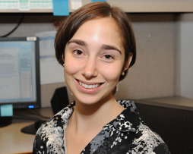


Many Thanks…
Rongling Li
Jackie Odgis
Simona Volpi
Ken Wiley

Slide 47
David’s Questions
Why does NHGRI need to stimulate this–10 yrs from now, if NHGRI didn’t do this would anyone notice
Rationale for requiring existing GWAS data-- barrier to entry of new sites
What are most significant achievements of phases I and II, how do they inform thinking about phase III
Distinguishing feature is breadth, both good and bad, then how to judge success or failure
Goals framed in health impact and cost effectiveness, over what timeframe-- is a 10yr program needed to have meaningful outcomes
Notes:
47

Slide 48
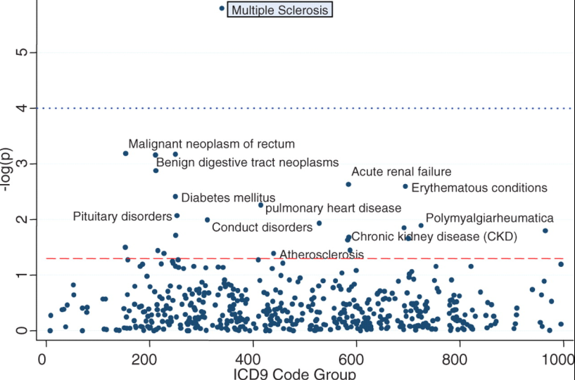
Phenome-Wide Scanning with EMR Data
Denny J et al., Bioinformatics, 2010; Mar 24.
Notes:
48

Slide 49


An eMERGE-wide phenotype analyzed with no extra genotyping: hypothyroidism
European Americans (1,306 cases and 5,013 controls)
Denny et al., 2011

Slide 50


The phenome-wide association study (PheWAS)
Target phenotype
association P value
GWAS:
chromosomal location
PheWAS (ΦWAS):
Target genotype
association P value
diagnosis code
PheWAS requirement: A large cohort of patients with genotype data and many diagnoses

Slide 51

PheWAS for rs965513 (FOXE1)
Analysis of 866 phenotypes in 13,617 European Americans
Adjusted for age and sex

Slide 52
PheWAS of “all” NHGRI GWAS Catalog SNPs
3,144 SNPs with prior GWAS-discovered associations
674 SNPs with
86 phenotypes
751 SNP-phenotype associations
3,144 SNPs
PheWAS for each SNP to discovery pleiotropy
Test for replication of 751 associations using PheWAS
Replication of novel associations
Replication Arm
Discovery Arm
Denny et al, Nat Biotech 2013

Slide 53


Replications of NHGRI GWAS associations via PheWAS
Binary traits
Continuous traits
Probability of replicating:
All - 210/751: 2x10⁻⁹⁸
Powered - 51/77: 3x10⁻⁴⁷
Denny et al, Nat Biotech 2013

