Slide 1

National Advisory Council for Human Genome Research
May 2015
Eric Green, M.D., Ph.D.
Director, NHGRI
DIRECTOR’S REPORT
Notes:
As is always the case, the Open Session of this meeting of the National Advisory Council for Human Genome Research is being webcast live.
It is also being videotaped, and those recordings will be made available as a permanent archive on the internet, including the presentations themselves and the various associated documents.

Slide 2
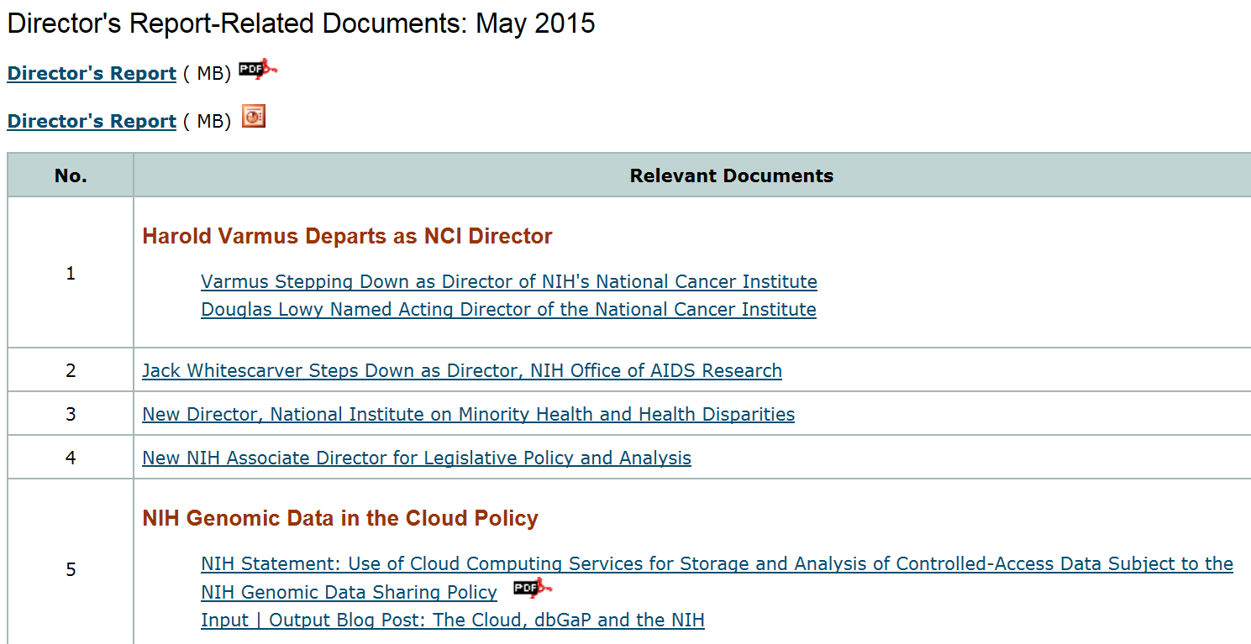
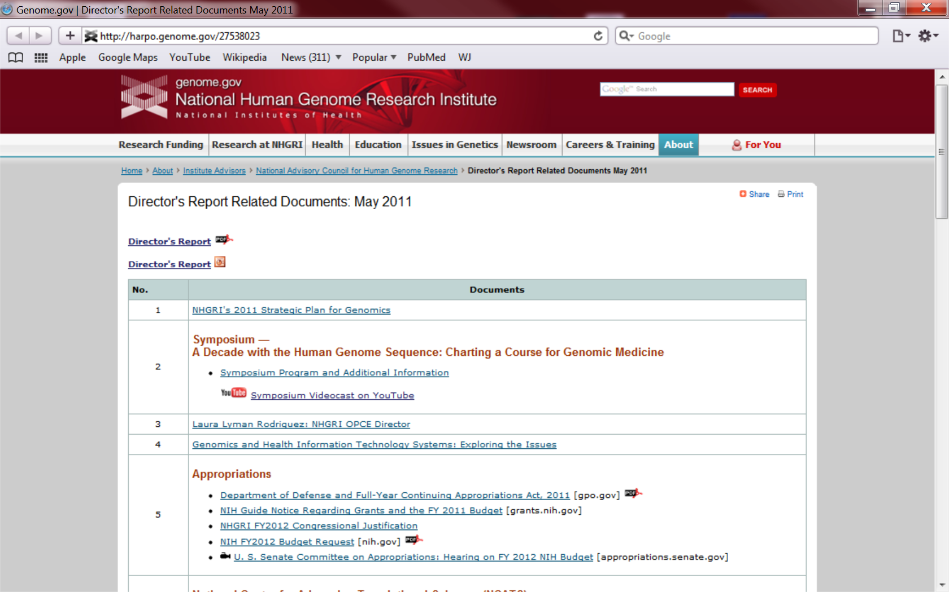
genome.gov/DirectorsReport
Document #
Notes:
For anyone new to our Council meetings, you should be aware that there is an ‘electronic resource’ associated with my Director’s Report. This is analogous to supplemental materials of a published paper, and can be accessed at the URL shown here.
The slides that I will show during my Director’s Report are also available electronically at this site– * both as PDF and Powerpoint files.
* For slides associated with specific documents or relevant web sites, there is a ‘Document #’ indicated on the bottom right, which references materials that can be accessed and/or downloaded at the website shown here.
In addition to the video archive, this web page and all linked documents will be archived on NHGRI’s website (genome.gov) as a permanent historic record of this meeting.

Slide 3
Open Session Presentations
  Concept Clearance:
  Workshop Report: “From Genome Function to Biomedical Insight— ENCODE and Beyond”
  Mike Pazin
  Concept Presentation: Functional Genomics
    Elise Feingold
Notes:
There will be several other presentations during the Open Session of this Council meeting. My Director’s Report is tailored around these presentations, and I will not discuss in detail the topics that others will cover.
* After my Director’s Report, * we will discuss the first of several concept clearances. * Specifically, Mike Pazin will present a report from the workshop “From Genome Function to Biomedical Insight— ENCODE and Beyond.” * This workshop set the stage for the concept clearance on Functional Genomics, which will be presented by Elise Feingold.

Slide 4
Open Session Presentations
  Clinical Sequencing Exploratory Research Program
    Gail Jarvik
  NHGRI ClinSeq Project
    Les Biesecker
Notes:
After lunch, * Gail Jarvik will give a presentation on the Clinical Sequencing Exploratory Research Program, and then * Les Biesecker from the NHGRI Intramural Research Program will provide an overview of the NHGRI ClinSeq Project. We selected these two presentations to provide Council an illustrative update about some of the clinical genomics research projects being supported by the Institute.

Slide 5
Open Session Presentations
  Concept Clearances:
  Concept Presentation: Data Analysis and Coordinating Center for Diversity Action Plans and Institutional Training Grants
  Tina Gatlin
  Workshop Report: “Genomic Technology Development”
  Concept Presentation: Genomic Technology Development
    Mike Smith
Notes:
* This will then be followed by two more concept clearances.
* Tina Gatlin will present a concept for a “Data Analysis and Coordinating Center for Diversity Action Plans and Institutional Training Grants.”
* Lastly, Mike Smith will give a report from the “Genomic Technology Development” Workshop, which provided important input for the development of a concept of the same name.

Slide 6
Director’s Report Outline
General NHGRI Updates
General NIH Updates
General Genomics Updates
NHGRI Extramural Research Program
NIH Common Fund/Trans-NIH
NHGRI Division of Policy, Communications, and Education
NHGRI Intramural Research Program
Notes:
For the rest of my Director’s Report, I will cover the 7 areas listed here, which together provide an excellent framework for reviewing the relevant topics.

Slide 7
Director’s Report Outline
General NHGRI Updates
General NIH Updates
General Genomics Updates
NHGRI Extramural Research Program
NIH Common Fund/Trans-NIH
NHGRI Division of Policy, Communications, and Education
NHGRI Intramural Research Program

Slide 8
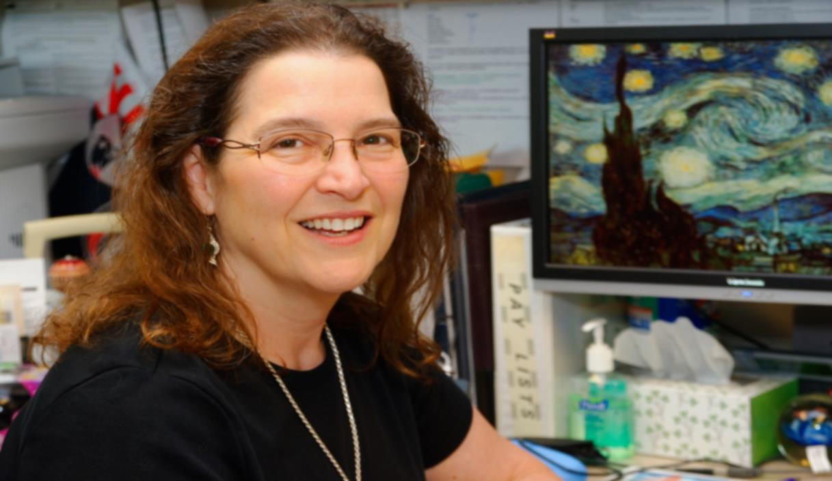
Retirement of NHGRI Chief
Grants Management Officer
Cheryl Chick
Notes:
After serving 11 years as NHGRI’s Chief Grants Management Officer, Cheryl Chick retired on April 3 of this year. While leading the Grants Management Branch, Cheryl faced many end-of-fiscal-year crunches, but she never failed to get the job done. At NHGRI, she experienced more than her fair share of funding ‘gymnastics’ for Common Fund projects, trans-NIH initiatives, and stimulus packages. Cheryl was terrific, and she will be missed.
Monika Christman is now serving as our Acting Chief Grants Management Officer while a search for a permanent replacement is conducted.

Slide 9
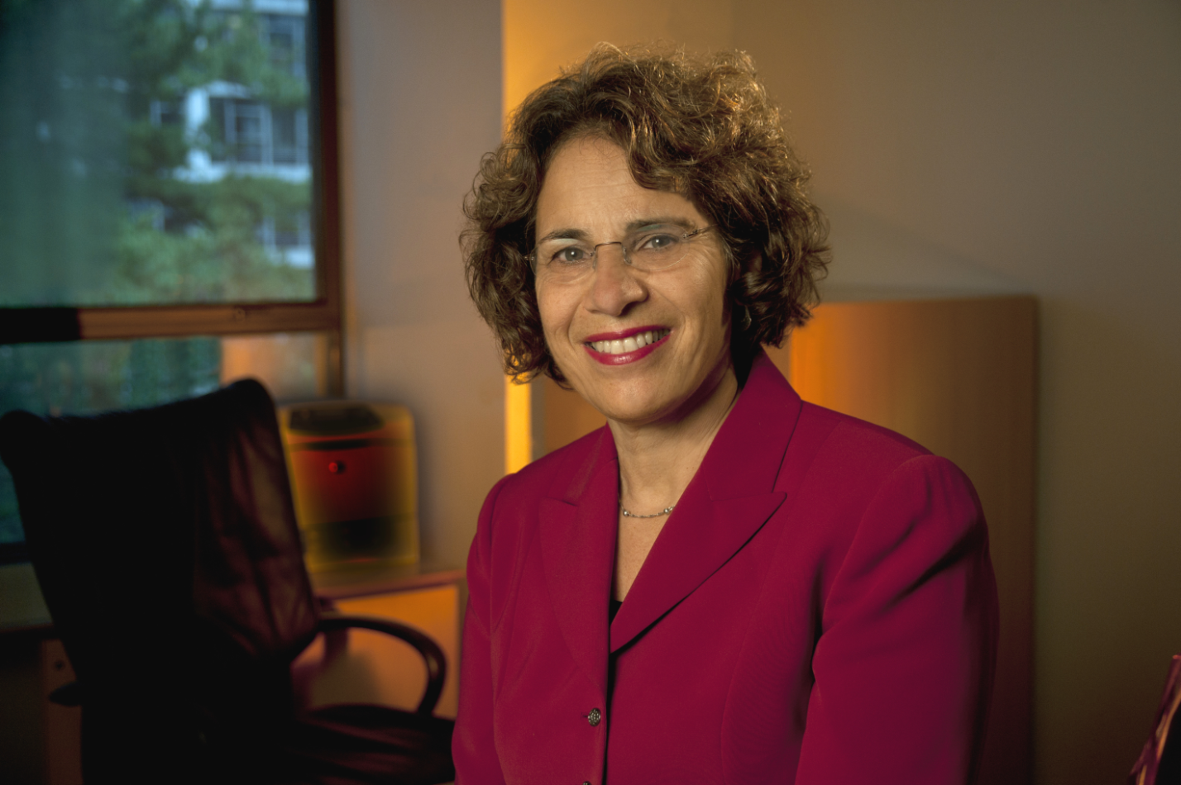
Departure of Senior Advisor to the Director
Karen Rothenberg, J.D., M.P.A.
Notes:
A quasi-departure from NHGRI will occur this summer. For the past four years, Karen Rothenberg has served as Senior Advisor to the NHGRI Director on Genomics and Society while on an extended sabbatical from the University of Maryland School of Law. She has been a constant source of support to me as a new Institute Director, and her advice helped to establish the Division of Genomics and Society of our Extramural Research Program. She has even created opportunities for me to hone my acting skills with some of her genomics and theater projects.
This summer, Karen will officially return to the University of Maryland, where she will help coordinate an externship for law students at NHGRI. She will also continue to work on a number of genomics and theater projects. I wanted to personally thank Karen for all of her contributions to NHGRI, especially those over the last four years.

Slide 10
Director’s Report Outline
General NHGRI Updates
General NIH Updates
General Genomics Updates
NHGRI Extramural Research Program
NIH Common Fund/Trans-NIH
NHGRI Division of Policy, Communications, and Education
NHGRI Intramural Research Program

Slide 11
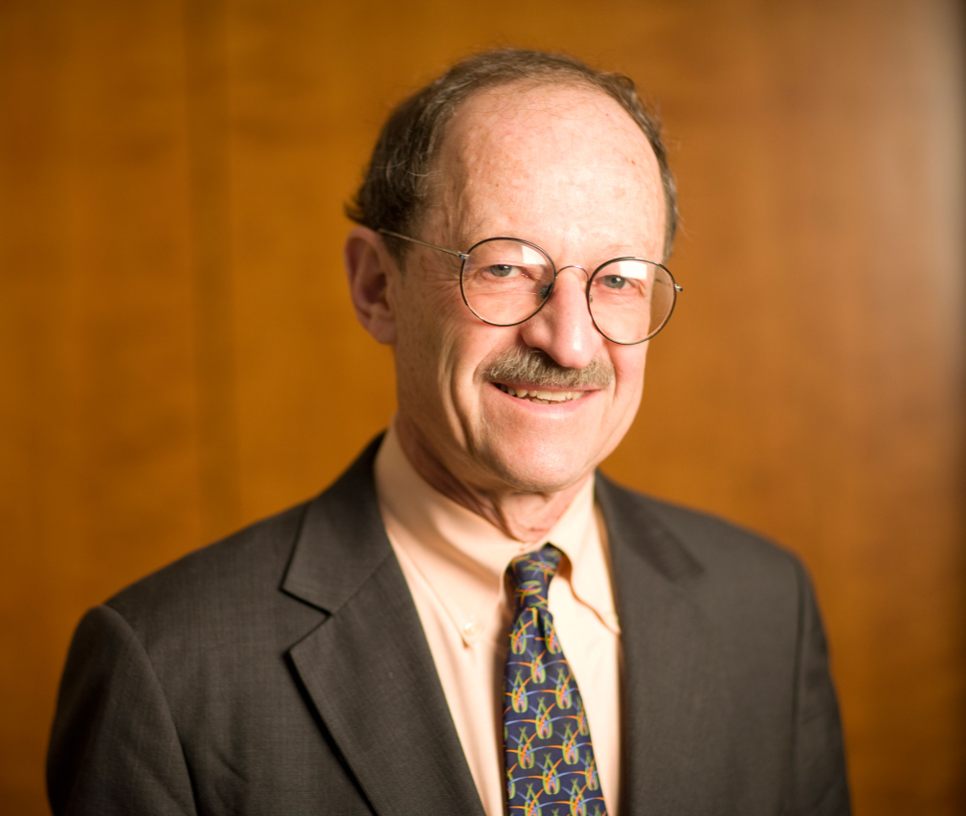


Harold Varmus Departs as NCI Director
Harold Varmus, M.D.
Doug Lowy, M.D.
Document 1
Notes:
After nearly five years, my good friend, colleague and mentor, Harold Varmus, ended his tenure as Director of the National Cancer Institute. I have had the pleasure of collaborating with Harold on a number of joint NCI-NHGRI efforts [most notably The Cancer Genome Atlas (TCGA)] and learning from him around the Institute Director’s table. We have also enjoyed having the Varmus research laboratory within the NHGRI Intramural Research Program. His scientific leadership has been invaluable to NCI and NIH, and we wish him all the best in his future pursuits in New York City.
* Another good friend and colleague, Douglas Lowy (previously an NCI Deputy Director) will now serve as Acting Director of the NCI.

Slide 12


Jack Whitescarver Steps Down as Director, NIH Office of AIDS Research
Jack Whitescarver, Ph.D.
Document 2
Notes:
Jack Whitescarver, who has led the NIH Office of AIDS Research since 2000, will step down from that position, effective July 1. Under Dr. Whitescarver’s leadership, the NIH Office of AIDS Research has developed and supported international research and training collaborations; supported domestic research programs to address HIV in minority populations; and expanded efforts to address HIV in women and girls.

Slide 13


New Director, National Institute on Minority Health and Health Disparities
Eliseo Pérez-Stable, M.D.
Document 3
Notes:
Eliseo Pérez-Stable has been named as Director of the National Institute on Minority Health and Health Disparities (NIMHD). He will oversee the Institute’s $270 million budget to conduct and support research, training, research capacity and infrastructure development, public education, and information-dissemination programs to improve minority health and reduce health disparities. Dr. Pérez-Stable comes to NIH from the University of California-San Francisco, where he is currently a Professor of medicine, Chief of the Division of General Internal Medicine, and Director of the Center for Aging in Diverse Communities. Dr. Pérez-Stable is expected to join NIH in September.

Slide 14
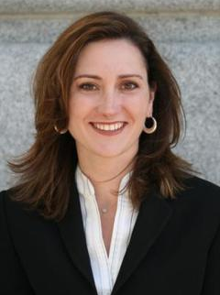

New NIH Associate Director for
Legislative Policy and Analysis
Adrienne Hallett, M.T.S.
Document 4
Notes:
Adrienne Hallet has been appointed the new NIH Associate Director for Legislative Policy and Analysis. Ms. Hallett comes to the NIH with 14 years of experience on the staff of the United States Senate Committee on Appropriations, where she served most recently as Senior Policy Advisor. During her tenure with that Committee, she worked with Senator Harkin to conceptualize, draft, and promote the Accelerating Biomedical Research Act.

Slide 15

NIH Genomic Data in the Cloud Policy
    NIH now allows use of public or private cloud systems for storing and analyzing controlled- access genomic data
    NIH expects Institutions to ensure that local and cloud computing systems meet data use and security standards
Document 5
Notes:
On March 23, NIH issued a position statement on the use of public or private cloud systems for storing and analyzing controlled-access genomic data obtained under the NIH Genomic Data Sharing Policy. * The position now allows investigators to request permission to transfer controlled-access genomic and associated phenotypic data obtained from NIH-designated data repositories under the auspices of the Genomic Data Sharing Policy to public or private cloud systems for data storage and analysis. * NIH expects data user’s institution’s to ensure that cloud computing systems meet the same data use and security standards as those expected for local computing systems, as outlined in NIH Security Best Practices for Controlled-Access Data Subject to the NIH GDS Policy. Cloud environments also are expected to meet any institutional IT security requirements and policies.
As a reminder, the NIH Genomic Data Sharing Policy went into effect on January 25 of this year. As the Chair of the internal NIH oversight committee for this policy and as the Director of the institute that has been a leader in data sharing since the earliest days of the Human Genome Project, I am committed to ensuring that NHGRI remains a leader in implementing the Genomic Data Sharing Policy within both our extramural and intramural research programs.

Slide 16
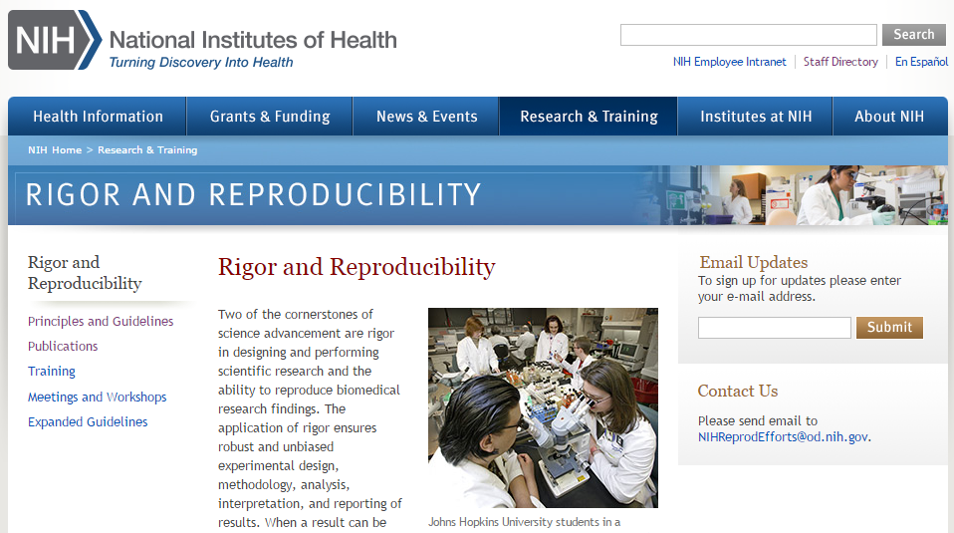
NIH Web Portal on
Rigor and Reproducibility
Document 6
Notes:
NIH has launched a new web portal to provide information about the efforts underway by NIH to enhance rigor and reproducibility in scientific research. The portal hosts the “Principles and Guidelines for Reporting Preclinical Research” (agreed to during the June 2014 joint workshop that NIH held with the Nature Publishing Group and Science on these issues). The principles and guidelines include best practices, statistical analysis, transparency in reporting, data and material sharing, and consideration of refutations. It also serves as a resource for NIH rigor and reproducibility information needs, such as online trainings, publications, and meetings.

Slide 17
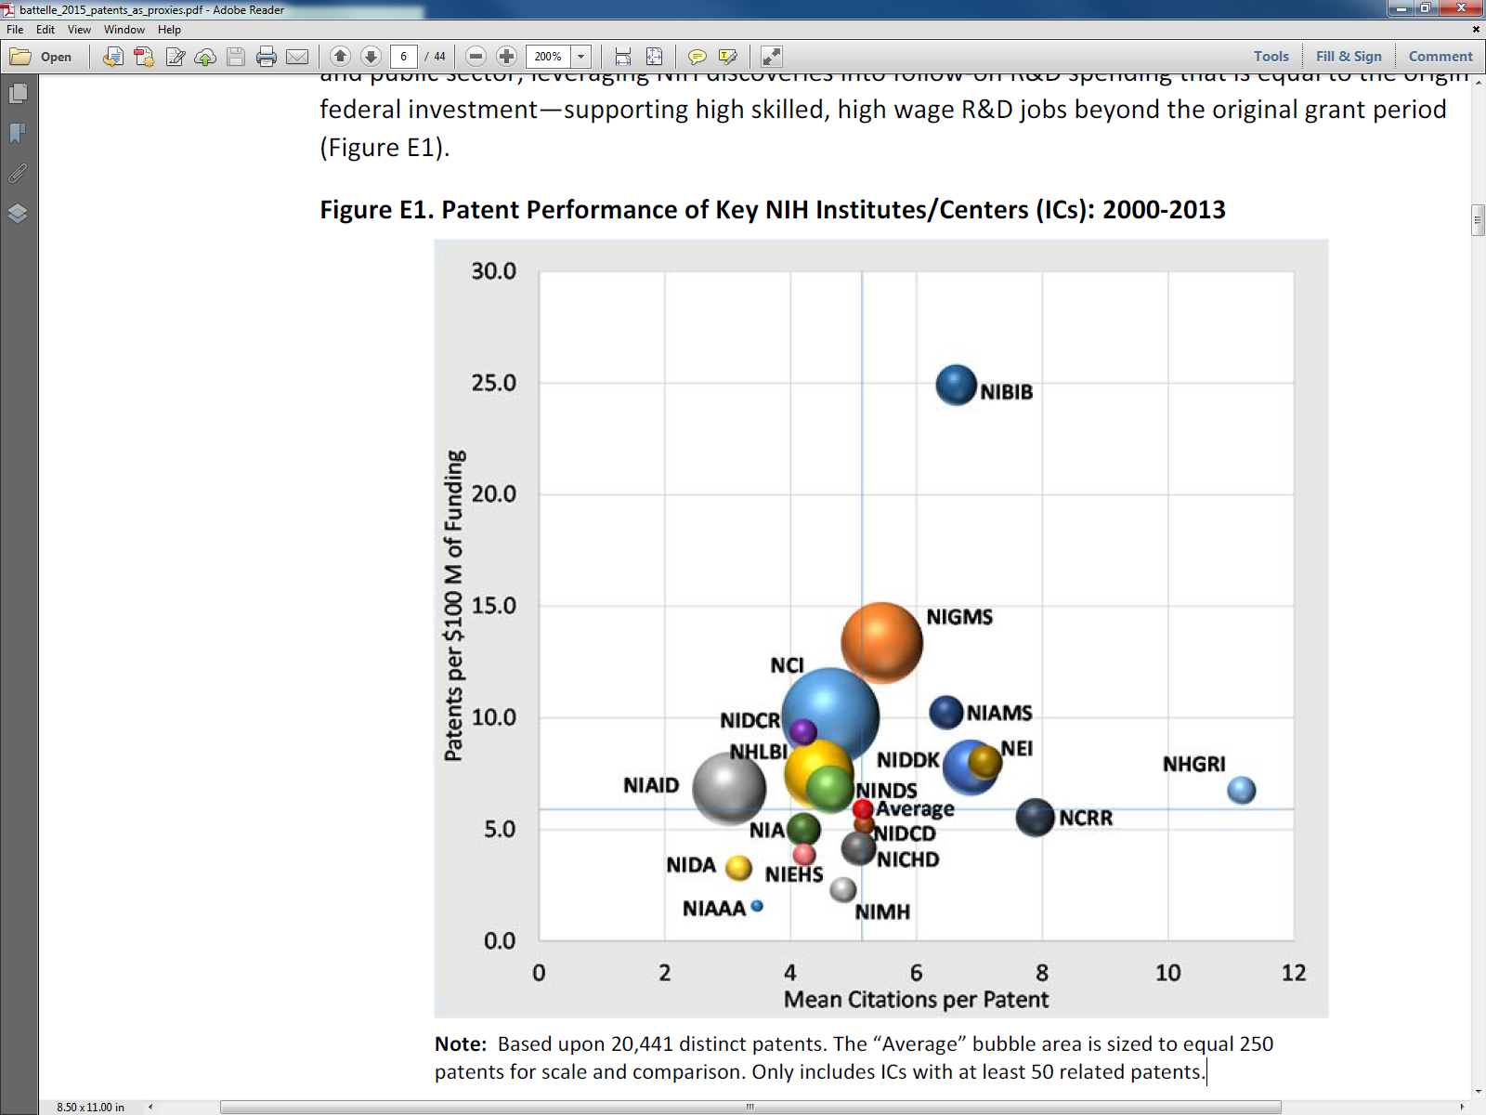
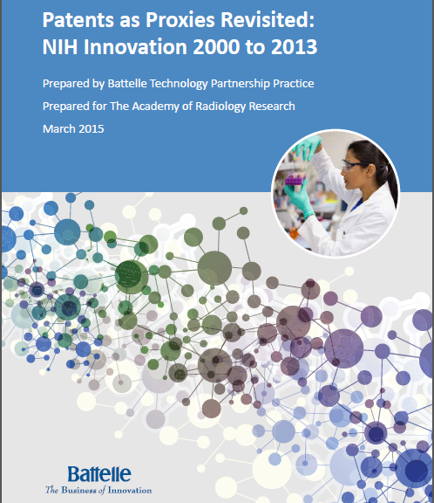
Battelle Report on NIH Innovation
Document 7
Notes:
This past March, Battelle’s Technology Partnership Practice published a report on how NIH funding drives innovation, and I thought you might be interested because the results also highlight NHGRI’s commitment to technology development.
The report’s authors found that NIH-funded research generated one patent for every $16.9 million invested between 2000-2013. * As shown in this figure, the report also looked at patents generated by research funding from each NIH Institute and Center. Note the light blue sphere for NHGRI at the far right of this figure. While NHGRI had an average number of patents per dollar spent, as illustrated by the size of the NHGRI circle in the figure, NHGRI-stimulated patents were exceptional in being highly forward cited— meaning that they were integral to subsequent technological developments. From 2000 to 2013, NHGRI-funded research was responsible for 448 patents, with an average of 11.2 citations per patent. In budget terms, for every $100 million spent on research, NHGRI stimulated 6.7 patents and also $263.5 million in downstream R&D spending.

Slide 18
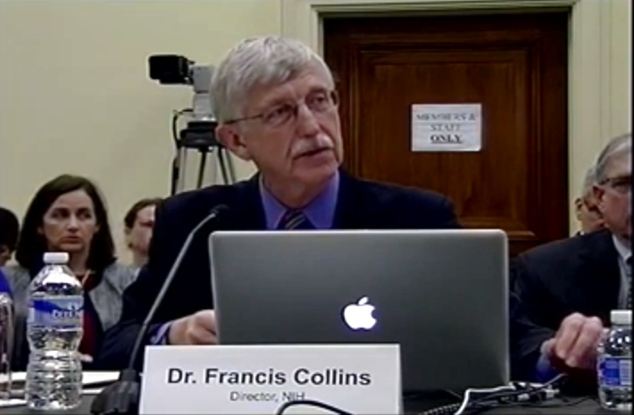
NIH and NHGRI Appropriations
 | FY 2014 | FY 2015 | FY 2016 President’s Budget
NIH | $30.2 B | $30.3 B | $31.1 B
NHGRI | $498 M | $499 M (+ 0.3%) | $515 M (+ 3.2%)
  President’s proposed Fiscal Year (FY) 2016 budget sent to Congress in February
  House and Senate hold NIH funding hearings
Document 8
Notes:
Over the past two months, Congress has been examining the President’s budget request for Fiscal Year 2016. * You will recall that in February, the President sent Congress a proposed budget for the next fiscal year that requests $31.1 billion for NIH, including $515 million for NHGRI (as indicated in the far-right column).
* On March 3, Francis Collins testified before the House Appropriations Labor-HHS Subcommittee in a hearing on NIH’s proposed budget, and on April 30, the Senate counterpart held its NIH hearing. Of particular relevance from a genomics perspective, there was much interest in both hearings from Members of Congress regarding the details of the Precision Medicine Initiative. More broadly, there was bipartisan support at both hearings for NIH, but it is unclear whether and how this will translate to increased NIH funding next fiscal year.
As another positive indicator of the level of support for NIH, two members of the Senate Labor-HHS Subcommittee, Senators Richard Durbin and Lindsay Graham, announced this month that they are forming a Senate NIH Caucus to educate senators about the importance of NIH and biomedical research. They plan to launch the caucus at an event tomorrow.

Slide 19
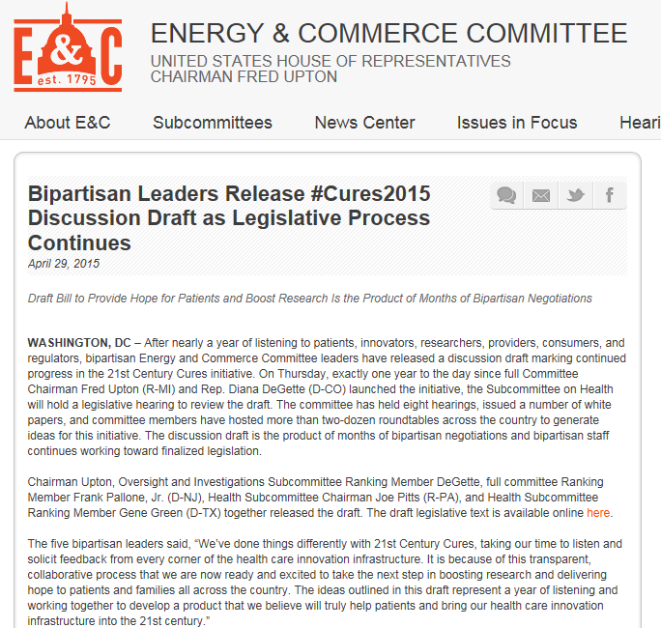
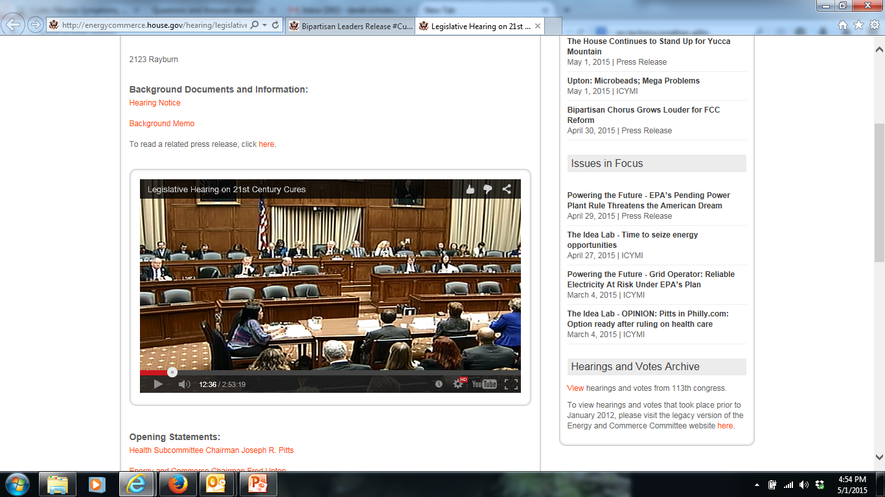
New Draft of 21st Century Cures Act
Document 8
Notes:
You might also recall that the House Committee on Energy and Commerce released a draft version of the 21st Century Cures Act earlier this year. This proposal aims to accelerate the rate of discovery in biomedical research and its translation to treatments and cures. To update you, on April 29, the Committee issued a new draft of the legislation. The new draft bill contains significant differences compared with the previous draft, including a new NIH Innovation Fund, which provides $10 billion of new, mandatory funding for NIH over the next five years.
* The day after the release of the draft legislation, the Committee’s Health Subcommittee held a hearing, with Dr. Kathy Hudson (NIH Deputy Director for Science, Outreach, and Policy) testifying, along with representatives of the Food and Drug Administration. Dr. Hudson thanked the committee for many provisions in the bill, including the proposed budget increase. Of particular relevance for NHGRI, Dr. Hudson requested that the committee consider an addition to the bill establishing that individual-level genomic data be deemed as confidential.
Last week, the Health Subcommittee of the Energy and Commerce Committee approved the legislation. The full Committee is scheduled to consider the bill later this week.

Slide 20

Senate Hearing on the
Precision Medicine Initiative
Document 8
Notes:
On May 5, the Senate Committee on Health, Education, Labor, and Pensions held a hearing entitled ”Continuing America’s Leadership: Realizing the Promise of Precision Medicine for Patients.” Francis Collins was one of a panel of witnesses, which also included representation from the Food and Drug Administration and the Office of the National Coordinator for Health Information Technology.
The hearing was well-attended by the committee members, and there was clear bipartisan interest on the details of the Precision Medicine Initiative, such as the make up of the large cohort and how research participants will be recruited.
This hearing was the latest in a series that the committee is holding as part of their Innovation for Healthier Americans initiative to assess the impact and efficiency of the FDA and NIH. At the end of the hearing, Committee Chairman Senator Alexander indicated that it is his hope to complete the committee’s work on this initiative by the end of 2015.

Slide 21
Director’s Report Outline
General NHGRI Updates
General NIH Updates
General Genomics Updates
NHGRI Extramural Research Program
NIH Common Fund/Trans-NIH
NHGRI Division of Policy, Communications, and Education
NHGRI Intramural Research Program

Slide 22


Dan David Prize 2015
Future – Bioinformatics
David Haussler, Ph.D.
Document 9
Notes:
Recently, David Haussler received the Dan David Prize 2015 for the Future Time Dimension in the Field of Bioinformatics. The Dan David Prize recognizes and encourages innovative and interdisciplinary research that cuts across traditional boundaries and paradigms. The prize covers three time dimensions - Past, Present, and Future - that represent realms of human achievement. The ‘Future’ category focuses on breakthroughs that hold great promise for improvement of our world.

Slide 23

Elected to NAS
Marianne Bronner
Aravinda Chakravarti
Scott Edwards
John Lis
Joachim Messing
Rodney Rothstein
NATIONAL ACADEMY OF SCIENCES
Document 10
Notes:
The National Academy of Sciences recently announced their newly elected members. Of relevance to the genomics community, the newly elected members include Marianne Bronner, Aravinda Chakravarti, Scott Edwards, John Lis, Joachim Messing, and Rod Rothstein.

Slide 24
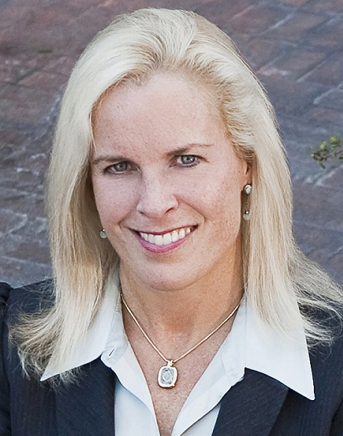

Elected to AIMBE
Deidre Meldrum, Ph.D.
Document 11
Notes:
Former Council member, Deirdre Meldrum was elected to the American Institute for Medical and Biological Engineering’s College of Fellows. DeeDee was recognized for her outstanding contributions and pioneering work in the automation of innovative single-cell analysis systems for discovering biosignatures that predict human health and disease.

Slide 25
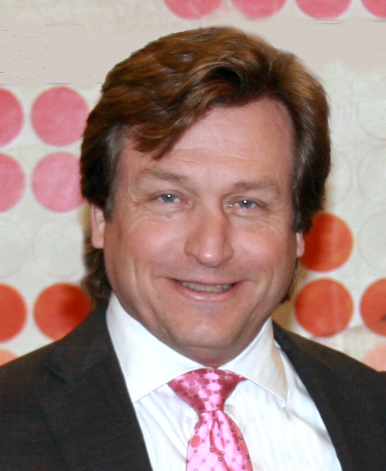

Executive VP for Medical Genomics and Chief Medical Genomics Officer, HudsonAlpha
Howard Jacob, Ph.D.
Document 12
Notes:
Council member Howard Jacob is joining HudsonAlpha as Executive Vice President for Medical Genomics and Chief Medical Genomics Officer.

Slide 26
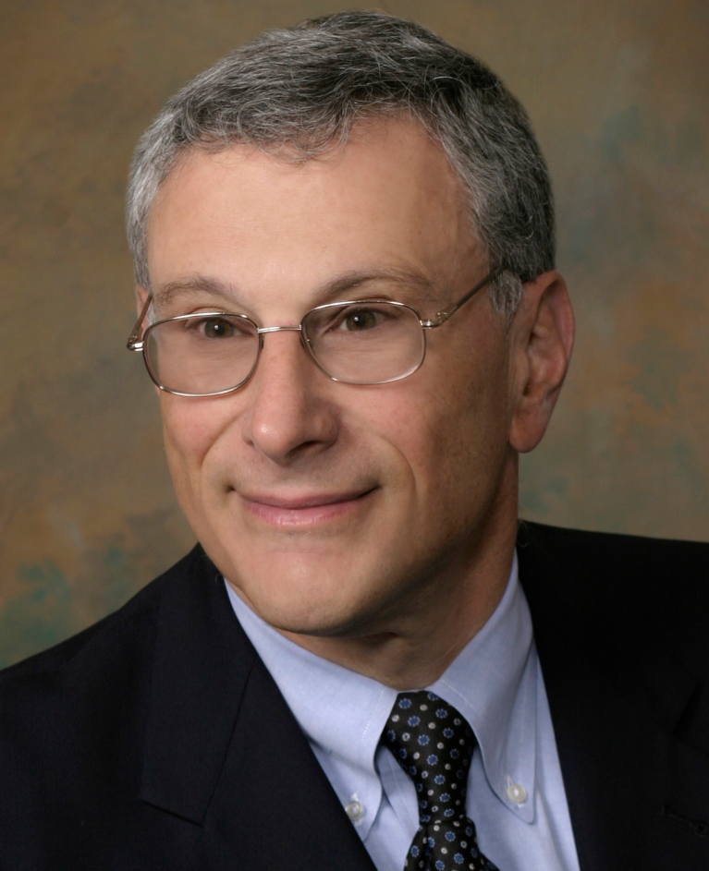

New Chief Medical Officer, Invitae
Robert Nussbaum, M.D.
Document 13
Notes:
And Council member Bob Nussbaum will be taking up the position of Chief Medical Officer at Invitae, a genetic testing company in San Francisco.

Slide 27



New Joint Directors of EMBL-EBI
Rolf Apweiler, Ph.D.
Ewan Birney, Ph.D.
Document 14
Notes:
There are other major transitions for giants in genomics that were announced recently. Rolf Apweiler and Ewan Birney have been appointed Joint Directors of the European Molecular Biology Laboratory – European Bioinformatics Institute (EMBL-EBI), as Janet Thornton steps down after 14 years in her leadership position. Rolf and Ewan will assume their new roles in July of this year.

Slide 28
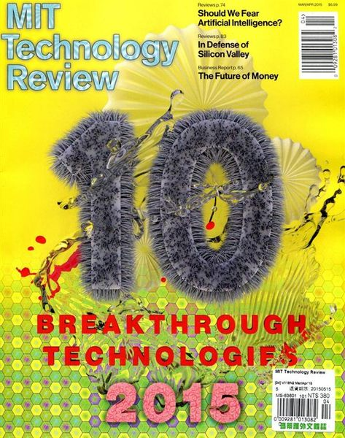
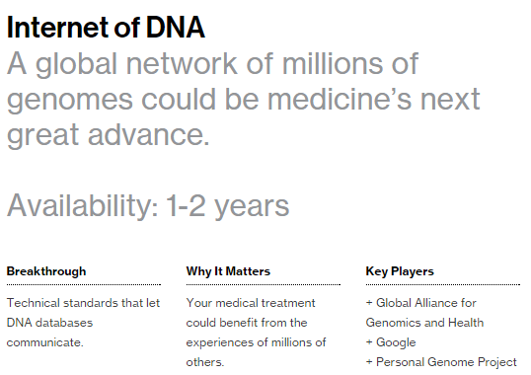
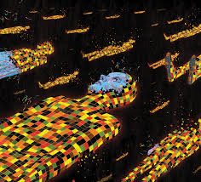
MIT Technology Review
Breakthrough Technologies 2015
Document 15
Notes:
The MIT Technology Review recently listed its Top 10 Breakthrough Technologies for 2015. Of note is number 10, the “Internet of DNA”— a global network of millions of genomes.

Slide 29
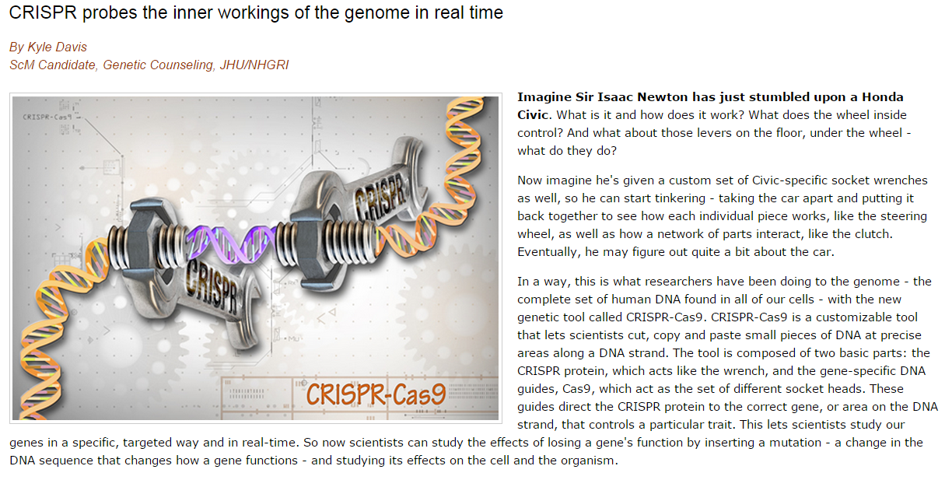
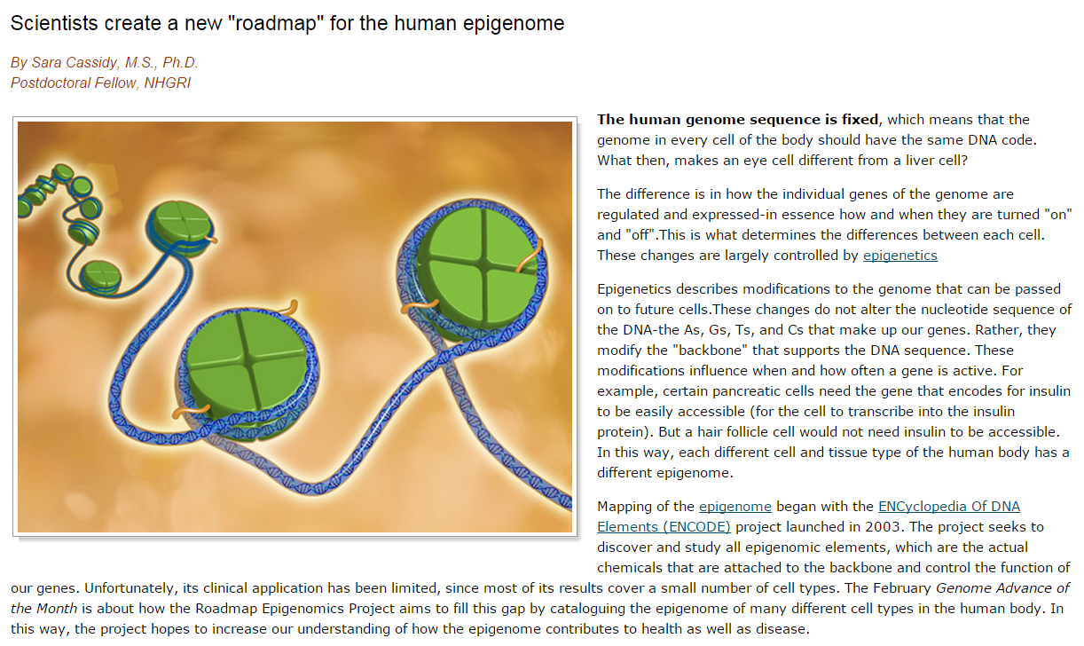
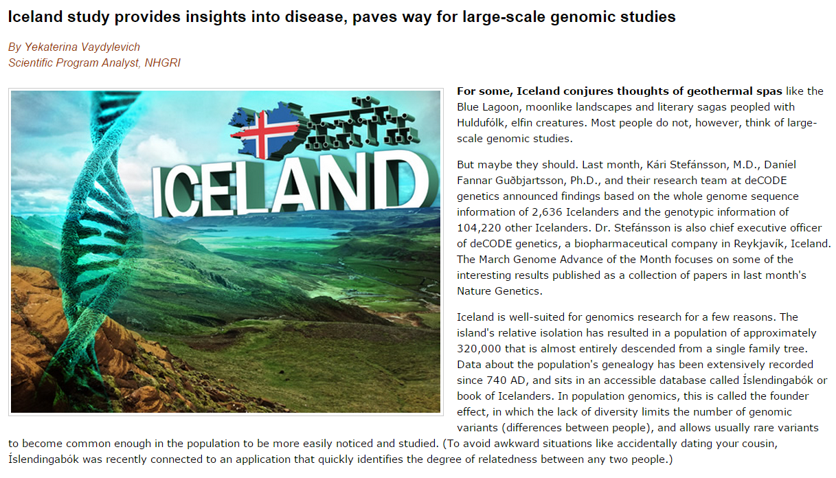
NHGRI Genome Advance of the Month
Document 16
Notes:
Featured as an NHGRI Genome Advance of the Month since the last Council meeting have been publications describing * the CRISPR-Cas9 gene editing tool, * research findings from the Roadmap Epigenomics Project, and * the genomics of Icelanders.

Slide 30



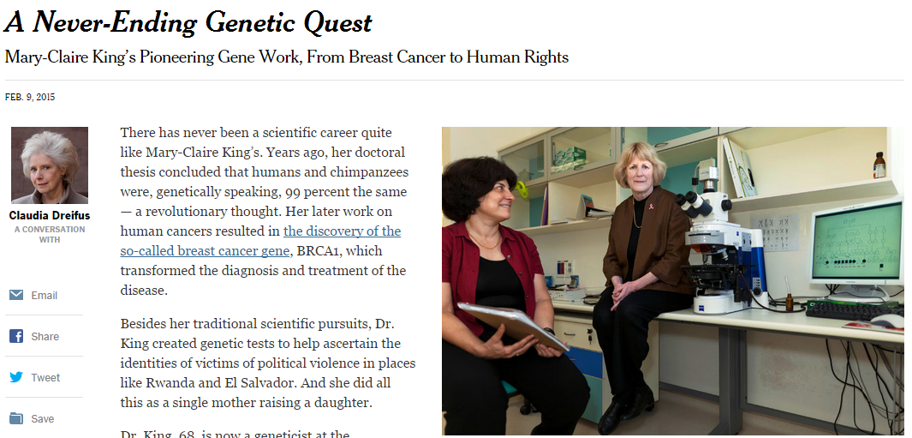
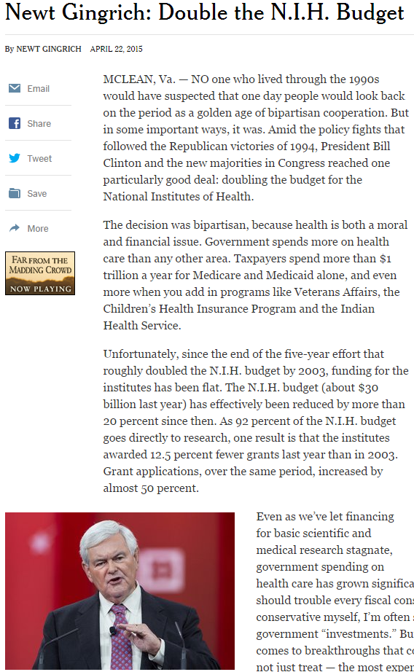
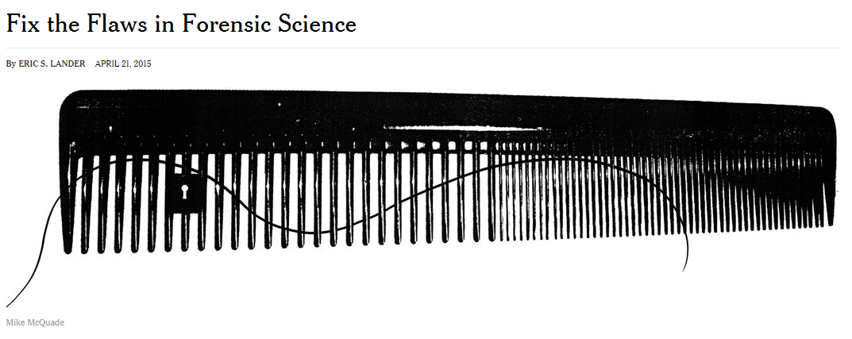
Genomics In The News…
Document 17
Notes:
For our “Genomics in the News” segment of the Director’s Report, we wanted to highlight three prominent pieces all coming from the * New York Times. These include * an interview with Mary Claire-King, * an op-ed from Newt Gingrich calling for a doubling in NIH funding, and * a piece by Eric Lander regarding forensic science.

Slide 31
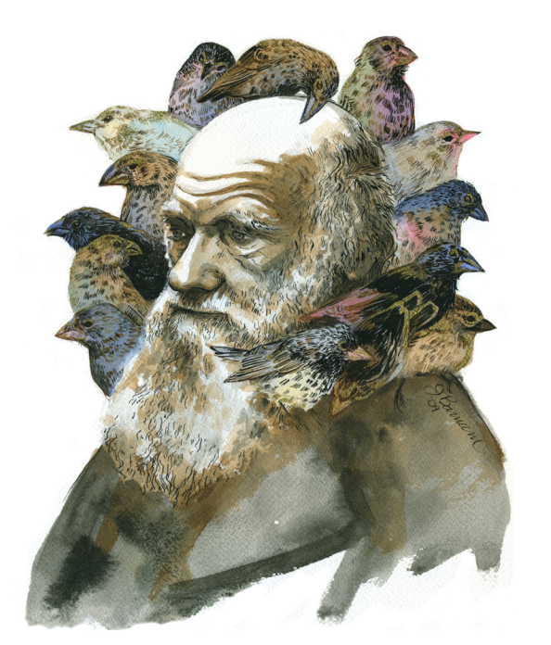


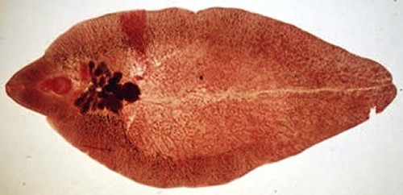



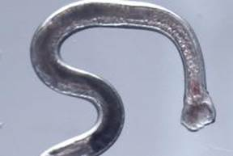




Genomes In The News…
Document 18
Notes:
And in terms of Genomes in the News, there have been a number of recently generated genome sequences reported since the last Council meeting, including: * 15 Species of Darwin’s finches, * eastern tiger swallowtail butterfly, * hookworm, * Tibetan plateau frog, * large yellow croaker (a fish), * mountain gorilla, * cotton species, * liver fluke, * two woolly mammoths, and * both the European buff-tailed bumblebee and the North American common eastern bumblebee (these latter genomes created quite a buzz).

Slide 32
Director’s Report Outline
General NHGRI Updates
General NIH Updates
General Genomics Updates
NHGRI Extramural Research Program
NIH Common Fund/Trans-NIH
NHGRI Division of Policy, Communications, and Education
NHGRI Intramural Research Program

Slide 33
Genome Sequencing Program
  Applications for CCDGs and CMGs in review
  Coordinating Center RFA released
  Genome Sequencing Program Coordinating Center (U24): RFA-HG-15-019
  FOAs for remaining concepts in process:
  Genome Sequencing Program Analysis Centers
    High-Quality (“Gold”) Reference Genomes
    Comparative Genomics
Document 19
Notes:
NHGRI’s Genome Sequencing Program currently has a number of funding opportunities at different stages of the application and review process.
* Applications for the Centers for Common Disease Genomics (CCDGs) and the Centers for Mendelian Genomics (CMGs) have been submitted and are in the process of being reviewed.
* An RFA for a Genome Sequencing Program Coordinating Center was released on March 25.
* Meanwhile, funding opportunities for three remaining Genome Sequencing Program concepts are still in process and will be released in the near future. Recall that these will be for Genome Sequencing Program Analysis Centers, High-Quality (“Gold”) Reference Genomes, and Comparative Genomics (as we discussed at the February Council meeting).

Slide 34

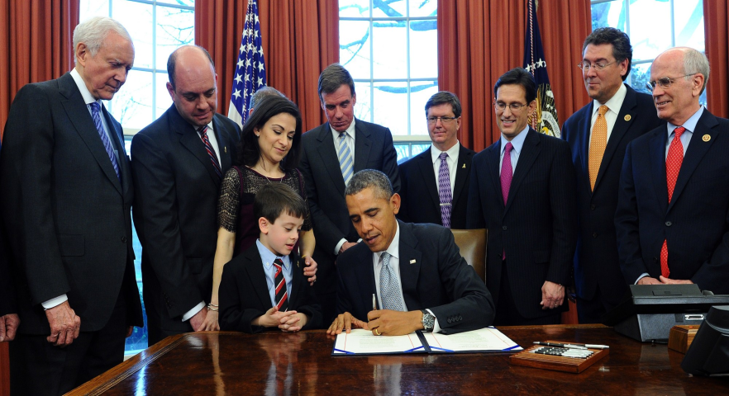
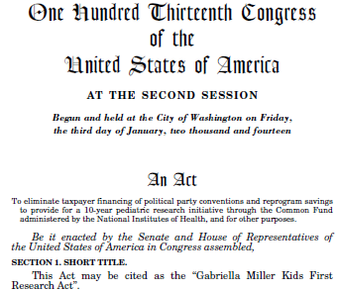
Sequencing Opportunity: Gabriella Miller Kids First Pediatric Research Program
  Facilitate discovering the genomic basis of structural birth defects and childhood cancers
  Access to whole-genome sequencing for available samples
  Applications due July 27
Document 19
Notes:
Relevant to our current Genome Sequencing Program is a recently released announcement for something quite new— the Gabriella Miller Kids First Pediatric Research Program (or Kids First). This new NIH Common Fund program is planning to develop a data resource for the pediatric research community of well-curated clinical and genomic sequence data. * These data are intended to facilitate discovering the genomic basis of structural birth defects and childhood cancer.
* The initial component of this program is providing access to whole-genome sequencing for available samples, with that sequencing to be provided by the NHGRI Genome Sequencing Program. An announcement about the opportunity for X01 awards for this program was released last Friday, * with a due date of July 27. The Common Fund will be providing all the funds to support genome sequencing of the samples identified through this announcement.

Slide 35
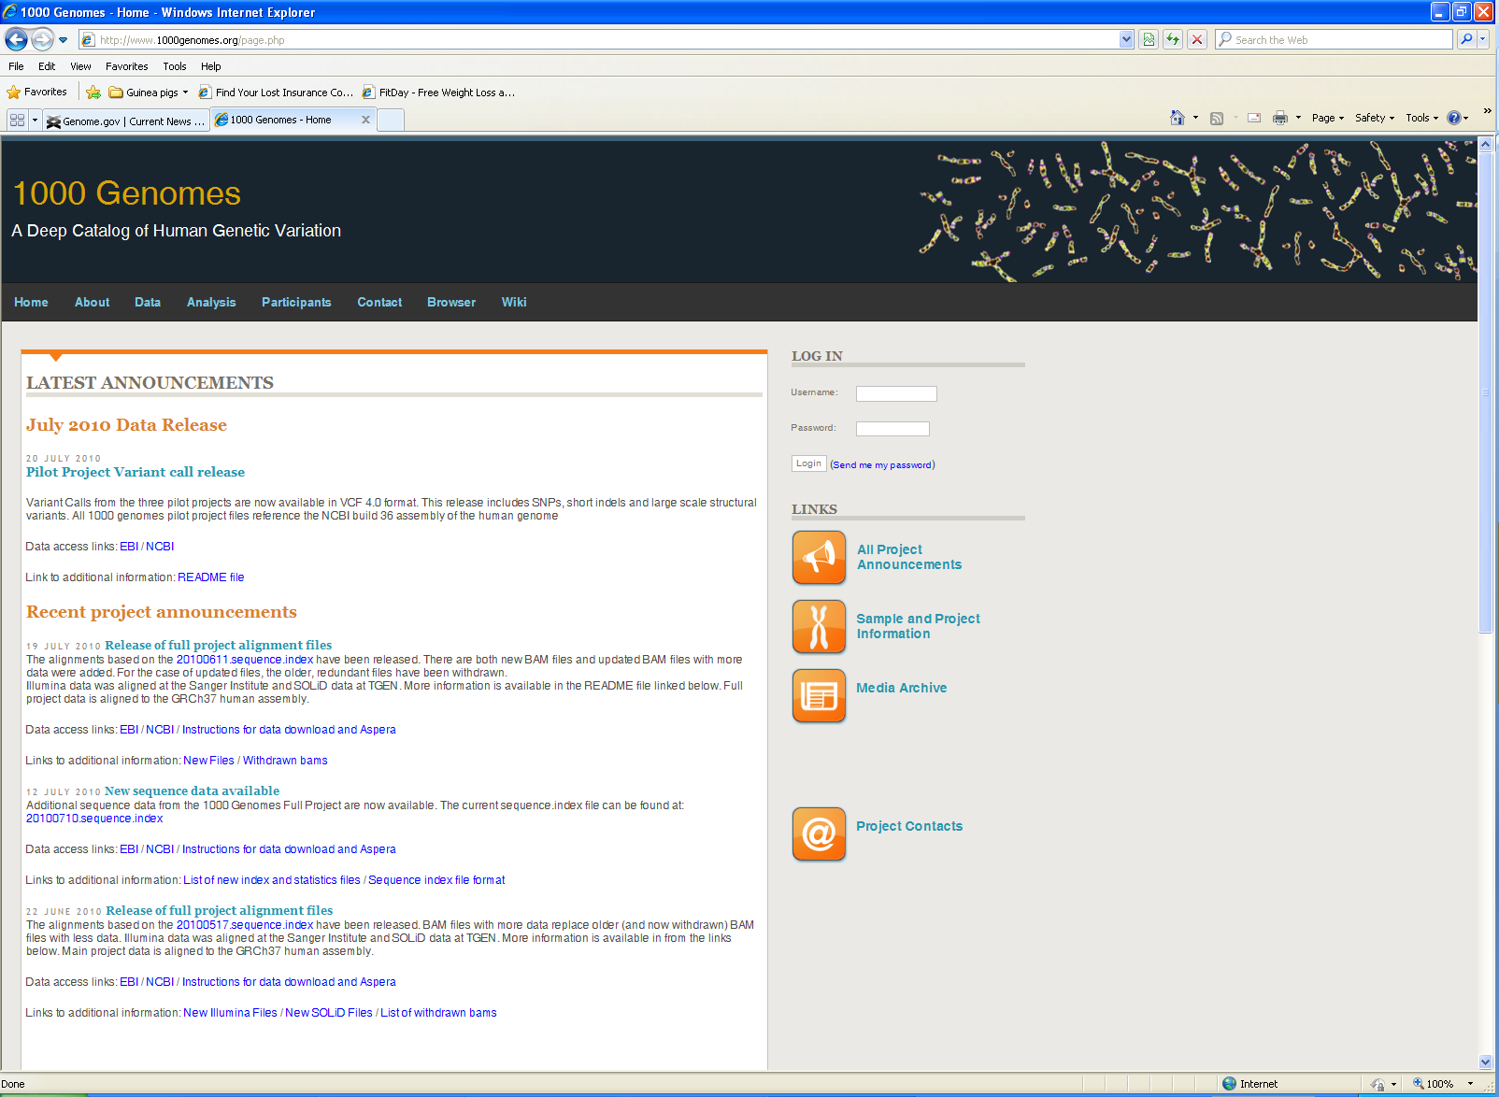
    Goal: Identify 95% of common variants
    Final dataset: >99% of common variants
    Based on 2,504 people from 26 populations
    >84 million variant sites:
        81M SNPs
        3.4M indels (insertions/deletions)
        68K structural variants
Final paper published by October
Document 20
Notes:
The 1000 Genomes Project is winding down. Recall that the project’s * goal was to identify and catalog 95% of the common human genomic variants (those with a frequency of at least 1%).
* Indeed, the final dataset appears to account for >99% of the common variants. * This was based on sequencing the genomes of 2,504 people from 26 populations.
* In total, 1000 Genomes has found >84 million variant sites in the human genome. These include 81 million single-nucleotide polymorphisms (or SNPs), 3.4 million insertions and deletions, and 68 thousand structural variants.
* The Project’s final paper should be published by October of this year.

Slide 36
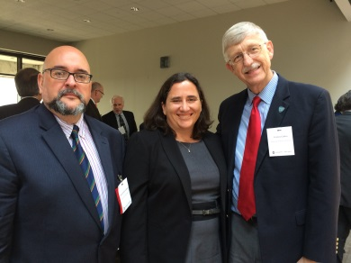
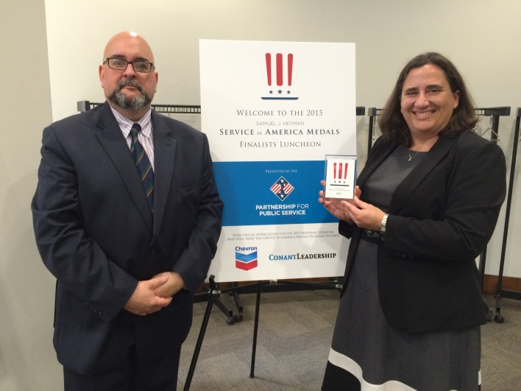
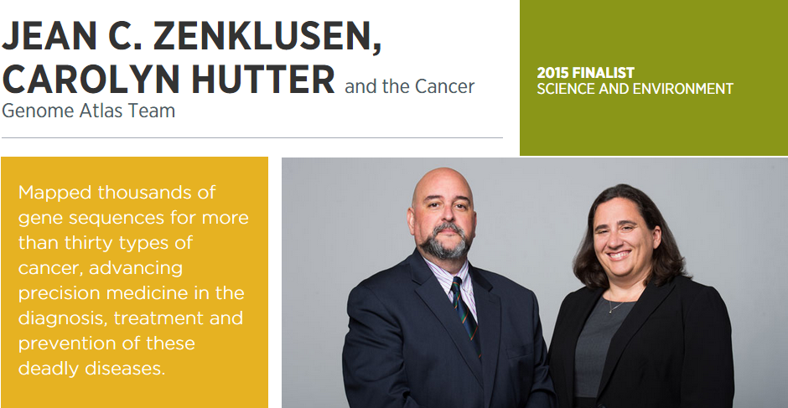

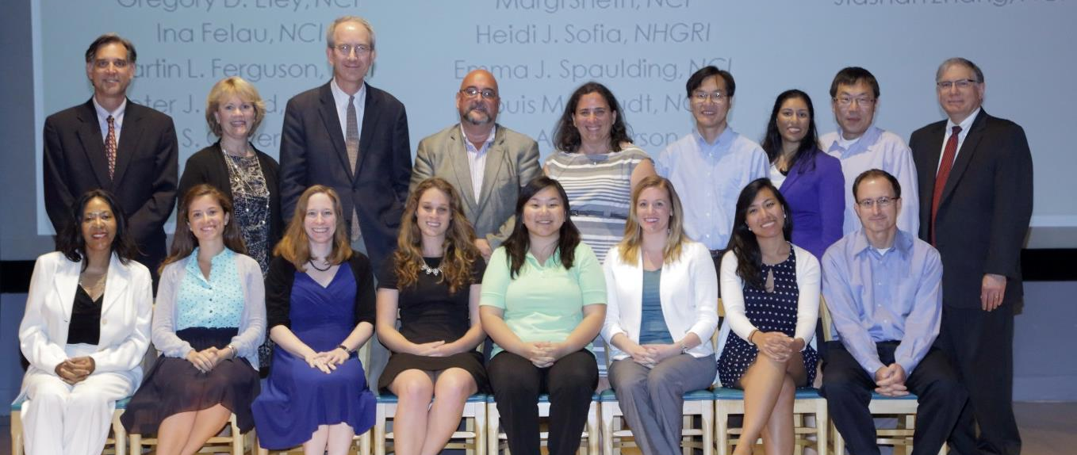
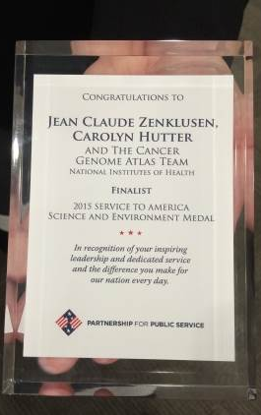
TCGA Project Team Named as
Finalist for Service to America Medal
The Samuel J. Heyman
SERVICE to AMERICA MEDALS
Document 21
Notes:
Another project that is winding down is the Cancer Genome Atlas project (or TCGA), which is a joint effort between NHGRI and NCI that aims to improve our understanding of the molecular basis of cancer.
* TCGA is now being recognized for its remarkable achievements. Specifically, the TCGA Project Team has been selected as a finalist for the 2015 Samuel J. Heyman Service to America Medals. This prestigious award, nicknamed “the SAMMIES,” is presented annually by the nonprofit, nonpartisan Partnership for Public Service to celebrate excellence in federal civil service (it is sometimes referred to as the Oscars for government service). * Shown here are NCI’s Jean Claude Zenklusen and NHGRI’s Carolyn Hutter, who lead a very successful and impressive group from both institutes that oversee the TCGA project.

Slide 37

    Discovery
    Discovered >1,100 causal genes
    453 novel causal genes
    >170 publications
    Resource Sharing
    PhenoDB (>216 downloads)
    ALoFT source code
    Data analysis workshops
    dbGaP data deposition
    GeneMatcher
1,923
201
Document 22
Notes:
The Centers for Mendelian Genomics (or CMGs) were launched 3.5 years ago aiming to find as many causal genes of Mendelian conditions as possible. * To date, the CMGs have been responsible for * discovering >1,100 causal genes for Mendelian conditions, of which * 453 are novel (in that they had not previously been associated with any Mendelian conditions). * Some of those discoveries have now been reported in >170 publications.
* Besides making direct contributions to finding the causes of single-gene disorders, the CMGs are playing a significant role in project matching in order to accelerate discoveries. GeneMatcher, a software that enables connections between investigators sharing an interest in the same candidate gene(s), has been used by a rapidly growing number of international investigators since its launch in December of 2013. This graph shows that by April of this year, 201 matches had been made out of the 1,923 submitted genes.
* Another focus of the CMGs’ attention is resource sharing in order to enable other investigators to conduct similar research. To name a few examples of these efforts, * PhenoDB, a tool for phenotype data entry and storage, has been downloaded by over 216 groups worldwide. * The source code of ALoFT, a program for analysis of loss-of-function variants, is now freely available. * Two CMG workshops have been held that provided participants with hands-on experience using CMG data analysis tools. In addition, * all the CMG groups deposit their sequence data into dbGaP.

Slide 38



Clinical Sequencing Exploratory Research Program
Enrolled 3,638 adults, 796 children
149 publications, 10 working group publications
Document 23
Notes:
The Clinical Sequencing Exploratory Research (or CSER) Program focuses on the integration of genome sequencing into the clinical workflow, including the generation, interpretation, and clinical reporting of genomic information. * CSER has enrolled over 3600 adult and almost 800 children as participants, nearly 3000 of whom have had germline genome sequence data generated and over 500 of whom have had tumor genome sequence data generated.
As one measure of overall impact, * CSER has generated 149 publications, including 10 cross-CSER working group publications.
* CSER was prominently featured at both the American College of Medical Genetics and Genomics Annual Meeting in March and * the American Association for Cancer Research Annual Meeting in April. In total, there were 29 CSER-related talks at these two meetings, including a short course on clinical exome sequencing and a panel discussion on investigating the actionability of tumor genome variants.
We will hear more about the CSER Program in presentations by Gail Jarvik and Les Biesecker later in open session.

Slide 39

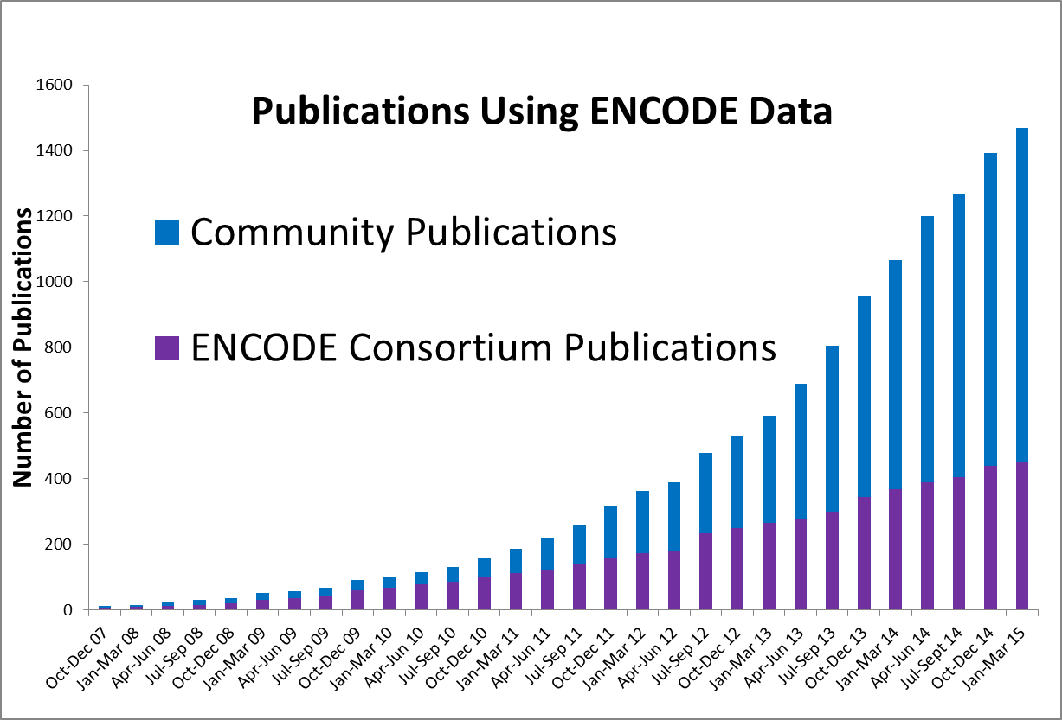
Encyclopedia of DNA Elements (ENCODE)
  Planning Workshop: “From Genome Function to Biomedical Insight— ENCODE and Beyond”
  ENCODE Community User’s Meeting
    June 29 to July 1 in Potomac, Maryland
    Hands-on workshops using ENCODE data
Document 24
Notes:
The goal of the Encyclopedia of DNA Elements (ENCODE) Project is to create a catalog of all functional elements in the human and mouse genomes and to make those catalogs available as a resource to the biomedical community.
* NHGRI held a small planning workshop entitled “From Genome Function to Biomedical Insight— ENCODE and Beyond” in March. The goal of this workshop was to obtain community input on possible future scientific directions in the area of genome function following the current phase of ENCODE in 2016. Later in today’s Open Session, we will hear a summary of the workshop followed by a presentation of concepts for four initiatives in functional genomics.
* ENCODE is planning a Community User’s Meeting that will * take place in late July in the DC area. * The Consortium will lead hands-on workshops on how to use ENCODE data, and community members will make presentations on how they are using the data. The registration website is now open.
* ENCODE data continue to be heavily used. There are at least 1,018 community publications from groups without ENCODE funding (shown in the blue bars) . In addition, ENCODE has published 452 consortium publications (shown in the purple bars).

Slide 40

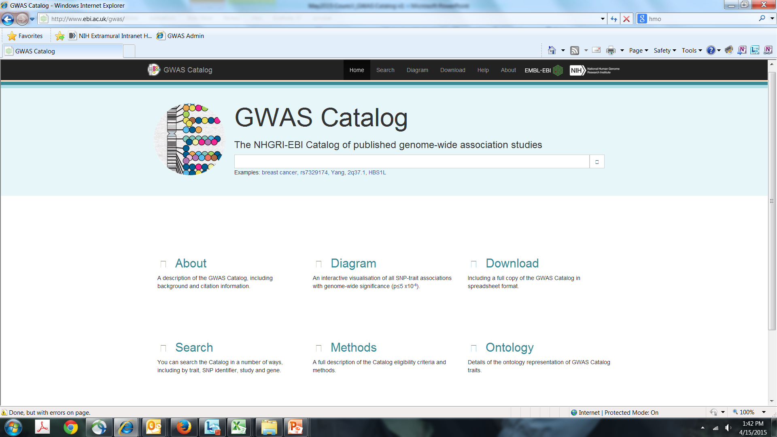
Genome-Wide Association Studies
(GWAS) Catalog
Courtesy Jackie MacArthur, EBI
Document 25
Notes:
The NHGRI Genome-Wide Association Studies (GWAS) Catalog is a curated, downloadable, user-friendly resource that catalogs the findings from published genome-wide association studies. It is produced as a collaboration among NHGRI, the European Bioinformatics Institute (EBI), and the National Center for Biotechnology Information (NCBI).
We reported at the February Council meeting that the GWAS Catalog content and search interface were in the process of migrating to EBI, and now that transition is complete. Announced with a “GWAS cake” (shown here) designed to mark the occasion, the new EBI site * features an enhanced search interface and updated content. For the time being, the existing NHGRI site will still be maintained with content prior to the transition.

Slide 41


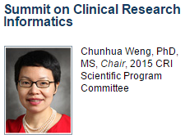

Distinguished Paper Award
A Prototype for Executable and Portable Electronic Clinical Quality Measures Using the KNIME Analytics Platform
Huan Mo, MD, Jennifer A. Pacheco, Luke V. Rasmussen, Peter Speltz, Jyotishman
Pathak, PhD, Joshua C. Denny, MD, William K. Thompson, PhD
Student Paper Award
Phenotyping Adverse Drug Reactions: Statin-related Myotoxicity
Laura K. Wiley, Jeremy D. Moretz, PharmD, Joshua C. Denny, MD, MS, Josh F. Peterson, MD, William S. Bush, PhD
Document 26
Notes:
Investigators in the Electronic Medical Records and Genomics (eMERGE) Network leverage data from large biorepositories linked to electronic medical records to conduct genomic discovery and clinical implementation research. In the final year of its second phase, the Network is actively disseminating its products and best practices to the broader scientific community.
* The American Medical Informatics Association (AMIA) 2015 Joint Summits on Translational Science were held in March. * eMERGE investigator Chunhua Weng led and organized this meeting as Chair of the Clinical Research Informatics Scientific Program Committee.
eMERGE researchers shared their experiences in designing phenotype algorithms using clinical information stored in participants’ electronic health records. They also fielded questions on implementing real-time clinical decision support for healthcare providers. They received * a Distinguished Paper Award for mapping institutional data to standard schema for representing clinical concepts and * a student paper award for developing a phenotype algorithm for adverse drug reactions to statins.

Slide 42

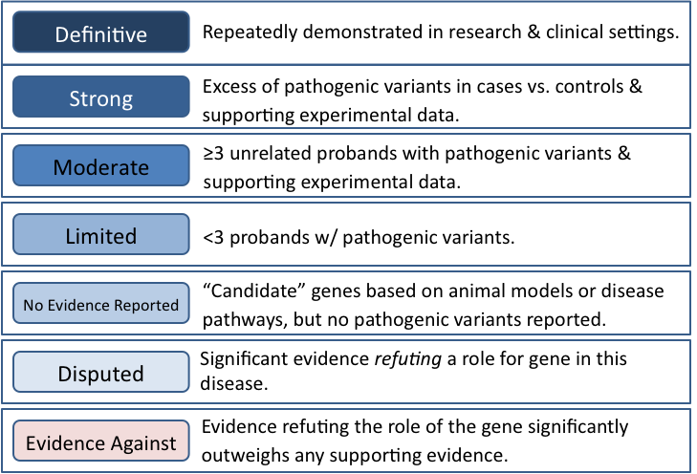

Clinical validity classification system
ClinGen-DECIPHER public meeting in May
Document 27
Notes:
The Clinical Genome Resource (ClinGen), designed to build an authoritative central resource that defines the clinical relevance of genomic variants for use in precision medicine and research, is proceeding well and will become a key resource for our genomic medicine implementation efforts.
* ClinGen investigators have developed a classification system to assess the clinical validity of specific gene-disease pairs, such as SMAD3 for Loeys-Dietz syndrome and RAD51D for ovarian cancer. This is an important addition to our set of tools for interpreting the clinical relevance of genes and variants. An abbreviated version of the classification system is shown here, but the complete framework and supporting documentation can be reviewed on the ClinGen website.
* United by the common goals of leveraging data sharing and collaboration to improve our understanding of human genomic variation, ClinGen and the Sanger Institute’s DECIPHER group will co-host a large public meeting next week in Washington DC. Meeting topics include approaches for curating gene-disease relationships, lessons learned from aggregating population and patient data, and initiatives facilitating clinical genomics IT development.

Slide 43



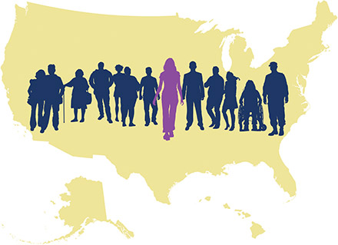
Implementing Genomics in Practice (IGNITE) Network
Marker paper submitted to Genetics in Medicine
Affiliate members:
Precision Medicine Initiative Working Group of the Advisory Committee to the Director
Document 28
Notes:
The Implementing Genomics in Practice (IGNITE) Network aims to advance genomic medicine by developing methods for incorporating genomic information into clinical care in diverse clinical settings and populations. * The Network has submitted their marker paper describing the six projects, the coordinating center, and the Network’s working groups and activities for publication.
* The Network is accepting affiliate members to share strategies in overcoming genomic medicine implementation challenges and in increasing power for analyses of outcomes. Investigators such as Howard McLeod at the Moffitt Cancer Center, Julio Duarte at the University of Illinois at Chicago, and John Lima at Nemours Children’s Health System have already joined as affiliates. Currently, the Network and its affiliate members are collaborating to assess outcomes of CYP2C19 testing to predict clopidogrel response.
* Of note, Josh Denny, an IGNITE PI, was appointed a member of the Advisory Committee to the NIH Director Working Group on the Precision Medicine Initiative.

Slide 44
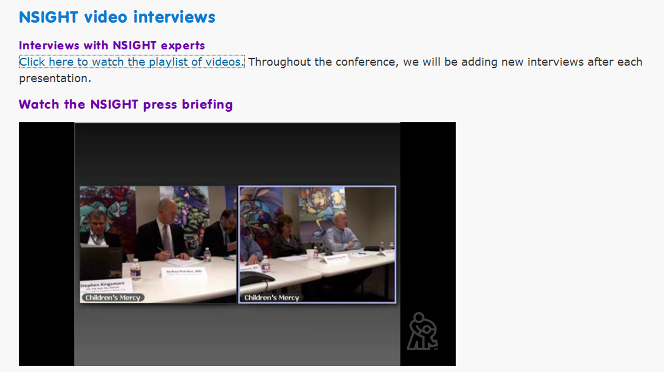
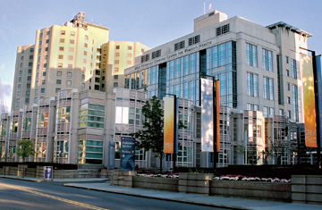
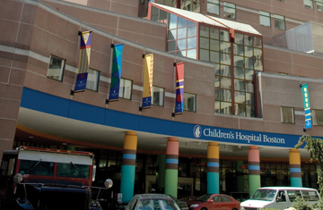

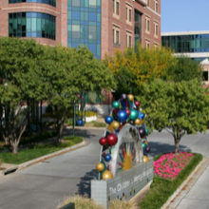

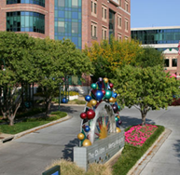
Newborn Sequencing in Genomic Medicine and Public Health (NSIGHT)
BWH, BC, and BCM
UCSF
Boston, MA
San Francisco, CA
Children’s Mercy
Kansas City, MO
UNC – Chapel Hill
Chapel Hill, NC
Document 29
Notes:
The Newborn Sequencing in Genomic Medicine and Public Health (NSIGHT) program will explore, in a limited but deliberate manner, the implications, challenges, and opportunities associated with the possible use of genomic sequence information for the care of newborns.
* Recently the four program sites participated in the Children’s Mercy Pediatric Genomics Medicine Conference in Kansas City, at which key personnel from each of the sites discussed their progress to date. Video from the associated press briefing and interviews with the NSIGHT presenters can be found on the Children’s Mercy Hospital’s conference website.

Slide 45

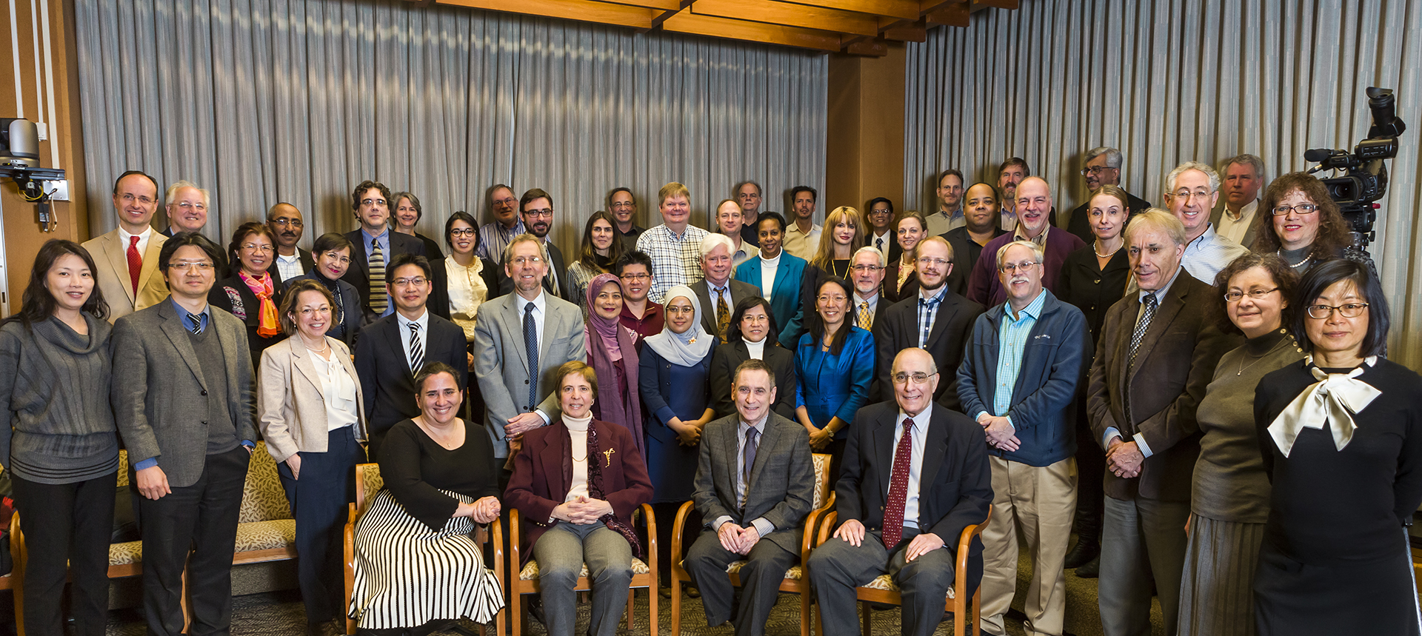




Genomic Medicine Working Group
NHGRI
Genomic Medicine Programs
IGNITE
G2MC
eMERGE
NSIGHT
ClinGen
UDN
CSER
Genomic Medicine #8
Bethesda, MD
June 8-9, 2015
Document 30
Notes:
The NHGRI Genomic Medicine Working Group is a working group of this Council and provides guidance to NHGRI in areas of genomic medicine implementation. As a follow-up to the 2014 Global Leaders in Genomic Medicine meeting, * the NIH and FDA sponsored a workshop on “Research Directions in Genetically-Mediated Stevens-Johnson Syndrome/Toxic Epidermal Necrolysis (SJS/TEN).”
* This workshop brought together global experts on SJS/TEN to discuss gaps and opportunities in basic research, clinical implementation, and pharmacosurveillance, and then discussed priorities for future research to globally eliminate genetically mediated Stevens-Johnson Syndrome.
* The Genomic Medicine Working Group is now planning its next meeting, entitled “Genomic Medicine 8: NHGRI’s Genomic Medicine Programs,” which will be held in early June. The Genomic Medicine 8 meeting will convene leadership from NIH and external groups to examine the NHGRI genomic medicine portfolio in light of evolving scientific knowledge and opportunities. As with the previous Genomic Medicine gatherings, the meeting will be videocast live and also videoarchived on our GenomeTV channel of YouTube.
Staff from the Division of Genomic Medicine will give a more detailed update on both of these meetings at the September Council meeting.

Slide 46

Genomics and Society Working Group
  Recent in-person meeting
  Topics discussed:
      Normative and conceptual research
      Portfolio balance
      Health services research
      ELSI and precision medicine
  Update planned for September Council meeting
Document 31
Notes:
The Genomics and Society Working Group of this Council is charged with providing advice on short- and long-range planning and priority setting for the genomics and society activities at the Institute.
* The Working Group held its annual in-person meeting in April. * Topics of discussion included: * the definition and rationale for continued support of normative and conceptual research within the ELSI Research Program; * the appropriate balance between investigator-initiated and program-initiated activities within the ELSI Research Program’s portfolio, including the role of embedded models for the conduct of ELSI research; * the appropriate role of the ELSI Research Program in the area of health services research; and * ELSI research issues raised by the Precision Medicine Initiative.
* The Working Group Chair, Lisa Parker, will be providing an update about the Working Group at the September Council meeting.

Slide 47

Centers of Excellence in ELSI Research (CEER)
  First Regional CEER Networking Meeting in February
  Annual CEER Investigator Meeting in March
  CEER RFA released, with applications due July 15
Document 32
Notes:
Since the February Council meeting, there have been a number of activities associated with the Centers of Excellence in ELSI Research (or CEER) program.
* The First Regional CEER Networking Meeting for trainees and investigators was held in late February. The purpose of this meeting was to provide a more sustained training and networking experience for trainees associated with CEERs in the Western half of the country, many of whom are unable to travel to the annual meetings on the East Coast.
* The Annual CEER Investigator Meeting was held in March. Highlights of this meeting included a grant writing workshop for CEER trainees, discussion of successes and challenges in trans-disciplinary research, and an overview of the variety of stakeholder engagement activities across the CEERs.
* A Request for Applications for the next round of CEERs was recently released. Applications are due July 15. Individuals interested applying are strongly encouraged to contact ELSI Research Program staff prior to submitting an application.

Slide 48

NHGRI Large Genomics Resources Meeting: May 20-21
  Goal: Develop strategic vision for NHGRI-funded large genomics resources
  Attendees:
      PIs and Advisors
      NIH staff (including NHGRI, NIGMS, and ADDS)
  Key discussion topics:
    Efficiency
    Impact on genomic research
    Long-term sustainability
Notes:
NHGRI has long supported genomics resources (such as databases) and recognized their critical role in enabling broad use of genomic data. Particularly in the current funding climate, the long-term sustainability of these resources is a very important topic to the Institute. NHGRI will take key steps toward developing a strategic vision for NHGRI-funded genomics resources in a meeting that will be held later this week.
* The goal of the meeting is to develop a strategic vision for NHGRI-funded large genomics resources.
* Attendees will include the PIs and a handful of advisors associated with NHGRI-funded genomics resources, such as the model organism databases (for fly, mouse, worm, yeast, and zebrafish), ClinGen, the GO Consortium, and UniProt. Council members Joe Ecker and Carol Bult will be among those participating. In addition, NIH staff from NHGRI, NIGMS, and the Associate Director for Data Science office will be attending.
* Key topics to be discussed during the workshop include: * measuring and improving efficiency in data curation, outreach, and training; * understanding user needs and the impact of these resources on biomedical research; and * ensuring appropriate long-term sustainability for the operations and services these resources support.

Slide 49
Director’s Report Outline
General NHGRI Updates
General NIH Updates
General Genomics Updates
NHGRI Extramural Research Program
NIH Common Fund/Trans-NIH
NHGRI Division of Policy, Communications, and Education
NHGRI Intramural Research Program

Slide 50

Integrative HMP (iHMP)
  Longitudinal research projects
      Inflammatory bowel disease
      Type 2 diabetes
      Preterm birth
  Data Coordination Center
  2nd iHMP Consortium Meeting
    June 2015, Bethesda
  International Human Microbiome Consortium Congress
    5th: March 2015, Luxembourg
    6th: October 2016, Houston
Document 33
Notes:
As a reminder, the “integrative HMP” (iHMP) program is made up of three research projects and a Data Coordination Center (DCC).
* The longitudinal research projects are studying onset of inflammatory bowel disease, Type 2 diabetes, and preterm birth, with the goal of integrating multi-omic data from the study subjects and their microbiomes.
* In January, the Common Fund provided full support for the iHMP Data Coordination Center. And in March, this Center met with the project data managers to develop data-harmonization and deposition protocols for these multi-omic data.
* The second annual iHMP Consortium meeting will be held in June.
* The 5th International Human Microbiome Consortium Congress was held in March in Luxembourg and was very well attended by ~500 researchers from 15 countries representing five continents. The 6th such Congress is planned for October in Houston.

Slide 51











  Fast-Track Action Committee:
  Mapping the Microbiome
  Chartered by OSTP
  Data call:
    Portfolio analysis
    11 departments and agencies
    Host- and ecosystem-associated microbiomes
  Report to OSTP:
    Identify gaps, needs, and challenges
    Outline a Federal coordinated plan to support President’s Fiscal Year 2017 budget request
FTAC
MM
2015
Notes:
A Fast-Track Action Committee on Mapping the Microbiome * was recently chartered by the President’s Office of Science and Technology Policy (OSTP) to analyze the U.S. Federal Government’s investment in microbiome research. The committee is co-chaired by DHHS, USDA, and OSTP. Lita Proctor is serving as the committee’s Executive Secretary.
* The committee initiated a data call to analyze the Federal microbiome research portfolio over the Fiscal Years 2012-2014. The analysis includes 11 departments and agencies and will include research support for both host- and ecosystem-associated microbiomes.
* The report back to OSTP is intended to identify the gaps, needs, and challenges (as determined by the portfolio analysis) for advancing this field. The report will also outline a Federal coordinated plan to support the President’s Fiscal Year 2017 budget request.

Slide 52

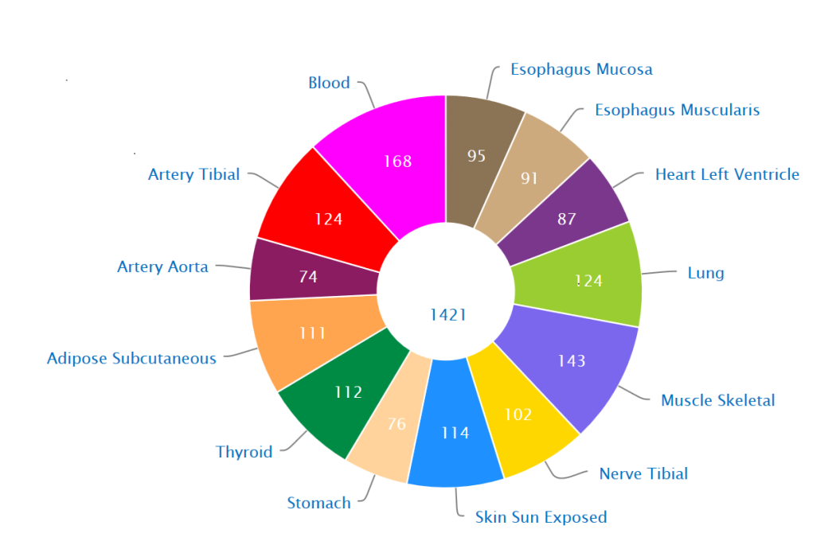
Genotype-Tissue Expression Project (GTEx)
Esophagus Mucosa
Blood
Esophagus Muscularis
168
95
91
Artery Tibial
Heart Left Ventricle
124
87
Artery Aorta
74
124
Lung
1421
Adipose
Subcutaneous
111
143
Muscle Skeletal
112
Thyroid
76
114
102
Nerve Tibial
Stomach
Skin Sun Exposed
    Donor recruitment to conclude by end of summer (n=900)
    Main manuscript and two companion papers published in Science
Document 34
Notes:
The Genotype-Tissue Expression Project (GTEx) is an NIH Common Fund study that aims to provide a comprehensive gene expression atlas across multiple human tissues and comprehensive cis- and trans-eQTL results for each tissue. These data should provide insights into the mechanisms of gene regulation and aid in the interpretation of many studies, including genome-wide association studies.
* For creation of this atlas, GTEx has collected and analyzed biospecimens from over 800 donors so far, and it is projected that donor recruitment will reach its goal of 900 by the end of this summer.
* A couple of weeks ago, a major paper describing the results of GTEx was published in Science, along with two companion papers (on multi-tissue transcriptomics and predicted protein-truncated variants).

Slide 53

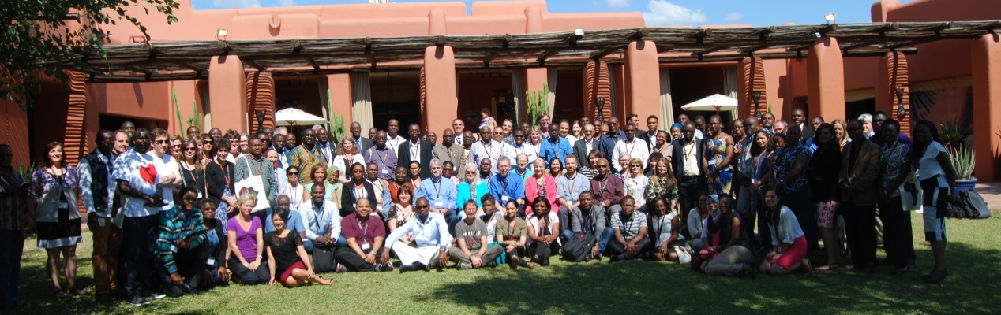
Human Heredity and Health in Africa (H3Africa)
  6th Consortium Meeting in May (Zambia)
    Grants Management Workshop
    Community Engagement Training Workshop
    2nd Ethics Consultation Meeting
  H3Africa and South African ethics guidelines
  3 New ELSI awards
  Alliance for Accelerating Excellence in Science in Africa (AESA)
Document 35
Notes:
H3Africa’s central goal is to develop a sustainable and collaborative African genetics and genomics research enterprise. * Last week, some of us (including me) attended the 6th H3Africa Consortium Meeting in Livingstone, Zambia. In addition to normal Consortium reporting and discussions, there was an * NIH Grants Management Workshop, a Community Engagement Training Workshop, and the 2nd Ethics Consultation Meeting (which included 44 Research Ethics Committee members from 17 countries). I must say that I am really quite impressed with progress by the H3Africa Consortium. In a few short years, I have witnessed impressive growth in the quality of the science, in the vibrancy of H3Africa’s collective research community, in the energies and enthusiasm of the trainees, and in the spirit of collaboration. I think all of us, including this Council, should feel a shared sense of pride in getting this important global initiative off the ground and thriving.
* Recently, we have seen indications that the H3Africa Ethics Working Group activities are having an impact on national policies; for example, H3Africa’s Informed Consent Guidelines were cited in the 2015 South African National Ethics Guidelines as a model for genomics. * Also in the realm of bioethics, an additional 3 ELSI awards have been made, two focusing on the ethics of biobanking and bioresources and one examining stigma in genomics research.
* Finally, there is a new development for research in Africa. The Alliance for Accelerating Excellence in Science in Africa (AESA) has received seed money from the Wellcome Trust, the U.K. Department for International Development, and the Bill & Melinda Gates foundation. This is a platform for managing Africa-focused research programs and also a think tank to direct the continent’s science. We are already exploring H3Africa and this new organization might interact in a productive way.

Slide 54
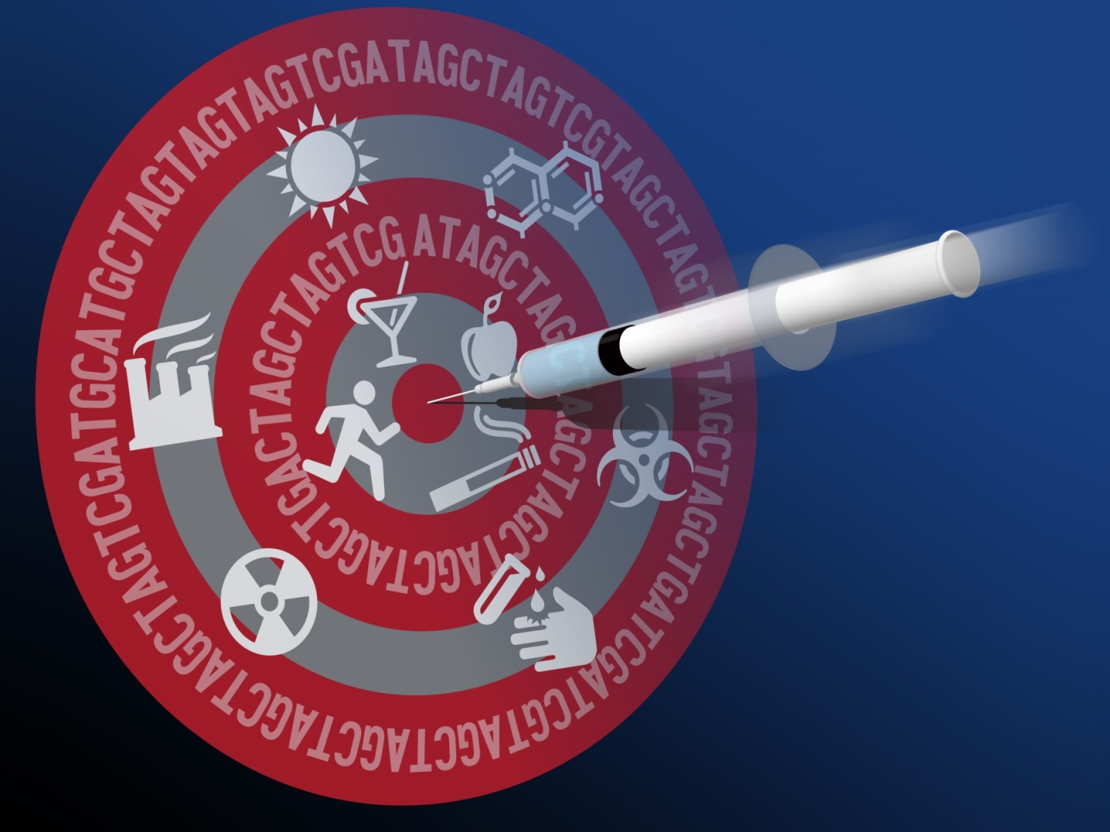
Precision Medicine Initiative
Document 36
Notes:
The February meeting of this Council came shortly after President Obama announced the new Precision Medicine Initiative— first in his State of the Union Address on January 20 and then more extensively in a formal event at the White House on January 28. Council has asked to be keep updated about this Initiative, and so I plan to regularly incorporate such updates into my Director’s Report from this point forward.

Slide 55
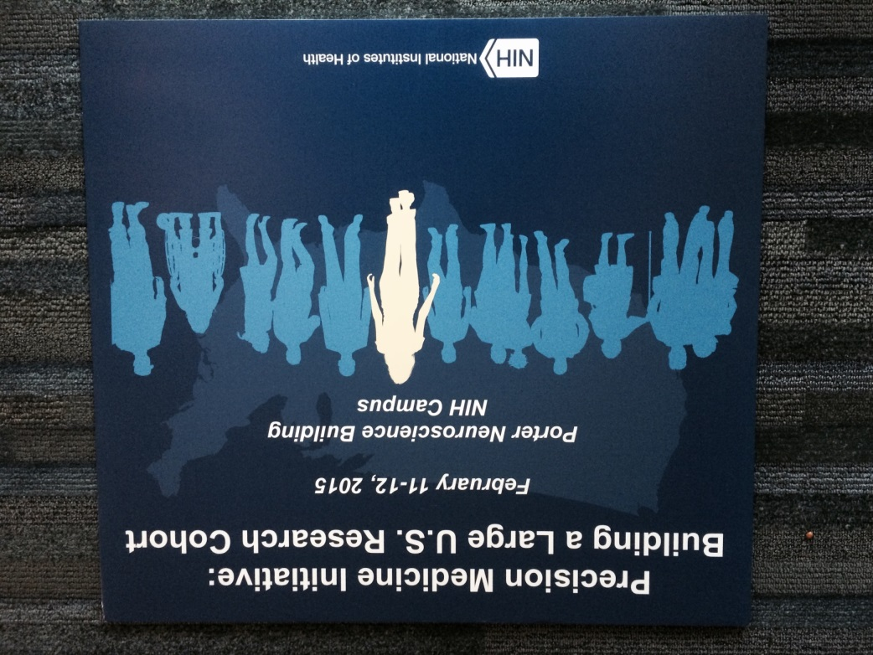

Notes:
Immediately following the February Council meeting was the first in what will be a series of initial planning workshops for the Precision Medicine Initiative. This meeting in mid-February focused on designing the proposed 1-million volunteer U.S. national research cohort, and the gathering aimed both to lay out the broad set of immediate issues that need to be faced and to begin compiling the many details that will need to be worked out. Shown here is the group of roughly 90 participants at this workshop, although the meeting was videocast live and over 1,700 remote viewers participated as well.

Slide 56
Advisory Committee to the NIH Director
Working Group on the Precision Medicine Initiative
Co-Chairs: Richard Lifton, MD, PhD Bray Patrick‐Lake, MFS Kathy Hudson, PhD
Esteban Gonzalez Burchard, MD, MPH | Sekar Kathiresan, MD
Tony Coles, MD, MPH | Sachin Kheterpal, MD, MBA
Rory Collins, FMedSci | Shiriki Kumanyika, PhD, MPH
Andrew Conrad, PhD | Spero M. Manson, PhD
Josh Denny, MD | P. Pearl O’Rourke, MD
Susan Desmond‐Hellmann, MD, MPH | Richard Platt, MD
Eric Dishman | Jay Shendure, MD, PhD
Kathy Giusti, MBA | Sue Siegel
Notes:
Several weeks later, Francis Collins announced the establishment of a Working Group of his Advisory Committee to the Director that would focus on the Precision Medicine Initiative, with a particular emphasis on the national research cohort component. That group is co-chaired by Rick Lifton (an NHGRI grantee and someone well known to this Council), Bray Patrick-Lake of Duke University, and NIH Deputy Director Kathy Hudson. The other members of the Working Group are listed here, and together they bring strong and diverse expertise to the group. Note that the Working Group also includes current Council member Jay Shendure.

Slide 57
Precision Medicine Initiative: Next Steps
Working Group of Advisory Committee to the Director
  Intense planning for next ~3-4 months
  Interim report in September
  Past and future meetings/workshops
  Implementation
  Trans-NIH implementation model
  Fall 2015: Initial funding opportunities announced
  Fiscal Year 2016: Funding begins
  Coordination with other U.S. government agencies
Notes:
The activities of this Working Group headline the immediate next steps for the planning of the Precision Medicine Initiative. * This group is in the midst of a very intense planning phase, which will be carried out over the next 3-4 months. * This is needed so that they can deliver an interim report in the early fall. * To accomplish this, a series of strategic workshops is being held, essentially monthly. The February workshop that I mentioned earlier was then followed by another workshop directly involving the Working Group last month. There are now three more workshops being held on behalf of the Working Group that will take place over the summer.
These steps are all oriented towards the development of a strategic plan for the Initiative. But what about actual * implementation of that plan? * The current plan is for NIH to implement the Precision Medicine Initiative using a trans-NIH implementation model, generally analogous to Common Fund projects and the Big Data to Knowledge (BD2K) initiative. Along with Gary Gibbons (Director of the National Heart, Lung, and Blood Institute), I am now co-chairing an implementation group consisting of about 16 Institute/Center Directors. Our immediate role is to implement the strategic vision for the national research cohort. This will involve work over the summer so as to * announce the initial set of funding opportunities in the early fall. * This timing is necessary because, assuming funds are provided, the Precision Medicine Initiative will begin next fiscal year. Needless to say, this represents a very tight timeline. * And keep in mind that while most of the heavy lifting for the Initiative is being done by NIH, we do need to coordinate carefully with multiple other U.S. government agencies.

Slide 58

Due Date: May 7, 2015
Notes:
As you might imagine with such a rapid planning and implementation process, many things are happening in parallel. Consuming a significant amount of attention is information gathering about many aspects of building this national research cohort. * For example, to inform the workshop that is happening at the end of this month, NIH recently issued this Request for Information (RFI) about existing research cohorts. This RFI already closed (on May 7), and had a vigorous response. Additional RFIs are already being planned, as there remains a considerable number of questions for which NIH could use additional information from the research community.
It is important to point out that (perhaps not surprisingly) NHGRI staff is being called on to provide a substantial amount of help in standing up the Precision Medicine Initiative. There have been multiple teams established to pursue more detailed analysis and planning in specific areas, and these are often aligned with one or more upcoming workshops. In addition to my co-chairing responsibilities for the major parent group, NHGRI senior staff are co-chairing three of the five area-specific teams (specifically, Teri Manolio, Laura Rodriguez, and Vence Bonham). So, at the end of the day, I fully expect NHGRI to be heavily invested in many aspects of the Precision Medicine Initiative, both in its planning and its execution.

Slide 59

Emphasis on Transparency
Notes:
I cannot possibly summarize all of the fast-moving developments with the Precision Medicine Initiative in my Director’s Report, and you might not want to wait between Council meetings to learn about the latest developments. The good news is that all of us at NIH are trying to make the strategic planning and implementation process for the Initiative as transparent as possible.

Slide 60

www.nih.gov/precisionmedicine
Document 36
Notes:
We are largely providing that transparency through the Web, starting with this dedicated landing page for the Initiative (with the simple URL of www.nih.gov/precisionmedicine). All sorts of information are already available on this site, and the aim is to continue to organize material for distribution using this site.
* For example, if you are interested in learning more about the various workshops that have or will be held, the ‘Events’ link takes you directly to that information.

Slide 61

Notes:
Shown here is the events page, which already includes * links to materials for the two past workshops and * also a listing about upcoming workshops, such as the three additional ones scheduled for later this summer.

Slide 62

Notes:
Clicking through to a specific workshop then brings you to * all the materials associated with that workshop, including complete videoarchives of the plenary sessions, the agenda, speaker biographies, and eventually the workshop report.
I encourage you to monitor these Web pages if you are interested in following developments with the Precision Medicine Initiative.

Slide 63




Apple Announces ResearchKit
Document 36
Notes:
Finally, I thought it was worth mentioning something that might have already caught your eye. Several weeks after the public announcement of the Precision Medicine Initiative and in conjunction with announcements about the new Apple watches, Apple announced the release of ResearchKit, which is an open source software framework that facilitates the creation of apps for medical research studies.
The notion of using such apps for participant recruitment and data collection (e.g., with mobile health devices) represents an integral aspect of the vision for the Precision Medicine Initiative. * Apple also announced the release of an initial set of apps specifically for participating in a small number of disease-specific research projects, and apparently a large number of volunteers were, as a result, recruited to these studies very quickly.
I mention Apple’s ResearchKit because it illustrates the likely commercial interests and, potentially, public-private partnerships related to some very important elements of the Precision Medicine Initiative. So, this is something that all of us will want to monitor as things progress.

Slide 64
Director’s Report Outline
General NHGRI Updates
General NIH Updates
General Genomics Updates
NHGRI Extramural Research Program
NIH Common Fund/Trans-NIH
NHGRI Division of Policy, Communications, and Education
NHGRI Intramural Research Program

Slide 65


Inter-Society Coordinating Committee for Practitioner Education in Genomics
New Co-Chairs:
In-person meeting in May:
    Patient Safety and Genomic Medicine
    Genetic Counselors’ Roles in Education
    Point-of-Care Education Modes
    Inter-Professional Education Collaborative (IPEC)
Ann Karty, M.D. American Academy of Family Physicians
Bob Wildin, M.D. NHGRI
Document 37
Notes:
The Inter-Society Coordinating Committee for Practitioner Education in Genomics (ISCC) continues its work to improve the genomic literacy of healthcare practitioners and enhance the practice of genomic medicine. * As I mentioned at the February Council meeting, NHGRI’s Genomic Healthcare Branch Chief, Bob Wildin, assumed the role of NHGRI Co-Chair this past winter; this spring, Ann Karty, Medical Director of the Division of Continuing Medical Education of the American Academy of Family Physicians, has become the external co-chair. Ann relieves Mike Murray of Geisinger Medical Center and member of the American College of Physicians, who served in this role since the ISCC’s inception.
* Later this week, the ISCC will hold its fourth in-person meeting. The invited speakers will discuss * patient safety and genomic medicine, * genetic counselors’ roles in education, * point-of-care education modes, and the * Inter-Professional Education Collaborative (called IPEC). In addition, breakout groups will discuss other important topics, including next steps for healthcare professional education and funding priorities.

Slide 66

Preserving Employee Wellness Programs Act (S.620/H.R.1189)
Document 38
Notes:
In March, legislation was introduced in Congress that, if passed into law, would weaken the protections afforded by the Genetic Information Nondiscrimination Act (or GINA). The Preserving Employee Wellness Programs Act, introduced by Senator Alexander of Tennessee in the Senate and by Representative Kline of Minnesota in the House of Representatives, would remove GINA’s protections with respect to workplace wellness programs that include financial incentives and penalties.
It would, for instance, allow employers to increase health insurance premiums for employees who choose not to participate in employer-sponsored wellness programs in order to keep their genetic information private and avoid it being shared with their employers. Currently, while GINA permits employers to ask employees questions about their genetic information in the context of a wellness program, it also says that answering such questions is entirely voluntary and that an employer may not penalize employees who choose not to answer such questions. NHGRI is monitoring the progress of the legislation closely.
In related news, the Equal Employment Opportunity Commission last month issued draft regulations on what constitutes a voluntary workplace wellness program, and NHGRI is examining the potential impact of the regulation on GINA and research participants.

Slide 67

NHGRI IDE Resources for
Research Community
Document 39
Notes:
As Council is aware, over the past year, NHGRI has been in discussions with the FDA on a range of topics related to the regulation of genomics research and genomics-based clinical tests. One such topic has been the applicability of FDA’s Investigational Device Exemption (IDE) regulations to genomics research, including some of our NHGRI-supported programs.
In order to help the research community understand and navigate these regulations, NHGRI has consulted with the FDA to develop a number of new resources on our web site, genome.gov. Last month the Policy and Program Analysis Branch launched new pages within the “Issues in Genetics” section of genome.gov including a plain-language guide for researchers that explains when the regulations might apply to their genomic medicine studies, as well as a series of case studies to explore how the regulations might apply to different research scenarios.
NHGRI staff will continue to develop case studies as more examples are explored with the FDA, so that we can provide a dynamic resource to the community that expands with our collective learning.

Slide 68


LabTV
A website of mini-documentaries about
scientists who are passionate about their work
Document 40
Notes:
I, along with 14 intramural trainees from NHGRI, are contributing to a project called LabTV, which is a website of mini-documentaries about scientists who are passionate about their work. Its primary goal is to inspire students to think about a research career.
In each video, the interviewee answers questions such as: Where did I come from? What inspired me to become a scientist? What challenges did I overcome to achieve my present role? Why am I excited to be working on my current projects? And what are my hopes and dreams for the future?
Once they are edited, all the videos will be posted on the LabTV website and then reposted on genome.gov.
The project is the brainchild of Jay Walker, who is the curator and chairman of TEDMED, an annual conference focusing on health and medicine. Many of the videos, including my interview, are being shot by David Hoffman, an Emmy Award-winning documentary filmmaker.

Slide 69


Capturing the Historical Legacy of the NHGRI: An Archival and Scholarly Initiative
Document 41
Notes:
In 2012, I launched a new initiative to capture and preserve NHGRI’s historic role in the Human Genome Project and in subsequent genomics programs. As part of these efforts, NHGRI recently held a two-day workshop, entitled “Capturing the History of Genomics.” About 40 participants (including scholars, NIH staff, and past and present NHGRI staff) met to discuss plans for the initiative. Among the attendees was Council member Jim Evans.
The external scholars of history, philosophy, technology, and ethics were invited to give talks on their areas of interest. Presentations included history of the Human Genome Project, human genomic variation research, genomics data sharing, and development of bioinformatics databases. Participants provided feedback about NHGRI’s efforts to develop an archival database, conduct oral history interviews, and produce scholarly work. A special issue of the Journal of the History of Biology on the historical legacy of the Human Genome Project and genomics is expected to be published based on the presentations at the meeting.

Slide 70




Genome: Unlocking Life’s Code Exhibition
“Big Data, Genomics, and Precision Medicine”
Document 42
Notes:
The NHGRI-Smithsonian exhibition Genome: Unlocking Life’s Code is now traveling across North America. The exhibition made its first stop in San Diego at the Reuben H. Fleet Science Center and then headed north to San Jose in early January, where it was on display at The Tech Museum of Innovation through mid-April.
To support the exhibition’s outreach and public programming while in San Jose, NHGRI partnered with the Life Sciences Foundation, Pacific Biosciences, and The Tech Museum to host an evening program called “Big Data, Genomics, and Precision Medicine.” The program featured San Francisco Bay area genomic research leaders from both the private and academic sector.
* To start the program, I provided an overview of precision medicine and then moderated three conversations featuring: * David Haussler and Mike Hunkapiller, * Carlos Bustamante and Neil Risch, and * Mildred Cho and Anne Wojcicki. More than 150 people attended the program. A videoarchive of the entire event is available via a link from the exhibition’s web site, unlockinglifescode.org.

Slide 71

Genome: Unlocking Life’s Code Exhibition
The Tech Museum of Innovation Family Day
Document 42
Notes:
Also, during the exhibition’s time in San Jose, The Tech Museum hosted an “Epic Genetics Day” in April, which was oriented for families. Attendees had an opportunity to participate in hands-on activities within the exhibition that explored and explained how DNA works. The day also featured a presentation about dog genomics by Elaine Ostrander from NHGRI’s Intramural Research Program.

Slide 72

Genome: Unlocking Life’s Code Exhibition
Travel Schedule
2015
  May 15 to September 10
  Saint Louis Science Center (St. Louis, MO)
  October 2 to January 3
  Oregon Museum of Science and Industry (Portland, OR)
2016
  January 18 to April 25
  Discovery World Milwaukee (Milwaukee, WI)
Document 42
Notes:
For the next three years, the Genome: Unlocking Life’s Code exhibition will make several stops across the country. * Currently, the exhibition is in my hometown of St. Louis at the Saint Louis Science Center.
NHGRI is sponsoring several programs for the public, high school students, and health care professionals in partnership with the Saint Louis Science Center, local organizations, NHGRI grantees, the Academy of Science of St. Louis, and nearby institutions. Please continue to check the unlockinglifescode.org website and follow it on social media for the most up-to-date program information.
Following its stay in St. Louis, the exhibition will close out 2015 in * Portland, Oregon and begin 2016 in * Milwaukee, Wisconsin.

Slide 73

Genome: Unlocking Life’s Code Exhibition
Website Interactive
Document 42
Notes:
One of the ways that we engage with museum visitors in the genome exhibition is by providing different types of interactive learning experiences, mainly through the use of computer monitors and kiosks. This interactive experience provides an opportunity for visitors to think about and discuss their views on complex topics, such as ancestry, ethical, legal, and social issues, and decision-making within families.
Over the past few months, our exhibition team has begun converting these interactive experiences for use online. In celebration of DNA Day, the exhibition interactive “What Do You Think?” was made available on the unlockinglifescode.org website as an online tool, bringing this popular exhibition activity into homes and classrooms.
In the web/mobile version, a short introductory video is played, and then visitors explore the ethical and social connections to genomics, answering thought-provoking questions about society, privacy, health, discrimination, research, identity, and children. Once the user completes the series of questions related to the topics, they can see how their responses compare to other respondents in real time.
The next interactive scheduled to be made available online is “In and Beyond Africa,” which looks at ancestry and our human population origins.

Slide 74

Genome: Unlocking Life’s Code Exhibition
Human Identity Lesson Plan
Document 42
Notes:
Another way that we are bringing the content of the exhibition to a wider audience is through the creation of inquiry-based lesson plans inspired by the exhibition. In April, the first in a series of these lesson plans was made available to educators and the public.
The first lesson focuses on genomics and human identity, and was developed by NHGRI’s Education and Community Involvement Branch with support from the Promega Corporation. This resource was created in collaboration with educators, scientists, teachers, and students nationwide, and guides middle and high school students through a learning experience that emphasizes collecting, analyzing, and interpreting data on population traits and genomic variants. It is also designed to raise awareness about career opportunities in genomics. The lesson plan can be found on the unlockinglifescode.org website.

Slide 75


National DNA Day
Document 43
Notes:
Every year, NHGRI celebrates National DNA Day. This year, our celebration was officially observed on April 24. Activities to engage educators, students, and the public were held throughout the month of April, and, as always, were organized by our Education and Community Involvement Branch.
* NHGRI took advantage of the power of social media and hosted our first-ever DNA Day Pinterest Challenge for K-12 teachers and their students. Teachers were challenged to create Pinterest Boards on the topic of genomics that could be used as teaching resources in the classroom. The top 10 boards selected can now be viewed on the unlockinglifescode.org website and the Pinterest page.
* In addition to social media efforts, Institute staff provided public tours of several NHGRI research labs, participated in activities hosted by local non-profit educational organizations, and organized the NHGRI Ambassador’s Program, which sent genetic counseling students, trainees, and scientists to local schools to participate in classroom activities. Finally, Larry Brody, Director of NHGRI’s Division of Genomics and Society, gave a special presentation in the Hall of Human Origins at the Smithsonian’s National Museum of Natural History.

Slide 76
Director’s Report Outline
General NHGRI Updates
General NIH Updates
General Genomics Updates
NHGRI Extramural Research Program
NIH Common Fund/Trans-NIH
NHGRI Division of Policy, Communications, and Education
NHGRI Intramural Research Program

Slide 77

Senator Cardin Applauds NHGRI’s Bill Gahl
Document 44
Notes:
On March 10, Senator Ben Cardin of Maryland took to the floor of the United States Senate to applaud the work of William Gahl and the NIH Undiagnosed Diseases Program (UDP). He spoke for several minutes about the dedication and hard work exhibited by Bill (NHGRI’s Clinical Director) and his UDP team in their pursuit of some of the most challenging medical mysteries, highlighting the impact for patients with conditions that have long eluded diagnosis. During his visit to NIH last month, Senator Cardin subsequently met with Bill to thank him personally for his service and efforts.

Slide 78

American Academy of Microbiology Fellow
Julie Segre, Ph.D.
Document 45
Notes:
Julie Segre, Chief and Senior Investigator of the Translational and Functional Genomics Branch, has been elected as a Fellow in the American Academy of Microbiology. She is one of 79 microbiologists to be elected in 2015.

Slide 79






NHGRI Intramural Research Highlights
Molecular Cancer Research
Homologous mutation to human BRAF V600E is common in naturally occurring canine bladder cancer-evidence for a relevant model system and urine-based diagnostic test
Journal of Health Psychology
Mothers’ guilt responses to children’s obesity risk feedback
Document 46
Notes:
Highlights from the NHGRI Intramural Research Program since the last Council meeting include:
* Elaine Ostrander and colleagues found that a BRAF mutation in 80 percent of canine bladder cancers is homologous to the human mutation found in about 8 percent of human bladder cancers. The finding suggests that dogs offer a new model for assessing the effectiveness of drugs designed to combat BRAF–associated cancers. Their article appeared in Molecular Cancer Research.
* A team led by Susan Persky published a study that explored the influence of family health history-based obesity risk feedback on overweight female participants, measuring for lifestyle versus genetic guilt that obesity might affect their children. Their study was published in the Journal of Health Psychology.
* Shawn Burgess and colleagues have developed transgenic zebrafish as a live animal model of metastasis, offering cancer researchers a new, potentially more accurate way to screen for drugs and to identify new targets against the disease. Their article was published in Disease Models & Mechanisms.

Slide 80
To receive The Genomics Landscape,
go to list.nih.gov
Search for NHGRILANDSCAPE
Past issues can be accessed at: genome.gov/27527308
Document 47
Notes:
Before ending my Director’s Report, I would like to put in a plug and say that anyone wishing to receive my monthly email update (called “The Genomics Landscape”) can simply go to list.nih.gov and then search for “NHGRILANDSCAPE.”

Slide 81


Thanks!
Special Thanks!
Notes:
Finally, a personal thanks to all of the various NHGRI staff (probably over 50-60 of you) who helped pull together the slides and information that I just reviewed. As always, such a group effort is essential for getting this large amount of information conveyed efficiently at each Council meeting.
An additional thanks to the NHGRI communications group and web team for making my Director’s Report into an electronic resource.
* And special thanks to Kris Wetterstrand, who serves as the ‘ring leader’ in coordinating material development, and who directly helps me produce the final Powerpoint file.

