Slide 1

National Advisory Council for Human Genome Research
September 2013
Eric Green, M.D., Ph.D.
Director, NHGRI
DIRECTOR’S REPORT
Notes:
The Open Session of this meeting of the National Advisory Council for Human Genome Research is being webcast live.
As is now our routine, the Open Session of all Council meetings are videotaped and made available as a permanent archive on the web, including the presentations themselves and the various associated documents.

Slide 2
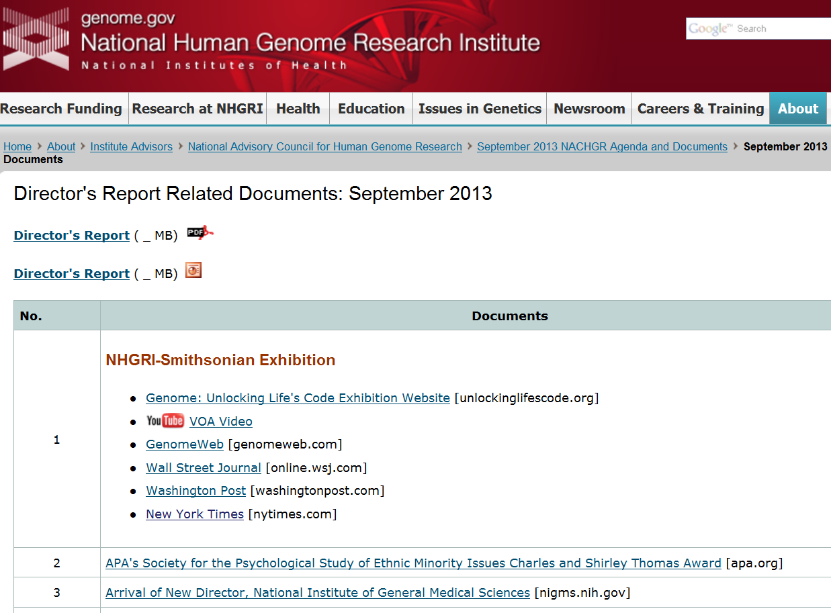
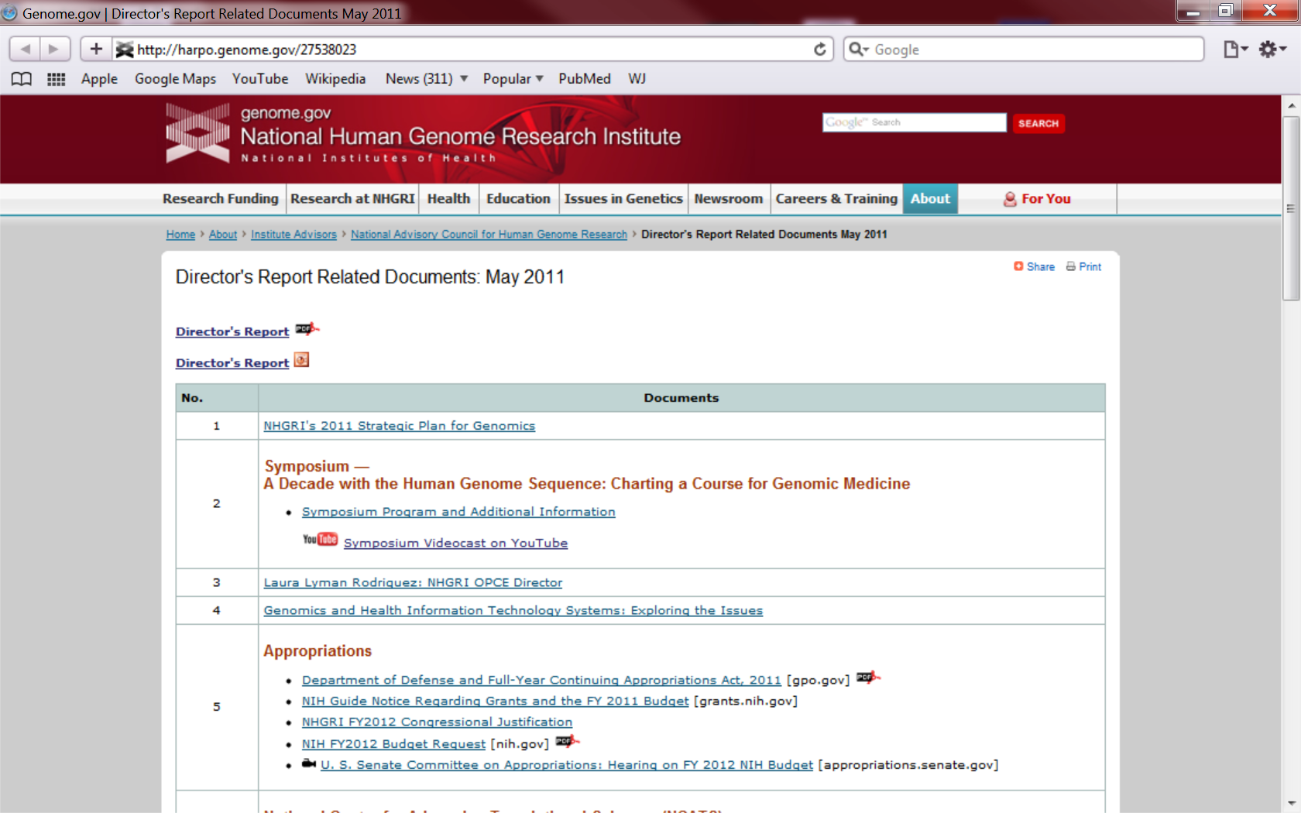
genome.gov/DirectorsReport
Document #
Notes:
For anyone new to our Council meetings, I want to make you aware that there is an ‘electronic resource’ associated with my Director’s Report.
This is analogous to the supplemental materials that are often made available with a published paper, and can be accessed at the URL shown here.
The slides that I am showing during my Director’s Report are also available electronically at this site– * both as PDF and Powerpoint files.
* For slides associated with specific documents or relevant web sites, there is a ‘Document #’ indicated on the bottom right, which references materials that can be accessed at the web site shown here.
In addition to the video archive that I mentioned earlier, this web page and all linked documents will be archived on NHGRI’s web site (genome.gov) as a permanent historic resource.

Slide 3
Open Session Presentations
  Major Presentations:
  Assoc. for Molecular Pathology et al. v Myriad Genetics Inc. et al.
    Arti Rai
  Data Sharing and the HeLa Genome Sequence
    Kathy Hudson
Recent NHGRI Meetings:
  Report of the Genomic Medicine Working Group
      Teri Manolio
Notes:
There will be multiple other presentations during the Open Session of this Council meeting. My Director’s Report is tailored around these presentations, and I will not discuss in detail the topics that others will be covering later.
* Among those presentations will be one from Council member Arti Rai regarding the recent Supreme Court decision on gene patents.
* After lunch today, Kathy Hudson (NIH Deputy Director for Science, Outreach, and Policy) will join us to discuss the recent developments related to the generated HeLa cell line genome sequence and data-sharing implications of this for future genomic studies that use HeLa cells.
* Teri Manolio will then give an update on the activities of the Genomic Medicine Working Group.

Slide 4
Open Session Presentations
      Project Updates:
  The NHGRI-Smithsonian Genome Exhibition
      Vence Bonham
  The NHGRI Bioinformatics Research Portfolio
      Vivien Bonazzi
  NHGRI Training & Career Development Program
      Heather Junkins
Notes:
There will also be three project updates later today:
* One from Vence Bonham about the NHGRI-Smithsonian Genome Exhibition.
* One from Vivien Bonazzi regarding the NHGRI Bioinformatics Research Portfolio.
* And one from Heather Junkins about the NHGRI Training and Career Development Program.

Slide 5
Director’s Report Outline
General NHGRI Updates
General NIH Updates
General Genomics Updates
NHGRI Extramural Research Program
NIH Common Fund/Trans-NIH
NHGRI Division of Policy, Communications, and Education
NHGRI Intramural Research Program
Notes:
For the rest of my Director’s Report, I will cover the 7 areas listed here.
Together, these areas provide a good framework for reviewing the relevant topics.

Slide 6
Director’s Report Outline
General NHGRI Updates
General NIH Updates
General Genomics Updates
NHGRI Extramural Research Program
NIH Common Fund/Trans-NIH
NHGRI Division of Policy, Communications, and Education
NHGRI Intramural Research Program
Notes:
Starting with some General NHGRI Updates.

Slide 7



NHGRI-Smithsonian Genome Exhibition
Document 1
Notes:
Without question, the biggest NHGRI highlight since the last Council meeting was the opening of the NHGRI-Smithsonian exhibition, Genome: Unlocking Life’s Code. In a remarkable two short years from conception to design to grand opening, this wonderful partnership between NHGRI and the Smithsonian’s National Museum of Natural History has produced a truly spectacular exhibition (in my humble opinion), one that Council members will be seeing in person tomorrow morning.
You will be getting a more detailed update about the exhibition and its associated programming from Vence Bonham later today, but let me just briefly mention a few quick highlights.

Slide 8
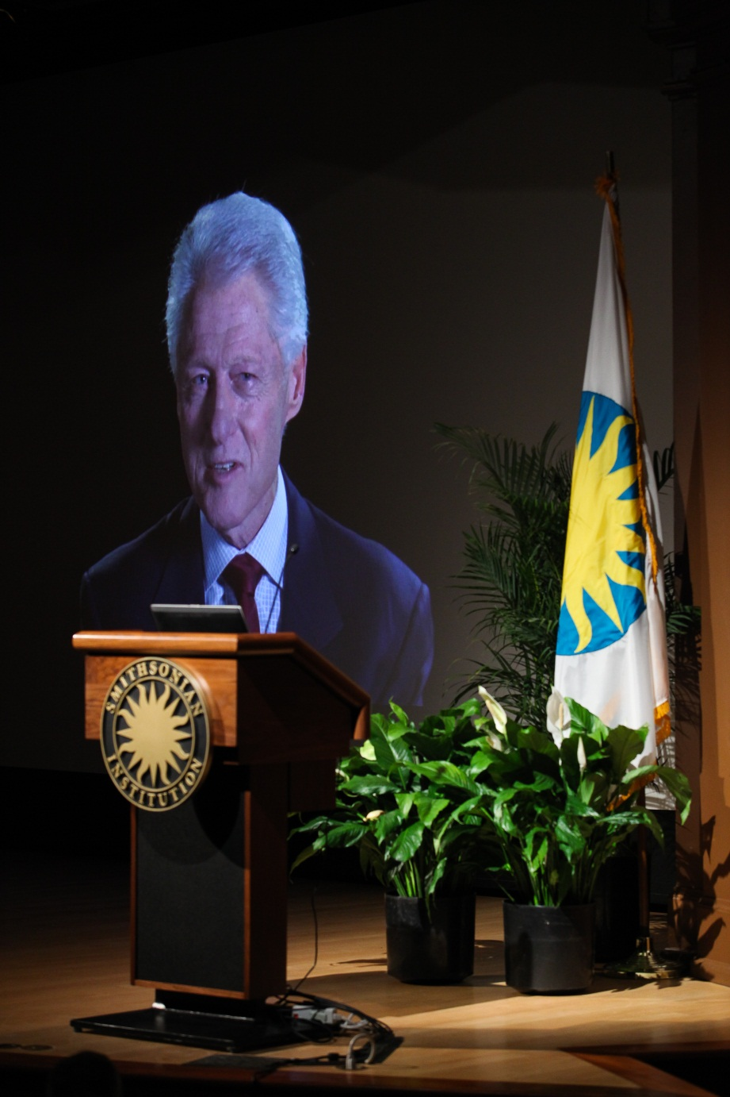
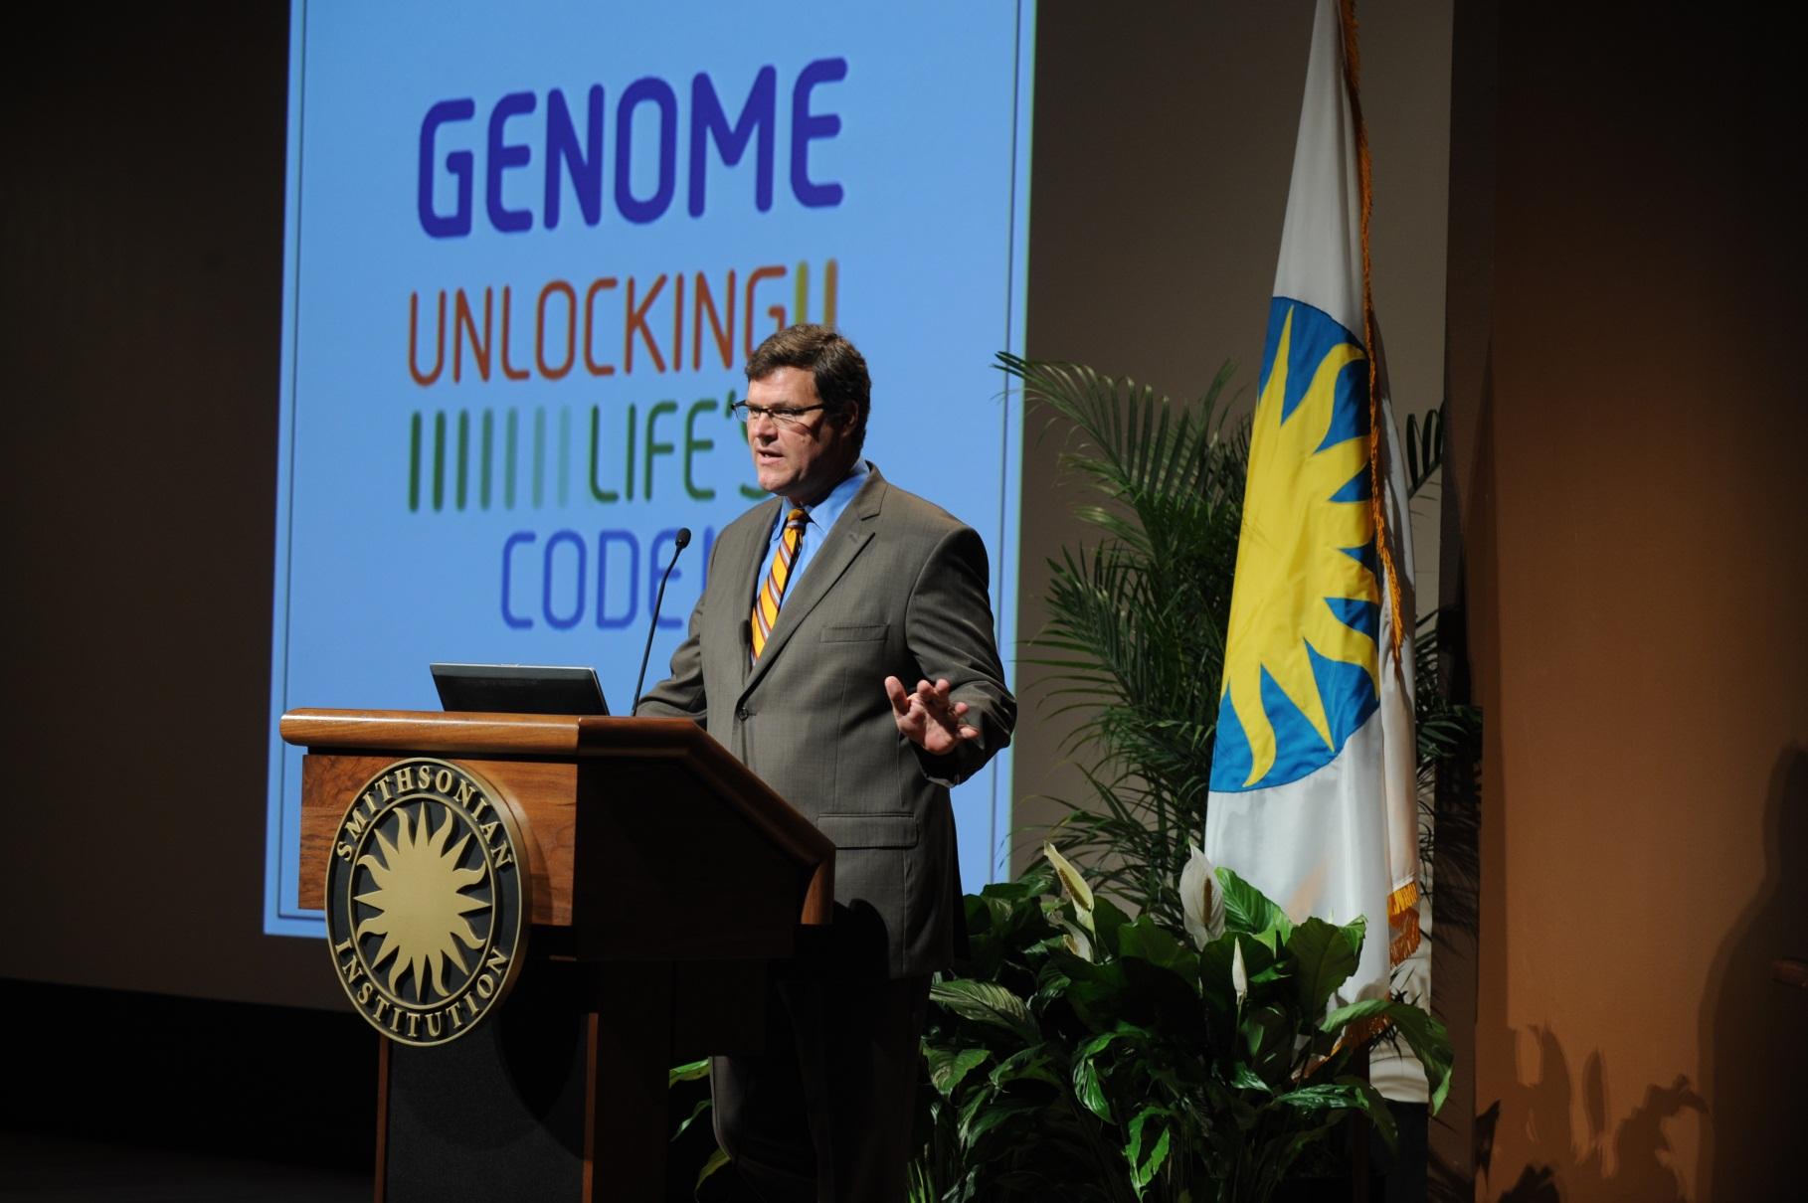
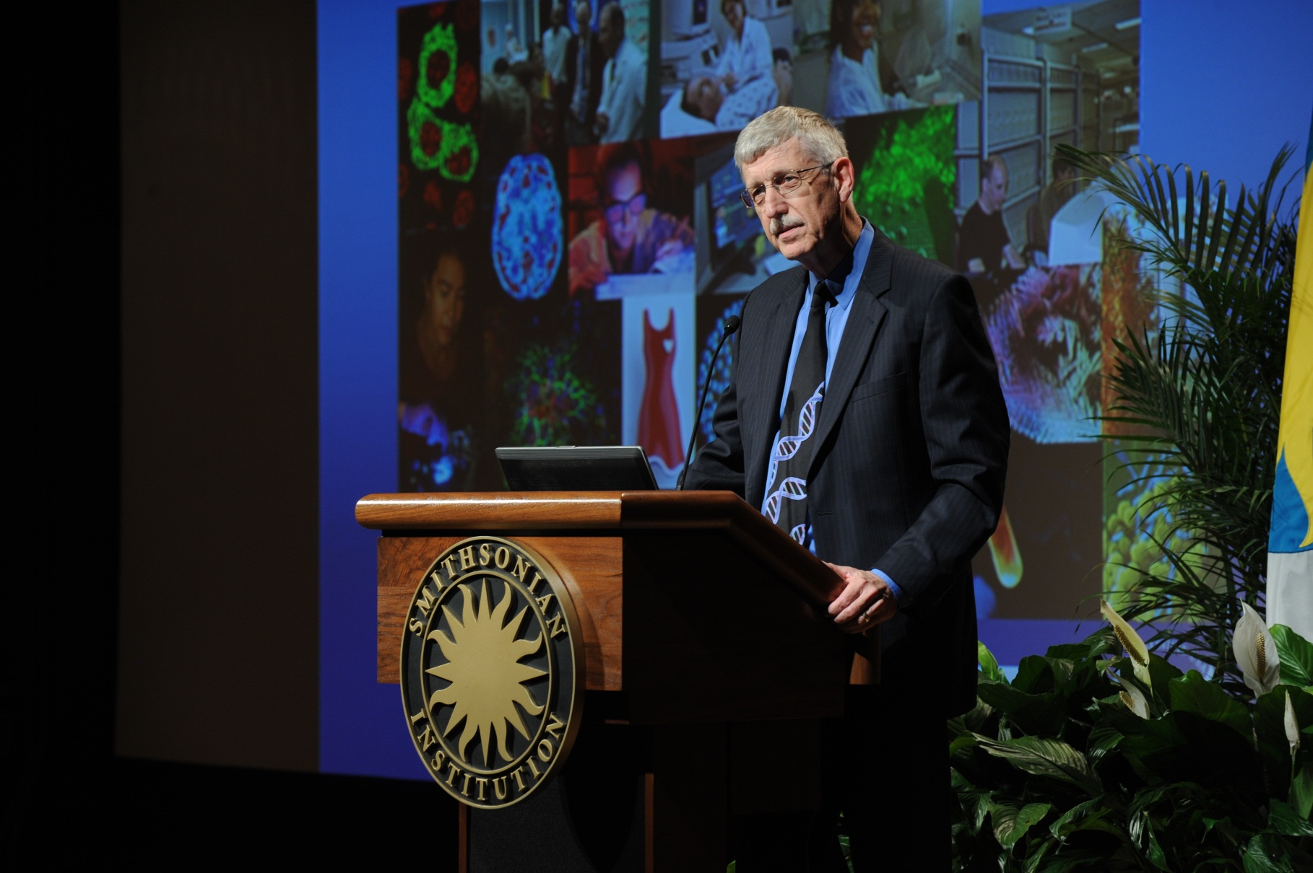
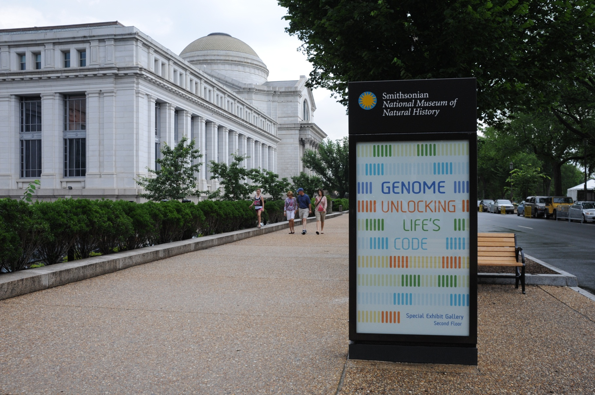
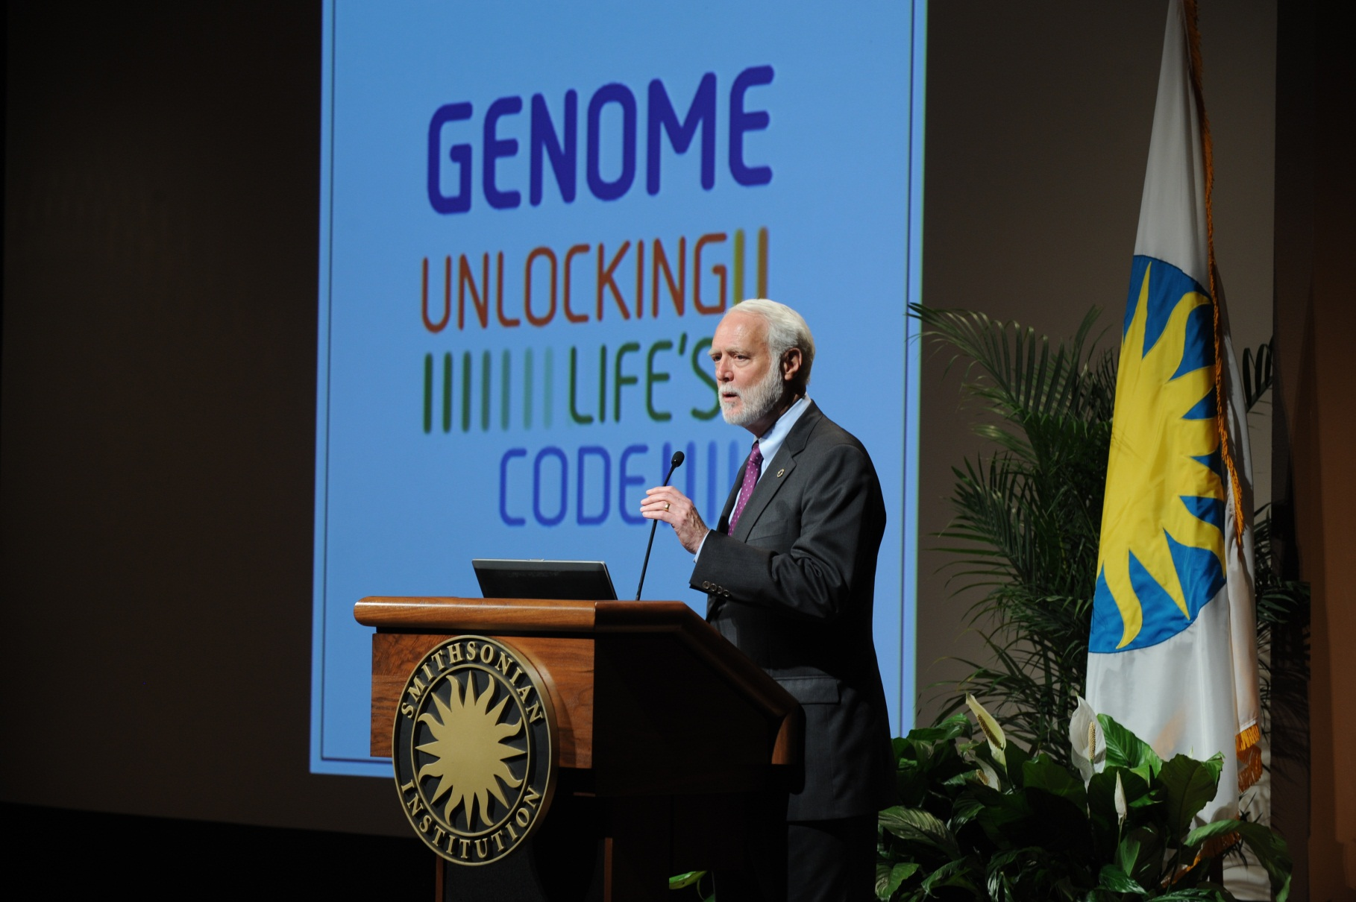
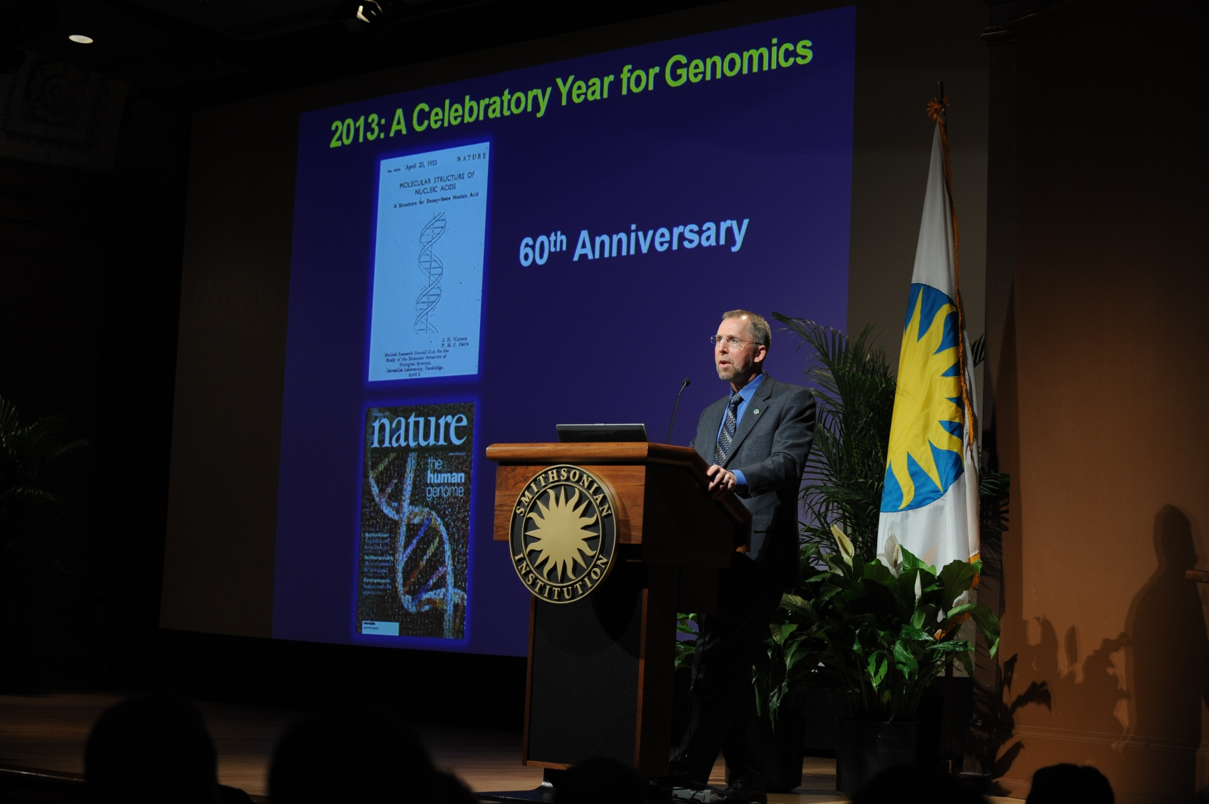

Exhibition Opening: June 14, 2013
Document 1
Notes:
The exhibition formally opened on June 14th. The day before the official opening, the NHGRI and the Smithsonian communications offices held a press event that was attended by representatives from local and national press outlets, which helped generate the very positive reviews of the exhibition that Vence will tell you about. And then that evening, the Smithsonian and the Foundation for NIH hosted an opening event that featured remarks and presentations by * Smithsonian Secretary Wayne Clough, * National Museum of Natural History Director Kirk Johnson, and * yours truly.
* There was then a very special video message from former President Bill Clinton, a huge genomics fan. * And finally, a keynote presentation by Francis Collins.
This was followed by a * wonderful reception in the museum’s rotunda for the more than 500 guests, who then had the opportunity to be the first to see the exhibition.
In the next year while resident at the Smithsonian in DC and then the following 4-5 years while it travels across North America, literally millions of visitors will get a chance to see the exhibition. Among those have already been some special VIP guests.

Slide 9
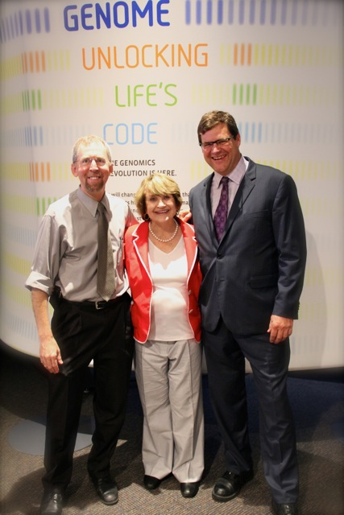
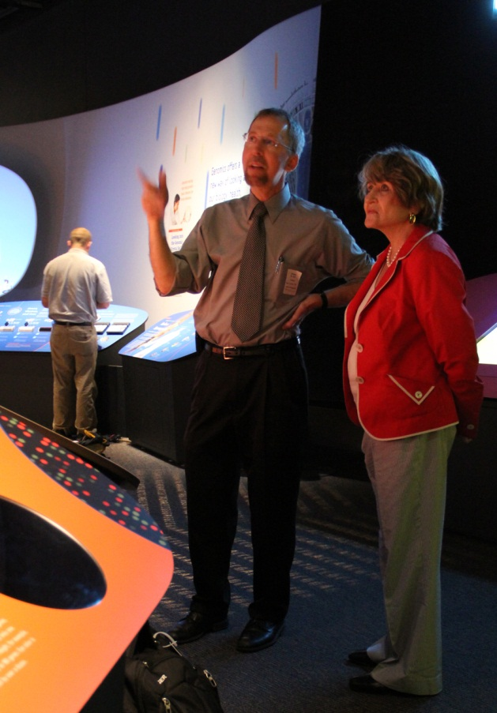
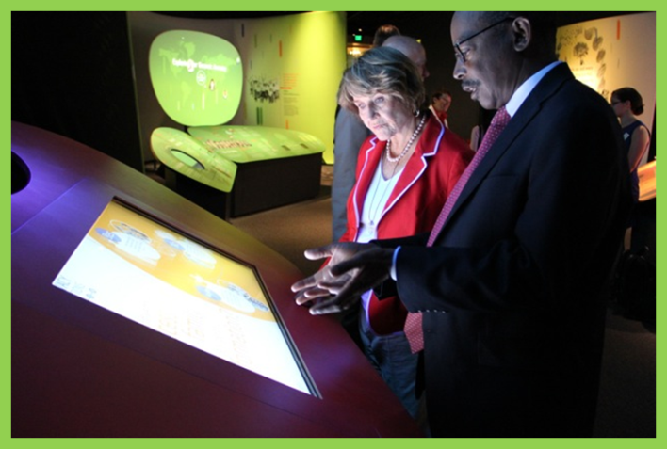
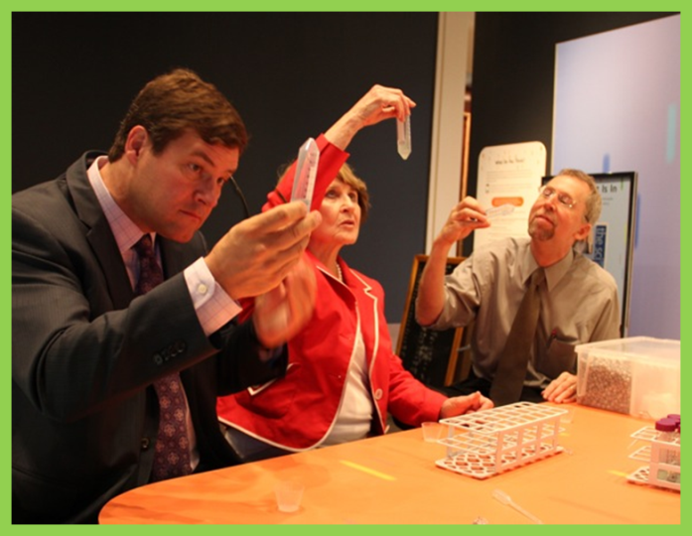
Genome Exhibition Visits
Notes:
For example, in July, Kirk Johnson, Vence Bonham, and I gave a private tour of the exhibition to Representative Louise Slaughter. You may recall that Congresswoman Slaughter was the sponsor and great champion of GINA, so she was thrilled to see what we had produced to help improve the nation’s genomics literacy.
The Congresswoman had a chance to explore the exhibition, learn from the interactives, and (as you can see from the bottom middle photograph) even isolate her own DNA.

Slide 10
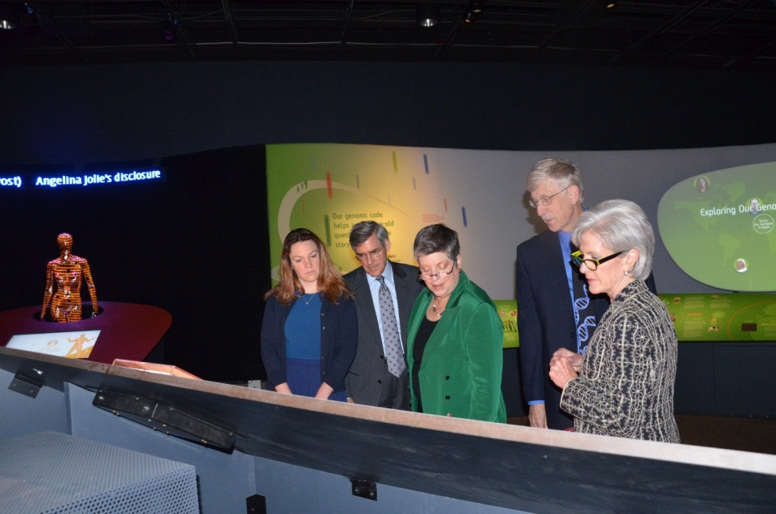
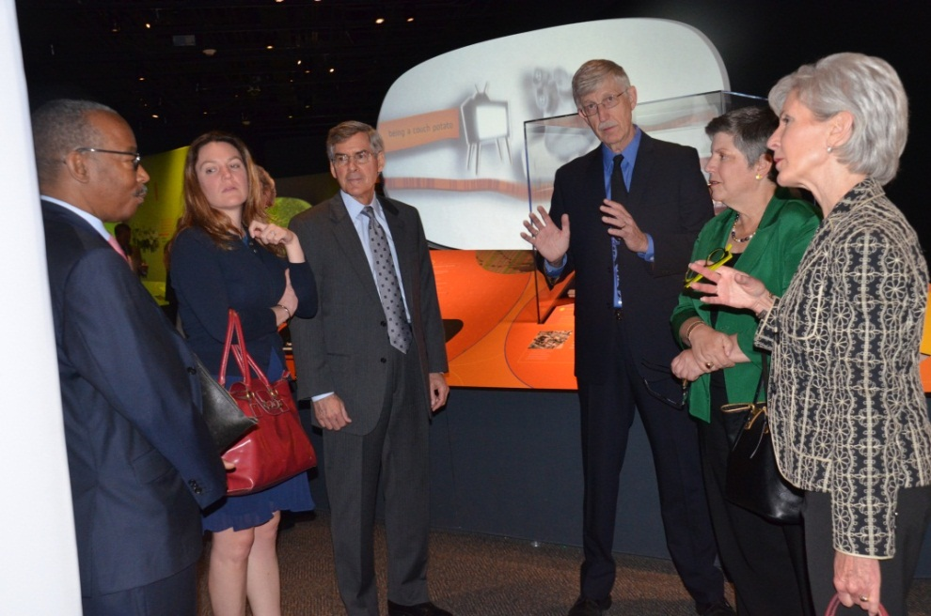
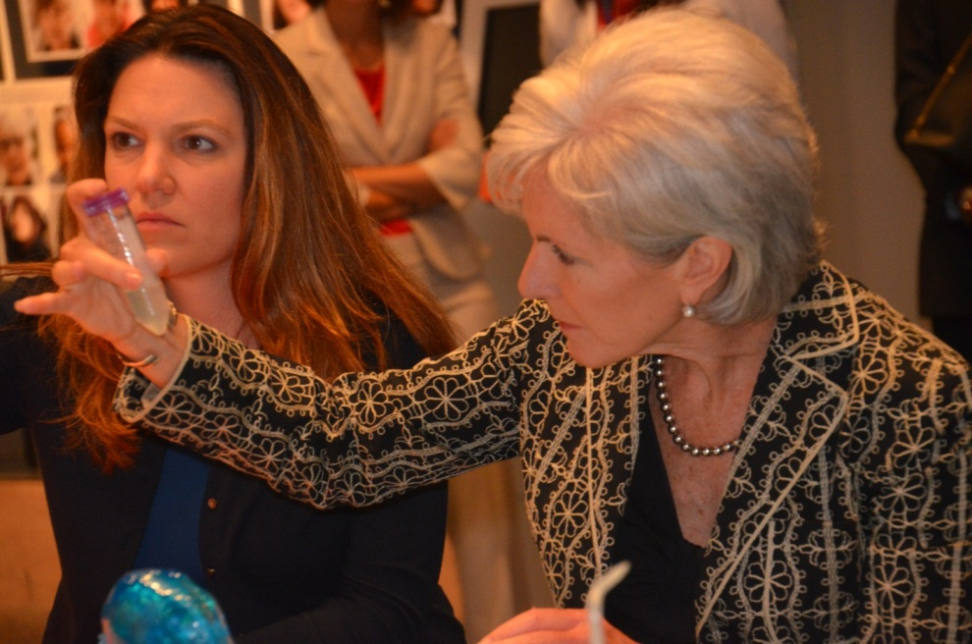
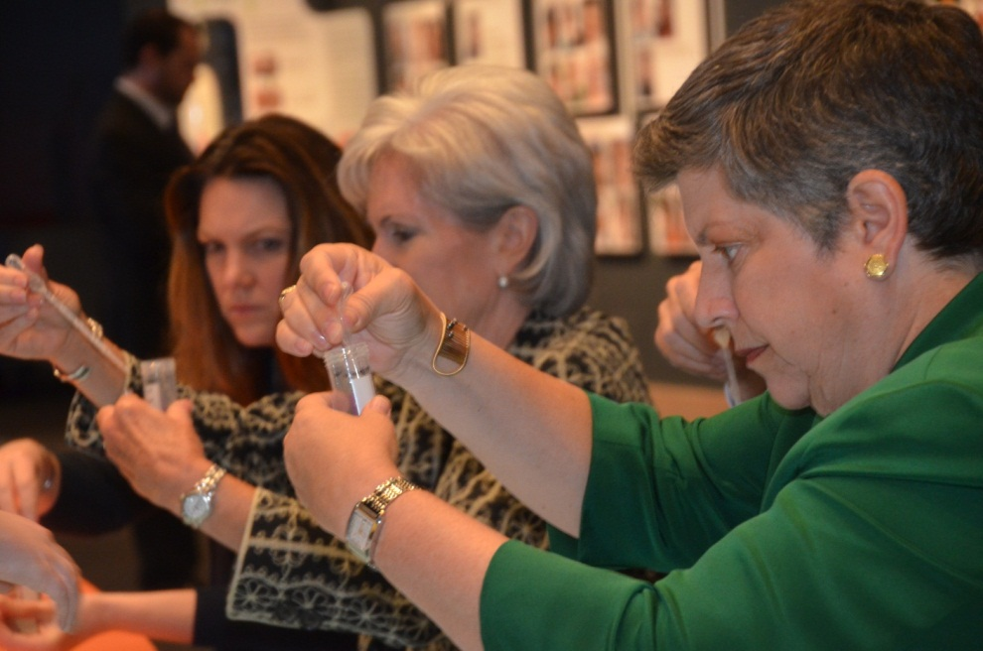
Genome Exhibition Visits
Notes:
Then in August, Francis Collins (along with Vence Bonham and Laura Rodriquez of NHGRI) gave a private tour of the exhibition to two cabinet secretaries: Kathleen Sebelius (Department of Health and Human Services Secretary) and Janet Napolitano (who was then Department of Homeland Security Secretary). These two Secretaries and some of their staff thoroughly enjoyed the exhibition, * including purifying their own DNA (which probably hasn’t been done by very many cabinet secretaries in the history of the United States!).
And I can assure you that this will not be the end of such private tours for VIPs, with several others either scheduled or soon to be scheduled. The exhibition is truly turning out to be an ideal venue to share excitement about genomics with colleagues, political leaders, and key members of the general public.
Besides these VIPs, I can tell you that MANY people have already visited the exhibition. In fact, last week I was informed that the Smithsonian estimated that we passed the 1 million visitor mark to the exhibition last week (with roughly 38% of visitors to the museum this summer stopping in to see our Genome Exhibition). So those are just the highlights, and you will be hearing more about the exhibition from Vence Bonham later today.

Slide 11

New ASHG/NHGRI Policy Fellow
Kate Donigan, Ph.D.
Notes:
As many of you know, we co-sponsor a policy fellowship with the American Society of Human Genetics. The program was started in 2002, and last month we welcomed our 12th fellow, Kate Donigan. Kate comes to us having completed her postdoctoral training at the National Institute for Child Health and Human Development. She will be working on a variety of policy issues in the NHGRI Division of Policy, Communications, and Education for the next several months, after which she will progress to the next stage of her fellowship in a to-be-determined Congressional office.
As an aside, we have been so pleased with our many-year collaboration with the American Society of Human Genetics with this science policy fellowship program, that we are now starting to explore with the society the possible establishment of a joint science education fellowship (more on that at a later date).

Slide 12
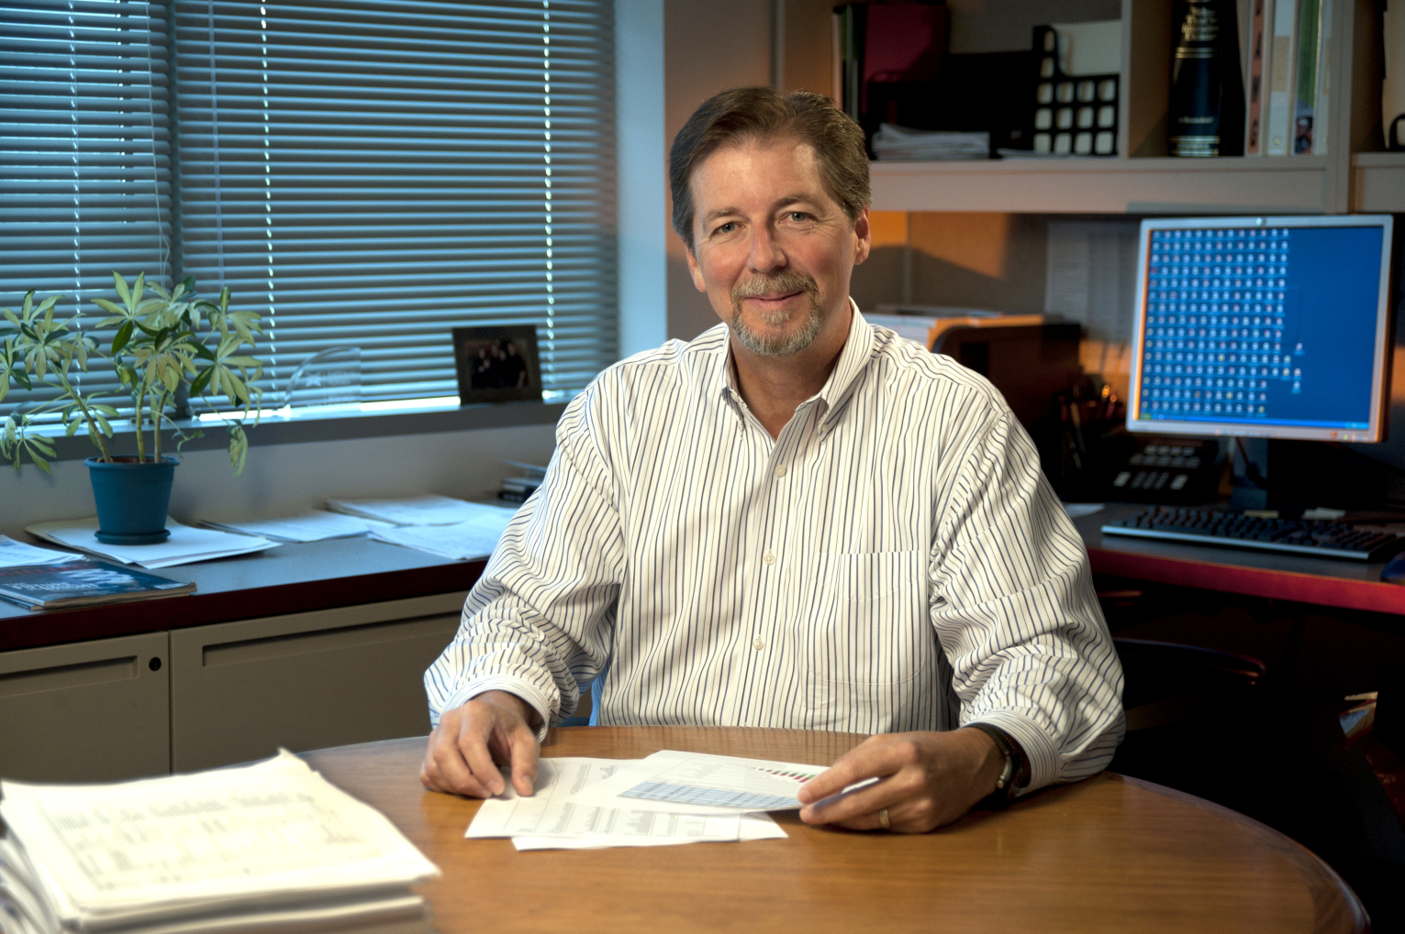
Extramural Staff Departure
Brad Ozenberger, Ph.D.
Notes:
Brad Ozenberger has left NHGRI to take a research faculty position at Washington University Medical School in St. Louis. Brad was a Program Director in our Extramural Research Program for 10 years, was a major leader of the TCGA program, and recently took on the position of Deputy Director of the Division of Genomic Medicine. His last day was this past Friday. We wish Brad all the best in his new position.

Slide 13



Ongoing NHGRI Recruitments
  Director, Division of Genomics and Society
  ELSI Program Director
  Bioinformatics Program Directors
  Chief, Genomics Healthcare Branch
Notes:
Other major personnel updates relate to important ongoing NHGRI recruitments.
* The search to identify a Director for the Division of Genomics and Society, one of the four divisions that constitutes the NHGRI Extramural Research Program, has progressed considerably since the last Council meeting. In brief, we are reaching a very advanced stage in that search process, and I am hopeful that I will be able to name a Director for this division well before the next Council meeting in February. Recall that NHGRI Deputy Director Mark Guyer is serving as the Acting Director of this division until I appoint a permanent Director.
* A related future recruitment, which is also now progressing, will involve the appointment of another Program Director for our ELSI Research Program.
* In addition, we are working hard at evaluating existing candidates and soliciting additional applications for two open Program Director positions in the general area of bioinformatics and computational biology, individuals who will work in our Extramural Research Program.
* And finally, we are about to re-launch our efforts to identify someone to serve as Chief of the Genomics Healthcare Branch within our Division of Policy, Communications, and Education.
So, as you can see, NHGRI has a number of key positions for which we have important ongoing recruitments.

Slide 14
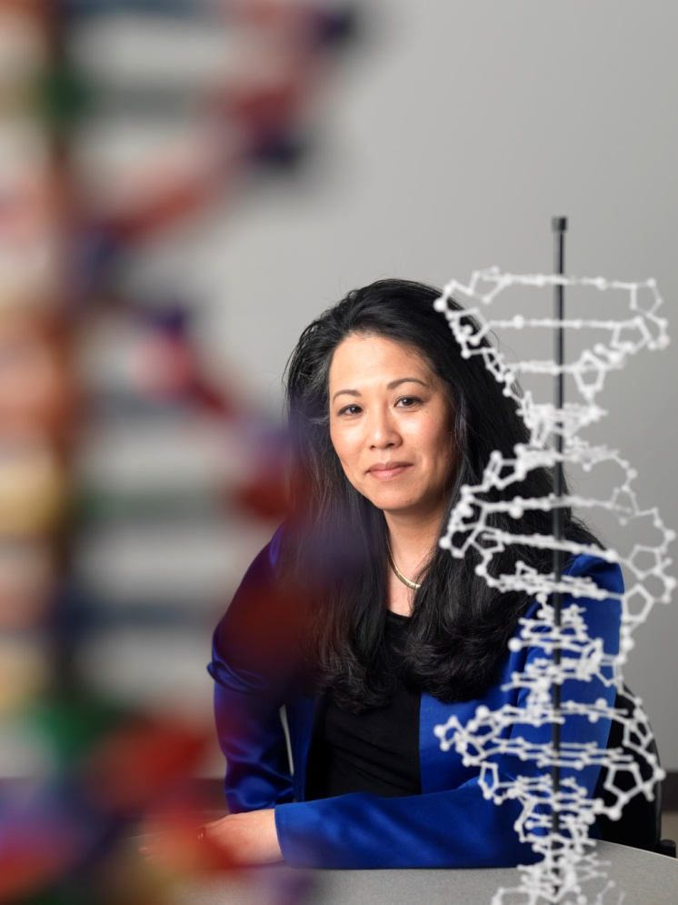

APA’s Society for the Psychological
Study of Ethnic Minority Issues
Charles and Shirley Thomas Award
Vivian Ota Wang, Ph.D.
Document 2
Notes:
Vivian Ota Wang of the NHGRI Extramural Research Program has been awarded the American Psychological Association’s Society for the Psychological Study of Ethnic Minority Issues Charles and Shirley Thomas Award.
This award was created by the APA to honor of the significant contributions made by Charles and Shirley Thomas in the area of student mentoring and development.

Slide 15
Director’s Report Outline
General NHGRI Updates
General NIH Updates
General Genomics Updates
NHGRI Extramural Research Program
NIH Common Fund/Trans-NIH
NHGRI Division of Policy, Communications, and Education
NHGRI Intramural Research Program

Slide 16
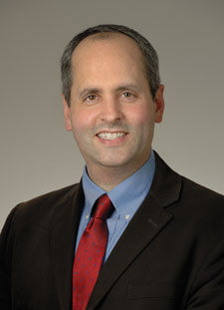

Arrival of New Director, National Institute
of General Medical Sciences
Jon Lorsch, Ph.D.
Document 3
Notes:
As I mentioned in May, Jon Lorsch was selected to be the Director of the National Institute of General Medical Sciences (NIGMS), and Jon officially started in this position last month.
As expected, Jon and I have already been working hard to explore how NHGRI and NIGMS can interact more substantially in the future since one can readily envision major areas of synergy. In fact, we just decided to hold a day-long retreat involving the extramural program staffs of both institutes in the coming months, and I fully expect to have more things to say about this at the February Council meeting.

Slide 17
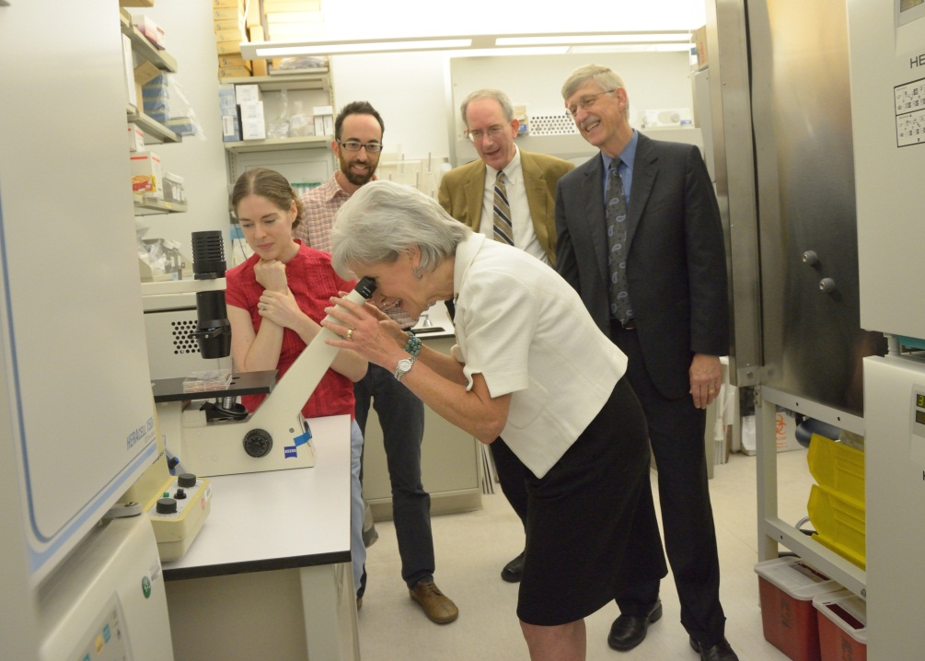
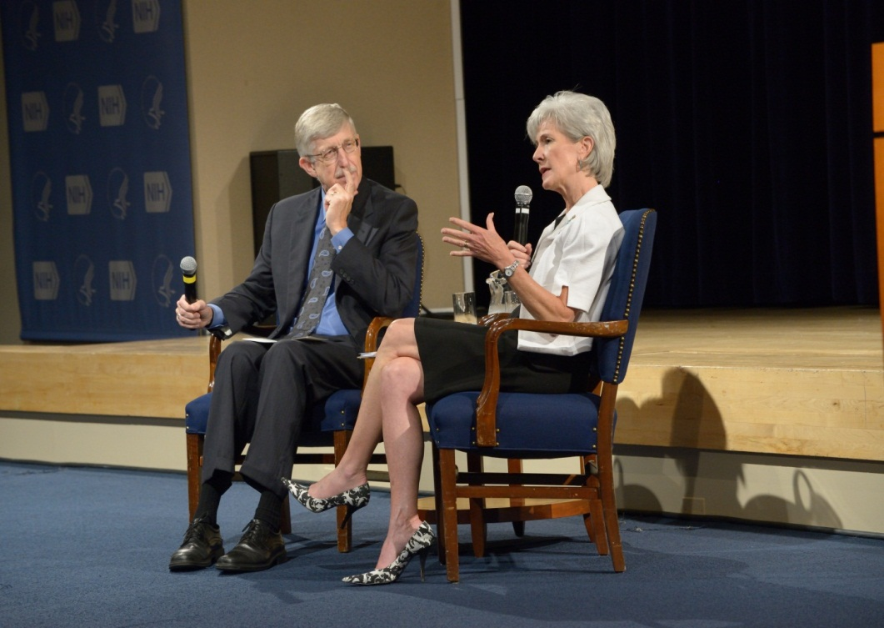
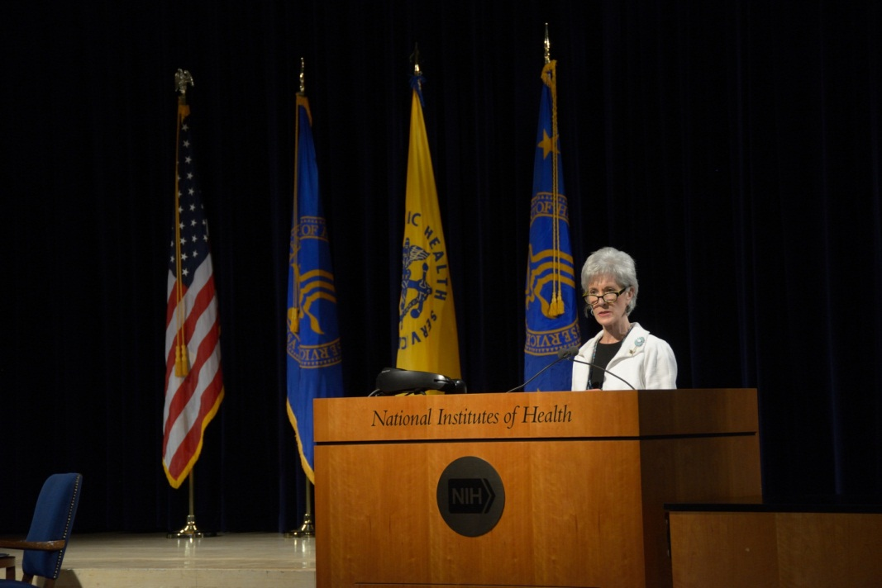
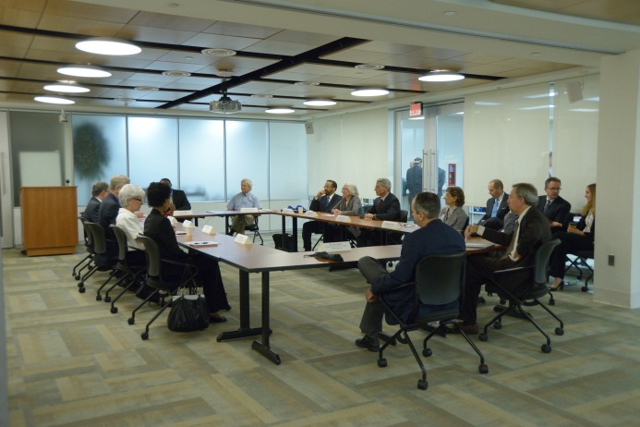
Secretary Sebelius Visits NIH
Notes:
Besides visiting the Genome Exhibition at the Smithsonian, Department of Health and Human Services Secretary Kathleen Sebelius also visited the NIH last month. She toured a number of NIH facilities and spoke at an all-NIH Town Hall.
In addition, I was fortunate to be included in a meeting that she held with a small group of institute and center Directors (shown on the bottom right). During that meeting, she offered her admiration of the good work that NIH scientists and grantees do, and spoke candidly of the negative effects of sequestration on the biomedical research enterprise.

Slide 18
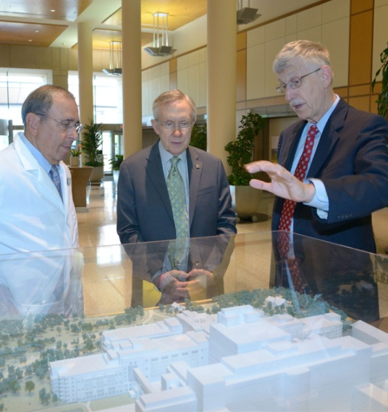
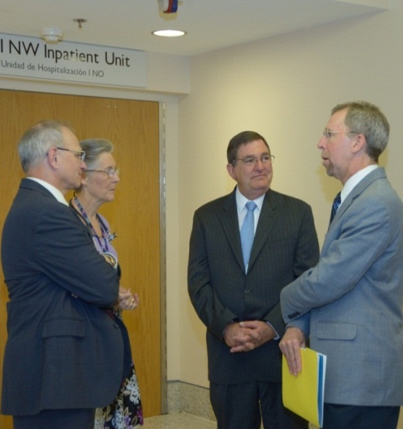
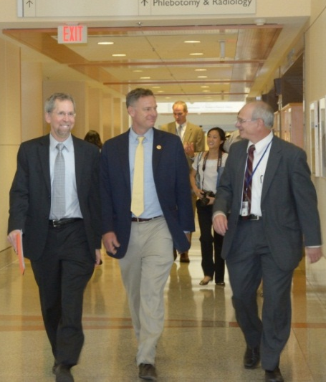
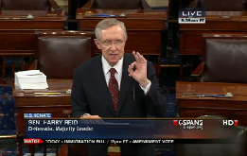
Visits of Congressional Members to NIH
Sen. Harry Reid (D-NV)
Senate Majority Leader
Rep. Michael Burgess (R-TX)
House – Energy and Commerce
Rep. Scott Peters (D-CA)
House – Sci. and Tech.
  “I toured the clinic where the best medical researchers in the country are trying to solve the world’s most elusive medical mysteries – diseases that have yet to be identified let alone cured.”
  – Sen. Harry Reid (Senate Floor, June 20 2013)
Document 4
Notes:
NHGRI staff also participated in three visits of Congressional members to the NIH campus during the summer.
* In June, Senate Majority Leader Harry Reid of Nevada visited the Clinical Center, and then * Representatives Michael Burgess of Texas and * Scott Peters of California both visited in one very busy week in July. During all three visits, the Congressmen met with pediatric patients and families enrolled in the Undiagnosed Diseases Program, met with NHGRI staff (among others), and were impressed by the commitment of the NIH researchers and doctors. I had the chance to meet with the two Representatives, and was able to discuss advances in genomics in a substantive way with each.
* Majority Leader Reid was so impressed that, shortly after his visit to NIH, he gave a speech on the Senate floor about the value of research like the Undiagnosed Diseases Program, and the negative effects of sequestration cuts on biomedical research. A quote from that speech is shown here.

Slide 19
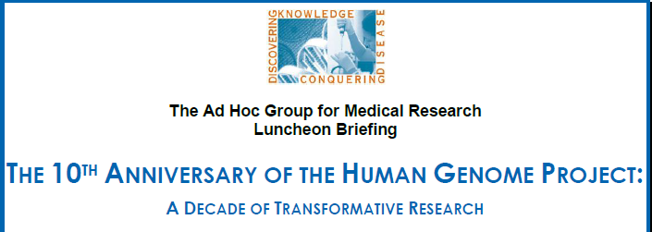
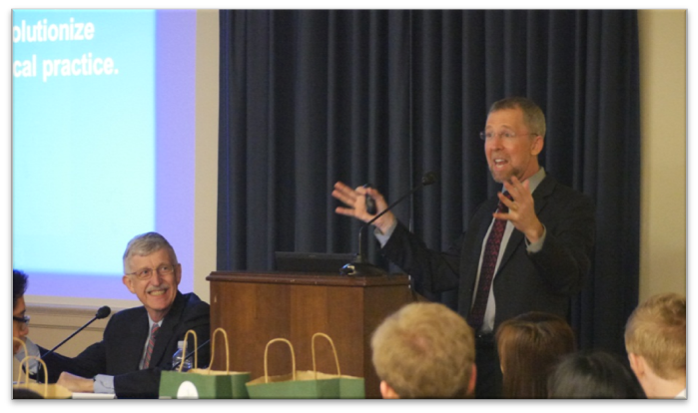

Congressional Briefing on Genomics
Notes:
And those remarks by Senator Reid could not have been better timed. Because also in June, Representative Louise Slaughter and Senator Tom Harkin, along with the Ad Hoc Group for Medical Research, sponsored a briefing on Capitol Hill to celebrate the 10th Anniversary of the Human Genome Project.
Francis Collins and I were invited to present on both the history of the Human Genome Project and how advances in DNA sequencing technologies have led to plummeting costs for genome sequencing and are enabling impressive research and clinical advances. The event was very well attended (standing room only, as you can see from photograph on the bottom right).

Slide 20


Surgeon General Steps Down
Regina Benjamin, M.D., M.B.A.
Document 5
Notes:
Regina Benjamin has stepped down as the U.S. Surgeon General. Deputy Surgeon General Boris Lushniak will serve as Acting Surgeon General until the next Surgeon General is appointed.

Slide 21
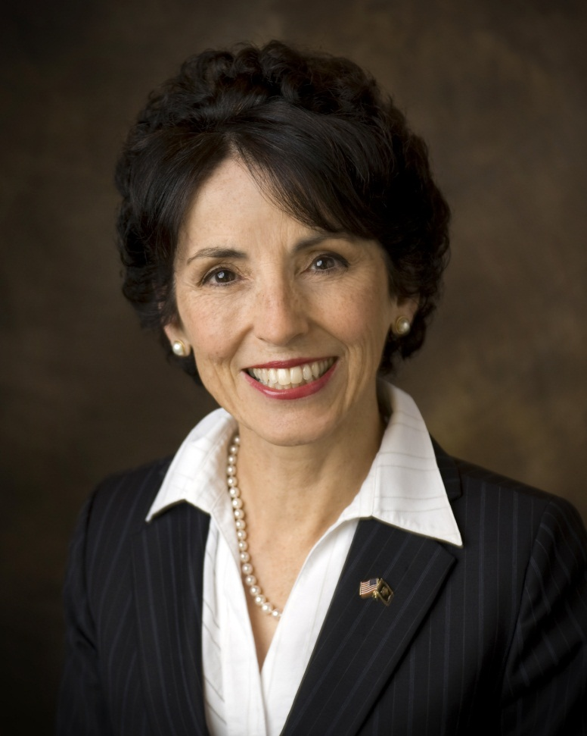

National Science Foundation
Director Nomination
France Córdova, Ph.D.
Document 6
Notes:
President Obama has nominated France Cordova to serve as the next Director of the National Science Foundation. Among other things, she is currently Chair of the main governing board for the Smithsonian Institution and, in fact, Vence Bonham gave her a private tour of the Genome Exhibition shortly before she was nominated for the NSF Directorship.

Slide 22
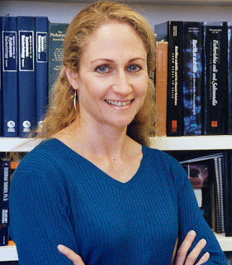

Office of Science and Technology Policy Associate Director Nomination
Jo Handelsman, Ph.D.
Document 7
Notes:
At the same time that the President announced his nominee for the NSF Director, he also announced his nomination of Yale University microbiologist Jo Handelsman to be the next Associate Director for Science at the White House Office of Science and Technology Policy (OSTP).
Jo would succeed Carl Wieman, the physics Nobel laureate who stepped down in June 2012 for health reasons. Jo is known to many of us at NHGRI, and is currently the PI on Yale’s T32 training grant from our Institute.

Slide 23
NIH Fiscal Year 2014 Appropriations
  Regular appropriations process will not be completed
  Continuing Resolution (CR) anticipated
 | FY 2013 Actual (after sequester) | President FY 2014 | House FY 2014 | Senate FY 2014
NIH | $29.1B | $31.3B | - | $30.955B
NHGRI | $483M | $517M | - | $514M
Document 8
Notes:
On now for our ‘super fun’ topic– appropriations and budget. When it comes to appropriations, it never seems to be a simple story. We are a mere three weeks from the start of a new fiscal year on October 1, but we truly have no idea what NHGRI’s budget will likely be in Fiscal Year 2014.
* Congress has yet to pass an appropriations bill to fund the NIH for the upcoming year, and it is highly unlikely that they will meet the end-of-September deadline for doing so. So, the regular appropriations process will not be completed. * Given this reality, Congress is now negotiating about the passage of a Continuing Resolution to avoid a government shutdown on October 1; such a CR is anticipated.
There has been some Congressional action on establishing NIH funding for Fiscal Year 2014. * In July, the Senate appropriations committee passed a bill that allocates nearly $31 billion to NIH, including $514 million for NHGRI (as shown on the far right of the table). Note that these figures are slightly lower than the President’s budget (shown in the third column from the left). Although this would represent a 6% increase for NHGRI compared to Fiscal Year 2013, it is only the case because sequestration reduced NHGRI’s budget to $483 million this year. So, a $514 million budget would be essentially flat compared with NHGRI’s Fiscal Year 2012 budget of $512 million. Notably, the Senate committee’s bill has yet to be considered by the full Senate, and the House appropriations committee has yet to issue draft legislation for Fiscal Year 2014.
In short, probably the only thing that we can be certain about is continued uncertainty regarding funding levels for NIH and NHGRI.

Slide 24
NHGRI Consequences of the Sequester
  Bioinformatics Resources and Analysis Research Portfolio
        REDUCED BY $5M
  ENCODE RFA
        REDUCED BY 16%
  Genomics of Gene Regulation RFA
        DELAYED FROM FISCAL YEAR 2012 TO 2014
  Genomic Sequencing & Newborn Screening Disorders RFA
        REDUCED BY 50%
  Genomic Medicine Pilot Demonstration Projects RFA
        REDUCED BY 20%
  Intramural Research Program
        NUMEROUS EXAMPLES OF DETRIMENTAL CUTS
Notes:
We were recently asked to submit a listing of the major consequences of the sequester on NHGRI’s research program. So, I thought I would share with you that ‘casualty list’ to give a flavor of the overall damage caused by the sequester. * In short, this year’s sequestration and budgetary reduction forced NHGRI to do all of the things listed on this slide.

Slide 25
Other Consequences of the Sequester
  BD2K Data Catalog
          REDUCED IN FISCAL YEAR 2014
  BD2K Framework for Community-based Development of Data and Metadata Standards
          REDUCED IN FISCAL YEAR 2014
  BD2K Training
          DEFERRED UNTIL FISCAL YEAR 2015
  BD2K Software RFA
          DEFERRED UNTIL FISCAL YEAR 2015
  BD2K NIH-Initiated Centers RFA
          DEFERRED UNTIL FISCAL YEAR 2015
Notes:
And while making lists about the impact of sequestration, we also should consider what it did to trans-NIH initiatives, such as the Big Data to Knowledge (BD2K) initiative (that I will talk more about later). * once again, the consequences were all negative.

Slide 26
Director’s Report Outline
General NHGRI Updates
General NIH Updates
General Genomics Updates
NHGRI Extramural Research Program
NIH Common Fund/Trans-NIH
NHGRI Division of Policy, Communications, and Education
NHGRI Intramural Research Program

Slide 27
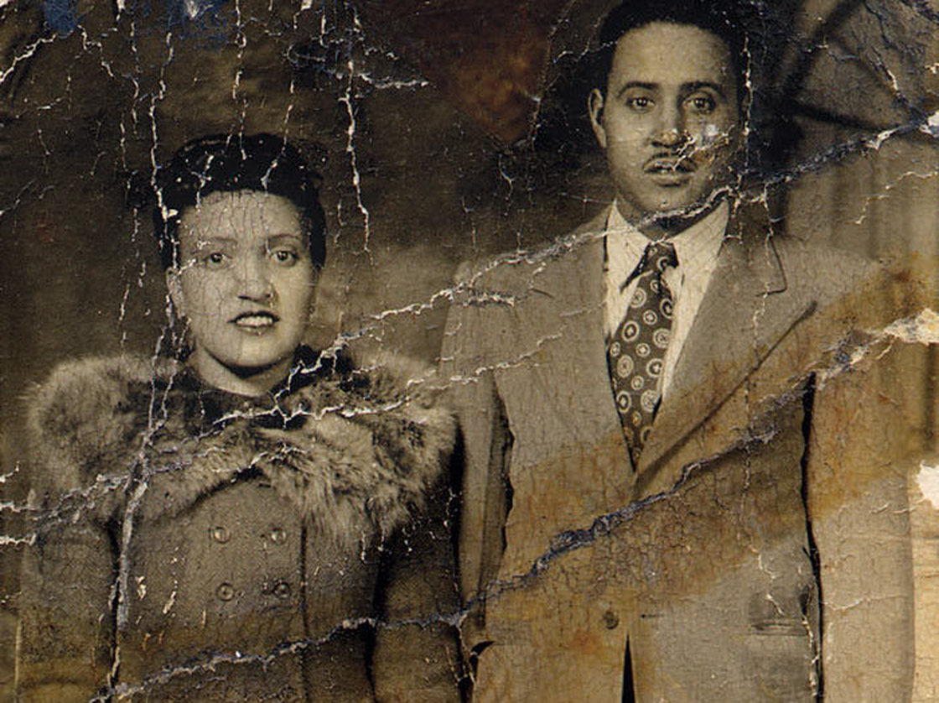
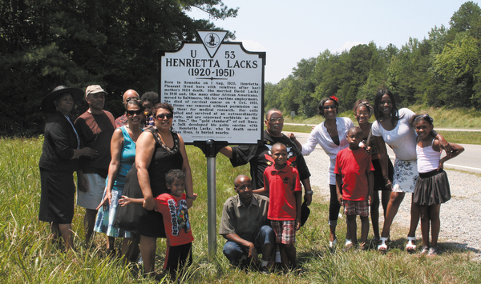
HeLa Whole-Genome Data Access
  NIH announced new policy for access to HeLa cell whole-genome data in August
  Presentation by Kathy Hudson later in the Open Session
Document 9
Notes:
An innovative policy solution for accessing HeLa cell line-derived whole-genome data was * announced by NIH in early August. You will recall that in March, a whole-genome sequence of the HeLa cell line was posted in open access data repositories upon publication of a paper analyzing the data in the journal G3. When the Lacks family learned of this, they asked that the data to be removed from those repositories, which it promptly was.
When NIH became aware of the situation, the agency felt that it was important to work with the Lacks family to identify an appropriate path forward for research and the family. The well-known story of this cell line (including the lack of informed consent from Henrietta Lacks, the widespread use of the cells, and the substantial publicity associated with the identity of the family) presented a unique but important moment for research policy development.
* To tell us more about how the story unfolded, Kathy Hudson will be here this afternoon to talk to us about the discussions with the family and the ultimate policy that was developed for accessing HeLa whole-genome data.

Slide 28
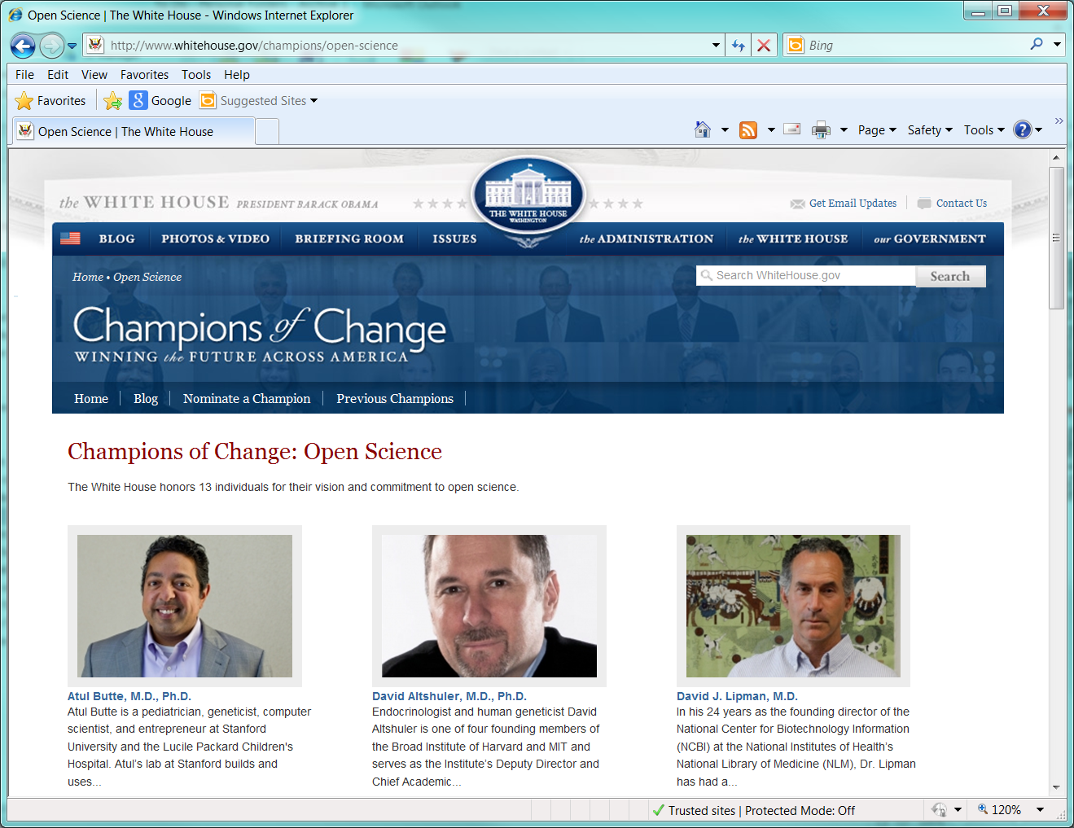
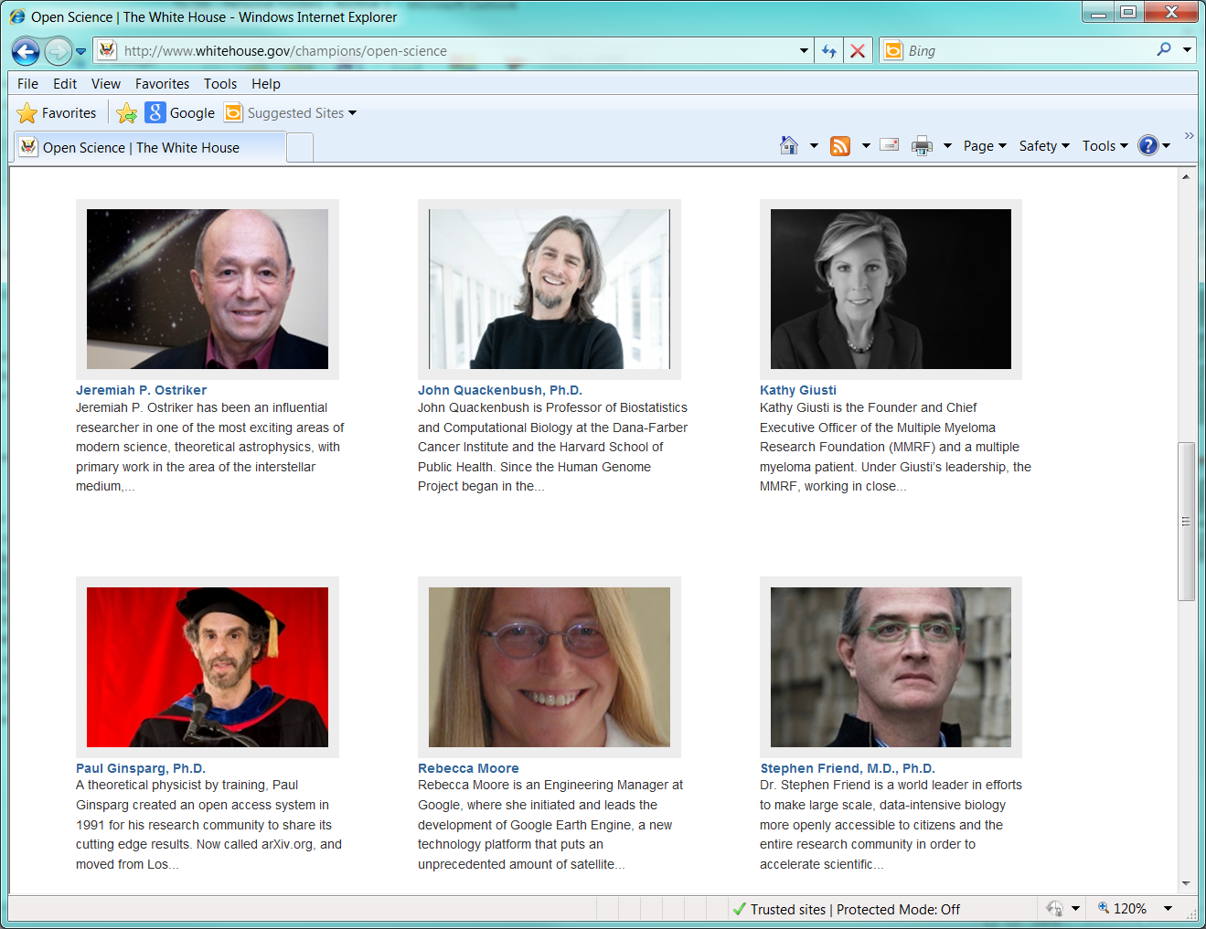
White House Open Science 'Champions' Highlight Genomic Data Pioneers
Document 10
Notes:
A number of scientists received the Open Science Champions of Change honor at the White House in June. The group included some familiar figures to NHGRI: Atul Butte, David Altshuler, David Lipman, Stephen Friend, and John Quackenbush.
The Champions of Change program was launched as part of President Obama's Winning the Future Initiative, which highlights individuals, businesses, and organizations who make positive impacts on communities.
This group of investigators and entrepreneurs are being singled out for their efforts to make open sharing of scientific data a reality, a goal that the Obama administration has promoted as a priority for enabling and enhancing scientific innovation.

Slide 29




Warren Alpert Foundation Prize
David Botstein Ph.D.
Ronald Davis Ph.D.
David Hogness Ph.D.
Document 11
Notes:
David Botstein of Princeton University, and Ronald Davis and David Hogness, both of Stanford University School of Medicine, are the recipients of the 2013 Warren Alpert Foundation Prize for their seminal contributions to concepts and methods of creating a human genetic map, and of positional cloning, leading to the identification of thousands of human disease genes and ushering in major advances in human genetics.

Slide 30


Knighthood for Services to Medical Science
Michael Stratton, Ph.D.
Document 12
Notes:
Professor (Sir) Mike Stratton, Director of the Wellcome Trust Sanger Institute, was recently knighted for services to medical science. The knighthood was awarded in recognition of his research into the genetic causes of human cancers. Mike’s laboratory discovered the BRCA2 cancer gene, and founded the Cancer Genome Project at the Sanger Institute.

Slide 31
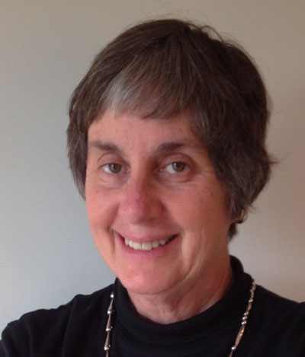

2013 Abbott Award in Clinical and Diagnostic Immunology
Jennifer Puck, M.D.
Document 13
Notes:
Jennifer Puck, UCSF Professor and former Branch Chief and Senior Investigator in the NHGRI Intramural Research Program, received the 2013 Abbott Award in Clinical and Diagnostic Immunology for her research on primary immunodeficiencies.

Slide 32
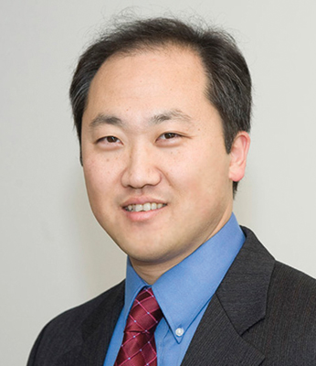

Founding Director, Jackson Laboratory
for Genomic Medicine
Charles Lee, Ph.D.
Document 14
Notes:
Charles Lee has been appointed the Founding Director of the Jackson Laboratory for Genomic Medicine. Charles is best known for his discovery that copy-number variation is widespread and significant in the human genome. In his new role, he will be responsible for the scientific direction of the Jackson Laboratory of Genomic Medicine in Farmington, CT.

Slide 33
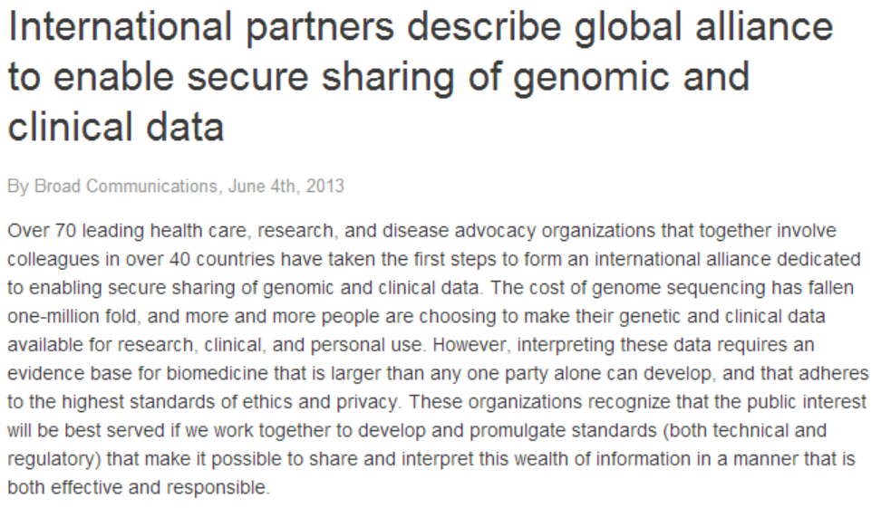
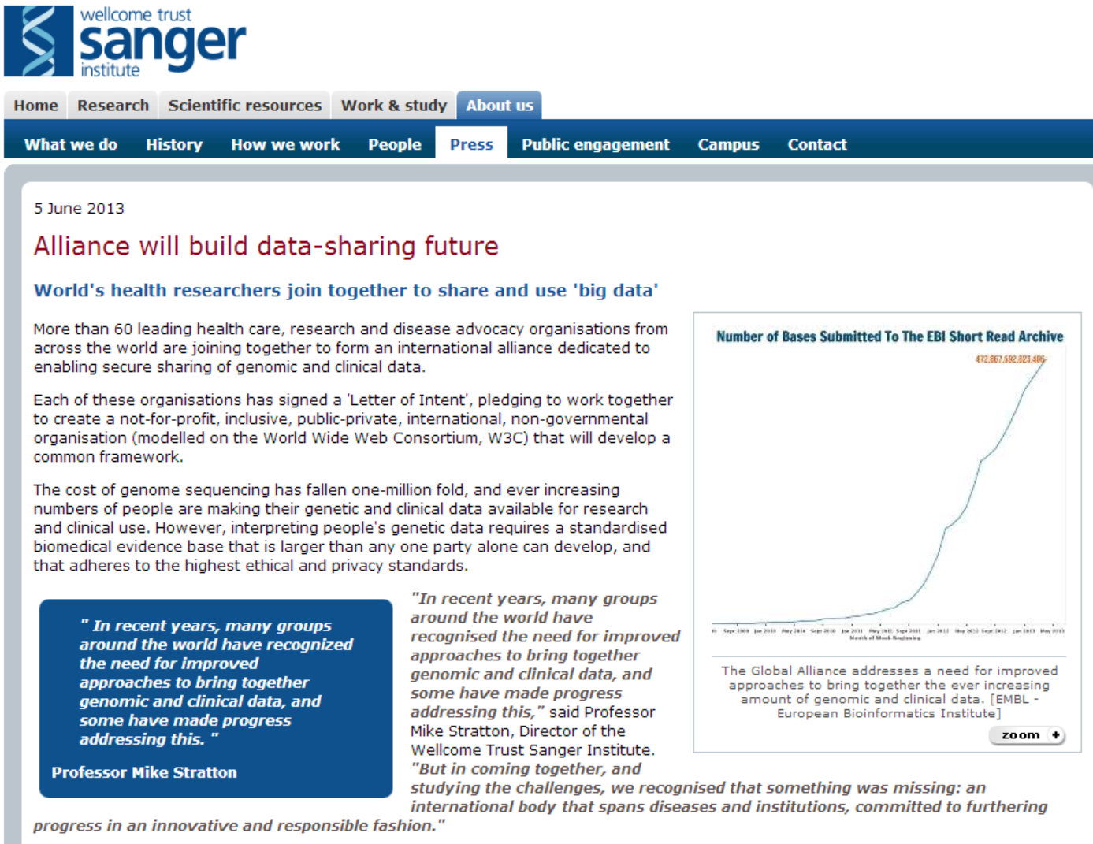
‘Global Alliance’ to Enable Responsible Sharing of Genomic and Clinical Data
Document 15
Notes:
Earlier this summer, there was a major announcement about the formation of an international ‘Global Alliance’ that will enable secure sharing of genomic and clinical data. Shown here are the press releases issued from the Broad Institute and the Sanger Institute.
The Global Alliance has many aims, including establishing inter-operable standards for genomic and clinical data, and developing a framework for harmonizing data-sharing practices to address issues related to ethics, privacy, and consent.
At the time of the announcement, they had obtained signatories of their Letter of Intent from >73 institutions (including NIH, NHGRI, and NCI) in >40 countries. In total, this included more 13 funding agencies.
There is notable overlap in some of their aims and components of NIH’s Big Data to Knowledge (BD2K) initiative, so there seems to be a great opportunity for synergy between these initiatives. We are in conversations with the key leaders of the Global Alliance as they get off the ground, and I expect to have more information to report to Council in the coming months as things develop.

Slide 34


Genomics England Launched
Document 16
Notes:
U.K.’s Health Secretary, Jeremy Hunt, has launched Genomics England, a new government organization to oversee the creation of a ‘genomic revolution’ in healthcare that will attract business investment. It will be led by Sir John Chisholm, a former Chair of the Medical Research Council.

Slide 35
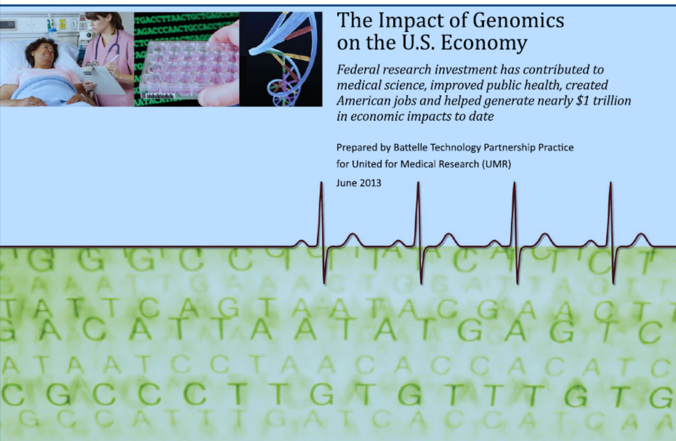
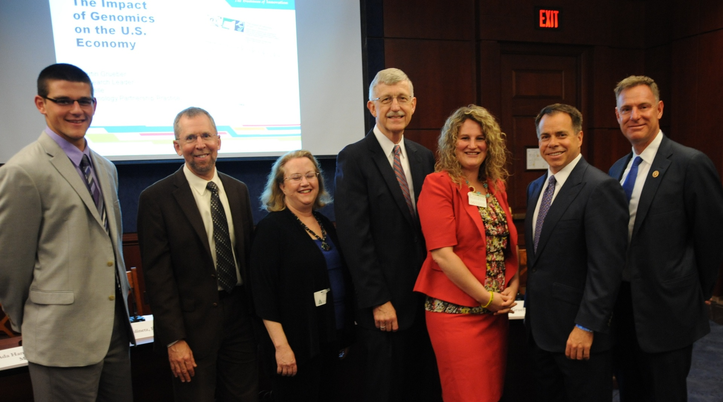
Genomics and the Economy
Document 17
Notes:
Recall that in May 2011, the Battelle Technology Partnership Practice published a study reporting that for every dollar of federal investment in genomics research, roughly $141 were created in the wider economy— a statistic quoted by President Obama in his 2013 State of the Union address.
* The Battelle group released an update of their report this past June, and the results were even more impressive. Between 1988 and 2012, the federal government invested $14.5 billion (in 2012 dollars) in genomics. This generated an economic output of nearly a trillion dollars over the same timeframe, creating more than 4.3 million job-years of employment. When one realizes that the U.S. government invested $3.8 billion in the Human Genome Project, that works out to be a return on investment of 178:1.
* Shown here is a photograph taken at a United for Medical Research briefing in June on Capitol Hill, where the updated Battelle report was announced. Among the briefing participants were myself, Ada Hamosh, Francis Collins, California Representative Scott Peters (far right), and Life Tech CEO Greg Lucier (second from right).

Slide 36

Genomics and the Economy
Document 17
Notes:
In May of this year, the McKinsey Global Institute, a research arm of the management consultancy group McKinsey and Company, released a report entitled Disruptive technologies: advances that will transform life, business, and the global economy. It is notable that ‘next-generation genomics’ was listed as one of the twelve technologies with profound disruptive potential. The other technologies grouped with ‘next-generation genomics’ were impressive, and included things like mobile internet, cloud technology, advanced robotics, 3D printing, and renewable energy.
While the report has some gaps and even debatable predictions, it is another interesting example of the growing awareness of genomics and its significance to a wide array of interests, including biotech, medicine, agriculture, and energy.

Slide 37
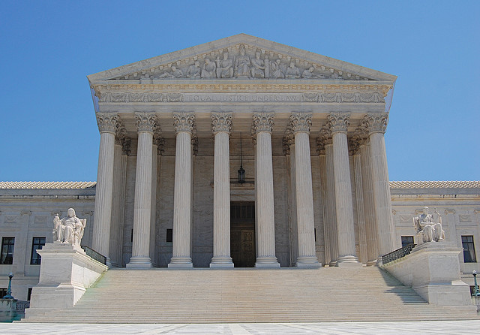
An End to Gene Patents?
Document 18
Notes:
The long-running legal battle over Myriad Genetics’ BRCA gene patent, which began in 2009, reached its conclusion on June 13 this year, when the U.S. Supreme Court released their unanimous opinion, deciding that isolated but otherwise unmodified human genes are products of nature and therefore not patent-eligible subject matter.
You will be hearing much more about this topic later today from Council member Arti Rai. But I would just note that the Court’s decision, written by Justice Thomas, follows closely the U.S. Government’s position, which NHGRI helped to develop.

Slide 38



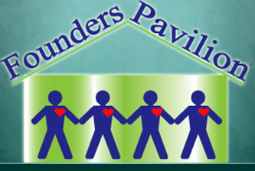
First GINA Cases Filed
1. Settled
V.
2. Pending
V.
Document 19
Notes:
It has been five years since the Genetic Information Nondiscrimination Act (or GINA) was passed and signed into law. NHGRI has been monitoring its implementation by the Courts. As you might know, GINA tasks the Equal Employment Opportunity Commission (EEOC) with protecting workers from genetic discrimination in the workplace. In May, the Commission announced the settlement of the first lawsuit it had filed for a GINA violation and the filing of a second suit. Both cases allege that the employer illegally included questions about family medical histories during pre-employment medical exams. Under GINA, it is illegal for companies to ask their employees for genetic information, which includes family medical history.
* In the settled lawsuit, the fabrics manufacturer Fabricut agreed to pay $50,000 compensation and provide antidiscrimination training to employees. * In the second suit, a New York nursing and rehabilitation center (Founders Pavilion Inc.) is similarly accused of requesting family medical histories during medical exams.
The EEOC reports that, as of September 2012 (which is the most recent data available), 762 charges of genetic discrimination have been filed. NHGRI will continue to monitor the Founders Pavilion case and any other charges that reach the courts.

Slide 39
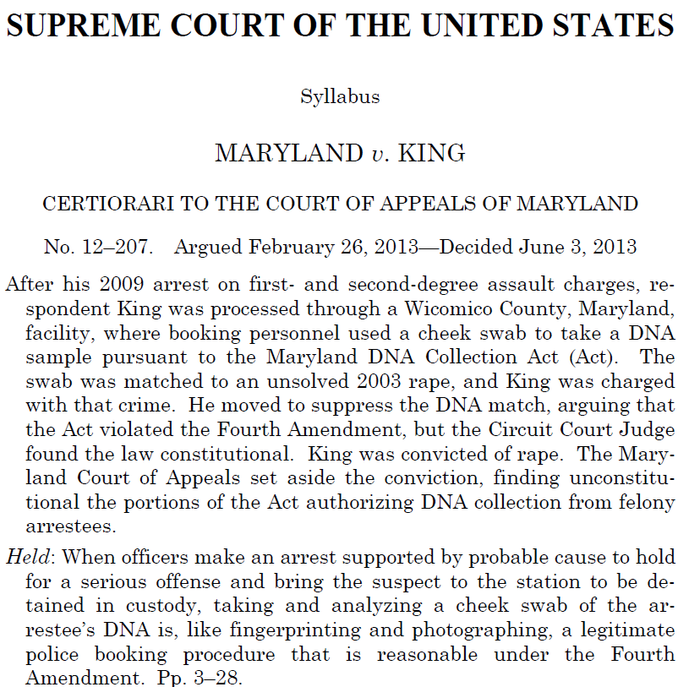
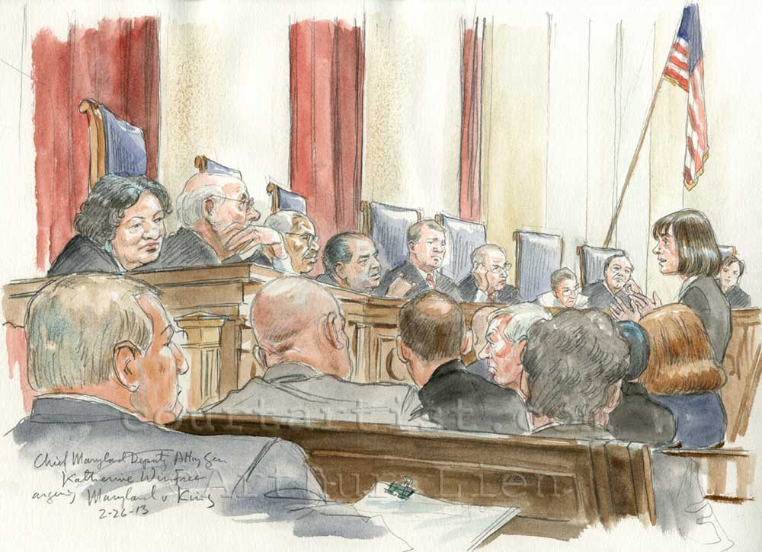
U.S. Supreme Court Upholds ‘DNA
Swabbing’ of People Under Arrest
Document 20
Notes:
On June 3 and in a 5 to 4 ruling, the U.S. Supreme Court determined that collecting and analyzing DNA from people arrested for serious crimes does not violate 4th amendment protections against unreasonable search and seizure. The ruling establishes that an arrestee’s DNA profile can be entered into a database before conviction of any crime to determine the involvement of the individual in unrelated criminal acts.
The case in question involved an individual whose cheek swab upon arrest for assault in 2009 led to him being charged and eventually convicted of an unsolved 2003 rape. The Supreme Court held that such DNA collection and analysis is justified and legal, and that the invasion is minimal. The dissenting opinion countered that this allows DNA profiling without probable cause for suspicion in unrelated cases, which violates the 4th amendment.
The Court’s decision could have a widespread impact on genetic privacy, especially if it is applied in states that collect DNA upon arrest for minor crimes. Also, criminal rights advocates argue that the decision will disproportionately affect racial minorities, who are more likely to be arrested regardless of the crime and are overrepresented in law enforcement databases.

Slide 40


NCHPEG Ceases Operations
  Promoted health professional education for two decades
  NCHPEG founded in 1996 through partnership of the American Medical Association, American Nurses Association, and NHGRI
  Ceased operations on August 31
  Resources will be maintained at the American Society of Human Genetics website
Document 21
Notes:
The National Coalition for Health Professional Education in Genetics (or NCHPEG) recently ceased operation. * As many of you know, NCHPEG promoted health professional education in human genetics and genomics for two decades.
* The group was initially founded in 1996 through a partnership of the American Medical Association, the American Nurses Association, and NHGRI.
* Its Director Joan Scott announced that NCHPEG ceased operations at the end of August. NCHPEG always had a liaison attend our Council and has been a consistent partner with NHGRI over the years.
* Fortunately, the wealth of information and resources collected on its website will be maintained for the time being at the American Society of Human Genetics website.
I applaud NCHPEG’s important educational efforts and their many contributions to bringing together diverse healthcare provider disciplines that continue to implement genomic applications into medical care. I also want to thank Joan Scott and her predecessor Joe McInerney for their many years of service.

Slide 41
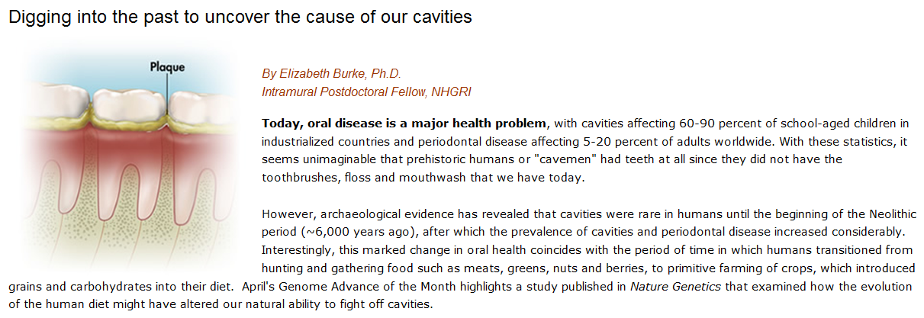
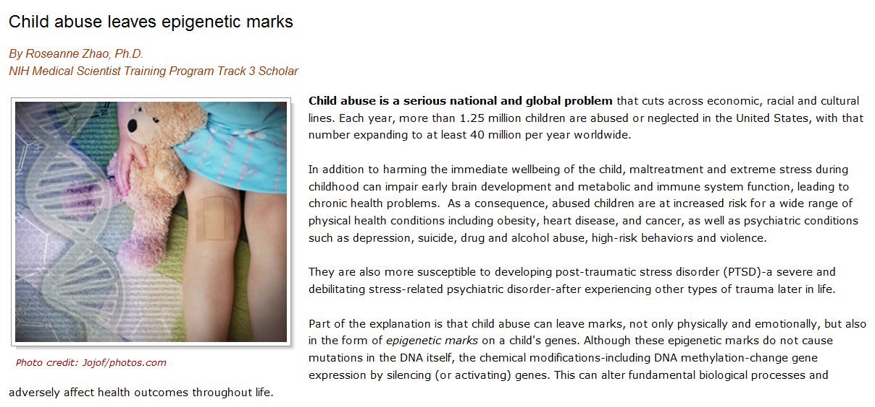
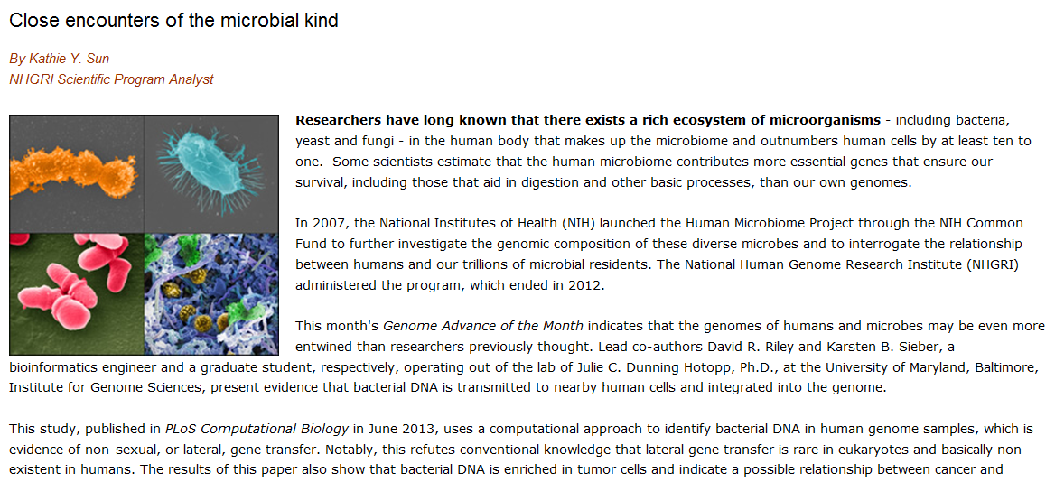
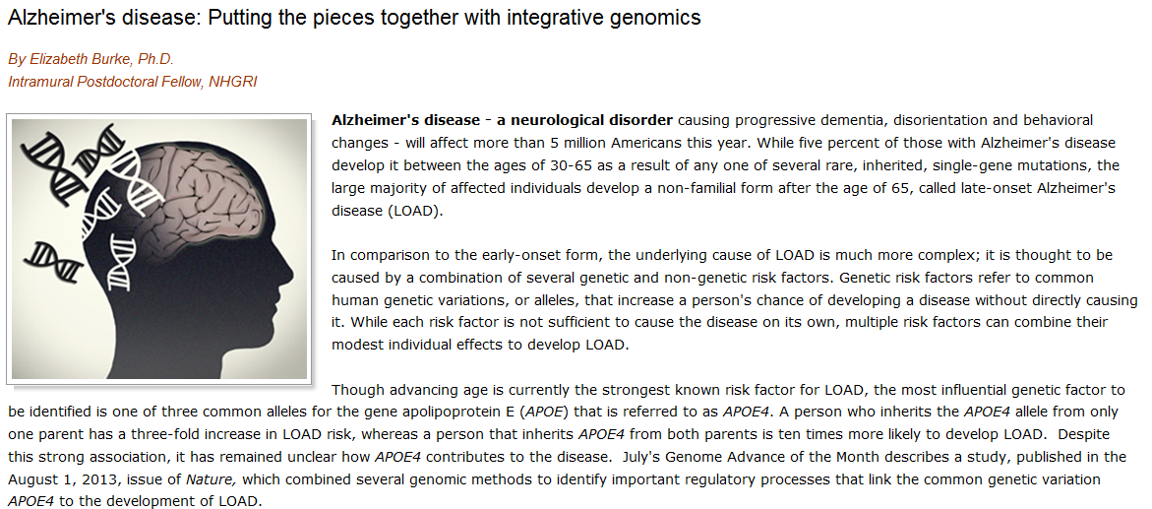
NHGRI Genome Advance of the Month
Document 22
Notes:
Featured as an NHGRI Genome Advance of the Month since the last Council meeting included publications describing * metagenomic sequencing to study bacteria in prehistoric mouths, * child abuse and epigenetics, * the human microbiome, and * genetic regulation of Alzheimer’s Disease.

Slide 42


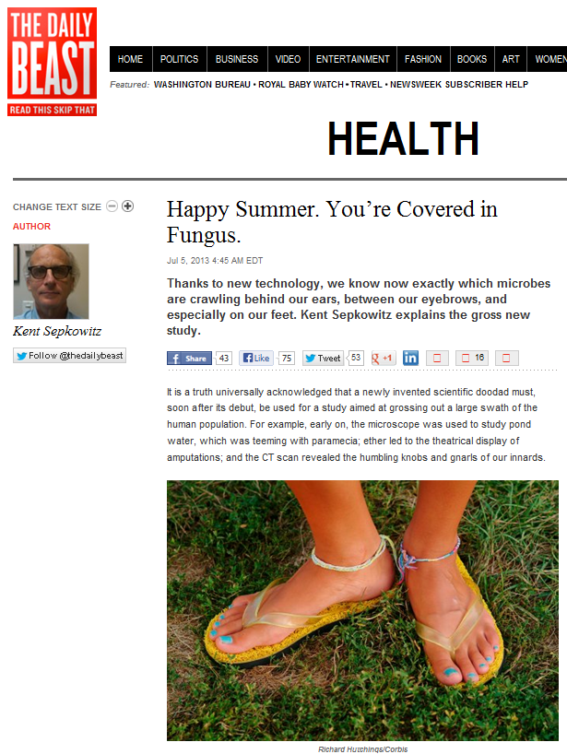








Genomics In The News…
"In the past we tended to think that the absence of microbes made people healthy, but as we're learning, bacteria are not just a source of disease—they're a source of health." Lita Proctor, PhD
Document 23
Notes:
Once again, there has been a considerable amount of Genomics in the News since we last met.
* Forbes named the NIH the second of “4 Government Programs That Drive Innovation” and mentioned the economic impact of the Human Genome Project.
I have had a busy summer in terms of media interactions, with videotaped interviews by the * Huffington Post, * Fox Business, and * BioCentury TV.
* O (the Oprah Winfrey magazine) ran a story on the microbiome, a topic also featured in an * NPR story that ran 8 minutes and aired during Morning Edition.
* The human microbiome was also featured in the Daily Beast, which featured a recent study from Julie Segre’s lab about the human fungal microbiome.

Slide 43









Genomics In The News…
Document 23
Notes:
Also in the news were a number of genomics researchers who authored ‘The Hottest Papers’ published over the preceding two years, as well as the papers published during 2012 that were most cited by year’s end.
There were 21 people named overall, with 8 being in genomics. They include Council member Rick Wilson, Jun Wang, Eric Lander, Kari Stephansson, Elaine Mardis, Goncalo Abecasis, Li Ding, and Bob Fulton.

Slide 44











Genomes In The News…
Document 24
Notes:
And in terms of Genomes in the News, there have been a number of genomes sequenced since the last Council meeting. These include the genomes of * the Sacred Lotus, * the Norway Spruce, * the Bactrian Camel, * the Mallard Duck, * the Pacific Bluefin Tuna, * the Green-podded Cocao, * the Pandoravirus, * the Oil Palm, and * the Chinese Alligator.
* Also, apparently, a scientist obtained the supposed Bigfoot sample and determined it was a mix of opossum and other species (go figure).
This was met by a Genome Daily Scan poll asking “Would you have taken the time to sequence a sample supposedly belonging to Sasquatch?”, which yielded the following results:
18% Yes. Of course! I want to be the discoverer of Bigfoot.
16% Yes. Just so we put these claims to rest.
24% Maybe. I might just to see what the samples were actually from.
19% No. Are you kidding? What a waste of time.
21% No. Bigfoot has a right to privacy.

Slide 45
Director’s Report Outline
General NHGRI Updates
General NIH Updates
General Genomics Updates
NHGRI Extramural Research Program
NIH Common Fund/Trans-NIH
NHGRI Division of Policy, Communications, and Education
NHGRI Intramural Research Program

Slide 46

Large-Scale Genome Sequencing
and Analysis Centers
  15 publications this quarter
  Current major projects:
    TCGA
    Alzheimer’s disease
    Other complex genetic disorders
Document 25
Notes:
NHGRI’s Large-Scale Genome Sequencing and Analysis Centers continue to be highly productive, * publishing 15 papers this quarter. These included studies on cancer, inherited disease genomics, comparative genomics, and sequencing methods development.
* Their current major projects include work on TCGA, the Alzheimer’s Disease Sequencing Project in collaboration with the National Institute on Aging, and other complex genetic disorders.
The Centers are in the process of re-orienting their goals towards the aims of the Disease 2020 document presented at the last Council meeting, particularly in the area of complex genetic diseases.

Slide 47


  Changes in TCGA leadership:
    TCGA Program Directors Brad Ozenberger and Kenna Shaw left NIH
    Lou Staudt named Director of the NCI Center for Cancer Genomics
  On target to meet goals
  Data available for 8,500 tumor specimens (from 26 tumor types)
  On course to reach ~11,000 specimens by project’s end
Document 26
Notes:
* The Cancer Genome Atlas program has faced the challenge of leadership changes. * The two principal TCGA Program Directors, Brad Ozenberger and Kenna Shaw, left the NIH recently for new career opportunities. I want acknowledge Jeff Struewing, who stepped into Brad’s role on an interim basis, and has very ably kept this program on track. We anticipate announcing a new NHGRI lead for TCGA very soon. * Harold Varmus also named a permanent Director of the NCI Center for Cancer Genomics, where TCGA is located. That new Director is Lou Staudt, a well-known cancer researcher with a distinguished career in the NCI Intramural Research Program.
* Meanwhile, TCGA remains on target to meet its goals. Sample collection should be completed in early 2014. Data is already available for 8,500 tumor specimens from 26 tumor types. This graph shows the progress over the last year, with the top line indicating tumor cases qualified and shipped to analysis centers (from about 6,000 a year ago to more than 8,000 today). The subsequent lines show the availability of primary analysis files from the TCGA data portal.
Overall, the project is on course to analyze roughly 11,000 specimens by the project’s end. Although sample accrual will be complete early next year, we anticipate another year or two of continued activities to complete the full spectrum of analyses.

Slide 48



  ‘Pan-cancer’ analyses reveal additional features of disease
  ~30 papers to be published in the next several weeks
Pan-Cancer Sites
Glioblastoma multiform
Integrative Analyses
Acute Myeloid Leukemia
Head and Neck squamous
Lung Adenocarcinoma
Breast carcinoma
Lung Squamous
Colon
Kidney Clear Cell
Ovarian
Rectum
Endometrial
Bladder
Thematic
Pathways
Document 26
Notes:
A new and exciting direction for TCGA is a recently completed large-scale * ‘pan-cancer’ analysis across the major tumor projects. Data from the 12 most advanced tumor projects (listed in this figure) were normalized and integrated to search for common features in the biology of cancer. Data files from more than 5,000 tumor samples were analyzed during this process.
The group’s integrative and cross-tumor analyses reveal the spectrum of mutations associated with different carcinogenic etiologies (such as tobacco and viral pathogens) in different parts of the body; the genomic and epigenomic patterns that characterize and define major cancer subtypes; the cellular pathways that appear to be involved in multiple cancer types and that could be clinically actionable; and the separation of important molecular patterns that are tissue-specific from those that are disease-specific.
* This groundbreaking pan-cancer work will be published in the next weeks in approximately 30 papers, which will be linked and threaded similar to the set of ENCODE papers last year.

Slide 49

Disease Gene Discovery:
>9600 whole-exome sequences for >617 diseases
Discovery of 199 disease genes underlying 114 diseases
Publications (31)
  Discoveries of diseases genes (22)
  Methods and resources (6)
  Practices for data sharing (3)
Network and Outreach:
Collaborative Network: 384 investigators, 189 institutions, and 30 countries
IRDiRC committees and working groups
Document 27
Notes:
The Centers for Mendelian Genomics started their work roughly 20 months ago, aiming to elucidate the genomic basis for as many Mendelian diseases as possible using whole-exome sequencing as their main approach.
* In terms of disease gene discovery, * the groups have collectively generated more than 9600 whole-exome sequences in studying over 617 rare diseases. 61 of these diseases have not been described before.
* These efforts have resulted in the discovery of 199 disease genes underlying 114 diseases. 64 of these disease genes have not been previously implicated in any disorder.
* There have been 31 publications so far from these Centers, with 22 reporting discoveries of disease genes, 6 describing methods and resources, and 3 providing information about practices for data sharing (including informed consent).
* In terms of the network and its outreach. * The Centers have thus far collaborated with 384 investigators from 189 institutions in 30 countries. * Furthermore, the Program is a member of the International Rare Diseases Research Consortium (IRDiRC), with Center members serving on committees and working groups of this young consortium.

Slide 50

Clinical Sequencing Exploratory Research (CSER) Program
  Three new CSER sites:
    HudsonAlpha Institute
    Kaiser Foundation Research Inst.
    University of Michigan
  Coordinating Center:
    University of Washington
  Enhanced integration with ELSI studies
Document 28
Notes:
The Clinical Sequencing Exploratory Research (or CSER) Program began with 6 awards in 2012 to support investigations of the technical challenges and the ethical and psychosocial implications of applying genome sequencing for medical care.
* We recently announced the awards for three new project sites. The new projects include a variety of different clinical situations, including pediatric developmental disorders at the * HudsonAlpha Institute, pre-conception carrier testing at * the Kaiser Foundation Research Institute, and rare tumor sequencing at the * University of Michigan. This last award is being co-funded by the National Cancer Institute.
* We also announced a new CSER Coordinating Center at the University of Washington; this group will lead important activities to disseminate the findings and approaches from CSER to the broader biomedical research community.
* The addition of these new grantees presented an opportunity to consolidate CSER with our Return of Results Consortium, which focuses on behavioral, social, and normative research on returning genomic results. Investigators in that consortium are now formally part of the CSER Consortium and fall under our new CSER Coordinating Center.

Slide 51


Genome Sequencing Informatics Tools
  iSeqTools Portal provides a ‘subway map’ for genome analysis
  User can drill down to details and individual tools with a ‘semantic zoom’ web feature
Document 29
Notes:
The Genome Sequencing Informatics Tools Program is known by the name “iSeqTools”. As a reminder, this program is comprised of six projects that are developing approaches to provide ‘researcher friendly’ sequence analysis tools. The primary target for this program is the community of users outside of large genome centers.
* The program will soon release the iSeqTools Portal as an important gateway to these tools. The heart of the portal is a dynamic visualization panel that will enable scientists to quickly identify the appropriate tools and pipelines for their sequence-analysis tasks. An easy-to-navigate ‘subway map’ will be provided to help researchers prepare their analyses rapidly and seamlessly.
Users will be able to choose from all available tools and pipelines developed by the six participant projects, and then * drill down to details and individual tools with a ‘semantic zoom’ web feature– navigating from a global view down to the details in the workflow, pipeline, and tool views.

Slide 52




DNA Sequencing Technology Development
  8 awards made this year
  RFAs posted in June with application receipt date of October 17, 2013
Document 30
Notes:
In terms of NHGRI’s DNA sequencing technology development efforts, this year * NHGRI made 8 awards for research to reduce the cost and improve the quality of DNA sequencing. The topics of these new studies range from improving the qualities of libraries for current next-generation platforms, to nanopore-based electronic sequencing, to sequencing-by-synthesis with electronic detection, to exploring two completely novel methods for detecting sequence.
*RFAs for R21, R01, and SBIR grants were re-issued for one additional receipt date, which is October 17 of this year.

Slide 53




ENCODE
  ENCODE Outreach Activities:
    ENCODE Tutorial at ASHG Meeting
    ENCODE Tutorial at CHARGE Consortium Meeting
  Cross-Species Comparison Papers Under Review:
    modENCODE (fly/worm/human)
    mouse ENCODE (mouse/human)
Document 31
Notes:
The goal of the Encyclopedia of DNA Elements (or ENCODE) project is to create a catalog of all functional elements in the genome, and to make that catalog freely available as a resource to the biomedical community.
* In terms of ENCODE outreach activities, * there will be a tutorial on how to use ENCODE and the Common Fund’s Epigenomics Project data at the annual American Society of Human Genetics meeting in October. This interactive tutorial will include round-table discussions in addition to presentations on the usage of these data.
* There will also be an ENCODE tutorial at the January Cohorts for Heart and Aging Research in Genomic Epidemiology (or CHARGE) Consortium meeting. The CHARGE Consortium facilitates genome-wide association study meta-analyses and replication opportunities among multiple large cohort studies. ENCODE anticipates that collaborations between CHARGE and ENCODE members may be forged through this interaction.
* Cross-species integrative analysis of functional elements is well underway, with manuscripts submitted and under review. Both modENCODE and mouse ENCODE groups have submitted main cross-species comparison papers and companion papers.

Slide 54



Publications Using ENCODE Data
Document 31
Notes:
NHGRI has been tracking publications that use ENCODE, modENCODE, and mouse ENCODE data. These can be viewed using the link on the sidebar at the ENCODE portal. ENCODE-funded publications are tracked separately from publications by non-ENCODE authors.
* ENCODE-funded publications include 19 papers by the mouse ENCODE group, over 220 papers by the ENCODE production groups, and over 120 papers by the modENCODE project.
* There are at least 280 publications that use ENCODE data and have been published by non-ENCODE authors, and at least 80 publications that use modENCODE data and have been published by non-modENCODE authors. Note that these numbers are likely to be underestimates because we manually curate the lists, and do not really have a systematic way to find all such publications.
* As shown on this graph for both classes of papers, the number of publications using ENCODE data has been steadily increasing over time and is, overall, quite impressive.

Slide 55

Genomics of Gene Regulation RFA
  Concept Clearance approved in May 2011
  RFA-HG-13-012: Genomics of Gene Regulation (U01)
  Exploring genomic approaches to understand the role of DNA sequence in gene regulatory networks
  Applications due November 15, 2013
Document 32
Notes:
Back at its * May 2011 meeting, this Council approved a Concept Clearance for an effort to study the genomics of gene regulation. That program ended up getting delayed due to the budget uncertainties in Fiscal Year 2012 and the sequester in Fiscal Year 2013.
* But I am pleased to tell you that the Genomics of Gene Regulation RFA was finally released in early August.
* The goal of this initiative is to support a set of demonstration projects that will explore the feasibility of predicting gene expression from genomic sequence. The program will study the use of genomic approaches to understand the role of DNA sequence in gene regulatory networks, and will combine computational analysis of networks along with functional genomics studies of the underlying regulatory elements.
* Applications are due November 15, 2013, with this Council then discussing their reviews at the May 2014 meeting and funding to start a few months later.

Slide 56

Centers of Excellence in Genomic
Science (CEGS) Program
  Annual meeting at the U. of Wisconsin in October
  New CEGS applications to be reviewed this fall for discussion at February 2014 Council meeting
Document 33
Notes:
This year’s annual * meeting for the Centers of Excellence in Genomic Science (CEGS) program, along with the Diversity Action Plan meeting, will be hosted by the Wisconsin CEGS, half of which recently moved to the Texas Biomedical Research Institute in San Antonio.
* The new CEGS applications received over the summer will be reviewed later this fall, and will then be discussed by Council at the February 2014 meeting.

Slide 57

Genomic Medicine Working Group
  5th Genomic Medicine Meeting
  (May 2013): Federal-wide strategies
  6th Genomic Medicine Meeting
  (January 2014): International approaches
  Progress of the Genomic Medicine
  Working Group will be discussed later in the Open Session
Document 34
Notes:
This Council’s Genomic Medicine Working Group continues to expand its portfolio of activities surrounding the implementation of genomic medicine. * Its 5th Genomic Medicine Meeting was held in May of this year, and focused on federal-wide strategies for genomic medicine implementation. That meeting included representatives from over a dozen federal organizations and NIH Institutes, as well as the military medical services and the Veterans Health Administration.
Plans are also underway for the * 6th Genomic Medicine Meeting of international leaders who are developing their own national plans and strategies for research, education, and implementation in genomic medicine. This meeting is likely to be held in January 2014.
* There is much more going on related to this Working Group, which you will hear about when Teri Manolio gives her annual update about their progress later in this Open Session.

Slide 58




Inter-Society Coordinating Committee
  Inter-Society Coordinating Committee for Practitioner Education in Genomics to meet
  in September
  20 professional societies currently participating
    AACC, AACME, AAFP, AAP, ABMG, ABMS, ACC, ACGME, ACMG, ACOG, ACP, AHA, AMP, APHMG, ASCO, ATS, CAP, CMSS, ISPG, SGIM
Notes:
Coming out of the 4th Genomic Medicine Meeting last January was the creation of the Inter-Society Coordinating Committee for Practitioner Education in Genomics. * This group held its first meeting by webinar earlier this year, and * will meet face-to-face later this month. Education in genomics for physicians and allied health personnel has not kept pace with genomic technology and knowledge. This committee aims to coordinate the medical societies and colleges by attempting to address barriers and expand education of healthcare providers across disciplines.
The response of the societies to our call for participation has been quite good, with approximately * 20 societies joining the meeting this month (as listed here via an alphabet soup). Other NIH Institutes and Centers also have expressed strong interest, and many will be sending representatives to the meeting.

Slide 59

Population Architecture using
Genomics and Epidemiology (PAGE) II
  Study Cohorts in PAGE II:
    Women’s Health Initiative
    Fred Hutchinson Cancer Research Center
    Mount Sinai Biobank
      Mount Sinai School of Medicine
    CALiCo Consortium
      University of North Carolina
    Multiethnic Cohort Study
    University of Hawaii
  Coordinating Center: Rutgers University
  Genotyping: Center for Inherited Disease Research
Document 35
Notes:
The Population Architecture using Genomics and Epidemiology (PAGE) program focuses on describing the genetic variants underlying a wide range of common diseases and traits in large, ethnically diverse cohorts. Last week, we announced the grants funded as part of PAGE II.
* Study cohorts in PAGE II include the * Women’s Health Initiative, the * Mount Sinai Biobank, the * CALiCo Consortium, and the * Multiethnic Cohort Study.
The awarded projects and the * Coordinating Center at Rutgers University, in collaboration with the * Center for Inherited Disease Research, plan to genotype approximately 50,000 participants of non-European descent from well-described cohorts, providing a clearer picture of how genetic variation (including rare and functional variation) is associated with a range of human diseases and traits.

Slide 60

Genomic Sequencing and Newborn Screening Disorders
  Brigham and Women’s Hospital
  Children’s Mercy Hospital
  University of California, San Francisco
  University of North Carolina at Chapel Hill
Document 35
Notes:
Following discussions with this Council and the NICHD Council in May and June of this year, awards for the joint NICHD and NHGRI Genomic Sequencing and Newborn Screening Disorders initiative were announced last week. This initiative will feature four pilot research projects investigating the implications, challenges, and opportunities associated with the possible use of genomic sequence information in the newborn period; these studies will take place at these four sites.
Each award will be for approximately $1.2 million per year over 5 years.

Slide 61

Genome-Wide Association Studies (GWAS) Catalog
  Webinar: “Current uses of and future directions for the Genome-Wide Association Studies Catalog”
Document 36
Notes:
On July 8 of this year, * the staff of the Division of Genomic Medicine presented a webinar that highlighted some of the current uses of NHGRI’s GWAS catalog and explored the future directions for this resource. Chaired by Nancy Cox, an international panel of researchers discussed how they are using the catalog in such projects like GTEx as well as studies of gene-gene interactions and regulatory genomics.
The webinar also presented the scientific community an opportunity to provide feedback to the Catalog staff. The entire webinar is archived on the web, and you can find the relevant links at Document 36.

Slide 62



eMERGE Tools
  My Results web page
  Clinical Decision Support (CDS) tools: CLIPMERGE
  SMART Genomics Advisor will be evaluated and piloted to standardize CDS approaches across eMERGE sites
www.myresults.org
Http://Clinical Implementation of Personalized Medicine through Electronic Health Records and Genomics (CLIPMERGE) Program
Document 37
Notes:
The key goal of the eMERGE Network is to explore and disseminate the best approaches to incorporate genomic variant data into electronic medical records for use in clinical care. The eMERGE network recently released several web-based tools to support this mission.
* MyResults.org, hosted by Children’s Hospital of Philadelphia, provides an intuitive platform designed for clinicians and patients to provide information about genetic test results (such as drug dosing implications of pharmacogenomic results) in language for the lay-person.
The eMERGE sites have also developed * Clinical Decision Support (CDS) tools to present genetic information to physicians in ways that can be easily integrated into the clinical workflow. An example developed by the Mount Sinai group is the Clinical Implementation of Personalized Medicine through Electronic Health Records and Genomics (also known as the CLIPMERGE tool), which is used to deliver decision-support messages to physicians.
Finally, the * SMART Genomics Advisor platform, a tool that integrates genomic information with electronic health records to produce standardized reports, will be evaluated and piloted across the eMERGE sites.

Slide 63
Centers of Excellence in ELSI
Research (CEER) Program
  CEERs Grants Funded this Summer:
    University of North Carolina (P50)
    Columbia University (P50)
    University of Utah (P20)
    Johns Hopkins University (P20)
    Kaiser/UCSF (P20)
Document 38
Notes:
NHGRI funded * five Centers of Excellence in ELSI Research (CEERs) grants earlier this Summer. * Two 5-year P50 Specialized Centers were funded at the University of North Carolina and Columbia University. The University of North Carolina Center is a renewal of their Center, and will be addressing the implications of integrating preventive genomics into healthcare for the general public. The Columbia University Center was originally funded as an Exploratory Center, and has now made the transition to a full P50 Center; it is focused on the impact of psychiatric, neurological, and behavioral genetic and genomic information at the individual, familial, and societal levels.
* Three 3-year P20 Exploratory Centers were also funded. The University of Utah Center is focusing on issues surrounding the use of genomics in prenatal and newborn screening. The Johns Hopkins Center is focusing on the issues surrounding the application of genomics to infectious diseases and epidemics. The Kaiser/UCSF Center is utilizing Kaiser's Research Program on Genes, Environment, and Health to address key ELSI questions in translational genomic research.

Slide 64

Genomics & Society Working Group
  Next Meeting: November 2013
  Areas to be discussed:
    Priority Setting
    Funding Mechanisms
    Boundaries of ELSI Research
Document 39
Notes:
Relevant to the CEERs program and our ELSI Research Program, * the next meeting of the Genomics and Society Working Group of this Council will be held in November. * This meeting will discuss three critical aspects of the genomic and society research efforts at NHGRI.
* First, determining research priorities— are the current priority-setting approaches effective and how can they be improved?
* Second, the strengths and weaknesses of different funding approaches and mechanisms— which mechanisms are most effective and what is the appropriate balance among these mechanisms?
* Third, the establishment of boundaries of ELSI Research— which research areas are within the scope of NHGRI’s ELSI Research Program and which are not?
In preparation for this meeting, three smaller working groups have been formed to identify key issues surrounding each of the topics, gather information to bring back to the rest of the group, and lead the discussion at the November meeting.

Slide 65

Training and Career Development
To align research training and career development programs with NHGRI strategic plan
To prepare future leaders in genomic science and genomic medicine
To harmonize our training and career investment with the rest of NIH
Document 40
Notes:
Back in April of this year, NHGRI held a workshop that took a careful and critical look at NHGRI’s extramural training and career development programs. That workshop was co-chaired by Gail Jarvik and Bob Waterston, with a summary is available as Document 40.
* The aims of the workshop and our subsequent internals discussions include the three things listed here.
From those efforts, NHGRI has now formulated a plan for enhancing its extramural training and career development programs, something that Heather Junkins will be presenting to you in detail later in this Open Session.

Slide 66
Director’s Report Outline
General NHGRI Updates
General NIH Updates
General Genomics Updates
NHGRI Extramural Research Program
NIH Common Fund/Trans-NIH
NHGRI Division of Policy, Communications, and Education
NHGRI Intramural Research Program

Slide 67

Molecular Libraries Program (MLP)
  Final year of production phase
  Screening Centers’ Goals:
    Completing projects
    Placing all data in PubChem
    Filing probe reports
Document 41
Notes:
The NIH Common Fund’s * Molecular Libraries Program is in its final year of the production phase. It will thus end next year after 9 years producing research-caliber probes on request from investigators.
Some of the important milestone achievements of the program are completion of 544 high-throughput screens, discovery of 355 small-molecule probes, and publication of 676 articles in peer-reviewed journals.
* The Screening Centers’ goals for the remaining time include * completing their projects, * placing all data in PubChem, and * filing probe reports to the NCBI Bookshelf.
Future screening by these Centers will depend on NIH institutional support through Research Project Grants. Program announcements for high-throughput screening project applications are out and signed on to by many of the categorical disease Institutes and Centers.

Slide 68

Human Microbiome Project (HMP)
Document 42
Notes:
Catalyzed by the Human Microbiome Project (HMP), 16 Institutes and Centers at NIH have begun developing extramural human microbiome research programs. Investigators from the HMP and staff from these 16 Institues and Centers organized a meeting to map the future of microbiome research.
The “Human Microbiome Science: Vision for the Future” meeting was held in July, at which presentations from 35 world-renowned microbiome researchers described recent advances and highlighted significant gaps, needs, and challenges for this field.
This meeting was at capacity with over 250 participants, and an equal number viewing the daily live webcast. White papers from the meeting are being prepared for consideration at Nature and the journal Microbiome .
A complete meeting archive consisting of videos of the talks and the associated Powerpoint presentations are available as Document 42.

Slide 69




HMP Data to be Hosted in Amazon Cloud
  September 2013: HMP data publically available on Amazon cloud
  December 2013: Collection of HMP analysis tools, tutorials, and documentation will be made available on Amazon cloud
Document 42
Notes:
More than 20 terabytes of HMP data have been submitted to NCBI and the HMP Data Analysis and Coordination Center. However, in order to analyze these HMP data, researchers must download the data and install tools on their local computers, which requires significant computing resources that may not be available to all users.
In response to these challenges, NHGRI and NIAID have initiated the NIH Microbiome Cloud Pilot to examine the use of cloud computing with biomedical ‘Big Data’— specifically to develop a better understanding of how the cloud environment can be utilized for the storage, management, and analysis of such large datasets. * This effort will provide HMP data on the Amazon cloud, starting this month. * And then in December of this year, a larger collection of materials will be made available on the Amazon cloud.
The results and the lessons learned in evaluation of the pilot will be shared with the broader scientific community, and will help to inform NIH guidance, policies, and governance procedures for using the cloud for biomedical data and analysis. Lessons learned from the NIH Microbiome Cloud Pilot should also be relevant to other aspects of genomics and data science research.

Slide 70


Knockout Mouse Phenotyping Project (KOMP2)
  ‘Perfect Host’ technology
  KOMP2 production on track
Document 43
Notes:
Relevant developments with the Knockout Mouse Phenotyping Project (KOMP2) include * a recent paper published in PLoS One from the Jackson Lab group on their ‘Perfect Host’ technology that promises significant improvement in efficiency of generating knockout mice. Specifically, this mouse host embryo selectively ablates its own germ cells, allowing competent microinjected ES cells to fully dominate the germ line and eliminating competition for this critical niche in the developing and adult animal.
Overall, * KOMP2 production is on track, as shown in this progress graph from the Jackson Laboratory group. The top graph shows ES cell microinjections— yellow is goals and blue is actual production. The lower graph shows production of mouse strains where the ES cell has transmitted through the germ line. Again, yellow is goals and blue is actual numbers. The green shaded areas at the bottom show excess of production relative to the goals.

Slide 71

    GTEx pilot data available in dbGaP
    Scale-up phase started
      900 genotyped donors
      >25,000 RNA-Seq studies
    June 2013 GTEx Community Meeting
    Funding plan for RFA “Enhancing GTEx with molecular analyses of stored biospecimens (U01)” will be presented in Closed Session
Document 44
Notes:
The Genotype-Tissue Expression (GTEx) Project aims to study human gene expression and regulation in multiple tissues through genomic analyses of rapid autopsy samples. The goal is to gain key insights into the mechanisms of gene regulation and, in the future, its disease-related perturbations.
* GTEx successfully completed its pilot phase and released the pilot data in April through dbGaP. This release included genotype data from 182 post-mortem donors and over 1,800 RNA-Seq studies from 38 different tissue types. * The project has now entered its scale-up phase, and donor enrollment is ramping up to include 900 genotyped donors and over 25,000 RNA-Seq studies.
* In June, GTEx held its first open Community Meeting in Boston. Over 250 people attended, and significant interest was generated about the eventual resources that the project will create. Presentations from both GTEx and non-GTEx investigators demonstrated the wide range of analyses that can be performed using GTEx data.
* Finally, there was a robust response to an RFA to enhance GTEx with additional molecular assays; those applications will be discussed in the Closed Session of this Council meeting.

Slide 72

Library of Integrated Network-based
Cellular Signatures (LINCS)
  New LINCS RFA (RM13-013) published
  LINCS-BD2K Coordinating Center RFA being drafted
  LINCS 2013 Community Meeting and Workshop at Broad Institute in November
Document 45
Notes:
The Library of Integrated Network-based Cellular Signatures (or LINCS) project aims to create a network-based understanding of biology by cataloging changes in gene expression and other cellular processes that occur when cells are exposed to a variety of perturbing agents. LINCS uses computational tools to integrate this diverse information into a comprehensive view of normal and disease states that can be applied for the development of new biomarkers and therapeutics.
The NIH Common Fund has approved the second phase of LINCS, which will begin in Fiscal Year 2014. * A new RFA calling for LINCS Data Producing Centers for Phase 2 has been published. * And an RFA for a joint LINCS-BD2K Coordinating Center is currently being drafted.
* The LINCS 2013 Community Meeting and Workshop will take place at the Broad Institute in November. The meeting will feature introductory workshops on LINCS resources, ‘power user’ workshops for experienced users of LINCS resources, and a variety of presentations on the current uses of the LINCS data and the potential future uses of LINCS data. This meeting will be open to everyone.

Slide 73

H3Africa
  H3Africa Consortium has funded 21 projects
      Bioinformatics network
      Pilot biorepositories
      Projects working on:
        Obesity Sickle Cell Disease
        HIV Kidney disease
        Stroke Microbiome
        Trypanosomes Fevers of unknown origin
        Heart disease Diabetes
        Neurological disorders Schizophrenia
    Next Consortium meeting in October
Document 46
Notes:
The Human Heredity and Health in Africa (or H3Africa) project aims to develop a sustainable and collaborative African genetics and genomics research enterprise. * The H3Africa Consortium recently funded 11 new grants, bringing the total to 21 projects. These include * a bioinformatics network, * pilot biorepositories, and * specific projects working on the various health conditions and areas listed here.
*The next H3Africa Consortium meeting will be held in October in Johannesburg, South Africa. The first two days of the meeting will focus on interactions of the working groups and the Steering Committee, who will be discussing and ratifying various documents and policies. The last day and a half of the meeting are open to the public, and will include H3Africa PIs presenting their projects and genome analysis session focusing on strategies for effective study of genetic variation in Africa.

Slide 74

H3Africa Research Network
Document 46
Notes:
With the new grants, H3Africa now has a total of 21 projects funded by the NIH and the Wellcome Trust. There are 21 primary awards in 8 different countries and 95 collaborators in 26 countries. As you can see, H3Africa is doing a fairly good job touching many different parts of the African continent.

Slide 75

Undiagnosed Diseases Network (UDN)
  UDN aims to increase the capacity for and use of genomic data in the diagnosis and management of rare and new diseases
  RFA-RM-13-018: DNA Sequencing Core for an Undiagnosed Diseases Network (U01)
  Application Due Date: November 19, 2013
Document 47
Notes:
Among the newest Common Fund projects is the * Undiagnosed Diseases Network (UDN), which is being established to increase the capacity for and use of genomic data in the diagnosis of rare and new diseases. The Network also hopes to aid in management strategies for patients with such disorders.
* The UDN currently has one open funding opportunity to establish a DNA sequencing core for network patients. This RFA seeks applications that will provide high-quality DNA sequencing and CLIA-variant validation services to the UDN; the due date for applications is in November

Slide 76
NIH Data Science Components
Associate Director
for Data Science
(ADDS)
Scientific Data
Council
(SDC)
Big Data to
Knowledge
(BD2K)
Notes:
As I have mentioned to the Council previously, NIH is tackling the ‘Big Data’ challenges facing biomedical research by a fairly aggressive, multipronged approach. This includes the * establishment of a new NIH leadership position (the Associate Director for Data Science), an individual who report to the NIH Director and be the NIH leader for data science. On an interim basis, I am serving in this position in an acting capacity. It also includes a * new internal governance group overseeing data science, the Scientific Data Council. * And finally, a new multi-faceted program called Big Data to Knowledge (or BD2K). Let me give you brief updates about each of these components.
In terms of recruiting the Associate Director for Data Science, that search (which I have co-chaired) is reaching a mature stage, we have some strong and viable candidates, and Francis Collins hopes to finalize this recruitment in the coming weeks.

Slide 77
Scientific Data Council: Membership
Acting Chair: Eric Green (Acting ADDS & NHGRI)
Members: James Anderson (DPCPSI)
            Sally Rockey (OER)
            Michael Gottesman (OIR)
            Kathy Hudson (OD)
            Amy Patterson (OSP)
            Andrea Norris (CIT)
            Judith Greenberg (NIGMS)
            Betsy Humphreys (NLM)
            Douglas Lowy (NCI)
            John J. McGowan (NIAID)
            Alan Koretsky (NINDS)
            Michael Lauer (NHLBI)
            Belinda Seto (NIBIB)
Acting Executive Secretary: Allison Mandich (NHGRI)
Notes:
Shown here is the current membership of the Scientific Data Council. Trans-NIH representation is provided not only by different Institutes and Centers, but also different types of NIH leaders (including institute directors and deputy directors, division directors, administrative management leaders, and a number of key members of the central NIH leadership).
This group is now operational and meeting on a regular basis to deal with a number of important data science issues, but it is also awaiting the arrival of a permanent Associate Director for Data Science. Probably its most important initial responsibility of this group is to provide internal oversight of the Big Data to Knowledge (BD2K) initiative.

Slide 78

Big Data to Knowledge (BD2K): Update
  Sequester is delaying launch of training, software development, and second round of centers components
  Three RFIs published, all with excellent responses
  Two workshops have been held, with two more coming later this month
Document 48
Notes:
And in terms of BD2K and as I mentioned earlier, * the sequester is delaying the launch of the training component, the software development component, and the second round of the centers component of BD2K.
* Even so, three Requests for Information (RFIs) have been published to collect input for framing the BD2K components; those RFIs related to the data catalog, to software needs, and to training needs. Excellent responses have been received to all three.
* Two BD2K workshops have been held to date one on training and one data catalogs. Two more workshops will be held later this month, one on enabling research use of clinical data and another on developing a framework for community-based standards.

Slide 79
Big Data to Knowledge (BD2K): Update
  FOA published for Investigator-Initiated Centers of Excellence (U54)
      Applicant Information Webinar: September 12
      Questions to BD2KCenterRFA@mail.nih.gov
Document 48
Notes:
Additionally, * one FOA has been published soliciting applications for Investigator-Initiated BD2K Centers of Excellence. Applications are due in late November, and * there will be an applicant information session in the form of a webinar later this week. * Questions about this FOA can also be sent to BD2KCenterRFA@mail.nih.gov.
Applications to this FOA and their reviews will eventually be coming to this Council for your consideration and feedback.

Slide 80
Director’s Report Outline
General NHGRI Updates
General NIH Updates
General Genomics Updates
NHGRI Extramural Research Program
NIH Common Fund/Trans-NIH
NHGRI Division of Policy, Communications, and Education
NHGRI Intramural Research Program

Slide 81


G2C2 Pharmacist Resources
  Pharmacist G2C2 Resource Review meeting was held in June
  Planned availability this Fall
Document 49
Notes:
The Genomic Healthcare Branch * held a G2C2 Resource Review meeting with pharmacist representatives in June. Reggie Frye, James Hoffman, Grace Kuo, and Mary Roederer (all representatives of pharmacist professional organizations that are collaborating to develop the resource) met with NHGRI’s Jean Jenkins to review recently approved pharmacist genetics/genomics competencies and evaluate submitted genomics education resources for approval and entry to the G2C2 site.
* The pharmacist G2C2 resources are planned to be available this Fall, bringing the total number of health professions represented in the resource to four.

Slide 82
Director’s Report Outline
General NHGRI Updates
General NIH Updates
General Genomics Updates
NHGRI Extramural Research Program
NIH Common Fund/Trans-NIH
NHGRI Division of Policy, Communications, and Education
NHGRI Intramural Research Program

Slide 83


Honorary Professor
University of Cape Town
Charles Rotimi, Ph.D.
Notes:
Charles Rotimi, NHGRI Senior Investigator and Director of the NIH Center for Research on Genomics and Global Health, has been made Honorary Professor in the Division of Human Genetics at the University of Cape Town.

Slide 84






NHGRI Intramural Research Highlights
Document 50
Notes:
Recent highlights from NHGRI’s Intramural Research Program include the following:
* Julie Segre and her NCI colleagues published in Nature the first study of fungal diversity on the human skin surface. This work was an extension of her recent genome-sequencing studies of the skin microbiome.
* Chuck Venditti, Irini Manoli, and their NIDDK colleagues reported in PNAS that a set of biomarkers indicates kidney damage in mice and humans with methylmalonic acidemia. They demonstrated that antioxidant therapy protected kidney function in the mice, and are making plans for a clinical study in patients with this disease.
* Bill Gahl and colleagues published in the New England Journal of Medicine the first description of a rare neutrophil disorder and identified VPS45 as the defective gene in this genetic condition. The new immunodeficiency syndrome involves defective endosomal intracellular protein trafficking.

Slide 85


Thanks!
Special Thanks!
Notes:
Finally, a personal thanks to all the various NHGRI staff (probably over 50-60 of you) who helped pull together the slides and information that I just reviewed. Needless to say, without such a group effort, I could never give such a detailed Director’s Report at each Council meeting.
* And Special thanks to Kris Wetterstrand, who serves as the ‘ring leader’ in coordinating material development and who directly helps me produce the final Powerpoint file.
Also, thanks to Larry Thompson and the NHGRI web team for making my Director’s Report into an electronic resource.

Slide 86

Advancing human health
through genomics research

