Slide 1

National Advisory Council for Human Genome Research
September 2014
Eric Green, M.D., Ph.D.
Director, NHGRI
DIRECTOR’S REPORT
Notes:
The Open Session of this meeting of the National Advisory Council for Human Genome Research is being webcast live.
And as a reminder, the Open Session of all NHGRI Council meetings are videotaped and made available as a permanent archive on the internet, including the presentations themselves and various associated documents.

Slide 2
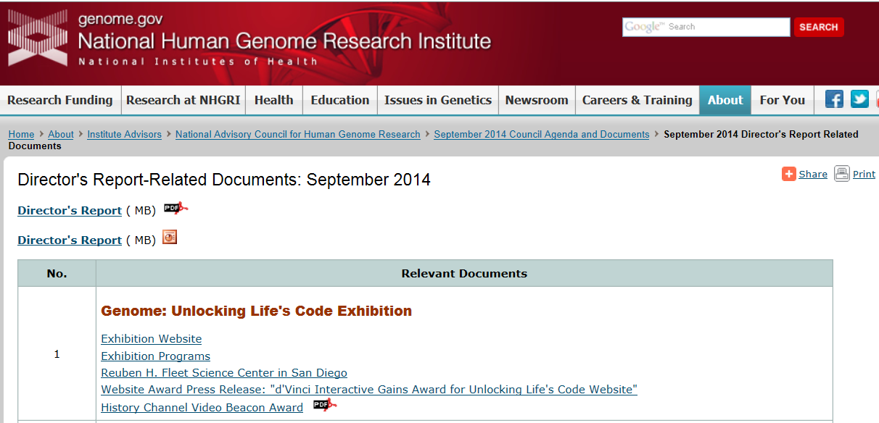
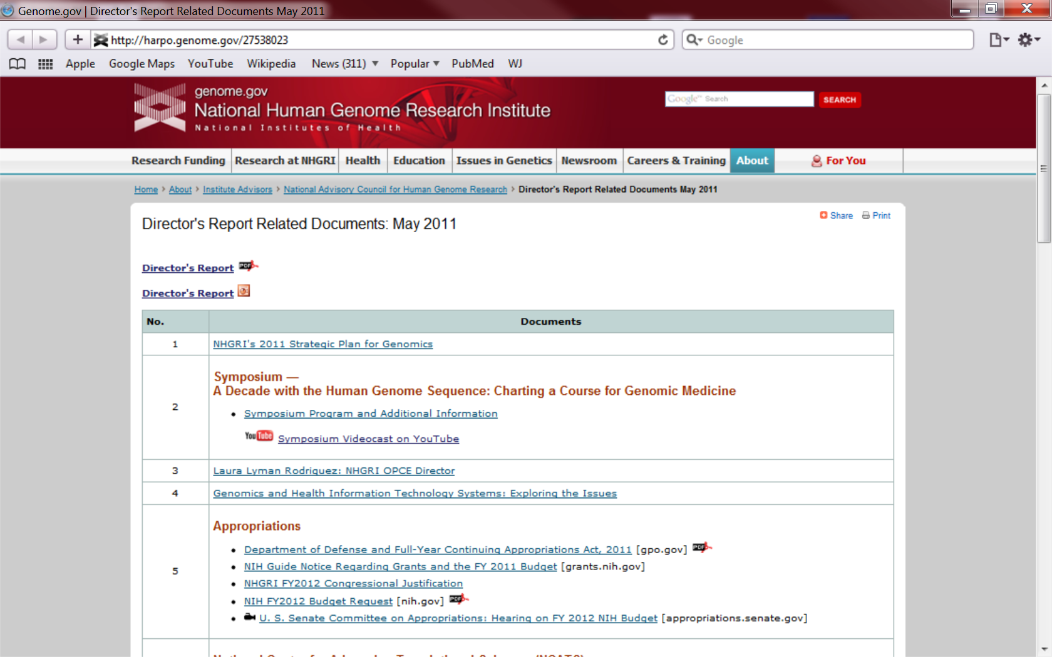
genome.gov/DirectorsReport
Document #
Notes:
For anyone new to our Council meetings, I want to make you are aware that there is an ‘electronic resource’ associated with my Director’s Report. This is analogous to the supplemental materials of a published paper, and can be accessed at the URL shown here.
The slides that I show during my Director’s Report are also available electronically at this site– * both as PDF and Powerpoint files.
* For slides associated with specific documents or relevant web sites, there is a ‘Document #’ indicated on the bottom right, which references materials that can be accessed and/or downloaded at the website shown here.
In addition to the video archive, this web page and all linked documents will be archived on NHGRI’s website (genome.gov) as a permanent historic resource.

Slide 3
Open Session Presentations
  Presentation from NIH Associate Director for Data Science
    Phil Bourne
  Genome Sequencing Workshop Report
    Adam Felsenfeld
  Concept Clearances: Genome Sequencing Program
    Adam Felsenfeld
    Lu Wang
Notes:
There will be several other presentations during the Open Session of this Council meeting. My Director’s Report is tailored around these presentations, and I will not discuss in detail the topics that others will cover.
* To begin with, later this morning, you will hear from Dr. Phil Bourne, the new NIH Associate Director for Data Science.
* After lunch, Dr. Adam Felsenfeld will give a report on the recent NHGRI workshop “Future Opportunities for Genome Sequencing and Beyond”
* This will be followed by a presentation about the initial set of Concept Clearances relating to the proposed renewal of the NHGRI Genome Sequencing Program, which will be given by both Dr. Felsenfeld and Dr. Lu Wang.

Slide 4
Open Session Presentations
  Concept Clearance: Center for Inherited Disease Research Contract Renewal
    Lawrence Brody
  NHGRI Division of Genomics and Society & the ELSI Research Program
    Lawrence Brody
  NACHGR Genomics and Society Working Group Update
    Pamela Sankar
  ENCODE Project Update
    Elise Feingold
Notes:
Another Concept Clearance will be then presented by Dr. Larry Brody for the contract renewal of the Center for Inherited Disease Research.
* Dr. Brody will also give a presentation describing the NHGRI Division of Genomics and Society and the ELSI Research Program, and this will be followed by an * update from Council’s Genomics and Society Working Group given by former Council member, Dr. Pamela Sankar.
* Lastly, Dr. Elise Feingold will give an update on the ENCyclopedia Of DNA Elements (ENCODE) Project.

Slide 5
Director’s Report Outline
General NHGRI Updates
General NIH Updates
General Genomics Updates
NHGRI Extramural Research Program
NIH Common Fund/Trans-NIH
NHGRI Division of Policy, Communications, and Education
NHGRI Intramural Research Program
Notes:
For the rest of my Director’s Report, I will cover the 7 areas listed here, which together provide a good framework for reviewing the relevant topics.

Slide 6
Director’s Report Outline
General NHGRI Updates
General NIH Updates
General Genomics Updates
NHGRI Extramural Research Program
NIH Common Fund/Trans-NIH
NHGRI Division of Policy, Communications, and Education
NHGRI Intramural Research Program
Notes:
And we will start with some General NHGRI Updates.

Slide 7
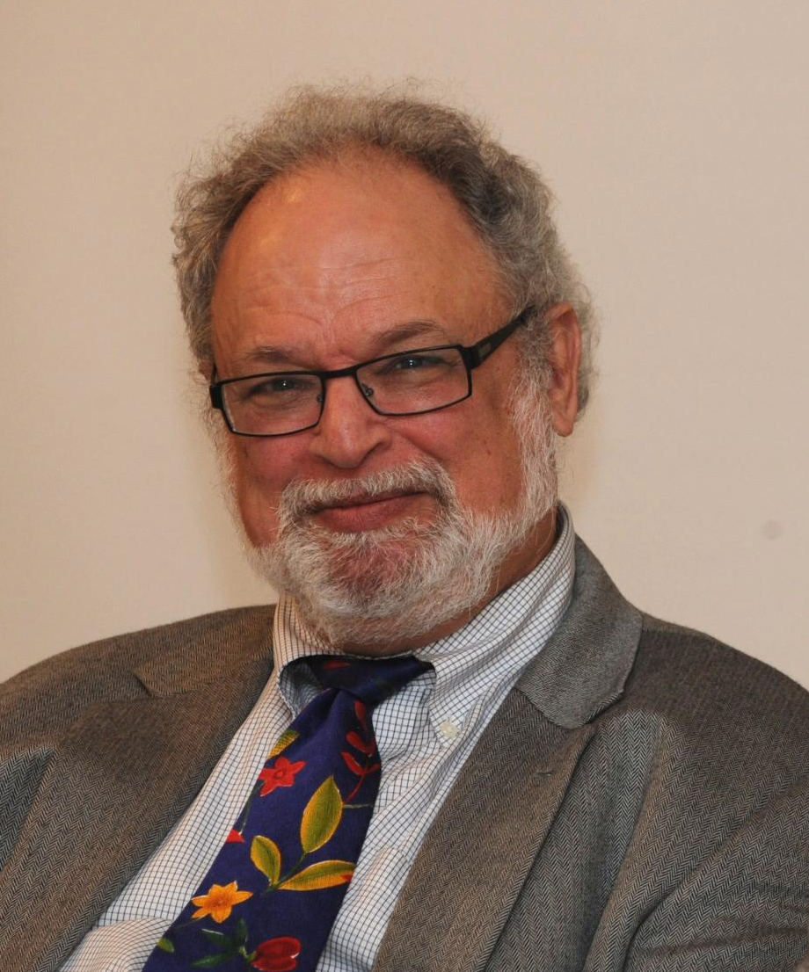
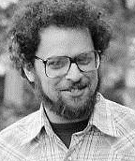
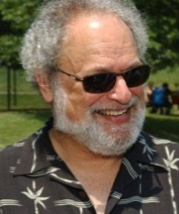
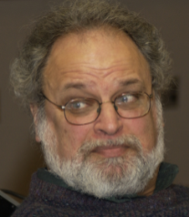

End of an NHGRI Era: Mark Guyer Retires
Mark Guyer, Ph.D.
Notes:
For the second time in 2014, a founding member and key leader of NHGRI has retired. We said goodbye to Dr. Jane Peterson earlier this year, and now we say farewell and enjoy retirement to Dr. Mark Guyer— after 26 years at NHGRI. For the bulk of that time, Mark was a key leader of the Extramural Research Program; most recently, he was the NHGRI Deputy Director. Mark had a critical role in the Human Genome Project. He saw the Project through its many phases, debates, competitions, races, and completions. He played an important role in developing the "Bermuda Principles" for data release, which laid the foundation for more widespread data sharing.
For many years, he was also a trusted advisor to me and other NHGRI leadership. He was centrally involved in crafting several five-year strategic plans for the Human Genome Project between 1990 and 2003 and, along with me, the 2003 and then 2011 NHGRI ‘visions’ for the future of genomics research. He had a major hand in establishing and managing prominent programs such as The Cancer Genome Atlas, ENCODE and modENCODE, the Human Heredity and Health in Africa (H3Africa) initiative, the Big Data to Knowledge (BD2K) program, and others. His leadership, wisdom, and dedication are the true foundations on which NHGRI has been built. While Mark retired from federal service at the end of June, he continues as a consultant on some key NIH and NHGRI programs, including H3Africa and BD2K. So fortunately, we are not completely losing Mark's involvement. Nonetheless, we are immensely grateful to him for his many years of contributions to NHGRI (and the field of genomics more broadly).

Slide 8
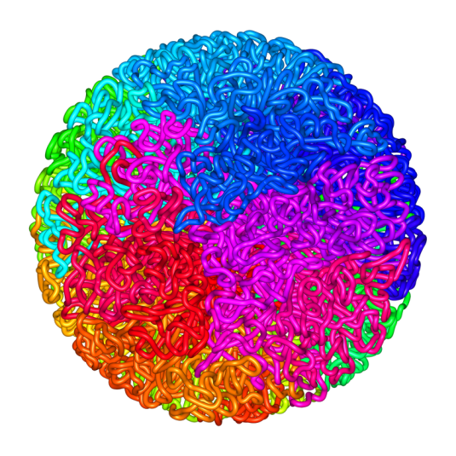
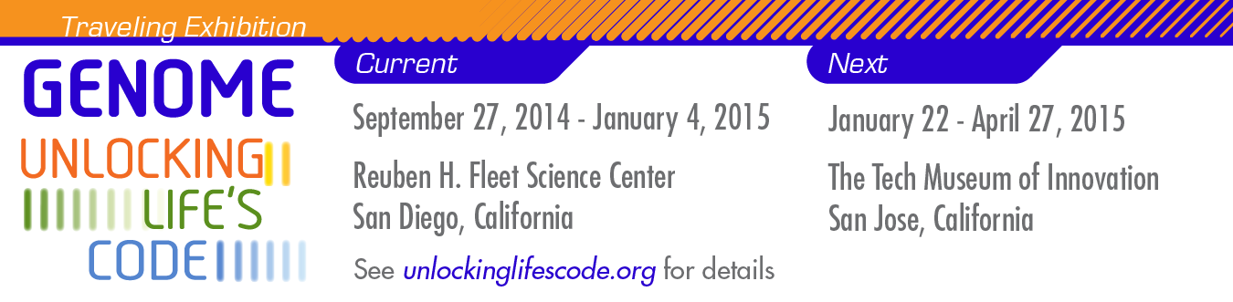
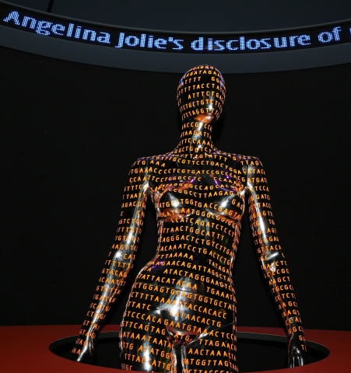

Genome: Unlocking Life’s Code Exhibition
  >3.3 million visitors since June 2013 opening
  Hosted 15 programs in conjunction with Smithsonian
  Website and videos received national recognition
  Closing Symposium on September 30
  1st stop on 4-5 year traveling tour: San Diego
Document 1
Notes:
The exhibition, Genome: Unlocking Life’s Code, has ended its tenure at the National Museum of Natural History in Washington DC. * The exhibition opened at this museum in June 2013 and closed on September 1. During this time, over 3.3 million people visited the exhibition. * In conjunction with the Smithsonian Institution, NHGRI hosted 15 outreach programs to enrich the learning experience provided through the exhibition’s content.
* The website, videos, and other media associated with the exhibition has been nationally recognized, receiving several awards this past summer. The website (unlockinglifescode.org) will continue to serve as the focal point for information about the exhibition and an educational resource for students, teachers, and the general public as the exhibition travels; it will also continue to feature news and events associated with the exhibition.
* To celebrate the exhibition’s incredibly successful run at the Smithsonian, we will be holding a Closing Symposium at the National Museum of Natural History on September 30.
* For the next 4-5 years, the exhibition will be traveling around North America, with its first stop being the Rueben H. Fleet Center in San Diego (where it will open on September 27 and be resident until early January). From there, it travels to San Jose for a stint from late January to late April.

Slide 9
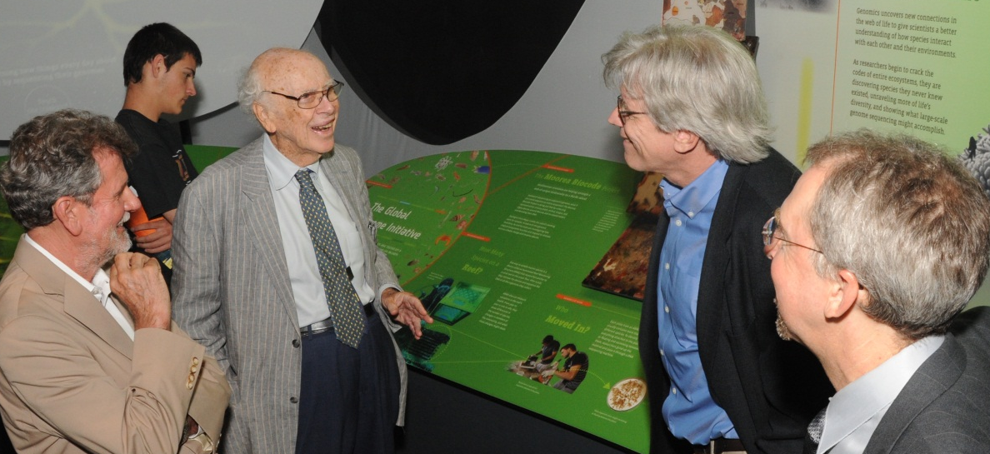
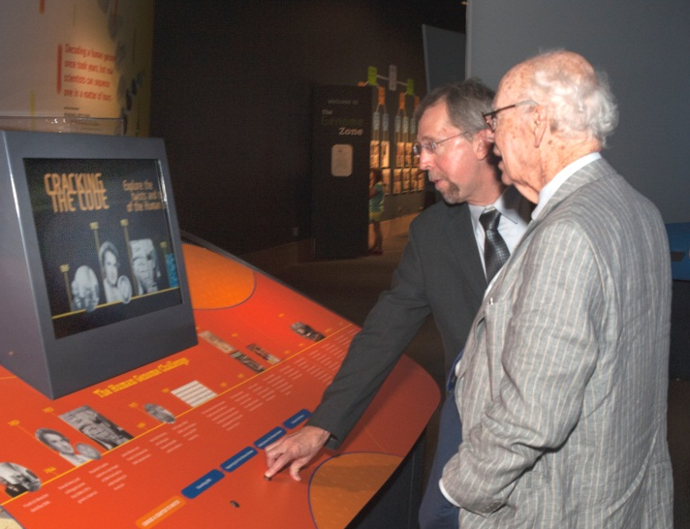
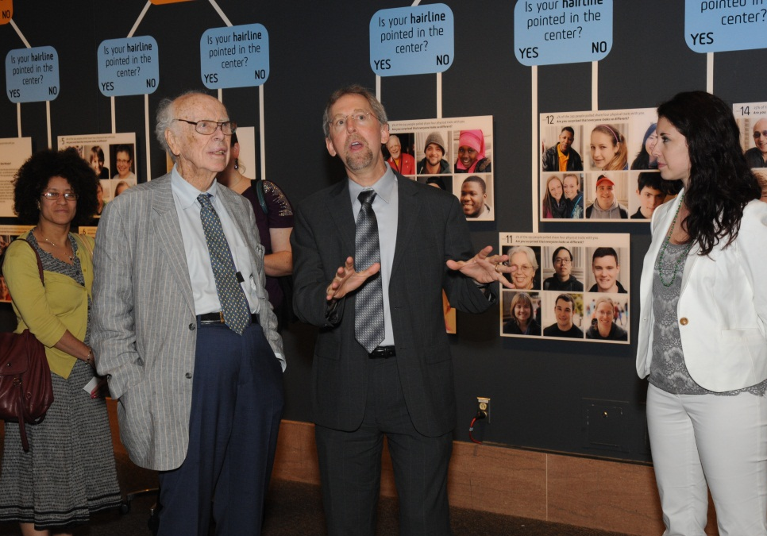
James Watson Tours
Genome: Unlocking Life’s Code
Notes:
In July, it was our pleasure to host Dr. James Watson, Nobel Laureate and former NHGRI Director, when he came to Washington DC to tour the Genome: Unlocking Life’s Code exhibition. Dr. Watson’s work in discovering DNA’s double-helical structure is prominently featured in the exhibition. Multiple NHGRI- and Smithsonian-affiliated staff members were excited to join Dr. Watson during his visit to the museum, as seen in these photos.

Slide 10
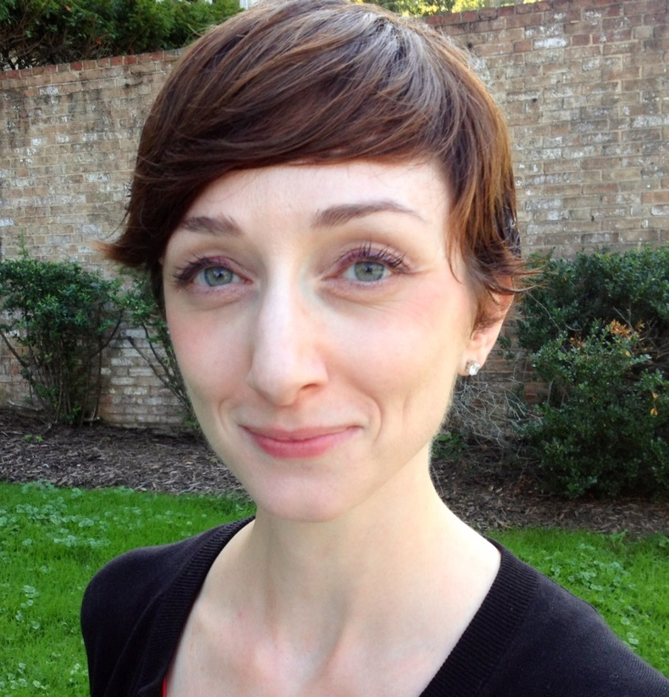

New ASHG-NHGRI Fellows
Kate Blizinsky, Ph.D.
Genetics and Public Policy Fellow
Elizabeth Tuck
Genetics and Education Fellow
Document 2
Notes:
As you many recall, NHGRI’s Division of Policy, Communications, and Education has for many years partnered with the American Society of Human Genetics in sponsoring a 16-month Genetics and Public Policy Fellowship. The program was developed in 2002 by the Policy and Program Analysis Branch, and provides each fellow with an opportunity to gain valuable policy experience at the Institute, at ASHG, and in the U.S. Congress. * Last week, we welcomed our latest fellow, Kate Blizinsky. Kate comes to us having recently earned her Ph.D. at Northwestern University, and will be working at NHGRI for the next four months before moving to a Congressional office.
Beginning this year, NHGRI is extending its partnership with ASHG to sponsor a new Genetics and Education Fellowship. The 16-month program will allow the fellow to work at ASHG and at NHGRI in the Education and Community Involvement Branch, where they will conduct educational research and develop educational programs for a wide range of audiences. The fellow will also have the option to do a rotation with a public or private organization involved in genetics education. * I am pleased to announce that Elizabeth Tuck will be the first ASHG-NHGRI Genetics and Education Fellow. Elizabeth is an upper school science teacher at The Wellington School in Columbus, Ohio, and she also began her tenure with us last week.

Slide 11
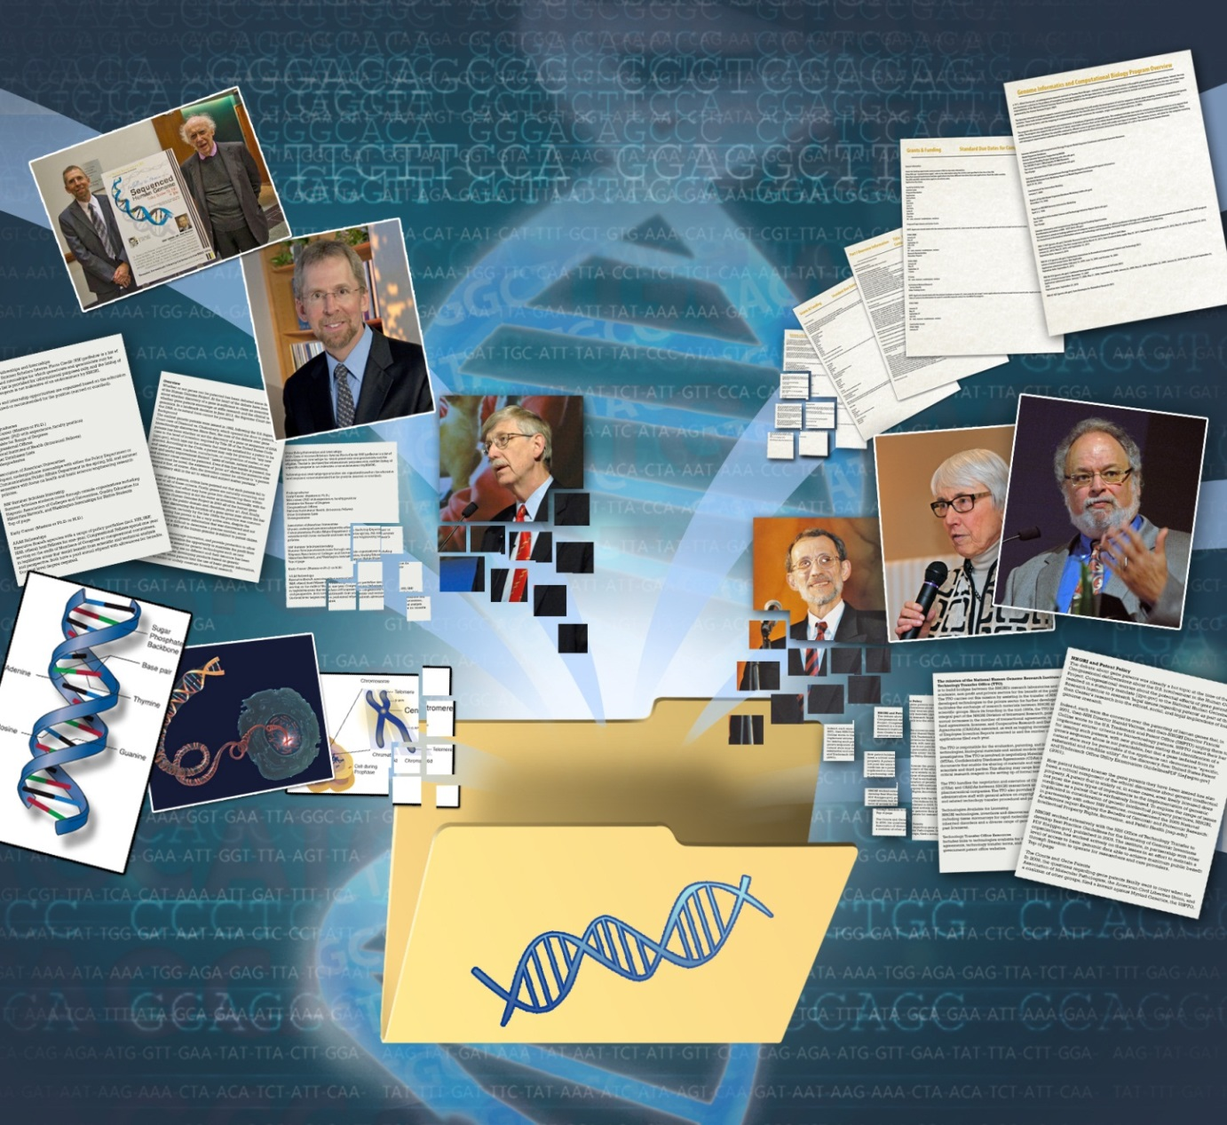
NHGRI Historical Archiving Initiative
Document 3
Notes:
In 2012, NHGRI began an institute-wide initiative to capture and preserve the details of its historic role in the Human Genome Project and in subsequent genomics programs.
Since then, we have developed and implemented an internal effort to archive, catalog, and summarize the institute's documents related to major NHGRI genomics programs and other institute endeavors, creating the substrate for a valuable historic resource. To date, we have digitized and/or described >400,000 NHGRI documents. In addition, we are in the process of creating a searchable archival database to enable public access to select files.
To augment these efforts, we have also launched an oral history program to capture on video the perspectives and experiences of those involved in major NHGRI programs and projects; to date, we have conducted 14 such interviews.
Over time, scholarly descriptions and analyses of some of the major NHGRI genomics programs and other institute endeavors will be undertaken. We expect the first such analysis to delve into NHGRI’s involvement in genomic variation programs.

Slide 12
Director’s Report Outline
General NHGRI Updates
General NIH Updates
General Genomics Updates
NHGRI Extramural Research Program
NIH Common Fund/Trans-NIH
NHGRI Division of Policy, Communications, and Education
NHGRI Intramural Research Program

Slide 13
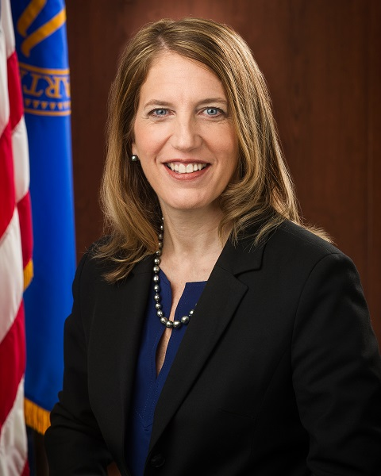
New DHHS Secretary:
Sylvia Mathews Burwell
Document 4
Notes:
At the May Council meeting, I informed you that President Obama had nominated Sylvia Mathews Burwell to be the 22nd Secretary of the Department of Health and Human Services, replacing Secretary Sebelius (who planned to resign from the position). Such Presidential nominations are subject to confirmation by the U.S Senate, and I am pleased to report that on June 5, Sylvia Burwell was indeed confirmed by the Senate by a strong bipartisan vote of 78 to 17.
Secretary Burwell began her official duties as DHHS Secretary on June 9, and has very quickly become engaged in issues important to NIH. She is already familiar with NIH, having visited the campus last year in her previous role as Director of the Office of Management and Budget.

Slide 14
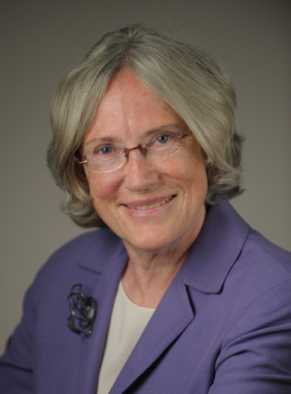


Retirement of Story Landis
Story Landis,
Ph.D.
Walter Koroshetz,
M.D.
Document 5
Notes:
A great friend of NHGRI’s, Dr. Story Landis, recently announced that she will be retiring as Director of the National Institute of Neurological Disorders and Stroke (NINDS), a position she has held since 2003. Story came to NIH in 1995 to be the NINDS Scientific Director, and was promoted 8 years later to become the NINDS Director. I have worked closely with Story for many years– first when we were both Scientific Directors and later when we were both Institute Directors; she has truly been a terrific scientific leader and a wonderful colleague and mentor (and I will personally miss her at NIH).
Dr. Walter Koroshetz will serve as Acting Director of NINDS while a national search for the new Director is conducted.

Slide 15
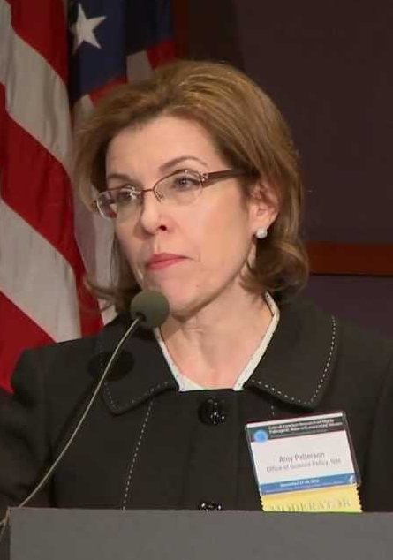
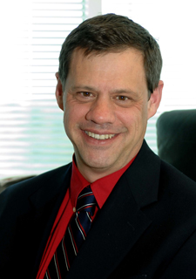

New NIH Program on Biosecurity and Biosafety Policy
Amy Patterson,
M.D.
David Shurtleff,
Ph.D.
Notes:
Recognizing the increasingly high-priority issues surrounding biosecurity and biosafety, and the need for a greater amount of NIH senior leadership dealing with these issues, Dr. Francis Collins recently created a new position to serve as the lead and primary point of coordination across NIH on matters relating to biosecurity and biosafety.
Based on her long track record of leadership, experience, and accomplishments in these areas, Francis appointed Dr. Amy Patterson to be the first NIH Associate Director for Biosecurity and Biosafety Policy. Amy was previously the NIH Associate Director for Science Policy.
Amy’s skilled analytical capacity and vision has been a hallmark of her career, and I am personally grateful for her commitment and skill as we worked together over the past four-plus years in crafting the new Genomic Data Sharing Policy.
Dr. David Shurtleff, Deputy Director of the National Center for Complementary and Alternative Medicine, will assume the role of Acting NIH Associate Director for Science Policy while the search for the new Associate Director is conducted.

Slide 16


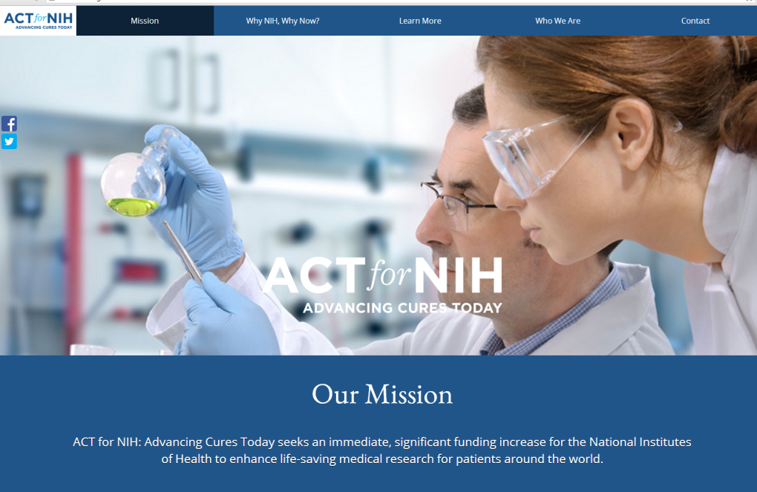
Departure of Francis ‘Pat’ White
Document 6
Notes:
Also over the summer, NIH saw the departure of a another Associate Director, Pat White, who had served as the NIH Associate Director for Legislative Policy and Analysis since 2010. During his tenure, Pat was a leading figure in the NIH Office of the Director, heading up NIH’s main office for interacting with Congress. He was terrific in this role, and is already greatly missed.
That said, Pat left NIH to become President of a brand new advocacy group to support the agency called “ACT for NIH.” The focus of this new group is to achieve budgetary increases for NIH, so we are very happy that he will still be working to support NIH research and in a capacity that will lead to continued interactions with many of us.
As you might imagine, with two high-profile and important NIH Associate Director positions now vacant, Francis is eager to identify their replacements. In fact, I am co-chairing the search committee charged with identifying and evaluating candidates for both of these vacancies. Advertisements for these positions are already out, and applications are being accepted through September 26. Please spread the word to colleagues who might wish to be considered for either NIH Associate Director position, and I would be happy to talk to anyone interested in applying.

Slide 17
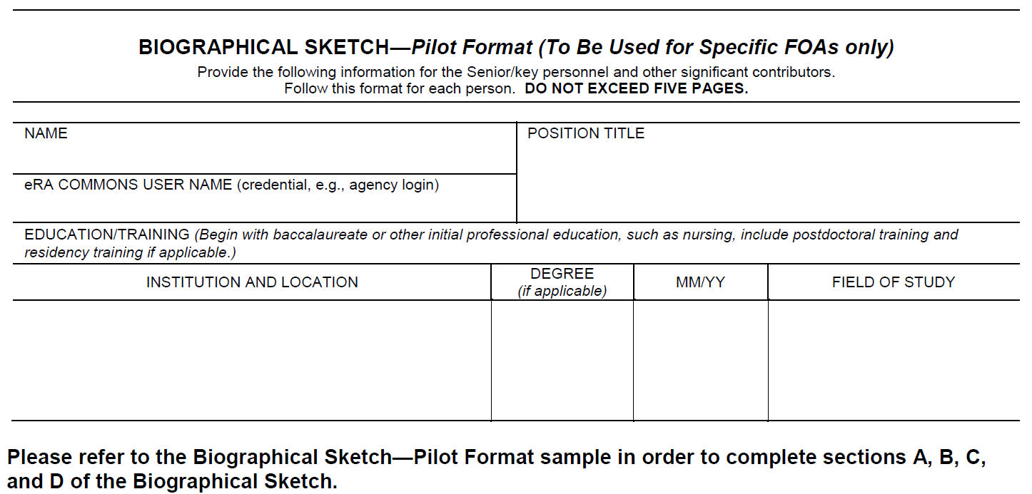
Changes to the Biosketch for
NIH Grant Applications
Length extended from 4 to 5 pages
Section A – Personal Statement
Section B – Positions and Honors
Section C – Contributions to Science (NEW)
Section D – Research Support
Now in Round 2 of piloting and evaluation
Roll-out for submissions in January 2015
Notes:
NIH recently announced changes that will be made next year to the content and format of the biosketch section of NIH grant applications. * The overall length of the biosketch will be extended from 4 to 5 pages, and will be comprised of four sections. * There are no significant changes to Sections A and B: the Personal Statement and Positions and Honors. * Section C, called Contributions to Science, is new and replaces a simple list of selected publications. Rather, the PI will be asked to briefly describe up to five significant contributions that he/she has made to science. This can include the central findings of their research, the influence of that research on progress in the field, and the PI’s specific role in the described research. For each contribution, up to four peer-reviewed papers can be provided, and a link to the PI’s full set of publications can be included. * Finally, Section D, a description of Research Support, remains unchanged.
* This revised biosketch format was initially piloted for two RFAs issued in the summer of 2013. The second round of piloting is being performed this summer, and will be evaluated by interviews with applicants and reviewers. The results of this evaluation will be used to fine-tune the instructions to applicants and guidance to reviewers. * The full roll-out of this new biosketch format will occur with application submissions occurring after January 16, 2015, and you should look for an NIH Guide Notice to be published sometime this fall with additional details.

Slide 18
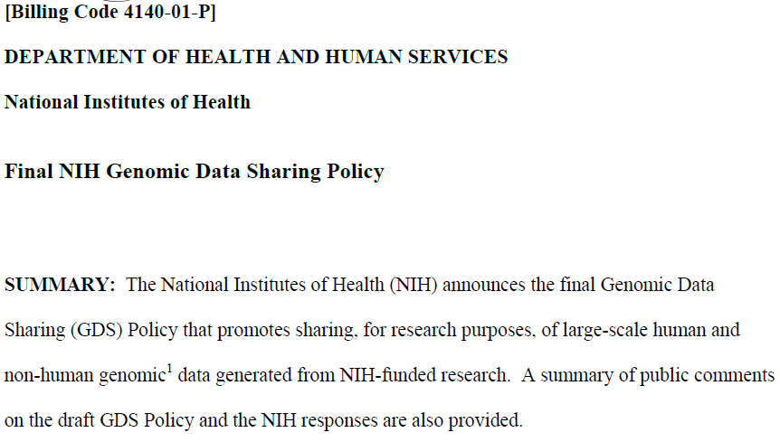

NIH Genomic Data Sharing Policy
Document 7
Notes:
After multiple years of effort and significant work by many NIH staff members, the final NIH Genomic Data Sharing Policy was published in the Federal Register on August 26. The effective date for the policy is January 25, 2015. The policy expands upon and replaces the 2007 NIH GWAS Policy.
As we have discussed previously with this Council, a draft of the policy was published in September 2013 for public comment. A total of 107 public comments were received, and they were considered in the development of the final policy.
The Genomic Data Sharing Policy is based on the principal that the optimal way to realize the full value of genomic data is through broad data sharing. The policy will apply to NIH-supported and -conducted research generating large human and non-human genomic datasets, produced by array-based methods or high-throughput DNA sequencing technologies.
NHGRI staff were heavily involved in the development of this policy, and remain actively involved in its implementation. I currently serve as chair of the internal NIH oversight committee for this policy.

Slide 19
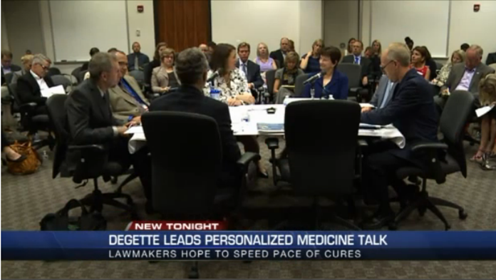
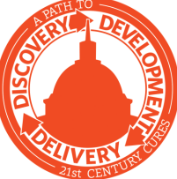
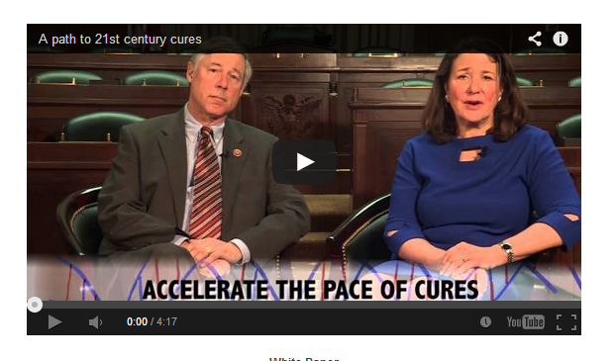
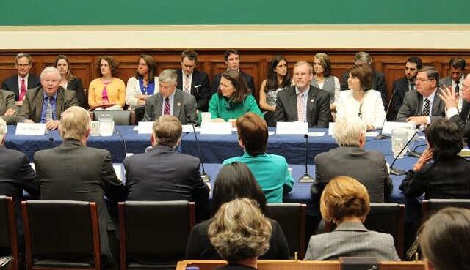
“A Path to 21st Century Cures”
Document 8
Notes:
At the May Council meeting, I described a new initiative by the Energy and Commerce Committee in the U.S. House of Representatives called “A Path to 21st Century Cures.” Under the bipartisan leadership of Congressman Fred Upton and Congresswoman Diana DeGette, the Committee has held multiple roundtables and hearings to solicit suggestions from a variety of stakeholders about the role that Congress could play in accelerating the pace of scientific discovery and its translation to treatments and cures. The topics have ranged from clinical trials and digital healthcare to evidence development and personalized medicine.
Over the summer and into this fall, the Committee has taken their ‘show on the road,’ holding a number of roundtables around the country. As part of this, * I participated in a roundtable hosted last week in Denver in Congresswoman DeGette’s district; the focus of this event was personalized medicine. Also participating were Janet Woodcock from the FDA and several researchers from the University of Colorado and the greater Denver area. It was a great discussion, and provided me a good chance to talk about genomics with the Congresswoman. The plan is for Congressman Upton and Congresswoman DeGette to use the information gathered from these roundtables and hearings to introduce a new bill in the House early next year.

Slide 20
Fiscal Year 2015 Funding
  Regular appropriations process not completed
  Continuing Resolution (CR) needed
 | FY 2014 Actual | President’s Budget FY 2015 | House FY 2015 | Senate FY 2015 (draft)
NIH | $30.2B | $30.4B | - | $30.5B
NHGRI | $497M | $498M | - - | $504M
Document 9
Notes:
Fiscal Year 2015 starts on October 1, and once again, we find ourselves quite uncertain about NIH’s or NHGRI’s budget. * The regular appropriations process has, once again, not been completed by the U.S. Congress.
Here is a summary of what has happened so far. * In the Senate, the relevant appropriations subcommittee responsible for NIH funding drafted a bill allocating $30.5 billion for NIH and $504 million for NHGRI, but that bill has not been approved by the full committee. Both of these numbers are just a small amount higher than the proposed President’s budget. The equivalent committee in the House has not issued a bill at all.
* What this means is that we are once again relying on Congress to pass a Continuing Resolution (or CR) to keep the government operational beyond September 30. Such a CR is expected, and will likely fund the government at least through the November elections. But it is really unclear what the budgetary forecast looks like beyond that point, especially with this being an election year.

Slide 21
Director’s Report Outline
General NHGRI Updates
General NIH Updates
General Genomics Updates
NHGRI Extramural Research Program
NIH Common Fund/Trans-NIH
NHGRI Division of Policy, Communications, and Education
NHGRI Intramural Research Program

Slide 22
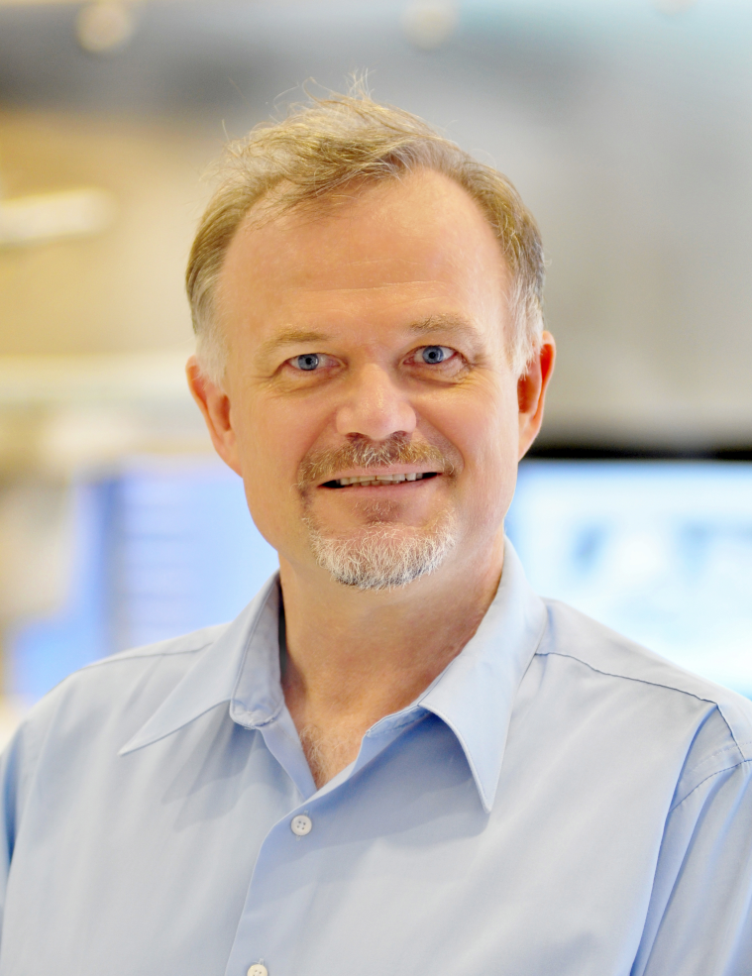

Richard Gibbs Awarded
Companion of the Order of Australia
Richard Gibbs, Ph.D.
Document 10
Notes:
Dr. Richard Gibbs, NHGRI grantee and former Council member, has been awarded the Companion of the Order of Australia. The award recognizes eminent achievement and merit of the highest degree in service to Australia or humanity at large.

Slide 23
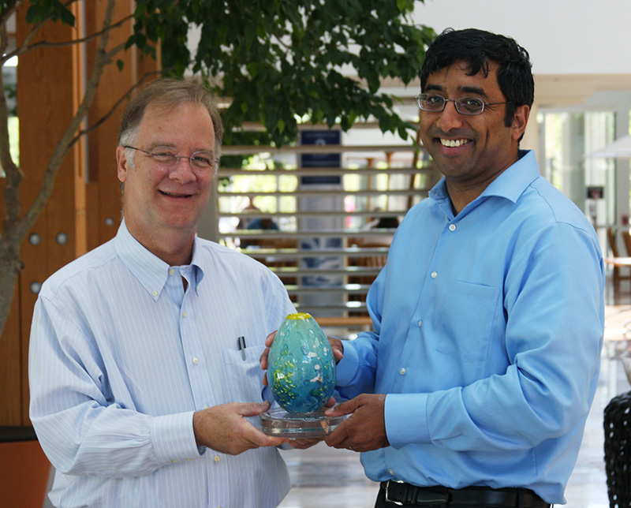

Jay Shendure Awarded
HudsonAlpha Life Sciences Prize
Jay Shendure, M.D., Ph.D.
On right, with Rick Myers (HudsonAlpha)
Document 11
Notes:
The HudsonAlpha Institute for Biotechnology has awarded Jay Shendure, NHGRI grantee and incoming Council member, its HudsonAlpha Life Sciences Prize for his work in the development and application of genomic technologies, including completing a genome sequence of the HeLa cell line.

Slide 24
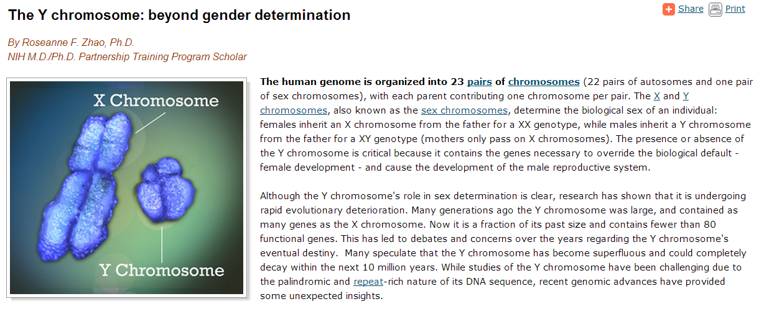
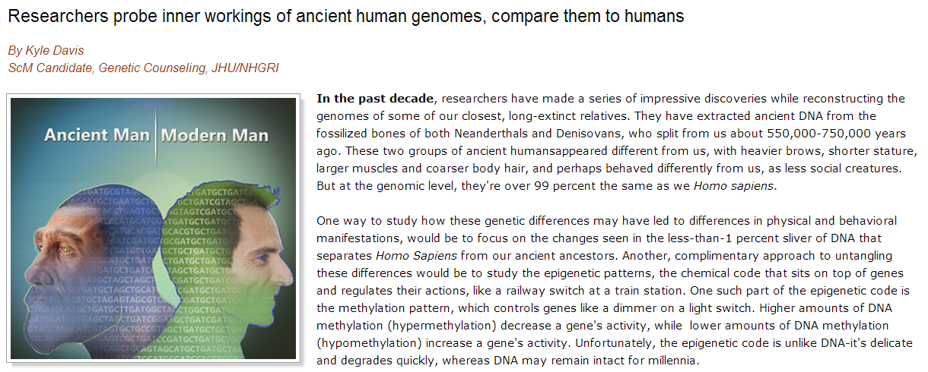
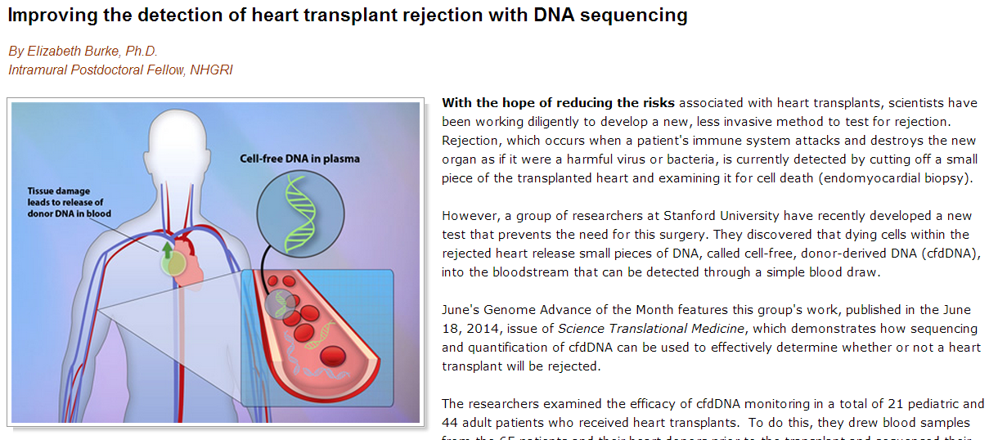
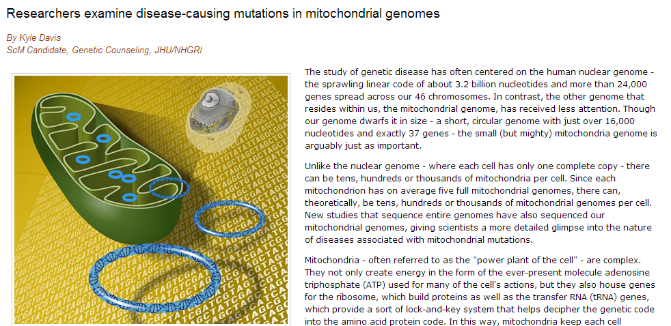
NHGRI Genome Advance of the Month
Document 12
Notes:
Featured as an NHGRI Genome Advance of the Month since the last Council meeting have been publications describing * Y chromosome evolution, * ancient methylation patterns in Neanderthal and Denisovan genomes, * detecting heart transplant rejection using DNA sequencing, and * disease-causing mutations in mitochondrial genomes.

Slide 25




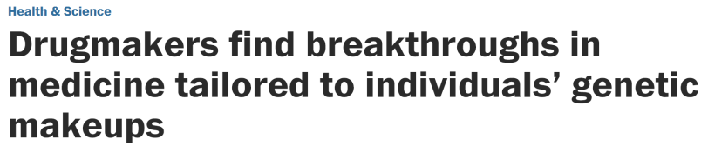
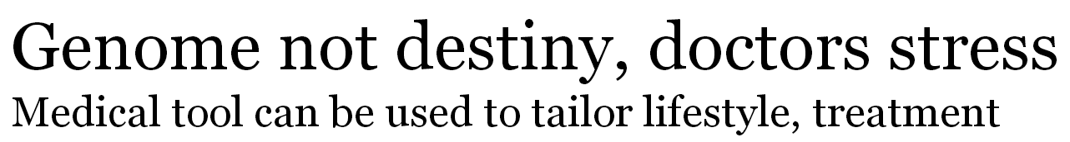

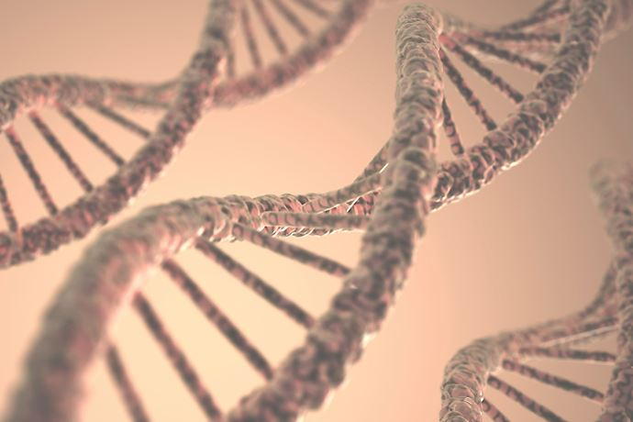
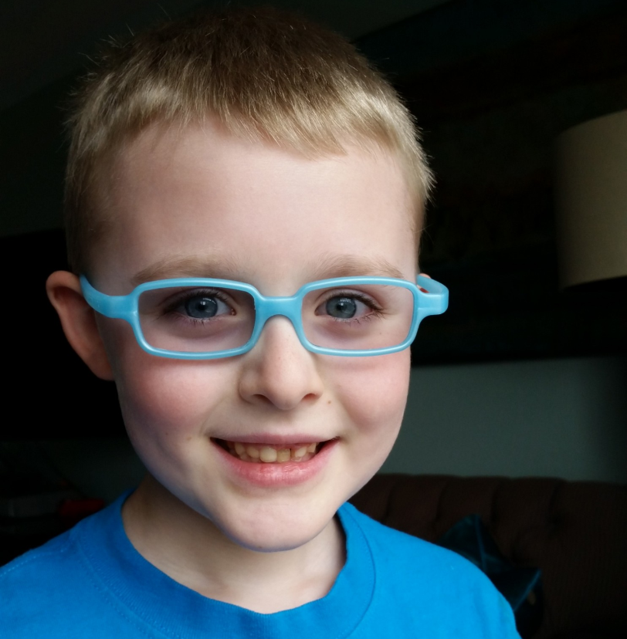
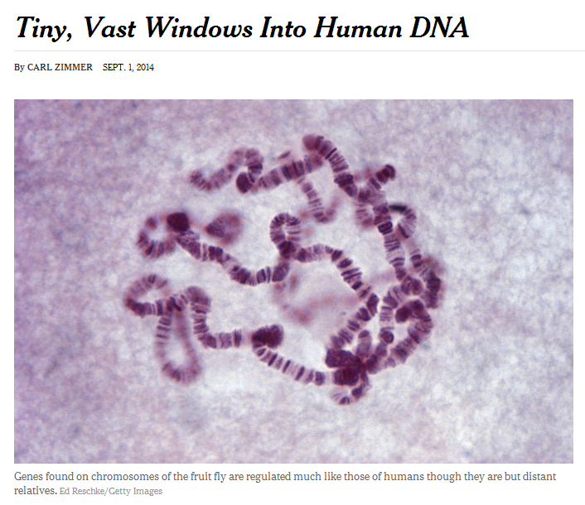
Genomics In The News…
Document 13
Notes:
Recent prominent genomics news stories include * a Washington Post article about personalized medicine, *an article in the Pittsburgh Post-Gazette that featured a conversation with NHGRI’s Les Biesecker about one’s genome not being one’s destiny, and a New York Times article about the recent publications from the modENCODE project.

Slide 26



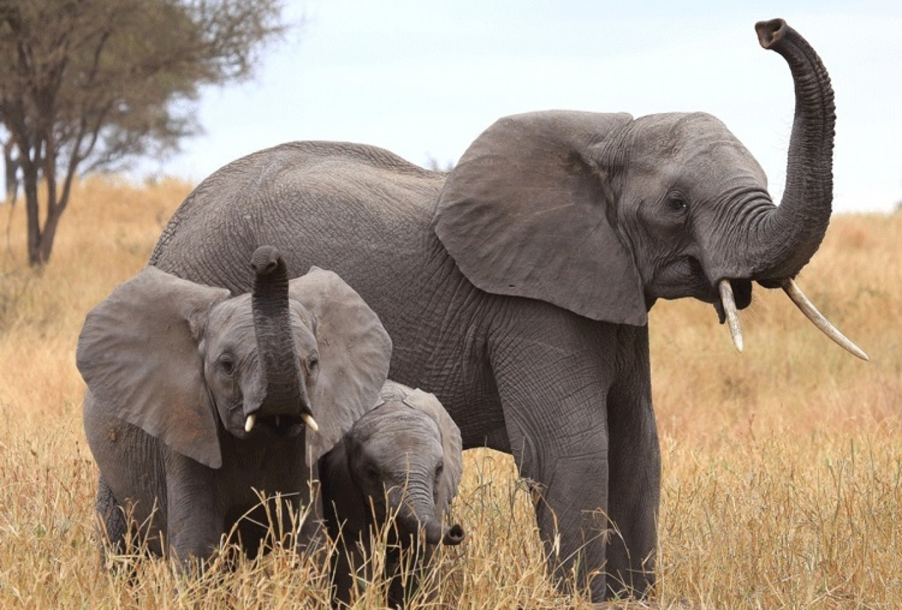
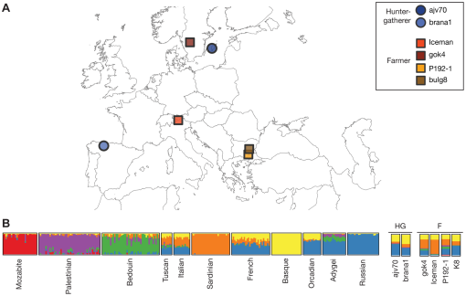

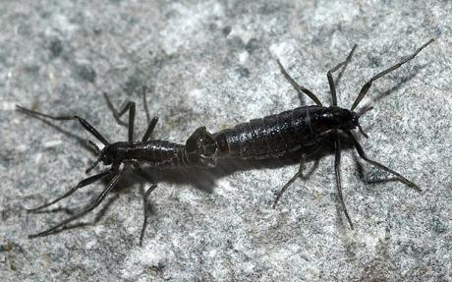



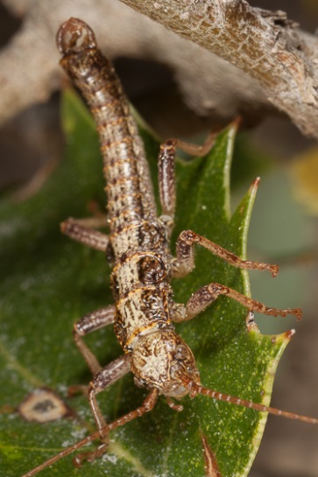


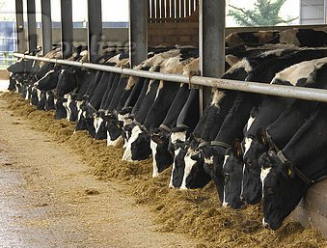
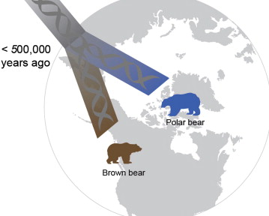

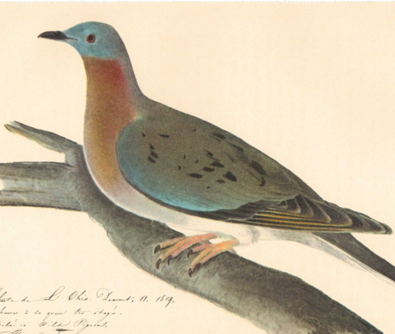


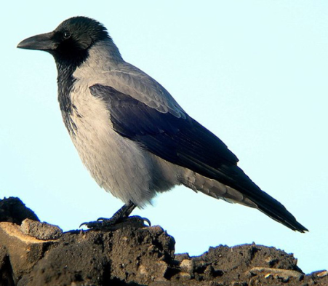

Genomes In The News…
Elephants have five times more olfactory receptors than humans and the most of any animal characterized to date, according to a new study. (Courtesy of Eric Green)
Document 14
Notes:
And in terms of Genomes in the News, there have been a number of newly generated genome sequences reported since the last Council meeting, including: * Tyrolean iceman, * stick insect, * 240 strains of brewer’s yeasts, * termite, * hooded crow, * passenger pigeon, * whipworm, * common bean, * eucalyptus, * Atlantic salmon, * sheep, 10 varieties of citrus (including * sweet orange, * sour orange, * mandarins, and * pomelos), * polar bears, * electric eel, * 1,000 Bull Genomes Project Phase 1 (234 individuals from 3 species), * Antarctic midge, * canola plant, and * elephant genes (specifically, a publication describing their novel repertoire of olfactory receptor genes). I like this last paper in particular because Genome Research released a press release about the paper that included this photograph of three elephants that I took while on vacation last year in Kenya, and that story and photograph was picked up and featured by a number of prominent news venues (convincing me further that if I ever get sick of this job, I am so going to become a professional photographer).

Slide 27
Director’s Report Outline
General NHGRI Updates
General NIH Updates
General Genomics Updates
NHGRI Extramural Research Program
NIH Common Fund/Trans-NIH
NHGRI Division of Policy, Communications, and Education
NHGRI Intramural Research Program

Slide 28
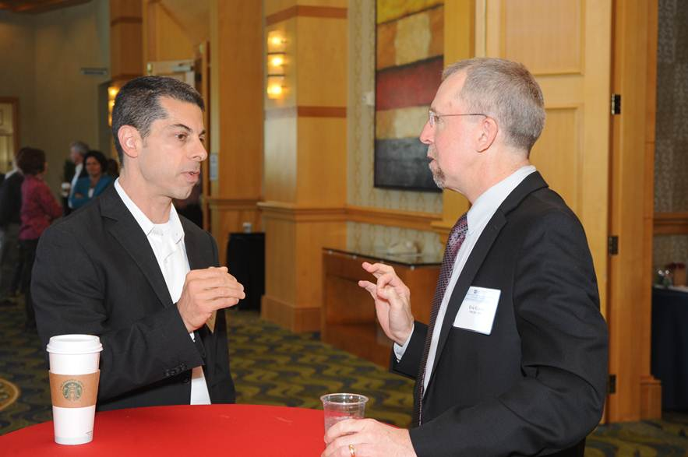
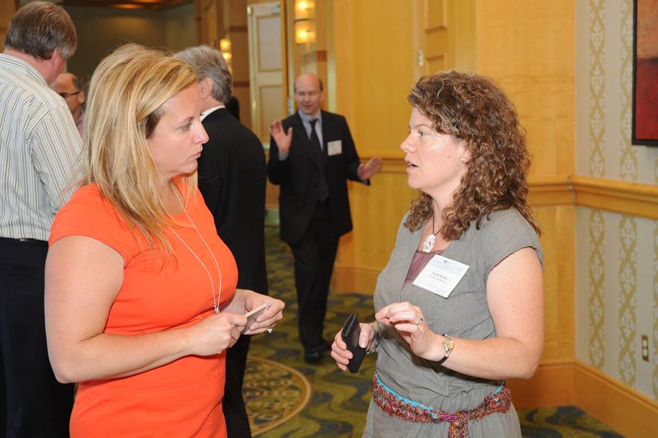
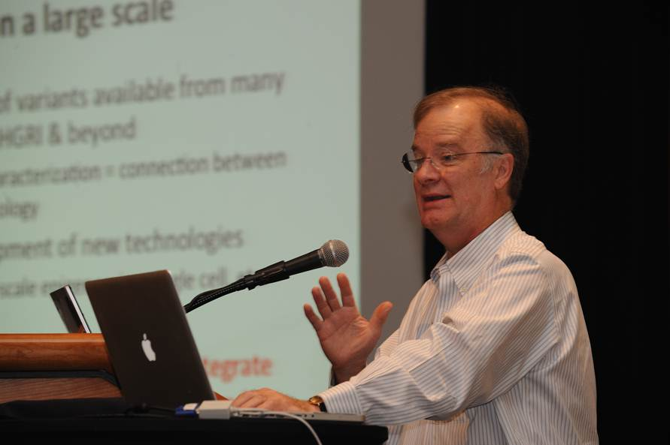
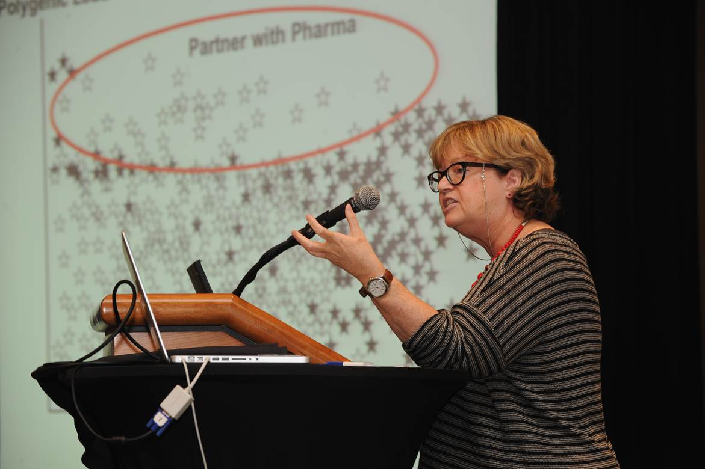
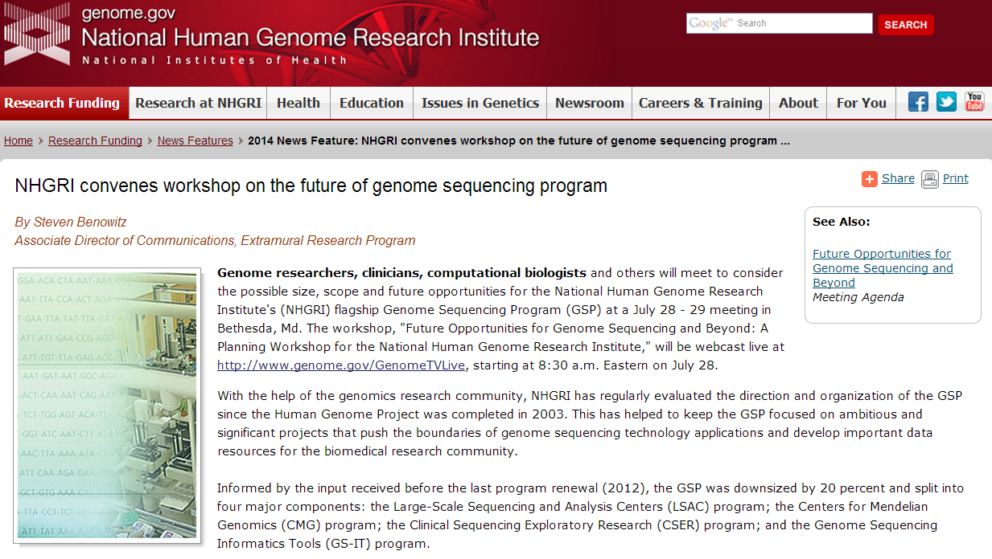
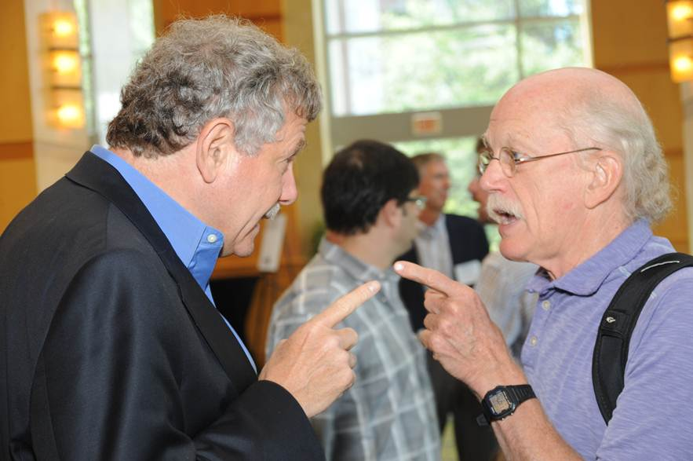




Genome Sequencing Program
Document 16
Notes:
The major development for the flagship of NHGRI’s Extramural Research Program– our Genome Sequencing Program– was the strategic planning workshop that we held in July. The URL for the workshop’s Website is provided under Document 16, through which you can also access the workshop agenda and video recordings of the plenary presentations.
* Later in the Open Session, you will be getting a formal and more detailed update about the workshop from Dr. Adam Felsenfeld. In my opinion, the workshop was successful in providing NHGRI advice about the scientific questions and opportunities that can be addressed by large-scale genomics studies. * In addition to the excellent series of presenters, there were breakout sessions to stimulate discussion, much of which spilled out into the hallways during the breaks.
It was a very rigorous and sometimes * vigorous meeting, with all discussions being very collegial (even this exchange between two genomics gladiators). To this day, there remains a dispute among my staff about the topic of this intense conversation (but one could only imagine!).

Slide 29





Nature 2014, July 31. Vol. 511 (7511)
Nature 2014, July 23. doi.10.1038/nature13480
Cancer Cell, 2014, Aug 21. doi.org/10.1016/j.ccr.2014.07.014
Cell 2014, Aug 14. Vol. 158
Document 16
Notes:
The Cancer Genome Atlas (TCGA) is a coordinated effort to better understand the molecular basis of cancer. Final sample shipments for over 10,000 cases were sent to genome sequencing and characterization centers in June.
For each of the over 30 cancer types, the TCGA Network is publishing a comprehensive, integrated analysis of sequence and mutation analysis, copy number variation, gene and micro RNA expression, and promoter methylation. TCGA papers focusing on * lung adenocarcinoma * and stomach adenocarcinoma were published in Nature in July.
* A kidney chromophobe paper was published in Cancer Cell in August, and is noteworthy as the first publication from the TCGA rare tumor effort. Other rare tumors being studied by TCGA include thymoma, uveal melanoma, and sarcomas.
Last fall, TCGA published a set of PanCancer manuscripts in Nature. * Building on that work, a paper reporting an integrated sub-types analysis of 12 cancer types was published in Cell last month.

Slide 30

15,790 samples / 6,421 families / 1,433 Mendelian disorders
11,800 whole-exome sequences, various stages of analysis
    Novel discoveries about the genomic bases or clinical phenotypes of >280 Mendelian disorders
Nearly 100 manuscripts published or in press
  Phenotype-driven and genotype-driven approach
  Disease genes/pathways and disease biology
  Pleiotropy and genetic heterogeneity
Document 17
Notes:
The Centers for Mendelian Genomics were established just under 3 years ago, with the aim of helping to establish the genomic bases for most of the remaining unsolved Mendelian disorders. To date, these groups have collaborated with 568 investigators from 255 institutions in 36 countries.
* In doing so, they have collected 15,790 samples from 6,421 families representing 1,433 Mendelian disorders. * To date, whole-exome sequences have been generated for 11,800 samples, with analyses ongoing.
* Novel discoveries about the genomic bases or the clinical phenotypes of over 280 Mendelian disorders have so far been made. * Nearly 100 manuscripts have been published or in press reporting some of these discoveries, in addition to developed methods and resources.
* As described in these publications, the phenotype-driven and genotype-driven approaches are both effective for disease-gene discovery. * Novel disease genes and pathways as well as the disease biology underlying a variety of rare diseases have been revealed. * And finally, it is worth noting that, along with discoveries made by others, the Centers’ studies have revealed pleiotropy and genetic heterogeneity among Mendelian conditions to a greater extent than previously thought.

Slide 31

GeneMatcher
As of August 1, 2014:
662 genes submitted
143 submitters
15 matches
Document 17
Notes:
The Centers continue to reach out to the broader community of researchers and clinicians in an effort to enable and accelerate Mendelian disease-gene discovery. For example, the recently launched GeneMatcher is a freely accessible website designed to enable connections between clinicians and researchers from around the world who share an interest in the same gene or genes. The principle goal for making GeneMatcher available is to help solve ‘unsolved’ Mendelian diseases. The site allows investigators to post genes of interest, and it then connects investigators who post interest in the same gene.
* As of August 1, 662 genes have been submitted to GeneMatcher by 143 submitters, and 15 matches have already been made.

Slide 32
2nd UWCMG Mendelian Data Analysis Workshop
17 participants
Interaction with Center analysts, IT team, and PIs
Concept-driven lectures on approaches to Mendelian gene discovery (e.g., how to design project)
Hands-on data analysis using open-source software and the testing of different genetic models
Positive post-workshop feedback from attendees
Document 17
Notes:
The Center at the University of Washington held a well-received Mendelian Data Analysis Workshop in 2013. Building on the success of the first workshop, they held a second one last month.
* 17 participants (including collaborators and various investigators) attended the Workshop, and * they appreciated the direct interaction with the Center analysts, IT team, and PIs.
* The workshop included concept-driven lectures on approaches to Mendelian gene discovery (e.g., how to design projects), and * hands-on exercises involving data analysis using open-source software and the testing of different genetic models for disease (e.g., de novo, autosomal recessive, autosomal dominant, and so forth).
* Based on the survey conducted after the workshop, the feedback was very positive (including the desire for an additional, more-advanced workshop in the future).

Slide 33


Genome Sequencing Informatics Tools
  iSeqtools being used in clinical research for analysis and annotation of complex genomic variants
    Annotation of CNVs (benign vs. pathogenic)
    Analysis of complex indels
    Prediction of structural variants
  2014 ASHG workshop “iSeqTools to demystify the cloud” sold out; “hands on” evening session added
Document 18
Notes:
The Genome Sequencing Informatics Tools (GS-IT) Program, known by the name “iSeqTools,” comprises six projects that are designed to democratize access to genome analysis and provide ‘researcher friendly’ sequence analysis tools. In contrast to most academic software, iSeqTools are designed to be reliable and easy to use, with robust software engineering, good user support, and innovative data science.
* iSeqTools can be used to analyze many complex genomic variants beyond simple single-nucleotide variants, and this is proving useful in clinical research. * Recent advances include the annotation of copy number variants with the ability to discriminate between benign and pathogenic CNVs using the SG ADVISER web server; * the characterization of complex indels using Pindel, GKNO, or GATK; * and powerful prediction of structural variants using Genome STRiP.
* GS-IT will present a workshop on iSeqTools at the 2014 ASHG Annual Meeting. The workshop will demonstrate the use of cloud-enabled iSeqTools for genome analysis and in the process help “demystify the cloud” for genomics researchers. The workshop itself is now sold out, but an additional “hands on” evening session has been added to accommodate additional participants.

Slide 34

DNA Sequencing Technology Development: New Awards
  Molecular biology to produce long read information using short-read sequencing technology
  Increased sequence accuracy with a protein nanopore
  Hybrid nanopore arrays with protein pores in solid-state or other support structures
  Solid-state graphene nanopore
  Electronic detection of polymerase motion
  Single-molecule sequencing using chemical detection of amplified reporter molecule
Document 19
Notes:
The Advanced DNA Sequencing Technology Development Program has made eight new awards that encompass a wide range of creative approaches to solving particular sequencing technology challenges.
* Two projects, one of which will be implemented on single-cell DNA using microfluidics, will develop methods to generate information that links together sequence obtained by short-read methods to generate long-range information. * Another seeks to increase base-calling accuracy, including the calling of epigenetic modifications obtained when reading DNA sequence using a protein nanopore. * Staying on the nanopore theme, two projects will explore ways to make large functional arrays of nanopores to increase the throughput of nanopore sequencing, * while another seeks to demonstrate how a graphene nanopore can distinguish among the 4 DNA nucleotides even with very fast reads.
* A seventh project will build a carbon nanotube-based sensor to electronically detect the motion of DNA polymerase molecules adding nucleotides to a DNA chain. * And an eighth project proposes single-molecule sequencing with downstream enzymatic signal amplification.
These are the last awards that will be made under this program. We are now entering a planning process to determine next steps for NHGRI in this technology development space.

Slide 35




ENCODE
  Updated Data Release Policy
  ENCODE Publications
Document 20
Notes:
The goal of the Encyclopedia of DNA Elements Project (or ENCODE) is to create a catalog of all functional elements in the human and mouse genomes, and to make those catalogs freely available as a resource to the biomedical research community. The goal of the modENCODE project was to provide similar catalogs for the model organism C. elegans and D. melanogaster.
* The recently updated ENCODE data release policy allows the scientific community to publish results based on any ENCODE data without restrictions, as soon as the data are released. Meanwhile, * ENCODE publications include over 361 papers by the ENCODE Consortium participants and over 148 paper by the modENCODE Consortium participants. There are at least 658 community publications from groups without ENCODE funding that have used ENCODE data and at least 149 community publications from groups without modENCODE funding that have used modENCODE data. Of note, modENCODE published 3 integrative papers in Nature in August comparing fly, worm, and human data. * A number of modENCODE companion papers have been or will be published in Nature, Genome Research, and Genome Biology this year. Funding for modENCODE ended in 2012, but we expect the community will continue to publish papers using modENCODE data for years to come.
Elise Feingold will give a more detailed update on the ENCODE Project later in the Open Session.

Slide 36

DHHS Award for Distinguished Service Given to NHGRI ENCODE Team
Document 20
Notes:
In June, the trio of NHGRI extramural Program Directors who lead the ENCODE project received the Department of Health and Human Services (DHHS) Secretary's Award for Distinguished Service.
As shown here, former DHHS Secretary Kathleen Sebelius presented the award to Drs. Elise Feingold, Peter Good, and Mike Pazin for their outstanding leadership of this important genomics initiative.

Slide 37


CEGS Program: High-Visibility Papers
“…no one, to our knowledge, has attempted anything approaching the complexity of sequencing inside the cell itself.”
“This work represents a technical tour de force…”
“FISSEQ has the potential to transform several areas of research.”
“The potential for in situ sequencing is enormous.”
“This is one of the first studies that looks for an epigenetic disease association in a really rigorous fashion.”
“I am quite impressed with their level of
rigor and sophistication.”
Document 21
Notes:
Turning our attention to the Centers of Excellence in Genomic Science (or CEGS) Program, there were two recent CEGS papers that attracted some very laudatory comments. * A paper published in Science from George Church’s CEGS at Harvard Medical School was entitled “Highly multiplexed subcellular RNA sequencing in situ.”
A Nature Biotechnology News and Views by Paul Ginart and Arjun Raj had the following comments about this paper: * “…no one, to our knowledge, has attempted anything approaching the complexity of sequencing inside the cell itself;” * “This work represents a technical tour de force that required the solution of several chemical and computational challenges;” * “FISSEQ has the potential to transform several areas of research.” * Also, a Nature Methods Research Highlight by Tal Nawy commented: “The potential for in situ sequencing is enormous.”
* A second paper published in Nature Biotechnology from Andy Feinberg’s CEGS at Johns Hopkins was entitled “Epigenome-wide association data implicate DNA methylation as an intermediary of genetic risk in rheumatoid arthritis.” A feature story written by Gina Kolata in the New York Times quoted two scientists well known to us. * Brad Bernstein said “This is one of the first studies that looks for an epigenetic disease association in a really rigorous fashion.” * And Kun Zhang noted “I am quite impressed with their level of rigor and sophistication.”

Slide 38
eMERGE Phase III RFAs
  RFA-HG-14-025 – Study Investigators (U01)
    Genomic discovery and clinical implementation research
  RFA-HG-14-026 – Coordinating Center (U01)
    Centralized support and communications
  RFA-HG-14-027 – Central Genome Sequencing and Genotyping Center (U01)
    High-quality sequencing and genotyping in a CLIA environment
  Deadline for submission: November 12, 2014
Document 22
Notes:
The goal of the eMERGE Network is to explore and disseminate the best approaches to incorporate genomic variant data into electronic medical records for use in clinical research and clinical care.
In July, NHGRI released three RFAs for eMERGE Phase III to expand and enhance the eMERGE Network’s activities in genomic discovery and clinical implementation research.
* The first RFA is open to applications that will leverage data from large biorepositories to build upon the genome sequencing, phenotyping, and implementation methods and knowledge generated in eMERGE II.
* The second calls for a Coordinating Center will provide centralized support and infrastructure for the program, facilitating communications between sites and leading cross-study analyses.
* The third RFA relates to something new to the Network in Phase III—centralized sequencing and genotyping facilities that will produce high-quality, CLIA-validated sequencing and genotyping data for returning clinically relevant results to eMERGE participants for clinical care.
* The submission deadline for all three RFAs is November 12, 2014.

Slide 39



eMERGE Network
  Special Issue of Frontiers in Genetics
    Genetic Research in Electronic Health Records Linked to DNA Biobanks
  IGES 2014
Document 22
Notes:
In December 2013, eMERGE investigators were invited to submit papers to a special issue of the journal Frontiers in Genetics on ‘Genetics Research in Electronic Health Records Linked to DNA Biobanks.’ Now, 15 papers have been published in the journal’s eCollection, and a total of 18 papers will be released in the special issue later this year. These papers draw on the vast experience of eMERGE in using EHRs to uncover novel genetic associations and in exploring the ELSI aspects of such work. For example, * in this paper, investigators describe their EHR-based PheWAS techniques used to explore pleiotropy of genomic variants in the FTO gene in a population of 10,000 subjects. Another paper * summarizes the challenges faced and knowledge gained from returning genomics results in EHR for use by physicians at point-of-care, and assesses the impact of incidental findings generated by targeted re-sequencing of 84 pharmacogenes.
* eMERGE was selected to participate at the 2014 International Genetic Epidemiology Society (IGES) meeting in August, which every year gathers prominent experts in multidisciplinary areas to share their research on the genetic basis of disease, complex traits, and disease risk factors. eMERGE investigator Shefali Verma presented on eMERGE’s unique PheWAS techniques and its utility in conducting genomic research.

Slide 40


Standardizing clinical assessment of variants and deposition into ClinVar
Consensus processes for identifying clinically relevant variants
2014 NSGC Education Conference and ASHG Annual Meeting
Document 23
Notes:
The purpose of the Clinical Genome Resource (ClinGen) is to create a centralized repository and interconnected resource of clinically relevant variants for both the clinical and research communities. * ClinGen investigators are working closely with NCBI and clinical laboratories to standardize the clinical assessment of genomic variants and the process of submitting them into the ClinVar database.* As of August 2014, more than 25 groups have submitted pathogenicity assertions on over 80,000 variants within over 23,000 genes.
* ClinGen’s Curation Working Groups is developing consensus processes for identifying clinically relevant variants. The Gene Curation Working Group has developed a procedure for classifying the clinical validity of gene-disease pairs, and the Actionability Working Group has drafted a semi-quantitative scale to assess clinical actionability in pre-symptomatic individuals. The latter two groups are testing performance of their procedures with a variety of gene-phenotype pairs.
* ClinGen investigators will be presenting posters, giving invited talks, and hosting a booth at the upcoming National Society of Genetic Counselors Education Conference and the 2014 ASHG Annual Meeting.

Slide 41


    PhenX user community continues to grow
    Rare Conditions and Obesity are newest PhenX domains
    Adding depth to Toolkit through NIH collaborations
Document 24
Notes:
The consensus measures of Phenotypes and eXposures (PhenX) project has produced an online resource of standard measures related to common diseases, phenotypic traits, and environmental exposures. Use of PhenX measures facilitates combining data from a variety of studies, and makes it easy for investigators to expand a study design beyond the primary research focus. * Thus far, over 1,500 investigators from 155 countries are registered users of the PhenX Toolkit, and 90 NIH Funding Opportunity Announcements (FOAs) have encouraged the use of PhenX measures in grant applications.
* Rare Conditions and Obesity are the newest domains that will be tackled by PhenX in the next year.
* Through collaborations with the National Institute of Mental Health and the Tobacco Regulatory Science Program within the NIH Office of Disease Prevention, PhenX is adding additional measures in the areas of post-traumatic stress disorder, suicide, and tobacco-use and smoking-related behaviors. A manuscript describing the results of the collaboration with the National Institute on Drug Abuse was recently published in the Journal of Drug and Alcohol Dependence.

Slide 42


























*
*
*
IGNITE Principal Site
*
Coordinating Center
New sites
*
*
Duke University – Geoffrey Ginsburg, M.D., Ph.D (Family History)
Baltimore Veterans Affairs Medical Center (BVAMC)
Mount Sinai School of Medicine – Erwin Bottinger, M.D. (Hypertension and CKD)
University of Florida – Julie Johnson, Ph.D.
(Pharmacogenomics)
University of Pennsylvania – Stephen Kimmel,
M.D. (Coordinating Center)
National Human Genome Research Institute
*
Vanderbilt University – Joshua Denny, M.D. (Pharmacogenomics)
Middle Tennessee Research Institute (MTRI) at Nashville Veterans Affairs Medical Center
*
University of Maryland – Toni Pollin, Ph.D. (Diabetes)
Indiana University – David Flockhart, M.D., Ph.D. (Pharmacogenomics)
Document 25
Notes:
Turning our attention to the Implementing Genomics in Practice (or IGNITE) Network, * the sites shown here are the first principal and satellite sites to be funded within the Network. IGNITE sites assess how knowledge of clinically actionable variants can improve patient care by integrating genetic information, like genotype and family history, into clinical care. Principal sites aim to implement their genomic medicine programs in the less-experienced satellite clinical sites to assess the challenges in translating genomic medicine programs into diverse clinical settings. Participating primary and satellite sites are implementing clinical decision support systems, and will be assessing clinical outcomes as well as cost-effectiveness measures.
* This year, we welcome three new sites to IGNITE, starred on this map. These sites are located at Vanderbilt University, Indiana University, and the University of Maryland in Baltimore. Toni Pollin’s team at Maryland will expand their established Personalized Diabetes Medicine Program to enhance the identification and treatment of individuals affected by highly penetrant diabetes gene mutations. At Vanderbilt, Josh Denny’s project will assess the impact of integrating pharmacogenetic test results into diverse EHR environments. David Flockhart’s site at Indiana will assess whether genotyping 24 pharmacogenetic variants can improve clinical outcomes and reduce both hospital and outpatient costs.

Slide 43

SBIR and STTR Grants
  SBIR ($10.5M): 23 Phase I and 9 Phase II
  STTR ($1.5M): 2 Phase I and 1 Phase II
  Small business funding increasing by ~0.6M/year
  2014 ASHG Annual Meeting Workshop:
    “Building your genomics business with SBIR/STTR support from NHGRI and NIH”
Document 26
Notes:
NHGRI invests about $12M dollars in small business grants annually. * Our currently portfolio has 25 Phase I and 10 Phase II awards. Our Phase II efforts include: decreasing oligonucleotide synthesis costs, molecular barcoding kits for RNA analysis, microfluidic-based DNA sequencing, nuclease probe-mediated gene expression analysis using next-generation DNA sequencing, enabling high-throughput RNAi-based functional genomics, software for mining next-generation DNA sequencing data, a web-based database and research engine for genetic discovery, extending genome-phenome analysis, and exact statistical tools for genetic association studies.
* Our small business allocation will be increasing by a Congressionally mandated 0.12% per year of our total budget— or about $0.6M per year for each of the next three years. We have been actively encouraging small businesses to apply by reaching out to the community and by targeting recent applicants and grantees. We hope that our Council will help get the word out about this opportunity for small businesses, many of which spring out of academic and research laboratories.
* We will also be holding a workshop at this year’s ASHG Annual Meeting entitled “Building your genomics business with SBIR/STTR support from NHGRI and NIH.”

Slide 44
Restructuring NHGRI Diversity
Action Plan (DAP) Program
  Notices: NOT-HG-14-029, NOT-HG-14-032
  Goal: prepare students to pursue a Ph.D. or M.D./Ph.D.
  Focus on undergraduates, post-baccs, and graduate students
  Annual DAP meeting will be folded into new annual meeting for all trainees
  DAP participation optional but strongly encouraged
Notes:
NHGRI recently * published two notices relating to our plans for restructuring the Diversity Action Plan (or DAP) program. The DAP has been in existence for over 10 years, and was extensively reviewed this past year. A restructuring plan was presented at the May Council meeting, and these new notices reflect the outcome of the Council and staff deliberations. The purpose of the notices is to alert grantees to the continued strong commitment of NHGRI to the DAP program and to announce program modifications.
* The goal of the DAP Program has been refined, and is now to prepare students to pursue a Ph.D. or M.D./Ph.D. in a biomedical research area relevant to genomics. Consequently, * the program will focus on three career levels: undergraduates, postbaccalaurates, and graduate students. * The annual DAP meeting will be folded into a new annual meeting for all trainees and scholars participating in NHGRI-supported institutional training grants and career development programs. The DAP students will be encouraged to participate in the annual meeting to enhance their networking and career development opportunities.
* Grantees of the three high-profile programs that anchor the DAP (the large-scale sequencing centers, large databases, and Centers of Excellence in Genomic Science) will be given the option to opt-out of having a DAP program, if they can provide a strong justification for non-participation. Participation, however, will be strongly encouraged.

Slide 45
Director’s Report Outline
General NHGRI Updates
General NIH Updates
General Genomics Updates
NHGRI Extramural Research Program
NIH Common Fund/Trans-NIH
NHGRI Division of Policy, Communications, and Education
NHGRI Intramural Research Program

Slide 46


NIH Common Fund Evaluation and
10th Anniversary Commemoration
the 2014 REVIEW OF Process and Management of THE NIH COMMON FUND:
REPORT BY
THE COMMON FUND EVALUATION WORKING GROUP
June 19, 2014
Document 27
Notes:
The NIH Council of Councils recently undertook an extensive evaluation of the processes associated with running the NIH Common Fund, and this involved interviews and surveys with NIH staff and a review of documentation about NIH Common Fund planning and program implementation. * The report of this evaluation made a number of recommendations about idea planning processes and the post-funding management of the NIH Common Fund.
The Common Fund also hit its 10th year of existence and celebrated with a symposium entitled “A Decade of Discovery.” Links to * a commemorative book, * symposium program, and videos of the event are available at the links under Document 27.
Also, * Dr. Francis Collins recently co-authored a Science perspective with former NIH director Dr. Elias Zerhouni and NIH Common Fund’s Dr. Elizabeth Wilder on the NIH Common Fund at 10 years.

Slide 47

Knockout Mouse Phenotyping Project (KOMP2)
    Annual meeting held in late June
      New version of website deployed
      Phenotype data for 1,000 knockout strains uploaded
    CRISPR technology pilots funded
    Metabolomics pilot approved
    Annual PSC Review Meeting in November
Document 28
Notes:
The Knockout Mouse Phenotyping Project (KOMP2) is jointly funded by the NIH Common Fund and 18 other NIH institutes and centers. It was launched in 2011 with the goal of making and phenotyping 2,500 mouse knockout strains over five years. * The annual KOMP2 meeting was held in late June. * Reported at that meeting was the deployment of a new version of the project website , which is * now populated with phenotype data from >1,000 knockout strains.
* The International Mouse Phenotyping Consortium (IMPC) is evaluating the CRISPR technology in a high-throughput production environment. The KOMP centers will make and phenotype about 100 knockout strains in order to test the CRISPR method (in addition to completing regular production of ES cell-derived mice). Supplemental funds have been awarded to support this pilot.
* The NIH Common Fund has approved a plan to evaluate metabolomic analyses of 100 knockout strains. Work will be performed at the Baylor College of Medicine.
* The annual review meeting of the Panel of Scientific Consultants (PSC) will occur in November.

Slide 48

Human Microbiome Project (HMP)
  Phase 2: “integrative HMP (iHMP)”
  iHMP marker paper
    Published in Cell Host and Microbe
    Immediate open access
  iHMP Data Coordination Center
  Report on 2013 NIH meeting: “Human Microbiome Science: Vision for the Future”
    Published in BMC Microbiome
Document 29
Notes:
The NIH Human Microbiome Project (or HMP) is now in Phase 2, and * is known as “integrative HMP (or iHMP)” to reflect the program goal of creating an integrated multi-omic dataset of microbiome and host properties.
* The iHMP marker paper, which describes the three longitudinal cohort studies on preterm birth, inflammatory bowel disease, and type II diabetes (and the data types that are being collected and their data repositories) was recently published in Cell Host and Microbe. The paper is in open access from the first day of publication.
* An iHMP Data Coordination Center is now operational, with co-funding provided by the NIH Common Fund and several other NIH centers and offices.
* A report on the 2013 NIH meeting “Human Microbiome Science: Vision for the Future” was recently published in the open access BMC journal Microbiome.

Slide 49


    Scale-up phase underway
        700 donors enrolled /12.5K RNA-Seq studies
        Whole-genome sequencing added
        Portal revamped
    Biospecimen access mechanism in place
    2nd GTEx Community Scientific Meeting
Document 30
Notes:
The Genotype-Tissue Expression (GTEx) Project aims to study human gene expression and regulation in multiple tissues through genomic analyses of rapid autopsy samples. The goal is to gain key insights into the mechanisms of gene regulation and, in the future, its disease-related perturbations. * The scale-up phase for GTEx donor enrollment is underway. To date, about 700 (of a projected 900) donors have been enrolled, and nearly 12,500 RNA-Seq studies have been completed. Additionally, whole-genome sequencing has been added to the pipeline, with the intent of having complete genome sequences of all donors by the end of the project. Also, the GTEx Portal has been revamped with enhanced capabilities.
* The GTEx biospecimen access mechanism has been running smoothly, and 7 requests for outside investigators to access GTEx samples have already been approved.
* GTEx held its 2nd Community Scientific Meeting at the Broad Institute in June. The meeting hit its capacity with 250 registered attendees from 8 countries, and 15 speakers from outside and within the GTEx Consortium gave presentations demonstrating the wide range of analyses that can be performed using GTEx data.

Slide 50


  >400 validated antibodies to human transcription factors available on the Data Portal
  4th Annual Consortium Meeting in December
Document 31
Notes:
The goal of the Protein Capture Reagents Program is to pilot the development of a community resource of low-cost, high-quality, renewable affinity reagents for human proteins and to develop technologies for next-generation platforms.
* The 5-year pilot project has just entered its 4th year, and currently there are over 400 validated monoclonal and recombinant antibodies to human transcription factor proteins available for low-cost purchase through the Protein Capture Data Portal.
* Meanwhile, the Protein Capture Reagents Program will hold its 4th Annual Consortium Meeting in mid-December in Bethesda.

Slide 51

  LINCS Multi-Program Meeting: July 2014
  Funding announcement for Phase 2 investigators to be released in early September
  LINCS Phase 2 Consortium Meeting: October 2014
  Funding plan for the BD2K-LINCS Data Integration and Coordination Center approved by the BD2K Multi- Council Working Group
Document 32
Notes:
LINCS aims to create a network-based understanding of biology by cataloging changes in gene expression and other cellular processes that occur when cells are exposed to a variety of perturbing agents. LINCS uses computational tools to integrate this diverse information into a comprehensive view of normal and disease states that can be applied for the development of new biomarkers and therapeutics.
The pilot phase of LINCS has concluded.* Phase 2 began this summer with a LINCS Multi-Program meeting held in July that focused on collaborations with other programs like ENCODE, GTEx, and the Common Fund Epigenomics Program. * The funding announcement for new Phase 2 investigators will be released in early September, and the * LINCS Phase 2 Consortium Meeting will be in October.
* Finally, the funding plan for the Big Data to Knowledge (BD2K)-LINCS Data Integration and Coordination Center (RFA HG-14-001) was approved by the BD2K Multi-Council Working Group.

Slide 52


H3Africa Initiative
  4th H3Africa Consortium Meeting: May 2014
    Cardiovascular Disease, Ethics, & Genome Analysis Workshops
  H3Africa marker paper published in Science
  Two new H3Africa ELSI grants
  5th H3Africa Consortium Meeting: November 2014
    Sickle Cell Disease, Grant Writing, & Custom Chip Workshops
Document 33
Notes:
Turning to the H3Africa Initiative, * the 4th H3Africa Consortium Meeting took place in late May in Cape Town, South Africa, and was attended by >200 participants. Highlights included increased participation of trainees and young investigators and * satellite workshops on cardiovascular disease, ethics, and genome analysis.
* The H3Africa marker paper has been published in Science. Related policy documents have been finalized and posted on the H3Africa website.
* Notice of Awards were issued last month for two new H3Africa ELSI grants with projects based in Nigeria and Ethiopia.
* The 5th H3Africa Consortium meeting will be held in November in Dar es Salaam, Tanzania. * Workshops are being planned to discuss sickle cell disease, grant writing, and the development of a custom genotyping chip.

Slide 53



Undiagnosed Diseases Network (UDN)
Document 34
Notes:
The NIH Undiagnosed Diseases Network (UDN) aims to improve the level of diagnosis and care for patients with undiagnosed diseases, facilitate research into the etiology of undiagnosed diseases, and create an integrated and collaborative research community amongst laboratory and clinical investigators. In doing so, the Networks will investigate these new and rare diseases and share this understanding so as to improve options for optimal patient management.
In June, six medical centers around the country were awarded UDN Clinical Site grants to select from the most difficult-to-solve medical cases and together develop effective approaches to diagnose them.

Slide 54









Undiagnosed Diseases Network (UDN)
Document 34
Notes:
The six new clinical sites are located at * Baylor College of Medicine, * Duke University, * Harvard Teaching Hospitals, * Stanford Medicine, * UCLA, and * Vanderbilt University Medical Center; the Network also includes a 7th clinical site within the * NIH Intramural Research Program. These 7 UDN Clinical Sites recently joined the * UDN Coordinating Center at Harvard Medical School for the inaugural UDN Steering Committee Meeting. Key personnel from each of the UDN sites were in attendance to ratify UDN’s Manual of Operations and establish standardized procedures prior to the first UDN patient being accepted.
We are excited to have these new clinical sites joining the Network, and look forward to them seeing patients soon. It is also important to note that for the present time, all applications to the UDN must come to the NIH clinical site.

Slide 55

Big Data to Knowledge (BD2K)
  Status of BD2K Programs
    Centers of Excellence
    LINCS-BD2K Perturbation Data Coordination and Integration Center— NHGRI and NHLBI Councils
    Data Discovery Index Coordination Consortium— NHLBI Council
    Joint Kickoff Meeting in November
Document 35
Notes:
The trans-NIH Big Data to Knowledge (BD2K) Initiative aims to enable scientists to capitalize on Big Data and use it to advance biomedical research. Phil Bourne, the NIH Associate Director for Data Science, will be speaking later in the Open Session to provide his vision for data science at NIH as well as details about BD2K programs. * I will provide some brief highlights.
* The Centers of Excellence applications were approved by this Council in May, and a funding plan has been approved by the BD2K Multi-Council Working Group. * The LINCS-BD2K Perturbation Data Coordination and Integration Center is a collaboration between BD2K and the LINCS program; it is the first NIH-initiated Center of Excellence. A funding plan has been approved by the BD2K Multi-Council Working Group, and will be discussed later in Closed Session.
* The funding plan for the Data Discovery Index Coordination Consortium has also been approved by the Multi-Council Working Group. This includes a coordinating center and a set of administrative supplements to existing NIH grantees to form a consortium. All of the awards will be made in September with Fiscal Year 2014 money, * and the investigators from all funded programs will be attending a joint kickoff meeting in November.

Slide 56

Big Data to Knowledge (BD2K)
    Training
      K01s & R25s— through Multi-Council Working Group
      T32s (new and supplements)— FOAs issued
    Targeted Software Development— applications received
Document 35
Notes:
The BD2K Training program has completed review of applications in response to three FOAs: * one for mentored career development awards, one for short courses on biomedical Big Data, and one for open educational resources. These have been through the BD2K Multi-Council Working Group and assigned to various institutes and centers. * The FOA for the T32 grants for pre-doctoral training in biomedical Big Data was released in late July, and another round will be released next July.
* The Targeted Software Development FOA has been released, and the applications were received in June. There was a robust response from the community to this FOA. The applications will come to this Council in February 2015.

Slide 57

BD2K Multi-Council Working Group
  Formed from council representatives to perform council-level review of BD2K applications
  Has met twice
  So far has primarily reviewed applications
  In future will provide input about future projects
Document 35
Notes:
And speaking of the BD2K Multi-Council Working Group… As was explained at the last Council meeting, BD2K cannot issue FOAs on its own, and its money comes from all the NIH institutes and centers. Therefore, it is important to have programmatic and scientific input from representatives from all the institutes and centers about BD2K, not just the one that issued the FOA. * For that reason, the BD2K Multi-Council Working Group (the first group of its kind at NIH) was created to provide council-level review of BD2K applications. Typically, this group will meet prior to council meetings so that it can review BD2K applications before they are approved by individual councils.
* To date, this group has met twice via conference call to discuss the various BD2K programmatic components I mentioned earlier.
* So far, the group has only been asked to review applications and pay lists recommended by BD2K staff. * But in the future, the group will also be asked to provide input about possible future BD2K programs and FOAs.

Slide 58
Director’s Report Outline
General NHGRI Updates
General NIH Updates
General Genomics Updates
NHGRI Extramural Research Program
NIH Common Fund/Trans-NIH
NHGRI Division of Policy, Communications, and Education
NHGRI Intramural Research Program

Slide 59


Genomics in Medicine Lecture Series
  Infectious disease
  Rational therapeutics
  Maternal-child health
  Cardiovascular disease
  Autoinflammatory diseases
  Neuromuscular diseases
  Ophthalmic diseases
  Pharmacogenomics
  Oncology
  Neurology
  Psychiatry
Document 36
Notes:
The Genomics in Medicine Lecture Series culminated in June. The series represented a collaboration involving NHGRI, Suburban Hospital, and Johns Hopkins University. It was launched in 2011, and consisted of 25 lectures.
The lecture series was intended to educate healthcare professionals about the increasing role of genomics in clinical care. It began with an introductory lecture on current knowledge of the human genome, and then included lectures on genomics and infectious disease, rational therapeutics, maternal-child health, cardiovascular diseases, autoinflammatory diseases, neuromuscular diseases, ophthalmic diseases, pharmacogenomics, oncology, neurology, and psychiatry. The speakers were all experts in their fields from NHGRI, other NIH institutes and centers, and Johns Hopkins University.
Video recordings of all the lectures are available on NHGRI’s GenomeTV channel of YouTube.

Slide 60

FDA Lab-Developed Test Guidance
Document 37
Notes:
At the end of July, the FDA released the long-awaited details of its draft guidance for the regulation of laboratory developed tests (or LDTs). Currently, if a molecular diagnostic test is developed and only performed in a single laboratory, it is classified as an LDT and receives no regulatory oversight before coming to market. This is in contrast to requirements for similar diagnostics that are marketed as kits and sold to multiple laboratories (even if the substance of the tests is the same). The FDA has stated for many years that it would like to level this playing field, and this much-anticipated draft guidance spells out how it proposes to do so.
The FDA plans to phase-in their oversight through a risk-based approach for regulating LDTs, with continued ‘enforcement discretion’ (that is, a hands-off approach) for many tests, including the lowest risk tests and those for rare diseases. Beginning 12 months after the guidelines are finalized, those tests that the FDA considers to be moderate and high-risk LDTs will be subject to the same kinds of clearance or approval process as test kits.
The FDA plans to hold public meetings to engage with stakeholders before finalizing the LDT guidance in the coming months.

Slide 61

FDA Companion Diagnostic Guidance
Document 37
Notes:
In addition to publishing the draft LDT guidance, the FDA published the final guidance for getting approvals of in vitro companion diagnostic devices. This guidance is intended to assist both developers of drugs seeking FDA approval where the use of a companion diagnostic is essential for a therapeutic’s safety and effectiveness and for developers of the diagnostic devices themselves.
The final guidance clarifies that, in most cases, the FDA would like to approve the therapeutic and companion diagnostic at the same time, and that companion diagnostics will go through FDA’s clearance or approval process using the same risk-based approach currently used for test kits and currently being developed for laboratory developed tests. It also states, however, that in cases where a therapy is intended to treat a serious or life-threatening condition and there are no satisfactory alternatives on the market, it may approve the drug even if the diagnostic has not yet passed regulatory muster.

Slide 62


A Spectrum of Perspectives:
Native Peoples and Genetic Research
Document 38
Notes:
In June, the NHGRI Education and Community Involvement Branch partnered with the National Congress of American Indians and the Smithsonian’s National Museum of the American Indian to host a symposium called “A Spectrum of Perspectives: Native Peoples and Genetic Research.” The event was held at the National Museum of the American Indian in Washington DC.
The symposium featured four panel discussions with speakers who represented an array of tribal affiliations, scholarly disciplines, and viewpoints. These conversations ranged from whether (and how) genetics research impacts American Indian and Alaska Native health; genomics and ancestry; training and health career pathways for Native researchers; and the ethics of blood, including viewpoints on specimen handling and identity. The conversation with the audience was rich and informative, and has already led to further discussion by stakeholders.

Slide 63



Brooklyn Community Celebrates
Henrietta Lacks
Document 39
Notes:
In mid-May, the NHGRI Education and Community Involvement Branch partnered with the Brooklyn Public Library and the Smithsonian's National Museum of African American History and Culture to honor the legacy of Henrietta Lacks at a community-based event entitled “We Speak Your Name: Exploring the Life of Henrietta Lacks ‘Heroine of Modern Science & Medicine’.” Students, educators, and audience members representing diverse cultures and socioeconomic demographics met at the Brooklyn Library to examine important questions in ancestry, genomics, and culture, and to explore issues of race, class, gender, and bioethics through the story of Mrs. Lacks.
Members of the Lacks family were present as the community honored Mrs. Lacks and publicly recognized her life and tremendous contributions to science and medicine. To commemorate the event, NHGRI created a graphical timeline (shown here) that highlights the various contributions that have been made to biomedical research through the use of HeLa cells. This timeline was given to participants attending the Brooklyn Library program, and is available for download on genome.gov. In addition to being a useful reference, we anticipate the timeline will be an excellent classroom resource.

Slide 64

2014 NHGRI Summer Workshop in Genomics (Short Course)
Document 40
Notes:
The NHGRI Summer Workshop in Genomics, commonly known as the “Short Course,” was held on the NIH campus in August. This intensive 4-day program focused on the latest updates in the changing landscape of genomics. The participants included faculty from universities and colleges that train students from various communities currently underrepresented in biomedical research, including racial and ethnic minority as well as rural communities.
This was the second time that the Short Course also included graduate students from underrepresented backgrounds in science who are pursuing careers in genomics. This Short Course’s scientific program was presented by 32 NHGRI and NIH staff members.

Slide 65
NHGRI Recruitment
  Chief
  Communications and Public Liaison Branch
  Division of Policy, Communications, and Education
Notes:
And finally, the Division of Policy, Communications, and Education will soon launch a search for someone to become Chief of the Communications and Public Liaison Branch. In essence, this person serves as the Communications Director for NHGRI, a very important position for the Institute. If any of you know of good candidates to suggest, please contact me or Laura Rodriguez.

Slide 66
Director’s Report Outline
General NHGRI Updates
General NIH Updates
General Genomics Updates
NHGRI Extramural Research Program
NIH Common Fund/Trans-NIH
NHGRI Division of Policy, Communications, and Education
NHGRI Intramural Research Program

Slide 67

Alan S. Rabson Award for Clinical Care Given to Bill Gahl
Notes:
This year, Bill Gahl, NHGRI Clinical Director and Founding Director of the Undiagnosed Diseases Program, received the NIH Alan S. Rabson Award for Clinical Care. This honor is now given each year to a physician in the NIH Intramural Research Program for scientific and medical excellence and the outstanding and compassionate care for patients and their families.

Slide 68






NHGRI Intramural Research Highlights
Science Translational Medicine
Macrophage Models of Gaucher Disease for Evaluating Disease Pathogenesis and Candidate Drugs
  Diagnostic Clinical Genome and Exome Sequencing
A Dual Role for Planar Cell Polarity Genes in Ciliated Cells
Document 41
Notes:
Other highlights from the NHGRI Intramural Research Program since the last Council meeting include:
* Ellen Sidransky’s group and colleagues at the National Center for Advancing Translational Sciences (or NCATS) successfully coaxed cultured cells to exhibit the signature traits of Gaucher disease, and used this model to test a drug compound that corrects the malfunctioning cells. Their work was published in Science Translational Medicine.
* Les Biesecker and Harvard Medical School’s Robert Green co-authored a report in the New England Journal of Medicine that provides guidance for clinicians in the use of genome sequence information.
* Yingzi Yang’s group and collaborators described the role of genes involved in planar polarity of cilia cells that coordinate circulation of cerebrospinal fluid. Their study was published in the Proceedings of the National Academy of Sciences.

Slide 69
To receive The Genomics Landscape,
go to list.nih.gov
Search for NHGRILANDSCAPE
Past issues can be accessed at: genome.gov/27527308
Document 40
Document 42
Notes:
Before ending my Director’s Report, I would like to put in a plug and say that anyone wishing to receive my monthly email update (called “The Genomics Landscape”) can simply go to list.nih.gov and then search for “NHGRILANDSCAPE.”

Slide 70


Thanks!
Special Thanks!
Notes:
Finally, a personal thanks to all of the various NHGRI staff (probably over 50-60 of you) who helped pull together the slides and information that I just reviewed. As always, such a group effort is essential for getting this large amount of information conveyed efficiently at each Council meeting.
An additional thanks to the NHGRI communications group and web team for making my Director’s Report into an electronic resource.
* And special thanks to Kris Wetterstrand (shown here as part of the entourage giving Jim Watson a tour of the Genome Exhibition at the Smithsonian), who serves as the ‘ring leader’ in coordinating material development, and who directly helps me produce the final Powerpoint file.

Slide 71

Advancing human health
through genomics research

