Slide 1
Genomic Medicine Working Group Update
National Human Genome Research Institute
U.S. Department of Health and Human Services
National Institutes of Health
National Human Genome Research Institute
National Institutes of Health
Teri Manolio, M.D., Ph.D.
National Advisory Council on Human Genome Research
September 21, 2015
U.S. Department of Health and Human Services

Slide 2
NACHGR Genomic Medicine Working Group Members
Carol Bult Jackson Lab
Rex Chisholm Northwestern
Geoff Ginsburg Duke
Howard Jacob HudsonAlpha
Howard McLeod Moffitt Cancer Ctr
Mary Relling St. Jude
Dan Roden Vanderbilt
Marc Williams Geisinger
Eric Green
Teri Manolio
Laura Rodriguez

Slide 3
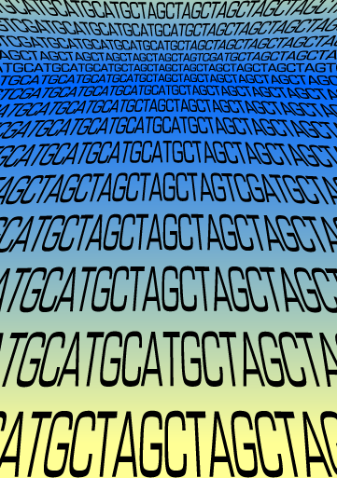
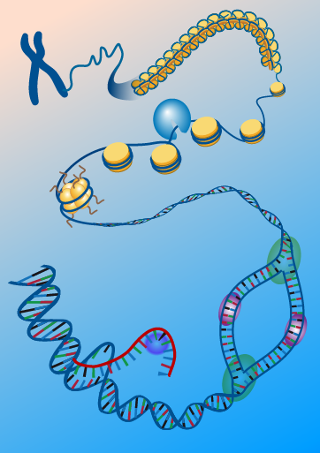
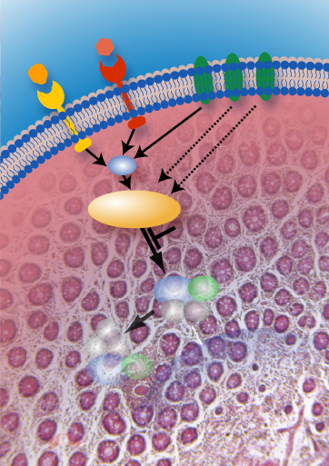
Genomic Medicine Working Group - Charge
Assist in advising NHGRI on research needed to evaluate and implement genomic medicine
Review current progress, identify research gaps and approaches for filling them
Identify and publicize key advances
Plan genomic medicine meetings on timely themes
Facilitate collaborations, coordination
Explore models for long-term infrastructure and sustainability of resulting efforts
Notes:
Advise on “identification and conduct of research on….”

Slide 4
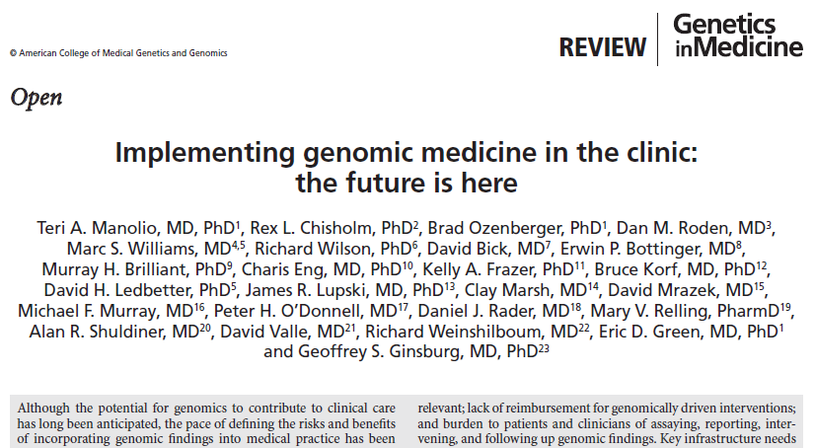
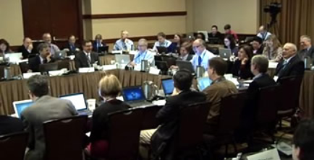
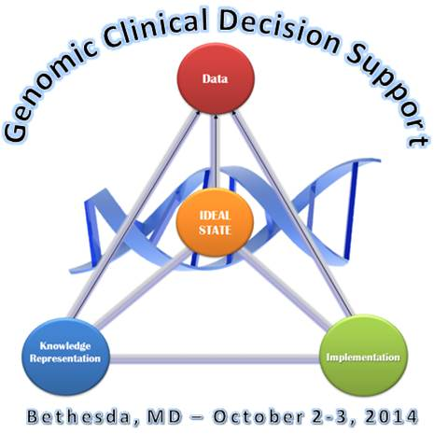
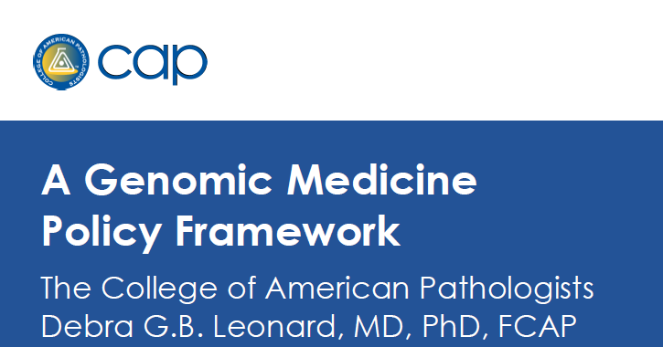
Genomic Medicine Colloquium, June 2011
GM IV: Physician Education, Jan 2013
GM VIII: NHGRI’s Genomic Medicine Programs, June 2015
GM VII: Genomic CDS, Oct 2014
GM II: Forming Collaborations, Dec 2011
GM V: Federal Strategies, May 2013
GM III: Stakeholders, May 2012
GM VI: Global Leaders, Jan 2014
Global Leaders in Genomic Medicine
2014
Notes:
Addressed isolation by promoting genomic medicine community, meetings

Slide 5
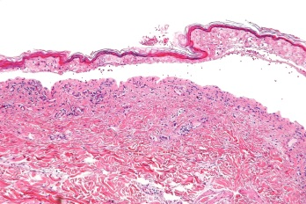
G2MC
SJS/TEN
Payers
7
6
Clin Action
5
4
GM VIII
3
2
1
ISCC
Trans-NIH WG
Genomics Roundtable

Slide 6
Genomic Medicine VIII: NHGRI’s Genomic Medicine Programs, June 8-9, 2015
Objectives
Review NHGRI’s genomic medicine portfolio, identify gaps, opportunities for collaborations
Identify related programs of other NIH ICs or other funders and opportunities for collaborations
Identify research needs in genomic medicine for NHGRI and partner agencies to pursue
Enhance approaches to capturing and disseminating best practices
Examine potential methods for assessing impact of programs

Slide 7
NHGRI’s Genomic Medicine Portfolio
Focus Programs | Related Programs
UDN | AFMS | IOM Roundtable
NSIGHT | CMG | ISCC
CSER | CPIC | LSAC
eMERGE | ENCODE | MVP
IGNITE | GA4GH | NCI-ALCHEMIST
ClinGen | GAPH | NCI-MATCH
 | GGR | PAGE
 | GS-IT | PCORNet
 | GTEx | PGRN
 | H3Africa | Phenx
 | HMORN | PMI
Notes:
Requested descriptive program summaries, objectives, barriers

Slide 8
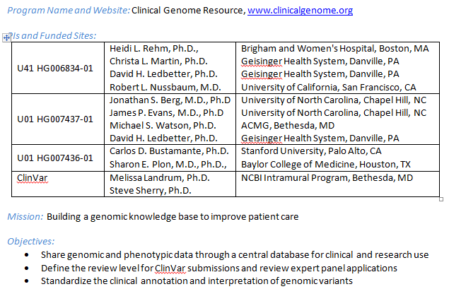
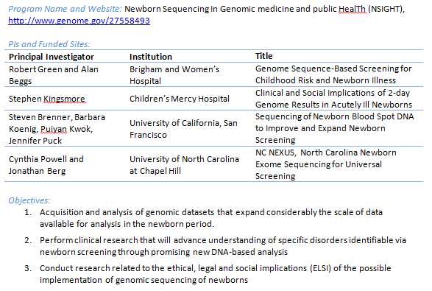
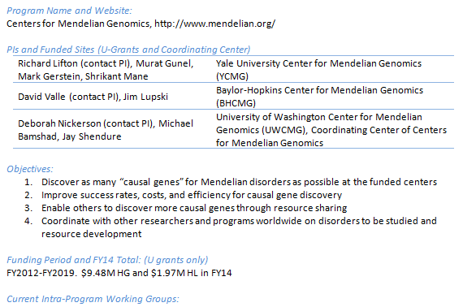
Program Summaries
Title, website, funded sites
Objectives
Funding period and FY14 total
Current working groups
Resources and tools produced
Key publications
Major obstacles or needs
Approaches to meet needs
Notes:
4 or more programs

Slide 9
Common Objectives of NHGRI’s Genomic Medicine Programs
Integrate genomic data into patient care
Incorporate actionable variants into EMR, CDS
Educate clinicians and patients on genomics in clinical care
Assess outcomes of using genomic information in clinical care
Define and share processes of implementation
Promote interaction and collaboration, reduce duplication
Translate implementation outside highly specialized centers
Notes:
4 or more programs

Slide 10
Specific Goals of Genomic Medicine Programs
 | UDN | NSIGHT | CSER | eMERGE | IGNITE | ClinGen
Improve genomic dx methods | ++ | + | +
Facilitate research in undiag-nosed/Mendelian diseases | ++ | + | +
Investigate use of genomic data in newborn care |  | ++
Develop electronic phenotypes |  |  |  | +
Identify variants related to complex traits | + |  | + | +
Characterize Pgx variants and use in care |  |  |  | + | +
Assess penetrance of potentially actionable variants |  |  |  | +
Standardize clinical annotation and interpretation |  |  | + |  |  | ++
Assess actionability of genes and variants for clinical use |  | + |  |  |  | ++
Create genomics-enabled learning healthcare systems |  |  | + | + | +

Slide 11
Barriers Facing Multiple Programs
Lack of evidence base
Need for common data elements
Frequency, impact of variants in ancestrally diverse populations
Rapid evolution of evidence on variants
Limited usefulness and interoperability of CDS
Regulations impeding return of results
Need for cloud computing
Reimbursement policies and regulations
Need for bedside back to bench research
Notes:
4 or more programs

Slide 12
Panel Topics; Questions to Answer
Evidence gaps
Variant interpretation
Changing evidence
Program metrics
EHR functionality
Patient diversity
Clinical workflow
Education/training
Patient-facing tools
Importance and impact of topic
Current programs addressing it
Gap areas and/or opportunities
Synergies across programs
Training opportunities and/or needs

Slide 13
Heavily Discussed GM VIII Recommendations (1)
Generating evidence
Maximize sharing of quality improvement (QI) projects by engaging health systems
Establish and maintain a knowledgebase of ongoing genomic medicine studies
Data sharing and improved phenotyping
Support standards for phenotype description that are common and comparable across model organisms to humans
Develop patient-oriented ontology and similar tools to facilitate patient-driven efforts

Slide 14
Heavily Discussed GM VIII Recommendations (2)
Identifying and carrying out innovative studies
Engage basic scientists more actively in planning of genomic medicine programs
Add FHx to large-scale sequencing effort to produce > 20K individuals with both, determine how/when FHx adds to sequence
Study impact and consequences of changes in variant annotation and duty to inform
Facilitating genomic medicine implementation
Create an implementation commons for sharing tools for implementing genomic medicine

Slide 15
Heavily Discussed GM VIII Recommendations (3)
Health disparities and patient engagement
Identify specific health disparities research questions related to genomics
Develop dedicated programs for non-EA populations to fill key gaps
Increase patient engagement in NHGRI genomic medicine programs
Education and Training
Explore joint training opportunities in genomic medicine with other organizations
Identify and disseminate best practices for clinician education and guidance

Slide 16
“Top 10” Rankings of GM8 Recommendations
0 2 4 6 8 10
Mean Ranking (1 = Highest)

Slide 17
Highest-Ranked GM VIII Recommendations (1)
Measure outcomes of value to patients, clinicians, payers…; involve them in design prior to launching studies (2.7)
Add FHx tool to large-scale sequencing effort to produce > 20K individuals with both, determine when FHx adds to sequence information (3.5)
Identify types of evidence (and goals they support) to collect and share across programs (4.0)
Accelerate rapid genotype-phenotype explorations at speed that would benefit patients (4.1)
Consider “cooperative sequencing groups” like COGs allowing rapid entry into studies (4.2)

Slide 18
Highest-Ranked GM VIII Recommendations (2)
Facilitate coverage with evidence development studies through payers (4.3)
Identify payers’ needs for evidence across diverse payers, integrate with HCSRN and AHIP (4.5)
Conduct post-marketing studies of genetic testing similar to pharmacovigilance studies (4.7)
Encourage agreed-upon nomenclature, variant definitions, and unique allelic identifiers, needed for computing by CDS (4.7)
Create “computable” guidelines that can be readily integrated with CDS systems if possible (4.9)
Conduct clinical trials of added value of WGS to more limited testing, include costs of follow-up (5.0)

Slide 19
Immediate Plans for Follow-Up
Engage basic scientists in GM9 meeting on bedside back to bench
Phenotypes c/w model organisms
Variant nomenclature
Function annotation

Slide 20
Immediate Plans for Follow-Up
Engage basic scientists in GM9 meeting on bedside back to bench
Pursue infrastructure needs internally
Knowledgebase of genomic medicine studies
Patient-oriented ontology
Implementation commons
Common data elements
Increased patient engagement
Comparative effectiveness research
WGS vs. targeted panel sequencing
WGS w/ vs. w/o adequate FHx

Slide 21
Many Thanks…
Alice Bailey
Ebony Bookman
Joy Boyer
Lisa Brooks
D. Colantuoni
Cati Crawford
Eric Green
Lucia Hindorff
Jean Jenkins
Heather Junkins
Rongling Li
Nicole Lockhart
Jean McEwen
Jacqueline Odgis
Erin Ramos
Laura Rodriguez
Elle Silverman
Simona Volpi
Robert Wildin
Anastasia Wise
Carol Bult
Rex Chisholm
Geoff Ginsburg
Howard Jacob
Howard McLeod
Mary Relling
Dan Roden
Marc Williams
GM Mtg Participts

Slide 22
Over to You…
Please comment on GMWG’s recent activities
Advise on priorities of the major recommendations of the Genomic Medicine VIII meeting and NHGRI’s role in pursuing them

