Slide 1

National Advisory Council for Human Genome Research
September 2015
Eric Green, M.D., Ph.D.
Director, NHGRI
DIRECTOR’S REPORT
Notes:
As is always the case, the Open Session of this meeting of the National Advisory Council for Human Genome Research, including this Director’s Report, is being webcast live.
It is also being videotaped, and those recordings will be made available as a permanent archive on the internet, including the presentations themselves and the various associated documents.

Slide 2
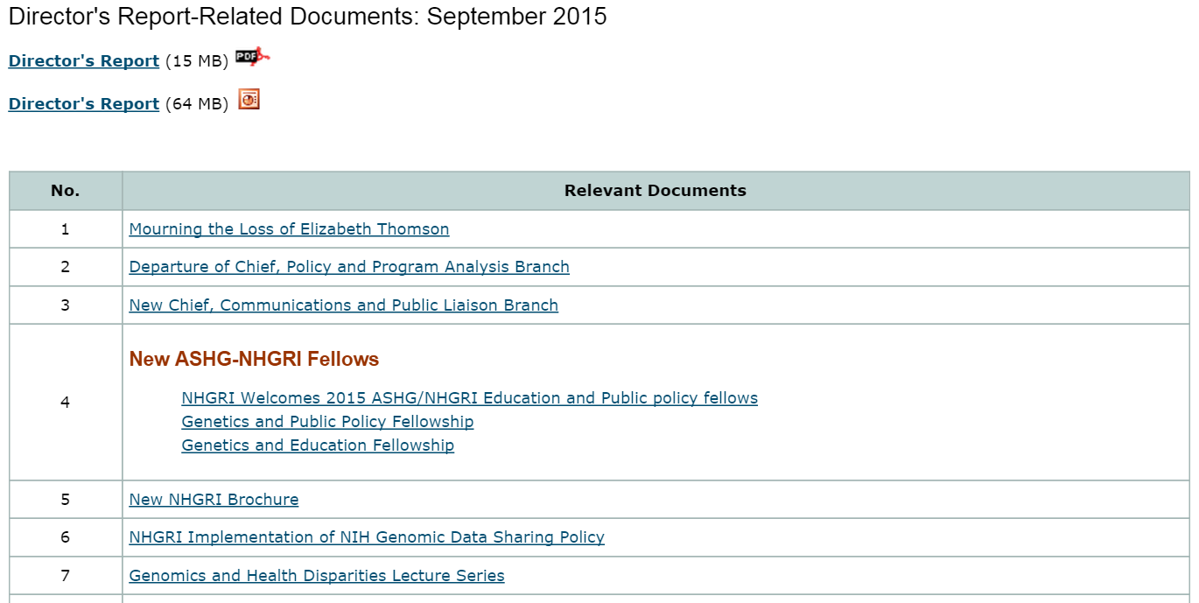
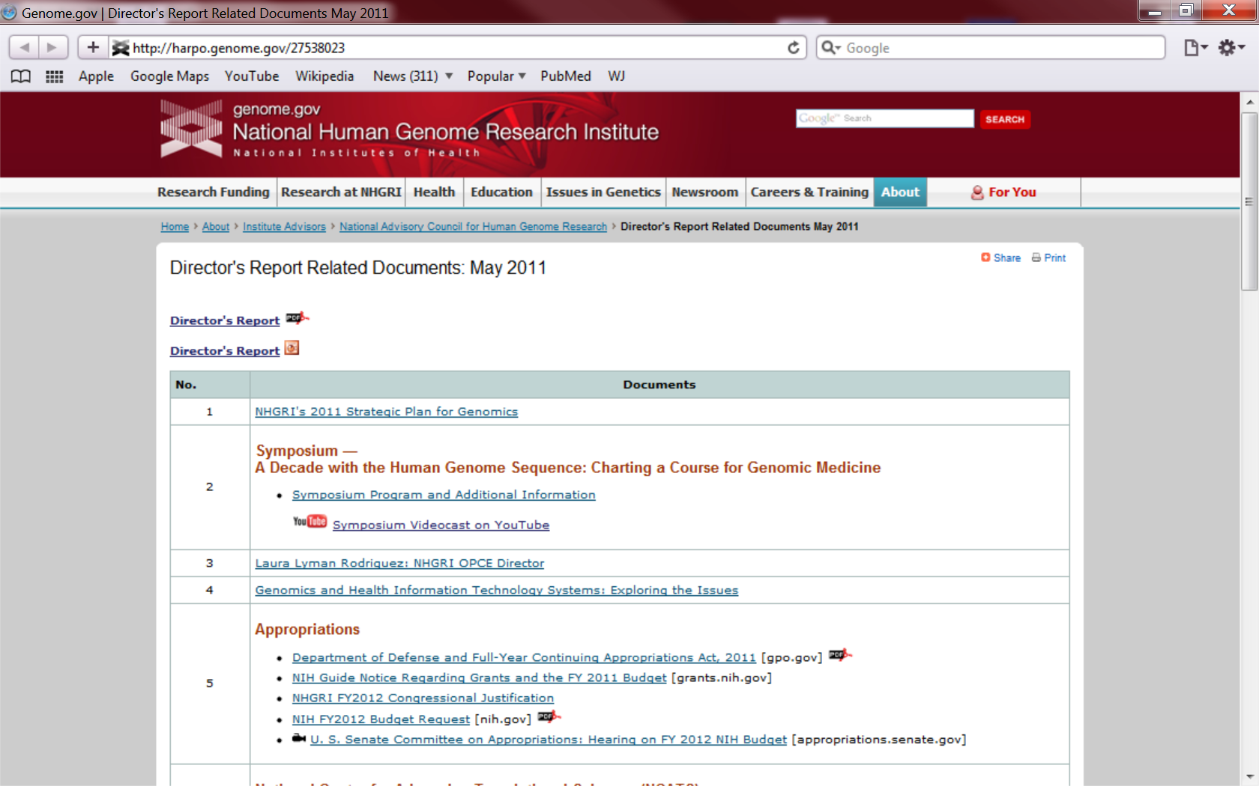
genome.gov/DirectorsReport
Document #
Notes:
For anyone new to our Council meetings, I want to make you aware of an ‘electronic resource’ associated with my Director’s Report. This is analogous to supplemental materials of a published paper, and can be accessed at the URL shown here.
The slides that I will show during my Director’s Report are also available electronically at this site– * both as PDF and PowerPoint files.
* For slides associated with specific documents or relevant web sites, there is a ‘Document #’ indicated on the bottom right, which references materials that can be accessed and/or downloaded at the web page shown here.
In addition to the video archive, this web page and all linked documents will be archived on NHGRI’s website (genome.gov) as a permanent historic record of this meeting.

Slide 3
Open Session Presentations
  Genomics and Society Working Group
    Lisa Parker
  Workshop Report: Research Directions in Stevens Johnson Syndrome – Toxic Epidermal Necrolysis
    Teri Manolio
Notes:
There will be several other presentations during the Open Session of this Council meeting. My Director’s Report is tailored around these presentations, and I will not discuss in detail the topics that others will cover.
* After my Director’s Report, Dr. Lisa Parker will present a report from the Genomics and Society Working Group of this Council. * Dr. Teri Manolio will then present a report from the recent workshop on Research Directions in Stevens Johnson Syndrome – Toxic Epidermal Necrolysis.

Slide 4
Open Session Presentations
  Genomic Medicine Working Group & Meeting Report: Genomic Medicine 8
    Teri Manolio
  The Complementarity of Comparative Effectiveness Research and Precision Medicine
    Joe Selby
Notes:
* After the lunch break, we will again hear from Teri Manolio, who will present an update from the Genomic Medicine Working Group of this Council and then a report from the recent Genomic Medicine 8 Meeting.
* The last presentation of the Open Session will be given by Dr. Joe Selby of the Patient‑Centered Outcomes Research Institute; Joe will be talking about “The Complementarity of Comparative Effectiveness Research and Precision Medicine.”

Slide 5
Director’s Report Outline
General NHGRI Updates
General NIH Updates
General Genomics Updates
NHGRI Extramural Research Program
NIH Common Fund/Trans-NIH
NHGRI Division of Policy, Communications, and Education
NHGRI Intramural Research Program
Notes:
For the rest of my Director’s Report, I will cover the 7 areas listed here, which reliably provide an excellent framework for reviewing the relevant topics.

Slide 6
Director’s Report Outline
General NHGRI Updates
General NIH Updates
General Genomics Updates
NHGRI Extramural Research Program
NIH Common Fund/Trans-NIH
NHGRI Division of Policy, Communications, and Education
NHGRI Intramural Research Program

Slide 7
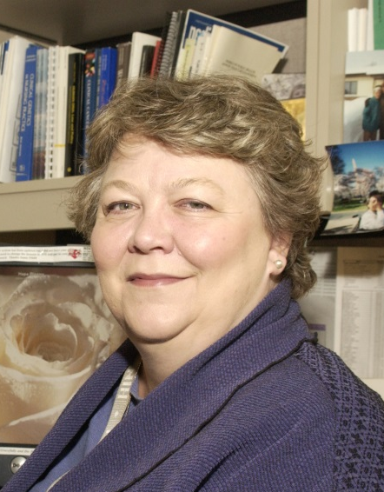
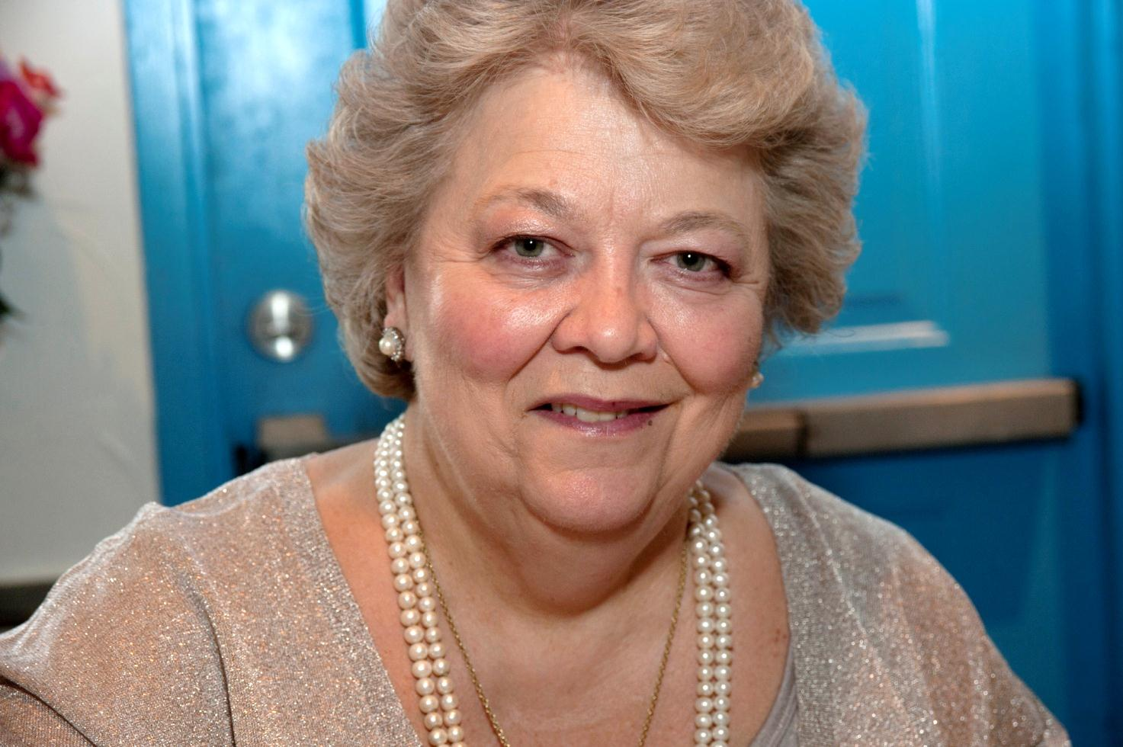
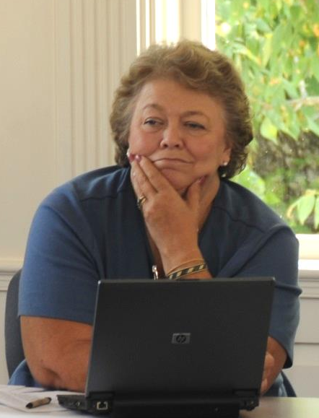
Mourning the Loss of Elizabeth Thomson
Document 1
Notes:
NHGRI has lost one of its longest serving employees. Former NHGRI Extramural Program Director Elizabeth Thomson passed away this past July.
From an early career in nursing, Elizabeth moved into genetic counseling and then founded the International Society of Nurses in Genetics. During her time at NHGRI, which began in 1991, she championed our Ethical, Legal, and Social Implications (ELSI) Research Program, and became a valued resource for the genomics community. She was the driving force behind many ELSI Research Program initiatives— from the successful and influential Cystic Fibrosis and Cancer Genetics Studies Research Consortia of the 1990s through the current Centers of Excellence in ELSI Research (CEER) Program.
She will be remembered most for her passionate support and generosity as a mentor to trainees and young investigators. She will be greatly missed.

Slide 8
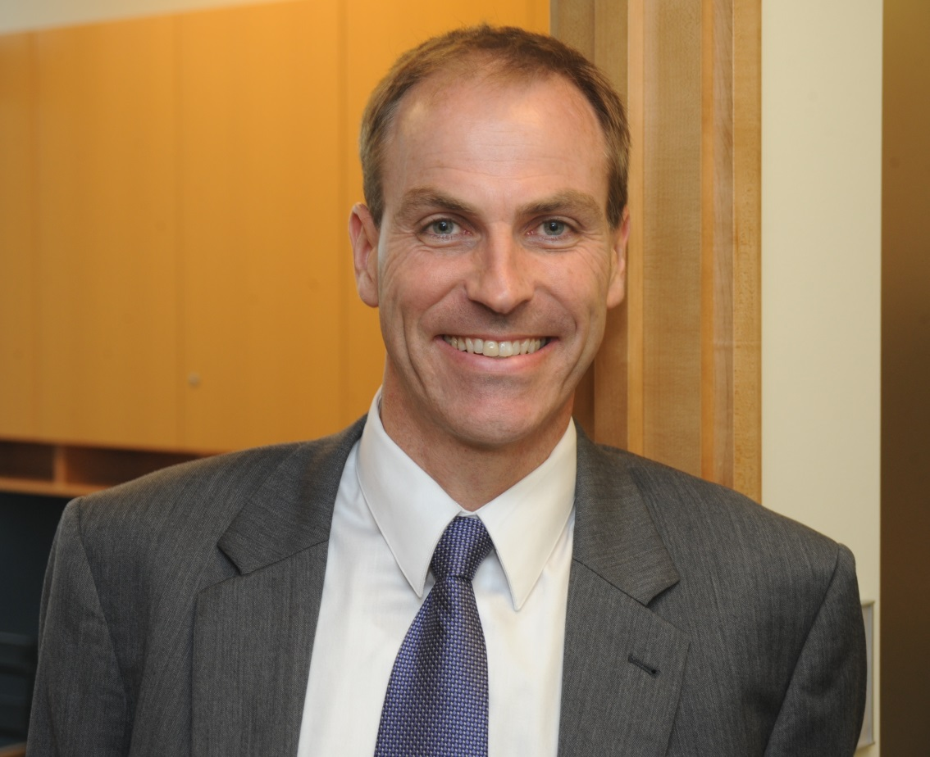
Departure of Chief,
Policy and Program Analysis Branch
Derek Scholes, Ph.D.
Document 2
Notes:
After four years serving as the Chief of the Policy and Program Analysis Branch within the Division of Policy, Communications, and Education, Dr. Derek Scholes left NHGRI in May to become the Vice President for Public Policy and Government Affairs at the Cystic Fibrosis Foundation.
While at NHGRI, Derek focused much of his energy on building relationships with Congressional staff, and was an outstanding mentor for the four American Society of Human Genetics (ASHG)-NHGRI Public Policy Fellows that came through the Institute during his tenure. We thank Derek for his contributions, and wish him the best with the Cystic Fibrosis Foundation.
Meanwhile, Dr. Laura Rodriguez is currently serving as the Acting Chief of this Branch while we conduct a search for Dr. Scholes’ replacement.

Slide 9
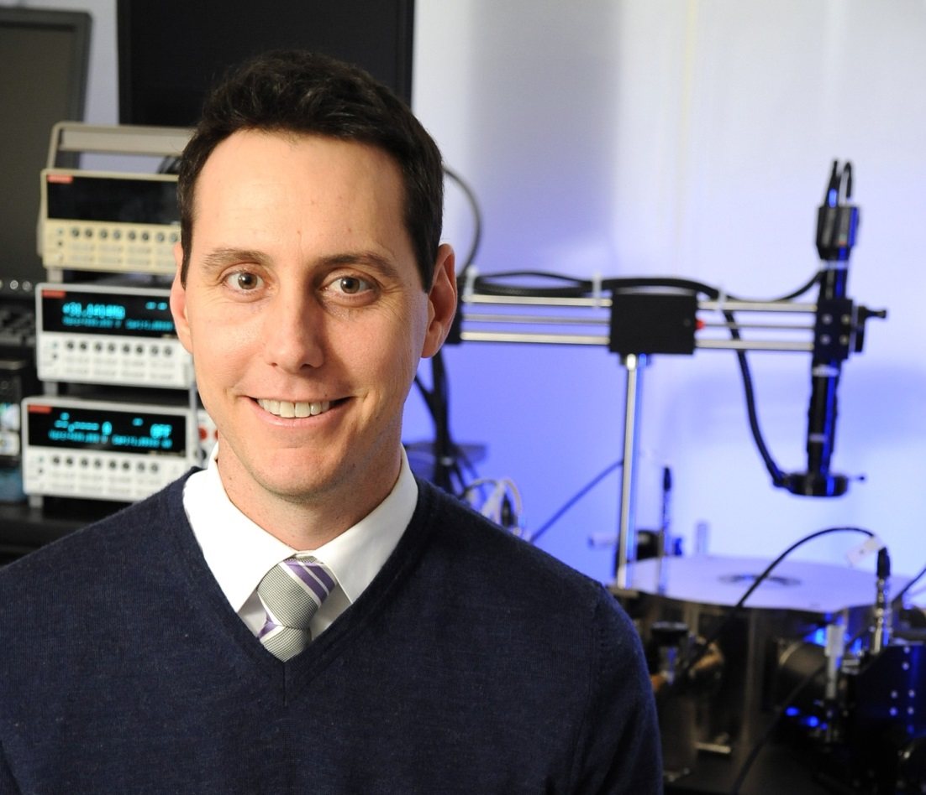
New Chief, Communications and
Public Liaison Branch
John Ohab, Ph.D.
Document 3
Notes:
Moving on to another important leadership position within the Division of Policy, Communications, and Education, Dr. John Ohab very recently joined NHGRI as Chief of the Communications and Public Liaison Branch.
Prior to joining the Institute, John played major leadership roles in the strategic communications programs for the Department of Defense, industry start-ups, and (most recently) the Naval Research Laboratory, where he served as Head of Communications and Social Media. In this most recent position, he led the development of a new comprehensive communications strategy, including a re-branding effort and the development of an extensive social media plan. NHGRI is excited to have John take the reins of our important and well-respected communications program.
I would like to thank Jeannine Mjoseth for serving as the Acting Chief of the Branch over the last 16 months. She and the entire Branch successfully maintained momentum during this period, and have continued to find new and innovative ways to capture the attention of NHGRI’s audience through our website, video, and media relations. Jeannine will continue to serve as the Branch’s Deputy Chief.

Slide 10
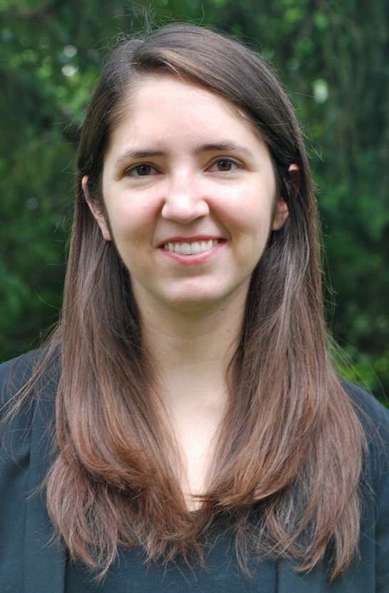
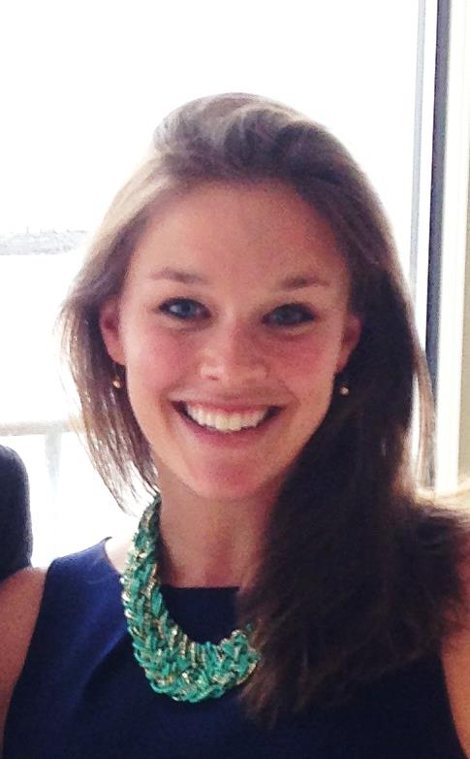
New ASHG-NHGRI Fellows
Caroline Young, M.S.
Genetics and Public Policy Fellow
Julie Nadel, Ph.D.
Genetics and Education Fellow
Document 4
Notes:
NHGRI’s Division of Policy, Communications, and Education partners with the American Society of Human Genetics (ASHG) in sponsoring two fellowships— the well-established Genetics and Public Policy Fellowship and the recently launched Genetics and Education Fellowship.
* This year’s Genetics and Public Policy Fellow is Caroline Young. Ms. Young attended Kenyon College, where she majored in biology and minored in classics, after which she earned a master’s degree in the Johns Hopkins/NHGRI Genetic Counseling Training Program (graduating this past spring).
This will be the second year for the ASHG-NHGRI Genetics and Education Fellowship, and * I am pleased to report that Dr. Julie Nadel will be this year’s Fellow. Julie just completed her doctoral studies in genetics at Albert Einstein College of Medicine. Prior to her graduate work, she earned a B.S. in life science and neuropsychology from Penn State University.
We are all looking forward to working with Caroline and Julie as our new fellows.

Slide 11
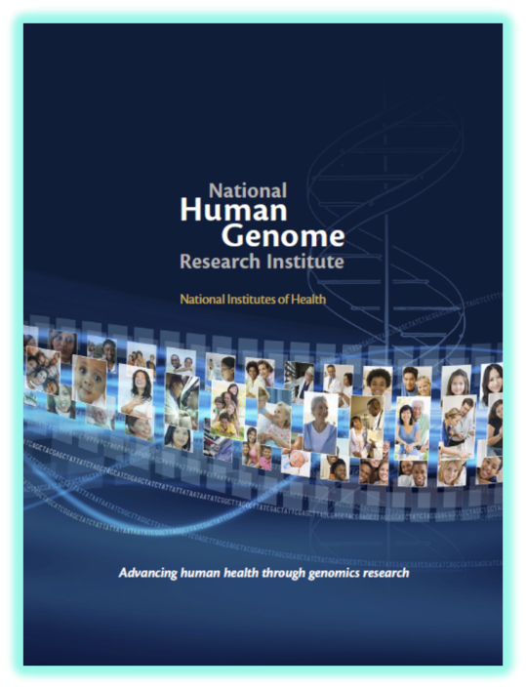
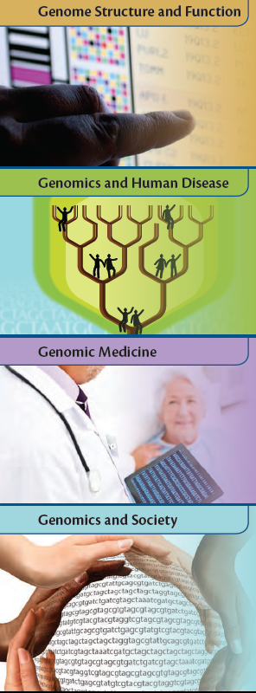
New NHGRI Brochure
    New brochure features NHGRI’s history, organization, core values, and research portfolio across four major scientific areas
    PDF version on genome.gov
    Printed copies available
Document 5
Notes:
Resulting from the collective efforts of numerous staff members, NHGRI recently published its first-ever general brochure about the Institute.
Designed for a broad audience, * the new brochure features NHGRI’s history, organization, core values, and research portfolio. The latter involves highlighting key Institute programs across the four major scientific areas depicted here: Genome Structure and Function; Genomics and Human Disease; Genomic Medicine; and Genomics and Society.
* A PDF version of the new NHGRI brochure can be readily downloaded from our web site (genome.gov), and * printed copies are available on request.

Slide 12
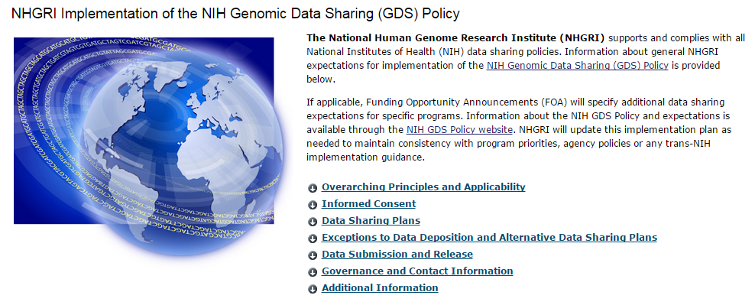
NHGRI Implementation of
NIH Genomic Data Sharing Policy
NHGRI-specific expectations:
  Same data sharing timelines for human and non-human genomic data on or after January 25, 2016
  Move toward using data sources with explicit consent for future research use and broad data sharing by early 2020
Document 6
Notes:
The NIH Genomic Data Sharing Policy was released a little over a year ago, in August 2014. Since before the policy’s release, NHGRI has been preparing to implement the policy at our Institute. * This month, we opened a series of pages on our web site (genome.gov) that provide information for extramural and intramural researchers about NHGRI’s specific implementation of the NIH-wide policy.
* We also announced on our web site two areas in which NHGRI’s expectations for genomic data sharing will go beyond the minimum expectations established by the NIH Genomic Data Sharing Policy. * First, while the NIH policy specifies different data submission and release timelines for human and non-human genomic data, NHGRI plans to harmonize these timelines for our funded research. For projects proposed on or after January 25, 2016, NHGRI will expect non-human genomic data to be submitted and released according to the same timelines as human genomic data.
* Second, supporting the NIH Genomic Data Sharing Policy’s expectation for explicit consent for future research use and broad data sharing, NHGRI will require that by January 25, 2020, all human genomic data used in NHGRI-funded or -supported research will be generated from specimens or cell lines obtained with explicit consent for future research use and broad data sharing. Exceptions to this expectation will continue to be granted when there is a compelling scientific reason, as allowed for under the NIH Genomic Data Sharing Policy.

Slide 13
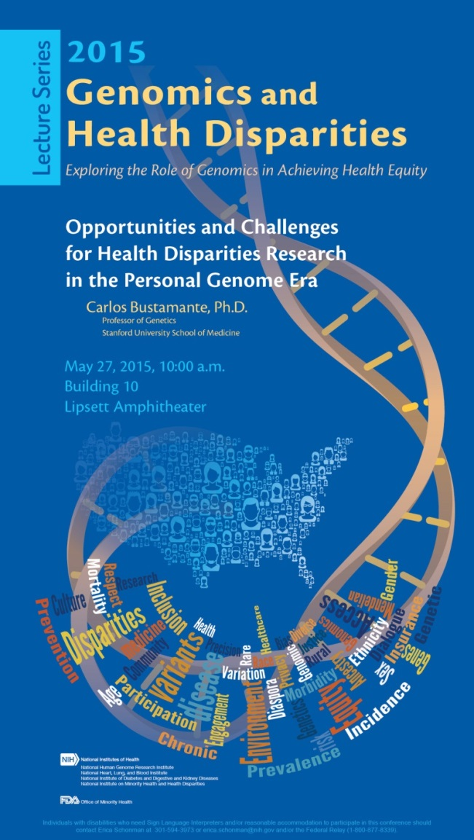
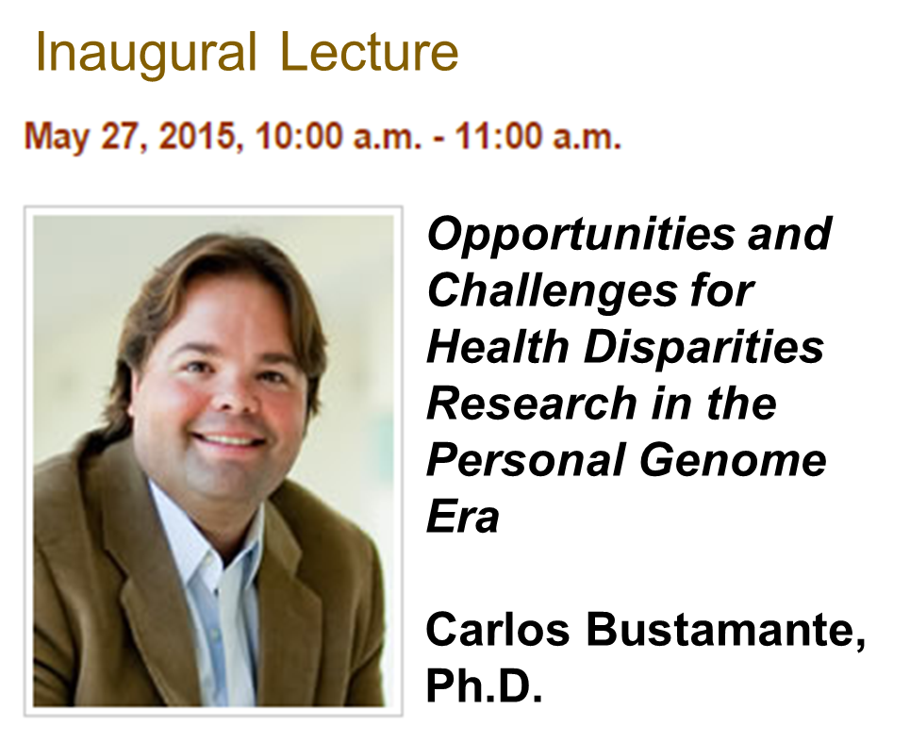
Genomics and Health Disparities
Lecture Series
Document 7
Notes:
NHGRI has established a Genomics and Health Disparities Lecture Series to enhance opportunities for dialogue about the role that genomics and ELSI research can have in addressing health disparities and inequities. Topics will range from basic science to translational and ELSI research.
The lecture series is being co-sponsored by the NHGRI; the National Heart, Lung, and Blood Institute; the National Institute of Diabetes and Digestive and Kidney Diseases; the National Institute on Minority Health and Health Disparities; and the Office of Minority Health at the Food and Drug Administration.
The inaugural lecture in this series was held this past May, with Council member Dr. Carlos Bustamante presenting a talk entitled “Opportunities and Challenges for Health Disparities Research in the Personal Genomic Era.” NHGRI and our co-sponsors are currently planning the additional lectures for the upcoming year.

Slide 14
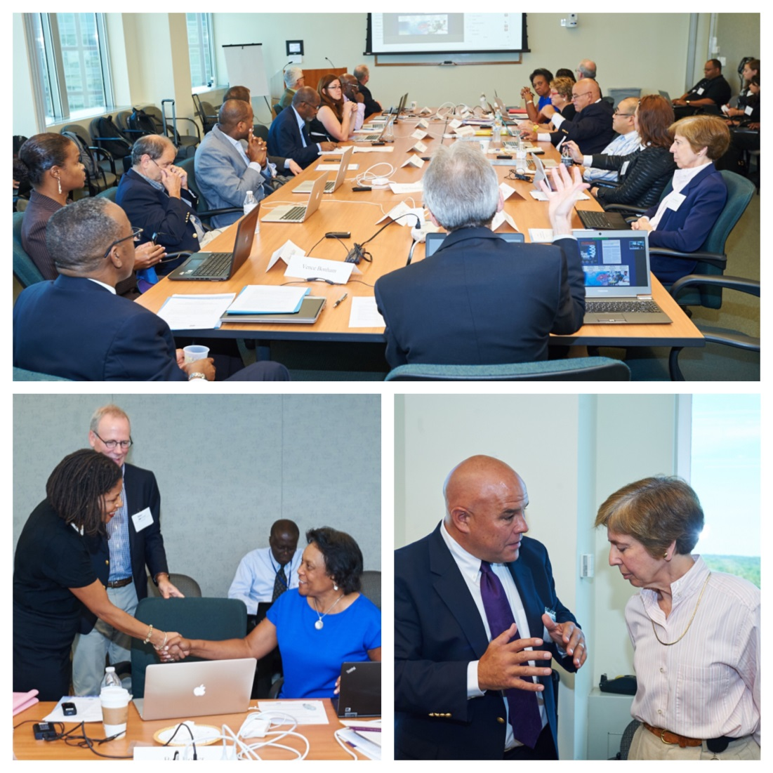
NHGRI Roundtable on Inclusion and Engagement of Underrepresented Populations in Genomics Research
Notes:
Last week, NHGRI held a ‘roundtable’ on the Inclusion and Engagement of Underrepresented Populations in Genomics Research. This gathering sought to bring together genomic science and health disparities researchers to discuss strategies to increase the participation of underrepresented populations in genomics research.
The goals of the roundtable included: (1) examining the scientific challenges that arise due to the lack of ancestral diversity in genomic studies, including the difficulty of enabling genomic science and medicine to benefit all populations; (2) identifying barriers to increasing the number of research participants from diverse ancestral populations in genomics research and strategies to overcome these barriers; and (3) defining genomic science and ethical, legal, and social implications research opportunities to address health disparities and inequities.
A report from this roundtable will be presented at the February 2016 Council meeting.

Slide 15
Director’s Report Outline
General NHGRI Updates
General NIH Updates
General Genomics Updates
NHGRI Extramural Research Program
NIH Common Fund/Trans-NIH
NHGRI Division of Policy, Communications, and Education
NHGRI Intramural Research Program

Slide 16

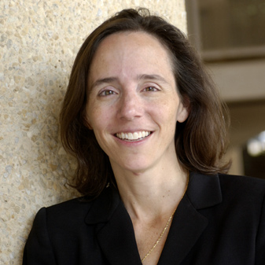

Alan Guttmacher Retires as NICHD Director
Alan Guttmacher, M.D.
Catherine Spong, M.D.
Document 8
Notes:
Dr. Alan Guttmacher recently announced that he will retire from being Director of the Eunice Kennedy Shriver National Institute of Child Health and Human Development (NICHD) in October.
Alan came to NHGRI in 1999, and was appointed as the Institute’s Deputy Director a few years later. He also served as the NHGRI Acting Director before I stepped into this position. Just when I became NHGRI Director, Alan was asked to serve as NICHD’s Acting Director, and was later appointed its Director. He has done a terrific job in this capacity for the past five years. Working with Alan, we have benefited from numerous interactions with NICHD, including launching the Newborn Sequencing In Genomic medicine and public HealTh (NSIGHT) program. His scientific leadership has been invaluable to NHGRI and NICHD, and we wish Alan all the best in his retirement.
* Dr. Catherine Spong, currently the NICHD Deputy Director, will serve as the Institute’s Acting Director while a search for its next permanent Director is conducted.

Slide 17


New Director, National Institute of Neurological Disorders and Stroke
Walter Koroshetz, M.D.
Document 9
Notes:
Dr. Walter Koroshetz has been named Director of the National Institute of Neurological Disorders and Stroke (NINDS). He has served as the NINDS Acting Director since October 2014.
Walter came to the NIH in 2007 as the NINDS Deputy Director. Among his many accomplishments, he had a significant role in the creation of StrokeNet, a national clinical trial network for research in stroke treatment, prevention, and recovery, and was a co-founder of the NIH-Uniformed Services Center for Neuroscience and Regenerative Medicine.

Slide 18


New Director, NIH Office of Behavioral and Social Sciences Research
Bill Riley, Ph.D.
Document 10
Notes:
Dr. Bill Riley was recently appointed Director of the NIH Office of Behavioral and Social Sciences Research, and Associate Director of NIH for Behavioral and Social Sciences.
Before his current NIH appointment, Bill served as a Health Scientist Administrator and Deputy Director in the Division of AIDS and Health Behavior Research at the National Institute of Mental Health, a Program Director at the National Heart, Lung, and Blood Institute, and Chief of the Science of Research and Technology Branch in the Division of Cancer Control and Population Sciences at the National Cancer Institute.

Slide 19
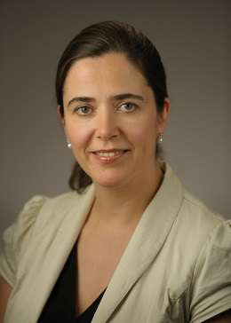

New Director, NCATS Office of Rare Diseases Research
Petra Kaufmann, M.D., M.Sc.
Document 11
Notes:
Dr. Petra Kaufmann has been named Director of the Office of Rare Diseases Research, which now resides within the National Center for Advancing Translational Sciences (NCATS).
This new role will be in addition to her current role as Director of the NCATS Division of Clinical Innovation. As the Director of the Office of Rare Diseases Research, Petra will actively oversee the Rare Diseases Clinical Research Network, the Global Rare Diseases Patient Registry Data Repository, and the Genetic and Rare Diseases Information Center (a long-time collaboration between this Office and NHGRI).

Slide 20
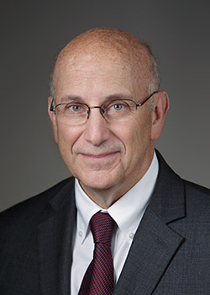
Acting Director,
NIH Office of AIDS Research
Robert Eisinger, Ph.D.
Document 12
Notes:
Dr. Robert Eisinger has been appointed the Acting Director of the NIH Office of AIDS Research while a search for a permanent director is conducted. As I mentioned at the May Council meeting, Dr. Jack Whitescarver stepped down from the Directorship of this Office in July.

Slide 21
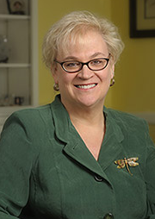
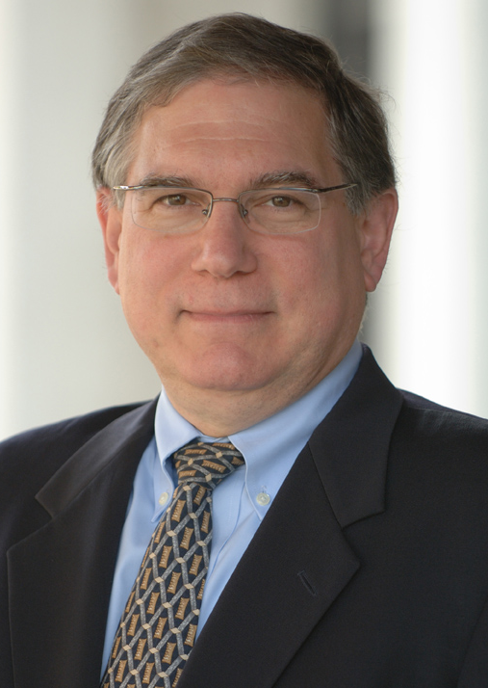
Sally Rockey Steps Down as Director,
NIH Office of Extramural Research
Sally Rockey, Ph.D.
Larry Tabak, D.D.S, D.Phil.
Document 13
Notes:
Dr. Sally Rockey has departed the NIH and her position as Director of the NIH Office of Extramural Research (and Deputy Director for Extramural Research) to become the Director of the Foundation for Food and Agriculture Research.
Among her many accomplishments, Sally managed the successful implementation of the American Recovery & Reinvestment Act at NIH, led the focus on the biomedical research workforce, and greatly enhanced NIH’s partnership and dialogue with the extramural research community.
* Dr. Larry Tabak, NIH Deputy Director, has agreed to take on the role of Acting Director of the NIH Office of Extramural Research while the search for a permanent Director is conducted.

Slide 22




Thomas Insel to Depart as NIMH Director
Thomas Insel, M.D.
Bruce Cuthbert, Ph.D.
Notes:
In breaking news from last week, Dr. Tom Insel just announced that he will be departing as Director of the National Institute of Mental Health (NIMH) on November 1. A great friend and colleague of NHGRI’s, Tom has served as NIMH Director for 13 years.
Tom was initially at NIMH from 1980 to 1994 in the Institute’s Intramural Research Program, and then returned as Director in 2002. As NIMH Director, he nurtured numerous major initiatives (too many to mention here). His leadership has also been central to many trans-NIH and major federal efforts, including chairing the Interagency Autism Coordinating Committee, co-chairing the Blueprint for Neuroscience Research, co-chairing the NIH Brain Research through Advancing Innovative Neurotechnologies (BRAIN) Program, and co-leading Common Fund efforts in Molecular Libraries, Single Cell Biology, and Genotype-Tissue Expression (GTEx).
When he departs NIH, Tom will join the Google Life Sciences team at Alphabet to lead a new effort that will focus on mental health.
* While a national search for a new NIMH Director is conducted, Dr. Bruce Cuthbert will serve as the Institute’s Acting Director. Bruce has held a number of leadership positions at NIMH, including Director of the Division of Adult Translational Research and Director of the Research Domain Criteria Unit.

Slide 23
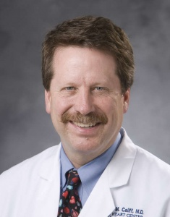

FDA Commissioner Nomination
Robert Califf, M.D.
Notes:
In another piece of breaking news from last week, Dr. Rob Califf has been nominated by President Obama to take on the role of Commissioner of the U.S. Food and Drug Administration. Upon Senate confirmation, Dr. Califf will take over for current Acting FDA Commissioner, Dr. Stephen Ostraff, who has been serving in that position since Dr. Peggy Hamburg departed in March.
Rob will inherit the agency along with a number of important current initiatives, including his overhaul of the regulation of electronic cigarettes, biosimilar drugs, and food safety. A well-known figure in medicine as a cardiologist, researcher, and professor at Duke University, Rob has been associated with the FDA since February when became the Deputy Commissioner for Medical Products and Tobacco.

Slide 24
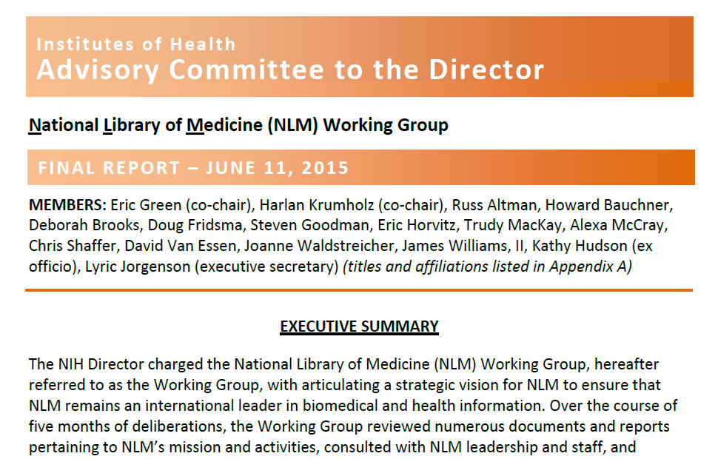
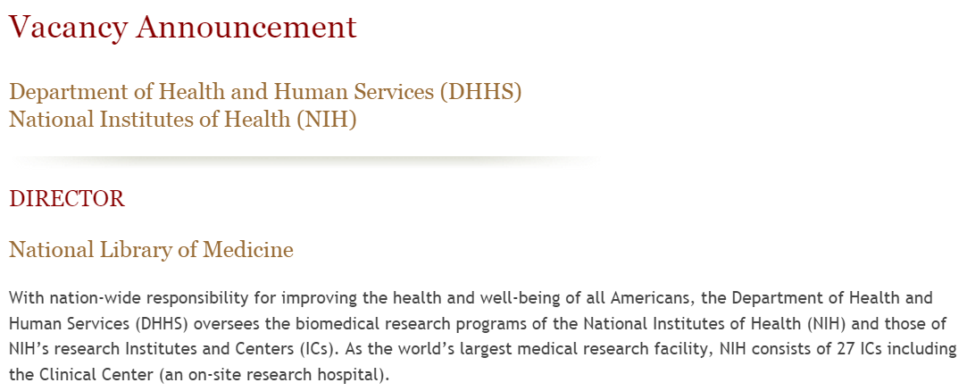
National Library of Medicine
Working Group Report
Document 14
Notes:
As you may recall, over the past year, I co-chaired a Working Group of the Advisory Committee to the NIH Director that was asked to articulate a renewed vision for the National Library of Medicine (NLM). This Working Group was constituted following the retirement of NLM’s long-standing Director, Dr. Don Lindberg, and prior to the recruitment of a new Director.
The Working Group was charged with reviewing the mission, organization, and programmatic priorities of the NLM, and articulating a strategic vision for NLM in order to ensure its continued leadership in biomedical and health information. The Working Group presented its final report for consideration at the June meeting of the Advisory Committee to the NIH Director, where it was unanimously approved by the Committee and accepted by the NIH Director. Of note, the report describes a vision for NLM as a unifying force in biomedicine that promotes and accelerates knowledge generation, dissemination, and understanding in the U.S. and internationally; it also calls for NLM to be the intellectual and programmatic epicenter for data science at NIH.
Following his acceptance of the report, * Dr. Francis Collins immediately launched a search for the next NLM Director, asking me and Dr. Jon Lorsch (Director of the National Institute for General Medical Sciences) to co-chair the search committee. That search is now active, with the first evaluation of applications to take place shortly after the initial application deadline of October 21. Anyone interested in applying for this important NIH leadership position should feel free to contact me directly.

Slide 25
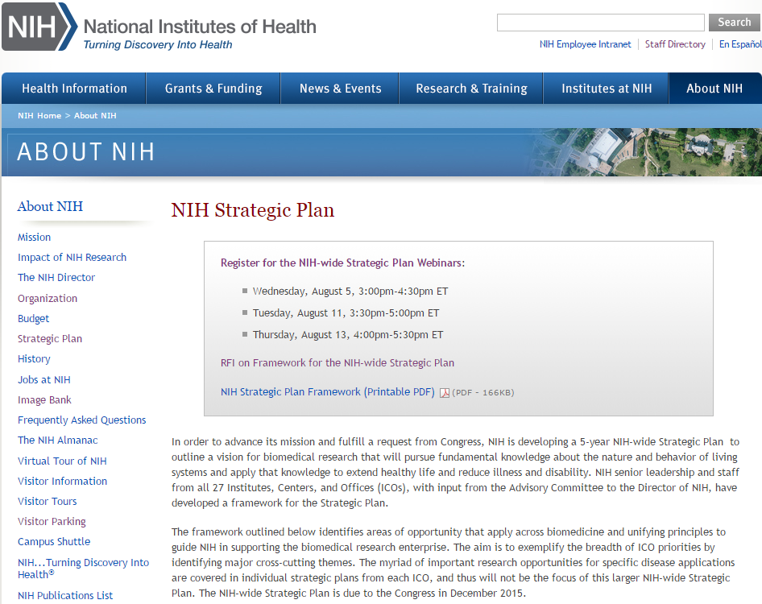
NIH Strategic Plan
Document 15
Notes:
As part of the Fiscal Year 2015 ‘CRomnibus' appropriation enacted last December, Congress included language requesting that NIH submit "an NIH-wide 5-year strategic plan no later than 1 year after enactment." Additionally, the 21st Century Cures Act, a bill that is currently pending in Congress and hopefully will pass sometime in the coming year, also includes language that instructs NIH to maintain a 5-year biomedical research strategic plan, which includes identifying strategic focus areas that consider research’s return on investment.
With such a Congressional requirement, NIH is now busily working to develop a new Strategic Plan to span the work of the entire agency, aiming to meet the deadline of having such a plan completed by December. Specifically, NIH is developing a ‘living document’ to help guide the agency in fulfilling its mission over the next 5 years.
The plan is intended to articulate the highest priorities across the NIH research portfolio, highlighting how NIH will achieve these priorities. It is not intended to describe all of the many important things that NIH does and will do in the future, nor to address priorities of specific Institutes and Centers (many of which have their own strategic plans that will be referenced in the Executive Summary of the broader NIH plan).

Slide 26
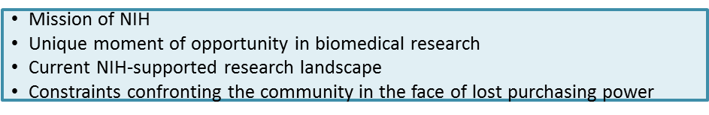
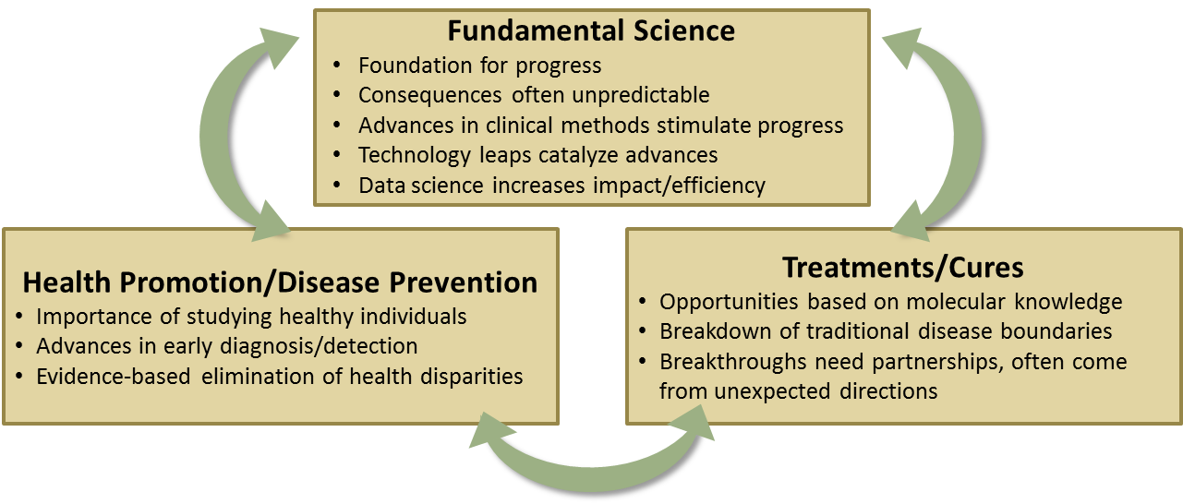
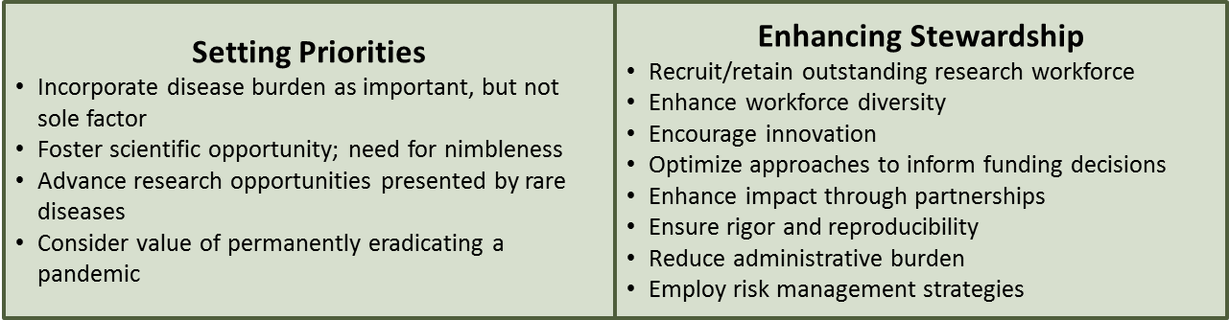
NIH Strategic Plan Framework
Overview
Areas of Opportunity
Unifying Principles
Document 15
Notes:
The framework for the new NIH Strategic Plan is organized into three sections: * an Overview, * Areas of Opportunity, and * Unifying Principles. Each section includes broad trans-NIH opportunities and priorities.
This framework was designed by NIH leadership, including input from the Advisory Committee to the NIH Director. Based on this framework, the Strategic Plan is being developed through a Working Group of Institute and Center representatives. A more complete set of slides with further details about this strategic planning process and its framework is available as Document 15 associated with my Director’s Report.
This summer, public input regarding the framework was collected through a Request for Information, which received 460 responses. Three webinars were also held in August, with over 700 participants. The Strategic Plan will be presented to the Advisory Committee to the NIH Director in early December and delivered to Congress by mid-December.

Slide 27
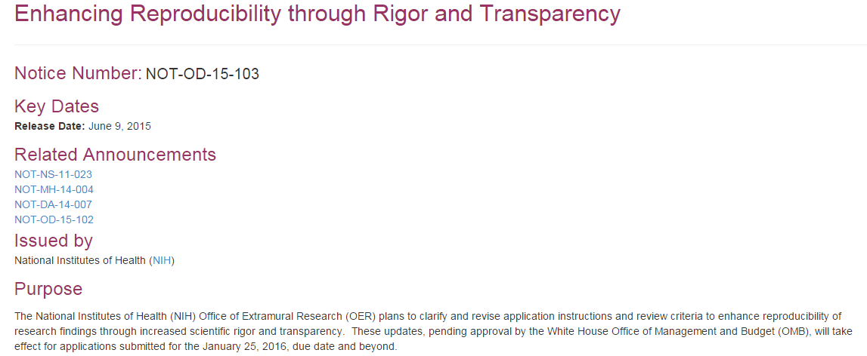
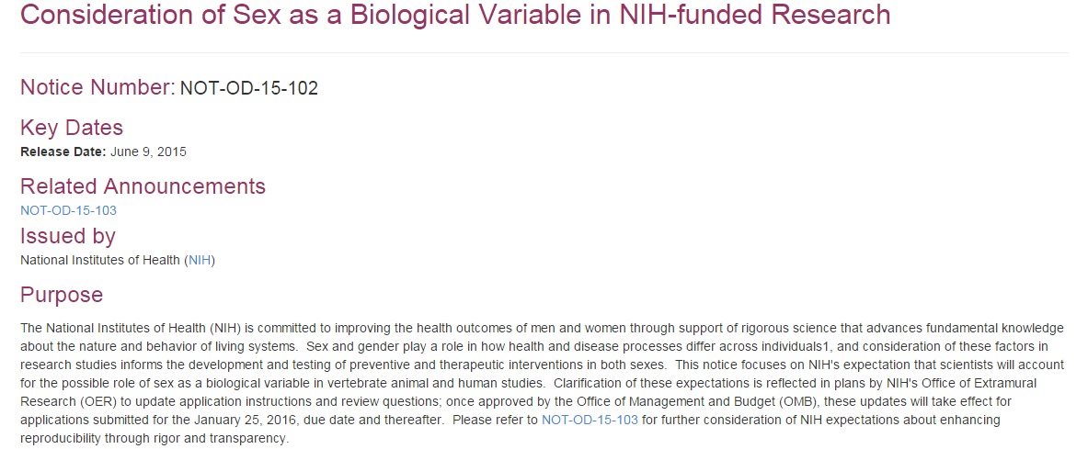
NIH Rigor and Reproducibility in
Grant Applications and Review
Document 16
Notes:
NIH continues its effort to enhance rigor and reproducibility in scientific research. The main goal is to clarify NIH’s long-standing expectations regarding rigor and transparency, and how we would like to see this described in grant applications. Recently, NIH notified the research community of plans to incorporate rigor and reproducibility in grant applications and review through the issuance of two Guide notices.
* The first notice (“Enhancing Reproducibility through Rigor and Transparency”) provides information to clarify NIH expectations in four areas covered in grant applications: scientific premise, rigorous experimental design, consideration of relevant biological variables (such as sex), and authentication of key biological and/or chemical resources. * The second notice provides additional information regarding the consideration of sex as a biological variable in NIH-funded research.
Pending approval of the Office of Management and Budget, the policy will go into effect for applications due January 25, 2016 and beyond. Instructions for applicants will be available in Fall 2015.

Slide 28

New Legislation: 21st Century Cures
(H.R. 6)
Passed by the House on July 10
Boosts NIH research and reforms FDA’s regulatory framework to accelerate the discovery, development, and delivery of cures
Senate continues to work on its “Innovations Bill”
Document 17
Notes:
The 21st Century Cures bill (H.R. 6) was * passed by the House of Representatives on July 10. In very general terms, the bill * boosts NIH research and reforms FDA’s regulatory framework, so as to accelerate the discovery, development, and delivery of cures
More specifically, the bill authorizes 4% annual increases in the NIH budget for Fiscal Years 2016-2018, and establishes a ‘NIH and Cures Innovation Fund,’ which would provide an additional $1.86 billion annually to NIH for Fiscal Years 2016-2020. As I mentioned earlier, the bill would also require the NIH to create 5-year strategic research plans. The House bill also identifies several strategic focus areas for research: biomarkers, precision medicine, infectious diseases, and antibiotics. Finally, each NIH Institute and Center would be mandated to spend a percentage of its budget on high-risk, high-return research; this percentage would be determined by the NIH Director.
* Meanwhile, the Senate has been developing its own vision for biomedical research reform and stimulation, referred to as the “Innovations Bill,” but a draft has not yet been released. Therefore, any proposals to alter the NIH budget or proposals for regulatory reform are subject to change.
In summary, there is both excitement and uncertainty with respect to the potential of a major NIH-enhancing bill becoming law. We are obviously following these developments very carefully.

Slide 29
NIH Appropriations and Budget
Fiscal Year 2016 Appropriations
Entity | Chamber | Amount | % Change | Difference
NIH | House | $31.3B | 3.3% Increase
 | Senate | $32.1B | 6.0% Increase | +$900M
NHGRI | House | $515.5M | 3.4% Increase
 | Senate | $526.1M | 4.4% Increase | + $10.6M
Document 18
Notes:
Looking ahead to Fiscal Year 2016 and the budget, the summer months have not seen the ideal federal budget process progress, and it is expected that a Continuing Resolution will be necessary to fund the government into the next Fiscal Year.
* As shown here, the House Labor/HHS Appropriations Subcommittee has approved a funding bill that includes a 3.3% increase for NIH and a 3.4% increase for NHGRI. The Senate’s counterpart has approved a 6.0% increase for NIH and a 4.4% increase for NHGRI. These increases would be significantly larger than the previous Fiscal Year and others that we have seen in recent budget cycles. However, neither chamber’s full Appropriations Committee has yet taken up these bills. As you know, if Congress does not pass a budget or a Continuing Resolution by October 1, the government will shut down.
Meanwhile, the President’s budget request as well as the current House and Senate bills contain a little over $200M of new funds for the Precision Medicine Initiative, which I will be discussing in greater detail later in my Director’s Report.

Slide 30
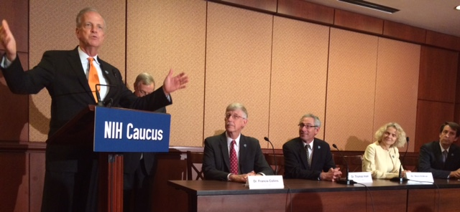
Congressional NIH Caucus
Announced in May 2015
Goal: Increase the purchasing power of NIH
Senate: bipartisan group of 23 senators; co-chaired by Durbin (D-IL) and Graham (R-SC)
House: bipartisan group of 17 representatives; co-chaired by Higgins (D-NY), King (R-NY), and Delauro (D-CT)
Document 19
Notes:
In May, * Senators Richard Durbin and Lindsey Graham held an event to announce a new Congressional NIH Caucus. * The goal of this Caucus is to increase the purchasing power that NIH has lost in the last several years and provide steady, predictable growth for biomedical research in the future. In addition, Caucus members hope to shine a light on what the NIH does, informing the American tax payer that NIH represents a great return on investment.
* The Senate Caucus consists of a bipartisan group of 23 senators, and is co-chaired by Senators Durbin and Graham. * The House Caucus consists of a bipartisan group of 17 representatives, and is co-chaired by Representatives Higgins, King, and Delauro.

Slide 31
Director’s Report Outline
General NHGRI Updates
General NIH Updates
General Genomics Updates
NHGRI Extramural Research Program
NIH Common Fund/Trans-NIH
NHGRI Division of Policy, Communications, and Education
NHGRI Intramural Research Program

Slide 32

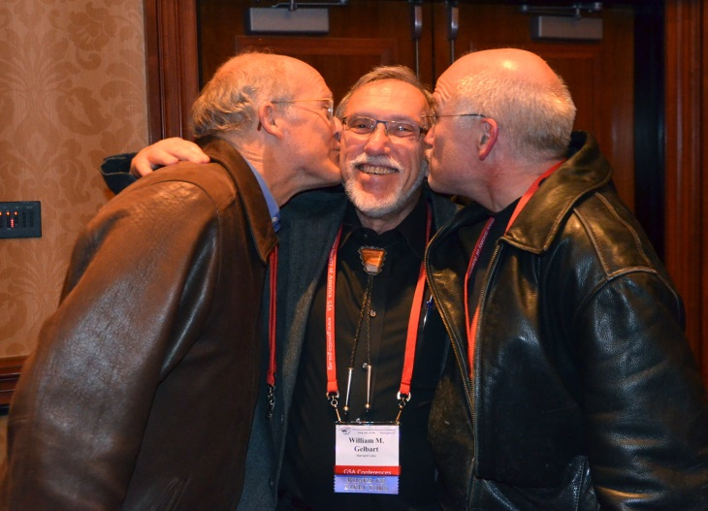
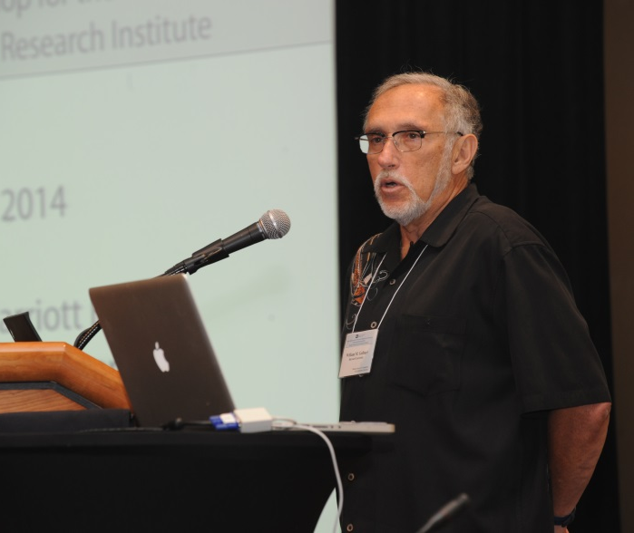
Mourning the Loss of Bill Gelbart
Document 20
Notes:
NHGRI grantee, friend, and colleague— Dr. Bill Gelbart— passed away in August. Bill was Professor of Molecular and Cellular Biology at Harvard University, and was a Principal Investigator of FlyBase since 1991. His laboratory focused on understanding the molecular basis of pattern formation in higher animals.
Bill also served as a member of this National Advisory Council for Human Genome Research, and was a long-time member (and most recently the Chair) of the NHGRI Sequencing Advisory Panel. He was a prototypic colleague of the Institute, and a well-respected member of the genomics community. He was a true friend, collaborator, and mentor to many of us here at NHGRI. He will be greatly missed.

Slide 33
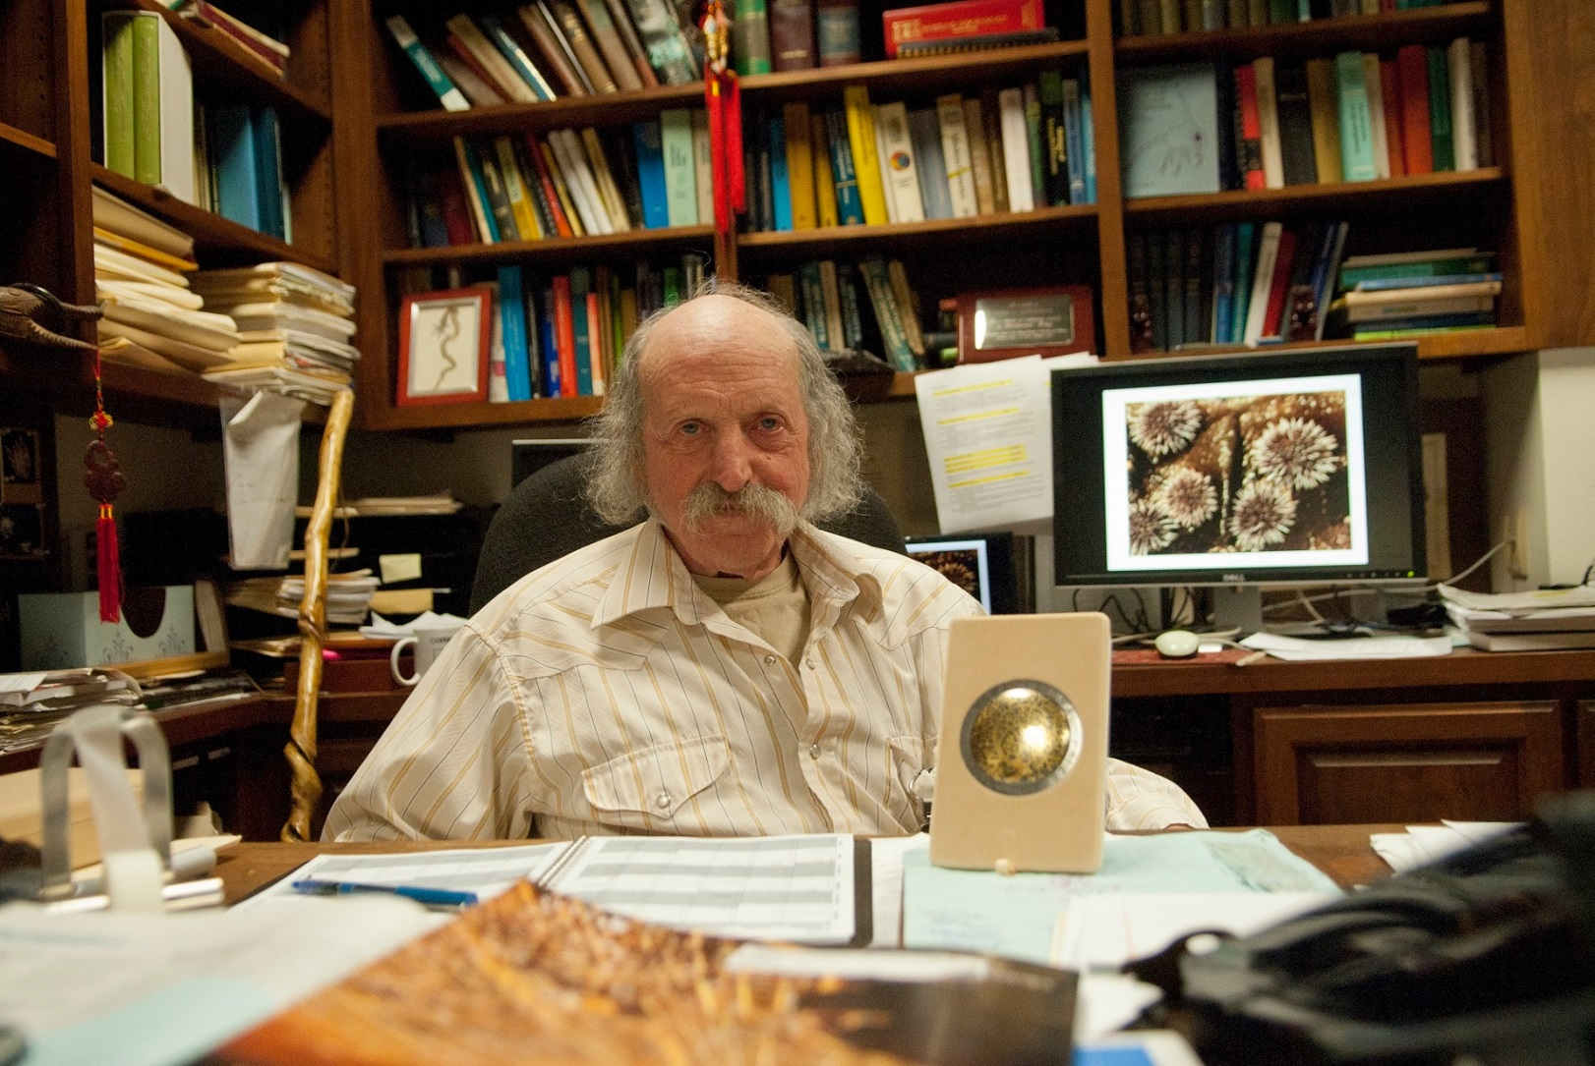
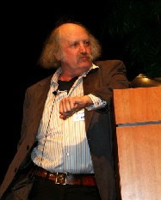

Mourning the Loss of Eric Davidson
Document 21
Notes:
I am also saddened to report that Dr. Eric Davidson passed away earlier this month. Eric was a long-time Professor of Cell Biology at Cal Tech, who greatly contributed to our understanding of the genomics of gene regulation and the importance of gene regulatory networks. He led the effort with others to derive the complete genome sequence of the purple sea urchin, and was a key participant in a number of important NHGRI meetings and planning sessions over the years (especially those related to comparative genomics).

Slide 34
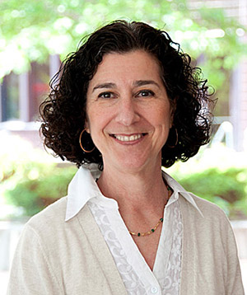

Associate Vice Chancellor for Computational Health Sciences,
University of California San Diego
Jill Mesirov, Ph.D.
Document 22
Notes:
In terms of highlights about major figures in the genomics community and good NHGRI colleagues, former Council member Dr. Jill Mesirov has been appointed Associate Vice Chancellor for Computational Health Sciences and Professor of Medicine at the University of California, San Diego School of Medicine and Moores Cancer Center.

Slide 35
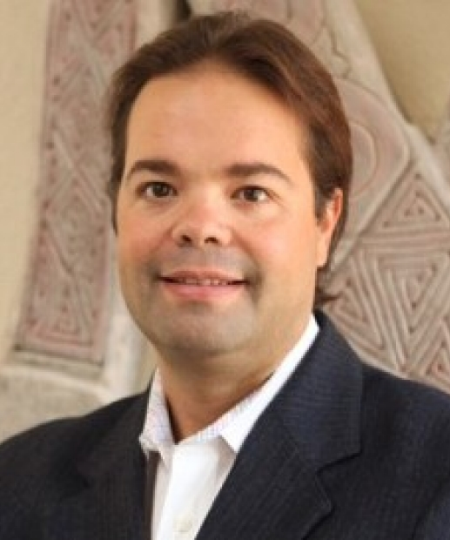

Inaugural Chair, Stanford Department of Biomedical Data Science
Carlos Bustamante, Ph.D.
Document 23
Notes:
Just two weeks ago, it was announced that Council member Dr. Carlos Bustamante has been appointed the Inaugural Chair of the Stanford Department of Biomedical Data Science.

Slide 36
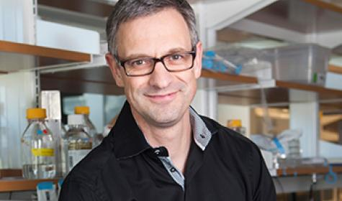


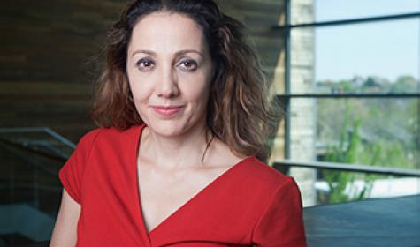
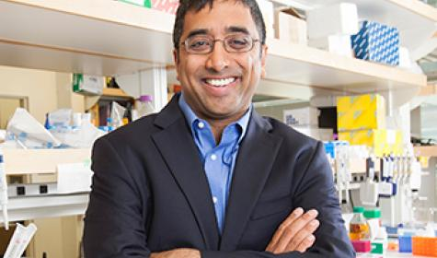
New Investigators,
Howard Hughes Medical Institute
Job Dekker, Ph.D.
Levi Garraway, M.D., Ph.D.
Pardis Sabeti, D.Phil., M.D.
Jay Shendure, M.D., Ph.D.
Document 24
Notes:
Finally, a number genomicists are among the 26 scientists selected as new investigators of the Howard Hughes Medical Institute (HHMI). These include Drs. Job Dekker, Levi Garraway, Pardis Sabeti, and Council member Jay Shendure.

Slide 37
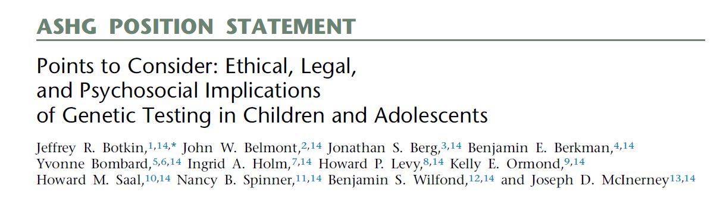
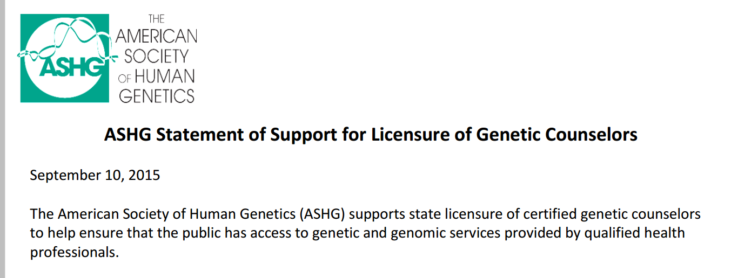
New ASHG Position Statements
Document 25
Notes:
In July, * the American Society of Human Genetics (ASHG) released an updated report on the ethical, legal, and psychosocial implications of genetic testing in children and adolescents. This report was a follow up to ASHG’s previous 1995 position statement about this area; this new statement was developed in light of the rapid advances in genomic technologies over the last 20 years. The report provides recommendations on numerous issues related to genetic testing, including: predictive testing; return of secondary findings; and professional education.
* Then, just last week, ASHG released a statement of support for state licensure of certified genetic counselors to help ensure that the public has access to the provision of genetic and genomic services by qualified health professionals. The licensing of genetic counselors also enables many hospitals to approve billing and reimbursement for counseling services. 15 states currently issue such licenses, and ASHG’s statement encourages the remaining states to move forward in a similar fashion.

Slide 38
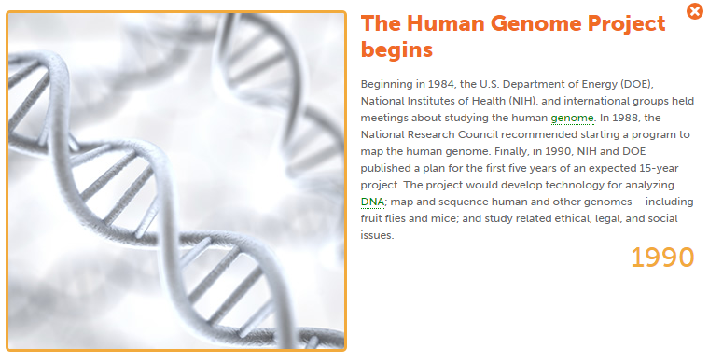
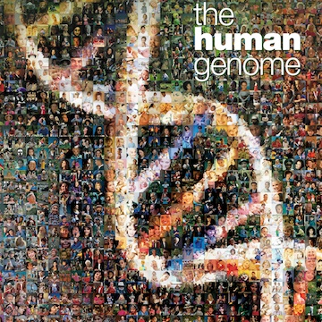
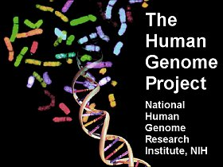
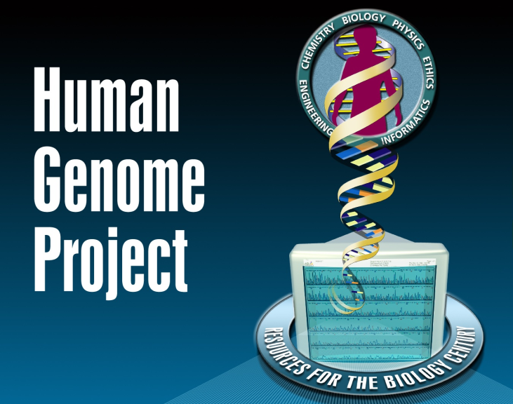
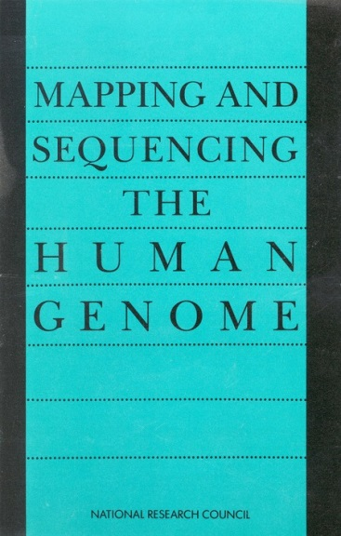
25th Anniversary of the Launch of the Human Genome Project
Notes:
In precisely 10 days, there will be an important ‘odometer moment’ for the field of genomics. * October 1, 2015 will mark the 25th anniversary of the launch of the Human Genome Project. I know that I do not need to tell this audience how this remarkable endeavor changed so many aspects of biomedical research and paved the way for other high-impact ‘big biology’ projects.
* To celebrate this important milestone and to help us reflect on the past quarter-century of progress in genomics, NHGRI’s History of Genomics Program will be hosting a monthly seminar series on the NIH campus that features Human Genome Project participants, who will be sharing their perspectives about the Project and how it affected their careers. The series kicks off in December with a panel discussion that will include the key NHGRI leadership during the Human Genome Project (Drs. Francis Collins, Elke Jordan, and Mark Guyer). Other confirmed speakers that will follow in early 2016 include Drs. Maynard Olson, Ewan Birney, Bob Cook-Deegan, Marco Marra, and David Bentley. The lectures will be videorecorded and made available on our GenomeTV channel of YouTube. The NHGRI History of Genomics Program will also conduct oral history interviews with all the presenters, and add these to our growing historical archives.

Slide 39
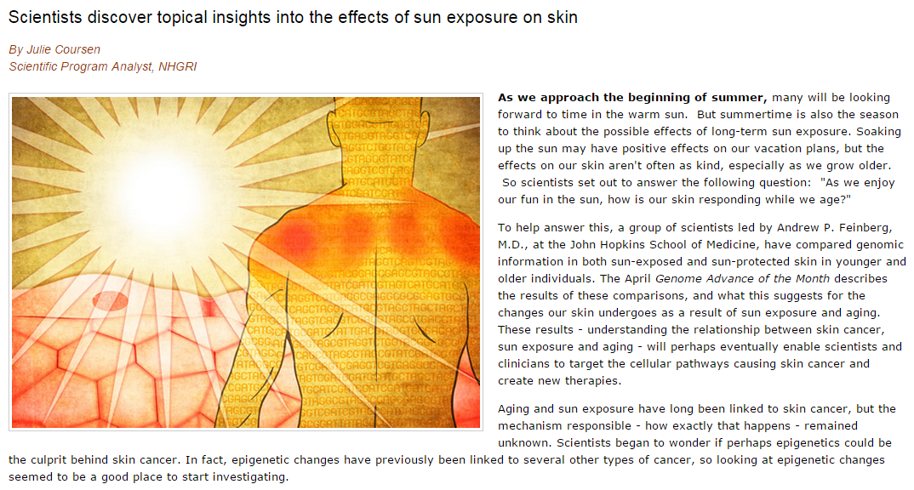
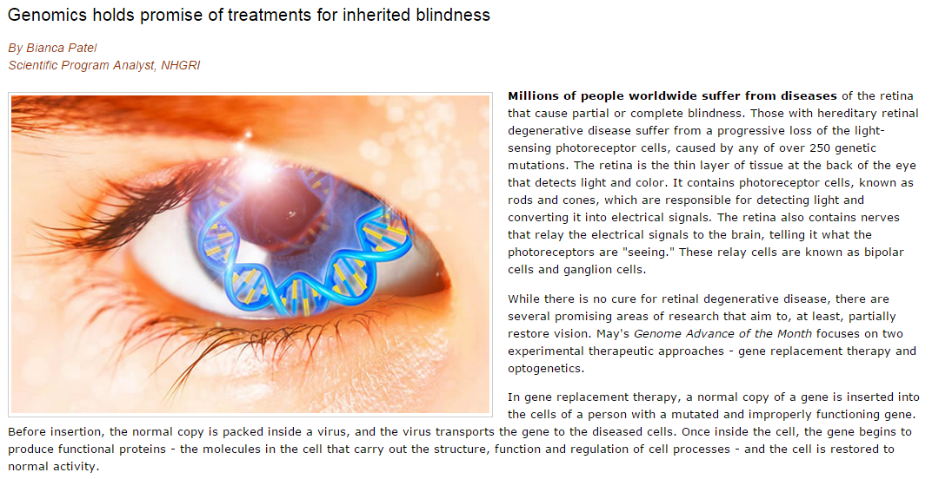
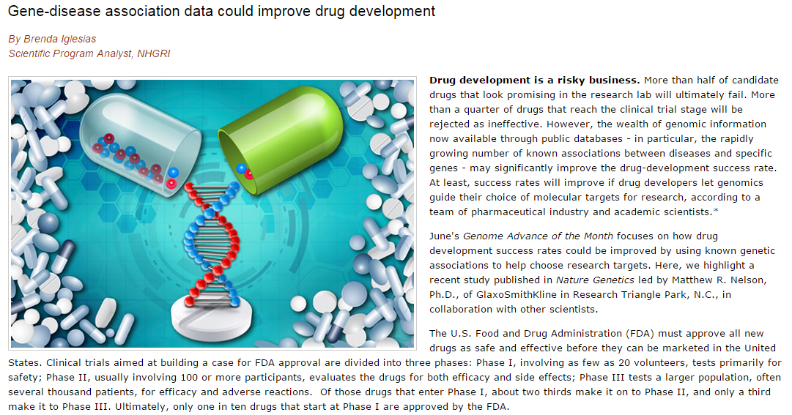
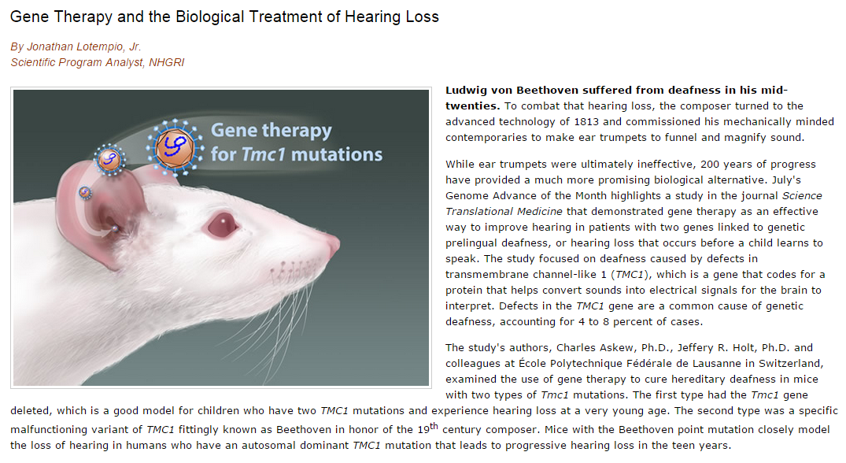
NHGRI Genome Advance of the Month
Document 26
Notes:
Featured as an NHGRI Genome Advance of the Month since the last Council meeting have been publications examining * genomic aspects of sun exposure on skin, * treating inherited blindness, * incorporating gene-disease association data into drug development, and *gene therapy for hearing loss.

Slide 40












Genomes In The News…
Document 27
Notes:
And in terms of Genomes in the News, there have been a number of recently generated genome sequences reported since the last Council meeting, including: * the Western camel , * ancient Eurasian genomes, * blowfly, * octopus, * kiwi, * Kennewick man, * sea anemone, * barley, * an ancient Iberian, * 99 Ebola genomes from the recent outbreak, and * 2500 Icelanders.

Slide 41
Director’s Report Outline
General NHGRI Updates
General NIH Updates
General Genomics Updates
NHGRI Extramural Research Program
NIH Common Fund/Trans-NIH
NHGRI Division of Policy, Communications, and Education
NHGRI Intramural Research Program

Slide 42

Extramural Research Program Retreat
Notes:
In July, the Extramural Research Program hosted an NHGRI retreat that examined the Institute’s 2011 strategic plan (“Charting a course for genomic medicine from base pairs to bedside”), specifically considering how well that document reflects the current opportunities and priorities for NHGRI’s genomics research portfolio. Using the original five ‘strategic domains’ of the plan as the organizing framework, staff worked to identify scientific gaps, opportunities not addressed in the 2011 document, shifting priorities for the goals described in the plan, and new challenges or barriers.
This proved to be a very rigorous and fruitful discussion, engaging individuals from all parts of the Institute. I think that this retreat helped to organize our thinking about how to monitor progress going forward in consideration of establishing when would be the appropriate time to launch a larger strategic planning effort. The overall take-home themes from this retreat were that the 2011 strategic plan still accurately captures the highest research priorities for NHGRI, and that we can wait at least a couple of years before launching a new strategic planning process.

Slide 43

Genome Sequencing Program
  Funding Plans Under Consideration
      Centers for Common Disease Genomics (UM1)
      Centers for Mendelian Genomics (UM1)
      Coordinating Center (U24)
  Letters of Intent Received
    Genome Sequencing Program Analysis Centers (U01)
    Human & Non-Human Primate Genome Sequences (U24)
Document 28
Notes:
As this Council is well-aware, the NHGRI Genome Sequencing Program is in the midst of various changes as part of its renewal. * Three components of the new program have seen applications received and reviewed, with the associated funding plans to be discussed during the Closed Session of this Council meeting. These components are the new Centers for Common Disease Genomics program, the Centers for Mendelian Genomics program, and the new Coordinating Center.
* Funding Opportunity Announcements (FOAs) were also issued for two additional new components: the Genome Sequencing Program Analysis Centers and High-Quality Human and Non-Human Primate Genome Sequences. Letters of intent have now been received in response to these FOAs, and we look forward to the next stage of standing up these two new elements of our overall Genome Sequencing Program.

Slide 44



Document 29
Notes:
The Cancer Genome Atlas (TCGA) is a coordinated effort to better understand the molecular basis of cancer. Data production, including whole-exome sequencing on over 10,000 tumor/normal pairs and whole-genome sequencing on over 1,000 tumor/normal pairs, has been completed. TCGA is currently focused on data analysis and manuscript writing.
For each of over 30 cancer types, the TCGA Network has published a comprehensive, integrated account of sequence/mutation analysis, copy number variation, gene and miRNA expression, and promoter methylation. TCGA papers focused on * cutaneous melanoma * and lower-grade gliomas were published this July in Cell and The New England Journal of Medicine, respectively. These papers provide new insights into classification of tumors in a clinical setting. TCGA looks forward to publishing more papers in the coming months as the project comes to a close next year.

Slide 45

    Discovery
    >1,500 ‘causal genes’ for Mendelian phenotypes; >590 novel causal genes
    >195 publications
    GeneMatcher
    >600 users
    43 countries
2,658 Genes
560 Matches
Document 30
Notes:
The Centers for Mendelian Genomics (or CMGs) were launched in November 2011, aiming to find as many causal genes for Mendelian diseases and traits (or Mendelian phenotypes) as possible.
* To date, the CMGs have been responsible for discovering >1,500 ‘causal genes’ for Mendelian phenotypes, of which >590 are novel (in that they had not previously been associated with any Mendelian phenotypes). * A subset of those discoveries have now been reported in >195 publications.
Besides making direct contributions to finding causal genes, the centers help genetics researchers working on similar phenotypes stay connected. GeneMatcher is a software tool launched in December 2013 that facilitates matching and connecting researchers with a shared interest in a candidate gene(s); this can speed up causal gene discoveries. * GeneMatcher is now used by >600 users from 43 countries, and * this graph shows the rapid growth of the user community and matches made. By August 1 of this year, 560 matches had been made out of the 2,658 genes submitted.

Slide 46



    AJHG
    ‘Scorecard’
Progress on causal gene discoveries, method improvement, and resource sharing
Remaining discoveries and challenges
Mendelian phenotypes associated with ‘causal genes’ - 57% (4,163/7,315)
Human genes known to underlie Mendelian phenotypes - 15% (2,937/19,580)
Document 30
Notes:
Recently, the CMGs * published a review article in the American Journal of Human Genetics that reported the CMGs’ progress on causal gene discoveries, method improvement, and resource sharing. * The article also debuted a ‘scorecard’ that shows progress towards the goal of finding all causal genes for Mendelian phenotypes.
The upper panel shows the proportion of Mendelian phenotypes for which causal genes have been identified– 57% to date. The lower panel shows the proportion of human genes that have been shown to be ‘causal’ for a Mendelian phenotype— 15%. Based on information in the scorecard and the growing number of newly defined Mendelian phenotypes, the CMGs concluded that a large number of novel causal genes remain to be discovered. Improvements to phenotyping, genome sequencing, analysis, and worldwide coordination are needed to discover the remaining causal genes.
The scorecard is now posted on the CMGs’ website, and will be updated periodically.

Slide 47



Clinical Sequencing Exploratory Research Program
Enrolled 2,889 adults, 759 children
161 publications, 12 working group publications
JAMIA 2015
Pediatrics, in press
Document 31
Notes:
The Clinical Sequencing Exploratory Research (or CSER) Program focuses on the integration of genome sequencing into the clinical workflow, including the generation, interpretation, and clinical reporting of genomic information. * CSER has enrolled nearly 2900 adult and almost 800 children, nearly 3000 of whom have had germline genome sequence data generated and over 500 of whom have had tumor genome sequence data generated.
As one measure of overall impact, * CSER has generated 161 publications, including 12 cross-CSER working group publications. Two of these recently published working group papers are highlighted here.
A joint * CSER and eMERGE paper was published in the Journal of the American Medical Informatics Association. This paper surveyed CSER and eMERGE sites about current and recommended display of genomic information in electronic health records. The * CSER Pediatrics Working Group has a paper in press at Pediatrics that discusses the disclosure of genome sequencing results in pediatric practice.
On September 28, the CSER and Beyond Meeting will be taking place in the Bethesda area. This meeting is charged with evaluating key contributions of the CSER Program and prioritizing future scientific opportunities to integrate genome sequencing into clinical care. The meeting will be webcast live and archived on the GenomeTV channel of YouTube.

Slide 48



Genome Sequencing Informatics Tools
>20K Users on GATK Forum
Mostly academic, noncommercial
  2015 GATK Forum
  (per month):
  ~650 users
  ~150 discussions
  ~100,000 views
Document 32
Notes:
The Genome Sequencing Informatics Tools (GS-IT) Program is known publicly by the name “iSeqTools.” The six funded GS-IT projects have the mission to democratize genome analysis by providing ‘researcher friendly’ sequence analysis tools to users outside of large genome centers.
The GS-IT Program relies on three approaches: robust software engineering to make tools reliable and easy to use; engaging users with support, documentation, and outreach; and taking advantage of innovative technologies such as the cloud and fast, interactive ‘app’ frameworks.
Two good metrics of the impact of iSeqTools are: (1) numbers of users who actively engage in discussions; and (2) automatic reporting directly from the software. * For example, there are over 20,000 registered users of the Broad Institute’s GATK software, with steady growth from 2012 when GS-IT support began. These users include a large proportion of academic institutions and smaller proportions of commercial and governmental users, as illustrated in the graph.
* In 2015, the GATK Forum has each month typically hosted ~650 users in ~150 discussions, and has had ~100,000 page views.

Slide 49

Technology Development Program
  RFAs for Novel Nucleic Acid Sequencing released:
  (R01): RFA-HG-15-032
  (R21): RFA-HG-15-031
  (R43/R44): RFA-HG-15-033
  FOAs for remaining concepts to be released soon:
  Genome Technology Development
  (R01, R21, R43/R44)
Document 33
Notes:
NHGRI’s Technology Development Program currently has funding opportunities at different stages of the solicitation and drafting process.
* RFAs for Novel Nucleic Acid Sequencing Technologies for both DNA and direct RNA sequencing were released in August, with three due dates of October 27, 2015; July 14, 2016; and June 15, 2017.
* Meanwhile, Funding Opportunity Announcements (FOAs) for the remaining more general genome technology development concepts will be released soon.

Slide 50


Encyclopedia of DNA Elements (ENCODE)
  2015 ENCODE Community Users Meeting
  ENCODE portal infrastructure used by ClinGen
Document 34
Notes:
The goal of the Encyclopedia of DNA Elements (or ENCODE) project is to create catalogs of all functional elements in the human and mouse genomes, and to make those catalogs available as a resource to the biomedical community.
* ENCODE held a Community Users Meeting this summer that attracted about 200 participants from outside of ENCODE who heard a distinguished panel of researchers describe how they use ENCODE data in their work. Attendees also took part in a series of hands-on workshops to learn how to use ENCODE data in their own research, culminating with participants simultaneously running ENCODE data-processing pipelines on a cloud-based platform. Workshop videos and slides are now available online. Feedback from the participants was overwhelmingly positive, and discussions are underway for a second Users Meeting in 2016.
* The ENCODE portal infrastructure, one of the key ENCODE Data Coordination Center deliverables, is being used by the ClinGen resource as the basis for their curation and portal interface. This demonstrates efficiencies being achieved by cooperation across NHGRI projects.

Slide 51




Encyclopedia of DNA Elements (ENCODE)
  Postponement of Functional Genomics Initiatives to September 2016 Council review
  ENCODE Publications:
Document 34
Notes:
At our May 2015 meeting, Council approved four Concepts for RFAs in Functional Genomics to build on work currently supported by ENCODE. * For budgetary and scientific reasons, we have postponed those initiatives by one Council round, moving them from an ultimate review by Council in May 2016 to such a review in September 2016. NHGRI anticipates that RFAs will be issued soon.
Meanwhile, ENCODE data continue to be heavily used. * There are about 1200 Community publications (see the blue bars) from groups without ENCODE funding who used ENCODE data for their studies. Further, ENCODE Consortium members have published 496 Consortium publications (in purple bars). In addition to the use of ENCODE data in studies of cancer, gene regulation, and psychiatric, immune, cardiovascular, and metabolic disorders, recent papers also used ENCODE data in * the study of susceptibility to HIV and other viruses, * the genetics of caffeine habituation, and * human adaptation to tropical forests.

Slide 52



New Functional Genomic Variation Grants
  Develop computational approaches to infer causal variants for phenotypes, and assess predictions with experimental data
  6 grant awards made thus far
  Information on transcripts, TF binding, nucleosomes, enhancers, DNA shape, conservation, & phenotypes
  Studies of autism, cancer, bipolar disorder, type 2 diabetes, & age-related macular degeneration
Document 35
Notes:
Many whole genome sequences will be generated in the coming years, but a major problem is that we do not know how to interpret most of the genomic variants, especially in non-coding regions. Some of those non-coding variants have been associated with human disease. * The goal of the new suite of NHGRI’s functional genomic variation grants (associated with our recent RFA is this area) is to develop approaches that integrate functional datasets to narrow the set of genomic variants and infer possible causal variants. The computational predictions will be assessed with experimental data. All the data and methods will be released to allow other researchers to compare methods.
* 6 grant awards were recently made based on the first set of applications in response to this RFA, including one made by NCI (to Council member Dr. Jay Shendure). The second set of applications will be considered by Council at the February 2016 meeting.
* The proposed approaches will use many types of information: transcripts, transcription factor binding, nucleosomes, enhancers, DNA shape, conservation, and phenotypes (including ENCODE, GTEx, and 1000 Genomes data).
* The funded grants will study autism, cancer, bipolar disorder, type 2 diabetes, and age-related macular degeneration.

Slide 53

Centers of Excellence in Genomic
Science (CEGS) Program
  Two new CEGS awards:
  Harvard Medical School-
    Center for Genomically Engineered Organs
  University of Washington-
    Center for Photogenomics
Document 36
Notes:
Two new Centers for Excellence in Genomic Science (or CEGS) have been awarded. * The goal of the CEGS at Harvard Medical School (led by Dr. George Church) is to develop and apply new methods for in situ single-cell profiling of RNA, protein, and epigenetic marks in intact tissue and in engineered tissue. Novel algorithms to analyze in situ spatial patterning and pathway activity profiles will be developed, as well methods to ‘write’ spatial patterns of ‘omic’ alterations in the context of engineered tissues.
* The new CEGS at University of Washington (led by Dr. John Stamatoyannopoulos) seeks to enable dynamic imaging of gene regulatory regions and chromatin organization, thus revealing gene activity and functional state, at single-molecule resolution within intact single cells at high throughput. The trajectory is to apply these technologies for research and lay a foundation for their use in clinical diagnostics.
The annual CEGS grantee meeting will be held in November and hosted by the CEGS led by Dr. Zac Kohane. Finally, new CEGS applications are due in May 2016. Potential applicants should be contacting program staff within the next couple of months.

Slide 54


Tools/Software
PheKB.org Myresults.org
SPHINX
InfoButton Project
eCDS KB
Phenotyping Tools
Genotyping Tools
Model Consent Language
Document 37
Notes:
The Electronic Medical Records and Genomics (eMERGE) network conducts genomic discovery and clinical implementation research by leveraging data from large biorepositories linked to electronic medical records. eMERGE recently finished its second phase, and * to date, it has completed and published 531 total projects.
* eMERGE publications have been cited nearly 9,300 times, with over 8,300 citations from Phase II alone.
* The network has also developed an impressive set of tools, methods, and software that are being widely shared with the scientific community.

Slide 55
















Document 37
Notes:
eMERGE has now begun Phase III with 12 awards: * 9 to investigative sites, * 2 to genome sequencing and genotyping centers, and * 1 to a coordinating center. * eMERGE III will run from September 1, 2015 to May 31, 2019; it aims to expand on best practices and knowledge in effective implementation of genomic medicine to define health outcomes associated with rare genomic variants in approximately 100 clinically relevant genes, and, potentially, in broader exome or genome sequence data in later years.
eMERGE III will detect rare variants presumed to affect gene function and assess the phenotypic implications of these variants by leveraging well-validated EMR data. It will also report actionable variants to patients and clinicians to improve clinical care and ultimately health outcomes.
Further, it will assess the health impact, cost-effectiveness, and ethical, legal, and social implications of reporting genomic variants on a broader population scale for patients, clinicians, and healthcare institutions while continuing efforts to improve electronic phenotyping. Lastly, it will provide electronic clinical decision support, enabling integration of genomic information into EMRs for clinical research and care.

Slide 56




Phenotypes & eXposures (PhenX) Toolkit
80 New Measures
Protocols in REDCap
NHLBI Sickle Cell Disease Meeting
ASHG Invited Session
Document 38
Notes:
The Phenotypes and eXposure (or PhenX) Toolkit has produced an online resource of standard measures for capturing data on common diseases, phenotypic traits, and environmental exposures.
* 80 new measures have been added to the PhenX Toolkit since February, bringing the total number of standard measures to nearly 500. These new measures are focused on areas such as obesity, eating disorders, and tobacco regulatory research.
* To further promote uptake of PhenX measures, investigators can now access all PhenX measures in REDCap, a secure web application for building and managing online surveys and databases. REDCap is an integral part of the NIH Clinical and Translation Science Awards (CTSA) program, and is used by thousands of researchers.
* You might recall that NHLBI provided Fiscal Year 2015 funds to launch a PhenX Sickle Cell Disease effort. This work is now complete, and the new collection of measures was launched during NHLBI’s Annual Sickle Cell Disease Clinical Research Meeting held at the NIH last month.
*Lastly, PhenX will be featured at the ASHG annual meeting in an invited session entitled “Human Phenotypes for Researchers, Clinicians and Patients.”

Slide 57



ClinGen NEJM Marker Paper
Clinical Actionability: ACMG 56 gene list
High visibility at ASHG and NSGC meetings
Document 39
Notes:
The Clinical Genome (ClinGen) Resource, designed to build an authoritative central resource that defines the clinical relevance of genomic variants for use in precision medicine and research, has made significant progress during the second year of this highly collaborative program.
* ClinGen’s marker paper, which describes project goals and progress, was published in the New England Journal of Medicine this past June. * The paper was accompanied by an editorial highlighting the importance of broad data sharing and collaborative curation efforts (such as that provided by ClinGen) that helps make sense of the rapidly accumulating genome sequence data.
* ClinGen’s Actionability Working Group, led by Drs. Jim Evans and Katrina Goddard, have nearly completed scoring the clinical actionability of the 56 genes on ACMG’s secondary findings list. A subset of the evidence reports and scores for the genetic conditions shown here are already available on ClinGen’s public website, with the rest being posted before the annual ASHG meeting.
* Meanwhile, ClinGen will have high visibility at both the ASHG and the National Society of Genetic Counselors meetings this fall. At the ASHG meeting, ClinGen will hold an interactive workshop that overviews ClinGen tools and frameworks for curating the clinical significance of genes and genomic variants.

Slide 58

Genomics and Society Working Group
  In-person meeting held in April 2015
  Update from Dr. Lisa Parker in Open Session
Document 40
Notes:
The Genomics and Society Working Group of this Council is charged with providing advice on short- and long-range planning and priority setting for the genomics and society activities at the Institute.
* The Working Group held its annual in-person meeting in April.
* The Working Group Chair, Dr. Lisa Parker, will provide an update about the Working Group later in the Open Session of this Council meeting.

Slide 59

Small Business Grants
Small Business | Phase I Proof of principle | Phase II Pre-commercialization
Innovation Research (SBIR) | 13 | 11
Technology Transfer (STTR) | 5 | 1
Total | 18 | 12
  Small business funding to increase ~$0.6M/year
Document 41
Notes:
NHGRI provides about $12M dollars in small business grants annually. * Our current Small Business Innovation Research (SBIR) and Small Business Technology Transfer (STTR) portfolio funds 18 Phase I (proof of principle) and 12 Phase II (pre-commercialization) awards. New Phase II efforts include: single-cell analysis at Cellular Research and Mission Bio; next-generation DNA sequencing innovations at Dovetail Genomics, Sage Science, Pressure Bioscience, and Genapsys; oligonucleotide synthesis advancements at MacConnell Research and PharmaSeq; and novel CMOS hybridization detection technologies at Insilixa. These small business grants are drawn from an increasingly stronger and competitive application pool.
* Our small business grant funding will be increasing by about $0.6M in each of the next two years. We have been actively encouraging small businesses to apply by reaching out to the community and by targeting recent applicants and grantees. We hope that our Council will help get the word out about this NIH-wide opportunity for small businesses, many of which spring out of academic and research laboratories.

Slide 60

Genomics Training and Career Development
  RFA-HG-15-025: Data Analysis and Coordinating Center (DACC) for Research Training and Career Development Activities
    Maintain, improve, and/or develop database
    Collect and analyze data about trainee career paths
    Logistical support for an expanded annual training program meeting
    Application due date: October 20, 2015
Document 42
Notes:
NHGRI has a long-term commitment to preparing the next generation of genomic scientists and scholars, and continues to enhance our investment in research training and career development programs. Therefore, it is important to ensure that NHGRI provides: (1) career enhancing activities, and (2) accountability by developing tools to track the career paths of participants, trainees, and career awardees. In 2009, we awarded the first Data Analysis and Coordinating Center to assist grantees and NHGRI in tracking the progress of mainly participants in our Diversity Action Plan Program.
At the last meeting, Council approved a concept for continuation of a coordinating center for the training program. * The open-competition RFA for this coordinating center has now been issued.
The main focus of the re-issued RFA is * to maintain, improve and/or develop a training database, and * to collect and analyze data about trainee career paths. The coordinating center will also provide * logistical support for an expanded annual training program meeting. The expansion of these activities will encompass all of our training, career development, and Diversity Action Plan programs— and these include activities of all three of NHGRI’s extramural programmatic divisions * Applications are due on October 20, 2015.

Slide 61
Director’s Report Outline
General NHGRI Updates
General NIH Updates
General Genomics Updates
NHGRI Extramural Research Program
NIH Common Fund/Trans-NIH
NHGRI Division of Policy, Communications, and Education
NHGRI Intramural Research Program

Slide 62


Knockout Mouse Phenotyping Project (KOMP2)
    Common Fund approves 5 year continuation
    18 Institutes/Centers/Offices contributing funds
    Total funds: ~$100M
    FOAs in process
Document 43
Notes:
The Knockout Mouse Phenotyping Project (KOMP2) was launched in 2011 with the goal of making and phenotyping 2,500 mouse knockout strains over 5 years. The project is on track to meet its goals in the fall of 2016.
* The project was approved for continuation by the NIH Common Fund, and thus will finish the final 5 years of the standard 10-year Common Fund project lifespan. The plan is for the NIH Common Fund to match the funds provided by other NIH Institutes, Centers, and Offices; in total, there will be * 18 Institutes, Centers, and Offices contributing funds to the next phase of the program for * a total of roughly $100 million of funding over the next 5 years. * The Funding Opportunity Announcements (FOAs) are being developed for publication in the NIH Guide.
* The program is planning to continue broad-based phenotyping of knockout mice in collaboration with our international partners through the International Mouse Phenotyping Consortium.

Slide 63

    Recent Progress:
      Public release of data and harmonized metadata
      Multiple internal collaborative projects
      Outreach efforts: 8 collaborations funded jointly by LINCS and other entities (NIAAA, NCCIH, NIEHS, NIMH, NINDS, & BD2K)
Document 44
Notes:
The Library of Integrated Network-based Cellular Signatures (or LINCS) program aims to create a network-based understanding of biology by cataloging changes in gene expression and other cellular processes that occur when cells are exposed to a variety of perturbing agents. LINCS uses computational tools to integrate this diverse information into a comprehensive view of normal and disease states that can be applied for the development of new biomarkers and therapeutics.
* Major elements of recent progress include the * public release of data and harmonized metadata. * There have also been multiple internal collaborative projects as well as LINCS-wide joint working groups on assay and data standards.
* With the aim of expanding the scope and relevance of the LINCS data and tools, the program solicited supplement requests for relevant grants from other Institutes/Centers. 15 supplement requests were received, and after a rigorous programmatic review, 8 collaborations will be supported. The awards are 1-year supplements with 50-50 co-funding by LINCS and the indicated entities.

Slide 64

Genotype-Tissue Expression
(GTEx) Project
    Donor recruitment goal (n=900) completed
    New GTEx portal and version 5 data release
Document 45
Notes:
The Genotype-Tissue Expression (GTEx) project is an NIH Common Fund study that aims to provide a comprehensive gene expression atlas. This will provide insight into the mechanisms of gene regulation and aid in the interpretation of genome-wide association studies.
* In August 2015, GTEx reached its initial goal of 900 donors. Because of efficiencies that have been realized, the project may be able to enroll an additional 50-60 donors. Analyses of the samples and data will continue for another 18 months.
* The new GTEx portal has been released and features updated visualization tools. The version 5 data release occurred in June and includes data from over 9000 RNA samples. The next version of the data is expected in the fall, with the release of matching genotype data from around 450 donors (or half of all the donors).

Slide 65

Protein Capture Reagents Program
  ~1100 validated antibodies to 370 human transcription factors; available via data portal
  Program near end of pilot phase, with one grantee finishing production of mouse monoclonals
  JHU subcontractor attended White House Demo Day
Document 46
Notes:
The goals of the Protein Capture Reagents Program are to pilot a community resource of low-cost, high-quality, renewable affinity reagents for human transcription factors and to develop technologies for next-generation platforms.
* The program has successfully produced ~1100 validated monoclonal and recombinant antibodies to 370 human transcription factors. These antibodies are available for affordable purchase through the protein capture data portal.
* The program is near the end of its pilot phase, with one remaining grantee at Johns Hopkins University finishing production of mouse monoclonals.
* Custom Designed Immunologics, a subcontractor of Johns Hopkins based in Puerto Rico, was recently invited to participate in the White House Demo Day, an exhibition that showcased the wide-ranging talents of innovators from across the United States and its territories.

Slide 66


Human Heredity and Health in Africa (H3Africa)
  7th Consortium Meeting in October (Washington DC)
    ASHG Session
    Presentations at NIH
    NIH-H3Africa Subject Area Meetings
  2 UH3 Biorepository awards (Nigeria and Uganda)
  Approval for a Phase II of H3Africa
Document 47
Notes:
The Human Heredity and Health in Africa’s (or H3Africa’s) central goal is to develop a sustainable and collaborative African genetics and genomics research enterprise.
* Next month, the 7th H3Africa Consortium meeting will be held in Washington DC. Several events will augment the main meeting, including an ancillary H3Africa session at the ASHG Annual Meeting in Baltimore and a full day of H3Africa presentations on the NIH campus. Another meeting will bring together researchers involved in planning the U.S. Precision Medicine Initiative with H3Africa investigators and other consortia to discuss strategies for inclusion of traditionally underserved communities in biomedical research.
* This year, two more biorepositories will be scaled up and begin receiving, storing, and sharing DNA samples. The addition of these biorepositories means that H3Africa will have sample storage facilities across Sub-Saharan Africa: one in the East, one in the West, and one in the South.
* H3Africa has been given the approval from the NIH Common Fund to plan for a Phase II, which will extend the program for an additional 5 years. NIH program staff are working on details of the proposal, which will be presented to this Council at our May meeting.

Slide 67



Undiagnosed Diseases Network (UDN)
Seven UDN Clinical Site Locations
Click ‘Apply’ button on any UDN webpage to apply!
Document 48
Notes:
The NIH Common Fund’s Undiagnosed Diseases Network (UDN) aims to improve the level of diagnosis and care for patients with undiagnosed diseases, facilitate research into the etiology of these diseases, and create an integrated and collaborative research community to identify and share improved options for optimal patient management.
* This September, the UDN launched its online patient application portal, called the UDN Gateway, and is now accepting patients at all seven UDN Clinical Sites across the country. For access to the UDN Gateway, anyone can click on the “Apply” button, which is located on any of the UDN webpages.

Slide 68





Undiagnosed Diseases Network (UDN)
PI Name | Gene | Model | Patient Phenotype
Hall | BAI2 | astrocytes from mouse | shrinking spinal cord area and limb muscle stiffness
Ye | YPEL3 | drosophila | reduced myelin, enlarged nerves, abnormal nerve conduction, normal cognition
Smith | BHLHB9 | knock down mouse neural stem cells and patient iPS neural cells | motor dysfunction, cognitive impairment, low brain volume, peripheral nerve damage
Yu | CHML | mouse | developmental regression, nerve damage with brain volume loss
Westerfield | YPEL3 | zebrafish | reduced myelin, enlarged nerves, eye abnormalities
Ho | FOXR1 | human fibroblasts, mouse | microcephaly, developmental delay, progressive brain atrophy
Document 48
Notes:
Meanwhile, six Gene Function Research (R21) awards for the UDN were made this summer. As you can see from this table, these six studies will investigate the underlying genetics, biochemistry, and/or pathophysiology of newly diagnosed diseases in association with gene variants identified through the NIH UDP – in many cases, using model organism and cell culture systems.

Slide 69

Gabriella Miller Kids First
Pediatric Research Program
NIH Common Fund Program ($12.6M/year for ten years)
Clinical and genome sequence data
    Childhood cancers
    Structural birth defects
Fiscal Year 2015
  PAR 15-259 (X01) seeking samples
  Up to 6000 samples
Fiscal Year 2016
    Creation of data resource
    Solicitation of additional samples
    Generation of genome sequence data
Document 49
Notes:
The Gabriella Miller Kids First Pediatric Research Act was passed by Congress in March 2014 and signed into law by President Obama in April 2014. The purpose of this act is to eliminate taxpayer financing of political conventions and repurpose those funds for a 10-year pediatric research initiative. * These funds, at $12.6 million per year for 10 years, are now designated for an NIH Common Fund program (referred to as Kids First).
* The program aims to develop a data resource for the pediatric research community of well-curated clinical and genome-sequence data. The major focus will be on cancers with an inherited basis and on relapse and treatment-resistant tumors, as well as on structural birth defects.
* A Program Announcement was released in Fiscal Year 2015 seeking samples for genome sequencing. The goal for the current year is the production of whole-genome sequences from up to 6000 samples.
* In early Fiscal Year 2016, the program will release more Funding Opportunity Announcements for the creation of a data resource (so that sequence data are both useful and accessible to researchers), solicitation of additional samples, and generation of additional genome sequence data.

Slide 70

Big Data to Knowledge (BD2K) Initiative
  Training the next generation of biomedical researchers in data science
  Funding for software projects in targeted research areas
  Funding supplement programs for data sharing, discovery, and interoperability
Document 50
Notes:
The Big Data to Knowledge (or BD2K) initiative is a trans-NIH data science effort that aims to transform the ability of scientists to take advantage of data resources and software in biomedical and translational research. Among a wide range of ongoing BD2K activities, NHGRI staff have been most actively involved in the following programs.
* BD2K is making a major investment to enhance the training of the next generation of biomedical researchers in computational, statistical, and data science skills. Several funding opportunities are available to researchers, and new training awards will be announced soon.
* Recently, BD2K funded 15 grants to develop software in targeted research areas, including data compression and visualization. Among the open BD2K funding opportunities is one for the development of software tools and methods in the areas of data privacy, data repurposing, and applications of metadata.
* A number of BD2K administrative supplement programs are in progress to support data sharing, discovery, and interoperability of datasets across databases. The supplement awards will be announced soon.

Slide 71


Precision Medicine Initiative
Document 51
Notes:
As expected, planning for the recently announced Precision Medicine Initiative reached a frenetic pace over the summer. With hopes to launch the high-profile Initiative in Fiscal Year 2016 (meaning, as early as October 1), NIH has been active on multiple fronts to prepare for this important new program.
* As I have mentioned previously, NIH is doing an excellent job of capturing and disseminating information about the Precision Medicine Initiative planning activities via this dedicated web page (www.nih.gov/precisionmedicine). I would strongly urge you regularly go to this site to get the latest information about the Initiative; I am certain this will continue to be ‘the place’ to go for remaining informed about plans, future meetings, funding opportunities, and so forth.

Slide 72
Precision Medicine Initiative Workshops
Digital Health Data in a Million-Person Precision Medicine Initiative Cohort
      May 28-29, 2015
      Vanderbilt University, Nashville, TN
  Participant Engagement and Health Equity July 1-2, 2015
      NIH, Bethesda, MD
  Mobile and Personal Technologies in Precision Medicine
      July 27-28, 2015
      Intel Corp., Santa Clara, CA
Document 51
Notes:
Recall that last spring, Dr. Francis Collins appointed a Working Group of the NIH Advisory Committee to the Director to develop a vision and plan for the U.S. National Research Cohort component of the Precision Medicine Initiative. Since the May Council meeting, that Working Group has held three more public workshops to assist them in developing that plan.
Specifically, there have been workshops on: * Digital Health Data in a Million-Person Precision Medicine Initiative Cohort (held in late May); * Participant Engagement and Health Equity (held in early July), and * Mobile and Personal Technologies in Precision Medicine (held in late July).
As with the earlier workshops, these events were videocast live, and there was a very active Twitter stream.

Slide 73

Document 51
Notes:
In addition, video recordings and various relevant documents (including summaries) from those workshops are available on the NIH Precision Medicine Initiative website under ‘Events’. Again, I want to emphasize the large amount of useful information about the Precision Medicine Initiative that is now available at this site.

Slide 74


Report on Precision Medicine
Initiative Cohort Program
Document 51
Notes:
The most important development with respect the Precision Medicine Initiative since President Obama’s announcement in January actually occurred last week. Specifically, the NIH Advisory Committee to the Director Working Group on the Precision Medicine Initiative released its report during a September 17 public teleconference meeting of the Advisory Committee to the Director. This lengthy and detailed report, shown on the left (with an accompanying press release shown on the right), provides many important recommendations, and articulates a key early vision for the development of the U.S. National Research Cohort.
Following discussion by the Committee, Dr. Francis Collins accepted the report.

Slide 75

Interim Director, Precision Medicine Initiative Cohort Program
Josie Briggs, M.D.
Notes:
And in yet more breaking news from last week, Dr. Francis Collins also announced that Dr. Josie Briggs, Director of the National Center for Complementary and Integrative Health, will immediately assume the role as Interim Director of the Precision Medicine Initiative Cohort Program. Josie will serve in this capacity until a permanent Director is identified, with the search for that individual beginning in the very near future.
I and other NHGRI staff who have been involved in planning efforts for the U.S. National Research Cohort component of the Precision Medicine Initiative look forward to working with Josie, as we together shift from the planning stage to the implementation stage. There are many details to be worked out, although this needs to now happen on a very fast pace. As I mentioned before, I fully expect to regularly update Council about developments with the Precision Medicine Initiative.

Slide 76


Notice of Proposed Rulemaking for Revisions to the ‘Common Rule’
Improve informed consent
Calibrate review to study risks
Require informed consent for use of biospecimens
New data security and information protection standards
Streamline IRB review
Extend protection to all research at federally-funded sites
Document 52
Notes:
Highly relevant to the Precision Medicine Initiative is an important development related to the ‘Common Rule’ for protecting human subjects in research. On September 2, the Department of Health and Human Services announced the Notice of Proposed Rulemaking to revise the Common Rule. The proposed rule is now open for public comment through December 7. The proposed revisions aim to bring the regulatory provisions for protecting human research participants in line with the changing nature of research since the Common Rule’s original publication in 1991. Specific changes aim to better protect and respect research participants while streamlining research oversight and decreasing ambiguity for responsible parties.
Major proposed revisions include * improving the informed consent processes, with shorter and clearer consent forms; * calibrating the level of review for studies with the risks posed through new exclusions and exemptions; * requiring informed consent for the secondary use of biospecimens through, for example, broad consent for future unspecified research; and * new data security and information protection standards to promote privacy and confidentiality.
Additional proposed revisions aim to * streamline IRB review and * extend protection to all research performed at sites that receive federal funding for human subjects research. This proposed rule (and its call for public comment) is an incredibly important opportunity, and I encourage everyone to consider the proposals and provide comments.

Slide 77
Director’s Report Outline
General NHGRI Updates
General NIH Updates
General Genomics Updates
NHGRI Extramural Research Program
NIH Common Fund/Trans-NIH
NHGRI Division of Policy, Communications, and Education
NHGRI Intramural Research Program

Slide 78



Method for Introducing a New Competency
Toolkit to Facilitate Integration of Genomics
Genomics
Admini-strator
Educator
TOOLKIT 2016
Promote genomic practice
Capture expertise and processes
Collect resources
Document 53
Notes:
The MINC study, which stands for Method for Introducing a New Competency, is a collaborative project led by Dr. Jean Jenkins of the NHGRI Genomic Healthcare Branch, Dr. Kathy Calzone of NCI, and Laurie Badzek of West Virginia University. MINC was a year-long genomic education intervention that trained, supported, and supervised institutional educator and administrator dyads in 21 Magnet Hospitals to increase the capacity to integrate genomics (the ‘competency’ in this case) into clinical nursing practice.
A group of these dyad members was brought together in June to share information and learn from the collective experiences. At this meeting, the group also began * to design a toolkit to promote genomic practice, capture the expertise and processes, and collect resources assembled by the Magnet Hospital dyads participating in the study. They also initiated plans for dissemination of this work.
The toolkit will be launched as a website and added to the many other genomics resources for healthcare providers that the Genomic Healthcare Branch maintains. The home page design has been created, reviewed, and plans for development are underway. It is expected that the toolkit will remain under construction for 2015, with the launch planned in early 2016.

Slide 79

Genetic and Rare Diseases (GARD) Information Center Videos
Document 54
Notes:
The Genetic and Rare Diseases Information Center (or GARD) was established by NHGRI and the Office of Rare Diseases Research, which now resides within the National Center for Advancing Translational Sciences (or NCATS). The goal of GARD is to help the public find useful information about genetic and rare diseases. GARD information specialists provide current and accurate information about genetic and rare diseases in both English and Spanish through phone inquiries and via the web.
In April 2015, GARD collaborated with the NHGRI Communications and Public Liaison Branch to present updated advice through a series of videos on topics such as “how to find a specialist,” “finding treatment,” and “getting involved with research.” For the first time, GARD also included a comprehensive overview in Spanish. These videos can be accessed through the main and underlying GARD pages on genome.gov, as well as the NCATS YouTube page. As of earlier this month, these videos have been viewed over 1300 times.

Slide 80




NHGRI Social Media
Document 55
Notes:
The NHGRI Communications and Public Liaison Branch continues to share written and visual information about the Institute's initiatives, studies, and funding opportunities with larger and more diverse audiences through the use of social media. Outlets such as Facebook, Twitter, and YouTube remain the primary portals for disseminating this information. NHGRI currently hosts 2 Facebook pages, 2 Twitter accounts, a YouTube channel, and a LiveStream account used to webcast events such as this Council meeting.
For context, I thought I would share with you some numbers. As of earlier this month, the genome.gov Facebook account had ~86,000 likes (a 64% increase over last year), and the genome.gov Twitter account had >18,000 followers (a 52% increase over last year). Our DNA Day Facebook account garnered ~41,000 likes, a 77% increase over last year, with the DNA Day Twitter account seeing a 7.2% percent increase over last year (to a total of ~8,000 followers).
Our GenomeTV channel of YouTube Channel currently features 1,266 videos (248 of which were added in 2015). The channel has close to 12,000 subscribers, while our LiveStream page is close behind with almost 9,000 subscribers.

Slide 81

Genome: Unlocking Life’s Code
Exhibition Travel Schedule
2015
  October 2-January 3
  Oregon Museum of Science and Industry
  Portland, OR
2016
  January 28-April 25
  Discovery World
  Milwaukee, WI
  May 21-September 5
  Natural History Museum of Utah
  Salt Lake City, UT
  September 30-January 1
  Exploration Place
  Wichita, KS
Document 56
Notes:
For the next three years, the NHGRI-Smithsonian exhibition Genome: Unlocking Life’s Code will continue making stops as it tours across North America. The exhibition just left St. Louis, and * is currently on its way to the Oregon Museum of Science and Industry in Portland, where it will open on October 2.
While the exhibition is in Portland, NHGRI will sponsor programs for the public and secondary school students in partnership with the Foundation for the NIH, the Native American Youth and Family Center, and the Oregon Museum of Science and Industry. Please continue to check the exhibition’s website (unlockinglifescode.org) and follow it on social media for the most up-to-date program information.
* Following its stay in Oregon, the exhibition will begin 2016 in Milwaukee at Discovery World, after which it travels to Salt Lake City and then to Wichita, Kansas.

Slide 82





Genome: Unlocking Life’s Code eNewsletter
Document 56
Notes:
The Genome: Unlocking Life’s Code exhibition’s accompanying website (unlockinglifescode.org) now publishes eNewsletters designed to help educators with tips, tools, and evaluation opportunities. The eNewsletter debuted in March 2015 and is published monthly. It has experienced steady growth in popularity since its launch, now having >1200 subscribers. For those interested, you can sign up by visiting the unlockinglifescode.org website.

Slide 83






Precision Medicine Event in St. Louis
Document 56
Notes:
A couple of weeks ago and while the Genome: Unlocking Life’s Code exhibition was still in St. Louis, NHGRI and the Foundation for the NIH partnered with the Academy of Science, St. Louis to put on a public program entitled “An Evening with the Experts: DNA, Personalized Medicine, and You.” The program featured experts from the St. Louis area discussing the promise of precision medicine, as well as associated ethical and health disparities topics.
I provided a keynote address at the event and moderated a panel session on the promise of precision medicine, which featured * Dr. Sess Cole from Washington University, Dr. Stephen Kingsmore from the University of Missouri-Kansas City, and Dr. Elaine Mardis from Washington University. NHGRI’s Dr. Laura Rodriguez moderated a second panel on ethics and health disparities issues, which featured * Washington University faculty members Dr. Sara Gehlert, Dr. Anya Plutynski, and Dr. Will Ross.

Slide 84


2015 NHGRI Summer Workshop in Genomics: The ‘Short Course’
High School Teachers
Nursing Faculty
Document 57
Notes:
In early August, the Education and Community Involvement Branch held its annual Summer Workshop in Genomics (known locally as the ‘Short Course’). This year, the course was focused on secondary teachers and faculty from nursing programs. * Nine high school teachers from the D.C. metropolitan area participated in the three-day course that featured presentations and interactive sessions with NHGRI researchers. During these sessions, participants had an opportunity to discuss novel ways to integrate genetics and genomics into their classrooms.
For the fifth year, the Genomic Healthcare Branch hosted a parallel course * that involved 15 nursing faculty who participated in an intensive four-day overview of genomics. Course presentations were focused on the relevancy of advances in genomics to healthcare educators, updates on the most current understanding of the genetic and genomic bases of disease, and potential strategies for nursing education in genomics.

Slide 85



Partnership for Community Outreach
and Engagement in Genomics
Notes:
The Partnership for Community Outreach and Engagement in Genomics, coordinated by our Education and Community Involvement Branch, held its second in-person meeting early this month in St. Louis. This partnership group is comprised of community liaisons and health advocates who are working together to engage their communities about genomics, to inform and share perspectives about genomics research, and to help refine the focus of research. This past year, the Partnership has been developing an infographic describing the basic elements of genomics that will be shared with their communities in healthcare facilities, classrooms, websites, and through social media.

Slide 86
Director’s Report Outline
General NHGRI Updates
General NIH Updates
General Genomics Updates
NHGRI Extramural Research Program
NIH Common Fund/Trans-NIH
NHGRI Division of Policy, Communications, and Education
NHGRI Intramural Research Program

Slide 87



Mourning the Loss of Rep. Louis Stokes
Document 58
Notes:
Former Congressman Louis Stokes passed away in August. Throughout his 30-year career as a Representative from Ohio, Stokes was strong supporter of federal funding for biomedical research in general and for NIH in particular. He was a champion of extending the benefits of biomedical research to all people, especially in the area of health disparities. Stokes was instrumental in launching NIH’s Office of Minority Programs in 1990, which became the Office of Research on Minority Health in 1993, rose to Center status in 2000, and finally gained Institute status in 2010.
Of relevance to the NIH Intramural Research Program, in June 2001, NIH dedicated Building 50 on the main NIH Bethesda campus as the Louis Stokes Laboratories. NHGRI intramural researchers occupy almost one entire floor of this building, shown on the bottom right.

Slide 88

American College of Rheumatology Distinguished Fellow Award
Pravitt Gourh, M.D.
Document 59
Notes:
Dr. Pravitt Gourh, a physician-scientist in the laboratory of Dr. Dan Kastner (NHGRI's Scientific Director), has been awarded the 2015 American College of Rheumatology Distinguished Fellow Award. This award is given to clinical and research fellows who are nominated while in a rheumatology fellowship training program in recognition of their meritorious performance throughout their clinical and research training.

Slide 89






NHGRI Intramural Research Highlights
The use of CRISPR/Cas9 as a genome-editing tool in various model organisms has radically changed targeted mutagenesis
The American Journal of Human Genetics
Individualized Iterative Phenotyping for Genome-wide Analysis of Loss-of-Function Mutations
A critical reappraisal of dietary practices in methylmalonic acidemia raises concerns about the safety of medical foods. Part 1: isolated methylmalonic acidemias
Document 60
Notes:
Highlights from the NHGRI Intramural Research Program since the last Council meeting include:
* Dr. Shawn Burgess and colleagues reported that the gene-editing technology knows as CRISPR/Cas9 is six-times more effective than other techniques at honing in on target genes and inserting or deleting specific sequences. Their study was published in Genome Research.
* A team led by Dr. Les Biesecker published a study that involved sequencing the genomes of presumed healthy participants, and then determining the frequency of putative (or presumed) mutations that should almost certainly lead to a genetic condition. Their study was published in the American Journal of Human Genetics.
* Dr. Chuck Venditti and colleagues published a study based on 10 years of observational studies with large patient groups with two inborn errors of metabolism. The team concluded that some ‘medical foods’ designed to help manage patients with rare inborn errors of metabolism may cause harm in some patients when their use is not carefully monitored and managed. Their study was published in Genetics in Medicine.

Slide 90
To receive The Genomics Landscape,
go to list.nih.gov
Search for NHGRILANDSCAPE
Past issues can be accessed at: genome.gov/27527308
Document 61
Notes:
Before ending my Director’s Report, I would like to put in a plug and say that anyone wishing to receive my monthly email update (called “The Genomics Landscape”) can simply go to list.nih.gov and then search for “NHGRILANDSCAPE.”

Slide 91


Thanks!
Special Thanks!
Notes:
Finally, a personal thanks to the 50-60 NHGRI staff members who contributed slides and information that I just reviewed. As always, such a group effort is essential for getting this large amount of information conveyed efficiently at each Council meeting.
An additional thanks to the NHGRI communications group and web team for making my Director’s Report into an electronic resource.
* And special thanks to Kris Wetterstrand, who serves as the ‘ring leader’ in coordinating material development, and who directly helps me produce the final Powerpoint file. Kris is shown here with Elizabeth Thomson in a photograph from 2009.

