Slide 1



Stevens Johnson Syndrome/Toxic Epidermal Necrolysis as a Paradigm of Pharmacogenetic Implementation
National Human Genome Research Institute
U.S. Department of Health and Human Services
National Institutes of Health
National Human Genome Research Institute
National Institutes of Health
Teri Manolio, M.D., Ph.D.
National Advisory Council on Human Genome Research
September 21, 2015
U.S. Department of Health and Human Services

Slide 2


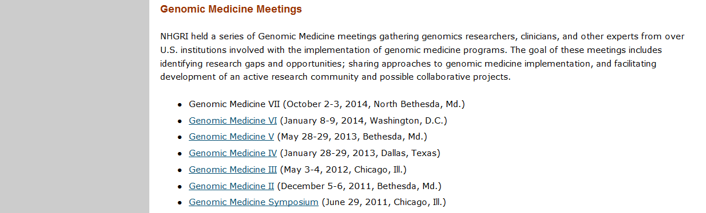
NHGRI Genomic Medicine Meetings
http://www.genome.gov/27549225 or google “NHGRI Genomic Medicine”

Slide 3
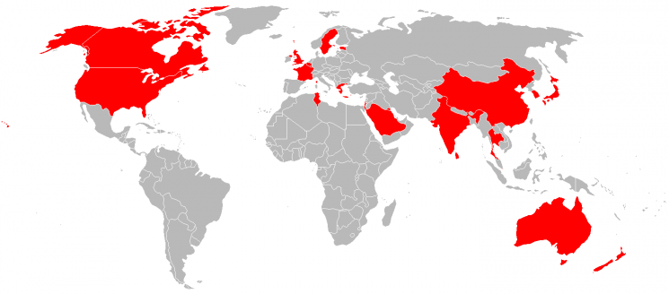
50 International Genomic Medicine Leaders
25 Countries
Courtesy,G Ginsburg, Duke U

Slide 4






Genomic Medicine in Thailand
Courtesy W Chantratita, Ramathibodi Hospital
Partly supported by

Slide 5
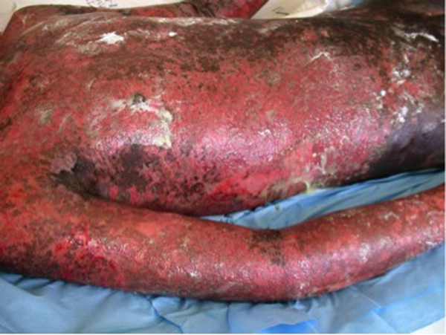
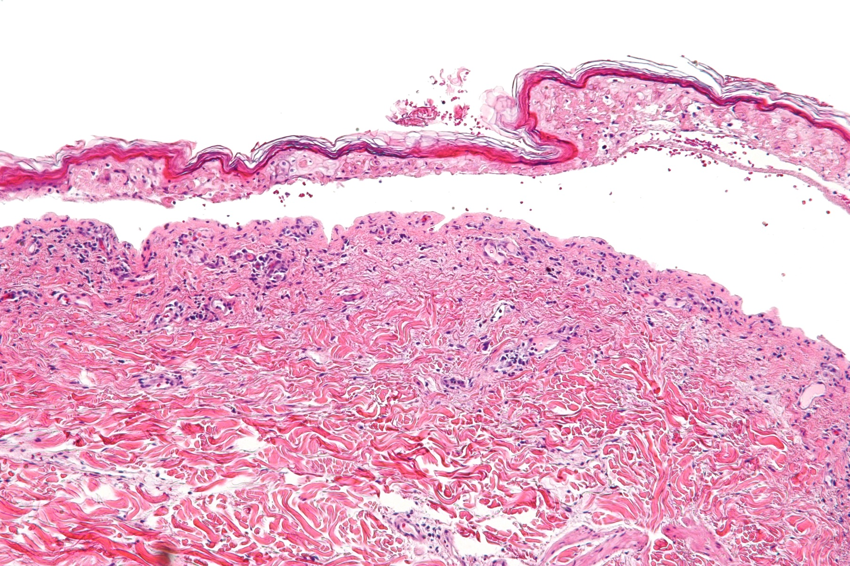

Slide 6
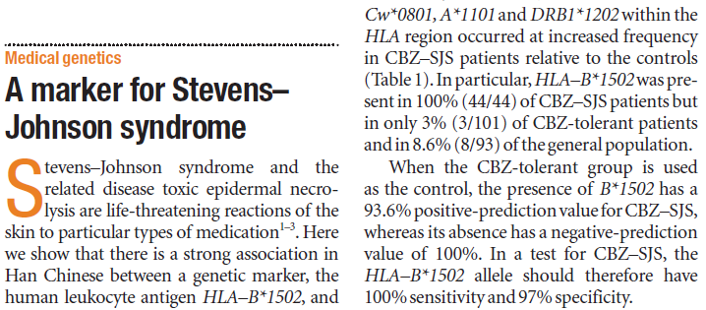
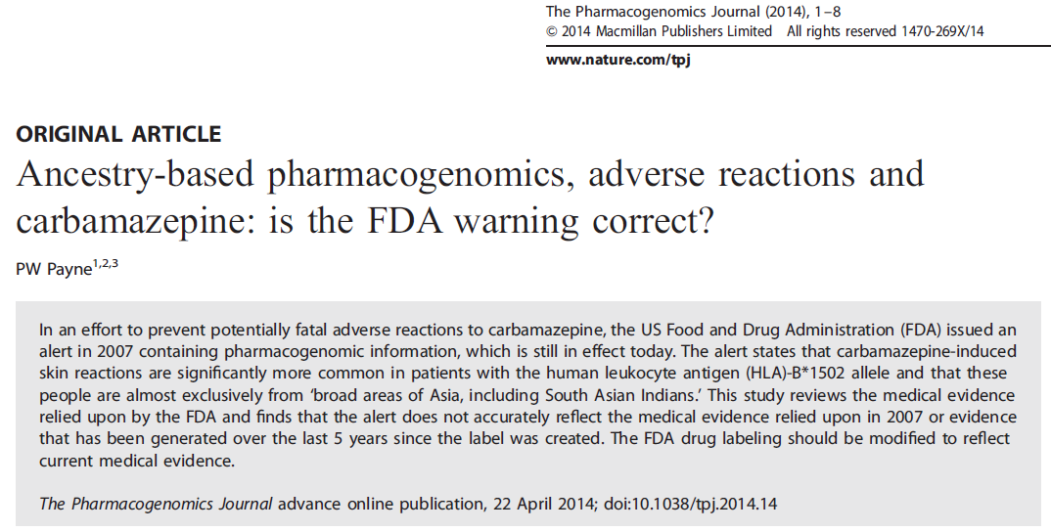
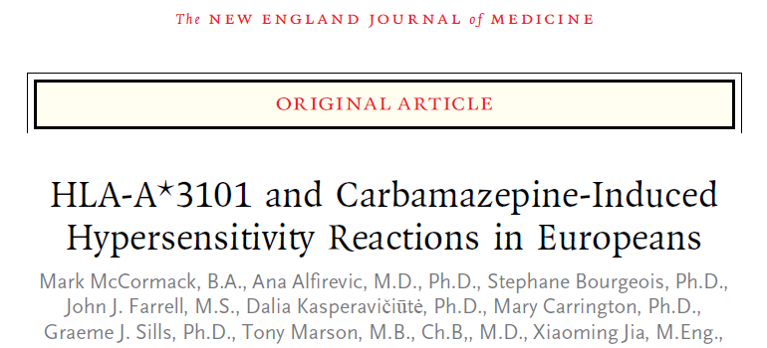
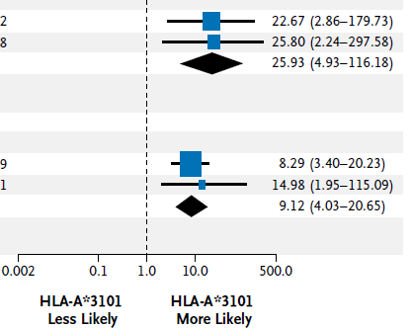

Stevens-Johnson Syndrome, HLA-B*15:02, and Carbamazepine
Chung et al., Nature 2004;428:486.
SJS/TEN
OR = 26
All Hyper-sensitivity
OR = 9.1
N Engl J Med. 2011;364:1134-43.
CAUTION: This patient carries the HLA-B*15:02 allele, a known risk factor for carbamazepine-induced SJS in persons of Asian ancestry…
“Clinicians must determine if a patient has ancestry across broad areas of Asia. This requires clinicians to know what ‘Asian ancestry’ means and use a consistent, reliable method to figure out which
patients have this ancestry.”
Notes:
B15:02 specific to SJS/TEN while A31:01 gives whole range of reactions

Slide 7
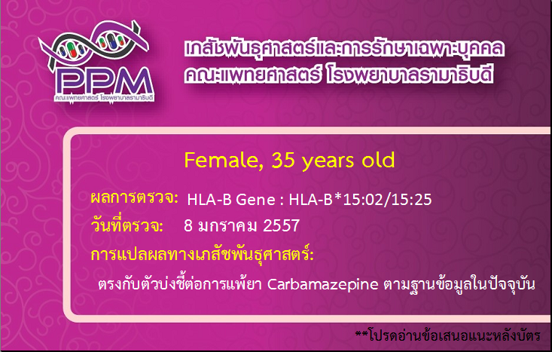
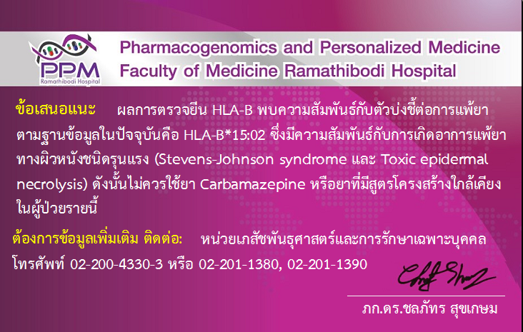
Name & Family Name
Outcome of the PGX assay
8 Jan 2014
PGx Interpretation
High Risk of SJS/TEN from Carbamazepine, according to update information
Suggestion: According to update information, this person has HLA-B*1502 which has a high risk to develop a severe skin disorder (SJS/TEN), if he takes carbamazepine or drug structurally similar.
Need more information: please contact our PGx laboratory. Tel 02-200-4330-3…
Signature of molecular clinical pharmacist.
Courtesy W Chantratita
Notes:
Positive 1502

Slide 8
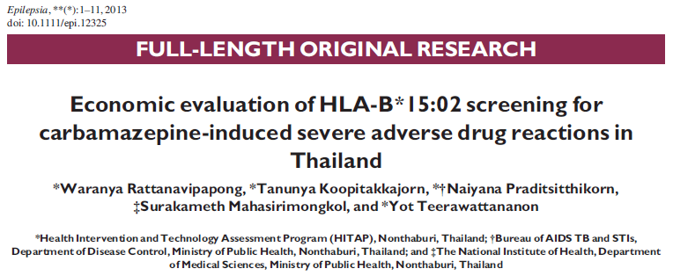
Cost Effectiveness Analysis
Incremental cost-effectiveness ratio of universal HLA-B*15:02 screening estimated at 222,000 THB ($6,660)/ QALY gained for epilepsy pts; 130,000 THB/QALY for neuropathic pain pts
Test 343 patients to prevent one case of SJS/TEN
Courtesy S Mahasirimongkol, Ministry of Public Health

Slide 9
Incidence of SJS/TEN in Thailand,
1984-2013
Unknown
Courtesy W Chantratita, Ramathibodi Hospital

Slide 10
Joint Effort and Collaborative Funding
NIAMS: National Institute of Arthritis, Musculoskeletal and Skin Diseases
NIAID: National Institute of Allergy and Infectious Diseases
NHGRI: National Human Genome Research Institute
NIDDK: National Institute of Diabetes and Digestive and Kidney Diseases
NCATS: National Center for Advancing Translational Sciences/Office of Rare Diseases Research
NINDS: National Institute of Neurologic Disorders and Stroke
FDA: Food and Drug Administration
NEI CC NIGMS NIMH

Slide 11
Workshop on Research Directions - Objectives
Review current state of knowledge of surveillance, pathogenesis, and treatment
Examine role of genomics and PGx in etiology, treatment, and eradication of preventable cases
Identify gaps, unmet needs, and priorities for future research to eliminate SJS/TEN globally
Planning Group
Mark Avigan, FDA Carolyn Hutter, NHGRI
Ricardo Cibotti, NIAMS Lois La Grenade, FDA
Robert Davis, U Tenn Neil Shear, U Toronto
Josh Denny, Vanderbilt Lisa Wheatley, NIAID

Slide 12

Research Directions in Genetically Mediated SJS/TEN, March 3-4, 2015
40 US Genomic Leaders and NHGRI Staff

Slide 13
Current State of Knowledge
Rare: incidence 1 per million general population
100-1000X greater in new users of high-risk drugs
1000X greater in HIV/AIDS patients
Carbamazepine, allopurinol, TMP-SMX, nevirapine
High mortality (30-50%), risk of recurrence
Higher risk in SE Asia
>80% believed genetically mediated in response to specific drugs
Multiple risk variants identified since HLA-B*15:02
Screening efforts have reduced incidence in Taiwan, Singapore, Thailand; cost-effectiveness demonstrated

Slide 14
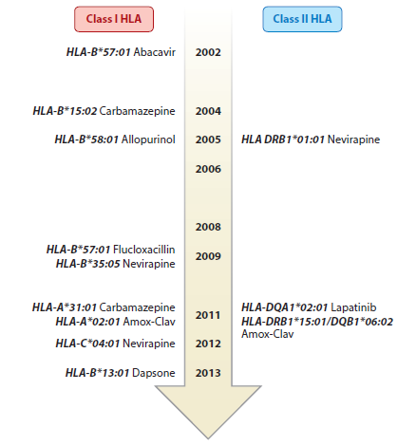
Timeline of Class I and II HLA Associations with Severe Drug Hypersensitivity
Pavlos R et al., Annu Rev Med 2015;66:439-54.
Notes:
Timeline of class I and II HLA associations with key examples of drug hypersensitivity reactions (HSRs).
The discovery of the association of abacavir hypersensitivity and HLA-B∗57:01 was the breakthrough
observation that first linked drug hypersensitivity to class I–restricted, T cell–driven mechanisms (7, 8).
Since then, associations between class I HLA alleles and severe immunologically mediated drugs reactions
have dominated. The early examples of carbamazepine and HLA-B∗15:02 in SJS/TEN (Stevens-Johnson
syndrome/toxic epidermal necrolysis) in Asians and allopurinol and HLA-B∗58:01 in SCAR (severe
cutaneous adverse reactions) have also provided key insights into HSR pathogenesis (3, 4, 9–11). In some
examples, such as amoxicillin-clavulanate drug-induced liver disease in Northern Europeans, class I/II
pairings appear important, whereas others, such as nevirapine hypersensitivity with hepatotoxocity
phenotype, appear restricted primarily to class II HLA alleles (5, 6, 11–18, 31, 32).

Slide 15
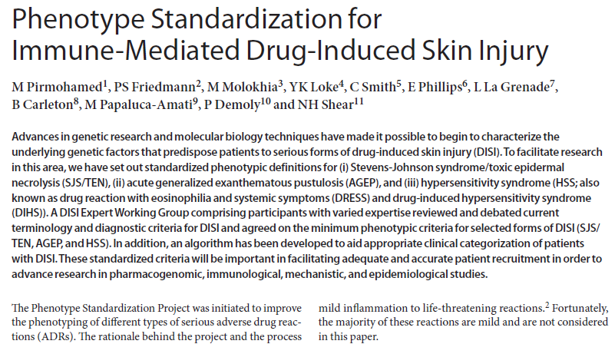
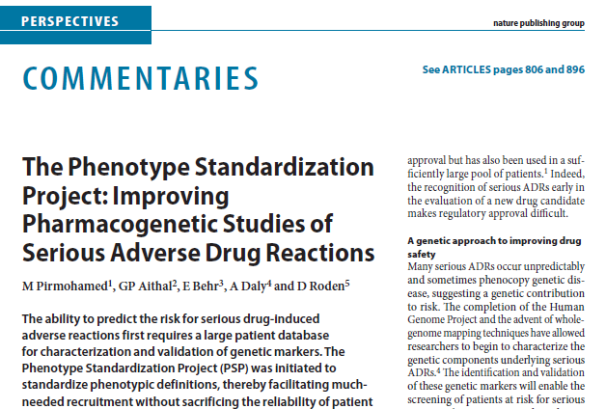
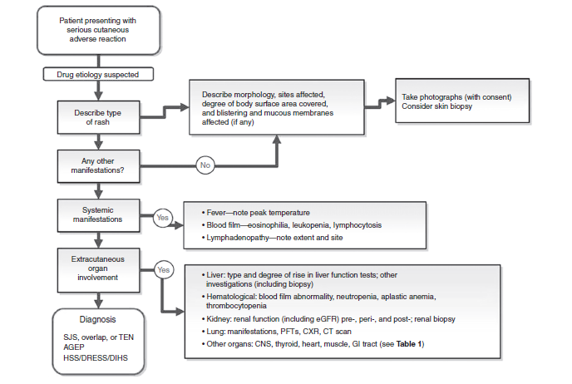
Clin Pharm Ther 2011; 89:784-85.
Pirmohamed M et al., Clin Pharm Ther 2011; 89:896-901.

Slide 16
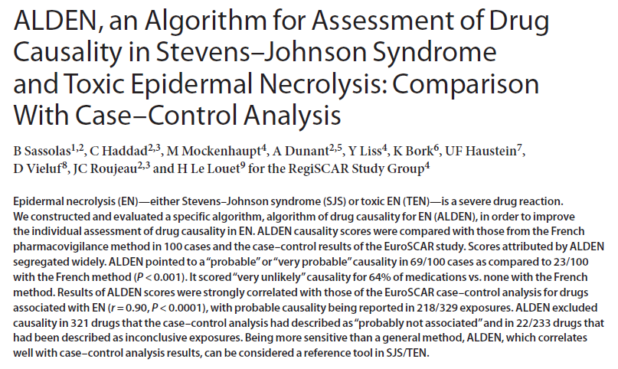
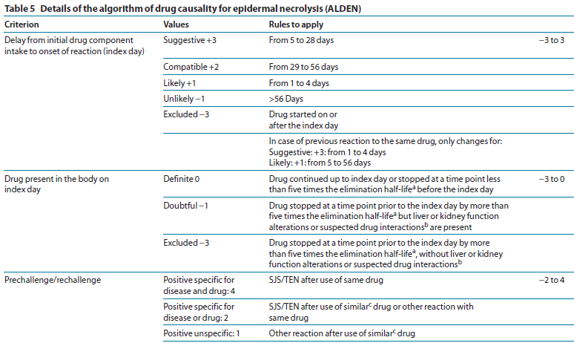
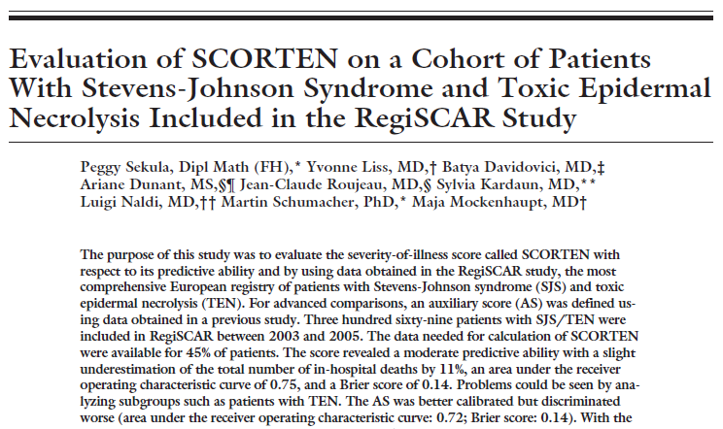
Causal Drug and Severity Algorithms
Clin Pharm Ther 2010;88:60-8.
J Burn Care Res. 2011;32:237-45.

Slide 17
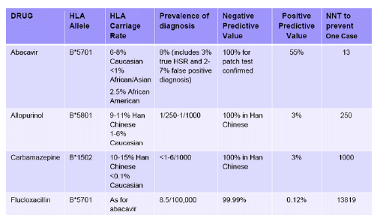
Number Needed to Test (NNT) to Prevent One Case
Phillips E et al., J Allergy Clin Immunol 2011;127:S60-6.
Notes:
Number needed to test (NNT) to prevent 1 case of specific drug reaction. Numbers shown are for abacavir
hypersensitivity, allopurinol-associated SJS/TEN/drug hypersensitivity, CBZ-associated SJS/TEN, and
flucloxacillin-associated drug-induced liver disease. Adapted from Phillips and Mallal.24

Slide 18
Current State of Ignorance
Mechanism of immune reaction
Mechanism of cellular damage
High-risk chemical features of drugs likely to cause SJS/TEN
Current treatments ineffective, largely supportive
Severe sequelae frequent including blindness
Incidence estimates poor: one large U.S. hospital estimated 20-year prevalence of 375 cases/10⁶
No in vitro tests for causative drug; have to stop and re-introduce gingerly, no pre-clinical ID

Slide 19
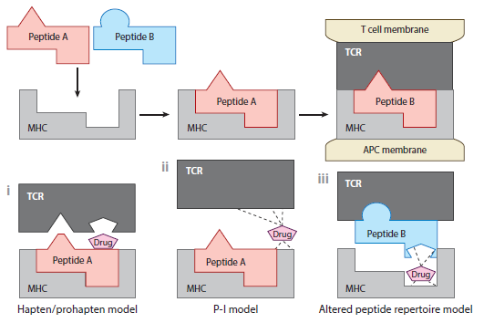
Models of T Cell-Mediated Drug Hypersensitivity
Pavlos R et al., Annu Rev Med 2015;66:439-54.
Notes:
Established models of T cell–mediated drug hypersensitivity. (i ) In the hapten/prohapten model, drugs form covalent bonds with endogenous proteins/peptides. The drug-modified peptides are then processed by antigen-presenting cells (APC) and presented on the major histocompatibility complex (MHC), resulting in a T cell response.
(ii ) In the P-I model, the drug in its native form is able to bind directly to immune receptors such as the T cell receptor (TCR) via noncovalent bonds with residues without a peptide. Dashed lines represent noncovalent bonds.
(iii ) In the altered peptide repertoire model, the drug forms noncovalent bonds within the antigenbinding
groove of the MHC to alter the chemistry of the binding cleft and repertoire of self-peptides that can bind to the HLA
molecule in question. Some of these newly presented self-peptides have not been previously tolerized, and their presentation results in a T cell response. Adapted from Reference 78 with permission.

Slide 20
Key Genomic Research Questions in SJS/TEN
What can ethnic-specific associations teach us about underlying mechanisms?
Why does only a minority of risk allele carriers develop SJS/TEN on exposure to culprit drugs?
Can HLA expression levels explain some of these differences?
Why are many of the same HLA alleles implicated repeatedly in immunologically mediated ADRs?
What is the impact of rare variation in HLA? Can we use sequencing and burden tests or pathway analyses to identify additional genetic risk factors?

Slide 21
Key Genomic Research Questions in SJS/TEN
Can DNA and other samples from drug trials that were halted due to SJS/TEN be accessed for genomic and immunopathogenesis studies?
Can pre-emptive HLA typing be of use in clinical care for a variety of conditions, particularly rheumatologic or autoimmune-related conditions?
What impact does pre-emptive HLA typing have on clinical care, outcomes, and resource utilization?
Can retrospective querying of EMR data across EMR-linked biobanks identify larger numbers of true SJS/TEN cases?

Slide 22
High Priority Basic Research
Develop in vivo, ex vivo, in vitro, and animal models to inform studies of causative drugs and preclinical testing of new drugs
Identify novel biomarkers in acute phases
Identify new predictive markers in addition to HLA and cytochrome P450 variants
Identify factors that discriminate risk allele carriers who have a reaction from those who do not

Slide 23
High Priority Clinical Research
Develop low-cost pharmacogenomic assays for implementation in state/national health programs
Expand beyond one gene-one drug models to multi-gene panels or genomic sequencing
Implement testing in high-risk populations and study impact on both safety and efficacy
Consider broader HLA typing and linking to EMR for association with multiple health outcomes
Study ethnic-specific HLA associations or differences between admixed groups and parent populations

Slide 24
High Priority PGx and Outcomes Research
Conduct additional cost-effectiveness analyses to support implementation of routine genotyping in clinical care systems
Develop pilot projects assessing patient prefer- ences for benefits and trade-offs of PGx testing
Address challenges of current screening recommendations such as low frequency and positive predictive value of risk alleles
Collect race/ethnicity information and study key population subgroups with high case burdens in the U.S. and globally

Slide 25
High Priority Research– Overarching and Facilitative
Stimulate U.S., combine international efforts to collect and pool large numbers of cases diverse in ethnicity and implicated drugs, including:
  Standardized case definitions, data collection
  Biospecimens from early in disease course
  Patient registries with associated biobanked samples in partnership with advocacy groups
  Long-term outcomes
Engage burn units and specialists involved in care of SJS/TEN patients

Slide 26
Needed Infrastructure – International Consortium
International leadership, pharma participation, deposition in public databases– distinguished by scale and diversity
Registry based on standardized phenotyping, including molecular signatures
Standardized case definition, harmonized minimum clinical datasets to satisfy both retrospective and real-time case ascertainment and data collection
Screening and biobanking in early onset phase, including PBMCs and tissue, to identify diagnostic and prognostic biomarkers
Ability to dig deeper for validation, causality assessment, factors associated with progression and outcome

Slide 27
Needed Infrastructure – Pharmacosurveillance
Improved case ascertainment especially in race-ethnic subgroups (beyond US Census groups)
Mandated reporting? Coordination with patient advocacy groups
Facilitated electronic transfer of case reports to FDA?
Deposition of genotypes in medical record with accompanying education, decision support, follow-up
Standardized processes for collecting and sharing genetic data across disparate sites
Coordination with burn units for case identification, focus on large cities or databases

Slide 28
Tensions of Genome-Wide and Disease- Specific Research
NHGRI
Genome-wide
Close to nucleotide
Resource-building
Paradigm-setting
Disease-specific
Problem-solving
Disease-Specific ICs

Slide 29
Stimulate High Priority Research
What:
  Large-scale effort to identify risk alleles, to include U.S. non-European groups
  Assess rare variation in and expression of HLA
  Examine variable penetrance, clarify biologic mechanisms of genomic risk
  Assess impact of pre-emptive genomic testing
How:
  Facilitate comparison and harmonization of phenotyping and case report efforts
  Work with partner ICs to invite applications and contribute to ongoing international collaborations
  Facilitate interactions of relevant investigators

Slide 30
Stimulate High Priority Research (2)
Call attention to area
  Draft white paper for publication
  Publish half-page summaries and calls to action in specialty journals
  Continue to work with patient advocacy groups
Announce multi-IC priority areas through PA
Pursue feasibility, cost-effectiveness, and other pilot studies in FY16-FY17
Prepare for FY18 large-scale risk allele finding and screening implementation efforts with partner ICs

Slide 31
Many Thanks…
Carolyn Hutter
Deborah Colantuoni
Jeff Struewing
Planning Group:
  Mark Avigan (FDA)
  Ricardo Cibotti (NIAMS/NIH)
  Robert Davis (U Tennessee)
  Josh Denny (Vanderbilt)
  Lois La Grenade (FDA)
  Neil Shear (U Toronto)
  L Wheatley (NIAID/NIH)

Slide 32
Over to You…
Please advise us on appropriate role for NHGRI in broad spectrum of needed research in genetically mediated ADRs, from basic mechanisms to population screening and prevention
Suggest priorities for pursuit of the workshop’s recommendations for research and implementation

