Slide 1
TITLE
Subtitle

Slide 2


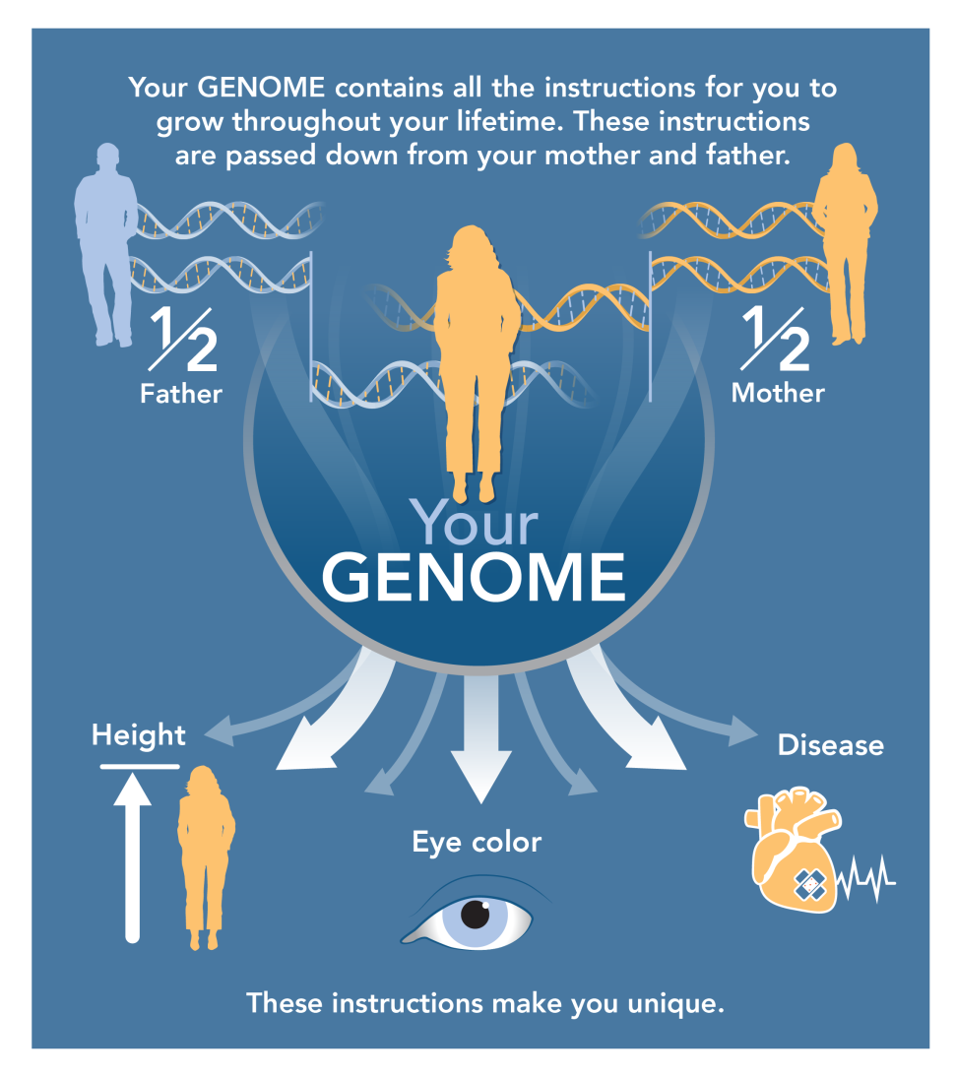


Slide 3


Slide 4
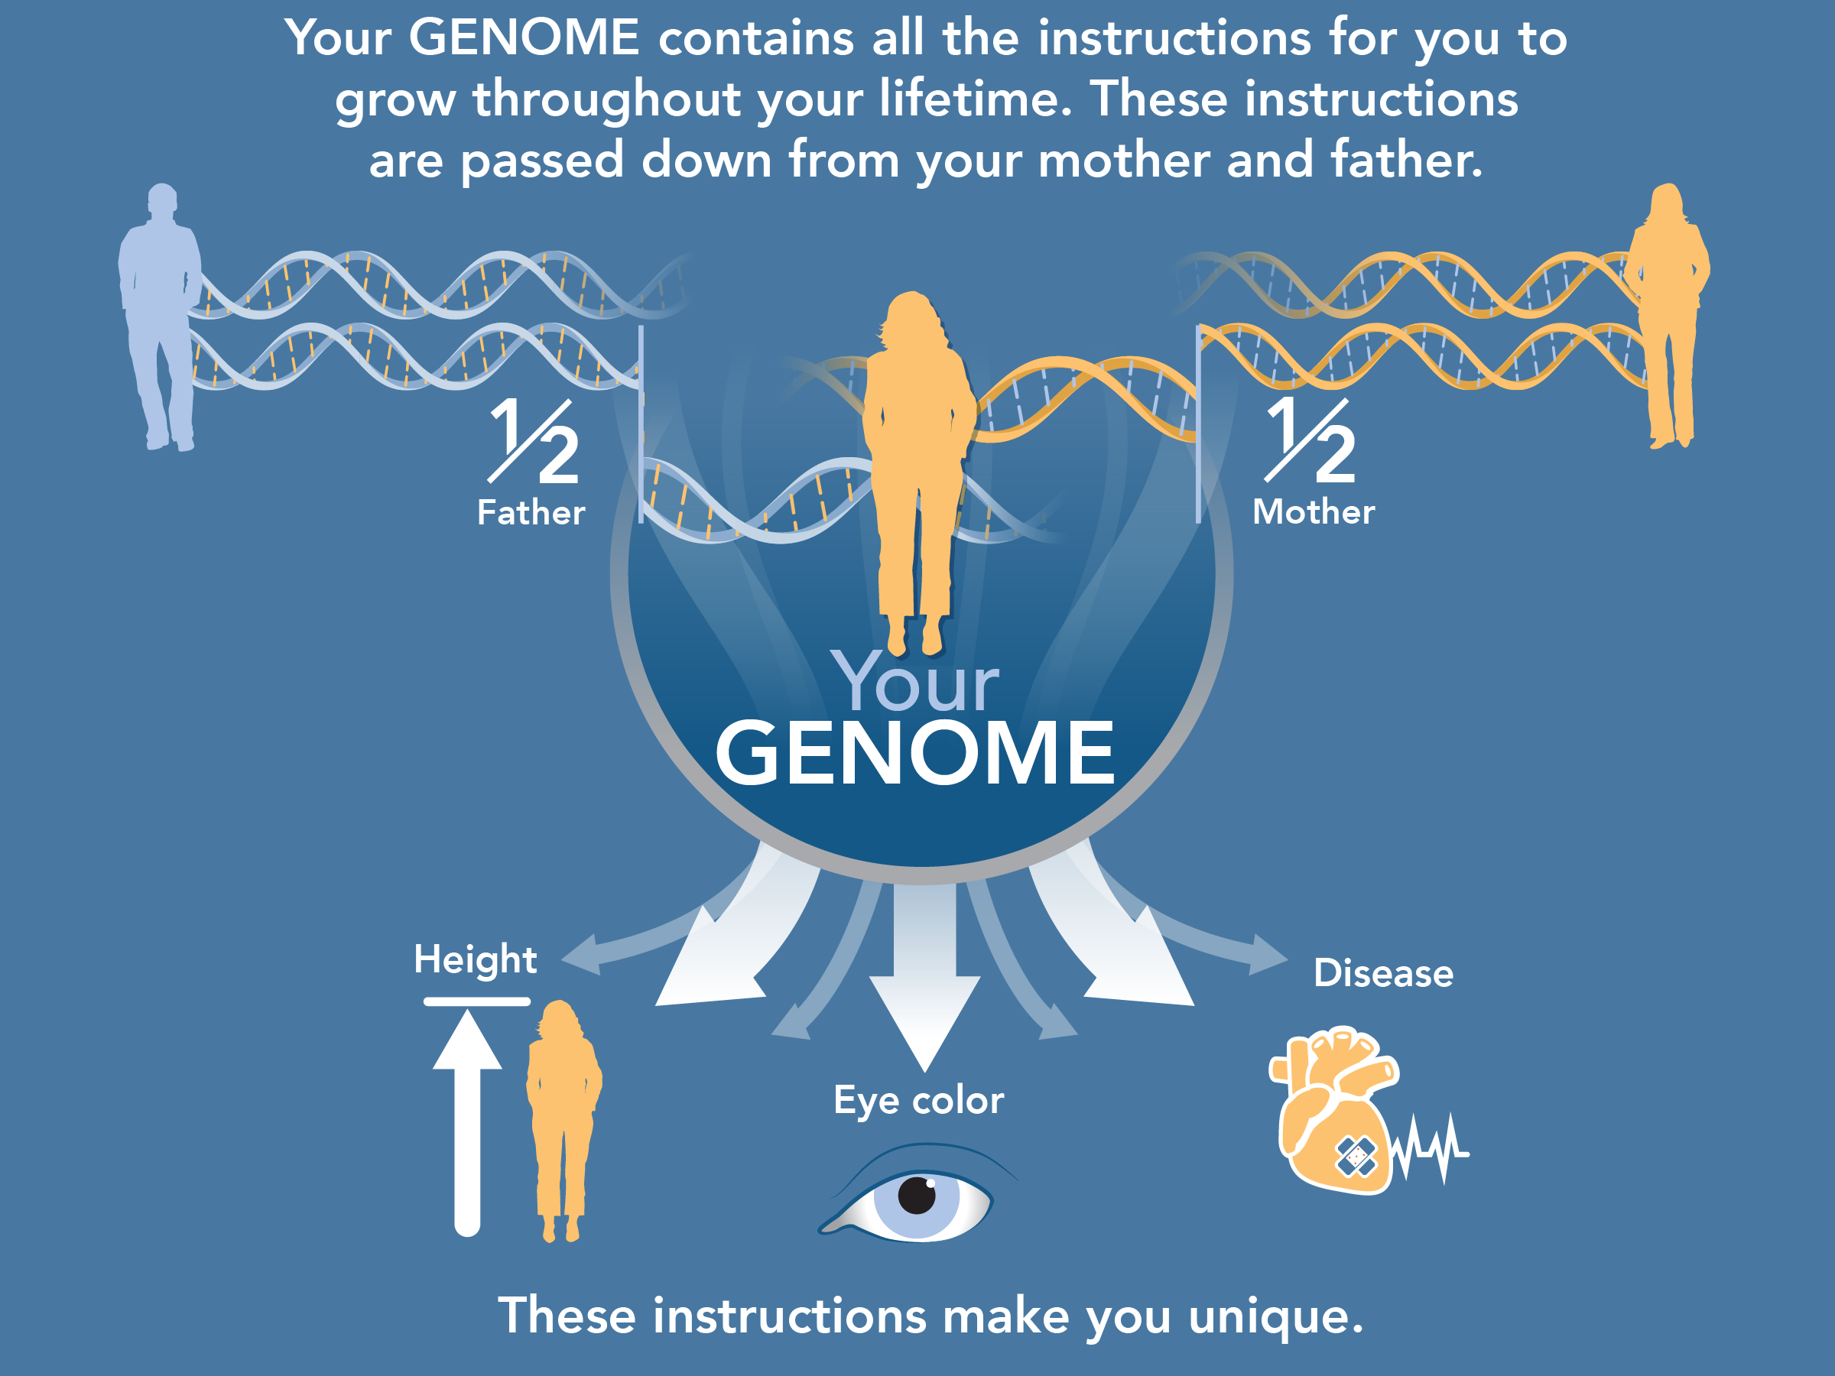

Slide 5


Slide 6


