Slide 1

DIRECTOR’S REPORT
National Advisory Council for Human Genome Research
February 2012
Eric Green, M.D., Ph.D.
Director, NHGRI
Notes:
The Open Session of this Council meeting is being webcast live.
We are also now creating a permanent video archive of the Open Session of all meetings of the National Advisory Council for Human Genome Research, and making them available on the web (including the video presentations themselves and the various associated documents).

Slide 2
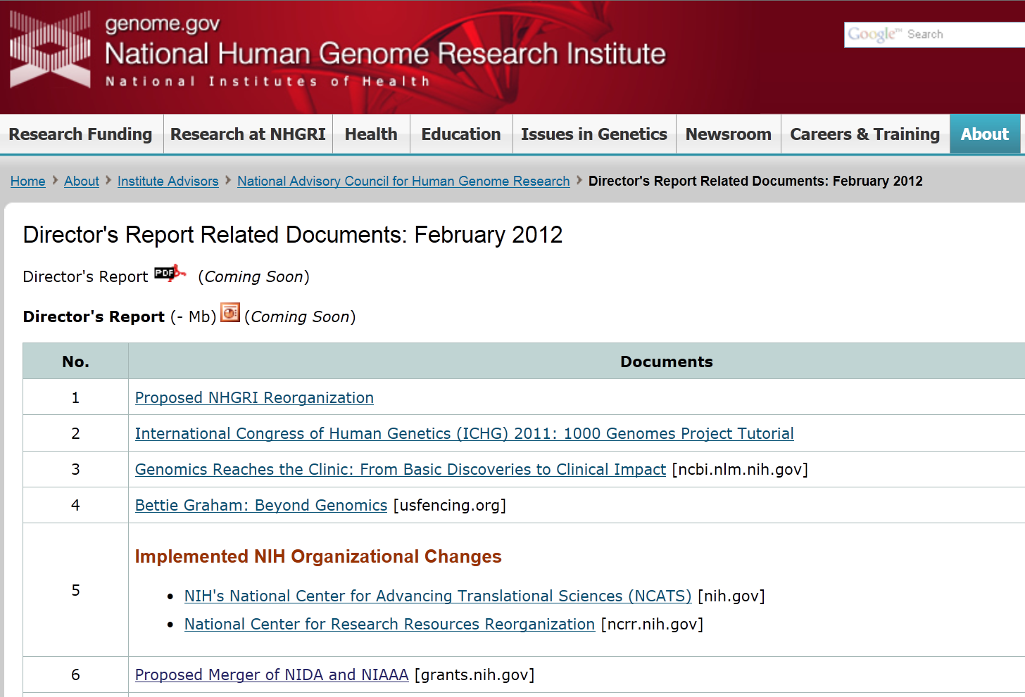
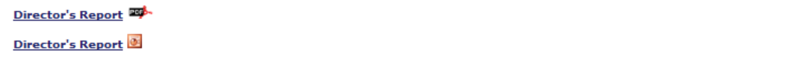
genome.gov/DirectorsReport
Document #
Notes:
For new Council members and new web viewers of our Council meetings, I want to make you aware that there is an ‘electronic resource’ associated with my Director’s Report.
This is analogous to the supplemental materials often made available with a published paper, and can be accessed at the URL shown here.
The slides that I am showing during my Director’s Report are also available electronically at this site– * both as a PDF and as a Powerpoint file.
* For slides associated with specific documents or relevant web sites, there is a Document # indicated on the bottom right, which then references materials that you can access at the web site shown here.
In addition to the video archive that I mentioned earlier, this entire site (including all linked documents) will be archived on NHGRI’s web site as a permanent historic resource.

Slide 3
Open Session Presentations
  DNA Sequencing Technology 2012
    Jeff Schloss
Genomics and Society: The ELSI Research Program and Beyond
    Karen Rothenberg
  NHGRI Extramural Portfolio Review
    Mark Guyer
Notes:
There will be multiple other presentations during the Open Session of this Council meeting.
My Director’s Report is tailored around these presentations; by that I mean that I will not discuss in any detail the topics that others will be covering in greater depth.
* * *

Slide 4
Open Session Presentations
Concept Clearances:
  PAGE Renewal
      Lucia Hindorff
  Clinical Exploratory Sequencing Coordinating Center
      Lucia Hindorff
  Genomic Medicine Pilot Projects
      Teri Manolio
Notes:
In addition to those first three talks, we will also have 6 Concept Clearances presented at this Council meeting.
* * *

Slide 5
Open Session Presentations
Concept Clearances:
  ClinAction
      Teri Manolio
  Centers of Excellence in ELSI Research
      Joy Boyer
  High-Throughput Genomic Analysis in Children with Newborn Screening Disorders
      Anastasia Wise
Notes:
* * *

Slide 6
Open Session Presentations
Meeting Report:
  Genomic Literacy
      Vence Bonham
Notes:
Finally, there have been multiple NHGRI-sponsored meetings held since the last Council meeting.
* A meeting on Genomic Literacy will be summarized in a presentation by Vence Bonham.
I will be referring to some of the other meetings later in my Director’s Report, and the remaining ones will be discussed within the context of Concept Clearances.

Slide 7
General NHGRI Updates
General NIH Updates
Genomics Updates
NHGRI Extramural Program
NIH Common Fund Programs
NHGRI Office of the Director
NHGRI Intramural Program
Notes:
For the rest of my Director’s Report, I will cover the 7 areas listed here.
These areas have proven to be a good framework for reviewing the relevant topics.

Slide 8
General NHGRI Updates
General NIH Updates
Genomics Updates
NHGRI Extramural Program
NIH Common Fund Programs
NHGRI Office of the Director
NHGRI Intramural Program

Slide 9
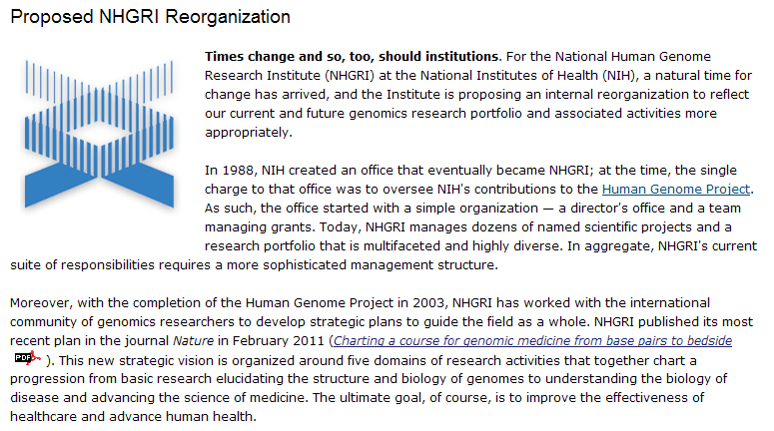
Proposed NHGRI Reorganization
genome.gov/reorg
Document 1
Notes:
The most substantive overarching thing to report about NHGRI is that we have moved forward in proposing changes to our organizational structure.
Shown here is the web site describing the details about both our proposed changes and the process that we are following in proposing this reorganization.
The latter involves holding public meetings to provide a forum for feedback about our proposed changes; the second of two such public meetings will be held at 1PM today as part of this Open Session of Council.
For that reason, I will not discuss our proposed reorganization at this time, deferring that presentation until 1:00 today.

Slide 10
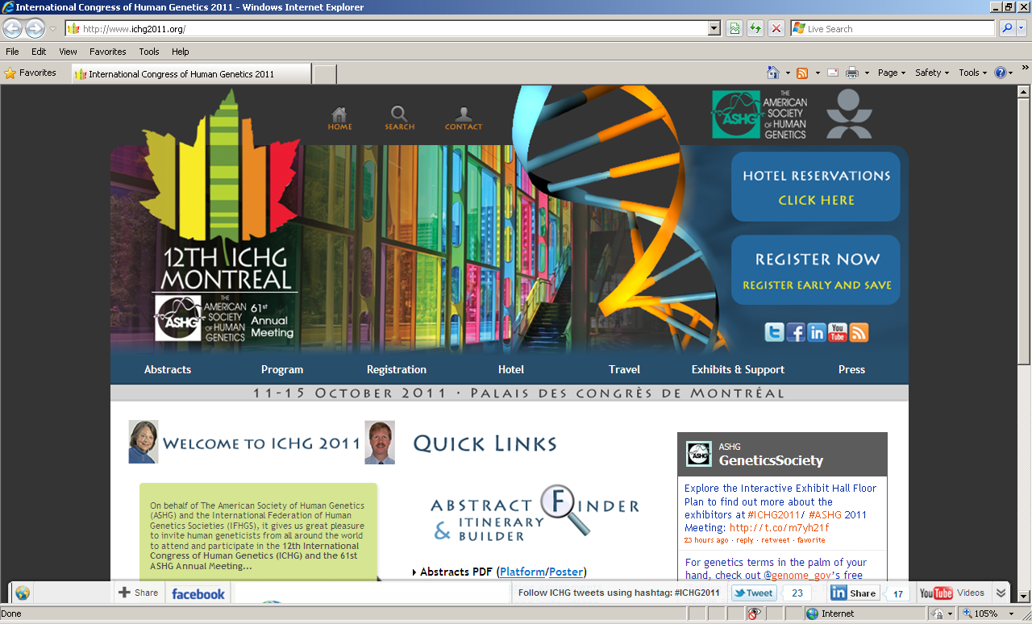
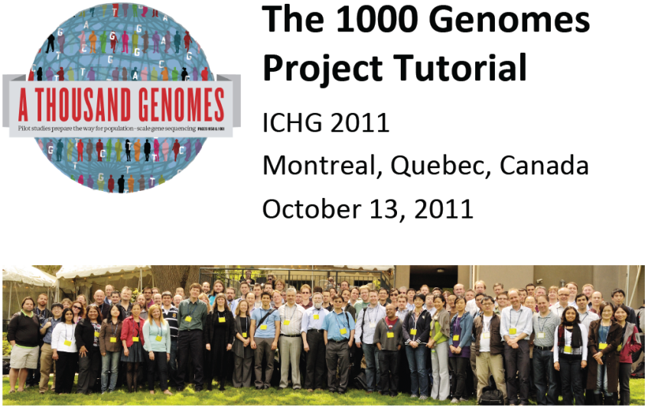
NHGRI @ ICHG/ASHG
  ELSI Concurrent Invited Session: “Emerging Ethical Issues in Large- Scale International Genomics Research Collaborations”
  1000 Genomes Meeting & Tutorial
Document 2
Notes:
At this past fall’s joint ICHG/ASHG meeting, NHGRI organized two very successful sessions.
* One was an invited session on “Emerging Ethical Issues in Large-Scale International Genomics Research Collaborations” that was moderated by NHGRI staff member Jean McEwen and former Council member Pilar Ossorio. Speakers came from various parts of the world and discussed both general issues and their unique perspectives. These issues are arising more and more frequently, especially for community resource projects that involve plans for broad data release and in situations where different cultural values and norms as well as different legal and regulatory requirements have to be reconciled.
* The second session was a tutorial on using 1000 Genomes project data. This gathering was attended >300 people; NHGRI videotaped that session, which has now been downloaded >350 times from our web site.

Slide 11
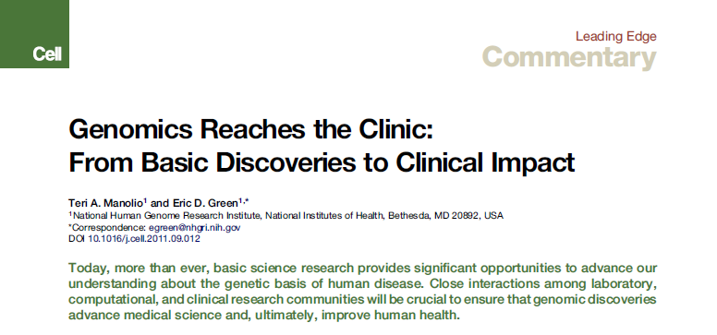
Cell Commentary on Clinical Genomics
Document 3
Notes:
Among the many publications emanating from NHGRI since the last Council meeting was this invited commentary published in Cell, in which Teri Manolio and I co-authored a piece that describes some of the clinical implications of genomic advances. Cell asked us to write something about the near-term clinical applications of genomics that provided a bit more detail than what we described in our strategic plan published in Nature last February.

Slide 12

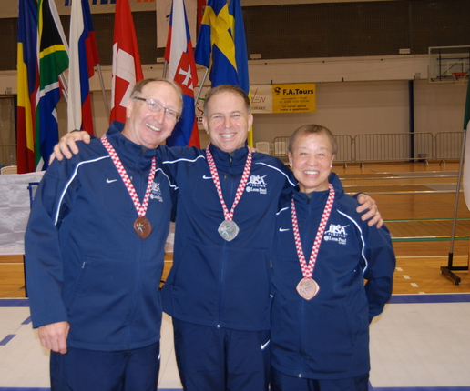
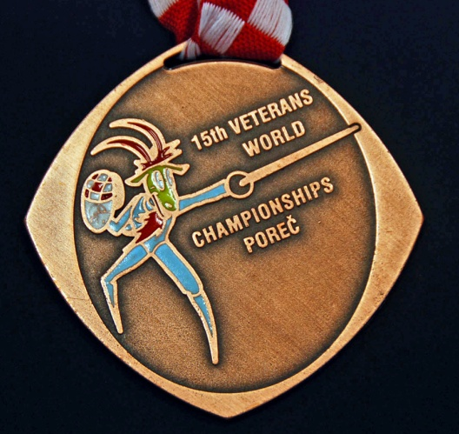
Bettie Graham: Beyond Genomics
Document 4
Notes:
And for those that think NHGRI staff members are only good at genomics, long-time NHGRI’er Bettie Graham also has a long and distinguished career as a competitive fencer.
* In fact, Bettie traveled to Croatia in October as a member of the USA Veteran Fencing Team to compete in the 2011 World Veterans Fencing Championship.
* And indeed, Bettie came home with the bronze medal in her class.
If my sources are correct, Bettie is the current U.S. Veteran National Champion in both foil and epee. And the 2011 Veteran World Championships was the ninth World Championships at which she has represented the United States.
Congratulations Zorro (I mean, Bettie)!

Slide 13
General NHGRI Updates
General NIH Updates
Genomics Updates
NHGRI Extramural Program
NIH Common Fund Programs
NHGRI Office of the Director
NHGRI Intramural Program

Slide 14
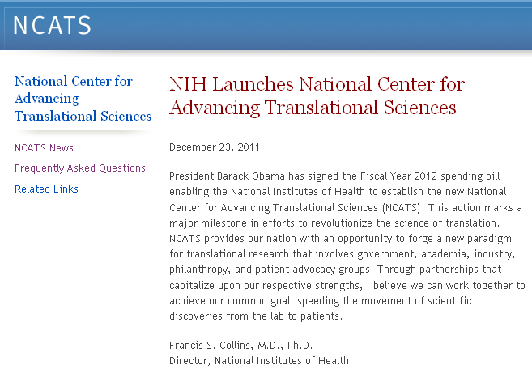
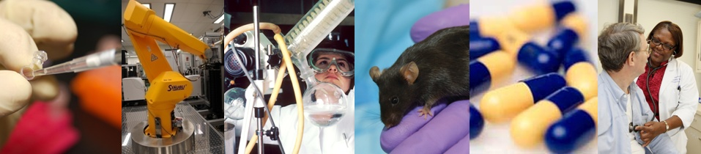
NIH’s National Center for Advancing Translational Sciences (NCATS)
Document 5
Notes:
The most significant organizational news at NIH in recent months was the creation of a new NIH Center– the National Center for Advancing Translational Sciences (or NCATS). As part of the Fiscal Year 2012 Omnibus Appropriations bill, the National Center for Research Resources (NCRR) was dissolved and NCATS was established. NCATS has a budget of $575 million in Fiscal Year 2012.
The Acting Director of NCATS is Thomas Insel (Director NIMH) and Acting Deputy Director is Kathy Hudson (NIH Deputy Director for Science, Outreach, and Policy). Note that the search for a permanent NCATS Director is very active (Eric Green and Tom Insel are co-chairs of that search committee).
Many components are now housed within NCATS, particularly notable ones include the Clinical and Translational Science Awards (CTSA) program, the Cures Acceleration Network, and the newly created Division of Preclinical Innovation (headed by Chris Austin). The latter has mostly been formed from the National Center for Translational Therapeutics (NCTT), an entity that grew up and operated within NHGRI for almost a decade. Note that >100 NHGRI employees (all under Chris Austin’s leadership) departed NHGRI en block as part of the creation of NCATS.

Slide 15

Relocation of Programs from the
National Center for Research Resources
NCATS
DPCPSI
NIBIB
NIGMS
NIMHD
NIDDK
NHLBI
Document 5
Notes:
In addition to the NCRR programs that went to NCATS, other components were assigned to either the NIH Office of the Director or to one of five Institutes.
There is a fairly lengthy list of such NCRR elements that have now been relocated, which is available at the web site provided under Document 6.

Slide 16
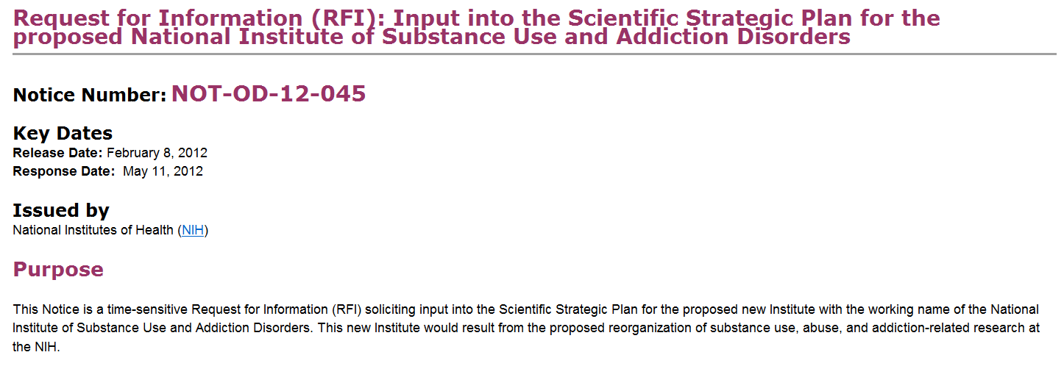


Proposed Merger of Institutes
Document 6
Notes:
As I have mentioned previously, the NIH Scientific Management and Review Board (SMRB) has recommended the merger of two NIH Institutes involved in research related to addiction and substance use— specifically, the National Institute on Drug Abuse (NIDA) and the National Institute on Alcohol Abuse and Alcoholism (NIAAA). As we have come to learn, abolishing, merging, creating, or even reorganizing NIH Institutes or Centers is a long and complex process.
Last week, NIH issued a Request for Information (or RFI) seeking input into the scientific strategic plan for the proposed new merged Institute, preliminarily named the National Institute of Substance Use and Addiction Disorders.
That input is due by May 11.

Slide 17

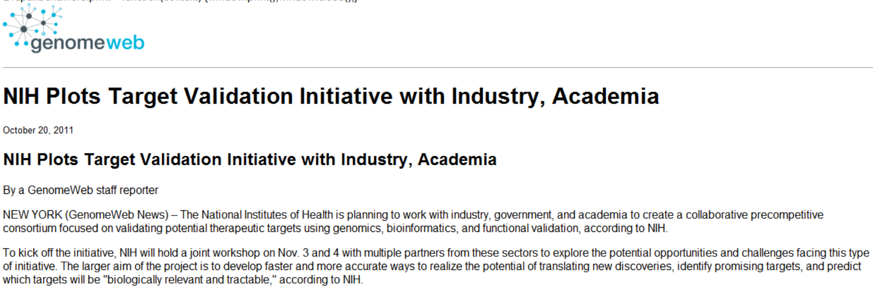
Target Validation Workshop
Document 7
Notes:
There was a joint NIH-industry workshop on the subject of target validation this past November. This gathering included high-level representatives from virtually all of the major pharmaceutical companies, with goal of exploring how to use various scientific opportunities (particular genomic advances) to improve the process of identifying suitable targets for drug development. The Executive Summary of that workshop is available as Document 7. Not surprisingly, NHGRI is being asked to help in many of these areas:
1. Eric Green is on the overarching steering committee for these efforts.
2. Teri Manolio will be co-leading an NIH-industry-academia working group to explore possible genomics-oriented projects that would move from genotype to phenotype and from phenotype to genotype in the pursuit of identifying and validating targets.
3. NHGRI has been asked to organize two workshops that will be relevant to these efforts: one on the notion of aggregating genome sequence data in fashion to accelerate genomic discoveries, and one on exploring the merits of using different types of cohorts in genome sequencing projects.

Slide 18
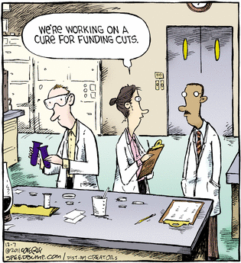
Appropriations Update
Notes:
Another critical area of NIH news relates to the budget situation.
For this, we try to find humor where we can, although there isn’t very much funny about the current situation…

Slide 19
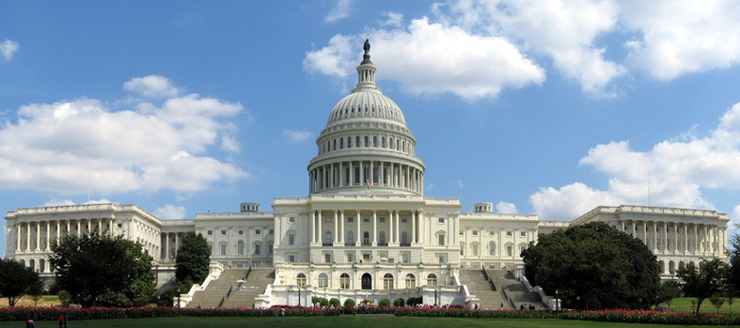
Fiscal Year 2012 Appropriations Update
 | Fiscal Year 2011 | Fiscal Year 2012 President | Fiscal Year 2012 House | Fiscal Year 2012 Senate | Fiscal Year 2012 Enacted
NIH | $30.7B | $31.7B | $31.7B | $30.5B | $30. B
NHGRI | $511M | $525M | $525M | $506M | $513M (0.27%)
Document 8
Notes:
Recall that when we last met, Congress was still debating the funding levels for federal agencies for Fiscal Year 2012 and that NHGRI’s budget for the current Fiscal Year was unclear.
As you no doubt now know, Congress was able to complete this just before the holidays with the passage of a ‘megabus’ bill containing funding for most of the federal government. This means we now know NHGRI’s budget until the end of September 2012.
* Specifically, recall that the President had requested an increase of NHGRI’s budget to $525M in Fiscal Year 2012 (up from the $511M in Fiscal Year 2011). This was the figure in a bill introduced in the House, while a Senate bill passed by the Appropriations Committee had NHGRI getting a $5M decrease. When all the dust settled, we ended up somewhere in-between– a very slight increase over Fiscal Year 2011: $513M or an increase of just under 0.3%.
So, we essentially ended up ‘flat’ with respect to last year. Sadly, ‘flat’ becomes the new ‘feel good’ budget, recalibrating your expectations such that you are happy to have dodged the bullet of a budget cut.

Slide 20
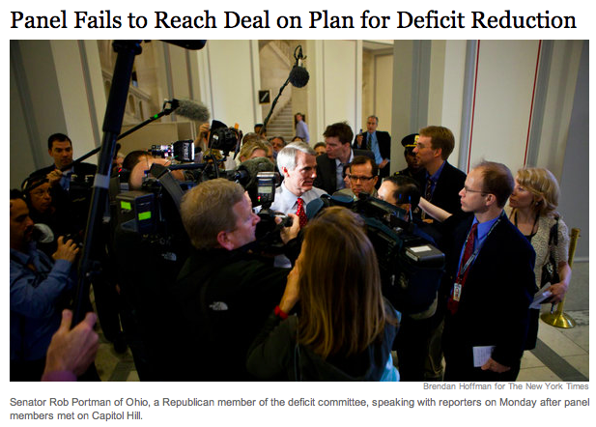
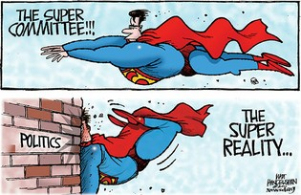
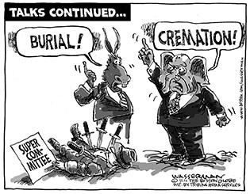

Fiscal Year 2013 Appropriations Update
Notes:
The next uncertainty is the Fiscal Year 2013 budget, which will be proposed and debated with the backdrop of an election year. This is further complicated by the recent failure to reach a deal for deficit reduction. Recall the creation of the ‘Supercommittee’ as part of the Budget Control Act, a law passed last year to limit government spending over the next decade. The charge to the Supercommittee was, by November 23rd, to identify ways to reduce the deficit by at least $1.2 trillion over the next decade. * They were not successful.
Failure of the Supercommittee triggers an automatic across-the-board $1.2-trillion cut to federal agencies in 2013. In theory, this would amount to an 8-9% cut to NHGRI’s budget starting next January 2 but retroactive to October 1 of this year. While seemingly unthinkable, we cannot ignore the possibility of an 8-9% cut next year, and so we have been actively developing ‘what if’ scenarios to deal with such a circumstance. But the overall Fiscal Year 2013 budgeting process must still march forward. And today is a significant day, in that the President will deliver his Fiscal Year 2013 budget to Congress, which will include his proposed funding for NIH and NHGRI. That is all I can say about the President’s Fiscal Year 2013 budget for now, but I aim to talk more about this later today– once the President has formally made his announcement.

Slide 21
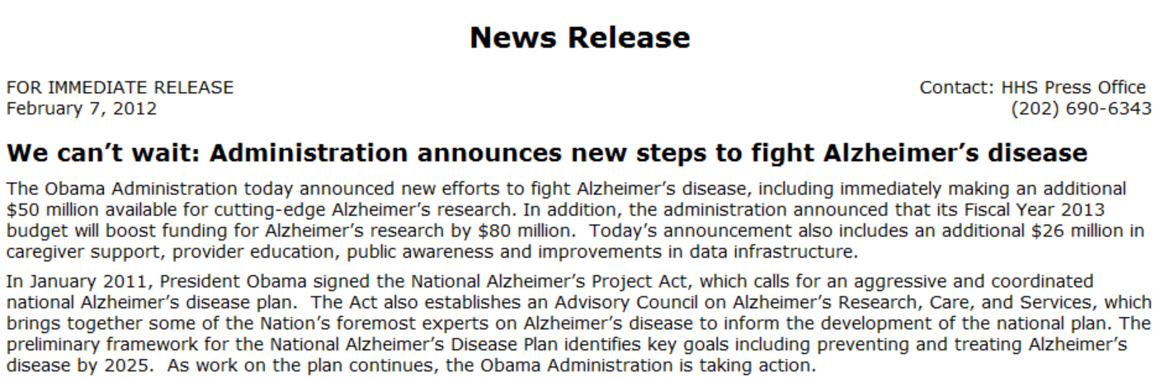
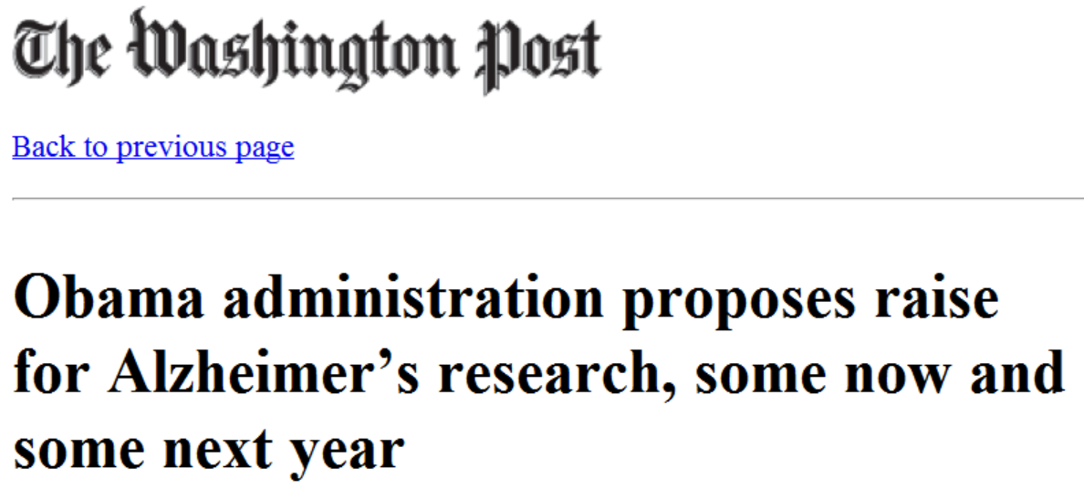
Alzheimer’s Research Initiative
“Investments will include research to identify genes that increase the risk of Alzheimer’s disease…”
Document 9
Notes:
In January 2011, President Obama signed the National Alzheimer’s Project Act, which calls for an aggressive and coordinated national Alzheimer’s disease plan.
* As part of that plan, DHHS Secretary Sebelius announced last week that NIH would make available $50 million for Alzheimer’s research in Fiscal Year 2012 and then $80 million in Fiscal Year 2013.
These efforts will include genomic studies aiming to identify genes that increase risk for the disease, and it is very likely that NHGRI will be involved in this research. The details about how NHGRI will become involved are actively being worked out, and we will undoubtedly have more to report on this at the May Council meeting.

Slide 22
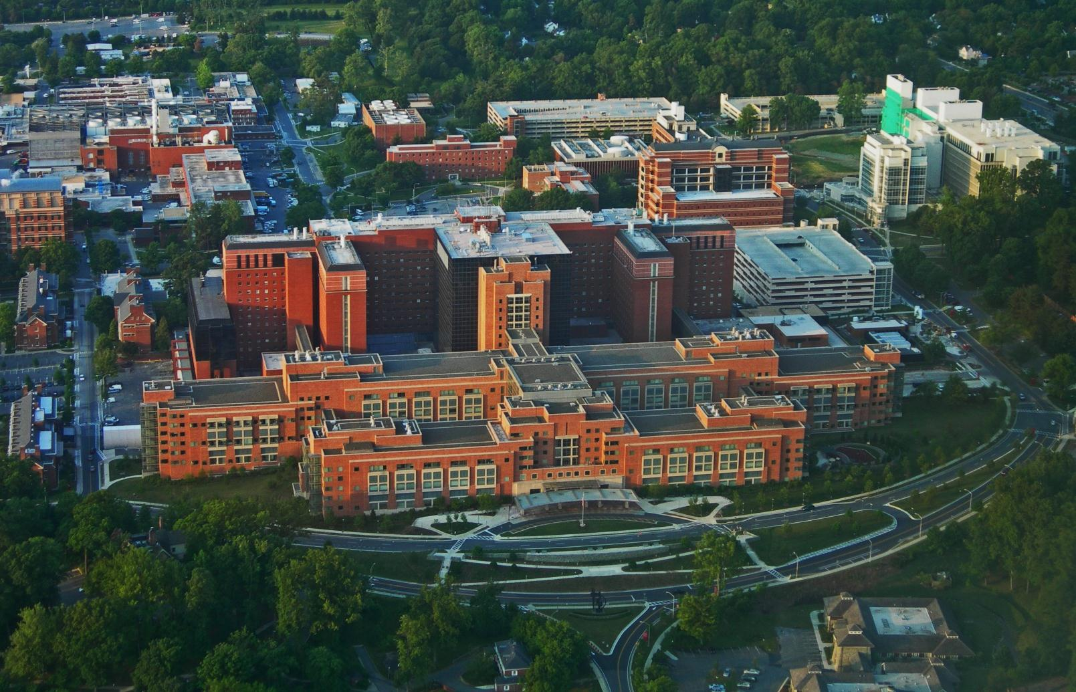

NIH Clinical Center Receives
Lasker-Bloomberg Public Service Award
Document 10
Notes:
A huge honor was bestowed upon NIH this past fall, when the NIH Clinical Center was awarded the 2011 Lasker-Bloomberg Public Service Award.
Largely regarded as the ‘crown jewel’ of the NIH Intramural Research Program, the NIH Clinical Center was given this highly prestigious award for serving as a model institution that has transformed scientific advances into innovative therapies and has provided high-quality care to numerous patients.

Slide 23
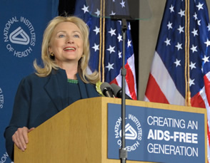
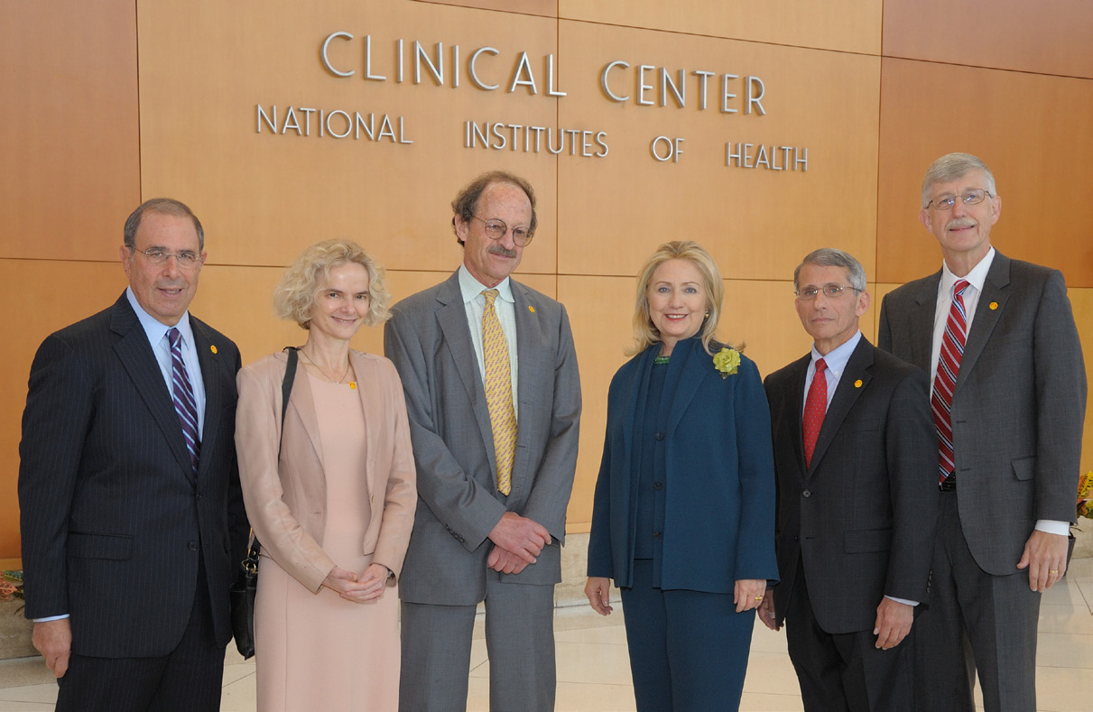
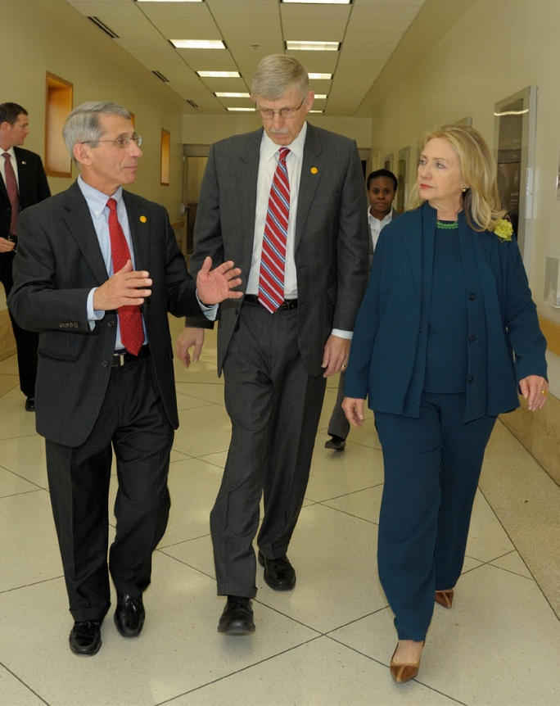
Secretary of State Hillary Clinton Visits NIH
Document 11
Notes:
In November, Secretary of State Hillary Rodham Clinton visited NIH to deliver a major speech in which she called for a renewed push for an “AIDS-free generation.”
This speech marked the 30th year in the fight against HIV/AIDS and kicked off preparation for World AIDS Day activities and the international conference “AIDS 2012” (which will be held in Washington, D.C. next June).

Slide 24

Advisory Committee to the NIH Director Working Group on Data and Informatics
Working group to investigate the management, integration, and analysis of large biomedical datasets
Called the NIH Data and Informatics Working Group
Co-chaired by David DeMets and Larry Tabak
Document 12
Notes:
Recognizing the pervasive bottleneck and challenges related to big data and informatics (an area of particular interest to NHGRI, this Council, and the genomics community), Francis Collins established a new working group of his Advisory Committee to the Director.
* This working group aims to investigate the management, integration, and analysis of large biomedical datasets.
* Called the NIH Data and Informatics Working Group, this group * is co-chaired by David DeMets (U. of Wisconsin) and Larry Tabak (NIH Deputy Director) and includes members such as Russ Altman, David Botstein, Dan Masys, and Council member Jill Mesirov.
Recommendations from the working group are due this summer. Meanwhile, NHGRI and NIGMS have been asked to co-lead a trans-NIH working group to take those recommendations forward in the area of molecular data; other NIH working groups will deal with other areas (such as phenotype and imaging data).

Slide 25

Request for Information:
NIH Data and Informatics Working Group
Scope of the issues
Standards development
Secondary use of data
Data accessibility
Incentives for data sharing
Support needs
Submit comments by March 12, 2012
Document 12
Notes:
As part of their deliberations, the NIH Data and Informatics Working Group has issued a Request for Information (RFI) to solicit input from the community on a broad series of topics relevant to this complex area.
* A subset of those topics is listed here, while detailed subtopics can be found in the RFI itself— a link to which is available as Document 12.
* The RFI will accept public comment through March 12, 2012.
Please share this link with your colleagues and any organizations that you feel are appropriate because the resulting information will inform both the current working group, as well as the new working group that NHGRI and NIGMS will be co-leading.

Slide 26
General NHGRI Updates
General NIH Updates
Genomics Updates
NHGRI Extramural Program
NIH Common Fund Programs
NHGRI Office of the Director
NHGRI Intramural Program

Slide 27
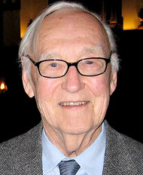

Mourning the Loss of James Crow
Document 13
Notes:
The legendary geneticist James Crow died January 4, 2012; he was 95 years old and still actively working at the University of Wisconsin at the beginning of this academic year.
James Crow was a leader in the field of population genetics, who helped shape public policy about atomic radiation damage as well as the use of DNA in the courtroom.
He was also a highly regarded genetics teacher; his ‘Crows Notes’ was a textbook widely used at the college level for introduction to genetics courses.
Eric Green took Genetics 101 course that was taught by Jim Crow in 1979 (most substantive formal course in genetics I have taken); an awesome teacher.

Slide 28
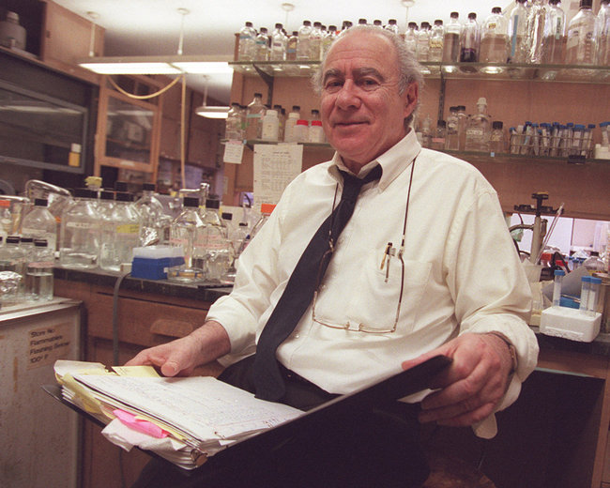
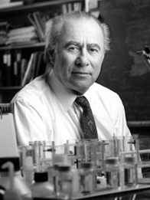
Mourning the Loss of Norton Zinder
Document 13
Notes:
Genetics pioneer Norton Zinder died on February 3; he was 83 years old.
Dr. Zinder was involved some of the early planning of the Human Genome Project. And in fact, served as a member of this Advisory Council when we were still known as the National Center for Human Genome Research.
Among his many scientific accomplishments was the discovery of transduction in bacteria.
He was a John D. Rockefeller Jr. Professor Emeritus at The Rockefeller University, where he spent his entire research career.

Slide 29
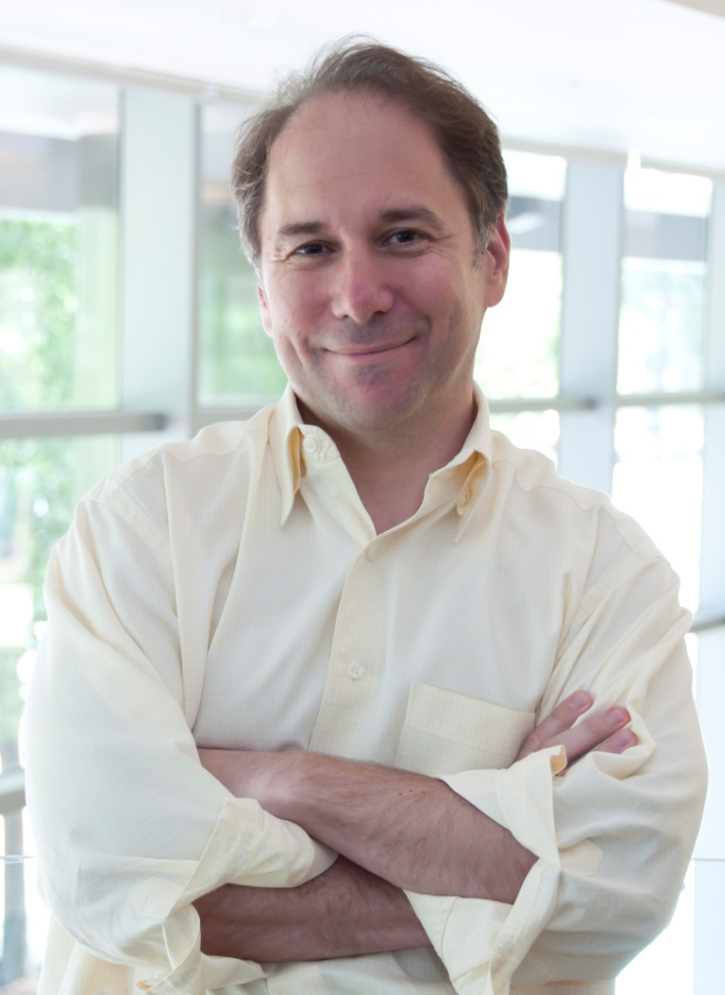

2011 ASHG Curt Stern Award
David Altshuler, M.D., Ph.D.
Document 14
Notes:
David Altshuler of the Broad Institute and Harvard University was given the 2011 Curt Stern Award by the ASHG.
David was honored “for his outstanding contributions as a leader in the study of human genetic variation and its application to common, complex diseases using tools and knowledge gained from the Human Genome Project.”
The Curt Stern Award is given annually by the ASHG in recognition of major scientific achievement in human genetics that has occurred in the last 10 years.

Slide 30


2011 NIH Director’s Pioneer Award
Andrew Feinberg, M.D., M.P.H.
Document 15
Notes:
Andrew Feinberg of Johns Hopkins University and NHGRI grantee was given an NIH Director’s Pioneer Award.
This award was based on a proposal entitled “A General Stochastic Epigenetic Model For Evolution, Development, and Disease.”

Slide 31
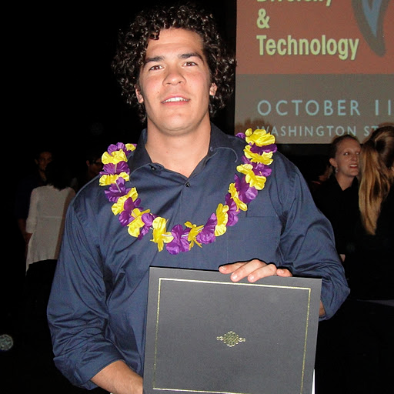

Best Graduate Student Presenter for Genetics at SACNAS National Conference
Keolu Fox, Ph.D.
Document 16
Notes:
Keolu Fox was a participant in the NHGRI Diversity Action Plan program, spent a couple of years in the NHGRI Intramural Research Program, and is now on an F31 fellowship at the University of Washington.
He was recently awarded the “Best Graduate Student Presenter for Genetics” at the Society for Advancement of Chicanos and Native Americans in Science National Conference.

Slide 32
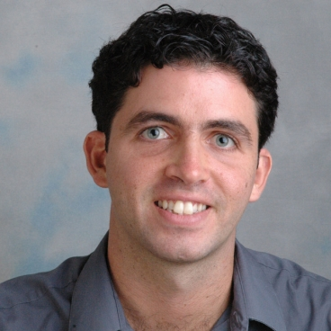

2011 "Niki" Award Recipient
Manolis Kellis, Ph.D.
Document 17
Notes:
Manolis Kellis, an associate professor in the Department of Electrical Engineering and Computer Science at MIT, was awarded the 2011 Niki Award by the Athens Information Technology Center of Excellence for Research and Education.
The award, which is presented annually, honors prominent Greeks or individuals of Greek descent who are internationally recognized for their contributions to science and technology and who inspire a new generation of scientists.

Slide 33

National Academy of Science
Public Welfare Medal Recipient
Harold Shapiro, Ph.D.
Document 18
Notes:
Another individual well-known to NHGRI, Harold Shapiro, will receive the Public Welfare Medal— the National Academy of Science's most prestigious award.
The medal is presented annually to honor someone demonstrating extraordinary use of science for the public good. Throughout his career, Harold has helped to shape science and public policy.
The Public Welfare Medal will be presented to Shapiro on April 30 during the Academy’s 149th annual meeting. Previous recipients of the medal include Neal Lane, Maxine Singer, C. Everett Koop, and Carl Sagan.

Slide 34
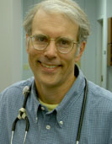
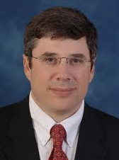
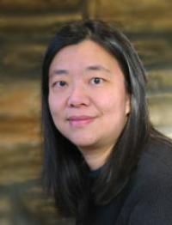
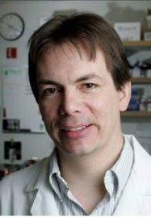
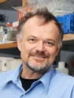
Newly Elected ASHG Leadership
President Elect:
Jeff Murray
Treasurer:
Geoff Duyk
Board of Directors:
Vivian Cheung
Evan Eichler
Richard Gibbs
Document 19
Notes:
Shown here are newly elected leaders of ASHG.
All are good friends, colleagues, grantees, and/or advisors of NHGRI.

Slide 35

Elected to the Institute of Medicine 2011
Martin Blaser
Vivian Cheung
Claire Fraser-Liggett
Richard Gibbs
David Relman
Document 20
Notes:
Similarly, a number of individuals with ties to NHGRI were recently elected to the Institute of Medicine.

Slide 36

Elected to AAAS
Andrew Feinberg
Edward Marcotte
Richard McCombie
Richard Myers
Document 21
Notes:
And the same holds true for recently elected Fellows of AAAS.

Slide 37
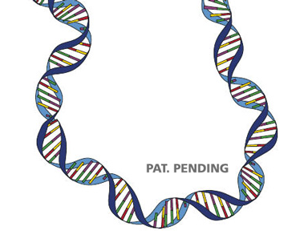

USPTO Study on
Genetic Diagnostic Testing
Notes:
Last fall, Congress passed the Leahy-Smith America Invents Act, reforming U.S. patent law to align it with the systems used by other countries. Of interest, buried within this Act is a requirement for the U.S. Patent and Trademark Office to conduct a study on genetic testing.
Specifically, the law requires that the PTO prepare a report for Congress on “effective ways to provide independent, confirming genetic diagnostic test activity where gene patents and exclusive licensing for primary genetic diagnostic tests exist.” The study is designed to examine the concern that gene patents and exclusive licenses can prevent patient access to genetic testing.
The report is due to Congress by June 16 this year, and the PTO is holding public hearings in February and in March. The public is further invited to submit written comments to the agency by March 26.
I will plan to report back on their findings at a future Council meeting.

Slide 38

Presidential Commission for the Study of Bioethical Issues Meeting:
Whole-Genome Sequencing
Notes:
On February 2, 2012, the Presidential Commission for the Study of Bioethical Issues met in San Francisco to discuss bioethical issues associated with whole-genome sequencing.
The Commission heard from a number of experts, including former NHGRI Council members Richard Gibbs and Pilar Ossario.
The Commission's focus was mainly on issues of privacy, although the discussions frequently returned to the issue of consent and how to make it meaningfully 'informed' in the light of very low genomic literacy among clinicians and the general public.
The Commission will be publishing a report on the subject later this year, and NHGRI staff are in close contact with the Commission’s staff both to serve as a resource for any information they might need and to provide input on the possible directions the Commission might pursue.

Slide 39
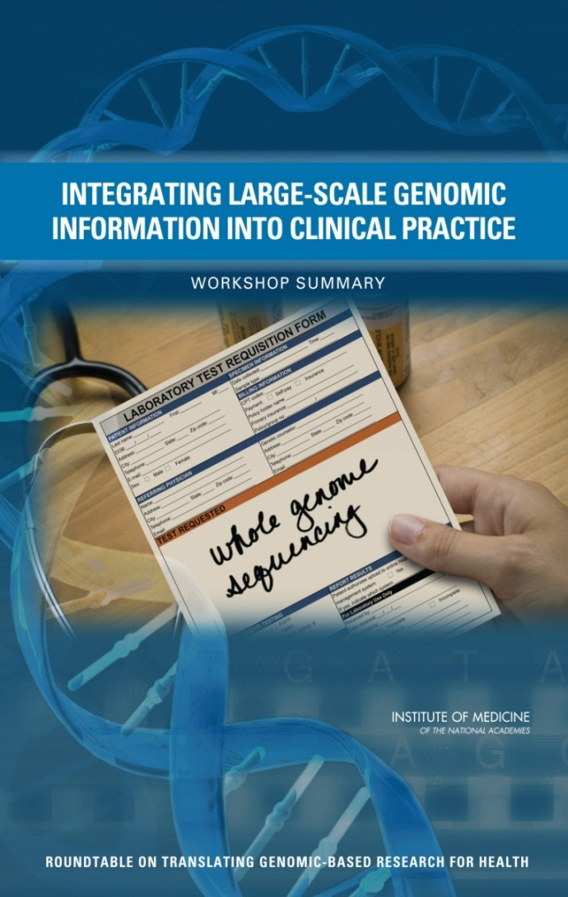

Institute of Medicine Report
Document 22
Notes:
This past July, the IOM Roundtable on Translating Genomic-Based Research for Health hosted a workshop to highlight and identify the challenges and opportunities in integrating large-scale genomic information into clinical practice.
The main objective of the workshop was to start a discussion on what needs to be done to prepare the necessary infrastructure and to address the various challenges for realizing genomic medicine.
The workshop summary is shown here and is available as Document 22.
We have heard that this report has generated the most interest of any of the meetings and reports generated to date by the Roundtable.
There will be a follow-on meeting July 2012 exploring aspects of the economics of clinical and research applications of whole-genome sequencing that Greg Feero is will be chairing.

Slide 40
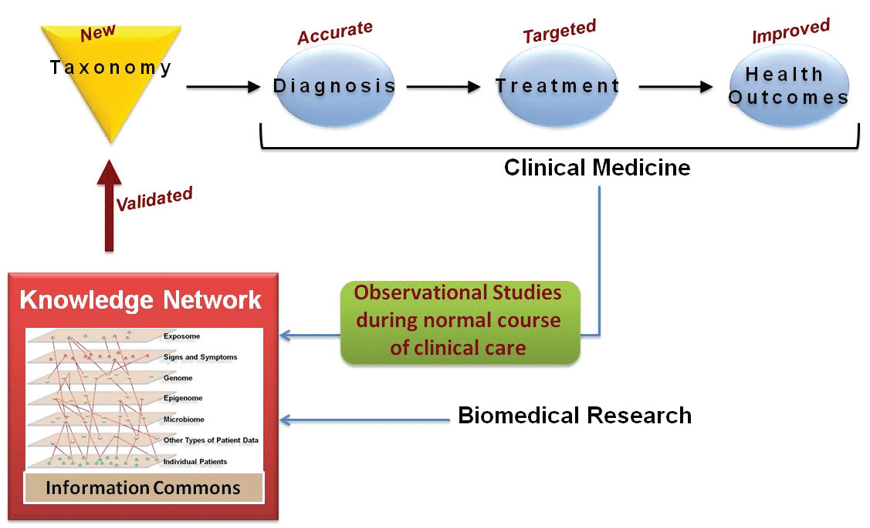

National Academies Report
“Toward Precision Medicine: Building a Knowledge Network for Biomedical Research and a New Taxonomy of Disease”
Document 23
Notes:
Motivated by the explosion of molecular data on humans— particularly data associated with individual patients— and the sense that there are large, as-yet-untapped opportunities to use these data to improve health outcomes, the National Academies issues this report on Toward Precision Medicine.
This report explores the feasibility and need for "a new taxonomy of human disease based on molecular biology" and develops a potential framework for creating one.
Toward Precision Medicine notes that moving toward individualized medicine requires that researchers and healthcare providers have access to very large sets of health-related and disease-related data linked to individual patients. These data are also critical for developing the information commons, the knowledge network of disease, and ultimately the new taxonomy.

Slide 41

Battelle Report on
Genomic Clinical Testing Industry
Document 24
Notes:
As you may recall, in May of 2011, Battelle Technology Partnership Practice published an economic analysis (supported by Life Technologies) on the economic and functional impacts of the federal investment in genomics R&D through the Human Genome Project and beyond.
Recently, they released a related report on behalf of the American Clinical Laboratory Association that examines the economic and functional impacts of genetic and genomic clinical laboratory testing.
The study found that the even though it is in its early stage, the genetics and genomics clinical testing sector has been responsible for directly and indirectly employing 116,000 workers, generating nearly $6 billion in personal income, and providing $1.2 billion annually in federal tax revenue.

Slide 42

American College of Medical Genetics Changes Name to American College of Medical Genetics and Genomics
and Genomics
Effective March 2012
at the ACMG Annual
Clinical Genetics Meeting
Document 25
Notes:
Our good friends at the American College of Medical Genetics recently decided to change the name of their organization to the * American College of Medical Genetics and Genomics
* This will take effect in March at their annual meeting; however, they will maintain the same acronym, ACMG.
According to ACMG, the name change "recognizes the increasingly central role of medical genomics and its importance alongside genetics in fulfilling the mission of the ACMG."

Slide 43
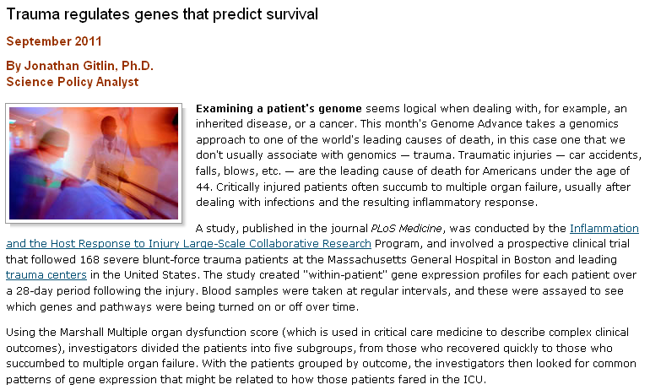
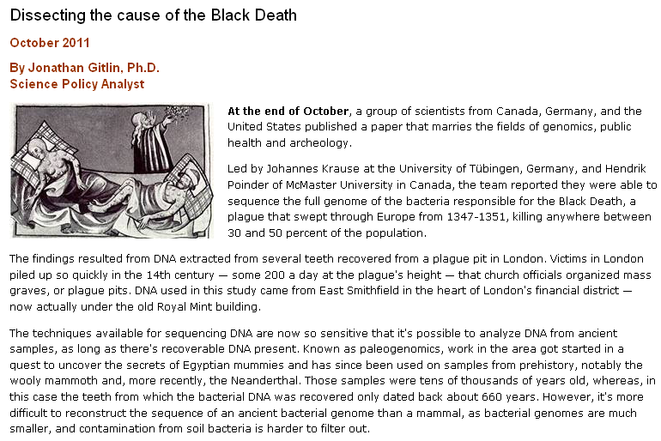
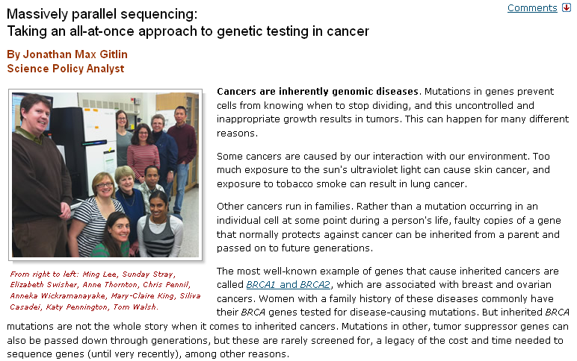
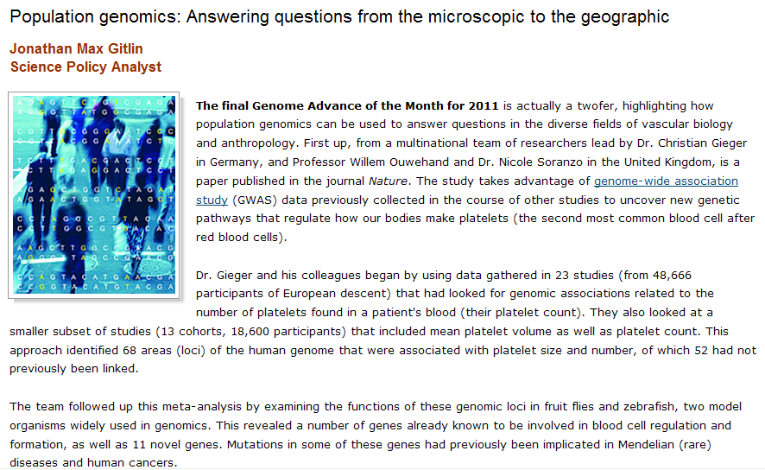
NHGRI Genome Advance of the Month
Document 26
Notes:
NHGRI continues to feature on our web site a monthly feature highlighting a genomic advance of the month.
Recent topics have included: a genomics approach to the study of trauma, the sequence of the full genome of the bacteria responsible for the Black Death, next-generation sequencing targeted at known tumor suppressor genes, and the use of previously collected GWAS data to uncover new genetic pathways that regulate how our bodies make platelets.

Slide 44



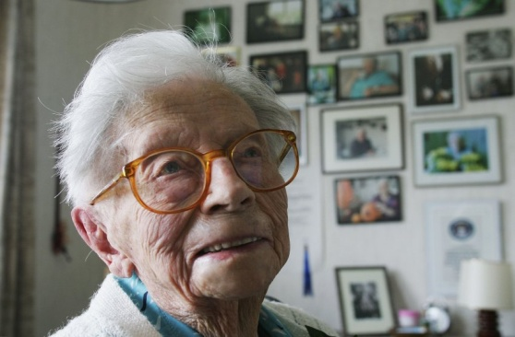
Genomics In The News…
First Australian Aboriginal Genome Sequenced
Genome Of World’s Oldest Woman Sequenced
Document 27
Notes:
I will now move to my regular “Genomics in the News” features, starting with recently sequenced genomes that captured news attention:
* The genome of an aboriginal man who lived in the 1920s was sequenced. An analysis of the resulting sequence data suggests that his ancestors started their migratory journey more than 60,000 years ago, branching off from humans who left Africa.
* Scientists recently sequenced the genome of a Dutch woman who lived to age 115 (Hendrikje van Andel-Schipper, 1890-2004). This woman overcame breast cancer at the age of 100, and never showed signs of dementia or Alzheimer’s disease.

Slide 45
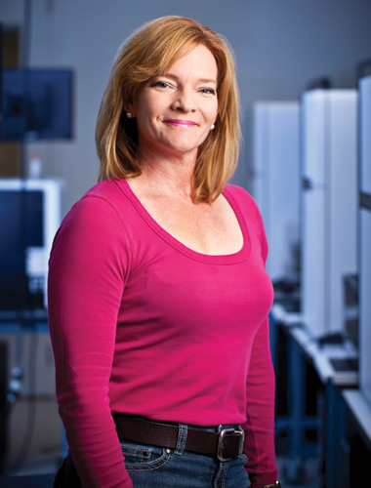
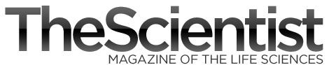
Genomics In The News…
Elaine Mardis, Ph.D.
“High-Tech Choir Master”
Document 27
Notes:
In January, The Scientist ran a feature story about Elaine Mardis entitled “High-Tech Choir Master.”

Slide 46
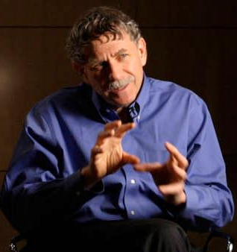
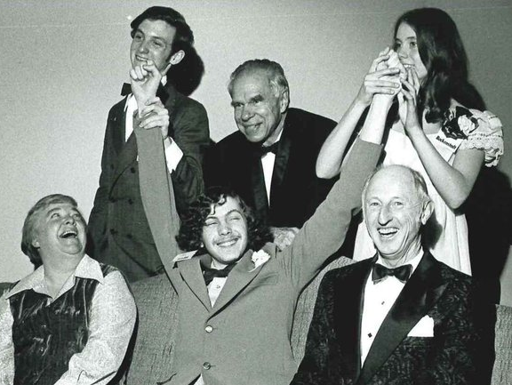
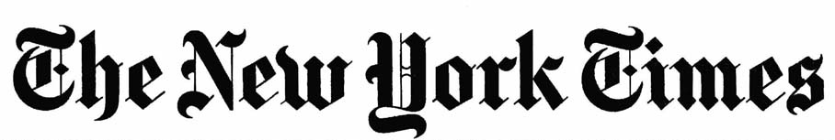
Genomics In The News…
Eric Lander, Ph.D.
“Power in Numbers”
Document 27
Notes:
Also in January, the New York Times ran a feature article about Eric Lander entitled “Power in Numbers.”
That article was accompanied by various pictures of Eric, including * this one of him winning first place in the 1974 Science Talent Search. In the same year, he made the American team in the Mathematics Olympiad.
* And here is another picture that more accurately captures his modern look and energy-filled gestures.

Slide 47
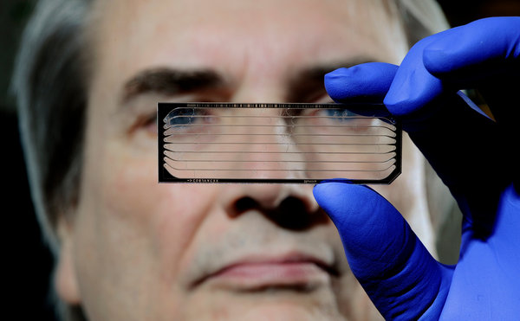

Genomics In The News…
“DNA Sequencing Caught in Deluge of Data”
Dick McCombie, Ph.D.
Document 27
Notes:
Another New York Times article highlighted the genomic data explosion, and had an interesting picture of Dick McCombie and a sequencing flow cell.

Slide 48
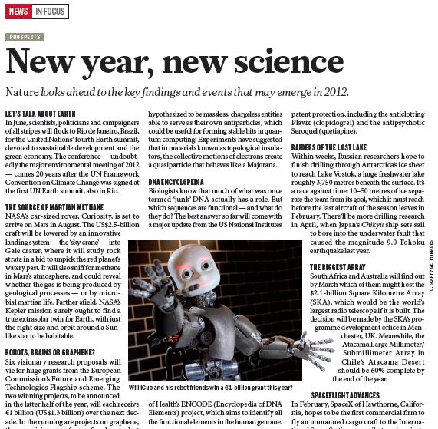
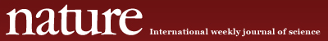

Genomics In The News…
Document 27
Notes:
ENCODE was identified by Nature magazine as a potential “key finding and event that may emerge in 2012.”
An accompanying article ‘foreshadows’ a major update from the project that is expected to be reported in a major publication in 2012.

Slide 49





Genomics In The News…
Document 27
Notes:
The NHGRI Sequencing Technology Development Program was featured in a flurry of stories reported in the Wall Street Journal, Reuters, National Public Radio, Nature, and other news outlets.
Those reports featured the announcement early last month that two major sequencing technology companies will release new systems in 2012 that are predicted to enable sequencing a whole human genome for $1,000.

Slide 50

Genomics In The News…
Document 27
Notes:
So, we now know that universities have DNA.

Slide 51

Notes:
And cars have DNA.
With such developments, one can only envision NHGRI’s portfolio of DNA research expanding…

Slide 52
General NHGRI Updates
General NIH Updates
Genomics Updates
NHGRI Extramural Program
NIH Common Fund Programs
NHGRI Office of the Director
NHGRI Intramural Program

Slide 53

Large-Scale Genome Sequencing Centers
  Baylor College of Medicine
    PI: Richard Gibbs
    $21.3M in Year 1
  Broad Institute
    PI: Eric Lander
    $35.9M in Year 1
  Washington University
    PI: Richard Wilson
    $28.4M in Year 1
Document 28
Notes:
Following the extensive discussion with Council about the renewal of our Genome Sequencing Program at the September meeting, we made final decisions and announced the new awards in December. Recall that there are four major components of the renewed NHGRI Genome Sequencing Program.
The first component is the Large-Scale Genome Sequencing Centers, which was renewed for 4 years at a Year 1 funding level of $86 million. As you all know, the funded centers are at Baylor College of Medicine, the Broad Institute, and Washington University, with the PIs and Year 1 funding levels shown here.
The Large-Scale Genome Sequencing Centers will conduct research into how the human genome works as well as studies of the genetic contributions to common complex illnesses and ongoing special projects, such as The Cancer Genome Atlas. The Centers will also be involved in new medical initiatives and will continue to implement technological advances in DNA sequencing; develop new techniques and software to analyze and understand the massive amounts of DNA sequence data now being produced; and continue to train genomic researchers.

Slide 54
Mendelian Disorders Genome Centers
  University of Washington (Coordination Center)
      PIs: Deborah Nickerson, Michael Bamshad, Mark Rieder, & Jay Shendure
      $5.2M per year
  Yale University
      PIs: Richard Lifton, Murat Gunel, Shrikant Mane, & Mark Gerstein
      $2.8M per year
  Baylor College of Medicine & Johns Hopkins University
  PIs: David Valle (Hopkins) & James Lupski (Baylor)
        $4M per year
Document 28
Notes:
The second component of our renewed Genome Sequencing Program involves the creation of new Mendelian Disorders Genome Centers.
For this, NHGRI partnered with the National Heart, Lung, and Blood Institute to invest $48 million over the next 4 years to fund 3 Centers (with NHGRI and NHLBI contributing $40 million and $8 million, respectively).
The funded Centers are located at the University of Washington (which will also serve as the Coordination Center for the group), Yale University, and a partnership between Baylor College of Medicine and Johns Hopkins University. The PIs and funding amounts are shown here.
These 3 Centers will collaborate with a worldwide network of rare disease experts to sequence the genomes of thousands of patients and their family members to identify the genetic variants responsible for rare genetic disorders.
As the Coordination Center, the University of Washington group will coordinate the center activities that are essential for the program’s success and will host the sole web portal for sample solicitation.

Slide 55

Clinical Sequencing Exploratory
Research Projects
  Baylor College of Medicine
      PIs: Sharon Plon & Will Parsons, $1.8M per year (with NCI)
  Brigham and Women's Hospital
      PI: Robert Green, $2.4M per year
  Children's Hosp. of Philadelphia
      PIs: Ian Krantz & Nancy B. Spinner, $2.2M per year
  University of North Carolina
      PI: James Evans, $1.6M per year
  University of Washington
      PI: Gail Jarvik, $2.3M per year (with NCI)
  Dana Farber Cancer Institute
      PIs: Levi Garraway & Pasi Janne, $1.6M per year
Document 28
Notes:
The third component of our renewed Genome Sequencing Program involves the creation of new Clinical Sequencing Exploratory Research Projects.
For this, 6 awards of the indicated amounts have been made to the indicated PIs, who will be investigating technical, ethical, and psychosocial questions related to the application of genome sequencing in the clinic.
Note that the 2 awards with particular emphasis on cancer are being co-funded by NCI.

Slide 56

Informatics Tools for High-Throughput Sequence Data Analysis Awards
Broad Institute ($1.0M in Year 1)
  PI: Mark DePristo
Boston College & U. Michigan ($1.0M in Year 1)
  PIs: Gabor Marth & Goncolo Abecasis
Washington University ($805K in Year 1)
  PIs: Li Ding & David Dooling
Harvard ($448K in Year 1)
  PI: Steven McCarroll
Scripps Institute ($382K in Year 1)
  PI: Ali Torkamani
University of Southern California ($345K in Year 1)
  PIs: Ting Chen, Ewa Deelman, & James Knowles
Notes:
The fourth and final component of our renewed Genome Sequencing Program involves grants for developing informatics tools for high-throughput sequence data analysis.
For this, 6 awards have been made for a total of $16M over four years. The goal of this program is to democratize access to next-generation DNA sequence analysis software so that independent researchers can analyze their own sequence data. This program builds on previous investments that have led to nascent software tools. The grantees will work to harden such software to make it reliable, robust, easy to install, and user friendly for independent researchers and non-genomicists.
The PIs and funding amounts are shown here. Also note that there will also be one or two SBIR awards eventually made as part of this program.

Slide 57



Genome Sequencing Program:
Comparative Genomics
Nature (2011)
Document 28
Notes:
One highlight worth featuring from the Genome Sequencing Program is the recent publication in Nature reporting the sequencing and comparative analysis of 29 eutherian genomes. The authors generated a high-resolution map of more than 3.5 million evolutionarily constrained elements that encompass about 4% of the human genome.
This study further used evolutionary signatures and comparisons with experimental data sets to suggest candidate functions for about 60% of the constrained bases.
Overlap with disease-associated variants indicates that these findings will be relevant for future studies of human biology, health, and disease.
The data sets for this study are publicly available at the Broad Institute and at the UCSC Genome Browser.

Slide 58

Document 29
Document #
Notes:
The Cancer Genome Atlas (TCGA) program held its first public scientific symposium in November.
All presentations described research using TCGA data. The meeting was very well attended, and actually “sold out”.
All of the talks are available on NHGRI’s GenomeTV channel of YouTube, and the link to those talks is provided in Document 29.
Based on the success of the meeting, there will be a second TCGA scientific symposium in November 2012. AACR has agreed to co-sponsor and advertise the meeting with NCI and NHGRI.

Slide 59
Document #
Notes:
TCGA continues to make great strides towards its ambitious goals.
The program had a goal of analyzing 5,000 tumor samples by end of 2011— and reached it. Another goal is to comprehensively analyze specimens from at least 20 tumor types— the list on the right shows the active 22 projects in TCGA today.
Accrual has actually closed for glioblastoma, ovarian, colorectal, and renal clear cell carcinoma, meaning the goal of qualifying 500 cases for these projects has been achieved.
There are active tumor working groups, preparing papers for publication for many of the tumor types, including some of the most prevalent cancers. A manuscript describing the full characterization of the colorectal carcinoma genome is under review, and papers for breast, lung, and kidney cancer as well as acute myeloid leukemia are in preparation and are expected to be published by the end of 2012.

Slide 60

  The Phase 1 paper is being written on 1094 samples from 14 populations, with 40 million SNP, indel, and deletion variants on integrated haplotypes
  The Phase 2 data set contains low-coverage and exome sequencing data on 1600 unrelated samples from 19 populations
  The Phase 3 sample collection from 7 more populations should be completed by April; all the sequencing should be completed by fall 2012, on 2500 unrelated individuals plus 161 trio kids
  Complete Genomics will deeply sequence 500 samples, including 161 trios
Document 30
Notes:
* * * *
In total, there are now 2661 samples being studied by the 1000 Genomes project.

Slide 61




DNA Sequencing Technology Development
Annual grantee meeting
    Grantees only: April 9-11
    Public: April 11-12
Presentation by Jeff Schloss later in Open Session
Document 31
Notes:
* The 8th annual meeting of the Advanced DNA Sequencing Technologies program grantees will be held in April in San Diego. As in past years, the last portion of the meeting will be opened to other interested members of the research community.
* Jeff Schloss will give an update about this program later today.

Slide 62

ENCODE & modENCODE
Technology development RFA applications to be discussed in Closed Session
Applications for the next production phase of ENCODE have been received and will be discussed at May 2012 Council meeting
modENCODE Symposium: June 20-21, 2012
Notes:
* Applications received in response to three technology development RFAs will be discussed during the Closed Session.
* Three ENCODE RFAs (with U01, U41, and U54 mechanisms) were released this past October, and applications were received in December. These RFAs aim to solicit applications for research projects to apply high-throughput, cost-efficient approaches to extend ENCODE resources toward as complete of catalogs as feasible. Applications will be reviewed in March and discussed by Council in May.
* NHGRI is currently in the planning stages for a modENCODE symposium to be held on the NIH campus on June 20-21. Our goal is to broaden community understanding of model organisms and showcase the contributions of the modENCODE Consortium. The meeting is planned to tie into the upcoming Model Organisms to Human Biology meeting (organized by the Genetics Society of America and scheduled at an adjacent time to our symposium).

Slide 63
Analyses
ENCODE analysis session at December GENEVA Steering Committee meeting launched new collaborations
Integrated analysis papers:
  ENCODE – integrated manuscript under revision along with many companion papers
  modENCODE – comparison of fly, worm, and human
  Mouse – comparison of mouse and human
Notes:
* At the December GENEVA Steering Committee meeting, there was a joint session including ENCODE and GENEVA investigators. ENCODE investigators analyzed 8 GENEVA/GARNET GWAS datasets, and they were paired up with the GENEVA/GARNET investigators for hands-on demonstrations of how to use ENCODE data to follow up GWAS findings. New collaborations between the consortia were established, already resulting in plans for publications and grant applications.
* Meanwhile, several integrated analysis papers are the works:
* The ENCODE Consortium has a major integrative paper under revision, along with many companion papers— all of which aim to be published in 2012.
* The modENCODE Consortium is working on a paper that integrates worm, fly, and human modENCODE and ENCODE data.
* The mouse ENCODE Consortium is currently planning a comparison of human and mouse data.

Slide 64

Return of Results Consortium
Components:
  ELSI Return of Results RFAs (R01 and R21)
  ELSI investigators in the Clinical Sequencing Exploratory Research Projects (U01)
  Related investigator-initiated projects
Goal: Identify areas of possible consensus that can form basis for policy development
Plans for sharing outcome measures and instruments underway
Joy
Notes:
In our ELSI Program, the new Return of Results Consortium is now active.
This is a consortium of investigators conducting either behavioral/social or normative research on ethical, legal, and social issues related to returning genomic results– including incidental findings– to study participants or to patients in the context of clinical care.
* The consortium includes investigators from 7 R01 and R21 grants funded through the recent Return of Results RFAs, the ELSI investigators funded in the 6 U01 Clinical Sequencing Exploratory Research Project grants, and investigators on two other ELSI grants who are studying related issues.
* The consortium aims to identify areas of possible consensus that can form the basis for policy development in this complex area.
* Already, plans are underway among the investigators for sharing outcome measures and instruments, which should facilitate standardization and ultimately make it easier to compare data generated across studies.

Slide 65

Centers of Excellence in Genomic Science (CEGS) & Diversity Action Plan (DAP)
CEGS applications to be discussed in the Closed Session of this Council meeting
Next receipt dates:
    CEGS: May 17, 2012
    DAP: May 25, 2012
Document 32
Notes:
The Centers of Excellence in Genomic Science (CEGS) and Diversity Action Plan (DAP) programs held back-to-back meetings this past October at the Dana-Farber Cancer Institute in Boston. This was our largest CEGS meeting, with 10 active groups. As usual the science was outstanding.
We are hoping to bring the two CEGS groups whose grants are now ending to a future Council meeting, so they can share their experiences and results with Council Members.
The summary of the Diversity Action Plan meeting has been provided under Document 32.
* We will be discussing the most recent round of CEGS applications and their reviews during the Closed Session of this Council meeting.
* The next receipt date for applications to the CEGS program is May 17 and to the Diversity Action Plan program is May 25.

Slide 66

Characterizing and Displaying Genetic Variants for Clinical Action Workshop
Goal: Consider processes, databases, and other resources needed to:
  Identify clinically relevant variants
  Decide whether they are actionable and what the action should be
  Provide for clinical use
  Video, presentations, and recommendations posted on genome.gov
  Concept Clearance presentation later today
Document 33
Notes:
In December, NHGRI hosted a workshop on characterizing and displaying genetic variants for clinical action– dubbed the ClinAction Workshop.
The workshop was a collaboration between NHGRI and the Wellcome Trust, and drew ~80 participants from a wide range of disciplines and organizations, including several NIH Institutes and Centers, the Centers for Medicare and Medicaid Services (CMS), and the Food and Drug Administration (FDA).
* The goal of the workshop was to consider processes, databases, and other resources needed to identify clinically relevant variants, decide whether they are actionable and what the action should be, and provide this information for clinical use.
* Videos, presentations, and recommendations from the workshop are now posted on our web site (genome.gov), and a manuscript describing the topics covered in the workshop is in preparation.
* A Concept Clearance about this area will be presented later today by Teri Manolio.

Slide 67

Genomic Medicine II Meeting
  Second in series of four planned genomic medicine meetings
  Goals:
  Develop ideas for multicenter collaborative pilot projects in genomic medicine
  Learn of new projects ongoing at partner sites
  Identify infrastructure needs and solutions to speed adoption of genomic medicine
Video, presentations, and recommendations posted on genome.gov
Concept Clearance presentation later today
Document 34
Notes:
Also in December, NHGRI hosted a Genomic Medicine II meeting, which built on the June Genomic Medicine I meeting that was presented at the last Council meeting by Geoff Ginsburg and Teri Manolio. * This was the second in at least four planned genomic medicine meetings under the auspices of Council’s new Genomic Medicine Working Group. The meeting was attended by ~70 people.
* The goals of the meeting were to develop ideas for multicenter collaborative pilot projects in translational genomic medicine, learn of new projects ongoing at potential partner sites, and identify infrastructure needs and solutions to speed the adoption of genomic medicine. Six subgroups in topical areas were created and are now actively meeting.
* Videos, presentations, and recommendations from the workshop are now posted on genome.gov. * A Concept Clearance about this area will be presented later today by Teri Manolio.
A Genomic Medicine III meeting will be held in Chicago in May and will focus on barriers to implementing genomic medicine programs and discussions with payers, professional organizations, and government regulatory agencies.

Slide 68
General NHGRI Updates
General NIH Updates
Genomics Updates
NHGRI Extramural Program
NIH Common Fund Programs
NHGRI Office of the Director
NHGRI Intramural Program

Slide 69

Molecular Libraries Program (MLP)
MLP Screening & Chemistry Centers’ mid- year reports showed good progress toward milestones
MLP Steering Committee meeting:
    Presentations on center-driven research projects
    Begin development of Molecular Libraries Biological Database
Document 35
Notes:
* The Molecular Libraries Program holds back 25% of each Center’s annual award for release based on demonstrated progress at the mid-year point toward a set of year-end milestones. The four NHGRI-managed centers demonstrated good to excellent progress toward all milestones this year.
* The MLP Steering Committee Meeting occurs twice a year. The November meeting had individual presentations on center-driven research projects funded as part of each centers’ U54 grant (the center-driven projects were added by request of Dr. Zerhouni in 2008). Another key topic at this meeting was the development of a “next generation database” to advance chemical biology data analysis beyond that currently provided by PubChem. Development of this Molecular Libraries Biological Database will be supported through grant supplements to several MLP centers.

Slide 70

Knockout Mouse Projects
KOMP Finale, KOMP2 Kickoff, and IMPC Launch Meeting: September 2011
KOMP2 Awards for Knockout Mouse Production and Knockout Mouse Phenotyping
    Baylor College of Medicine: Justice/Justice
    The Jackson Laboratory: Donahue/Braun
    UC Davis: Lloyd/Lloyd
KOMP2 Award for Data Coordination Center and Database
    European Bioinformatics Institute: Flicek
Document 36
Notes:
The KOMP program came to an end in September, but there are some no-cost extensions to cover wind-down activities.
* The KOMP Finale and KOMP2 Kickoff meeting was combined with an International Mouse Phenotyping Consortium (IMPC) Meeting in September.
* For KOMP2, awards were made in Fiscal Year 2011, with overall funding for the program being $111M over 5 years. The goal is to produce and phenotype 2500 mouse strains.
Three centers that had submitted paired mouse production and mouse phenotyping applications were funded, as shown here.
* One application was funded for the Data Coordination Center and Database to the EBI.

Slide 71
Genotype-Tissue Expression (GTEx)
December 2011 meeting: Pilot roughly half completed
Enrolling 10 post-mortem donors/month (on target); RNA integrity very good
Proposal for scale up being developed
Document 37
Notes:
* GTEx investigators had their third in-person meeting in December 2011, at the point when the pilot phase of the project was roughly half completed.
* There has been excellent progress in meeting the milestones for the pilot phase, especially with respect to donor enrollment (as shown on the bar graph). Specifically, the program is averaging 10 donors/month, with the current total number approaching 100 (note that the pilot phase target is 160).
Also, the resulting quality of the purified RNA from the rapid-autopsy tissues has been very good, essentially at the proposed target levels.
The External Scientific Panel was very impressed with progress.
* A proposal for scaling up the project to include an additional 600-800 donors is being developed, and will be submitted to the Common Fund group shortly for possible Fiscal Year 2013 funding.

Slide 72

Library of Integrated Network-based
Cellular Signatures (LINCS)
Consortium meeting in October 2011
LINCS program public web site now live
Bridge funding proposal for Fiscal Year 2013
Data release policy under development
Document 38
Notes:
* The LINCS program held a Consortium meeting in October with members of the production centers as well as newly awarded collaborative supplement, technology development, and computational tool awardees. The External Advisory Panel members for the project were also in attendance and provided several recommendations, including developing a trans-center project between the U54 and U01 groups, creating a public data release policy, and defining metrics for the program.
* The LINCS centers have created a public web site to inform the community about the LINCS program as well as to describe the data available through the respective center’s web sites, to discuss current experimental components of the program, and to update users on new developments in LINCS.
* NIH staff is in the process of developing a plan for bridge funding for LINCS in Fiscal Year 2013. The proposal is being coordinated with the Common Fund and should be finalized shortly.
* As recommended by the External Advisory Panel, NIH staff is currently developing language for a data release policy for the program, which will include input from the LINCS U54 and U01 production centers.

Slide 73

Protein Capture Reagents Program
Protein Capture Consortium meeting in December
  Working groups formed
  Development of public portal
External Scientific Panel established for the program
Document 39
Notes:
For the Common Fund’s Protein Capture Reagents Program, the newly funded grantees of the antibody production and technology development centers (which comprise the Protein Capture Consortium) * met for a kick-off meeting in December.
Accomplishments of the meeting included the formation of working groups to complete certain tasks and the development of a public portal to access the affinity reagents.
* In addition, NIH staff put together an External Scientific Panel comprised of five members with appropriate expertise for the program. This Panel had a chance to make initial suggestions during the December Meeting, and NIH staff is planning a follow-up conversation in the coming months.

Slide 74

Human Heredity and Health
in Africa (H3Africa)
Applications for four RFAs (centers, research projects, biorepositories, and bioinformatics network) received in December; excellent response
Review of applications: March → May
Biorepository RFA re-issued
Wellcome Trust application process proceeding well and on similar timeline
Ethics and Genomics Research in Africa (EAGER-Africa) Meeting in November 2011
Document 40
Notes:
* Applications for all four RFAs (centers, research projects, biorepositories, and bioinformatics network) were received in December; the response was excellent.
* The initial review of these applications will be in March, while the second-level review will be at the May Council meeting.
* The biorepository RFA was re-issued for technical reasons; the due date is in February.
* The Wellcome Trust application process is proceeding well and is on a similar timeline.
* Finally, an important meeting was held in November in Nigeria, called Ethics and Genomics Research in Africa (or EAGER-Africa). At this meeting, a group of bioethicists, researchers, policy makers, and representative from various African countries, the U.S., and the U.K. gathered to discuss the ethical conduct of genomics research in Africa. These deliberations will inform some of the broader plans for H3Africa.

Slide 75

Single Cell Analysis RFAs Issued
Studies to Evaluate Cellular Heterogeneity using Transcriptional Profiling of Single Cells (U01)
Exceptionally Innovative Tools and Technologies for Single Cell Analysis (R21)
Accelerating the Integration and Translation of Technologies to Characterize Biological Processes at the Single Cell Level (R01)
Applications were due in January
Document 41
Notes:
For the Common Fund’s new single cell analysis initiatives, new RFAs were published since our last Council meeting. They were in the following areas: * * *
* Applications were due in late January.

Slide 76

New Common Fund Initiative?
‘Disruptive Proteomics Technologies’
Chosen for potential new Common Fund program starting in Fiscal Year 2013
NIGMS and NHGRI as co-leads
Strategic planning underway
Document 42
Notes:
And finally, among the new areas chosen for a potential future Common Fund initiative is “disruptive proteomics technologies.”
* This potential initiative was proposed during the solicitation for potential new Common Fund programs last summer for funding in Fiscal Year 2013. The Institute and Center Directors endorsed this idea, so the Common Fund is moving forward in developing this program. * NIGMS and NHGRI have been asked to co-lead this effort.
A trans-NIH working group has been established (including Tina Gatlin and Adam Felsenfeld from NHGRI) and * strategic planning is underway, which includes a portfolio analysis and gathering community input. A proposal for the program by the working group is due April 27; if approved for further consideration, then a Concept Clearance will be brought to the Council of Councils at their June meeting.
Meanwhile, early planning for new Common Fund programs that will begin in Fiscal Year 2014 has just started, and I will have more to say about these efforts at later Council meetings.

Slide 77
General NHGRI Updates
General NIH Updates
Genomics Updates
NHGRI Extramural Program
NIH Common Fund Programs
NHGRI Office of the Director
NHGRI Intramural Program

Slide 78

NHGRI Catalog of Published Genome-Wide Association Studies (GWAS)
5619 SNPs, January 2012!
Document 43
Notes:
The NHGRI GWAS catalog team continues to curate GWAS data from the published literature.
That curation effort now accounts for 1,615 associations for roughly 250 traits at p<5 x 10-8 values.
* As of January of this year, the catalog has reached over 5600 associated SNPs with p values of <10-5.

Slide 79



GWAS Catalog: New Features
NEW
NEW
Document 43
Notes:
Recently, two new columns of information were added to the GWAS catalog: mapped gene and SNP context.
* If you click on one of the links under the mapped gene column, for example, * you are taken to the relevant Entrez gene page.
These fields are a result of continued collaborations with NCBI to improve the quality of data that are made available to the scientific community. A collaboration with EBI has also been recently initiated to add curation expertise to the catalog team and make informatics improvements— such as automating the catalog diagram and standardizing trait names to an ontology.

Slide 80





NEJM Genomic Medicine Series
Document 44
Notes:
13 articles have now been published as part of the NEJM genomic medicine series edited by Greg Feero and Alan Guttmacher. There are a total of 14 articles planned for this series.
Shown here are the latest four articles published since the last Council meeting.

Slide 81

U.S. Science and Engineering Festival
Document 45
Notes:
The 2nd USA Science and Engineering Festival will take place on April 28-29, 2012 at the Washington Convention Center.
As with the last festival held in October 2010, NHGRI will be heavily represented as NIH representatives with booths for hands-on activities. As a result, many many strawberries will be sacrificed in pursuit of their DNA.
This year we are also partnering with the American Society of Human Genetics to have joint activities.

Slide 82


My Family Health Portrait
Notes:
Greg Feero chairs a trans-NIH working group charged with exploring trans-NIH collaborations on family history research and My Family Health Portrait-related activities.
Meanwhile, Geoff Ginsburg and Lori Orlando co-chair an NHGRI-organized working group on family history as part of our broader extramural genomic medicine planning efforts.

Slide 83



Genomic Medicine Lecture Series
Monthly seminars being held at Suburban Hospital in Bethesda
David Valle, M.D.
Larry Brody, Ph.D.
Document 46
Notes:
NHGRI is collaborating with Suburban Hospital in Bethesda and the Johns Hopkins University School of Medicine to hold a monthly grand rounds-style seminar covering topics in genomic medicine.
Greg Feero is leading the planning committee for this series, which will run from last December to this coming June.
All the talks are being videotaped and will be made available on NHGRI’s GenomeTV channel of YouTube.

Slide 84

Genomic Opportunities for Studying Sickle Cell Disease Meeting: December 2011
Co-Chairs: Michael DeBaun, Richard Gibbs, and Julie Makani
Notes:
A meeting to explore the genomic opportunities for studying sickle cell disease was held last December in California.
While NHGRI was the lead organizer, we partnered with several other NIH institutes including NHLBI, NICHD, NIDDK, NIMHD, and NINDS for the meeting.
* The meeting was co-chaired by Micheal DeBaun, Richard Gibbs, and Julie Makani (from Tanzania). Attendees included Council member Rick Wilson.
There was general enthusiasm from the participants for accelerating research into sickle cell disease using genomic approaches. The discussion also emphasized the fact that attention needs to be paid to the appropriate selection of samples and to phenotyping.
The participating NIH Institutes are continuing discussions to explore future collaborations in this area.

Slide 85

Pharmacist Education Meeting
Notes:
Late last year, the Genomic Healthcare Branch in collaboration with Grace Kuo held a meeting on pharmacist education in the era of genomic medicine that included representatives of major U.S. pharmacy organizations.
The meeting discussed pharmacist education in genomics and identified a number of priorities to pursue.
A meeting summary will be forthcoming in the near future.

Slide 86
General NHGRI Updates
General NIH Updates
Genomics Updates
NHGRI Extramural Program
NIH Common Fund Programs
NHGRI Office of the Director
NHGRI Intramural Program

Slide 87

Blue Ribbon Panel Review of NHGRI Intramural Research Program
David Page, M.D. (Chair)
Rick Myers, Ph.D. (NACHGR)
Bruce Korf, M.D., Ph.D. (BSC)
Wylie Burke, M.D., Ph.D
Nancy Cox, Ph.D
Bob Waterston, M.D., Ph.D
Huda Zoghbi, M.D.
Notes:
As I mentioned at the last Council meeting, the NHGRI Intramural Research Program is undergoing a Blue Ribbon Panel review (the last one being in 2001).
Shown here is the Panel’s membership (note that Rick Myers is the representative from Council).
The first meeting of the Blue Ribbon Panel occurred last month.
Future steps for this review will include a conference call in the spring and then a final in-person meeting in July.
At the September Council meeting, there will be:
A presentation about the NHGRI Intramural Research Program by Dan Kastner (Director of the Division of Intramural Research)
A presentation about the Report of the Blue Ribbon Panel by Rick Myers

Slide 88






NHGRI Intramural Research Highlights
Document 47
Notes:
Recent highlights from NHGRI’s Intramural Research Program include the following:
* Dan Kastner and colleagues published a study in the NEJM identifying a genetic mutation that causes cold temperatures to trigger allergic reactions— a condition known as cold urticaria. In addition to pointing the way toward a potential cure, this finding provided new insights about immune system function.
* Yardena Samuels and an NIH-led team studying the genetics of melanoma reported in Nature Genetics that mutations in a metabotropic glutamate receptor-3 gene are relevant to the pathogenesis of melanoma.
* Les Biesecker and colleagues at the NIH Intramural Sequencing Center, the Children’s National Medical Center, and Johns Hopkins University published a nice paper in the American Journal of Human Genetics that reported the use of next-generation genome sequencing method to identify the gene mutated in the pediatric condition known as paroxysmal nocturnal hemoglobinuria.

Slide 89



William Gahl Honored with Prestigious Service to America Medal
Document 48
Notes:
At last May’s Council meeting, I mentioned that Bill Gahl— NHGRI’s Clinical Director and Founding Director of the NIH Undiagnosed Diseases Program— was one of nine finalists to receive the Samuel J. Heyman Service to America Medal from the Partnership for Public Service.
* And I very proud to tell you that he indeed won that award in the category of Science and Environment.
The Sammie awards (as they are called) pay tribute to members of the federal workforce, highlighting those who have made significant contributions to our country. Honorees are chosen based on their commitment and innovation, as well as the impact of their work on addressing the needs of the nation.

Slide 90




Notes:
By far the most significant event since the last Council meeting (at least for me and Rick Wilson) was…

Slide 91

Special Thanks!
Notes:
Special thanks to Kris Wetterstrand.
Also, Larry Thompson, Judy Wyatt, and the NHGRI web team.

Slide 92

Notes:
Questions?

