Slide 1

National Advisory Council for Human Genome Research
May 2013
Eric Green, M.D., Ph.D.
Director, NHGRI
DIRECTOR’S REPORT
Notes:
The Open Session of this National Advisory Council for Human Genome Research meeting is being webcast live.
As is now our routine, the Open Session of all of our Council meetings are videotaped and made available as a permanent archive on the web, including videos of the presentations themselves and the various associated documents.

Slide 2
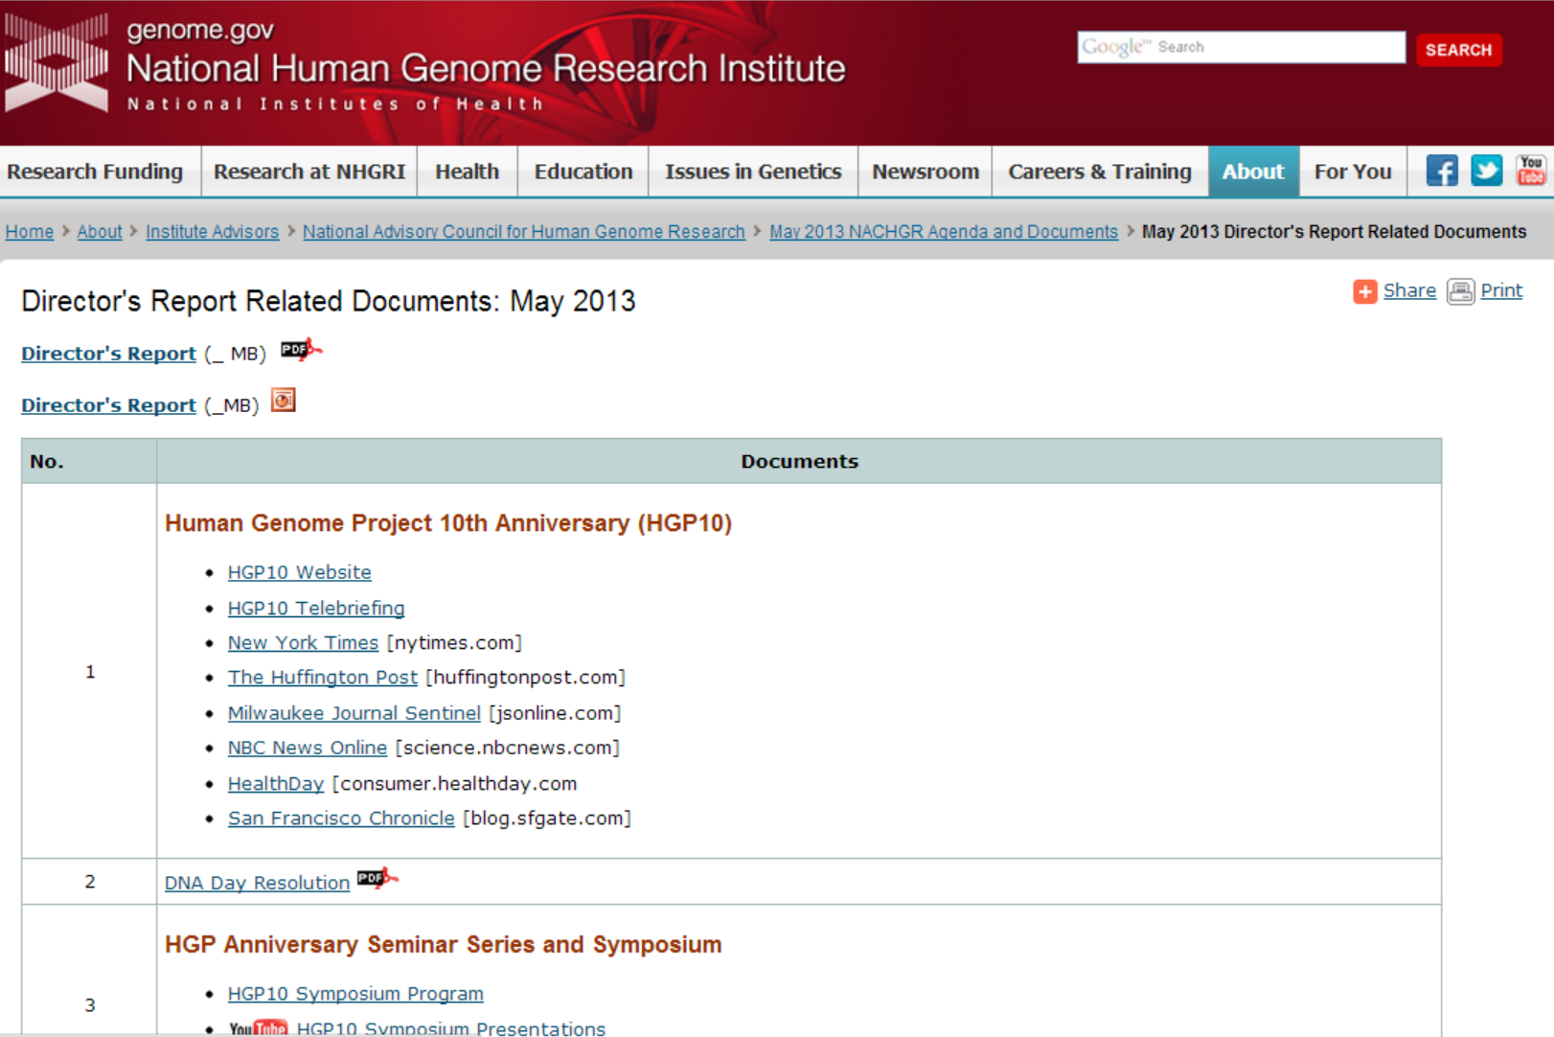
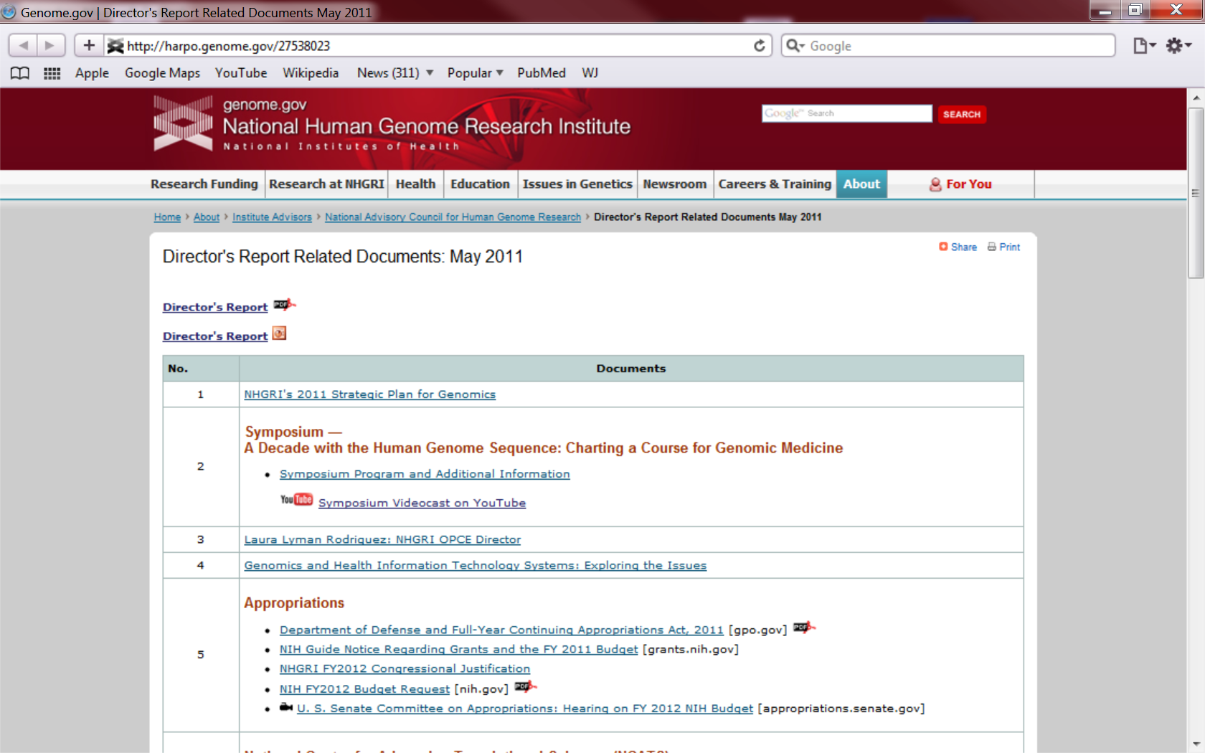
genome.gov/DirectorsReport
Document #
Notes:
For anyone new to our Council meetings, I want to make you aware that there is an ‘electronic resource’ associated with my Director’s Report.
This is analogous to the supplemental materials that are often made available with a published paper, and can be accessed at the URL shown here.
The slides that I am showing during my Director’s Report are also available electronically at this site– * both as a PDF and as a Powerpoint file.
* For slides associated with specific documents or relevant web sites, there is a ‘Document #’ indicated on the bottom right, which then references materials that can be accessed at the web site shown here.
In addition to the video archive that I mentioned earlier, this web page and all linked documents will be archived on NHGRI’s web site (genome.gov) as a permanent historic resource.

Slide 3
Open Session Presentations
  NIH Center for Scientific Review
    Richard Nakamura
  ACMG Recommendations for Reporting Incidental Findings
    Bob Nussbaum
Recent NHGRI Meetings:
  Genomics and Society Working Group
      Pamela Sankar
  NHGRI Training and Career Development
      Bettie Graham
Notes:
There will be multiple other presentations during the Open Session of this Council meeting. My Director’s Report is tailored around these presentations, and I will not discuss in detail the topics that others will be covering later.
* Following my Director’s Report, we will have a presentation from Richard Nakamura, who is the recently appointed Director of the NIH Center for Scientific Review.
* Later today, Council member Bob Nussbaum will present the recent recommendations issued by the American College of Medical Genetics and Genomics (ACMG) regarding the reporting of incidental findings.
* We will then hear reports about two recent NHGRI meetings.
* Council member Pamela Sankar will discuss the first meeting of the Genomics and Society Working Group.
* And Bettie Graham will discuss a recent workshop about NHGRI training and career development programs.

Slide 4
Open Session Presentations
Program Update:
  Genome Sequencing Program Update: Disease 2020
      Adam Felsenfeld
Concept Clearance:
  Interpreting Variants in Non-Coding Regions of the Genome
      Lisa Brooks
Notes:
We will then have one program update and one concept clearance from NHGRI staff members.
* Adam Felsenfeld will give an update about the Genome Sequencing Program, with an emphasis on a strategic proposal for that program called Disease 2020.
* Lisa Brook will then present a concept clearance entitled “Interpreting Variants in Non-Coding Regions of the Genome.”

Slide 5
Director’s Report Outline
General NHGRI Updates
General NIH Updates
General Genomics Updates
NHGRI Extramural Research Program
NIH Common Fund Programs
NHGRI Division of Policy, Communications, and Education
NHGRI Intramural Research Program
Notes:
For the rest of my Director’s Report, I will cover the 7 areas listed here.
Together, these areas have proven to provide a good framework for reviewing the relevant topics.

Slide 6
Director’s Report Outline
General NHGRI Updates
General NIH Updates
General Genomics Updates
NHGRI Extramural Research Program
NIH Common Fund Programs
NHGRI Division of Policy, Communications, and Education
NHGRI Intramural Research Program

Slide 7


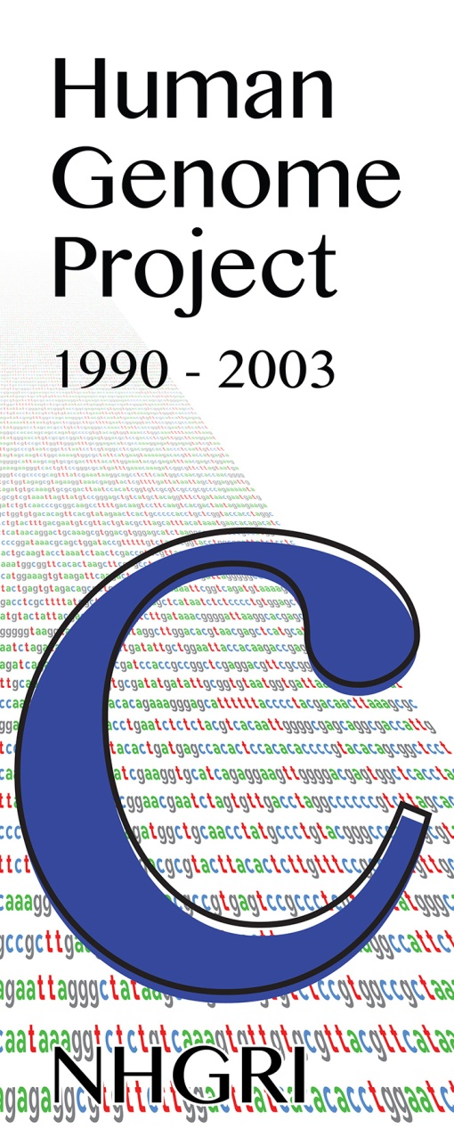
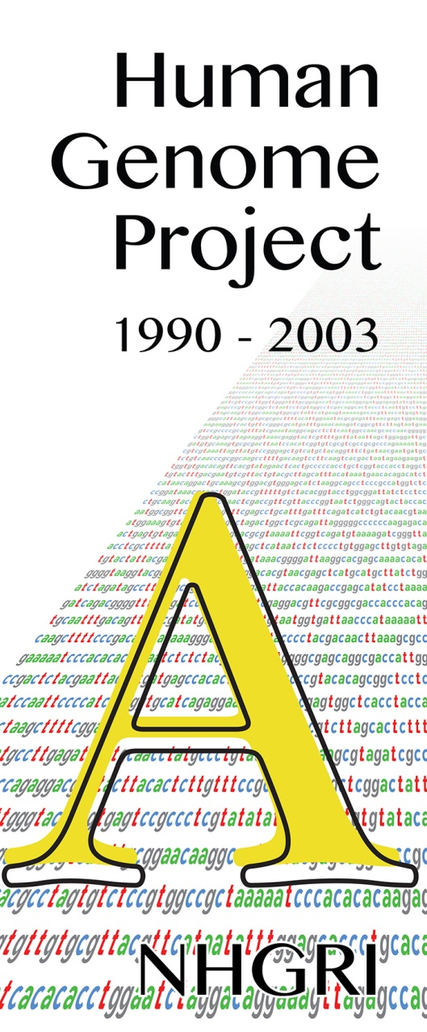

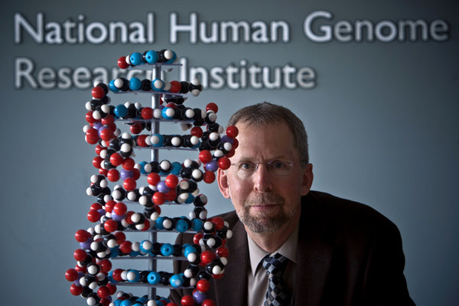

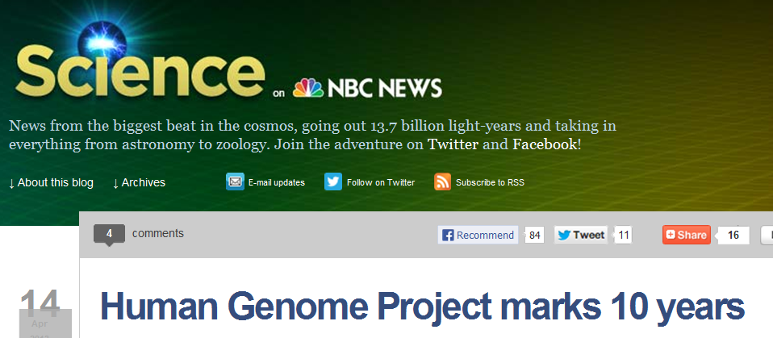



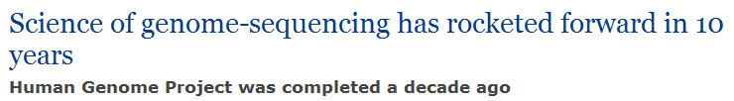
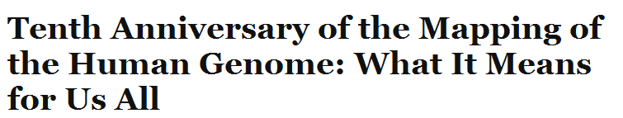
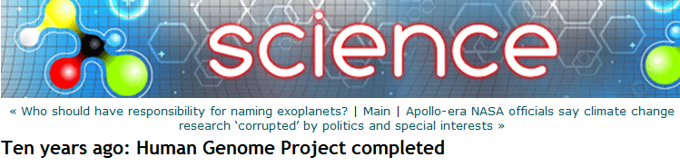
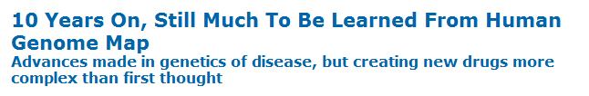
10th Anniversary of Human Genome Project
Document 1
Notes:
Believing that it is always nice to begin with ‘feel good’ topic, April 14, 2013 marked the 10th anniversary of the completion of the Human Genome Project. This milestone was met with some excellent press coverage, * including an interview with yours truly in the New York Times.
Other coverage included stories in * the Huffington Post, * the Milwaukee Journal Sentinel, * NBC News Online, * HealthDay, and * the San Francisco Chronicle.

Slide 8
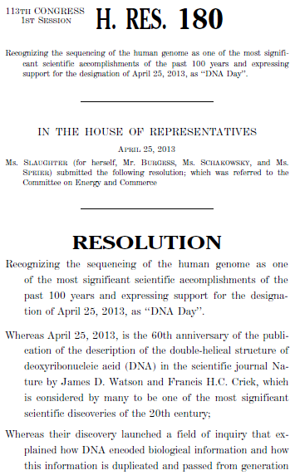

Happy 10th Anniversary from U.S. Congress
Document 2
Notes:
The 10th anniversary of the Human Genome Project did not go unnoticed by Congress.
On DNA Day (April 25), Congresswoman Louise Slaughter of New York and Congressman Michael Burgess of Texas, together with some of their House colleagues, introduced House Resolution 180 recognizing the 10th anniversary of the completion of the Human Genome Project.
The Resolution praised the sequencing of the human genome as one of the most significant scientific accomplishments of the past 100 years, and recognized the ongoing public education activities in genomics.

Slide 9
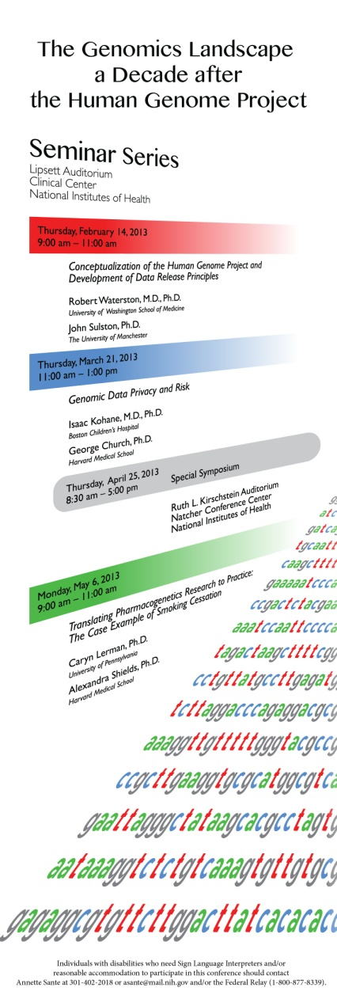
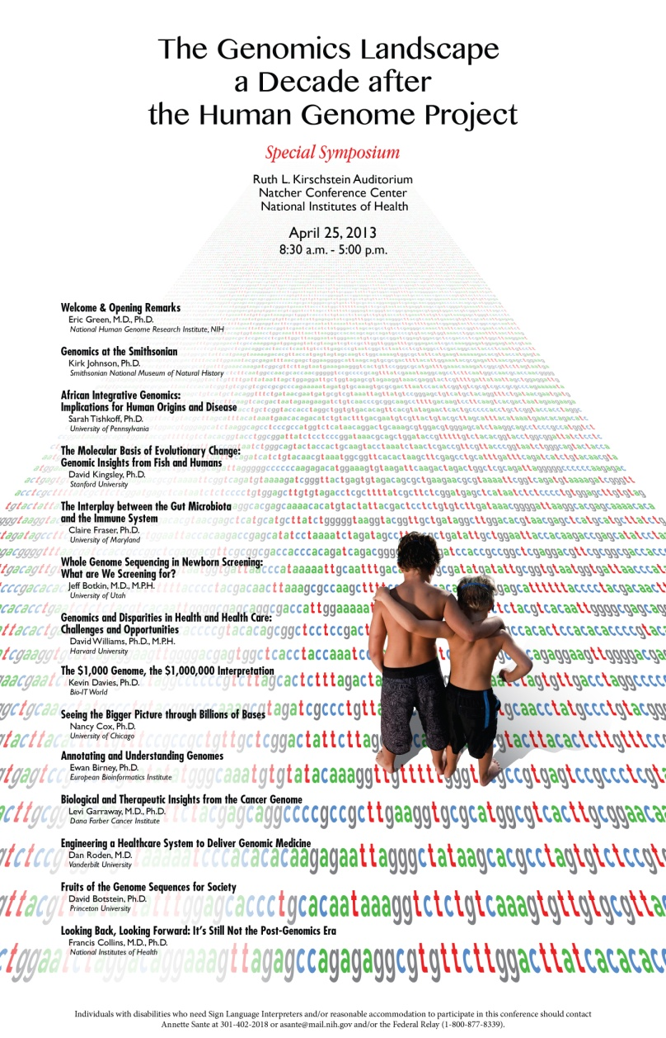
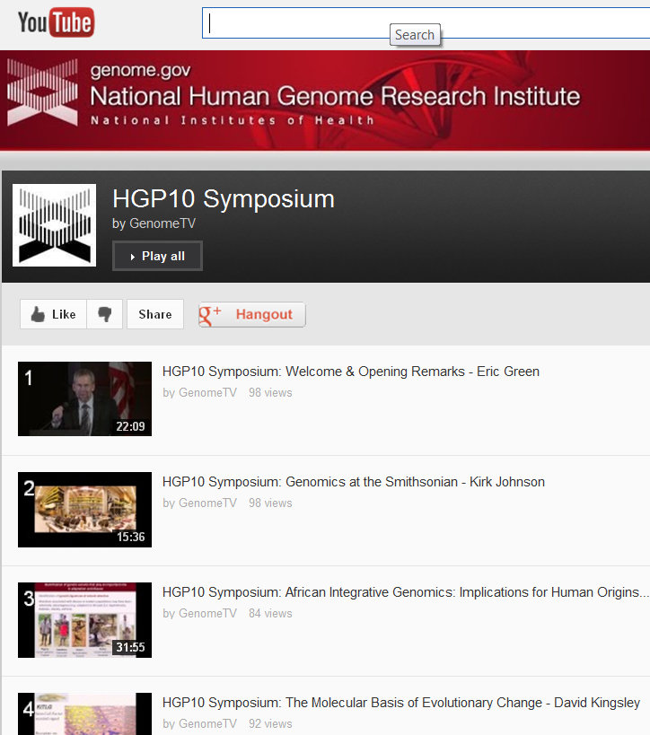
HGP 10th Anniversary Seminar Series and Symposium
Document 3
Notes:
As you may recall, to commemorate the 10th anniversary of the Human Genome Project, * NHGRI held a series of paired seminars beginning in February and also a day-long symposium last month.
The last of the paired seminars was held on May 6, and featured Carlyn Lerman and Alexandra Shields in a pair of talks together entitled “Translating Pharmacogenetics Research to Practice: The Case Example of Smoking Cessation.”
Then on April 25 (DNA Day 2013), NHGRI held a day-long symposium on the NIH campus, with participating speakers listed on the right side of this poster. The all-star cast included Council members David Kingsley and David Williams, as well as Sarah Tishkoff, Claire Fraser, Jeff Botkin, Kevin Davies, Nancy Cox, Ewan Birney, Levi Garraway, Dan Roden, David Botstein, and Francis Collins. It was truly an outstanding day.
* While all of these events took place at NIH, the presentations were videotaped and are now available on the GenomeTV channel of YouTube.

Slide 10


Smithsonian Exhibition: June 2013 Opening
  ~2900 square foot exhibition
  Significant associated programming and outreach
  Resident in NMNH for ~1 year
  Subsequently will tour North America for 4-5 years
Document 4
Notes:
And, of course, the really novel component of our year-long 2013 celebration of genomics will be the exhibition that we are co-developing with our good friends and colleagues at the Smithsonian National Museum of Natural History.
After much anticipation and an extraordinary amount of work, * the ~2900 square foot exhibition— ‘Genome: Unlocking Life’s Code’ — will open at the National Museum of Natural History in June.
* Also planned is a significant amount of associated programming and outreach in terms of genomics literacy and education programs.
* The exhibition will be resident in Washington, DC for just over1 year (until September 2014) and * will then tour North America an additional 4-5 years.

Slide 11
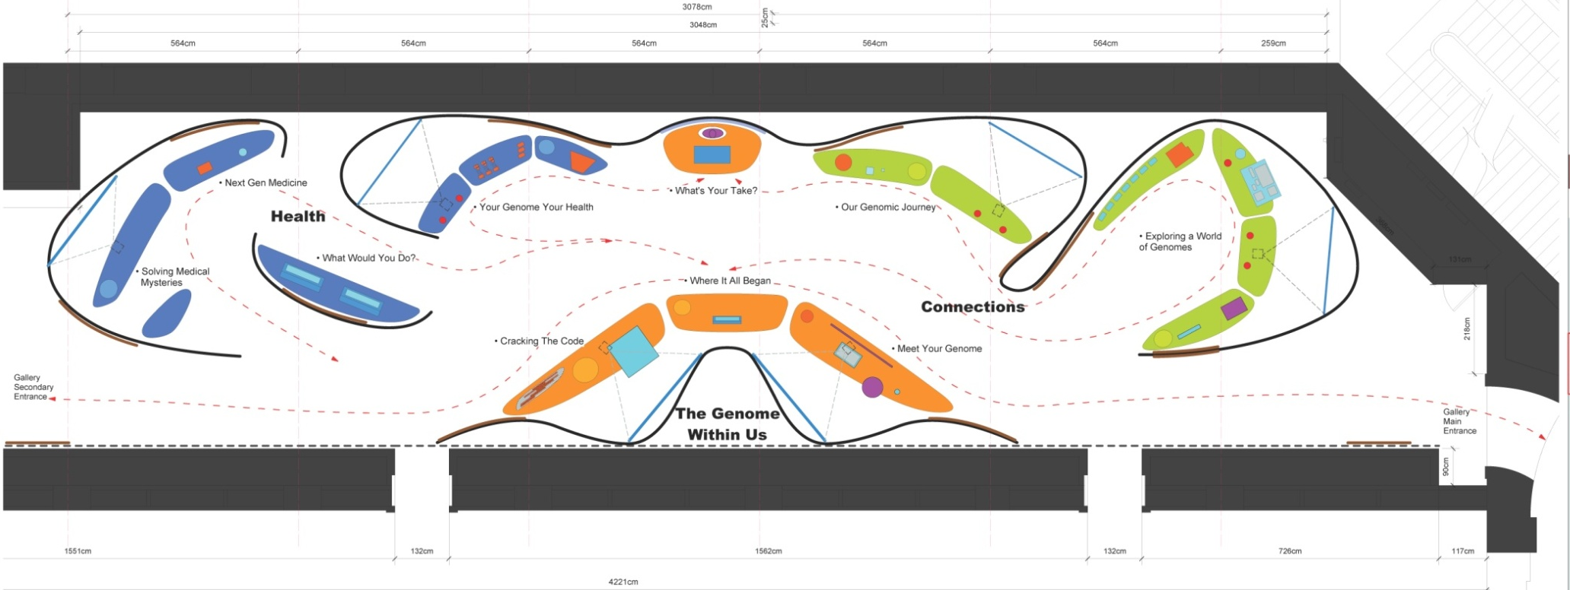
Smithsonian Exhibition: Layout By Theme
Next Gen Medicine
Natural World
Genome Within
Your Genome, Your Health
Genomic Journey
Document 4
Notes:
Shown here is a ‘bird’s eye’ preview of the exhibition, which will be located in Hall 23 on the 2nd floor of the museum (immediately adjacent to the Hope Diamond). * The exhibition will consist of five major thematic areas, as shown here.
Each of the areas will contain engaging interactives and interesting stories that will highlight various aspects of the thematic topic. The exhibition will include stories about our health, cancer, genetic testing, personalized medicine, comparative genomics, ancestry, and the ethical, legal, and social implications of genomics.
And with ~7 million people visiting the National Museum of Natural History each year, of which over 4 million visit the Hope Diamond immediately next door, we anticipate that a very large number of individuals will benefit from this incredibly creative and instructive exposure to genomics.

Slide 12


Smithsonian Exhibition: Public Programs
  Ancestry and genetic testing
  Genomic themes in plays
  Consumer-based testing
  Debate on an ethical, legal, and social question
  Evolutionary genetics
  Genomics in pop culture
Document 4
Notes:
To complement the physical exhibition, NHGRI, the National Museum of Natural History, and the Smithsonian Associates have partnered to develop a series of educational programs for the public— lectures, symposia, discussion panels, and gatherings— that will be offered from September 2013 to July 2014.
* A few themes that will be covered in the series are listed here. As you can see, we will be covering a range of interesting topics, and we look forward to engaging public on these and other important issues.
The first of these public programs will be held on September 12, in partnership with the National Museum of Natural History and the National African American History and Culture Museum. This event will explore the role of genomics and ancestry in understanding health, culture, and history. A panel discussion will follow with members of the scientific community and the audience. Of note, NHGRI is providing funding to support an ASHG Scientific Roundtable on Genetic Inference and Ancestry, which will be held September 10 and 11. Speakers from that roundtable event will participate in the public program on September 12.
Additional information on the other public programs will be forthcoming as details become available.

Slide 13
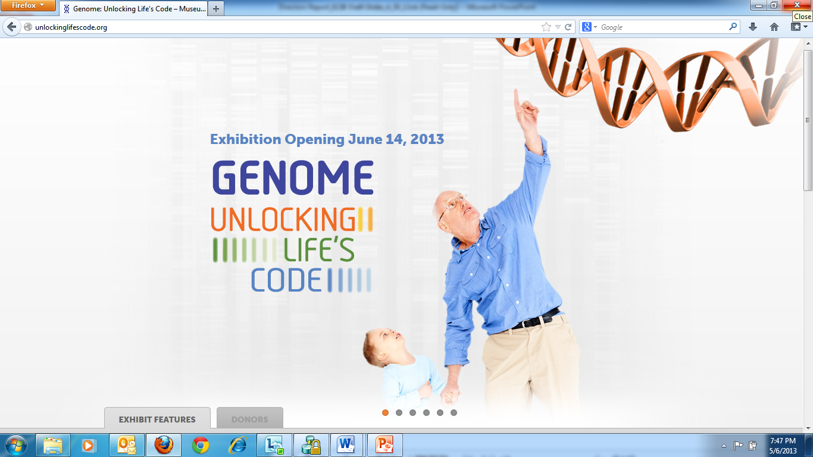
Smithsonian Exhibition: Website
www.unlockinglifescode.org
Document 4
Notes:
Finally, NHGRI and the National Museum of Natural History are creating a website to promote, feature, and centralize materials related to the exhibition and the related public outreach efforts. The website will include a virtual tour of the exhibition, a dynamic timeline of the history of genomics, a calendar of ongoing programs, an educator’s guide, and many other resources. It will also offer insights into many of the exhibition’s topics, as well as information on basic genetics and genomics.
* With the ULR of www.unlockinglifescode.org, the website will be updated regularly as the exhibition travels.
And finally, I should point out that none of this (the exhibition, the website, or the associated programming) would have been possible without the generous contributions of many companies, organizations, and individuals. And I want to give a special thanks to the Foundation for the NIH, which spearheaded those fundraising efforts and were also terrific partners to work with on this project. You will see the full list of those contributors and partners when you visit the exhibition or the exhibition’s website.

Slide 14
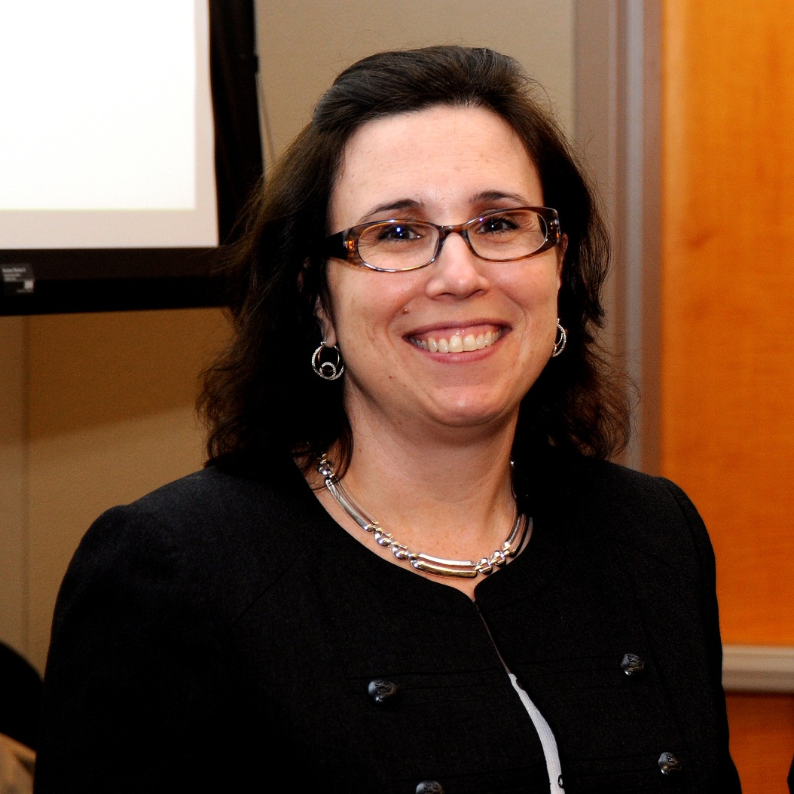
Acting Executive Officer at NHGRI
Ellen Rolfes, M.A.
Notes:
One of NHGRI’s seven divisions— the Division of Management— is responsible for all aspects of administrative management at the Institute. The Director of that division is also known as the Institute’s Executive Officer.
Janis Mullaney, who had served for over 5 years in this position, recently left NHGRI to become the Executive Officer at the National Center for Advancing Translational Sciences (NCATS).
Until a search for a permanent Executive Officer and Director of the Division of Management is launched and completed, I have asked Ellen Rolfes to serve in this role in an acting capacity. Ellen has been at NHGRI for over 16 years and has served as the Institute’s Deputy Executive Officer for 3 years.

Slide 15

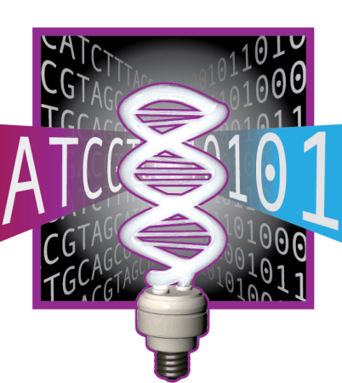

NHGRI Recruitments
  Director,
  Division of Genomics and Society
  Extramural Bioinformatics Program Directors
  Physicians (Division of Genomic Medicine & Division of Policy, Communications, and Education)
Document 5
Notes:
The other major personnel updates relate to important ongoing NHGRI recruitments. * I recently launched the search to identify a Director for the Division of Genomics and Society, one of the four divisions that constitutes the NHGRI Extramural Research Program. Recall that NHGRI Deputy Director Mark Guyer is now serving as the Acting Director of this division. This position will be advertised through USAJobs from May 22 to June 4.
* Second, we aim to expand the number of program directors responsible for the bioinformatics research activities in the Extramural Research Program. We will soon be advertising for two such program director positions.
* And finally, two of our divisions— the Division of Genomic Medicine of the Extramural Research Program and also the Division of Policy, Communications, and Education— are actively looking to recruit physicians or other senior healthcare professionals to serve various roles in their respective divisions.
Some information about these recruitments is available as Document 5; but meanwhile, if you have ideas of prospective candidates for any of these positions or questions about the recruitments, please feel free to email me directly.

Slide 16
Director’s Report Outline
General NHGRI Updates
General NIH Updates
General Genomics Updates
NHGRI Extramural Research Program
NIH Common Fund Programs
NHGRI Division of Policy, Communications, and Education
NHGRI Intramural Research Program

Slide 17
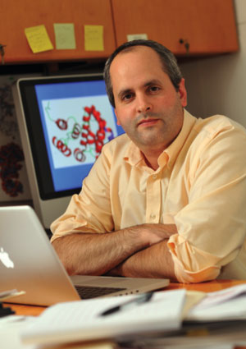

New Director, National Institute
of General Medical Sciences
Jon Lorsch, Ph.D.
Document 6
Notes:
Jon Lorsch has been selected to be the next Director of the National Institute of General Medical Sciences (NIGMS). He comes to the NIH from Johns Hopkins University School of Medicine, where he is a Professor in the Department of Biophysics and Biophysical Chemistry. His research group developed a fully reconstituted yeast translation initiation system, and used it to dissect the molecular mechanisms of each stage of the process.
Jon will assume the NIGMS Directorship in August. In the meantime, I am meeting with him regularly to discuss the many topics of mutual interest to our Institutes. I fully expect those discussions will lead to some important and productive new interactions. And I also expect that we will have Jon come to make a presentation to this Council in early 2014.

Slide 18
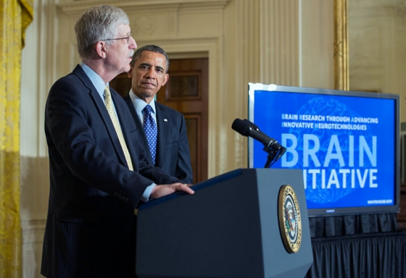
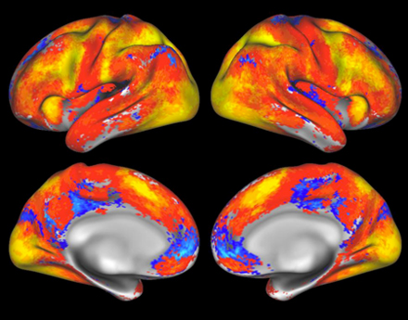
Brain Research through Advancing Innovative Neurotechnologies
(BRAIN) Initiative
  $40M from the NIH to develop new tools, training opportunities, and other resources
  NIH Working Group co-chaired by Cori Bargmann and William Newsome
Document 7
Notes:
Last month, President Obama announced the Brain Research through Advancing Innovative Neurotechnologies (BRAIN) Initiative. BRAIN is part of a new Presidential focus aimed at revolutionizing our understanding of the human brain.
The BRAIN Initiative is now associated with $100 million in the President’s proposed Fiscal Year 2014 Budget.
* $40M will come from the NIH to develop new tools, training opportunities, and other resources. An additional $50M will come from DARPA for understanding the dynamic functions of the brain and demonstrating breakthrough applications, and $20M will come from NSF for supporting research that spans physical, biological, social, and behavioral sciences.
* NIH has established a high-level working group co-chaired by Cori Bargmann (of Rockefeller University) and William Newsome (of Stanford University) to define the scientific goals for NIH’s investment and to develop a multi-year scientific plan for achieving these goals, including timetables, milestones, and cost estimates.

Slide 19
NIH is Tackling the ‘Big Data’ Problem
Associate Director
for Data Science
(ADDS)
Scientific Data
Council
(SDC)
Big Data to
Knowledge
(BD2K)
Document 8
Notes:
The past few months have brought steady progress on the ‘big data’ and data science front at the NIH level. Recall that last June, a working group of the Advisory Committee to the NIH Director made a series of recommendations for NIH to tackle the ‘big data’ problem faced by the biomedical research community.
There are three major elements in those recommendations.
* First, a new leadership position reporting directly to the NIH Director has been created called the Associate Director for Data Science. This person will be NIH’s strategic and programmatic leader in data science, broadly defined; on an interim basis, I am serving as the Acting Associate Director for Data Science.
* Second, Francis Collins has convened a Scientific Data Council, which is a high-level internal NIH group that will now oversee and coordinate NIH data science activities. This group is now meeting regularly, and has significant responsibilities for overseeing trans-NIH data science initiatives and for long-term strategic planning in this area.
* Finally and highly overlapping conceptually with these other two elements, the new Big Data to Knowledge initiative (or BD2K) is reaching a mature stage in terms of planning.
Let me now provide more details about the first and third of these three elements.

Slide 20
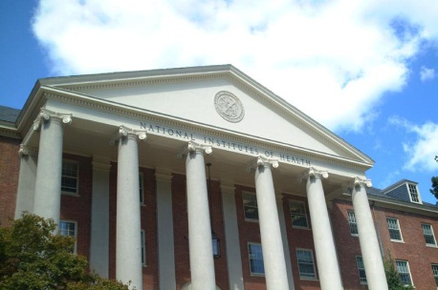
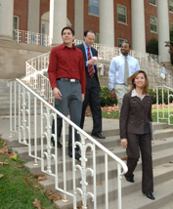

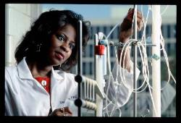
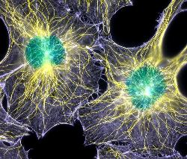


Associate Director for Data Science
Office of the Director, National Institutes of Health, Department of Health and Human Services
The NIH is the center of medical and behavioral research for the Nation
----making essential medical discoveries that improve health and save lives.
Are you a top-level Scientific Researcher or Scientific Administrator seeking a career at the one of the preeminent biomedical research institutions in the Nation and the world? Are you at that point in your career where you’re ready to “give back?” The position of Associate Director for Data Science (ADDS), Office of the Director (OD), National Institutes of Health (NIH), offers a unique and exciting opportunity to provide critical leadership for basic and translational research. The era of “Big Data” has arrived for the biomedical sciences. There is an urgent need and, with it, spectacular opportunities for NIH to enhance its programs in data science, such as those involving data emanating from different sources (e.g., genomics, imaging, and phenotypic information from electronic health records). The ADDS provides a vision for the utilization and extraction of knowledge from the data generated by, and relevant to, NIH research, and advises experts throughout the agency on a variety of complex, unique, and/or sensitive situations and issues in data science to ensure continual achievement of NIH’s dynamic biomedical research mission.
We are looking for applicants with senior-level experience who have a commitment to excellence and the energy, enthusiasm, and innovative thinking necessary to lead a dynamic and diverse organization.
The successful candidate for this position will be appointed at a salary commensurate with his/her qualifications. Full Federal benefits will be provided including leave, health and life insurance, long-term care insurance, retirement, and savings plan (401k equivalent).
If you are ready for an exciting leadership opportunity, please see the detailed vacancy announcement at http://www.jobs.nih.gov (under Executive Careers). Applications will be reviewed starting May 13, 2013, and will be accepted until the position is filled.
THE NATIONAL INSTITUTES OF HEALTH AND THE DEPARTMENT OF HEALTH AND HUMAN SERVICES ARE EQUAL OPPORTUNITY EMPLOYERS
Notes:
In addition to serving as the Acting Associate Director for Data Science, I am also co-chairing the search committee to identify the first permanent Associate Director for Data Science. Shown here is the advertisement associated with that search. Last week was the initital cut-off date for applications, and those received to date will be evaluated by the search committee shortly.
However, the search will be open until the position is filled. So, if you know of potential candidates, please send them my way or send me their names and I will contact them directly. This is a very important search for NIH and for the broad field of computational biology, bioinformatics, data science, etc.– and so the search committee is working very hard to find the most outstanding candidates possible.

Slide 21

Big Data to Knowledge (BD2K): Overview
Trans-NIH effort with the overarching goal of:
  By the end of the decade, enable a quantum leap in the ability of the research community to maximize the value of the growing volume and complexity of biomedical data
  Strong support across NIH
  Working group has about 125 members
  Staff from 24 Institutes/Centers and several other offices involved
Document 8
Notes:
The flagship component of NIH’s ‘big data’ efforts is BD2K, which is a trans-NIH effort designed to be transformational, catalytic, and synergistic.
* BD2K’s overarching goal is “By the end of this decade, enable a quantum leap in the ability of the biomedical research enterprise to maximize the value of the growing volume and complexity of biomedical data.”
This is a huge task, but there is * strong support for it across NIH, including an agreed-upon plan for funding that ramps up to over $100M per year within a few years and goes through Fiscal Year 2020.
NHGRI Deputy Director Mark Guyer is leading the planning efforts for BD2K, with the working group he directs * having about 125 NIH staff members * and those individuals come from 24 institutes, centers, and offices.
Planning for BD2K will take place throughout this fiscal year, with the launching of some of its initial elements starting in Fiscal Year 2014. We expect that NHGRI will end up leading some of the elements of the program; as such, we will likely be bringing specific BD2K components to this Council for your input.

Slide 22




BD2K: Four Programmatic Areas
Facilitating Broad Use of Biomedical Big Data
II. Developing and Disseminating Analysis Methods and Software for Biomedical Big Data
III. Enhancing Training for Biomedical Big Data
IV. Establishing Centers of Excellence for Biomedical Big Data
Document 8
Notes:
Let me briefly remind you of the four major programmatic areas of BD2K.
* Area 1, Facilitating Broad Use of Biomedical Big Data. This covers policies that encourage data sharing and also ways to make shared data easier to find and use.
* Area 2, Developing and Disseminating Analysis Methods and Software for Biomedical Big Data. This involves developing software, making software easier to find, and making it easier to use software for analyzing large datasets.
* Area 3, Enhancing Training for Biomedical Big Data. This covers both improvements to the existing educational framework and training for existing scientists.
* Area 4, Establishing Centers of Excellence for Biomedical Big Data. These Centers will address major biologically-driven big data problems.

Slide 23

BD2K: Update
Timeline:
  Series of workshops, beginning this summer
  Funding starts in Fiscal Year 2014
Unique funding model
    FY14 FY15 FY16
    Requested: $64M $96M $109M
    Available: $27M $80M $99M
Document 8
Notes:
In summary, extensive planning for BD2K is well underway.
* In terms of a timeline, there will be series of BD2K-planning workshops, beginning this summer. And initiative funding will begin in Fiscal Year 14.
* This program has a unique funding model, with funds coming from both the NIH Common Fund and also from all institutes and centers, with the institute/center support increasing each year and Common Fund support going away completely by around 2020.
We are gratified that, despite tight budgets, * the collective NIH leadership has identified both Common Fund monies and institute/center funds that will allow the initiative to grow from $27M in Fiscal Year 2014 to $99M by Fiscal Year 2016. While those available funds for the next three fiscal years (shown in green) are less than those originally requested (due to overall budget constraints), these amounts are still sufficient for initiating a strong program.

Slide 24
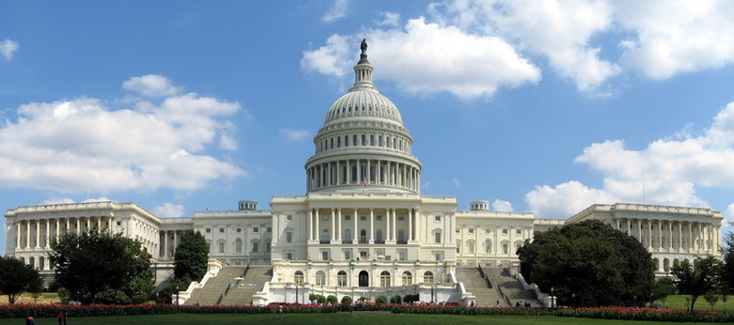
Fiscal Year 2013 Funding Finalized
  Federal government funded through continuing resolution for Fiscal Year 2013
  Sequester resulted in a 5.1% reduction
  Total NIH reduction of 5.8%
  NHGRI’s final Fiscal Year 2013 budget: $483M
Notes:
Turning then to the broader set of budgetary issues and constraints, when we last met in February, the federal government was at that time being funded by a continuing resolution through the end of March. * Congress has now passed a year-long continuing resolution that would keep the NIH operating for the rest of Fiscal Year 2013 at Fiscal Year 2012 levels.
* However, the other significant development was the much talked-about sequester, which was implemented because Congress failed to act before the March deadline. Therefore, as required by the Budget Control Act of 2011, our budget was reduced by 5.1% due to the sequester.
* Because of all the complexities of the sequester combined with the Continuing Resolution, there was then an additional 0.7% cut to the NIH budget, so that the overall reduction is actually 5.8% relative to Fiscal Year 2012. * So, at the end of the day, NHGRI’s final Fiscal Year 2013 budget is lower by 5.8% compared to last year, for a total of $483 million.
This is obviously an incredibly challenging time for us, as we now move forward in implementing such a 5.8% reduction. With respect to our Extramural Research Program, last week we posted our 2013 Funding Policy on our web site. One important element of that policy is a 4.5% reduction to non-competing awards (consistent with the NIH-wide policy). Meanwhile, competing awards are being examined on a case-by-case basis.

Slide 25

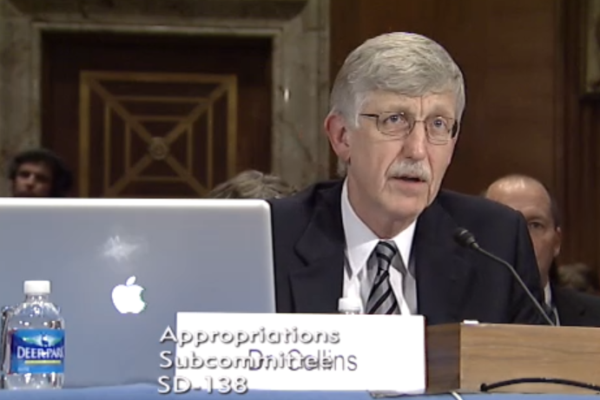
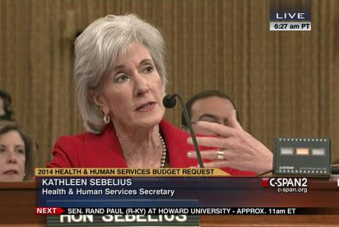
Fiscal Year 2014 Appropriations
  NIH: $31.3 billion
  NHGRI: $517 million
Document 9
Notes:
Now that the Fiscal Year 2013 budget has been finalized, the focus moves to Fiscal Year 2014. * Accordingly, on April 10, President Obama sent his proposed Fiscal Year 2014 budget to Congress for their consideration.
* It includes a $31.3 billion budget for NIH and * $517 million budget for NHGRI.
Congress is now starting to examine the proposed budget through Appropriations Committee hearings. * Last month, Secretary Sebelius testified before the House and Senate appropriations subcommittees charged with drafting the budget for the Department of Health and Human Services, and * last week, Francis Collins and a subset of institute directors testified before the same Senate subcommittee.
At this point, it is too early to predict whether the appropriations bills emerging from the House and Senate will match the President’s request. I will certainly continue to keep Council updated throughout the year as we learn more.

Slide 26
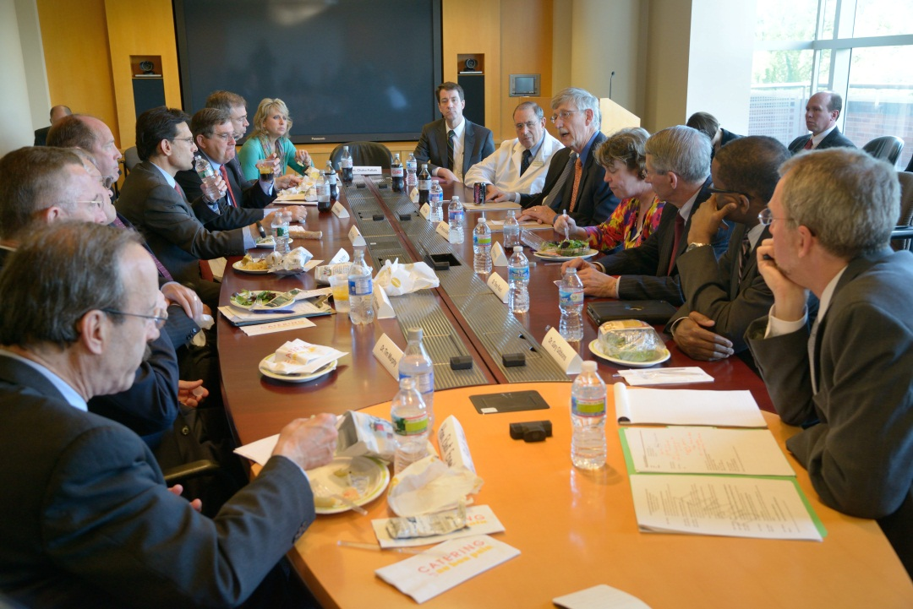
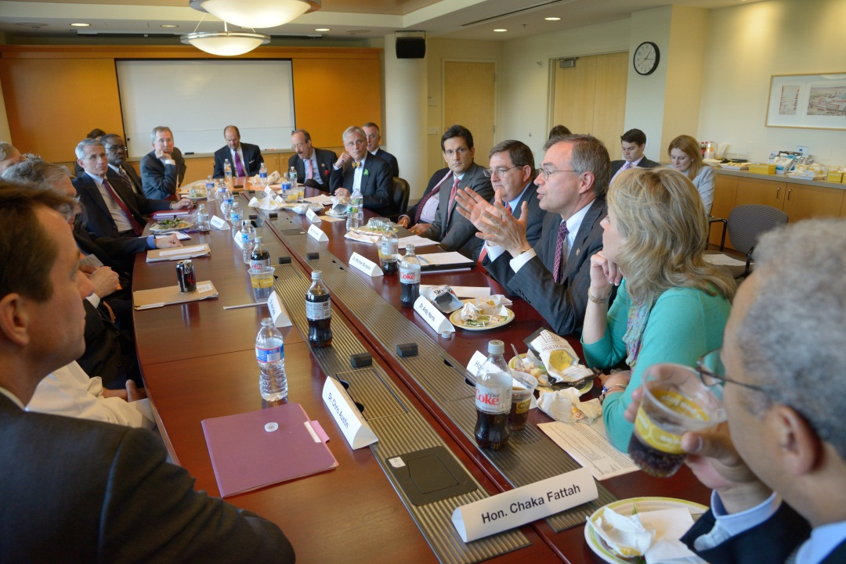
Congressional Delegation Visits NIH
Notes:
One positive development related to the U.S. Congress occurred two weeks ago, when a bipartisan delegation from the U.S. House of Representatives visited the NIH. House Majority Leader Eric Cantor led the delegation, and he was joined by eight other Members from both sides of the aisle, including two physicians, one veternarian, a nurse, and a clinical psychologist.
I joined Francis Collins and a few other institute and center directors in meeting with the delegation. For many of the Members, it was their first visit to the NIH campus, so Francis gave a quick overview of NIH before opening it up for discussion. Members raised a wide number of issues, including the effects of sequestration on research funding and the appropriate level of indirect costs. The meeting was very cordial, and the delegation unanimously expressed support for NIH.
The House Member speaking in the photo on the bottom right is Congressman Andy Harris of Maryland, who is the only member of the Congress who has had an NIH grant. Dr. Harris is an anesthesiologist who was previously a physician-scientist at Johns Hopkins University.
During the visit, Members also visited Dr. Lou Staudt’s cancer genomics laboratory, where they also heard about work going on as part of the TCGA program.

Slide 27



Reorganizing STEM Education
Prepare Students for STEM Careers in the 21st Century Economy. Our future competitiveness demands that we move American students from the middle or bottom to the top of the pack in science and mathematics…The Budget proposes a comprehensive reorganization of Federal STEM education programs to enable more strategic investment in STEM and more critical evaluation of outcomes… (page 22)
Document 10
Notes:
One particular proposal within the President’s Fiscal Year 2014 Budget that has garnered a fair amount of attention is a plan to significantly restructure Federal science, technology, engineering, and mathematics (commonly known as STEM) education programs. Over the past ten years, a series of reports have expressed concern over the large number of Federal STEM programs and recommended better coordination among agencies.
* The President's Fiscal Year 2014 Budget responds to these reports by proposing a reorganization of Federal STEM education program funding to promote strategic coordination and investment in education activities. * These activities are proposed to be focused through just three agencies going forward: the Department of Education, the National Science Foundation, and the Smithsonian Institution.
As part of this realignment, 9 Federal agencies are scheduled to terminate 78 programs, including 9 at NIH. The President’s proposal will provide an additional $100 million to the Department of Education to improve K-12 instruction, another $25 million to the Smithsonian Institution to develop infrastructure to support K-12 instruction and engagement, and $51 million to the National Science Foundation to support STEM undergraduate education and development of a national strategy for fellowships.
There will certainly be an extensive amount of discussion and debate about this proposal in the weeks and months to come.

Slide 28
Director’s Report Outline
General NHGRI Updates
General NIH Updates
General Genomics Updates
NHGRI Extramural Research Program
NIH Common Fund Programs
NHGRI Division of Policy, Communications, and Education
NHGRI Intramural Research Program

Slide 29


Mourning the Loss of Frank Ruddle
Document 11
Notes:
Francis (Frank) Ruddle passed away in March. He was the first scientist to produce a transgenic mammal (a mouse). He was also one of the first researchers to map genes to specific human chromosomes, laying some important groundwork for the Human Genome Project.

Slide 30
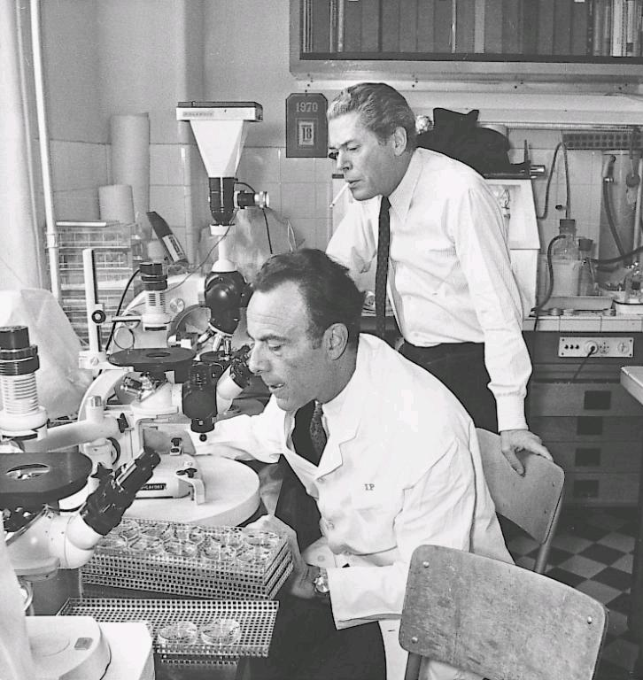

Mourning the Loss of François Jacob
Document 12
Notes:
François Jacob, the research partner of Jacques Monod, passed away in April. He shared the Nobel Prize in Physiology or Medicine with Monod and André Lwoff for discovering that cells can switch on and off certain genetic information through regulatory genes.

Slide 31
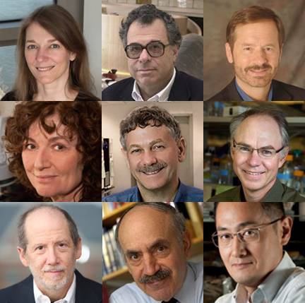

Breakthrough Prize in Life Sciences
David Botstein
Titia de Lange
Eric Lander
Charles Sawyers
Bert Vogelstein
Document 13
Notes:
The new Breakthrough Prize in Life Sciences has been awarded to 11 scientists. This new prize is sponsored by Genetech's Art Levinson, Google's Sergey Brin, 23andMe’s Anne Wojcicki, Facebook's Mark Zuckerberg and Priscilla Chan, and Yuri Milner, the founder of the Mail.ru Group.
The first set of winners include some familiar names to NHGRI, including * David Botstein, * Titia de Lange, * Eric Lander, * Charles Sawyers, and * Bert Vogelstein.

Slide 32

Newly Elected: National Academy of Sciences
Jef Boeke
Marcus Feldman
Michel Georges
Mary Lidstrom
Norbert Perrimon
Stephen Quake
Lou Staudt
Hunt Willard
Fred Winston
Document 14
Notes:
Recently, a number of individuals with ties to NHGRI were elected to the National Academy of Sciences.
That list includes * Jef Boeke, * Marcus Feldman, * Michel Georges, * Mary Lidstrom, * Norbert Perrimon, * Stephen Quake, * Lou Staudt, * Hunt Willard, and * Fred Winston.

Slide 33

Newly Elected: American Academy of
Arts and Sciences
David Altshuler
Martin Blaser
Eugene Koonin
John Lis
Jim Lupski
Jonathan Pritchard
Document 15
Notes:
The same holds true for recently elected Fellows of the American Academy of Arts and Sciences (AAAS). That list includes * David Altshuler, * Martin Blaser, * Eugene Koonin, * John Lis, * Jim Lupski, and * Jonathan Pritchard.

Slide 34

New Investigators: HHMI
Chuan He
Vamsi Mootha
Aviv Regev
David Reich
Document 16
Notes:
Finally, a number of individuals with ties to NHGRI were recently selected as new investigators in the Howard Hughes Medical Institute. That list includes * Chuan He, * Vamsi Mootha, * Aviv Regev, and * David Reich.

Slide 35


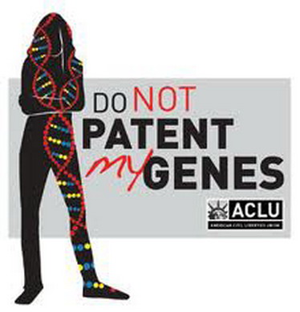
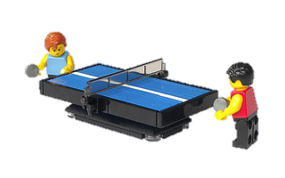
Gene Patents and the Courts
Document 17
Notes:
The lawsuit over Myriad Genetics’ BRCA gene patents, and possibly gene patents altogether, is heading towards a final resolution. The case began in 2009, when several pathology societies, clinical pathologists, and breast cancer patients challenged the U.S. Patent and Trademark Office, Myriad Genetics, Inc., and the directors of the University of Utah Research Foundation over Myriad's BRCA1- and BRCA2-related patents.
After working its way through the lower courts, the U.S. Supreme Court heard arguments in the case on April 15 *. I was fortunate enough to attend those arguments as a guest of the U.S. Solicitor General, whom I had helped to brief in preparation for his argument. Here is a photo of me along with Francis Collins, Eric Lander, Bob Cook Deegan, and some of Bob’s students at Duke on the steps of the Supreme Court after the hearing. I would sum up my reaction to being there for this important event in five words: interesting, amazing, historic, surreal, and frustrating.
The court is expected to issue their ruling by the end of June. It is difficult to speculate on how they will rule, but most analysts are suggesting that the court will agree with the U.S. government position, finding that isolated but otherwise unmodified human genes should not be patent-eligible, but allowing cDNA patent claims to remain. I have asked Council member Arti Rai to discuss the Court’s decision during our September Council meeting.

Slide 36

Affordable Care Act Covers BRCA Testing
Document 18
Notes:
As more of the Affordable Care Act is being implemented, we are keeping an eye on what it means for the implementation of genomic medicine. Recently, a joint FAQ was issued by the Department of Labor, the Department of Health and Human Services, and the Department of Treasury, clarifying that BRCA testing is covered by the Affordable Care Act.
Under the Act, certain healthcare plans are required to cover for no- charge preventive services that are recommended by the U.S. Preventive Services Task Force (USPSTF). However, there was a question as to whether the USPSTF recommendation for BRCA testing covered the testing itself or only the genetic counseling services.
The agencies have now clarified that the recommendation covers both BRCA testing and genetic counseling, if appropriate, for a woman, as determined by her healthcare provider.
Associated with this, the USPSTF is now working to update its BRCA testing recommendations, and recently issued an updated draft for public comment.

Slide 37


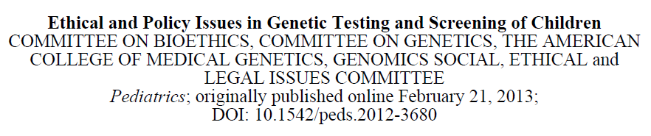
ACMG/AAP Statement on Testing and Screening in Children
Document 19
Notes:
Late in February, the American College of Medical Genetics and Genomics (ACMG) and the American Academy of Pediatrics (AAP) released a joint policy statement on the issues related to genetic testing and screening in children. This statement represents an update of previous policy recommendations by ACMG and AAP from 1995 and 2001, respectively.
This new statement emphasizes that decisions about testing and screening should be made with the interests of the child paramount. It expresses strong support for newborn screening, but opposes routine carrier testing that would not provide health benefits in childhood, and similarly recommends deferring predictive genetic testing for adult onset conditions. The recommendations were published in the journal Pediatrics, with a more detailed discussion in a complementary paper in the journal Genetics in Medicine.

Slide 38
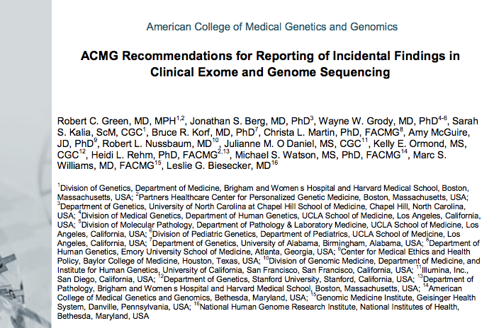
ACMG Recommendations for Clinical Genomic Incidental Findings
Document 20
Notes:
A few weeks after issuing the joint statement with AAP, the American College of Medical Genetics and Genomics (ACMG) published recommendations for reporting incidental findings that arise from clinical exome and genome sequencing, building on their 2012 Points to Consider in the Clinical Application of Genomic Sequencing.
Among the authors of the recommendations are a pair of Council members, Amy McGuire and Bob Nussbaum. Les Biesecker, Chief of the Genetic Disease Research Branch in NHGRI’s Intramural Research Program, was co-chair of the working group that developed these recommendations. You will be hearing more about these recommendations from Council member Bob Nussbaum later in this Open Session.

Slide 39

AMA on Personalized Medicine
Document 21
Notes:
In other professional society news, the American Medical Association (AMA) published a white paper on personalized medicine in February. The paper recognizes how genomics will influence the practice of medicine, and highlights the need for important policy questions to be addressed in order for genomic medicine to be realized.
The paper also expresses the position of the AMA on a range of policy issues, including a call to strengthen privacy and protections against genetic discrimination. It also affirms AMA’s strong support for the NIH Genetic Testing Registry.

Slide 40

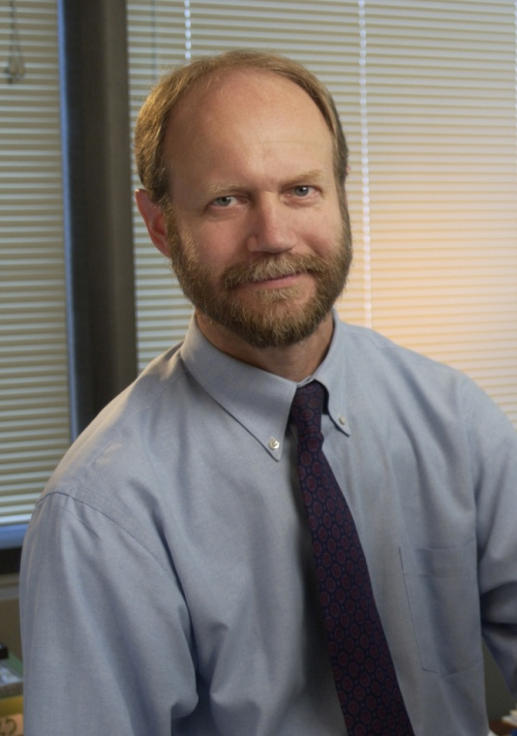
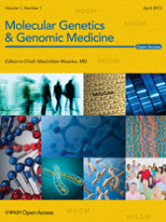
New Journal:
Molecular Genetics & Genomic Medicine
Max Muenke, M.D.
Document 22
Notes:
A new journal titled Molecular Genetics & Genomic Medicine was launched last Fall, with the first issue released last month. Max Muenke, Chief of the Medical Genetics Branch in NHGRI’s Intramural Research Program, is the new journal’s founding editor.
Molecular Genetics & Genomic Medicine is one of Wiley’s open access journals, and will published research in all areas of human, medical, and molecular genetics and genomics.

Slide 41
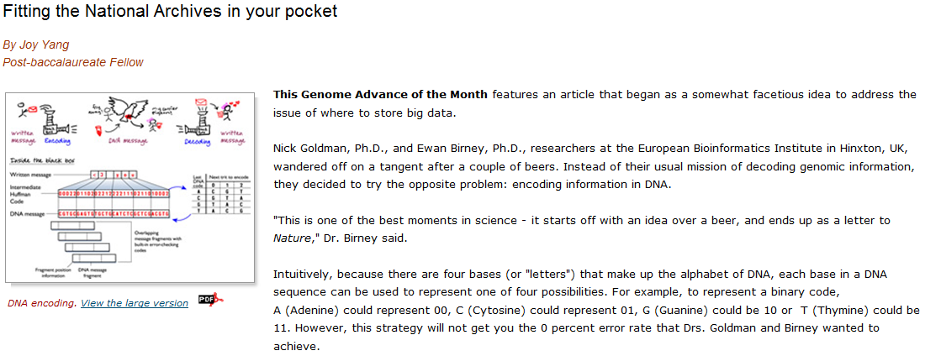
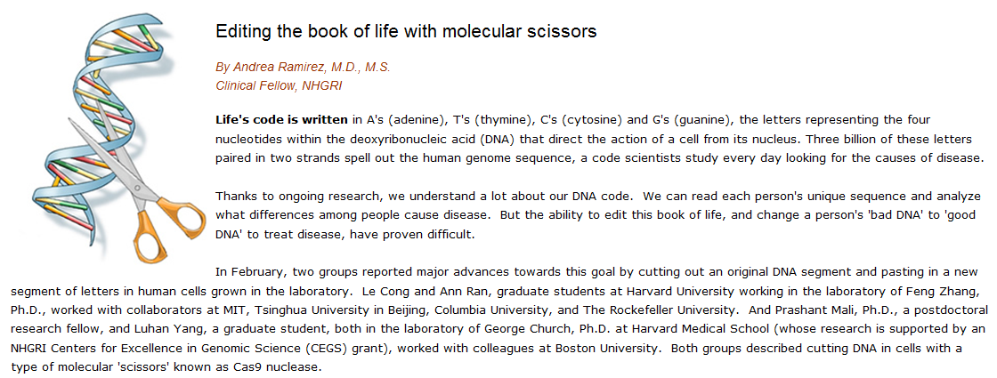
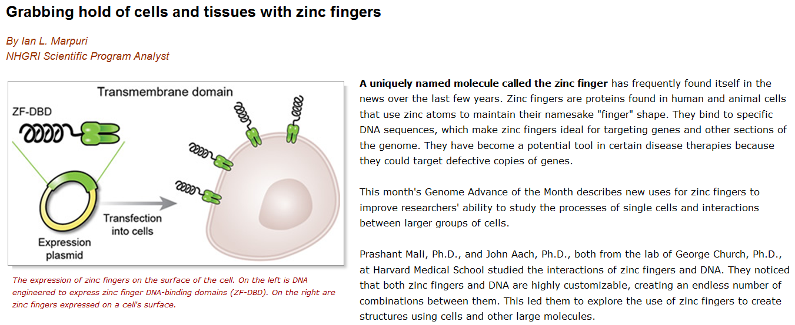
NHGRI Genome Advance of the Month
Document 23
Notes:
NHGRI continues to feature a ‘Genome Advance of the Month’ on our web site, genome.gov.
Publications that were featured since the last Council meeting described * encoding information in DNA, * DNA editing in human cells using the Cas9 nuclease, and * engineering zinc fingers to target cells.

Slide 42


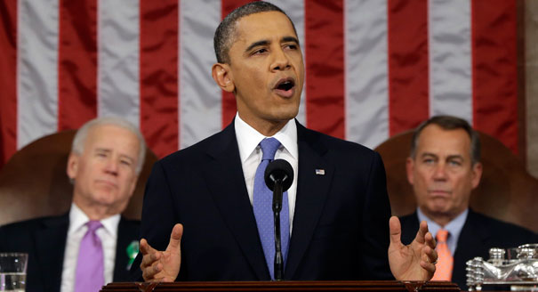
Genomics In The News…
“Every dollar we invested to map the human genome returned $140 to our economy -- every dollar.”
– President Obama, February 2013
Document 24
Notes:
Turning to my regular ‘Genomics In The News’ section.
In case you missed it, I wanted to point out that the value of genomics is receiving recognition at the highest levels. * In his 2013 State of the Union address, President Obama directly referred to the economic impact of the Human Genome Project in support of continued Federal biomedical research investments, citing the 2011 Battelle report that provided evidence for a 140-to-1 return-on-investment from the project.
As an aside, I understand that Battelle will be updating their economic impact report this year with figures for 2012 and 2013. The anticipated release for the new report is in June.

Slide 43
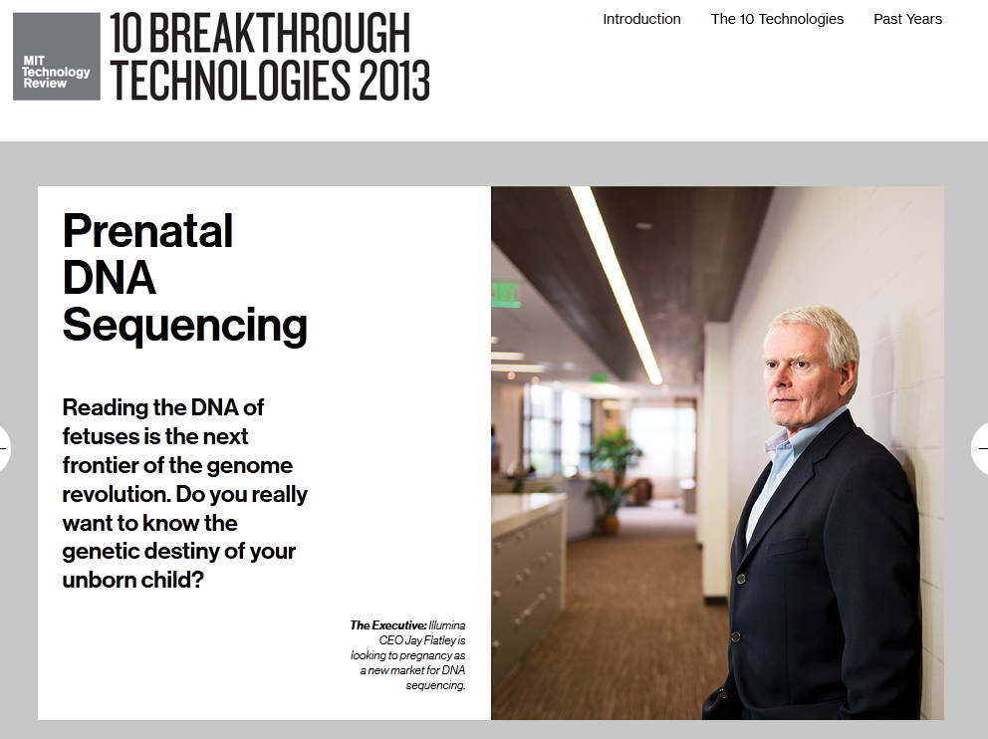
Genomics In The News…
Document 24
Notes:
Also in the news, the application of genomic technologies for prenatal DNA sequencing was named as one of the Top Ten Breakthrough Technologies of 2013 by MIT Technology Review.

Slide 44

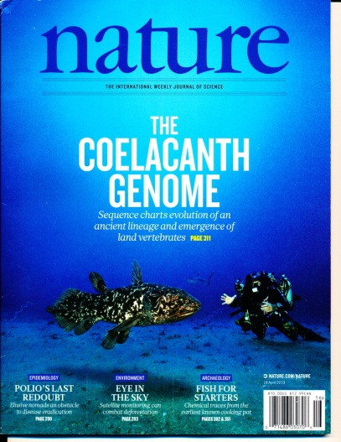
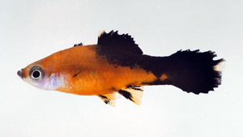

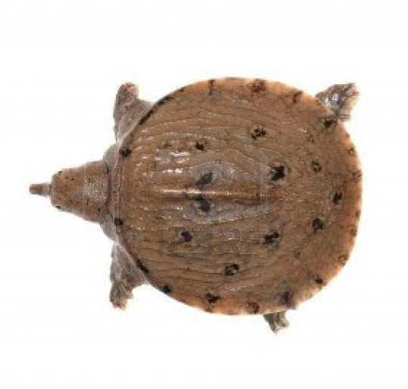


Genomics In The News…
Document 24
Notes:
And as always, there have been a number of genomes sequenced that have garnered some recent press attention.
These include reports about * platyfish, * aye-aye Lemur, * sea lamprey , * coelacanth, * zebrafish, * chinese soft-shell turtle, and * green sea turtle.
* There continue to be some mutterings about the sequencing of the Sasquatch genome, although none of this has yet to be substantiated.

Slide 45
Director’s Report Outline
General NHGRI Updates
General NIH Updates
General Genomics Updates
NHGRI Extramural Research Program
NIH Common Fund Programs
NHGRI Division of Policy, Communications, and Education
NHGRI Intramural Research Program

Slide 46

Large-Scale Genome Sequencing
and Analysis Centers
  101 Tb generated in last quarter
  >200 ongoing projects (e.g., cancer, complex disease, rare diseases, and comparative genomics)
  >25 papers published or in press this quarter
Document 25
Notes:
Starting with the flagship component of our Genome Sequencing Program, the Large-Scale Genome Sequencing and Analysis Centers are undertaking numerous projects, mostly related to complex disease and cancer.
* In the most recent quarter, the three Centers produced over 100 terabases of sequence— the equivalent of ~1,000 high-coverage whole human genome sequences (or ~13,500 whole-exome sequences). This pace puts them on track to increase production by 25% compared to last year.
* At the Centers, there are over 200 ongoing projects focused on cancer, complex disease, rare diseases, and comparative sequencing.
* Meanwhile, these groups together have over 25 papers either published or in press in the past quarter alone.

Slide 47
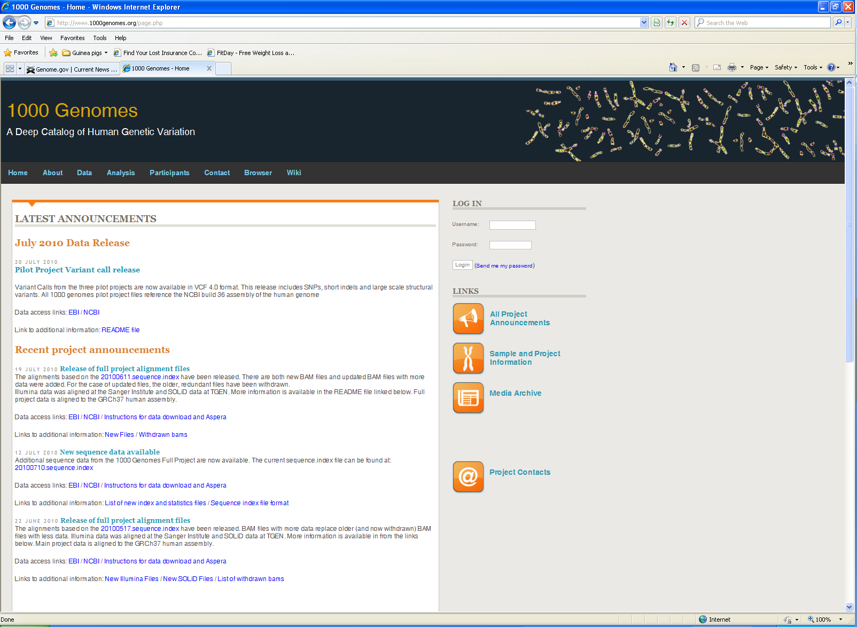
NHGRI
  Sequencing is now complete!
    26 populations
    2683 samples: low-coverage whole-genome
    2658 samples: whole-exome
    2642 samples: whole-exome & low-coverage whole-genome
    ~465 samples: deep Complete Genomics data
  1000 Genomes analysis meeting at CSHL
  Next 1000 Genomes analysis meeting prior to ASHG annual meeting
Document 26
Notes:
Among the major efforts being pursued by our large Centers is the 1000 Genomes project.
* Sequencing is now complete for the 1000 Genomes project, with * data generated from 26 populations.
Those data reflect the following: * for 2683 samples, there will be low coverage (3X or higher) whole-genome sequence; * for 2658 samples, there will be whole-exome sequence; * for 2642 samples, there will be both whole-exome and low-coverage whole-genome sequence; and for 465 samples, there will be deep whole-genome sequence generated by Complete Genomics (including about 150 children in trios with parents sequenced by other parts of the project).
* A 1000 Genomes analysis meeting was held two weeks ago at the Cold Spring Harbor Laboratory Genome Biology Meeting, during which plans were finalized analyzing this final dataset.
* And the next 1000 Genomes analysis meeting will take place prior to the ASHG annual meeting in October.

Slide 48

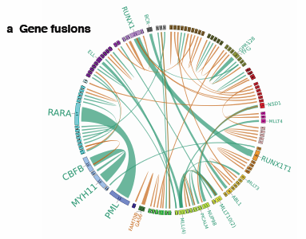
  TCGA meeting in early May
  Recent publications:
    Acute Myeloid Leukemia
    (NEJM, 2013)
    Endometrial Carcinoma
    (Nature, 2013)
    Clear Cell Renal Cell Carcinoma
    (In press)
AML gene fusions: in-frame shown in green; out-of-frame in orange.
Document 27
Notes:
The Cancer Genome Atlas program continues to generate prodigious amounts of data and publish groundbreaking papers. * TCGA investigators met in Seattle earlier this month to discuss the analysis of >8,000 samples from 26 types of cancer, with all the data being made available on the TCGA portal.
* The TCGA Network has had three major papers that were recently published or are now in press. * On May 1, a description of the genomic and epigenomic landscape of acute myeloid leukemia, work led by Tim Ley and Rick Wilson at Washington University, was published in the New England Journal of Medicine. * On the same day, the TCGA paper on endometrial carcinoma, work led by Doug Levine at Memorial Sloan-Kettering Cancer Center and Elaine Mardis at Washington University, was published in Nature. * And the TCGA paper on renal clear cell carcinoma, work led by Richard Gibbs and Chad Creighton at Baylor College of Medicine, has been accepted for publication and will be out next month.
* The circos plot shown here illustrates the discovery power of TCGA. Shown are all of the gene fusions observed in the 200 tumor samples analyzed for the AML project. In-frame gene fusions are shown in green and out-of-frame in orange. Although gene fusions have been studied in AML for many years, of the 128 fusions revealed by the TCGA study, 71 (more than half) had not been reported previously.

Slide 49

  Disease Gene Discovery:
  >9000 whole-exome sequences have entered pipelines for studying 526 Mendelian disorders of all major organ systems
  64 disease genes and 116 candidate disease genes
  Collaborations and Outreach:
  323 investigators, 189 institutions, 30 countries
  More than 100 presentations
  First Face-to-Face Meeting:
  New working group on data analysis
  Potential collaborations
Document 28
Notes:
Another component of NHGRI’s Genome Sequencing Program, the Centers for Mendelian Genomics at the University of Washington, Yale, and Baylor-Hopkins, aim to elucidate the molecular basis for as many Mendelian disorders as possible by genome sequencing.
* With respect to disease gene discovery, to date, more than 9000 whole-exome sequences have entered production pipelines for studying 526 Mendelian disorders involving all major organ systems. And to date, 64 disease genes and 116 candidate disease genes have been identified, providing insights into new pathways, mechanisms, and models of inheritance.
* In terms of collaborations and outreach, these three Centers collaborate with researchers worldwide to solicit samples and disseminate methods. So far, they have worked with 323 investigators from 189 institutions in 30 countries, and they have given >100 presentations about the program.
* The Centers had their first face-to-face program meeting in March. A new working group was formed to focus on data analysis. They also discussed potential new collaborations, especially with the three Large-Scale Genome Sequencing and Analysis Centers.

Slide 50

International Rare Diseases
Research Consortium
  Goals by 2020:
  Diagnostic tests for most rare disorders
  New treatments for 200 rare disorders
  NHGRI and CMG Involvement:
  Executive Committee
  Diagnostic Committee
    First IRDiRC Scientific Meeting
    2013 Bio International Convention
Document 29
Notes:
Relevant to our Centers for Mendelian Genomics program, the International Rare Diseases Research Consortium was launched in April 2011.
* This consortium aims, by the year 2020, to develop diagnostic tests for most rare disorders and new treatments for 200 rare diseases.
* The consortium is governed by an Executive Committee, three Scientific Committees, and a number of working groups. NHGRI is represented on the Executive Committee (Jane Peterson previously and now Jeff Schloss). Mike Bamshad (of the Coordinating Center for the Centers for Mendelian Genomics) is a co-chair of the Diagnostic Committee, which focuses on solving rare disorders and genome-wide diagnostic sequencing.
* The first scientific meeting of the consortium took place in Dublin in April, at which Mike Bamshad made a presentation about the Centers for Mendelian Genomics program.
* And then the consortium organized a panel discussion at the 2013 Bio International Convention in Chicago. NHGRI Program Director Lu Wang participated in that panel and discussed the Centers for Mendelian Genomics program.

Slide 51

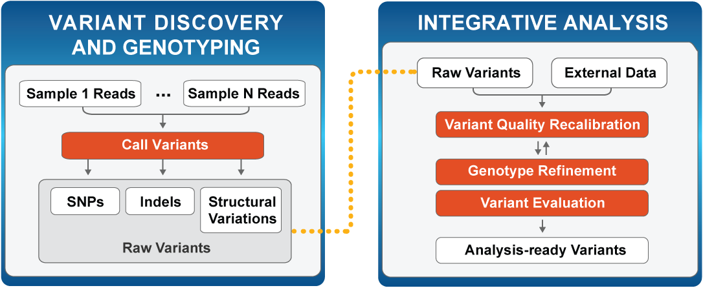
Genome Sequencing Informatics Tools
GS-IT Program: “iSeqTools”
iSeqTools projects hosting workshops for users
Broad Institute GATK Workflow
Document 30
Notes:
Another component of NHGRI’s Genome Sequencing Program, the Genome Sequencing Informatics Tools (GS-IT) Program, * has adopted the name iSeqTools as part of its public outreach effort. This program, comprised of six projects, is developing methods to provide access to sequence analysis tools for the community of users outside of large centers.
* The iSeqTools projects are hosting workshops to help users learn how to apply improved tools for sequence analysis. The next workshop will be July 9-10 at the Broad Institute, where users will work with the popular * Genome Analysis Toolkit (GATK) package. As further outreach, the GATK group supports a forum where registered users can join live Q&A sessions that are designed for questions that are too complex for online support.

Slide 52
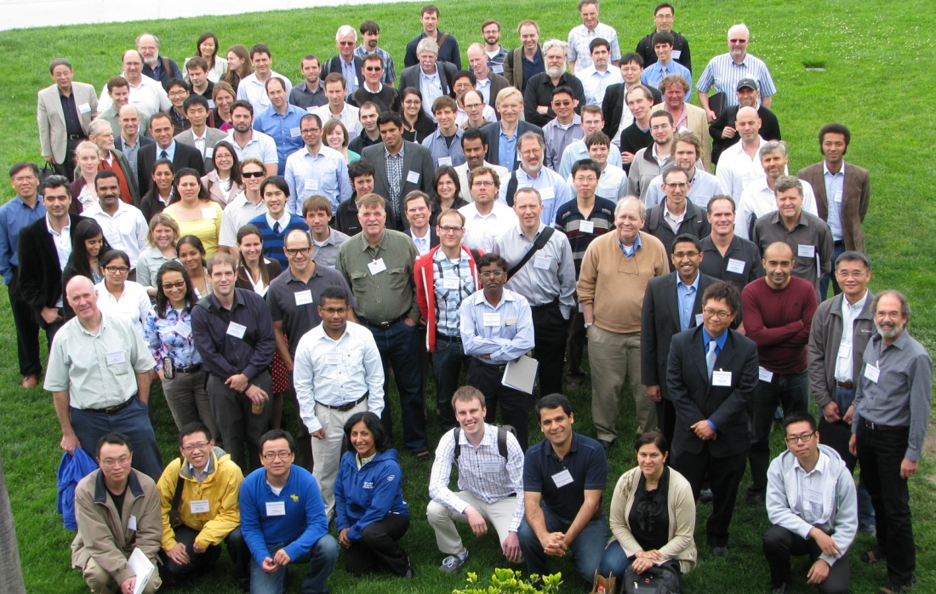
DNA Sequencing Technology Development
  Grantee meeting April 29-May 2
    Direct reading of modified cytosines
    Fabrication of solid state nanopore arrays
    Protein analysis
  New applications will be discussed in the Closed Session
Notes:
Last month, * 150 scientists participated in the annual grantee meeting for NHGRI’s $1000 Genome technology development program, in which grantees shared their results and were joined on the last day by non-grantees working in the field.
The most striking results reported included demonstration by several groups of methods for * (1) direct reading of modified cytosines in genomic DNA; * (2) fabrication of solid state nanopore arrays; and * (3) as a spin-out of experiments to sequence DNA using nanopores, early demonstrations of protein analysis using nanopores.
* A new set of grant applications for this program will be discussed in our Closed Session.

Slide 53



ENCODE
  CSHL ‘Biology of Genomes’ ENCODE Tutorial
  ENCODE Consortium Meeting on May 29-31
  Cross-species manuscripts submitted or in final preparations
    modENCODE (fly/worm/human)
    mouse ENCODE (mouse/human)
Document 31
Notes:
The goal of the Encyclopedia of DNA Elements (or ENCODE) project is to create a catalog of all functional elements in the genome, and to make that catalog freely available as a resource to the biomedical research community.
* A widely attended tutorial on using ENCODE data to understand the role of genetic variation in human disease was held at the Cold Spring Harbor Laboratory Biology of Genomes Meeting two weeks ago.
* An ENCODE Consortium Meeting will take place later this month, at which the data production centers, data analysis and coordination centers, computational analysis groups, and technology development groups will present updates on their projects, begin to develop coordinated analysis plans, and finalize consortium goals and policies.
* Cross-species integrative analysis of functional elements is well underway, with manuscripts submitted or in final preparations. Both modENCODE and mouse ENCODE are also writing sets of companion papers.

Slide 54




ENCODE
  Mike Pazin gave ENCODE presentation at TEDMED 2013 in Washington, D.C.
  Two former ENCODE program analysts (Rebecca Lowdon and Judy Wexler) awarded NSF Graduate Research Fellowships
Rebecca Lowdon
Judy Wexler
Document 31
Notes:
Mike Pazin, one of ENCODE’s program directors, gave a talk about ENCODE at TEDMED 2013 held at the Kennedy Center in Washington DC in April. * The talk entitled “Can an orchestra of scientists find the hidden music in your DNA?” shed light on how collaborations can help unlock more DNA secrets, with experiences in the ENCODE project used as ex.
* NHGRI would also like to congratulate Rebecca Lowdon and Judy Wexler, two former ENCODE program analysts, who were each awarded an NSF Graduate Research Fellowship. Rebecca is currently a graduate student at Washington University, and Judy is a graduate student at U.C.-Davis.

Slide 55

Centers of Excellence in Genomic Science
(CEGS) & Diversity Action Plan (DAP)
  Program Announcement PAR-13-198
  Letters of intent due June 8, 2013
  Applications due July 9, 2013
  CEGS Grantee and DAP Meeting in October
Notes:
Following Council’s agreement in February to renew the Centers of Excellence in Genomic Science (CEGS) program, * NHGRI and NIMH published a new program announcement in April, with modifications that broadened the scope of the CEGS program so that it better aligned with NHGRI’s new strategic plan. * Letters of intent for CEGS and their associated Diversity Action Plans are due in June and * applications are due in July.
The current program announcement is for one year. Later this year, we will issue a new program announcement for three more CEGS application receipt dates. This is because NIH is making a transition to electronic submission of these more complex grant applications.
* This year’s annual CEGS Grantee and DAP Meeting will be hosted by the CEGS at the Medical College of Wisconsin and the University of Wisconsin, and will be held in Madison, Wisconsin in October. Shown here is a group photograph from a previous such meeting.

Slide 56


  1,000th registered PhenX Toolkit user!
  7 new FOAs recommend using PhenX measures (NIAAA, NIDA, NCI, DoD, etc.)
Document 32
Notes:
During the first quarter of 2013, the PhenX Toolkit, an online resource of standard phenotypic and environmental exposure measures, met an exciting milestone– * the 1,000th registered user! As of the end of April, there are now close to 1,100 registered users.
In addition, * 7 new Funding Opportunity Announcements (FOAs) that strongly recommend the use of PhenX measures were published in 2013 (for a total of 35 such FOAs from a variety of NIH institutes and centers).
Lastly, * the NIH recently launched a web portal to improve access to information about NIH-supported Common Data Element initiatives (such as PhenX) and to assist investigators with tools and resources for developing protocols for data collection. NHGRI program staff participates in this trans-NIH effort, in which PhenX measures have had a strong presence.

Slide 57


GAIN Data Access Committee
Document 33
Notes:
You may recall that the Genetic Association Information Network (GAIN) was established to investigate the genetic basis of common diseases by creating a network of six collaborative genome-wide association studies, including those studying ADHD, depression, type I diabetes, and other conditions. Since making the GAIN study available through dbGaP in 2007, the GAIN Data Access Committee has received and reviewed over 1,000 project requests.
In April, * a commentary describing the experience of the GAIN Data Access Committee was published in the American Journal of Human Genetics. Over 5 years of experience with this controlled data access model have demonstrated substantial use of GAIN data by investigators from academic, nonprofit, and for-profit institutions, with relatively few policy violations.
* As you can see from this table included in the commentary, roughly 200 project requests have been submitted to the GAIN Data Access Committee in each of the past few years, with the majority being approved. The availability of GAIN data has allowed for advances in both understanding the genetic underpinnings of specific diseases and the development and refinement of statistical methods for identifying genetic and environmental factors related to complex common disorders.

Slide 58


NHGRI GWAS Catalog
Published Genome-Wide Associations through 12/2012
Published GWA at p≤5X10⁻⁸ for 17 trait categories
Document 34
Notes:
The NHGRI GWAS catalog identifies, curates, and disseminates data from the published GWAS literature in a user-friendly, downloadable resource. * Recently, the iconic GWAS ideogram was updated to include studies from 2012. In addition to the snapshot found at our genome.gov site, an interactive and enhanced version of the graphic can be found at the EBI website shown here.
* Zooming in on a region of chromosome 16, * and clicking on this orange dot at 16q12, for example, * shows information about the association of the FTO locus with type 2 diabetes.
* Also at this website, graphics customized for the most popular searches of the catalog (such as for obesity, as shown here) have been generated and are available for download.

Slide 59

Population Architecture using
Genomics and Epidemiology (PAGE)
  Metabochip genotyping completed on >60,000 non-European participants
  Analyses on >20 phenotypes underway
Document 35
Notes:
The Population Architecture using Genomics and Epidemiology (PAGE) program focuses on elucidating the genetic variants underlying a wide range of common diseases and traits in large, ethnically diverse cohorts.
Recently, * PAGE completed Metabochip genotyping of over 60,000 non-European participants, making this one of the largest (if not the largest) collections of well-phenotyped, diverse ancestry participants.
* Analyses on over 20 diseases or traits are now underway.

Slide 60





Population Architecture Using
Genomics and Epidemiology (PAGE)
Document 35
Notes:
And in recent months, PAGE has published several papers on obesity, diabetes, and lipids, as shown here.

Slide 61





Phenotype-Genotype Integrator (PheGenI)
Document 36
Notes:
The Phenotype-Genotype Integrator (or “Phee-GEE-nee”) is an NCBI-NHGRI collaboration to integrate GWAS data from the NHGRI GWAS catalog and dbGaP with other genomic resources at NCBI. This resource has been introduced to Council previously, but here we provide a few updates of interest.
* The search-specific ideogram is now available in a high-resolution and downloadable format to facilitate use in posters, papers, and talks.
* A PheGenI overview paper (by Ramos et al.) is now in press at the European Journal of Human Genetics.
* And finally, PheGenI was honored as a “Silver Medallion” poster at the recent AMIA Summit on Translational Bioinformatics.

Slide 62
Genomic Medicine
Pilot Demonstration Projects
  Awards will be made summer 2013
  First Steering Committee meeting on July 9-10
  RFA re-issued– RFA-HG-13-004: Genomic Medicine Pilot Demonstration Projects (U01)
  Application Due Date: July 17, 2013
Document 37
Notes:
The first set of Genomic Medicine Pilot Demonstration Projects were awarded on May 1.
* You can see the four award recipients here. The goals of the program are to develop best practices for the incorporating genomic information into healthcare settings, with the program including new and ongoing genomic medicine projects.
* The consortium will hold its first Steering Committee meeting in July.
* And the reissued RFA for this program has been released, with applications due in July.

Slide 63

Genomic Medicine Working Group
  Inter-Society Coordinating Committee for Practitioner Education in Genomics (ISCC- PEG) created
  ISCC-PEG Goal: To facilitate professional societies’ efforts in educating physicians and other practitioners in the use of genomic medicine in clinical care
Document 38
Notes:
You may recall that NHGRI’s Genomic Medicine Working Group held its fourth Genomic Medicine Meeting this past January. Representatives from 10 different professional societies across a range of disciplines, as well as representatives from two regulatory bodies, attended the meeting.
One of the outcomes of the meeting was the creation of an * Inter-Society Coordinating Committee for Practitioner Education in Genomics (ISCC-PEG). * The goal of this new group to facilitate professional societies’ efforts in educating physicians and other practitioners in the use of genomic medicine in clinical care
The Committee is anticipated to include one representative from each interested professional society and NIH institute and center. We currently have representation from 13 medical professional societies and 11 NIH institutes and centers. The Committee expects to hold its first in-person meeting in June.

Slide 64

Ethical, Legal, and Social Implications (ELSI) Research Program
  Return of Results Consortium to hold joint meeting with CSER investigators on May 22-23
  Topics include:
  ACMG recommendations on return of incidental findings
  Liability issues
  Legal issues related to CLIA
  Implications of recent finding on identifiability of genomic data for data sharing
Document 39
Notes:
Turning to our ethical, legal, and social implications (ELSI) research program.
* The Return of Results Consortium and the Clinical Sequencing Exploratory Research (CSER) Program will hold their second joint meeting on May 22-23. This meeting will bring together investigators from CSER as well as the R01, R21, and other independent projects funded by the ELSI research program related to return of results.
* The meeting will include a wide range of topics of interest to both CSER and the Return of Results Consortium members including: the recent ACMG recommendations on return of incidental findings, legal issues related to liability as well as the Clinical Laboratory Improvement Act (CLIA), and implications of recent finding on identifiability of genomic data for data sharing.

Slide 65

Genomics and Society Working Group
  First meeting of the Genomics and Society Working Group held in April
  Next meeting in fall of 2013
  Presentation later in the Open Session
Document 40
Notes:
In the fall of last year, NHGRI established the Genomics and Society Working Group as a working group of this Council. The mission of the Genomics and Society Working Group is to provide advice to Council and to NHGRI on short- and long-range planning and priority setting for genomics and society activities at the Institute (broadly defined), with particular emphasis on the ELSI Research Program.
* The first meeting of this working group was held in April, and * planning for their next meeting in the fall is underway.
* Finally, Pamela Sankar will provide a report about the first meeting of this working group later in the Open Session.

Slide 66

NHGRI Training and Career
Development Workshop
  ~20 experts in genomics, genomic medicine, and training met in April
  First review of NHGRI training programs since the Human Genome Project began
  Presentation later in the Open Session
Document 41
Notes:
Earlier this year, * NHGRI invited 20 experts in genomics, genomic medicine, and training to a workshop that discussed the future of NHGRI’s training and career development programs. * This was the first review of NHGRI training programs since the Human Genome Project began, and yet the needs in training and career development have changed substantially over the last two decades.
With the publication of NHGRI’s new strategic plan in 2011, there is a need to assess and re-align the Institute’s training and career development programs. The expected outcome of this workshop and subsequent discussions will likely be new FOAs for NHGRI training programs.
You will hear from Bettie Graham about NHGRI’s training programs and specific recommendations from this workshop later in the Open Session.

Slide 67
Director’s Report Outline
General NHGRI Updates
General NIH Updates
General Genomics Updates
NHGRI Extramural Research Program
NIH Common Fund Programs
NHGRI Division of Policy, Communications, and Education
NHGRI Intramural Research Program

Slide 68

Molecular Libraries Program (MLP)
  Final year of the production phase
  Outcomes from past 5 years of production:
      Initiated 352 probe discovery projects
      Completed 340 high-throughput screens
      Produced 348 small molecule probes
Document 42
Notes:
The Molecular Libraries Program (MLP) offers researchers access to the screening capacity needed to identify small molecules that can be optimized as chemical probes to study the functions of genes, cells, and biochemical pathways in health and disease. Chemical probes may also be used to validate new drug targets. The program began as a pilot in 2004 to develop screening centers. The probe production phase then began in 2008.
* Support from the Common Fund will end in May 2014, so we are now in the final year of the production phase.
* Several achievements have been made over the past 5 years of the production phase. * These include the initiation of 352 probe discovery projects, * the completion of 340 high-throughout screens, and * the production of 348 small molecule probes.
The Molecular Libraries Program screening data is available in PubChem for every project, and probes are published on the NCBI ‘Bookshelf.’

Slide 69


Knockout Mouse Phenotyping Project (KOMP²)
  Launched in Fall, 2011
  Goal: make and phenotype 2,500 knockout strains
  Recent KOMP2 meeting
  Bloomsbury report on embryo phenotyping published
Document 43
Notes:
The goal of the Knockout Mouse Phenotyping Project (KOMP2), * launched in the fall of 2011, is to make and phenotype * 2,500 knockout mouse strains over five years. The phenotype data will be deposited into a central core database, and the mouse strains will be available from the KOMP repository.
The project is part of the International Mouse Phenotyping Consortium (IMPC), whose overall goal is make over 5,000 strains during these five years. * These graphs show a typical report. The top graph shows ES cell microinjections, while the bottom graph shows the production of mouse strains for which the ES cell has transmitted through the germ line. The yellow lines reflect the project’s goals, and the blue lines show the actual production.
* The KOMP2 Annual Meeting was held a few weeks ago, at which overall progress at the international level was reviewed by the IMPC Panel of Scientific Consultants.
* The Bloomsbury report on mouse embryo phenotyping was published in March. This presented the rationale for the embryonic lethal phenotyping supplement that was recently granted (for $9.6 million) by the NIH Common Fund.

Slide 70

    GTEx pilot data in dbGaP
      182 post-mortem donors genotyped
      >1800 RNA-Seq studies
    1st GTEx Community Meeting in Boston on June 18
    RFA “Enhancing GTEx with molecular analyses of stored biospecimens (U01)’ will come to September Council meeting
Document 44
Notes:
The Genotype-Tissue Expression (GTEx) Project aims to study human gene expression and regulation in multiple tissues through genomic analyses of rapid autopsy samples. The goal is to gain valuable insights into the mechanisms of gene regulation and, in the future, its disease-related perturbations.
* GTEx released its pilot data in April through dbGaP. This includes genotype data from 182 post-mortem donors and over 1,800 RNA-Seq studies from 38 different tissue types. Shown in the figure are data for nine organs with 90 or more samples analyzed.
* On June 18, GTEx will hold the 1st GTEx Community Meeting in Boston.
* There was a robust response to an RFA designed to enhance GTEx with additional molecular assays and, after review in June, these applications will come to the Council meeting in September.

Slide 71

Library of Integrated Network-based
Cellular Signatures (LINCS)
  LINCS Data Forum held in March
    ~150 total participants and >90 non-LINCS scientists (including 15 from pharma)
    Included a joint LINCS-VIZBI session
  LINCS Phase 2 approved by NIH Common Fund
Document 45
Notes:
The Library of Integrated Network-based Cellular Signatures (LINCS) project aims to create a network-based understanding of biology by cataloging changes in gene expression and other cellular processes that occur when cells are exposed to a variety of perturbing agents, and by using computational tools to integrate this diverse information into a comprehensive view of normal and disease states that can be applied for the development of new biomarkers and therapeutics.
* In March, a LINCS Data Forum was held at Harvard Medical School. Approximately 150 people attended the forum, over 90 of which were non-LINCS scientists (including 15 researchers from pharma). In addition, 40 people from Europe and Asia attended via a live videocast. The forum showcased the LINCS tools that were released in November, and provided interactive hands-on demonstration sessions that allowed participants to try out the new tools with expert guidance.
* The follow-up LINCS-VIZBI meeting afforded an opportunity for LINCS groups to introduce the broader biomedical visualization community to the data visualization and analysis challenges being faced by LINCS.
* Finally, the NIH Common Fund has approved a Phase 2 for LINCS, which will begin in Fiscal Year 2014.

Slide 72

Protein Capture Reagents Program
  Recent site visits of all 7 Centers
  Recent EU Affinomics Meeting
  First affinity reagents deposited in public repositories
Document 46
Notes:
The Protein Capture Reagents Program is in its 3rd year. The three production centers, one antigen center, and two antibody centers are focused on production of human transcription factor affinity reagents. * All seven of these groups were recently subjected to site visits by NIH program staff and external advisors. There has been an overall slowdown in production due to a bottleneck in the antigen supply and the unforeseen difficulty in providing two different antigen formats to two different antibody-production groups. Program staff and the external advisors are working with the centers to solve this bottleneck and to get production back on track.
* The biennial EU Affinomics Meeting was held in March. This program is a European Commission-funded effort with similar goals as the Protein Capture Reagents Program. The two programs are looking to expand their collaborative efforts. The Protein Capture Reagents program is also in the process of strengthening ties with the European Human Protein Atlas program.
* The first affinity reagents emanating from our program have been deposited in public repositories.

Slide 73


  2nd H3Africa Consortium meeting in Ghana
  Working groups met and presented policy recommendations to H3Africa Steering Committee
      Joint meeting with the AfSHG (May 19-21)
Document 47
Notes:
The Human Heredity and Health in Africa (H3Africa) Program, which provides funding directly to African institutions to support genomics research, * had its second consortium meeting in Ghana last week. The first day was devoted to a series of * working group meetings so that these groups could finalize the policy recommendations that were then presented to the H3Africa Steering Committee for revision and enactment.
* Immediately following the H3Africa meeting, there was a joint meeting with the African Society of Human Genetics, which began on May 19 and ends today. That the H3Africa meeting was held back-to-back with the African Society of Human Genetics meeting was no coincidence, and is part of H3Africa’s outreach efforts to engage African scientists across the continent.
The next H3Africa consortium meeting will be held in Johannesburg, South Africa in October, and will coincide with the Southern African Society for Human Genetics Congress.

Slide 74

Undiagnosed Diseases Network
  RFA-RM-13-003: Undiagnosed Diseases Gene Function Research (R21)
  Application Due Date: June 14, 2013
  RFA-RM-13-004: Clinical Sites for an Undiagnosed Diseases Network (U01)
  Application Due Date: June 19, 2013
Document 48
Notes:
The Undiagnosed Diseases Network (UDN) is being established across the country to increase the capacity for and use of genome sequencing in the diagnosis of rare and new diseases. The Network also hopes to aid in management strategies for patients with such disorders. The Undiagnosed Diseases Network has two open funding opportunities, with applications for both due in June.
* The Undiagnosed Diseases Gene Function Research (R21) solicitation will support gene function studies to investigate the underlying genetics, biochemistry, and/or pathophysiology of newly diagnosed diseases in association with gene variants identified through the Undiagnosed Diseases Network.
* Clinical Sites for an Undiagnosed Diseases Network (U01) solicitation aims to add to and build upon the NIH Intramural Research Program’s Undiagnosed Diseases Program. This program seeks to provide improved patient access to state-of-the-art diagnostic methods, which will be pursued by expanding the available expertise and facilities serving patients with these unusual disorders and by accelerating discovery and innovation in diagnosing and treating these patients.

Slide 75
Director’s Report Outline
General NHGRI Updates
General NIH Updates
General Genomics Updates
NHGRI Extramural Research Program
NIH Common Fund Programs
NHGRI Division of Policy, Communications, and Education
NHGRI Intramural Research Program

Slide 76


GenomeTV on YouTube
genome.gov/GenomeTV
Document 49
Notes:
In late 2009, NHGRI began distributing its video content on GenomeTV, a channel on YouTube.com. Since then, NHGRI has produced and posted more than 630 videos, ranging from recorded webcasts of these Council meetings to major events, such as our recent symposium celebrating the 10th anniversary of the completion of the Human Genome Project. As of April 29, GenomeTV had 5,159 subscribers, and the videos on GenomeTV had been viewed more than 1.1 million times.
While you can access all of the videos on GenomeTV directly through YouTube, we have also conveniently organized all of the Institute’s GenomeTV video assets on our website, * specifically, at genome.gov/GenomeTV. In the upper right corner of that page, users can also see any live webcasts currently underway.
In addition, the Broadcast Media tab in the lower left of this page links to full-resolution, high-definition video that news organizations and other broadcasters can download directly and use in their own shows.
For historic purposes, the Archived Video tab in the lower right links to older videos that were produced prior to the middle of 2007.

Slide 77



GenomeTV: Anecdotal Evidence of Outreach
Notes:
I am a big enthusiast of our GenomeTV channel and our general video-based outreach efforts. One of the reasons for this is that not infrequently, I get a * ‘feel good’ email that just makes me smile in otherwise crazy and stress-filled day.
* As anecdotal evidence of GenomeTV outreach, here is an email I received back in March from someone at Lahore College for Women University in Pakistan. This individual asks specific questions about my personal favorite GenomeTV video— the * one that Carla Easter and I produced demonstrating how to purify strawberry DNA using materials you can find in your kitchen.
The thought of someone in Pakistan watching Carla and I doing a laboratory demonstration, and then sending me an email with technical questions about analyzing the resulting DNA just made me smile.

Slide 78








Genomics in Medicine Lecture Series
2013 Focus on Genomics & Oncology
Neal Young, M.D.
Kathleen A. Calzone, Ph.D., R.N.
Thomas Ried, M.D.
Electron Kebebew, M.D.
Lee J. Helman, M.D.
W. Marston Linehan, M.D.
Louis M. Staudt, M.D., Ph.D.
Kenneth H. Kraemer, M.D.
Document 50
Notes:
The Genomics in Medicine lecture series began its third round of lectures earlier this month. The lecture series is a collaboration between NHGRI, Suburban Hospital in Bethesda, and the Johns Hopkins University School of Medicine to educate healthcare professionals about the increasing role of genomics in clinical care. This round of lectures will focus on genomics and oncology, and will include a special lecture on integration of genomics into nursing practice.
Lectures in this series have been held monthly since December 2011 as part of Suburban Hospital’s Grand Rounds. Lectures are attended by 80-100 in-person practicing physicians, and all of the talks are videotaped and made available on the GenomeTV channel of YouTube.

Slide 79


DNA Day 2013:
Washington, DC & Brooklyn, NY
>250 students at NMNH from 8 local high schools in Washington, DC
High school students from 5 partner schools in Brooklyn, NY
Document 51
Notes:
To celebrate DNA Day 2013 and in partnership with the National Museum of Natural History, * NHGRI held a program for over 250 high school students from 8 different local schools on April 19 at the National Museum of Natural History. While at the museum, these students listened and participated in a question/answer session with a panel of genomics researchers, and were sent on a scavenger hunt throughout the museum (which illustrated how genomics is relevant to many of the current exhibitions). Students also participated in hands-on genomics activities, and concluded their busy day with a viewing of an IMAX film.
* Staff from NHGRI also celebrated DNA Day 2013 in partnership with Medgar Evers College, the Brooklyn Public Libraries, and five Brooklyn high schools. As part of the day, students spent two hours isolating DNA from cheek cells, and discussed the relevance of ethic issues in genomics research.

Slide 80
Director’s Report Outline
General NHGRI Updates
General NIH Updates
General Genomics Updates
NHGRI Extramural Research Program
NIH Common Fund Programs
NHGRI Division of Policy, Communications, and Education
NHGRI Intramural Research Program

Slide 81


International Canine Health
Lifetime Achievement Award
Elaine Ostrander, Ph.D.
Document 52
Notes:
Elaine Ostrander, Chief of the Cancer Genetics Branch in NHGRI’s Intramural Research Program, received the International Canine Health Lifetime Achievement Award for her leading role in sequencing and analyzing the canine genome, and thus providing a lasting legacy for the improvement of dog health and the understanding of several human diseases.

Slide 82

Social & Behavioral Research Branch (SBRB) 10th Anniversary: 2003-2013
SBRB founded in December 2003
Kick-off celebration coincided with last of the paired seminars commemorating 2013
Upcoming celebration on October 30
Alexandra Shields, Eric Green, and Caryn Lerman
Notes:
NHGRI founded the Social and Behavioral Research Branch * almost 10 years ago (on December 4, 2003), making it the seventh of NHGRI’s branches in its Intramural Research Program.
The Branch is planning various events to celebrate their 10th anniversary.
* For example, Drs. Caryn Lerman and Alexandra Shields gave the last of the series of paired lectures as part of our commemorative 2013 activities (in honor of the 10th anniversary of the Human Genome Project). Their lectures served as a kick-off to celebrating the Social and Behavioral Research Branch’s 10th anniversary.
* A larger celebration is being planned for October 30, an event that will include two internationally recognized speakers, NIH colleagues, alumni trainees, and visiting faculty. There will also be an afternoon exhibition that will include posters and interactive exhibits to showcase innovative science of both intramural and extramural genomics and society programs.

Slide 83








NHGRI Intramural Research Highlights
A meta-analysis identifies new loci associated with body mass index in individuals of African ancestry
A Copy Number Variant at the KITLG Locus Likely Confers Risk for Canine Squamous Cell Carcinoma of the Digit
Document 53
Notes:
Finally, some recent highlights from NHGRI’s Intramural Research Program include the following:
* A study by an international research team that included Ellen Sidransky and Tyra Wolfsberg reported that people who carry gene alterations that cause Gaucher disease have an elevated risk for Parkinson's disease and even higher probability for dementia with Lewy bodies.
* A large study by a consortium that includes Charles Rotimi and members of the Center for Research on Genomics and Global Health identified genomic regions associated with body-mass index (BMI) among people with African ancestry.
* A team of researchers led by Elaine Ostrander studied dogs with squamous cell carcinoma of the digit and established the genetic cause of the disease. Standard poodles are among those at highest risk, and the condition only affects standard poodles with dark coats.
* Jim Mullikin and colleagues at the NIH Intramural Sequencing Center collaborated on a study with researchers at Duke University that could help researchers determine which proteins to use in investigational vaccines to induce antibodies capable of preventing infection from an array of HIV strains.

Slide 84


Thanks!
Special Thanks!
Notes:
Finally, a personal thanks to all of the various NHGRI staff (probably over 50-60 of you) who helped pull together the many slides that I just reviewed. Needless to say, without a group effort across the Institute, I could never give such a detailed Director’s Report at each Council meeting.
* And special thanks to Kris Wetterstrand, who serves as the ‘ring leader’ in coordinating material development and who directly helps me produce the final Powerpoint product. This photograph is a screen shot from a video trailer about the Smithsonian genomics exhibition that includes an interview with Kris, who is among many at NHGRI that has contributed greatly to the exhibition’s development.
Also, a big thanks to Larry Thompson, Judy Wyatt, and the NHGRI web team for making my Director’s Report into an electronic resource on the web.

Slide 85

Advancing human health
through genomics research

