Slide 1
A Glimpse Into the Microbiome
An Introductory Lecture
Andrew Lee
Adjunct Assistant Professor
Department of Biology
Northern Virginia Community College

Slide 2
What lives here?
Photo: pixabay
Notes:
TEXT: So, we’re staring today with the simple question: What lives here? We’ll take one minute and have you write down what you think lives here.
After 1 minute: OK, raise your hand if you wrote…deer….tree…grass….
For the next minute, think about other things living here.
[Hint: they may be very small, and you might not see them in this picture]
Anyone have anything else?
GOAL: Encourage careful observation, Spending time to closely examine and reflect

Slide 3
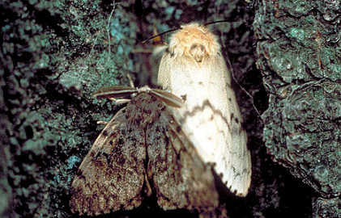
There’s more than meets the eye
Photo: USDA
Photo: Rutgers NJAES
Photo: CDC
Photo: Science Photo Library
Notes:
TEXT: Well we might have missed a few things. The tick that feeds off the blood of the deer…..the caterpillar & moths found on trees….or the combination of algae and fungus forming lichens on the side of trees (a symbiotic relationship, where it is mutually beneficial to both the tree and the lichens), or lastly... the invisible millions of bacteria, fungi and viruses living in soil.
As we start, we’re thinking about the unseen landscape and the interrelationships that go beyond the deer tick feeding on the deer. These species have their own space, and it overlaps with species. Biologists say these species are living in a community…different species that live in a shared space.
But all these species are living in balance, carving out their own little corner in the neighborhood. And by all measures, they’re stable and in good health…pending disruption…. If we brought in other grazing animals, all the grass might be eaten up. Other types of foreign ticks might kill off deer.
What would happen if the nitrogen-fixing rhizobia and others such as Frankia died off? Then the plants would die too. So you can think of this as a neighborhood where everyone has their own house, and it isn’t crowded, and people do their own thing. They help each other out, but mostly keep to themselves. If a bunch of new families moved in, or there was another big change to the roads or sidewalks, it would disrupt the balance in the neighborhood.
ENDING QUESTION: If large, complicated organisms (eukaryotes) live in such a relationship, do you think simpler organisms, like bacteria do?
GOAL: Consider the small species, introduce symbiosis, convey distinct corners of a biological “community”, species largely live in harmony, introduce the idea of disharmony/big change, analogy drawn to a neighborhood

Slide 4
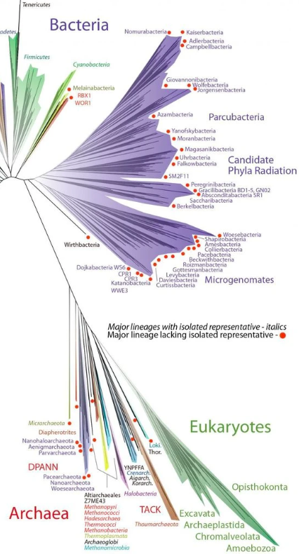
What does “microbiome” mean?
Nature Biotechnology (2016)
“The ecological community of commensal, symbiotic and pathogenic microorganisms that literally share our body space and have been all but ignored as determinants of health and disease.” – Josh Lederberg 2001
Photo: Rutgers
Photo: microscopy UK
Photo: NHGRI
Image: Banfield/UC Berkeley
Photo: NIH
Notes:
TEXT: What does microbiome mean?
The definition is on the slide and the term was coined back in 2001 by a Nobel prize winner (who discovered more about how DNA provides the code of life). We’re noticing how organisms help each other (commensal and symbiotic) and those that cause disease (ie., pathogenic) live in a shared space. This can determine health, or lack of health.
So this idea, this term was created nearly 20 years ago, and it is still thought of as a revolutionary idea. Science takes time and the idea of the microbiome really only entered the general public’s knowledge 5-10 years ago. Looking closer at the definition what organisms are mentioned in this definition?….microorganisms. This means we could be looking at bacteria, or fungus, or viruses….all of these organisms meet this definition.
In fact, we thinking that plants and animals are the dominant inhabitants of the planet…why? Because we see so many examples, everywhere. But this has been challenged. Only 3 years ago, researchers in California proposed rewriting the traditional tree of life to reflect the fact that bacteria are the dominant kingdom. The most interesting thing about this model is that it uses computer simulations to guess that many bacteria species are yet to be discovered (extrapolating from the number already discovered).
GOALS: Define microbiome, reinforce how inter-species relationships impact health, consider what are microorganisms, introduce species diversity and revised ”tree of life”, science is always changing with discovery

Slide 5
What about bacteria and people?
“Molecular cartography of the human skin surface in 3D” PNAS 2015
Considering just the skin…
Notes:
TEXT: Let’s talk about our own bodies and how they host microorganisms. Specifically our skin: which has unique microclimates… small areas where the environment is hospitable to specific types of bacteria. While this has been known for decades, a 2015 article shows us this cool looking map. This study developed a biological heat map, with the red and yellow the most active bacterial growth, green and blue, less so….along the bottom we see three bacteria….you’ve probably heard of a staph infection, but propionibacterium and corynebacterium are maybe less familiar.
This diagram also differentiates between males and females, with female samples on the top and male on the bottom.
Staphylococcus tends to inhibit moist areas, but there is more to the story. This strain really likes the sole and back of the foot in men, and a little less so in women. So an interesting difference here: propionibacterium is a bacteria that really likes oily skin…when you high concentrations of glands that produce oil, you get more of the bacteria. So parts of the face, and back….and this is bacteria is the one that causes acne infections in young adults.
Again, note there is a difference in where men and women have these bacteria on their face. And lastly, corynebacterium….like staph, it likes moist areas, so like staph, we have activity in the foot….but also on the hand, all up and down men’s backs, a lot more activity in women’s scalps on the top, and also in the crotch area of men, and to a much lesser extent in women.
What causes different bacteria to prefer different parts of the body? What makes the foot different from the back? Isn’t it the same skin? What’s going on?
Answer: Different skin chemistry, including oil content, pH, water/sweat. Bacteria will naturally live where they can take advantage of a stable environment where there is food they can use, like fats found in skin oil.
Did you noticed that this staph bacteria on the foot is the same deadly staph bacteria that can kill you if it gets into your blood stream? Hanging out on your foot, it’s not causing any problems with your foot or your body as a whole.
This cool work was done by a big group of researchers from three different countries, including people in three different US states, so cool science involving people from all over the world.
GOALS: introduce 2015 research study mapping three bacteria to different parts of the body, encourage close examination of charts (noting male/female differences, comparing bacteria), introducing chemistry’s role in determining where bacteria preferentially live, highlighting staph can kill in the blood, but is harmless on the foot, research is an international effort

Slide 6
Prokaryotes predate people
Stromatolite
Homo sapiens
Photo: CA State Univ. Long Beach
Photo: Science
3,500,000,000 (3.5 billion) years ago
300,000 years ago
Notes:
TEXT: Are we the oldest things on the planet? No, not by a long shot. We’ve only been on the scene for a short time. Only 300,000 years.
Prokaryotes, that is, basic single-celled organisms like bacteria have been around for more than 1,000x longer. In fact, this picture on the left shows fossil evidence of layers of bacteria preserved in the middle of what was a tree. Now, it’s a fossil called a stromatolite and scientists can study the bacteria found inside, seeing that it is a so-called cyanobacteria: a bacteria that can harvest energy from the sun, just like plants do.
GOALS: Introduce bacteria as ancient organisms, give an idea of the short time people have been on earth, show overlap between plants and bacteria (cyanobacteria)

Slide 7
Mitochondria’s prokaryote roots
double-membrane
mtDNA
ribosomes
Photo: Science Source
Notes:
TEXT: So we saw that it is hard to think of bacteria as different from complicated cells, like eukaryotes (plants).
What if we look inside our own cells and see evidence of actually being in existence because of a cooperative relationship with bacteria.
What are we looking at here? The organelle in cells, the mitochondria. What do they do? They power the cell, providing it with energy.
And its kind of odd that they have these characteristics listed on the right:…a bilayer, a plasmid of DNA, and ribosomes…as if they were completely self sufficient.
Also strange to note that mitochondria are about the same size as some bacteria.
This is the so-called endosymbiotic theory, that mitochondria used to be prokaryotes, doing their own thing….until our eukaryotic ancestors came along and ate them up. Basically forcing them to make energy for our cells.
GOALS: Reinforcing organelles & mitochondria definition, introducing the endosymbiotic theory

Slide 8
Chloroplast’s prokaryote roots
double-membrane
cpDNA
ribosomes
Photo: Getty Images
Notes:
TEXT: We saw this a few slides ago, there are bacteria that behave like plants (the cyanobacteria that are capable of photosynthesis). But flipped around, just like with us and the mitochondria, plants are taking advantage of bacteria. The chloroplasts, filled with the photosynthetic dye chlorophyll also have their own double membrane covering them, a plasmid circle of DNA unique to them, and ribosomes….and, like mitochondria, are coincidentally the same small size as some bacteria.
So we’re here because of bacteria that are now part of us, and plants too owe their amazing powers of photosynthesis to bacteria that can take light and carbon dioxide to turn it into sugar.
The endosymbiotic theory is applicable not only to mitochondria we have, but also to structures that are unique to plants, the chloroplasts.
GOALS: Review chloroplast definition, connect bacteria to plants’ photosynthesis, tie chloroplasts to the endosymbiotic theory.

Slide 9
Microbiome advances
Gastrointestinal:
nutrient absorption: starvation/obesity
autoimmune
biome-aided metabolism
inflammation
drug effectiveness
cardiovascular
hmpdacc.org
Pre-term birth
Inflammatory bowel disease
Type-2 diabetes
Notes:
TEXT: We introduced the mapping of skin bacteria hot zones a bit ago and the other area of big interest in the body is the gastrointestinal tract, your belly, gut, stomach….all the tubes that move food and drink through your body….going all the way from the mouth to the anus. Our bodies have interesting and distinct bacteria living and helping us digest food. These bacteria even help us make vitamins, like vitamin K in the large intestine and we couldn’t do it without them.
Its not a big surprise to think that a balance of bacteria in our guts can help us to digest our food, and if this bacterial mix was not diverse, we could imagine we might even have poor health because of bad digestion and inability to make crucial vitamins.
It isn’t as obvious that the same balance, or lack of balance could impact how we process drugs. Whether it be processing certain anti cancer drugs in the bloodstream that is impairing them or encouraging them to work properly…. correctly converting a drug to its proper form for Parkinson’s disease….what bacteria we have in our intestines impacts how drugs get converted.
A less obvious connection to bacteria can be seen with inflammation. We can all scratch our hands with our fingers and after a few seconds we start to see reddening….well this inflammation is part of your body’s natural response to stress (in this case the stress on your skin of the constant scratching). So what if all of your body was constantly stressed because of a lack of peace with the bacteria living in your digestive system, or on your skin? This is exactly what may be contributing to autoimmune diseases you may have heard of, like Crohn’s disease, or inflammatory bowel disease. Auto-immune diseases come about because your body is so agitated that it starts attacking itself, to defend against invaders it thinks are around. This overall lack of calm, peaceful bacteria living in your body have put your insides in a constant state of stress. Though we’re skipping a few steps here, your body’s response to being inflamed all the times is thought to also contribute to heart attacks and strokes.
The take-away message here is that bacteria influence how we digest anything we eat or drink and that they also may be responsible for whether our body’s reaction to stress, called inflammation, is exaggerated which can lead to autoimmune diseases and cardiovascular diseases like heart attacks.
So we’re only just starting to understand how a peaceful, balanced gut and skin, full of different types of bacteria may be crucial for promoting health and may explain how people can get sick. Its exciting to see that research is examining whether some types of asthma may be related to an imbalance of naturally occurring bacteria in the lungs.
And at the National Institutes of Health, near Washington, DC all of this research information is being analyzed and stored in an ongoing project called the Human Microbiome Project. This project has a separate site that covers research into 3 diseases that are thought to be linked to microbiome imbalance. We talked about autoimmune disease Inflammatory Bowel Disease, there is evidence to suggest that early births could be caused by imbalance in the vaginal birth canal, sending a signal to the baby that it’s time to leave, and lastly, there is research showing that types of gut bacteria may influence who gets sugar diabetes and who doesn’t.
GOALS: connecting bacteria in the gut to digesting anything that comes in the body, highlighting bacterial role in vitamin production, connecting bacteria to the body’s inflammation response, connection to ongoing research (via Microbiome Project)

Slide 10
Deadly bacteria
M. tuberculosis: still a top-10 worldwide cause of death
E. coli causing deadly food contamination
Y. pestis caused Bubonic Plague
Photo: I.D. Advisor
900,000 U.S. cases of pneumonia/year
Photo: ACS
Photo: Britannica
Photo: CDC
Notes:
TEXT: Thus far, we’ve painted a nice picture of our bacterial friends, living in our bellies and on our skin. But for most of human history, bacteria have bene thought of as the enemy who have wiped out entire villages. Bacteria were undiscovered, invisible and viewed as the cause of great suffering. The 1300s saw the black death, or bubonic plague, where 60% of Europe was wiped out as travelers spread it along trade routes that were just starting to connect east to west.
Tuberculosis has been a part of human history for hundreds of years and killed 1 out of 7 (almost 15%) of all people in Europe and the US around the time of the US Civil War….so ‘x/7’ people in this room would have died. It is still a top-10 cause of death all over the world, but it less frequently deadly in the US.
Pneumonia, which can be caused by bacteria, still makes 900,000 people sick every year (or as many people as in the city of San Francisco).
Lastly, we can even see in the news where restaurants like Chipotle made many people sick due to e.coli contamination from contaminated vegetables in 2018.
So when bacteria run wild, they make us very sick and can even kill us.
GOALS: providing historical (& contemporary) examples of bacteria causing harm

Slide 11
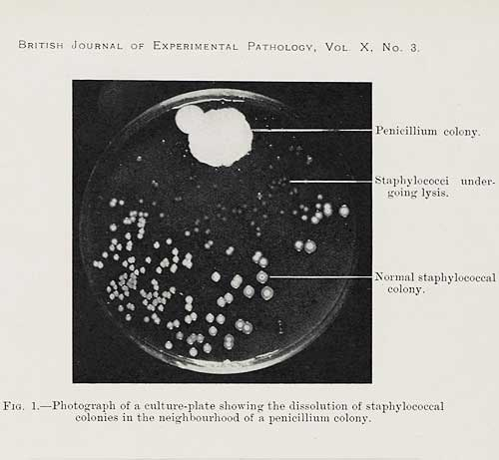
Penicillin revolution
Alexander Fleming’s accidental discovery
Fungus keeps staph bacteria at bay
Photo: Imperial War Museum
Photo: Brit. Jrnl. of Experim. Path.
Notes:
TEXT: Since the 1950s, deaths from infection have been prevented because of antibiotics…drugs that kill bacteria. In fact, humans live longer now vs. 100 years ago largely because of the lives saved by antibiotics targeting bacteria. We owe this largely to a Scottish scientist, Alexander Fleming, who carelessly left an experiment out over the weekend in 1928 that he didn’t clean up before going home.
When he came back to work, he found that a staph bacteria (like the kind we saw earlier on certain moist parts of the skin), was killed by a fungus. In a dish like the one on the right, the fungus up top in green was giving something off that killed the staph colonies at the bottom of the dish. They wanted to come closer to the fungus, but they couldn’t. It turns out the fungus was making a chemical, penicillin, that killed staph bacteria.
Fleming studied this for another 3 years, but it took another 14 years before this discovery was turned into medicine that people could take. The discovery saved millions of lives and penicillin drugs became available in World War II, saving injured soldiers from bacterial infection death.
GOALS: Highlight Fleming’s discovery, introduce principles of natural chemical production, provide historical timeline of discovery

Slide 12
Antibacterial soap everywhere!
Triclosan banned in 2016
Photos: FDA
Notes:
TEXT: The discovery of chemicals that could kill bacteria ushered in a new era. We went to war against bacteria and have been doing so since the 1950s…total destruction of bacteria, by pills and also antibacterial soap.
Killing dangerous e.coli bacteria on our hands does prevent food poisoning and death from food poisoning. But there are innocent bacteria who also die. We’re also killing all the bacteria that happen to be on our hands naturally, like the Corynebacterium found in the heat map slide.
Experts agree that handwashing is the single best thing you can do to prevent the spread of disease, we’ve been using a soap that may cause other problems. Only 3 years ago, the FDA banned the active ingredient found in Dial antibacterial soap because of concerns that this chemical, triclosan, could cause cancer. So our fight against bugs now has some serious doubters owing to negative side effects, killing bacteria that don’t present any harm and also from harmful effects of the chemicals used (like triclosan).
GOALS: Balance importance of killing deadly bacteria with side effects, introduce FDA oversight and recall

Slide 13
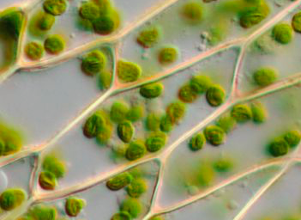
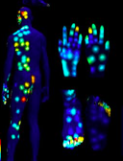
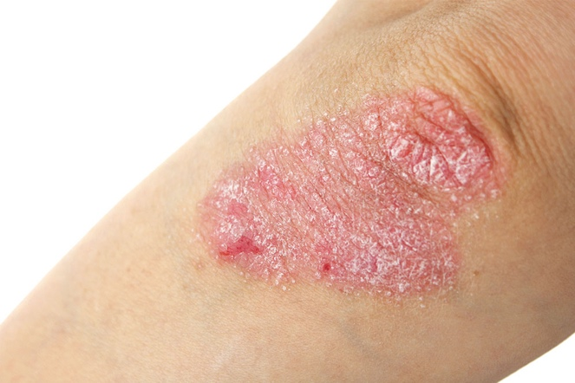
Maybe we’ve killed friends?
Illustration: StickPNG
Notes:
TEXT: What if we have killed harmless bacteria that actually help us by taking so many antibiotics (in pill form) and washing our hands with aggressive antibacterial soaps?
What if the presence of all these antibiotics also harms other plant species because the prokaryote-derived chloroplasts are unintentionally harmed? What if our own prokaryotic-derived mitochondria are indirectly hurt by certain antibiotic exposure? After all, if antibiotics target bacteria, they might accidentally kill these ancient bacteria that live inside us. Same for the chloroplasts, plants may not work as efficiently with antibiotics as part of our water system.
And lastly, what if some skin diseases caused by auto-immune reactions, such as psoriasis with its itchy, scaly plaques, are caused by an eradication of good bacteria along with the dangerous bacteria?
If you’re a bit unsure about all this, it is natural. This is all very complicated. What is good? What is bad? There are bad bacteria that don’t belong in our bodies and blood, but there are equally important bacteria playing a role in maintaining our health. We take for granted work they do in the background that keeps us safe and free from disease. Looking back at our first slide, these bacteria live near other bacteria and they all contribute to their community. So, yes, it is very likely that we’ve killed helpful bacteria in the process of wiping out the bad bugs.
Maybe future scientists, like you will one day invent a soap that will only target the bad form of e. coli that gives us food poisoning, while leaving alone all other bacteria on the skin.
GOALS: Good bacteria that are sadly killed. Not all bacteria are bad. Organisms and systems are inter-related.

Slide 14
Microbiome: New lease on life for bacteria
Fermented foods
Illustration: StickPNG
Photos: Cooks Illustrated
Notes:
TEXT: The publicity about the microbiome has led people all over the world to think about how to help encourage good bacteria living in our intestines. Today we think of bacteria as having a potential for great harm and disease, as well as promoting health. Bacteria aren’t only bad, they can be helpful and even promote health.
Recognizing the benefits of a balanced ecosystem that includes “good” bacteria, we see a health food craze associated with fermented foods. These fermented foods contain naturally-occurring bacteria and many of these foods talk about how they are “probiotic”…encouraging bacteria that promote health. Other traditional fermented foods are also being sold as miracle cures, foods like sauerkraut popular in Europe and fermented cabbage kimchi found in Asia.
We have rethought this idea of killing all the bacteria that started in the 1950s, and now we’re promoting good bacteria. Check out this label in the middle on the yogurt: it claims to have 10 million units of good bacteria…who knows if 10 million is enough, or too little, or overkill, but is sure sounds good! Drink 10 million of something that is good for you!
It’s important to note that there haven’t been tests of which bacteria are most helpful, whether they vary from person to person, and how much bacteria is helpful.
GOALS: Conclude with discussing that bacteria aren’t bad or good. Tying health to food. Introducing “probiotic”. Discuss lack of testing associated with health claims.

Slide 15
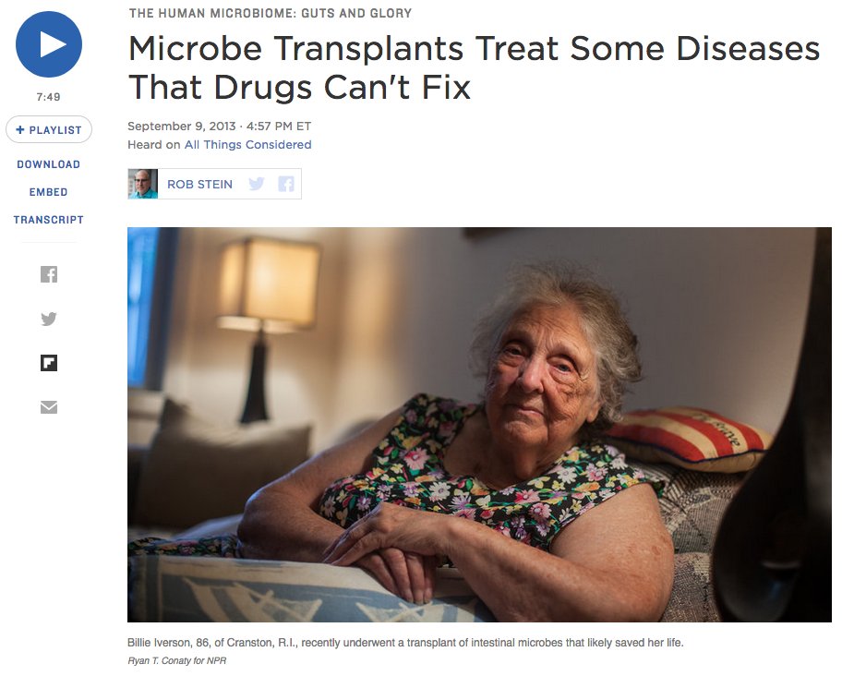
New research (short module):
Bacterial imbalance = deadly bacteria “wins”
Persistent c. difficle infection caused by antibiotic use
Intro activity:
General media,
topic in the news
NPR “All things considered”
Notes:
This short module has students listen to a short 7-minute National Public Radio story
(https://www.npr.org/sections/health-shots/2013/09/10/216553408/microbe-transplants-treat-some-diseases-that-drugs-cant-fix).
It introduces students to the use of fecal transplantation to treat c. difficle (pronounced “diff-eh-seal”) infections caused by extensive antibiotic use for serious infections in the blood. After extended treatment with aggressive antibiotics, the strongest bacteria remaining is c. difficle . At this point, it isn’t kept in check by its bacterial neighbors. It essentially wild and results in another serious infection that is dangerous to a patient who has already fought other bacterial blood infections. This short National Public Radio piece discusses how using decontaminated fecal transplants and some antibiotics has had very positive results. Many news outlets have covered fecal transplantation, this story provides an introduction suitable for all ages.

Slide 16
References
Book
• I Contain the Multitudes, by Ed Yong
Via HHMI & PBS short videos, based on the book at:
https://www.biointeractive.org/classroom-resources/world-without-microbes
Articles
Bouslimani, A., et al. ”Molecular cartography of the human skin surface in 3-D,” PNAS. 2015/03/30/online.
Banfield, J. F., et al. “A new view of the tree of life,” Nature Microbiology. 2016/04/11/online.
Notes:
For further information, refer to the above book. The articles listed are the two scientific articles mentioned in the slides and should be available online. Questions, comments: please email Andrew Lee (earhttoajl@gmail.com).

