Slide 1
NHGRI Genomic Data Science Working Group (GDSWG)
Shannon McWeeney, Ph.D.
Oregon Health & Sciences University
Anshul Kundaje, Ph.D.
Stanford University
February 12, 2024

Slide 2
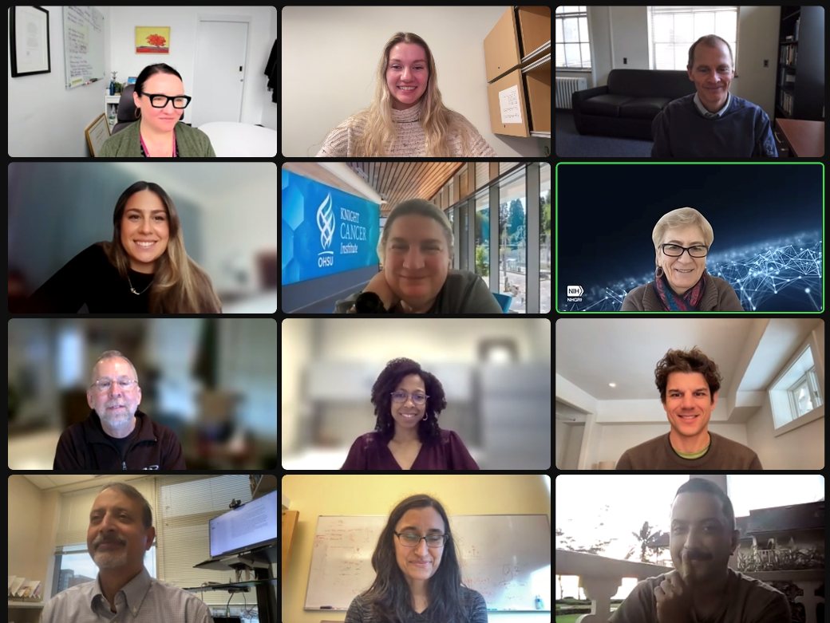
What is the NHGRI Genomic Data Science Working Group?
A Subcommittee of the National Advisory Council for Human Genome Research (NACHGR)
Formed in 2017
Meetings are held virtually every two months
GDSWG Meeting 1.11.24

Slide 3
Working Group Functions
Advises NHGRI on plans related to genomic data science outside of Council meetings
Provides input to NHGRI Director and other Institute leaders about trans-NIH issues related to data science
Addresses broad challenges including data management, analysis, computing and data science policy, as they relate to all areas of genomics, from basic science to genomic medicine

Slide 4
Current GDSWG Members
Updated February 2024
Mark Craven, Ph.D.
University of Wisconsin- Madison
Anshul Kundaje, Ph.D.
Stanford University
Tim Reddy, Ph.D.*
Duke University
2024 GDSWG Co-Chair
Barbara Engelhardt, Ph.D.
Stanford University
Christina Leslie, Ph.D.
Memorial Sloan-Kettering Cancer Institute
Marylyn Ritchie, Ph.D.
University of Pennsylvania
Eimear Kenny, Ph.D.
Icahn School of Medicine at Mount Sinai
Shannon McWeeney, Ph.D.
Oregon Health & Sciences University
Rahul Satija, Ph.D.
New York University
Iftikhar Kullo, M.D.*
Mayo Clinic
Casey Overby Taylor, Ph.D.*
Johns Hopkins University
2024 GDSWG Co-Chair
Paul Sternberg, Ph.D.
California Institute of
Technology
NHGRI Representatives: Eric Green, Valentina Di Francesco, Helen Thompson
* = Member of NACHGR
4
Notes:
Please note:
Shannon McWeeney and Anshul Kundaje are the outgoing 2023 co-chairs and Tim Reddy and Casey Overby Taylor are the new 2024 co-chairs.
Gail Jarvik rotated out of the GDSWG at the end of 2023, and Iftikhar Kullo rotated on in early 2024.
Which members are on council (Iftikhar Kullo and Tim Reddy)

Slide 5
Working Group Discussion Topics in 2023
NHGRI Training in Genomics and Data Science
New Initiatives and Renewals:
ML/AI Tools to Advance Genomic Translational Research
Investigator Initiated Research in Computational Genomics and Data Science (R01 and R21): PAR-21-254 and PAR-21-255
GDSWG Recommendations for the NHGRI-Funded Genomic Community Resources Portfolio
Notes:
1. The working group started 2023 off with discussions surrounding various offerings by the NHGRI training program opportunities offered through, focusing in particular on genomic data science training opportunities at multiple career stages, and on diversifying the genomic data science workforce.
2. Next, new initiatives and renewals were brought to the working group for feedback:
a. the new initiative entitled “ML/AI Tools to Advance Genomic Translational Research” aims to create a foundation for the development and validation of ML/AI tools to be used in clinical genomic research settings, and a systematic approach for assessing the Ethical, Legal, and Social Implications (ELSI) of utilizing these tools in clinical decision making. The GDSWG expressed support for this concept and highlighted the importance of validating these tools for clinical applications across clinical research sites. This initiative was cleared by the NHGRI Council in May 2023.
b. The Computational Genomics and Data Science PARs (Program Announcements with special Review criteria) were also brought to the working group to discuss their upcoming renewal in 2024. These two PARs were released in 2018 to solicit investigator initiated applications across a broad range of computational genomics and data science topics. The GDSWG was supportive of their renewal and made suggestions to focus their scope and to expand the pool of new and early stage investigator awardees. These funding opportunities are presented for clearance by the NHGRI Council today.
3. Finally, the group reviewed information provided by NHGRI staff about the genomic community resources portfolio, and generated a few recommendations for NHGRI to consider. The remainder of this presentation will focus on the workgroup’s discussions around this topic. First of all, let’s start with some background information about the genomic community resources portfolio.

Slide 6
Genomic Community Resource PARs
PARs: Program Announcements with special Review criteria
Investigator-Initiated applications
Budget Requests > $500k DC require NHGRI approval
U24: Resource-Related Research Projects, Cooperative Agreements
Issued by | Title | Funding Opportunity | Reviewed by
NHGRI | Genomic Community Resource | PAR-23-124 | NHGRI
Trans-NIH | Biomedical Data Repository | PAR-23-089 | NIH CSR
 | Biomedical Knowledgebases | PAR-23-078 | NIH CSR
Notes:
The Genomic Community Resources portfolio reviewed by the GDSWG consists of U24 grants that NHGRI solicited through the NHGRI Genomic Community Resource PAR-23-124, as well as the trans-NIH PAR-23-089 and PAR-23-078 for biomedical data repository and knowledgebases. While the trans-NIH funding opportunities focus only on biomedical data resources, the NHGRI funding opportunities accept also applications with a broader focus, such as analysis resources, reagents and community outreach and engagement.
These resources are investigator initiated, although applicants need to ask for NHGRI’s approval when the budget request is greater than $500K
Note: The portfolio analyzed by the GDSWG excludes resources solicited by NHGRI under RFAs (Requests for Applications), such as the AnVIL or ENCODE resources.

Slide 7
NHGRI’s investment in resources
Notes:
In 2023, NHGRI invested over $70M in Genomic Community Resources. This is about 17% of NHGRI's grant budget and a larger percentage than any of NHGRI's managed programs. This number is also likely to increase.
These grants are mostly comprised of data and software informatics resources. In general, resources tend to receive long-term funding. NHGRI is working to set a balance for supporting long term resources (U24s) and funding innovation (R01s).

Slide 8
Portfolio Review
The GDSWG reviewed the NHGRI-funded genomic community resource portfolio upon request by NHGRI
A sub-group of the GDSWG was formed to address questions raised by NHGRI and generate a list of recommendations
Notes:
In early 2023 a small group was formed to generate a list of recommendations aimed at guiding NHGRI’s investment in genomic community resources. The recommendations were based on (1) Presentations to GDSWG’ (2) Small group working meetings; (3) Requests for additional information from NHGRI and clarifications and (4) meeting between NHGRI and co-leads to review draft. The final document was approved by the GDSWG on the GDSWG meeting on November 9th, 2023. The following slides display the final recommendations from the GDSWG to NHGRI.

Slide 9
Global Core Biodata Resources at NHGRI
20/52 funded by NHGRI
NHGRI should assess which Global Core Biodata Resources are at the “Forefront of Genomics”
Notes:
In December of 2023 the Global Biodata Coalition (GBC), a forum for international research funders to coordinate and share approaches for the efficient management and growth of biodata resources worldwide, announced the latest set of 52 Global Core Biodata Resources. Of the 52, 20 were funded by NHGRI. Global Core Biodata Resources are described to be “of fundamental importance to the wider biological and life sciences community and the long-term preservation of biological data.”
Regarding how NHGRI should approach the Global Core Biodata Resources (GCBR), it is critical for NHGRI to assess these resources carefully. A resource could be of high global value, yet not be at the forefront of genomics. NHGRI should consider which resources are broadly high-valued resources. In addition, resources should be evaluated based on if they are (1) aligned with NHGRI's mission and (2) at the forefront of genomics (NHGRI’s motto for its Vision 2020 strategic plan). GCB Resources aligned with NHGRI’s mission and strategic plan should receive more stable support.
By definition, GCBRs have a global value on the biomedical research community
By definition, resources funded by NHGRI are in alignment with the NHGRI’s mission
NHGRI should define the GCBRs that are “at the forefront of genomics” and plan for more stable support for them.

Slide 10
Strategic Growth
Plan for growth using the resources life cycle framework:
Innovation for early stage resources
Maintain competitiveness, collaboration and value for mid/mature stage resources
Consolidate or ramp down at end-of-cycle
Investments in early-stage resources should focus on cost-effectiveness, impact, and integration within the NHGRI ecosystem.
NHGRI’s budget allocation for resources should be adequate to strategically support the various stages of the resources’ life cycle
Notes:
Regarding NHGRI investment in genomic community resources, the GDSWG was not comfortable recommending a percentage of budget allocation to be dedicated to the resources. There was universal agreement that there needs to be a plan for growth and proliferation of resources. NHGRI was encouraged to use the framework of the resource lifecycle to identify end-of-life plans for resources. In this life cycle, resources should exhibit innovation early on, maintain competitiveness in the context of other resources and when possible, leverage efforts with other resources and when appropriate mid-stage and then condense at end of life. Existing resources should lay the groundwork for these efforts. The GDSWG recognizes that this will mean consolidation and ramping down for some resources.

Slide 11
Balancing investments in research versus resources
Research grants (e.g. R01s/R21s) are critical for innovation
Resources enable innovative research through data and tools, and have a “capacity building” role that should be considered when making funding decisions.
Notes:
Regarding balancing the investment and value of large-scale resources relative to R01s, the GDSWG recognized there is a clear capacity building nature of resources given the data and tools they provide to the research community that should be considered when making funding decisions. While there is critical innovation from R01’s, it has not been the mechanism to generate large community resources (e.g, Reactome, ClinVar etc) that have wider impact and usage.

Slide 12
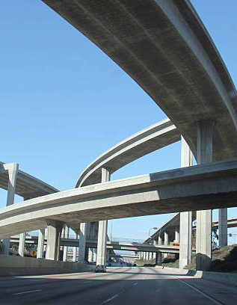
Sustainability Planning
NHGRI endorses free and unencumbered access to resources, in line with the GCBRs eligibility requirements.
No pre-defined investment caps or limits on the number of years of funding is recommended by the GDSWG
NHGRI should identify off-ramping mechanisms for resources at the end of the life cycle
Notes:
The GDSWG did not feel that funding caps (such as NSF’s 10 year limit on funding for resources) were warranted at this time as there are not clear “off-ramp” mechanisms for critical resources. While potential mechanisms have been suggested in the past (commercial content licensing, “freemium” etc) and were discussed by GDSWG, NHGRI does not currently encourage privatization, licensing fees and different fees for commercial/academic entities (as this not only contradicts the requirements of the NHGRI resources PAR but also the eligibility criteria of the Global Core Biodata Resources). It is recommended that this be revisited during the NHGRI strategic planning process. The NIH DMS policy also has implications for any solution as resources are often used as repositories for research data. Recognizing that this is a critical issue given limited funding and the continued need for innovation and cutting-edge resources, the NHGRI ecosystem should be assessed now for such “off-ramps” where key data and tools could be absorbed (if still highly utilized and/or impactful). This should be done in conjunction with the needs assessment and portfolio review (see below) so that this is done strategically to avoid the abrupt sunsetting of key resources due to funding constraints.
When considering the lifecycle, early stage should also be a focus of early stage investment (NIH or other technical support, UI/UX consultants, integration into existing resources, portability, flagship resources sharing knowledge or acting as consultants and contributing back to other resources in commons/ecosystem etc.) as this could prove to not only be cost effective but also could increase usage and impact, reducing technical debt and lack of integration.

Slide 13
Landscape Analysis and Needs Assessment
NHGRI should conduct a thorough landscape analysis, including an assessment of needs and gaps.
Determine in which areas there is an abundance or lack of resources.
Identify any overlap and/or synergy among the existing resources.
Determine the value of resource utilization, taking into account the complexities of community needs and impact.
Portfolio should align with NHGRI at the “forefront of genomics”.
Develop a communication plan about the resource portfolio.
Notes:
The GDSWG felt it was critical that NHGRI conduct a landscape analysis. This would include a needs assessment concurrently with a portfolio review to identify gaps within the genomic community resources landscape. Other grant mechanisms and data products (that operate like a resource but funded very differently) should be included in the portfolio review. Once this is completed, having the full portfolio more visible would assist not only NHGRI but also the research community. Global research indexes (such as re3data.org) were discussed which not only improve visibility and community engagement but also provide key metadata to improve discoverability. The landscape analysis would help:
Determine which areas there is an abundance or lack of resources.
Identify any overlap and/or synergy among the existing resources.
Determine the value of resource utilization, taking into account the complexities of community needs and impact.
Determine impact and success of deliverables across different mechanisms.
It was noted that the biggest challenge may not be in identifying the gaps but on deciding what is aligned with the mission of NHGRI.

Slide 14
Upcoming Working Group Discussion Topics
Phenotypic data collection and sharing across NHGRI programs
Genomics research transition to the cloud
Hosting a GDSWG workshop
Making the NHGRI data ecosystem more FAIR, AI/ML-ready and equitable
Unification of knowledgebases

Slide 15
Acknowledgments
NHGRI Genomic Data Science Working Group
NHGRI Office of Genomic Data Science
Notes:
Anshul and Shannon, who would you like to acknowledge (whole GDSWG, NHGRI)?

Slide 16
Questions?

