Slide 1
Introducing a new competency into Nursing Practice: genomics
Becky Montesino-King
Laura Carey

Slide 2
A Working Definition of Genomics
Genomics can be described as the study of genetic inheritance in populations, with a specific focus on disease conditions thought to have a major genetic component

Slide 3

Why Study Nursing Genomics
“Health care will increasingly include genomic information in prevention, screening, diagnostics, prognostics, selection of treatment, and monitoring of treatment effectiveness.”
Consensus Panel on Genetic/Genomic Nursing
Competencies. (2009). Essentials of genetic and
genomic nursing: Competencies, curricula guidelines,
and outcome indicators (2nd ed.). Silver Spring, MD:
American Nurses Association

Slide 4

Project Overview
West Virginia University and the National Council of State Boards of Nursing took the lead to research how to introduce a new competency into nursing, specifically genomics; endorsed by NIH and NCI
21 Magnet Hospitals were selected from blinded applications; we applied and were notified that Baptist Hospital of Miami was selected as one of the 21; Becky Montesino-King and Laura Carey are the project dyad

Slide 5
Research Question
What is the relationship between nursing knowledge, attitude and practices related to established genetic and genomic competencies?

Slide 6


Study Methodology
IRB approval
Pre-survey
A researcher-designed educational process
Post-survey

Slide 7
Pre-Survey
Direct care nurse participants = 21.4% (n=352)
Survey period from July 15, 2012—August 13, 2012
Survey from WVU; data gathered from 21 Magnet hospitals
Data from survey provided September 8, 2012

Slide 8
Pre-Survey Results
Question 1
How important do you think it is for nurses to become more educated about the genetics of common diseases?
  Very important=64.7%
  Somewhat important=27.8%.
  Neutral=6%
  Not very important=0.9%
  Not at all important=0.0%
  Not sure=0.6%

Slide 9
Pre-Survey Results
Question 7
To what extent do each of the following limit your ability to discuss the genetics of common diseases with individuals? (Choose all that apply)
  My limited expertise in genetics=76.2%
  My difficulty in finding information on genetics and common diseases=32.9%
  Lack of use of genetics in my clinical area=58.0%
  Not in my scope of practice=36%

Slide 10

GENOMICS EDUCATION SPECIFICS
One hour program--classroom setting
Hand-outs; film clip
Case histories with targeted discussion
3 generation assessment
Reference sources (CDC, G2C2, etc.)
Laura Carey dedicated to project—engaging early adopters and other educators to assist
69 classes set throughout April; sign up in BHU

Slide 11
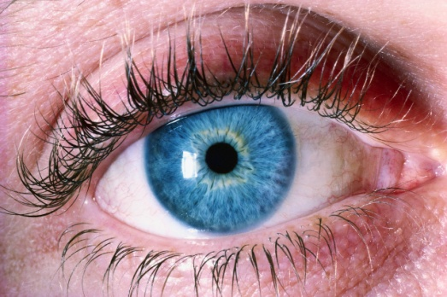

“get those eyes?”
Where did you get those eyes?
Such a flattering question elicits a meaningful genetic probe into your family history. You could just as easily be asking a patient, “Do allergies, high cholesterol, or cancer run in your family?”
“Genetics is a central science for all nursing practice because essentially all diseases and conditions have a genetic or genomic component. Health care will increasingly include genetic and genomic information along the pathways of prevention, screening, diagnostics, prognostics, selection of treatment, and monitoring of treatment effectiveness.” (The Consensus Panel on Genetics/Genomics Nursing Competencies, Essentials of Genetic/Genomic Nursing, Curricula Guidelines, and Outcome Indicators, 2nd Ed., 2009, Silver Spring, MD: American Nurses Association.)

Slide 12

21 MAGNET HOSPITAL DYADS: SEPTEMBER 2012--NIH

