Slide 1
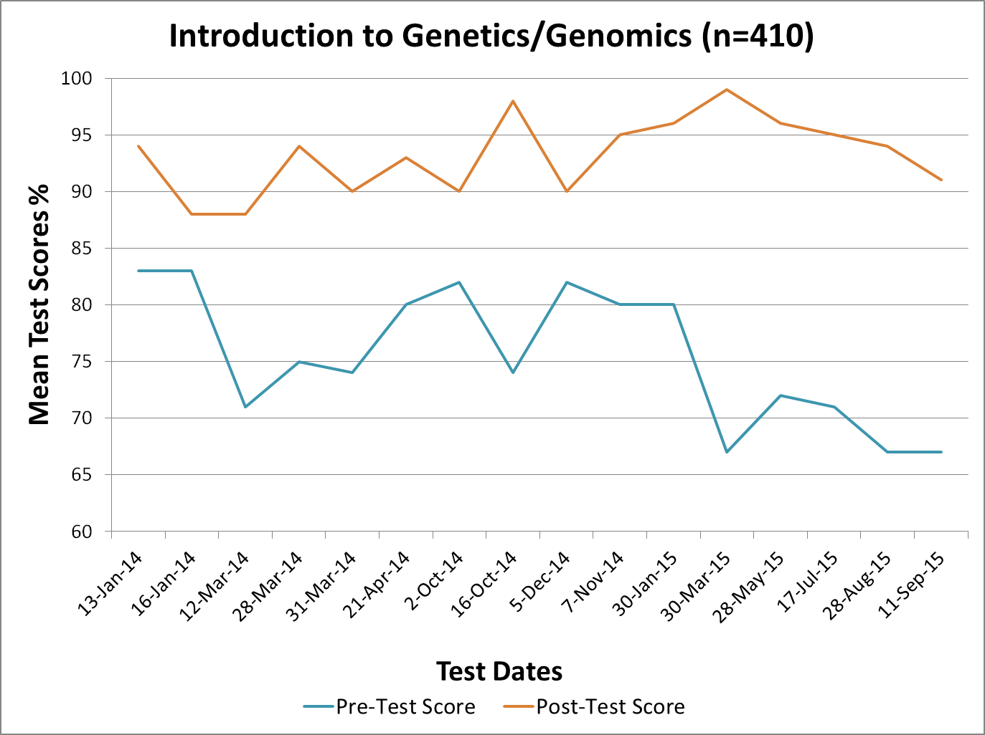
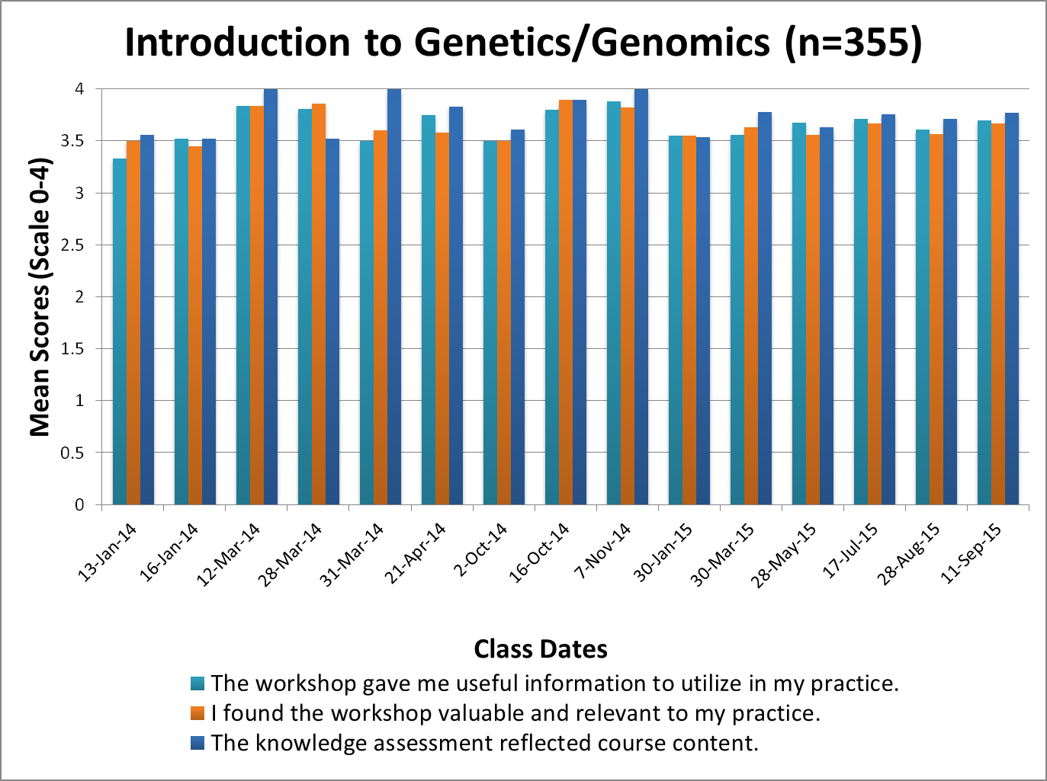
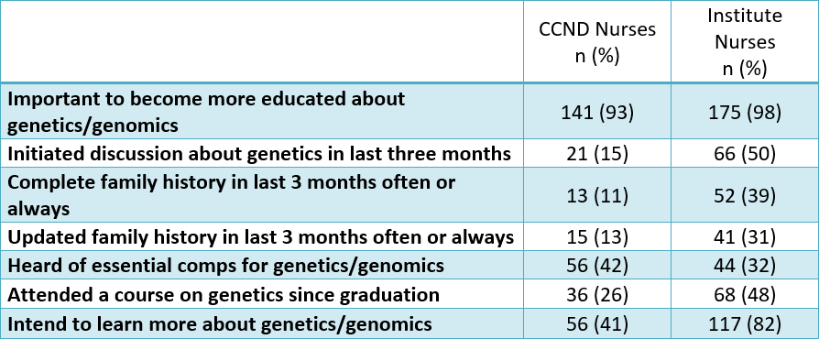
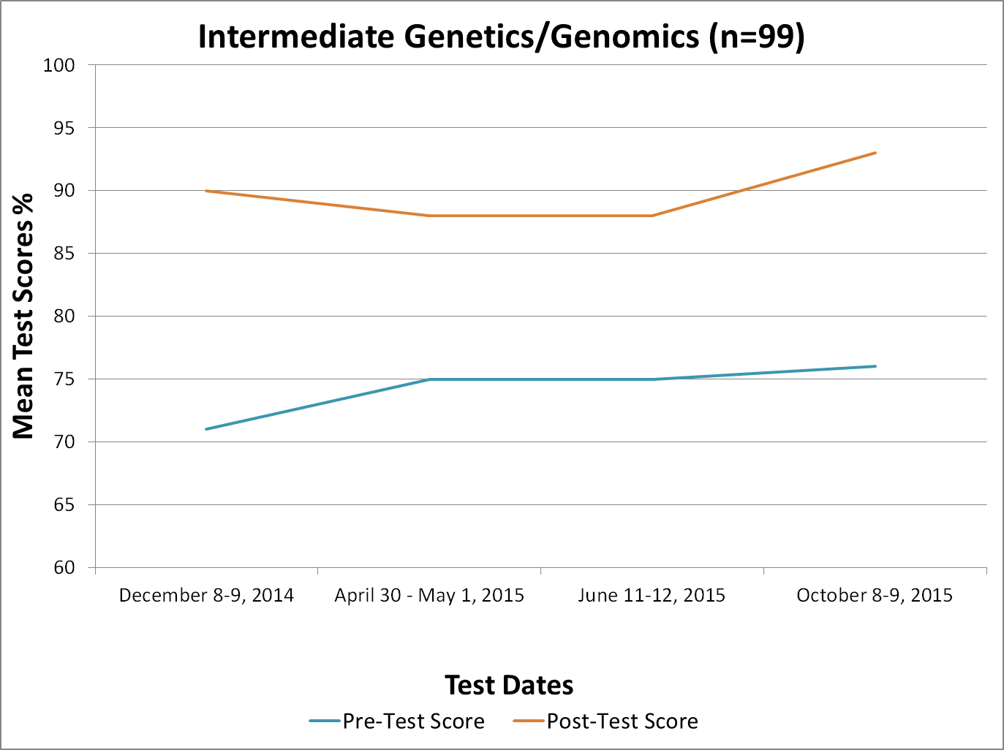
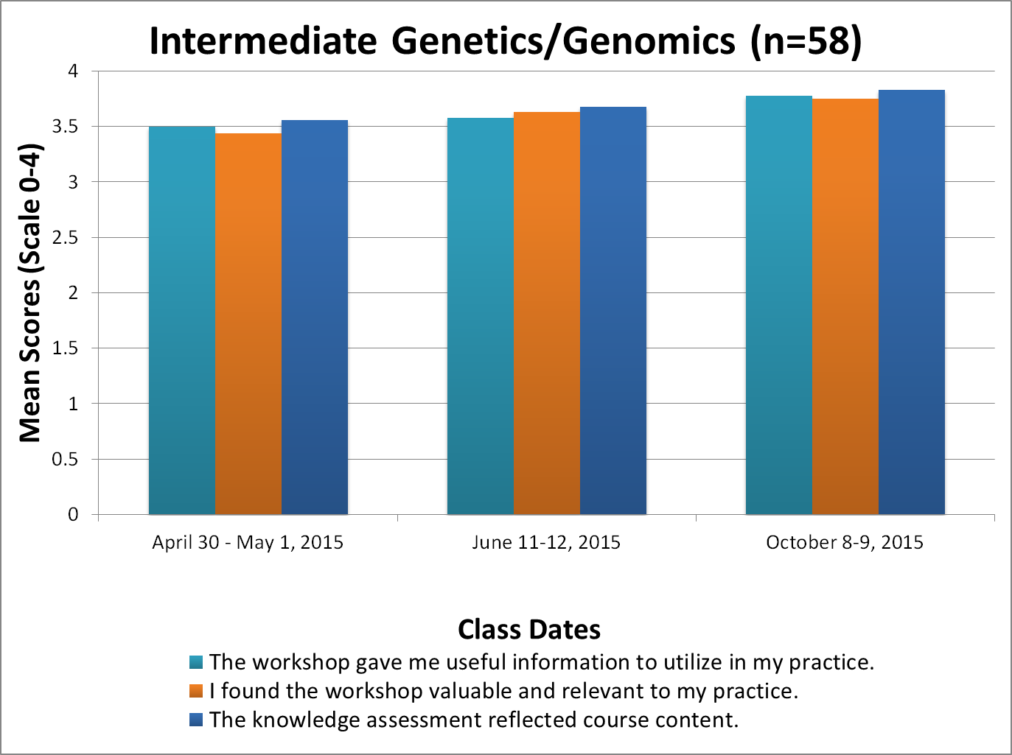
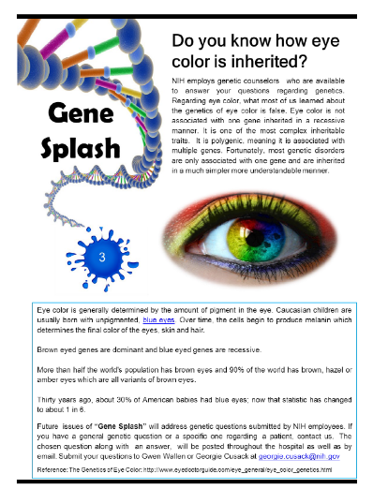
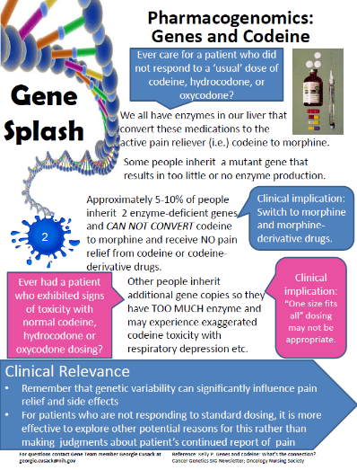
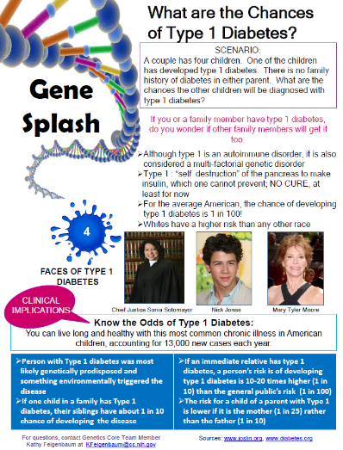
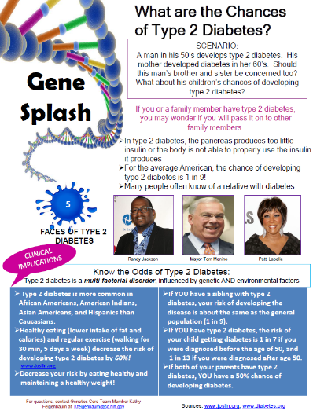
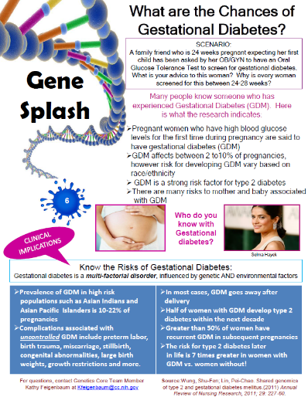
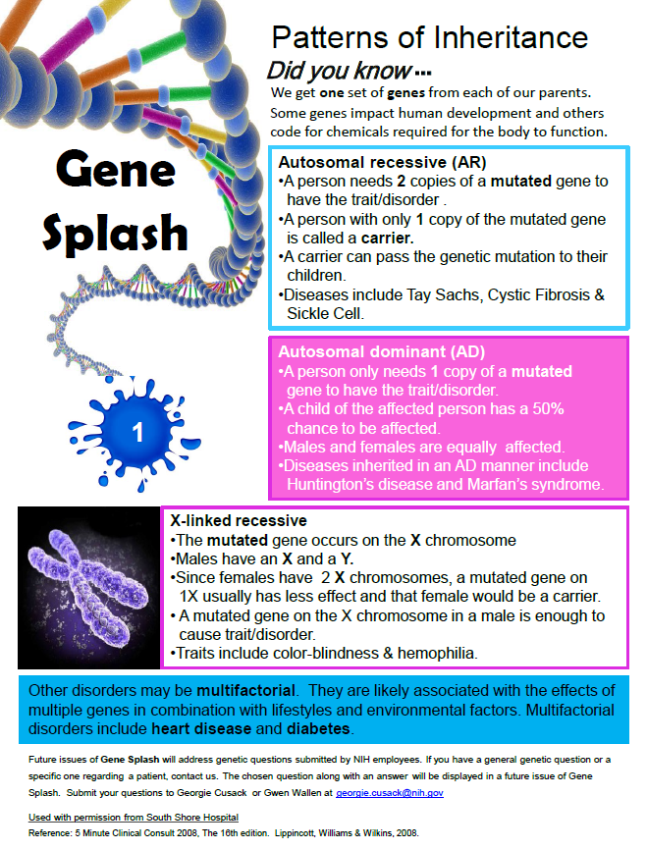
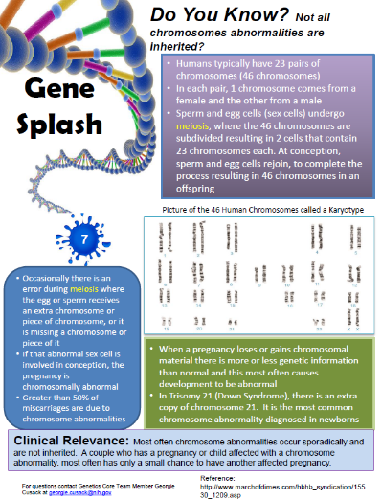
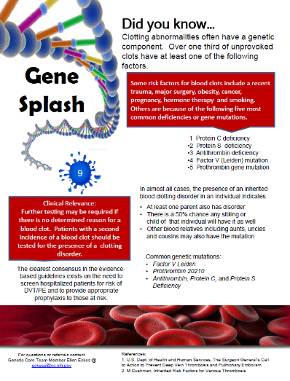
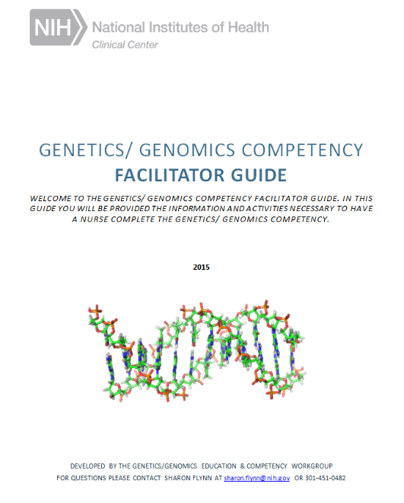
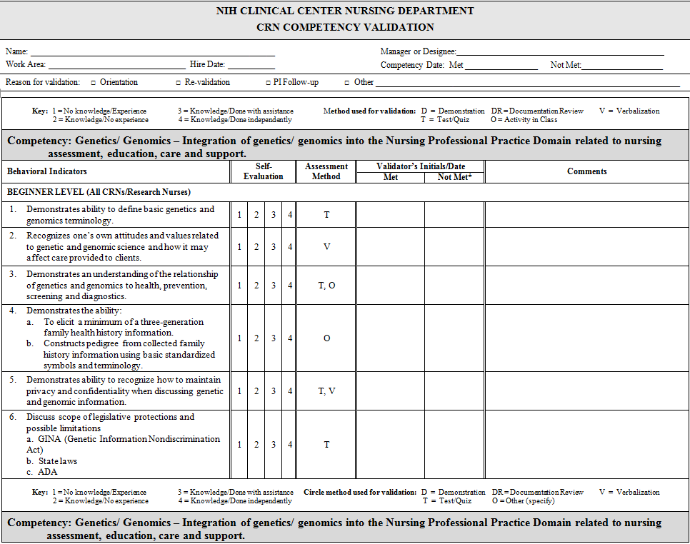
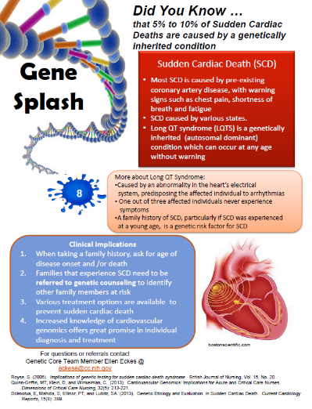
Main Title Here…
Authors and affiliations…
Igniting Genetic and Genomic Education and Competency in a Research Facility: Successes and Challenges
Georgie Cusack¹, Sharon Flynn², Kathy Feigenbaum², Ellen Eckes², Kathleen Calzone³, Jean Jenkins⁴, Gwenyth Wallen² 1 National Heart, Lung, and Blood Institute, 2 Clinical Center, Nursing Department, 3 National Cancer Institute, 4 National Human Genome Research Institute
Main Title Here…
Authors and affiliations…
ABSTRACT
IMPLEMENTATION CHALLENGES
EDUCATION/COMPETENCIES
OUTCOMES
The rapidly expanding field of genomics has prompted nurses to re-examine our knowledge of basic genetic/genomic concepts. Nurses must have a thorough understanding and be competent to care for patients receiving genetic testing and complex medical treatments. The importance of family history to identify high risk patients, and the provision of resources for patients requiring additional support are essential concepts to be comprehended. A core team of nurses at our research institution participated as adjunct faculty in an initiative to integrate genetics/genomics across our organization. The “Method of Introducing a New Competency” (MINC) model was used in developing and implementing strategies to raise awareness, and to prepare our nurses to be competent in caring for patients undergoing genetic/genomic testing and treatments. Participation in online and in person meetings, as well as a study to evaluate nursing workforce attitudes, receptivity, confidence, competency, knowledge and practices regarding genomics, provided insight into training requirements. Networking with other colleagues was instrumental in providing ideas for engaging staff. Integration strategies included initiation of a nursing Genetics/Genomics Special Interest Group (SIG), Gene Splash Laminated Posters, development of interactive introductory and intermediate genetics courses, and institution-based competencies in genetics/genomics. Feedback, pre/post-tests and evaluations from over 500 staff have assisted with the evolution of the genetic/genomic program at our institution. Overall, the feedback has been extremely positive. Using the MINC model has allowed us to provide our nurses with the appropriate training and support in genetics/genomics to improve patient outcomes and optimize care.
Competing priorities within Clinical Center and Institutes
Content development
Dedicated time for initiative
Administrative support
COURSE CONTENT
Introduction to Genetics/Genomics in HealthCare*
Video: Welcome to the Genome Era
Cells to Genes
From Genes to Proteins
How Genes Work
Mutations and Health
Inherited Genetic Conditions: Inheritance Patterns and Understanding Risk
Pedigree Activity
Genetic Testing
Genetics and Genomics Resources
Genetics and Genomics in Current Practice
Intermediate Genetics/Genomics in Healthcare*
Welcome and Pre-Course Learning Assessment
Review Key Concepts from Introduction Course
Integration of Genomics into Nursing Practice
Incidental Findings
Ethical, Legal, and Social Implications of Genetics and Genomics
Gene Therapy
Genetics and Genomic Case Studies
Epigenetics
Pharmacogenomics
Genetic Consultation
Assessing the Research Participant’s Knowledge of Genetics and Genomics
*Interactive sessions with you tube videos, class exercises, and pre/post test
GENETICS/GENOMICS NURSING SURVEY
MARKETING INITIATIVES TO RAISE AWARENESS
Special Interest Group
Flyers Highlighting Courses
FUTURE IMPLICATIONS
Repeat Genetics/Genomics Survey in 2016
Educate and validate all nurses in introductory Genetics/Genomics Competencies by end of 2016
Incorporate Advanced Genetics/Genomics Education Series in 2016
2012
REFERENCES
PROJECT TIMELINE
Gene Splash Documents
2013
Calzone, K., Jenkins, J., Culp, S., Caskey, S., & Badzek, L. (2014). Expanding RN Scope of Practice: A Method for Introducing a New Competency into Nursing Practice. Journal of Nursing Regulation, 5(1), 40-47.
Jenkins, J., Calzone, K., Caskey, S., Culp, S., Weiner, M., & Badzek, L. (2015). Methods of Genomic Competency Integration in Practice. Journal of Nursing Scholarship, 47(3), 200-210.
2012
2013
MINC Kick Off Meeting
MINC Action Plan
Core team training
Genetics Survey
Genetics Special Interest Group
Introduction of Marketing Initiatives
Introductory Genetic/Genomics Course Development
MINC Action Plan Update
2014
2014
Facilitator’s Guide
Competency Form
Introductory Genetics Course Implementation
Focus groups conducted by CNS and Educators
Introductory Competency Development
Intermediate Course Development
2015
2015
Introductory Genetics Competency Implementation (Mandatory)
Intermediate Genetics Course Implementation
Intermediate Genetics Competency Development
NIH Policy Discussions
2016
2016
ACKNOWLEDGEMENTS
Intermediate Genetics Competency Implementation
Advanced Genetics Course Development and Implementation
The core genetics/genomics team would like to acknowledge Mike Krumlauf for his expertise in graphic design and layout of this poster.
Adapted and used with permission from South Shore Hospital, Boston, MA.

